Slide 1
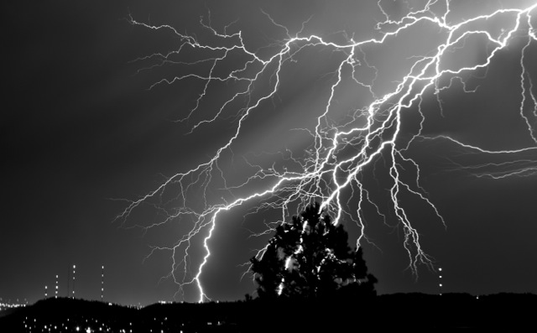
Lightning and Climate
Earle Williams
MIT
Workshop on “Severe Convection and Climate”
Lamont Climate Center
March 14-15, 2013

Slide 2
Outline
Global perspective on thunderstorms and world views
CAPE versus aerosol control of lightning in present climate
Natural variations in global temperature and lightning
Impact of urban areas on lightning
Increases in lightning at high northern latitude
Puzzlements on 11 year solar cycle
Long-period trends and stability of tropical chimneys
Lightning and atmosphere chemistry
Expectations for lightning in a warmer world
Conclusions

Slide 3
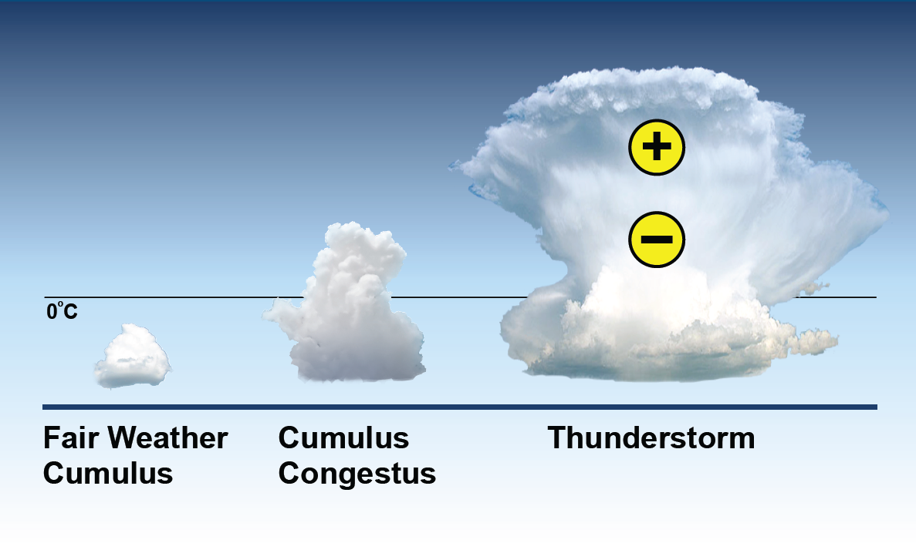
Extreme Moist Convection: The Thunderstorm

Slide 4
World Views
Majority View
Weather &
Climate
Electrification
& Lightning
Thermodynamics
Aerosol
Minority View
Electrification
& Lightning
Weather
& Climate
Cloud microphysics
Atmospheric chemistry
Forest fire initiation

Slide 5
World Views on
Variability of Lightning
Role for Thermodynamics
  Temperature, CAPE, cloud base height are main causal variables
Role for aerosol
  Cloud condensation nuclei are key components
Both aspects are crucial considerations for climate change

Slide 6
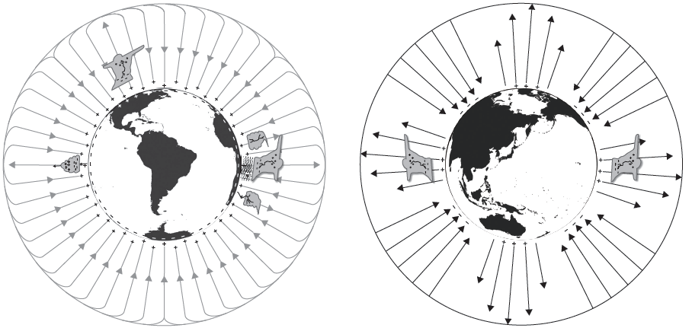
Natural frameworks for monitoring global electrification
DC Global Circuit
AC Global Circuit
Schumann Resonances
Integrator of Electrified Weather
Integrator of Global Lightning

Slide 7
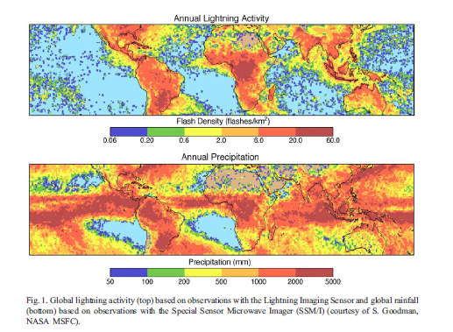
The contrast between lightning and rainfall (NASA TRMM)

Slide 8
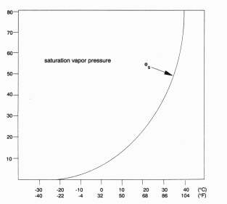
Why should lightning activity follow surface air temperature?
In all climates, water vapor increases with increasing temperature (Clausius-Clapeyron relationship)
  + 7% per degree C at 0°C
In the present climate, Convective Available Potential Energy (CAPE) increases with temperature
Vapor Pressure
Temperature (°C)

Slide 9
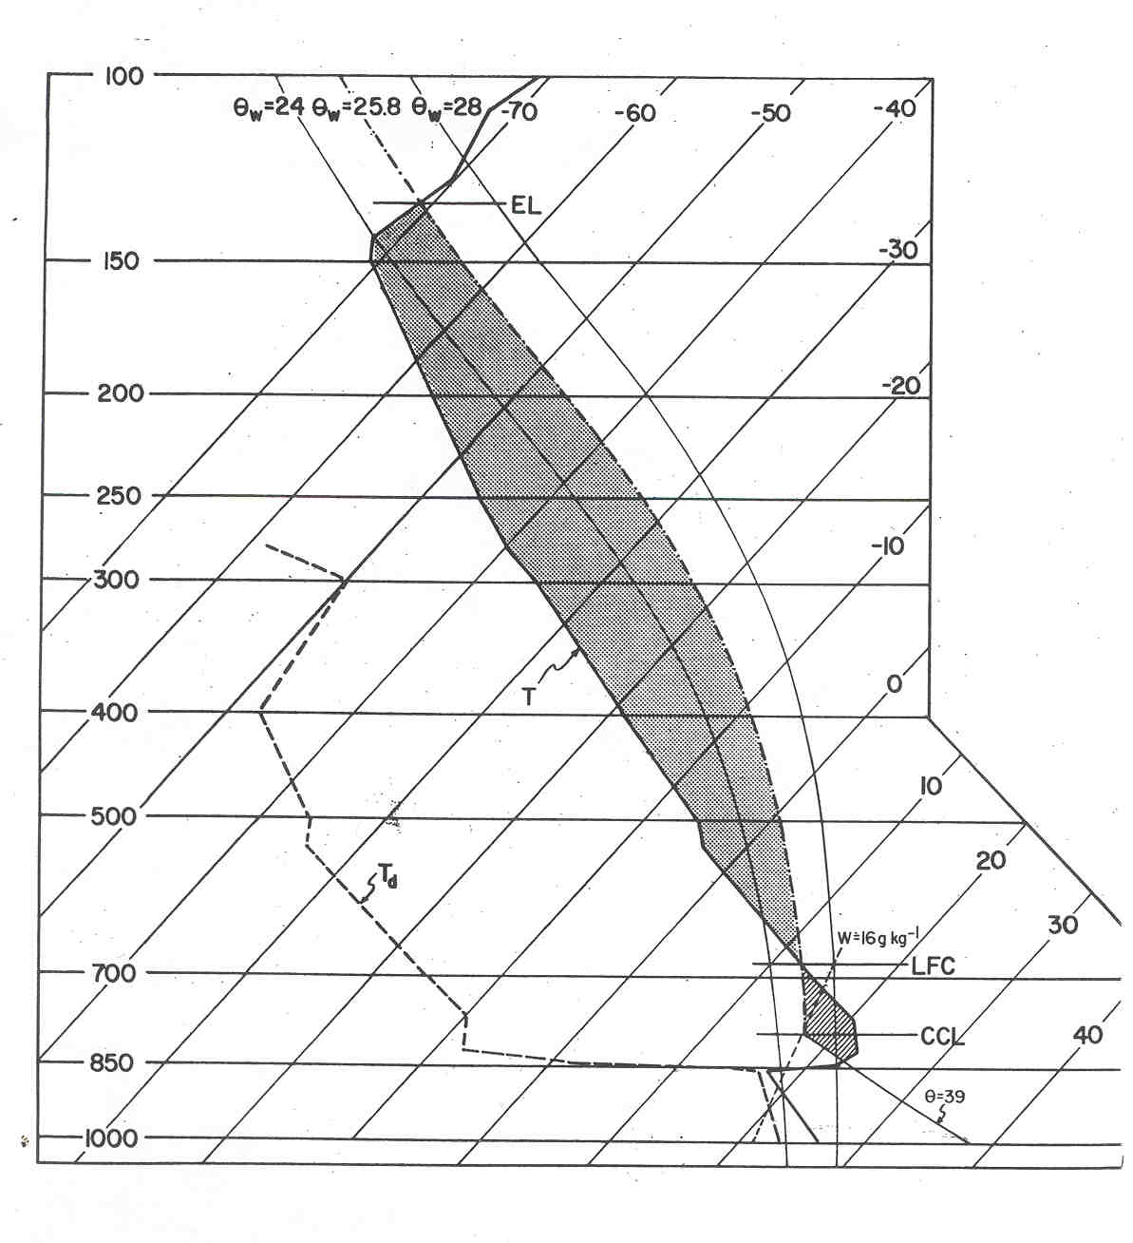
Convective Available Potential Energy (CAPE)
Moist Adiabat
Temperature
Profile

Slide 10
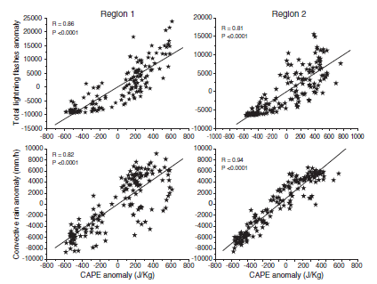
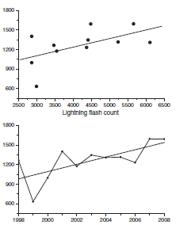
CAPE – Lightning Relationships
Southeast Asia (Siingh et al., 2012)
India (Pawar et al., 2011)
CAPE (J/kg)
Lightning Flash Count
Years

Slide 11
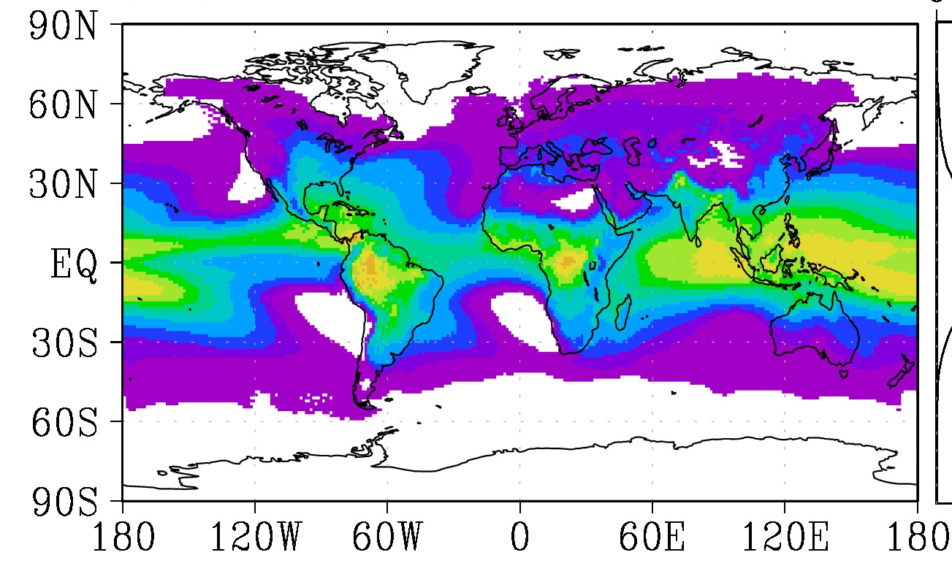
Global climatology of Convective Available Potential Energy (CAPE)
(from Riemann-Campe, 2010)

Slide 12
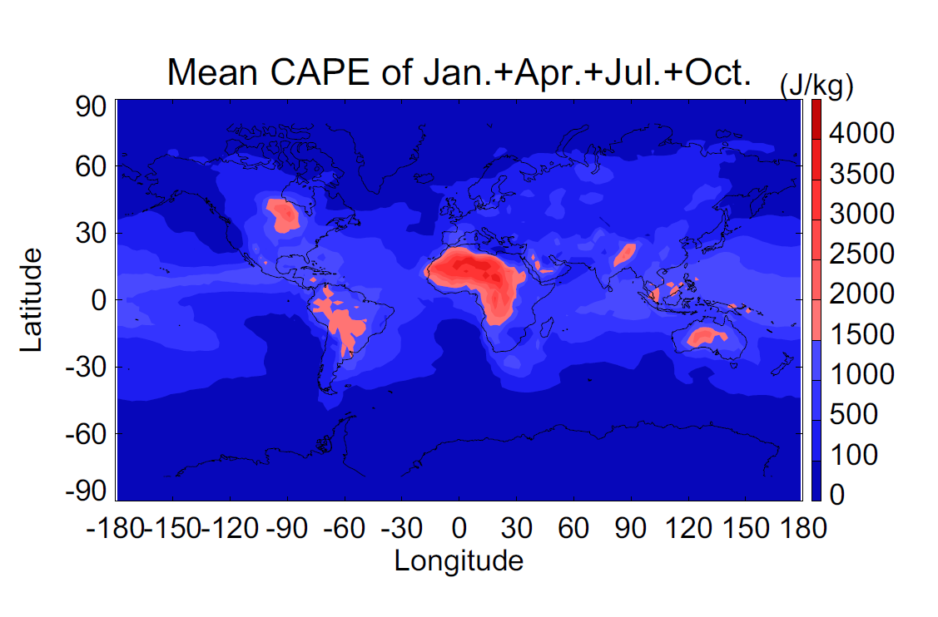
Global Climatology of CAPE NASA GISS GCM
(Del Genio, 2012)
One year of model results

Slide 13
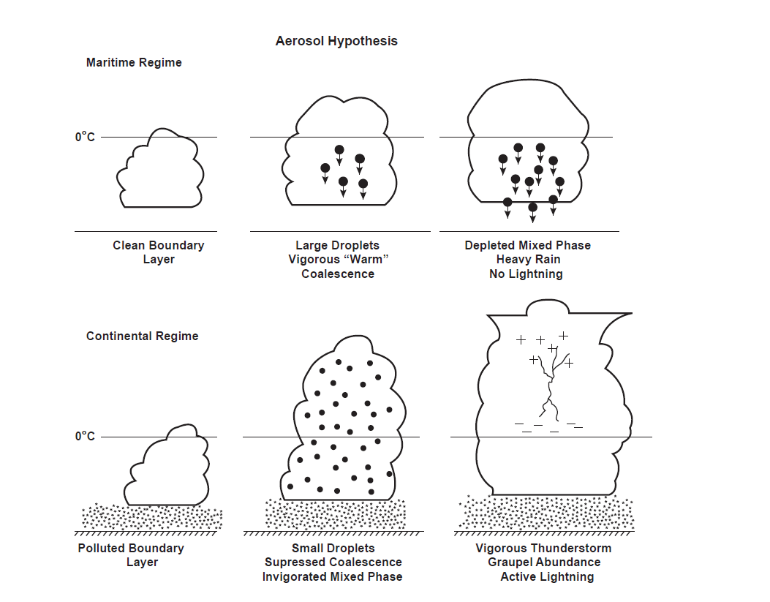
Illustration of aerosol hypothesis for thunderstorm electrification
Model Support from:
Khain et al. (2005)
Li and Zhang (2008)
Mansell and Ziegler (2012)

Slide 14
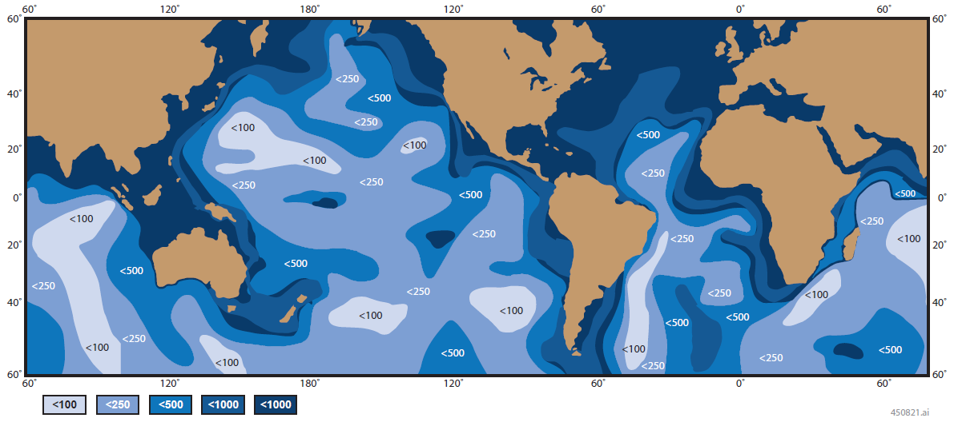
First global map of aerosol concentration (Shiratori, 1934)
Observations from Carnegie cruises
Particles/cc

Slide 15
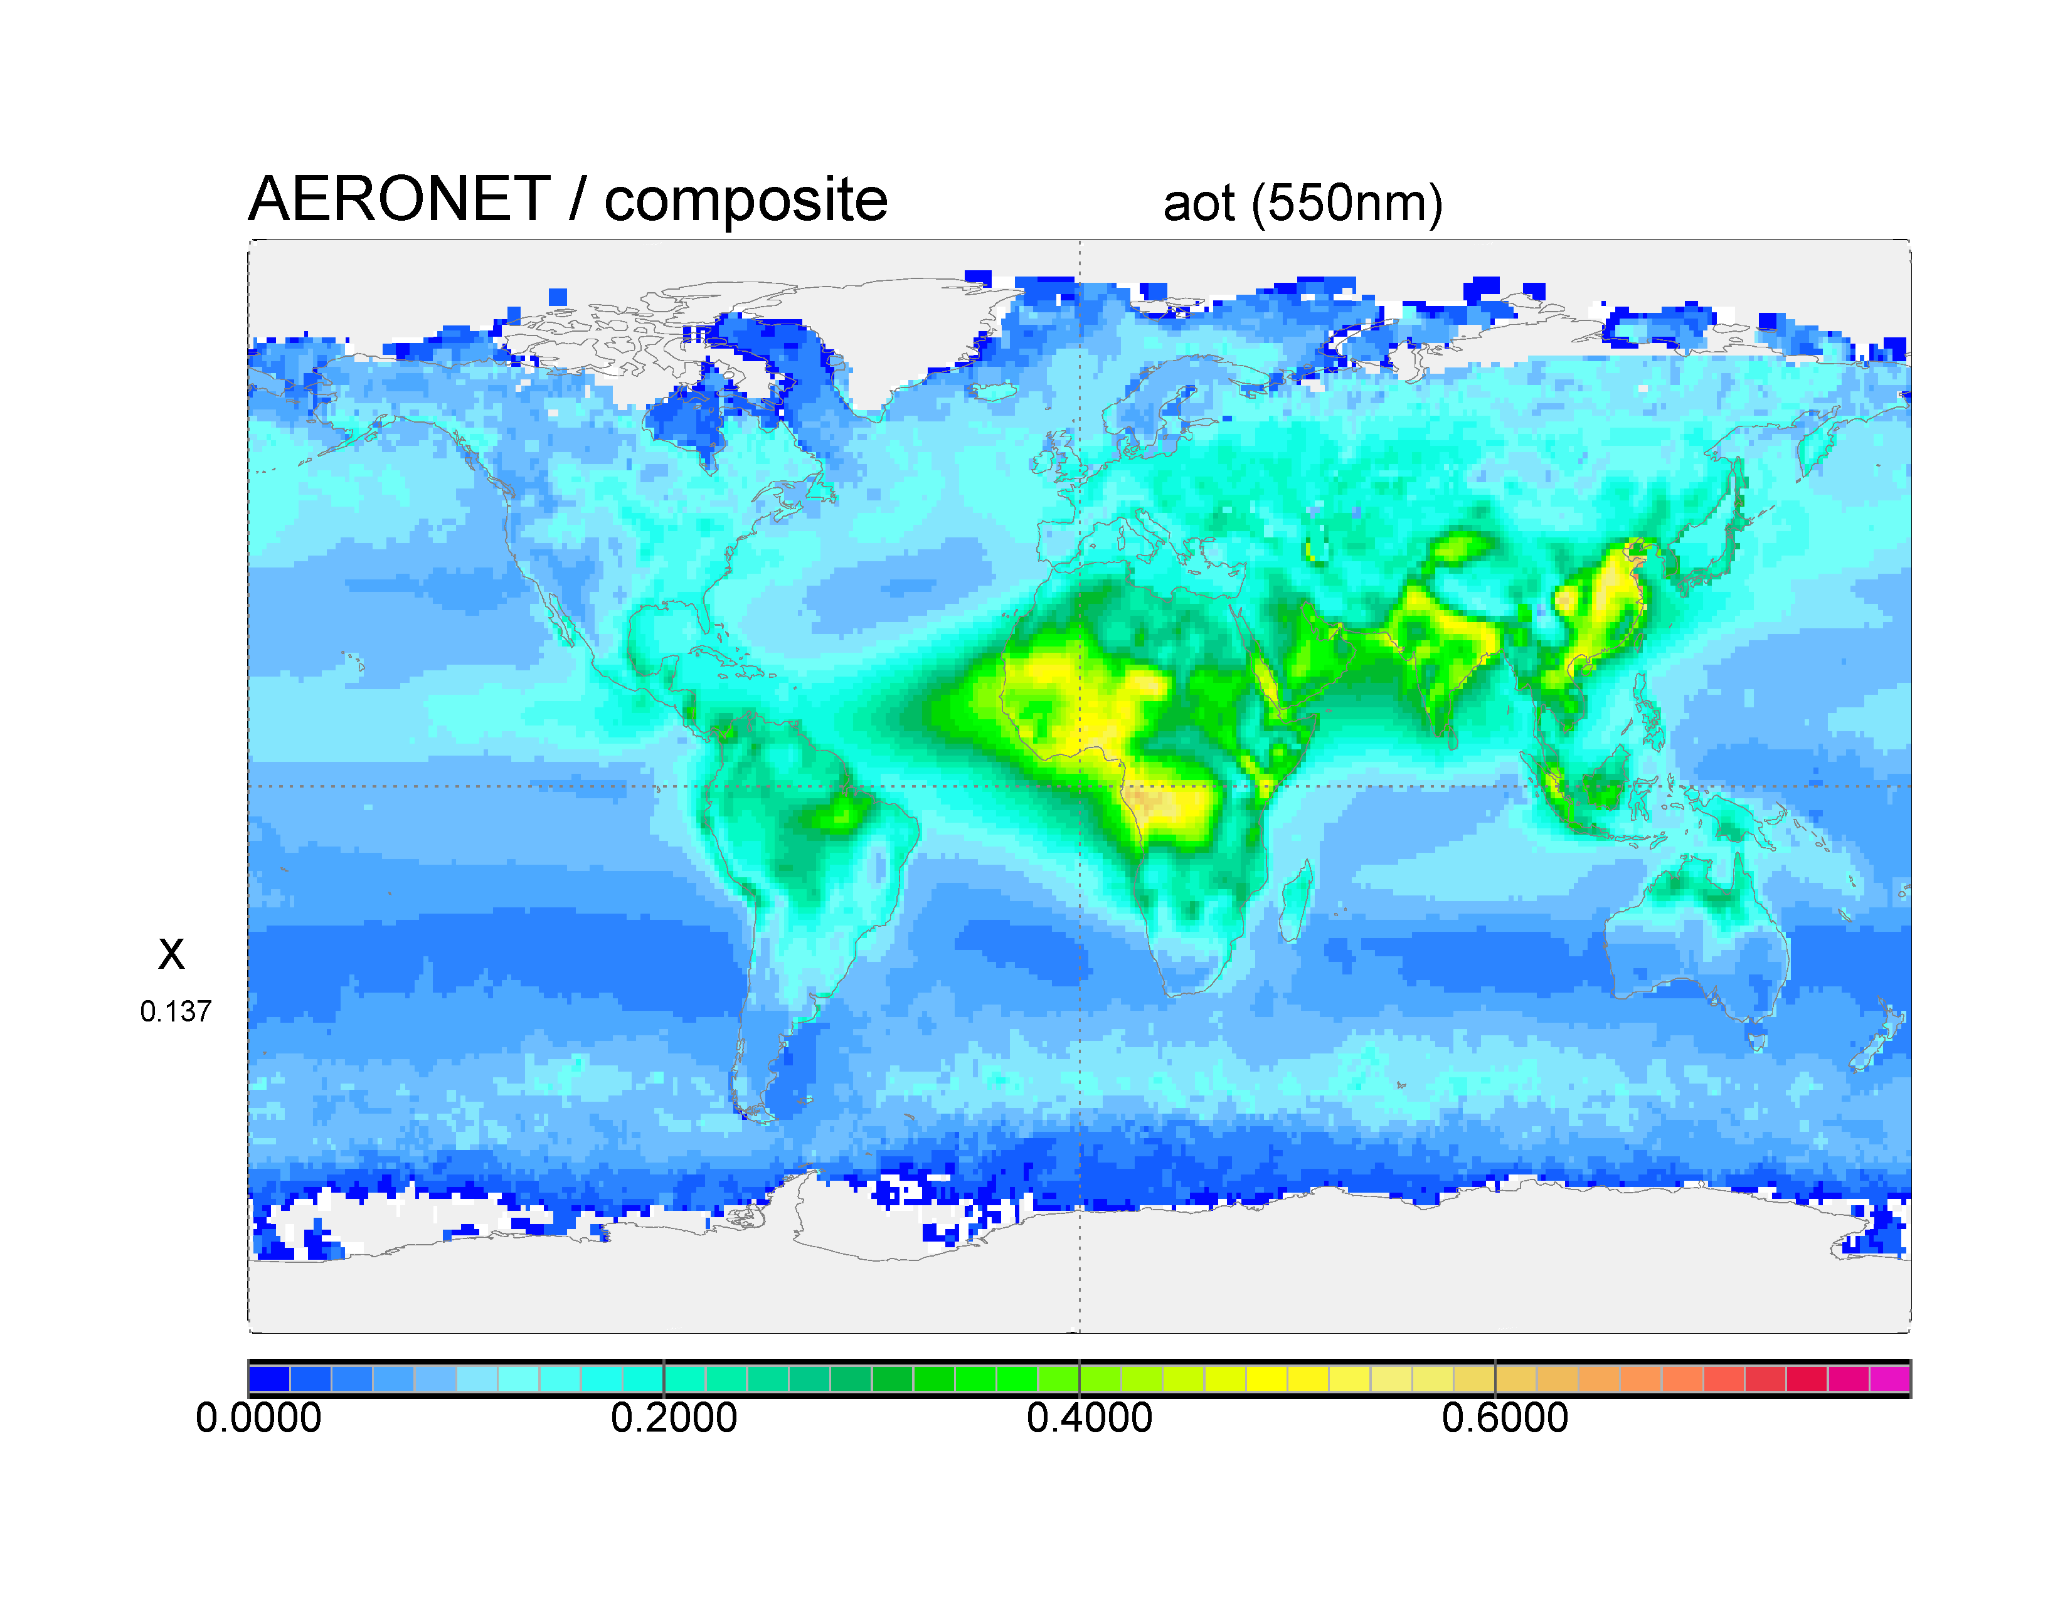
Global Aerosol Observations
(Kinne, 2009)

Slide 16
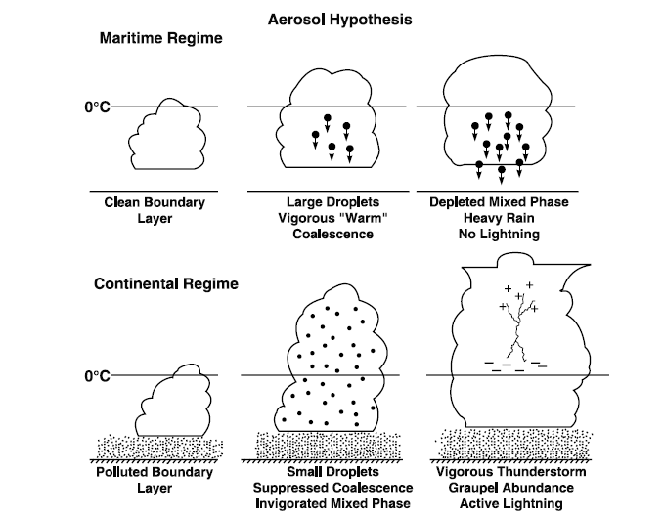
Role of aerosol in cloud buoyancy and land/ocean updraft contrast
CAPE debate: Saunders (1957)
Betts (1982)
Xu and Emanuel (1989)
Williams and Renno (1993)
Lucas and Zipser (1994)
Rosenfeld et al. (2008)
Riemann-Campe (2010)
How should CAPE be calculated for land and ocean?
Reversible CAPE
  Lift the condensate as droplets
  Benefit from latent heat of freezing
  Appropriate for polluted continents
Irreversible CAPE
  Condensate removed by warm rain
  Superadiabatic loading of updraft
  Appropriate for clean oceans
0°C
0°C

Slide 17
Outline
Global perspective on thunderstorms and world views
CAPE versus aerosol control of lightning in present climate
Natural variations in global temperature and lightning
Impact of urban areas on lightning
Increases in lightning at high northern latitude
Puzzlements on 11 year solar cycle
Long-period trends and stability of tropical chimneys
Lightning and atmosphere chemistry
Expectations for lightning in a warmer world
Conclusions

Slide 18
Natural time scales with a global lightning response
Diurnal
Semiannual
Annual
ENSO

Slide 19
Thunderstorm Day
AMS Glossary definition for Thunderstorm Day:
An observational day during which thunder is heard at the station

Slide 20
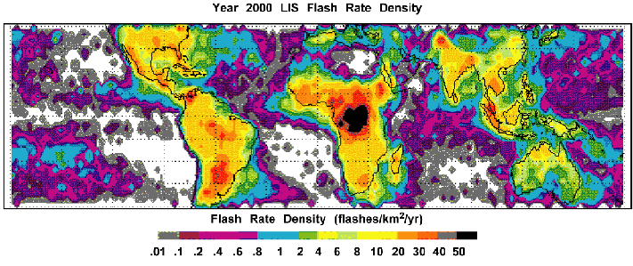
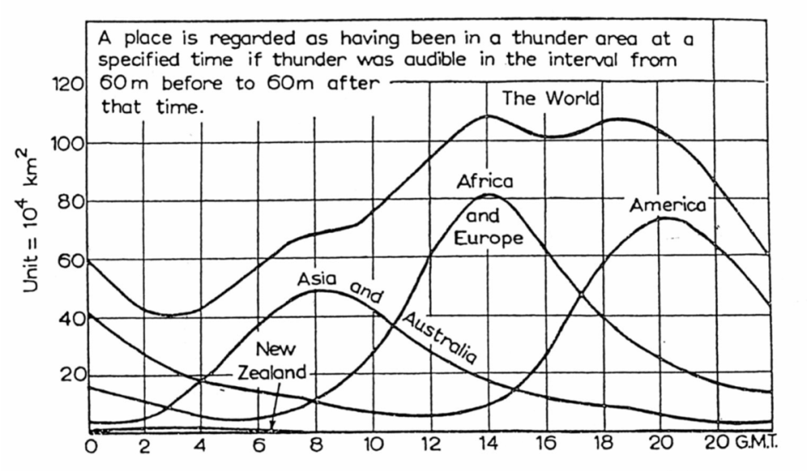

Diurnal Variation of Global Lightning
Lightning Flash Density
Carnegie Curve
Thunder Area

Slide 21
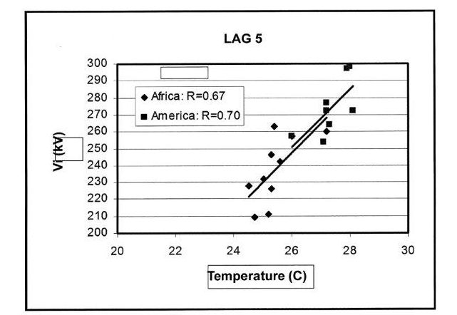
Global circuit temperature dependence- diurnal time scale (Markson, 2003)
Ionospheric Potential (kV)
Slope
~7% change Vi
per °C
Temperature (C)

Slide 22
Evidence for Semiannual variation in lightning activity
23°
Physical origin : 23° obliguity of Earth’s orbit
Authors
Observations
Williams (1994)
Satori and Zieger (1996)
Fϋllekrug and Fraser-Smith (1997)
Nickolaenko et al. (1998)
Manohar et al. (1999)
Christian at al (2003)
Satori et. al. (2009)
Hobara et al. (2011)
Thunder days
Schumann resonances
ELF
Schumann resonances
Surface observations
OTD satellite
Schumann resonances
Schumann resonances

Slide 23
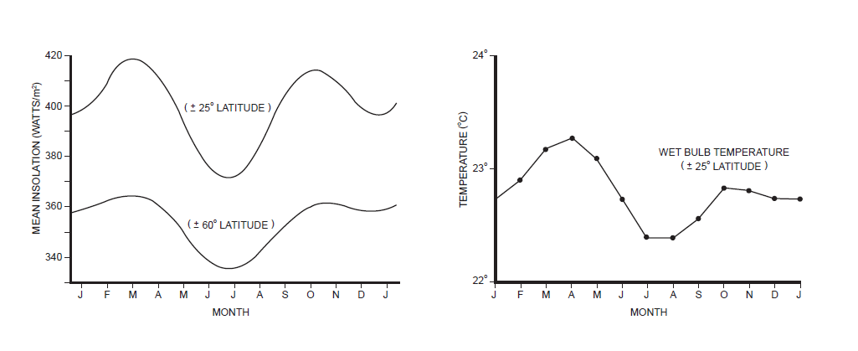
Semiannual time Scale:
Seasonal variation of insolation and air temperature for the tropics

Slide 24
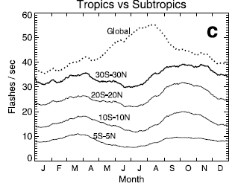
Evidence for semiannual variation in lightning from the Optical Transient Detector
(Christian et al., 2003)

Slide 25
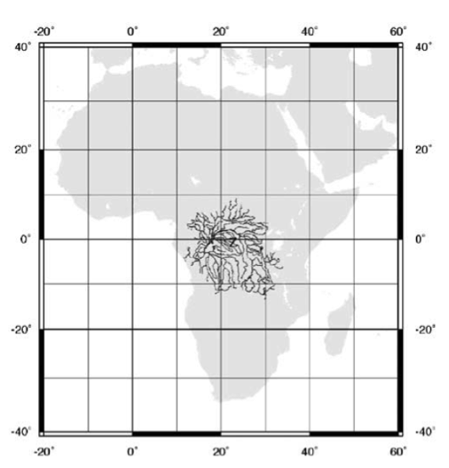
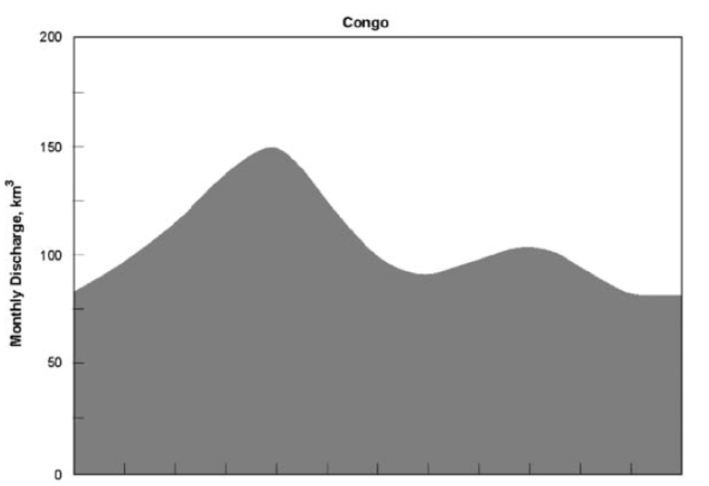
Semiannual signal in Congo River discharge
Drainage area
Annual discharge record
Aug
Dec
Apr
Aug

Slide 26
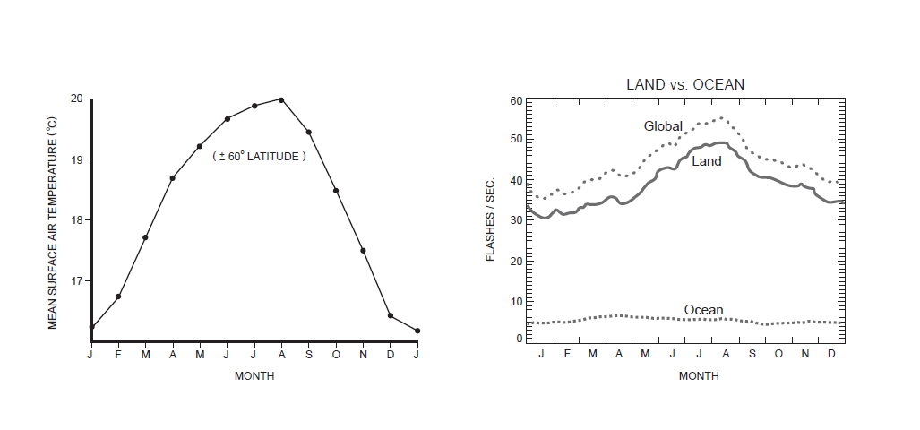
Annual variation of global temperature and global lightning (11% change/°C)
Global temperature variation
(Williams et al., 1994)
Global lightning variation
(Christian et al., 2003)

Slide 27
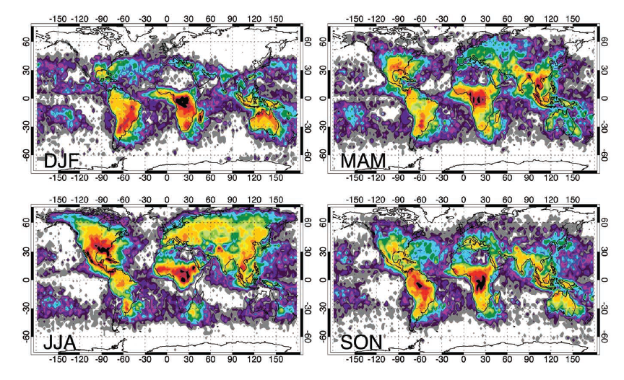
Seasonal variation of global lightning activity (Christian et al., 2003)
Global
Maximum

Slide 28
El Nino Southern Oscillation (ENSO)
Strong thunderstorm activity favored by synoptic scale subsidence
Best evidence: Pre-monsoon thunderstorms everywhere are more electrically active than monsoon thunderstorms
Tropical ‘chimney’ regions are in stronger subsidence in the warm El Nino phase (from Pacific Ocean upwelling)
Best evidence: The discharge of the Amazon and Congo rivers is reduced during this warm phase

Slide 29
Variations in lightning activity on the ENSO time scale
Evidence for higher temperature in El Nino phase over tropical continental ‘chimneys’
Hansen and Lebedeff (1987)
Evidence for greater lightning (and reduced rainfall) in the El Nino phase
Hamid, Kawasaki and Mardiana (2001)
Yoshida, Morimoto, Kawasaki and Ushio (2007)
Chronis, Goodman, Cecil, Buechler, Robertson, Pittman and Blakeslee (2008)
Pinto (2009)
Satori, Williams and Lemperger (2009)
Kumar and Kamra (2012)
Evidence for increase in exceptional oceanic lightning and ELVES
  Wu et al. (ISUAL Satellite Team) (2012)

Slide 30
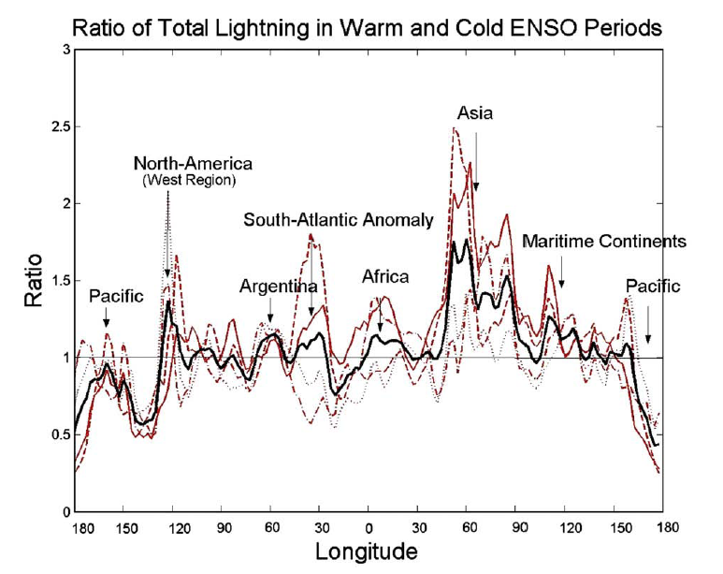
Zonal variation of lightning enhancement in warm El Nino phase
Mean ratio = El Nino lightning
La Nina lightning
“from Satori et al. (2009)”

Slide 31
Outline
Global perspective on thunderstorms and world views
CAPE versus aerosol control of lightning in present climate
Natural variations in global temperature and lightning
Impact of urban areas on lightning
Increases in lightning at high northern latitude
Puzzlements on 11 year solar cycle
Long-period trends and stability of tropical chimneys
Lightning and atmosphere chemistry
Expectations for lightning in a warmer world
Conclusions

Slide 32
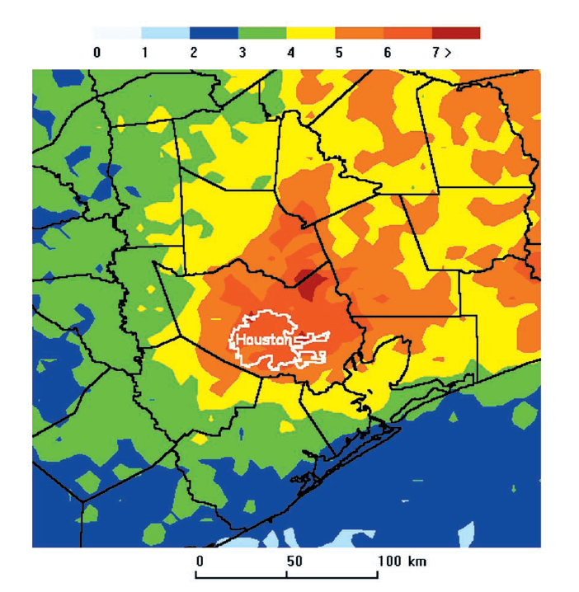
Lightning enhancement over Houston, Texas (Steiger et al., 2002)

Slide 33
Evolution of thunderstorm days and temperature in Sao Paulo, Brazil (Pinto,2009)
Sensitivity:
~10% change in
thunder days
per °C
Slope
~3.6 °C/century

Slide 34
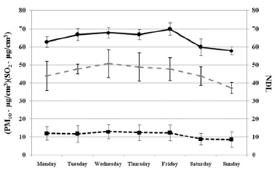
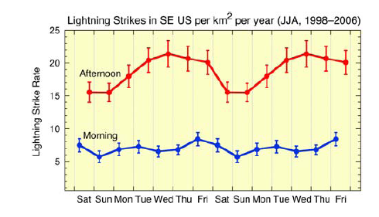
Evidence for a weekly cycle in lightning
Sao Paulo, Brazil (Farias et al.,2009)
Southeastern United States (Bell et al., 2009)
Number of Lightning Days
Flash Rate
Weekend
Weekend
Weekend

Slide 35
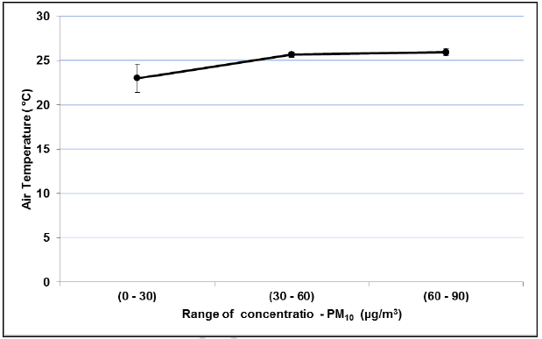
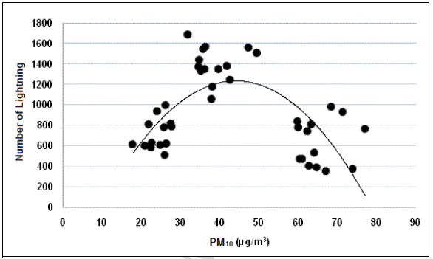
Evidence for role of aerosol in lightning activity (Farias et al., 2009)
“Control” of temperature
Lightning dependence on aerosol concentration
See also model results by Mansell and Ziegler (2012)

Slide 36
Outline
Global perspective on thunderstorms and world views
CAPE versus aerosol control of lightning in present climate
Natural variations in global temperature and lightning
Impact of urban areas on lightning
Increases in lightning at high northern latitude
Puzzlements on 11 year solar cycle
Long-period trends and stability of tropical chimneys
Lightning and atmosphere chemistry
Expectations for lightning in a warmer world
Conclusions

Slide 37
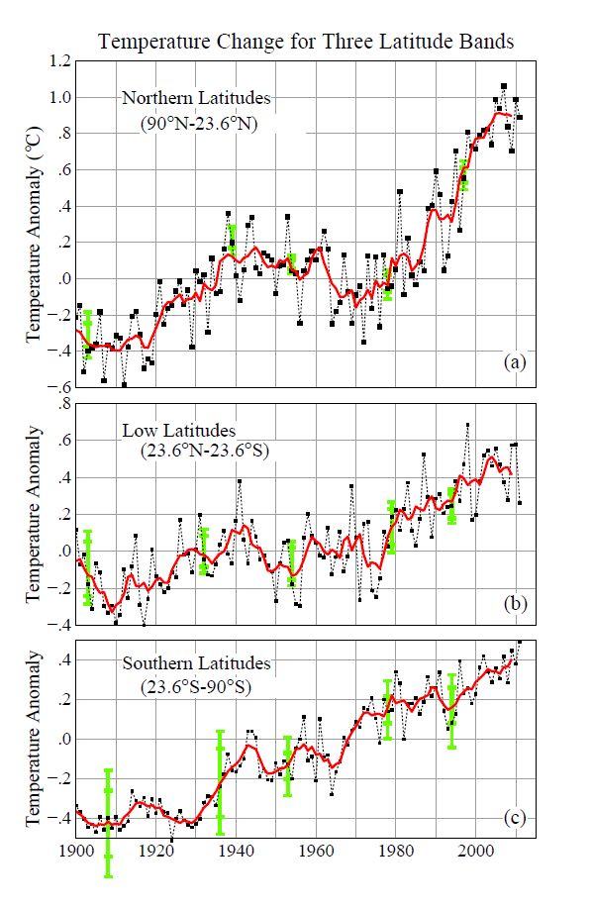
Global warming most pronounced at high northern latitude (NASA GISS)
Northern Latitudes
Tropics only
Southern Latitudes

Slide 38
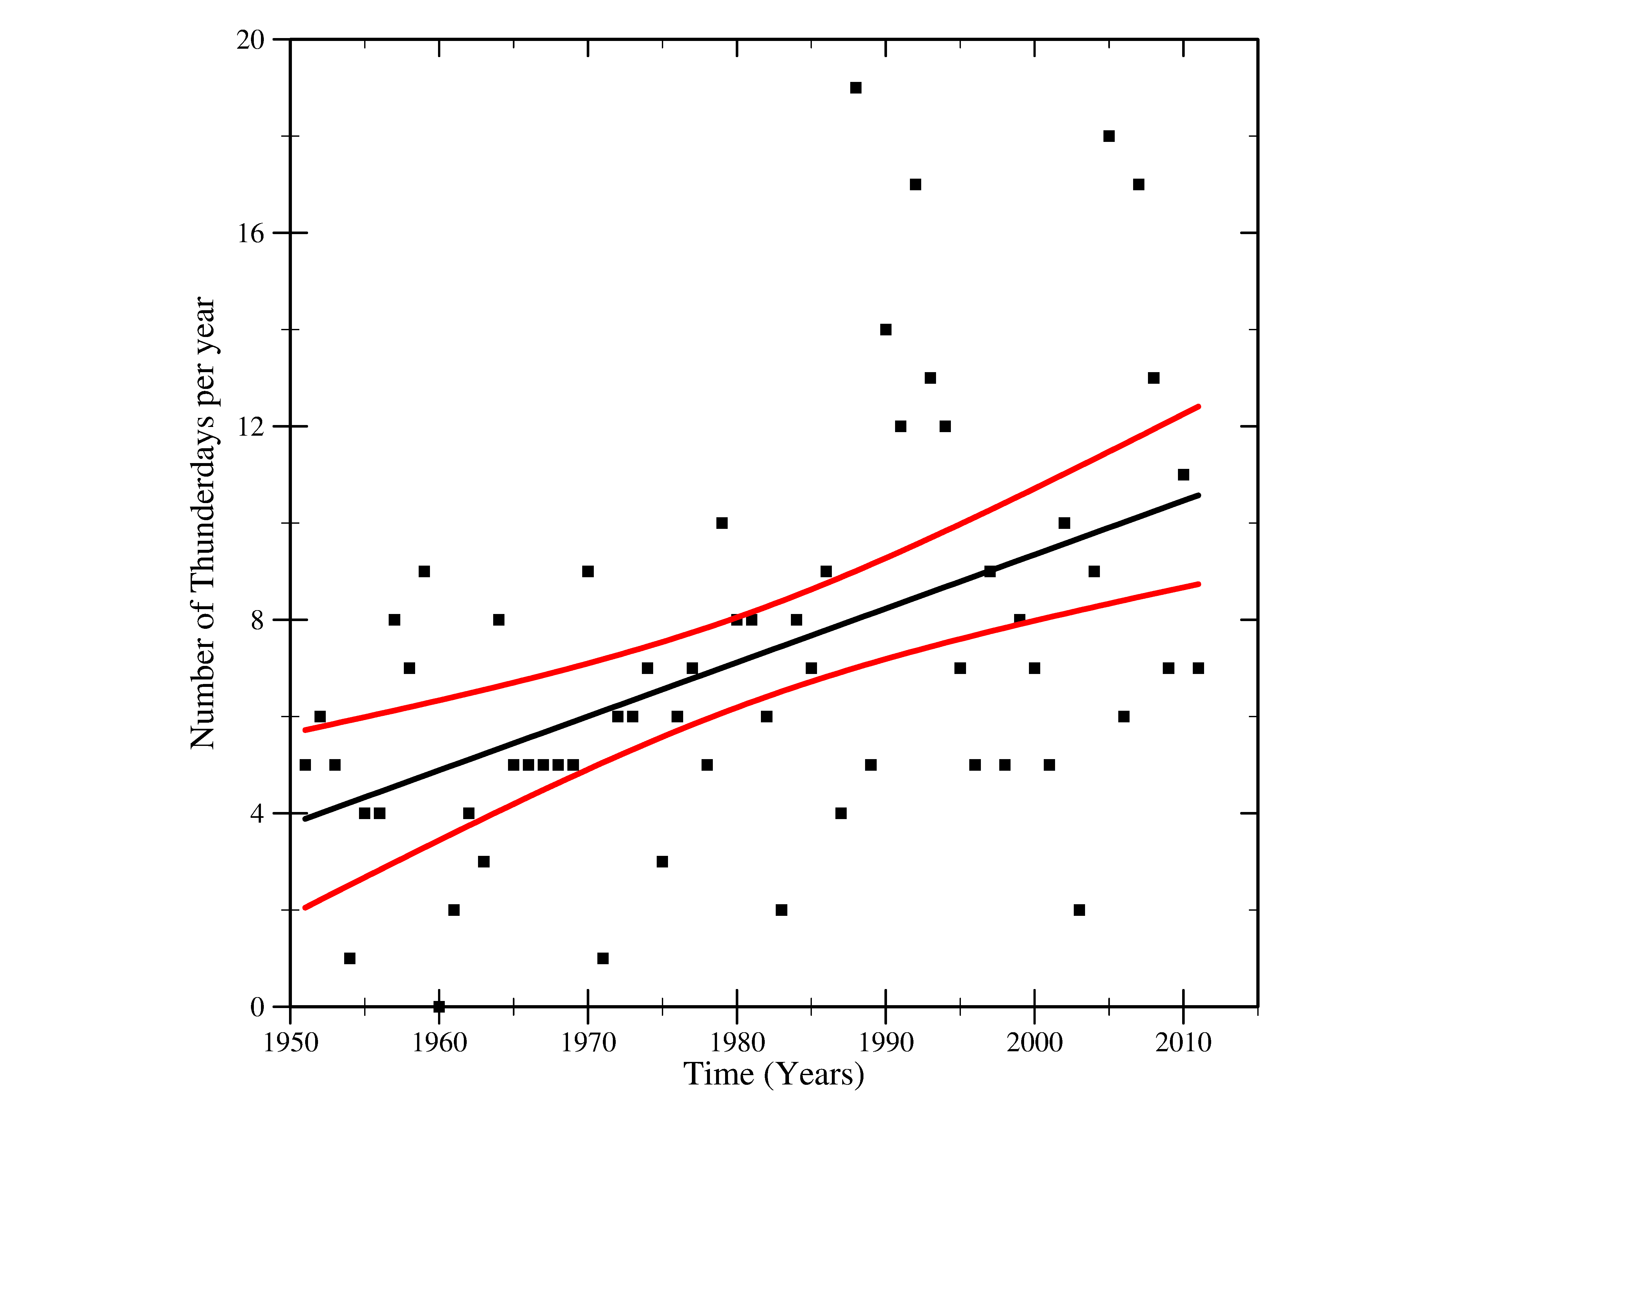
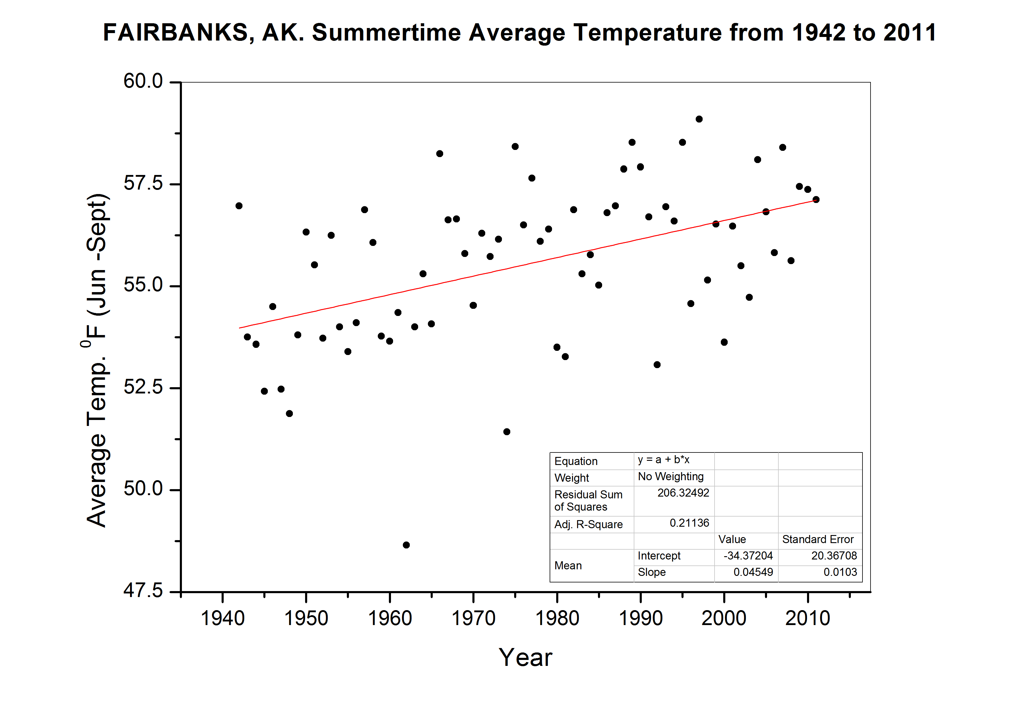
Thunderstorm Days versus Summer Temperature: Fairbanks, Alaska (65°° N)
Thunderstorm Day Trend
300% change/century
Summertime Temperature Trend
3.2 °C/century

Slide 39
Outline
Global perspective on thunderstorms and world views
CAPE versus aerosol control of lightning in present climate
Natural variations in global temperature and lightning
Impact of urban areas on lightning
Increases in lightning at high northern latitude
Puzzlements on 11 year solar cycle
Long-period trends and stability of tropical chimneys
Lightning and atmosphere chemistry
Expectations for lightning in a warmer world
Conclusions

Slide 40
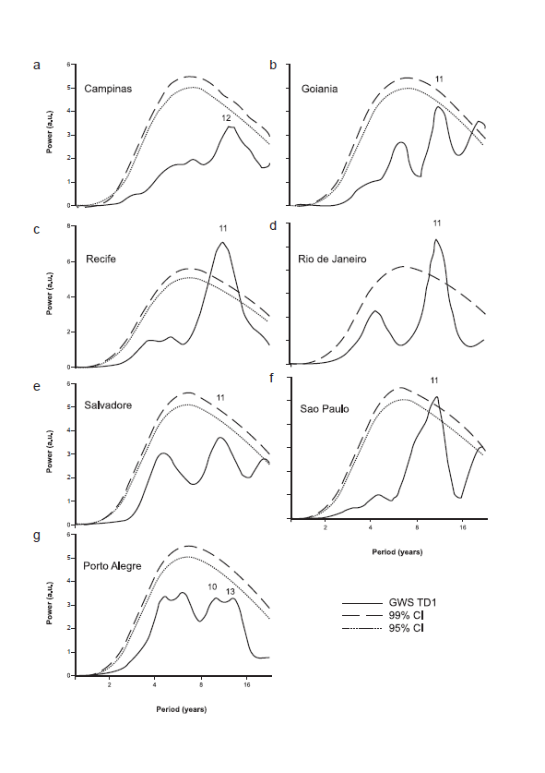
Thunderstorm days on the
11-year solar cycle
Brooks (1934)
  Global sites
  In phase behavior
  No time series
Klejmenova (1967)
  Global sites
  Out-of-phase behavior
  No time series
Girish and Eapen (2008)
  India (tropics)
  Out-of-phase behavior
  Yes, time series
Siingh et al. (2012)
  Southeast Asia
  Out-of-phase behavior
  Yes, time series
Pinto et al. (2012)
  Brazil stations
  Out-of-phase behavior
  Yes, time series
Pinto et al. (2012)

Slide 41
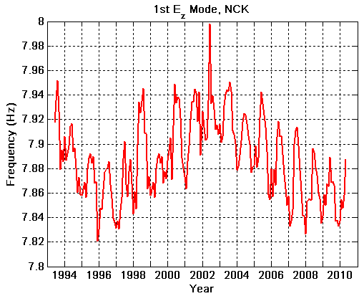
Richness of frequency information in Schumann resonances (Satori, 2012)
On display:
11-year cycle
Annual thunderstorm migration
Northward migration due to warming
Solar Max
Solar Min
Solar Min

Slide 42
Outline
Global perspective on thunderstorms and world views
CAPE versus aerosol control of lightning in present climate
Natural variations in global temperature and lightning
Impact of urban areas on lightning
Increases in lightning at high northern latitude
Puzzlements on 11 year solar cycle
Long-period trends and stability of tropical chimneys
Lightning and atmosphere chemistry
Expectations for lightning in a warmer world
Conclusions

Slide 43
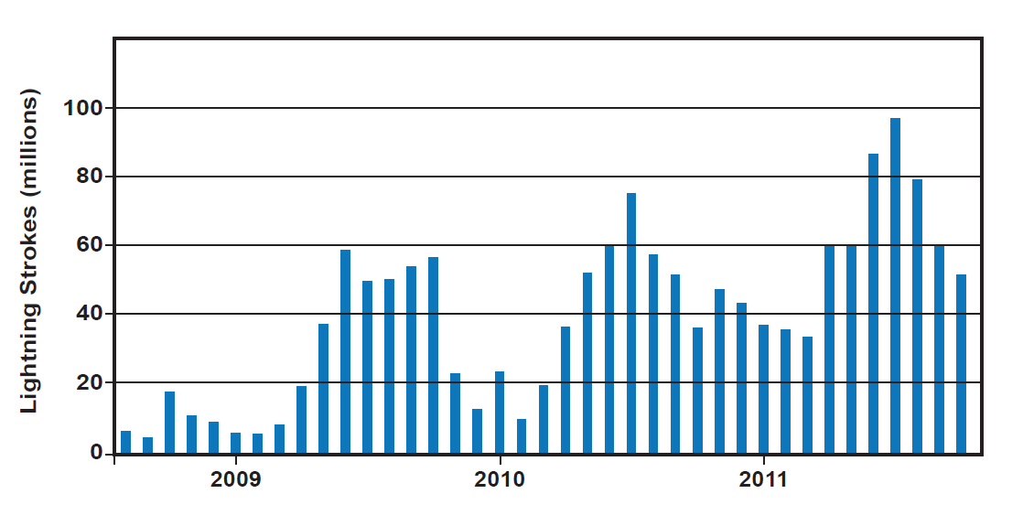
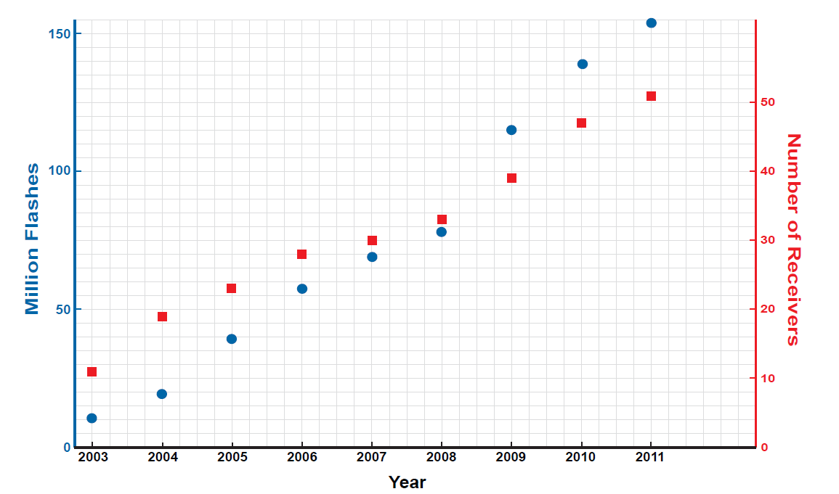
Time-dependent lightning detection by global networks
Vaisala GLD360
(R.Said)
World wide Lightning Location Network
(WWLLN) (C. Rodger)
Lightning Strokes (millions)
Million Strokes

Slide 44
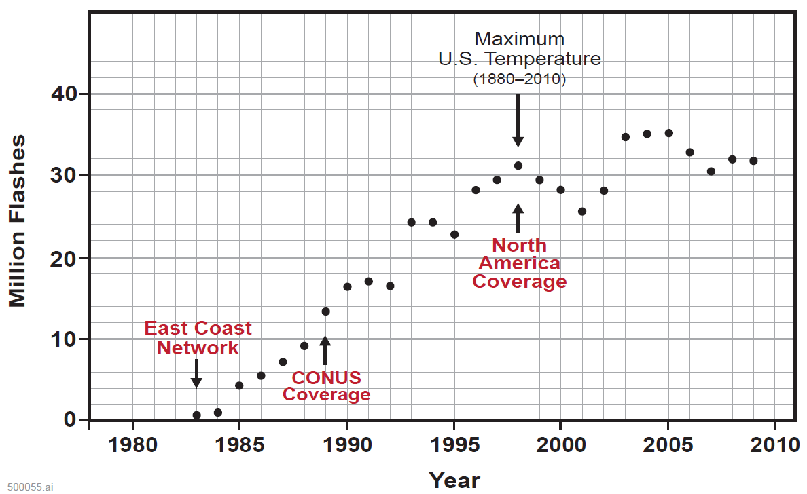
National Lightning Detection Network
Annual totals: Ground Flashes
(numerous Orville papers)
North
American
Coverage
East Coast
Network
Full CONUS
Coverage

Slide 45
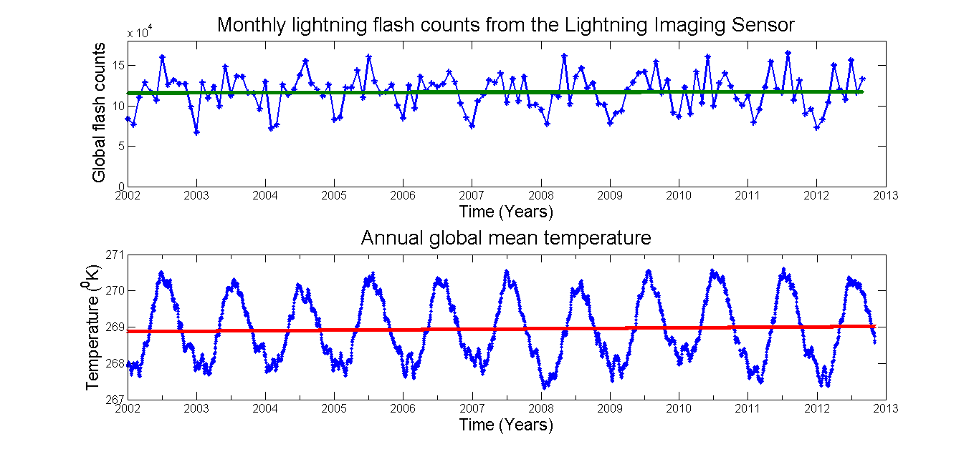
Decade Record from Lightning Imaging Sensor vs Global Tropospheric Temperature
(NASA MSFC)
(NASA MSFC)

Slide 46
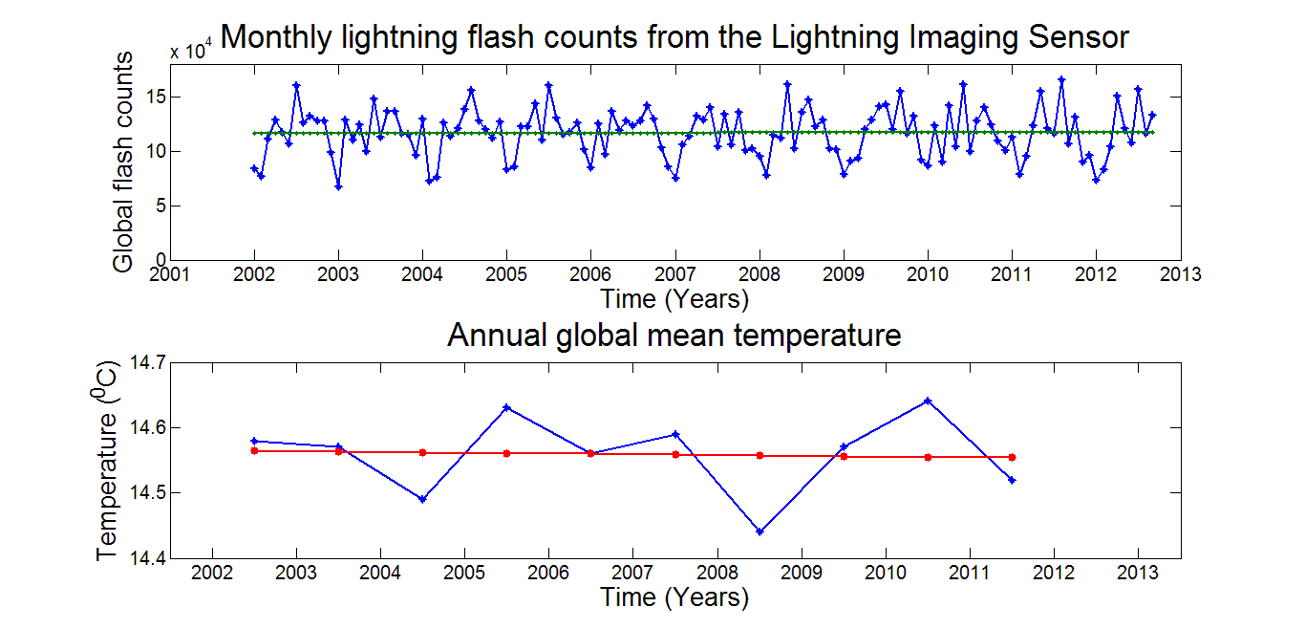
Decade record from Lightning Imaging Sensor (NASA MSFC)
(Best record available of global lightning)
(NASA GISS)

Slide 47
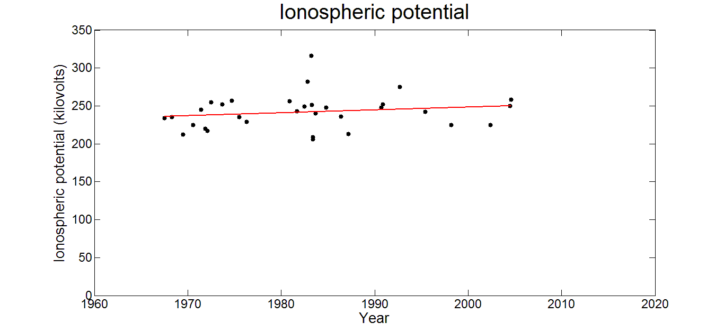
Four-decade record of ionospheric potential (Markson, 2007)
Positive trend +16% per century but not statistically significant

Slide 48
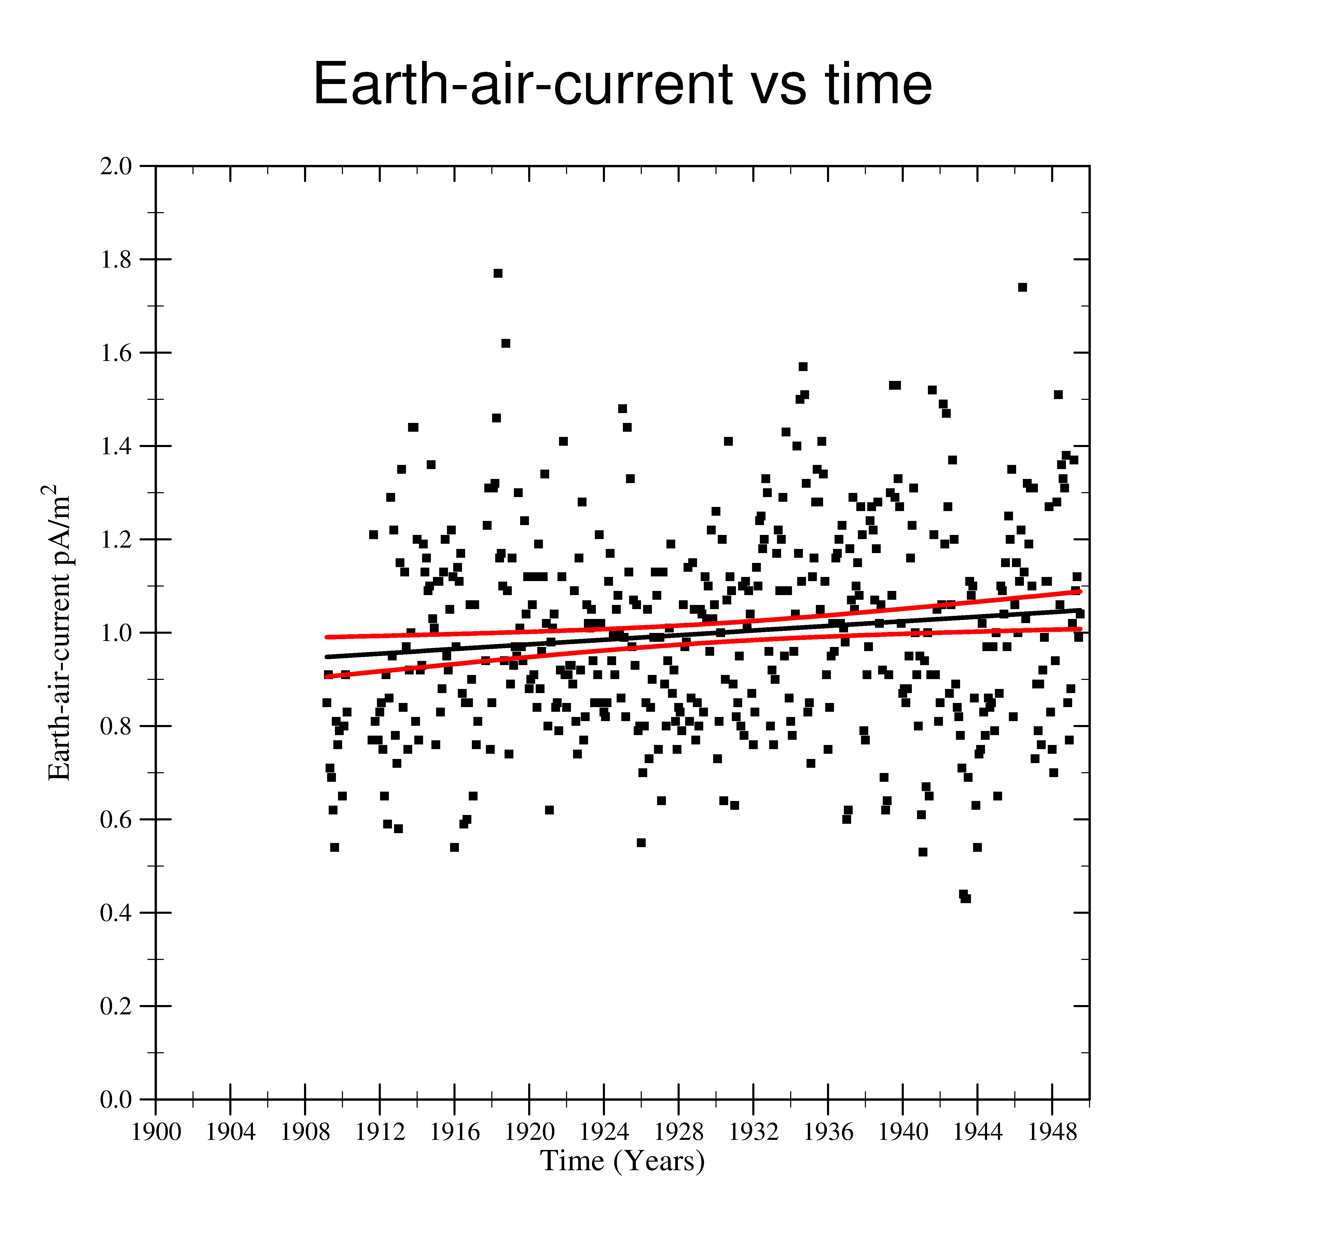
Trend in four-decade record of air-earth current at Kew (London)
Positive trend +25% per century and statistically significant
Harrison and Ingram (2005)

Slide 49
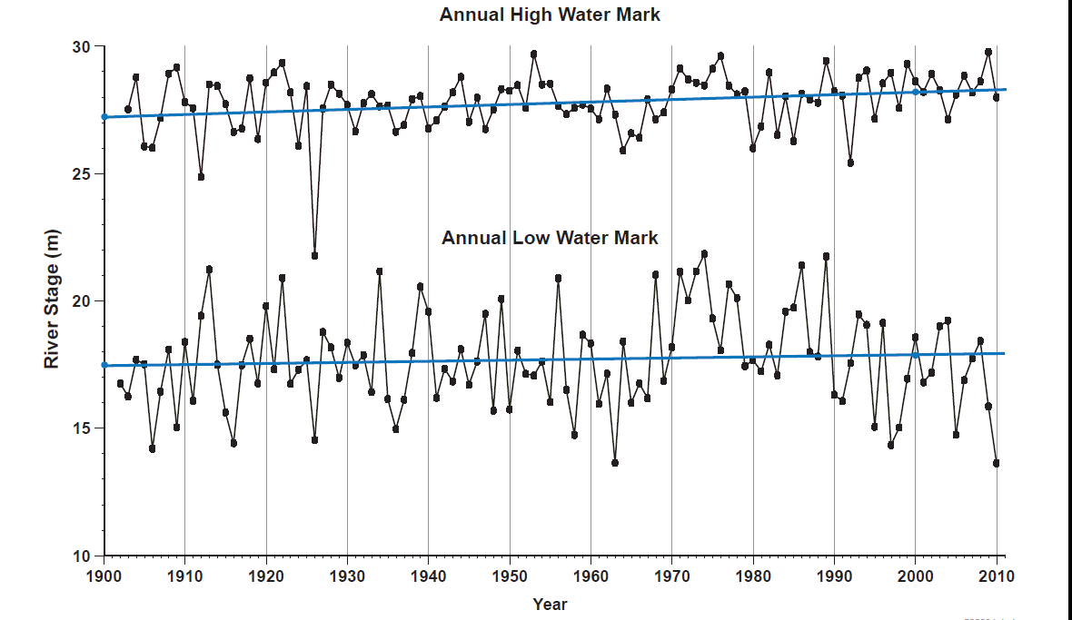
High and low water marks in Amazon basin at Manaus (1903-present)
Positive trends - statistically significant
+4 % change
per century
+1 % change
per century

Slide 50
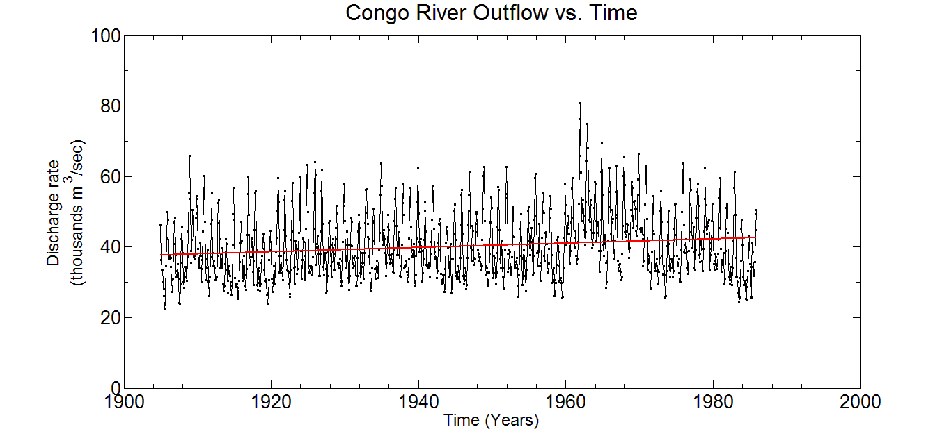
Trend in discharge of Congo River (1905-1985)
Positive trend +15% per century and statistically significant

Slide 51
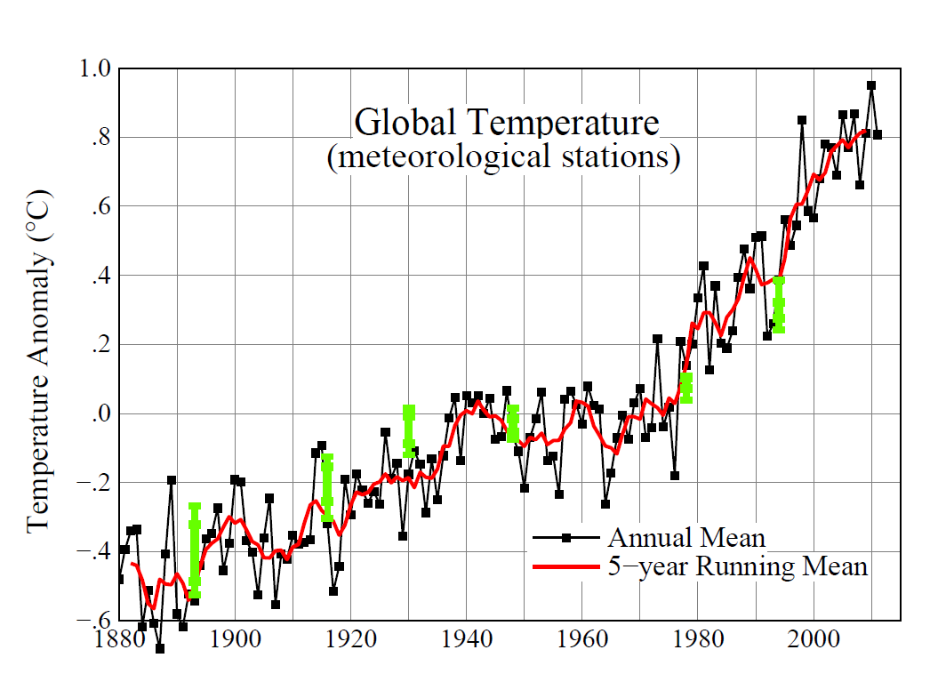
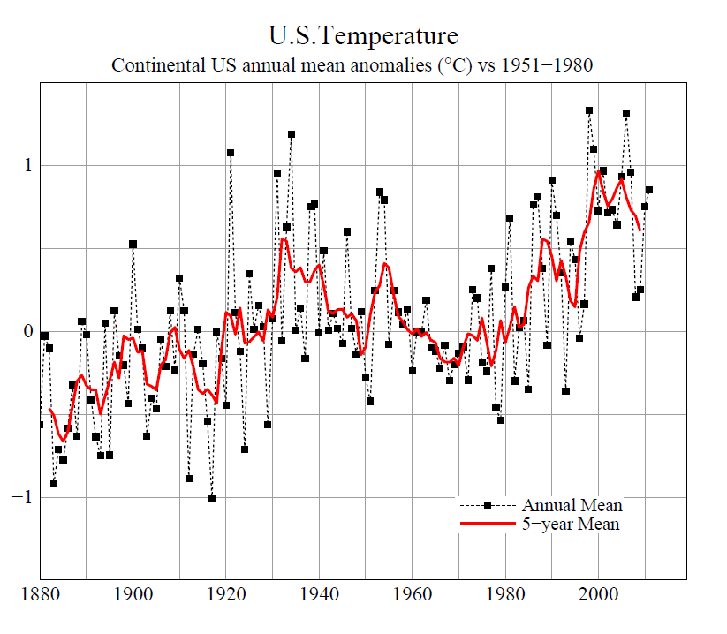
Period of Declining Global Temperature
Global record
US record

Slide 52
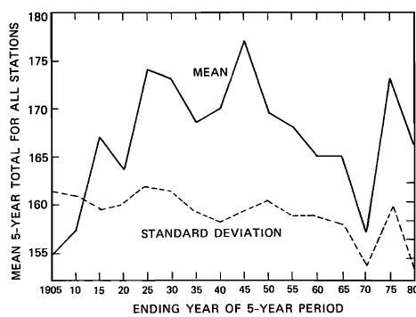
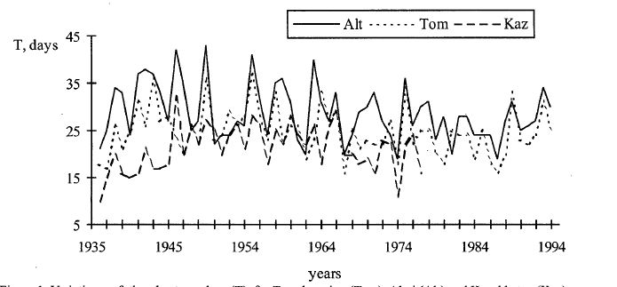
Consistent decline in thunderstorm days in the period of global and regional cooling
Chagnon (1985)
86 stations in US
- 19% thunder day/°C
Gorbatenko and
Dulzon (2001
3 stations
Central Asia

Slide 53
Outline
Global perspective on thunderstorms and world views
CAPE versus aerosol control of lightning in present climate
Natural variations in global temperature and lightning
Impact of urban areas on lightning
Increases in lightning at high northern latitude
Puzzlements on 11 year solar cycle
Long-period trends and stability of tropical chimneys
Lightning and atmosphere chemistry
Expectations for lightning in a warmer world
Conclusions

Slide 54

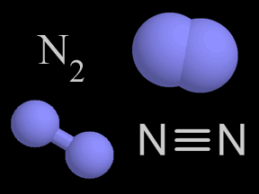


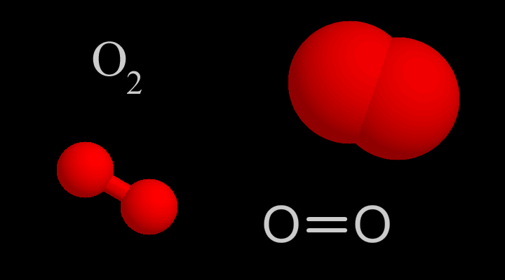
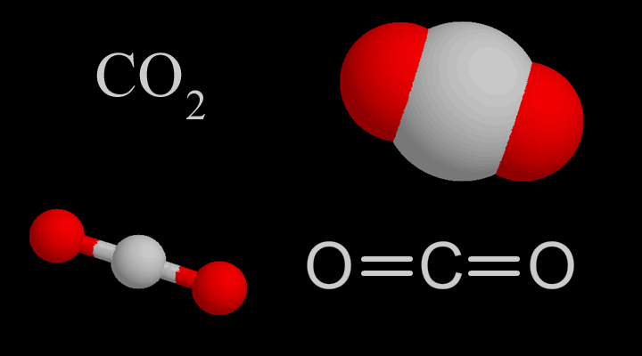
Molecules and Climate
Non-greenhouse gases
Primary greenhouse gases
Greenhouse compounds
made by lightning

Slide 55

NOx delivered to upper troposphere by lightning source → Ozone Enhancement
Boundary Layer: Anthropogenic source for NOx

Slide 56
Outline
Global perspective on thunderstorms and world views
CAPE versus aerosol control of lightning in present climate
Natural variations in global temperature and lightning
Impact of urban areas on lightning
Increases in lightning at high northern latitude
Puzzlements on 11 year solar cycle
Long-period trends and stability of tropical chimneys
Lightning and atmosphere chemistry
Expectations for lightning in a warmer world
Conclusions

Slide 57

CAPE response to warming scenarios

Slide 58


CAPE changes in a warmer climate: two GCM predictions
(A. Del Genio, NASA GISS)
(D. Randall, CSU)

Slide 59
Higher flash rate in warmer climate?
Tail of
Flash Rate
Distribution

Slide 60
Lightning in our future?
Thermodynamic view: More lightning probable
Aerosol view: More difficult to say

Slide 61
Outline
Global perspective on thunderstorms and world views
CAPE versus aerosol control of lightning in present climate
Natural variations in global temperature and lightning
Impact of urban areas on lightning
Increases in lightning at high northern latitude
Puzzlements on 11 year solar cycle
Long-period trends and stability of tropical chimneys
Lightning and atmosphere chemistry
Expectations for lightning in a warmer world
Conclusions

Slide 62
Conclusions
Both thermodynamics and aerosol are influencing lightning activity; disentanglement is difficult task
Lightning activity in cities and at high northern latitudes is on the rise
11-year thunder day antiphase condition most prevalent at low latitude
  Possible role for galactic cosmic rays
Decadal trends in global lightning and temperature are flat
Long-term trends in tropical chimney regions are positive
Expectation for more lightning in a warmer world
Both global circuits deserve greater exploitation as inexpensive global monitors

Slide 63

Acknowledgements
Thank you, Ben Franklin
R. Albrecht
M. Andreae
M. Baker
M. Barth
T. Bell
R. Blakeslee
R. Boldi
H. Christian
T. Chronis
S. Cummer
A. Del Genio
R. Dickinson
E. Eltahir
M. Fullekrug
S. Goodman
A. Guha
R. Hallowell
J. Hansen
S. Hardy
G. Harrison
S. Heckman
Y. Hobara
A. Hogan
K. Hood
E. Huang
H. Iskenderian
S. Kandalgaonkar
S. Kinne
W. Lyons
D. MacGorman
A. Malhado
T. Mansell
R. Markson
V. Mushtak
R. Orville
W. Petersen
K. Pickering
N. Renno
K. Riemann-Campe
M. Riley
C. Rodger
D. Rosenfeld
S. Rutledge
X. Qie
R. Said
G. Satori
H. Schiffer
D. Sentman
E. Simons
D. Smalley
N. Taylor
B. Tinsley
H. Viswanatha
J. Wu
R. Zhang
E. Zipser

Slide 64

Global lightning at midnight (Orville and Henderson 1986)

Slide 65


Global oceanic maps of CCN concentration (Hogan, 1977)

Slide 66

Physical causes for the frequency variations of Schumann resonances (SR)
SR frequencies are responsive to both the changes in properties of the Earth-ionosphere cavity and to variations in the lightning source-observer distance.
Frequency (Hz)
Hard X-ray flux (W/m²)
Sol Min
Sol Min
Solar cycle
Solar cycle variation of SR frequencies is attributed to the variations in hard x-ray flux of more than two orders of magnitude influencing the upper boundary layer of the Earth-ionopshere cavity (Sátori et al. 2003). One would expect lower frequency values at the last solar minimum in 2008/2009 than in the previous one in 1996 if the frequency during the solar cycle is only responsive to the changes of ionospheric propagation conditions due to hard X-ray flux variations. Frequency observations at Nagycenk, Hungary above don’t support this expectation.

Slide 67

Intensified
warming
(Source: J.E. Hansen, R. Ruedy, M. Sato, and K. Lo; NASA Goddard Institute for Space Studies)
Northward shift of the global lightning position indicated by SR frequency variations is attributed to the more intense global warming of the Northern Hemisphere starting at around 1995 (Sátori et al., 2011).

Slide 68

Contrasting the behavior between solar cycle minima
Frequency of the 1st Ez mode has maximum while the 1st horizontal magnetic mode exhibits minimum at NCK (Northern hemisphere) in summer. The summer peak fequencies of the 1st Ez mode (black segments) were higher in the 2008/2009 solar minimum than in the previous one in 1996. Even the frequency was much higher in summer, 2007 (red segment) than in 1996 in spite of the fact that the solar activity in 2007 already returned to the activity level of 1996. The opposite frequency response can be seen in case of the 1st horizontal magnetic mode when comparing summer frequency values at the two solar minima. The frequency minima are deeper in summer in 2008/2009 than in the previous solar minimum. The opposite frequency variation of the vertical electric and horizontal magnetic field components at the two consecutive solar minima hints that the centroid of the world lightning distribution is systematically shifted northward with 4°- 6° in latitude in the Northern hemisphere summers during the last elongated solar cycle (12-13 years) (Sátori et al., 2011).
Sol Min
Sol Min
Sol Min
Sol Min
Solar cycle

Slide 69

Smoke ingestion by thunderstorms and inversion of electrical polarity (Rudlosky and Fuelberg, 2011)

Slide 70

Variation of fair weather electric field at Kennedy Space Center (Harrison, 2006)

