Slide 1
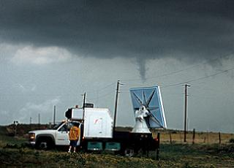
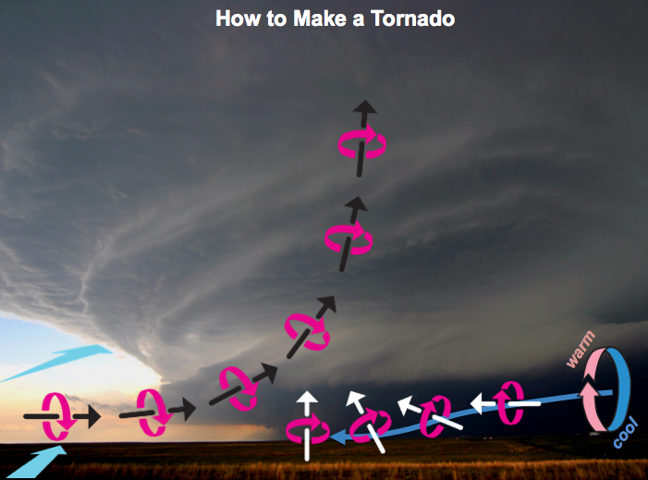
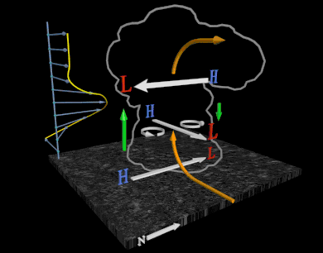
How tornadoes develop: Ideas emerging from decades of theory, simulation, and field observations
Paul Markowski
Associate Professor of Meteorology, Penn State University

Slide 2
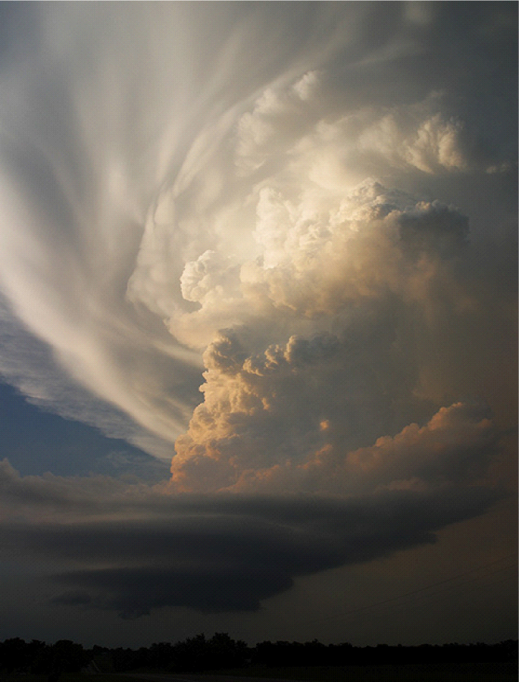
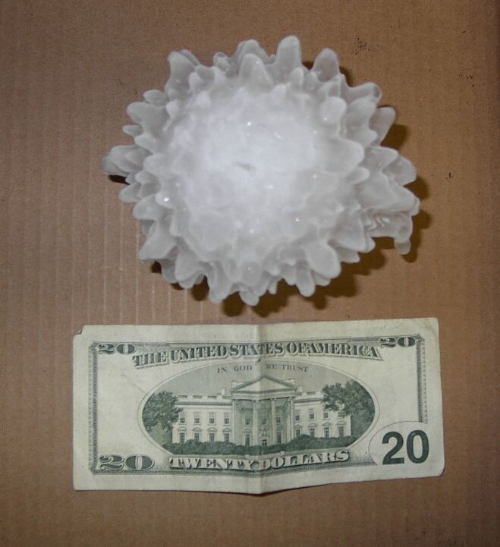
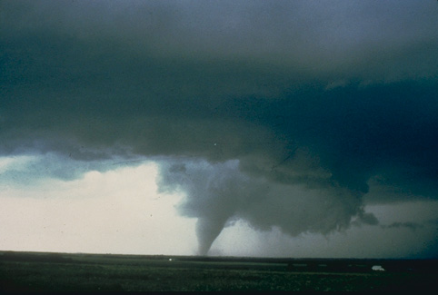
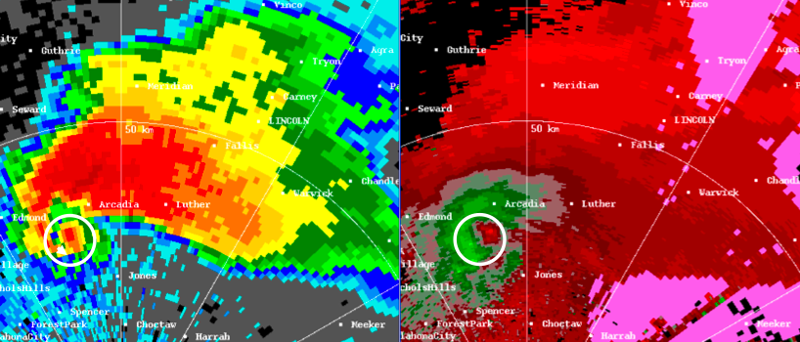
Supercell storms
Storms having deep, persistent, rotation about a vertical axis
“gust fronts”
mesocyclone
cyclonically rotating supercell in Australia (southern hemisphere)
velocity couplet associated w/mesocyclone
hook echo
Notes:
My focus is on supercells. Tornadoes can occur in nonsupercells too, but virtually all violent tornadoes are associated with supercells, so they’ve deservedly gotten most of the attention.

Slide 3
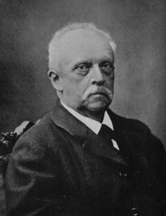
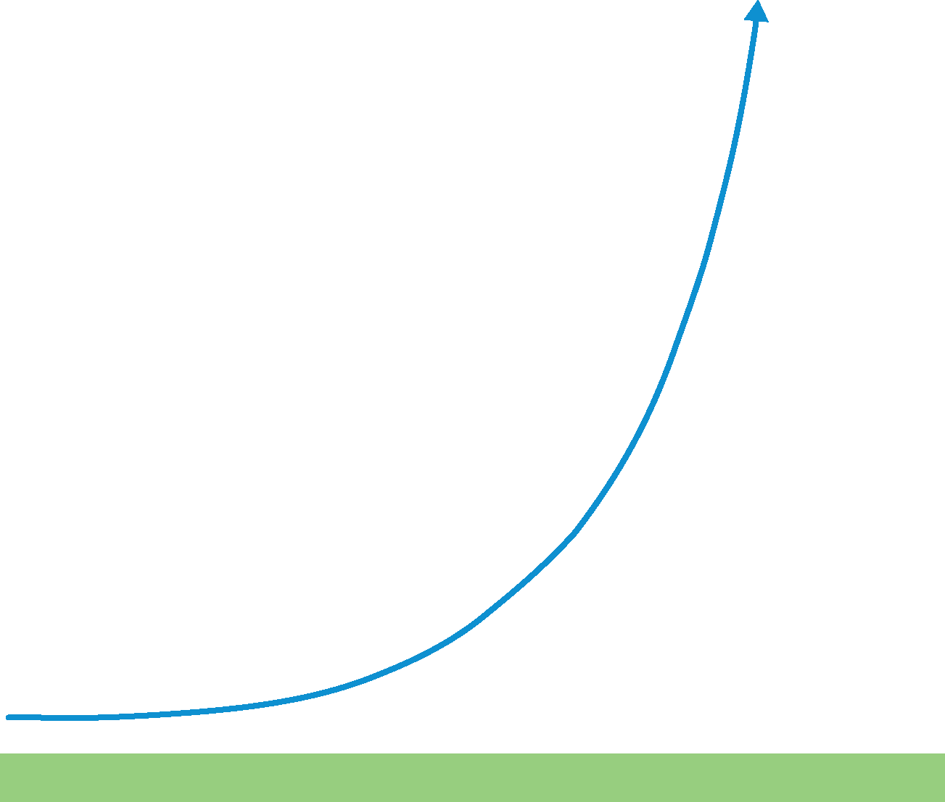
Theoretical constraints on tornadogenesis
Helmholtz’ (1858) theorem: In an inviscid, barotropic flow, vortex lines move as material lines (vortex lines are ‘‘frozen’’ into the fluid and behave like elastic strings that the flow moves, stretches, and reorients)
Consider two parcels following the same trajectory. Also assume that the parcels lie on the same vortex line.
Hermann von Helmholtz
(1821–1894)
At some later time, the parcels have moved and the segment of the vortex line moves as a material line according to the trajectories of the parcels.
A
B
Notes:
The origins of midlevel updraft rotation are well understood.
You might recall Helmholtz’ theorem…
This was actually his second vorticity theorem, though he didn’t distinguish them as first, second, or third.
Regarding the assumption that the parcels lie on the same vortex line, we could envision the far field of a convective storm environment in which vortex lines and trajectories both are horizontal. For sake of simplicity, assume no vorticity component in or out of page, i.e., it’s streamwise.

Slide 4
Theoretical constraints on tornadogenesis
Helmholtz’ (1858) theorem: In an inviscid, barotropic flow, vortex lines move as material lines (vortex lines are ‘‘frozen’’ into the fluid and behave like elastic strings that the flow moves, stretches, and reorients)
Consider two parcels following the same trajectory. Also assume that the parcels lie on the same vortex line.
At some later time, the parcels have moved and the segment of the vortex line moves as a material line according to the trajectories of the parcels.
Notes:
Tilting by an updraft alone cannot produce vertical vorticity at the surface. Air is rising away from the surface as the vorticity vector acquires a vertical component.

Slide 5
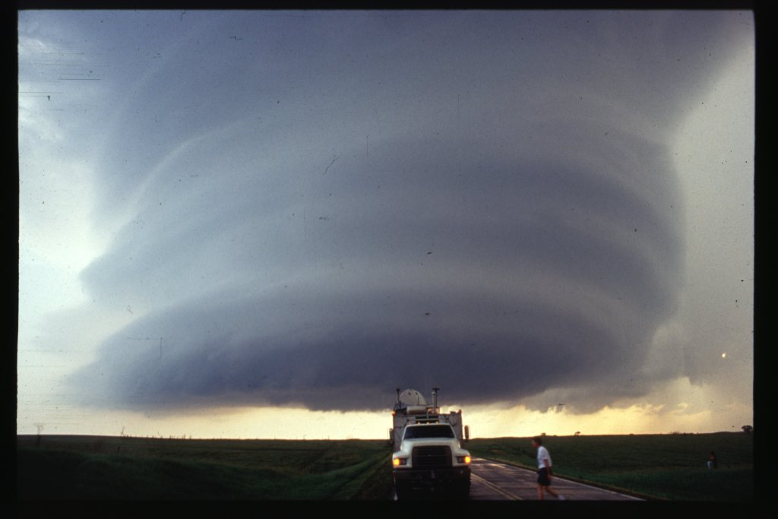
Theoretical constraints on tornadogenesis
Helmholtz’ (1858) theorem: In an inviscid, barotropic flow, vortex lines move as material lines (vortex lines are ‘‘frozen’’ into the fluid and behave like elastic strings that the flow moves, stretches, and reorients)
Consider two parcels following the same trajectory. Also assume that the parcels lie on the same vortex line.
At some later time, the parcels have moved and the segment of the vortex line moves as a material line according to the trajectories of the parcels.
Notes:
Tilting by an updraft alone cannot produce vertical vorticity at the surface. Air is rising away from the surface as the vorticity vector acquires a vertical component.

Slide 6
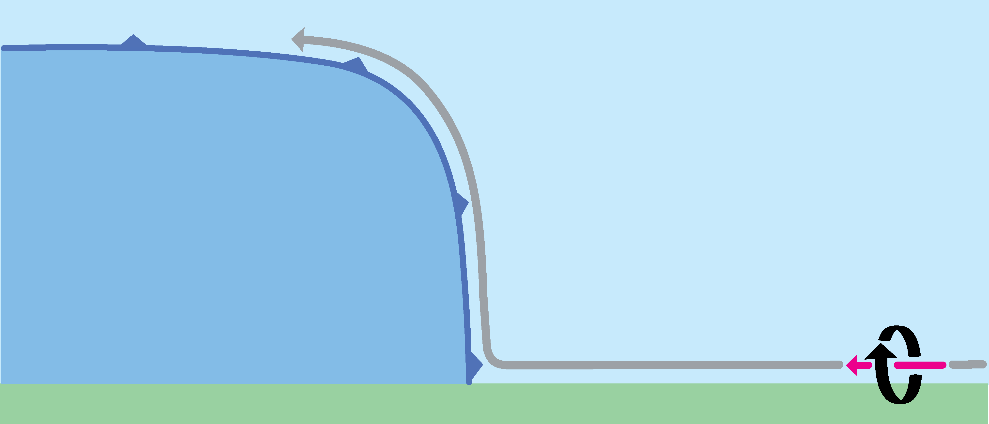
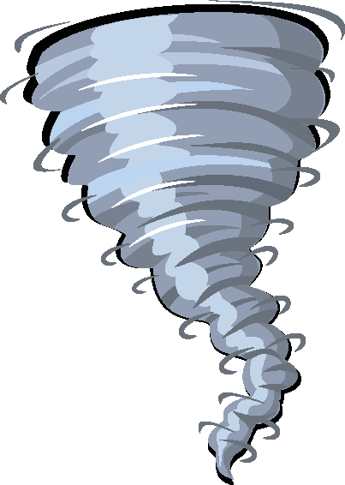
But what if the tilting is extremely abrupt (for example, a strong gust front tilts vortex lines)?

Slide 7
But what if the tilting is extremely abrupt (for example, a strong gust front tilts vortex lines)?
X
zonal vorticity
vertical vorticity
Davies-Jones, R., and P. M. Markowski, 2013: Lifting of ambient air by density currents in sheared environments. J. Atmos. Sci., 70, in press.

Slide 8
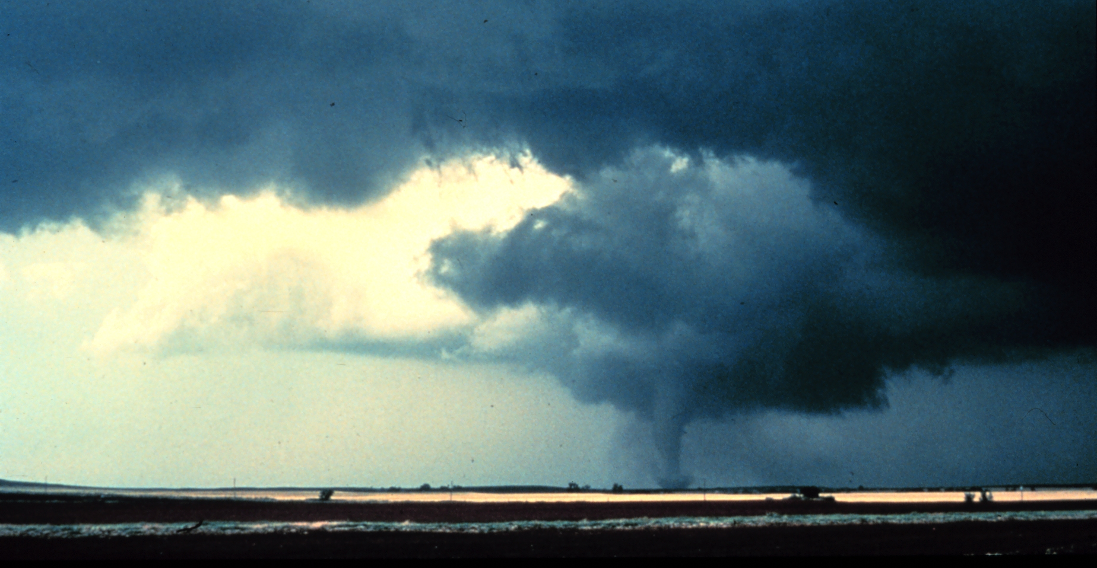
So how does large vertical vorticity ever develop next to the surface?
downdraft
Downdrafts are key!
NSSL archive photo
downdraft
downdraft
Courtesy of Dave Blanchard
Courtesy of Dave Blanchard
Notes:
We see lots of evidence for downdrafts, and though I don’t have time to show it, there’s observational evidence for this dynamical process as well, though it’s hard to observe directly because it occurs so close to the surface.

Slide 9
Theoretical constraints on tornadogenesis
Evolution of the vorticity vector along
a downdraft trajectory (with baroclinity)
warm air into the page
cold air out of the page
The vorticity vector is initially tipped downward during descent, but with less inclination than the trajectories because southward-pointing horizontal vorticity is continually being generated baroclinically; the vorticity vector is then tilted upward by velocity gradients.
Notes:
The only way to get vertical vorticity at the surface is via a downdraft. In supercells, air that passes along the left side of a downdraft acquires vertical vorticity via the combination of descent and baroclinic vorticity generation. The vorticity is fairly streamwise upstream, and then blah blah blah…

Slide 10
Theoretical constraints on tornadogenesis
Evolution of the vorticity vector along
a downdraft trajectory (with baroclinity)
Davies-Jones & Brooks (1993): “…the horizontal vorticity generation forcing introduces ‘slippage’ between the (descending) fluid and vortex lines…”
Notes:
The only way to get vertical vorticity at the surface is via a downdraft. In supercells, air that passes along the left side of a downdraft acquires vertical vorticity via the combination of descent and baroclinic vorticity generation. The vorticity is fairly streamwise upstream, and then blah blah blah…

Slide 11
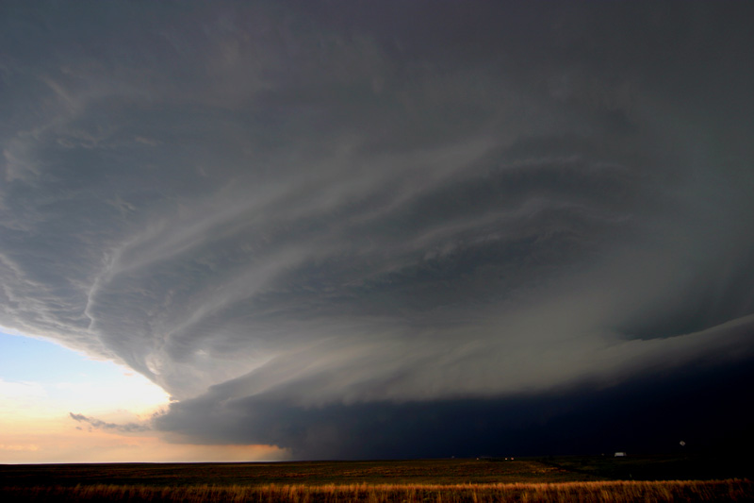
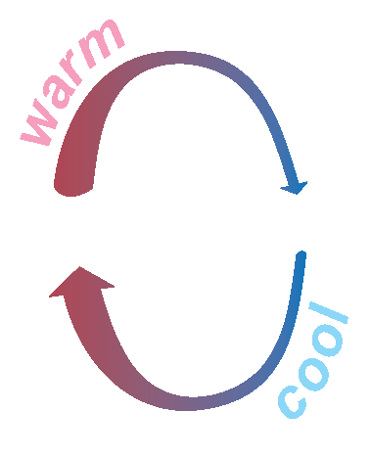
How to Make a Tornado
wind shear
streamwise vorticity
downdraft
Photo by Eric Nguyen

Slide 12
How to Make a Tornado
Photo by Eric Nguyen
Notes:
Airplane analogy.

Slide 13
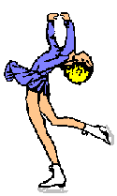
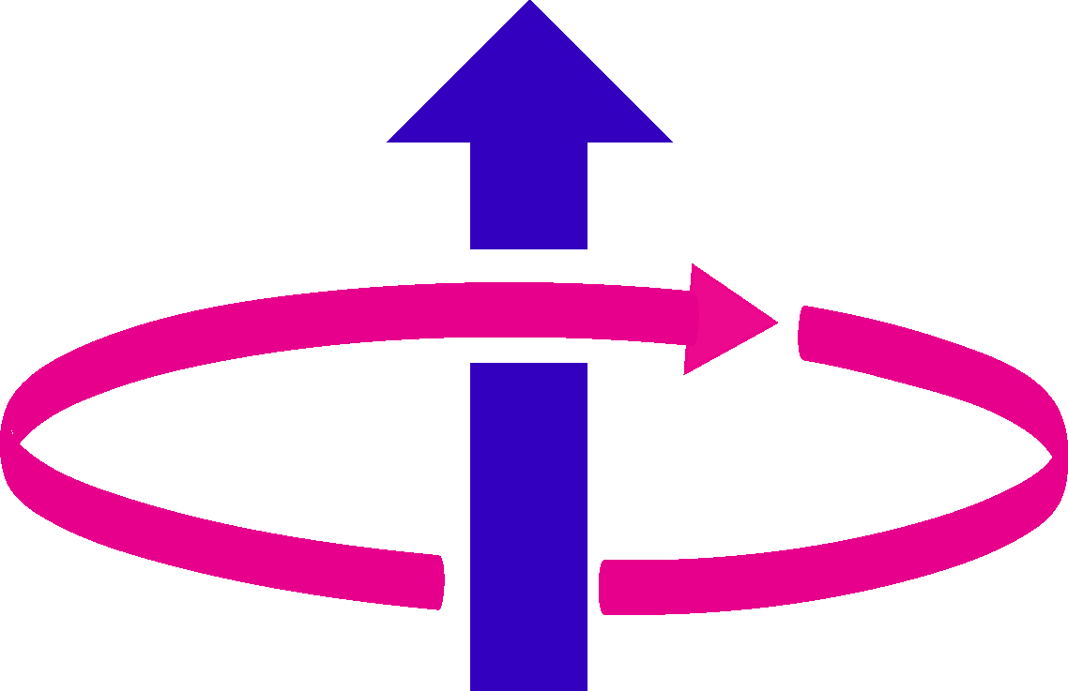
not too cold and strong sucking from above
too cold and/or weak sucking from above
Notes:
So we know that downdrafts are important. We can see downdrafts in the videos and in the tornado pictures we saw earlier. But even nontornadic storms have downdrafts. Something else has to happen. The rotation still must be intensified via the figure-skater effect. We thing the temperature of the downdraft air is important, as well as the sucking from above.

Slide 14
Forward trajectories through low-level mesocyclone in tornadic supercell intercepted by VORTEX2 (5 June 2009)
Forward trajectories through low-level mesocyclone in nontornadic supercell intercepted by ROTATE (12 June 2004)
Markowski et al. (2011)
not too cold and strong sucking from above
Notes:
So we know that downdrafts are important. We can see downdrafts in the videos and in the tornado pictures we saw earlier. But even nontornadic storms have downdrafts. Something else has to happen. The rotation still must be intensified via the figure-skater effect. We thing the temperature of the downdraft air is important, as well as the sucking from above.

Slide 15
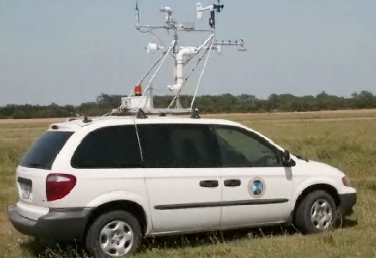
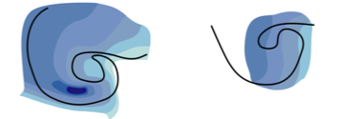
Low-level buoyancy fields of observed supercells
adapted from Markowski et al. (2002)
tornadic
16 May 1995 (Burdett, KS)
2 June 1995 (Dimmitt, TX)
nontornadic
29 April 1995 (Sherman, TX) 12 May 1995 (Hays, KS)
Paradox: Though baroclinic vorticity generation is crucial, excessively cold downdrafts and outflow appear to be detrimental to tornadogenesis!
not too cold and strong sucking from above
Notes:
So we know that downdrafts are important. We can see downdrafts in the videos and in the tornado pictures we saw earlier. But even nontornadic storms have downdrafts. Something else has to happen. The rotation still must be intensified via the figure-skater effect. We thing the temperature of the downdraft air is important, as well as the sucking from above.

Slide 16
What is the role of environmental horizontal vorticity?
Answer: to lower the base of the midlevel mesocyclone, which enhances the dynamic vertical pressure gradient force (“sucking”); in other words, the role is largely indirect in that environmental vorticity does not contribute directly to the circulation of the near-surface mesocyclone or tornado
not too cold and strong sucking from above
too cold and/or
weak sucking from above
Notes:
So we know that downdrafts are important. We can see downdrafts in the videos and in the tornado pictures we saw earlier. But even nontornadic storms have downdrafts. Something else has to happen. The rotation still must be intensified via the figure-skater effect. We thing the temperature of the downdraft air is important, as well as the sucking from above.

Slide 17
Evolution of the vorticity vector along
a downdraft trajectory (with baroclinity)
downdraft air not too cold and/or strong forced lifting via dynamic VPGF
ζ ∂w/∂z >> 0
downdraft air too cold for the given dynamic VPGF
ζ ∂w/∂z ~ 0

Slide 18
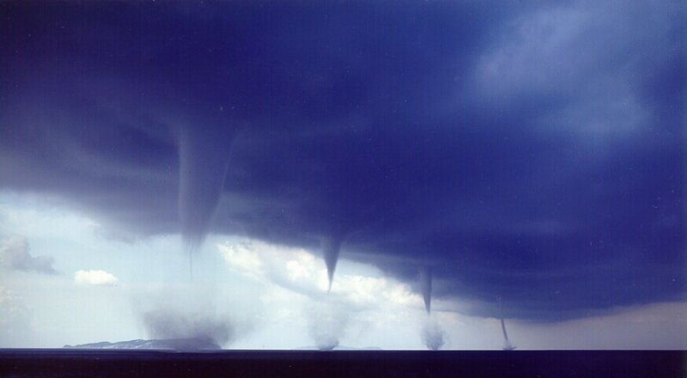
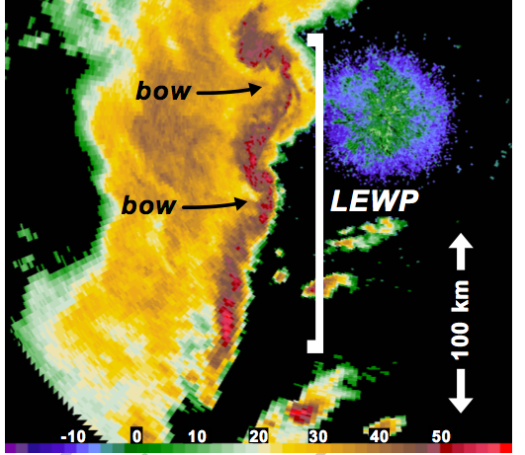
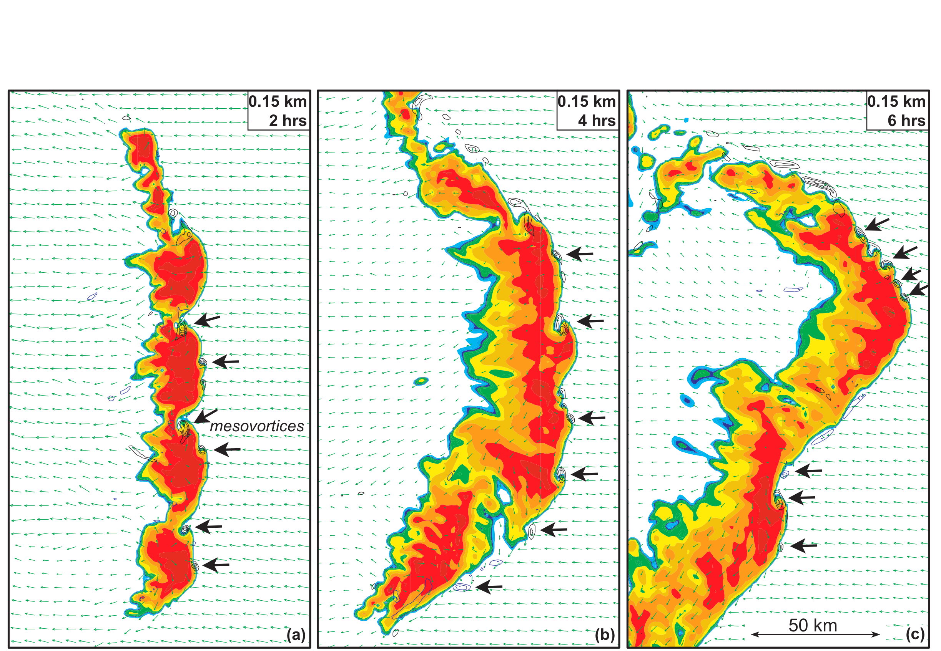
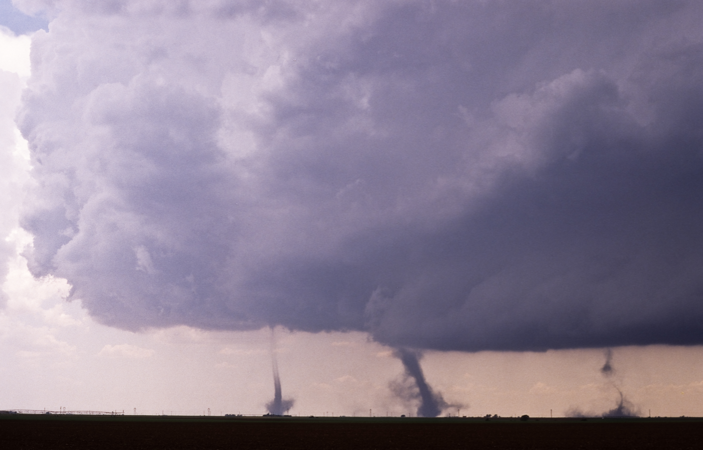
Non-supercell tornadoes
(sometimes called non-mesocyclonic tornadoes)
Tornadoes occasionally develop within mesoscale convective systems
“waterspouts”
Roberto Giudici
“landspouts”
Peter Blottman

Slide 19
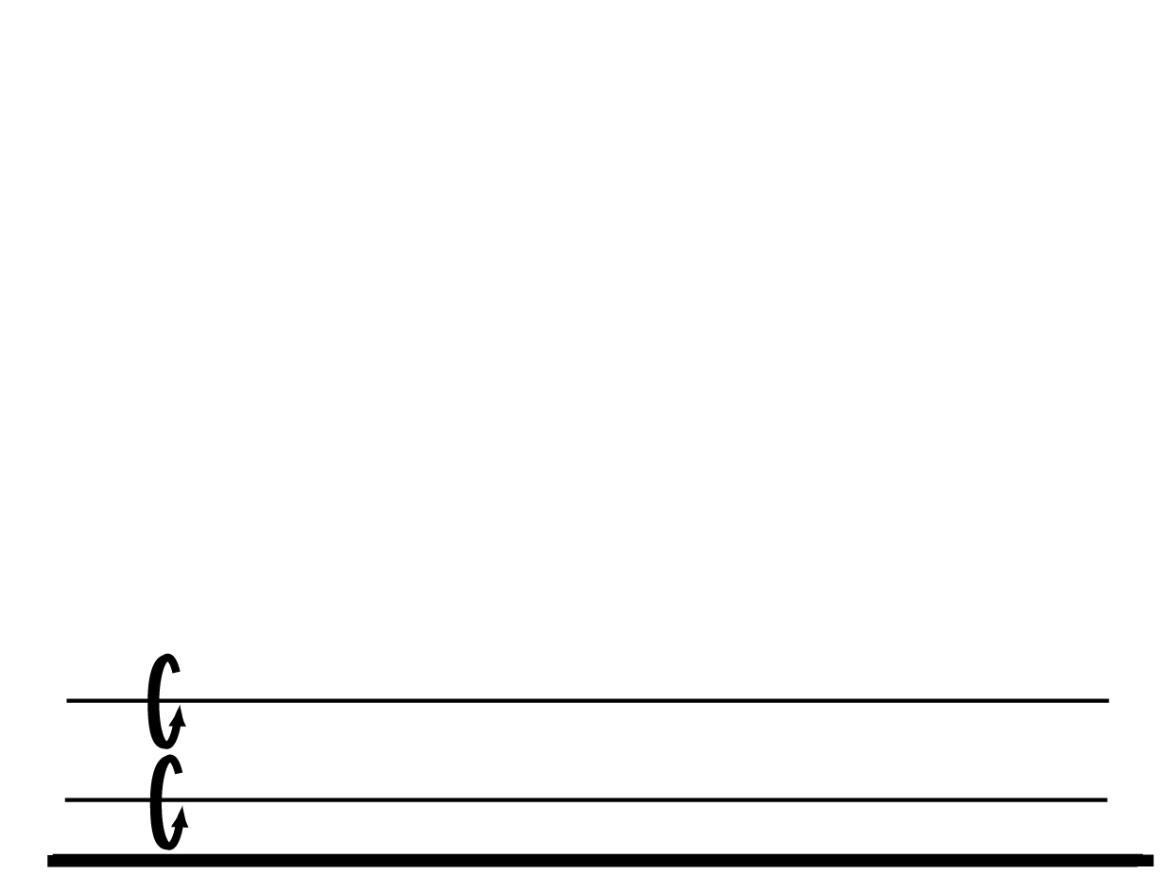
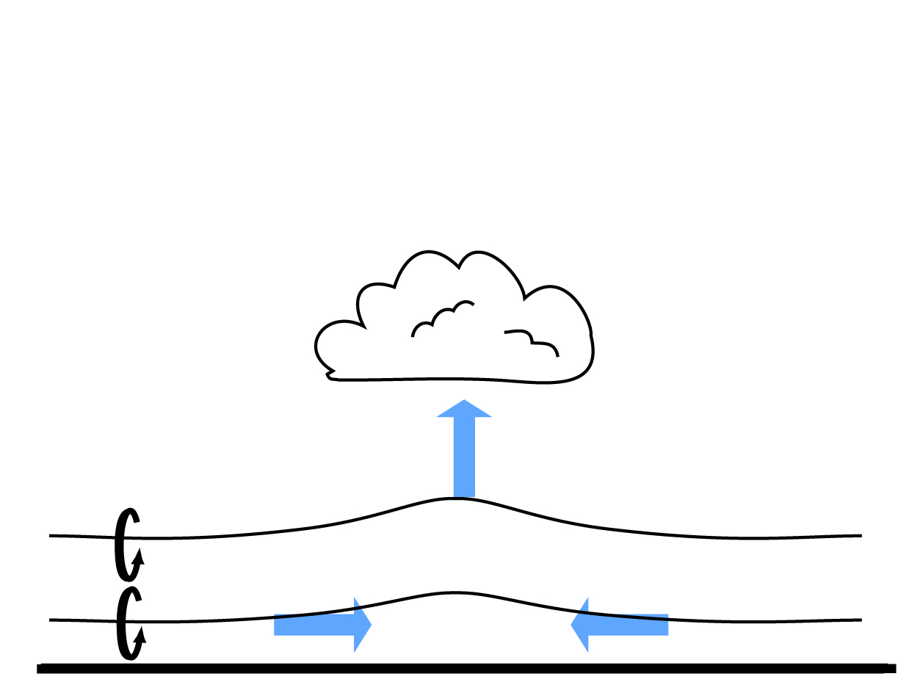
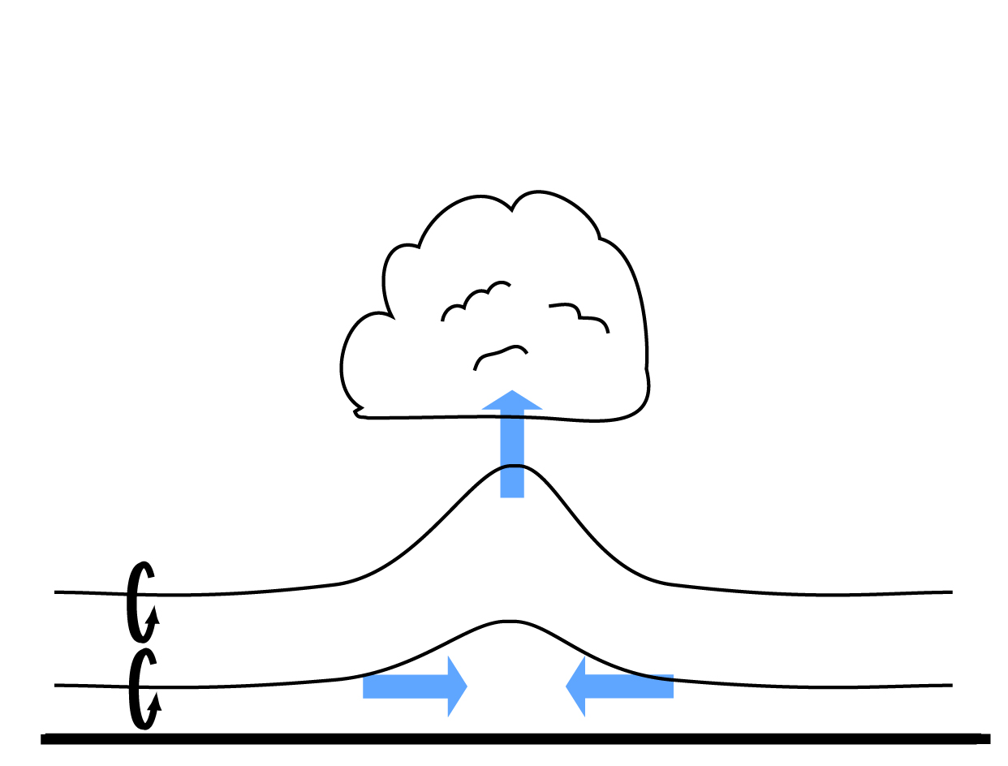
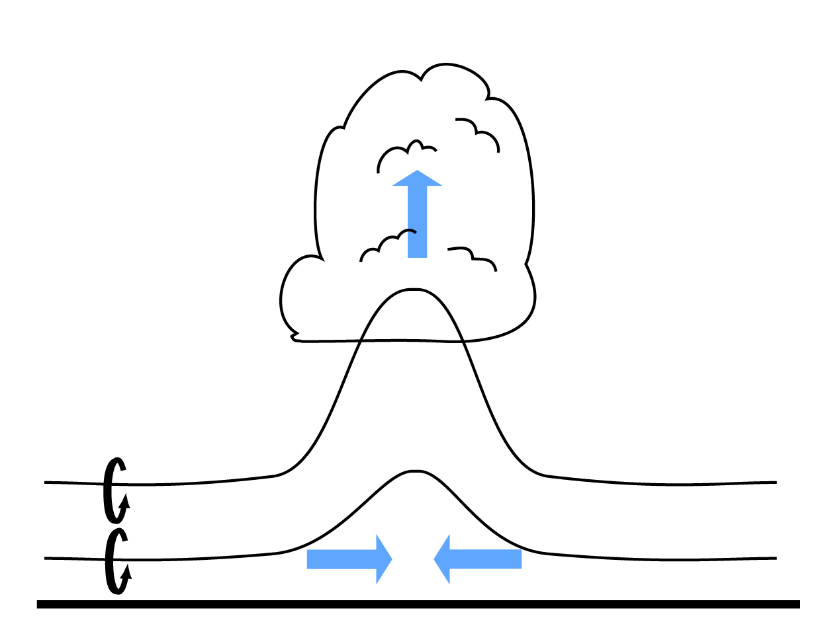
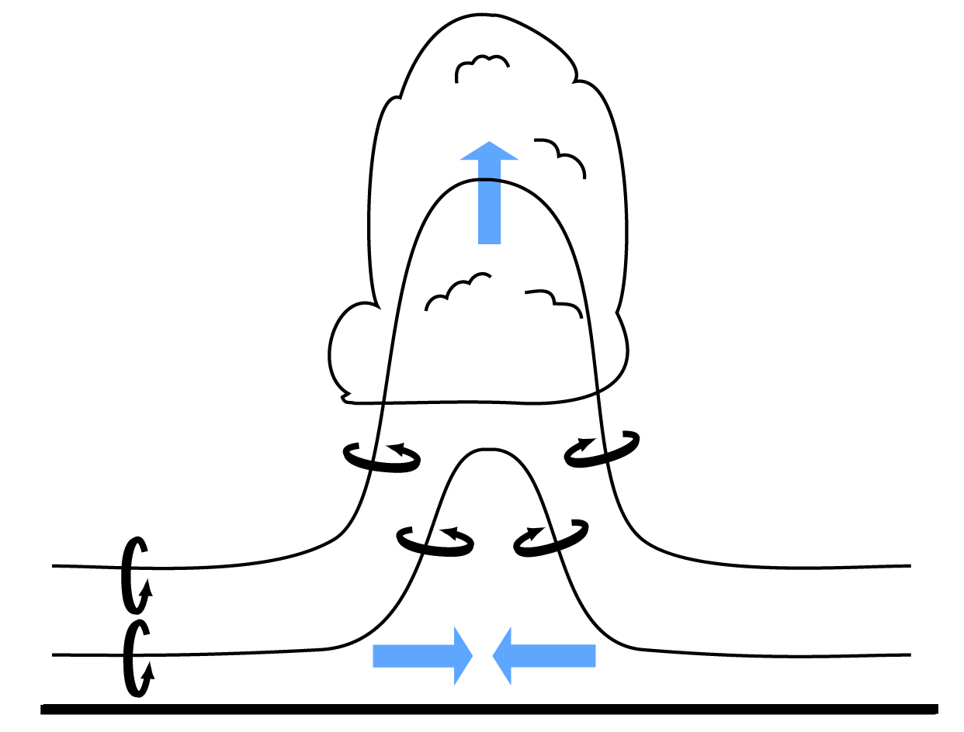
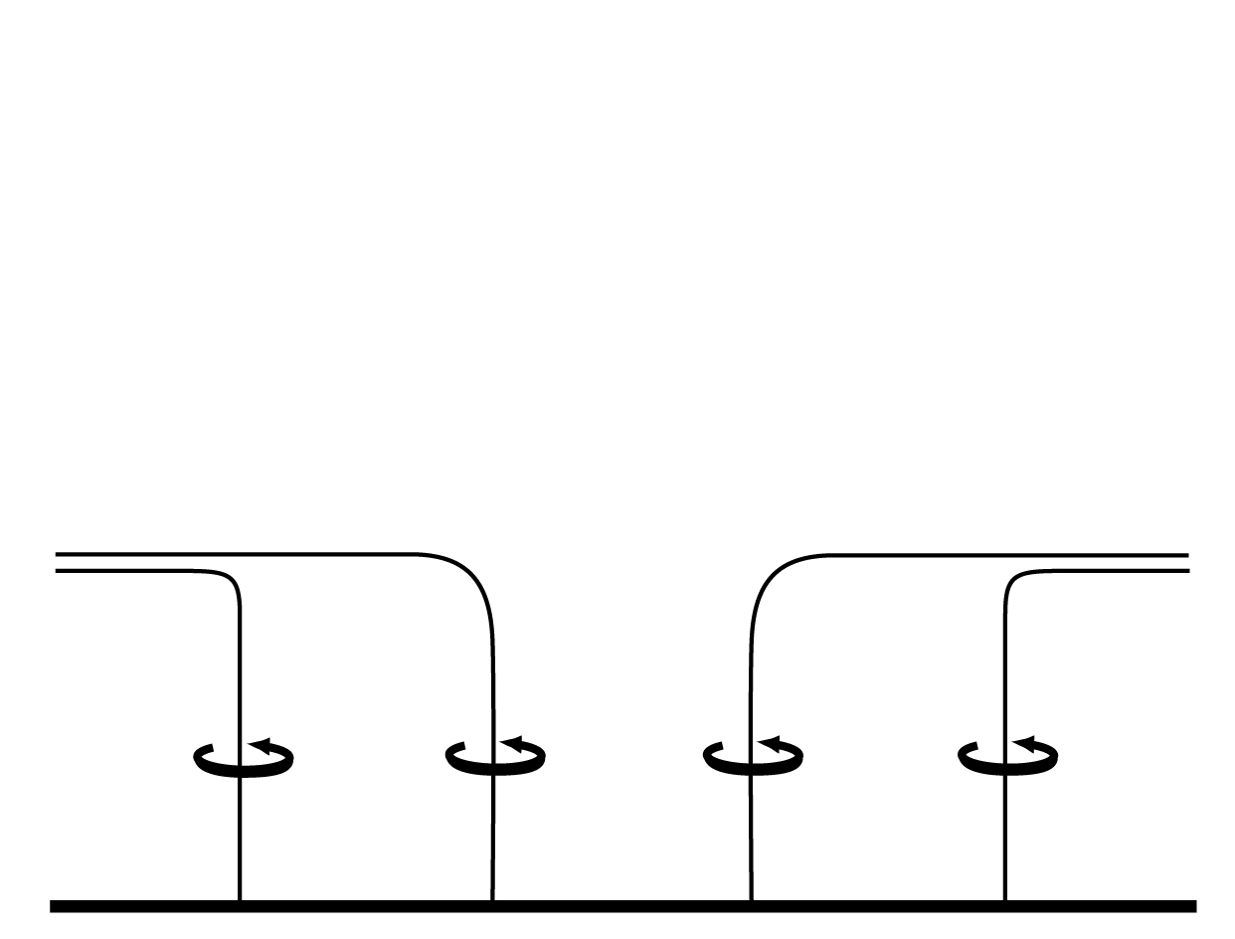
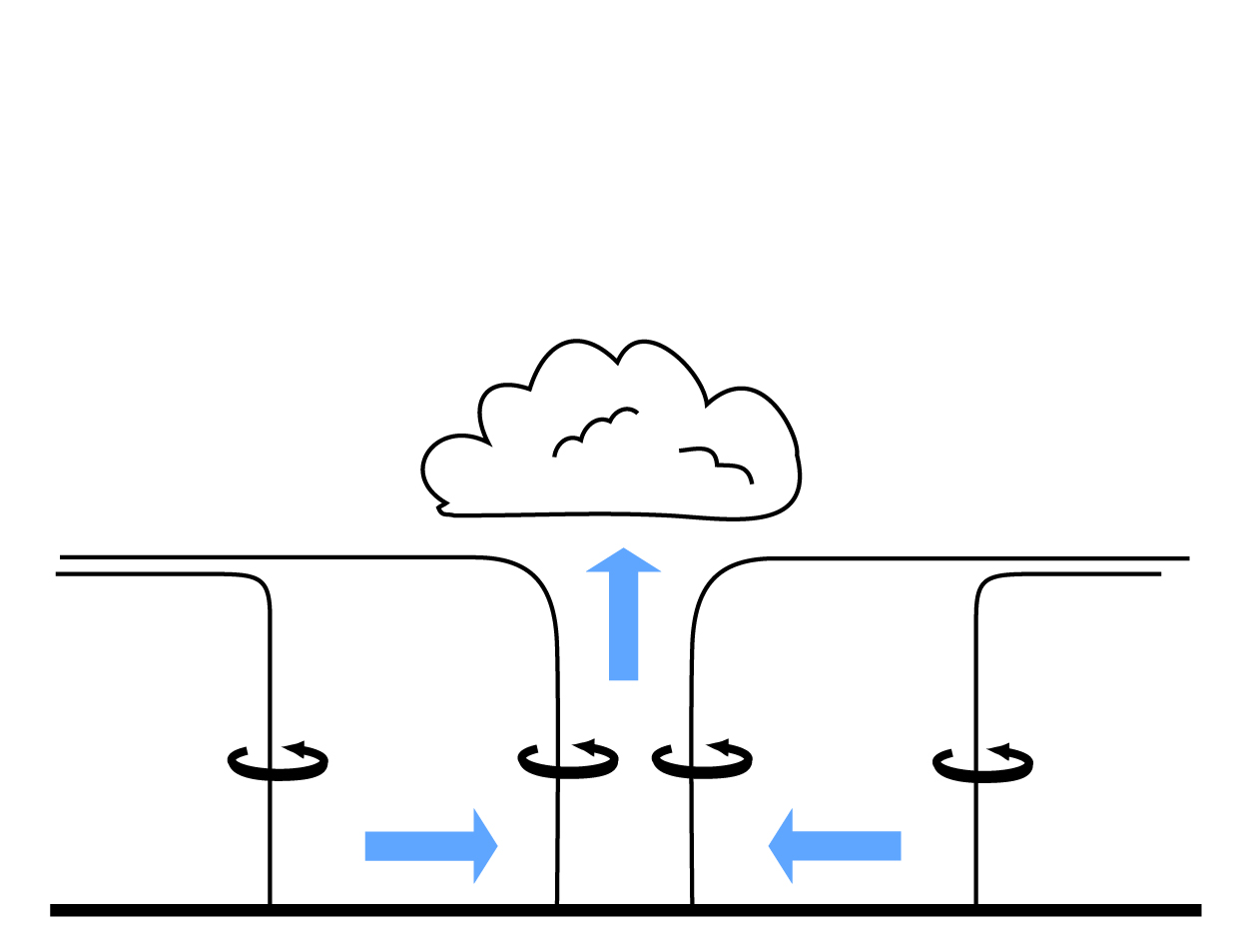
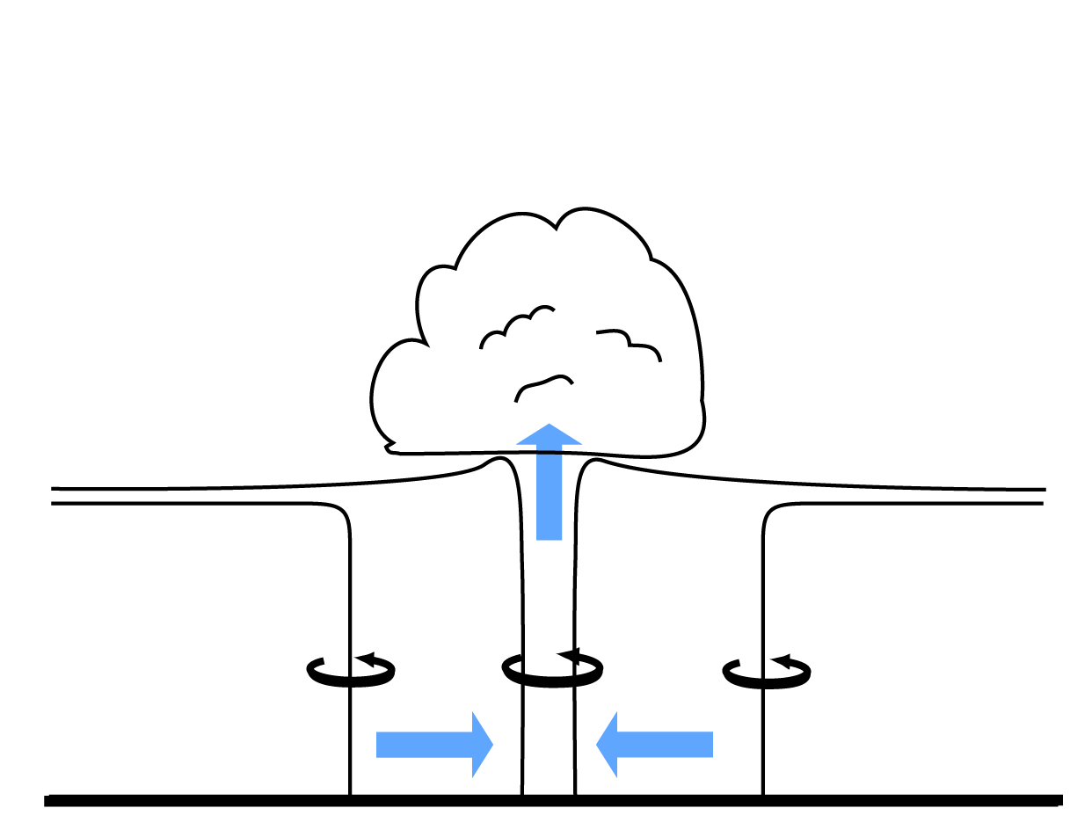
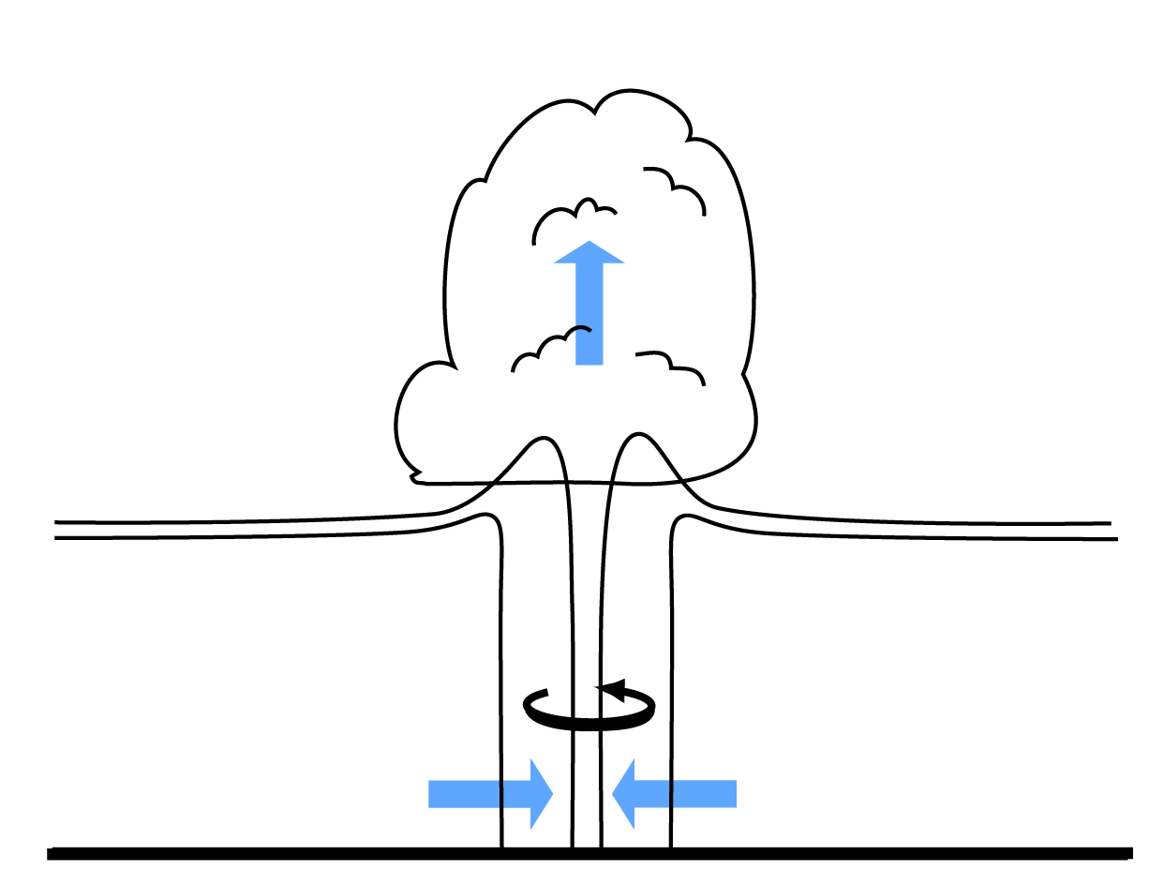
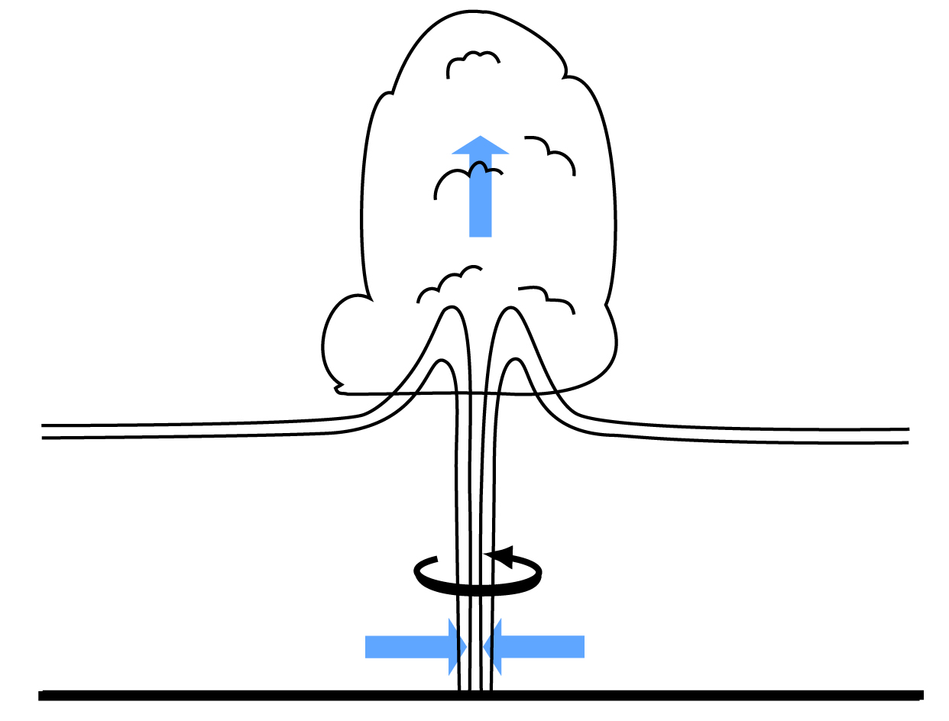
This explanation is most relevant for landspouts/waterspouts, but maybe not tornadoes in quasilinear convective systems (QLCSs), which might still involve downdrafts, just not classic supercell downdrafts. Other QLCS tornadoes are associated with supercells embedded in squall lines.
Supercell tornado environment: large environmental horizontal vorticity, negligible preexisting vertical vorticity at the surface
Nonsupercell tornado environment: preexisting vertical vorticity at surface
zeroth order assumption: no baroclinity or viscosity; vortex lines are material lines

Slide 20
Summary: Tornadogenesis in Supercells
The baroclinic generation of vorticity along descending trajectories is the means by which “tornadogenesis-ready” angular momentum arises at the surface—but excessive negative buoyancy is unfavorable for tornadogenesis.
The role of large low-level environmental vorticity in tornadogenesis seems to be “indirect”—it leads to a strong, upward-directed, dynamic VPGF that promotes the convergence of the angular momentum-bearing air that reaches the surface via downdrafts (vertical vorticity stretching).

Slide 21
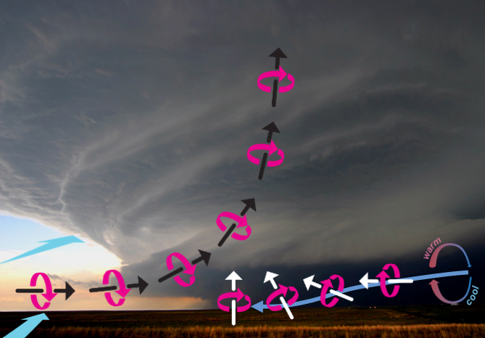
Ingredients for significant tornadoes i.e., what an SPC forecaster would look for in preparing a tornado outlook
Significant CAPE (large CAPE is not necessary, but CAPE is usually >1000 J kg^{–1} in significant tornado environments)

Slide 22
Ingredients for significant tornadoes i.e., what an SPC forecaster would look for in preparing a tornado outlook
Significant CAPE (large CAPE is not necessary, but CAPE is usually >1000 J kg^{–1} in significant tornado environments)
Strong deep-layer wind shear (vector velocity differential usually >20 m s^{–1} over the lowest ~6 km)

Slide 23
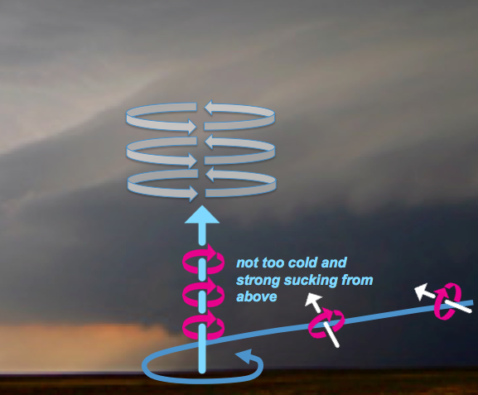
Ingredients for significant tornadoes i.e., what an SPC forecaster would look for in preparing a tornado outlook
Significant CAPE (large CAPE is not necessary, but CAPE is usually >1000 J kg^{–1} in significant tornado environments)
Strong deep-layer wind shear (vector velocity differential usually >20 m s^{–1} over the lowest ~6 km)
Strong low-level wind shear (vector velocity differential usually >10 m s^{–1} over the lowest ~1 km), with an orientation such that environmental horizontal vorticity has a large streamwise component

Slide 24
Ingredients for significant tornadoes i.e., what an SPC forecaster would look for in preparing a tornado outlook
Significant CAPE (large CAPE is not necessary, but CAPE is usually >1000 J kg^{–1} in significant tornado environments)
Strong deep-layer wind shear (vector velocity differential usually >20 m s^{–1} over the lowest ~6 km)
Strong low-level wind shear (vector velocity differential usually >10 m s^{–1} over the lowest ~1 km), with an orientation such that environmental horizontal vorticity has a large streamwise component
Low LCLs (i.e., high boundary-layer RH)

Slide 25
Ingredients for significant tornadoes i.e., what an SPC forecaster would look for in preparing a tornado outlook
Significant CAPE (large CAPE is not necessary, but CAPE is usually >1000 J kg^{–1} in significant tornado environments)
Strong deep-layer wind shear (vector velocity differential usually >20 m s^{–1} over the lowest ~6 km)
Strong low-level wind shear (vector velocity differential usually >10 m s^{–1} over the lowest ~1 km), with an orientation such that environmental horizontal vorticity has a large streamwise component
Low LCLs (i.e., high boundary-layer RH)
strong low-level shear
Tornadic supercells likely
courtesy of Harold Brooks
weak
low-level
shear
Tornadic supercells unlikely
high RH /
low LCL
low RH /
high LCL

Slide 26
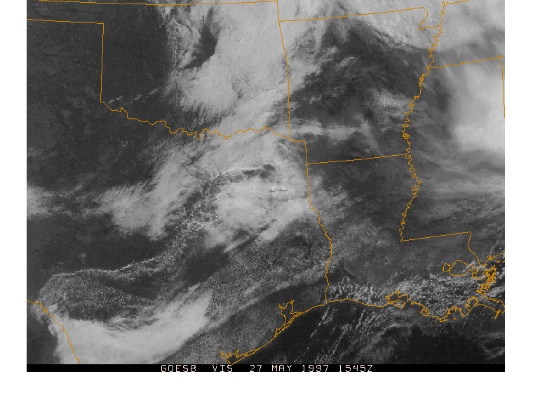
Ingredients for significant tornadoes i.e., what an SPC forecaster would look for in preparing a tornado outlook
Significant CAPE (large CAPE is not necessary, but CAPE is usually >1000 J kg^{–1} in significant tornado environments)
Strong deep-layer wind shear (vector velocity differential usually >20 m s^{–1} over the lowest ~6 km)
Strong low-level wind shear (vector velocity differential usually >10 m s^{–1} over the lowest ~1 km), with an orientation such that environmental horizontal vorticity has a large streamwise component
Low LCLs (i.e., high boundary-layer RH)
All of this assumes that convection can be initiated! (this depends on CIN and capping inversions)

Slide 27
Summary
Tornadogenesis is a localized and fragile process
Instability and shear aren’t the only ingredients for tornadoes
Some ingredients can probably be forecast pretty well by climate models (CAPE & shear?)
Other ingredients probably cannot be forecast well by climate models (CIN? LCL?)
There are important ingredients that haven’t yet been (and might never be) tied to anything obvious in the environment (e.g., small-scale outflow surges, descending rain shafts)
An upward (i.e., favorable) trend in multiple ingredients does not guarantee an upward trend in tornadoes if there are additional large-scale processes at work that prevent the favorable ingredients from overlapping

