Slide 1
The Multi-Year Reanalysis of Remotely Sensed Storms (MYRORSS)
Travis Smith
U. Of Oklahoma &
National Severe Storms Laboratory
Severe Convection and Climate Workshop
14 Mar 2013

Slide 2
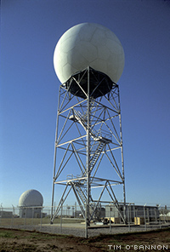
Some background on radar
weather

Slide 3
Some background on weather radar
Some Uses:
severe weather monitoring / warning operations
quantitative precipitation estimation
air traffic control operations
“Reflectivity” / “Radial Velocity”
New capabilities (2012/13):
hydrometeor type: hail / rain / snow / biological targets(bugs / bats / birds)

Slide 4
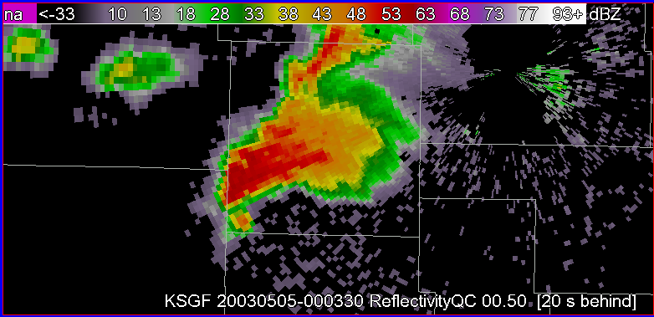
Experimental Warning Program
Focuses on:
Warning decision-making
Feature identification
Data mining
Now:
Evolution of how severe weather information is produced
Traditional Deterministic Warning
Probabilistic
Hazard
Information
Expresses
Uncertainty

Slide 5
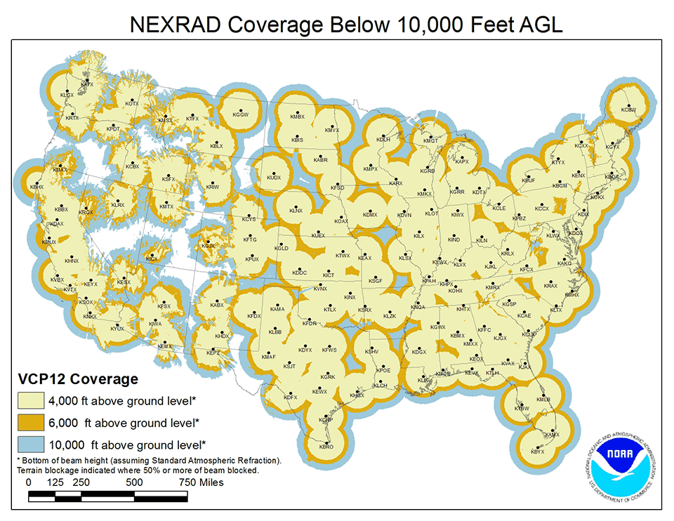
CONUS network coverage
5-10 minute
update rate
~160 individual radar sites
10 cm wavelength = best for seeing through precipitation
Polar:
0.5° x 460km

Slide 6
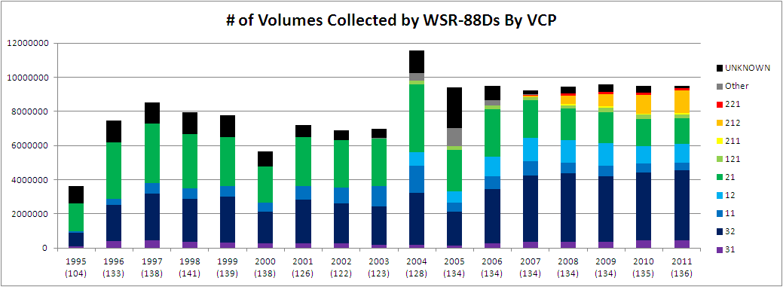
Radar “base data” archive
National Climate Data Center houses the archive
~9,000,000 5-10 minute 3D “volume scans” / year
5 – 20 MB / “volume scan” (uncompressed)

Slide 7
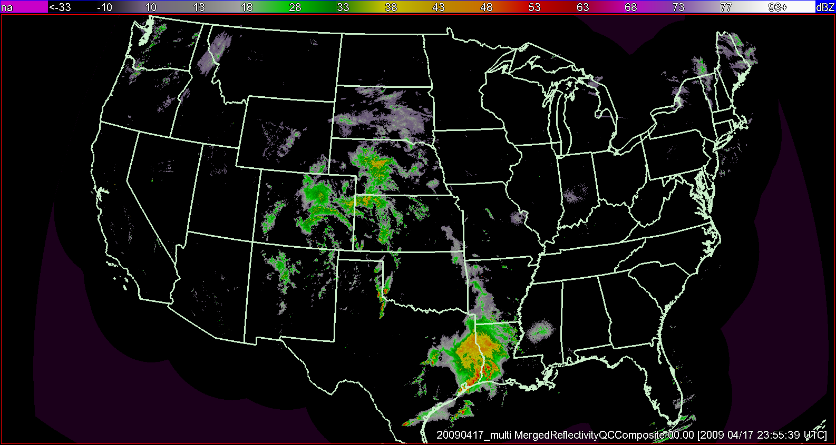
Data Blending: e.g. 3D Radar Mosaic
5-minute temporal resolution
0.01° x 0.01° x
31 vertical levels (20 km MSL
Software: Warning Decision Support System – Integrated Information (WDSS-II
http://wdssii.org
About 100,000 grids / year (instead of 9,000,000

Slide 8
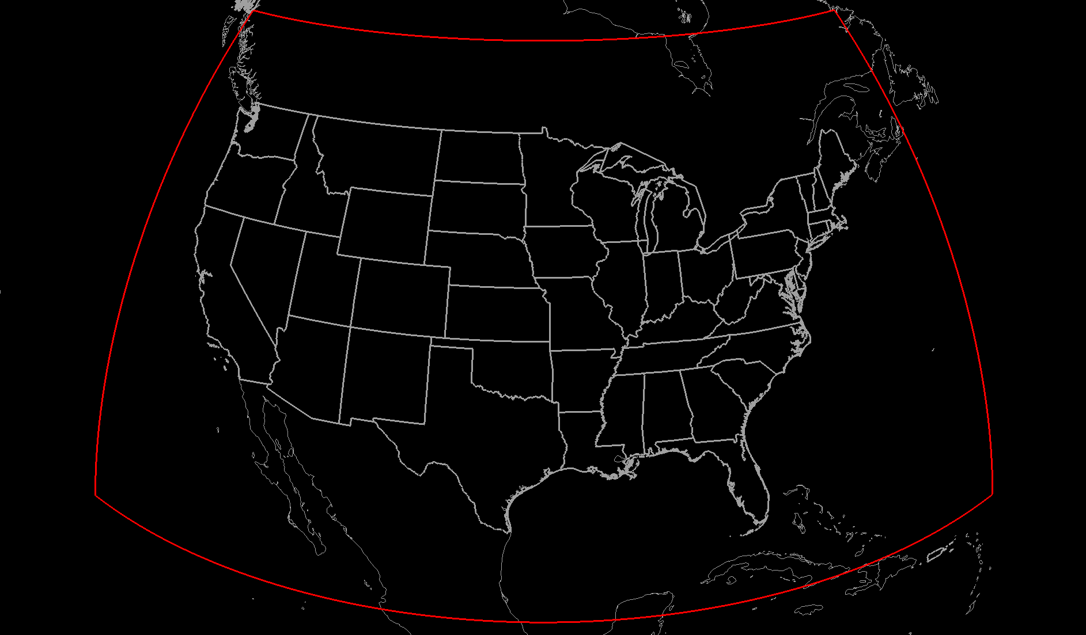
Actual Domain
(insert Canadian 5-cm radars here?)
We also include
environmental data
RUC – 2002-present
NARR?
Easy to add:
Satellite
Lightning
Mexico? (future /
no archive)

Slide 9
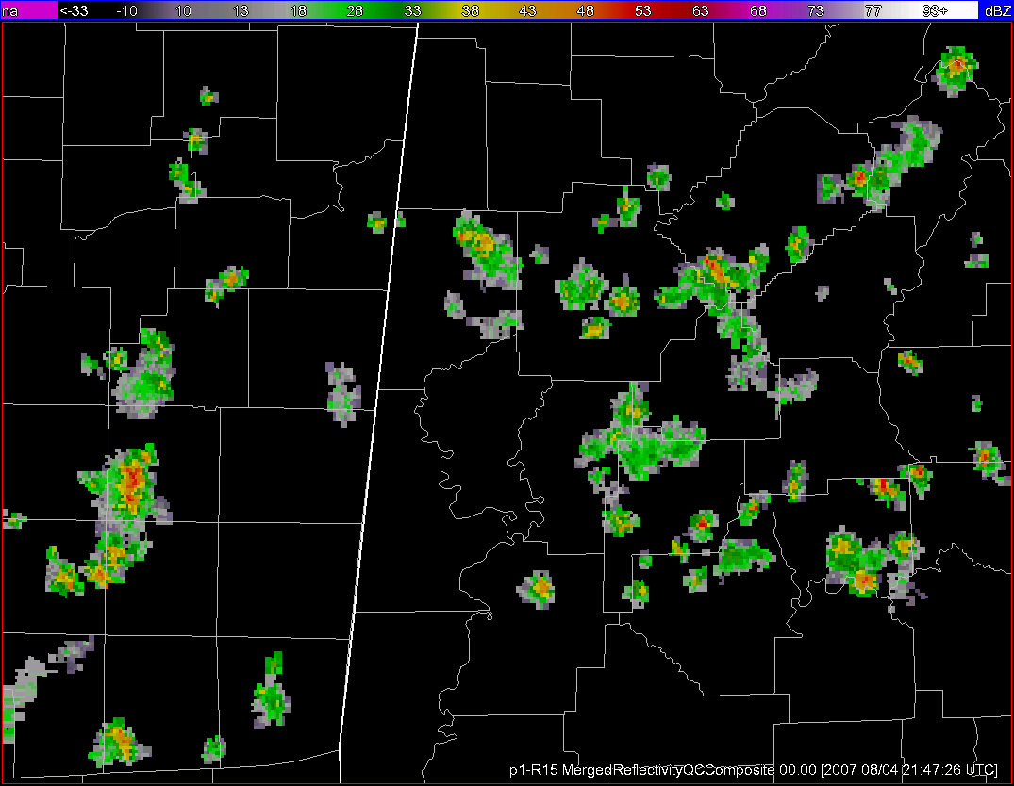
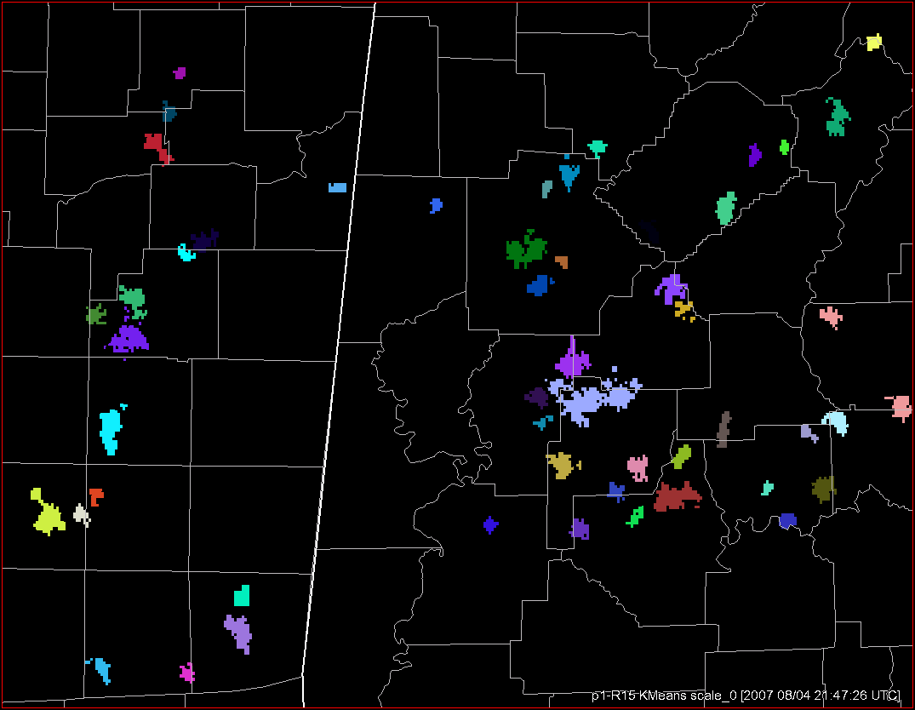
Data mining: Storm clustering & mode classification
reflectivity
clusters
Smith et al (2013) – manually classified storm modes
MYRORSS – will automate the process
scale = 15 km²

Slide 10
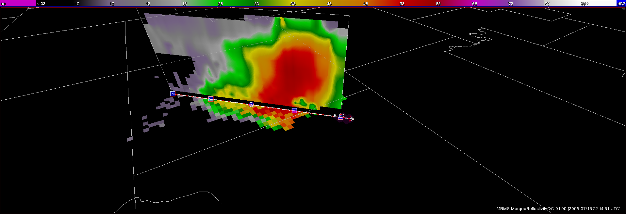
A few products:
3D Reflectivity Mosaic:
Echo Tops
Max Expected Size of Hail
Reflectivity:
On isothermal levels
Average/max in layer
Near surface
Vertically Integrated Liquid
QPE:
Precipitation type
Precipitation rate
Quality field
Gauge-corrected QPE
Rotation:
0-3 km (low-level)
3-6 km (mid-level)
Data mining allows us to filter down the huge data set into just the vital information

Slide 11
Example: “Rotation Tracks” (3-day accumulation)

Slide 12
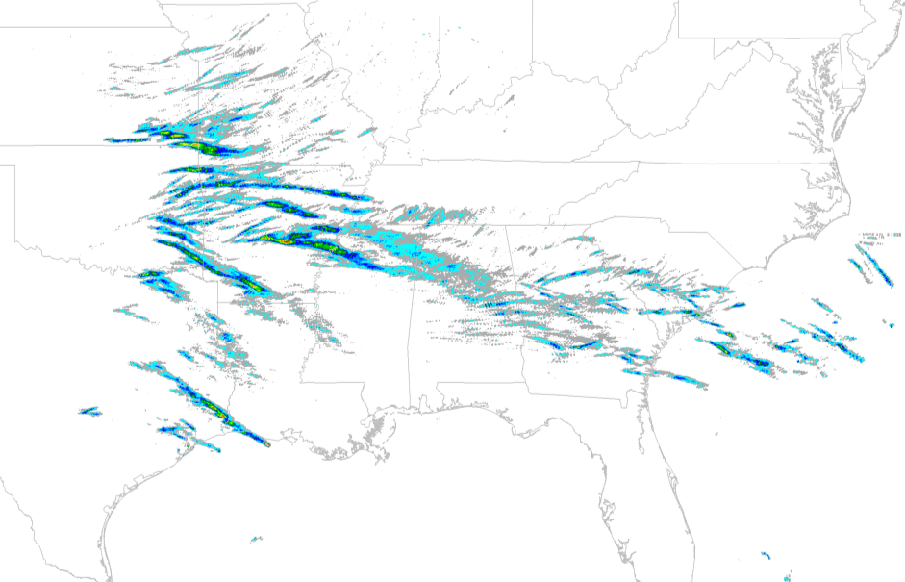
Example: “Hail Swath” (1-day maximum)

Slide 13
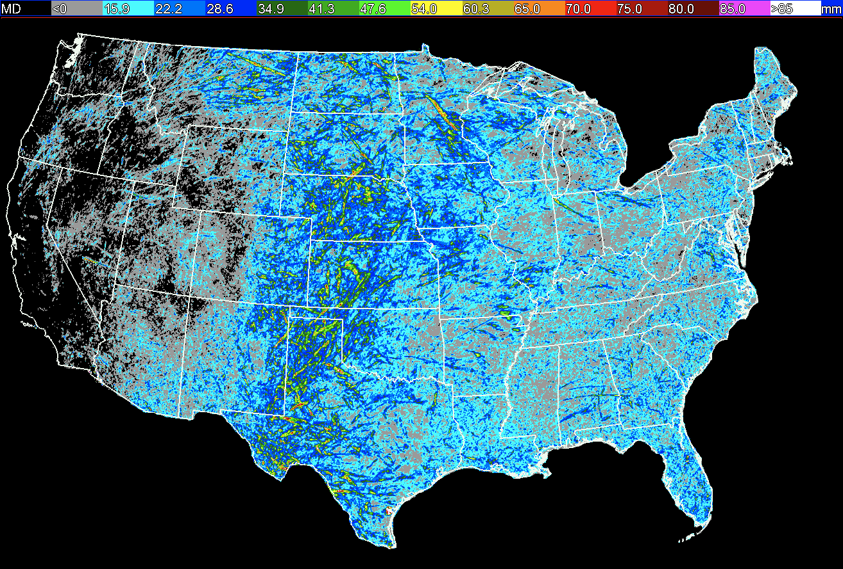
With MESH grids, we can create…
# of days where MESH ≥ 21mm
Maximum MESH in 2007

Slide 14
Annual # of days with MESH ≥ 21 mm
Cintineo et al. 2012

Slide 15
Annual # of days with MESH ≥ 29 mm

Slide 16
2007-2010 Annual # of Hail Days
(radar-derived)
Notes:
-resolution decreased to compare with Storm Data reports

Slide 17
Annual P(severe hail) for reports-based (2007-2010)

Slide 18
Potential Uses
Probability of severe weather
Changes the way we issue warnings – quantifying uncertainty
Convective initiation studies
Climate applications? Link severe weather events / storm morphology to specific environments?
Quantifying storm longevity
Hail / circulation impacts
Etc. / what else?

Slide 19
Some thoughts
Strengths:
- independent of NWS reporting system!
- much more spatially complete
Limitations:
“True” resolution changes depending on range from radar
Not all locations are covered
QC issues remain
Beam blockage / Radar interference
Chaff / Clutter / Hardware issues
Velocity aliasing

Slide 20
Summary
Data blending & data mining make this a useful and accessible data set.
15 year record
Fills the need for a high quality, high resolution, common reference dataset for severe weather and quantitative precipitation estimation (QPE)
Status:
Computational process has been set up
NSSL: even years; NCDC: odd years
2008: done; 2010: halfway done
Contact: Travis.Smith@noaa.gov

