Slide 1

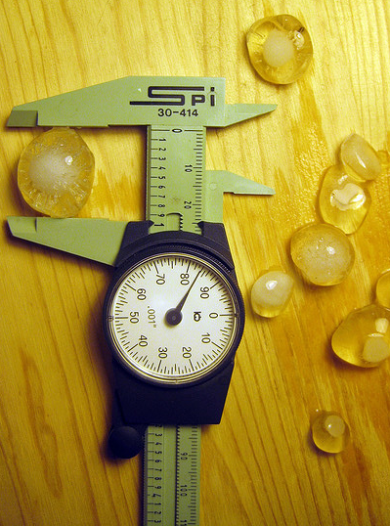
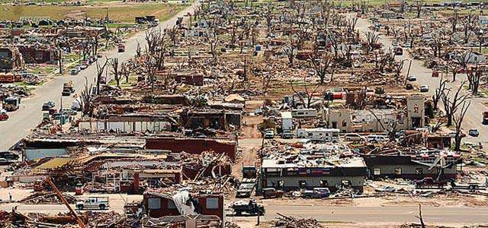
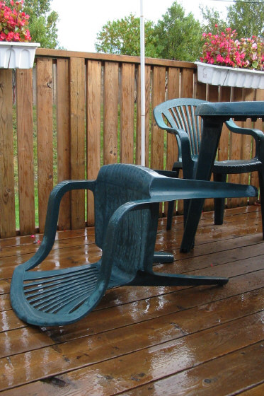
- NOAA/National Weather Service -
Observational records for
Hail…Wind…and Tornadoes
The good,
the bad,
the ugly…
Greg Carbin, NOAA/NWS
Storm Prediction Center
Norman, Oklahoma

Slide 2
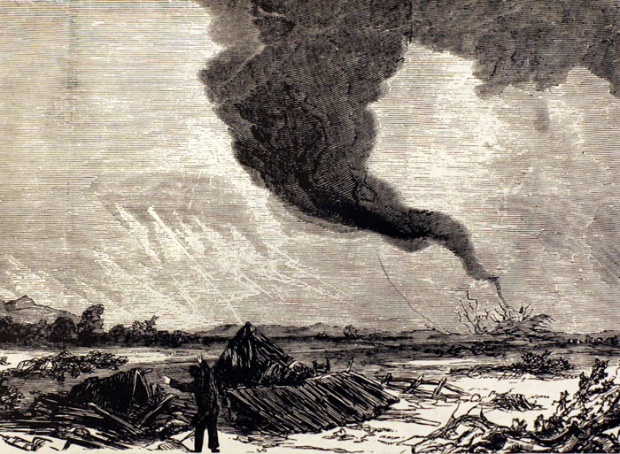
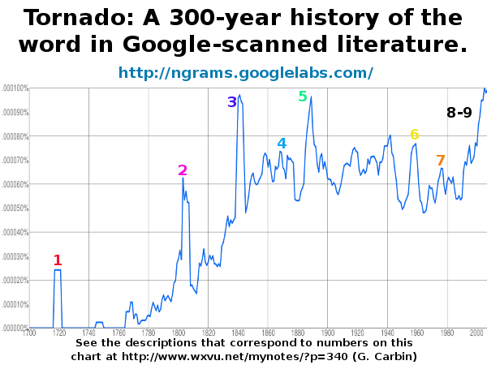
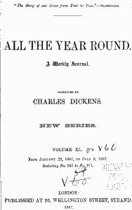
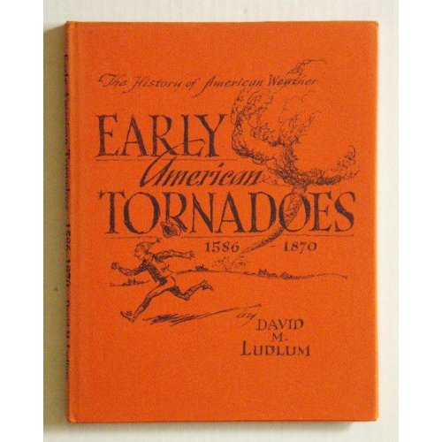
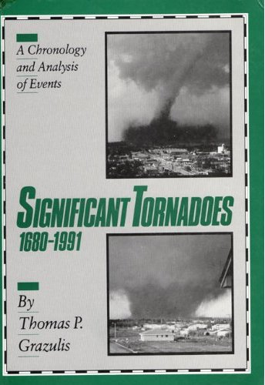
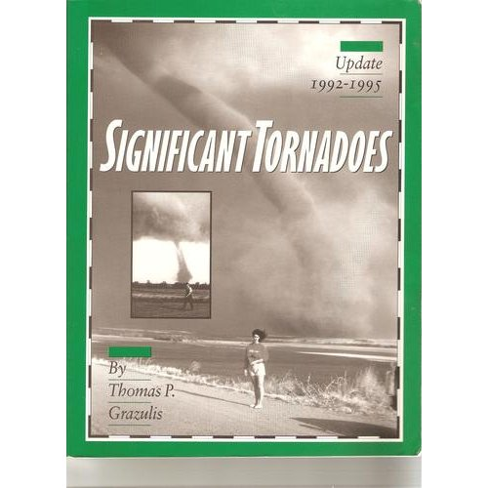

Slide 3
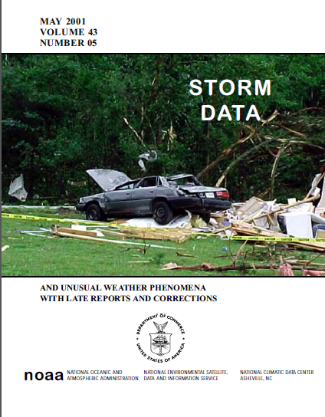
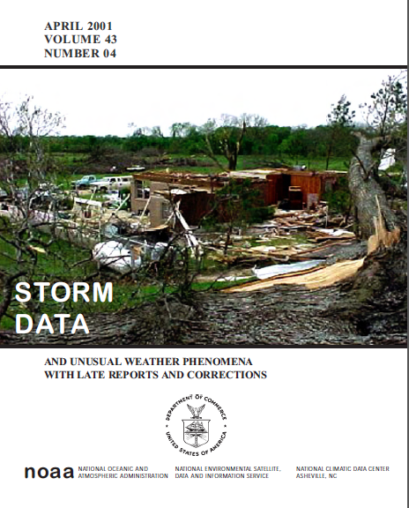
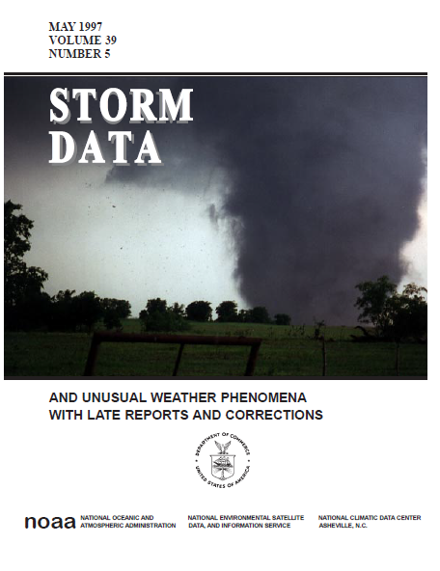
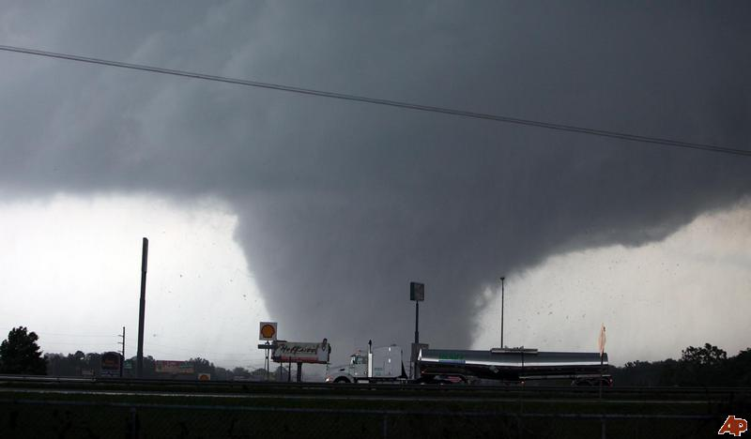
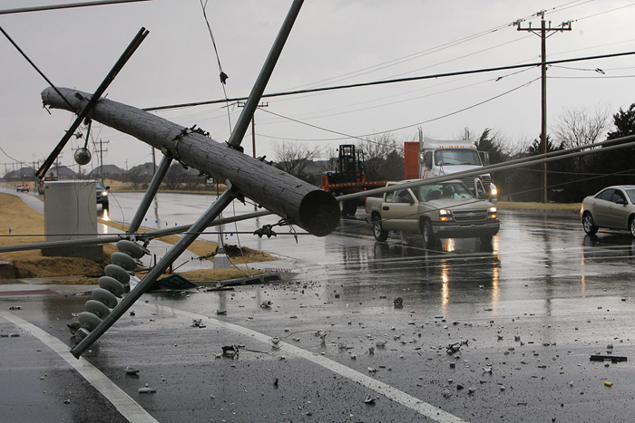
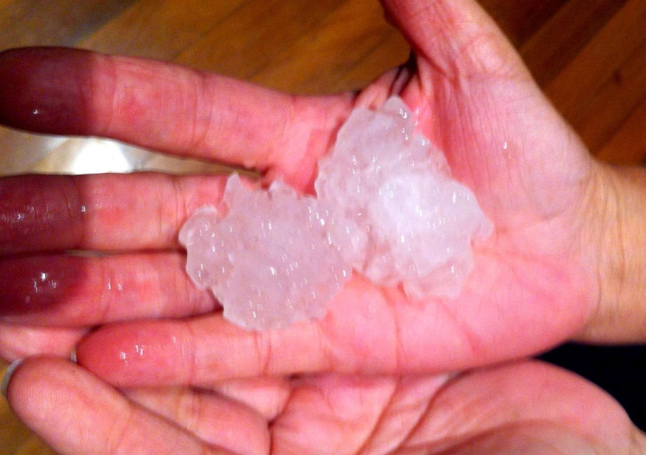

Slide 4
“Severe” Hail
1955-2012

Slide 5
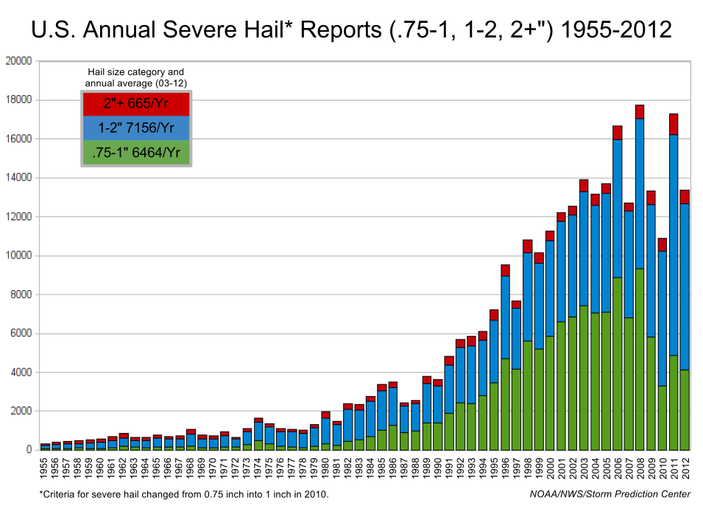

Slide 6
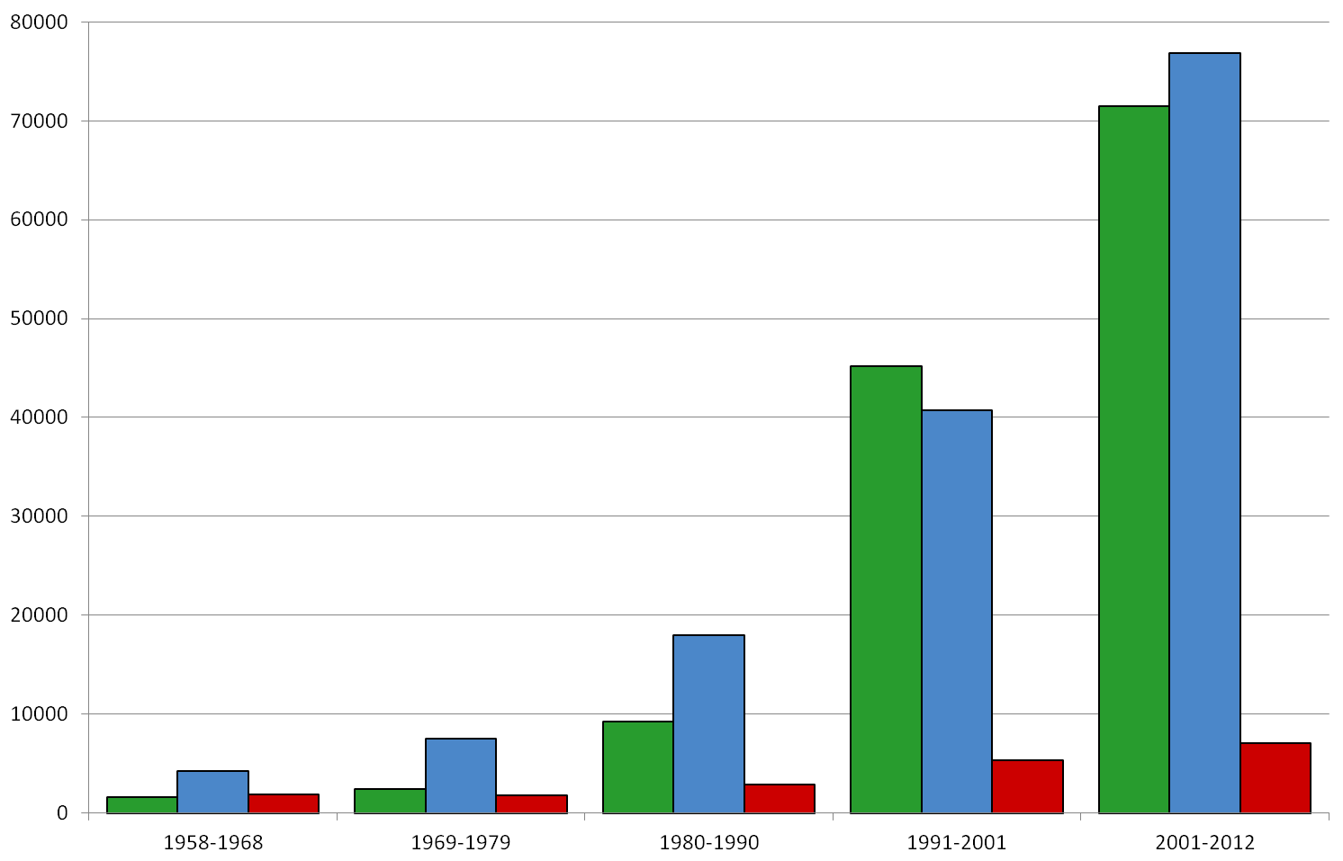
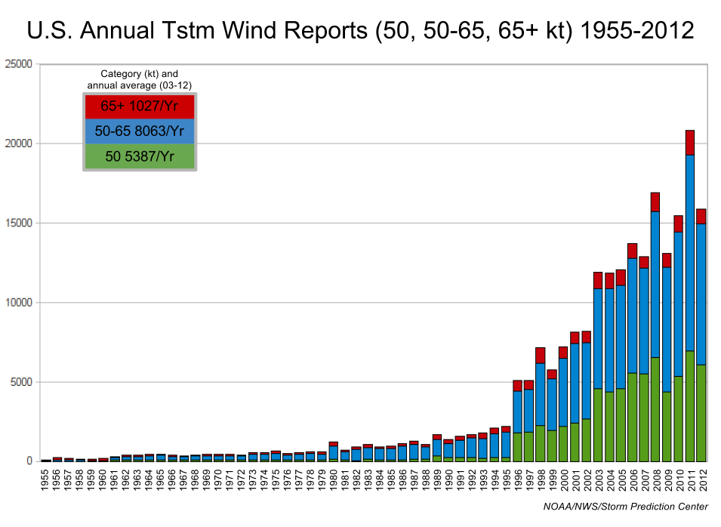
1958-2012

Slide 7
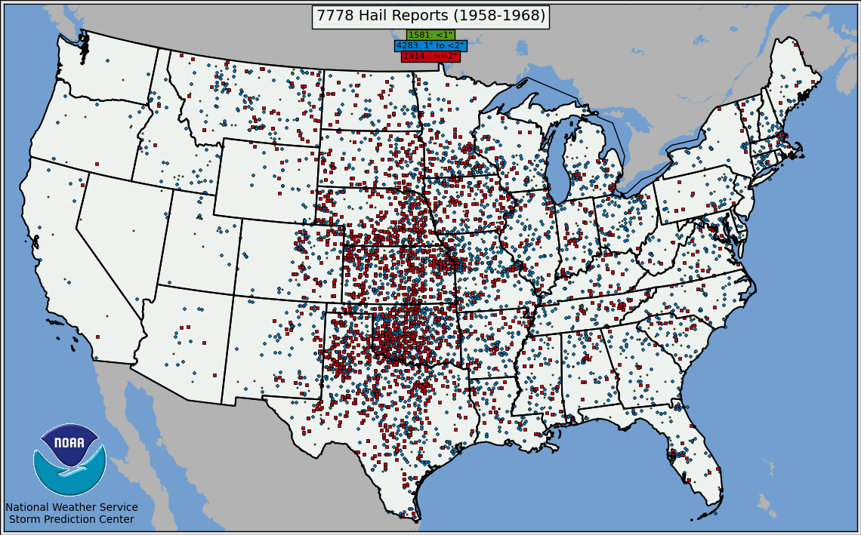
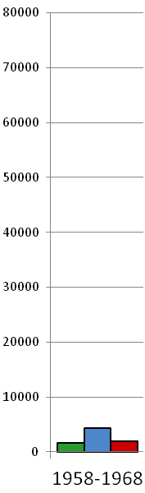
Hail – 11-years, 1958-1968

Slide 8
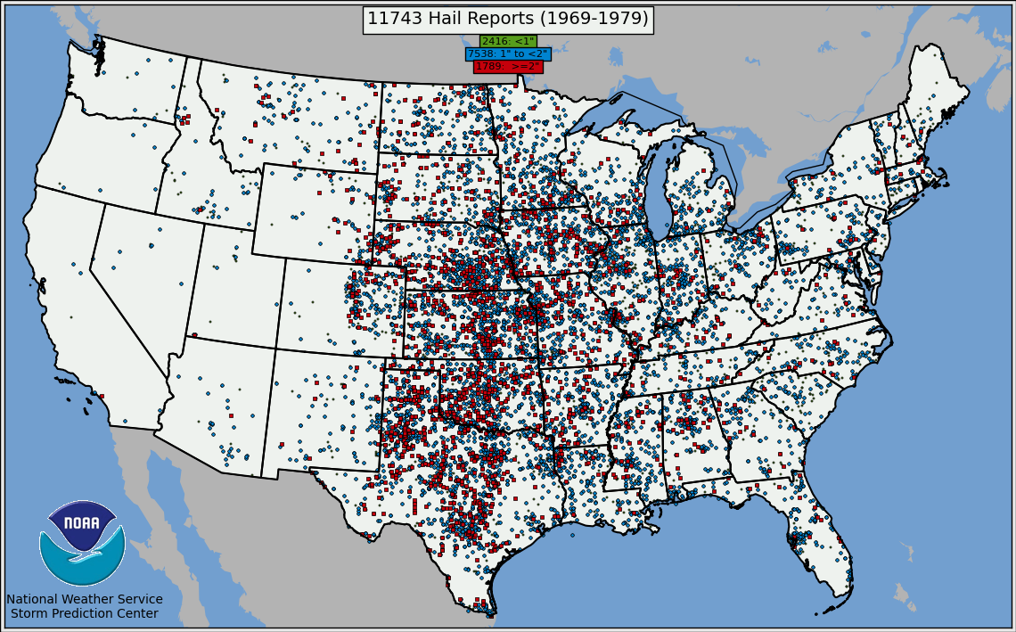
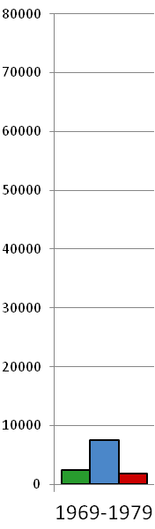
Hail – 11-years, 1969-1979

Slide 9
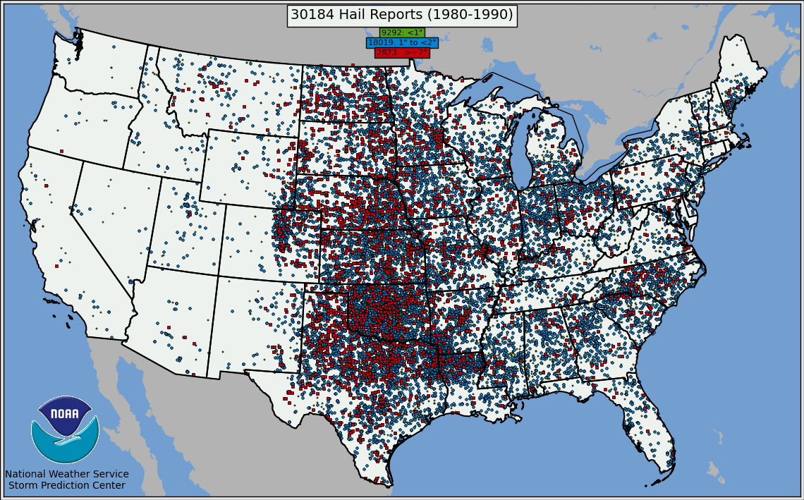
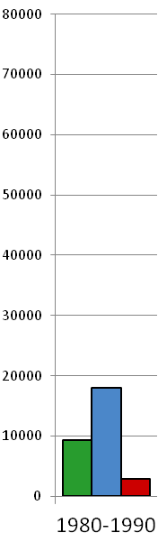
Hail – 11-years, 1980-1990

Slide 10
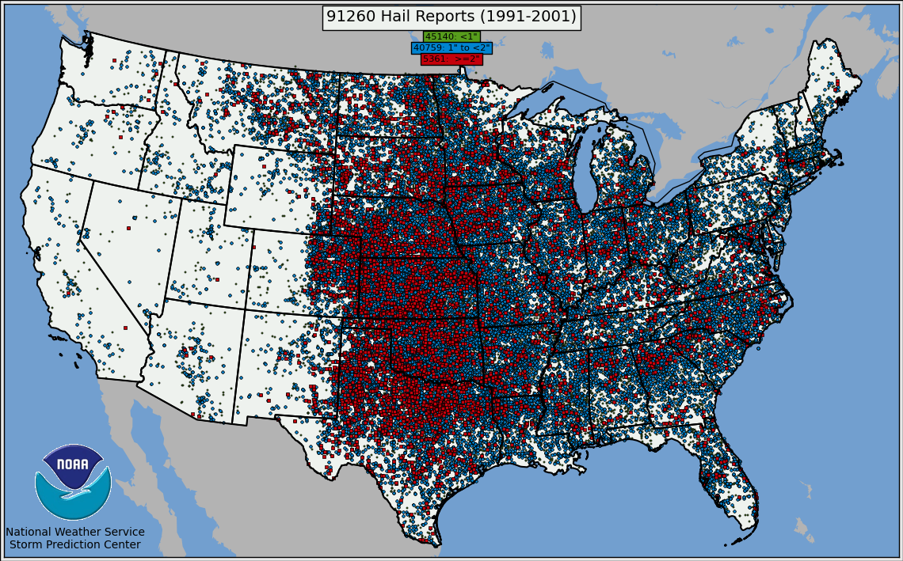
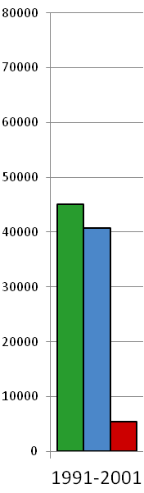
Hail – 11-years, 1991-2001

Slide 11
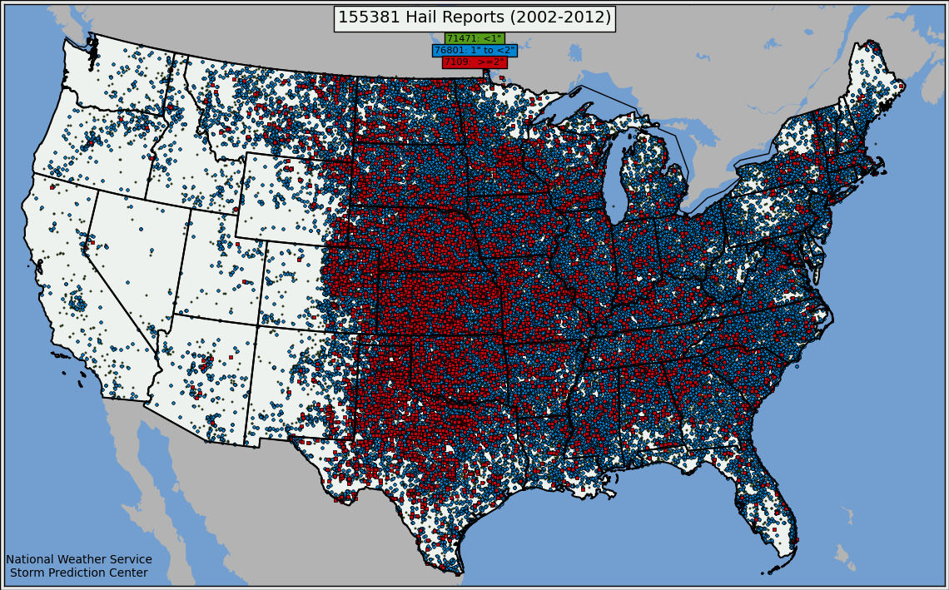
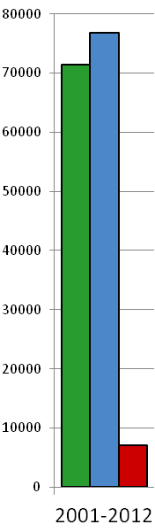
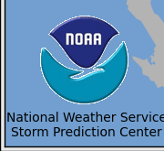
Hail – 11-years, 2002-2012

Slide 12
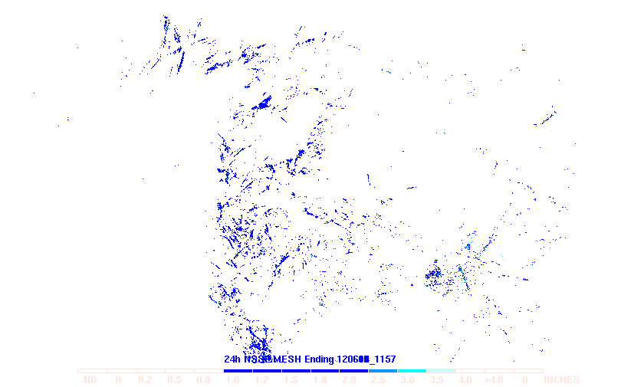
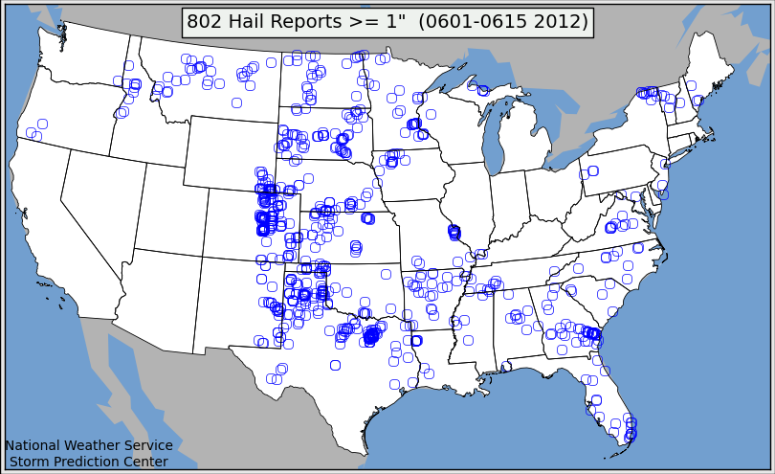
Is there hope for hail?
NSSL Max. Est. Hail Size : 1→2” 2+”
Storm Data reports of “severe” hail >=1 inch for June 1 through June 15, 2012.

Slide 13
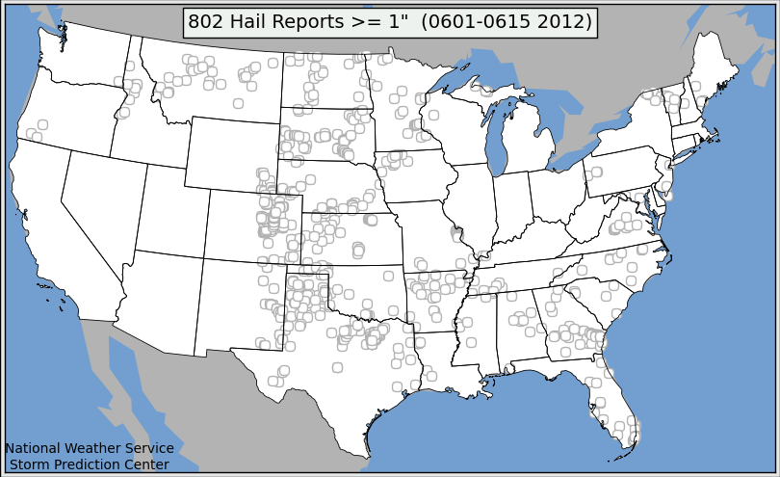
Is there hope for hail?
NSSL Max. Est. Hail Size : 1→2” 2+”

Slide 14
Thunderstorm Winds
1955-2012

Slide 16
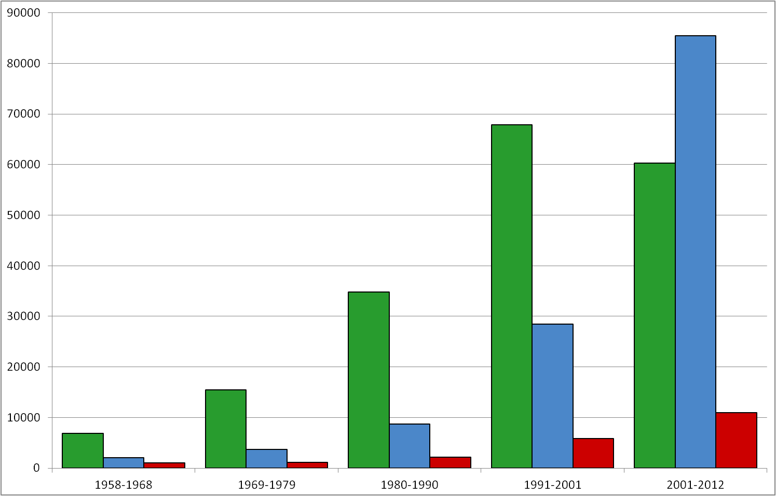
1958-2012

Slide 17
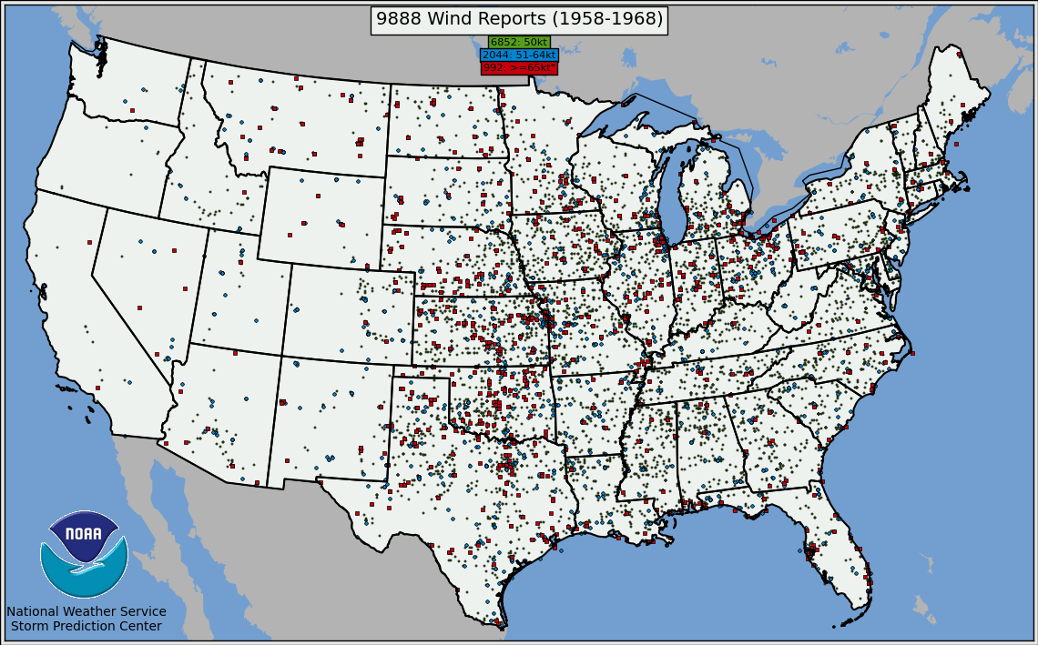
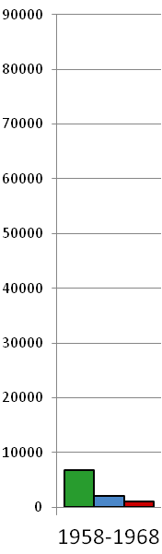
Wind – 11-years, 1958-1968

Slide 18
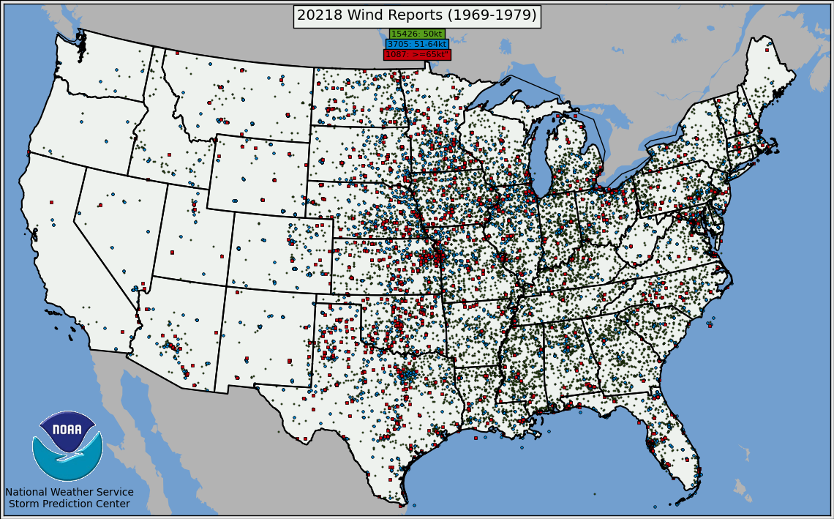
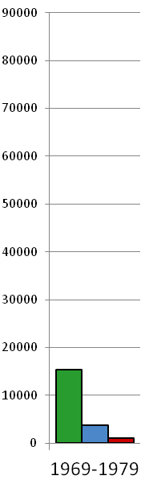
Wind – 11-years, 1969-1979

Slide 19
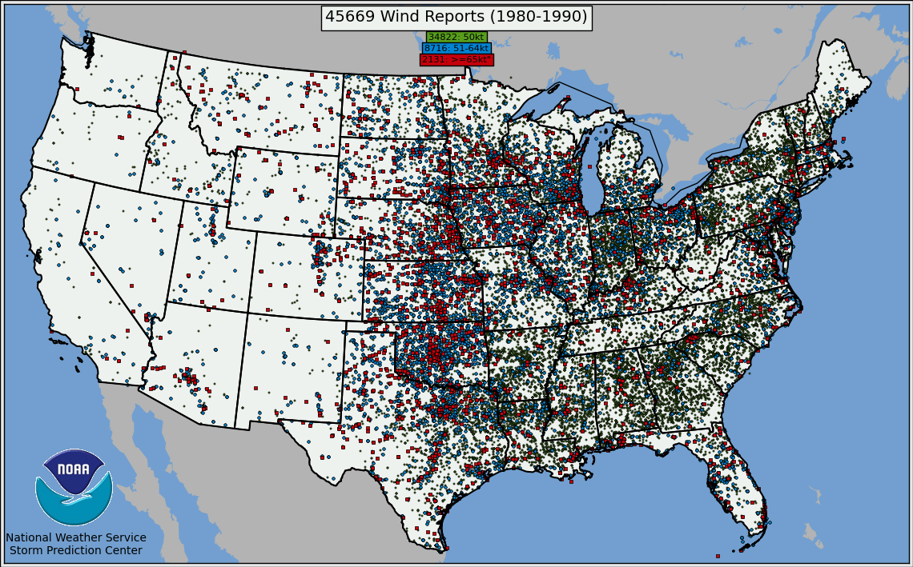
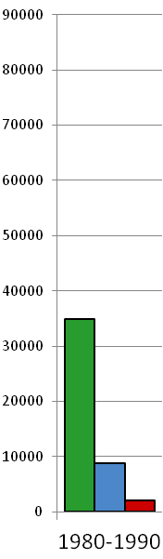
Wind – 11-years, 1980-1990

Slide 20
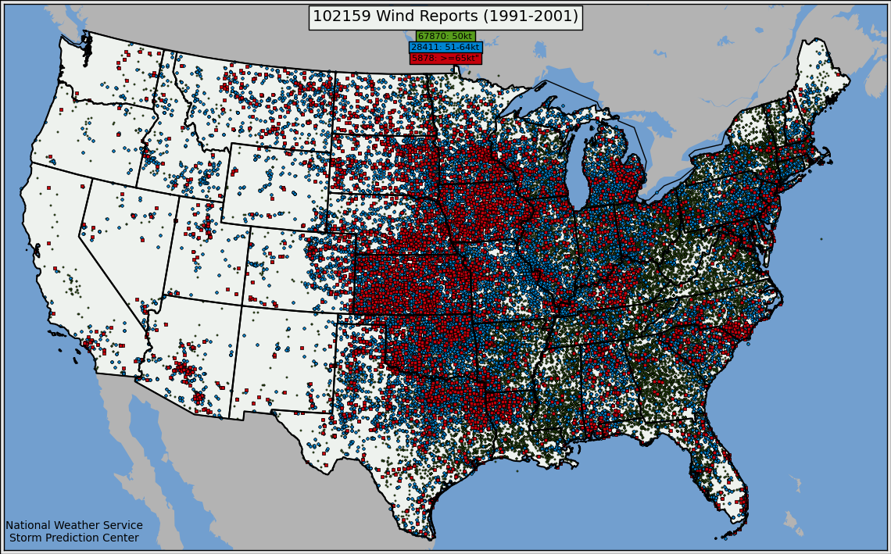
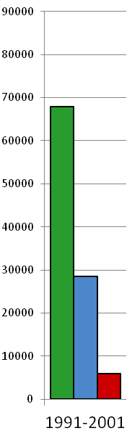
Wind – 11-years, 1991-2001

Slide 21
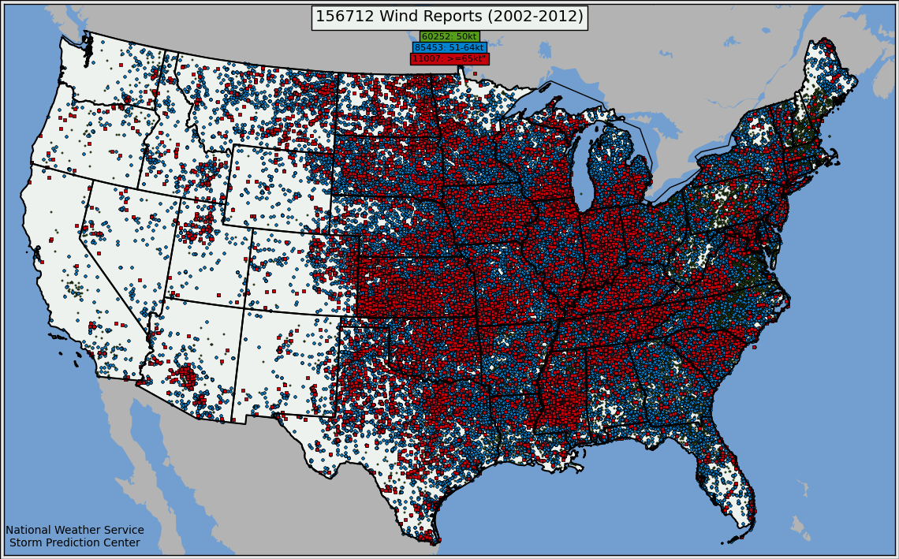
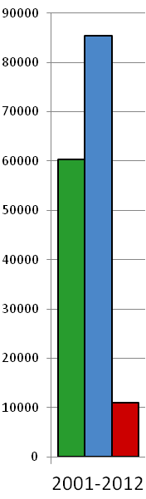
Wind – 11-years, 2002-2012

Slide 22
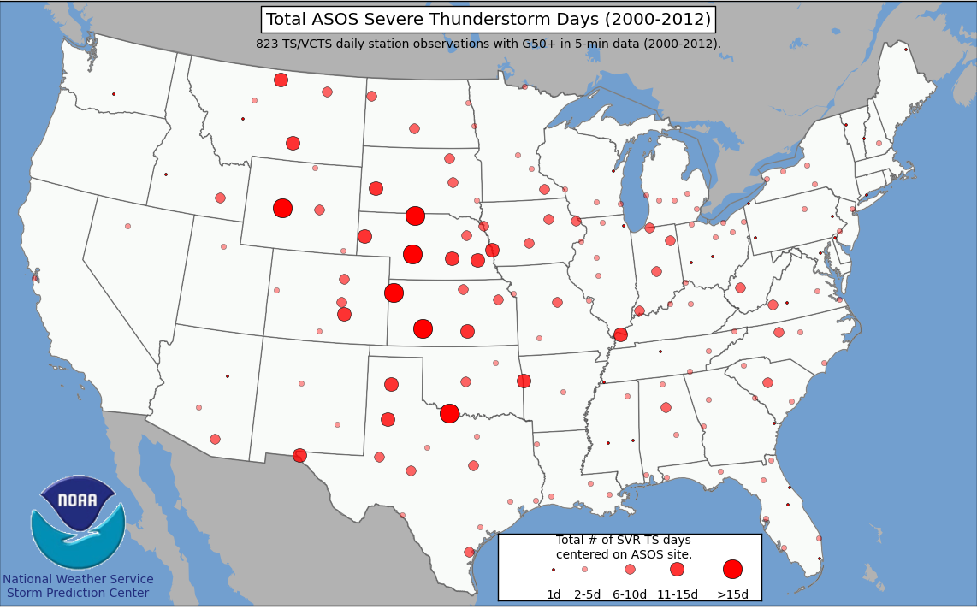
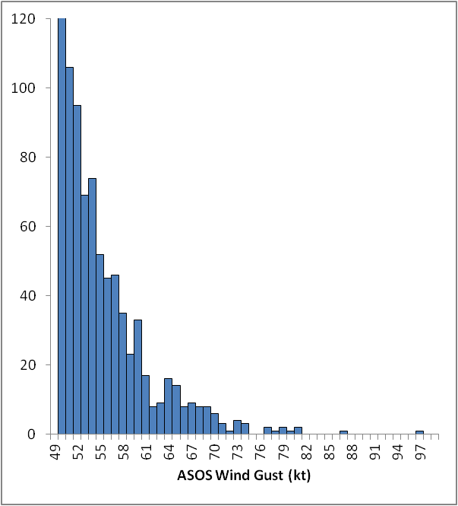
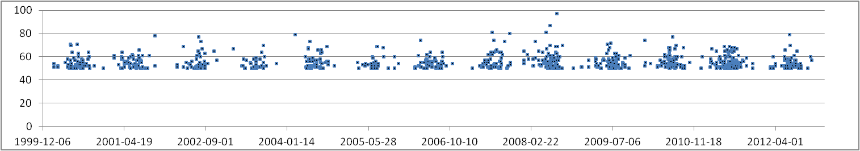
A fix for severe wind woes?
Also see: Smith, et al., Weather and Forecasting , Feb. 2013

Slide 23
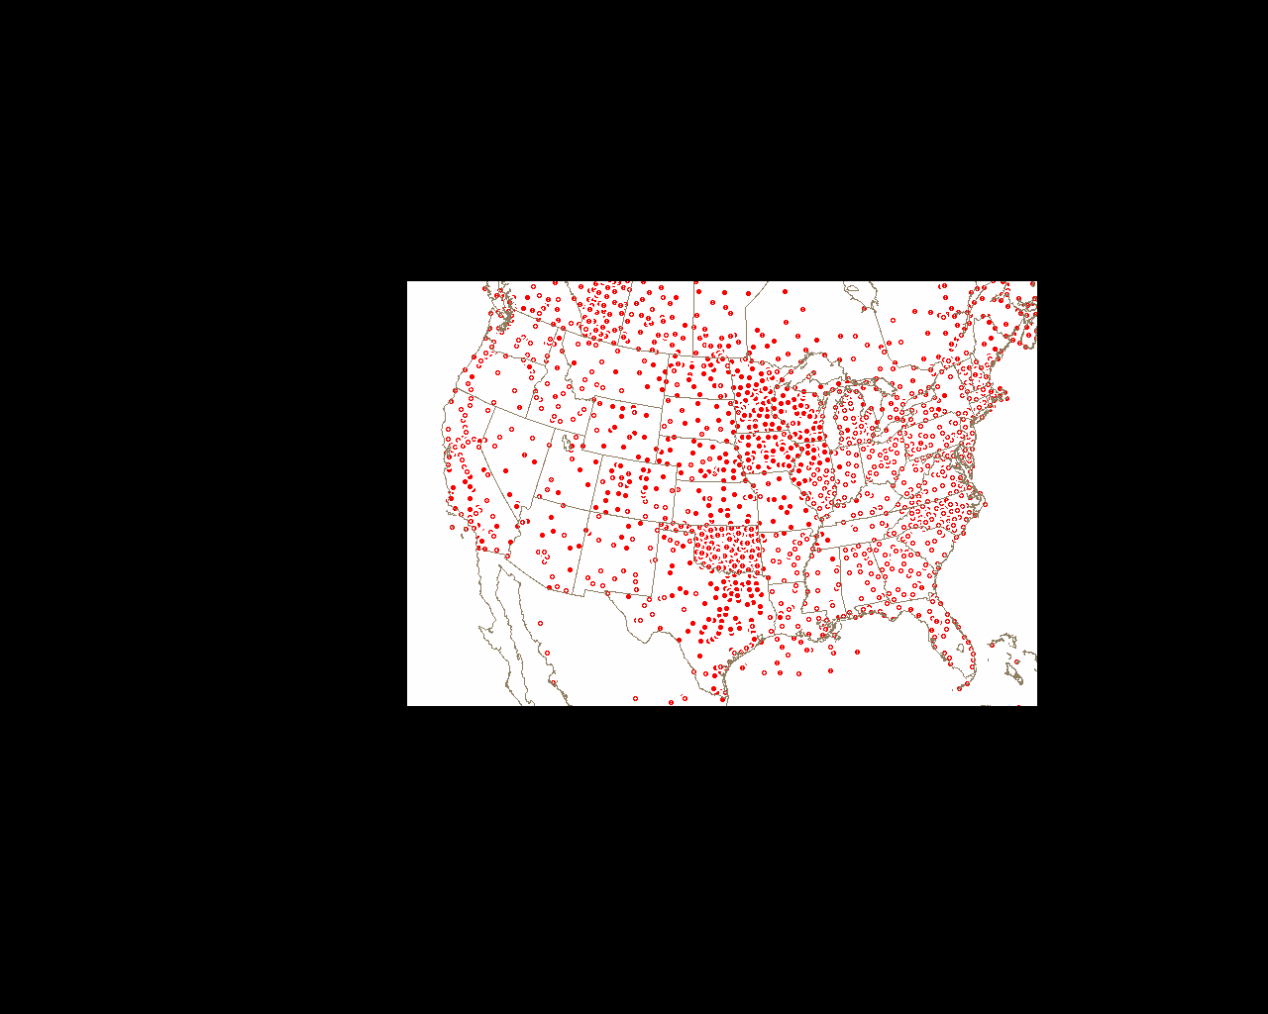
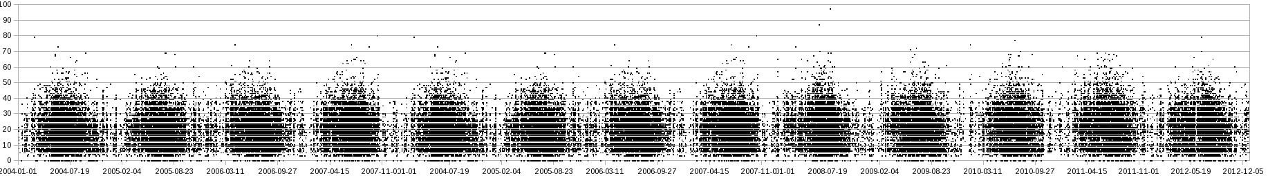
A fix for severe wind woes?

Slide 24
Tornadoes
1950-2012

Slide 25
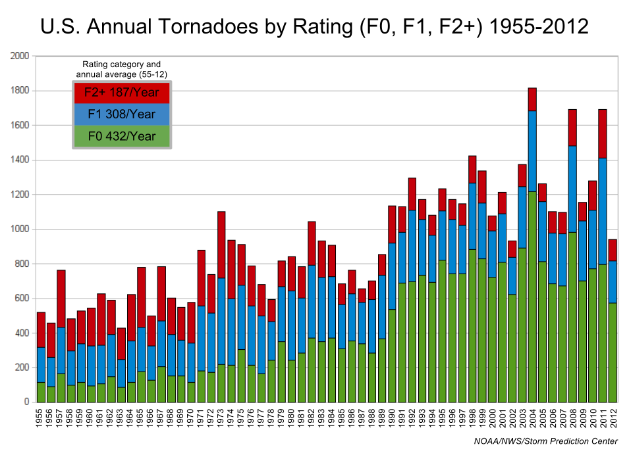

Slide 26
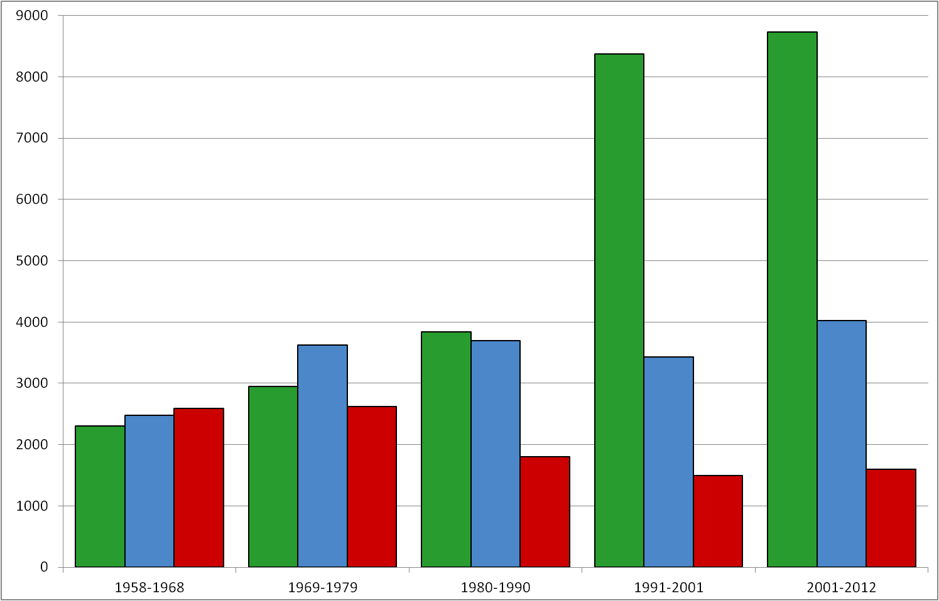
1958-2012

Slide 27


Torn. – 11-years, 1958-1968

Slide 28


Torn. – 11-years, 1969-1979

Slide 29


Torn. – 11-years, 1980-1990

Slide 30


Torn. – 11-years, 1991-2001

Slide 31


Torn. – 11-years, 2002-2012

Slide 32

What is tornado truth?
About 500 F1 and up per year over last ~60y

Slide 33


What is tornado truth?
Surveyed tornado tracks after 27 April 2011 Super Outbreak vs. NSSL radar rotation tracks.

Slide 34



What is tornado truth?

Slide 35
In Summary
All databases suffer from under-reporting early and significant over-reporting
and poor QC in most recent decades
Databases have evolved from documenting storm events to being exclusive
sources for NWS verification program
Dangerous and erroneous results are certain if these databases are used for
research without any understanding of serious underlying flaws
Filtering and better QC, especially for tornado data, can yield useful
information
Advances in remote sensing, higher density and quality of surface observations,
as well as high resolution environmental data/grids, all show potential to
transform and improve the recording of severe thunderstorm events.

