Slide 1
Severe Convection and Climate Workshop
LDEO, March 14-15, 2013
Adam Sobel
Organizing committee: Michael Tippett, Harold Brooks, Suzana Camargo, Adam Sobel

Slide 2
Thanks!
Lamont Climate Center
Lamont-Doherty Earth Observatory
International Research Institute for Climate & Society
Office of Naval Research
All of you who traveled to be here!

Slide 3
Why is this workshop happening here?
A little of our history…

Slide 4
We (Camargo and Sobel) started doing
research on tropical cyclones & climate ~13 years ago.
It was a relatively small corner of the field…

Slide 5
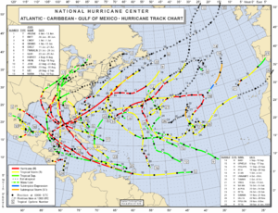
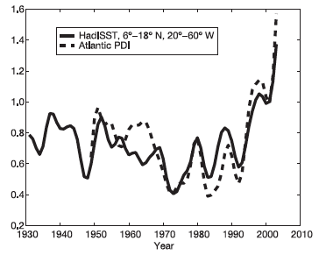
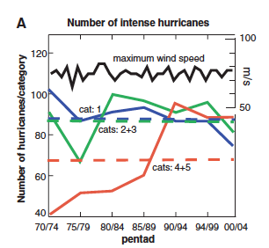
NHC, 2005
Then it was 2005.
Webster et al. (2005)
Emanuel (2005)

Slide 6
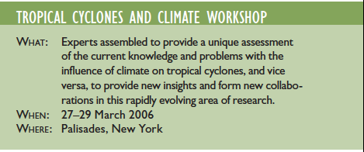
We had already been organizing a workshop.

Slide 7
How did we get interested in tornadoes?

Slide 8
We started having them here…

Slide 9
Then spring 2011 happened.

Slide 11
Tornadoes vs. TCs – any similarities?
In terms of physics, no.
But both are rare events that have some relationship to climate (not that well understood)
Climate models can’t handle them.
There is some data – but maybe not good enough to do trends, due to inhomogeneities in reporting etc.
There’s a specialized community, closely tied to operational prediction.
Climate people are somewhat clueless.
There are some papers on relation to climate… but there need to be a lot more.

Slide 12
Our goals
Learn from the severe convection/tornado experts
Get a more serious and sustained effort going on severe convection and climate
Get insurance industry perspective
We are planning a Columbia Center on Weather and Climate Extremes – this may be its first workshop!

