Slide 1
RISK MANAGEMENT AND REINSURANCE: THE BROKER PERSPECTIVE
Severe convection and climate workshop
Columbia University
March 14, 2013

Slide 2
The risk food chain
Insurance
Policyholders
Insurance
Companies
Reinsurance
Companies
e.g. Lloyd’s of London
Agents / Brokers
(e.g. Willis Retail)
Reinsurance intermediaries
(e.g. Willis Re)

Slide 3
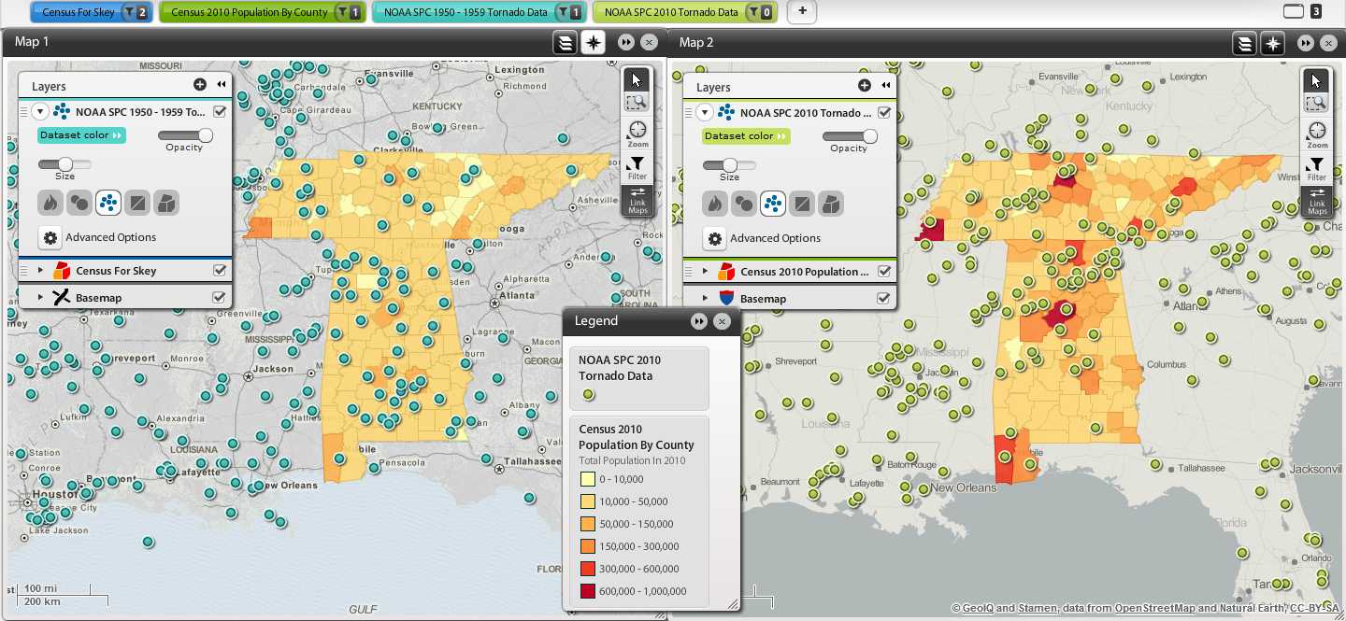
The SCS world our clients see…
1910 Census / 1958 Reported Tornadoes
2010 Census / 2010 Reported Tornadoes

Slide 4
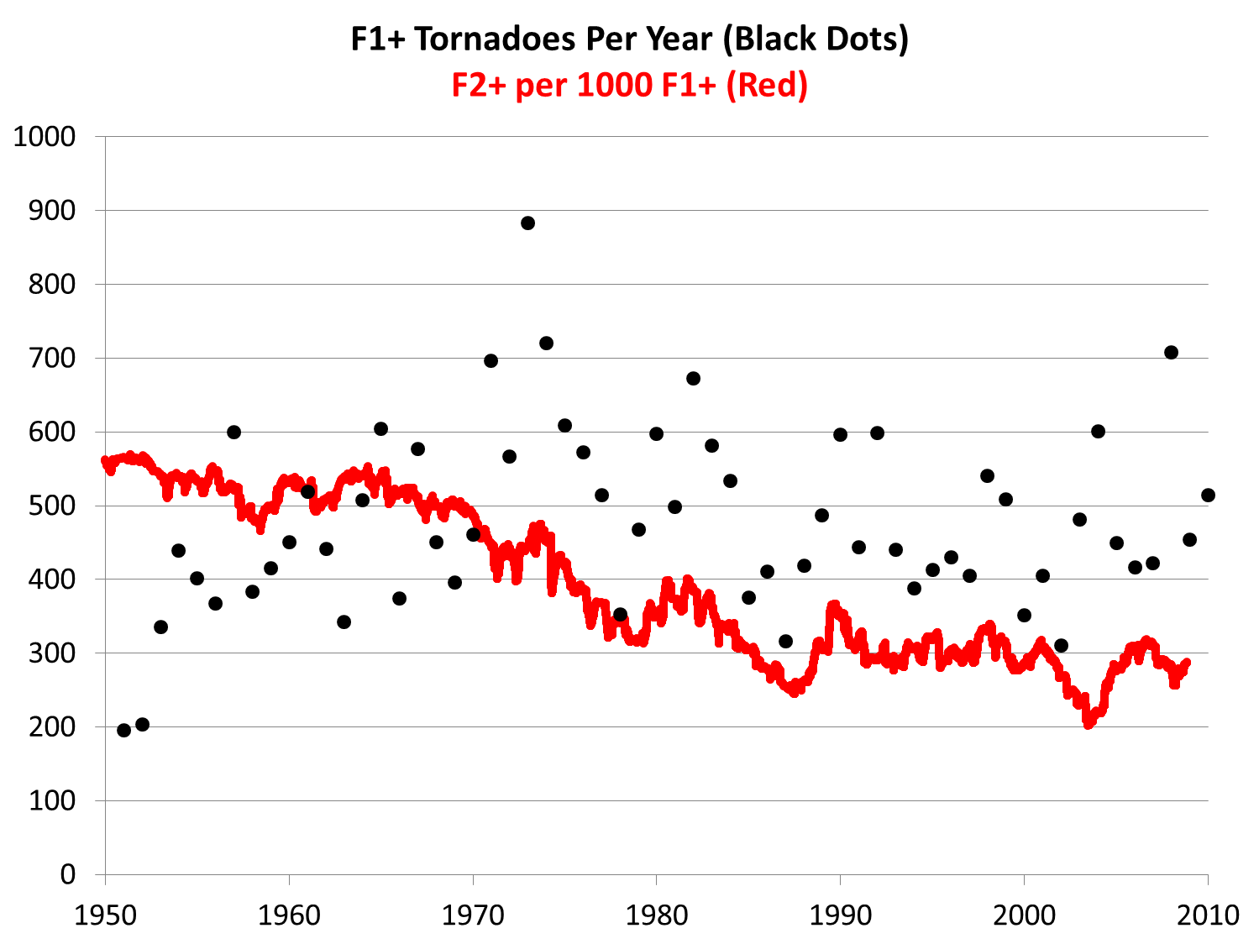
But normalized trend in severe U.S. tornado activity is down…
F-scale adopted
Harold Brooks, 2011
4
Notes:
4
Alice

Slide 5
…and so are normalized tornado losses
US tornado damage indexed to
national GDP,
1950-2010
1950-2010 average = index value 100
Source: tornado damage data from K. Simmons, Austin College, presentation 12 July 2011, Geneva Association; GDP data from US BEA; graph prepared by R. Pielke, Jr., 13 July 2011
Notes:
Alice

Slide 6
Insurance / reinsurance market dynamics
 | US HU | US EQ | SCS
Vendor models | Well accepted | Well accepted | Not well accepted
Modeling focus | Probabilistic (simulation) | Probabilistic (simulation) | Deterministic (scenario)
Confidence about short term / long term effects | Low | Low | Low
Understanding of climate change effects | Low | N/A | Low

Slide 7
My clients want to know…
How much risk am I exposed to?
How do I interpret differences in the modeled results?
What can I do when no
off-the-shelf model is suitable?
How can I improve my business processes?
What’s the
best strategy?

Slide 8
Communicating effectively with businesspeople
Main Point
Detail
Detail
Detail
Therefore
Because
Detail
Detail
Detail
Main Point
8

