Slide 1
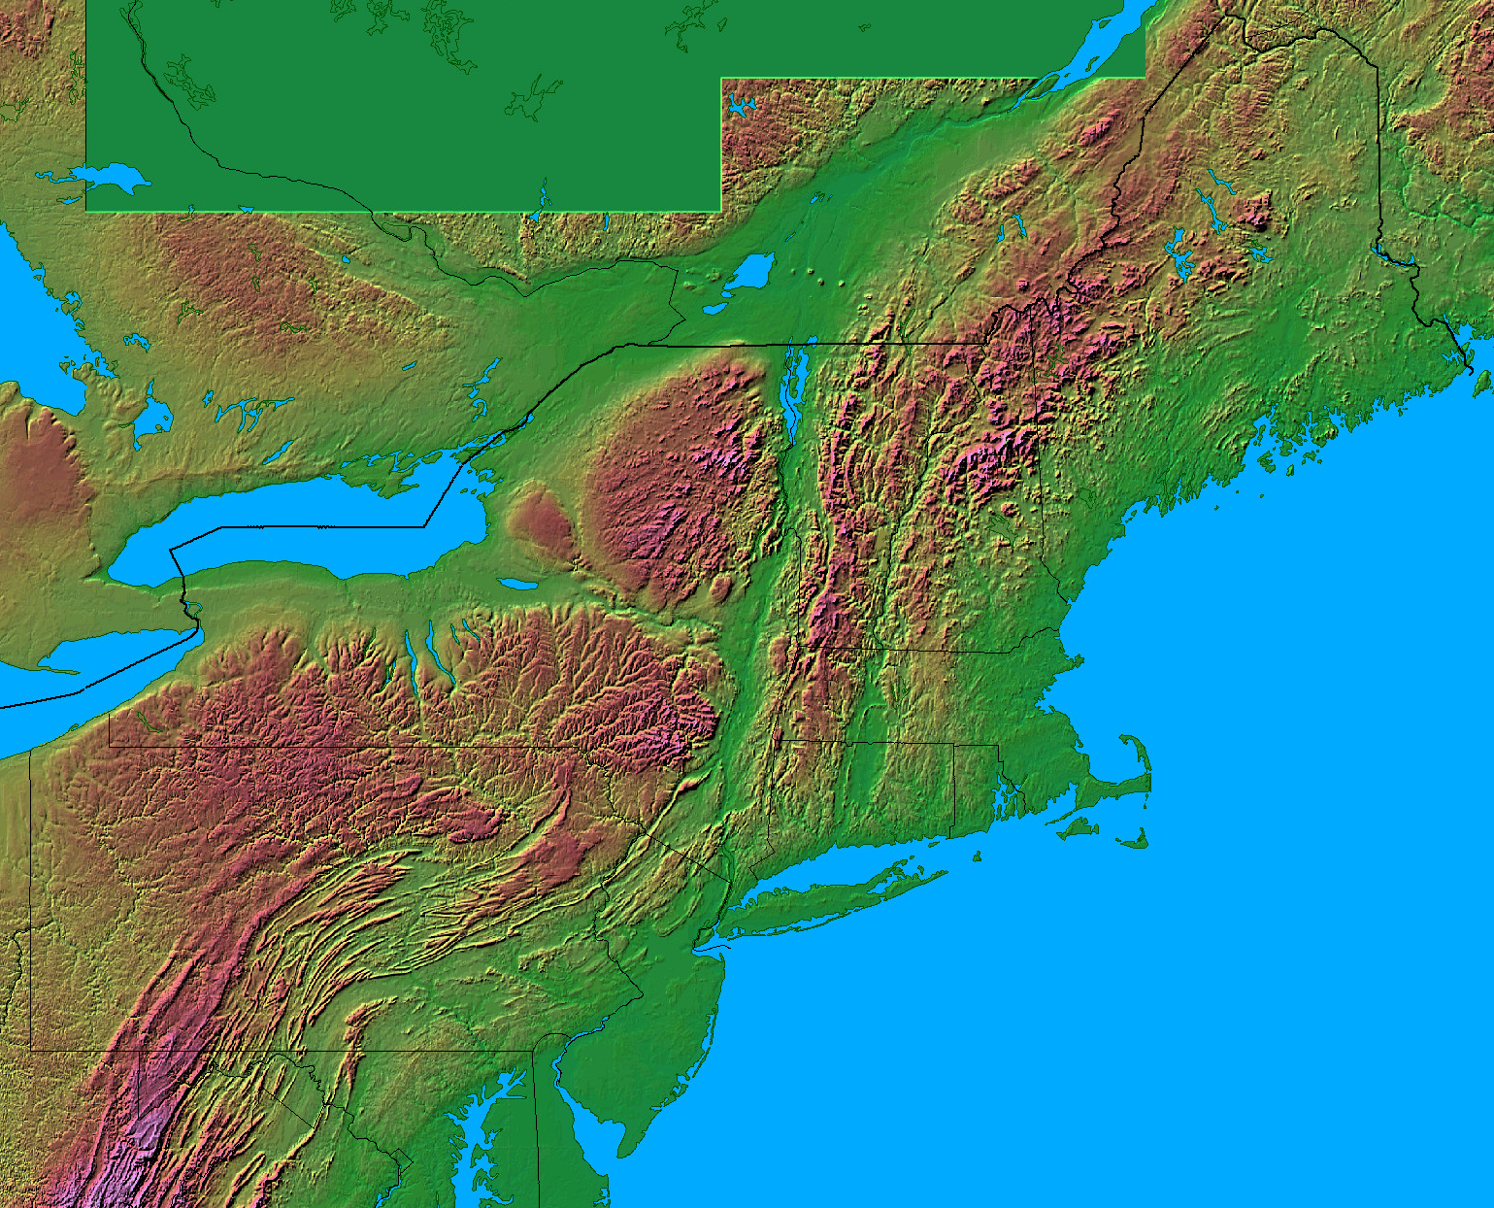
A Spatial Climatology and Long Term Trends of Convective Storms over the Northeast U.S.
Brian A. Colle, John Murray², Harrison Li³, and Kelly Lombardo¹
¹School of Marine and Atmospheric Sciences, Stony Brook University, Stony Brook, NY
² National Weather Service, Upton, NY
³ Ward Melville High School, Stony Brook, NY

Slide 2
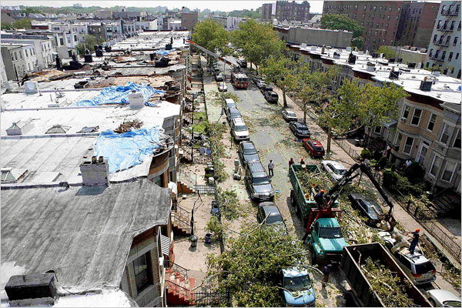
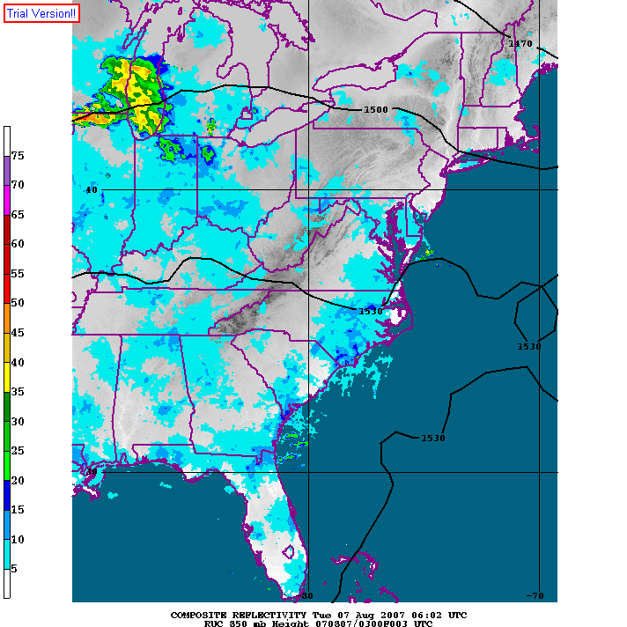
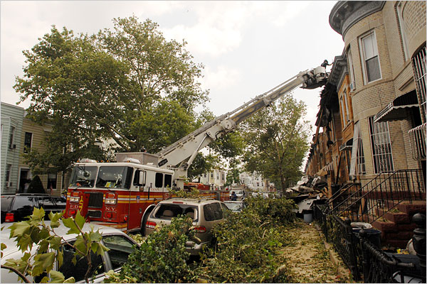
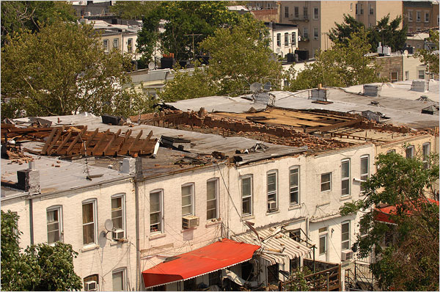
New York City Tornadoes – 8/8/2007
The NYC tornadoes consisted of an EF-1 tornado that formed over Station Island and an EF-2 tornado that moved across the Verrazano Narrows and into Brooklyn.
Unfortunately the climatology and dynamical understanding of Northeast convection is poorly understood since most of the emphasis has been over the U.S Plains.

Slide 3
Where is the tornado?
Brooklyn
Staten Island
TEWR Radar 1029 UTC 8 August 2007
Storm evolution: Colle et al. (2012)

Slide 4
Motivational Questions
What is the spatial distribution of convection over the Northeast U.S. during the warm season and its relationship with different geographical features?
How does the frequency of convective storms over the Northeast U.S. vary annually, monthly, and diurnally?
How have the ingredients for convection (instability, moisture, lift) and the number of storms changed for specific regions across the Northeast U.S. from 1979-2011?
Notes:
4

Slide 5
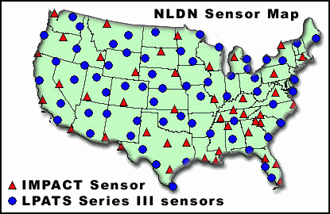
Spatial Distribution of Convection – Murray and Colle (2011)
2 Methods for Quantifying Convection:
1) NOWrad (WSI NCAR): WSR-88D
Available on a 2x2 km² grid at 15 minute intervals (largest reflectivity at a point from surrounding radars)
Composite from April through September 1996-2007 by counting frequency of reflectivity exceeding 45 dBZ.
2) Cloud to Ground Lightning Data National Lightning Detection Network (NLDN)
Interpolated to a 10x10 km grid centered over the Northeast U.S.
Available from 2000-2007.
WSR 88D (Maddox et al 2002)
From thunder.msfc.noaa.gov
Notes:
5
No need to talk about gaps in coverage. Start with “I used 2 datasets for this study.”

Slide 6
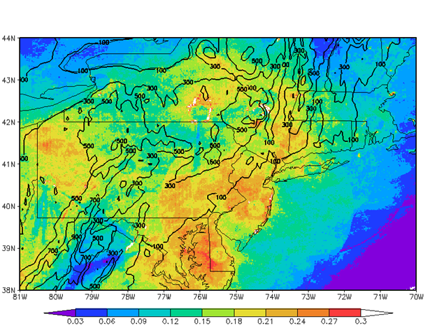
Probability of ≥ 45 dBZ for any 15-min period

Slide 7
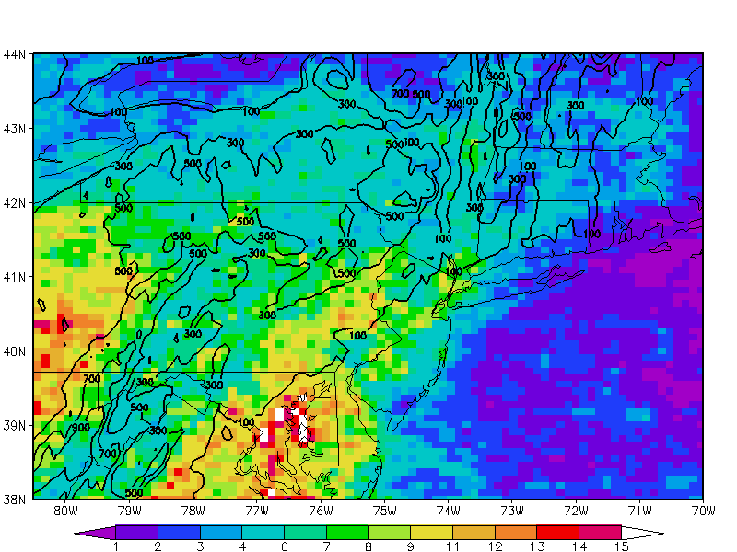
Average Monthly Lightning Frequency per 10 km²
Notes:
7

Slide 8
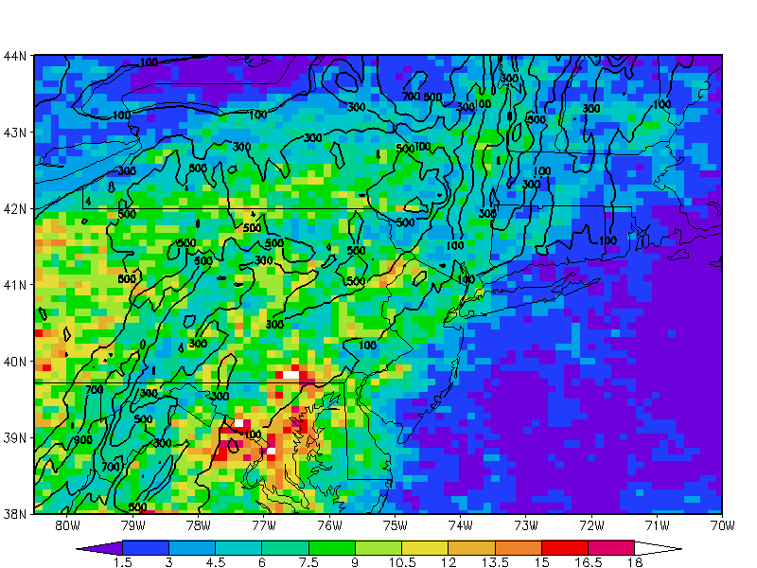
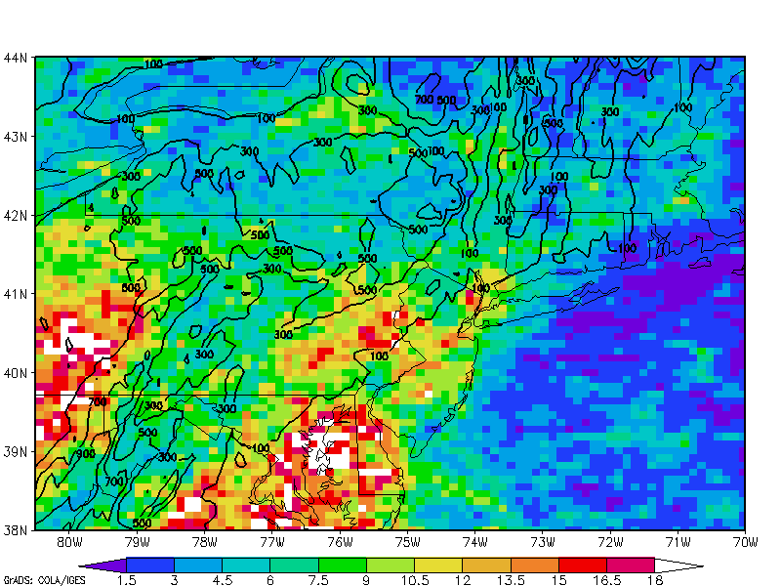
Early vs Late Warm Season
May and June
July and August

Slide 9
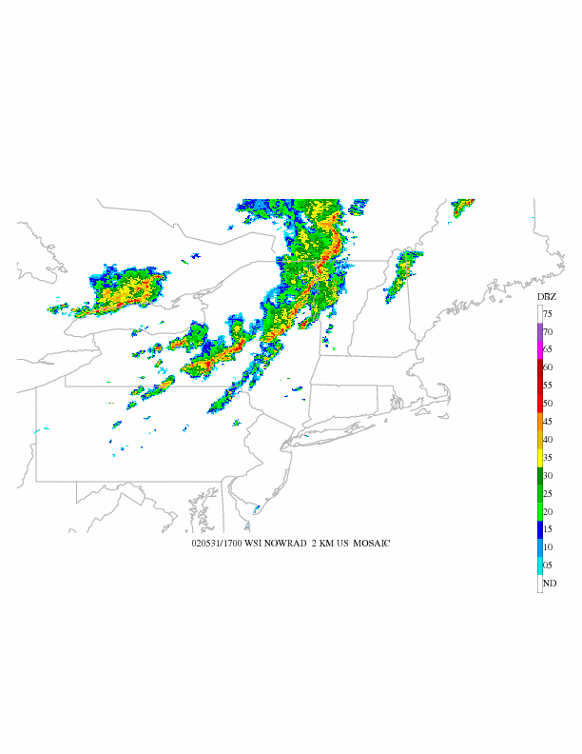
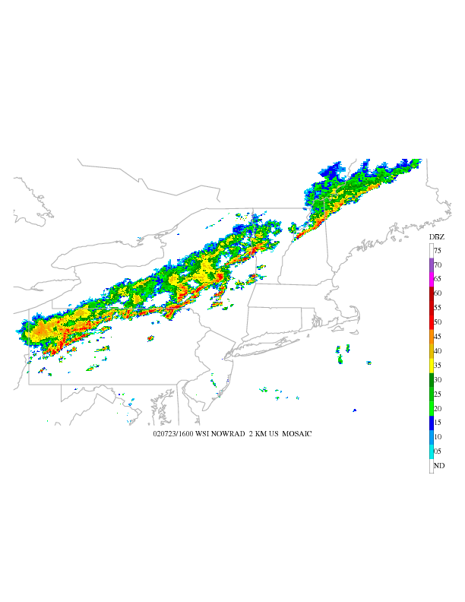
Decay Vs Maintaining QLCS’s Approaching the Coast – 2 Cases
31 MAY 2002 1700 UTC –
01 JUN 2002 1000 UTC
23 JUL 2002 1600 UTC –
24 JUL 2002 0400 UTC
Why does one event maintain its intensity over the Atlantic
while the other decays upon reaching the coastline?

Slide 10

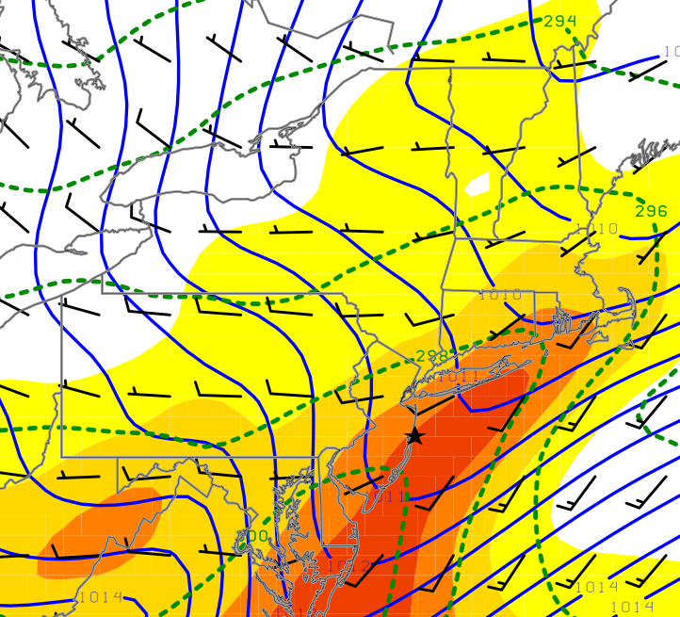
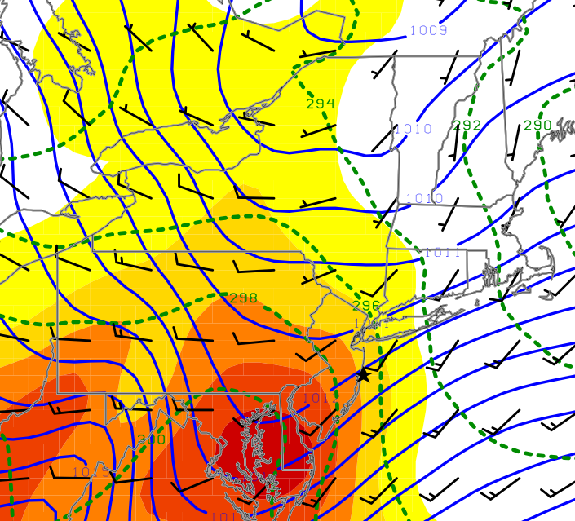
Decay Vs Maintaining QLCS’s Approaching the Coast – Composites (Lombardo and Colle 2012)
Decay
MUCAPE (J kg⁻¹), MSLP (hPa), 1000 theta (2 K), 10 m wnd (kts)
Maintain
Decay: MUCAPE 1250 J kg⁻¹; collocated with a surface pressure trough & 1000 hPa thermal ridge.
Maintain: MUCAPE 1000 J kg⁻¹; surface pressure trough 300 km to west; QLCS collocated with 1000 hPa baroclinic zone.
Geography for reference only: Star center point for feature based composites.
Notes:
Firstwe’ll look at most unstable CAPE, MSLP, 1000thte and 10m wind for these 3 composites with decay on the upper left, slow decay on the lower left and the maintaining events on the lower right. For all these plots, the geography is only there for reference since these are feature based composites and the star marks the center point for the composites. At a quick glance they all look pretty similar. Decaying QLCSs cross the coast with 1250 J/kg of MUCAPE…Differences here aren’t too impressive…

Slide 11
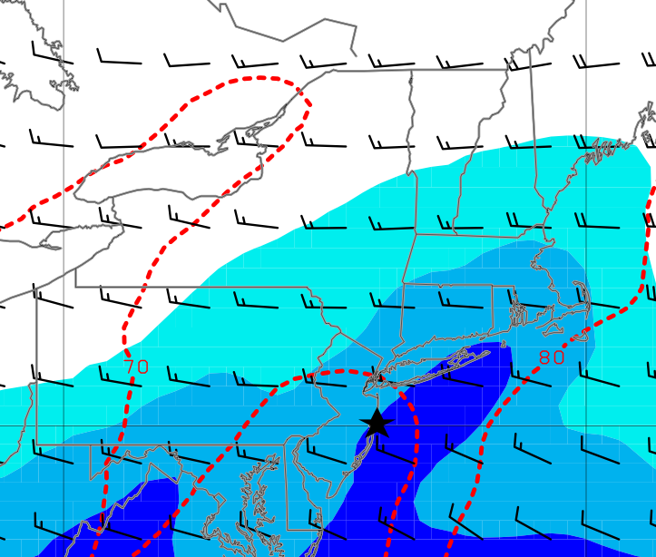
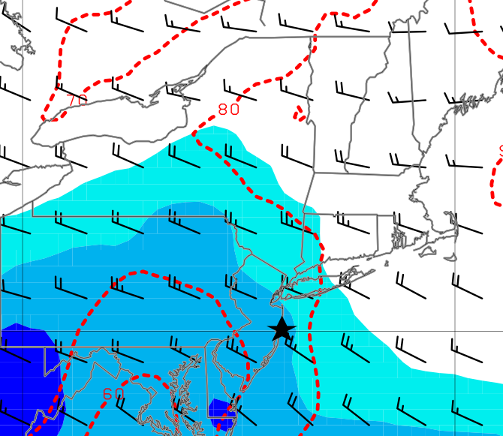
Decay Vs Maintaining QLCS’s Approaching the Coast – Composites
Decay
1000 hPa mixr (shaded, g kg⁻¹), 1000 hPa RH (red, %),
0-3 km wind shear (kts)
Maintain
70
80
80
70
Decay: RH of 68% (lowest 100 hPa); potential for evaporative cooling; Shear 15 kts.
Maintain: RH 77%; less of a chance for evaporative cooling; shear 25 kts.
Geography for reference only: Star center point for feature based composites.
Notes:
Wnd shear is important for determining the organizatinal structures of convection. What is the role of the evaporative cooling and what is the importance of the greater shear during these maintenance of these systems?

Slide 12
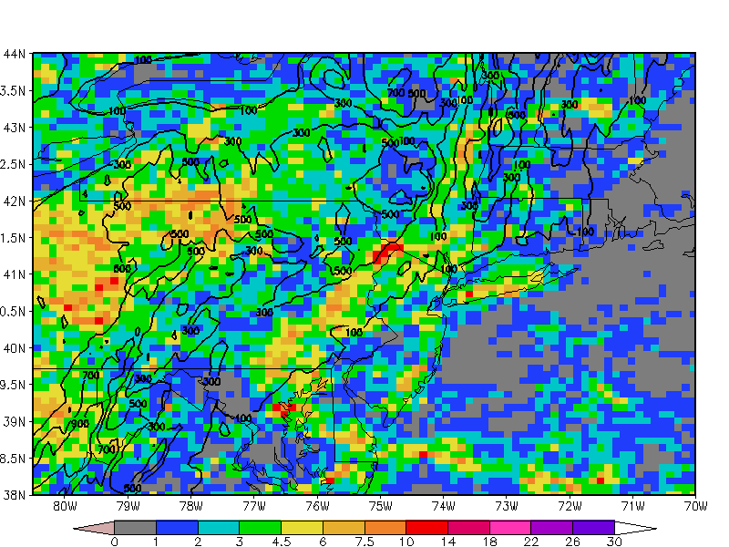
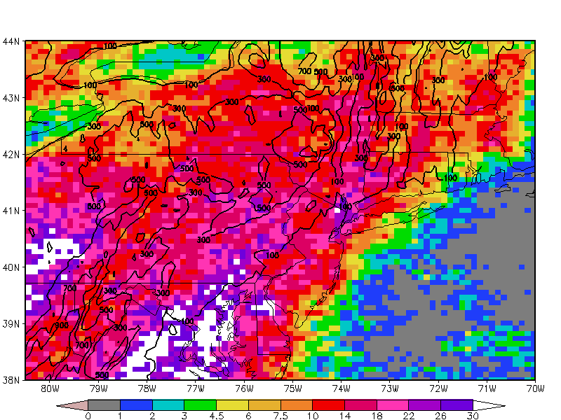
Diurnal Frequency of Lightning (Morning to Early Evening Hours)
12-18 UTC
18-00 UTC

Slide 13
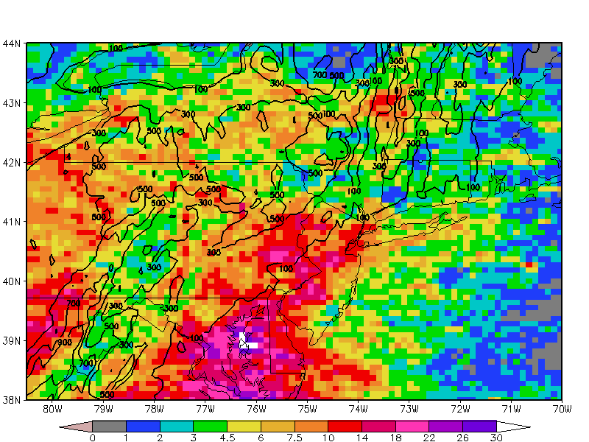
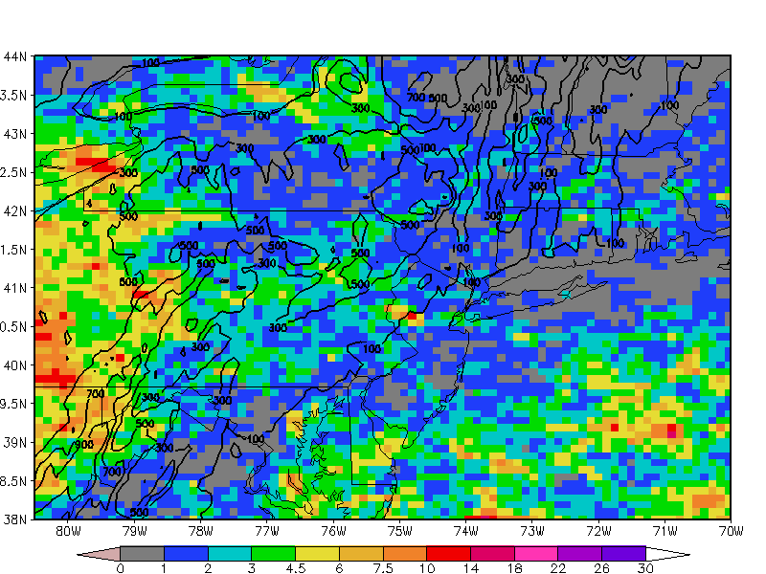
Diurnal Frequency of Lightning (Night to Morning Hours)
00-06 UTC
06-12 UTC

Slide 14
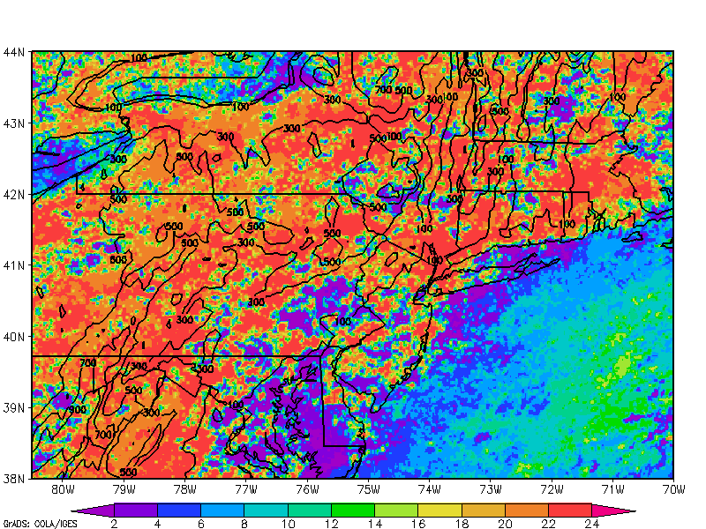
Hour (shaded in UTC) of Maximum Frequency Exceeding 45 dBZ

Slide 15
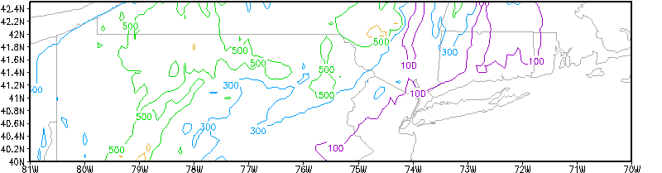
Interannual Storm Frequency
(number of storm days in box)
50
45
40
35
30
25
20
15
10
5
8
1
5
8
1
5
Active Coastal
Non-Active Coastal
1996 1997 1998 1999 2000 2001 2002 2003 2004 2005 2006 2007

Slide 16
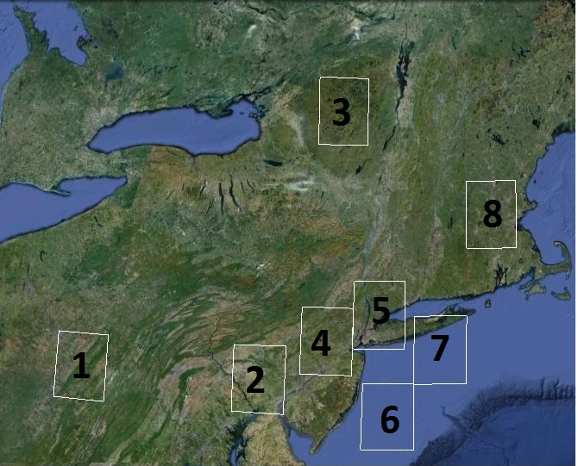
Composite of Warm Season Days With Convective Storms
Active (1998-2001)
Non-Active (2002-2005)
500z, MSLP Anomaly)
925Z, ThetaE, MUCAPE, SFC Winds)

Slide 17
Longer-Term Trends Using Parameter-based Predictions
of Convective Days
Use daily-averaged NARR: Surface convective available potential energy (CAPE), precipitable water, and vertical motion (averaged from 500 and 700 hPa).
Use Linear discriminant analysis (LDA) with CAPE, omega, and precipitable water to develop a threshold predictor for a convective day in a particular region, similar to Brooks et al. (2003) for severe weather (they used shear and CAPE).
A convective day is defined as a day in which the areal sum of > 45 dBZ within a 1-degree boxed region is greater than 1000 (~0.4% given number of 2-km points and daily 15-min times).
Analyze the interannual and spatial trends in convective frequency predicted by the thresholds.

Slide 18
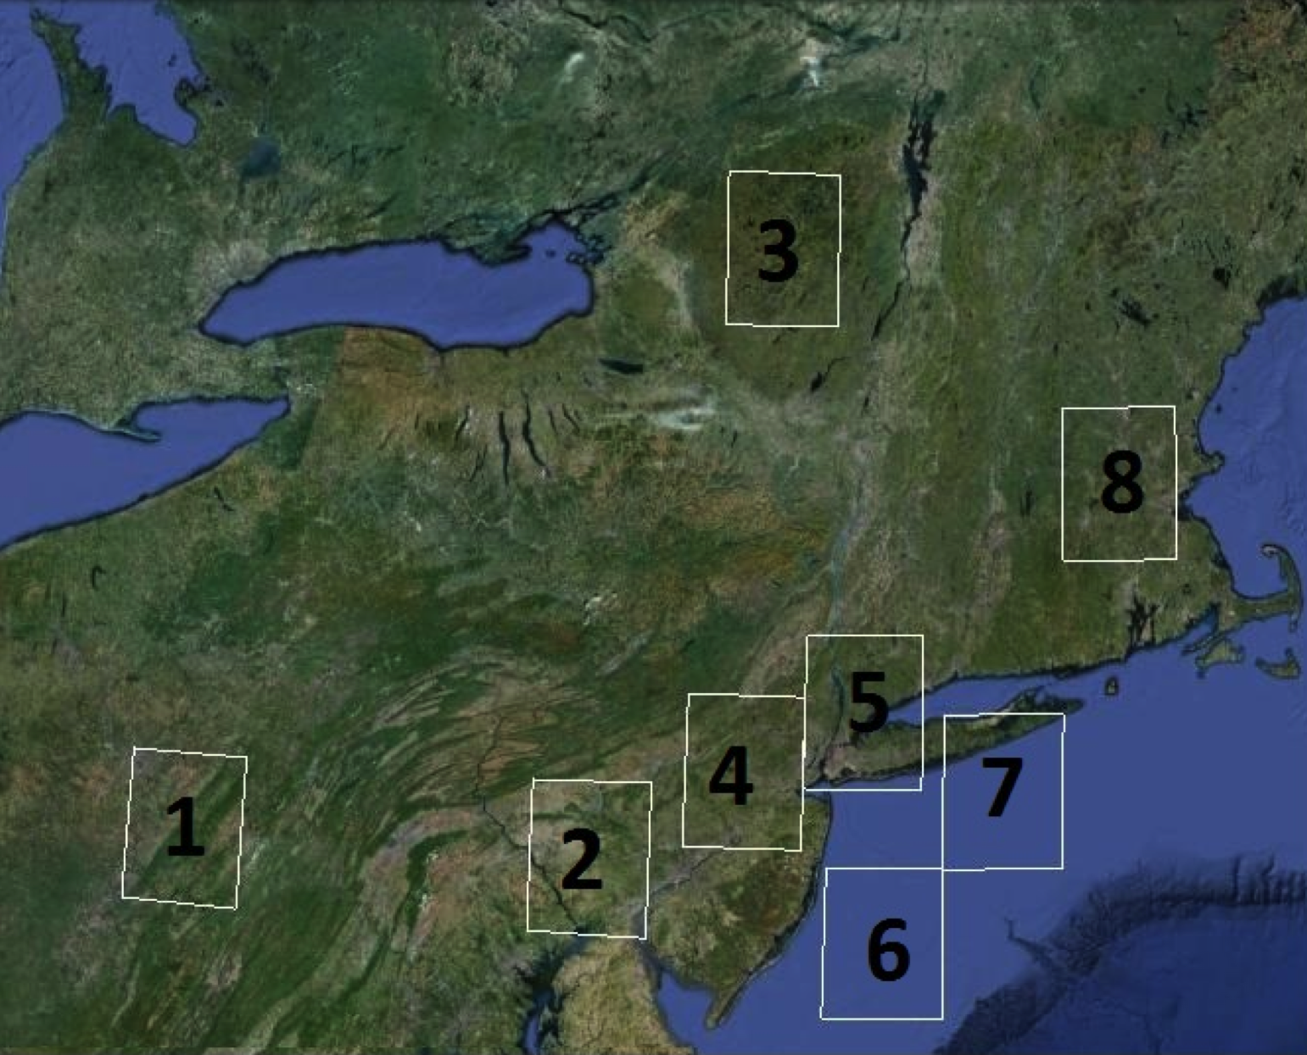
Regions 1,2,4, NYC, and 7 are highlighted
NYC

Slide 19
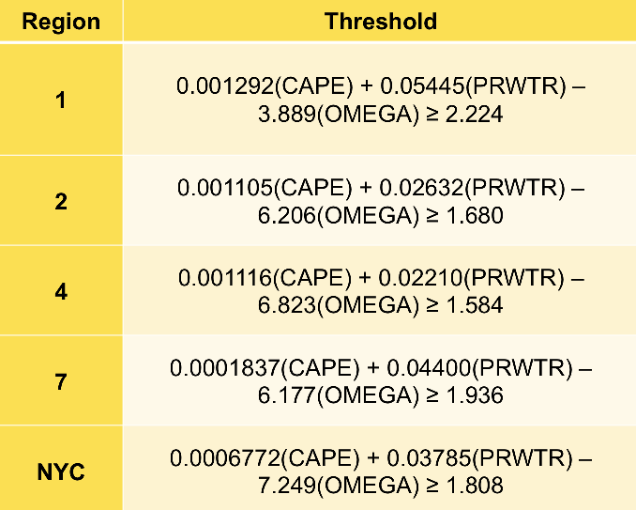
Convective thresholds created using LDA on NARR data and radar storm frequency for even years between 1996 and 2007

Slide 20
Verification of the statistically-predicted convective days in each region using odd years between 1996 and 2007
Region | False alarm rate | Prob of Detection
1 | 26.6% | 89.9%
2 | 19.6% | 84.2%
4 | 19.7% | 82.9%
7 | 17.6% | 80.4%
NYC | 25.9% | 82.9%
Note: False alarms increase 5-15% if vertical motion is not included

Slide 21
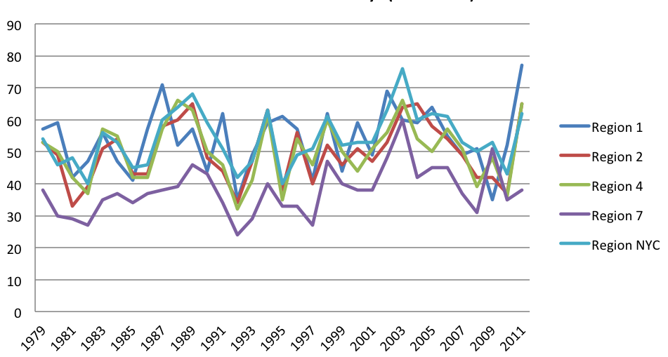
Number of predicted convective storm days 1979 to 2011
Only significant trend is region 7 (R² = 0.162, p =0.01); so convective frequency increasing more rapidly over coastal waters.

Slide 22
Average CAPE, Precipitable water, and vertical motion (omega) changes for all 1,2,4,7, and NYC regions from 1979-2011

Slide 23
Change in CAPE and 2-m Temperature for Regions 1 and 7

Slide 24
Summary and Conclusions
Convective frequency varies across the region, with localized maxima across western PA, Hudson Valley and along the VA to NJ coastal plain. There is a sharp gradient in convective frequency across the coast and over southern New England.
Convection reaches a maximum over inland areas during the day (18-00 UTC) and over the coastal plain during the late night (00-12 UTC)
There is large interannual variability related in part to the strength and frequency of synoptic troughs during the warm season.
Linear Discriminate Analysis (LDA) using NARR (CAPE, vertical motion, and precipitable water) can realistically obtain the convective days for various subregions.
There is an increase in the number of convective days over Long Island and coastal waters, which may be related in part to an increase in SST.

Slide 25
For More Information
Colle, B. A., K. A. Lombardo, J. Tongue, W. Goodman, and N. Vaz, 2012: Tornadoes in the New York Metropolitan Region: Climatology and multiscale analysis of two events. Wea. Forecasting, 27, 1326-1348.
Lombardo, K, and B. A. Colle, 2012: Ambient conditions associated with the maintenance and decay of quasi-linear convective systems crossing the northeastern U.S. coast. Mon. Wea. Rev., 140, 3805-3819.
Lombardo K., and B. A. Colle, 2011: Convective storm structures and ambient conditions associated with severe weather over the Northeast U.S. Wea. Forecasting., 26, 940-956.
Lombardo, K., and B. A. Colle, 2010: A climatology of convective structures over the Northeast U.S. and the associated ambient conditions. Mon. Wea. Rev, 138, 4456–4474.
Murray, J., and B. Colle, 2011: A climatology of convective storms over the Northeast United States. Mon. Wea. Rev., 139, 992-1012.

