Slide 1
Associating U.S. monthly tornado activity with environmental parameters
  Michael K. Tippett^{1,2}, Adam H. Sobel^{3,4} and Suzana J. Camargo⁴
¹ International Research Institute for Climate and Society, Columbia University, Palisades, NY
²Center of Excellence for Climate Change Research, Department of Meteorology, King Abdulaziz University, Jeddah, Saudi Arabia
³ Department of Applied Physics and Applied Mathematics and Department of Earth and Environmental Sciences, Columbia University, NY, NY
⁴Lamont-Doherty Earth Observatory, Columbia University, Palisades, NY
Severe Convection & Climate Workshop, 14-15 March 2013

Slide 2
Main points
Likelihood of severe weather events can be related to the immediate environmental conditions or “ingredients”
  Guidance for short-range outlooks
How to connect climate variability & tornado/severe weather activity?
  MJO, Drought, ENSO, Climate change
Challenging to connect tornado activity directly to climate
  Dynamical
  Statistical
Monthly-averaged “ingredient”-based index is a potentially useful proxy for tornado activity variability.
  Climatology
  Interannual variability

Slide 3
The “ingredients” approach:
Associate environmental factors with likelihood of tornado activity

Slide 4
Typical environmental parameters associated with tornadoes
Instability, updrafts, e.g., CAPE
Shear, e.g., 0-6km shear, Storm Relative Helicity (SRH)

Slide 5
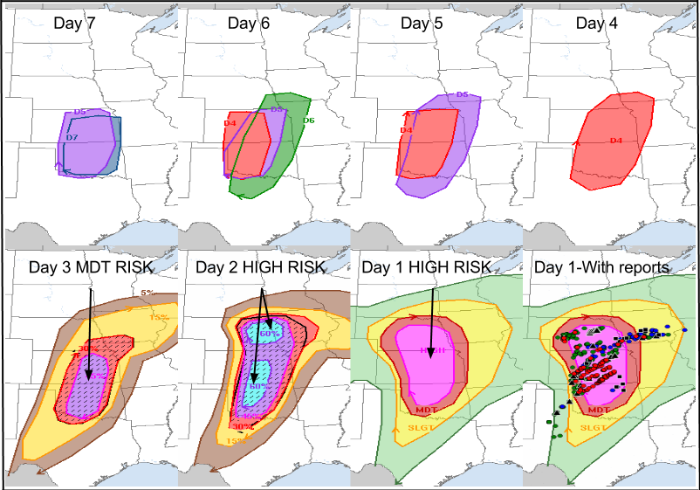
Useful relation between large-scale environmental parameters and tornado activity on short time-scales
Evolution of SPC Forecasts Leading to April 14, 2012
Notes:
First 7-day forecast

Slide 6
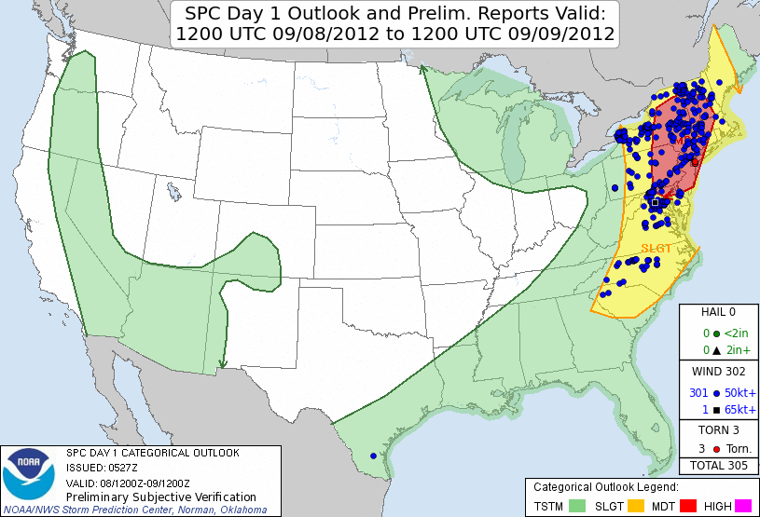
September 8, 2012

Slide 7
Connecting climate and tornado activity:
Conditional probabilities
Prob (tornadoes | MJO phase)?
Prob (tornadoes | ENSO)?
Prob (tornadoes | Climate change)?
Two approaches:
Statistical (data)
  Expectation[tornadoes | climate forcing] =
  regression, composites
Dynamical (model)
  Tornadoes in physical model with climate forcing specified
Notes:
Conditional probabilities are the formal way of answering the question of whether things are related.

Slide 8
The challenge of statistical and dynamical approaches
“Tornadoes, the deadliest weather disaster to hit the country this year, present a particularly thorny case.”
“Tornadoes are small and hard to count, and scientists have little confidence in the accuracy of older data.”
“The computer programs they use to analyze and forecast the climate do not do a good job of representing events as small as tornadoes.”
Harsh Political Reality Slows Climate Studies Despite Extreme Year -- NY Times 12/25/2011
“Tornadoes are not in the least bit ‘thorny.’”-- Roger Pielke, Jr, The Worst NYT Story on Climate Ever?

Slide 9
Approach: Develop a proxy (“index”) for tornado activity whose parameters can be observed/modeled

Slide 10
A monthly index for the number of U.S. tornadoes
Index = exp(constants x environmental parameters)
Constants estimated by Poisson regression
Potential parameters = CAPE, CIN, lifted index, lapse rate, mixing ratio, SRH, vertical shear, precipitation, convective precipitation and elevation
Estimate constants from observed climatology
  Avoids issues with changing technology and reporting practices
  Same constants at all (U.S.) locations, all months of year
Data
  NARR data 1x1 degree grid. 1979-2010.
  SPC Tornado, Hail, and Wind Database. 1979-2010.
  All tornadoes (>F0). [F1 and greater gives smaller values, similar sensitivities]
Same method used for tropical cyclone genesis

Slide 11
Tropical
Cyclone
Genesis
Obs. &
Index
annual values
(Tippett et al., 2011)

Slide 12
Let the data select the predictors
Error of fit
cPrcp
cPrcp:SRH

Slide 13
A monthly index for the number of U.S. tornadoes
Index = exp(c0 + c1 x SRH + c2 x cPrcp )
  Monthly averages
Estimate 3 constants from annual cycle data
  No annually varying data used to select parameters or fit constants
  No forecast data used. “Prefect prognosis”
Index = Expected number of tornadoes/month
  1x1 degree grid
  All tornadoes (>F0).

Slide 14
How well does the index capture the climatology?

Slide 15
Log(Expected # tornadoes)
Obs
Index
Difference

Slide 16
When and when are the biases?
B1
B2

Slide 17
Climatology
Observations
Index
Notes:
Climatology. OK. Biases. Underestimate of peak. Spatial biases in late summer and fall.

Slide 18
Month of Maximum Activity
Observations
Index

Slide 19
Annual cycle spatial performance
Mean-squared error skill score
Correlation

Slide 20
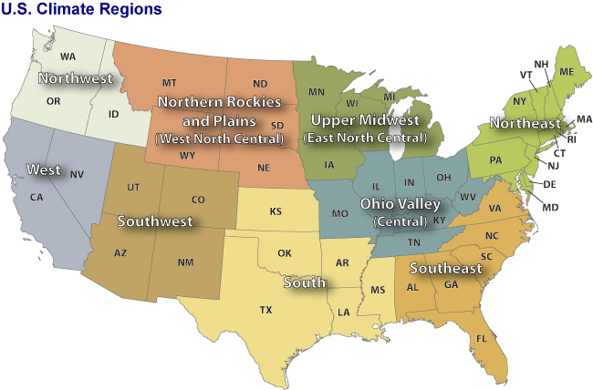

Slide 21
Regional climatology
Obs.
Index

Slide 22
April

Slide 23
May

Slide 24
June

Slide 25
July

Slide 26
August

Slide 27
September

Slide 28
The problem with late summer?

Slide 29
Spatially varying coefficients
cPrcp (1.4)
SRH (1.9)

Slide 30
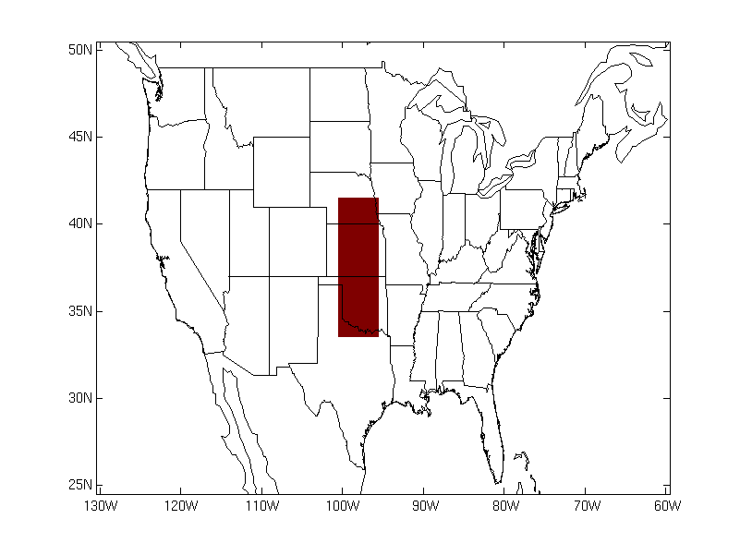
A single index based on monthly averages does not work well everywhere
Notes:
To decrease the slope of the isolines, increase the coefficient of SRH.

Slide 31
Does the index capture interannual variability?

Slide 32
US totals

Slide 33
US totals
 | Jan | Feb | Mar | Apr | May | Jun | Jul | Aug | Sep | Oct | Nov | Dec
Index | 0.75 | 0.64 | 0.54 | 0.50 | 0.60 | 0.67 | 0.75 | 0.40 | 0.15 | 0.25 | 0.48 | 0.74
SRH only | 0.24 | 0.12 | 0.14 | 0.34 | 0.41 | 0.39 | 0.51 | 0.31 | -0.16 | 0.13 | 0.21 | 0.37
cPrcponly | 0.76 | 0.58 | 0.68 | 0.60 | 0.30 | 0.54 | 0.60 | 0.33 | 0.15 | 0.28 | 0.53 | 0.74
Correlation between index and observed number
Which factor explains more interannual variability?

Slide 34
Regional variability

Slide 35
Conclusions
Some association between environmental parameters and tornado activity on monthly time-scales.
  Climatological variability
  Interannual variability
Tornado “index” is a potentially useful tool for:
  Attributing observed variability
  Extended-range prediction
  Climate projections

