Slide 1
Ingredients approach for severe weather
Harold Brooks
NOAA/NSSL
Harold.brooks@noaa.gov

Slide 2
Reports-A logical place to start
US reporting database
  Target of opportunity
  Changes in de jure and de facto standards
  Carbin’s talk earlier

Slide 3
Ingredients
Look at problem from forecasting perspective
What things do we need in the environment for event?
Applicable to any weather event
  Doswell et al. (1995) on flash floods
  Implicit assumption is that if all ingredients come together, event will happen with “high” probability

Slide 4
Another way to think about it
Meteorological covariates (Brown and Murphy-aviation)
Build statistical model relating events to environments
Typically some sort of discriminant analysis
Count environments

Slide 5
Big problems
Do we know all of the physical relationships?
For climate scale, do we estimate all of the ingredients?
How good are the physical quantities predicted?

Slide 6
Severe Thunderstorm Definition (US)
Hail at least 1 inch diameter (3/4 inch through 2009), winds of 50 kts (58 mph), tornado
Significant severe
  2 inch hail, 65 kt winds (hurricane force), F2+ tornado
  ~10% of severe

Slide 7
“Ingredients” for severe thunderstorms-the supercell
Thunderstorms
  Low-level warm, moist air
  Mid-level (~2-10 km) relatively cold, dry air
  Something to lift the warm, moist air
  Combine first two to get energy available for storm (CAPE or Wmax)
Organization
  Winds that increase and change direction with height over lowest few km
  From equator at surface, west aloft

Slide 8
Shear→
Energy→

Slide 9
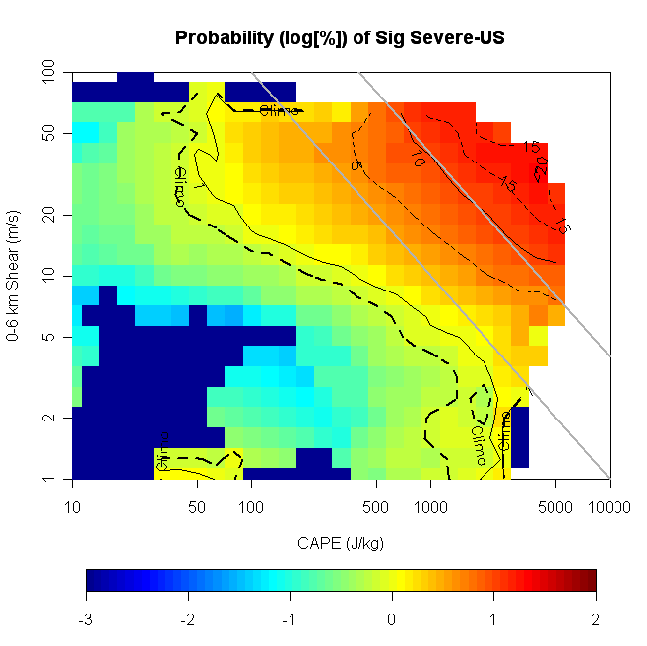
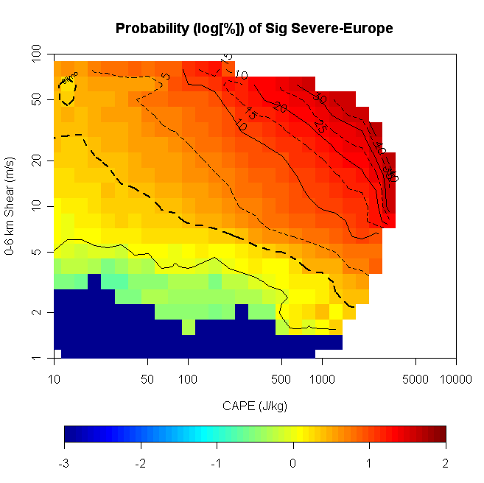
Probability of Sig Severe
Line~k*CAPE*S06^1.6
From Brooks et al (2009)

Slide 10
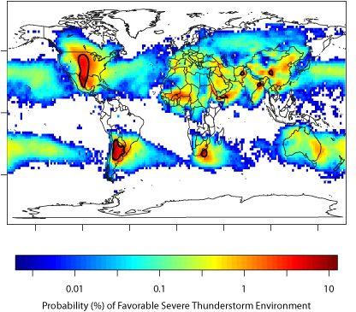
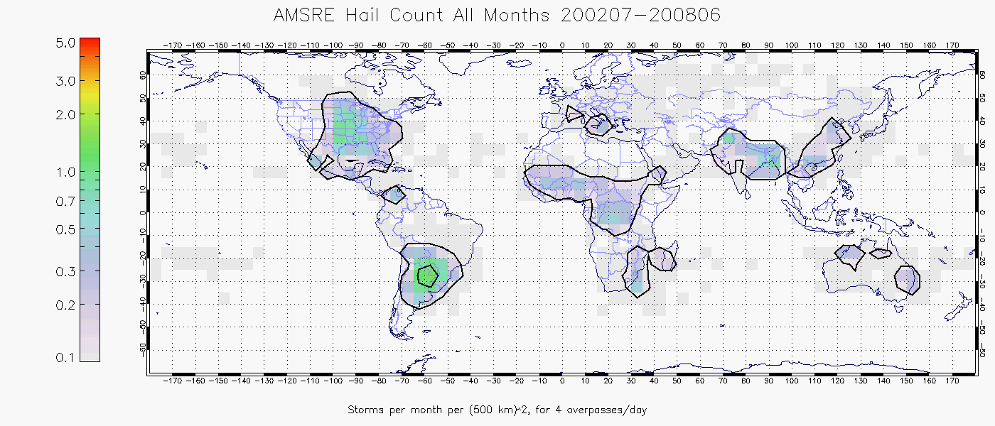
(Dan Cecil, Univ. of Alabama-Huntsville)
Updated from Brooks et al (2003)

Slide 11
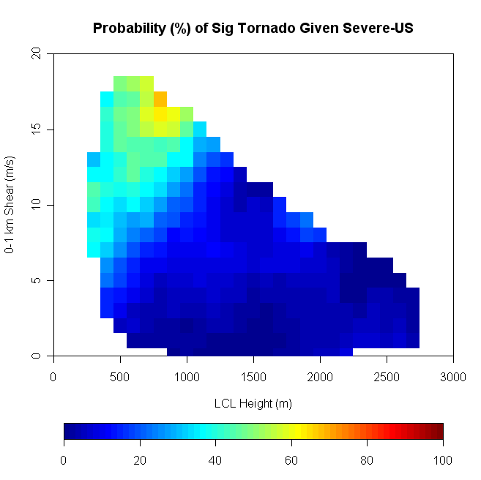

Slide 12
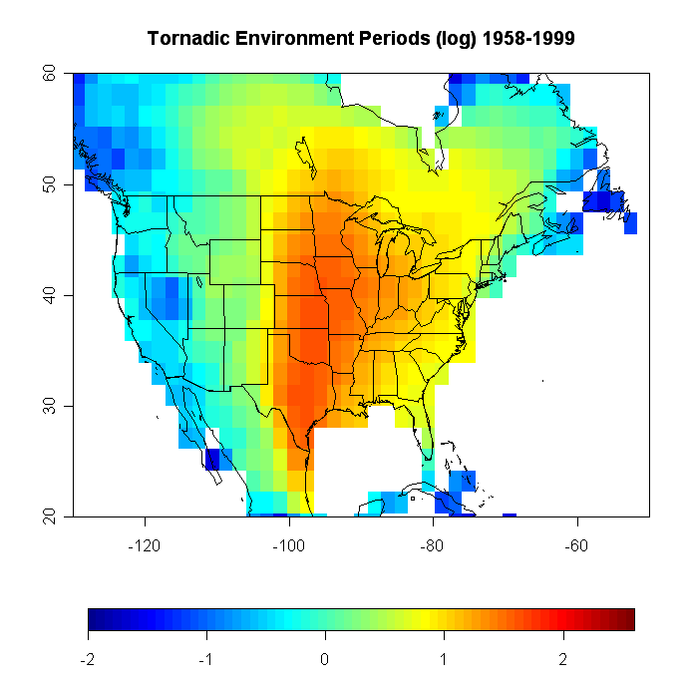

Slide 13
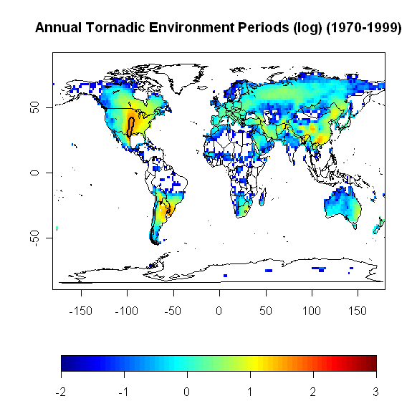

Slide 14
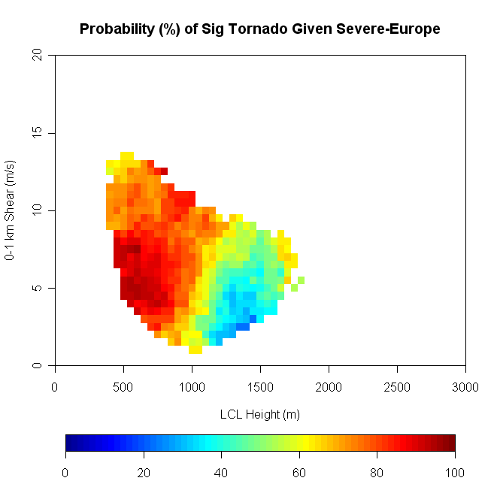

Slide 15
US in more detail
Look at all environmental conditions from 1991-9
Individual threats
  Consider probability of different threats, given significant severe
  Probability of big event given any event
  Focus on patterns
Small change in the variables-energy converted to updraft speed

Slide 16
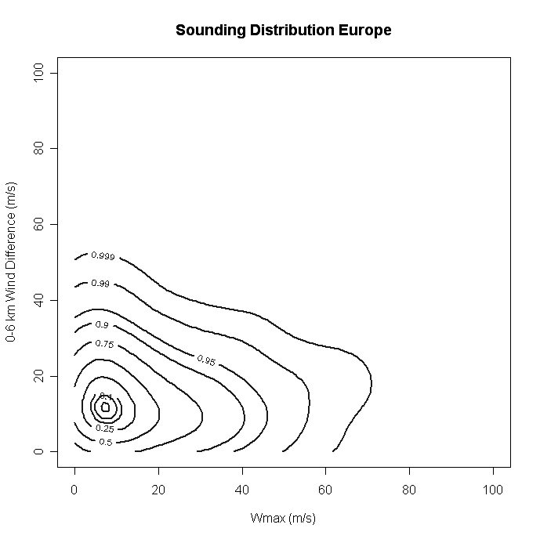
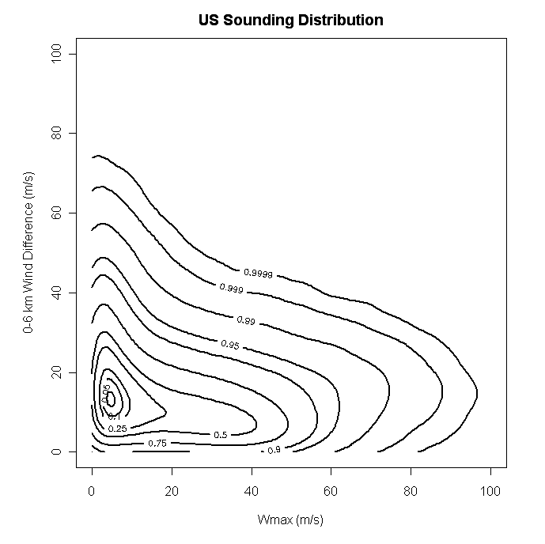
Organization
Updraft

Slide 17
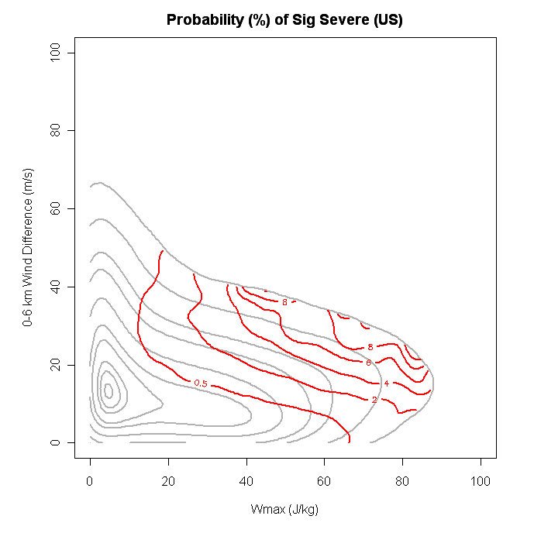

Slide 18
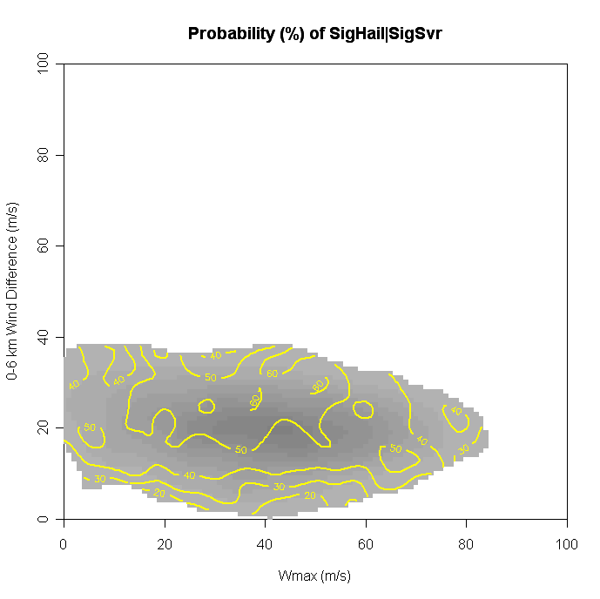
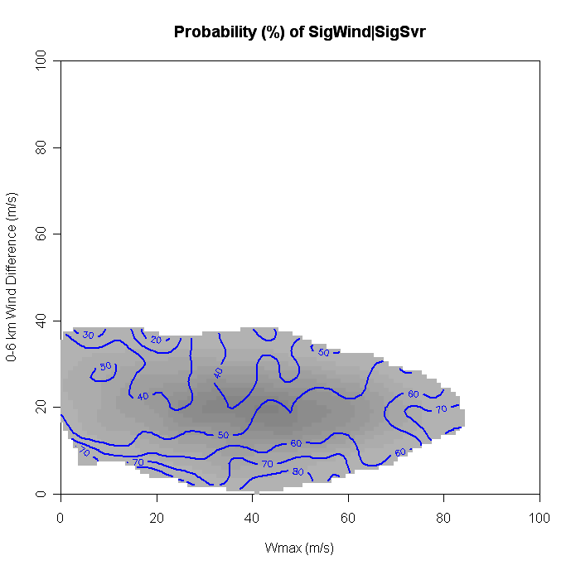
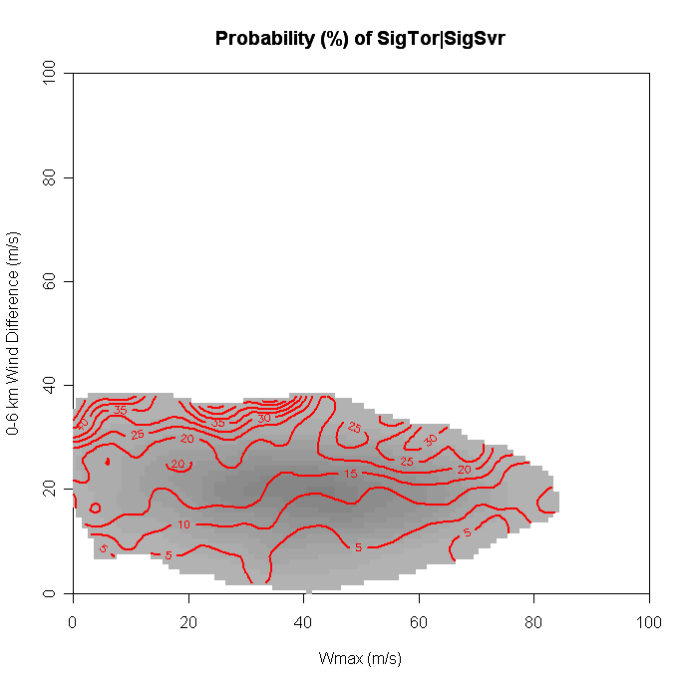
Hail
Wind
Conditional Probability
of Events Given
Any Significant Event
Tornado

Slide 19
Closing thoughts
Initiation is question
Are there sufficiently general recipes to do global?

