Slide 1
Severe thunderstorms and climate change
Harold Brooks
NOAA/NSSL
Harold.brooks@noaa.gov

Slide 2
Big questions
Have severe thunderstorms/tornadoes changed?
How and why do we expect severe thunderstorms to change in a greenhouse-enhanced atmosphere?
How do severe thunderstorms fit into climate?

Slide 3
Reports-A logical place to start
US reporting database
  Target of opportunity
  Changes in de jure and de facto standards
Hail in other countries
  China-yes/no reports available at >500 sites with some size data
  Italy, France, and Spain-hailpad networks

Slide 5
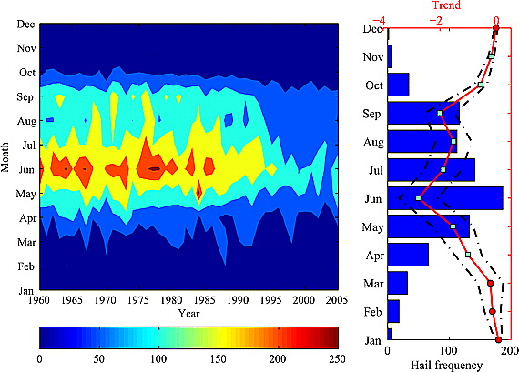
China-Hail Frequency
Xie et al. 2008 (GRL)

Slide 6
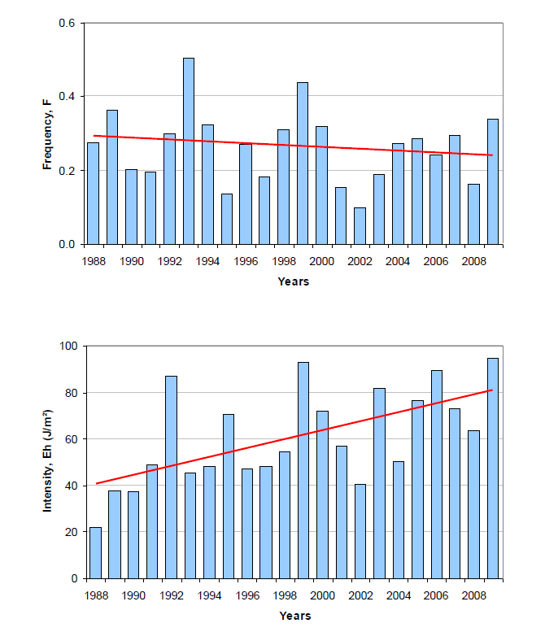
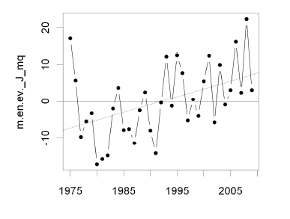
France/Italy Hailpad Data
Occurrence
Kinetic Energy
Berthet et al. (2011)
Eccel et al. (2011)

Slide 7
Hail Obs Summary
Little change to slight decrease in occurrence
Small decrease in mean size, but increase in kinetic energy of hailfalls
  Start with slightly larger hail at beginning of fall
  Melt more because of higher freezing level height, particularly impacting small
  Leaves distribution shifted to larger stones
Does it extend to larger sizes?

Slide 8
Severe Thunderstorm Definition (US)
Hail at least 1 inch diameter (3/4 inch through 2009), winds of 50 kts (58 mph), tornado
Significant severe
  2 inch hail, 65 kt winds (hurricane force), F2+ tornado
  ~10% of severe

Slide 9
“Ingredients” for severe thunderstorms-the supercell
Thunderstorms
  Low-level warm, moist air
  Mid-level (~2-10 km) relatively cold, dry air
  Something to lift the warm, moist air
  Combine first two to get energy available for storm (CAPE or Wmax)
Organization
  Winds that increase and change direction with height over lowest few km
  From equator at surface, west aloft

Slide 11
Using large-scale conditions
Downscaling
  Statistical (look at favorable conditions, ingredients-based)
  Dynamical (nested models)
Applicable to past observations, climate models
Ingredients based
  Define events in terms of environmental conditions
    Energy for storm “strength”-CAPE or Wmax
    Organization-0-6 km wind shear
    Initiation?

Slide 12
Shear→
Energy→

Slide 13
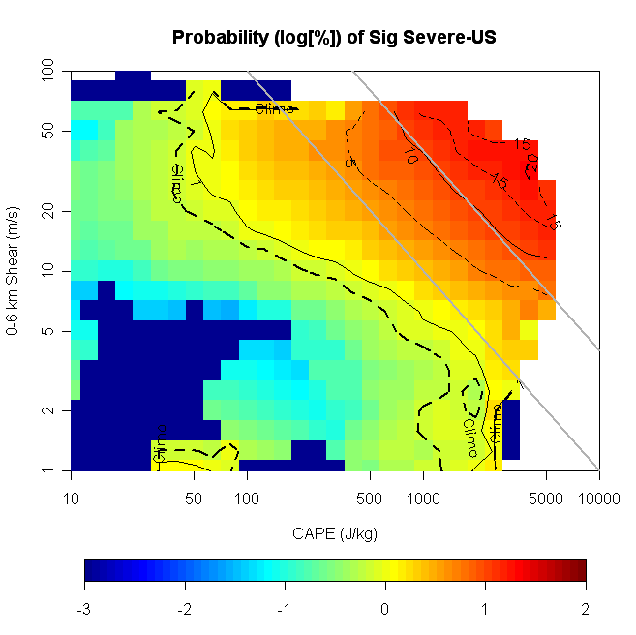
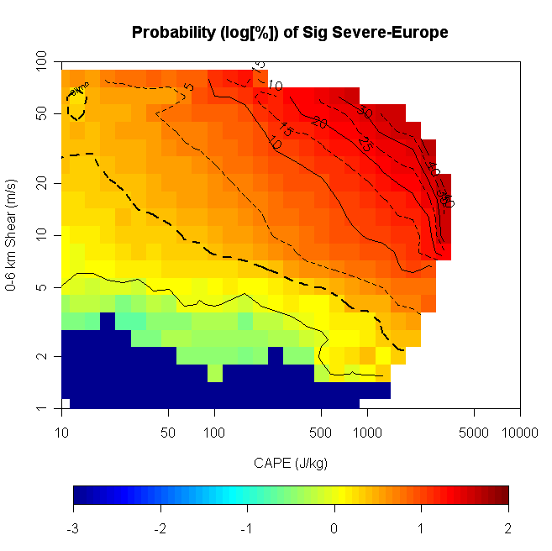
Probability of Sig Severe
Line~k*CAPE*S06^1.6
From Brooks et al (2009)

Slide 14
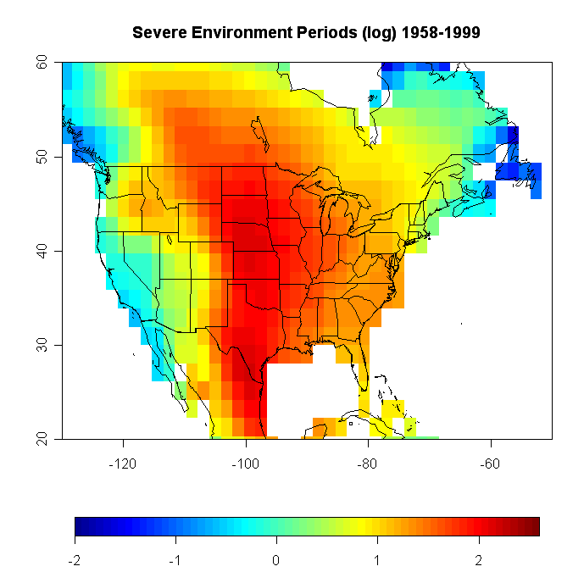

Slide 15
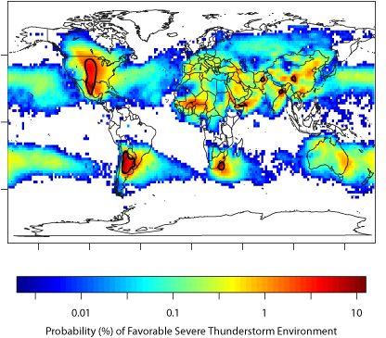
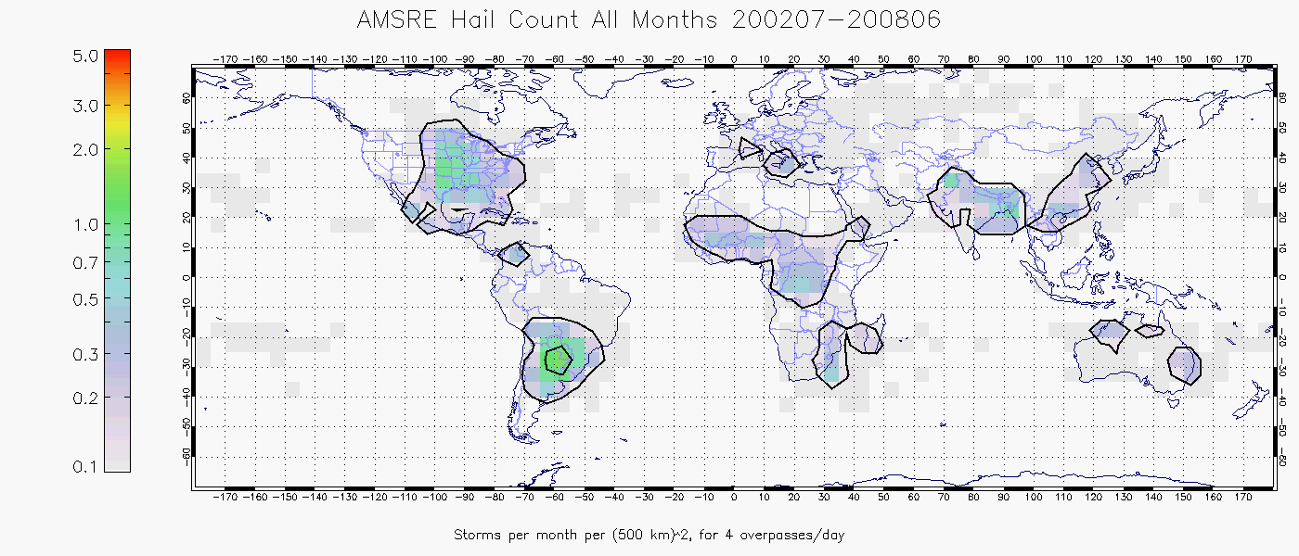
(Dan Cecil, Univ. of Alabama-Huntsville)
Updated from Brooks et al (2003)

Slide 16
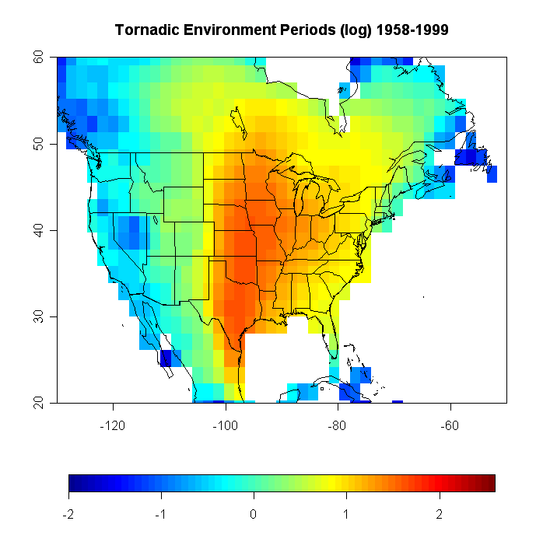

Slide 17
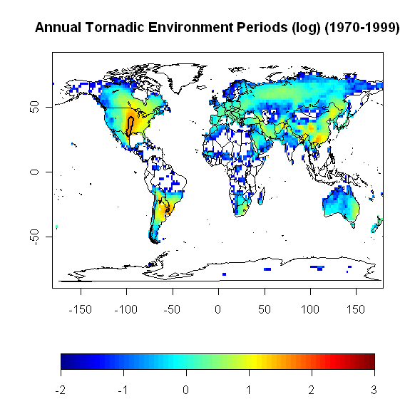

Slide 18
US in more detail
Look at all environmental conditions from 1991-9
Individual threats
  Consider probability of different threats, given significant severe
  Probability of big event given any event
  Focus on patterns
Small change in the variables-energy converted to updraft speed

Slide 19
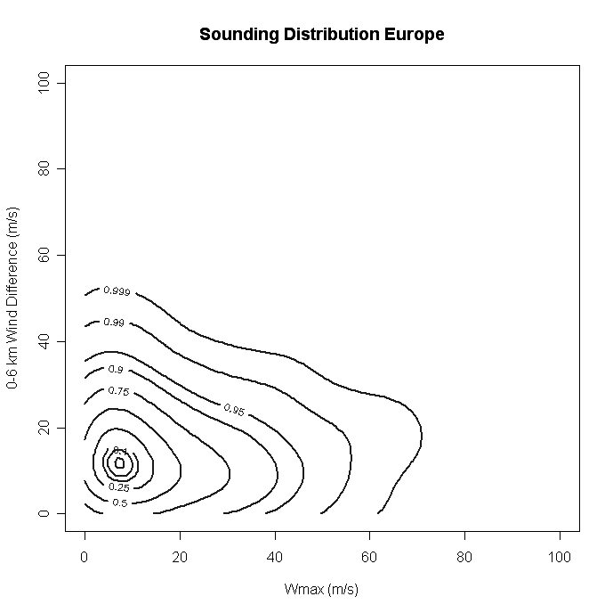
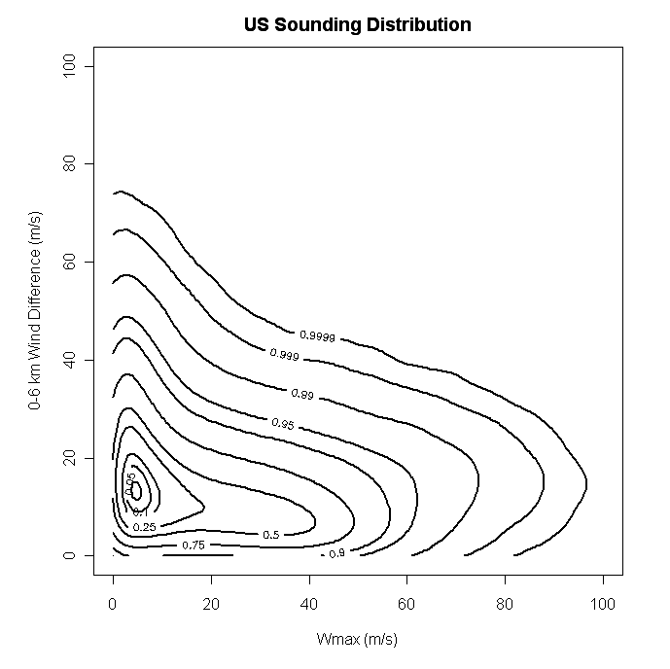
Organization
Updraft

Slide 20
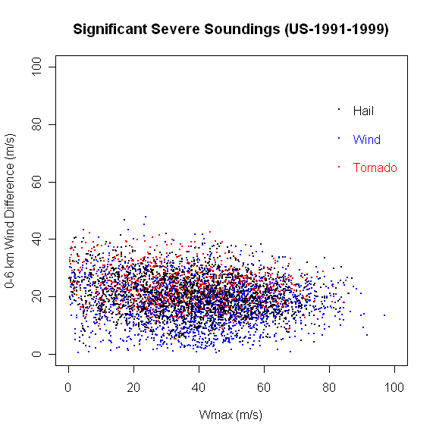

Slide 21
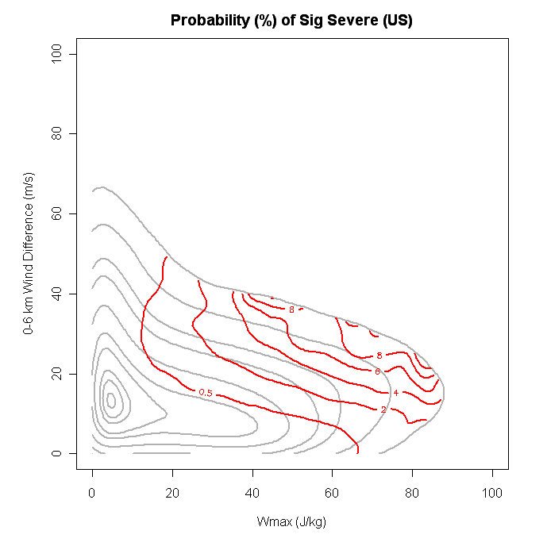

Slide 22
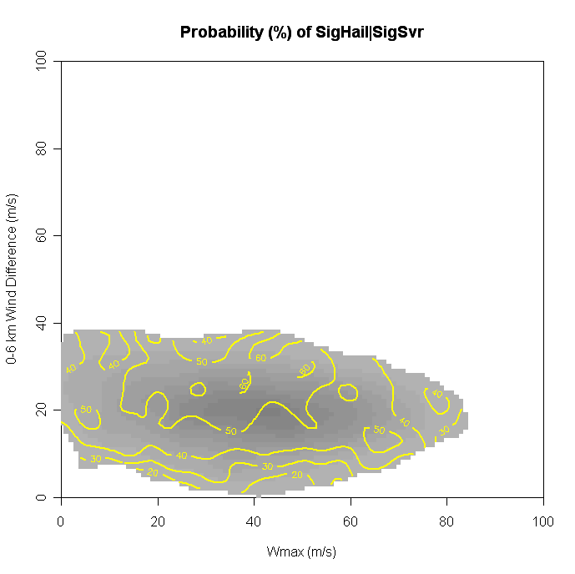
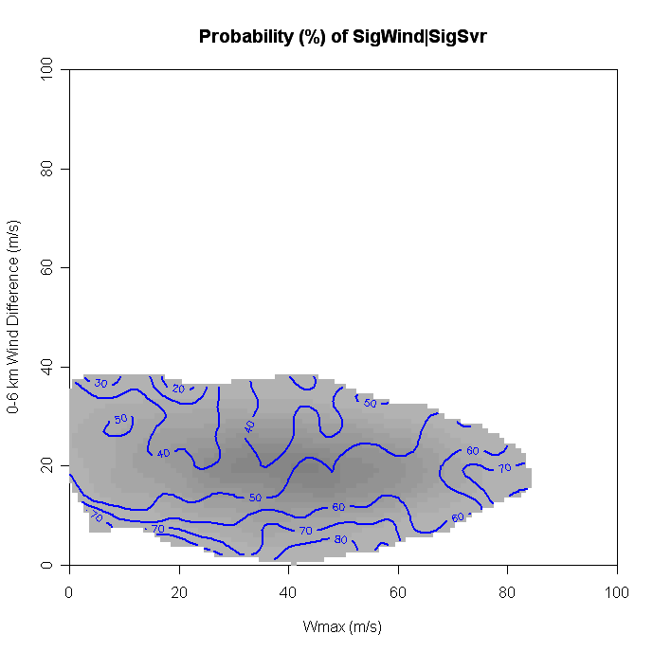
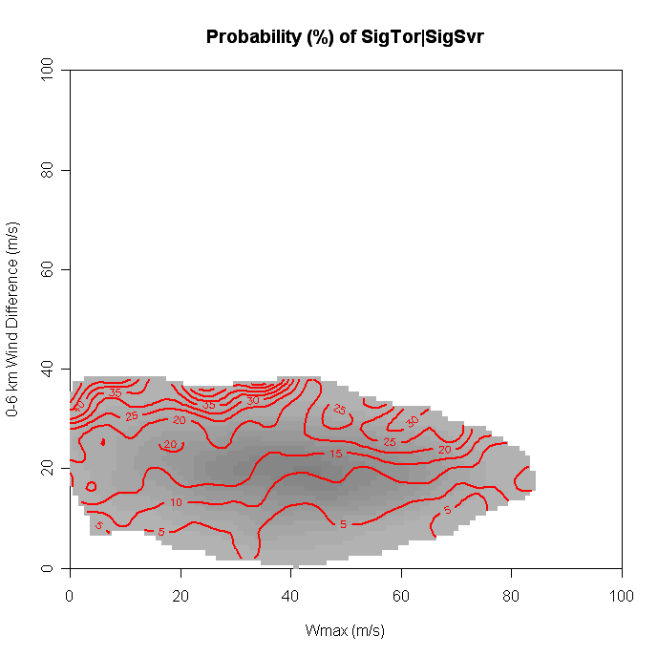
Hail
Wind
Conditional Probability
of Events Given
Any Significant Event
Tornado

Slide 23
Tornado/
Hail
Wind

Slide 24
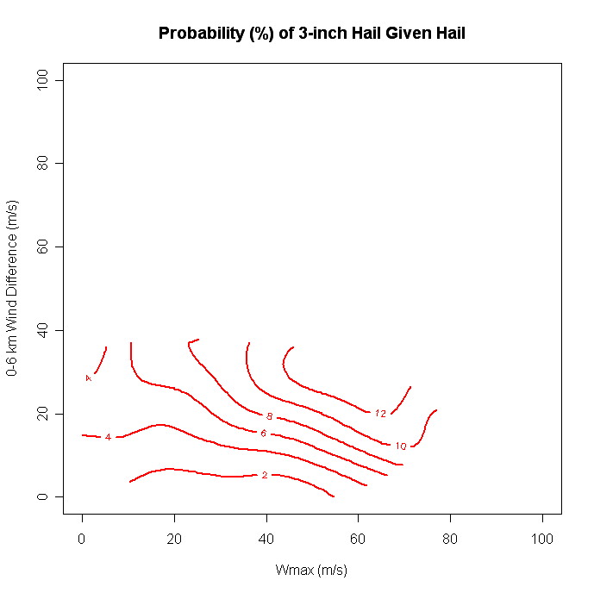
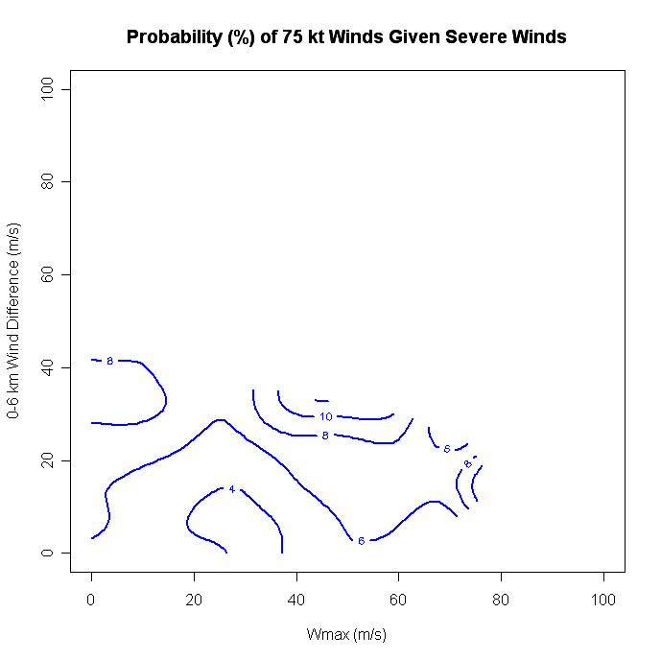
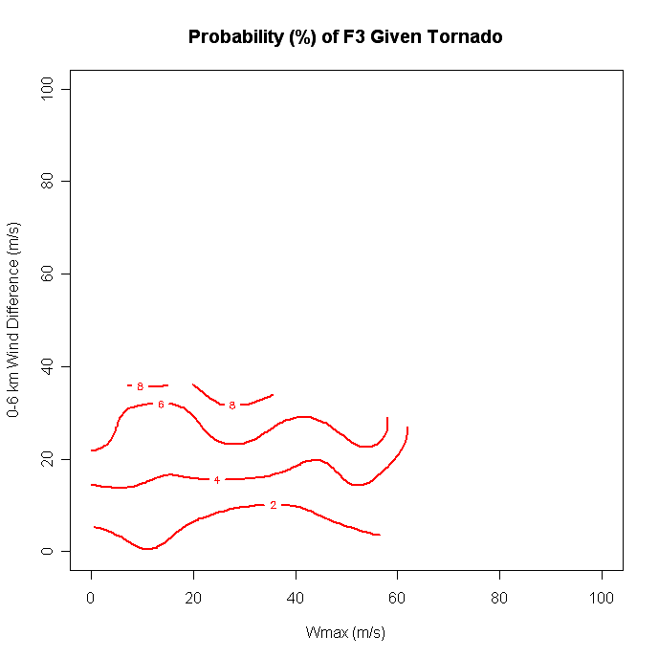
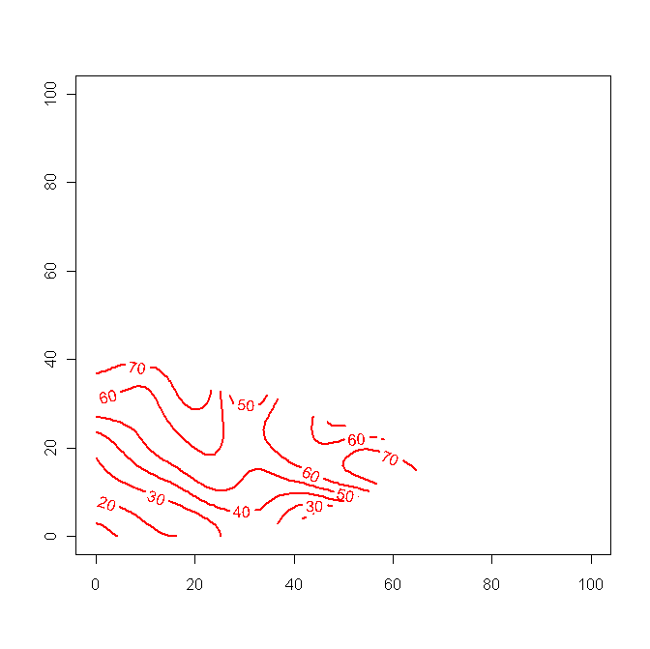
Hail (3 in)
Wind (75 kt)
Tornado (F2-ESWD)
Conditional Probability of Really Big Events
Tornado (F3)
Grunwald and Brooks (2011)

Slide 25
Importance of shear
Big tornado years typically have hail as dominant non-tornadic event
  Predominantly shear
Intensity of tornado/hail increases with increasing shear

Slide 26
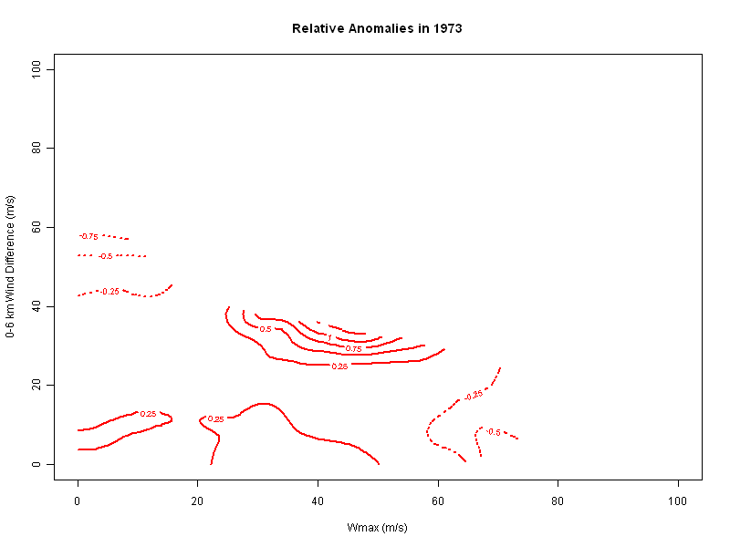
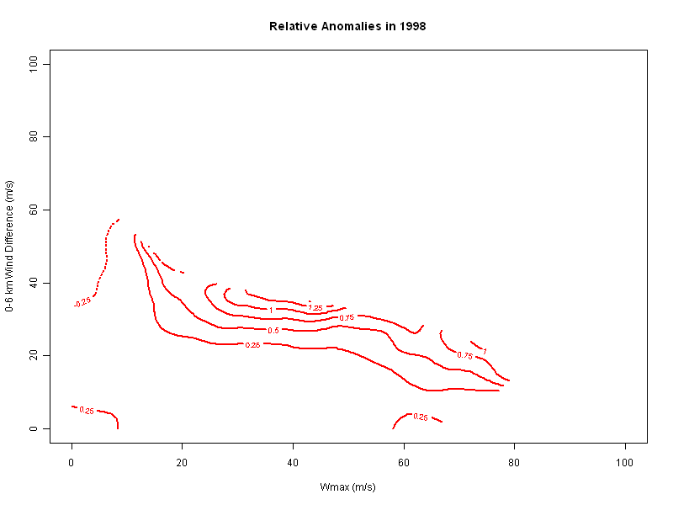
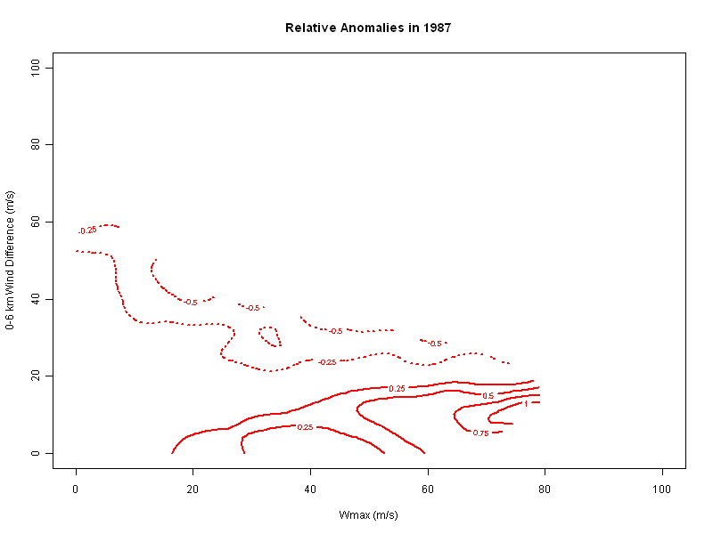
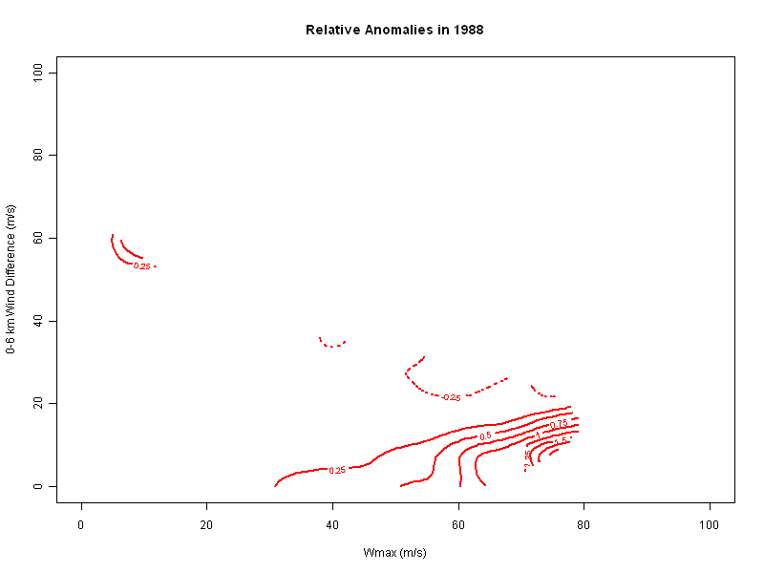
1973
1998
Big Tornado Years
Solid Contours-More than normal, dashed-less than normal
1987
1988
Small Tornado Years

Slide 27
What will happen in the future
Mean expected changes
  CAPE goes up (related to moisture increase)
  Shear goes down (decrease in equator-to-pole gradient)
Climate model simulations
  Three main groups (so far)
    GISS (parameterized updraft)
    Oklahoma/Melbourne
    Purdue
  Look at favorable conditions (statistical modelling)
    Concentrate on changes in model world

Slide 28
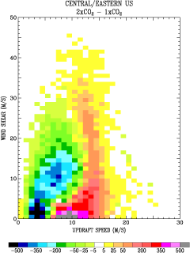
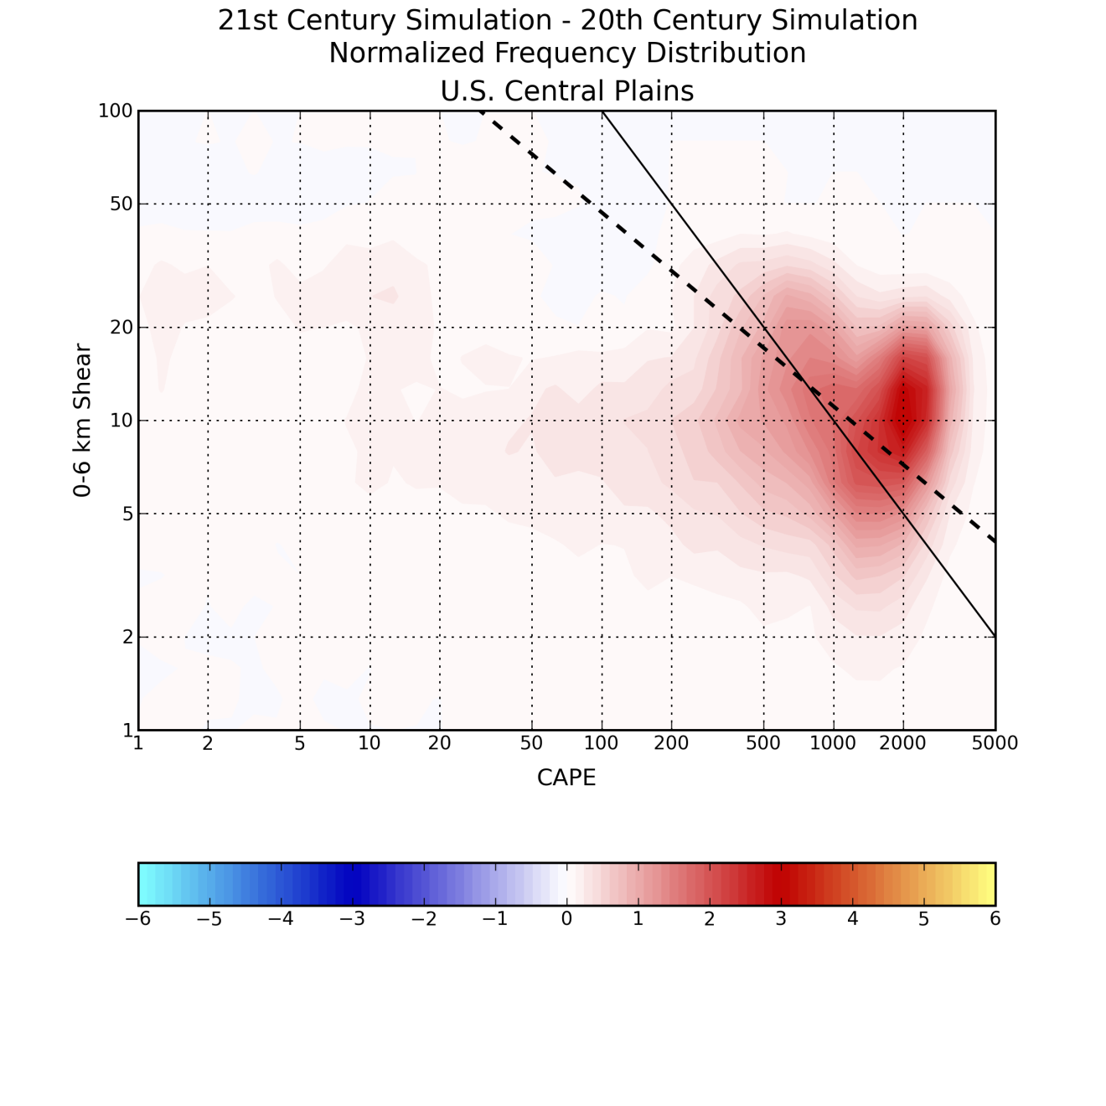
Doubled CO2
(GISS)
Late 21st-Late 20th
(OU/Melbourne)
(Del Genio et al., 2007)
(Marsh, 2008)

Slide 29
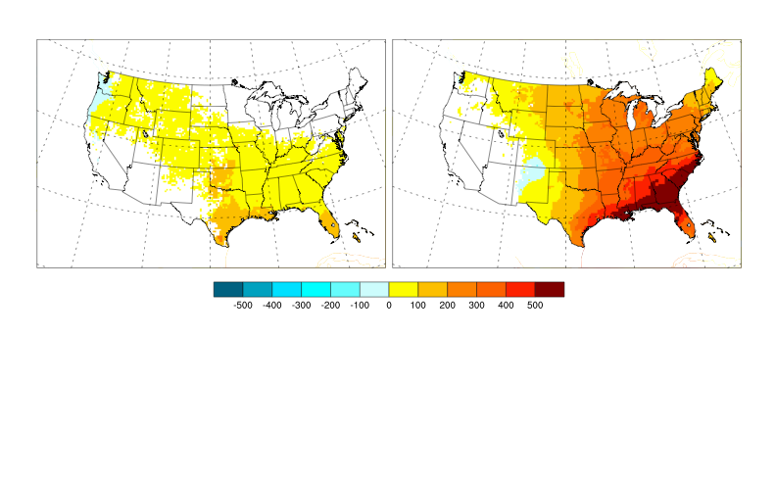
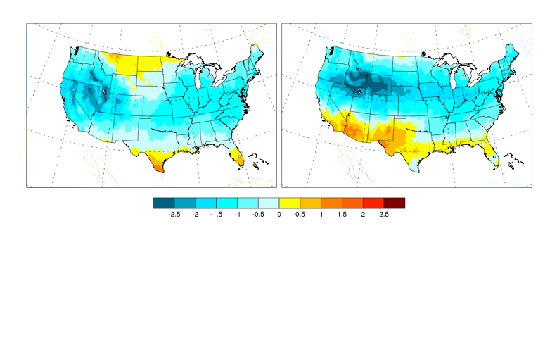
21st Century-20th Century (RegCM)
CAPE
MAM
JJA
6-km Shear
Trapp et al. (2007, PNAS)

Slide 30
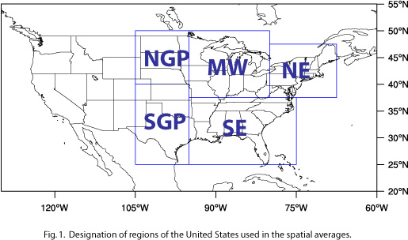
Trapp et al. (2009) Regional Analyses
Notes:
30
regionally averaged time series
local polynomial regression
compute confidence bands at 90% level (Wu and Zhao 2007)

Slide 31
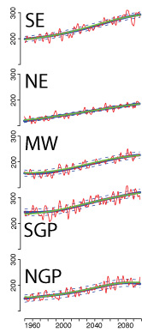
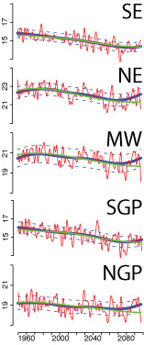
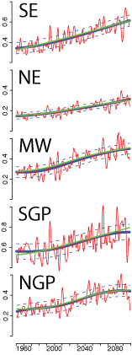
Updraft
Shear
Combination

Slide 32
Model summary
Energy term increases in all regions
Shear term decreases
Overall, more environments favorable for severe storms
How do we look at long time series?
  New tool-20th Century Reanalysis-surface pressure, monthly SST

Slide 33
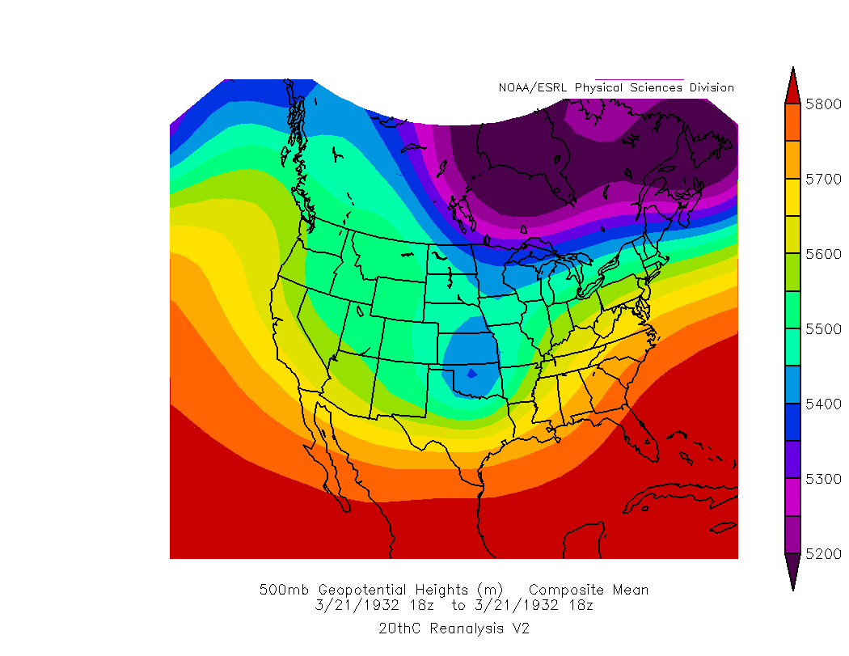
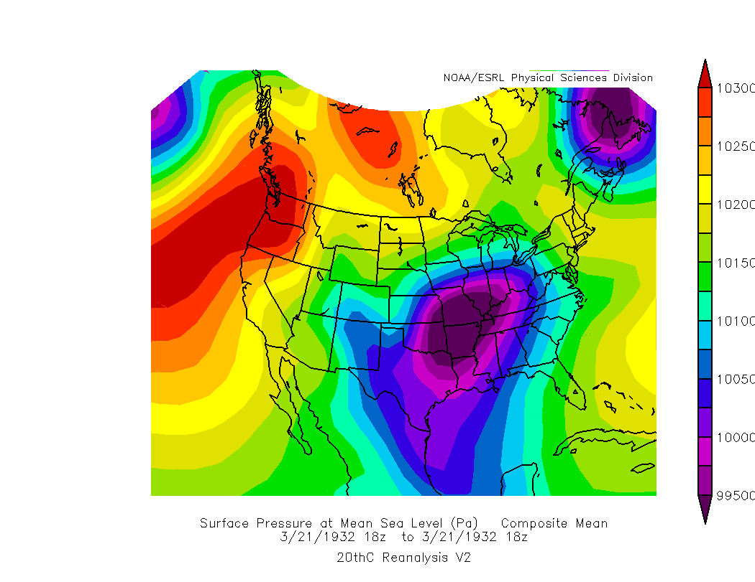
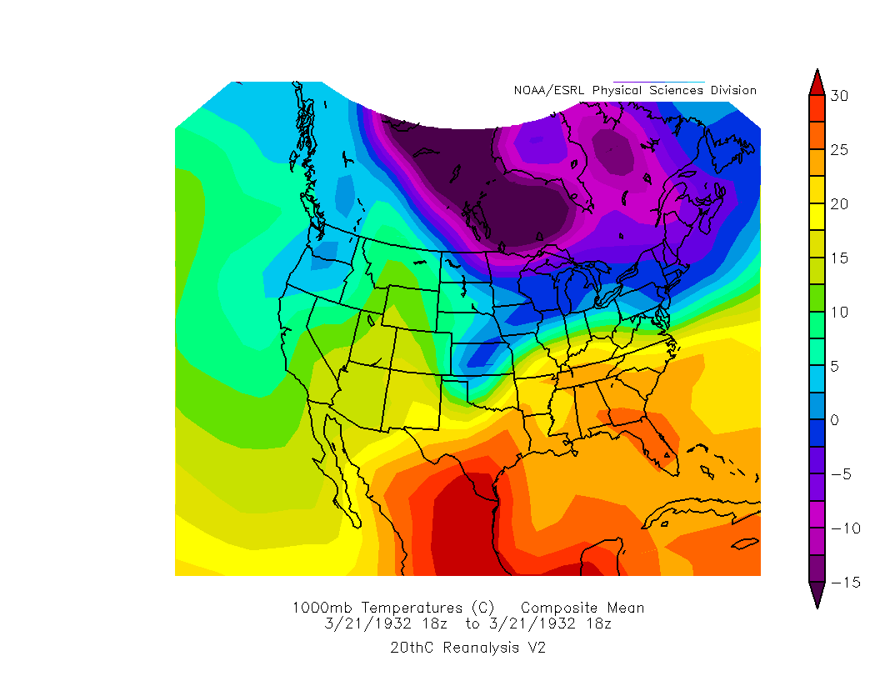
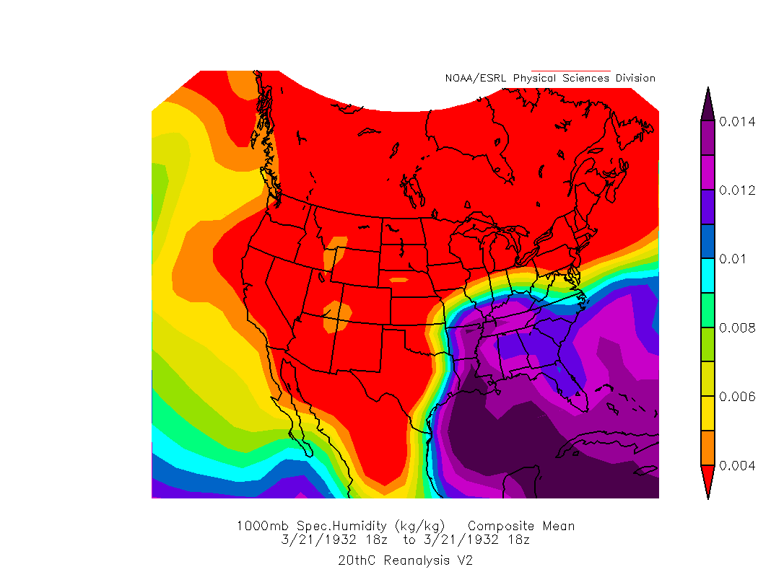
Upper level flow
Surface pressure
Temperature
Moisture

Slide 34
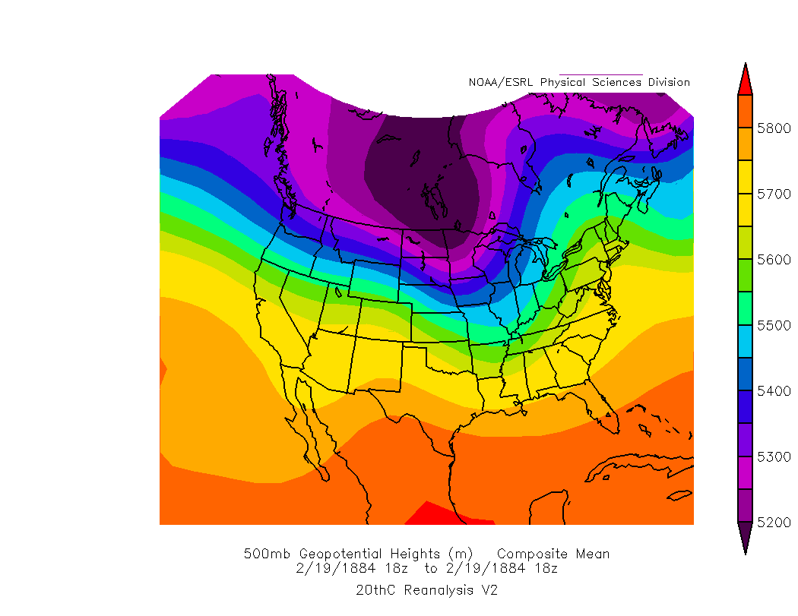
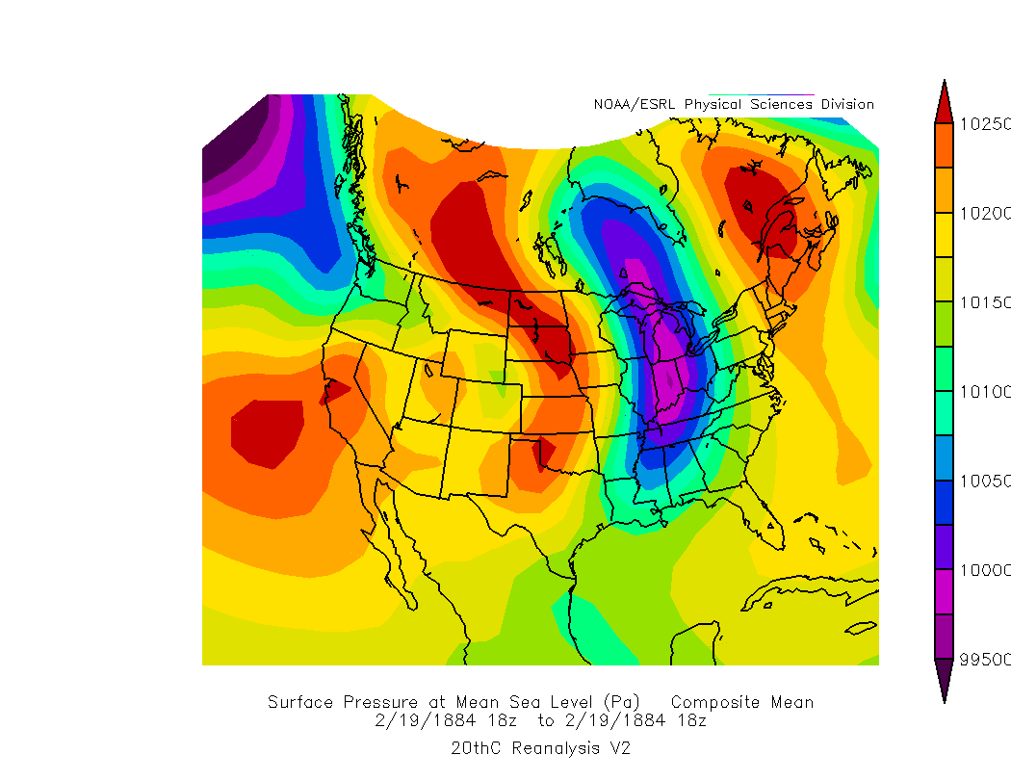
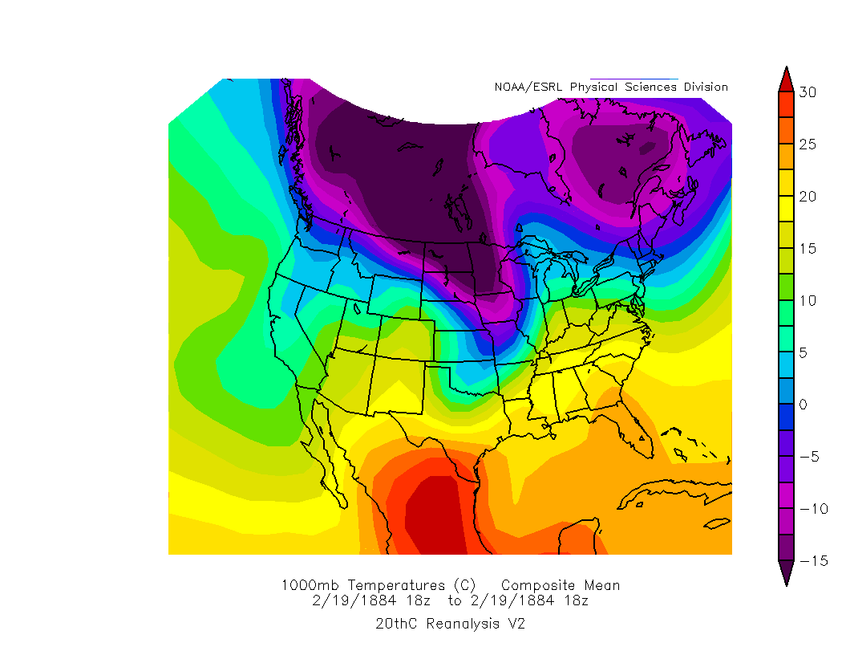
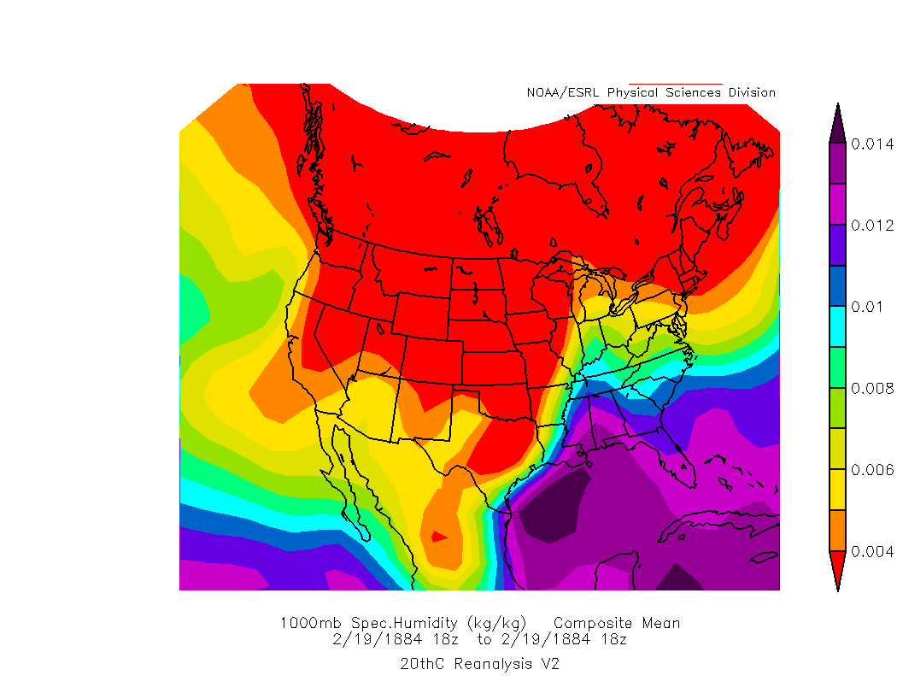
Upper level flow
Surface pressure
Temperature
Moisture

Slide 35
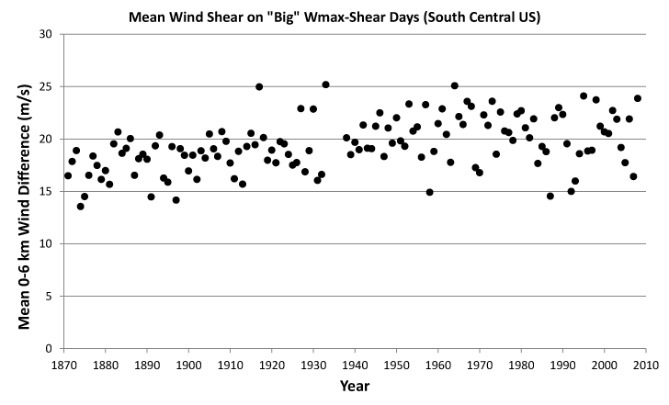
20th Century Reanalysis
Large-scale cyclones underestimated?

Slide 36
Summing up environments
Shear is important for kind and intensity
Models show CAPE increase, shear decrease (for most part)
Gedankenexperiment
  Assume conditional probabilities are true
  Move environmental conditions around

Slide 37
Return to reports
Impacts of seasonal temperature swings?

Slide 38
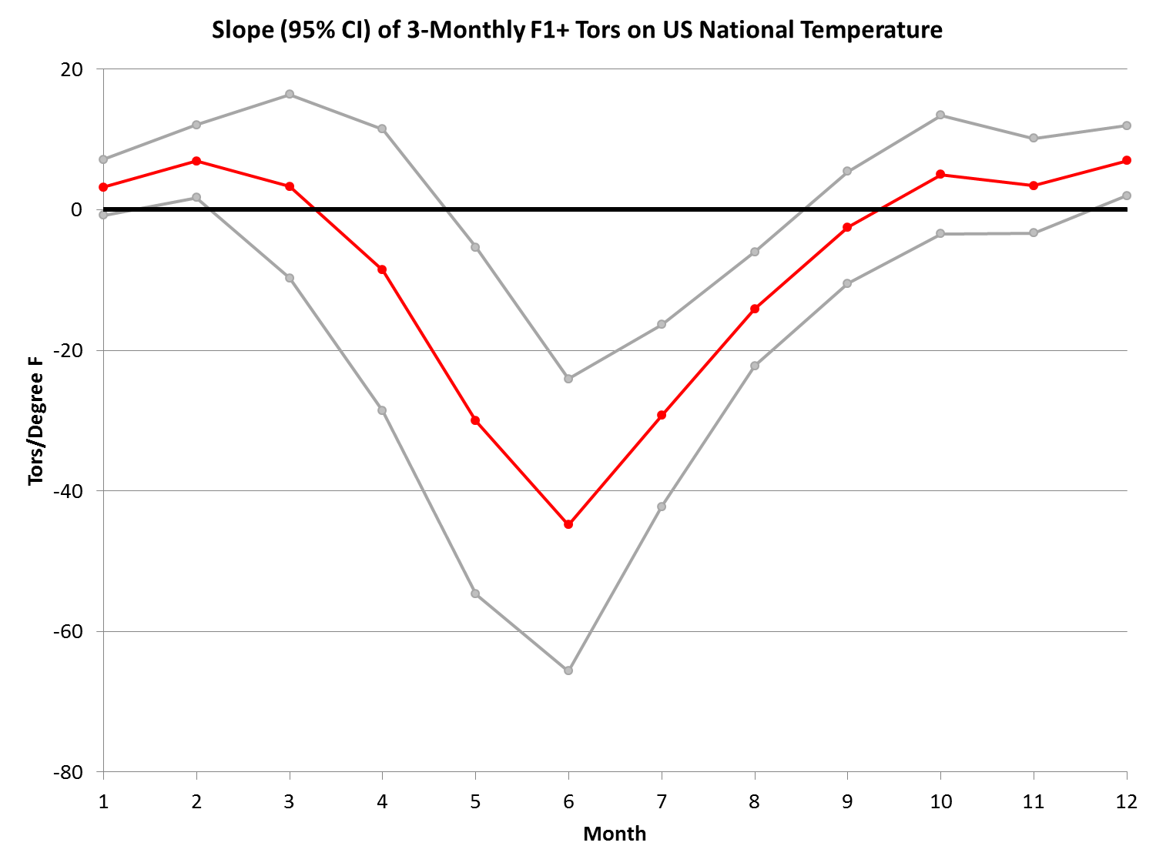
Change in National Tornado Count as Temperature Warms
Fewer
More
More

Slide 39
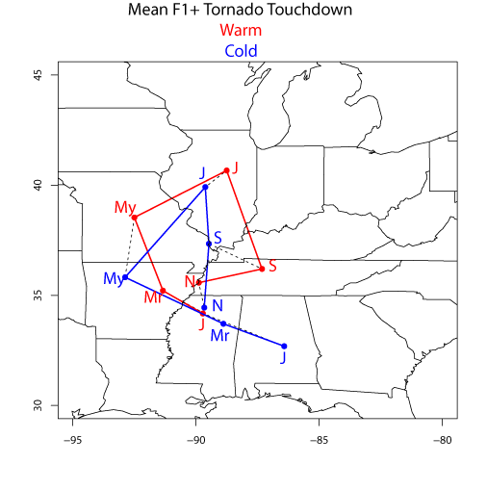

Slide 40
Return to reports
Impacts of seasonal temperature swings?
Timing of season
"As spring moves up a week or two, tornado season will start in February instead of waiting for April”-K. Trenberth
When does tornado season start?

Slide 41
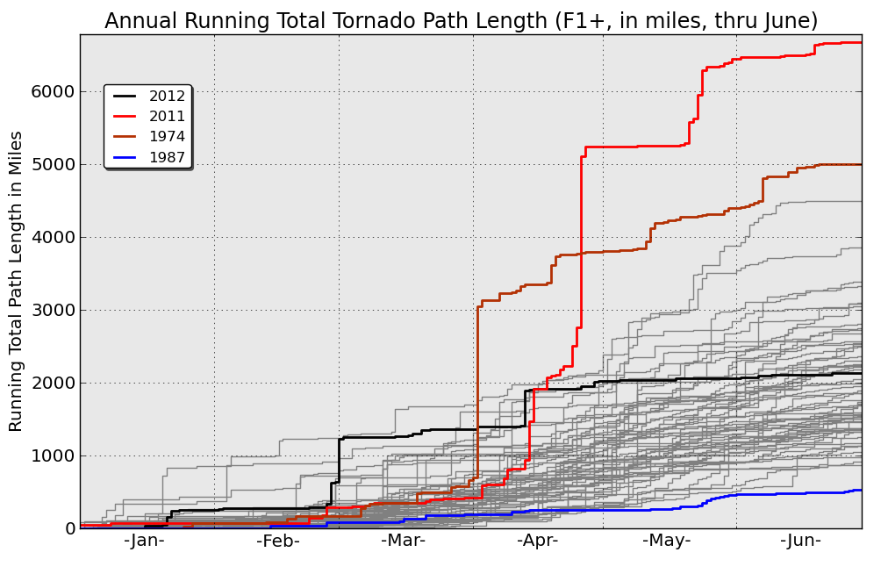
Are tornadoes happening earlier
in the year ?
Notes:
*
And 2011 was quite unusual in that the point at which the PL for the year-to-date reached 1000 miles occurred much earlier than normal, at the end of February/beginning of March. However, you can see that there have been a few other years where the PL increased earlier than in 2011.

Slide 42
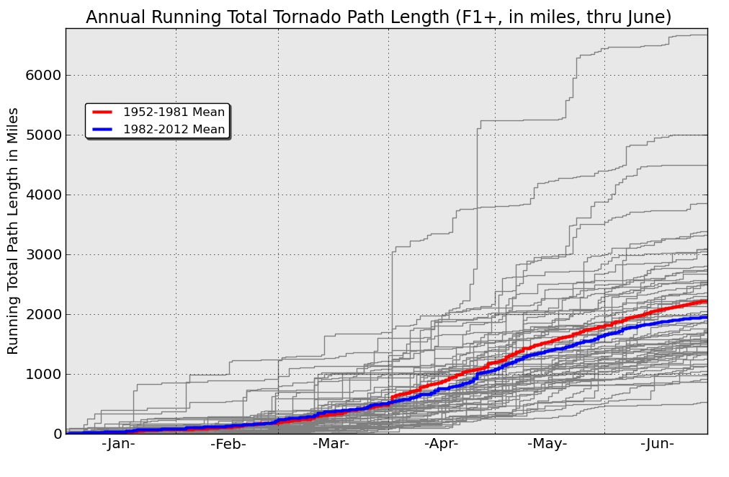
Are tornadoes happening earlier
in the year ?
Notes:
*
When we compare the two mean trend lines for the two periods we see very little difference in the lines for the first three months of the year, the recent years average slightly greater in mean PL but the difference is small. Starting in April, the earlier year’s mean PL exceeds that of the latter half of the dataset and continues to be the period in which mean PL is greater through the end of June. Thus, from this analysis, it does not appear that tornadoes are increasing in the earlier part of the year in recent years.

Slide 43
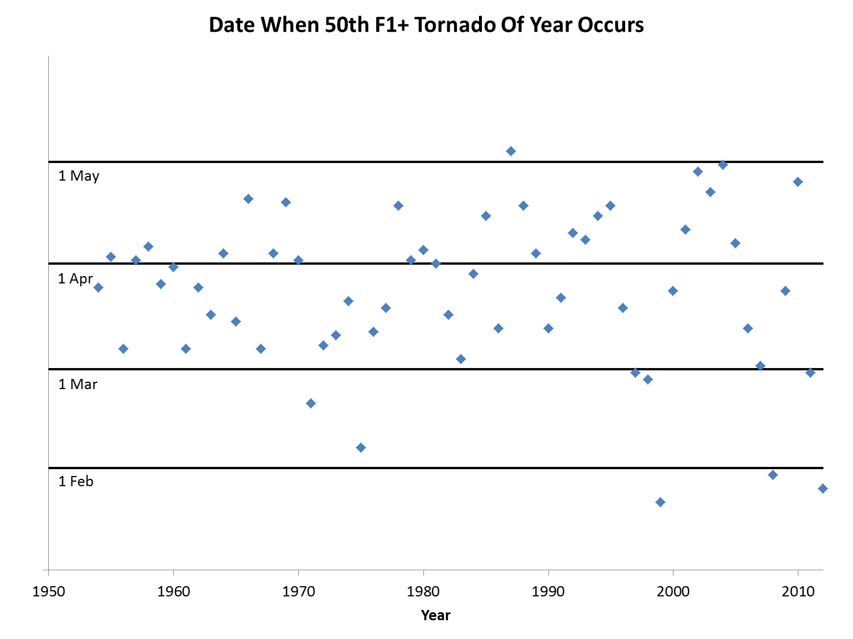

Slide 44
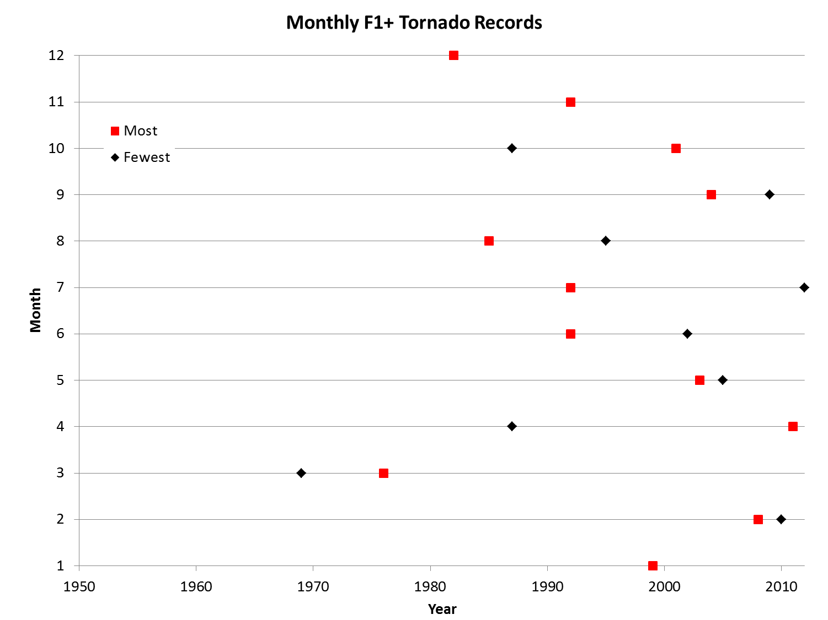

Slide 45
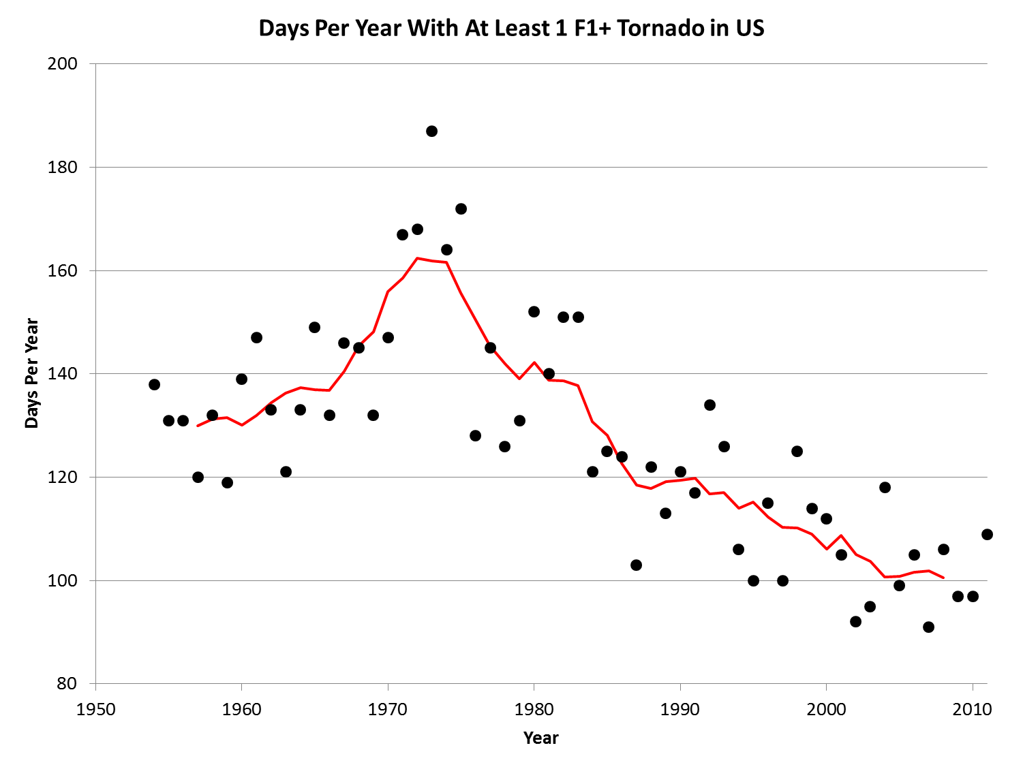
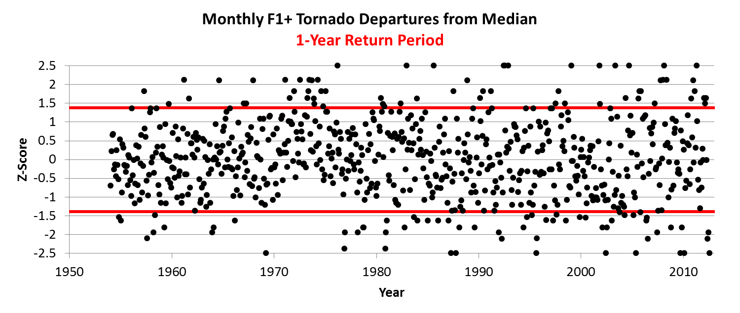
What has changed about tornado distributions?
Appearance of increased variability
  Starting date
  Since 2002, set or tied records for monthly F1+ extremes
    Max-4 (Feb 08, Apr 11, May 03, Sept 04)
    Min-6 (Jan 03, Feb 10, May 05, Jun 02, Jul 12, Sept 09)
Days per year (F1) decreased
More tornadoes on biggest days

Slide 46


Slide 47


Slide 48
Statistical model
Yes/no tornado on a day
Number of tornadoes on a day
Assumptions
  Distribution of T/T day is same throughout year
  No day-to-day correlation in tornado occurrence
Run for 1000 years

Slide 49


Slide 50


Slide 51

Max
696
848
698
766
899
Min
340
389
303
278
267

Slide 52


Slide 53
Closing thoughts
Applicability of US to rest of world?
  Thermodynamics dominated by boundary-layer moisture
  China may follow, but other locations may not show same
Improved modelling
  Need to improve environment-event relationships
  Higher resolution, better reanalyses
  Increased use of high-res models
Tornadoes appear to be more variable
  Fewer days, more on outbreak days

