Slide 1








Severe Thunderstorm Environments in the CMIP5 Ensemble
Noah S. Diffenbaugh
Department of Environmental Earth System Science
and
Woods Institute for the Environment
Stanford University

Slide 2
To be submitted any day now….

Slide 3

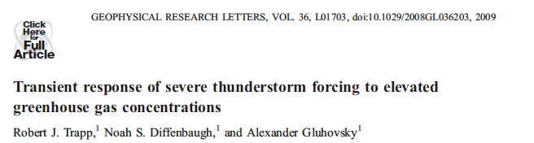
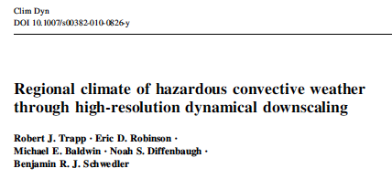
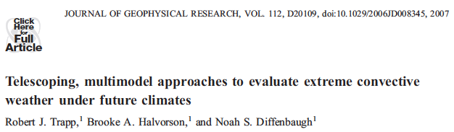
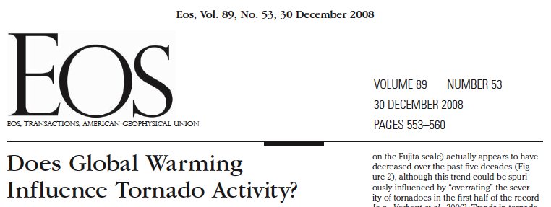


Slide 4
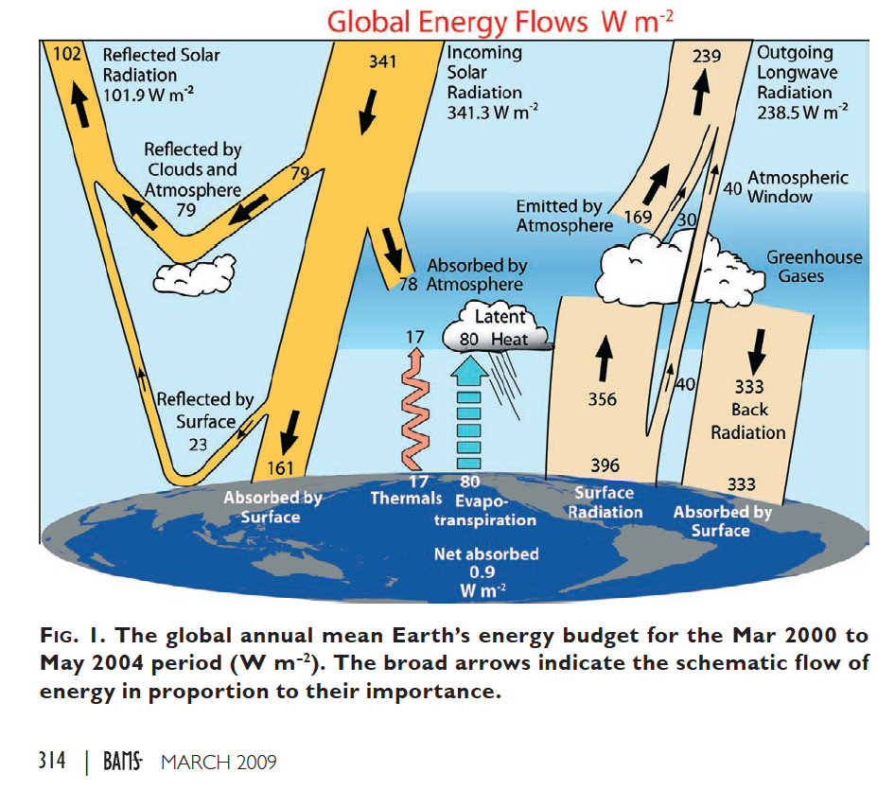
Trenberth et al., 2009

Slide 5
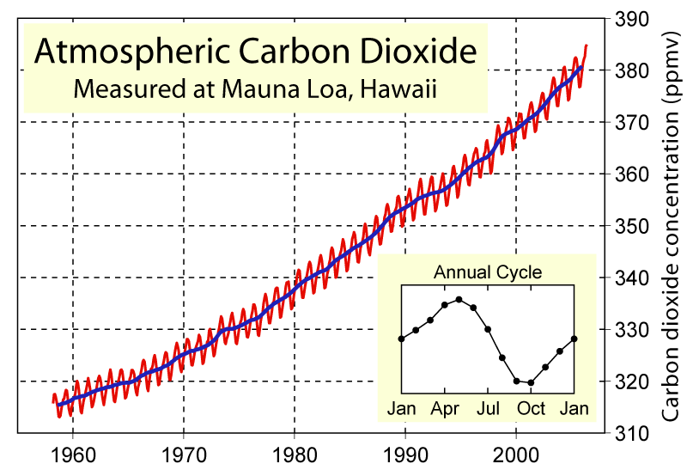
Keeling Curve
Global Warming Art

Slide 6
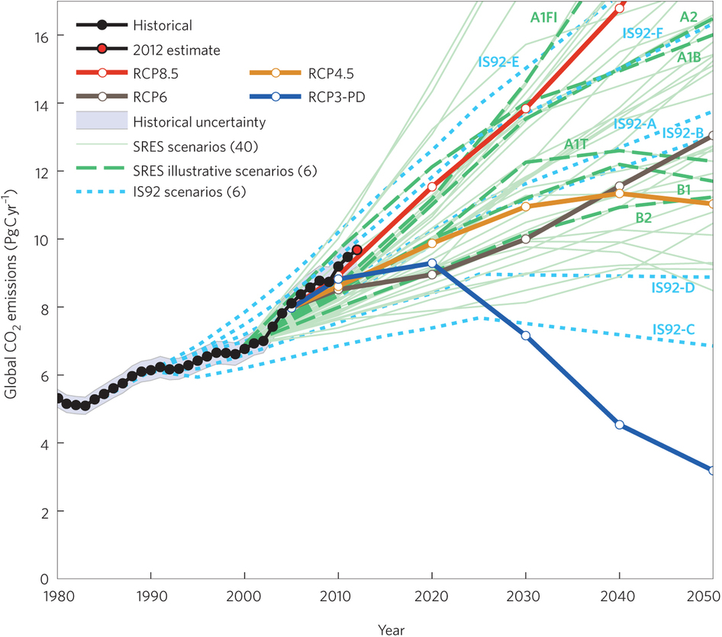
Peters et al., 2013

Slide 7
Some General Climate Questions
I. Has climate changed? (Observations)
II. Why has climate changed? (Observations and Climate Models)
  Detection & Attribution of Observed Changes
III. How will climate change if greenhouse forcing continues to increase? (Climate Models)
  Quantifying costs/benefits of climate change
  Adaptation/resilience planning
IV. What is required to “stabilize” climate? (Climate Models)
  Climate Change “Commitment”

Slide 8
Severe thunderstorms and tornados are one of the most persistent and prominent unknowns about the impacts of climate change on humans:
=> at the nexus of “high impact” and “complex physical dynamics”

Slide 9
Why have severe thunderstorms and tornados remained a prominent unknown about climate change?
Limitations of observational record
Conflicting expectations from theoretical arguments (increased CAPE and decreased shear)
  theoretical expectation also reflected in climate models
processes that are important for the realization of individual storms in the real atmosphere has remained mostly inaccessible in climate model experiments
    deficiencies in understanding, model development, and/or computational resources

Slide 10
Two modeling approaches to probing questions about climate change and severe thunderstorms:
“explicit” – e.g., Trapp et al. 2007 (JGR); Trapp et al. 2010; Mahoney et al. 2012; Gao et al. 2012
“implicit” – e.g., Del Genio et al. 2007; Marsh et al. 2007; Trapp et al. 2007 (PNAS); Trapp et al. 2009; Van Klooster and Roebber 2009; Lee 2012; Allen and colleagues

Slide 11
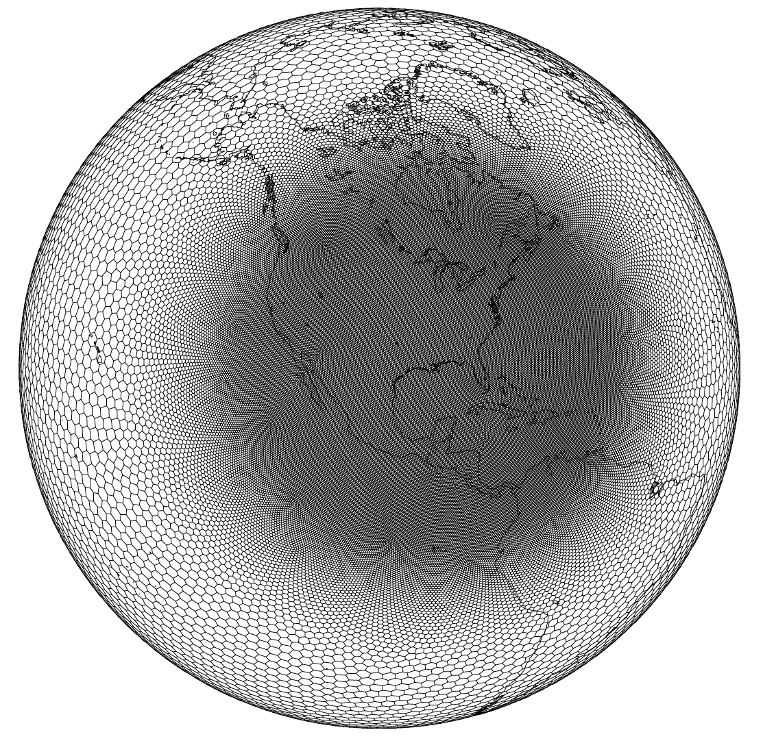
Approaches to High-Resolution Climate Modeling
LANL
Nesting is only due to computational limitations => we’d like to run the globe at non-hydrostatic resolutions.

Slide 12
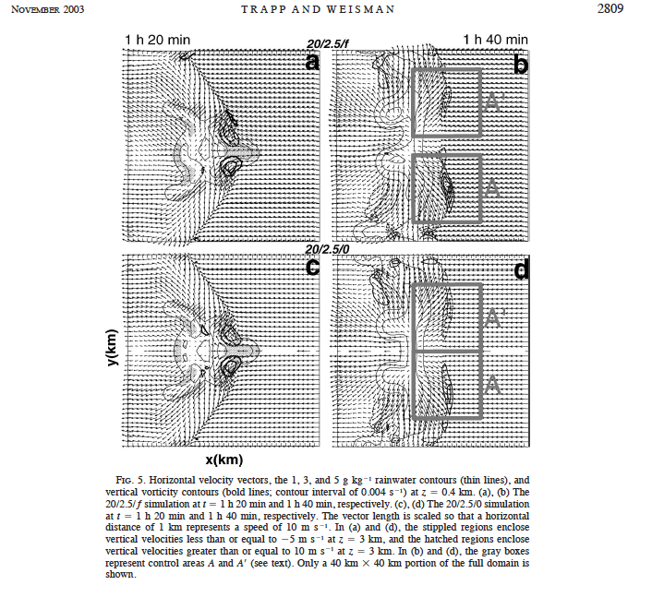
Explicit Approach
1-km horizontal resolution
Now 10-100m “cloud resolving” simulations, e.g. with WRF
How would one run a climate-scale experiment given available computing resources?

Slide 13
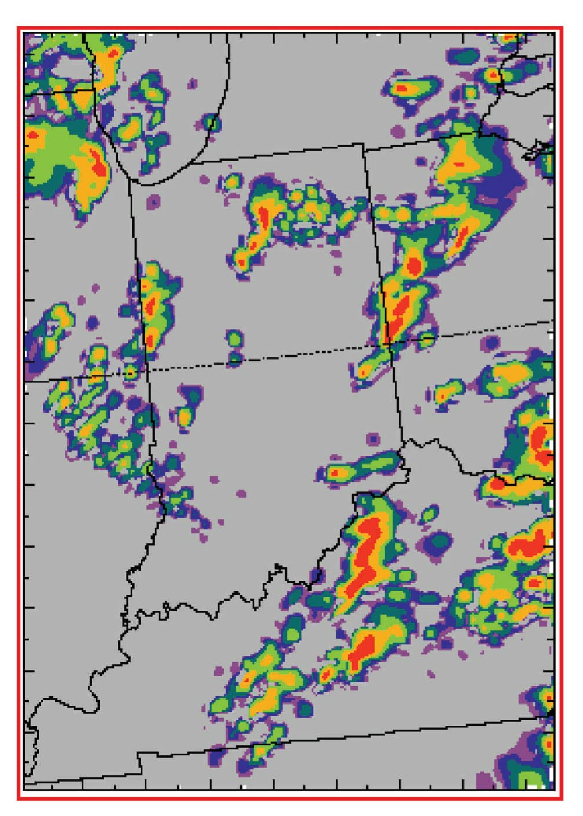
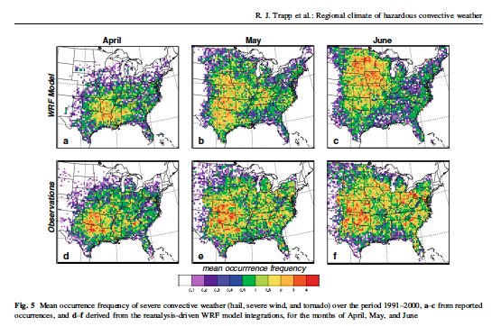
Individual Event
3-4 April 1974
3-km horizontal resolution
A Decade of Spring Seasons – 1991-2000
4.25-km horizontal resolution
Trapp, Halvorson, and Diffenbaugh, JGR, 2007
Trapp et al., Climate Dynamics, 2010

Slide 14
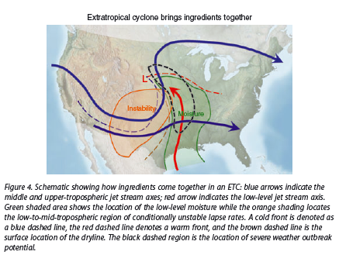
Implicit Approach
“Ingredients”
Doswell et al., 2012

Slide 15
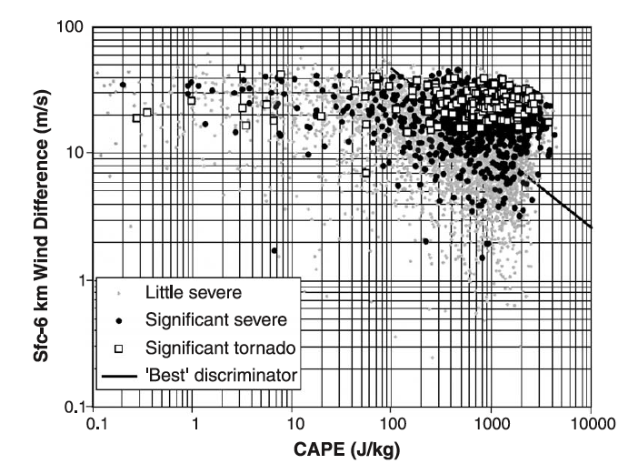
Brooks et al. 2003

Slide 16
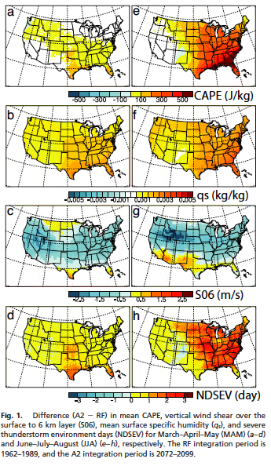
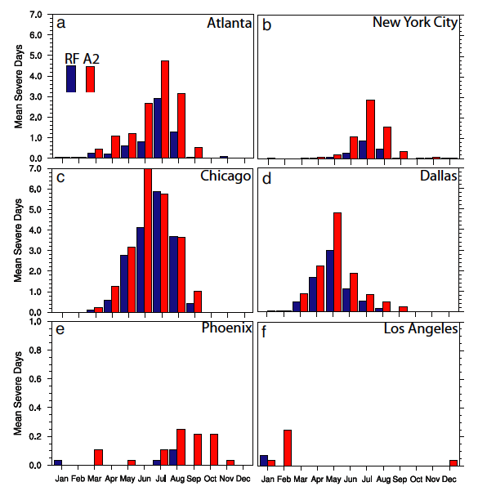
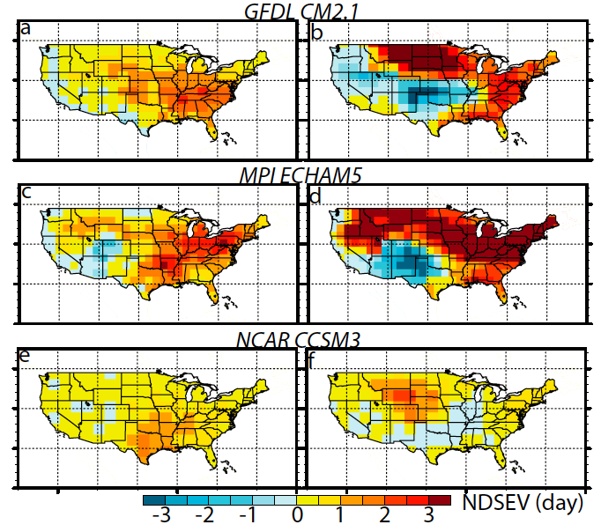
Spring
Summer
Spring
Summer
Trapp, Diffenbaugh, et al., PNAS, 2007

Slide 17
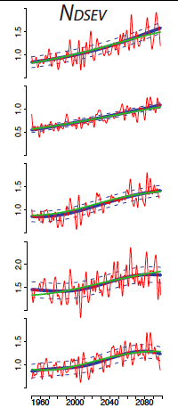
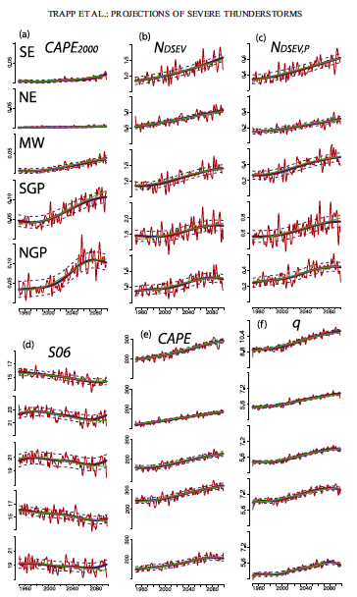
“high CAPE”
Screened for
Convective Precip
SE
NE
MW
SGP
NGP
1980
2040
2100
Trapp, Diffenbaugh and Gluhovsky, 2009

Slide 18
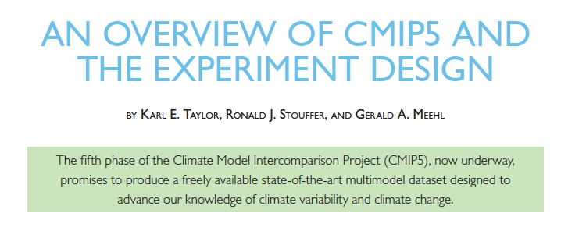
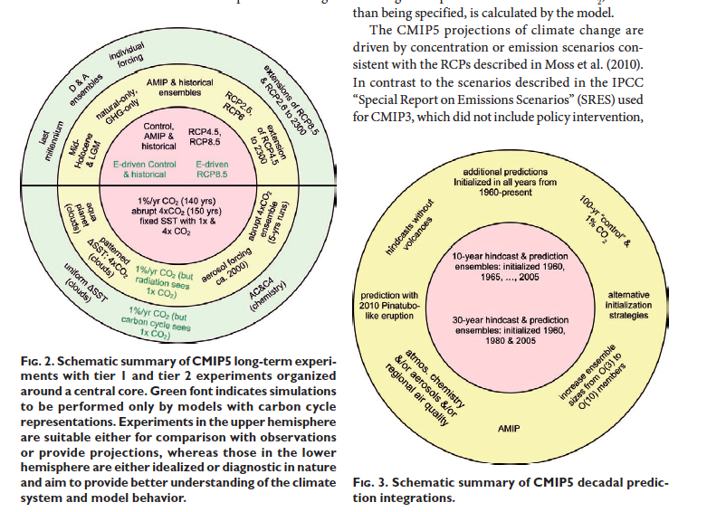
Analysis requires sub-daily, 3-d atmospheric variabbles
=> 10 GCMs

Slide 19
Eastern US
31-year running mean
Gray = individual realizations
Black = multi-model mean
Diffenbaugh et al., in prep

Slide 20
2070-2099 minus 1970-1999
divided by 1970-1999
x 100%
Black: S/N > 1
Gray: S/N > 2
Diffenbaugh et al., in prep

Slide 21
Black: S/N > 1
Gray: S/N > 2
2070-2099 minus 1970-1999
Diffenbaugh et al., in prep

Slide 22
Very little change in relative influence of CAPE and S06 on NDSEV variability
Diffenbaugh et al., in prep

Slide 23
Diffenbaugh et al., in prep

Slide 24
Diffenbaugh et al., in prep

Slide 25
At least 4 New Results (for Spring):
Increases in CAPE are robust, while decreases in S06 are not
Decreases in S06 are concentrated in low CAPE days, while increases in CAPE result in increased occurrence of high-CAPE/high-S06 and high-CAPE/high-S01
Increases in NDSEV emerge early in RCP8.5
Increases in NDSEV result from robust physical changes
But this is all “implicit” based on “ingredients”. The caveats associated with actual dynamics of severe storms persist.

Slide 26
Since Adam mentioned interest in potential for “event attribution”…..
This is actually what I was most interested in analyzing in CMIP5, but…
Requires sub-daily, 3-dimensional atmospheric fields for Pre-Industrial Control simulations
How might we approach this question if we had the necessary model output?

Slide 27
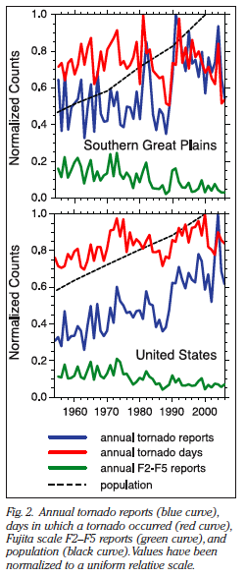
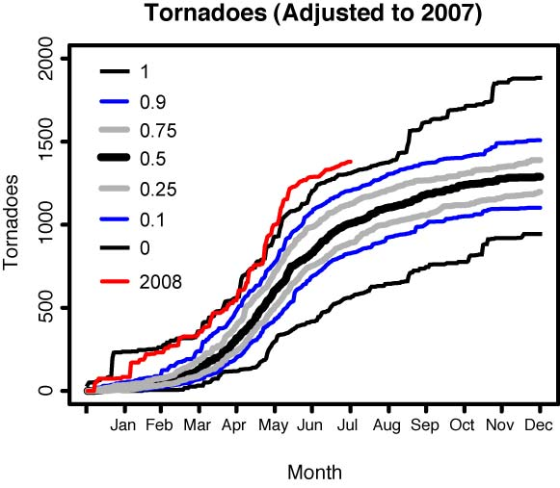
Annual U.S. Tornado Reports
Diffenbaugh et al., 2008

Slide 28
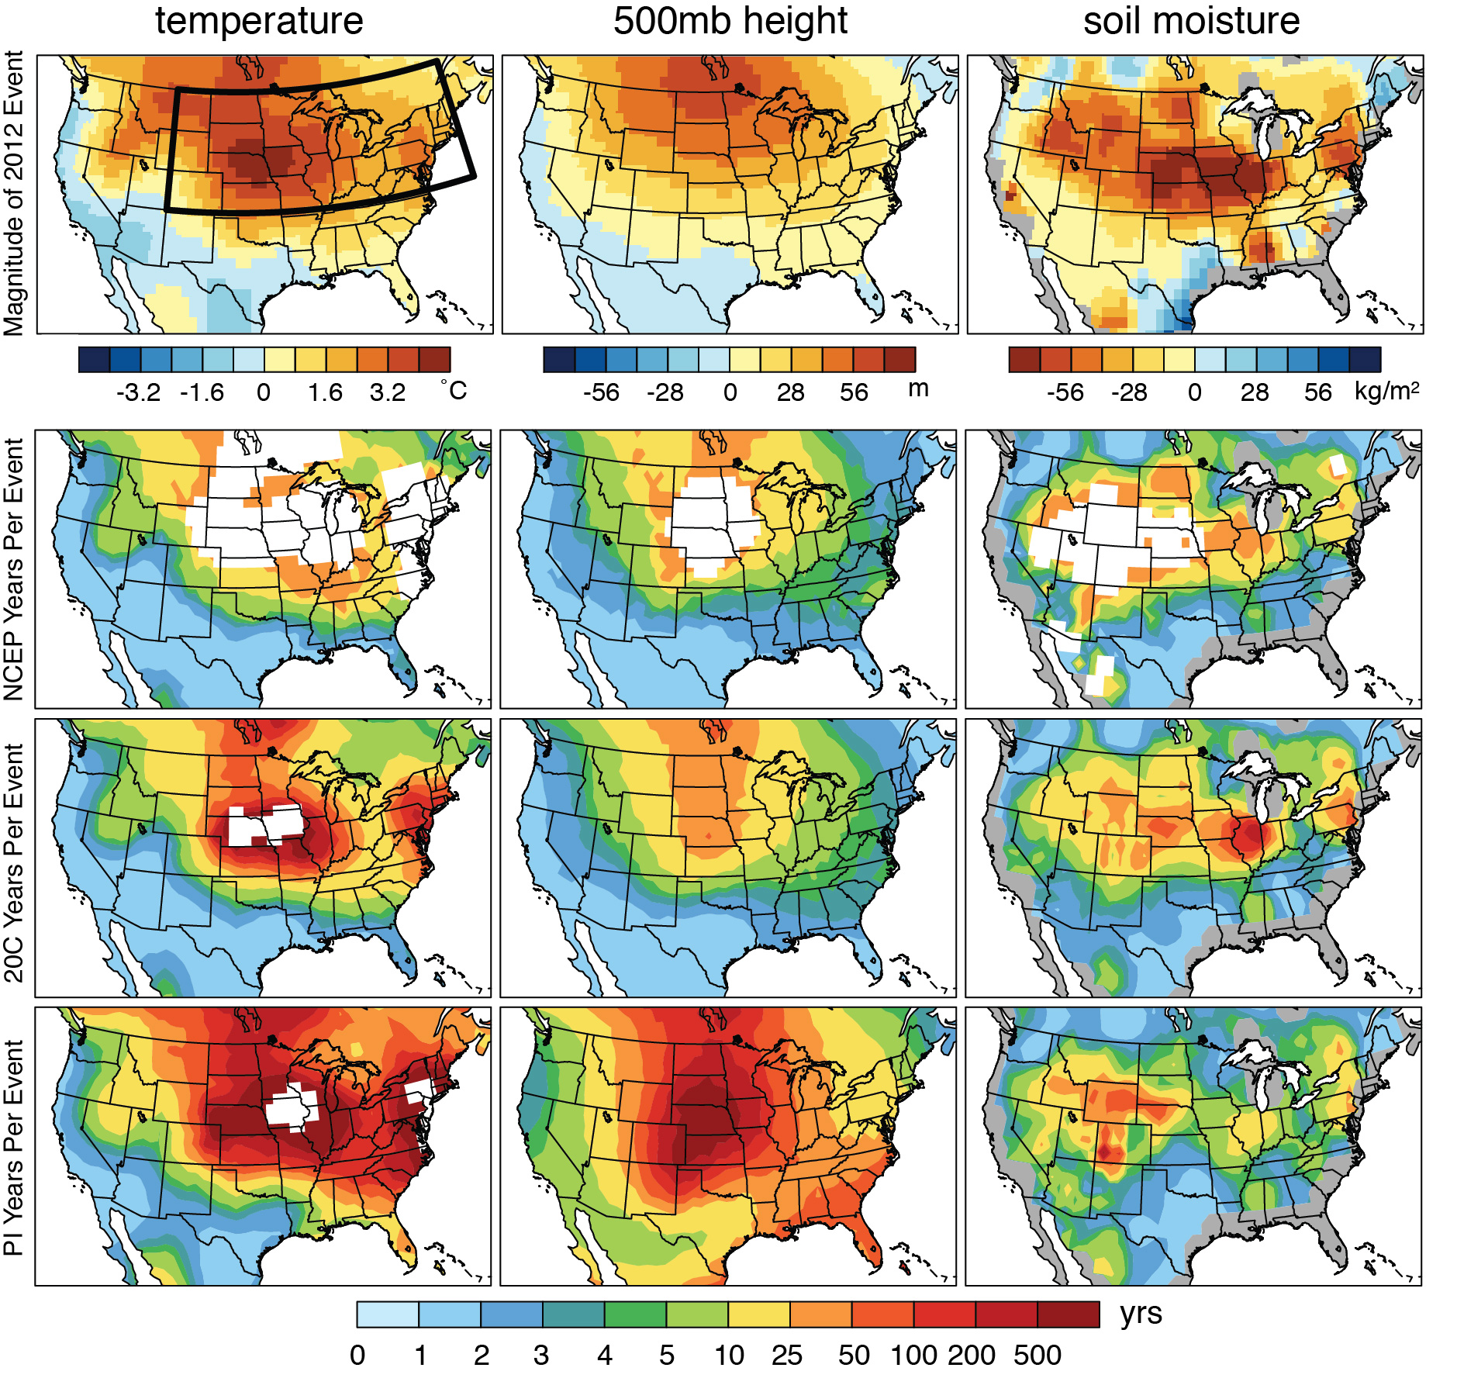
July 2012 anomaly
Occurrence of July 2012 in 1979-2011 of NCEP
Occurrence of July 2012 in 1979-2011 of CMIP5
Occurrence of July 2012 in Pre-Industrial Control of CMIP5
Diffenbaugh and Scherer, submitted to BAMS State of the Climate special issue

Slide 29
Thanks for Listening!
Questions?

Slide 30
CMIP5 “Validation”

Slide 31
Diffenbaugh et al., in prep

Slide 32
Diffenbaugh et al., in prep

Slide 33
Diffenbaugh et al., in prep

Slide 34
Diffenbaugh et al., in prep

Slide 35
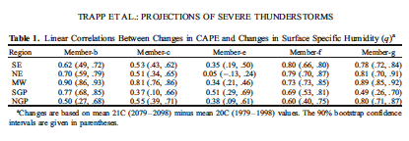
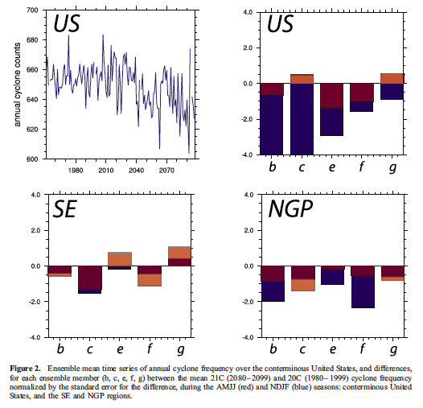
Trapp, Diffenbaugh and Gluhovsky, 2009

Slide 36
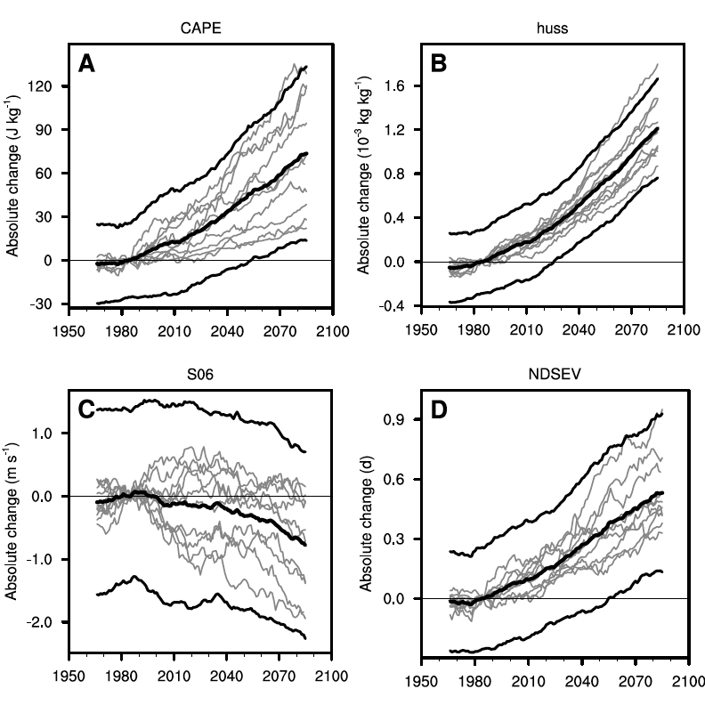

Slide 37
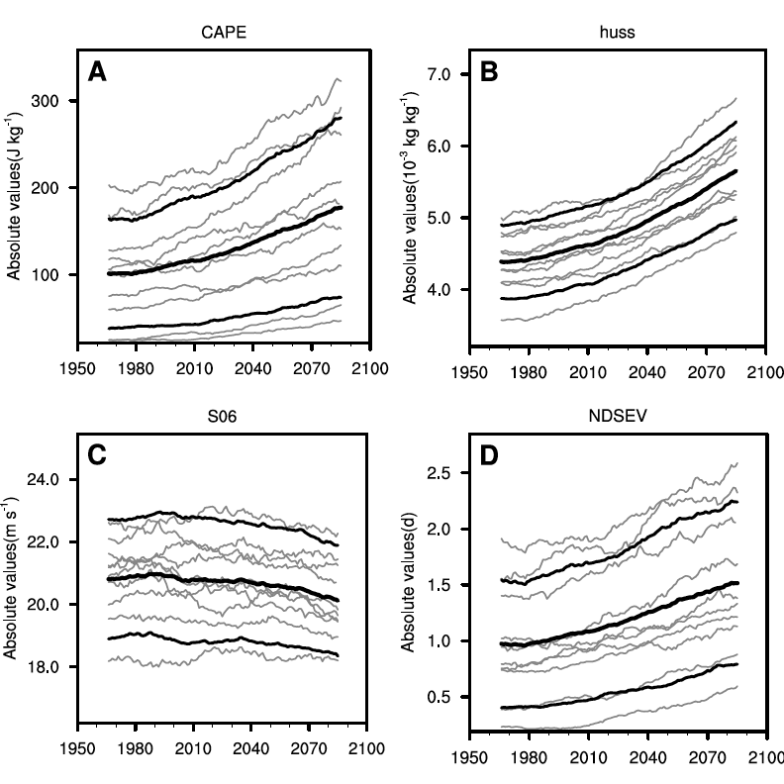

Slide 38
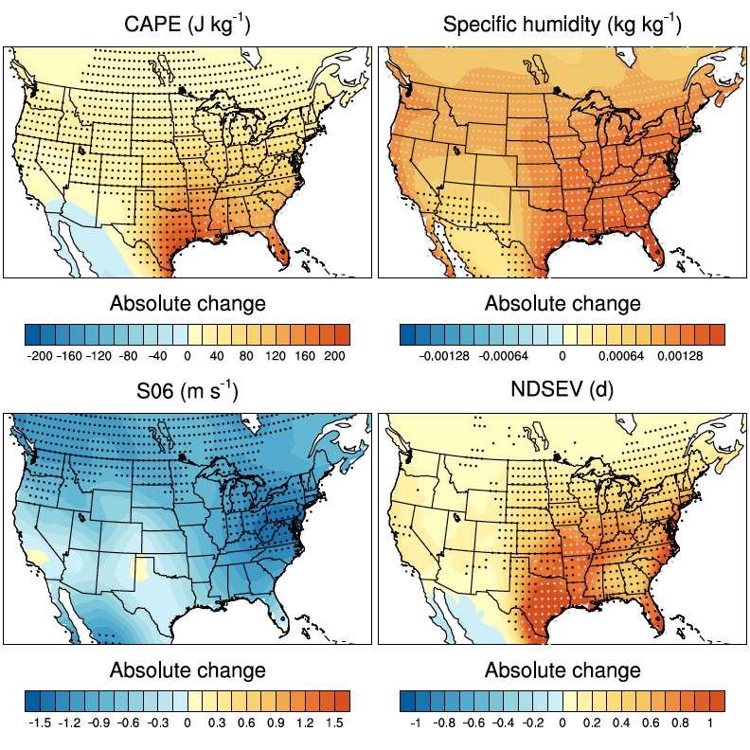

Slide 39
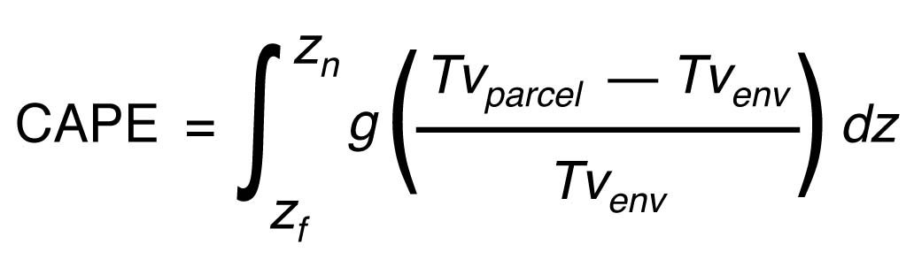

Severe Thunderstorm Environments
Convective Available Potential Energy (CAPE)
• Vertical Wind Shear
S6
Pole-equator temperature gradient
Thermal Wind Relation
Trapp et al., 2007
Brooks et al., 2003

