Slide 1
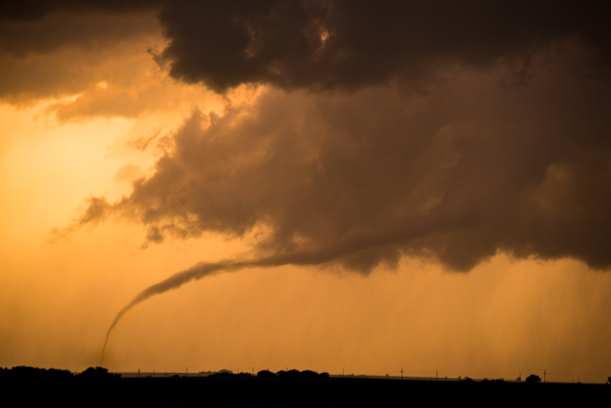
Tornado Frequency: Can we point the finger at ENSO?
John Allen jallen@iri.columbia.edu
Workshop on Severe Convective Storms & Climate
Lamont-Doherty Earth Observatory
Photo: John Allen

Slide 2
Where Do We Stand?
A ‘poisoned low-hanging fruit’
Perhaps some relationship to La Nina events and strong outbreaks over geographically limited areas (Bove 1998)
El Niño seems to have no positive correlation with the tornadic activity occurring anywhere in the U.S. (except possibly for very small regions). Even the strongest of the correlations are so weak that they have little prognostic value. (Marzaban & Schaefer 2001)
Winter (January-March) tornadoes spatially change depending on ENSO. However, neither the frequency of tornado days nor of violent tornado days appears to be related to ENSO phase over the entire US. (Cook & Schaefer 2008)

Slide 3
Where Do We Stand?
Not pre-supposing an SST pattern, there appears to be modes representing several oscillations including ENSO in the signal related to the precipitation from the LLJ (Weaver et al. 2012)
Tornado days via environmental proxy reinforces the ENSO winter link, little significance in spring, relationship between SSTs and parameters still unsure and clouds seasonal forecast potential. (Pegion et al. 2012)
TNI only explains 10% of total variance in April, May tornadoes – predictability relative to climate noise is low and is reliant on a weak correlation (Lee et al. 2012)
Is the linkage being pursued too complex in its ingredient interplay or is ENSO just not that important due to phase alignment/other factors?

Slide 4
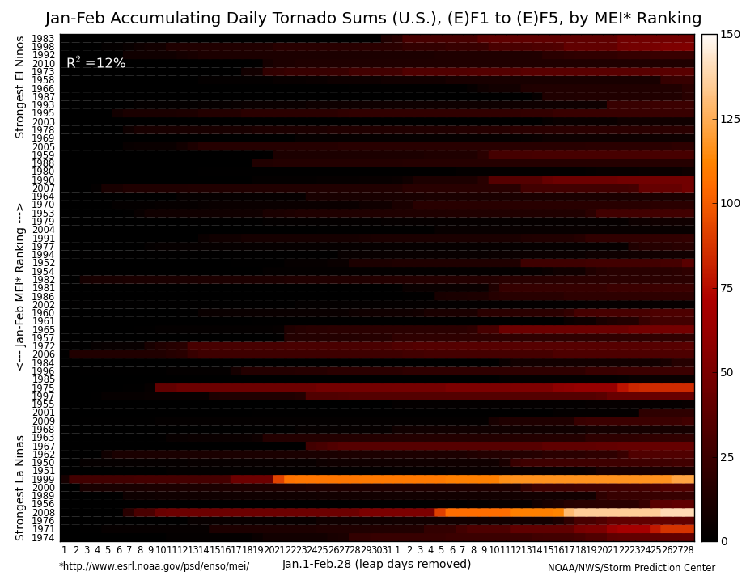
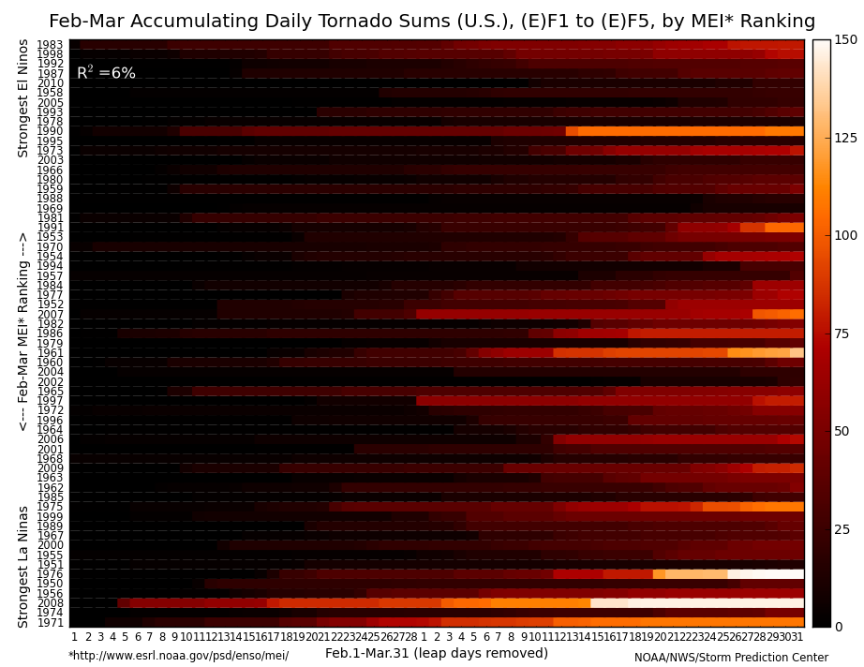
Observational Climatology
Few successes in finding relationships (Cook and Schaefer 2008 and Jan, Feb, Mar. tornadoes).
4-tier classification for JFM 1979-2011 (ONI, SOI, BEST, MEI):
El Nino Years – 83,87,88,92,95,98,03,10 La Nina Years – 85,89,99,00,01,08,09,11
Figure Credits: Greg Carbin

Slide 5
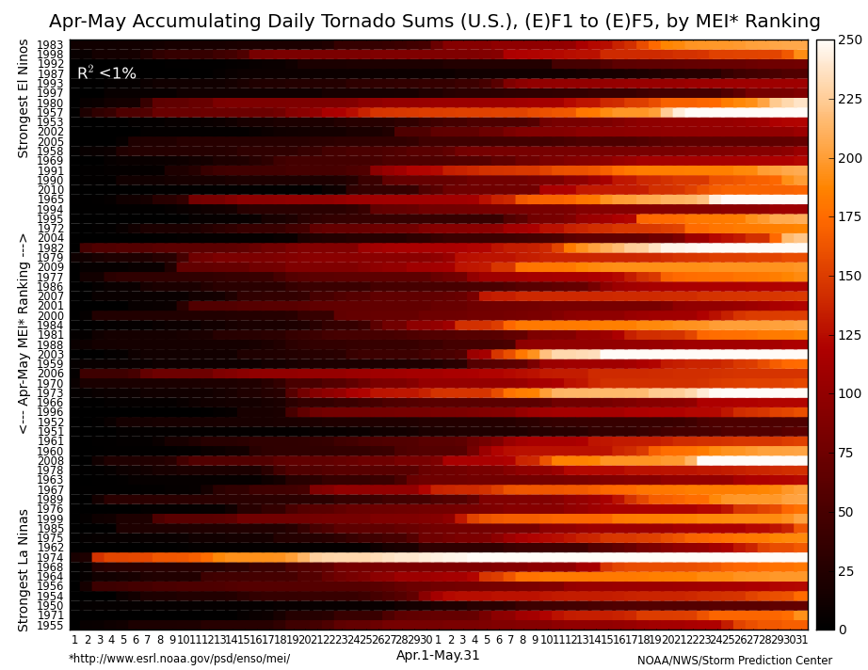
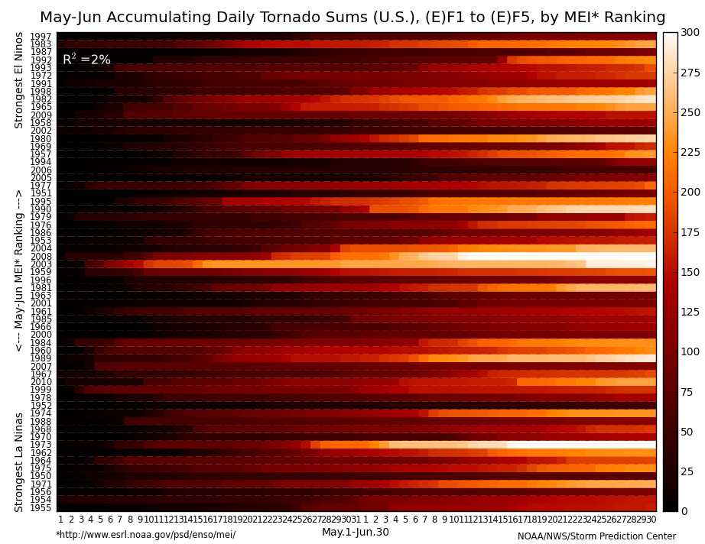
Observational Climatology
Weak ENSO signal in AM and few samples creates a difficult prospect.
4-tier classification for AMJ 1979-2011 (ONI, SOI, BEST, MEI):
El Nino Years – 83,87,92,97 La Nina Years – 85,89,99,2011
Figure Credits: Greg Carbin

Slide 6
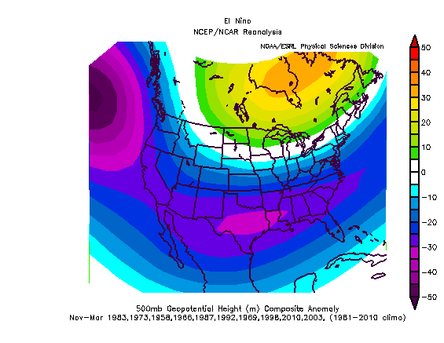
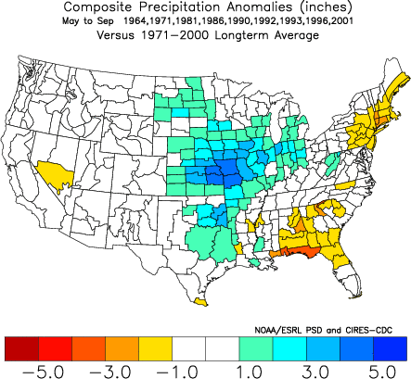
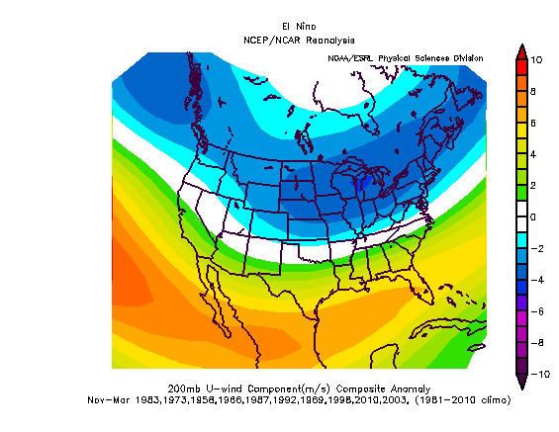
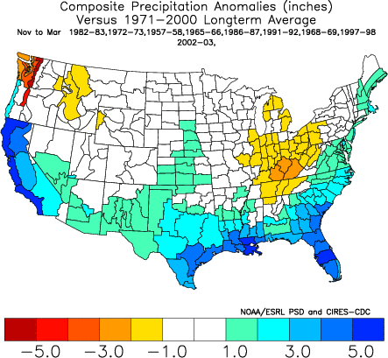
Stepping Back – Environment Implications (1)
El Nino Summer
El Nino Winter

Slide 7
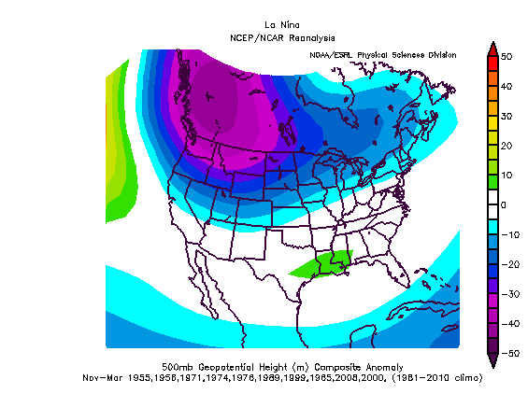
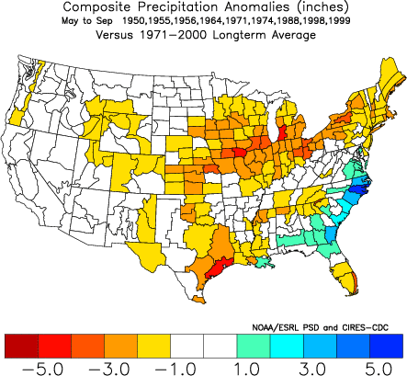
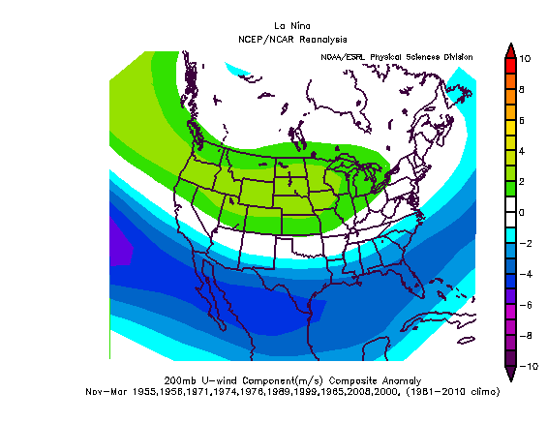
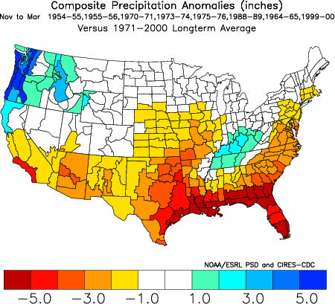
Stepping Back – Environment Implications (2)
La Nina Summer
La Nina Winter

Slide 8
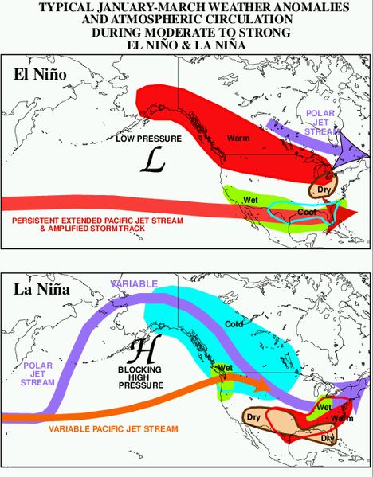
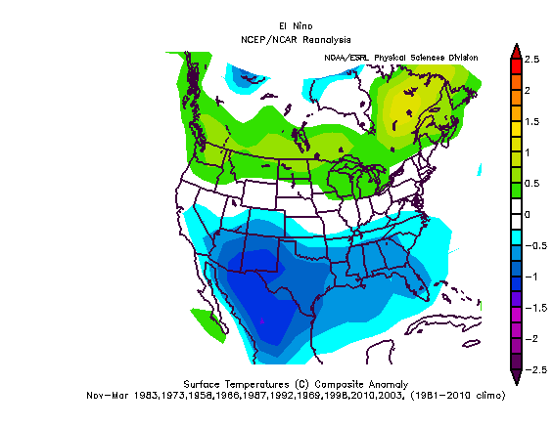
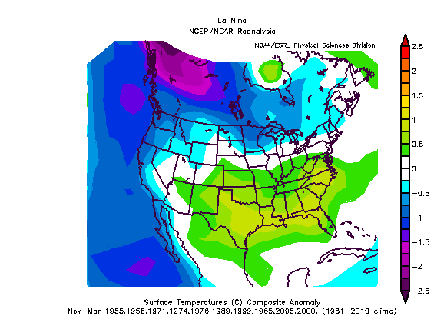
Stepping Back – Environment Implications (3)

Slide 9
Environmental/Index Composites (1)
Allen and Karoly 2013

Slide 10
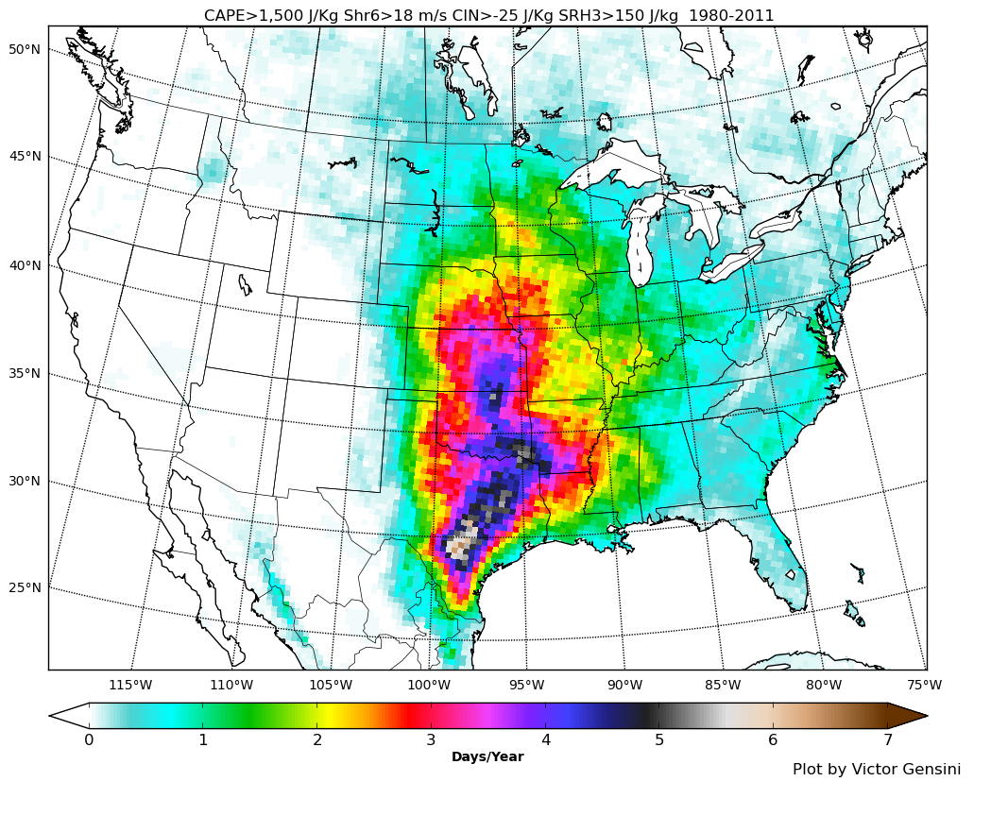
Environmental/Index Composites (2) - SCP
Figure Credit: Victor Gensini

Slide 11
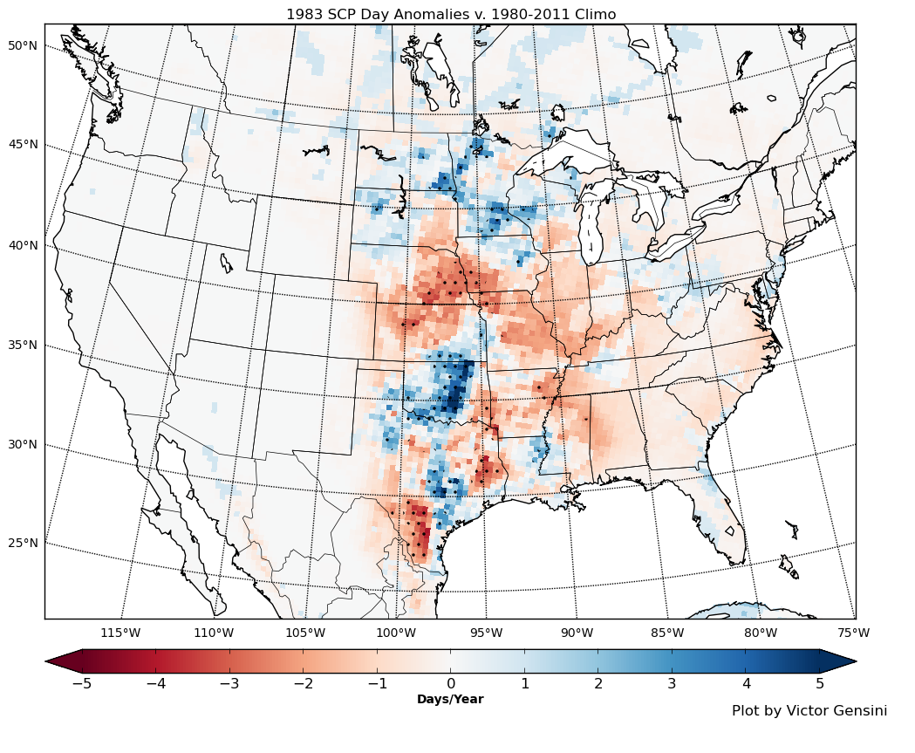
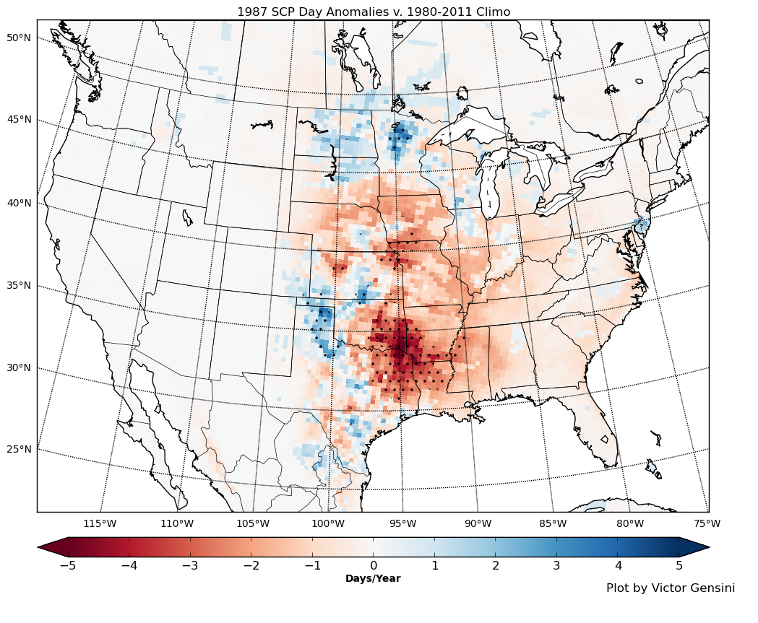
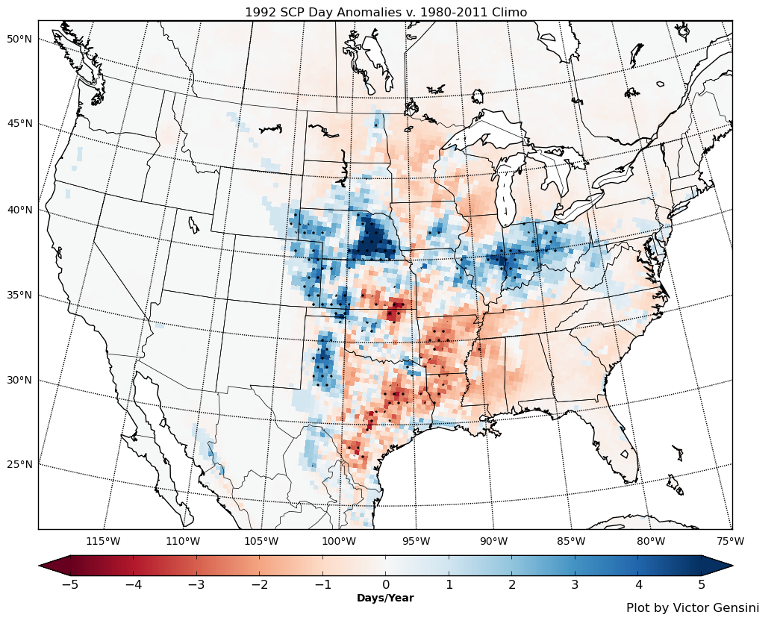
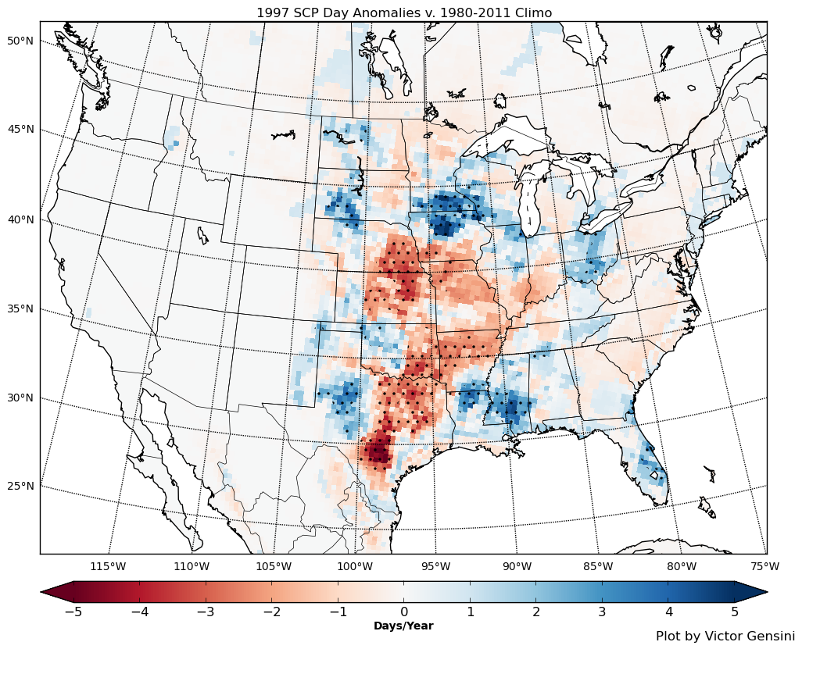
Environmental/Index Composites (3) – El Nino Anomalies (83,87,92,97)

Slide 12
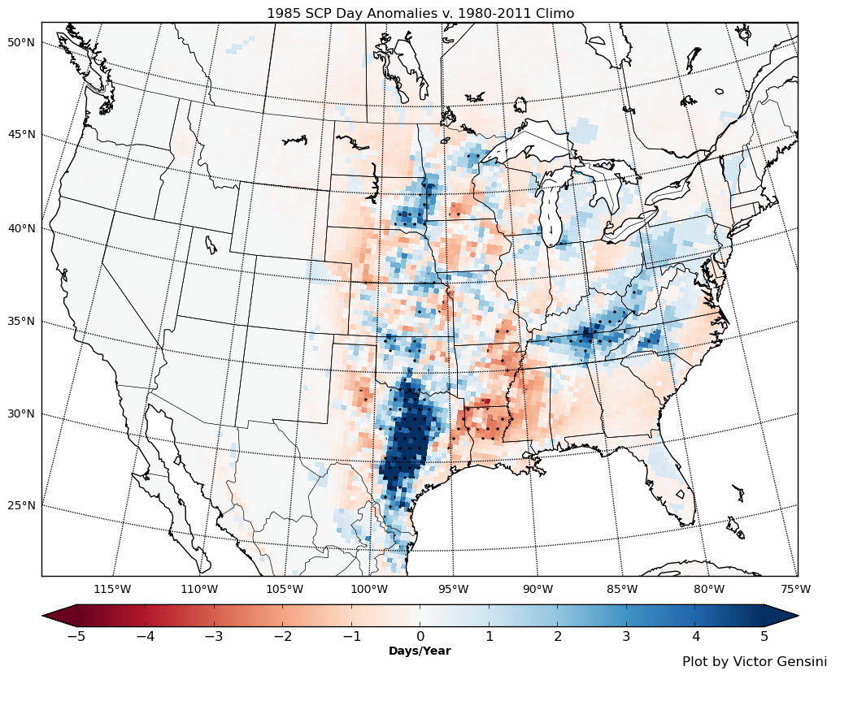
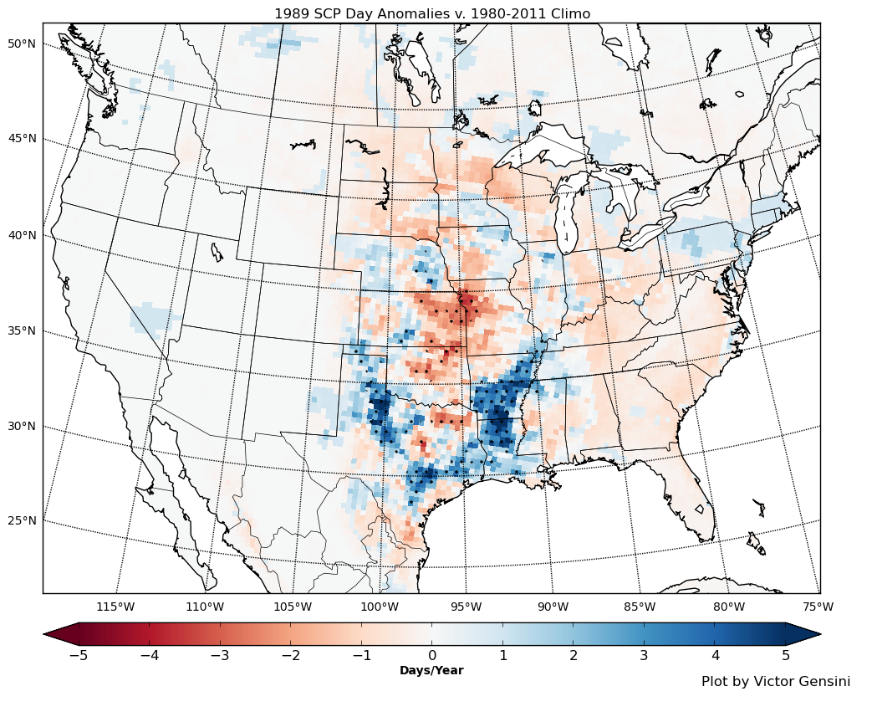
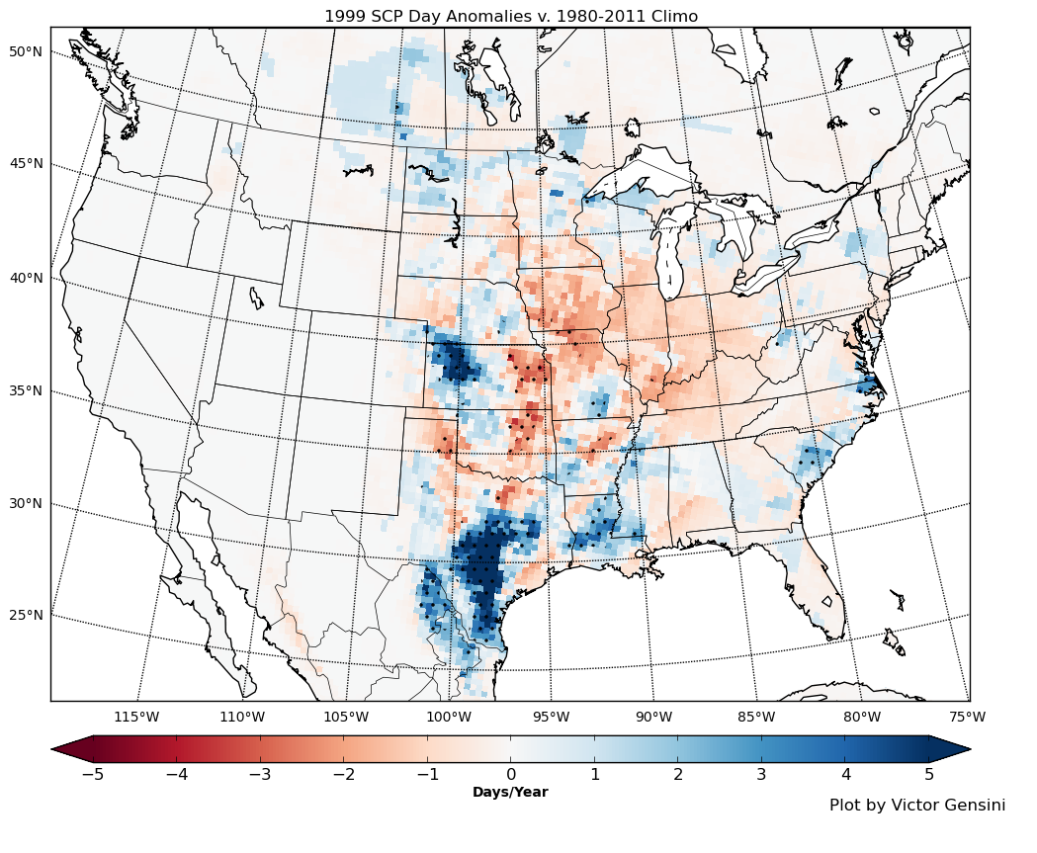
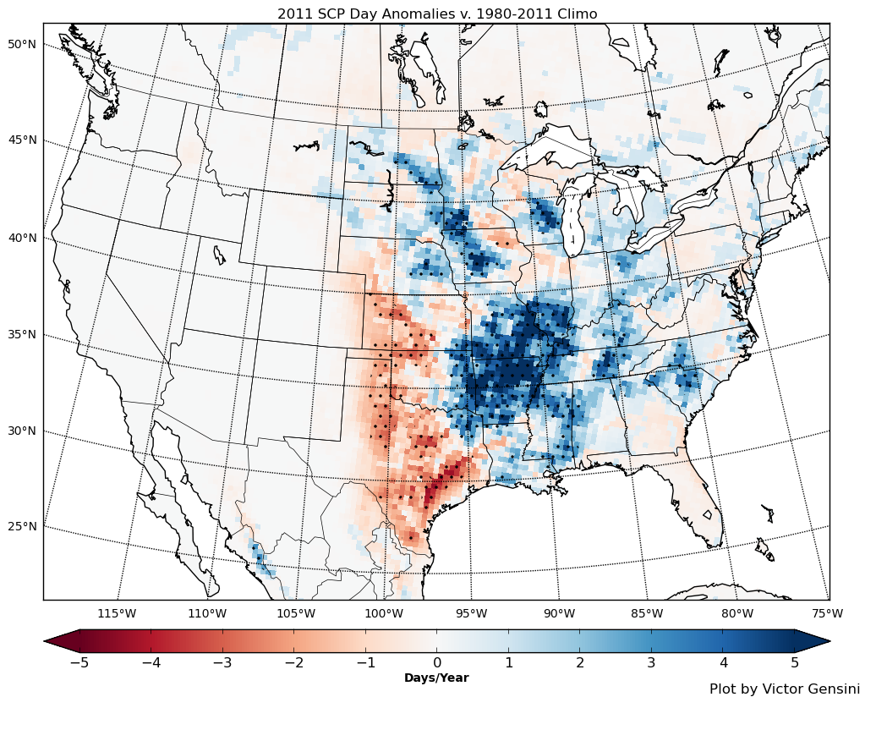
Environmental/Index Composites (4) – La Nina Anomalies (85,89,99,11)

Slide 13
The Road Forward
‘The adequacy of a sample for a hypothesis is related to its variability, where variability is high the greater the sample required to prove the hypothesis – many such samples are needed when artifacts convolute the data used unless the signal is unusually strong’. Doswell 2007
The sample size for stronger tornadoes and its relationship to climate scale events is a dangerous game of a small sample being used while looking for a quick explanation to a complex multifaceted relationship.
The daily and inter-annual variability of the component ingredients relating to major tornado events (and indeed most tornado events) is high – seasonal and monthly values may gloss over relationships.
Far better to look at environmental approaches – applying Brooks et al. 2003 is a good start – better fitting of the indices is required as is an understanding of their necessity in the pre-tornadic supercell environment.
Perhaps a step back towards basic contributing variables is needed to avoid the issues with the derived CAPE, Convective precipitation, CIN resulting from parameterization.

Slide 14
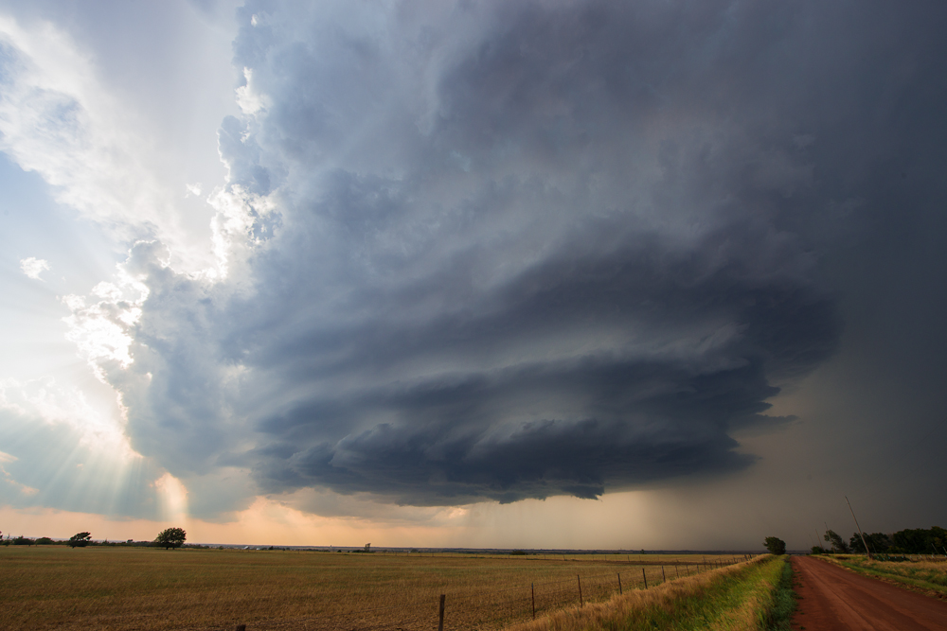
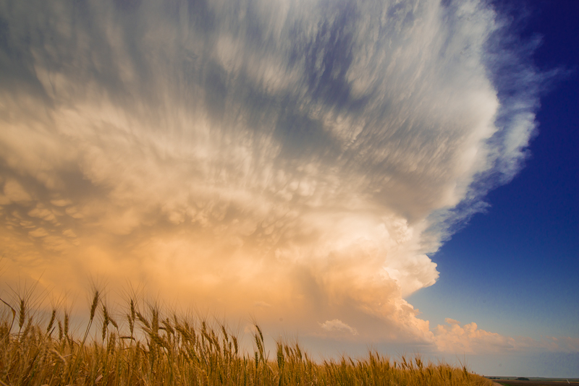
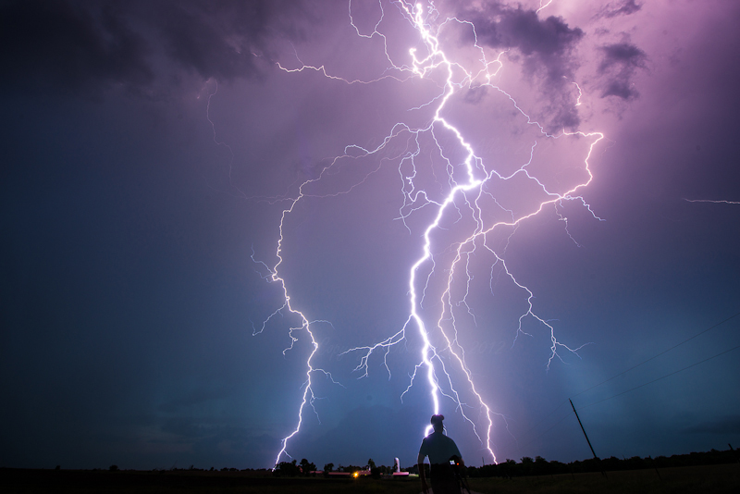
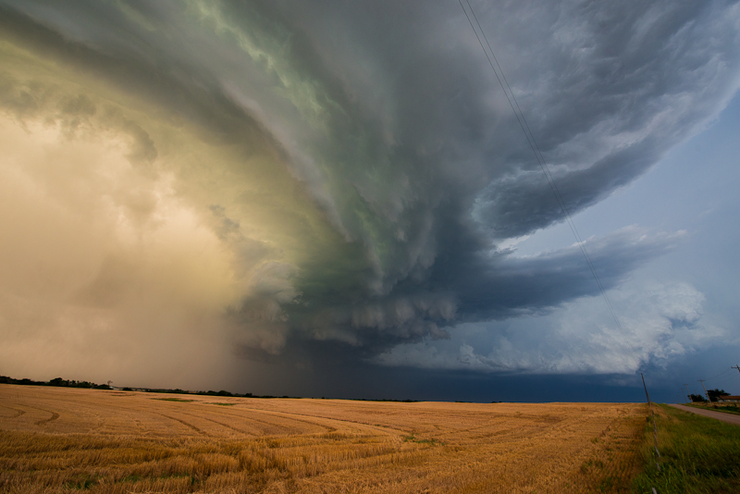
jallen@iri.columbia.edu
Photos: John Allen

