Slide 1
Perspectives for extended-range prediction and predictability
  Michael K. Tippett^{1,2}, Adam H. Sobel^{3,4} and Suzana J. Camargo⁴
¹ International Research Institute for Climate and Society, Columbia University, Palisades, NY
²Center of Excellence for Climate Change Research, Department of Meteorology, King Abdulaziz University, Jeddah, Saudi Arabia
³ Department of Applied Physics and Applied Mathematics and Department of Earth and Environmental Sciences, Columbia University, NY, NY
⁴Lamont-Doherty Earth Observatory, Columbia University, Palisades, NY
Severe Convection & Climate Workshop, 14-15 March 2013

Slide 2
Main points
Likelihood of severe weather events can be related to environmental conditions or “ingredients.”
Those ingredients are predictable to some extent.
Therefore
The index can be predicted with some skill
Possibility of:
  Monthly forecasts?
  Extended-range forecasts?

Slide 3
Main points (Business version)
Tornado activity can be predicted with modest skill up to a month in advance.
Because
Likelihood of severe weather events can be related to the environmental conditions or “ingredients.”
Those ingredients are somewhat predictable.
The predicted index has some skill.

Slide 4
A monthly index for the number of U.S. tornadoes
Index = exp(c0 + c1 x SRH + c2 x cPrcp )
  Monthly averages
Estimate 3 constants from annual cycle data
  No annually varying data used to select parameters or fit constants
  No forecast data used. “Prefect prognosis”
Index = Expected number of tornadoes/month
  1x1 degree grid
  All tornadoes (>F0).

Slide 5
Forecasts with the NOAA Climate forecast system (CFSv2)

Slide 6




Operational Configuration for CFSv2 real time forecasts (T126L64)
There will be 4 control runs per day from the 0, 6, 12 and 18 UTC cycles of the CFS real-time data assimilation system, out to 9 months.
In addition to the control run of 9 months at the 0 UTC cycle, there will be 3 additional runs, out to one season. These 3 runs per cycle will be initialized as in current operations.
In addition to the control run of 9 months at the 6, 12 and 18 UTC cycles, there will be 3 additional runs, out to 45 days. These 3 runs per cycle will be initialized as in current operations.
There will be a total of 16 CFS runs every day, of which 4 runs will go out to 9 months, 3 runs will go out to 1 season and 9 runs will go out to 45 days.
0 UTC
6 UTC
12 UTC
18 UTC
9 month run (4)
1 season run (3)
45 day run (9)

Slide 7
CFSv2 hindcasts
1982-2010
First month lead
16 ensemble members (9-24)
Forecast June average = start from May 21, May 26, May 31 and June 5
Same index constants (no MOS)

Slide 8
Climatology

Slide 9
April indices

Slide 10
April parameters

Slide 11
May indices

Slide 12
May parameters

Slide 13
June indices

Slide 14
June parameters

Slide 15
Forecast skill of the ingredients and index
First-lead CFS monthly forecasts of
ingredients and index

Slide 16
Correlation between index and observed number CONUS
 | Jan | Feb | Mar | Apr | May | Jun | Jul | Aug | Sep | Oct | Nov | Dec
NARR | 0.75 | 0.64 | 0.54 | 0.50 | 0.60 | 0.67 | 0.75 | 0.40 | 0.15 | 0.25 | 0.48 | 0.74
CFSv2 | 0.36 | 0.38 | 0.30 | 0.35 | 0.31 | 0.72 | 0.59 | 0.41 | -0.25 | 0.18 | 0.41 | 0.37

Slide 17
Notes:
An indication of the potential utility of CFSv2 for monthly forecasts of severe weather.
Scatter plot of observed and 0-month-lead CFSv2 forecast model-based predicted number of June CONUS tornadoes 1982–2010. The 2-digit number indicates the year.
Correlation (Pearson or rank) is 0.7.
Forecast June average = starts from May 21, May 26, May 31 and June 5.
Index depends on SRH and convective precp. “Perfect prog” developed with NARR annual cycle only data.

Slide 18
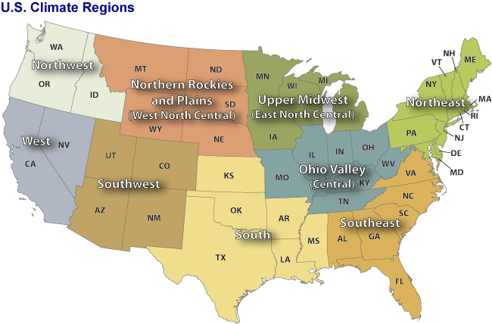

Slide 19
Regional correlations
 | Jan | Feb | Mar | Apr | May | Jun | Jul | Aug | Sep | Oct | Nov | Dec
South | 0.16 | 0.36 | 0.29 | 0.05 | 0.28 | 0.51 | 0.09 | 0.34 | 0.05 | 0.30 | 0.29 | 0.33
Southeast | 0.22 | 0.24 | 0.00 | 0.41 | 0.66 | 0.25 | -0.01 | 0.00 | 0.49 | 0.26 | 0.45 | 0.47
Central | 0.47 | 0.50 | 0.64 | 0.23 | 0.37 | 0.45 | 0.42 | 0.05 | 0.19 | 0.03 | 0.24 | 0.42
Midwest |  |  | -0.12 | 0.58 | 0.15 | 0.67 | 0.39 | 0.42 | 0.02 | 0.39 | -0.04
Plains |  |  | 0.12 | 0.37 | 0.40 | 0.50 | 0.53 | 0.27 | -0.03 | 0.03
Northeast |  |  |  | 0.15 | 0.05 | 0.15 | 0.41 | 0.18 | 0.70 | 0.15 | -0.02
Southwest |  |  |  | 0.02 | -0.10 | 0.32 | 0.04 | -0.01 | -0.44 | 0.30
Northwest |  |  |  | -0.14 | 0.15 | 0.30 |  | 0.19
West |  | 0.21 | 0.34 | 0.13

Slide 20
Toward extended-range forecasts

Slide 21
Data practicalities
Even for monthly activity forecasts high-frequency data is needed
  e.g., running 30-day averages
  Explore different averaging windows and lead times
Substantial amount of data
  Real time > 1TB/ week
  Not all hindcast variables readily available
    Scott Weaver, Wanqui Wang
Started looking at the real time data in Dec 2012

Slide 22
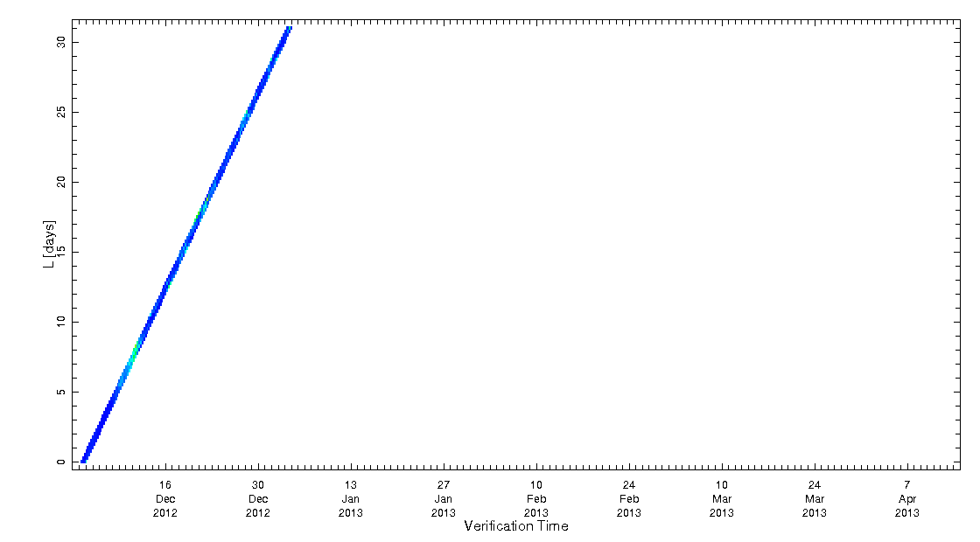
“Chiclet Chart”
Greg Carbin, SPC
CFS CONUS index total

Slide 23
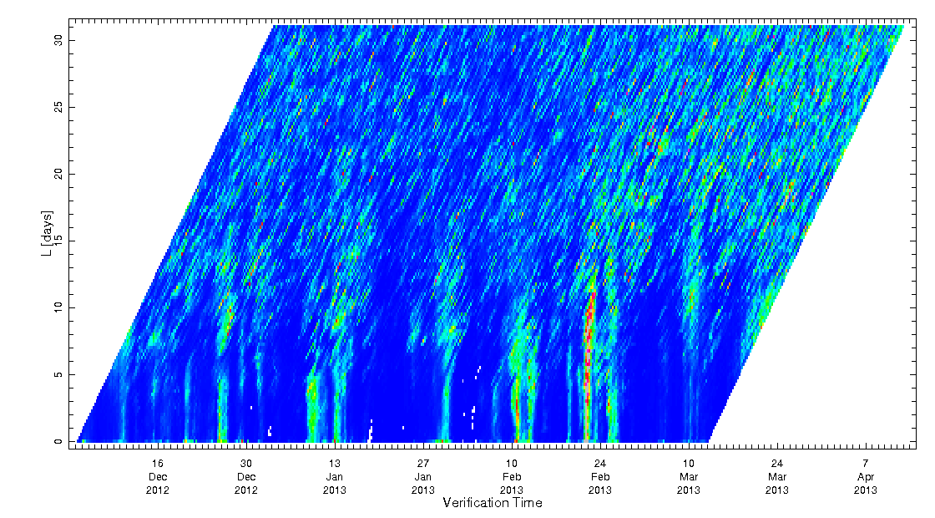
“Chiclet Chart”
Greg Carbin, SPC
CFS CONUS index total

Slide 24
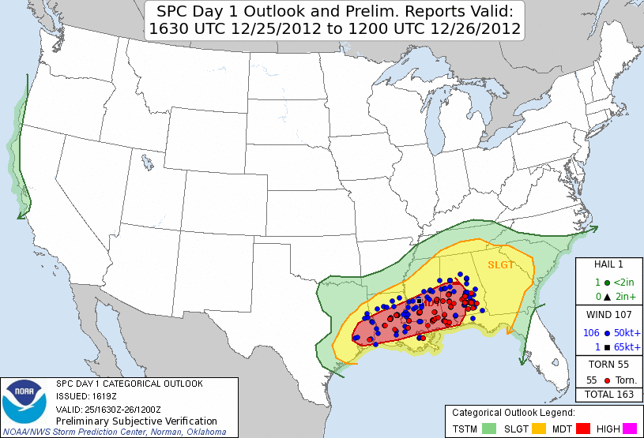
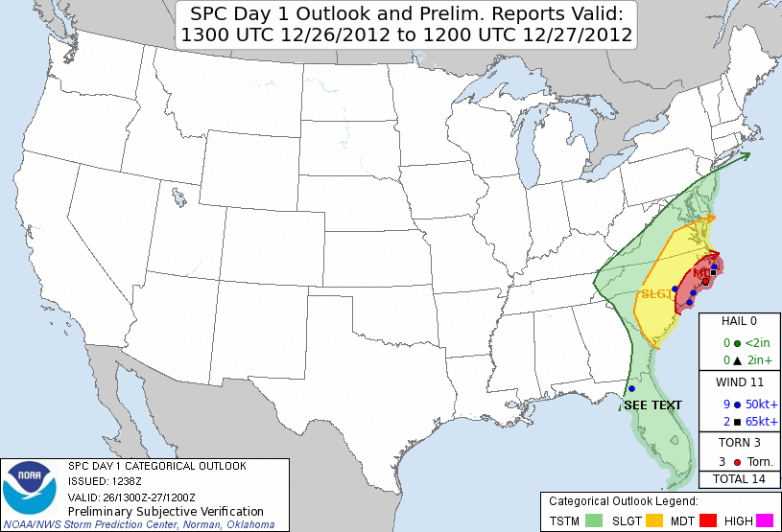
Dec 25-26, 2012

Slide 25
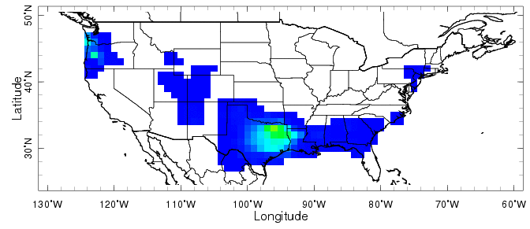
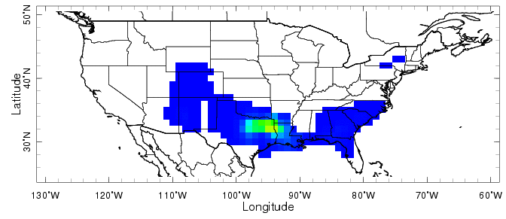
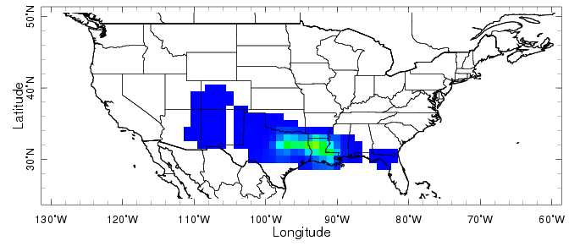
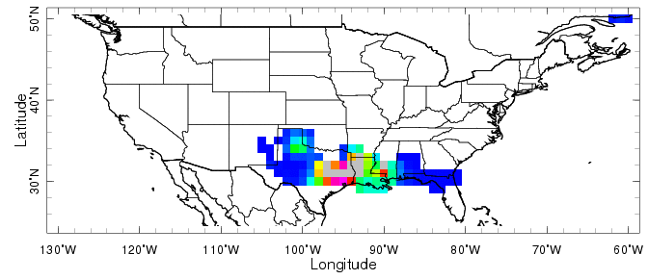
Lead = 4 days
Lead = 2 days
Lead = 1 day
Lead = 0 days

Slide 26
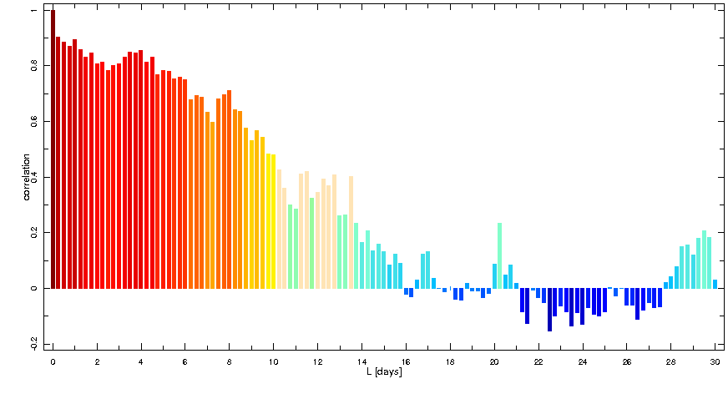
Correlation. Really?

Slide 27
Future
Hindcasts
  Data issues
Activity vs. event forecasts
  Lead-time?
  Averaging window
    Weeks?
    Season?
Sources of predictability?

Slide 28
Conclusions
Some association between environmental parameters and tornado activity on monthly time-scales.
  Climatological variability
  Interannual variability
Tornado “index” is a potentially useful tool for:
  Attributing observed variability
  Extended-range prediction
  Climate projections

