Slide 1

Storm Prediction Center
Severe Weather Outlooks, Tools, & Verification
Greg Carbin, Warning Coordination Meteorologist
NOAA/National Weather Service
Storm Prediction Center

Slide 2
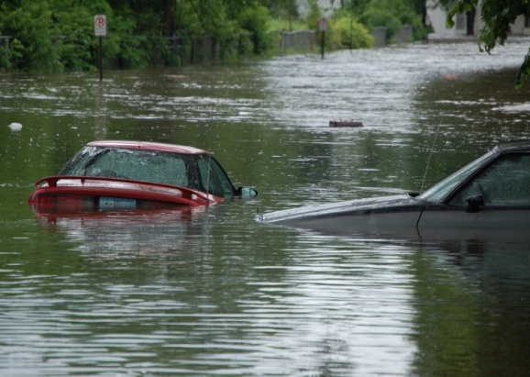
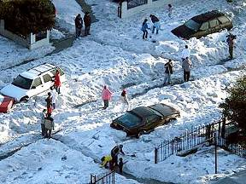
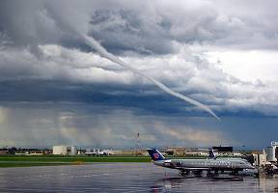
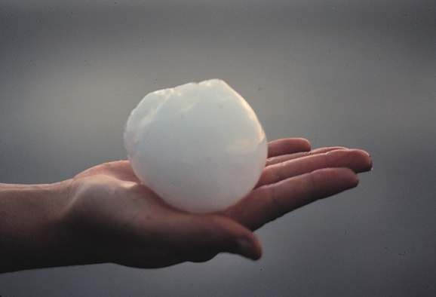
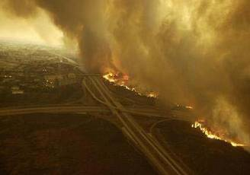
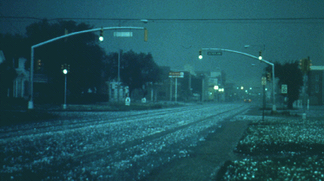
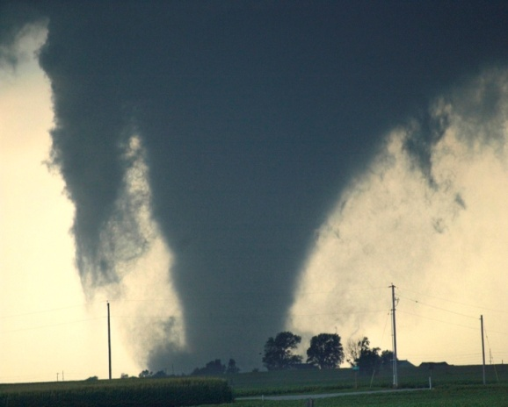
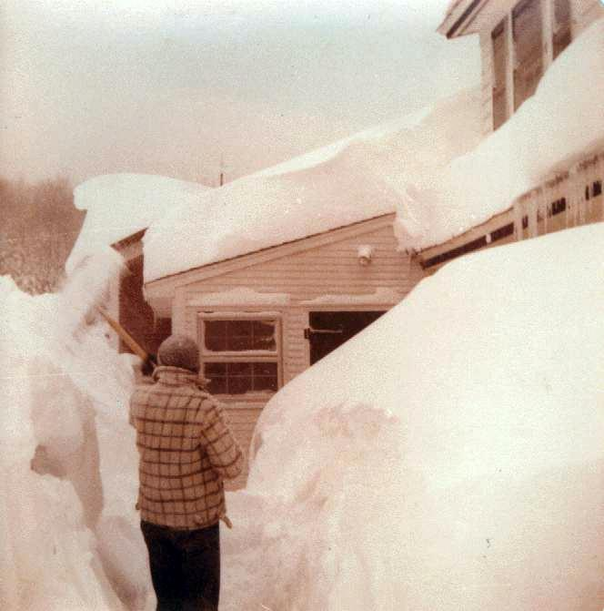
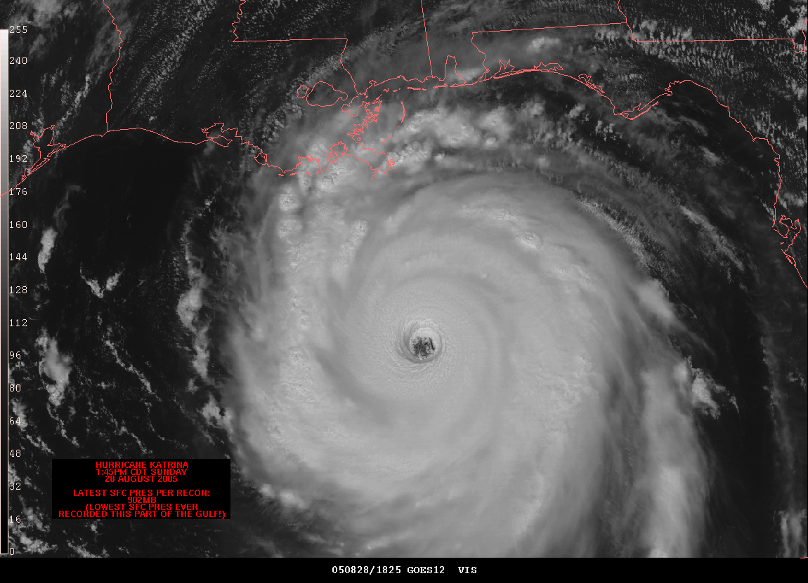
SPC Mission Statement
“SPC exists to protect life and property of the American people through the issuance of timely and accurate watch and forecast products dealing with tornadoes and other mesoscale hazardous weather.”

Slide 3
The Forecast Funnel and SPC
Days
Thunderstorm, Fire Weather,
Severe Weather OUTLOOKS
Detailed Mesoscale
DISCUSSIONS
Hours
SPC
Products
SVR/TOR
WATCHES
Minutes
WARN
Local NWS
Products (WFO)

Slide 4
SPC Thunderstorm Outlooks
All accompanied by categorical and probabilistic graphics, and a technical discussion
Day 4-8 Convective Outlook
  Issued once daily by 4 am CT
  Brief text discussion and week-long overview
  Highlight high-end SLGT equivalent or higher (>30% in Day 1)
    Won’t capture all severe
Day 3 Convective Outlook
  Issued once daily by 2:30 am CT
  Categories (no TSTM) and Probabilities (all severe)
Day 2 Convective Outlook
  Issued twice daily – early overnight and updated around midday
  Categories and Probabilities (all severe)
Day 1 Convective Outlook
  Issued 5 times daily
  Categories (SLGT, etc.) and 3 Probabilities (torn, wind, hail)

Slide 5
Outlook Chronology – 25 Dec., 2012
All accompanied by categorical and probabilistic graphics, and a technical discussion
Day 4-8 Convective Outlook
  Issued once daily by 4 am CT
  Brief text discussion and week-long overview
  Highlight high-end SLGT equivalent or higher (>30% in Day 1)
    Won’t capture all severe
Day 3 Convective Outlook
  Issued once daily by 2:30 am CT
  Categories (no TSTM) and Probabilities (all severe)
Day 2 Convective Outlook
  Issued twice daily – early overnight and updated around midday
  Categories and Probabilities (all severe)
Day 1 Convective Outlook
  Issued 5 times daily
  Categories (SLGT, etc.) and 3 Probabilities (torn, wind, hail)

Slide 6
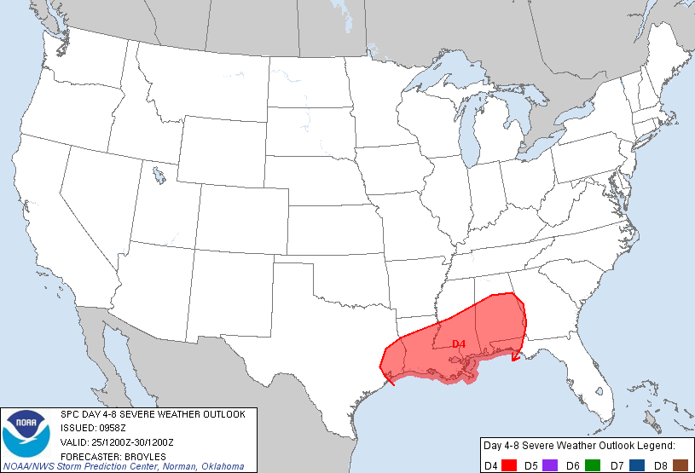
Day 4 Outlook issued 22 Dec., 2012
IT APPEARS THAT A SUBSTANTIAL SEVERE WEATHER THREAT WILL BE POSSIBLE ON TUESDAY AND TUESDAY NIGHT ACROSS A BROAD CORRIDOR FROM SE TX EXTENDING ENEWD ACROSS LA...MS ...AL AND INTO THE FL PANHANDLE.

Slide 7
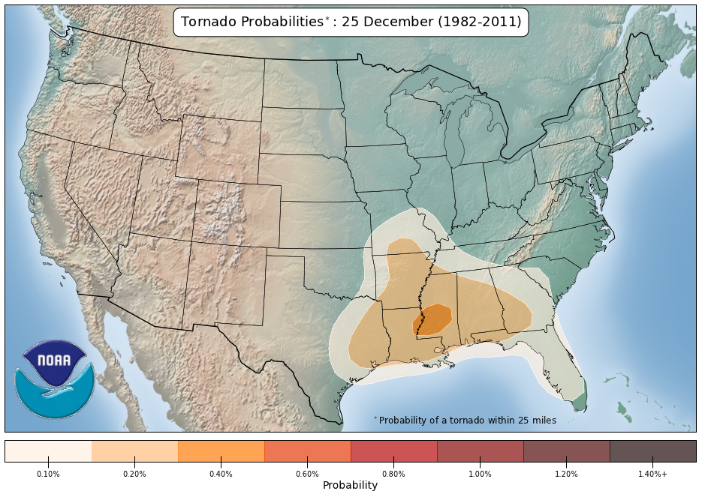
Tornado Climatology – 25 December

Slide 8
Outlook Chronology – 25 Dec., 2012
All accompanied by categorical and probabilistic graphics, and a technical discussion
Day 4-8 Convective Outlook
  Issued once daily by 4 am CT
  Brief text discussion and week-long overview
  Highlight high-end SLGT equivalent or higher (>30% in Day 1)
    Won’t capture all severe
Day 3 Convective Outlook
  Issued once daily by 2:30 am CT
  Categories (no TSTM) and Probabilities (all severe)
Day 2 Convective Outlook
  Issued twice daily – early overnight and updated around midday
  Categories and Probabilities (all severe)
Day 1 Convective Outlook
  Issued 5 times daily
  Categories (SLGT, etc.) and 3 Probabilities (torn, wind, hail)

Slide 9
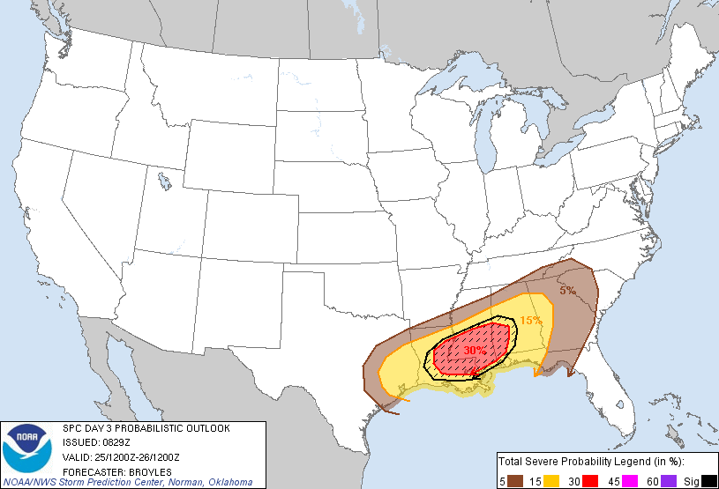
Day 3 Outlook issued 23 Dec., 2012
FORECAST SOUNDINGS ACROSS THE LOWER MS VALLEY AND CNTRL GULF COAST STATES TUESDAY INTO TUESDAY NIGHT SHOW POTENTIAL FOR A SUBSTANTIAL SEVERE WEATHER EVENT. THE COMBINATION OF SHEAR AND INSTABILITY COMBINED WITH A POTENT WEATHER SYSTEM SUGGESTS A 30 PERCENT PROBABILITY OF SIGNIFICANT SEVERE STORMS.

Slide 10
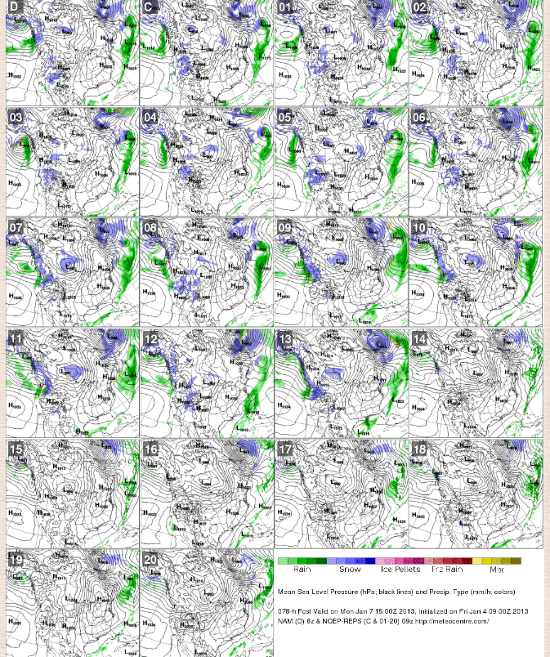
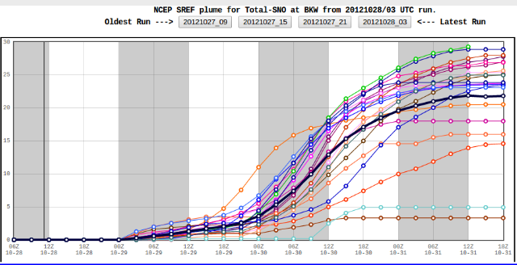
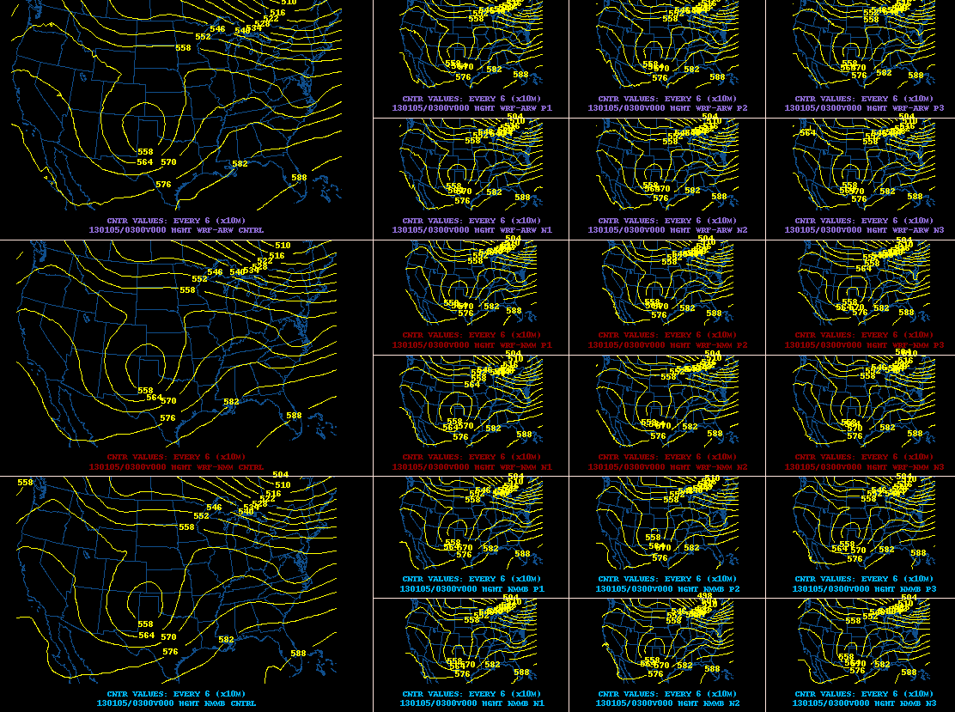
Ensemble Forecast Tools at SPC

Slide 11
21 Member NCEP SREF Configuration
Member (Model) | IC | IC perturb. | physics |  |  |  |  |  |  | Land surface
 |  |  | conv | mp | lw | sw | pbl | Sfc layer | stochastic | model | initial | perturb.
nmmb_ctl | NDAS | BV | BMJ | FER | GFDL | GFDL | MYJ | MYJ | no | NOAH | NAM | no
nmmb_n1
nmmb_p1
nmmb_n2 |  |  | SAS | GFS | GFDL | GFDL | GFS | MYJ | no | NOAH
nmmb_p2
nmmb_n3 |  |  | BMJ | WSM6 | GFDL | GFDL | MYJ | MYJ |  | NOAH
nmmb_p3
nmm_ctl | GFS | Blend | BMJ | FER (new Eta) | GFDL | GFDL | MYJ | M_Obuhov (Janjic Eta) | no | NOAH | GFS | no
nmm_n1
nmm_p1
nmm_n2 |  |  | SAS | FER (new Eta) | GFDL | GFDL | MYJ | M_Ouhov (janjic Eta) | no | NOAH
nmm_p2
nmm_n3 |  |  | KF (new Eta) | FER (new Eta) | GFDL | GFDL | MYJ | M_obuhov (janjic Eta) | no | NOAH
nmm_p3
arw_ctl | RAP | ETR | KF (new Eta) | FER (new Eta) | GFDL | GFDL | MYJ | M_obuhov (Janjic Eta) | no | NOAH | RAP | no
arw_n1
arw_p1
arw_n2 |  |  | BMJ | FER (new Eta) | GFDL | GFDL | MYJ | M_obuhov (Janjic Eta) | no | NOAH
arw_p2
arw_n3 |  |  | BMJ | FER (new eta) | GFDL | GFDL | MYJ | M_Obuhov (Janjic Eta) | no | NOAH
arw_p3
NMM-B (7)
NMM (7)
ARW (7)

Slide 12
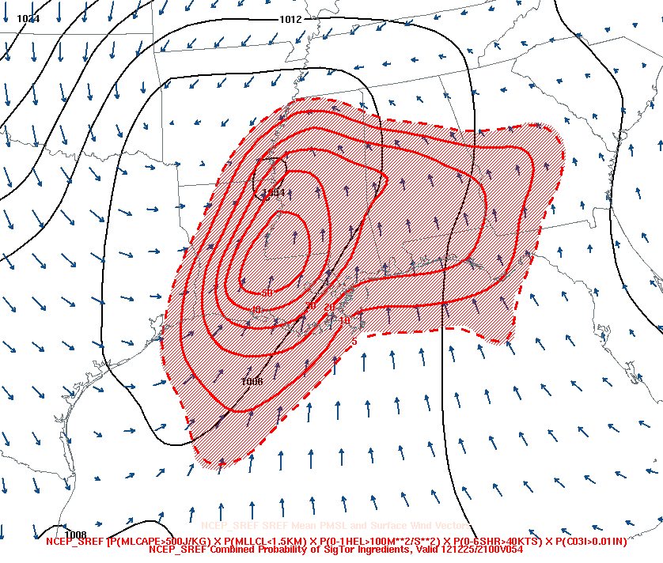
SREF Example: Joint Prob (tornadoes)
54h forecast probability of thunderstorms with CAPE, low LCL, strong 0-1 helicity and strong deep shear
Pr [3h CPCPN <=.01 in.] X
Pr [MLCP <= 500 J/Kg] X
Pr [MLLCL <= 1.5 km] X
Pr [0-1 SRH > 100 m2/s2] X
Pr [0-6km Shear > 40 kt]
http://www.spc.noaa.gov/exper/sref/

Slide 13
Outlook Chronology – 25 Dec., 2012
All accompanied by categorical and probabilistic graphics, and a technical discussion
Day 4-8 Convective Outlook
  Issued once daily by 4 am CT
  Brief text discussion and week-long overview
  Highlight high-end SLGT equivalent or higher (>30% in Day 1)
    Won’t capture all severe
Day 3 Convective Outlook
  Issued once daily by 2:30 am CT
  Categories (no TSTM) and Probabilities (all severe)
Day 2 Convective Outlook
  Issued twice daily – early overnight and updated around midday
  Categories and Probabilities (all severe)
Day 1 Convective Outlook
  Issued 5 times daily
  Categories (SLGT, etc.) and 3 Probabilities (torn, wind, hail)

Slide 14
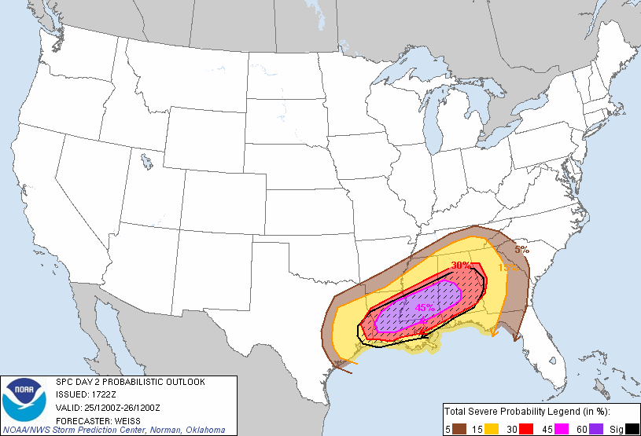
Day 2 Outlook issued 24 Dec., 2012
THE POSSIBILITY EXISTS FOR SEVERAL LONG-TRACK STRONG TORNADOES ASSOCIATED WITH ANY LONG-LIVED FAST-MOVING SUPERCELLS

Slide 15
Outlook Chronology – 25 Dec., 2012
All accompanied by categorical and probabilistic graphics, and a technical discussion
Day 4-8 Convective Outlook
  Issued once daily by 4 am CT
  Brief text discussion and week-long overview
  Highlight high-end SLGT equivalent or higher (>30% in Day 1)
    Won’t capture all severe
Day 3 Convective Outlook
  Issued once daily by 2:30 am CT
  Categories (no TSTM) and Probabilities (all severe)
Day 2 Convective Outlook
  Issued twice daily – early overnight and updated around midday
  Categories and Probabilities (all severe)
Day 1 Convective Outlook
  Issued 5 times daily
  Categories (SLGT, etc.) and 3 Probabilities (torn, wind, hail)

Slide 16
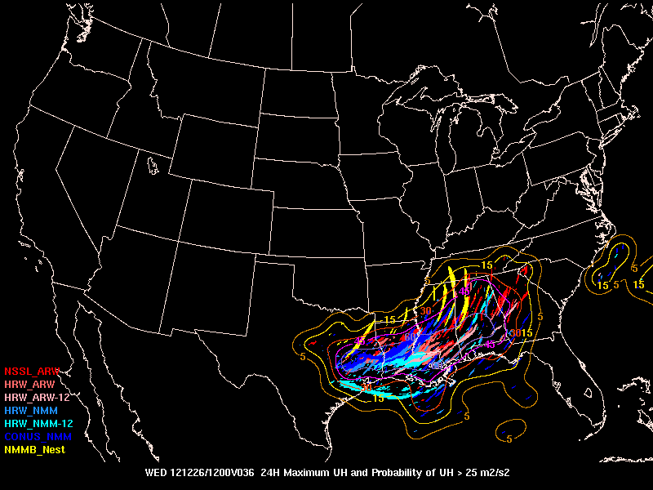
SPC Storm-scale Ensemble Forecast

Slide 17
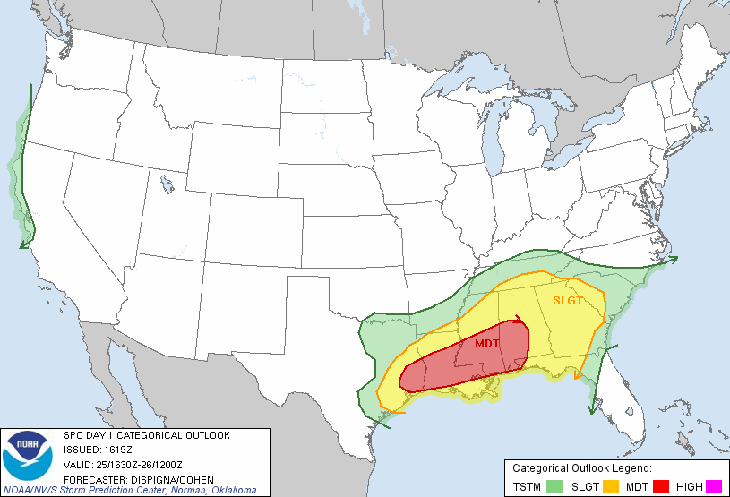
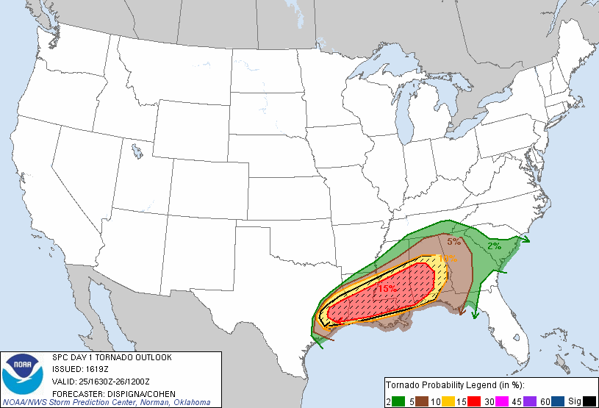
Day 1 Outlook issued 25 Dec., 2012
DISCRETE SUPERCELLS CAPABLE OF ALL THREATS OF SEVERE WEATHER /INCLUDING THE POTENTIAL FOR LONG-TRACKED TORNADOES/ MAY BE POSSIBLE AS THE AFOREMENTIONED MID-UPPER LEVEL JET APPROACHES...SUBSEQUENTLY STRENGTHENING DEEP LAYER SHEAR PROFILES AND PROMOTING STRONG ROTATION.

Slide 18
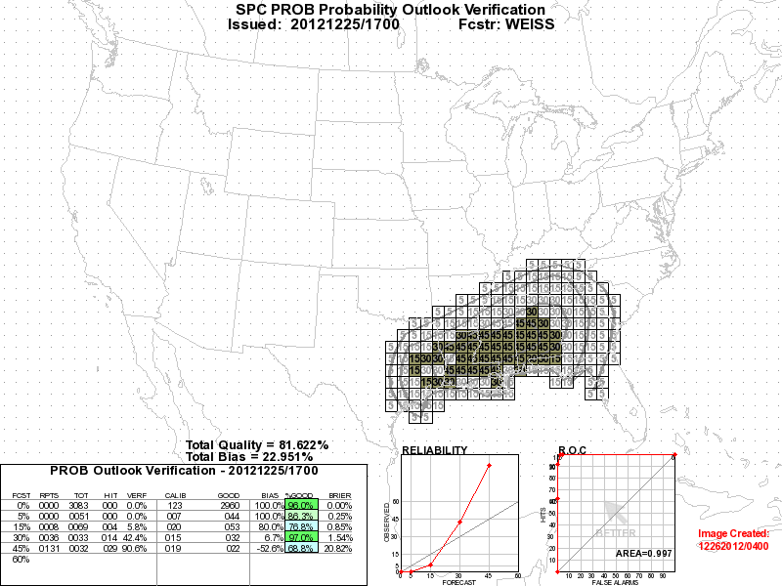
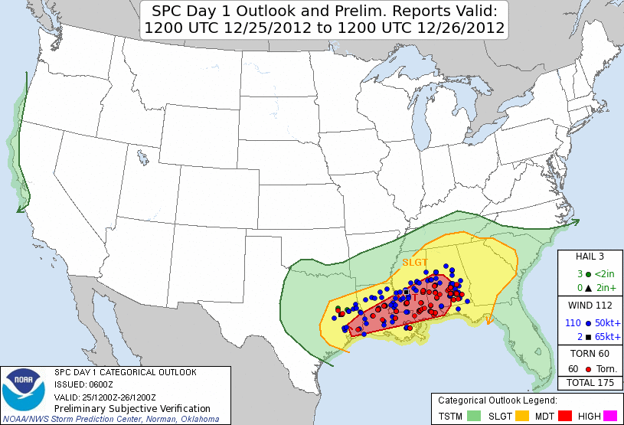
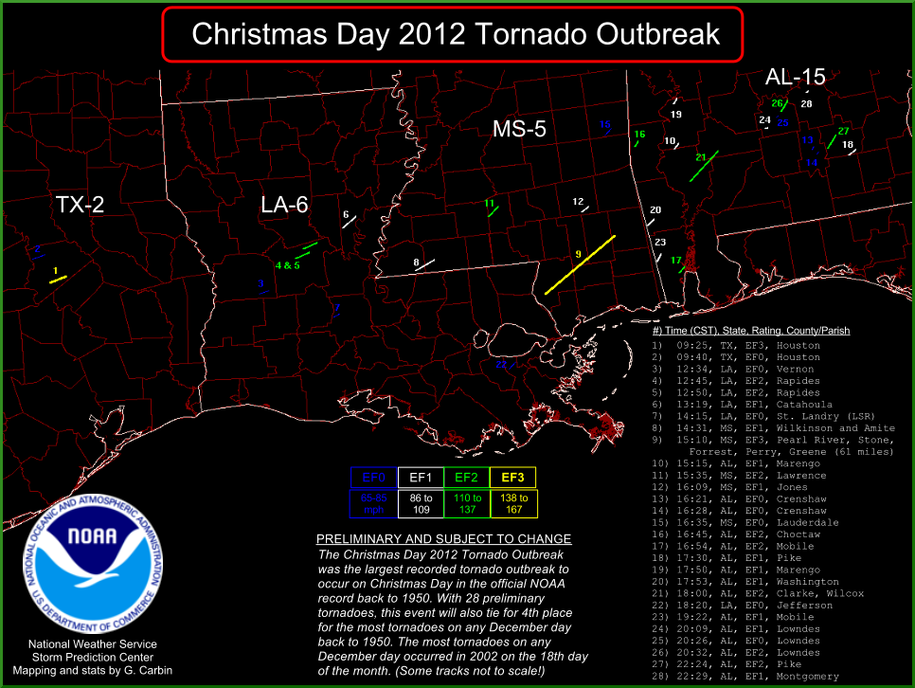
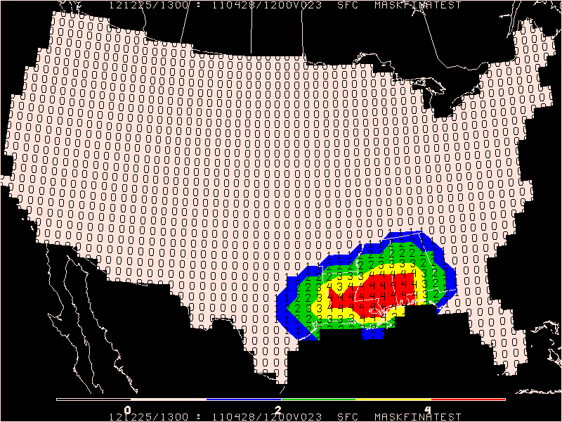
So, what happened? (Verification)

Slide 19
So, what happened? (Verification)
54h forecast probability of thunderstorms with CAPE, low LCL, strong 0-1 helicity and strong deep shear
61-mile track EF3 Christmas Day
tornado in PDS Tornado Watch
Pr [3h CPCPN <=.01 in.] X
Pr [MLCP <= 500 J/Kg] X
Pr [MLLCL <= 1.5 km] X
Pr [0-1 SRH > 100 m2/s2] X
Pr [0-6km Shear > 40 kt]
http://www.spc.noaa.gov/exper/sref/

Slide 20
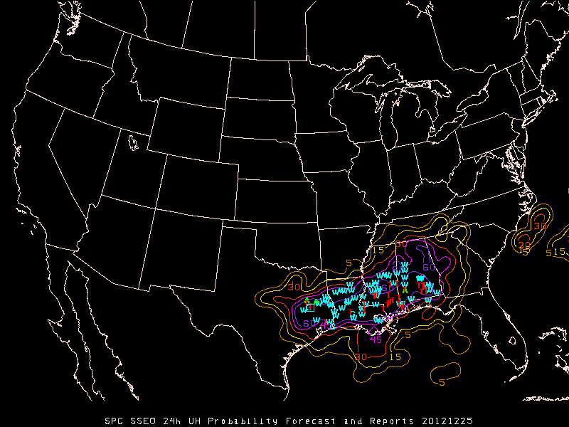
So, what happened? (Verification)

Slide 21
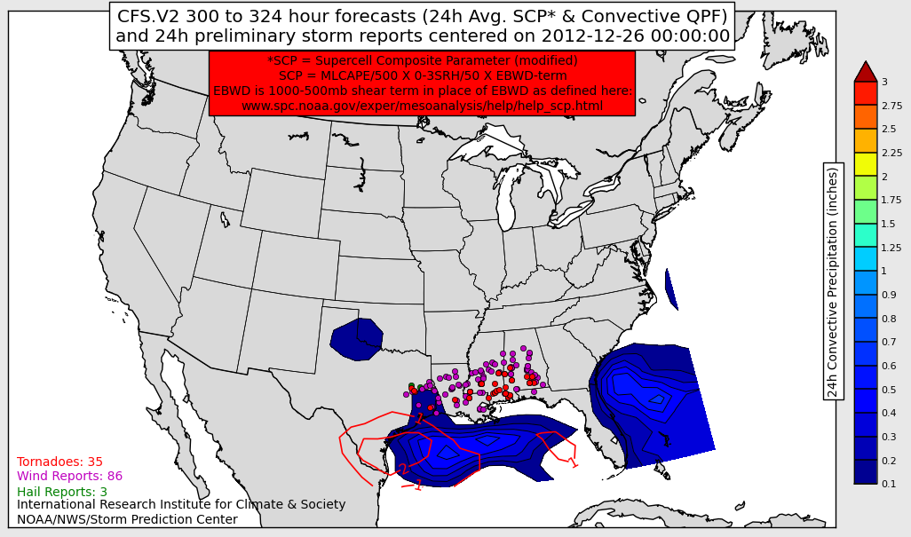
CFSv2 Severe Weather Forecasts

Slide 22

CFSv2 Severe Weather Forecasts
10 consecutive forecasts all valid Dec. 25 from CFS runs Dec. 12 to Dec. 22

Slide 23
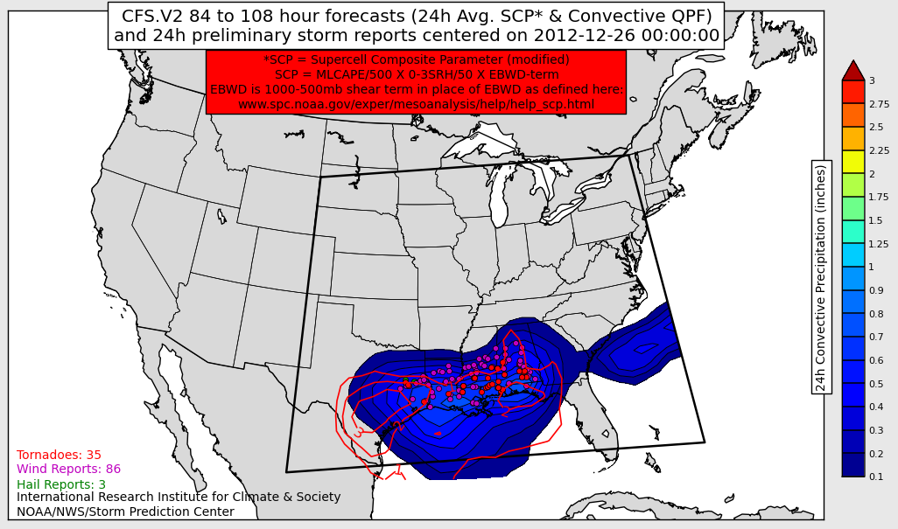
CFSv2 Severe Weather Forecasts
651 total
grid points
~70 grid points
with SCP >= 1

Slide 24
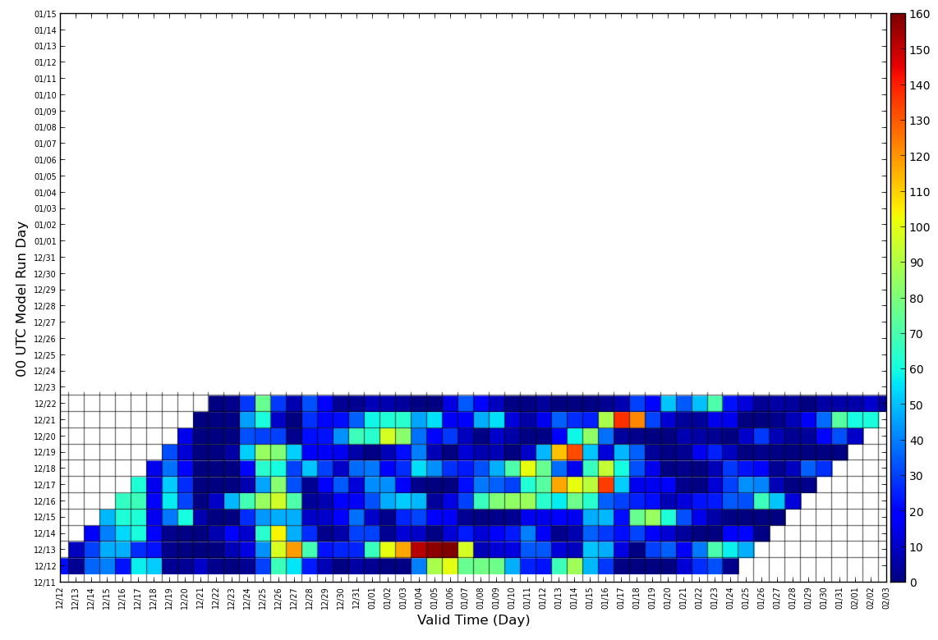
CFS.V2 Severe Weather Chiclet Chart
One way to track run-to-run model consistency
Average grid count
Consistent forecasts with similar
average grid counts over many model runs
Oldest Model Run Latest
Possible signals showing up
in recent runs or just noise?
Forecasts out in time

Slide 25
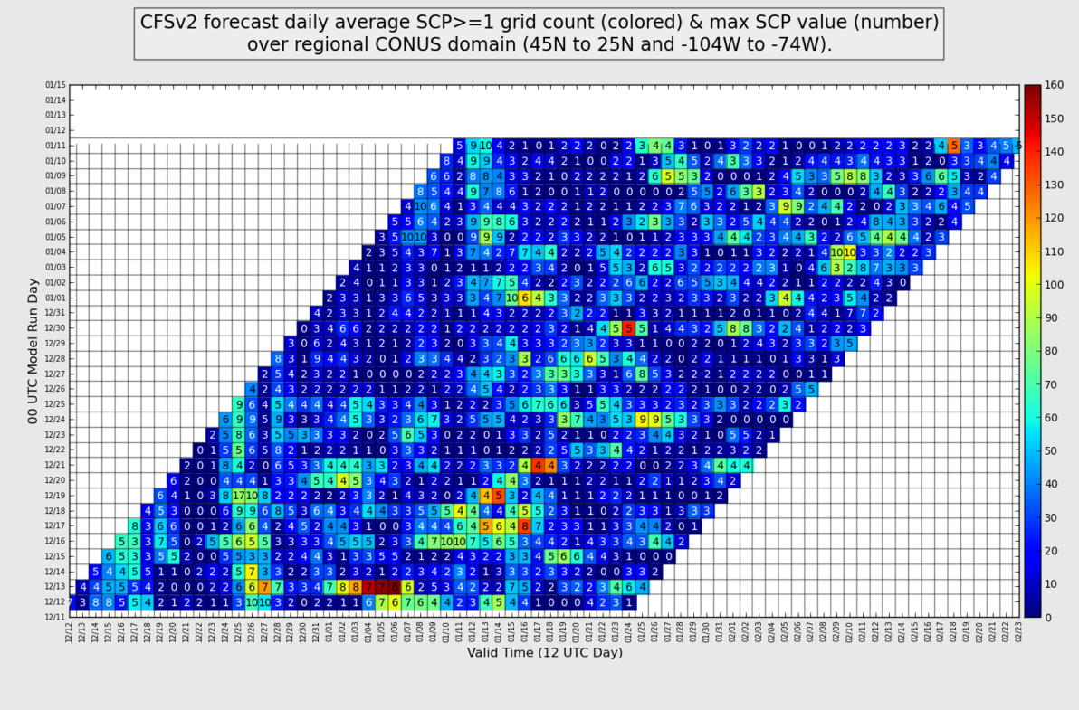
CFSv2 Chiclet Chart from Dec/Jan.

Slide 26
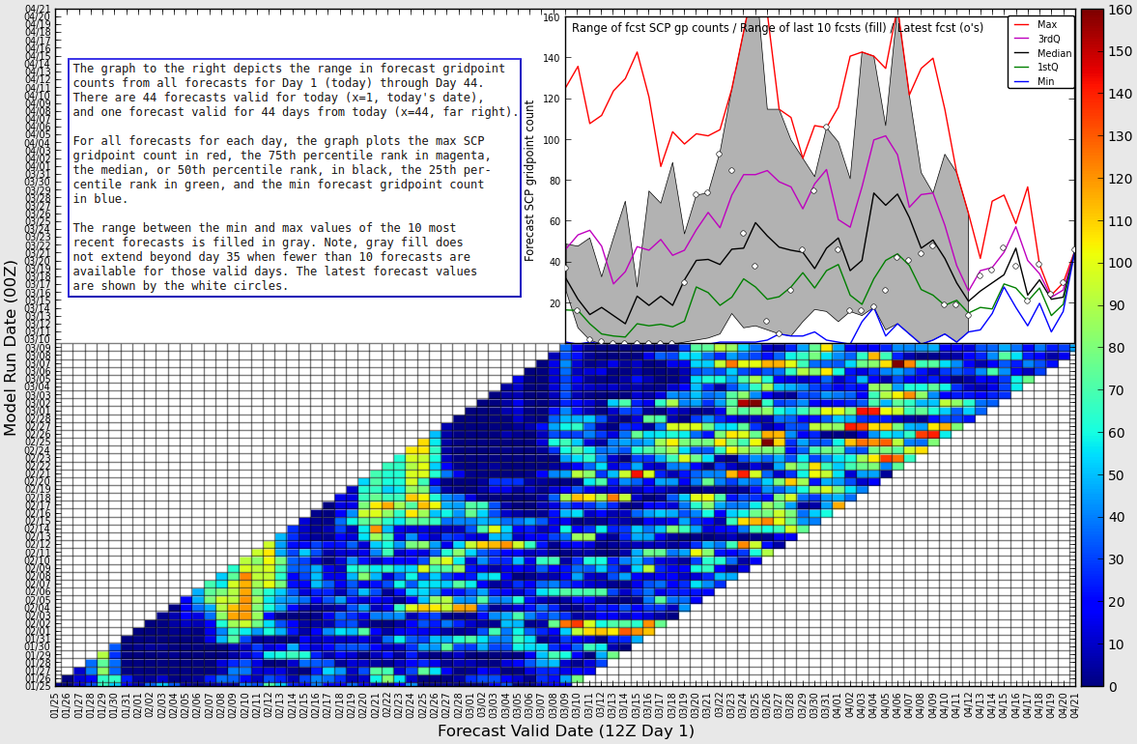
Latest Version CFSv2 Chiclet Chart

Slide 27
Questions?
Greg Carbin, Warning Coordination Meteorologist
Gregory.Carbin@noaa.gov
NOAA/National Weather Service
Storm Prediction Center

