Slide 1
Climate prediction and services at IRI:
A Focus On The Agriculture Sector
  Michael K. Tippett^{1,2}, Lisa Goddard¹,Andy Robertson¹, Tony Barnston¹, Walter Baethgen¹, Jim Hansen^{1,3}, Amor Ines¹, Dan Osgood¹
¹ International Research Institute for Climate and Society, Columbia University, Palisades, NY
²Center of Excellence for Climate Change Research, Department of Meteorology, King Abdulaziz University, Jeddah, Saudi Arabia
³Climate Change, Agriculture and Food Security Theme Leader

Slide 2
Outline
Seasonal climate forecasts
  Format, recent changes, future plans
  ENSO forecasts
Relevant climate information for agriculture
  Forecasts
    Temporal downscaling
    Adding remote sensing via data assimilation
    Forecasting quantities that impact agriculture
Climate risk management
  Index insurance

Slide 3
IRI seasonal forecasts
Issued monthly. (Same day as CPC)
Seasonal averages of precipitation and near-surface temperature
Tercile (equally-likely) category probabilities
  Flexible forecast tool for other percentiles
Global grid. IRI and NOAA/CPC forecasts match over the US
Verifications online as observations become available
Global and regional maps. Digital data

Slide 4
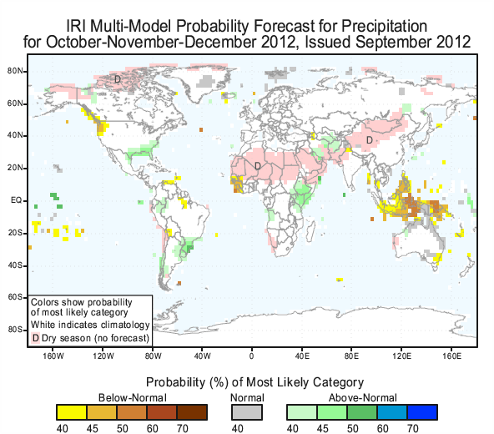
September 2012 forecasts issued for OND - JFM

Slide 5
IRI Forecast Methodology
Atmospheric GCMs forced with forecast SST scenarios
  Mean of CFSv2, CA and LDEO
  Positive and negative scenarios based on historical error
Pattern-based correction of individual model ensemble means.
    Regression based on historical model runs
      Forecast SST (CA)
      Observed SST
    Spread estimate from historical forecasts with forecast SST.
Equal weighting of corrected models
Forecast probabilities
  Gaussian distribution for temperature
  Transformed Gaussian for precipitation

Slide 6
Forecast probabilities beyond tercile categories

Slide 7
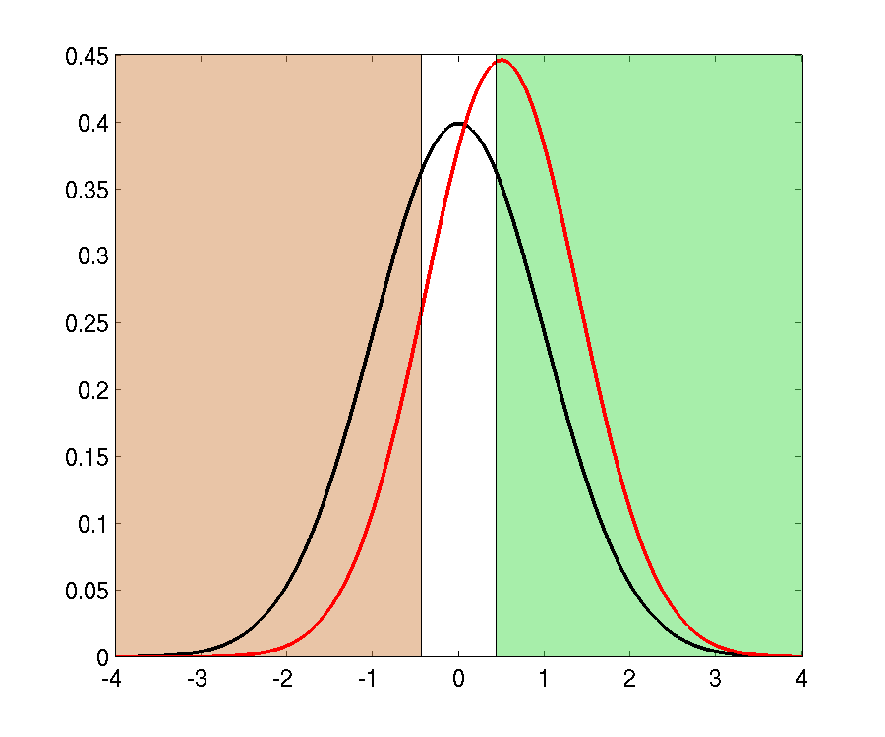
Shifted Gaussian
Near-Normal
Below
Normal
Above
Normal
Historical distribution
(climatological distribution)
(33.3%, 33.3%, 33.3%)
FREQUENCY
Forecast distribution
(15%, 32%, 53%)
NORMALIZED RAINFALL
model output
Notes:
Move from just terciles to complete pdf. POE for user selected percentiles.

Slide 8
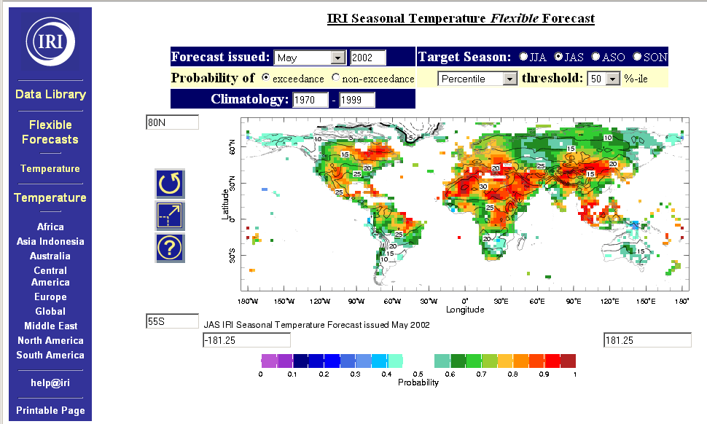
Flexible format map room
Notes:
“Map room”
Choose, start, target, POE, climatology period

Slide 9
Future plans
Robust methodologies
  Can handle models entering/leaving
  Short hindcasts (e.g, UKMet)
NMME
  NCEP, NASA, GFDM, CCSM3/4, EC Cam3/4

Slide 10
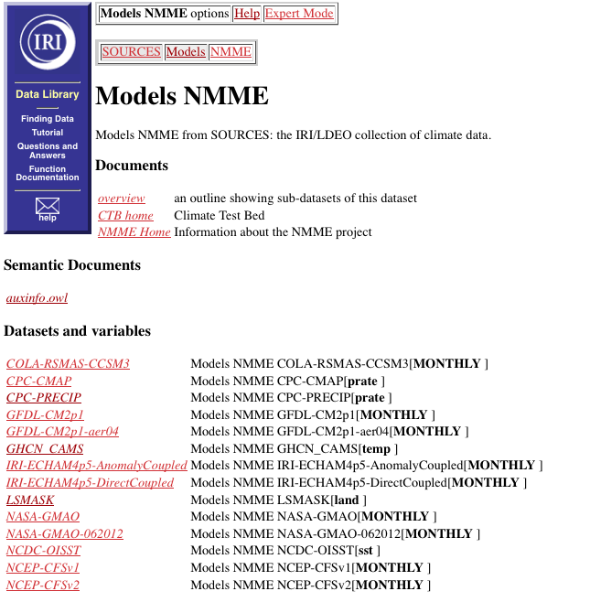

Slide 11
Changes to ENSO forecasts

Slide 12
Joint CPC-IRI ENSO Products
1. Definition of ENSO events reverts to NOAA’s simpler
+/- 0.5C thresholds for all seasons; will improve in future.
2. Beginning-of-month ENSO Diagnostic Discussion becomes
Joint CPC-IRI product; Barnston and L’Heureux alternate on
developing it (1-page narrative, 5-6 figures).
--Is the only official general message for the month
(IRI General ENSO Update is discontinued)
--New probabilistic aspect (subjective; 9 people):
Michelle L’Heureux Wayne Higgins
Tony Barnston Vern Kousky
Z-Z Hu Mike Halpert
Yan Xue Gerry Bell
Wanqui Wang

Slide 13
3. Mid-month IRI plume becomes joint IRI-CPC product
--Probabilities issued by IRI at mid-month become
objective, based on plume model predictions, and
are labeled “unofficial” (because early month proba-
bilities are the only official ones for the whole month)
4. Mid-month IRI Technical Update continues, but transfers
into an CPC-IRI blog update managed mainly by Barnston
--hope to get contributions from others at IRI
--hope to get contributions from external scientists.

Slide 14
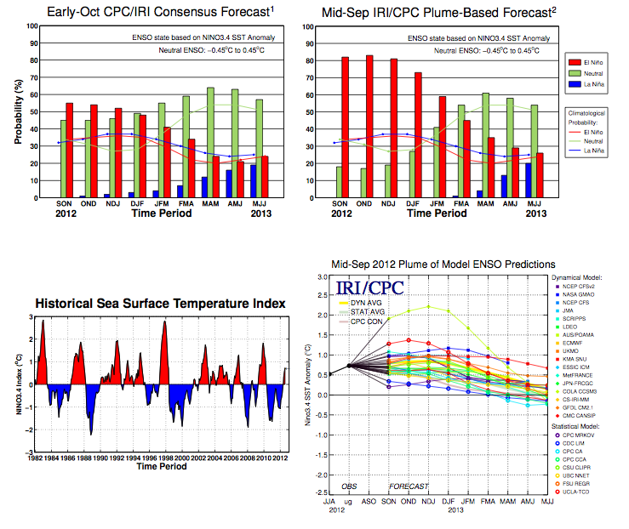

Slide 15
Forecaster: |  | Yan Xue
 |  |  |  |  |  |  | NOTE: (1) you can elect to not assign an "X" in any category if you feel that no category merits a 50% or greater chance
 | E | N | L |  |  |  | (2) If you feel that two categoires are 50-50 you can assign an "X" in both categories (i.e. two Xs in one row)
Nov |  |  | x | OISST
Dec |  |  | x | OISST
Jan |  |  | x | OISST |  |  | IGNORE THESE BOXES IF THERE IS NO ENSO EVENT (ONI between -0.5 and 0.5)
Feb |  |  | x | OISST |  |  |  | Weak | Moderate | Strong
SON |  |  | x | ERSST |  |  | SON | x |  |  |  | Weak: ONI 0.5 to 0.9
OND |  |  | x | ERSST |  |  | OND | x |  |  |  | Moderate: ONI 1.0-1.4
NDJ |  |  | x | ERSST |  |  | NDJ | x |  |  |  | Strong: ONI 1.5+
DJF |  |  | x | ERSST |  |  | DJF | x
 |  |  |  |  |  |  |  |  |  | REASONS FOR YOUR FORECAST
 | Sept (ERSST.v3b): |  | -0.48 | degC (base period 1971-2000)
 | Sept (OI.v2b): |  | -0.74 | degC (base period 1981-2010)
 |  | Weekly for October (OI.v2)- base period 1971-2000:

Slide 16
Making climate forecasts relevant to agriculture

Slide 17
Temporal mismatch
e.g. JAS
Seasonal Climate Forecasts
Daily Weather Sequences
Cropping system models
A
35
Yield forecasts, water balance etc.
N
30
B
35
<<<GAP>>>

Slide 18
Stochastic disaggregation
Crop simulation models (DSSAT)
Monthly rainfall
Stochastic disaggregation
Weather Realizations
GCM ensemble forecasts
Stochastic weather generator
Crop forecasts
<<<Bridging the GAP>>>

Slide 19
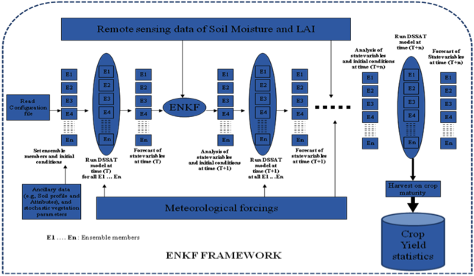
Remote Sensing Data Assimilation
Singh
EnKF-DSSAT-CSM for maize prediction
MODELING STRATEGY: (STORY Co. Iowa, 2003-2009)
Open loop – DSSAT-CSM-Maize was run without data assimilation
Data assimilation with AMSR-E soil moisture (SM)
Data assimilation with MODIS leaf area index (LAI)
Data assimilation with SM + LAI
Compositing results

Slide 20
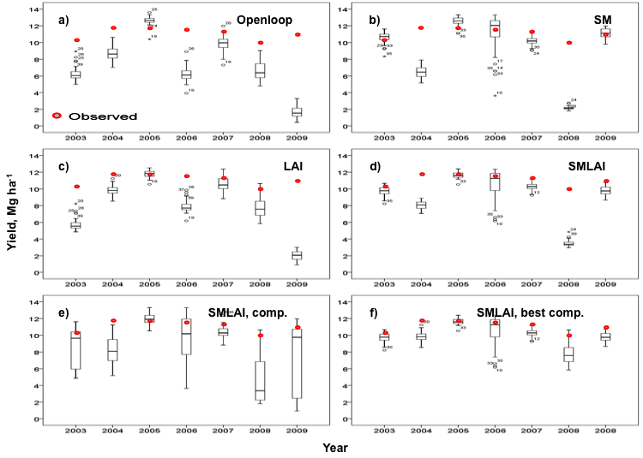
Data assimilation updates improve crop yield estimates
Ines, Das, Hansen & Njoku (2012), Remote Sens. Environ.
R= 0.47
MBE= -3.7
RMSE= 4.7
R= 0.50
MBE= -1.9
RMSE= 3.6
R= 0.51
MBE=- 3.2
RMSE= 4.2
R= 0.65
MBE= -2.0
RMSE= 2.9
R= 0.73
MBE= -2.4
RMSE= 3.0
R= 0.80
MBE= -1.2
RMSE= 1.4

Slide 21
Forecast quantities that impact agriculture
Verbist, Robertson et al. (2010, JAMC)

Slide 22
Climate Risk Management Approach in the IRI
(from months, through Decades, to Climate Change)
Four Pillars
Identify Vulnerabilities and Opportunities in Climate Variability
and Change in Collaboration with “Users”
(which systems, what components within systems)
Understand / Quantify / Reduce Uncertainties
(learn from the past, monitor the present, provide relevant info on the future)
Identify Interventions (Technologies) that Reduce Vulnerability
(e.g., drought resistance cultivars, water holding capacity, irrigation)
Identify Policies and Institutional Arrangements that reduce
Vulnerability and/or Transfer Risks (Early Warning Systems, Insurance, Credit)
(Baethgen, 2010)

Slide 23
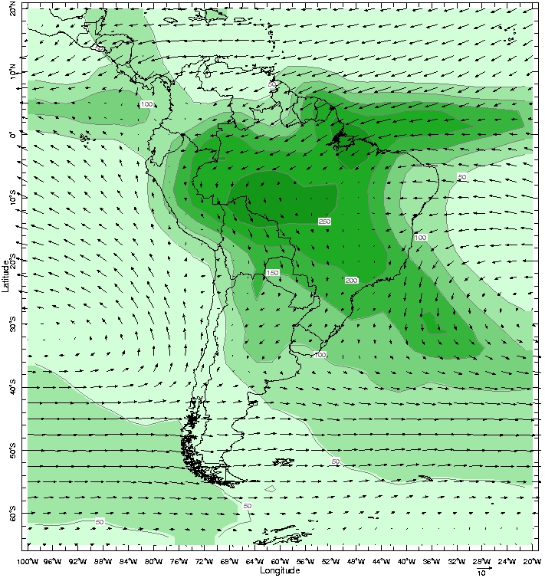




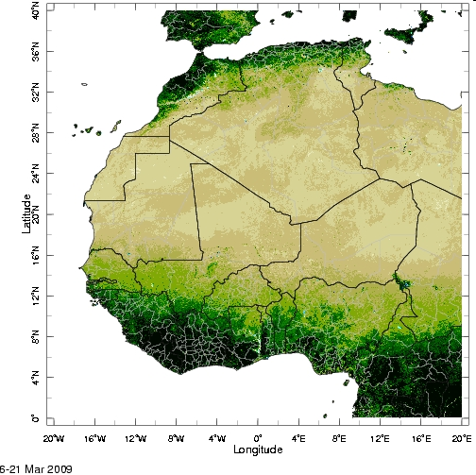
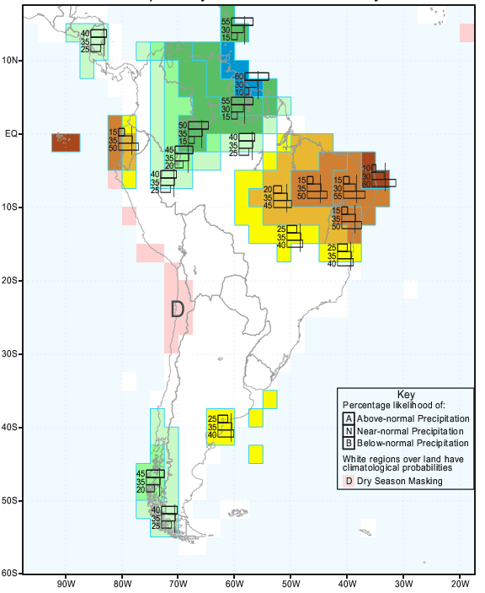

IRI Approach: Climate Risk Management
Start with
Stakeholder
Needs, Demands
Ministries (Ag, Envir.)
Farmer NGOs
Health Institutes
Emergency Systems
Water Managers
International Agencies
Learn from the Past
Decision Support
Systems
Simulation Tools,
Applied Systems
Climatology,
Variability,
Risks, Technologies,
Interventions
Present
Monitoring
Vegetation
(Satellite)
Inform and Assist
Decisions, Policies
Agriculture
Food Security
Water Management
Health
Disasters
Seasonal
Climate
Forecasts
(Scenarios for
Longer Term)

Slide 24
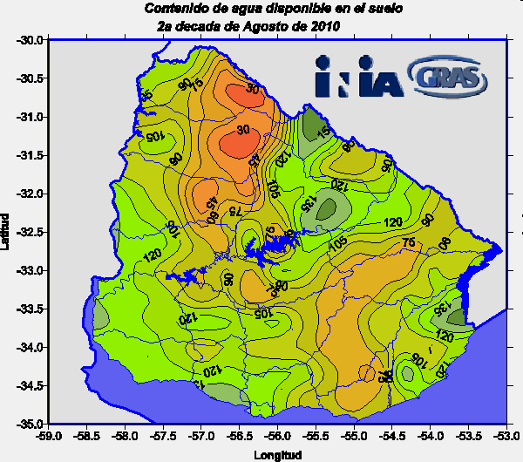
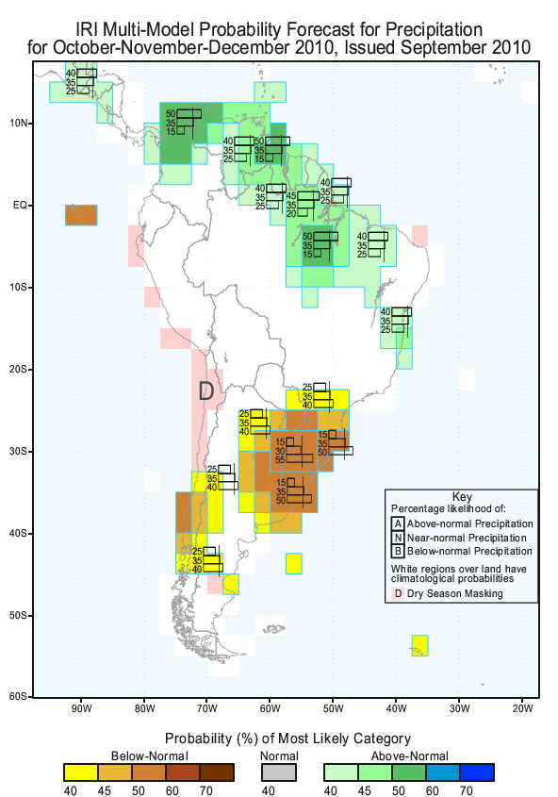
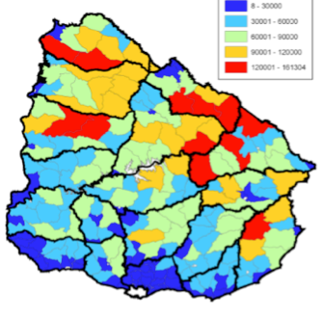
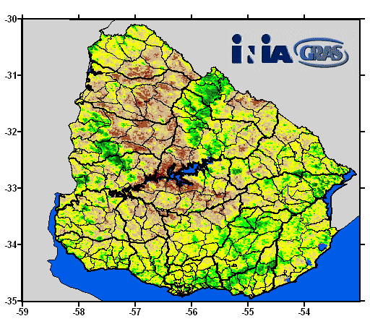
Uruguay: Examples of the IDSS at National Scale:
“Translating” Climate Infromation into Agronomic Information
Monitoring and Forecast
Soil Water Balance
IRI’s Seasonal
Climate
Forecast
Monitoring
Livestock
Population
Early warning systems
Emergencies
Planning
Decisions
Monitoring and Forecast
Pasture Production

Slide 25
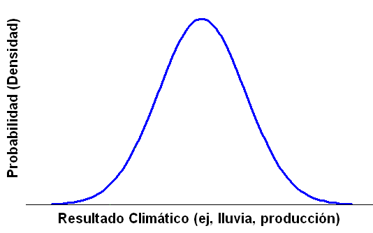
CRM: Manage the Entire Range of VARIABILITY
Probability (Density)
Climate related Outcome (e.g., food production)

Slide 26
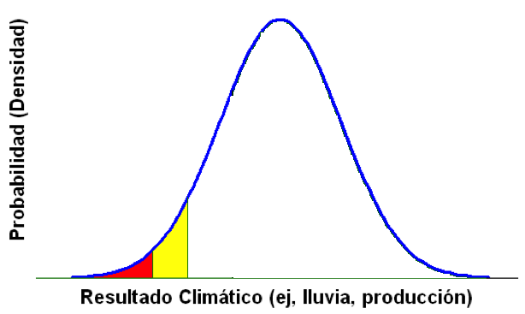
CRM: Manage the Entire Range of VARIABILITY
Probability (Density)
HARDSHIP
e.g., Drought
CRISIS
e.g., Mitch
Climate related Outcome (e.g., food production)

Slide 27
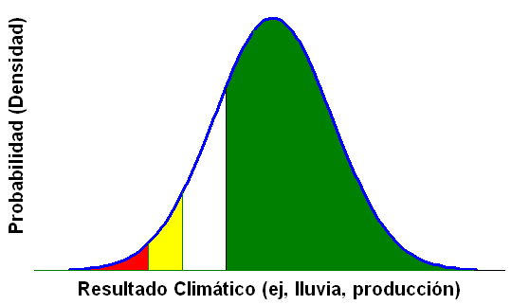
CRM: Manage the Entire Range of Risks
Also Critical
For Development:
Risk aversion reduces Technology Adoption
Effect on Natural Resources
“Poverty Traps”
Taking Advantage of THIS
Requires being covered
for THIS (Insurance)
Probability (Density)
HARDSHIP
e.g., Drought
MISSED
OPPORTUNITIES
CRISIS
e.g., Mitch
Climate related Outcome (e.g., food production)

Slide 28
Index insurance for climate change/variability adaptation
Adaptation: increase productivity in normal years to cover losses in bad years
Strategies that increase productivity in most years face lead to increased losses in bad years
Threat of 1 drought year out of 5 prevents other 4 from being much more productive
Key to adaptation is to reduce the losses of bad year to unlock productivity options in good years

Slide 29
Why index insurance?
Insurance: reduce risk to unlock productivity
Problems with traditional insurance have made it tough to implement
  Cost of looking at crop damage
  Moral hazard
Recent innovation
  Observation-based “weather” indices designed to replicate crop yields
  Provide payout if there is drought
  Cheap, “easy” to implement, good incentives
Still many limitations (basis risk)

Slide 30
One IRI partner is CCAFS
The CGIAR Research Program on Climate Change, Agriculture and Food Security (CCAFS) is a 10-year research initiative of the Consortium of International Agricultural Research Centers (CGIAR) and the Earth System Science Partnership (ESSP). CGIAR is a global research partnership for a food secure future
Notes:
NEEDS: SLIDES 2-4. STATUS: SLIDES 5-6. UNDER ”COMMUNICATION,” WE ARE PERHAPS INTERPRETING THIS LOOSELY BY SAYING HOW CCAFS IS TRYING TO INVEST.

Slide 31
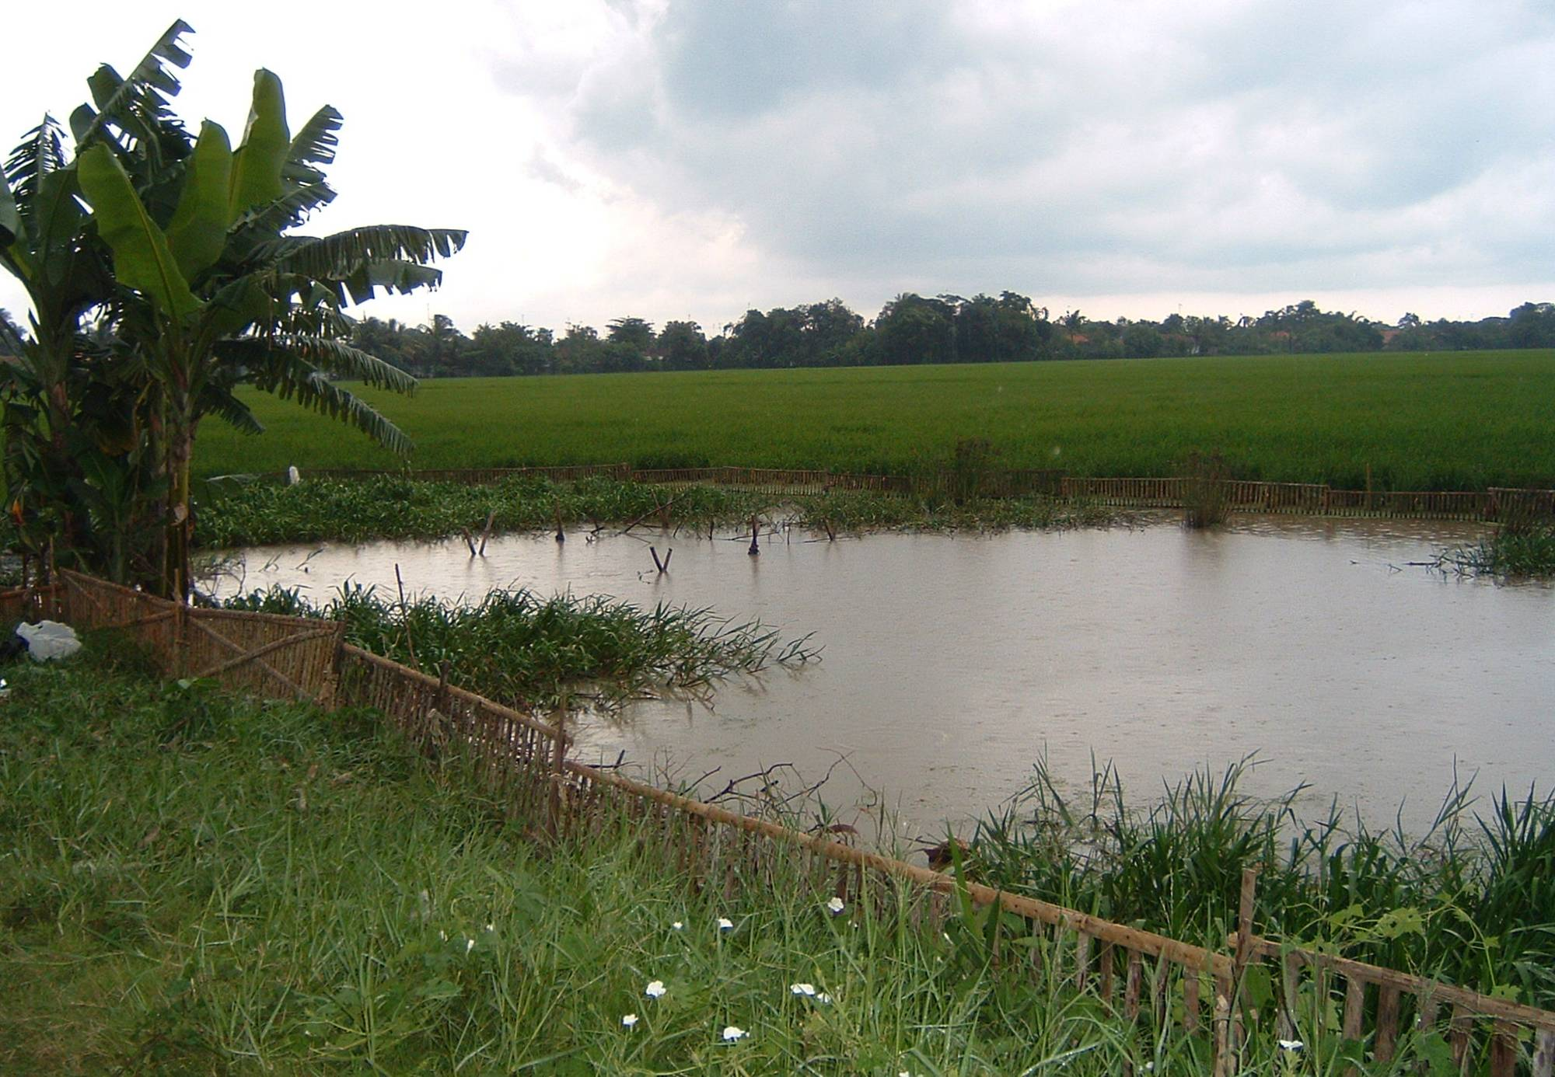
The CGIAR investing in Climate Services
Climate Change, Agriculture and Food Security (CCAFS), a research program of the CGIAR
  Part of CGIAR restructuring
  Mechanism for coordinating and funding work on climate adaptation and mitigation across the CGIAR
World’s largest research effort on this issue
Pro-poor adaptation and mitigation practices, technologies, policies for agriculture and food systems
Support inclusion of agriculture issues in climate policies, climate issues in agricultural policies
Notes:
2 SLIDES BRIEFLY INTRODUCE CCAFS. LAST 2 BULLETS ARE THE OFFICIAL GOALS, BUT WE SEEM TO HAVE STOPPED EMPHASIZING THEM.

Slide 32
The CGIAR investing in Climate Services
CCAFS Themes:
  1. Adaptation to progressive climate change
  2. Adaptation through managing climate risk
  3. Pro-poor climate change mitigation
  4. Integration for decision-making
CCAFS Focus regions:
  East Africa
  West Africa
  South Asia
  Adding Southeast Asia, Latin America
Notes:
THEME 2 IS HIGHLIGHTED BECAUSE THIS IS THE FOCAL POINT IN CCAFS FOR CLIMATE SERVICES.

Slide 33
Theme 2 Strategy: Climate services support risk decision-making
Improved, climate-informed responses
Resilient food systems,
Improved food security
Scale
Objective 2:
Food System Risk Management
Goal: Enhanced food security
Target: food system (trade, crisis response, etc.)
Fill key gaps:
Knowledge
Tools & Methods
Evidence
Capacity
Coordination
Enhanced climate services
Objective 3:
Climate Information and Services
Goal: Enhance products and services to support food security and rural livelihoods
Target: climate community, communication intermediaries,
Enhanced climate services
Objective 1:
Local Risk Management
Goal: Resilient rural livelihoods
Target: rural communities & markets; supporting institutions & policies
Enhanced support for managing risk
Resilient rural livelihoods
GENDER & EQITY LENS
Notes:
The Theme 2 strategy is defined by three objectives.
The first is to improve the management of climate-related agricultural risk at the local level of farms and rural communities, with the goal increasing the resilience of rural livelihoods.
The second is also about improving risk management, but at the level of food systems. This includes thing such as management of food delivery, trade, food security safety nets and food crises, in the face of seasonal climate fluctuations.
The third objective is to strengthen climate-related information and climate services to support risk management at the two scales.
As a research program, CCAFS outputs are meant to address strategic gaps in … with a gender and social equity lens.
The target outcomes are enhanced climate services to strengthen agricultural and food security management…
…And at the level of food systems: improved use of information to improve responses to climate fluctuations…
…Leading to more resilient food systems and improved food security.
…And enhanced technical and policy support for managing risk at the level of rural communities, …
… leading to more climate-resilient rural livelihoods.

Slide 34
Summary
IRI continues to:
Improve seasonal climate forecasts;
Research the predictability and prediction of climate qunatities relevant to agriculture;
Integrate climate information into comprehensive climate risk solutions.

