Slide 1

Tailoring forecasts
Simon Mason
simon@iri.columbia.edu
World Food Programme Visit
Palisades, NY, 28-29 September 2015

Slide 2

Tailoring
Tailoring to improve the skill
Tailoring to improve the usefulness

Slide 3
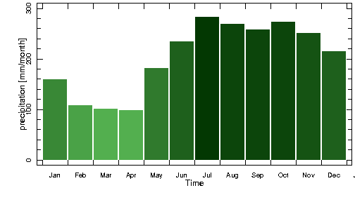
Annual cycle
The Philippines

Slide 4
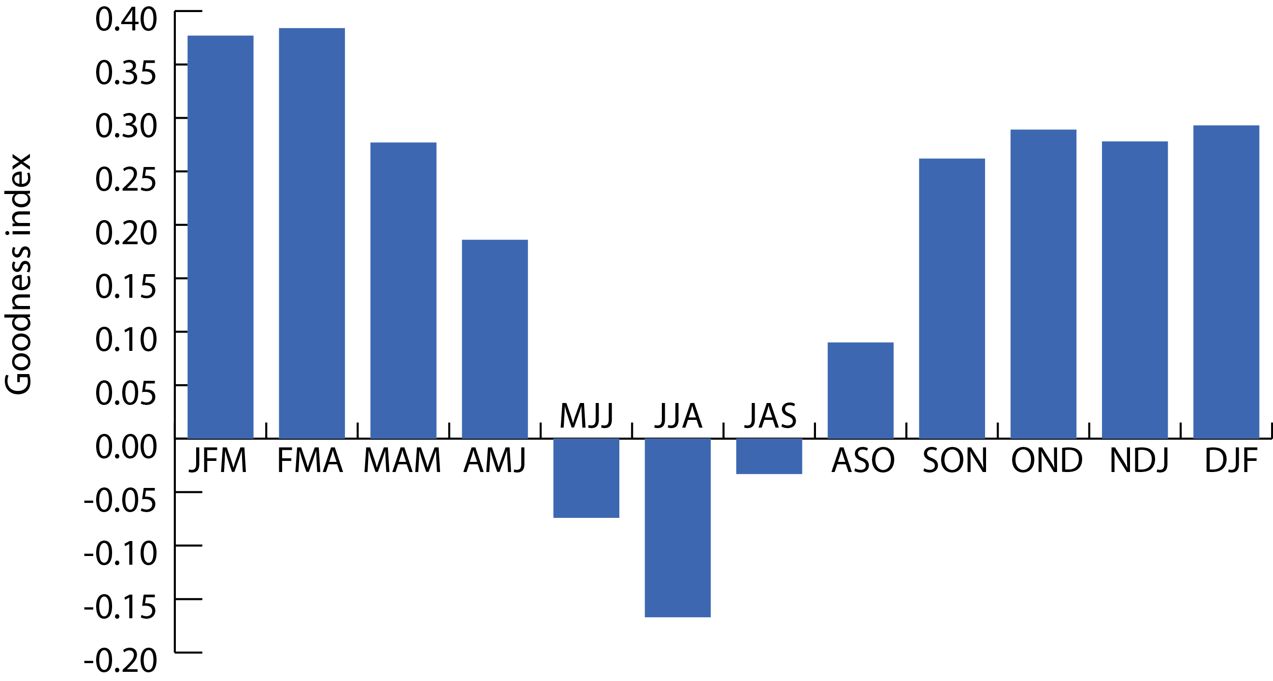
Seasonal forecast skill
NINO3.4 predicting the total rainfall for the following 3 months
1961 – 2010 (50 years)

Slide 5
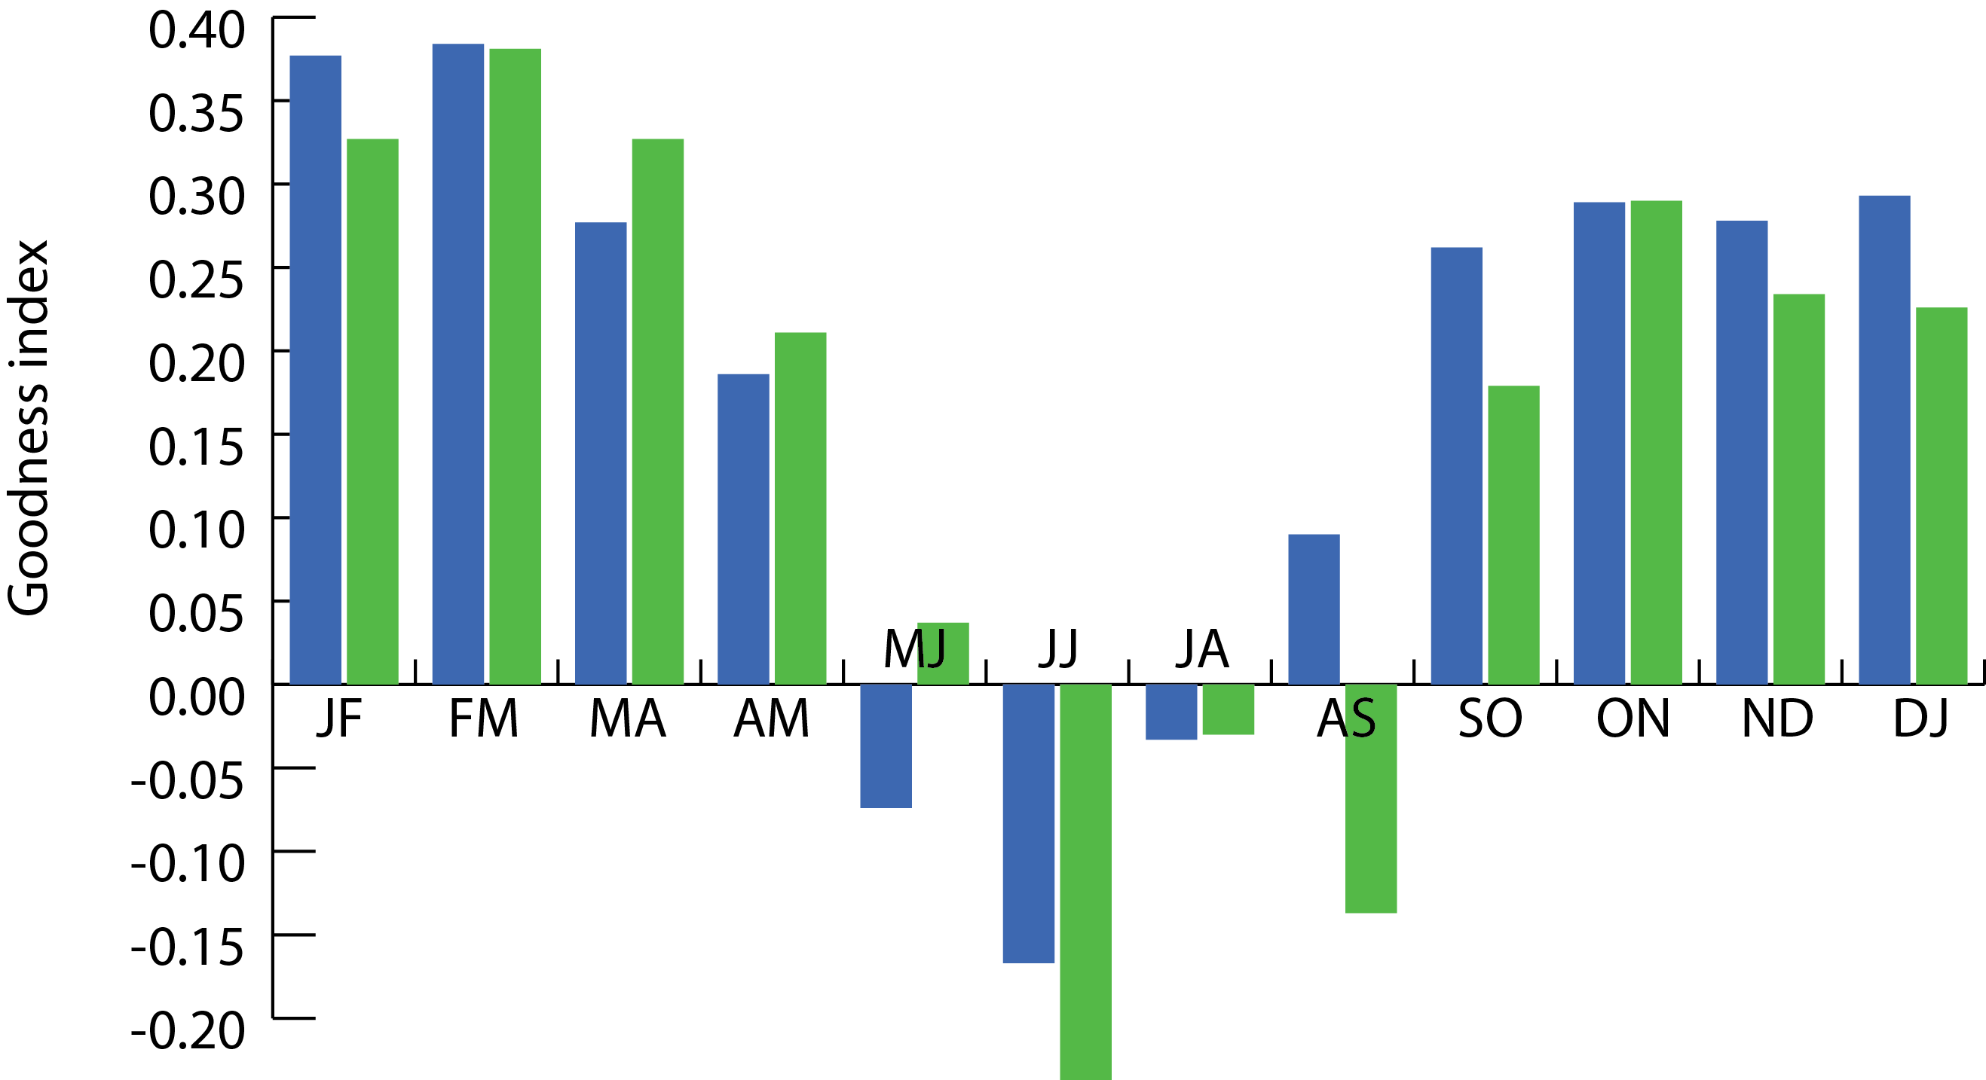
Length of season
NINO3.4 predicting the total rainfall for the following 2 months
1961 – 2010 (50 years)

Slide 6
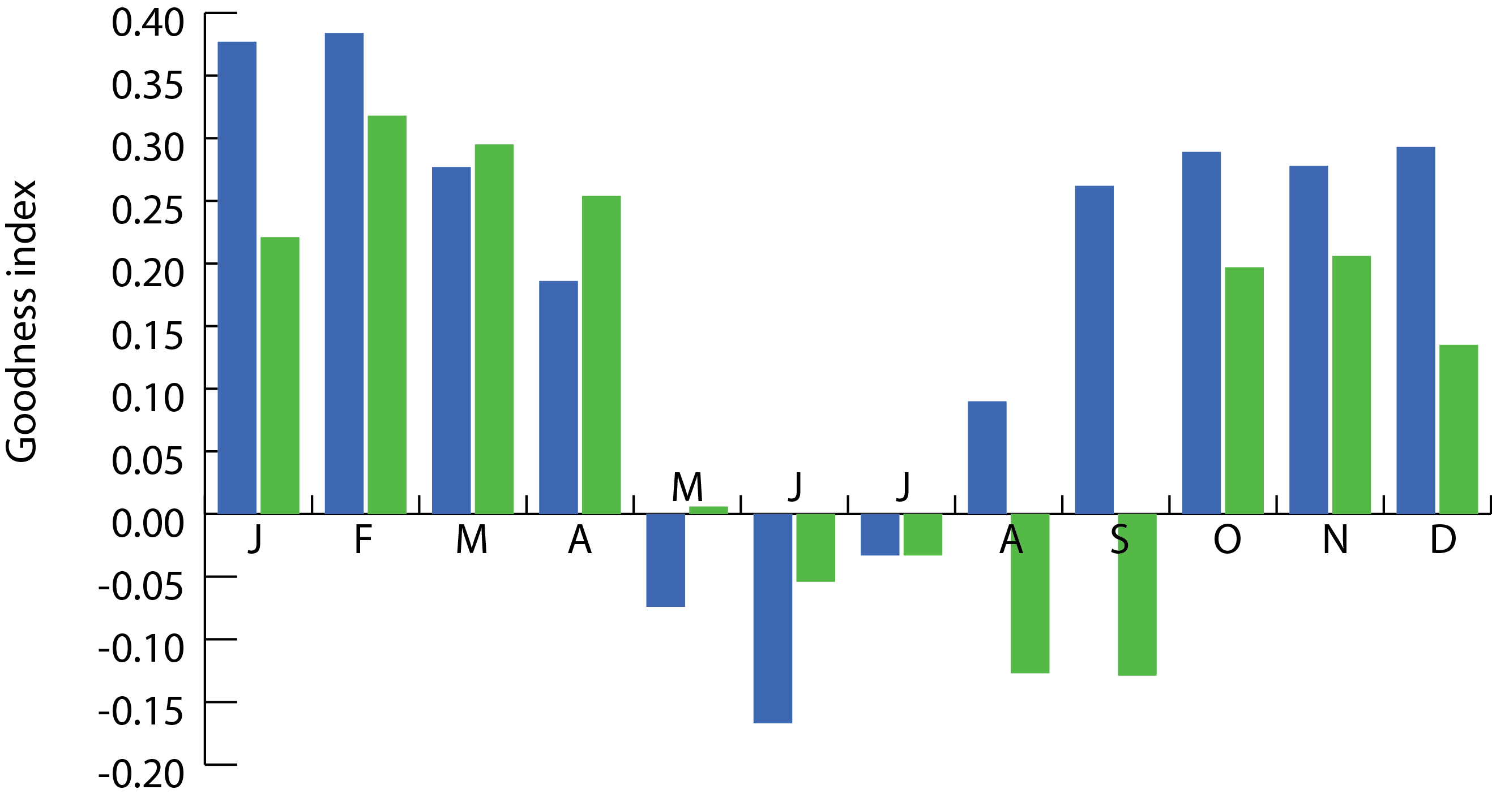
Length of season
NINO3.4 predicting the total rainfall for the following 1 months
1961 – 2010 (50 years)

Slide 7
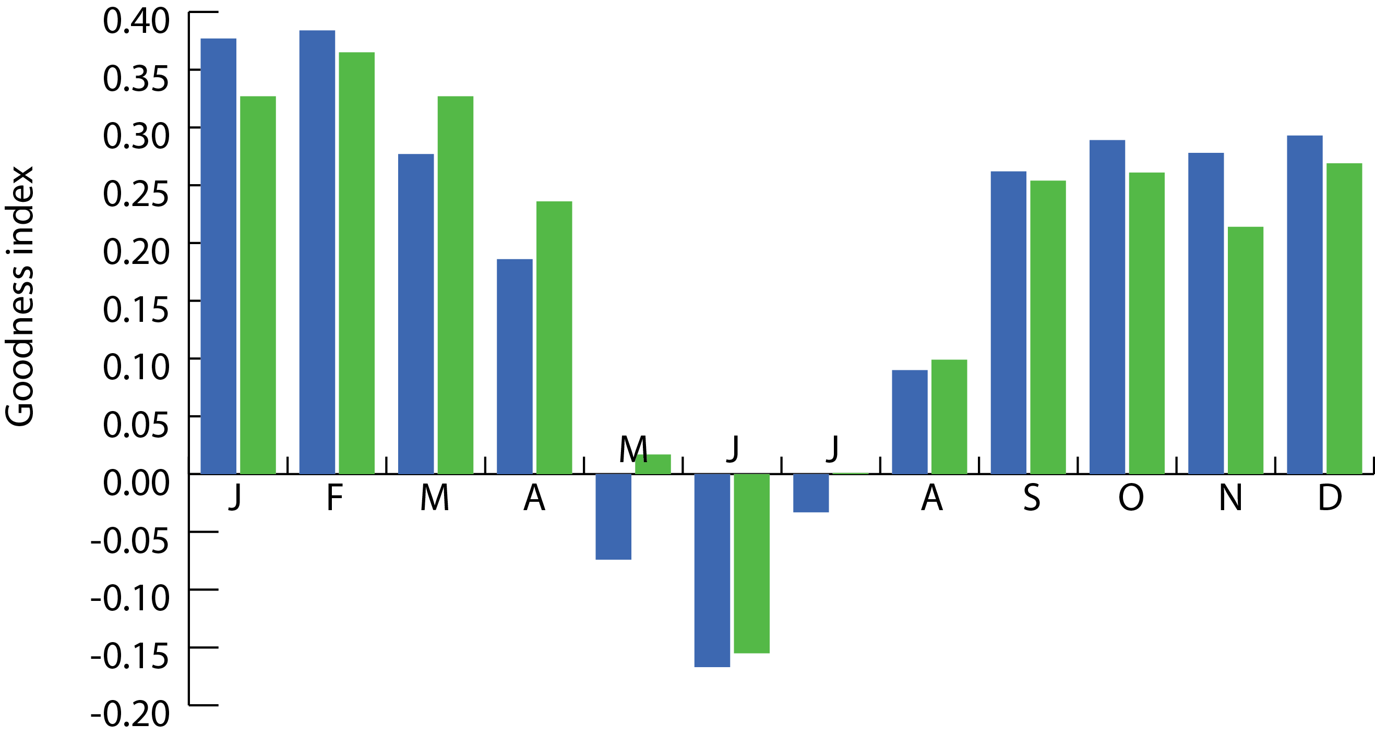
Rainfall parameter
NINO3.4 predicting the rainfall frequency for the following 3 months
1961 – 2010 (50 years)

Slide 8
Tailoring to improve the skill
What is the best length of season?
With the exception of the end of the dry-season, seasonal forecasts of three-month totals are more skillful than for 1- or 2-month totals.
What aspects of precipitation should we predict?
Forecasts of rainfall frequency are more skilful than for rainfall total only for the late dry season and the onset of the wet season.

Slide 9
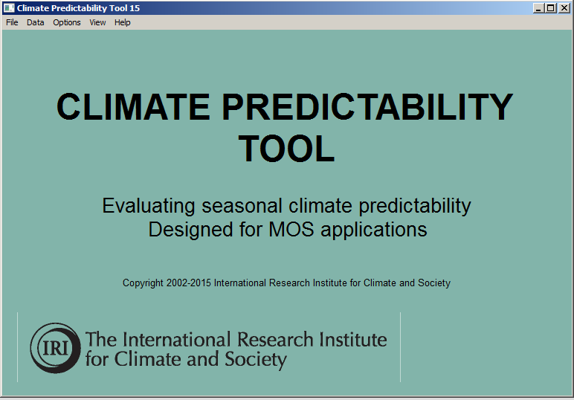
Tailoring to improve the usefulness
Format
Units
Thresholds
Flexible format
Additional information
Monitoring component

Slide 10
National capacity
Simon Mason
simon@iri.columbia.edu
World Food Programme Visit
Palisades, NY, 28-29 September 2015

Slide 11
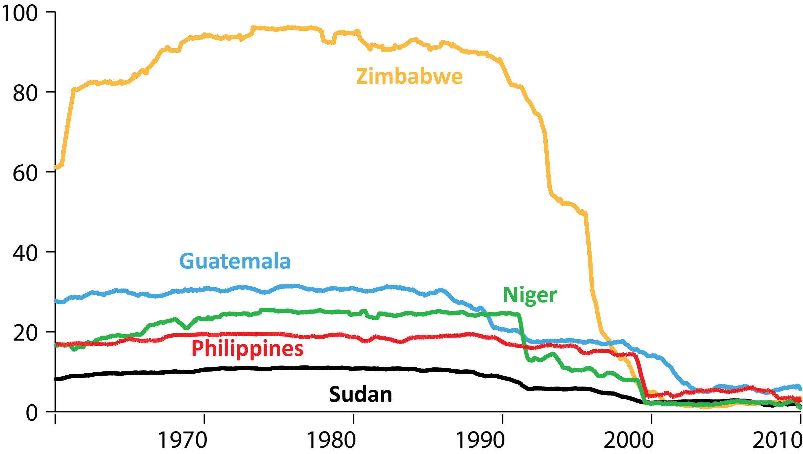
Climate observing network
Average number of stations within a reasonable distance of each gridbox

