Slide 1

IRI Seasonal
Climate Outlooks

Slide 2
Climate Information TOOLBOX
ENACTS: Enhancing National Climate Services
Timescales Map Room → Explore relative importance of climate at different timescales
Seasonal Forecasts→ Flexible Forecast Format; Drought; Extremes
Stochastic Simulations (Near Term Climate Change) → Explore possible decadal scale fluctuations, including all timescales
Verification (at all timescales) → Demonstrating ability of tools to answer the questions we use them to answer
IRI Data Library → Disseminate, analyze, display data
Research:
  Subseasonal-to-seasonal climate: characterization & prediction
  Decadal variability and prediction
  Climate change processes and regional scale change

Slide 3
… (continued)
Financial Instruments
Remote sensing and environmental monitoring
Crop models
Climate & ecosystems research
Climate Predictability Tool (CPT) → seasonal prediction & downscaling
Full vision of IRI Data Library & Maprooms
Broader view of Decision Support Systems

Slide 4
Information Products for
Seasonal-to-Interannual Timescales
ENSO Outlooks
“Net Assessment” seasonal forecast
“Flexible format” seasonal forecast

Slide 5
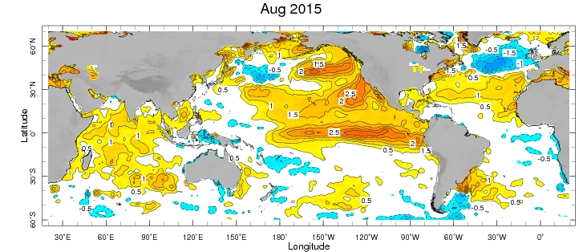
Last week’s SST anomaly
--------------------------------------------------------------------------------------------------------------------------------------
http://iridl.ldeo.columbia.edu/maproom/Global/Ocean_Temp/Weekly_Anomaly.html

Slide 6
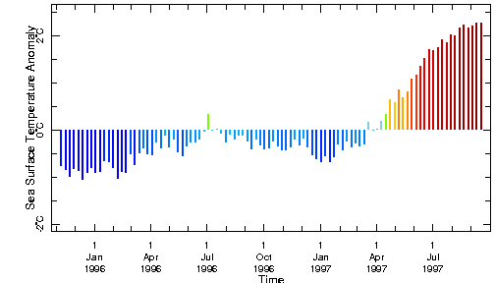
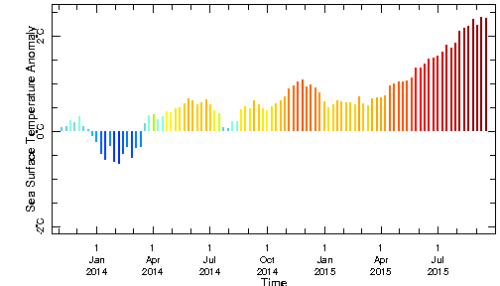
NINO3.4 SST anomaly – Nov ’95 - Sep ‘97
NINO3.4 SST anomaly – Nov ’13 – Sep ‘

Slide 7
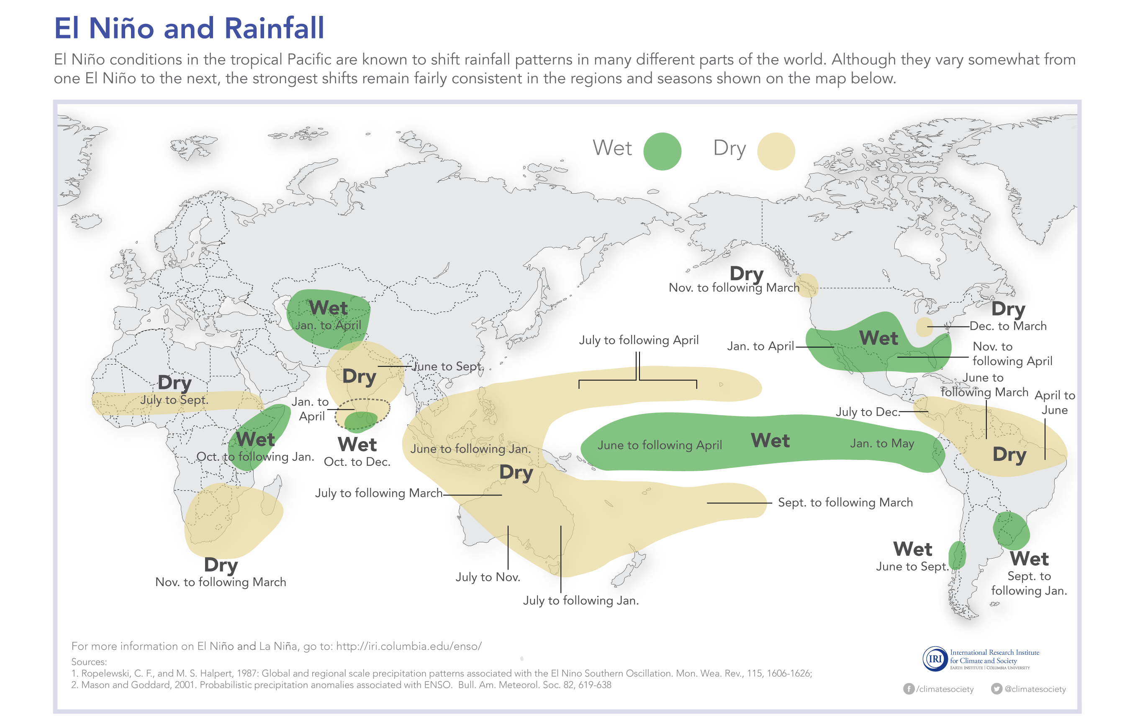
“Expected” Climate Impacts During El Niño
http://iridl.ldeo.columbia.edu/maproom/IFRC/ → “Past Conditions”

Slide 8
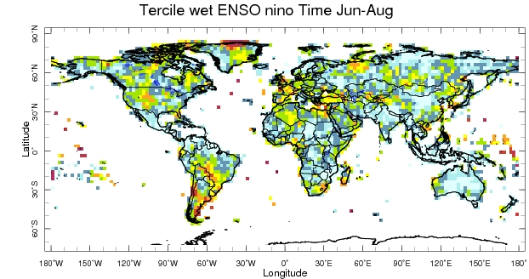
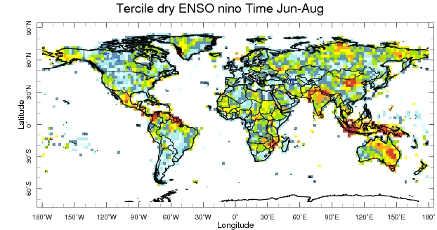
Frequency of Climate Impacts due to El Niño
In the biggest 10
El Niño events since 1950,
how often was it very wet?
There is more that affects regional climate
than just tropical Pacific SSTs
In the biggest 10
El Niño events since 1950,
how often was it very dry?
http://iridl.ldeo.columbia.edu/maproom/
ENSO/Climate_Impacts/
ENSO_PRCP_Prob_TS2p1.html

Slide 9
Information Products for
Seasonal-to-Interannual Timescales
ENSO Outlooks
“Net Assessment” seasonal forecast
“Flexible format” seasonal forecast

Slide 10
SEASONAL-TO-INTERANNUAL
VARIABILITY
“Reliable” forecasts are needed for threshold-based decisions

Slide 11
Information Products for
Seasonal-to-Interannual Timescales
ENSO Outlooks
“Net Assessment” seasonal forecast
“Flexible format” seasonal forecast

Slide 12
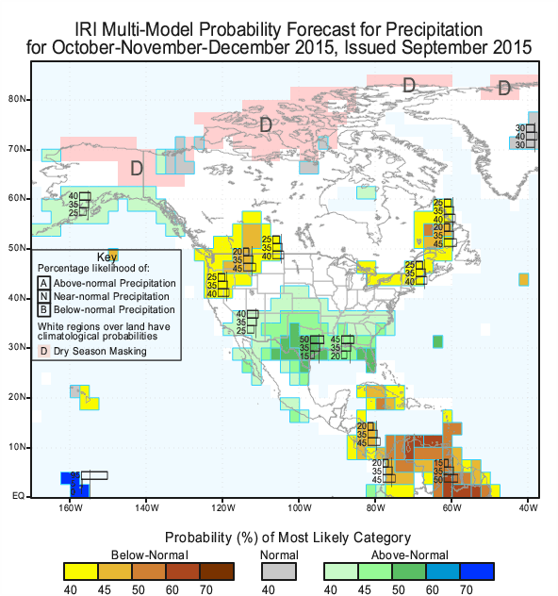

Slide 13
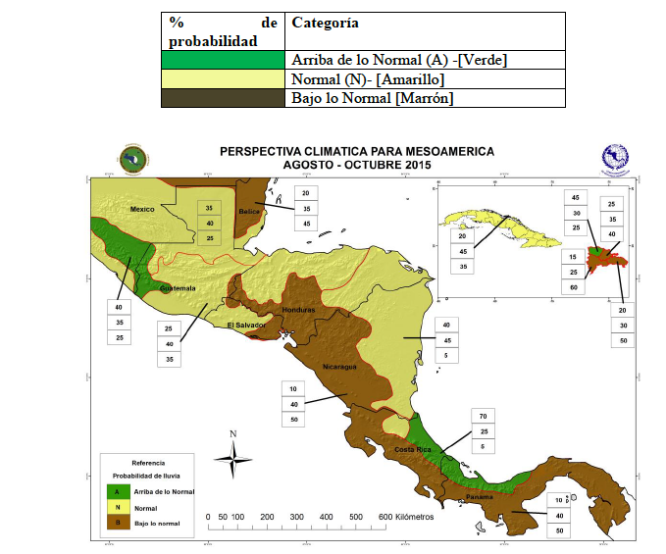
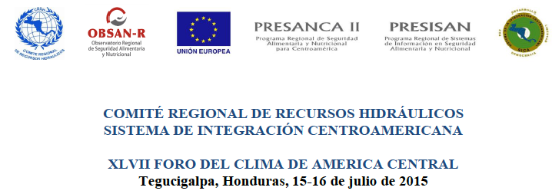
Common format for
Seasonal Climate Forecast
Regional
Categorical
Fixed

Slide 14
Information Products for
Seasonal-to-Interannual Timescales
ENSO Outlooks
“Net Assessment” seasonal forecast
“Flexible format” seasonal forecast

Slide 15
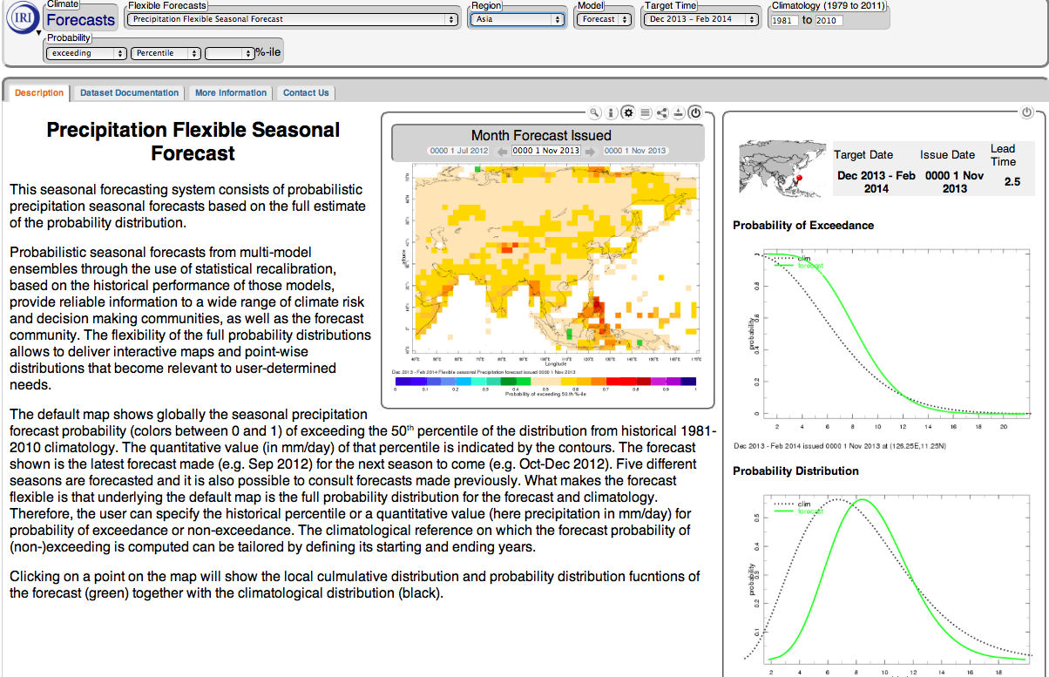

Slide 18
OBSERVATIONS
It all starts here…

Slide 19
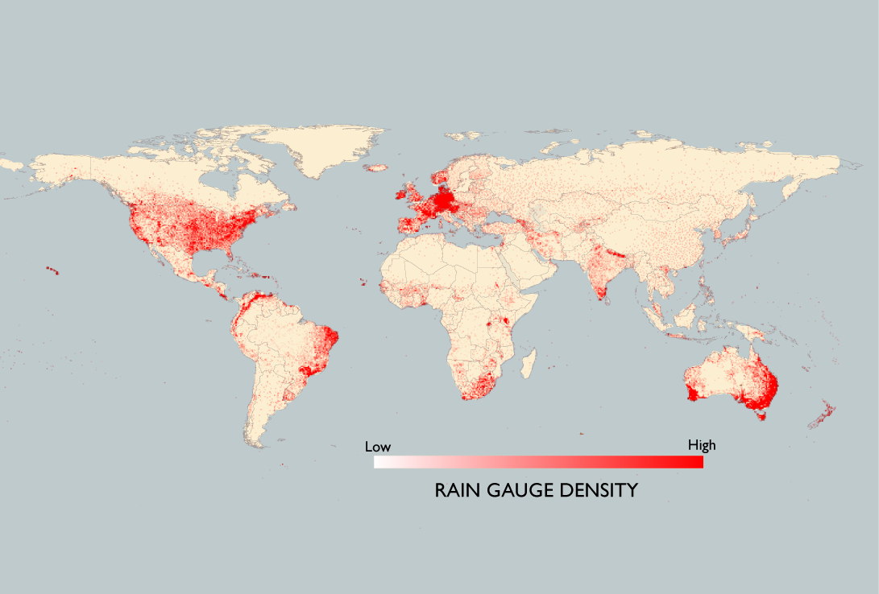
DATA POVERTY
Notes:
data poverty

Slide 20
Notes:
data poverty

Slide 21
Rain Gauges
Africa: 2,967
Germany: 4,133
Land Area
Rain Gauges
Africa: 2,967
Germany: 4,133
Africa
11.7
million sq. miles
Land Area (million sq. miles)
11.7
0.14
Germany
0.14
Africa
Germany
Notes:
data poverty

Slide 22
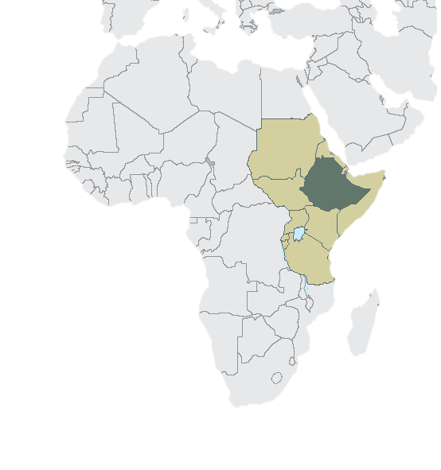
ETHIOPIA – A MODEL
Notes:
add ethiopia map

Slide 23
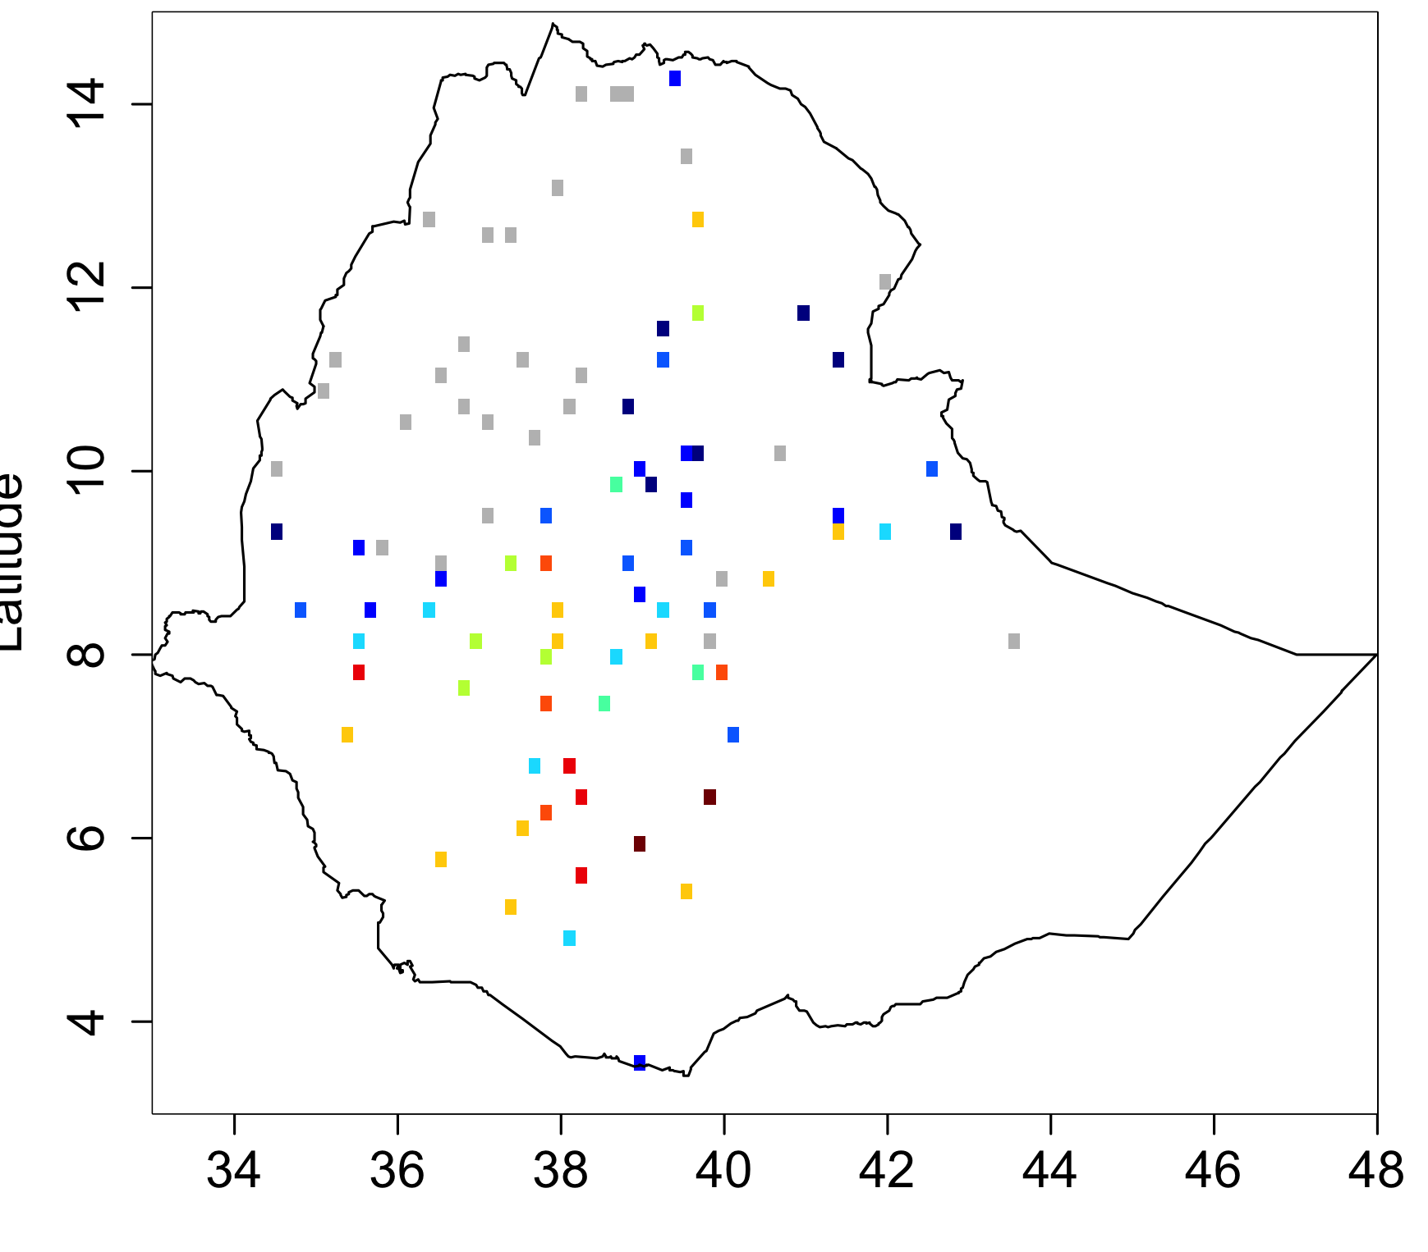
Rain Gauges

Slide 24
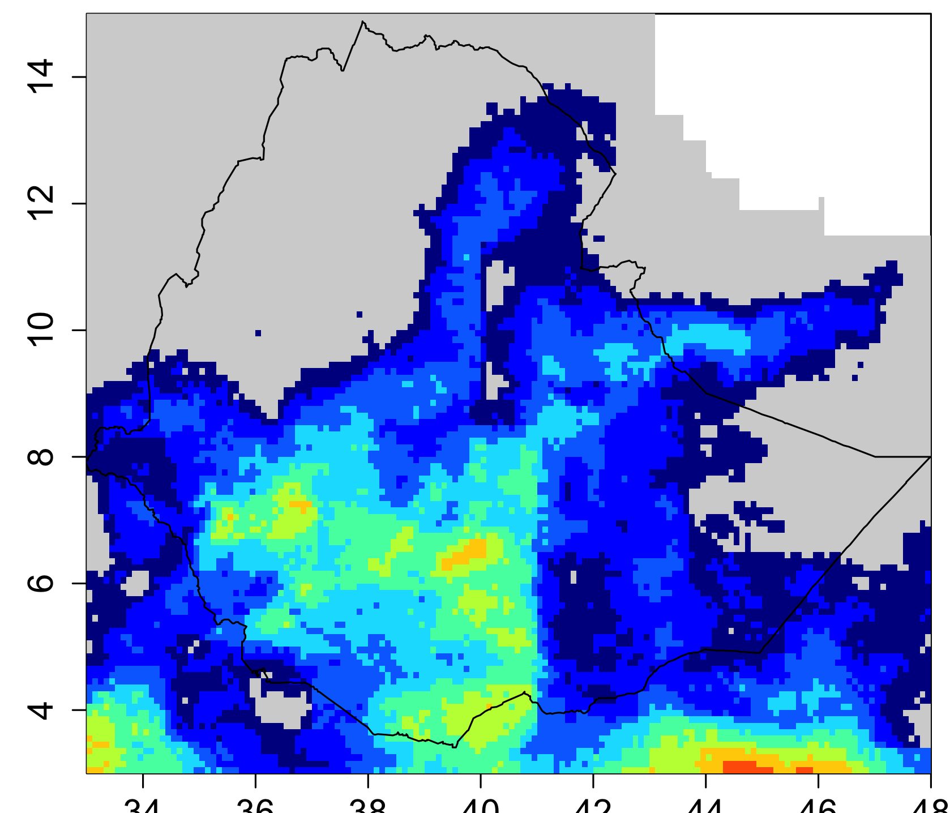
Rain Gauges
Satellite Estimates

Slide 25
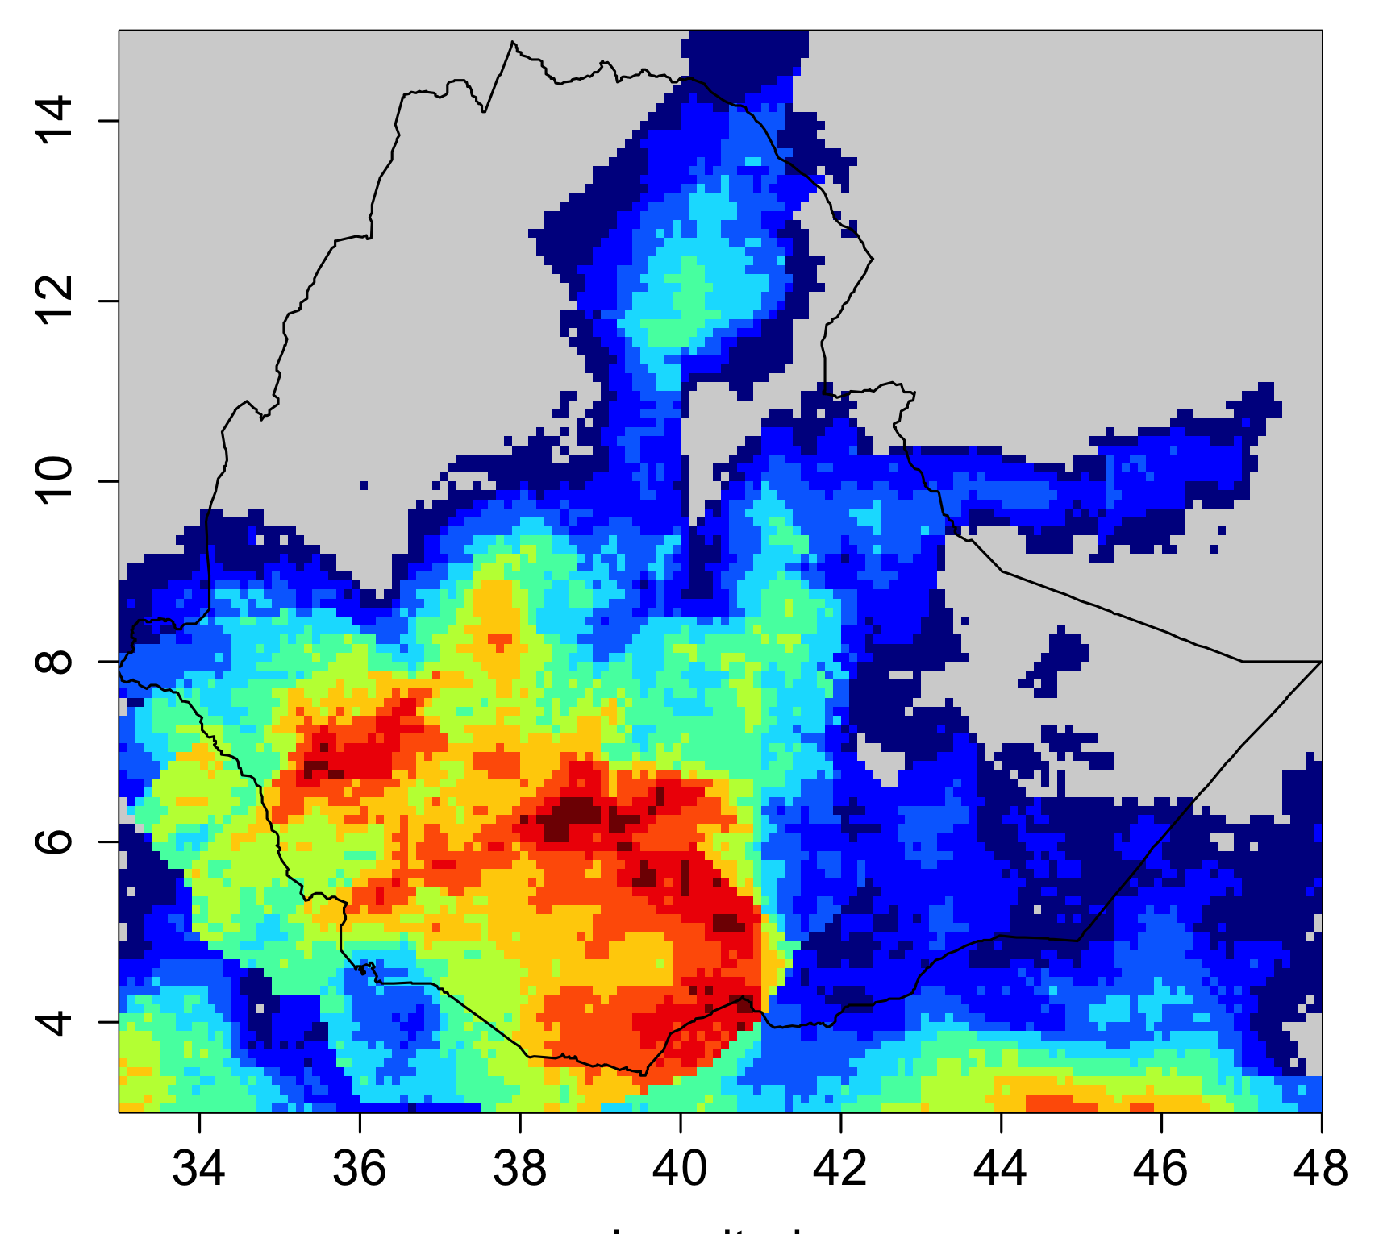
Rain Gauges
Hybrid Data Sets
Satellite Estimates

Slide 26
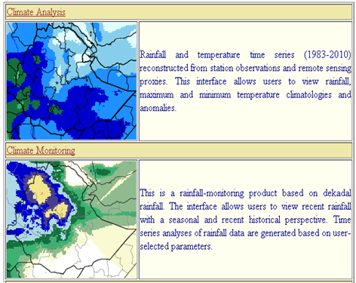
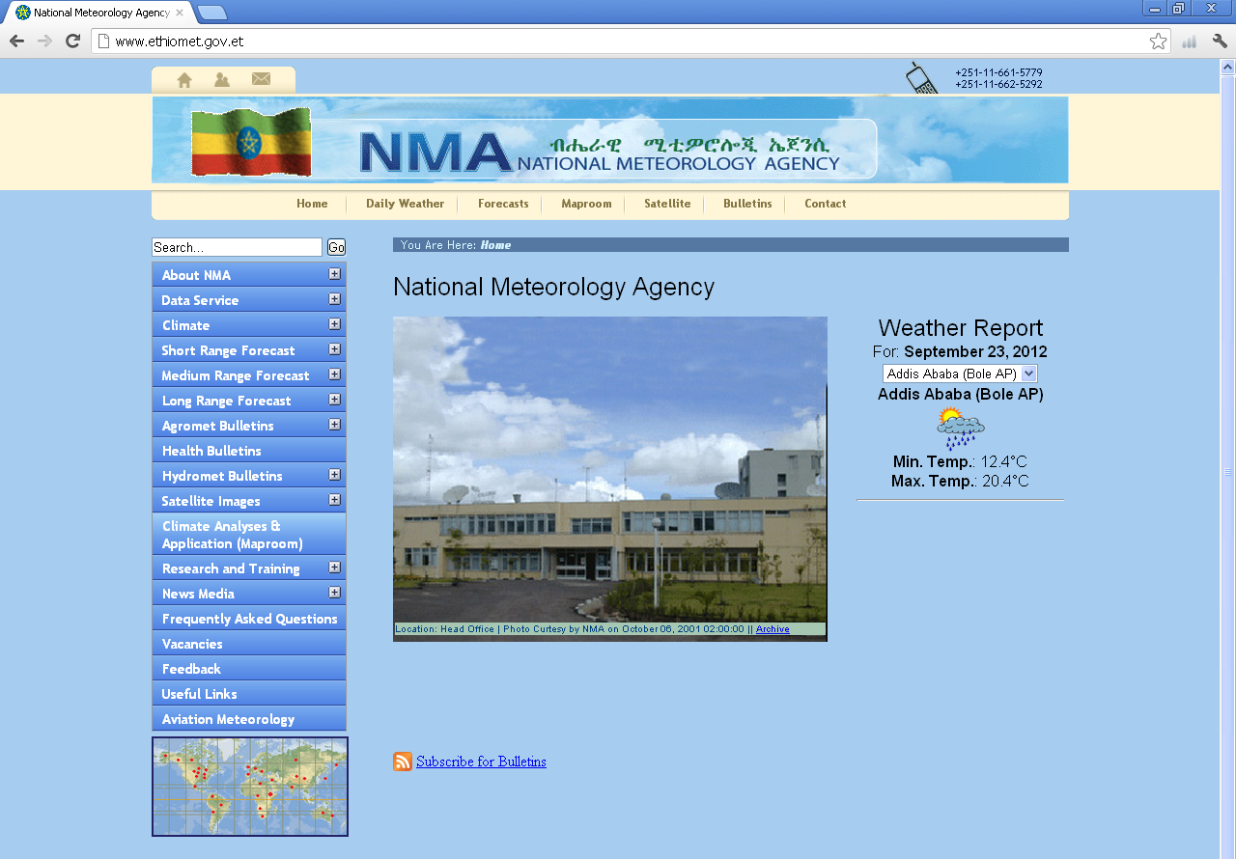
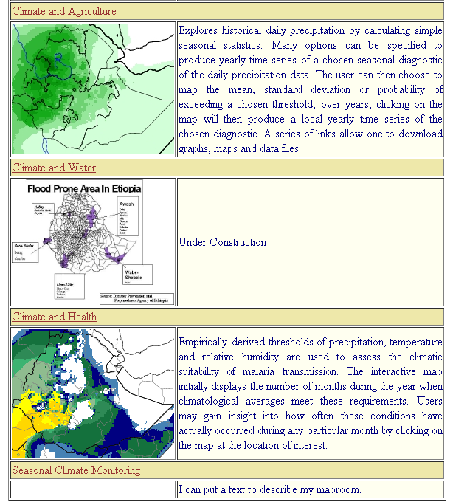
Ethiopia Climate Service: Information Delivery
The online digital climate map-room of Ethiopia: www.ethiomet.gov.et

Slide 27
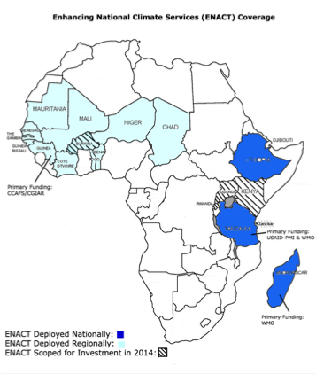





Five Pillars of IRAP Approach
2
Understand/Quantify/Reduce
Uncertainties
Enhancing National Climate Services (ENACTS)
In Ethiopia:
Anti-Malaria Association

Slide 28
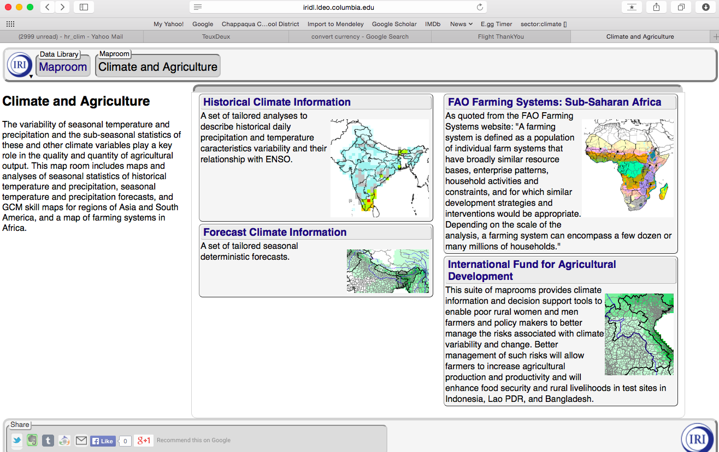

Slide 29
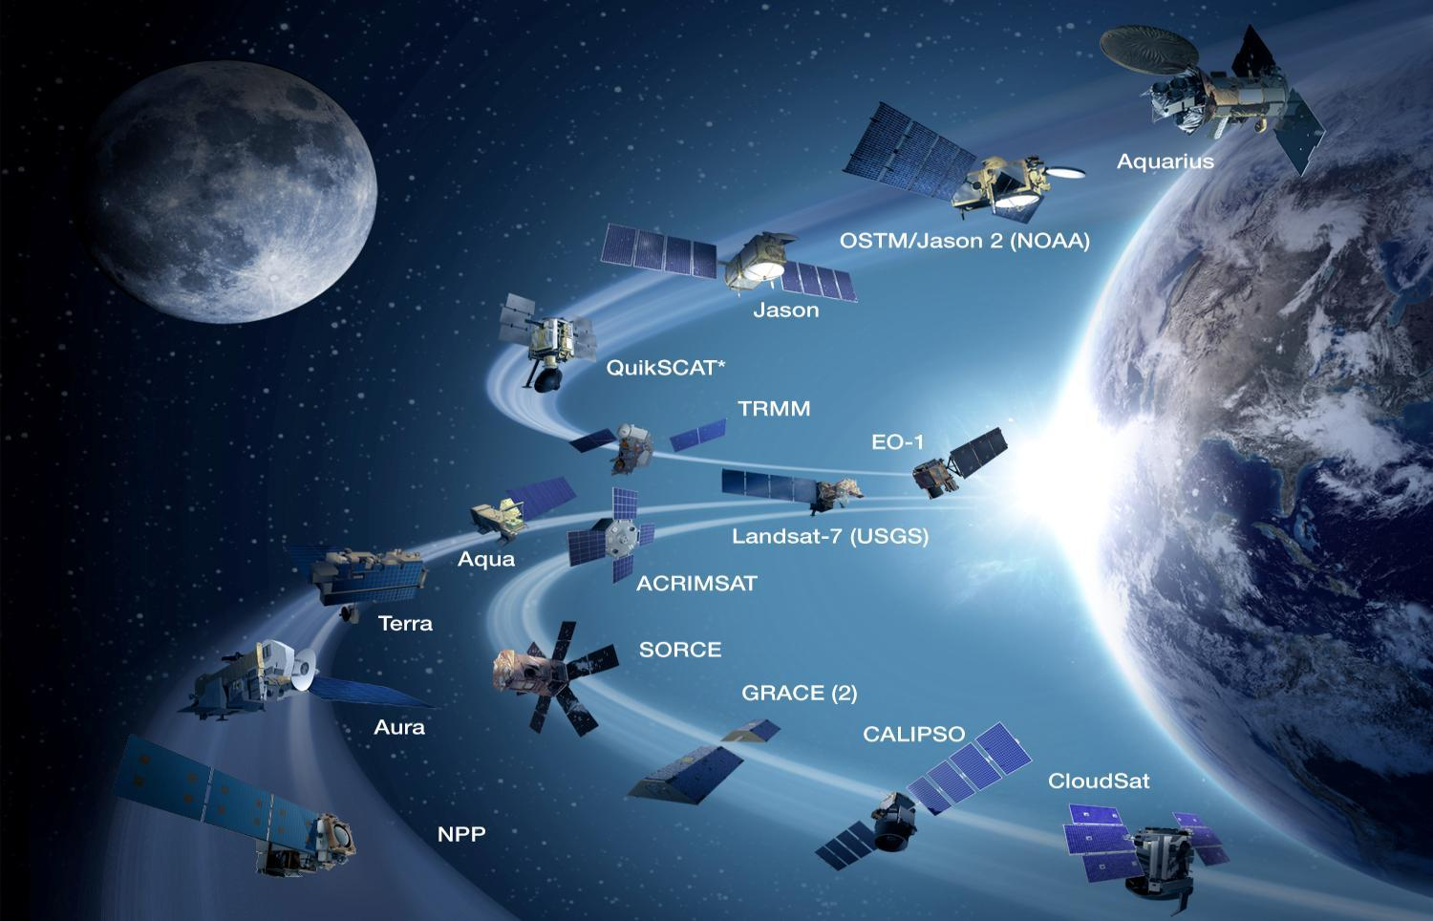
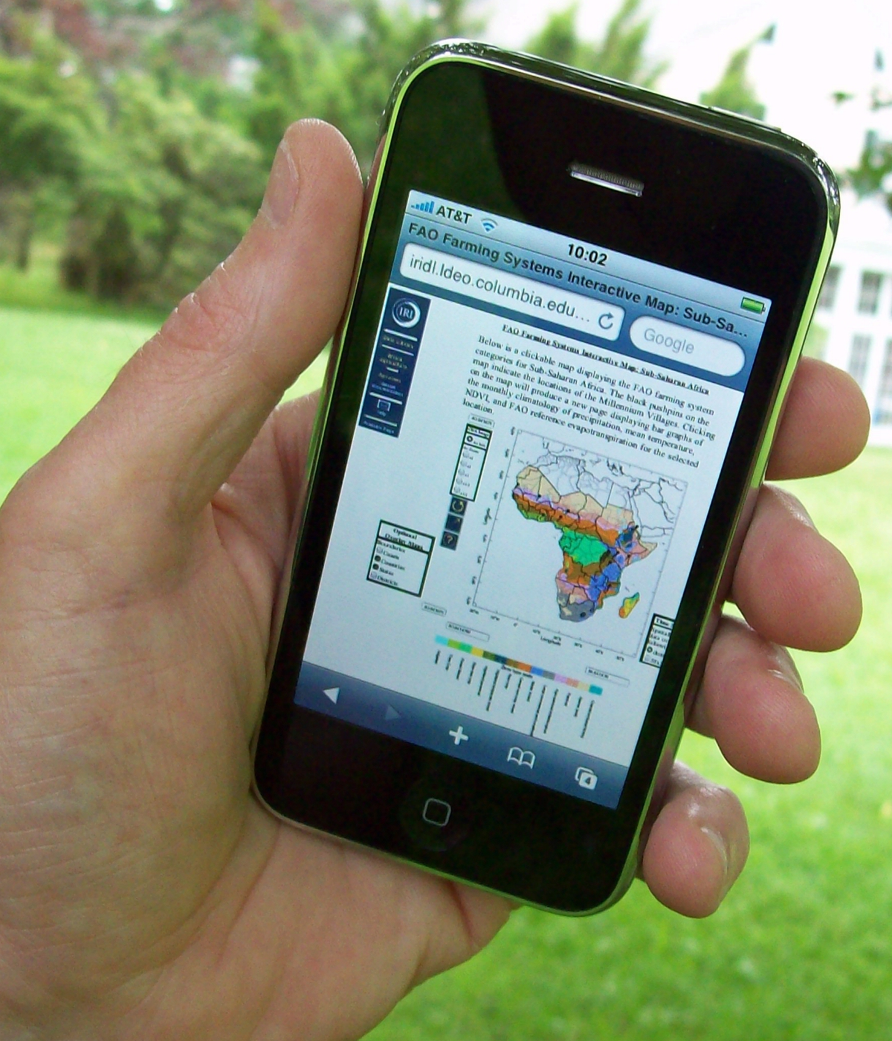
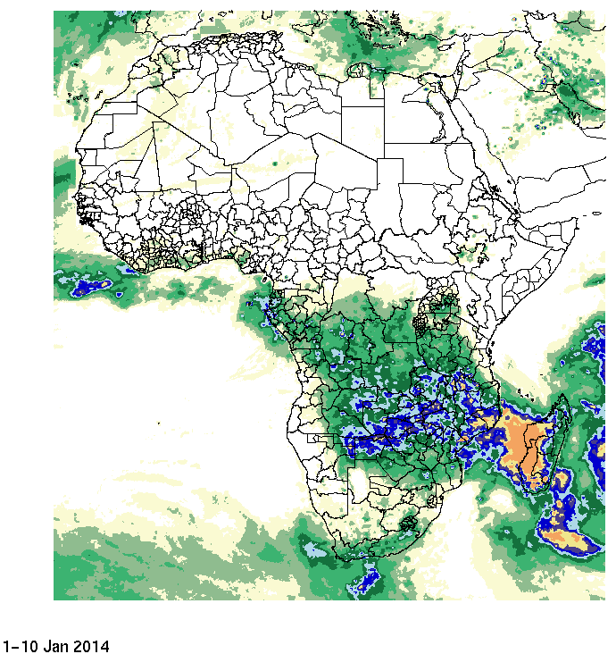
Dissemination of Information to Local Communities
Notes:
Climate services, on whatever timescale, absolutely depends on data – on observations of the past and present in order to inform our use of tools for the future, whether that is for the next week or the next decade.
Observations are an essential starting point, but they are not climate services in and of themselves.
That data must be accessible, and then translated and tailored to suit the context of the decision/action/policy.
Data is not knowledge, but that knowledge does depend on the data. We can put that knowledge into the hands of those who need it and can use it.
This is how the efforts of the scientific community, technology, and political will, can change the world.

Slide 30
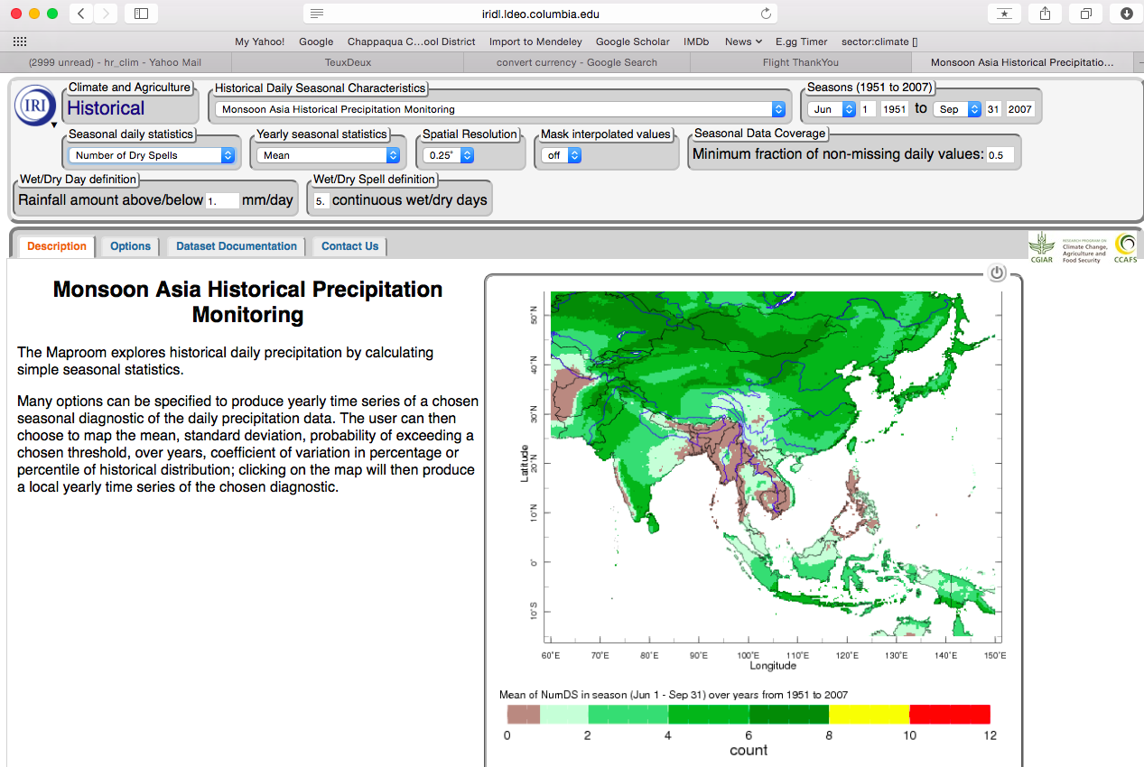

Slide 32
CLIMATE CHANGE [PROJECTIONS]
What are we adapting to?

Slide 33
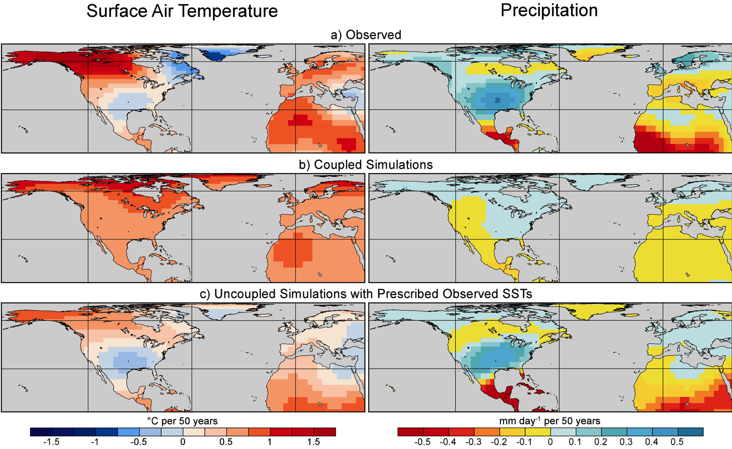
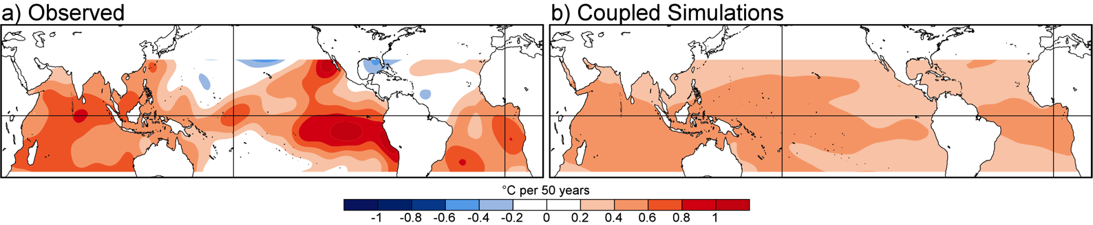
Models may not get correct pattern of trend
20th Century:
Observed patterns of T & P trends
agree better with
models that have
more realistic
patterns of
SST trends.
(Shin and Sardeshmukh,
2010, Climate Dynamics)

Slide 34
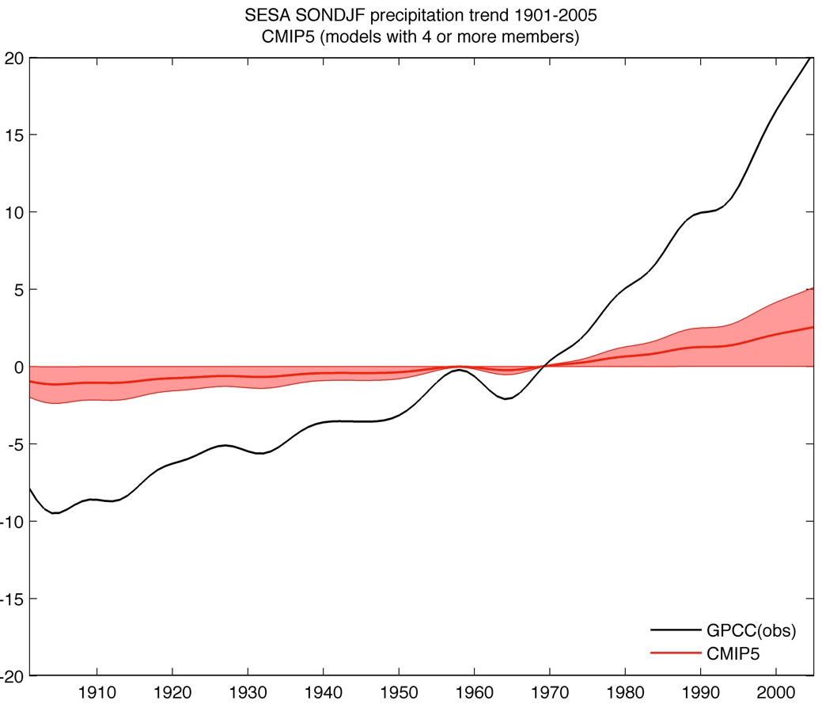
Models may not get correct magnitude of trend
Precipitation Changes over SE South America (Sep-Feb 1901-2005)
Observed Precipitation “trend”
IPCC 20th Century Simulations

Slide 35
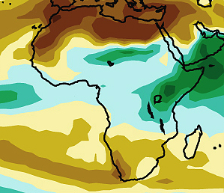
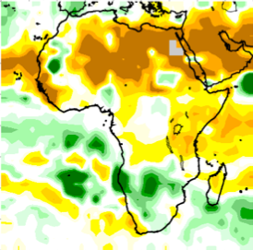
Decadal-scale variability is important
Climate Change Projections
(end of 21st century)
Observations
(last 15 years)

Slide 36
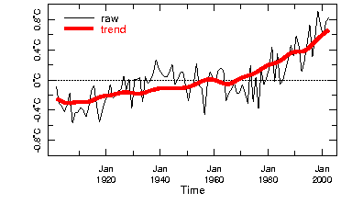
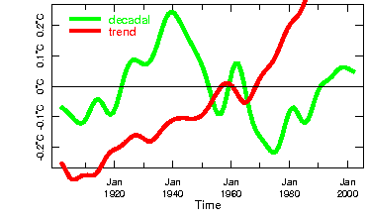
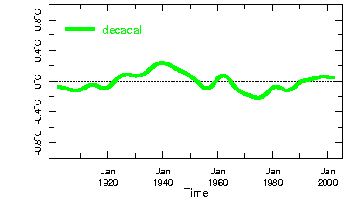
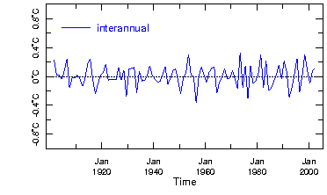
Climate Variability & Change Globally
Annual Mean Temperature
CC Hiatus?
Temperature
65%
Most of the variability in the
globally-averaged temperature
is contained in the slowly
varying “climate change”
component.
13%
CC Acceleration?
21%
(Greene, Goddard & Cousin, EOS, 2010)
Notes:
- Break up & look at relative variance
- No attribution here
Gives some sense (not complete) of how much of the future climate signal you could hope to capture by
predicting processes acting on these timescales (assuming you had skillful predictions at those timescales
for this region).

Slide 37
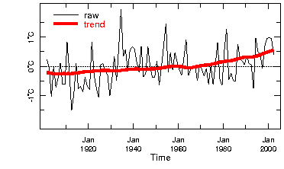
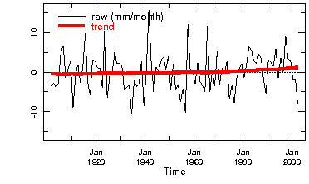
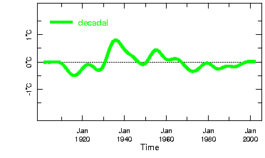
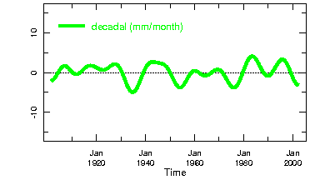
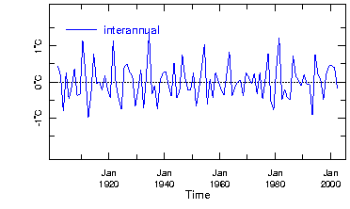
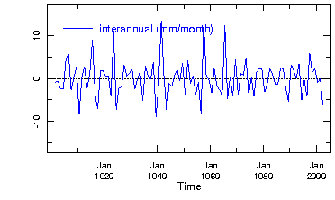
Climate Variability & Change Locally
Temperature
Observations for Colorado, USA - DJF
Precipitation
12%
1%
21%
19%
65%
75%
All timescales matter

Slide 38
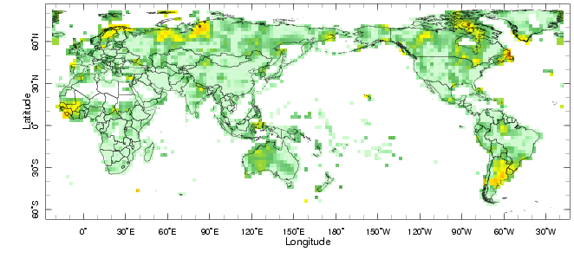

Precipitation Trends: % of total variance
20th Century Observations -- Annual Means
http://iridl.ldeo.columbia.edu/maproom/Global/Time_Scales/
Notes:
The regions with higher percentage of variance in the trends indicates that these are regions where the trend is particularly noticeable.
There are few regions where the trends is more than 10% of the observed variance. Noteworthy exceptions are southeastern South America and West Africa.
This map does NOT tell you:
What is the magnitude of the trend, particularly relative to the average rainfall. It only indicates the magnitude of the trend relative to the total variation over the 20th Century, The average rainfall over that period has been removed.
What has caused the apparent trends. This is not a statement of attribution. It is only the portion of the observed rainfall that has changed, in time, consistently with increases in globally-averaged temperatures as simulated by the models.
Whether these trends will continue with similar magnitude in the future. This is not a forecast.

Slide 39
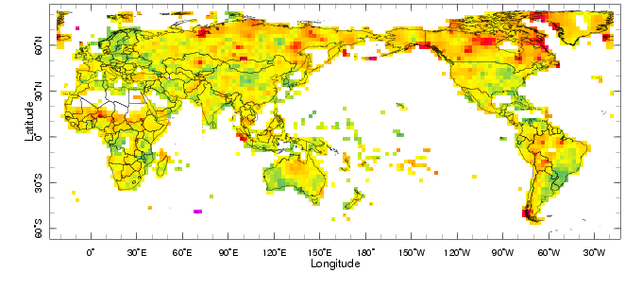
Precipitation Decadal Variability: % of variance
20th Century Observations -- Annual Means
http://iridl.ldeo.columbia.edu/maproom/Global/Time_Scales/
Notes:
The regions with higher percentage of variance in the decadal variability indicates that these are regions where information about this timescale should be considered in any analysis of trends or estimates of future “climate change”.
There are few regions where the trends is more than 10% of the observed variance. Noteworthy exceptions are southeastern South America and West Africa.
This map does NOT tell you:
What is the magnitude of the trend, particularly relative to the average rainfall. It only indicates the magnitude of the trend relative to the total variation over the 20th Century, The average rainfall over that period has been removed.
What has caused the apparent trends. This is not a statement of attribution. It is only the portion of the observed rainfall that has changed, in time, consistently with increases in globally-averaged temperatures as simulated by the models.
Whether these trends will continue with similar magnitude in the future. This is not a forecast.

Slide 40
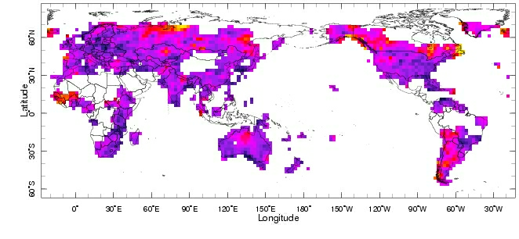
Precipitation Decadal Variability: % of variance
20th Century Observations -- Annual Means
http://iridl.ldeo.columbia.edu/maproom/Global/Time_Scales/
Notes:
The regions with higher percentage of variance in the decadal variability indicates that these are regions where information about this timescale should be considered in any analysis of trends or estimates of future “climate change”.
There are few regions where the trends is more than 10% of the observed variance. Noteworthy exceptions are southeastern South America and West Africa.
This map does NOT tell you:
What is the magnitude of the trend, particularly relative to the average rainfall. It only indicates the magnitude of the trend relative to the total variation over the 20th Century, The average rainfall over that period has been removed.
What has caused the apparent trends. This is not a statement of attribution. It is only the portion of the observed rainfall that has changed, in time, consistently with increases in globally-averaged temperatures as simulated by the models.
Whether these trends will continue with similar magnitude in the future. This is not a forecast.

Slide 41
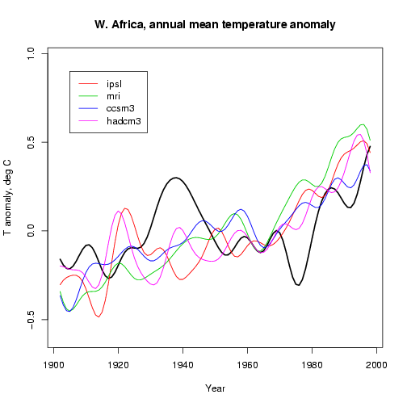
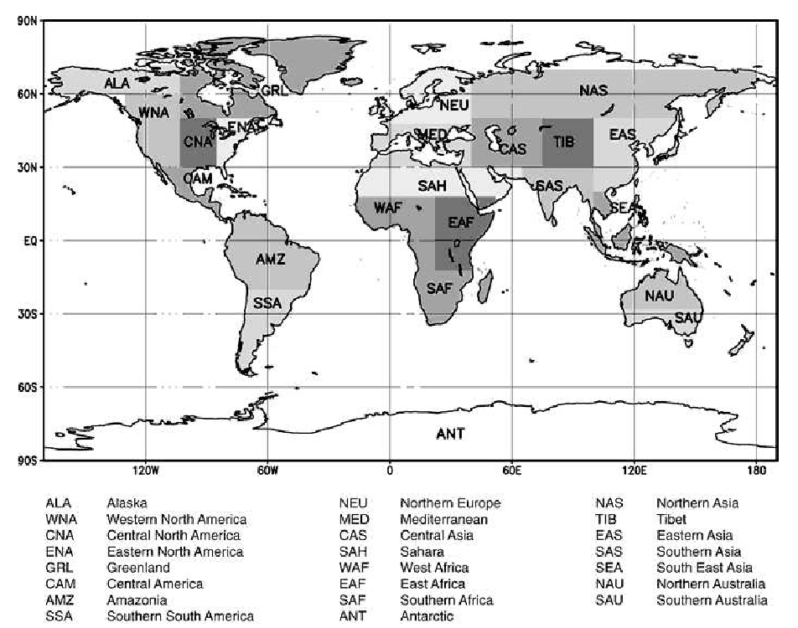
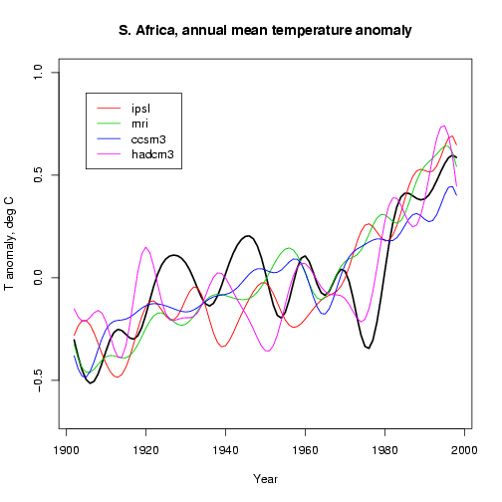
Regional Scale Decadal Predictions?
Western Africa : Annual-Mean Temperature
Southern Africa : Annual-Mean Temperature
Climate Change Projections
cannot deliver predictions
of decadal variability
Notes:
Examples from 2 regions : models in colors, obs in black
Models have decadal variability, but it is not synced in time
→ Don’t initialize ocean, for one thing
How the decadal variability (natural) plays out will influence our realization of the trend
- Lot of work in this area to start producing dynamical decadal predictions
- Until that time, we can at least provide information on the magnitude, and possibly, time scale(s) of natural low-frequency variability from the observed record, if such a long record exists.

Slide 42
INTERANNUAL-to-DECADAL
VARIABILITY
Prediction / Projection
Skill ??

Slide 43
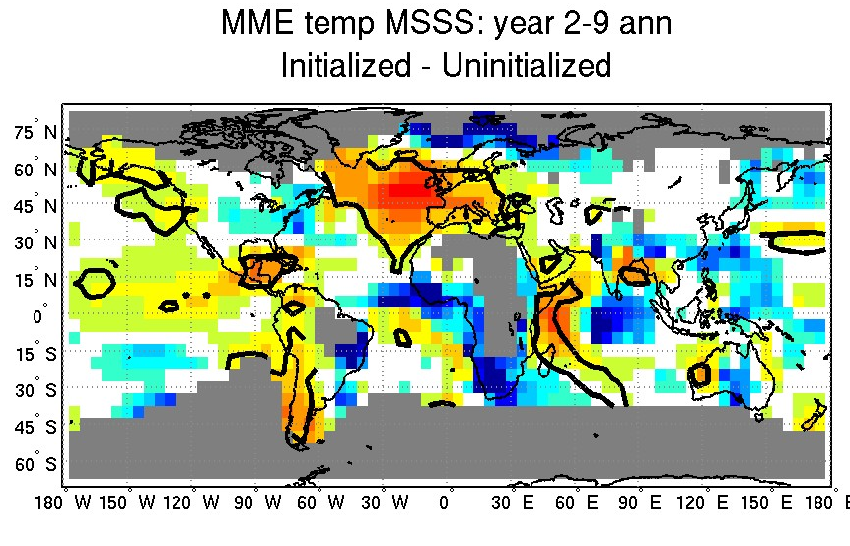
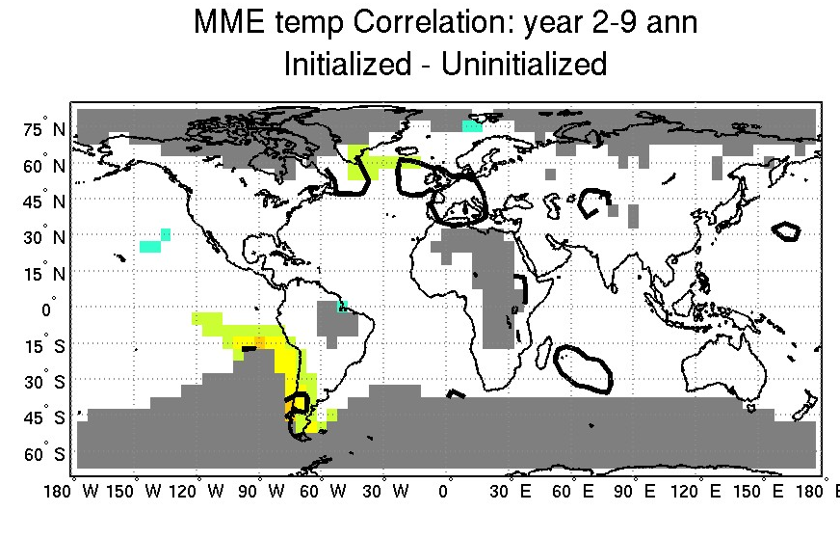
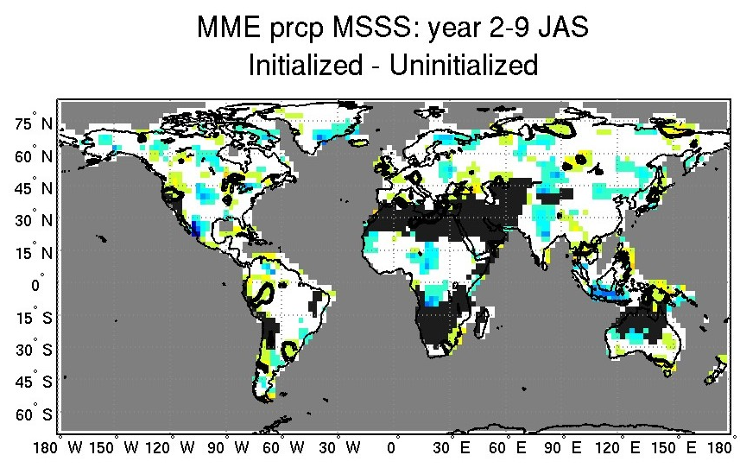
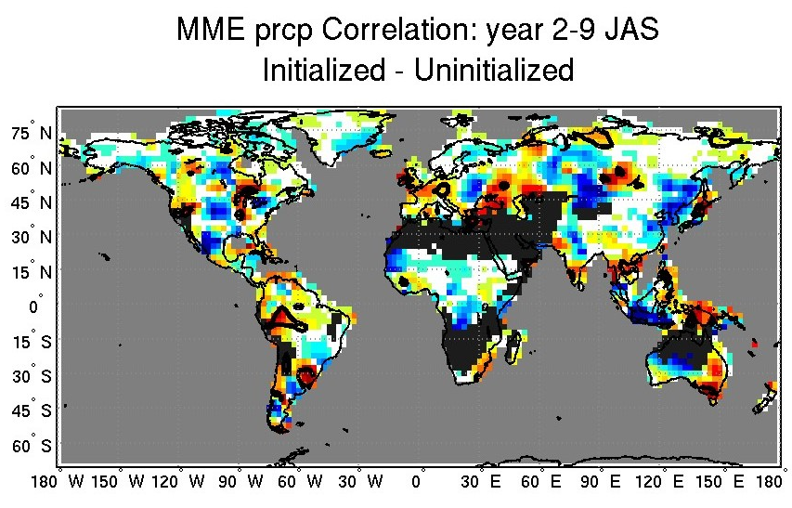
Decadal Predictions: Skill still to be demonstrated
Multi-model Ensemble (12 models: Equal Weighting )
Mean Squared Skill Score
Correlation
Annual T
Jul-Aug-Sep P
(based on Goddard et al. 2012, Climate Dynamics; See also http://clivar-dpwg.iri.columbia.edu)

Slide 44
INTERANNUAL-to-DECADAL
VARIABILITY
Capturing characteristics/quantifying risk

Slide 45
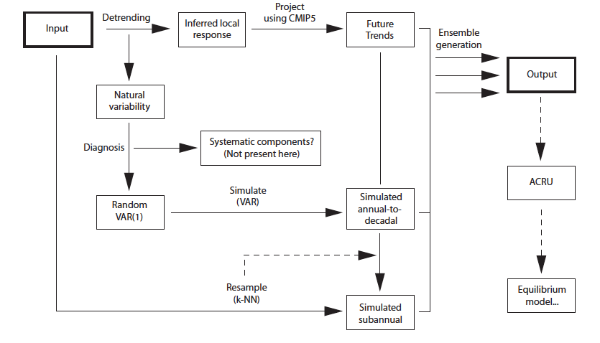




STOCHASTIC SIMULATIONS: 2 Ensemble Members
(Greene, et al. 2012)

Slide 46


STOCHASTIC SIMULATIONS: 2 Ensemble Members
Decadal Variability

