Slide 1

The Climate Services Partnership
Catherine Vaughan
Senior Staff Associate
International Research Institute for Climate & Society
June 25, 2013
Notes:
Hi, everyone … my name is Cathy Vaughan. I'm a senior staff associate here at IRI where, as one of my main responsibilities, I serve as the program manager of the international Climate Services Partnership. I am very grateful for the opportunity to spend a few minutes talking about the CSP and its relationship to the IRI.

Slide 2
Introducing the CSP
Notes:
To provide a little context …
The Climate Services Partnership is an informal interdisciplinary partnership that works to improve the provision and development of climate services. For those who don't know, "climate services" is a term we use to describe the provision of timely, tailored climate information to decision makers, generally in the forms of tools, products, websites, or bulletins.
Climate services are important in improving our ability to manage climate-related risk; as such, they are touted as an important part of the adaptation agenda.
While the IRI -- and a number of other organizations -- has been working on climate services for quite some time now, climate services have received a great deal of increased attention in recent years.

Slide 3
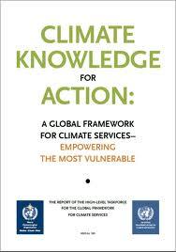
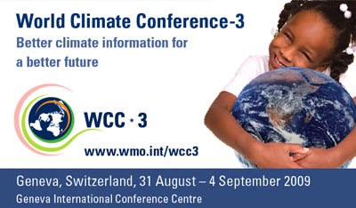
World Climate Conference - 3
Notes:
Most notably, this attention came with the third World Climate Conference, which was organized by the World Meteorological Organization in 2009. To give you a little perspective, the first World Climate Conference resulted in the creation of the World Climate Program, the World Climate Research Program, and ultimately, the IPCC. The second World Climate Conference lead to the creation of the UNFCCC.
In this context, the third World Climate Conference garnered a lot of attention -- not only from climate scientists, but also from users, potential users, and those looking to invest in climate change adaptation. It also resulted in the creation of the Global Framework for Climate Services -- which is a newly minted intergovernmental structure for enabling the development and incorporation of science-based climate information and prediction into planning, policy, and practice on global, regional, and national scales.
While the GFCS holds a lots of potential for improving the provision and development of climate services around the world, it must follow the strictures of UN system and, as such, moves a bit slow. It also has some difficulty engaging with non-governmental organizations, including for instance, humanitarian organizations, research institutes, and the private sector.
In this context, a lot of the momentum that came out of the World Climate Conference didn’t find an immediate outlet in the GFCS and thus bled into a range of different activities that were designed to help this diverse group of organizations to prime themselves to engage with climate services in the near term.

Slide 4
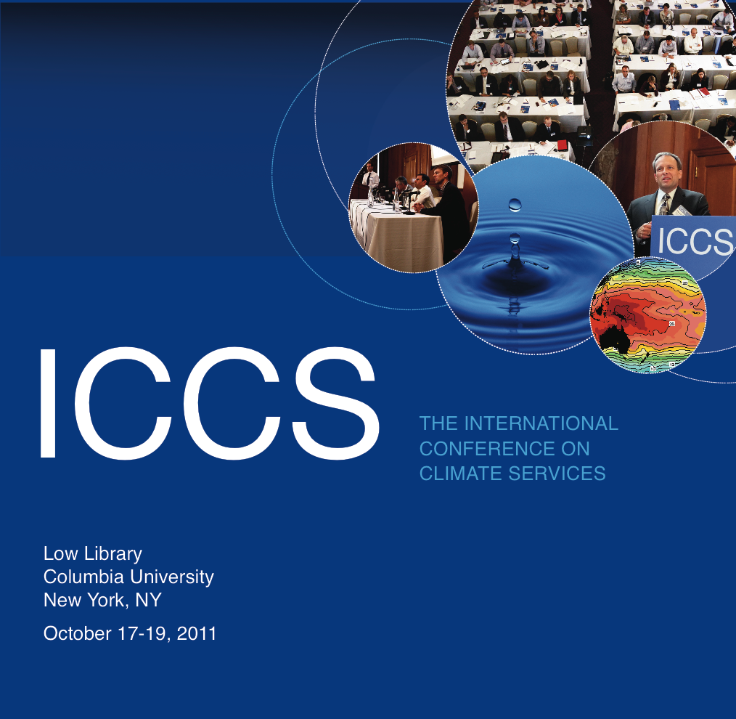
International Conference on Climate Services
Notes:
One of these was the first International Conference on Climate Services -- proposed by a consortium of organizations including NOAA, NCAR, UK Met, the CSC, USAID, and the IRI. The IRI took the lead on organizing and planning this conference, hosting it here at Columbia in 2011.
This first ICCS was a very dynamic experience, and it brought together a range of different groups -- including climate information users, providers, donors, and researchers. At the end of the three-day meeting, participants endorsed a conference statement that led to the creation of an informal alliance – that is, the Climate Services Partnership -- designed to provide a structure for continued collaboration and shared learning on climate services.
The Climate Services Partnership, articulated three goals, which I'll come back to a bit later; it was also focused on supporting the activities of the GFCS.
In this content, IRI saw the mission of the CSP as very well aligned with its own mission to improve the use of climate information for decision making and so, with the generous support of the Earth Institute, offered to host the CSP secretariat here in NY. Eventually USAID, CCAFS, and others provided additional resources that have allowed the IRI to host the secretariat for the past several years.

Slide 5
Activities of the CSP
Fostering connections
  Monthly calls, updates, international conferences
Sharing existing knowledge
  Case studies, guidance review, webinar, compendium of capacities, etc.
Generating new knowledge
  Evaluation methodologies, etc.
Notes:
I recognize it's been a long day, so I don't want to get too bogged down into the various activities of the CSP -- but I do want to give some general outlines so I'm sure you all know what kinds of things we're talking about.
I'd of course be more than happy to talk offline with anyone who'd like to learn more; there are also representatives from quite a few other CSP members in the audience, who can provide more details.
Anyway, the CSP works toward three goals, which I'll quickly flip through here
1. Fostering connections
The CSP hosts a number of activities to improve connections between and among climate information users, providers, donors, and researchers, including monthly phone calls, a quarterly newsletter, and of course the International Conference on Climate Services itself; the last one took place in Brussels, Belgium in September. We're looking forward to ICCS 3 in December in Jamaica.
2. Sharing existing knowledge
The CSP also seeks to share existing knowledge and experience on climate service development and provision. To this end, we've compiled a database of more than 30 case studies of current climate service activities; these case studies have also been synthesized to provide overarching lessons. A more academic paper is forthcoming.
We're also working with the German Climate Service Center and the European Joint Programming Initiative to conduct a survey of global climate service capacities. A related activity involves a review of existing climate service guidance materials, providing potential users with a road map of what's out there, and offering some perspective on where future efforts should concentrate.
We've also got a white paper and webinar series; the next webinar will take place at the end of the week and two new white papers are expected at the end of the summer.
3. Generating new knowledge
The CSP is also working to draw on the resources of our large membership to push forward on certain issues essential to the improvement of climate services. In this realm, we have a rather large effort directed toward developing and testing methodologies for evaluation; we've also got activities geared toward developing ethical principles for climate services and are gearing up to start a working group to identify research priorities for climate service development.

Slide 6
Climate Services Partnership in the world
Notes:
The IRI has invested quite a bit of time and energy into the CSP over the last few years, and in the time that remains I'd like to talk about the returns on this investment.
First, I'd like to stress that the CSP is improving the way that climate services are developed and provided around the world.
In many ways, this has to do with the current state of knowledge regarding climate service development and provision.
That is, while the WCC both created and responded to interest in climate services from a range of sectors and all regions of the world, there is still a lot of confusion on what constitutes good practice and how different kinds of organizations should work together to provide useful information to the end user.
The CSP provides a place where researchers can share what they've learned and where users can ask for advice regarding how to best use the reams of information that are now coming their way. In this sense, the CSP responds to a very real need -- and I think that's evidenced from the interest we've seen around the world.
While the CSP has been a nexus of knowledge sharing, it's also important to point out that the CSP creates a platform for more formal collaboration - and that these collaborations are improving the climate services that are provided.
An easy example here is a collaboration between the International Environmental Data Rescue Organization and the African Center for Meteorological Applications for Development, which was brokered directly by the CSP secretariat.
Of course, it's always possible that this collaboration would have developed without the CSP, but the timeframe would have certainly been different … we believe this is true with other collaborations as well, including the range of activities on which CCAFS, IRI and USAID are now collaborating.

Slide 7
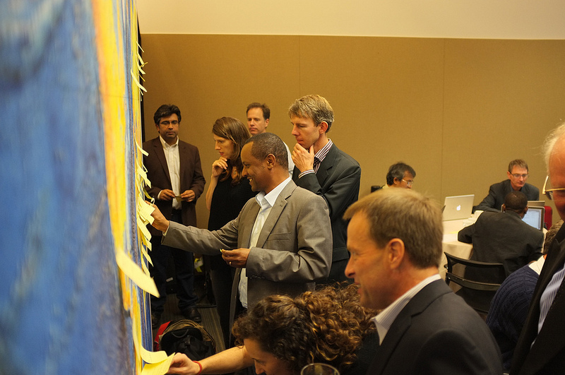
Climate Services Partnership in the IRI
Notes:
As I mentioned earlier, the CSP’s goal of improving the provision and development of climate services is consistent with IRI’s mission. In that sense, the CSP provides the IRI a new way to achieve its goal of enhancing society's capability to understand, anticipate and manage the impacts of climate in order to improve human welfare and the environment.
An example of this is a working group on research priorities for climate services; this group will provide a platform for IRI to share and pursue what it considers the most pressing research needs.
The CSP provides an opportunity to learn from other organizations engaged in climate service activities.
By creating a platform for exchange, the CSP also creates an opportunity for IRI to more easily learn from activities going on in other places. This is not just because the CSP hosts an annual conference for the exchange of ideas, but also because of the range of different communications mechanisms it has created.
An example I have at hand here, involves the use of lessons on stakeholder engagement learned by two large-scale European projects, CLIM RUN and EUPORIAS, which we recently incorporated into stakeholder engagement workshops in Central America.
Finally, the CSP creates access to new partners and funding opportunities.
Of course, this is just a logical extension of the points I’ve made above, but I think its bears a special mention. By locating the IRI at the center of international discussions regarding climate services, the CSP has created a number of opportunities for IRI, creating new opportunities for financial support to do important, interesting work.
A personal example came when I was collecting information for a CSP quarterly update a year or so ago; the Caribbean Institute for Meteorology and Hydrology forwarded along a call to work with them and the University of the West Indies on capacity development regarding climate risk management in the water sector.
I forwarded this opportunity to the partnership as a whole, but in my capacity as regional program coordinator for Latin America and the Caribbean, I also applied for it as well, which resulted in an interesting and substantial three-year collaboration.

Slide 8
Questions? Comments?
Climate Services Partnership
www.climate-services.org
Catherine Vaughan
cvaughan@iri.columbia.edu
Notes:
Anyway, I apologize if I went on a bit too long; as I mentioned, I’m happy to talk more afterward if there’s anyone who wants to know more about the activities of the CSP, or the its relationship to IRI.

