Slide 1
Climate and Health:
Opportunities and Challenges
Madeleine C. Thomson

Slide 2
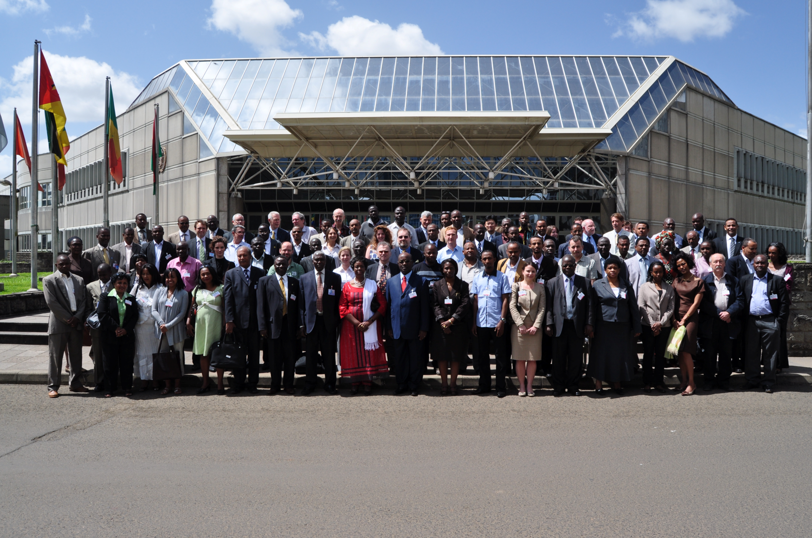

Climate and Health
Madeleine C Thomson
Theme 1 Policy
Theme 2 Practice
Theme 3 Services and Data
Theme 4 Research and Education
4-7 April 2011
Addis Ababa
IMPACT at Scale

Slide 3
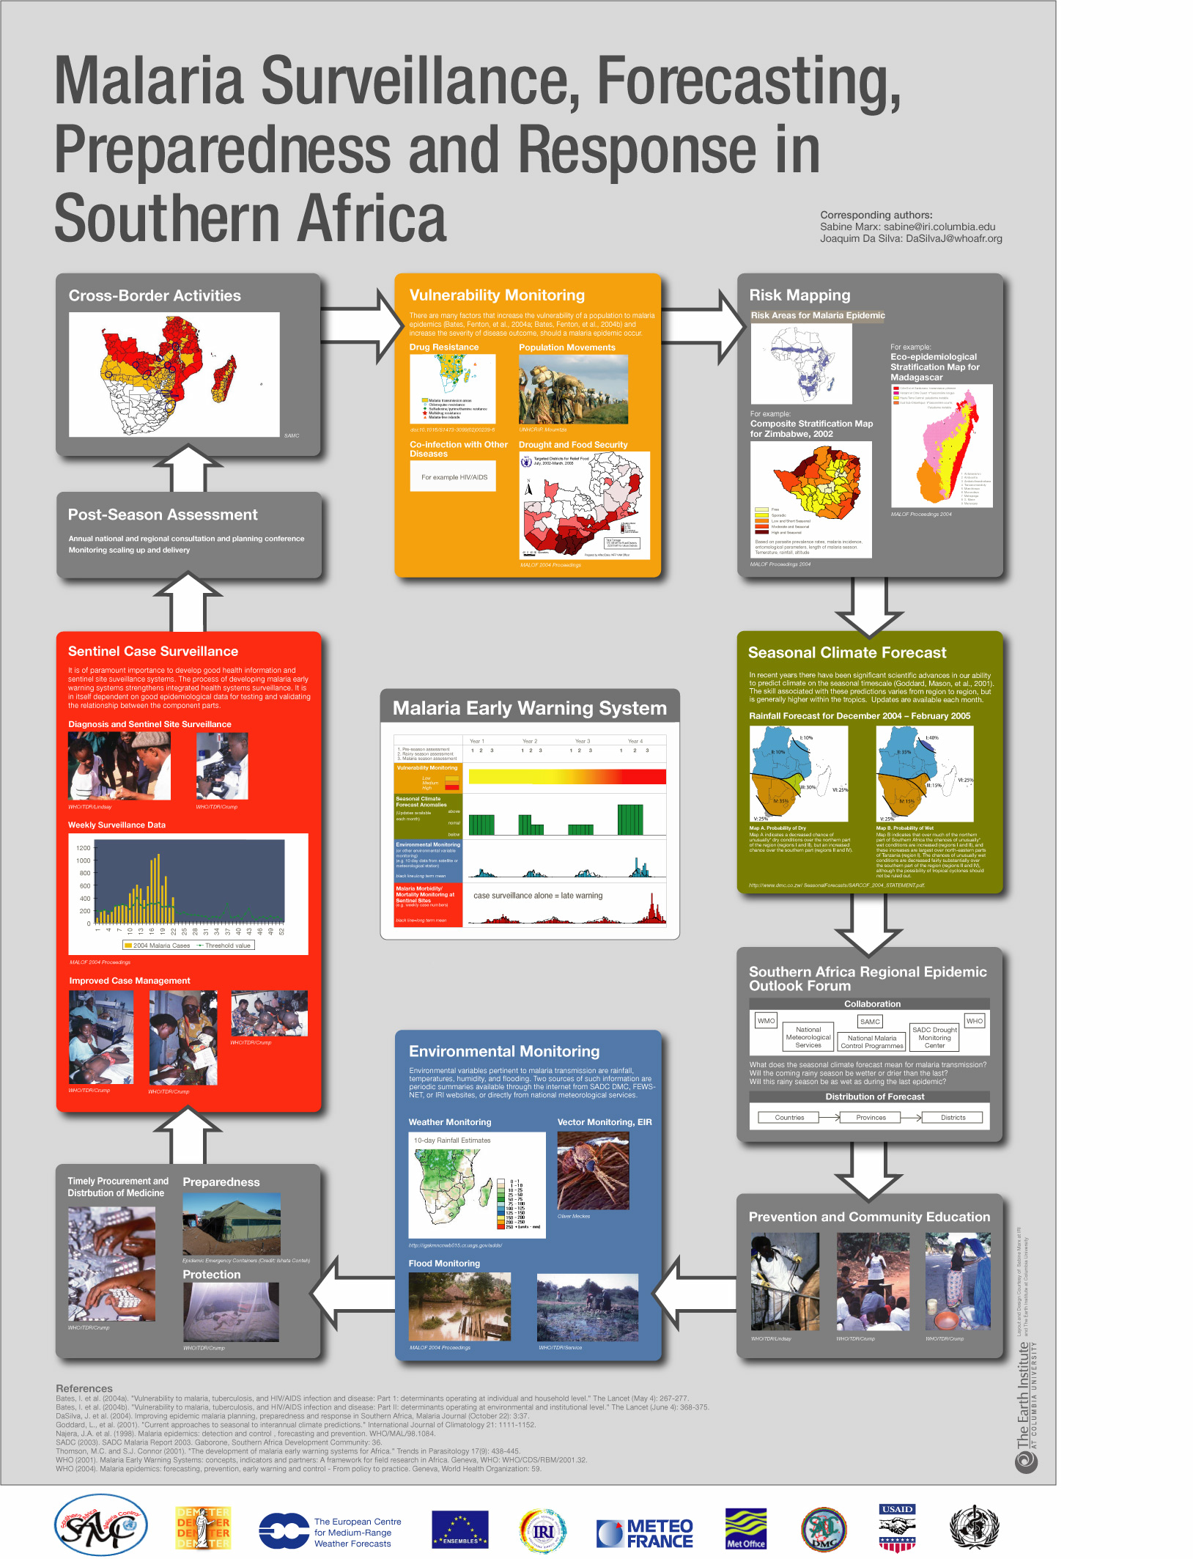
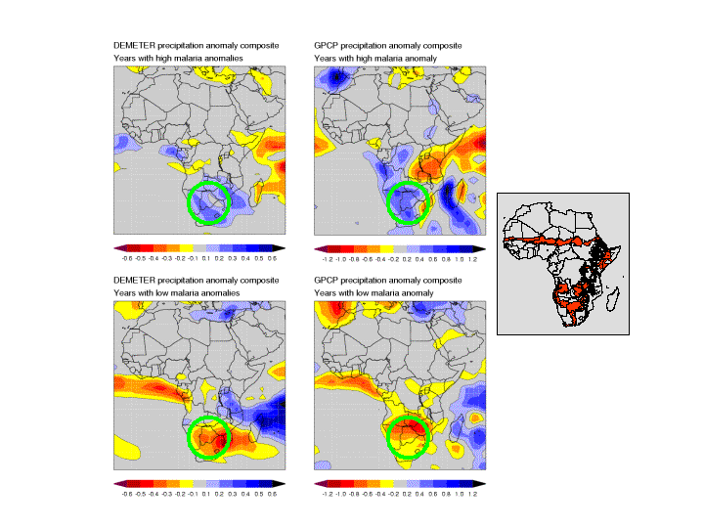
Climate forecasts Satellite rainfall
5 month warning 2 months warning
Botswana 1982-2002
5 high malaria anomaly years
WET
DRY
5 low malaria anomaly years
Thomson, M. C., F. J. Doblas-Reyes, S. J. Mason, R. Hagedorn, S. J. Connor, T. Phindela, A. P. Morse, and T. N. Palmer, 2006: Malaria early warnings based on seasonal climate forecasts from multi-model ensembles. Nature, 439, 576-579.
Notes:
Seasonal climate forecasts (left) and satellite based rainfall (right) give 5 and 2 months warning of changes in epidemic risk in Botswana
Thomson, M. C., F. J. Doblas-Reyes, S. J. Mason, R. Hagedorn, S. J. Connor, T. Phindela, A. P. Morse, and T. N. Palmer, 2006: Malaria early warnings based on seasonal climate forecasts from multi-model ensembles. Nature, 439, 576-579.

Slide 4
Innovation areas:
improve understanding of the mechansisms of climates impact on transmission and disease
estimate populations at risk (risk mapping)
estimate seasonality of disease and timing of interventions
monitor and predict year-to-year variations in incidence (including early warning systems)
monitor and predict longer term trends (climate change impacts and vulnerability assessments)
improve assessment of the impact of interventions (by removing climate as a confounder)

Slide 5
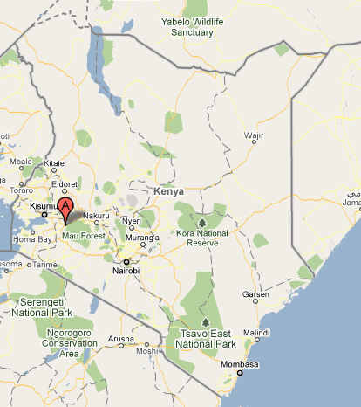
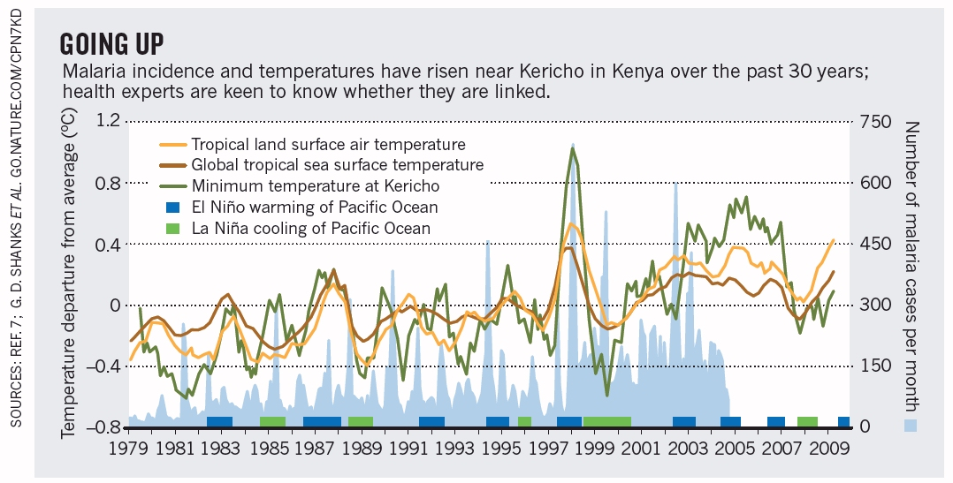
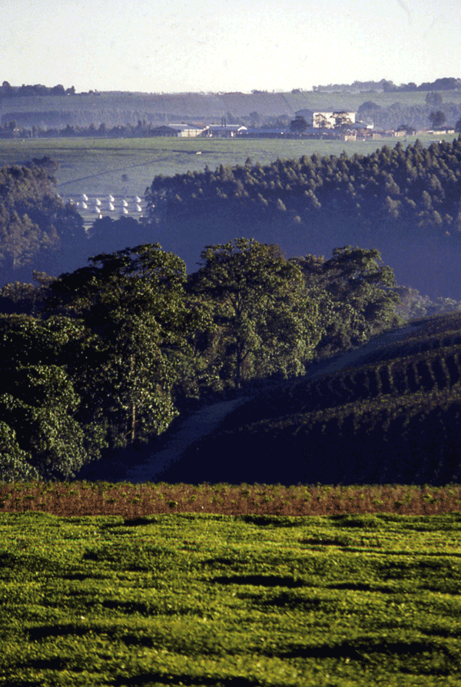
Is it warming in Kericho?
if yes – is the warmng due to climate change?
If yes – has this warming impacted on malaria
Thomson, et al., (2011) Africa needs climate data to fight disease. Nature, 471 440-442
Omumbo, et al., (2011) Raised temperatures over the Kericho tea estates: revisiting the climate in the East African highlands malaria debate Malaria Journal 10.1186/1475-2875-10-12

Slide 6
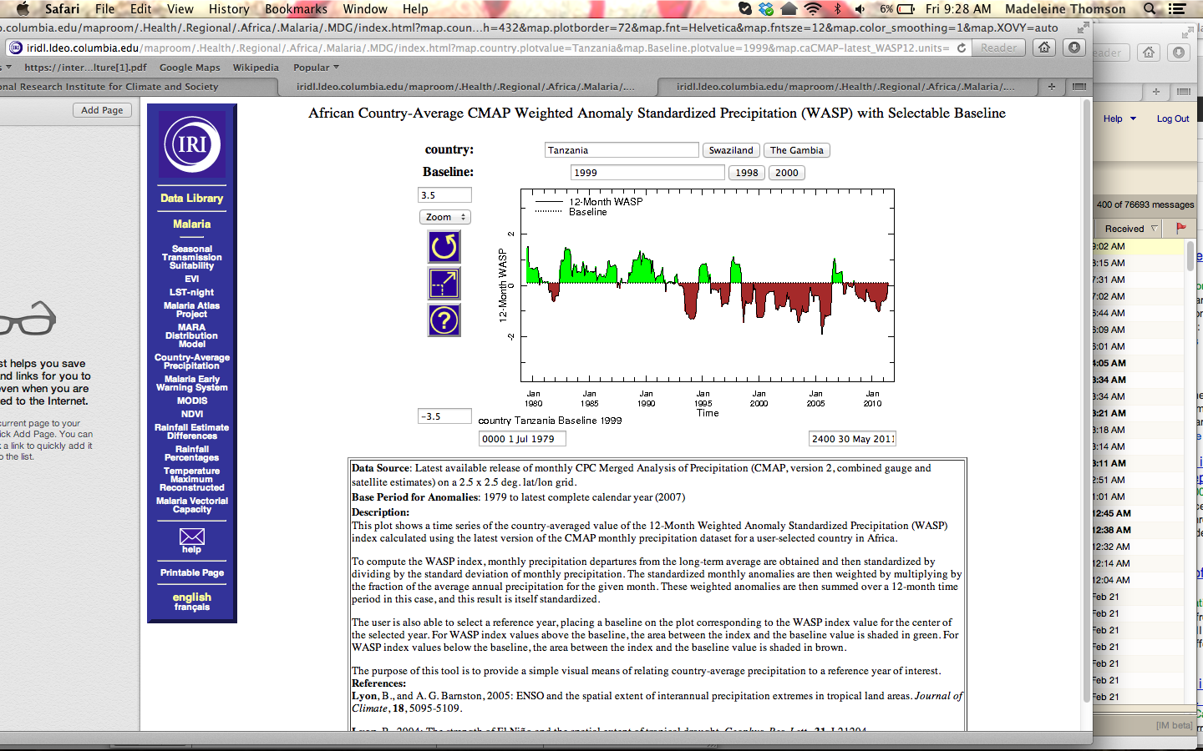
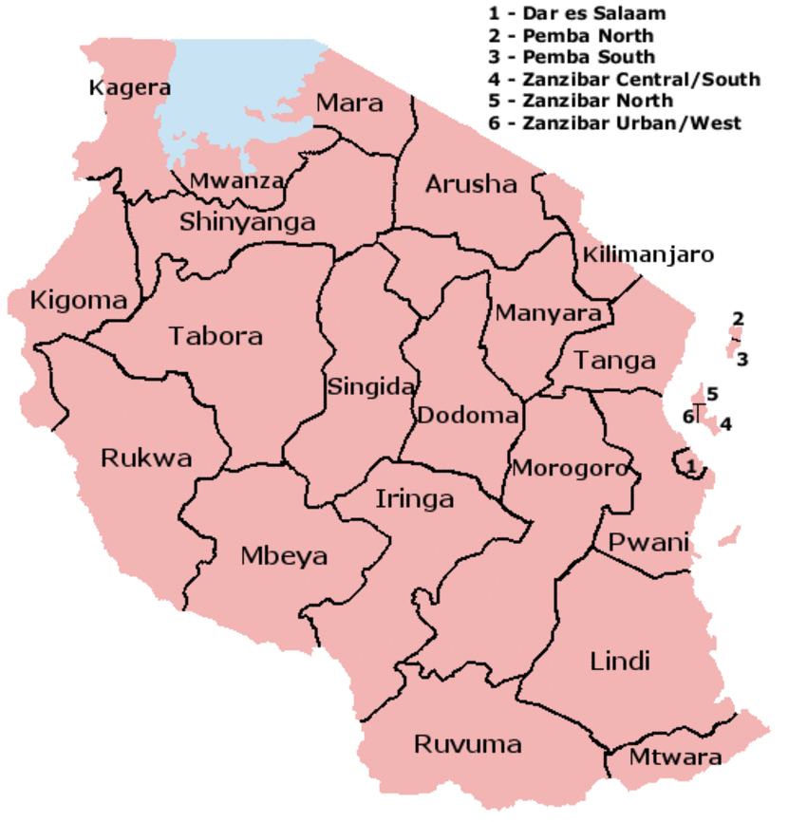
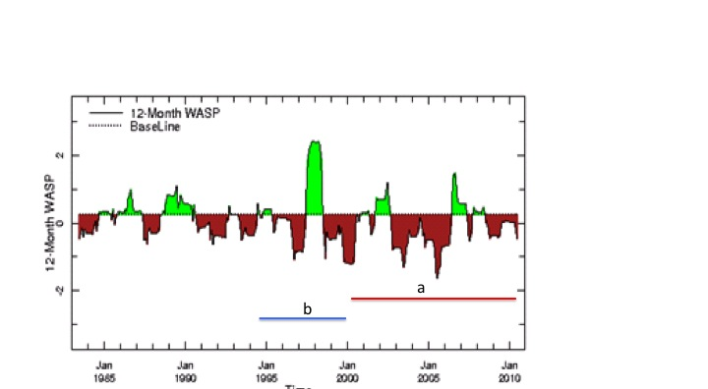
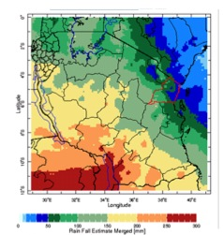
Tanzania Rainfall/Drought Analysis for The Presidents Malaria Initiative

Slide 7
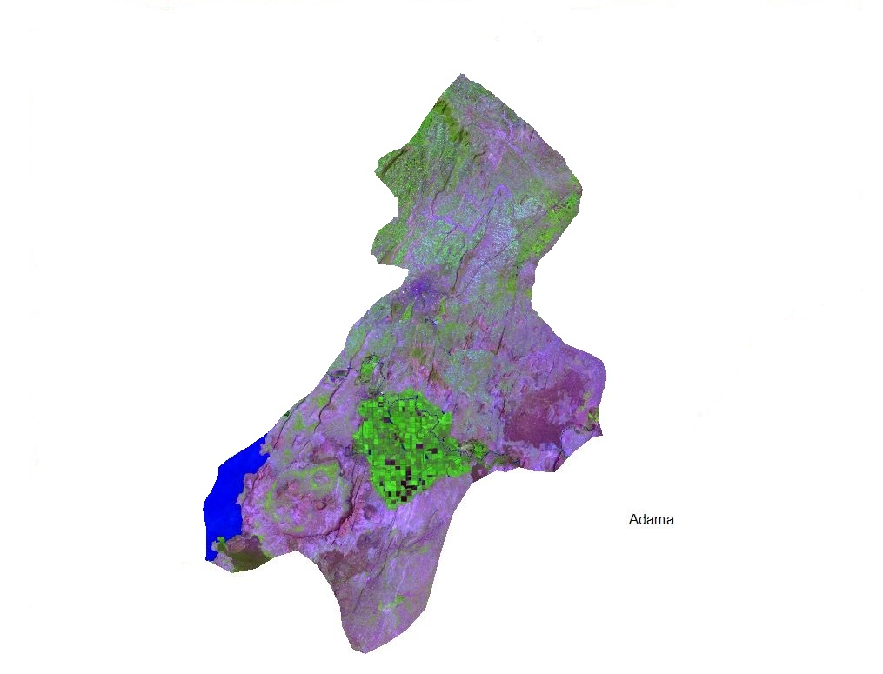
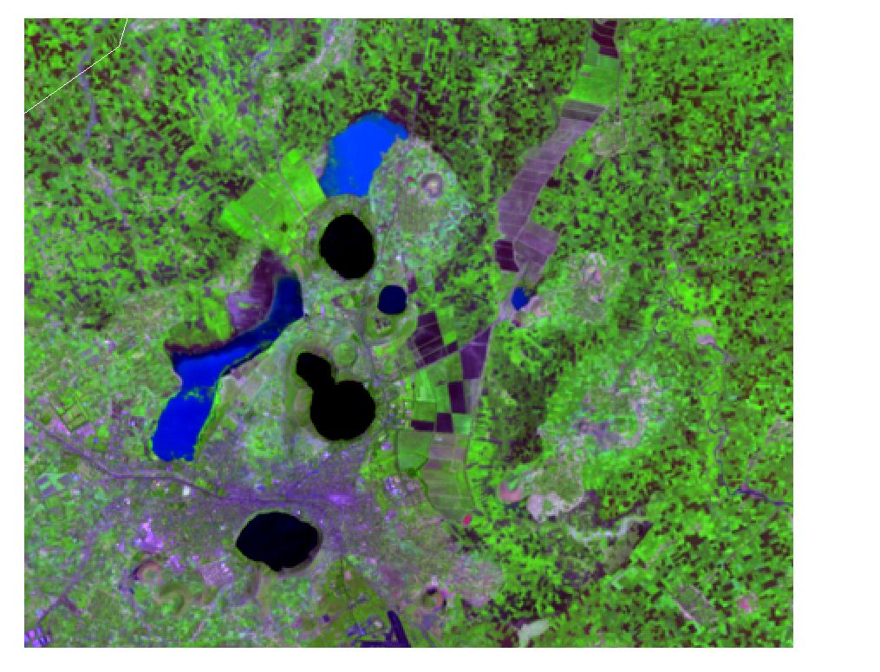
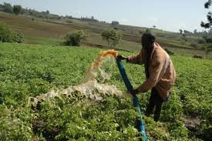
Malaria control and elimination and food security in conflict in East Shoa - Ethiopia
Woreda and sub-Woreda analysis

Slide 8
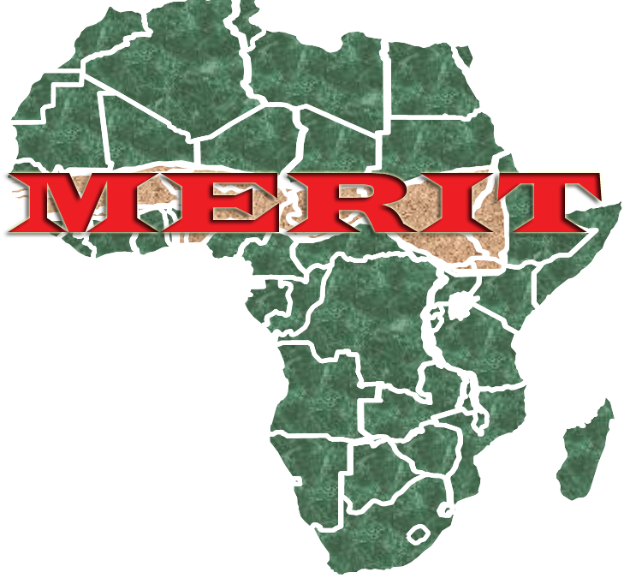


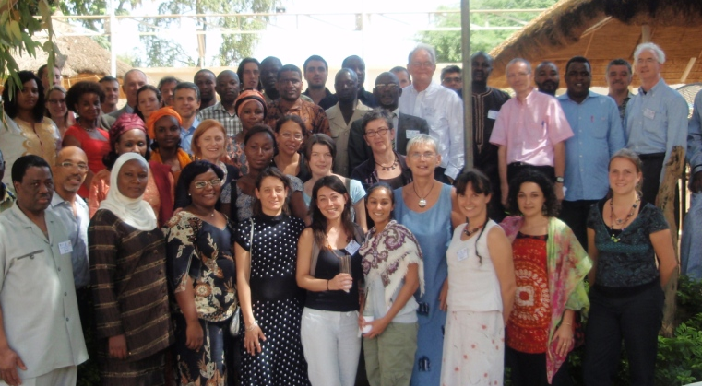







MERIT (Meningitis Environmental Risk Information Technologies) Partnerships –
3rd Technical MERIT meeting Niamey 2009.
Notes:
The Role of the IRI?
bridge the gap between ‘state of the art’ climate science and resource-constrained ground-level action aimed at preventing, detecting and controlling epidemics

Slide 9
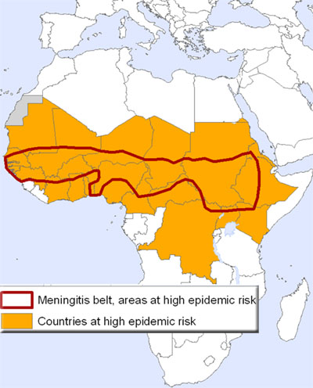
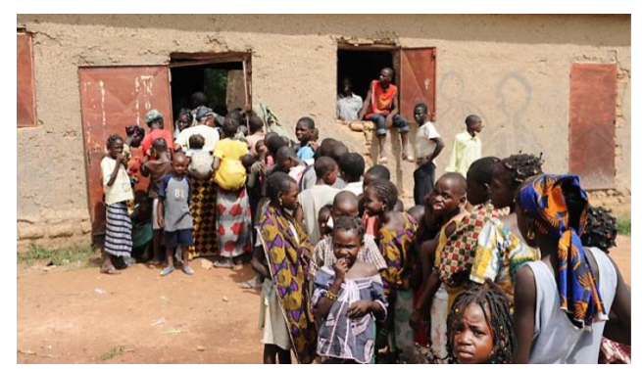
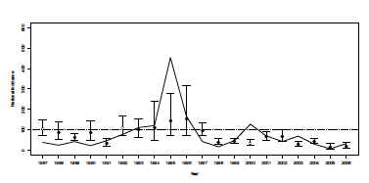
Meningococcal Meningitis A
Prevention and Control strategies
Reactive - polysaccharide vaccine – used in response to epidemic (A, C, X etc)
Proactive – Conjugate vaccine – used to prevent epidemics of Meningococcal Meningitis A.

Slide 10
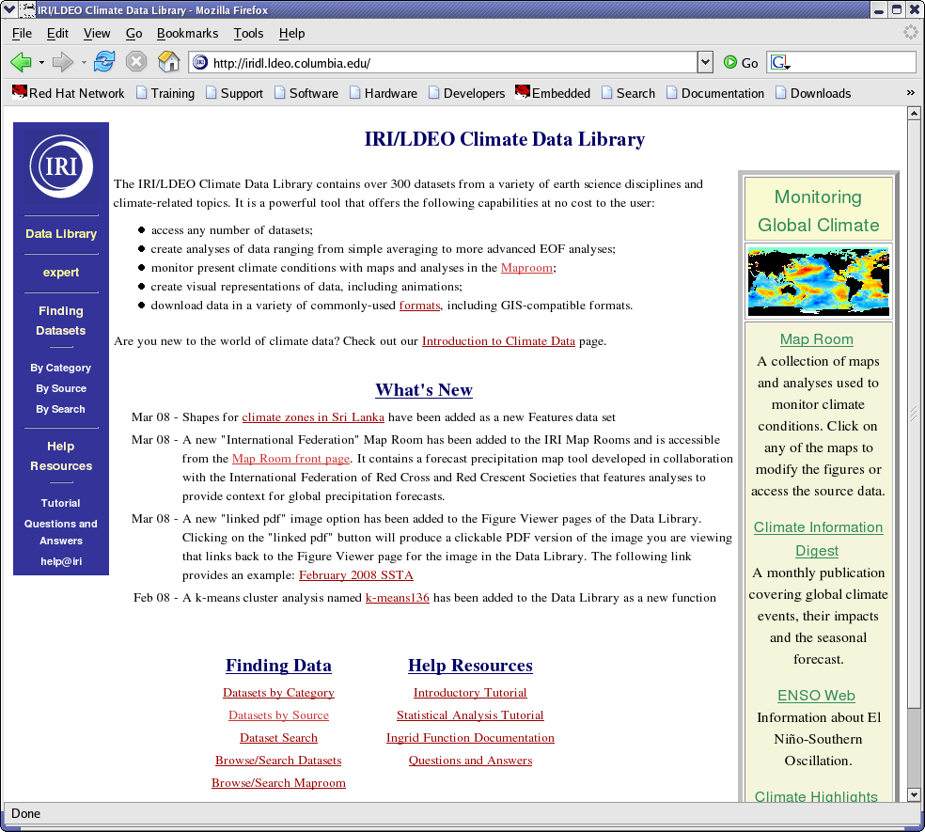
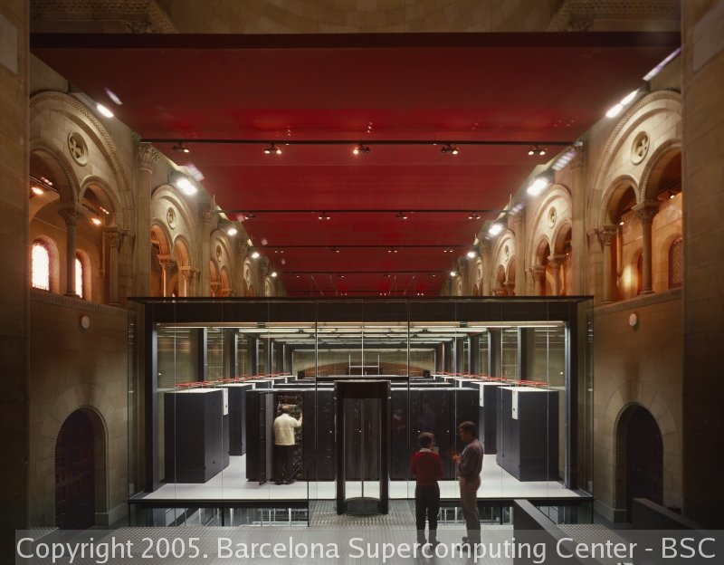
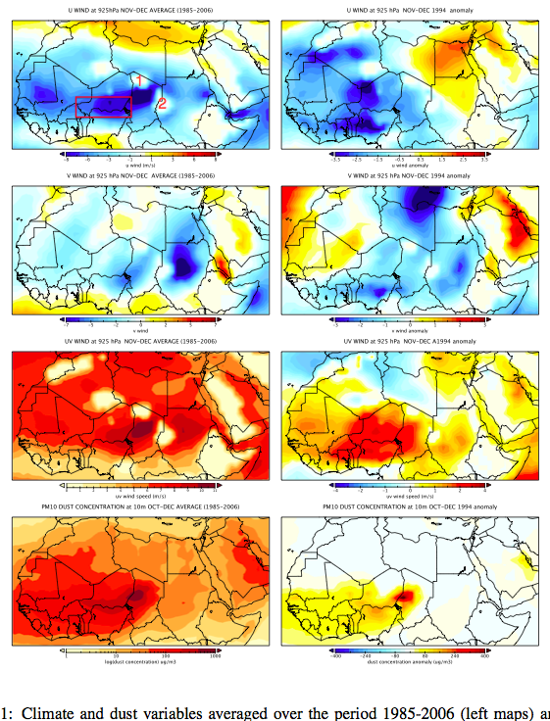
SDS – WMO - MERIT
Pérez, C., et al. (in press). "Soil dust aerosols and wind as predictors of seasonal meningitis incidence in Niger." Environmental Health Perspectives

Slide 11
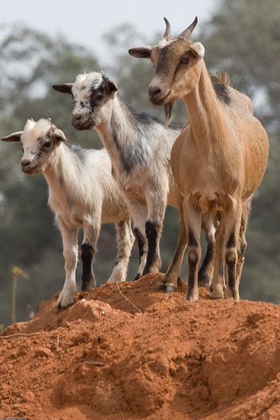
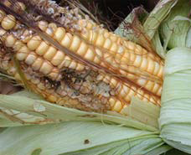
Learning for plant and animal diseases
Peste des Petite Ruminants
Aflatoxins are toxic carcinogenic by-products of the moulds Aspergillus flavus and Aspergillus parasiticus

Slide 12

Infectious disease
Nutrition
Food Security
Maternal Care

Slide 13
Climate Sensitive Public Health Challenges: Infectious Diseases, Disasters, & Nutrition
Innovate
Undertake natural and social science research to build the evidence
Demonstrate
Educate
Educate key researchers and practitioners in the use of environmental information for public health decision making
Engage Key stakeholders including WHO
Serve
Provide services and facilitate a growing global community of practice with new data, tools and methodologies
Demonstrate the utility of the climate information in real world
Advocate
Monitor and evaluate changes in behaviour and outcomes
Promote evidence-based approach
Assess how best to communicate results
Develop new technologies
.
Learning environment (students, professionals, public)
Web Interface and product delivery
Data Library – Expert mode/Map rooms
CIPHA CENTER: Climate Information for Public Health Action

Slide 14
Thank you
Madeleine C. Thomson
mthomson@iri.columbia.edu

