Slide 1
Climate Diagnostics
and Modeling
Bradfield Lyon & IRI Climate Group

Slide 2
The Role of Climate Diagnostic Research
Undertake strategic research to address fundamental climate
questions that arise in regional settings…
Innovative climate research at IRI builds institutional credibility,
is critical to establishing research partnerships going forward (US
and beyond)
Diagnostic analysis can help build climate science capacity in
developing countries where we’re working
Funding agencies are increasingly looking for applications of more
fundamental research -- an advantage for partnering with IRI and
for IRI securing funding

Slide 3
Three Illustrative Examples
Southeast South America – Thinking outside the box
The Sahel – Addressing fundamental questions
East Africa – Event-driven analysis

Slide 4
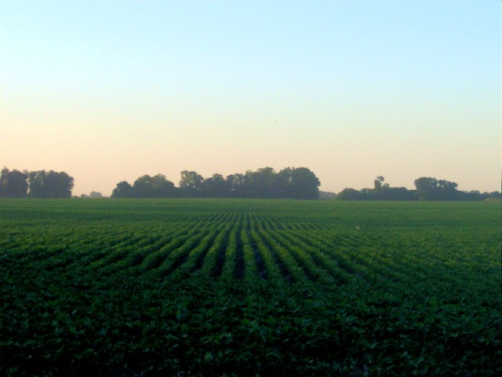
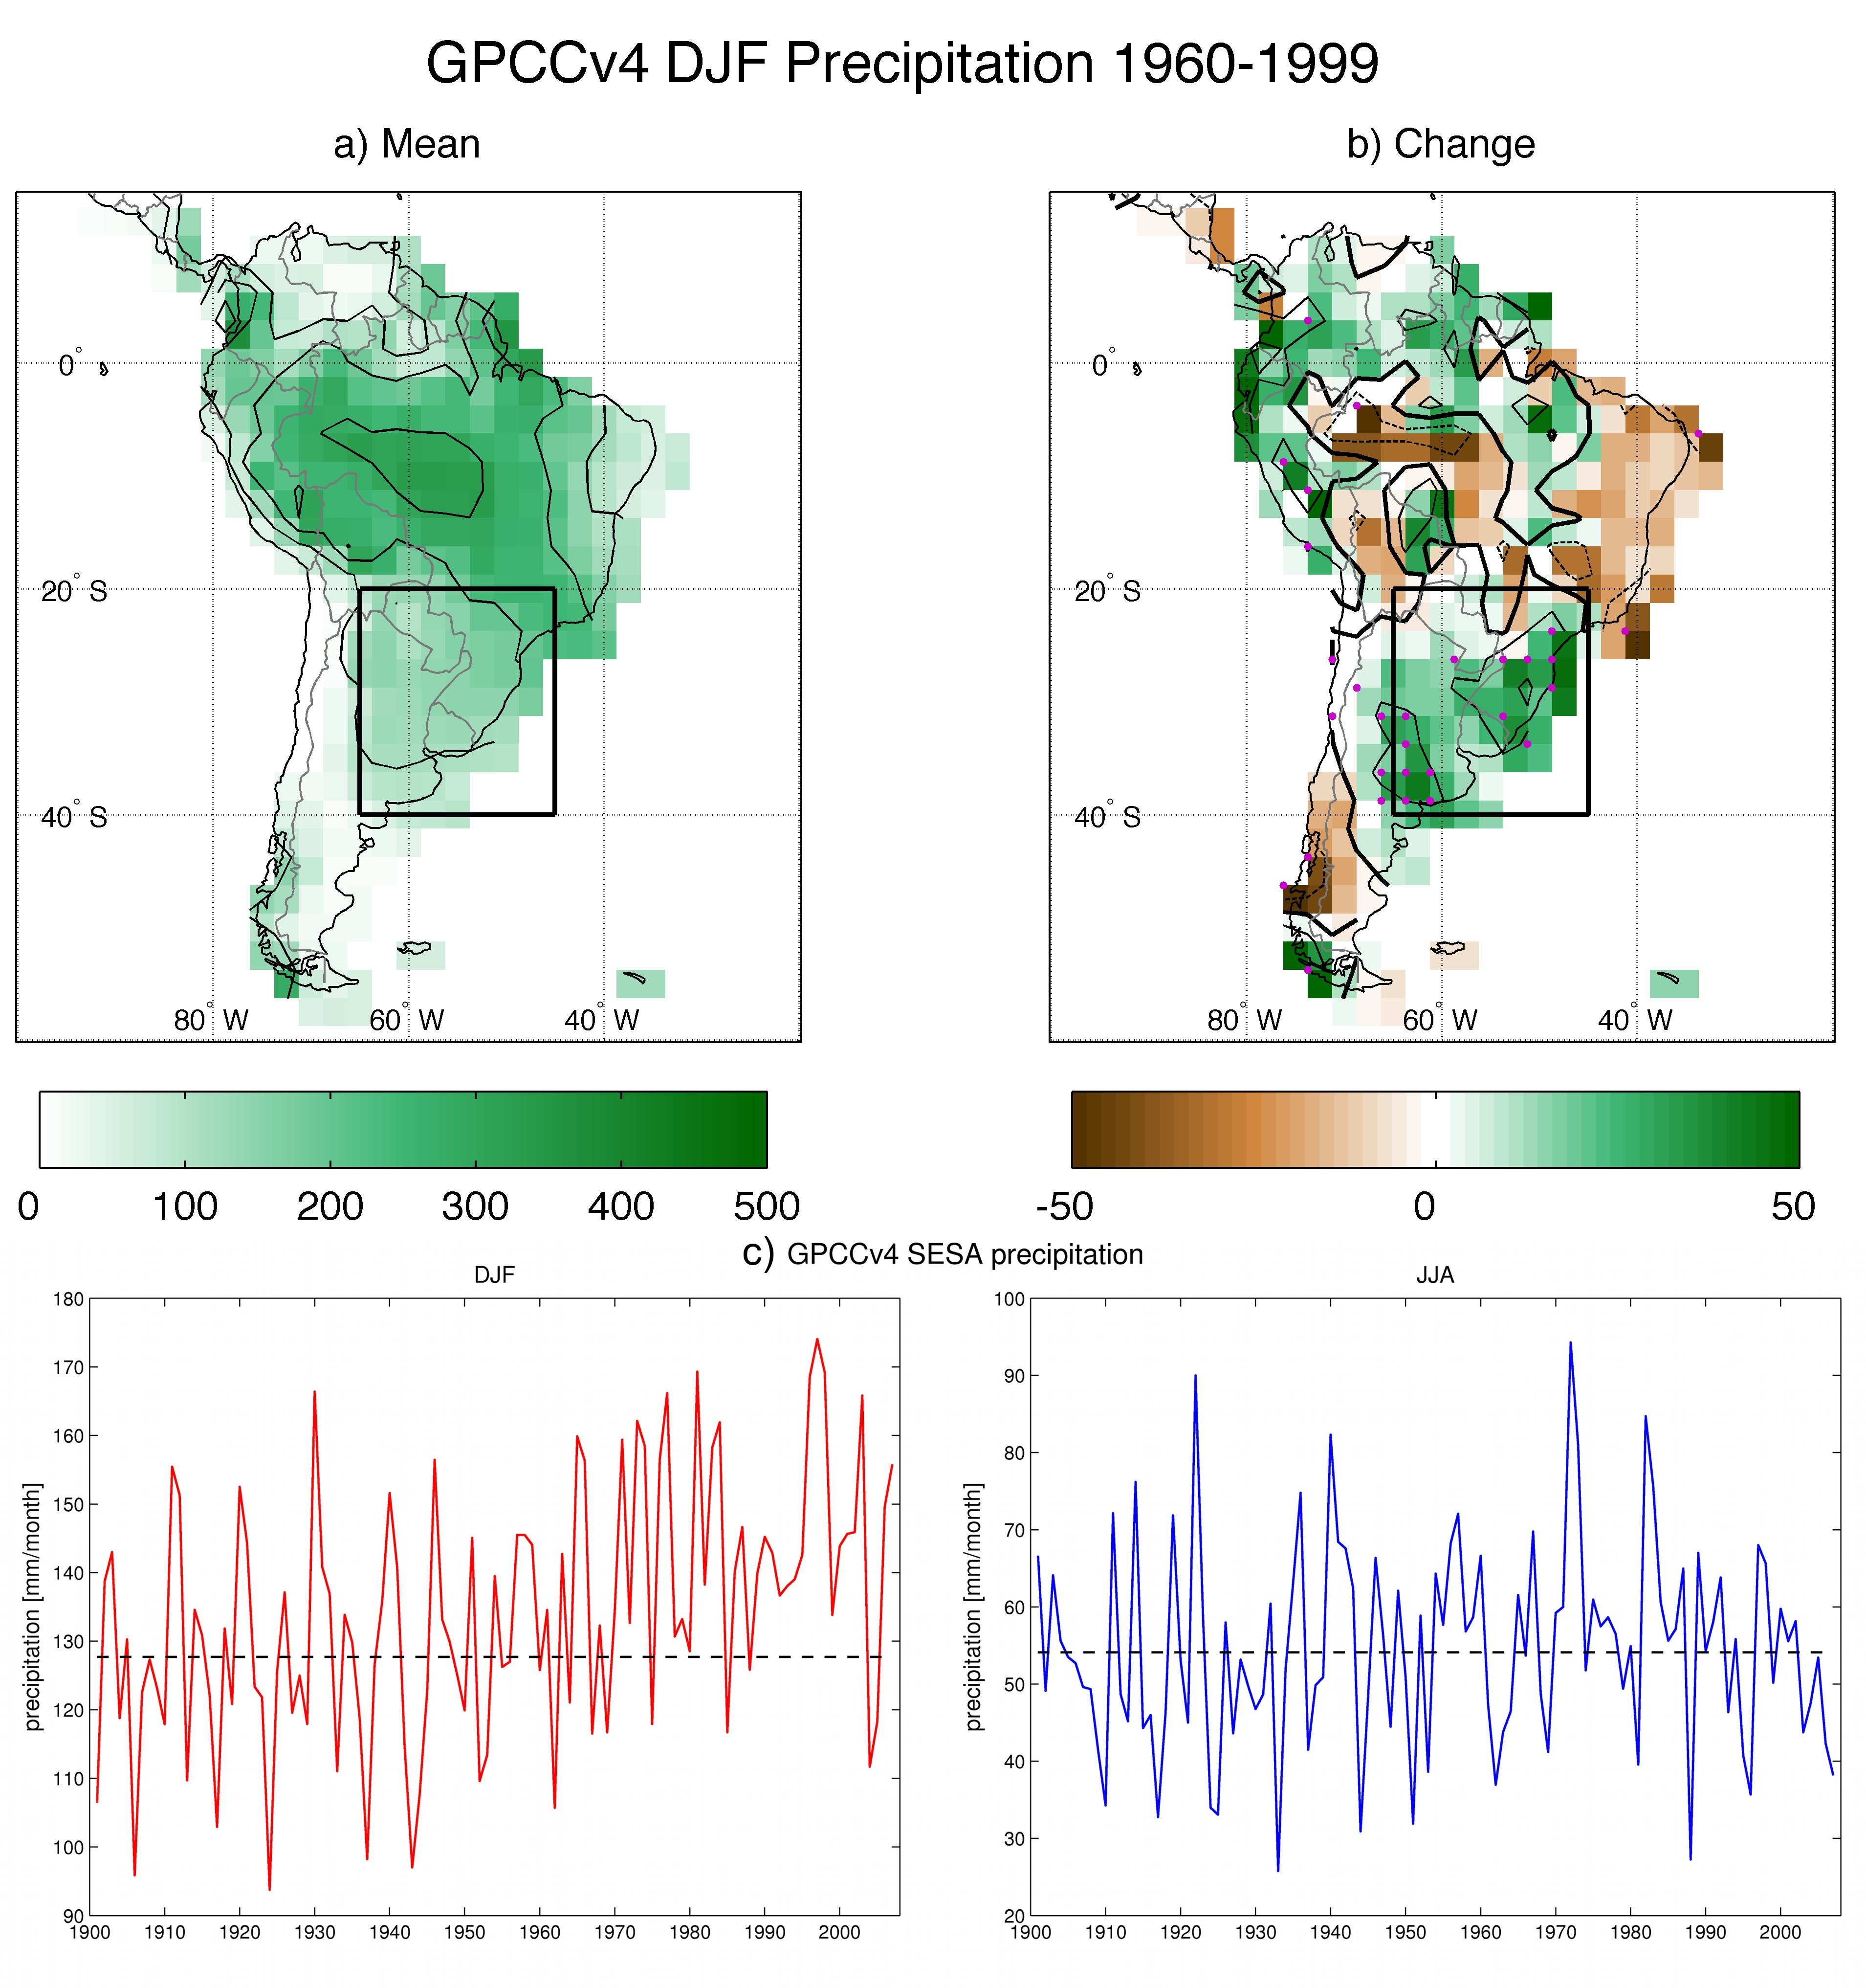
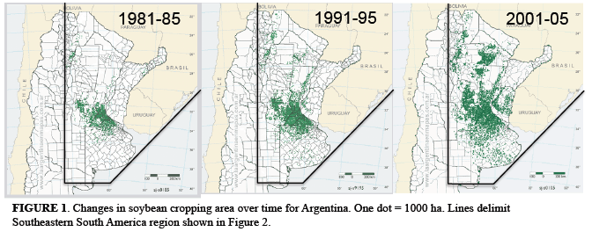
Increased Summer Rainfall
in Southeast
South America
(Paula Gonzalez et al.)
Summer Rainfall Trend
Is this GHG-Forced Climate Change?
Something else?
Dominant role of ozone depletion
identified in modeling studies.
Project Funding: NSF
Partners: LDEO, Columbia Univ.,
University of Buenos Aires, Univ. Miami
Gonzalez et al. 2013, Climate Dynamics
Summer Rainfall (1900-2008)
Green Shading: Areas Planted in Soybeans
Photo: wordpress.com

Slide 5
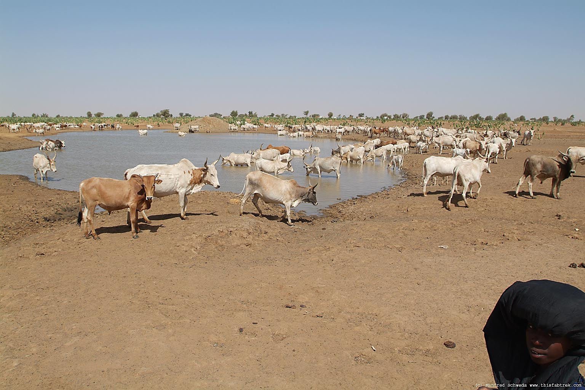
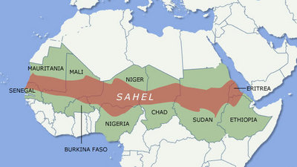
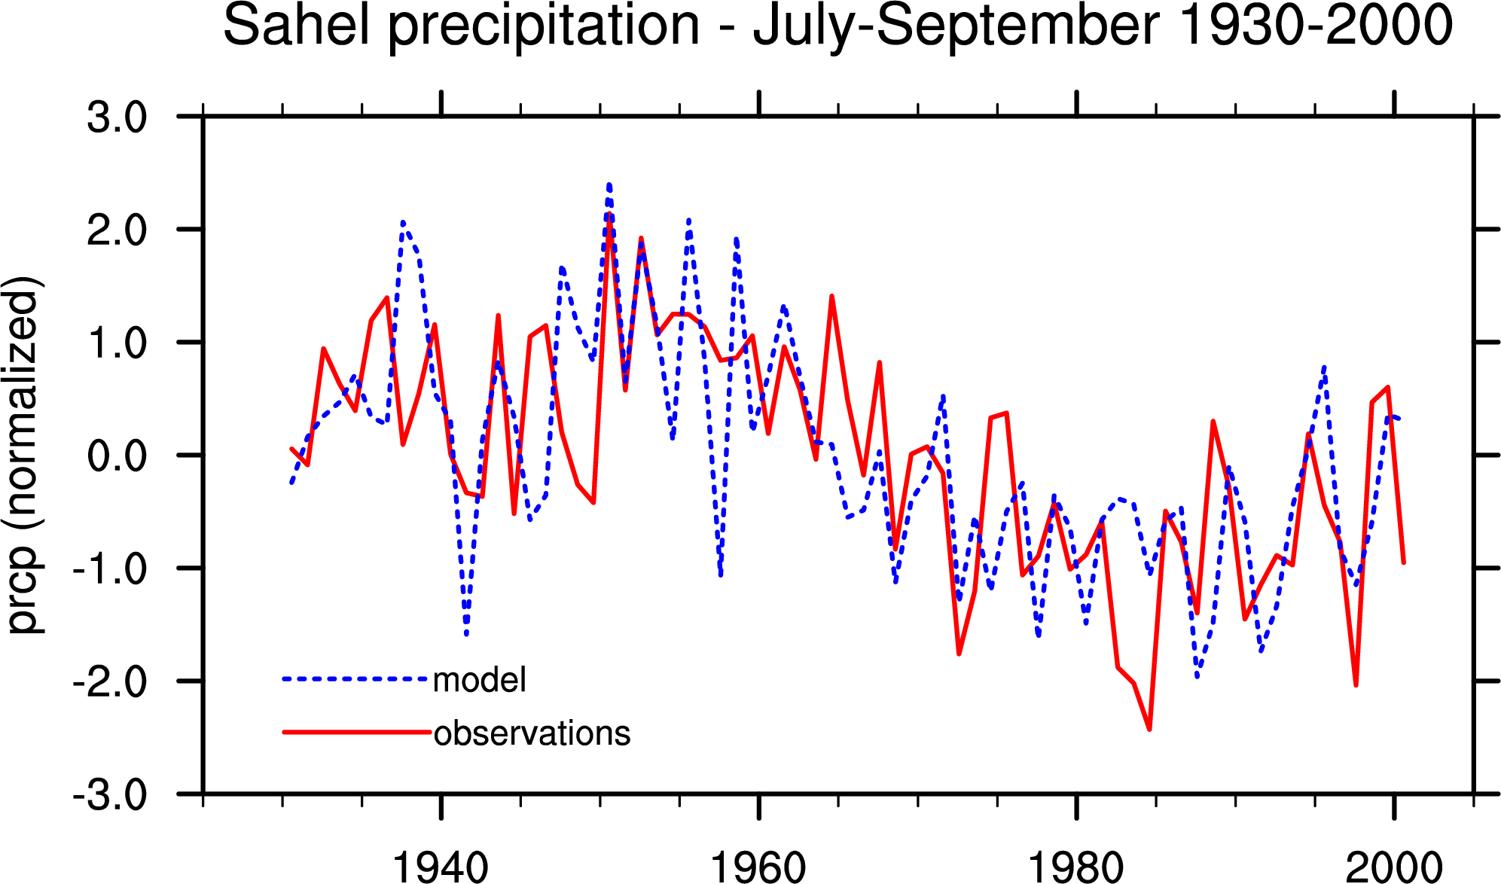
20th Century Drying
in the Sahel
(Alessandra Giannini et al.)
Did human activities and associated
land use and degradation provide the
dominant mechanism for drying in the
1970s and 1980s?
Modeling studies show the drying was
forced by sea surface temperature
variations… with land surface
conditions acting to exacerbate
the drying.
Project Funding: NSF, NOAA
Partners: LDEO, NCAR, ICRISAT
Giannini et al. 2003, Science
Photo: Manfred Schweda, Texas A&M Univ.

Slide 6
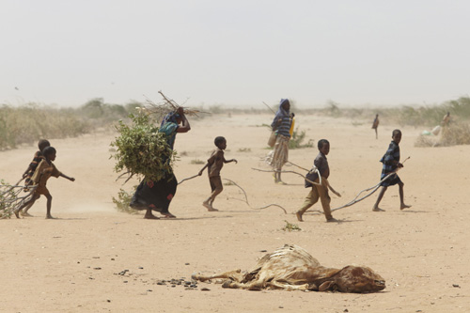
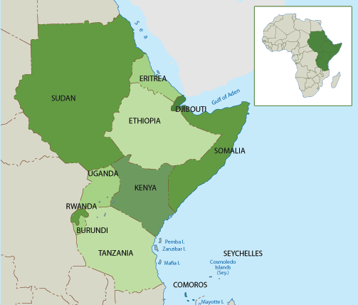
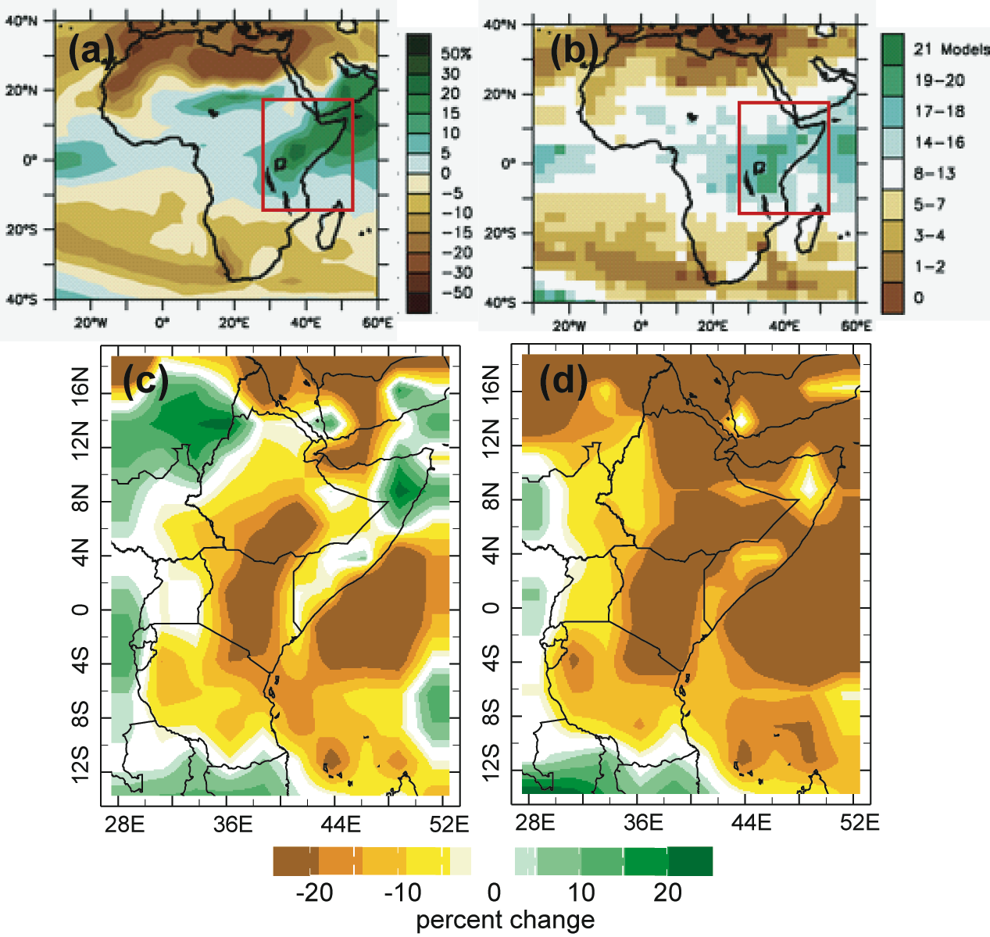
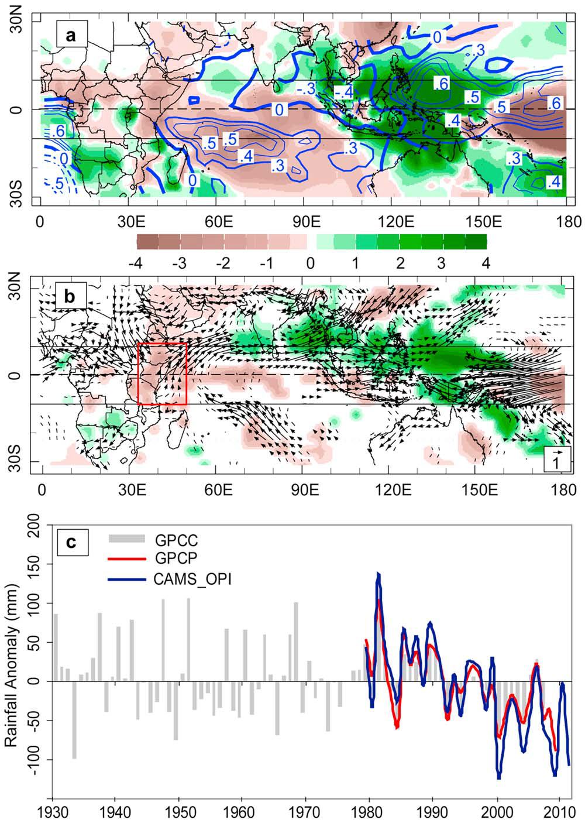
Increasing Drought Frequency
in East Africa
(Bradfield Lyon et al.)
Over the past ~15 years, drought has
become much more frequent, with
major implications for food security
(USAID providing 1.5B USD in food
assistance between 2009-11)
Severe drought in 2010-11 was
associated with ~250,000 fatalities
in Somalia alone
WHY are droughts becoming more
frequent?
Is this climate change?
Photo: Oxfam America

Slide 7
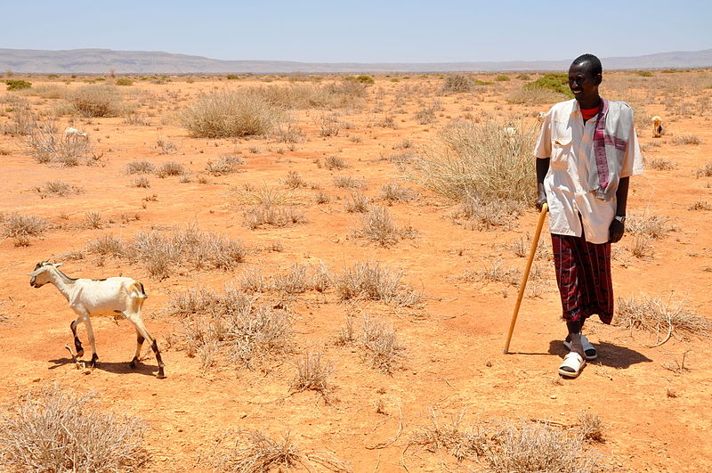
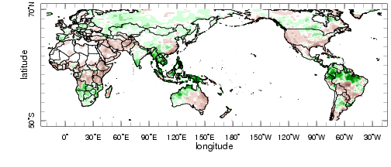
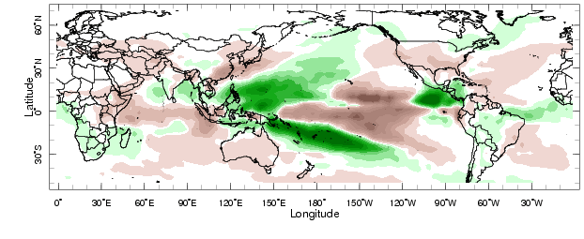
Increasing Drought Frequency
in East Africa
(Bradfield Lyon et al.)
The increased frequency of drought
in East Africa is mainly the result of
multi-decadal climate variability in the
Pacific
The recent shift in East African rainfall is part of a global climate shift that occurred in 1998-99
Project Funding: NSF, NOAA, NASA
Partners: LDEO, UCSB, MSFC, JPL
Lyon et al. 2012, 2013, GRL, Clim. Dyn.
Observed
Model

Slide 8
Diagnostic Studies
Run the gamut from statistical assessments of regional climate
variations to discernment of the physical drivers of those variations
Are aided tremendously by the IRI Data Library technology
Advance climate science while providing practical information that:
can influence the pricing of index insurance, affect strategies for
malaria prevention, inform CC adaptation strategies…
Add another dimension to IRI as a provider of value-added climate
information, vis-à-vis “off the shelf” assessments, projections, etc.

