Slide 1
Applications in Ecosystems Kátia Fernandes

Slide 2
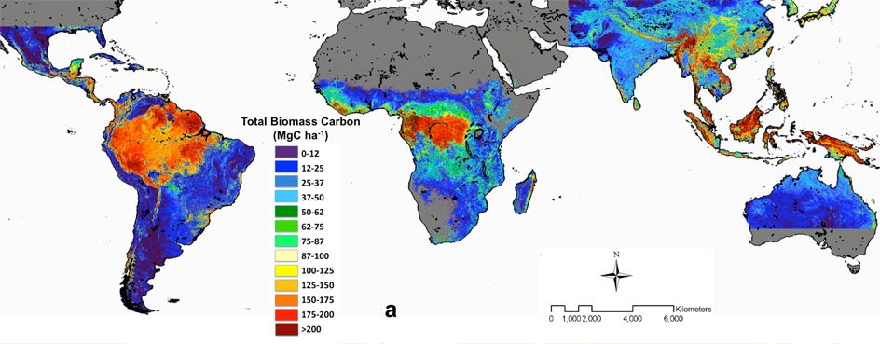
Tropical Forests and Climate
Deforestation and forest degradation contribute 15% to 20% of global carbon emissions.
Latin America holds 49% of the world's tropical forests carbon.

Slide 3
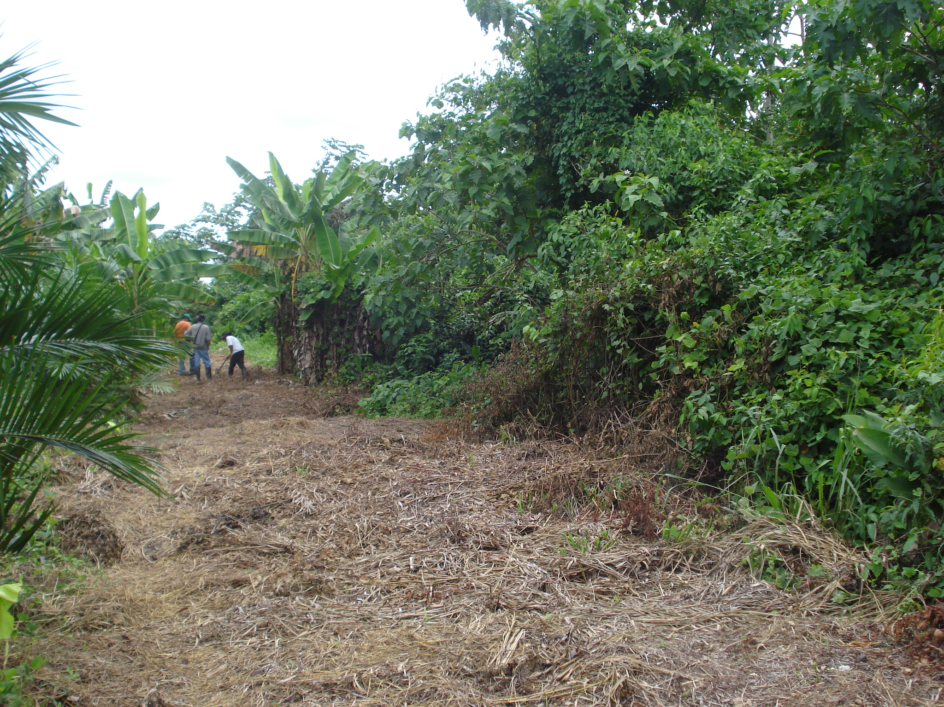
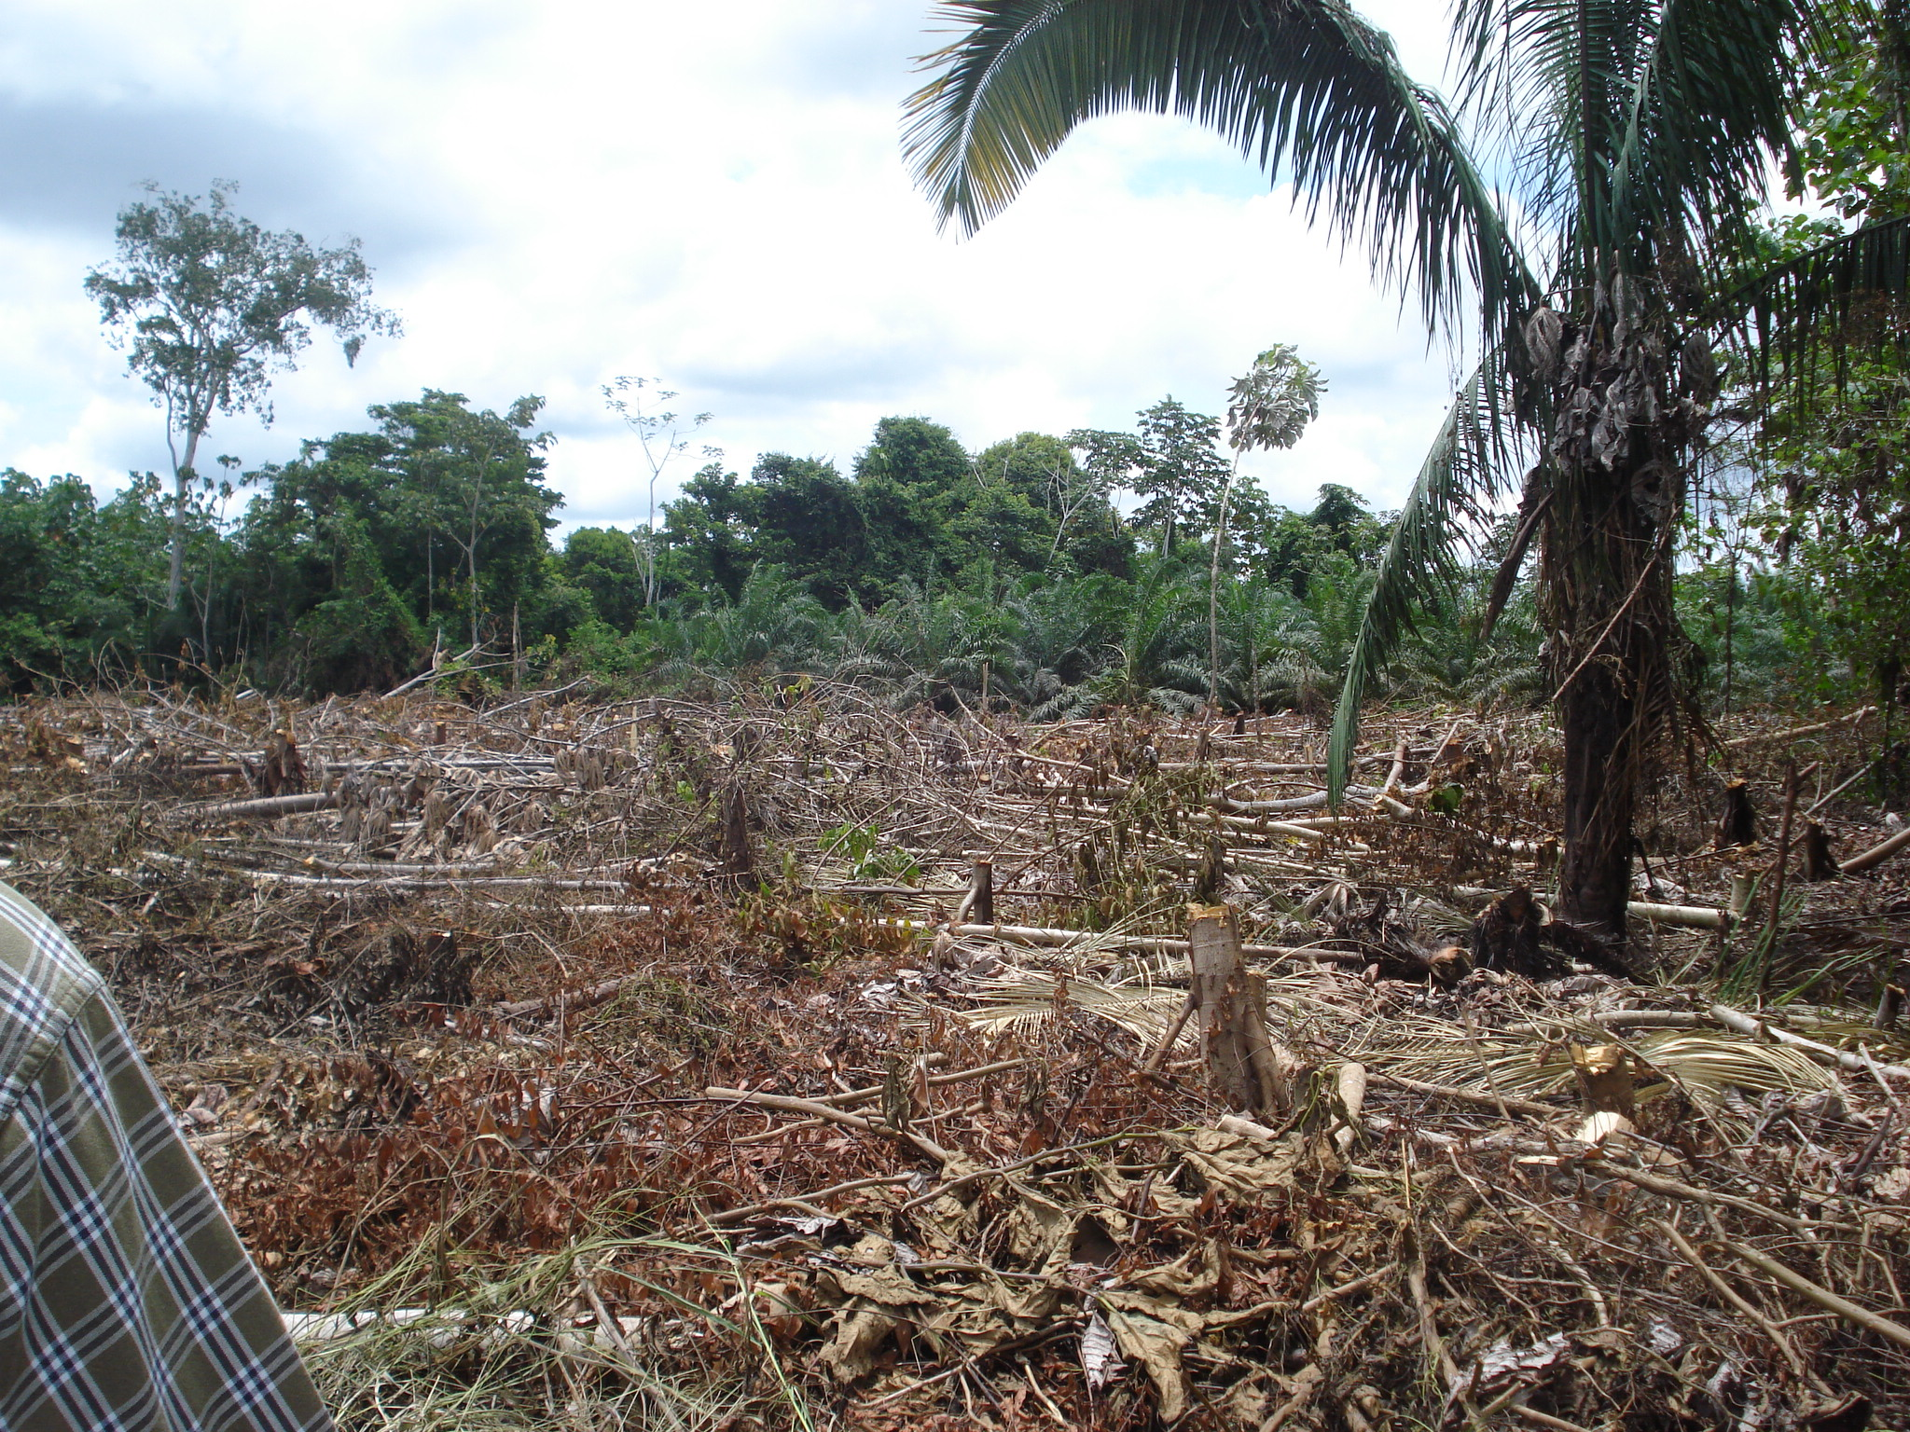
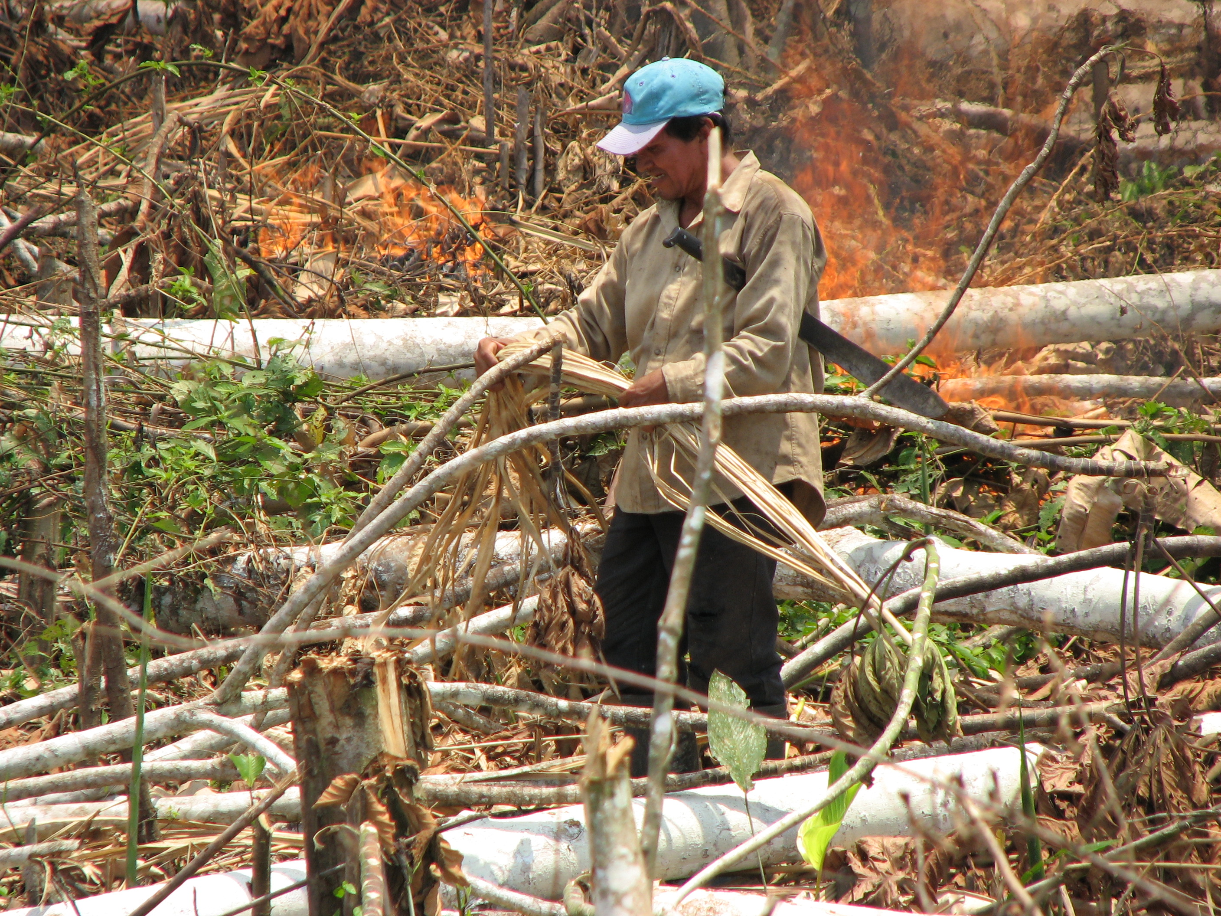
The Western Amazon (WA) landscape
Fires are NOT natural to the rainforest ecosystem processes.
Fires are used in slash and burn practices.
Unintended spread of fires to cultivated and native vegetation areas has become a common threat.

Slide 4
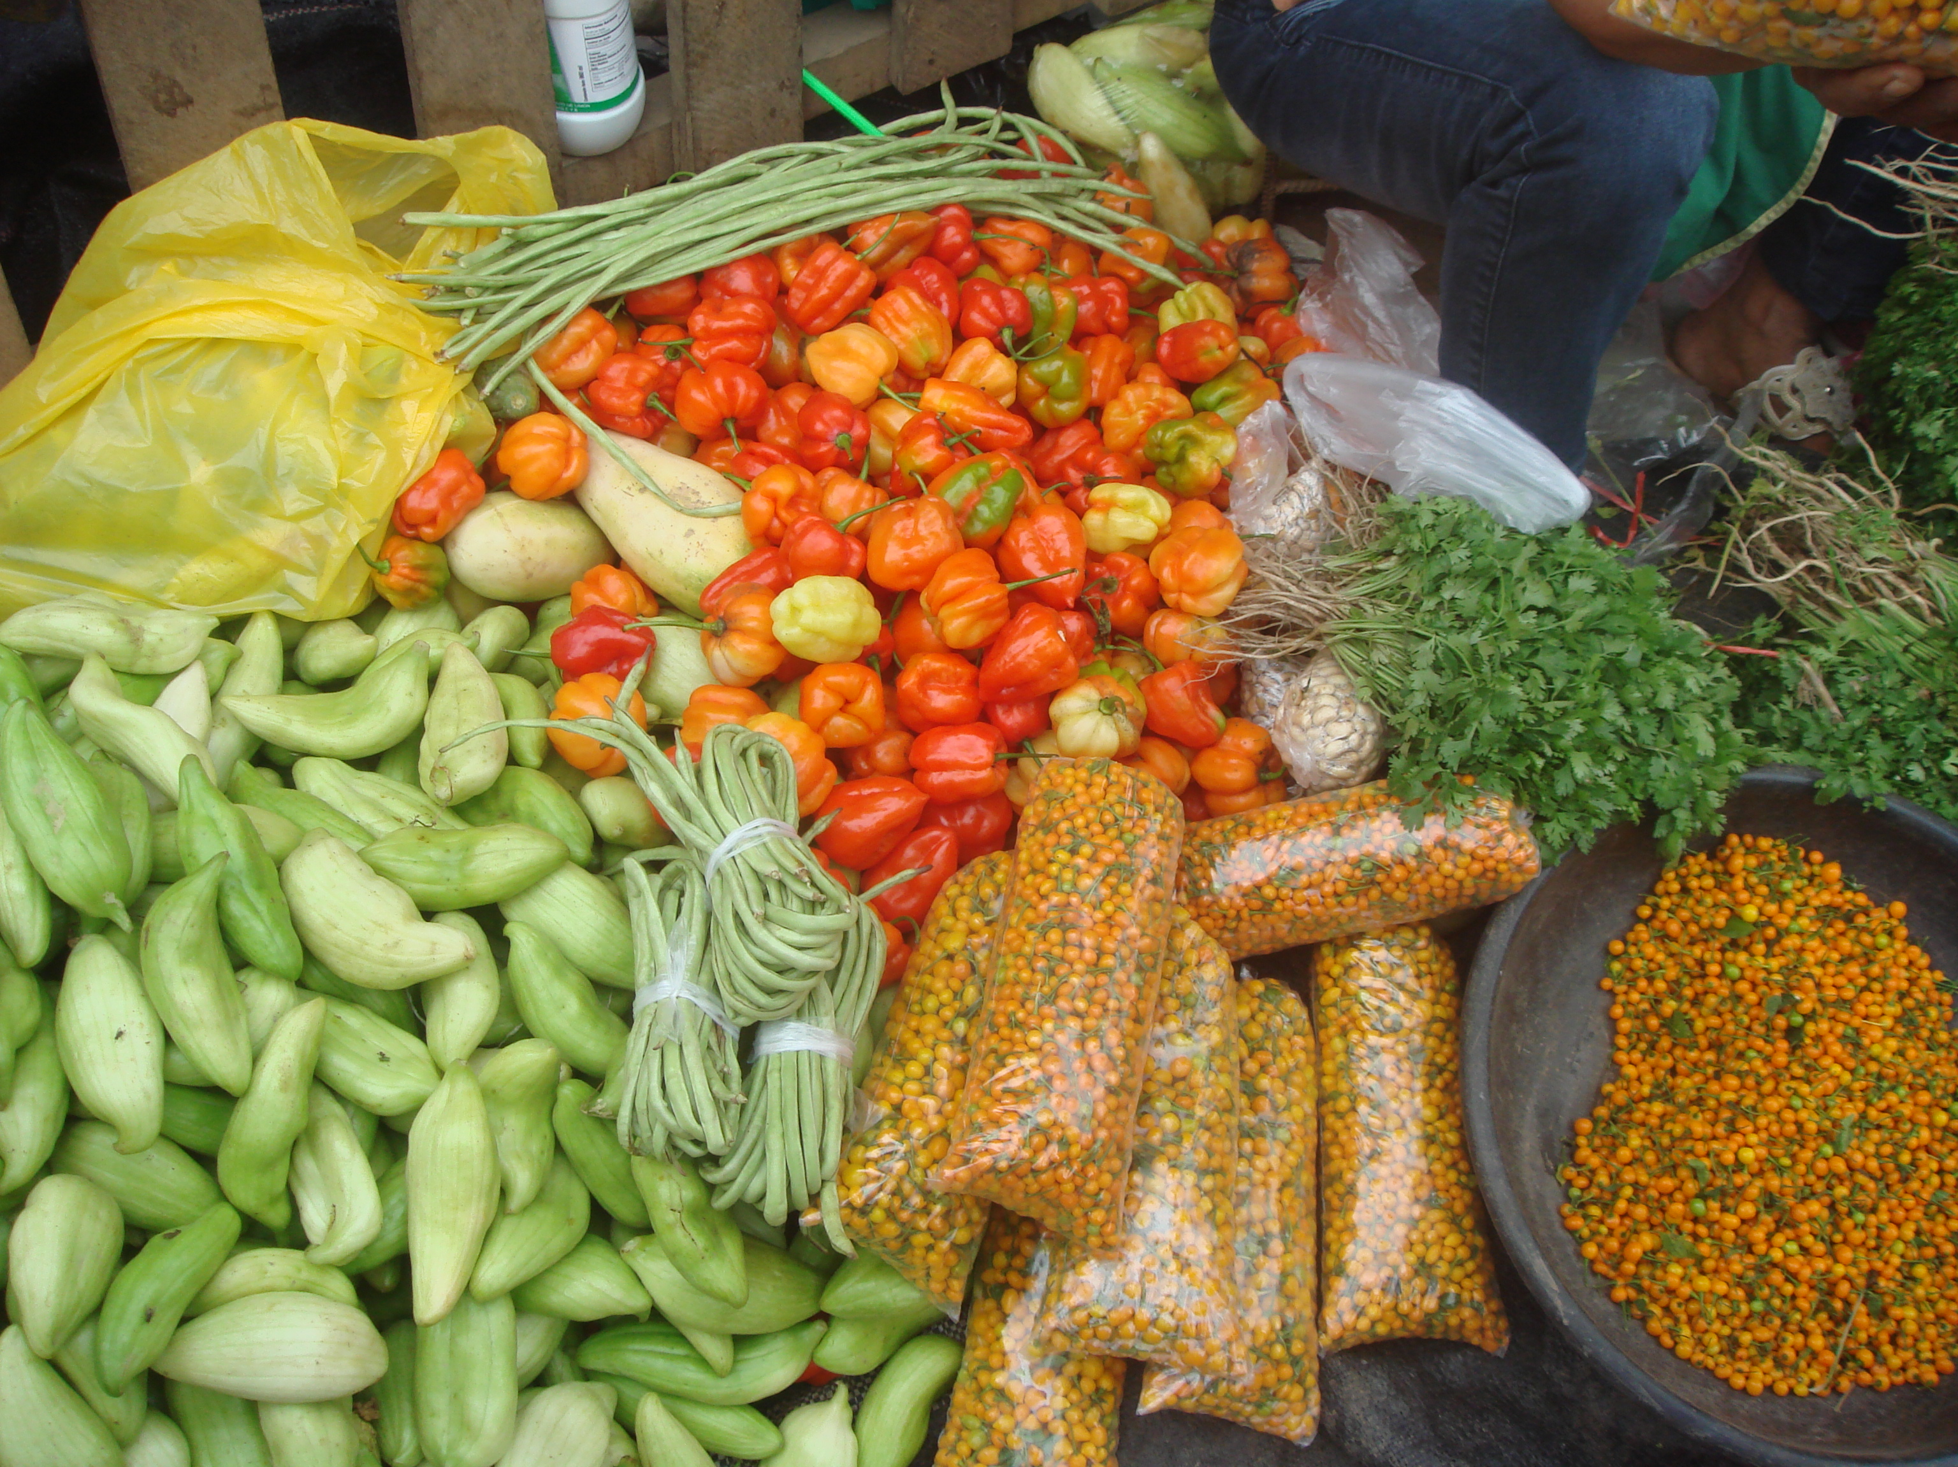
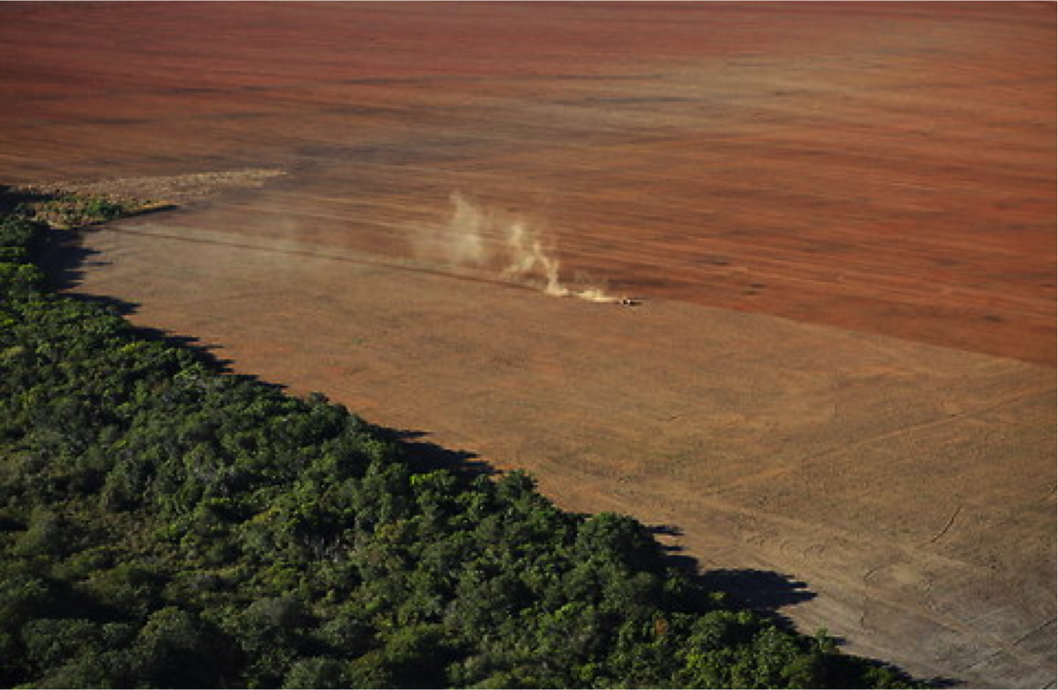
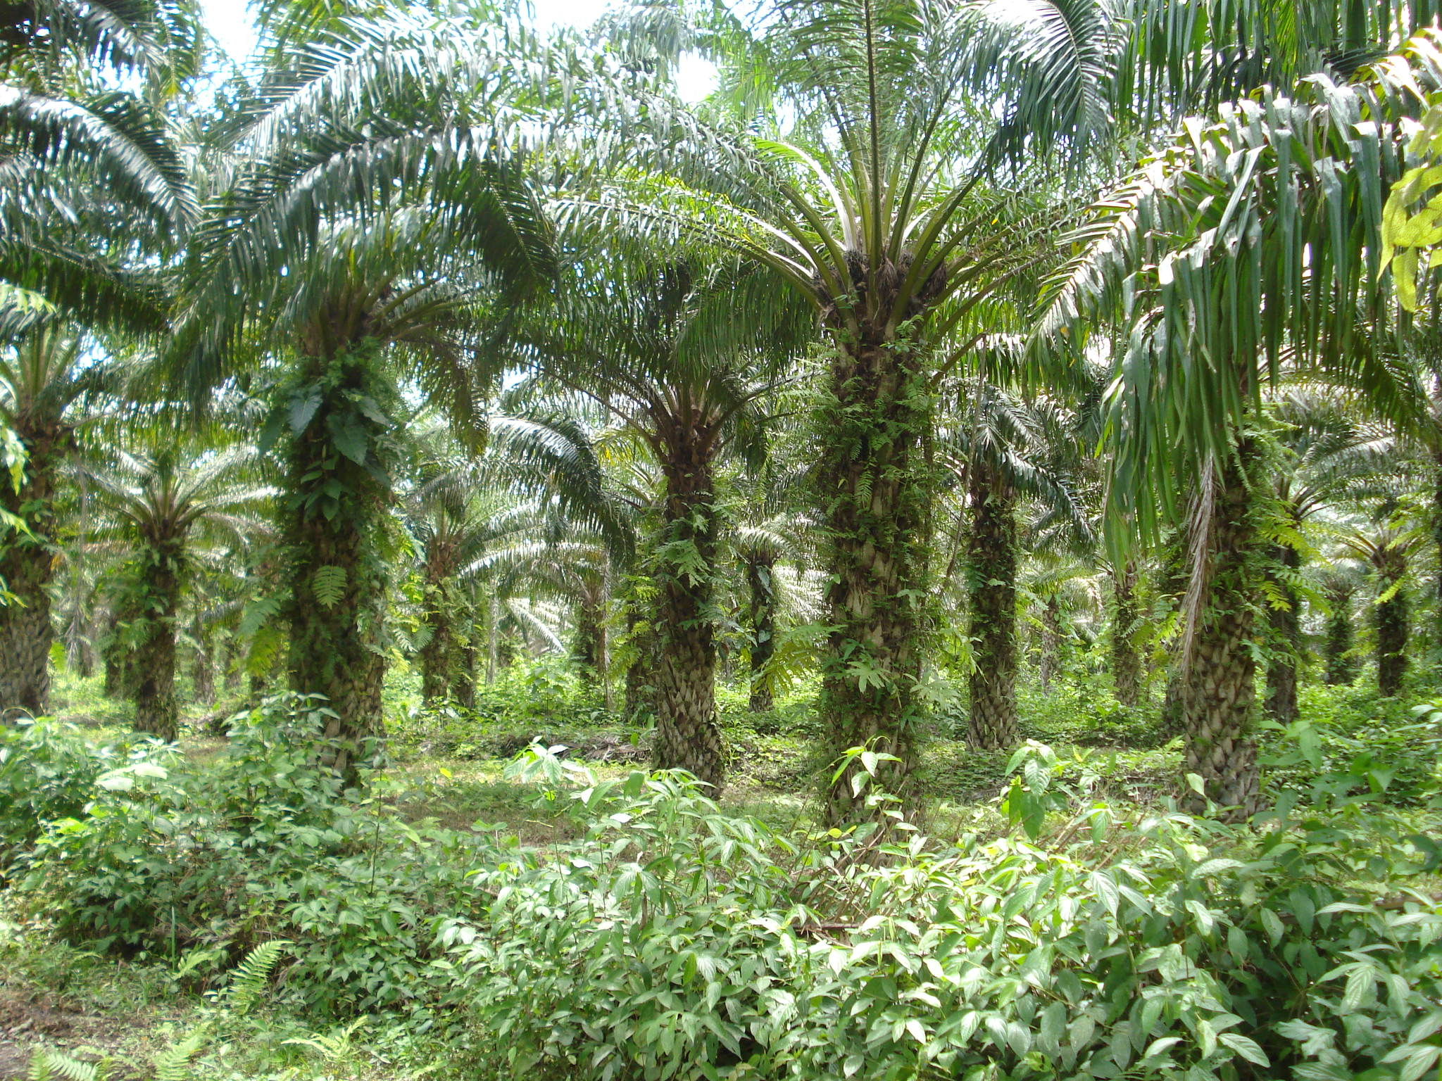
Central Questions
How do changes in climate disturbances affect the occurrence and frequency of fires in WA?
How do land use and other human activities interact with climate to impact fires?
Could our understanding of the drivers help inform policy to prevent fires?

Slide 6
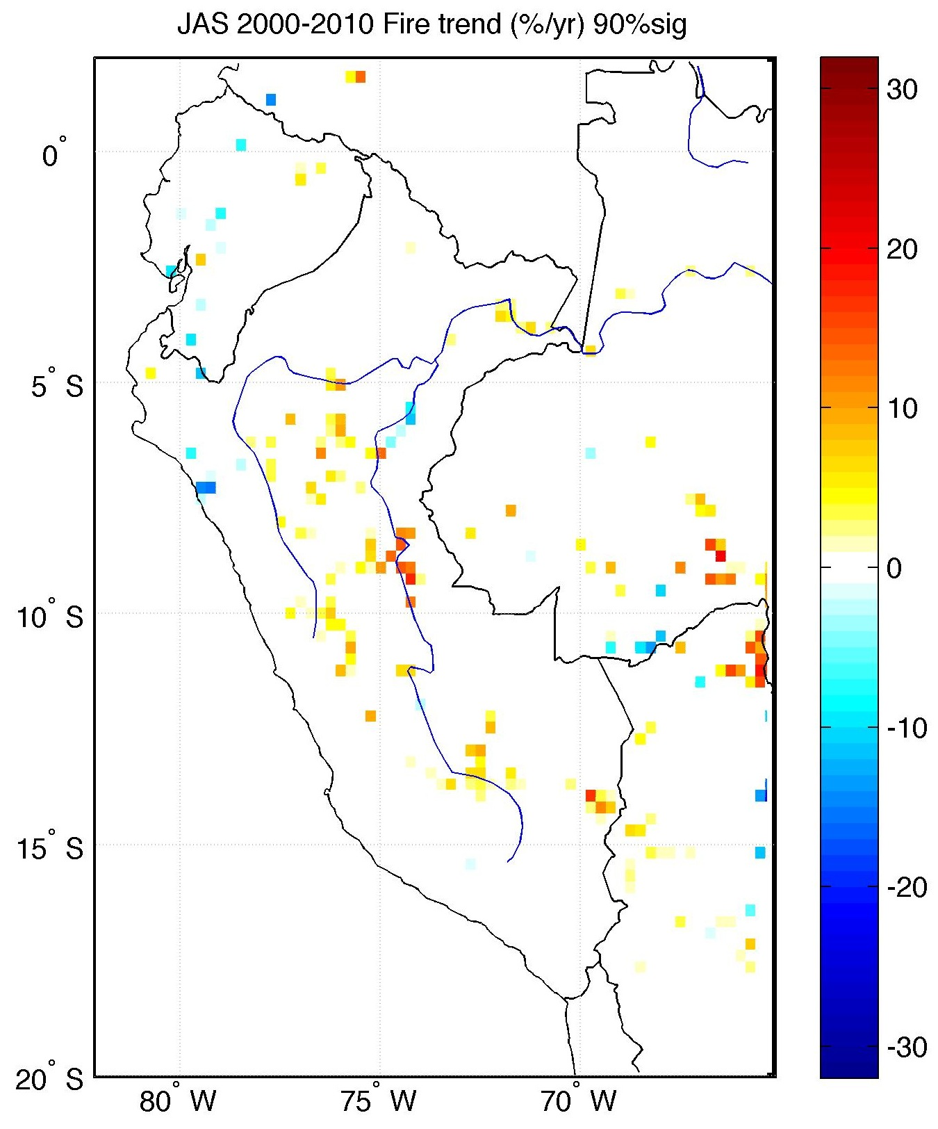
Recent changes in fires
July-August-September (JAS) MODIS Active Fires product.
The 2005 drought resulted in 300,000 ha and 16,000 ha of forests burned in Acre (BR) and Ucayali (Peru).
Trends (%) in JAS fires 2000-2010.

Slide 7
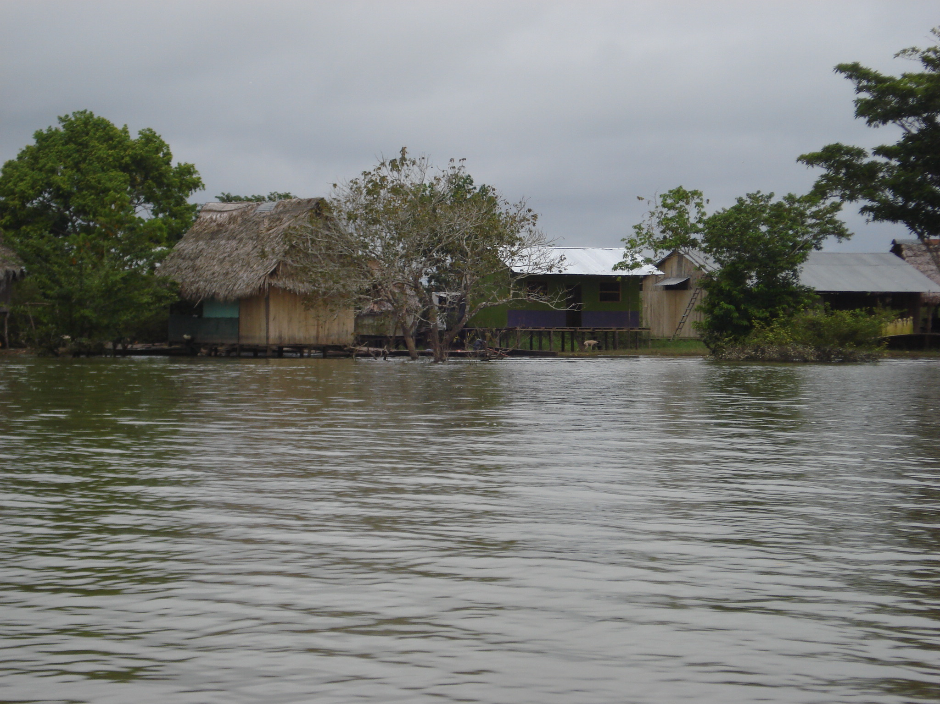
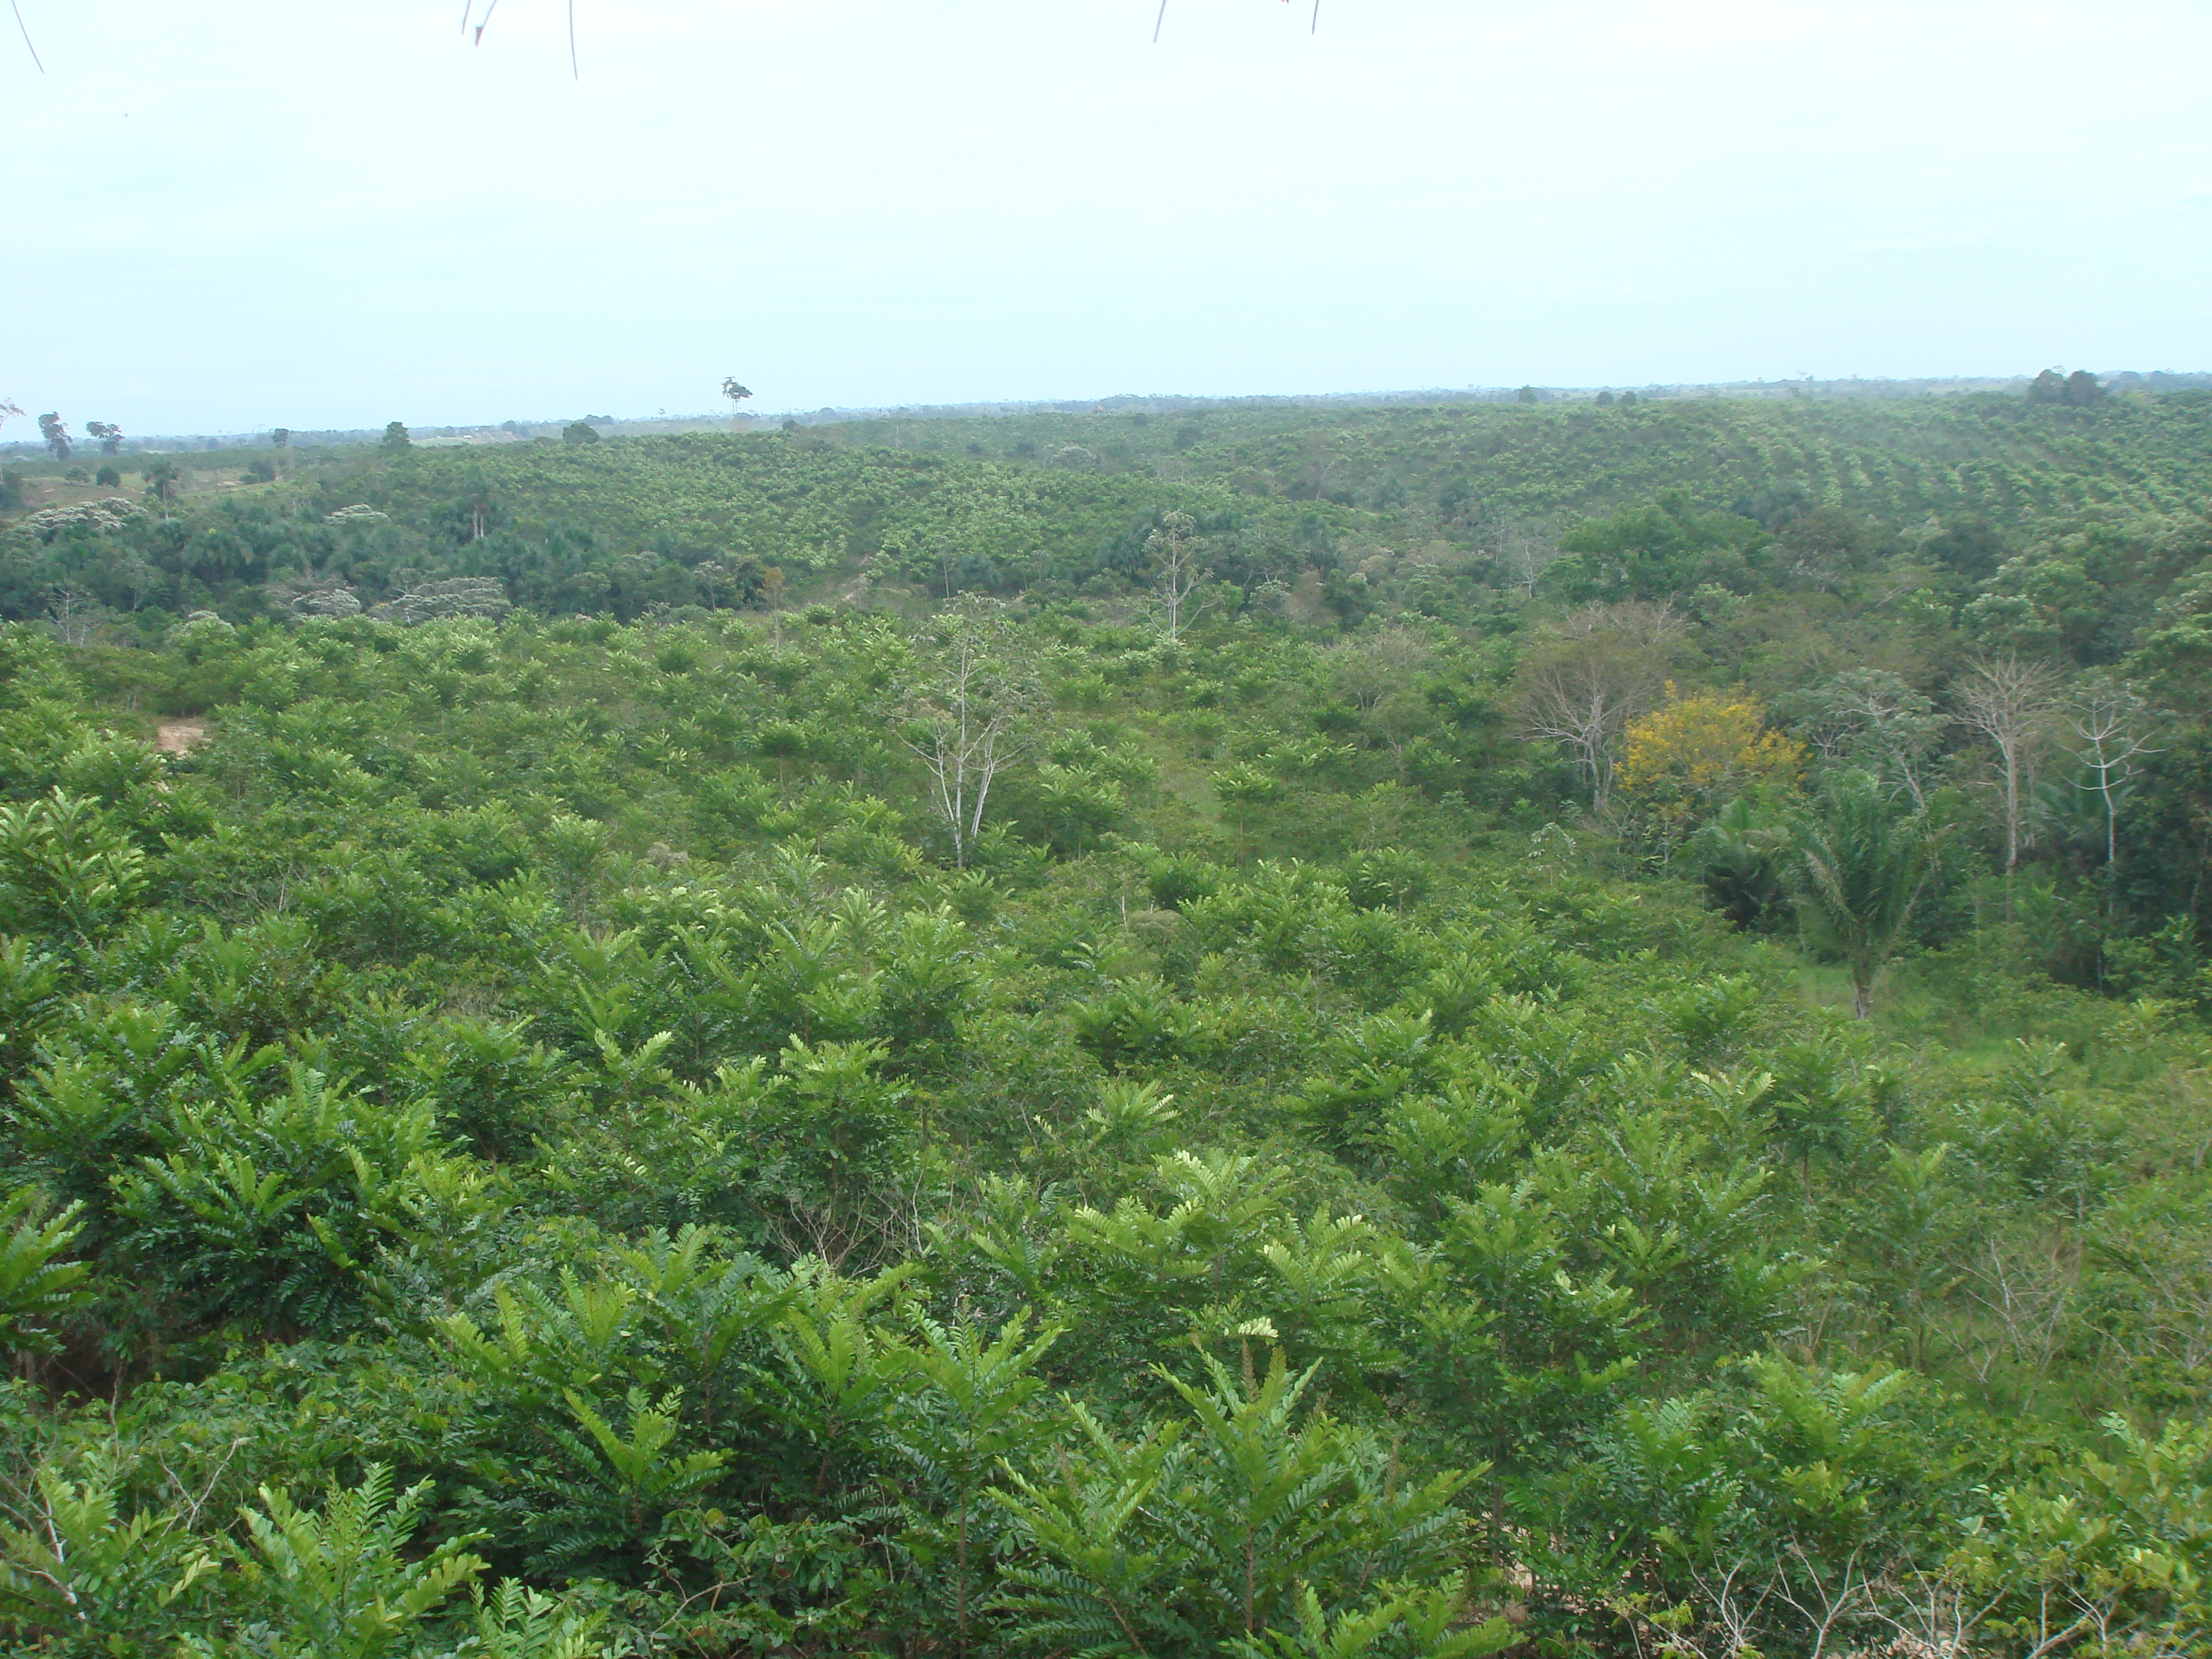
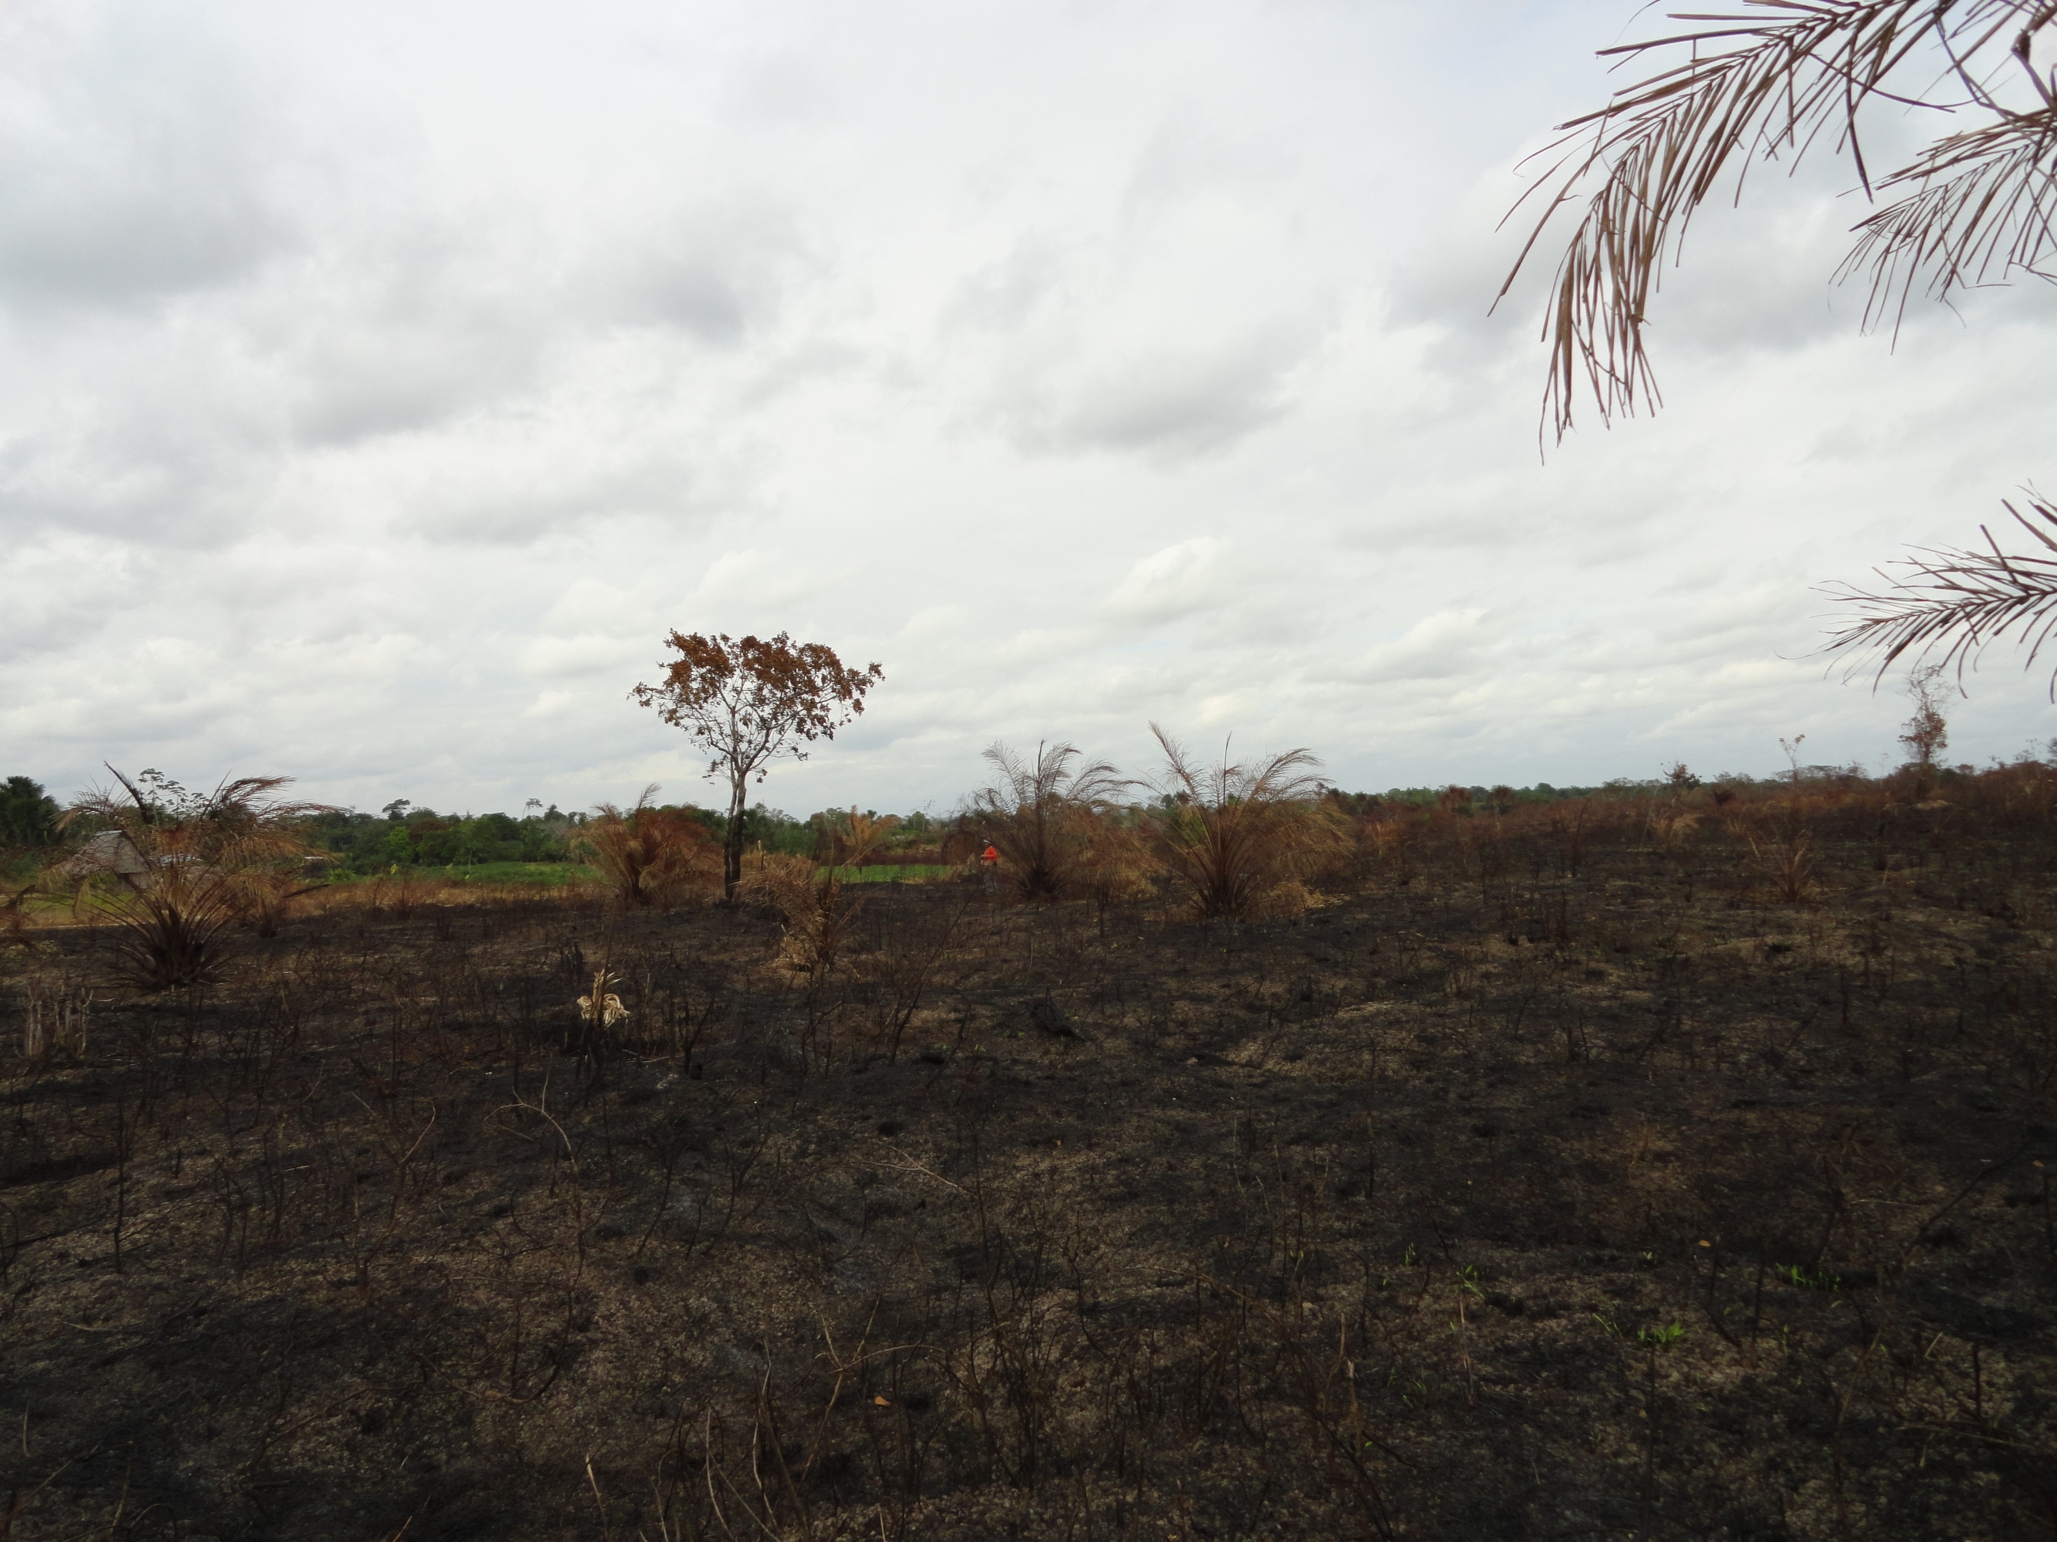
The Climate…
Domain averaged precipitation anomalies (SPI) is highly correlated to fire variability (R=-0.89)

Slide 8
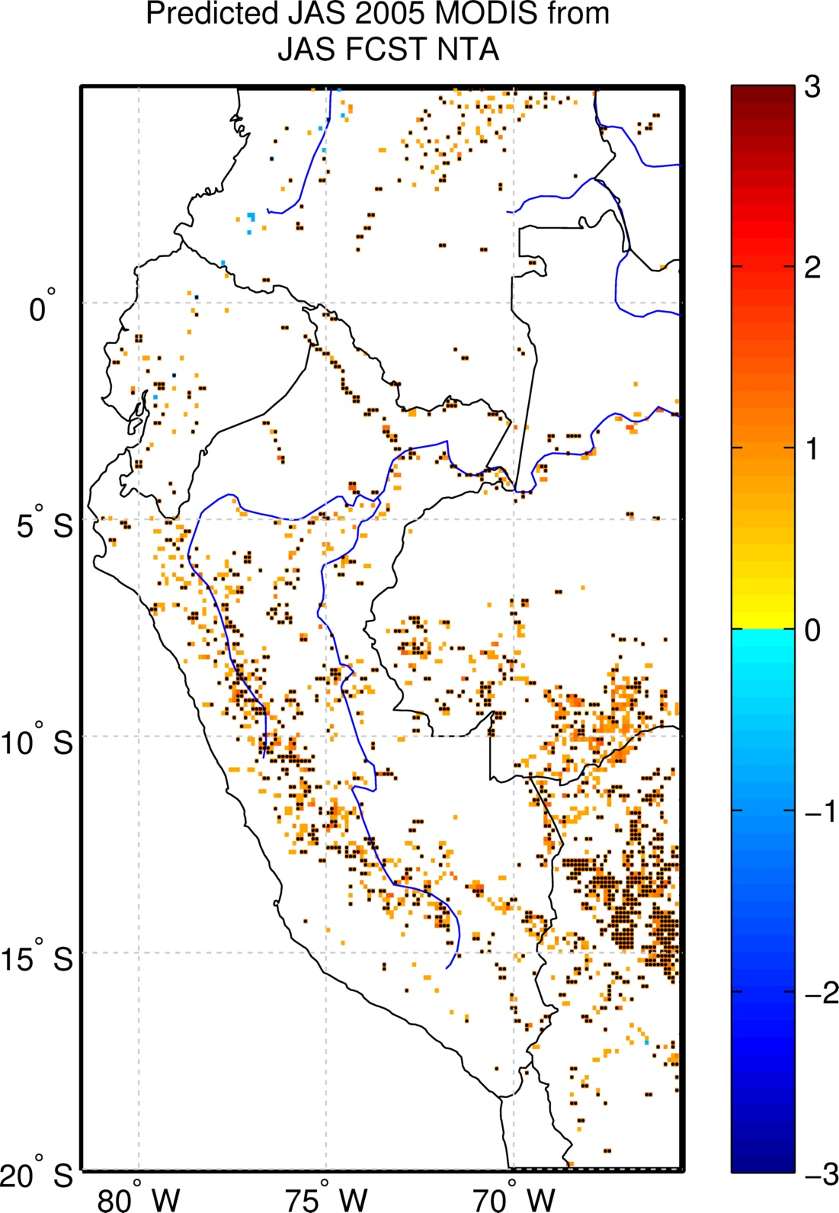
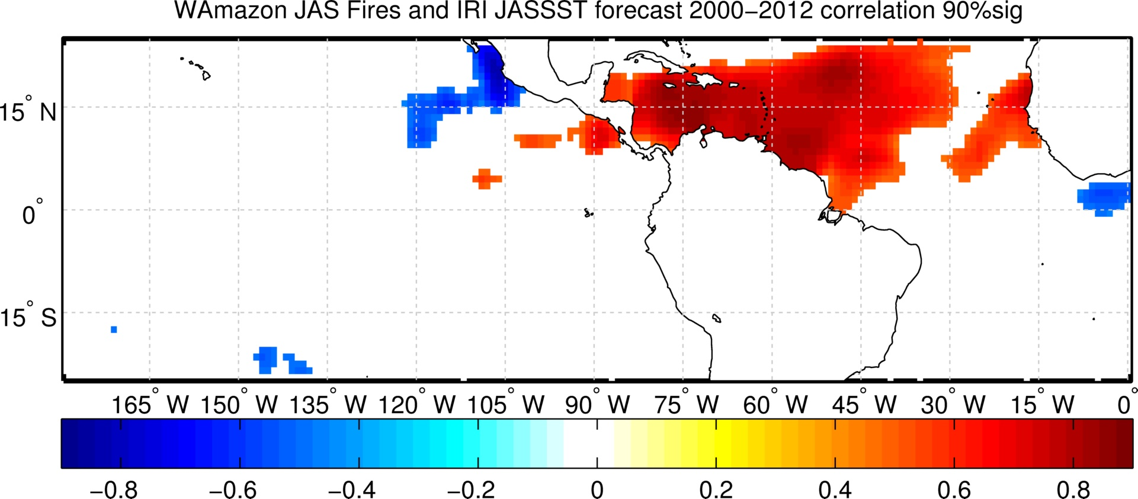
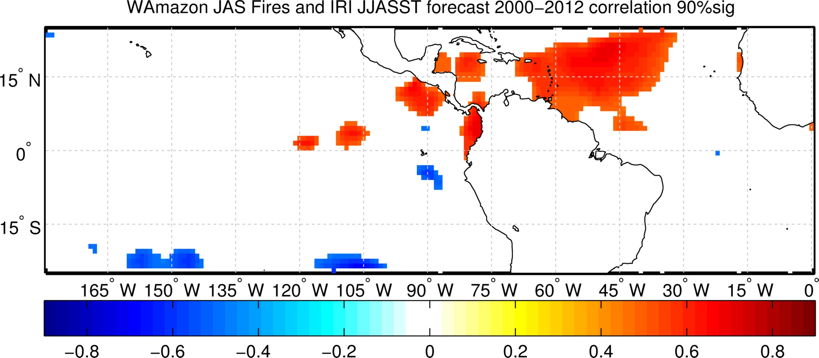
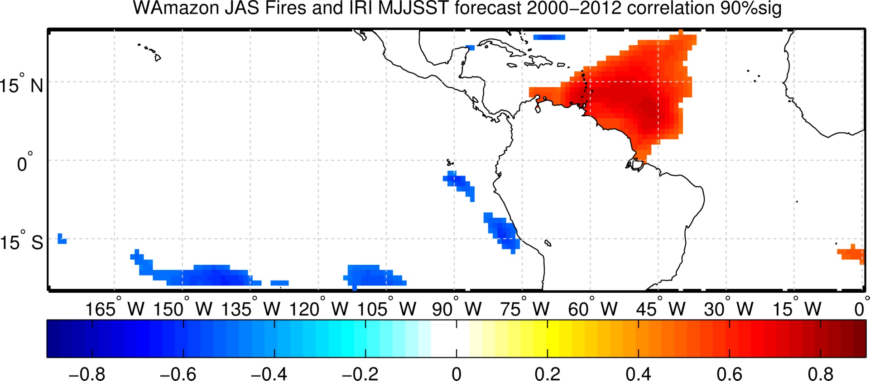
Fire Prediction-Early Warning System
Correlation between observed WA domain Fires and IRI evolving SST retrospective forecast.
(c) JAS
(b) JJA
(d) MJJ

Slide 9
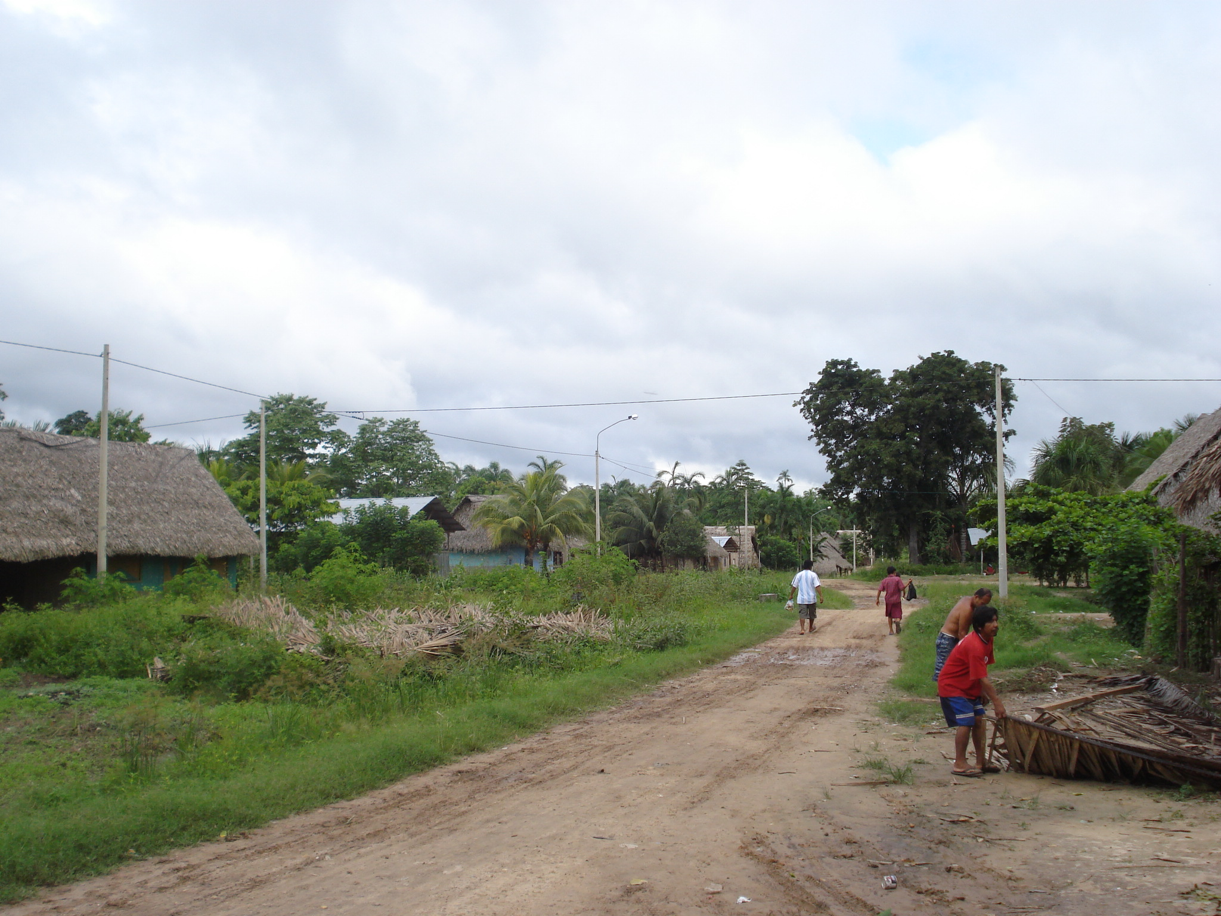
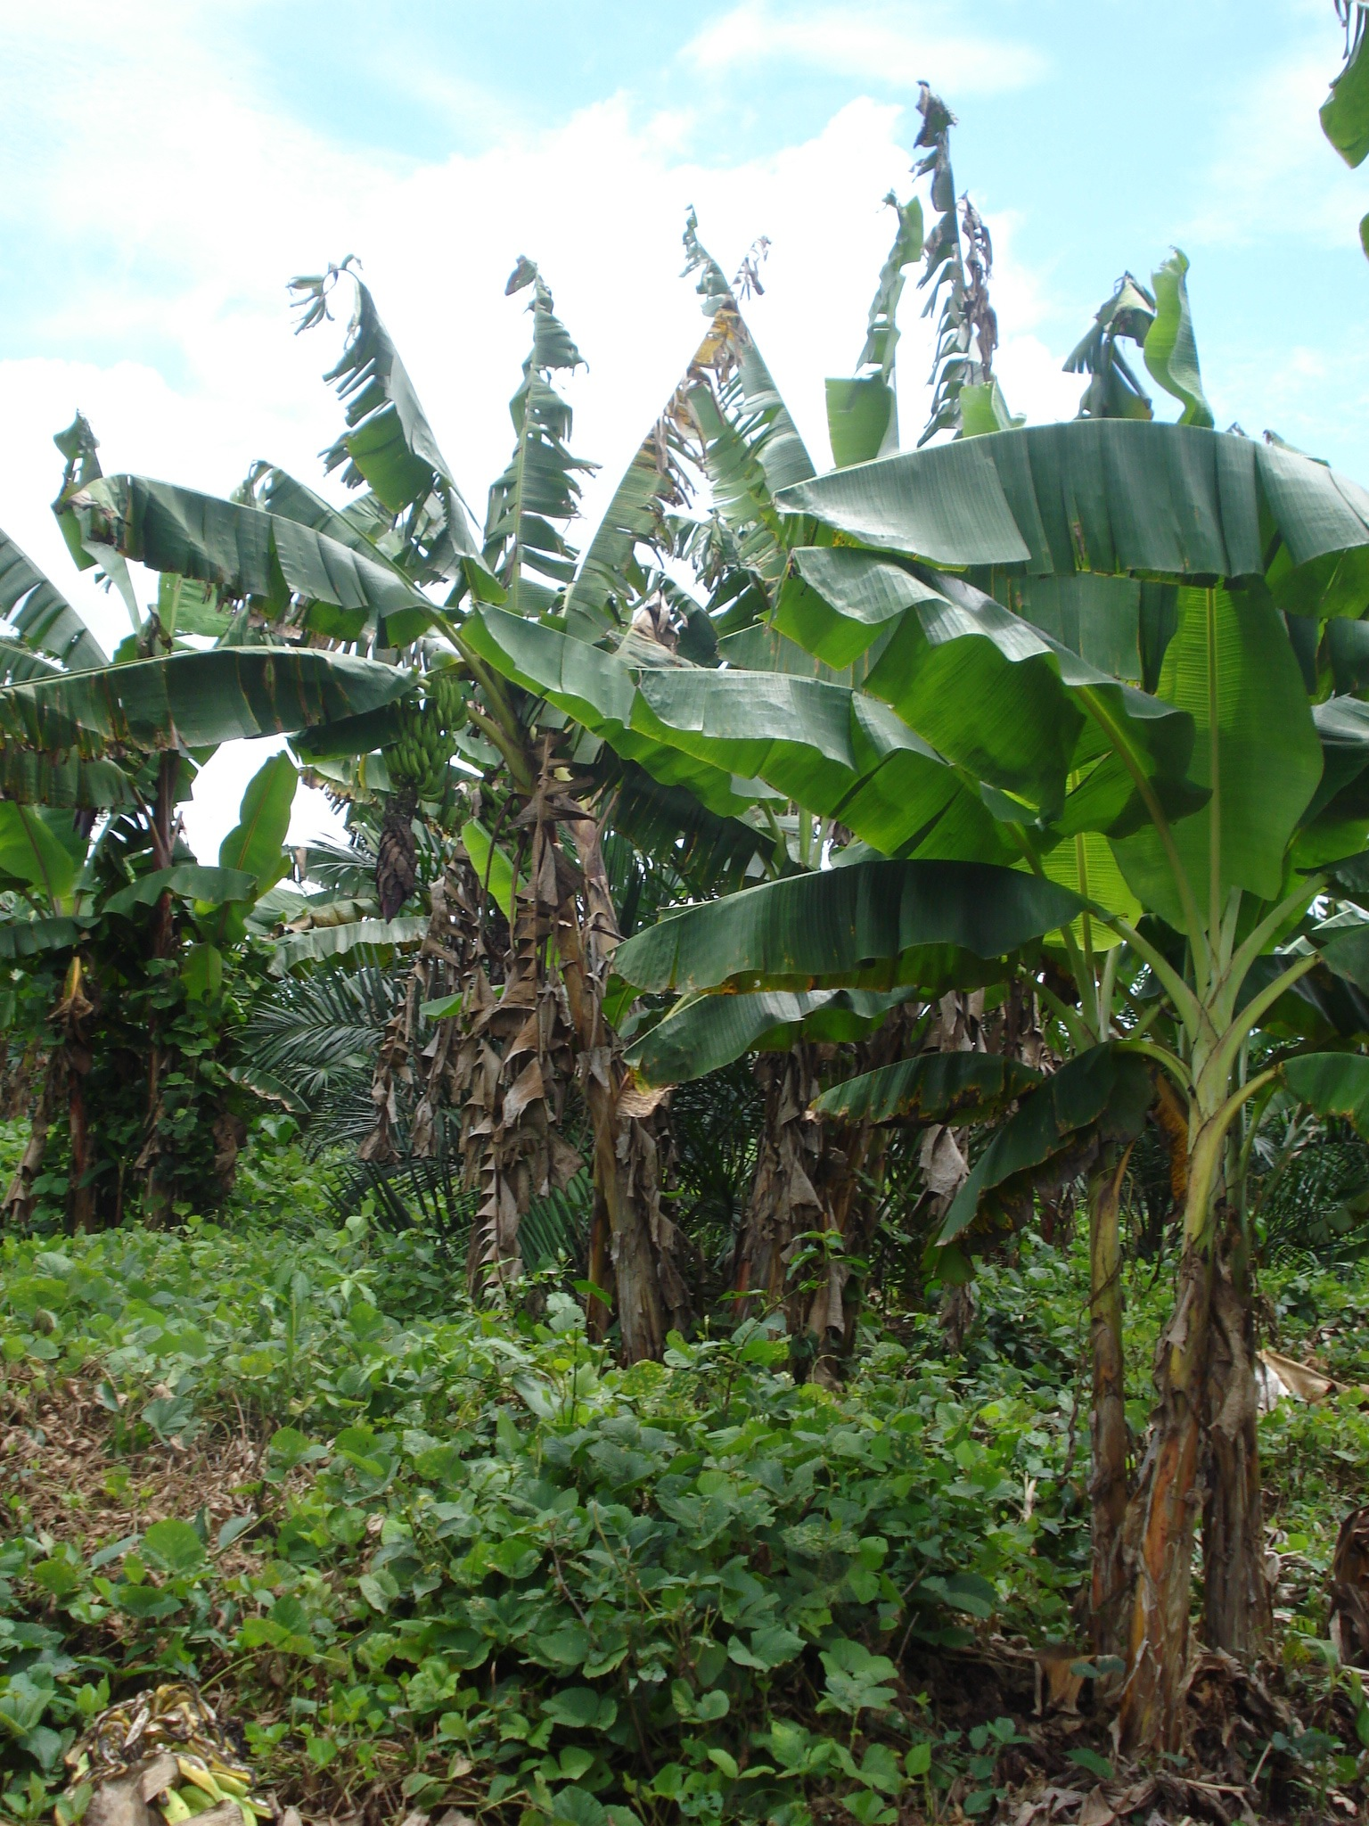
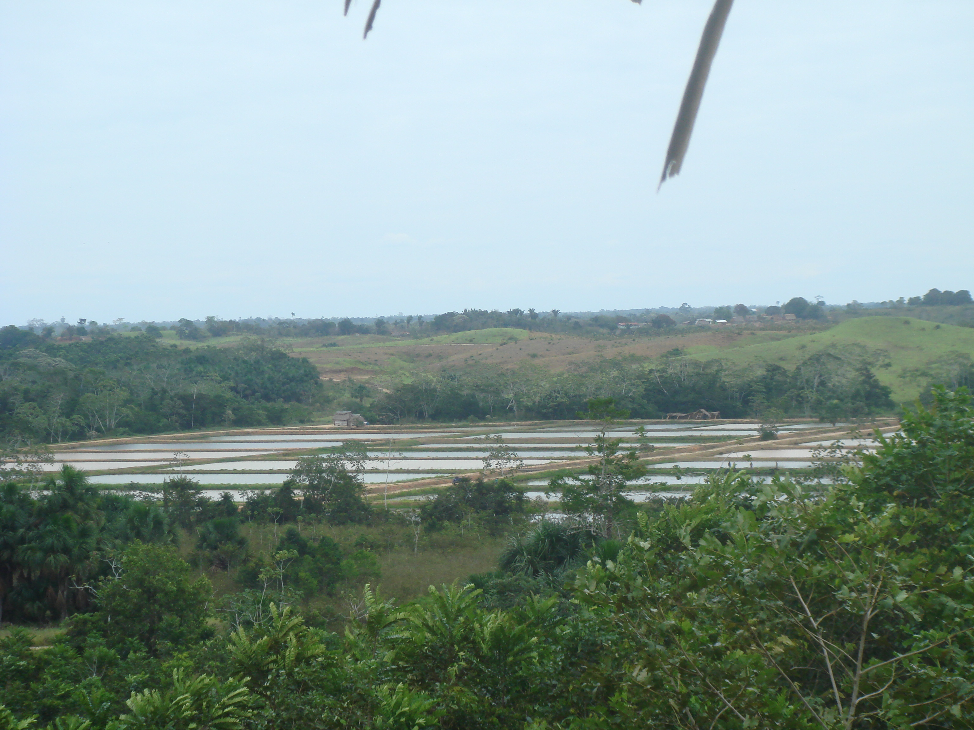
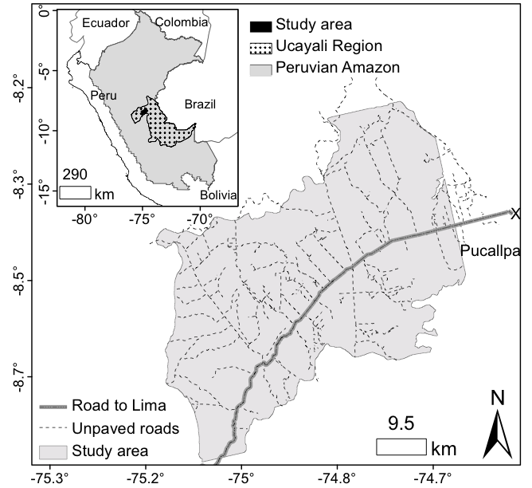
Land-use and population dynamics
Survey and census data were collected.
Depopulated rural areas are more prone to frequent fires.
Uriarte et al., 2012, PNAS.

Slide 10
Fires, land use and droughts
Drought
Standardized parameter estimate
More fire
Young
Fallow
Pastures
Adolescent
Degraded
Adult
Secondary

Slide 11
Fires, land use and droughts
Drought
Standardized parameter estimate
More fire
Drought x Pastures
Drought x Degraded
Drought x Fallow
Drought x Secondary
Drought x Adult

Slide 12
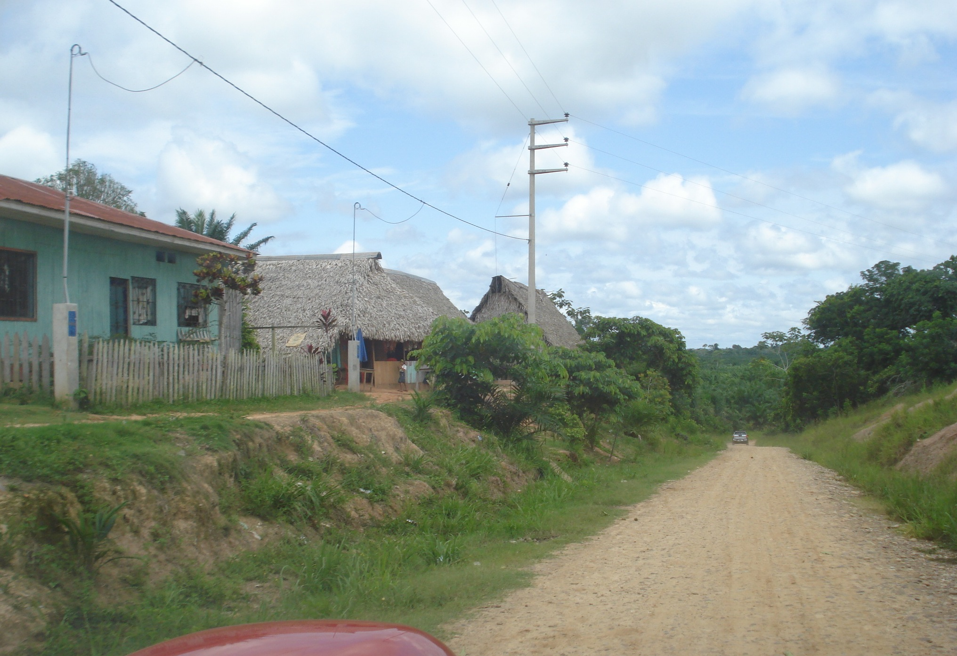
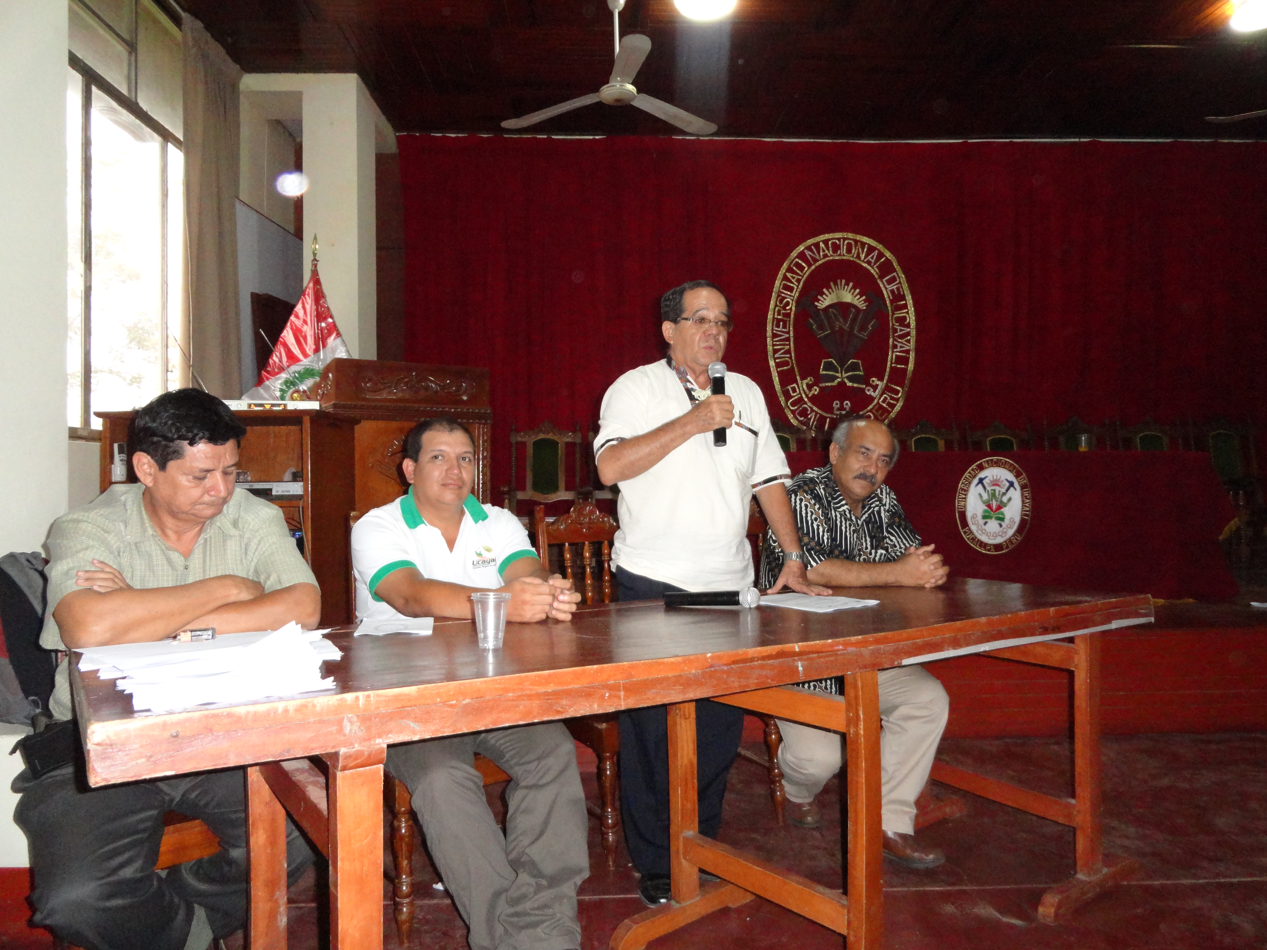
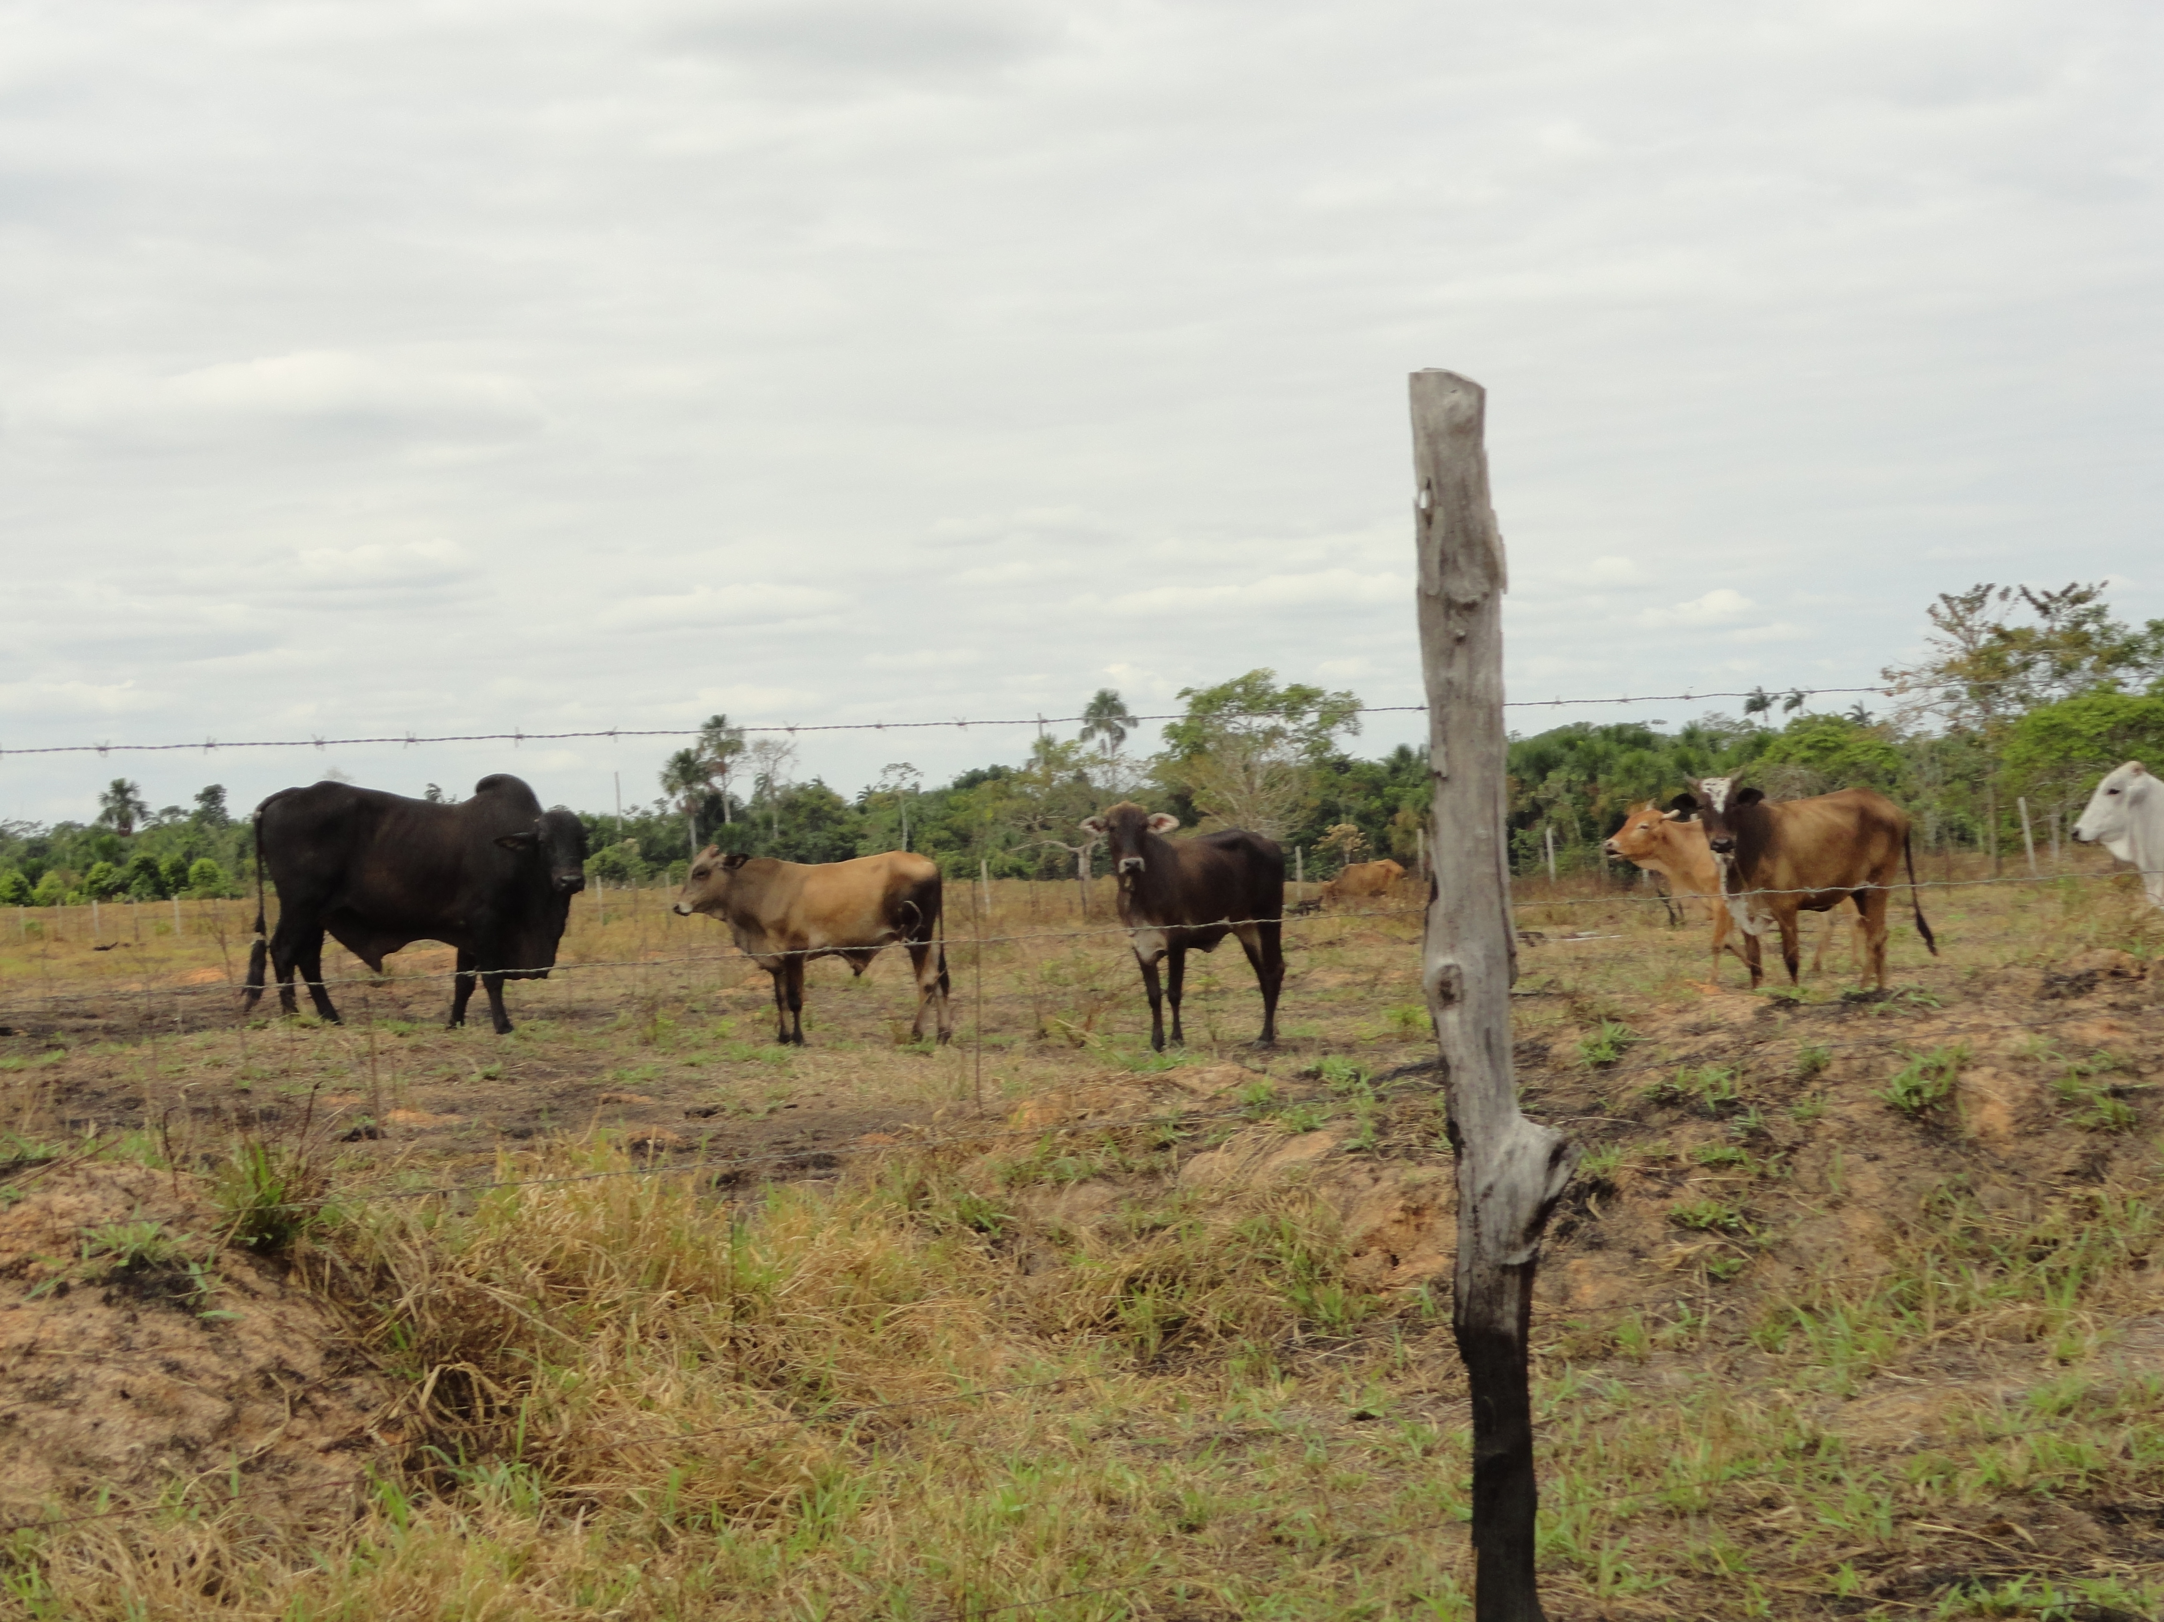
Policy implications
Development of Fire and Droughts Early Warning Systems.
Provision of social services that maintain population in rural areas.
Promote fire prevention and control in higher fire risk land covers.
Promote training of local authorities and communities to prevent unintended spread of fires.

Slide 13
Future work
Evaluate how longer-term modes of climate variability (decadal and trends) may impact fires in WA.
Evaluate how climate disturbances may impact other functionality of tropical ecosystems.
Center for International Forestry Research

