Slide 1
IRI Data Library: enhancing accessibility of climate knowledge
M. Benno Blumenthal, Michael Bell, John del Corral, Rémi Cousin, and Igor Khomyakov
Notes:
Introducing the team

Slide 2
Problem?
Database, tables, spreadsheets, GRIDB, netCDF, images, binary, servers, OpenDAP, THREDDS, shapefile
Barriers: Technology constraints
Generate knowledge
Barriers: Access in relevant and timely manner
Access to knowledge
Barriers: Uptake of Climate Information
Informed action by decision-maker
Notes:
What problems are facing in the implementation and design of such a Maproom?
The crude source of information is available as data in files in various formats and coming from different sources worldwide
We want decision makers to trigger informed actions based on that information
There is a long way to go and obstacles to get there:
Technological constraints in the first place make data files manipulation difficult to generate knowledge;
once knowledge is generated, it needs to be effectively disseminated in a relevant and timely manner to make that knowledge accessible;
finally decision-makers would use, understand and demand that information only if they had uptaken all the concepts behind it.
Following are examples illustrating how we are able to address those problems

Slide 3
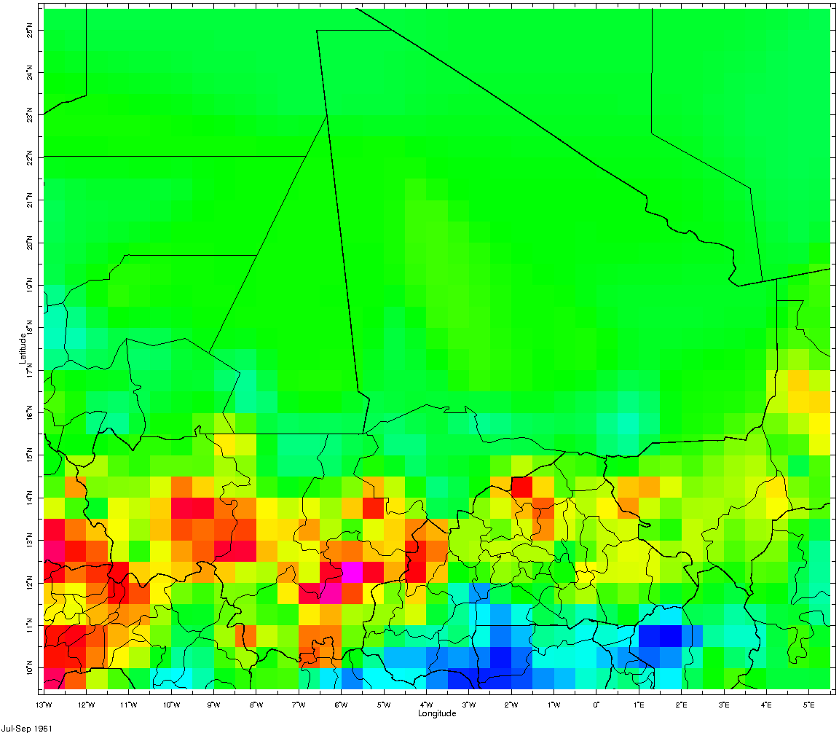
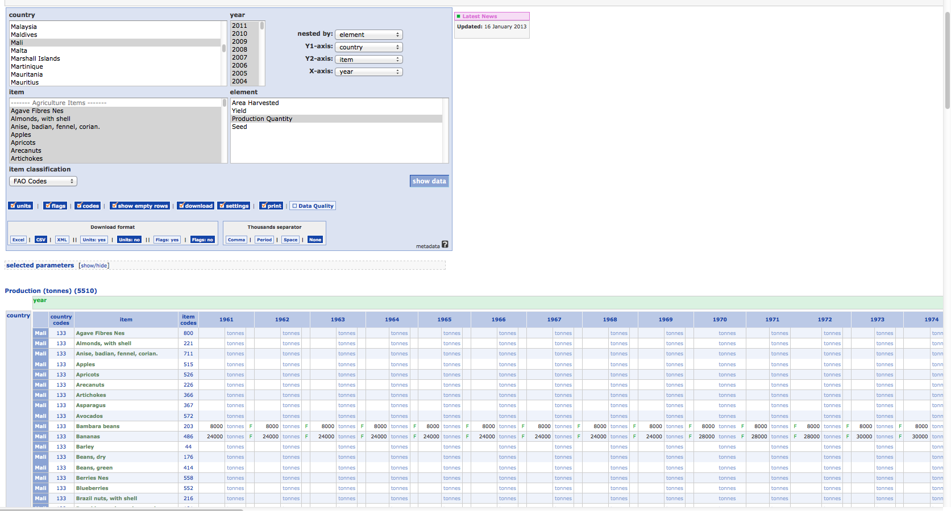
Datasets Inter-operability
mali cfsva2005 climate change.sav
Notes:
The Data Library solves all or part of those problems and obstacles.
Here is an example of very disparate sources:
WFP CFSVA household survey by village location (lat/lon)
FAO Crop statistics yearly for the Mali
CMAP monthly rainfall gridded

Slide 4
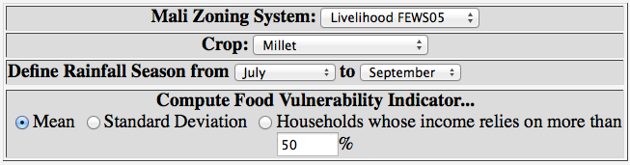
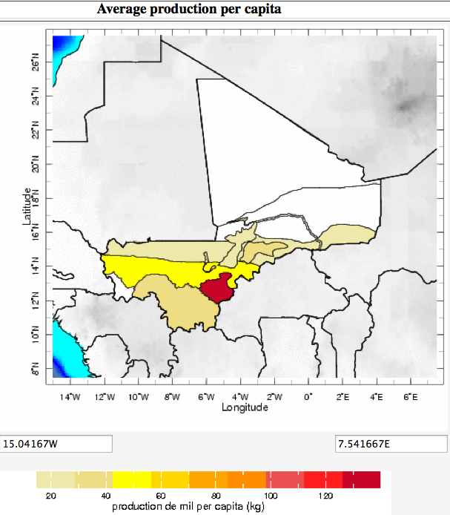
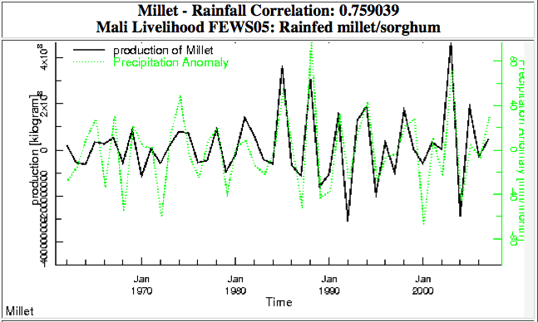
Datasets Inter-operability
Notes:
Once integrated to the DL (much less time consuming than dealing with each file and appropriate software for each to produce analysis and graphs) different space and time scales and organization can be exploited all together in this maproom.
Brief description: choice of crop, choice of geographical entities (here FEWSNET livelihoods), map averaging a household survey variable by geo entity, then click on map to get rainfall/crop prod correlation for that geo entity
The Data Library Technology brings different sources, a variety of formats and different data cultures in a unified semantics framework allowing inter-operability; Let the user think in terms of manipulation of ds/var rather than files of numbers; In particular it integrates traditional GIS capacities and smartly processes vast quantity of data flow by selecting the small portion needed by a query

Slide 5
Problem?
Solution!
Database, tables, spreadsheets, GRIDB, netCDF, images, binary, servers, OpenDAP, THREDDS, shapefile
Data Library Technology
Semantics Framework
Barriers: Technology constraints
Generate knowledge
Barriers: Access in relevant and timely manner
Access to knowledge
Barriers: Uptake of Climate Information
Informed action by decision-maker
Notes:
Data inter-operability solved.
But not enough: need to generate knowledge

Slide 6
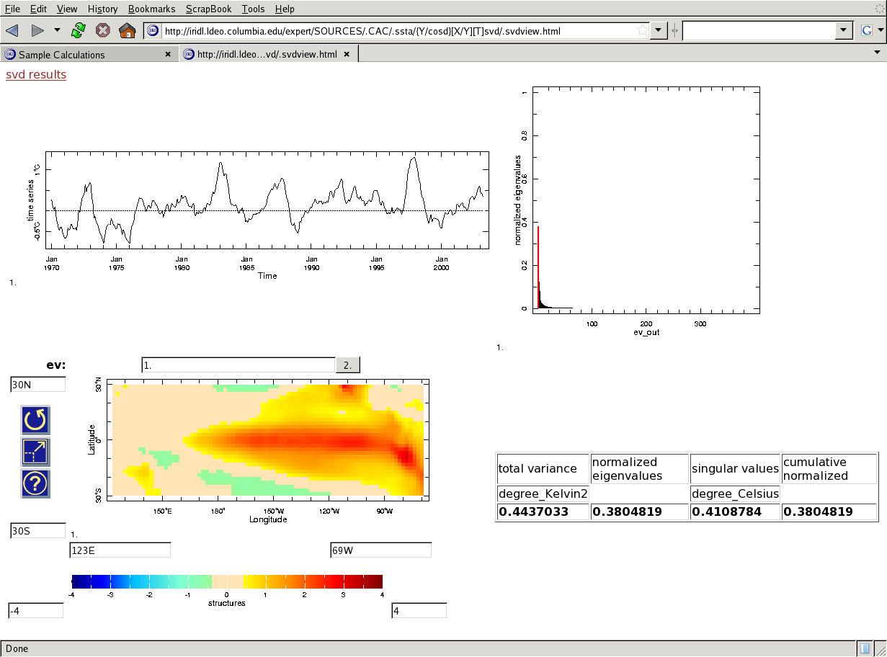
Generating Knowledge
Notes:
The Ingrid Data Language allows from simple to complex data analysis in space, time and other dimensions, and visualization, enabling reproduction of IRI concepts developed by scientists to generate knowledge by practitioners and researchers who have in-depth knowledge of the DL system
From simple to complex analysis: here SVD depicting ENSO. Tool for science community

Slide 7
Problem?
Solution!
Database, tables, spreadsheets, GRIDB, netCDF, images, binary, servers, OpenDAP, THREDDS, shapefile
Data Library Technology
Semantics Framework
Barriers: Technology constraints
Ingrid Data Language
IRI science
Generate knowledge
Barriers: Access in relevant and timely manner
Access to knowledge
Barriers: Uptake of Climate Information
Informed action by decision-maker
Notes:
Knowledge generation solved
But not enough: How can users access that knowledge?

Slide 8
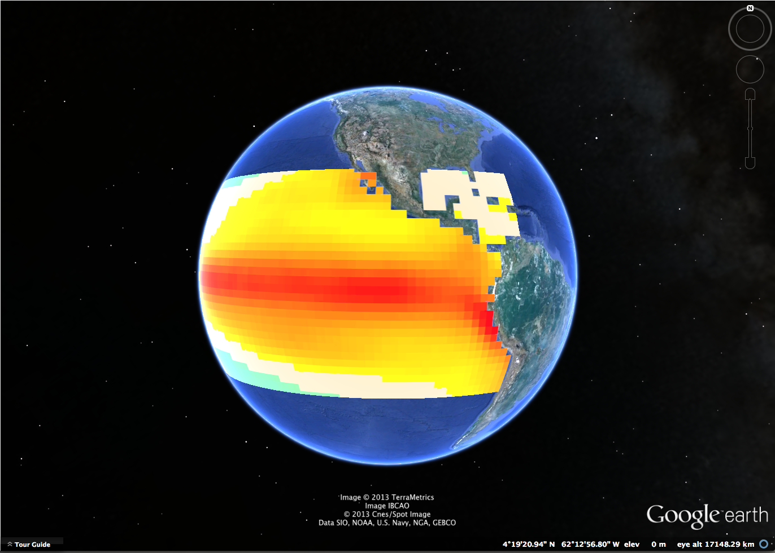
Serving data
Notes:
Whether you generate knowledge yourself with the Ingrid Data Language or find it in a Maproom, the DL is an internet-based system that can serve information as data files in various formats or sharing it to various software.
Here one example: Sharing the previous SVD analysis to Google Earth

Slide 9
Problem?
Solution!
Database, tables, spreadsheets, GRIDB, netCDF, images, binary, servers, OpenDAP, THREDDS, shapefile
Data Library Technology
Semantics Framework
Barriers: Technology constraints
Ingrid Data Language
IRI science
Generate knowledge
Barriers: Access in relevant and timely manner
Internet-based technology
Serving data
Maprooms
Access to knowledge
Barriers: Uptake of Climate Information
Informed action by decision-maker
Notes:
Now user can access relevant information in a timely manner.
But what if they don’t know how to use, understand and demand relevant Climate Info?

Slide 10
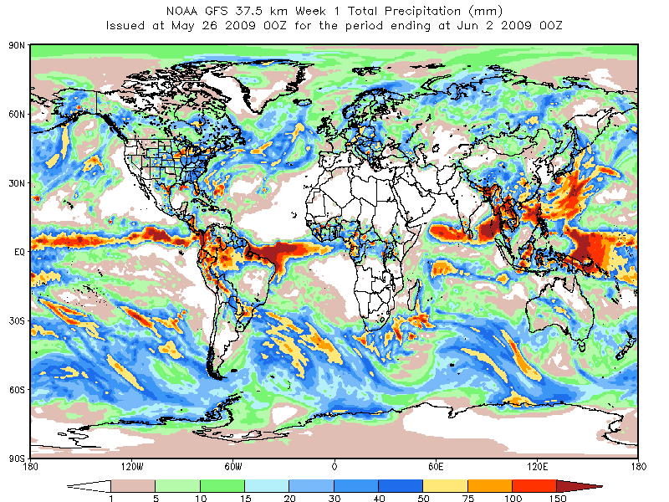
The birth and life of the IFRC Maprooms
Notes:
Maprooms are the web-manifestation of a process which evaluates user-group needs and builds a web-accessible tool that displays the relevant analyses, for practitioners who don’t have that in-depth knowledge of climate science or data manip
The IFRC came up with a question to answer: Where and when are the risks of floods? in DRM optic.
They originally looked at this map: total precipitation forecast in the coming 6 days.

Slide 11
The birth and life of the IFRC Maprooms
If floods relate to unusual rainfall, does this map tell where rainfall is unusual?
No! Need for historical context: Compare current 6-day forecast with historical 30-year average same 6-day period
Need for a new dataset
Notes:
IRI staff and IFRC staff started discussion on how to answer that question

Slide 12
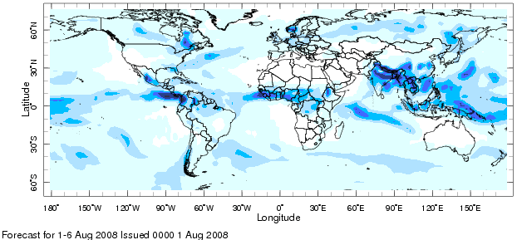
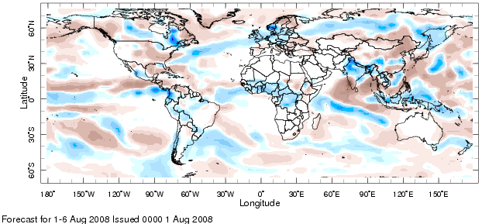
The birth and life of the IFRC Maprooms
Notes:
They came up with a new dataset that allowed to compute anomalies of rainfall to figure out where anomalous rainfall were forecasted
Compare SE Asia / Philippines rainfall

Slide 13
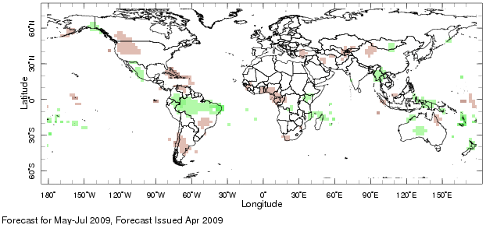
The birth and life of the IFRC Maprooms
New relevant information identified: seasonal forecast and context (historical, socio-economics)
Notes:
This was great for monitoring short-term upcoming risk. But what about a longer lead time?
Introduction of seasonal forecast

Slide 14
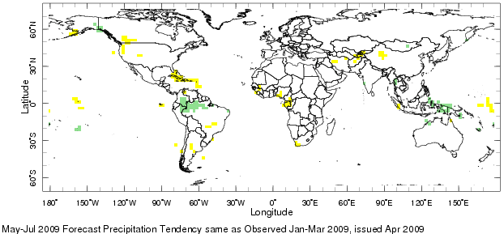
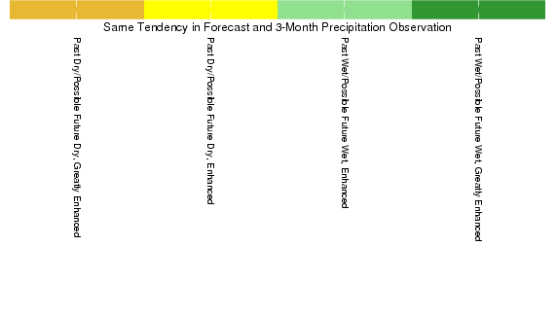
The birth and life of the IFRC Maprooms
New relevant information identified: seasonal forecast and context (historical, socio-economics)
Notes:
Additional context became relevant and Forecast in context was added, merging historical information with the seasonal forecast

Slide 15
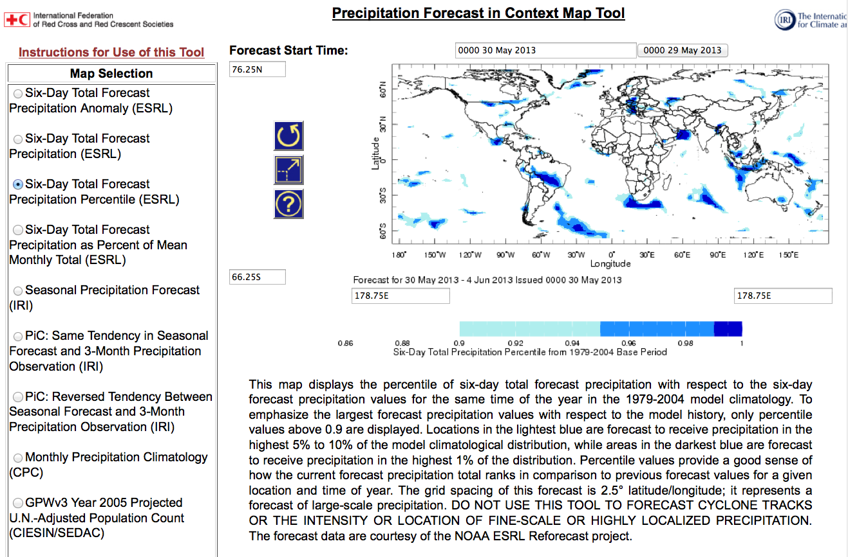
The birth and life of the IFRC Maprooms
Notes:
Percentie variables were used to indicate where rainfall was likely to be exceptionally heavy. But percentile is not a common term for IFRC staff

Slide 16
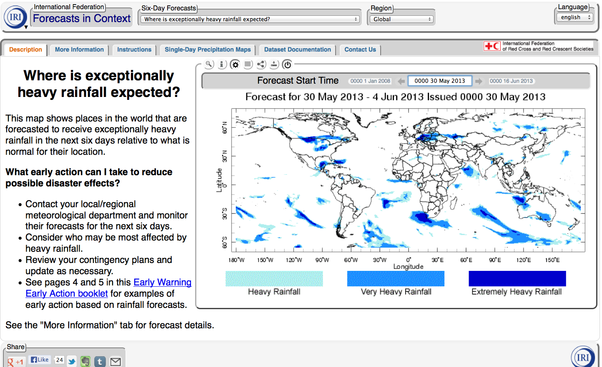
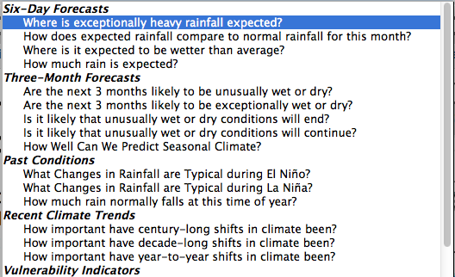
The birth and life of the IFRC Maprooms
Notes:
So why not be clearer on what each tool is for and what question it intends to address?
Continuous interaction between IFRC staff, IRI experts and scientists, led to a complete tool with many sections spanning a range of questions addressing different time scales and concerns for flood DRM.
We recently came up with a new design outperforming the previous one, giving more visibility for the map and better descriptions for Google, and compatible with small cellular screens for operators on the field

Slide 17
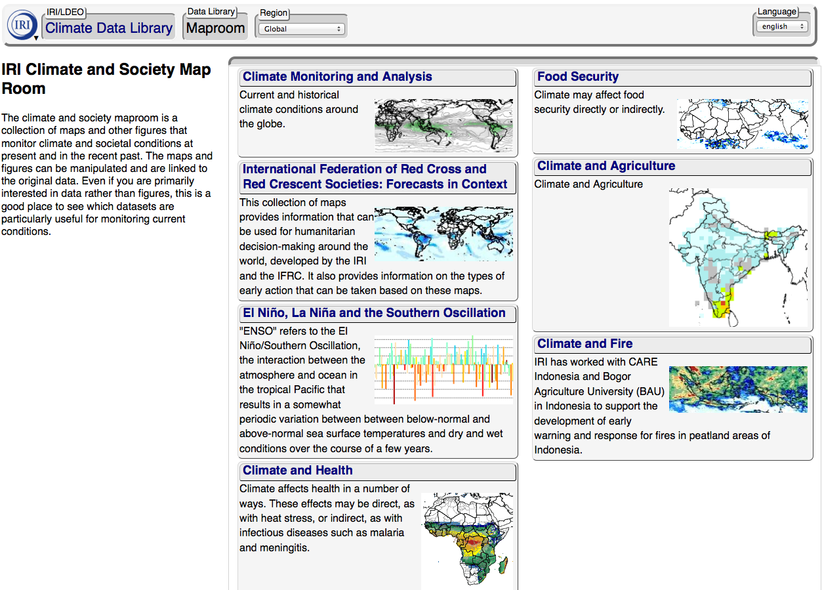
More Maprooms

Slide 18
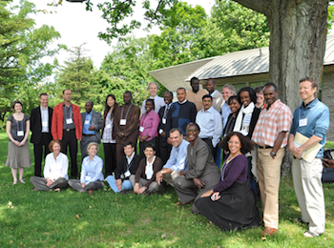
Training Tool
Summer Institute for professionals of climate and health in Lamont – reproduced locally in Andean countries, Mercosur countries, Ethiopia, Madagascar.
Training on the Fire Maprooms in Indonesia
Columbia University classes
Etc.
Let trainee think the abstract of data manipulation and focus on actual scientific analysis therefore helping the uptake of IRI science behind the generated knowledge
Notes:
it is a useful training tool (whether in its portable or online version) to have users and partners think the abstract of data manipulation and focusing on actual scientific analysis therefore helping the uptake of the IRI science behind the generated knowledge.
Using or not a protable DL to overcome intermittent, slow or non-existing connectivity
Here are a few examples of trainings relying on the DL

Slide 19
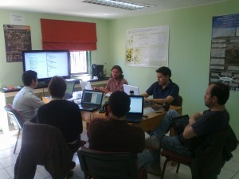
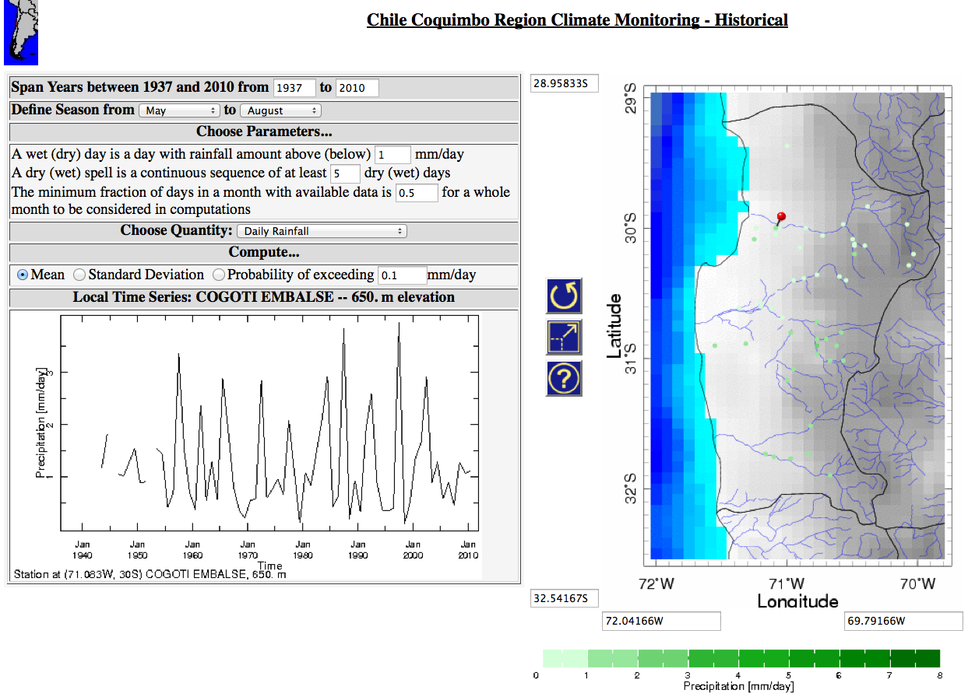
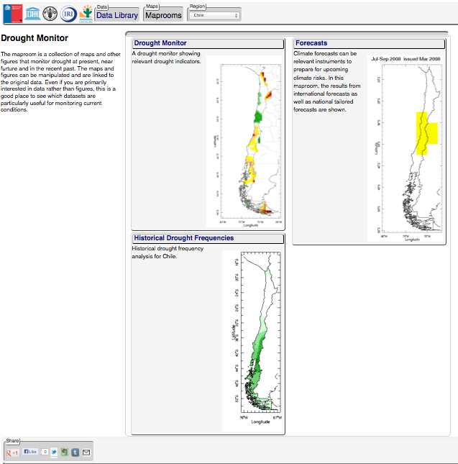
Technology Transfer
NMA (Ethiopia)
TMA (Tanzania)
AGRHYMET (West Africa)
CEAZA (Chile)
ACMAD (Africa)
IIT-Delhi (India)
IMD (India)
CAZALAC (LAC)
CCROM (Indonesia)
Syngenta Nairobi (East Africa)
Notes:
Partners have now even uptaken the technology itself where bad internet connectivity, targeted data services are needed, or data policy constrains sharing, with minimal start-up costs
List DL install across the World.
Stress case of NMA/TMA/AGRHYMET by quoting NMA Director: “NMA is shifting from one desk service to one-click service”
Training process:
Design a prototype at IRI with partners that will make the case and serves as training materials
Install sofware and train staff locally
Local Maprooms made locally: here Drought Observatory for Chile

Slide 20
Problem?
Solution!
Database, tables, spreadsheets, GRIDB, netCDF, images, binary, servers, OpenDAP, THREDDS, shapefile
Data Library Technology
Semantics Framework
Barriers: Technology constraints
Ingrid Data Language
IRI science
Generate knowledge
Barriers: Access in relevant and timely manner
Internet-based technology
Serving data
Maprooms
Access to knowledge
Barriers: Uptake of Climate Information
Maprooms
Training tool
Technology Transfer
Informed action by decision-maker
Notes:
Uptake of info solved.
The combination of all those tools and capacity make the DL a unique tool to disseminate relevant Climate Information

Slide 21
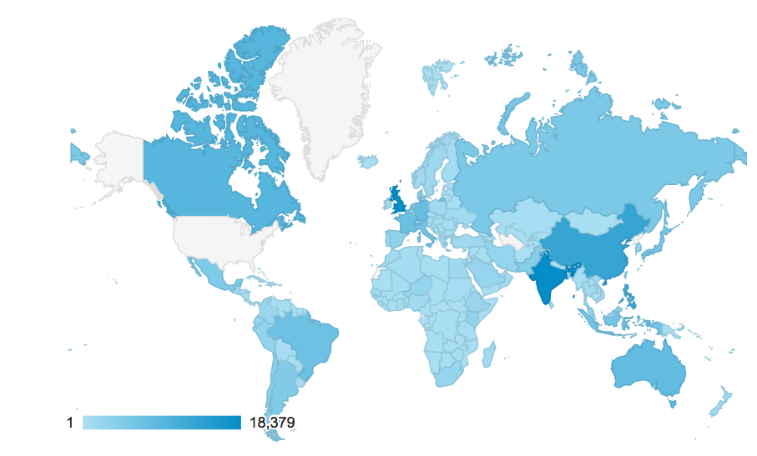
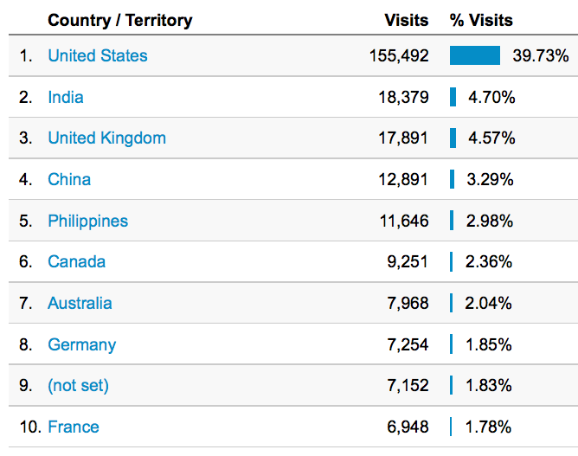
Reach
Notes:
Who is this solution?
Google Analytics of visits over the past 12 months (USA removed from the map for better viewing

Slide 22
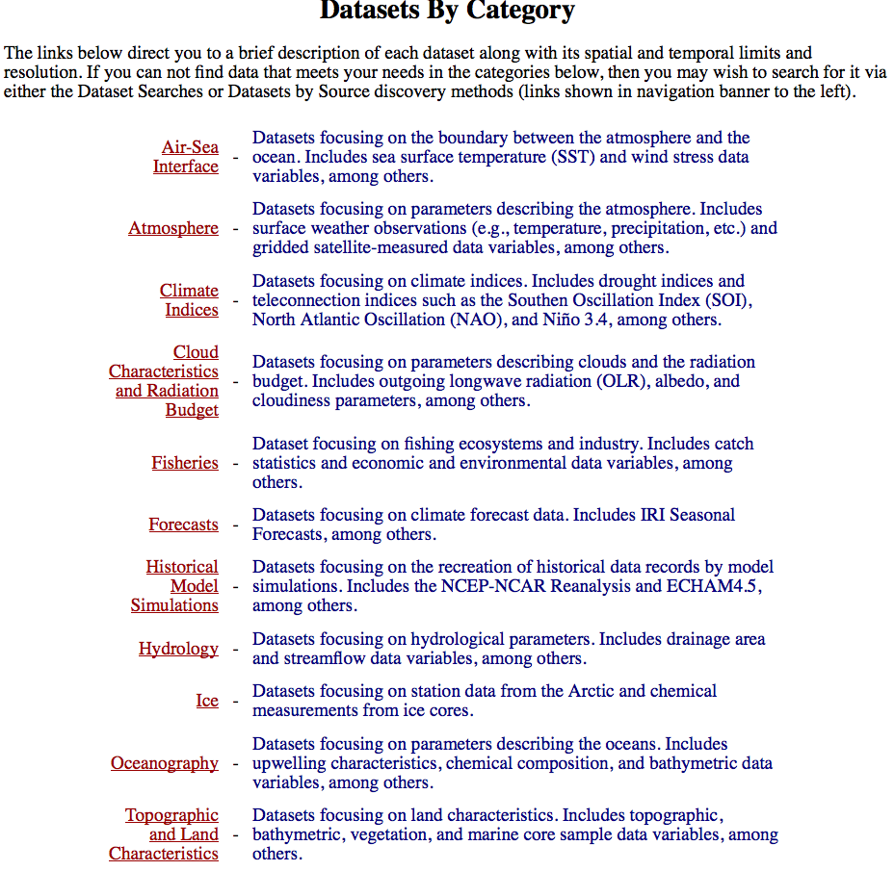
Resources and Funding
CCAFS
CSIRO
IICA – INMET
NASA
NIH
NOAA
NSF
RISE
Uruguay Ministry of Agriculture
USAID CCRD
USAID E3
USAID IFAD
USAID UPLBFI
Notes:
Let’s not forget that the DL is a Library and therefore relies on data production across the World: hundreds of datasets currently served
FY14 funding in alphabetical order gives us 2 messages:
There is a diversity of communities that need this type of tool
However to serve as a Public Goods, project-based funding only makes it difficult (eg develop core of the tools, support users…)

Slide 23
New Challenges and Vision
A community of Data Library Developers Worldwide who address data issues, tool development, etc.
Stronger semantic framework to allow more automatic analyses
Better management of provenance of any analysis and graphics for accurate referencing
Introduce parallel computation to improve efficiency
Solid work done to disseminate public health information: pursue the same for Agriculture, Water Management, etc.
Notes:
Help

Slide 24
Ingridly yours
Notes:
A bit of humor?

