Slide 1
Forecast development at the IRI
Michael K. Tippett

Slide 2
Outline
Our approach
Vision
Values
Past, present and future strategies

Slide 3
Approach to forecast development
Vision
Provide global climate forecasts for societal benefit
Values
High-quality climate forecast information/ingredients
In-house
Partners
Transform forecast information into useful products
Match user systems with scientific capabilities
Products informed by research (R2O/O2R)
Physical
Social
Provide benefit via product content as well as process
“Best practices”

Slide 4
What is a good forecast product?
One that is used.
Fits into a user’s decision system
Hard to convince users to change their systems
Easier to get them to add inputs
Available.
Data library
Trusted.
Verification

Slide 5
Forecast verification

Slide 6
Strategic elements
Forecast inputs/ingredients
Forecast models
Observational data
Products
Categorical probabilities
PDFs
Methodologies
Combination/calibration of forecast inputs
Product delivery

Slide 7
Differing classes of forecast models
Carbon
Ocean
Chemistry
Atmosphere
Ice
Land
Coupled processes
Two classes of forecast models:
Ocean-atmosphere coupled models: Initial state of climate system is prescribed
Atmosphere-only models: Future SST is prescribed
http://www.cmmap.org

Slide 8
The very beginning
Forecast ingredients:
Prescribed SST AGCMs (not coupled)
Products
Issued seasonally
3-month averages
Near-surface temperature and precipitation
Tercile probabilities
No digital data
Methodology
Basis for RCOF (subjective)
Manual map production

Slide 9
ATB (After Tony Barnston)
Forecast ingredients:
Prescribed SST AGCMs (not coupled)
Products
Issued monthly
3-month averages
Near-surface temperature and precipitation
Tercile probabilities
Digital data available
Methodology
Objective estimation of probabilities
Automated map production (CRED)

Slide 10
Present
Forecast ingredients:
Prescribed AGCMs
CFSv2 (coupled)
Products
Issued monthly
3-month averages
Near-surface temperature and precipitation
Maps of tercile probabilities
Full PDFs
Digital data via Data Library
Methodology
Objective estimation of probabilities
Automated map production
More realistic estimates of uncertainty

Slide 11
Flexible forecast format maproom

Slide 12
Future
Forecast inputs
More coupled models
NMME
Products
Additional quantities, time-scales
Leverage emerging research
Methodologies
More agile, able to adapt to changing inputs
Leverage emerging research

Slide 13
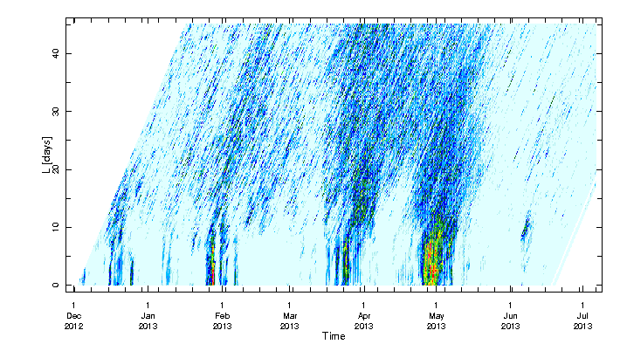
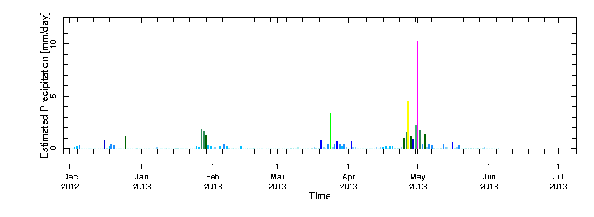
Forecast and monitoring of regional extremes
Motivated by IRFC collaboration
45-lead
Forecast lead (days)
Forecasts
0-lead
Verification time
Observations
Monitor and forecast
regional indices e.g.:
Rainfall
Severe weather
Fire

