Slide 1
Climate Change, Agriculture and Food Security (CCAFS) program of the CGIAR
James Hansen, Kevin Coffey
IRI Review
Columbia University, New York
June 24, 2013
Notes:
Objective 2.2 About food system-level interventions in the face of climate-related shocks. …Using advance information to better manage climate risk through, e.g. delivery, trade and crisis response

Slide 2
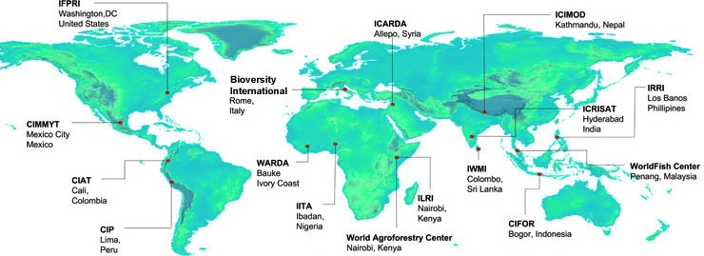
What is CCAFS?
Strategic partnership of international agriculture (CGIAR) and global change (Future Earth) research communities
Notes:
For bullet to:
Mechanism for organizing, funding climate works across CGIAR
Involves all 15 CGIAR Centers
$67M/year

Slide 3
What is CCAFS?
Strategic partnership of international agriculture (CGIAR) and global change (Future Earth) research communities
World’s largest research program addressing the challenge of climate change and food security
Mechanism for organizing, funding climate-related work across CGIAR
Involves all 15 CGIAR Centers
$67M per year
Notes:
For bullet to:
Mechanism for organizing, funding climate works across CGIAR
Involves all 15 CGIAR Centers
$67M/year

Slide 4
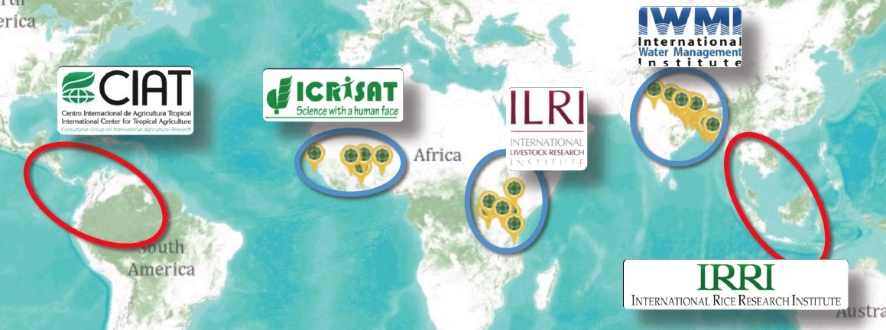
What is CCAFS?
Strategic partnership of international agriculture (CGIAR) and global change (Future Earth) research communities
World’s largest research program addressing the challenge of climate change and food security
5 target regions across the developing world
Notes:
For bullet to:
Mechanism for organizing, funding climate works across CGIAR
Involves all 15 CGIAR Centers
$67M/year

Slide 5
What is CCAFS?
Strategic partnership of international agriculture (CGIAR) and global change (Future Earth) research communities
World’s largest research program addressing the challenge of climate change and food security
5 target regions across the developing world
Organized around 4 Themes:
Adaptation to progressive change
Adaptation through managing climate risk
Pro-poor climate change mitigation
Integration for decision-making
Notes:
For bullet to:
Mechanism for organizing, funding climate works across CGIAR
Involves all 15 CGIAR Centers
$67M/year

Slide 6
Theme 2 overview
Scale
Objective 2:
Food System Risk Management
Fill key gaps:
Knowledge
Tools & Methods
Evidence
Capacity
Coordination
Objective 3:
Climate Information and Services
Objective 1:
Local Risk Management
GENDER & EQITY LENS

Slide 7
Theme 2 overview
Scale
Objective 2:
Food System Risk Management
Enhanced climate services
Objective 3:
Climate Information and Services
Enhanced climate services
Objective 1:
Local Risk Management

Slide 8
Theme 2 overview
Scale
Objective 2:
Food System Risk Management
Improved, climate-informed responses
Resilient food systems,
Improved food security
Objective 3:
Climate Information and Services
Objective 1:
Local Risk Management
Enhanced support for managing risk
Climate-resilient rural livelihoods

Slide 9
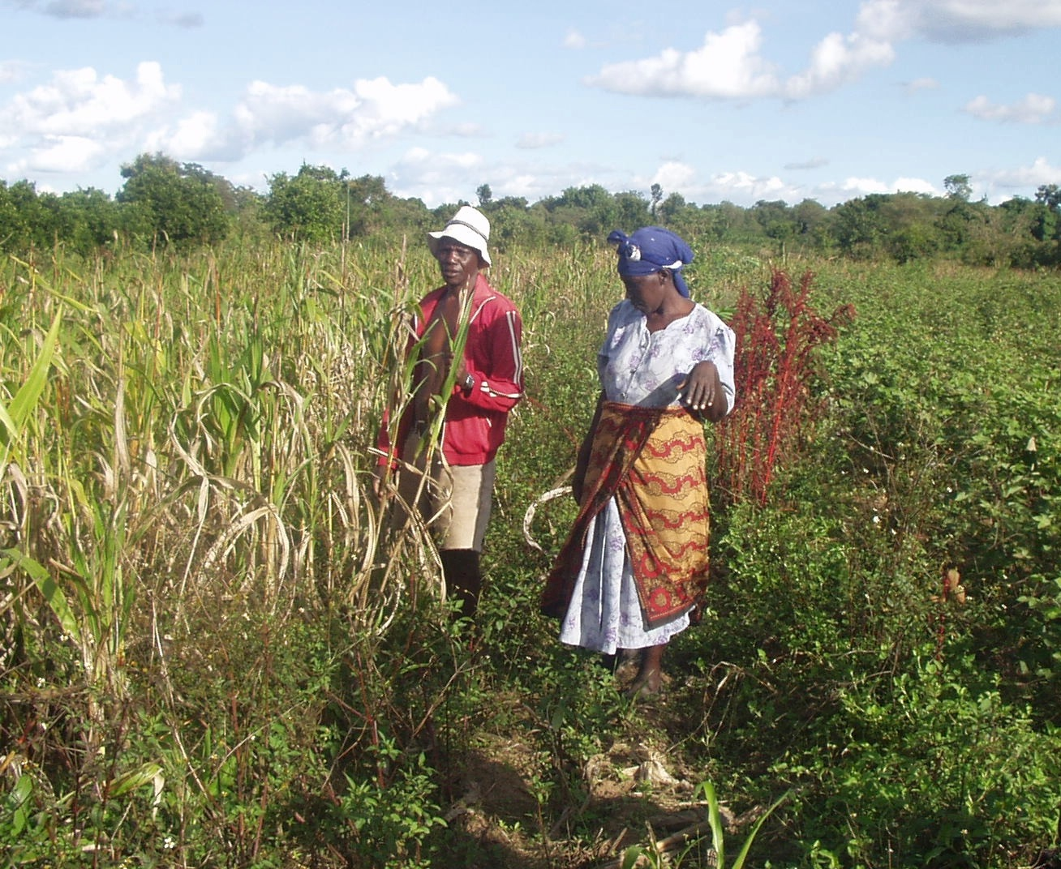
1. Scaling Up Climate Services for Smallholder Farming Communities
How can investment in climate services empower smallholder communities
– at scale?

Slide 10
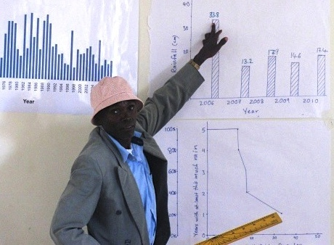
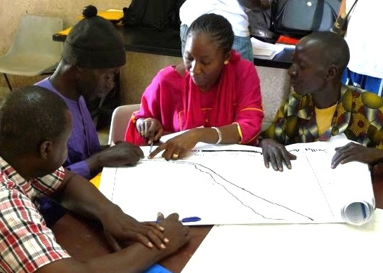
Piloting in Kenya, Senegal
Notes:
We have learned a lot about how to design seasonal climate information that meets the need of smallholder farmers, and communicate it in a way that they can communicate

Slide 11
From hundreds to millions? World Vision
World’s largest development NGO
Secure the Future

Slide 12
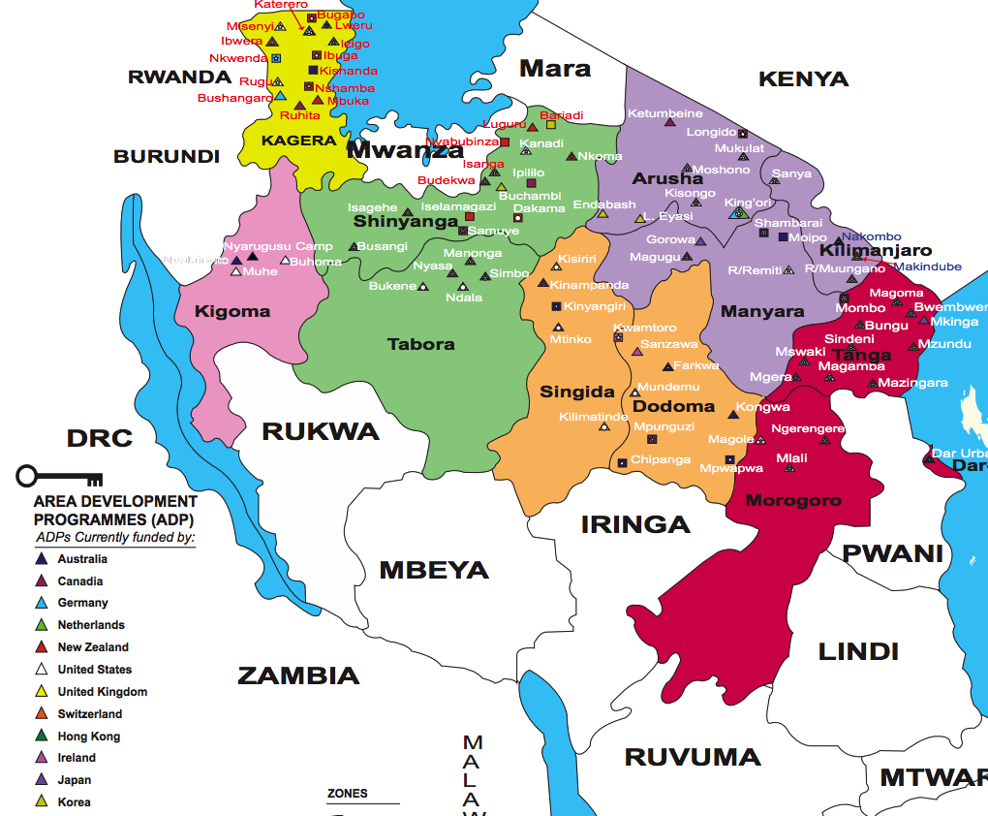
From hundreds to millions? World Vision
World’s largest development NGO
Secure the Future
Tanzania:
Reach ~1.7M farmers + pastoralists
66 ADP offices
staff, partnership
infrastructure
Long-term commitment, where needed

Slide 13
From hundreds to millions? World Vision
World’s largest development NGO
Secure the Future
Tanzania:
Reach ~1.7M farmers + pastoralists
66 ADP offices
staff, partnership
infrastructure
Long-term commitment, where needed

Slide 14
A foundation for scaling up
Identifying and addressing the big challenges
Salience: tailoring content, scale, format, lead-time to farm decision-making
Legitimacy: giving farmers an effective voice in design and delivery
Access: providing timely access to remote rural communities with marginal infrastructure
Equity: ensuring that women, poor, socially marginalized benefit
Integration: climate services as part of a larger package of support

Slide 15
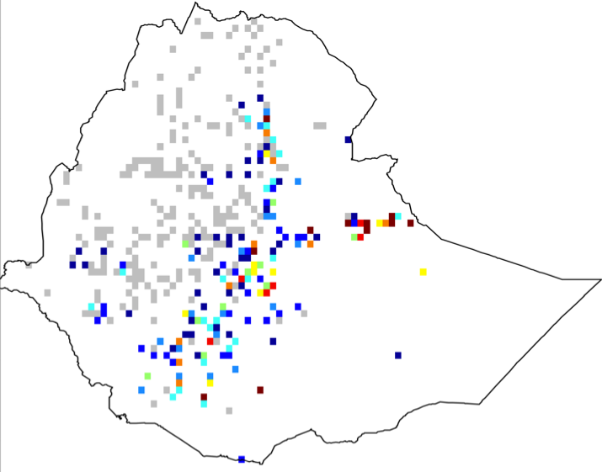
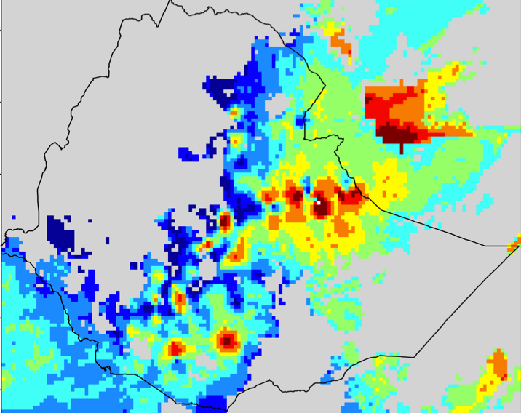
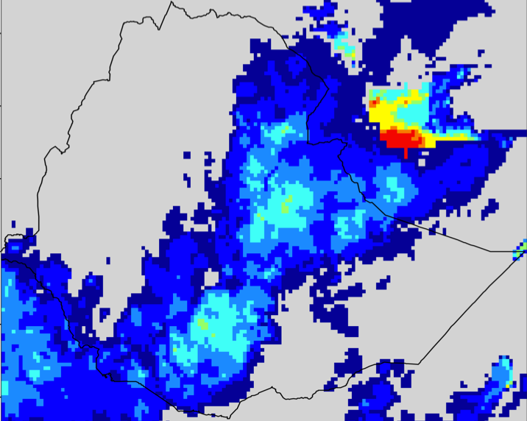
A foundation for scaling up
Identifying and addressing the big challenges
Capacity to deliver relevant climate information
STATION
BLENDED
SATELLITE
Notes:
Professional training for agricultural extension, NGOs, other farmer advisors
Expert workshop (Nairobi, 12-14 June 2013)
Review, compile materials and experiences
Resource book, adaptable training modules, e-training

Slide 16
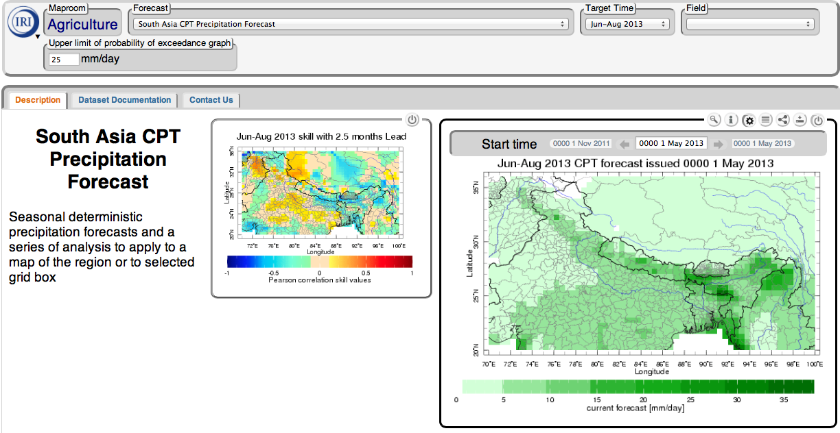
A foundation for scaling up

Slide 17
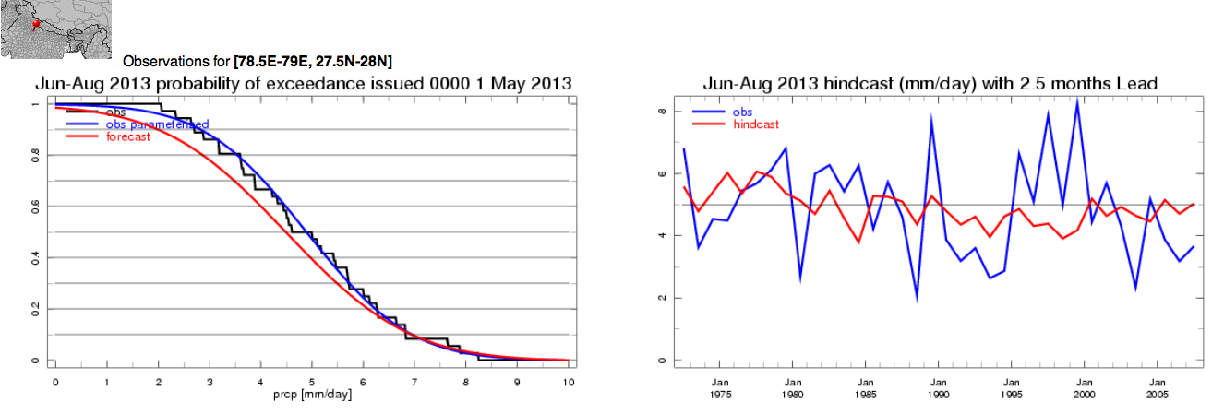
A foundation for scaling up

Slide 18
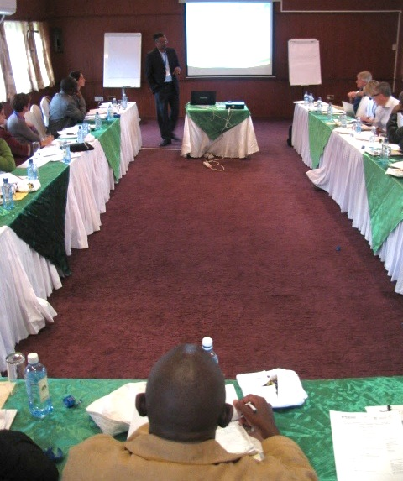
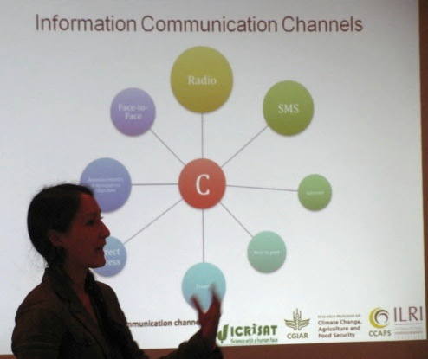
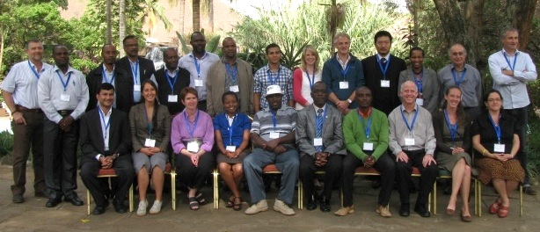
A foundation for scaling up
Identifying and addressing the big challenges
Capacity to provide relevant climate information
Training curricula to equip existing intermediaries

Slide 19
2. Integrated Food Security Modeling
Can climate prediction inform more timely food security intervention?

Slide 20
2. Integrated Food Security Modeling
Can climate prediction inform more timely food security intervention?
^{NORMAL YEAR}
Monitoring
Hunger season
Hunger season
Mar Apr May Jun Jul Aug Sep Oct Nov Dec Jan Feb Mar Apr May Jun Jul Aug

Slide 21
2. Integrated Food Security Modeling
Can climate prediction inform more timely food security intervention?
Emergency response
Fundraising
^{NORMAL YEAR}
Appeal
^{DROUGHT YEAR}
Assessment
Monitoring
Coping responses
(assets divested)
Hunger season
Hunger season
Hunger season
Mar Apr May Jun Jul Aug Sep Oct Nov Dec Jan Feb Mar Apr May Jun Jul Aug

Slide 22
2. Integrated Food Security Modeling
Can climate prediction inform more timely food security intervention?
Emergency response
Fundraising
^{NORMAL YEAR}
Appeal
^{DROUGHT YEAR}
Assessment
Monitoring
Coping responses
(assets divested)
Hunger season
Hunger season
Hunger season
Mar Apr May Jun Jul Aug Sep Oct Nov Dec Jan Feb Mar Apr May Jun Jul Aug

Slide 23
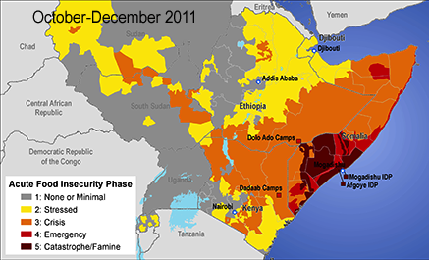
Integrated food security modeling
IPC a common language and entry point
Government ministries
FAO and WFP
international NGOs
NARES and academia

Slide 24
Integrated food security modeling
IPC a common language and entry point
The hole in food security information
Risk & vulnerability baseline
Food security monitoring
Emergency needs assessment
the missing piece:
Food security forecasting

Slide 25
Integrated food security modeling
Climate forecast
Food production
Food prices
Household food status
Food security forecasting
IPC a common language and entry point
The hole in food security information
Risk & vulnerability baseline
Food security monitoring
Emergency needs assessment
the missing piece:
Food security forecasting

Slide 26
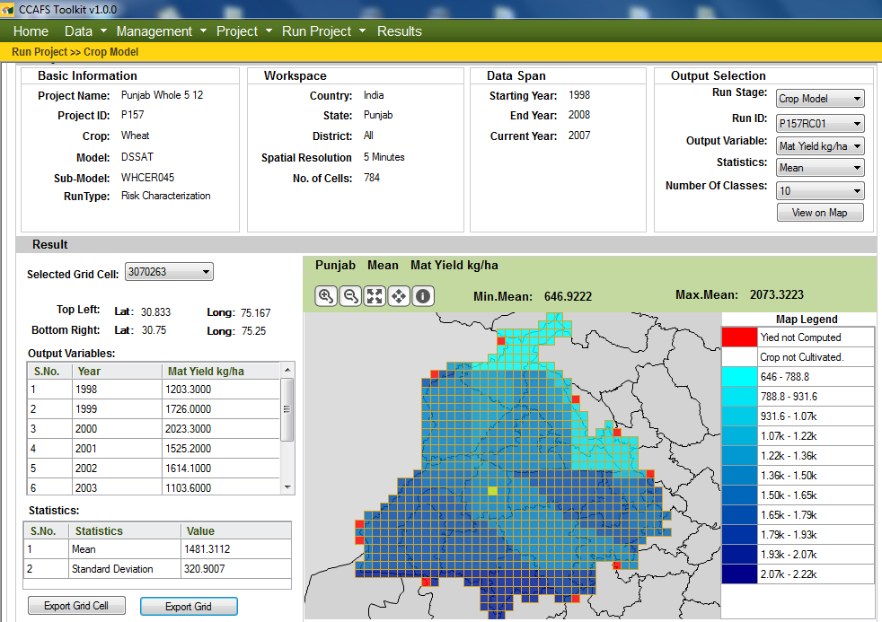
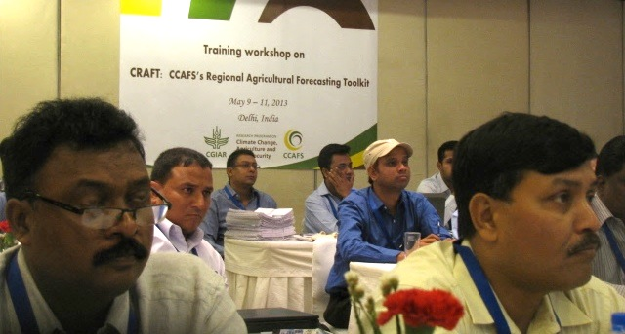
Integrated food security modeling
IPC a common language and entry point
The hole in food security information
Crop forecasting with CRAFT

Slide 27
CRAFT: CCAFS Regional Agricultural Forecasting Toolbox
SEASONAL FORECAST MODEL
Daily weather (historic, monitored)
CROP MODEL
Soil, Cultivar, Management
Target researchers, institutions in the developing world
Facilitate research, testing, implementation of crop forecasting
Accessible: free, open-source
Adaptable: support multiple crop model families
Point yield simulated series
Seasonal predictors (hindcasts,
forecast)
STATISTICAL
MODEL
(CPT)
Point yield forecast distribution
AGGREGATION
Spatial layers,
Freq. distr.
CALIBRATION
District historic yields
District yield forecast
District production forecast
District area

Slide 28
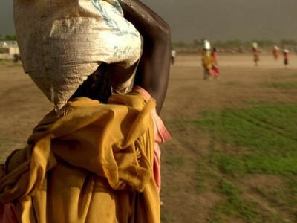
3. Government Food Security Decision-Making in Ethiopia
Can information and evidence overcome obstacles to more timely and better-targeted food security decisions?

Slide 29
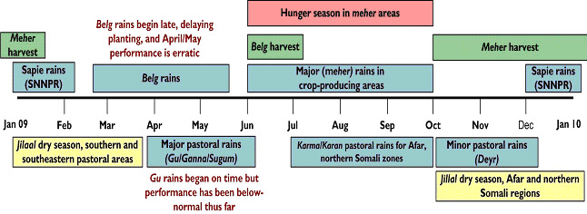
Ethiopia government food security decision-making
Climate forecast
Seasonal climate
Analyze decision processes
Action
Cost Effective?

Slide 30
Ethiopia government food security decision-making
Analyze decision processes
Annual planning & budget process

Slide 31
Ethiopia government food security decision-making
Ask Decision-Makers:
What they want to do?
Information they used?
What risks, tradeoffs?
Analyze decision processes
Annual planning & budget process
Pre-Negotiation Surveys
Federal
Observe:
Who wins, looses?
Information used?
State
Zone
Woreda
Observe Negotiations
Keb.
April May June July Aug Sept

Slide 32
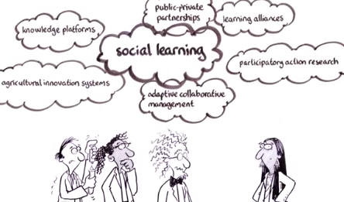
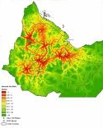
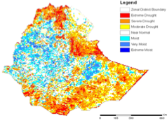
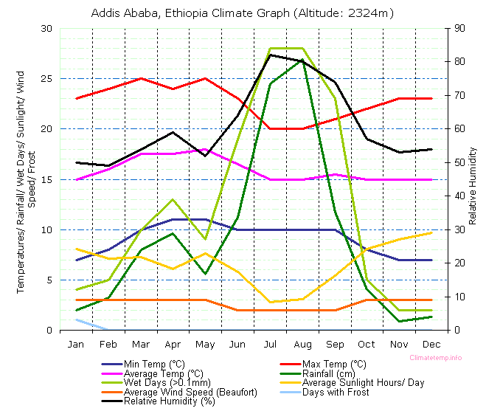
Ethiopia government food security decision-making
Analyze decision processes
Annual planning & budget process
“Marketplace” with decision-makers and information providers

Slide 33
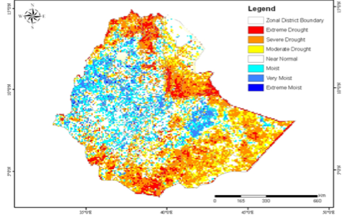
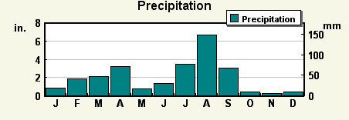
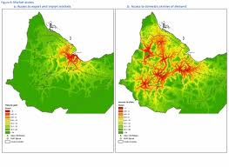
Ethiopia government food security decision-making
Analyze decision processes
Annual planning & budget process
“Marketplace” with decision-makers and information providers
Targeted dissemination and evaluation in 2014

Slide 34
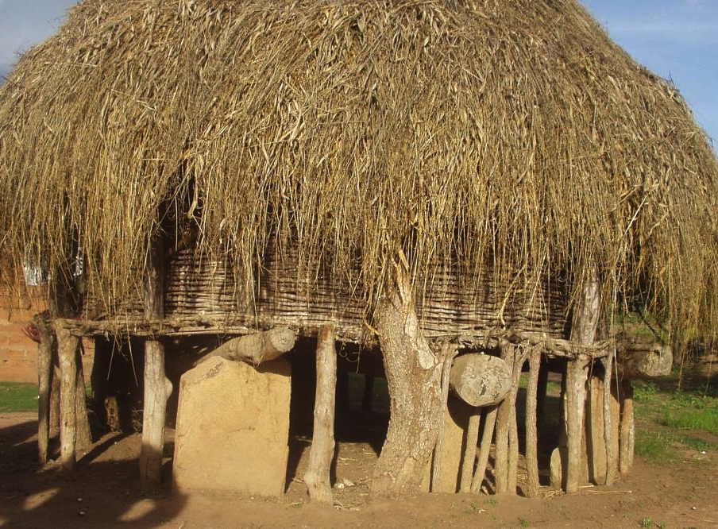
What does CCAFS mean for IRI?
Access to the CGIAR’s capacity, credibility, reach
Mainstreamed an expanded agenda, partnerships
New opportunities for research-for-development
Resources for impact:
Directly leads ~$10M/year component (~60 projects)
Shares overall leadership ($60M-$70M/year)
Access to all CGIAR Centers and their partners
Credibility with development partners

