Slide 1
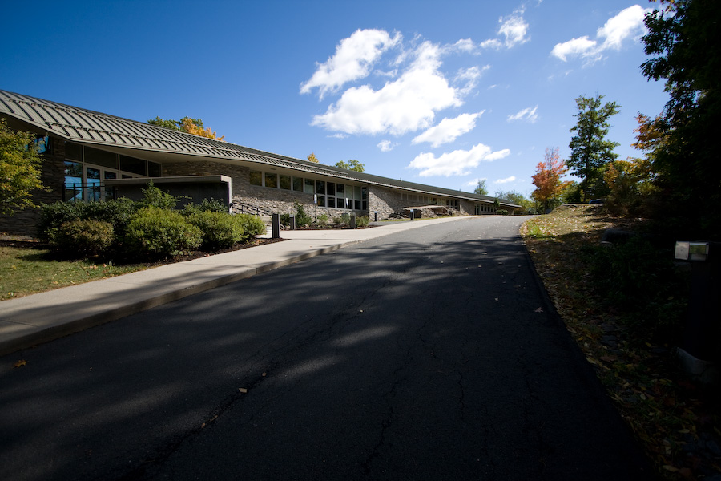

International Research Institute for Climate & Society (IRI)
Lisa Goddard, Director
goddard@iri.columbia.edu

Slide 2
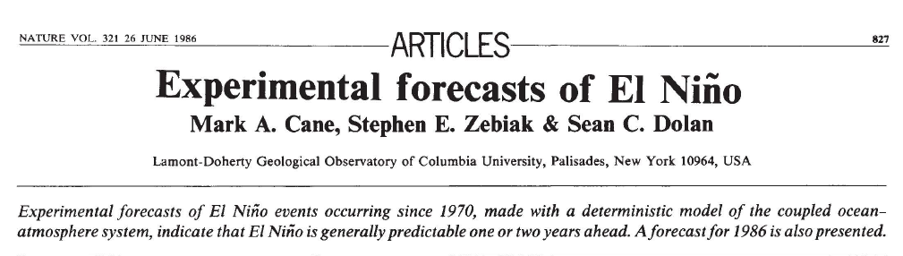
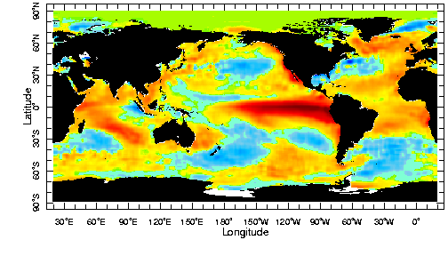
‘86
1990
2000
2010
1st El Niño
Forecast
Large El Nino event
Sea Surface Temperature Anomalies

Slide 3
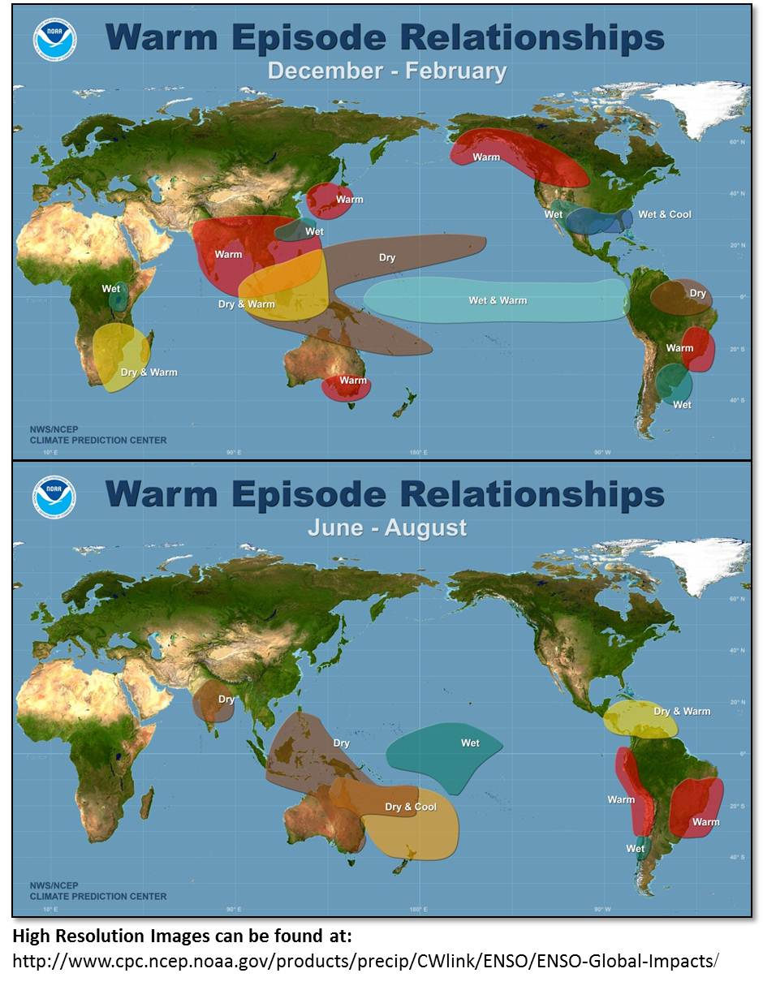
‘87
1990
2000
2010
El Niño Events Affect Climate Worldwide
-- especially in the tropics

Slide 4
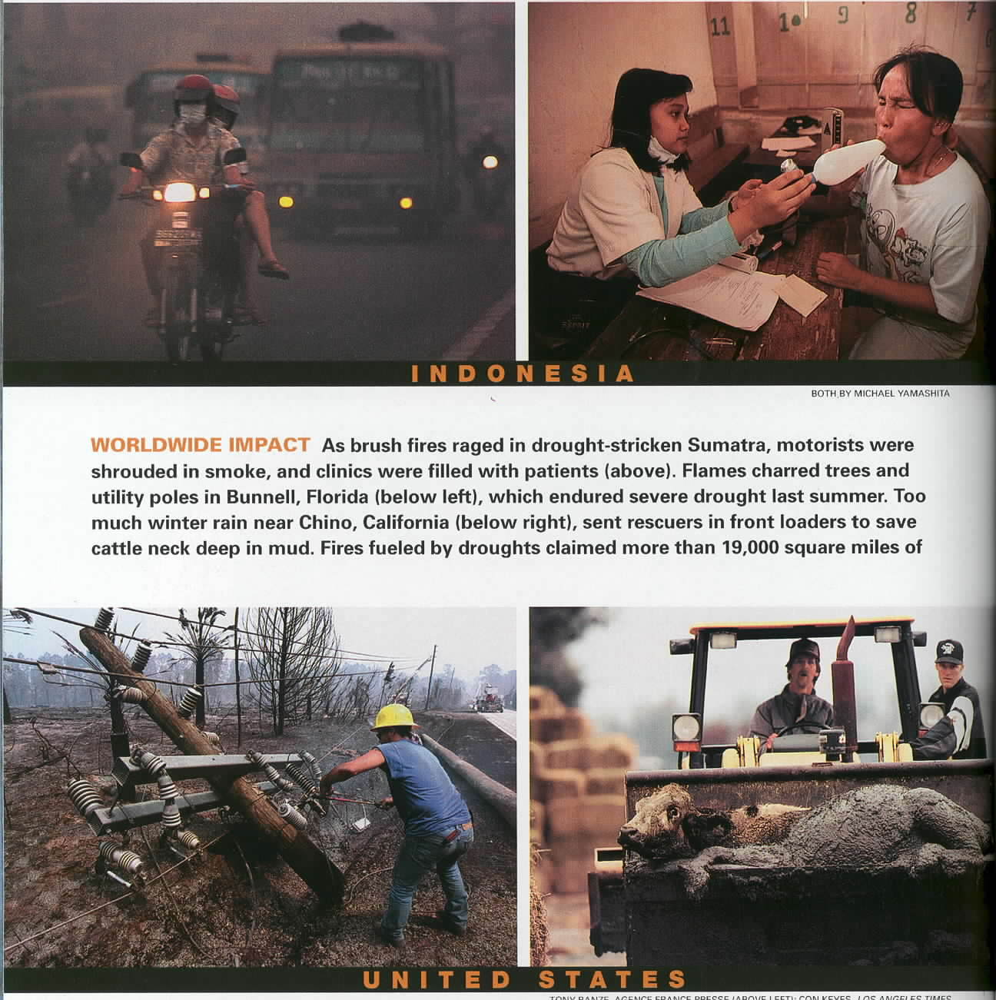
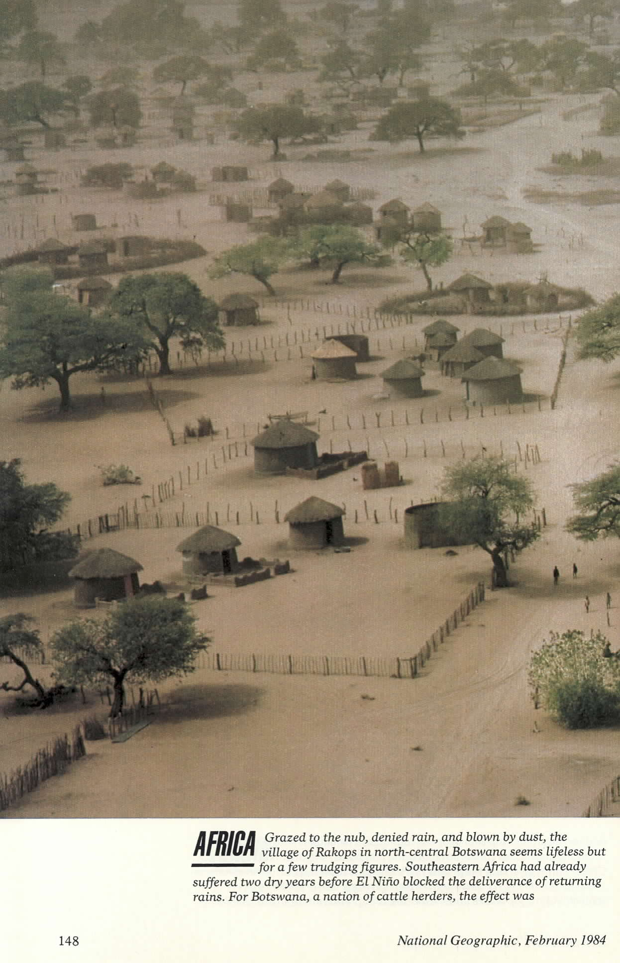
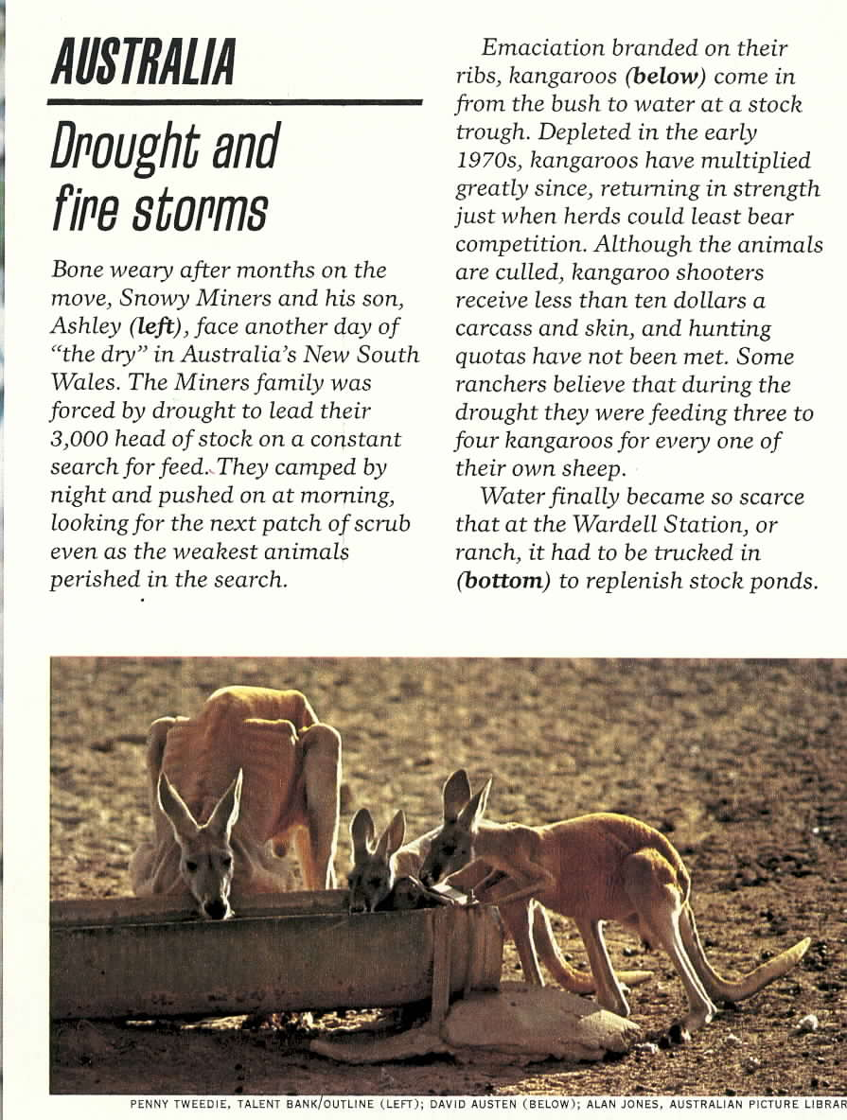
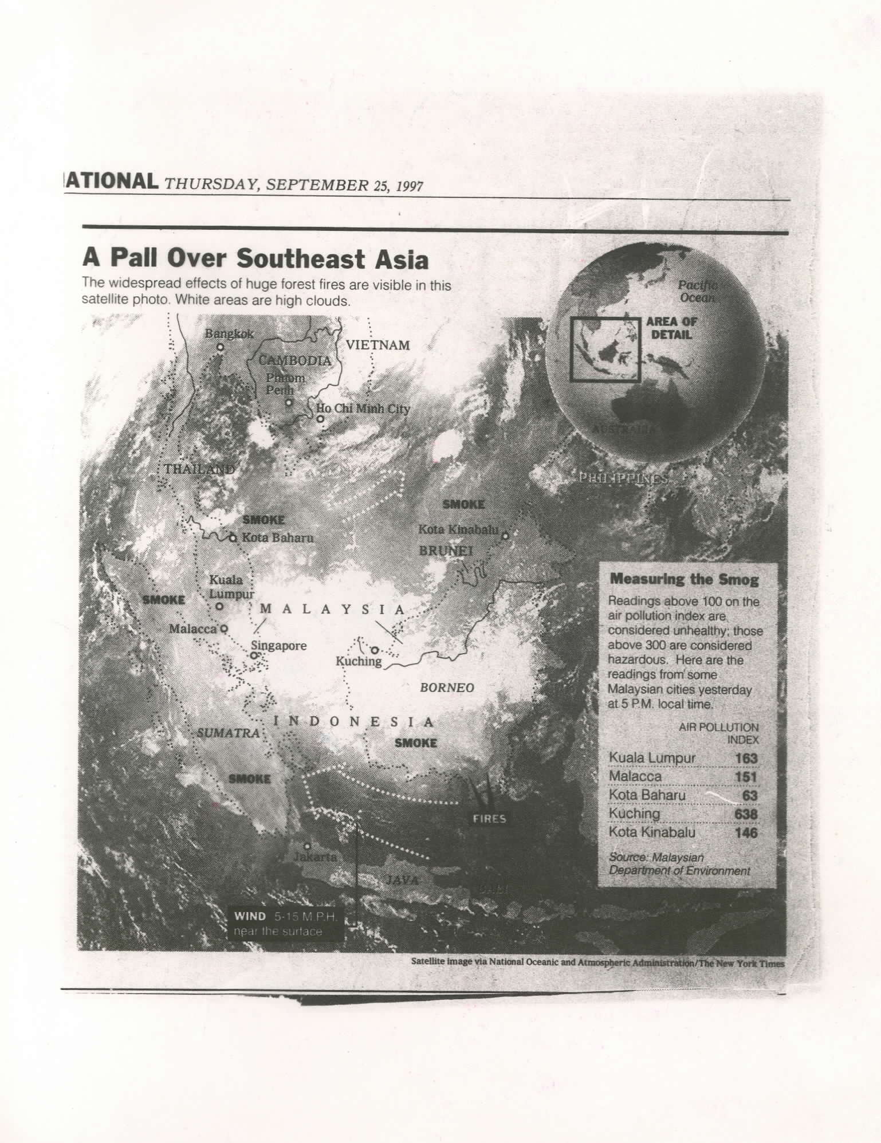
DROUGHTS
Southern Africa
Air Quality/Health
Infrastructure
Animals/Livestock
Agriculture

Slide 5
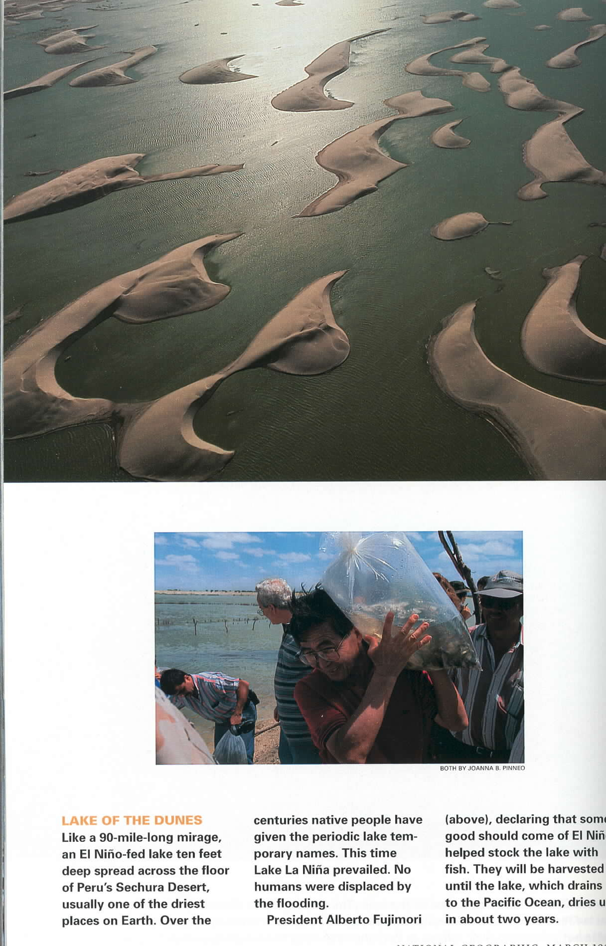
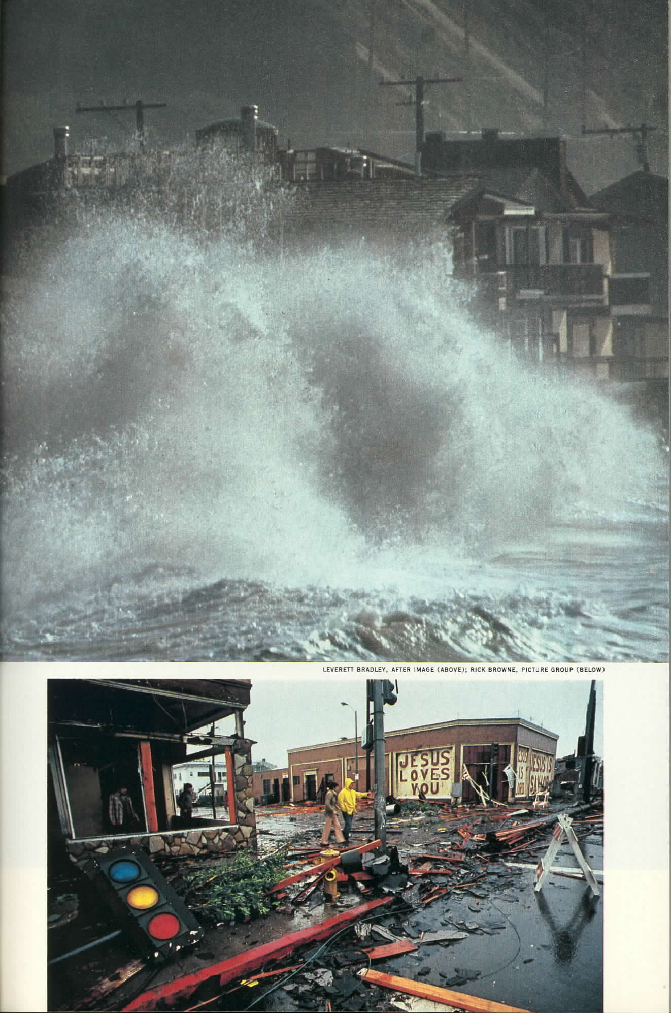
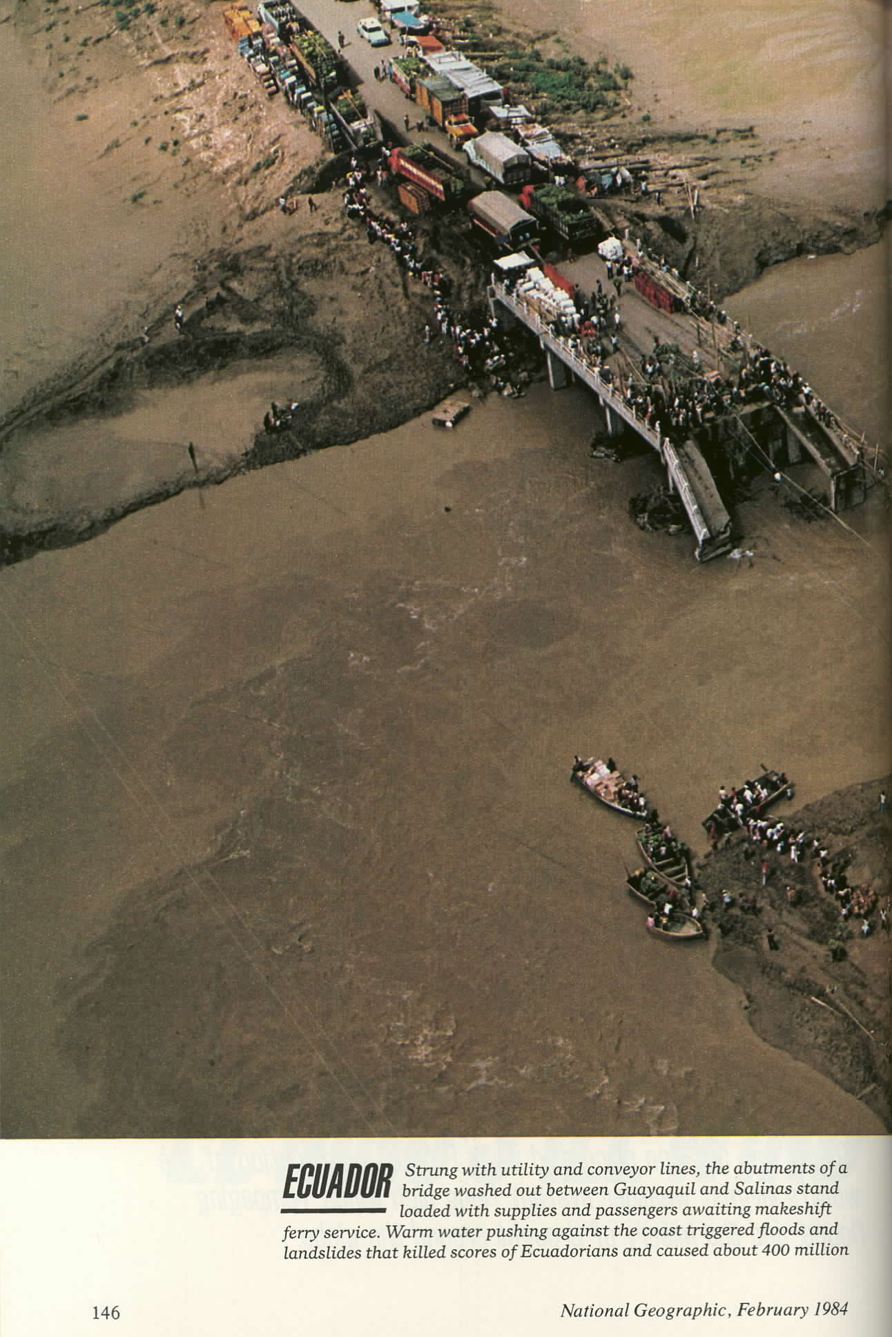
FLOODS
Peru
Southern California
PROPERTY &
LIVES
INFRASTRUCTURE

Slide 6
1990
‘93
2000
2010
IRI Pilot Project
Training (CU)
IRI’s Mission
The mission of the IRI is to enhance society's capability to understand, anticipate and manage the impacts of climate in order to improve human welfare and the environment, especially in developing countries.

Slide 7
1990
‘94
2000
2010
IRI Pilot Project
Prediction (Scripps)
IRI’s Mission
The mission of the IRI is to enhance society's capability to understand, anticipate and manage the impacts of climate in order to improve human welfare and the environment, especially in developing countries.

Slide 8
1990
‘96
2000
2010
NOAA Cooperative Agreement
IRI’s Mission
The mission of the IRI is to enhance society's capability to understand, anticipate and manage the impacts of climate in order to improve human welfare and the environment, especially in developing countries.

Slide 9
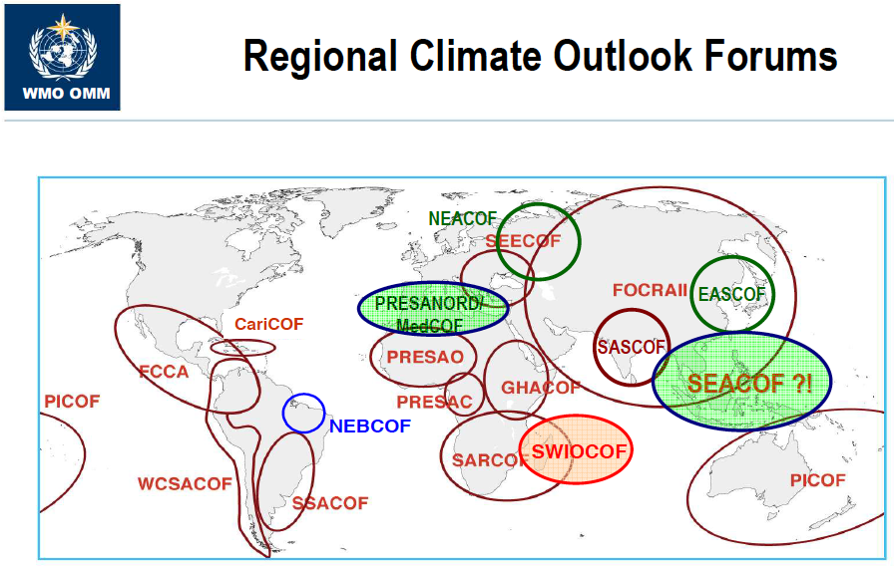
1990
`97/98
2000
2010
Major El Niño Event
1997 - Present

Slide 10
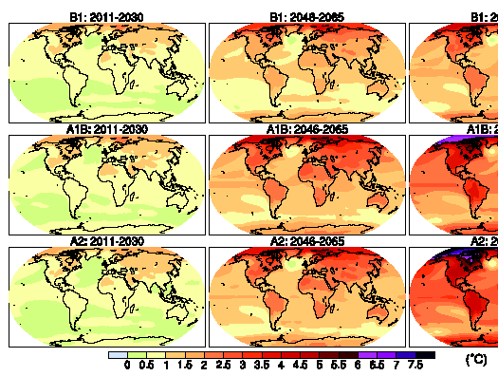
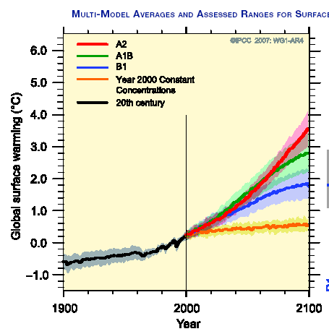
1990
‘95
2000
‘01
‘07
2010
AR1
AR2
AR3
AR4
IPCC Process and Global Climate Change
Source: IPCC 4th Assessment Report, Working Group 1: The Physical Science Basis for Climate Change
http://ipcc-wg1.ucar.edu/wg1/wg1-report.html

Slide 11
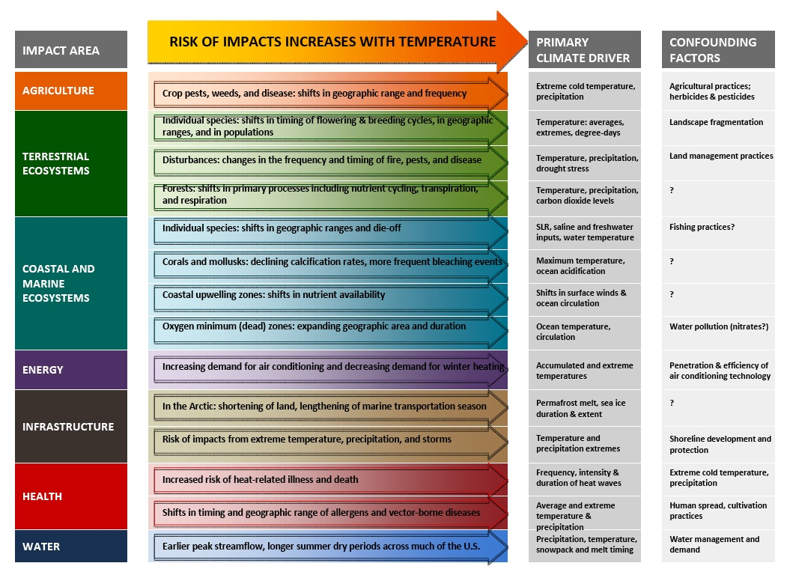
“Climate-Change Related” Impacts

Slide 12
Adaptation
Resilience
Sustainability
Climate is more than “climate change”.
Climate variability is of primary importance to all of these issues.

Slide 13
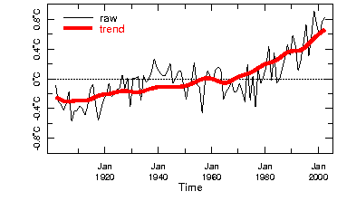
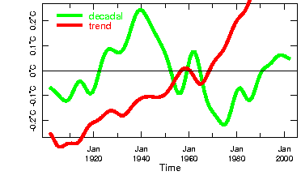
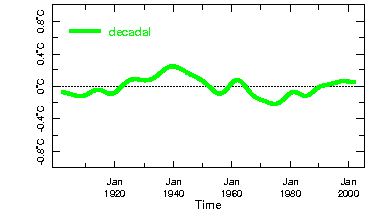
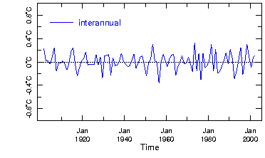
Climate Variability & Change Globally
Annual Mean Temperature
Temperature
65%
Most of the variability in the
globally-averaged temperature
is contained in the slowly
varying “climate change”
component.
13%
21%

Slide 14
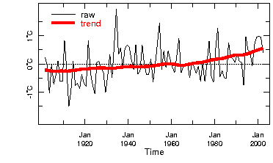
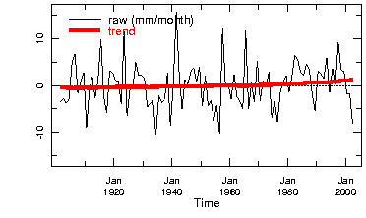
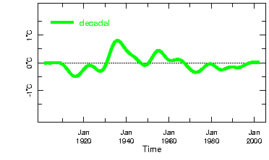
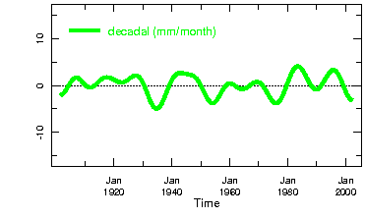
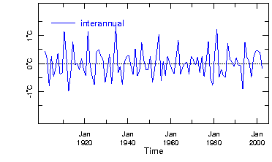
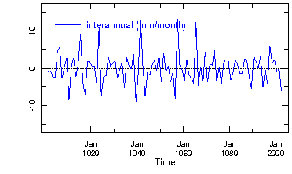
Climate Variability & Change in Colorado, USA
Temperature
Precipitation
12%
1%
21%
19%
65%
75%

Slide 15
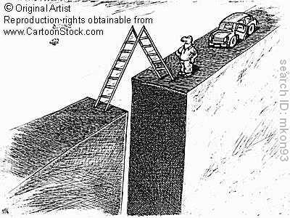
1990
2000
‘09
2010
WCC-3
Climate Information
for Risk Management
& Decision Making

Slide 16
1990
2000
2010
‘12
GFCS
Climate Information
for Risk Management
& Decision Making
Relevance?
Access?
Capacity?

Slide 17
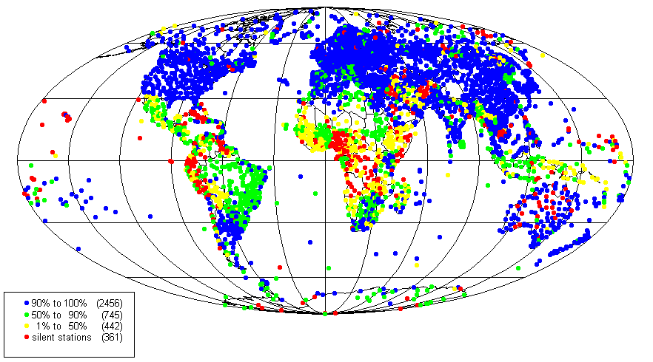
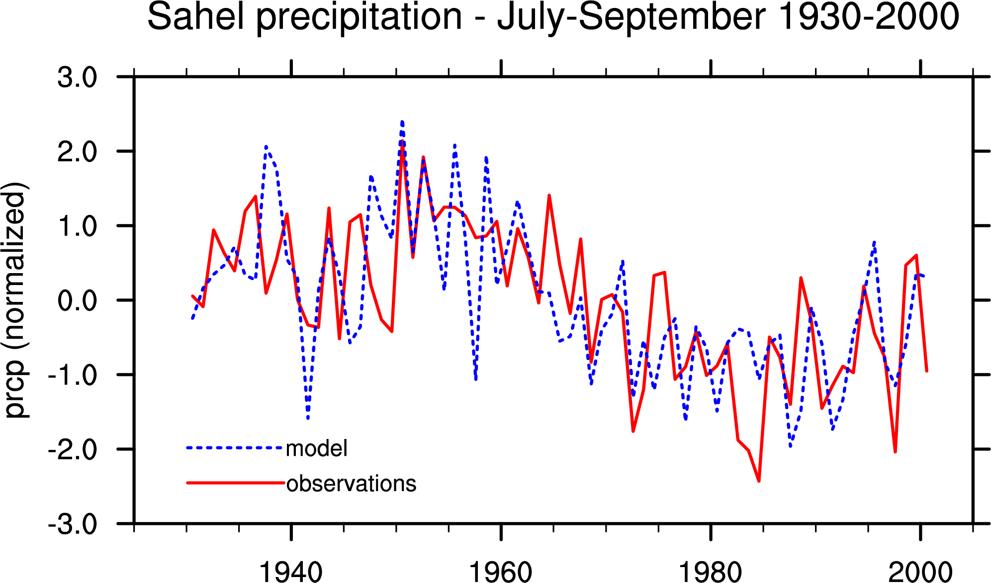
Ingredients for Climate-Informed
Policy/Decisions/Action
SCIENCE
Relevance
Access
Capacity
Observations
graph courtesy of U. Redding
Physical
Understanding and Modeling

Slide 18
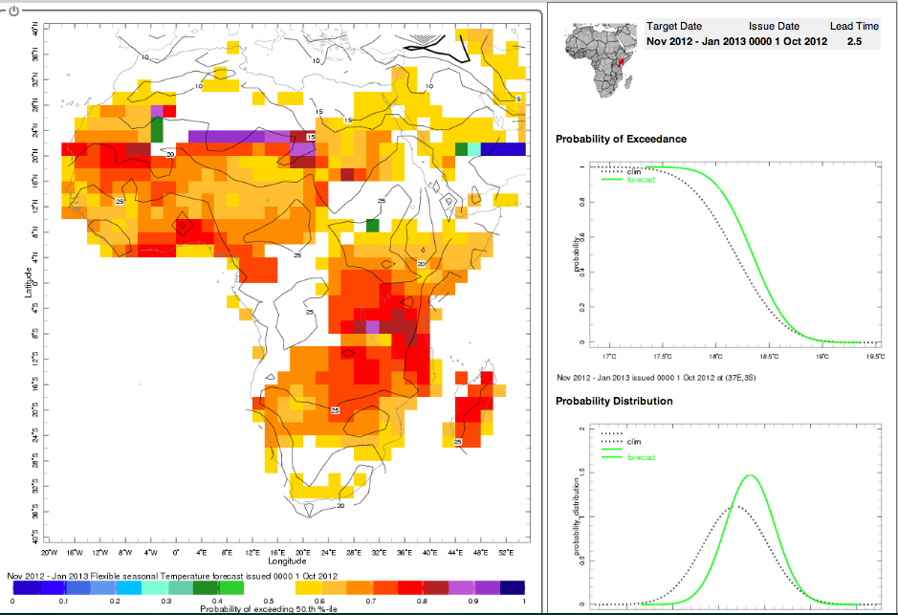
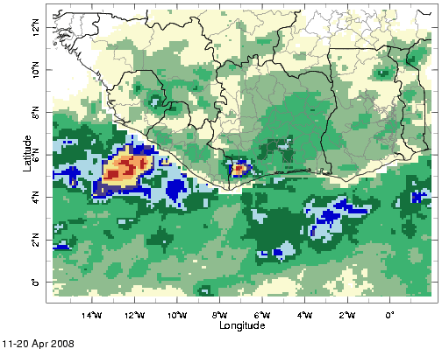
Ingredients for Climate-Informed
Policy/Decisions/Action
SCIENCE
Relevance
Access
Capacity
Fcst Likelihood of Above-Average Temperature
Risk of Malaria due to Climate & Environment
Early Warning
Systems for
Early Action

Slide 19
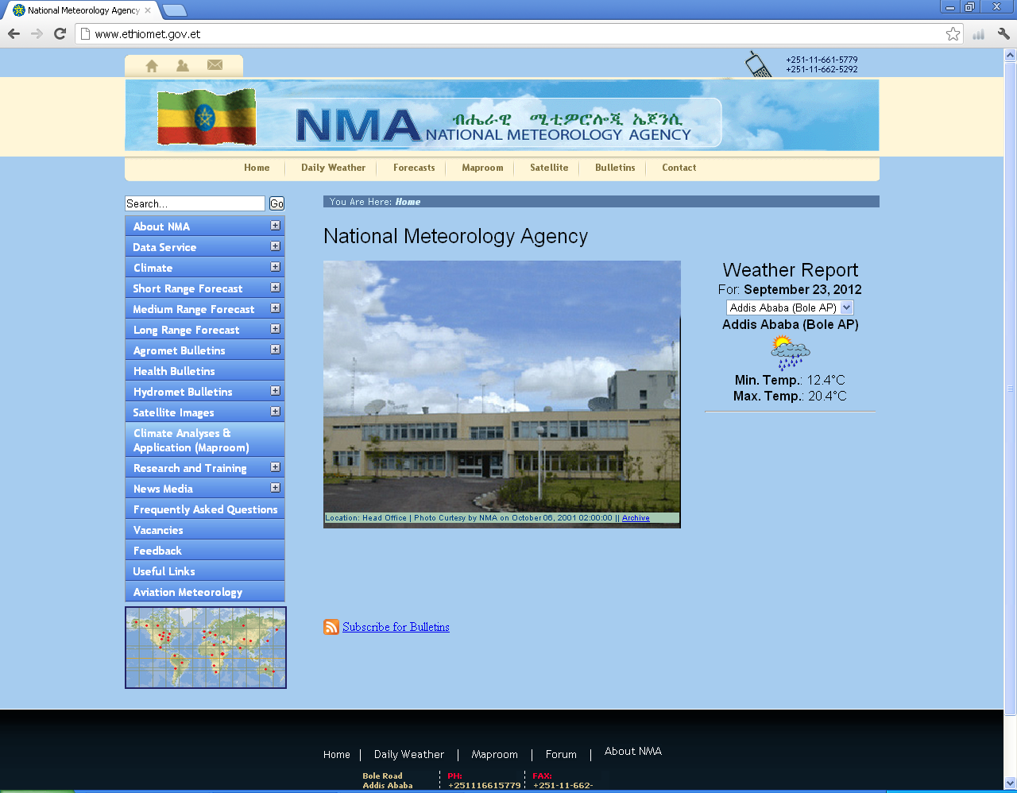
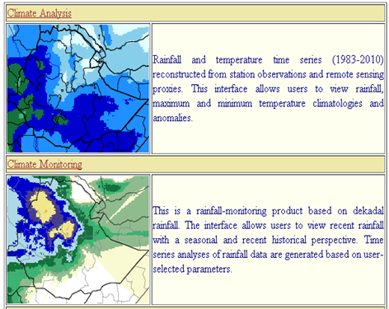
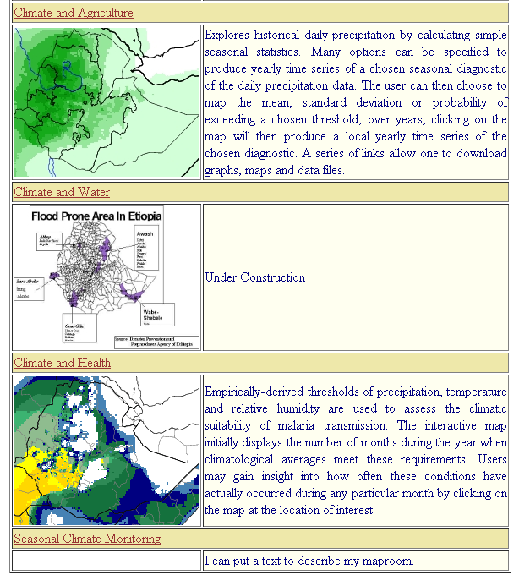
Ingredients for Climate-Informed
Policy/Decisions/Action
The online digital climate map-room of Ethiopia: www.ethiomet.gov.et
Relevance
Access
Capacity
TECHNOLOGY

Slide 20
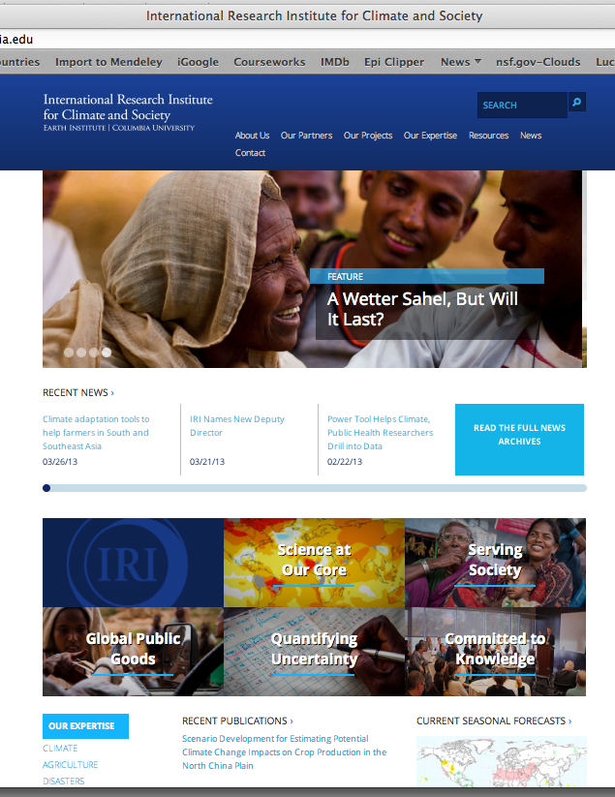
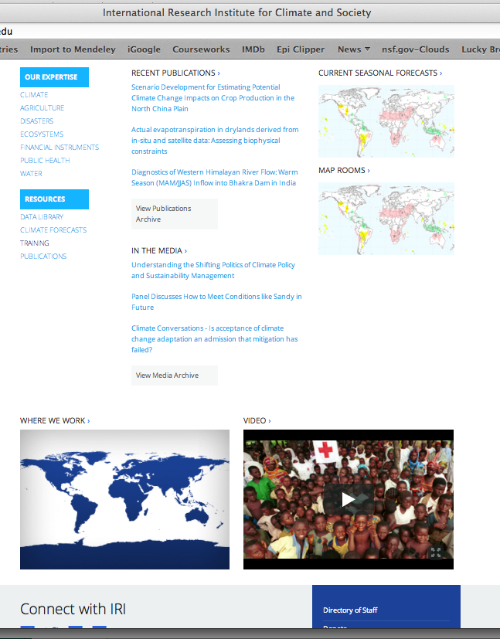
Ingredients for Climate-Informed
Policy/Decisions/Action
Relevance
Access
Capacity
TECHNOLOGY

Slide 21
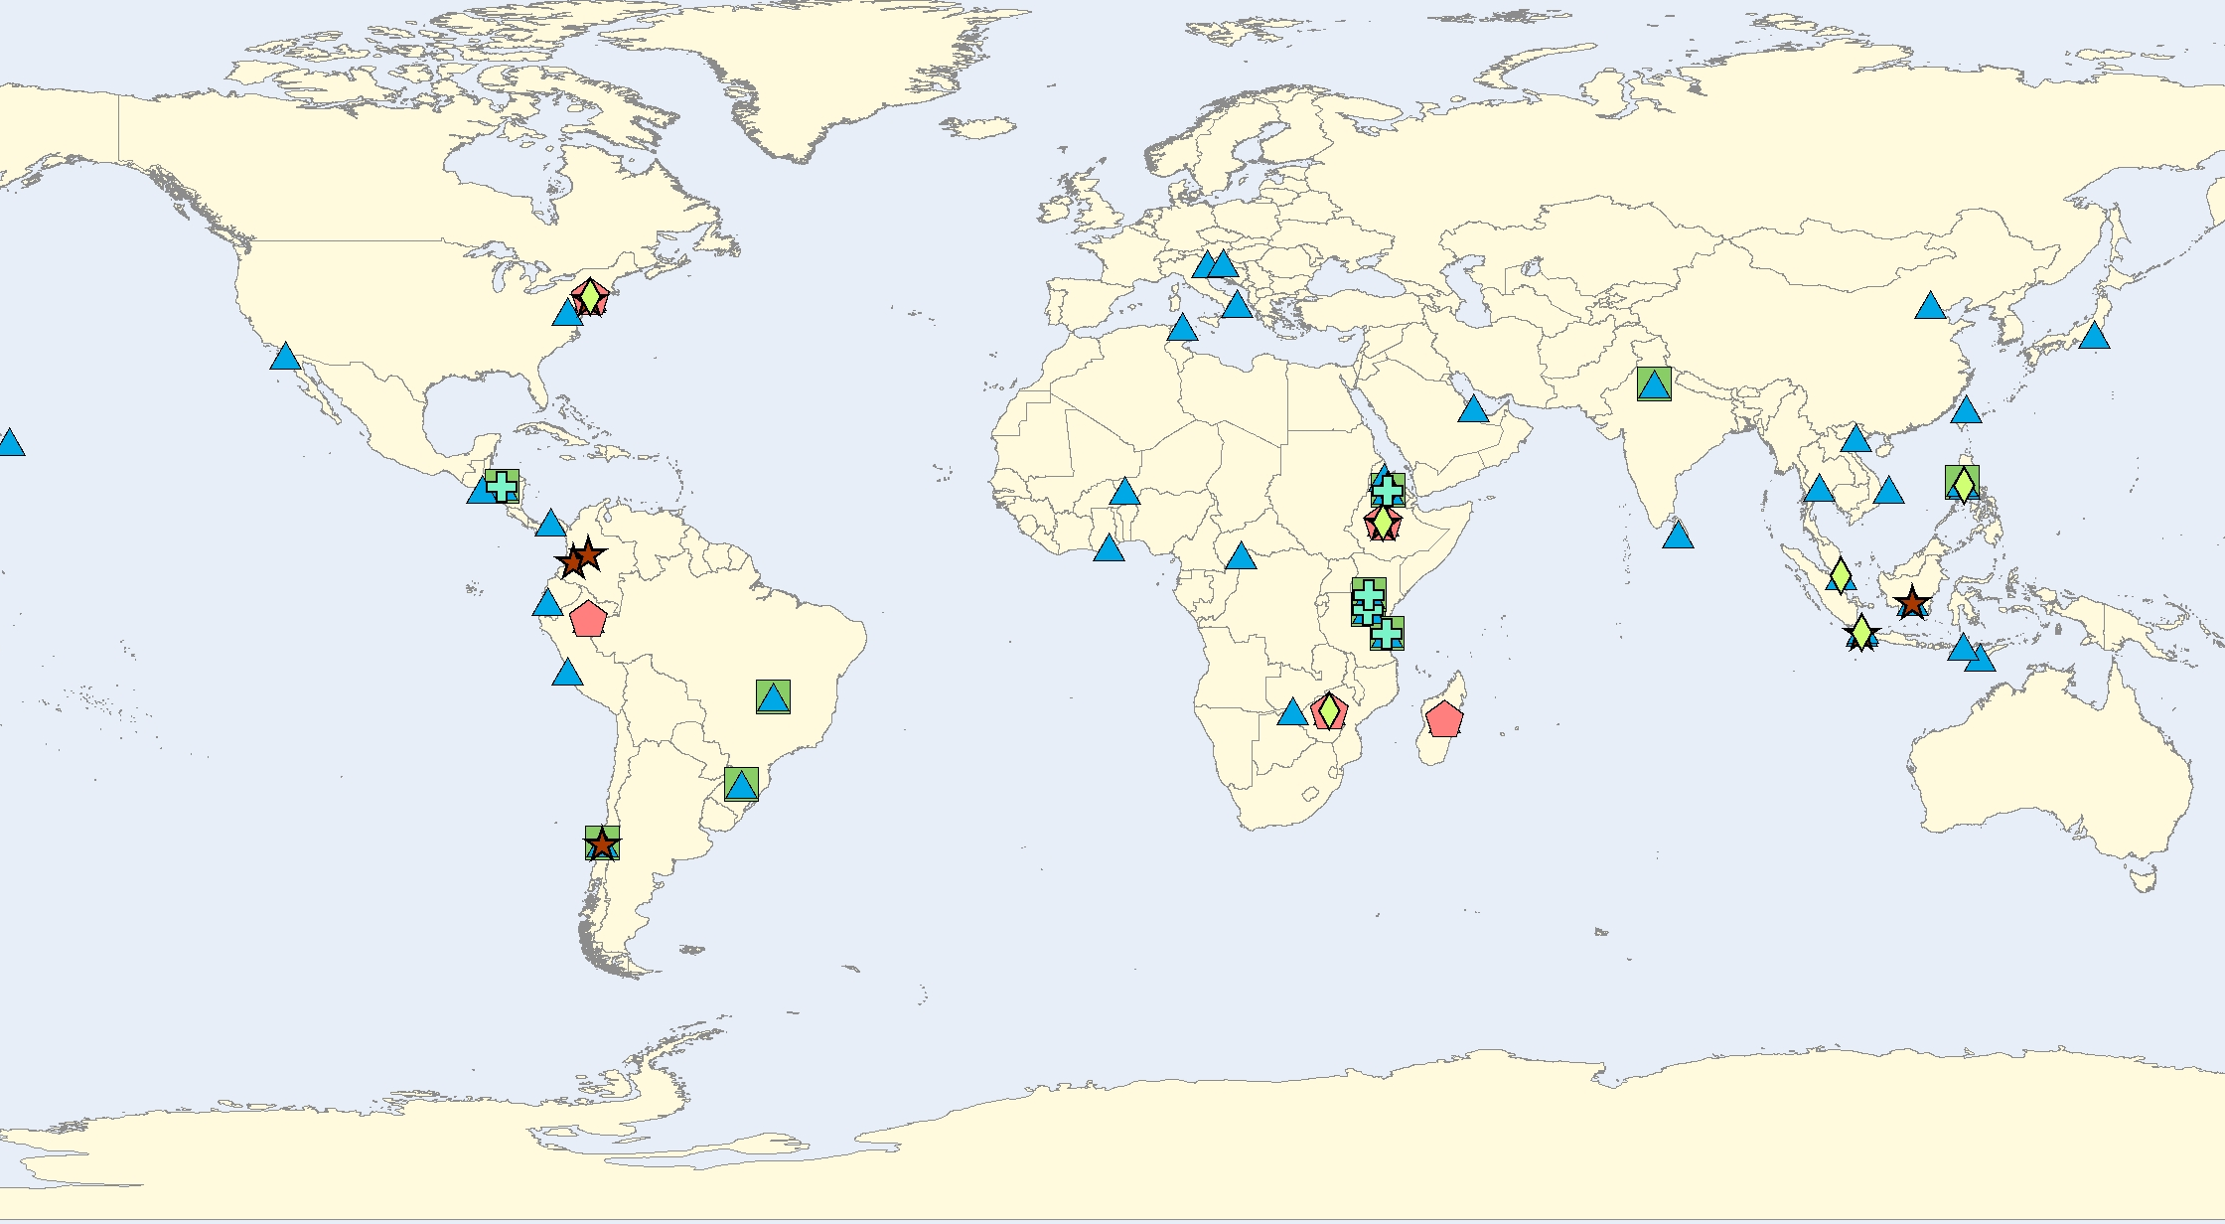
Ingredients for Climate-Informed
Policy/Decisions/Action
Relevance
Access
Capacity
IRI Trainings (04/04-12/09)
TRAINING
: Climate
: Health
: Environmental Monitoring
: Agriculture
: Water
: Economics

Slide 22

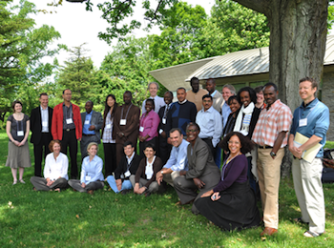
Ingredients for Climate-Informed
Policy/Decisions/Action
Relevance
Access
Capacity
TRAINING
2010 Summer Institute on
Climate & Public Health

Slide 23
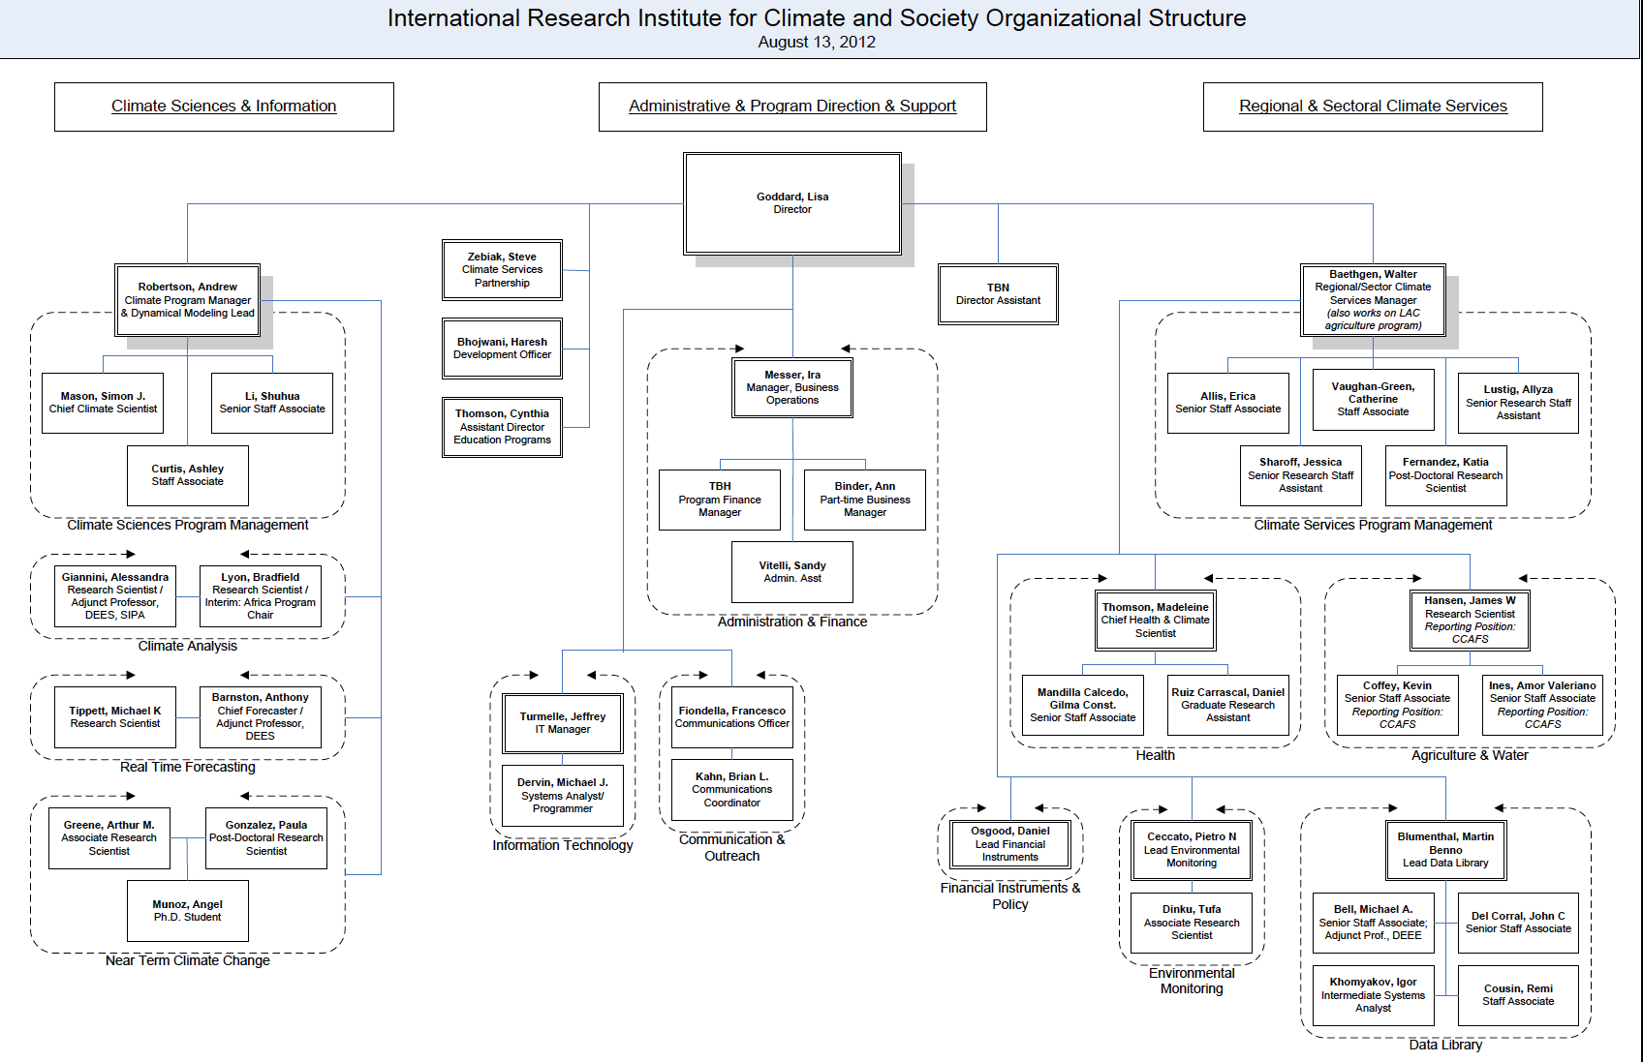






1990
2000
2010
‘12
Fppdff Climate sdppd
Science
Management & Institutional Support
Regional & Sectorial
Science
Climate Services
Partnership,
Secretariat
Regional & Program
Support
Climate Program
Support
Finance &
Administration
Climate Diagnostics
Health
Agriculture
Climate Forecasts
IT
Communications
Financial
Instruments
Near-Term
Climate Change
Environ.
Monitoring
Data Library
Shared appointments:
CWC, CRED, Mailman SPH

Slide 24
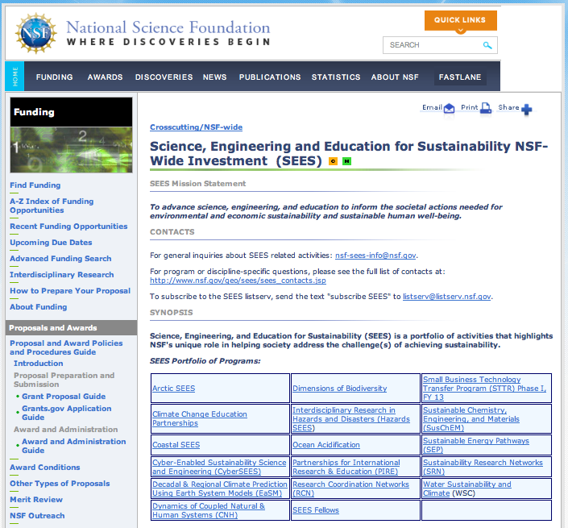
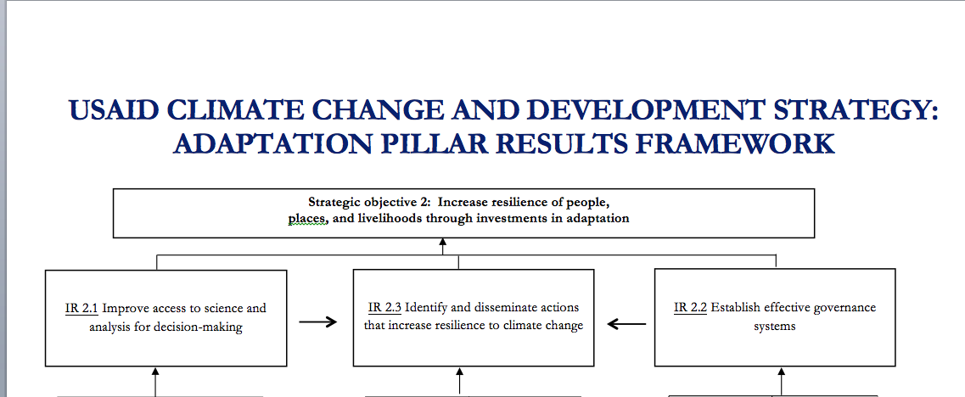
1990
2000
2010
‘12
Opportunities

Slide 25
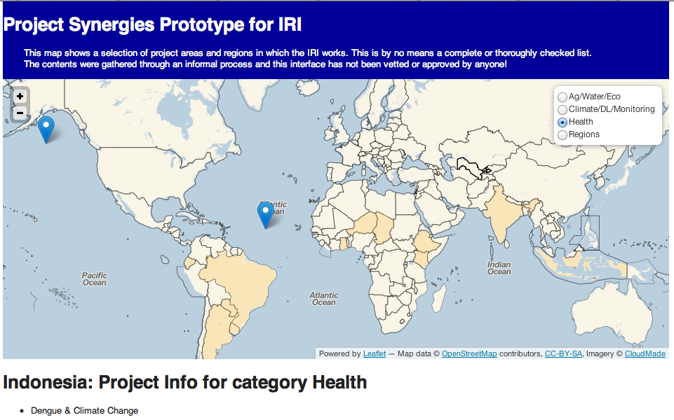
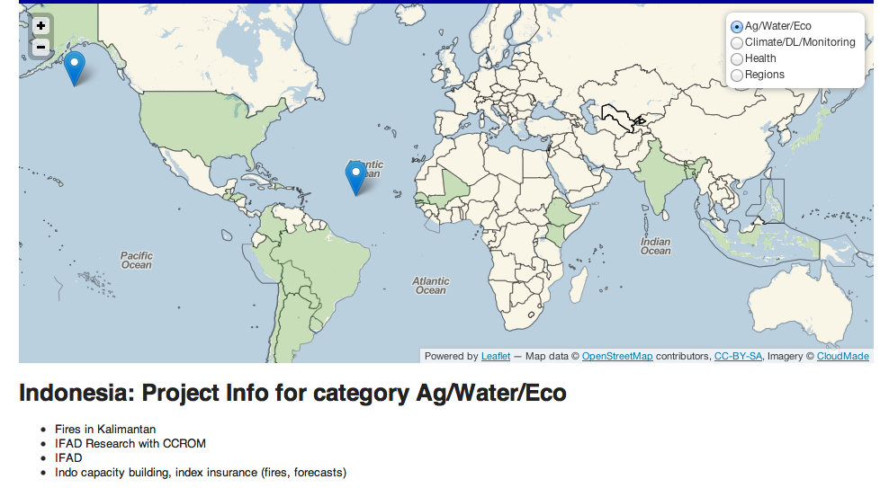
1990
2000
2010
‘12
Opportunities

