Slide 1
Adapting IRI –
new environment
growth and evolution
challenges and responsibilities

Slide 2
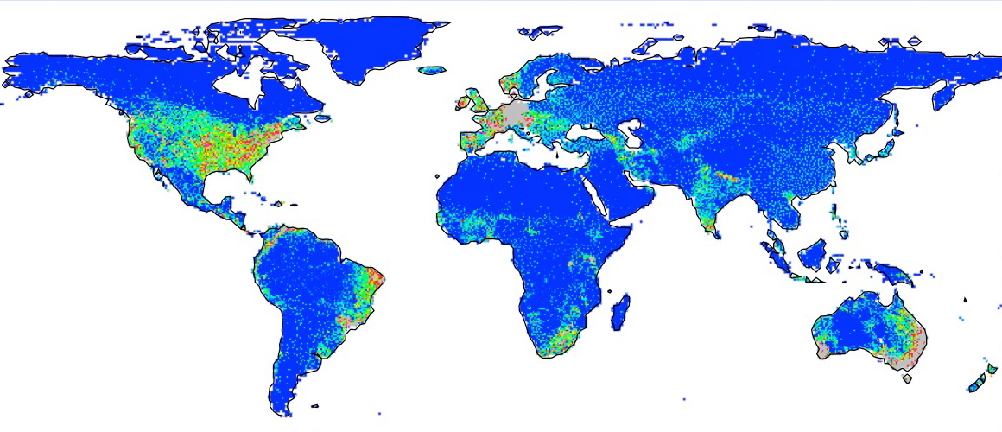

Where is there a need for climate information and services?
GCOS GPCC
Notes:
This map shows where rain gauges are reporting to the global climate observing system
Typically used to show where more stations are needed –
But its not simply that – it’s where there are significant gaps in the ability to collect, digitize, report data – where there are gaps in policies to make data available and to use it.
These are basic gaps… and they also translate into the inability to produce basic information that societies need to manage their climate risk and something we feel a responsibility to work on – translated into products and training.

Slide 3
“The work USAID is funding at IRI has enabled us this year to expand our index insurance project, to 37,000 additional farmers in Rwanda.
Insurance will allow these smallholder farmers to withstand the impacts of bad years, and to risk making productive investments.
A major challenge to index insurance is the paucity of local historical weather data. In Rwanda this is greatly exacerbated by the impacts of the civil war and genocide, which left the last 19 years with virtually no record.
The IRI has worked to validate and make available US-NOAA’s ARC2 satellite data for this purpose.”
Fritz Brugger - Syngenta Foundation
Head Agricultural Support Services, May 2013.

Slide 4
Funding
Notes:
One of the great changes in our environment has been in our funding and staffing environment.
For our entire history we had the generous and visionary support of NOAA – it translated into 9M a year of core funding.
This came to an end in 2010 when the ground shifted under us and very tough decisions were taken.
The last two years – and the future of the IRI – were heavily shaped by this set of facts.

Slide 5
2010
2014
Notes:
We transitioned through this period and worked to build a new financial model for the IRI
New Donors – an expansion of our non-NOAA funding – and to understand how to work with, satisfy, manage new relationships – For FY 2014 we are fully covered – and expect to be going forward –
Point out USAID, NOAA, CCAFS, NASA, UN, Brazil, Uruguay, Foundations like Syngenta and Welcome Trust – others

Slide 6
Notes:
The left are contracts and grants –
We adapted to a completely new environment – PIs, administrators, communications, management – all took on this task – 35 grants and contracts negotiated for FY14

Slide 7
Total staff then, now
Down
35%
- 25
Up
27%
+ 12
Notes:
As I mentioned earlier we had a very significant drop in staff - Drops 35%- impacted our morale – but it also impacted our ability to deliver and to propose
But – we have turned the corner – compared to 2011 we have taken grown by 27%

Slide 8
Staffing
Promotions by Title | 2011 → 2013
Research Scientist → Senior Research Scientist | 5
Associate Research Scientist → Research Scientist | 2
Post Docs → Associate Research Scientist | 2
Staff Associate → Senior Staff Associate | 3
Research Assistant → Staff Associate | 1
Notes:
Another sign of our academic and intellectual health are the promotions –
As you know – our promotions process is a University based process – in most research positions, promotions have to pass a rigorous committee process.
It also documents the commitment of our staff to the IRI and its mission.

Slide 9
Despite cuts, the staffing level for researchers is close to 2010 levels
The ratio of administrative staff to research staff declined by 46% ( .35 to .19)
Staffing
Notes:
The one area where we have not grown – and have instead sustained a continuous decline is in outreach, communications, and management –
3 critical and separate functions – on which much of our success has been built –
Serious concerns about our sustainability – about not being able to capitalize on the opportunities

Slide 10
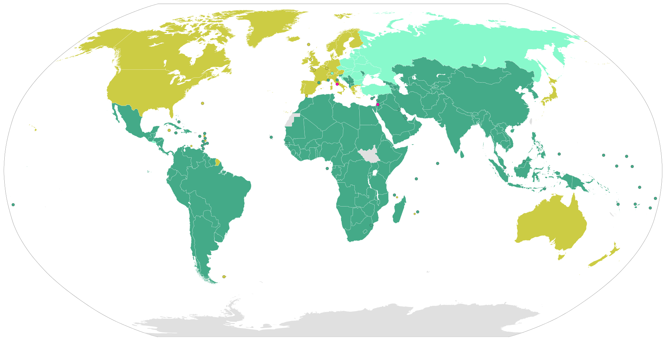
Frameworks
$60-180 B a year in adaptation spending by 2030.
870 M people do not have enough to eat.
Members of the UNFCCC
Party
Party (Annex I)
Party (Annex I and II)
Notes:
Large extent the conversation revolves around cc adaptation
Dark green are countries that can receive adaptation funding – where the most vulnerable are – further breaks down into small island developing states, LDCs and other classifications that imply different issues – different responsibilities and opportunities
yellowish ones are the ones that have agreed to provide funding and technical support for adaptation – each with its own preferences and approach
Big issues with big ethical and human dimensions – opportunities and responsibilities – where should we be focusing our efforts -

Slide 11
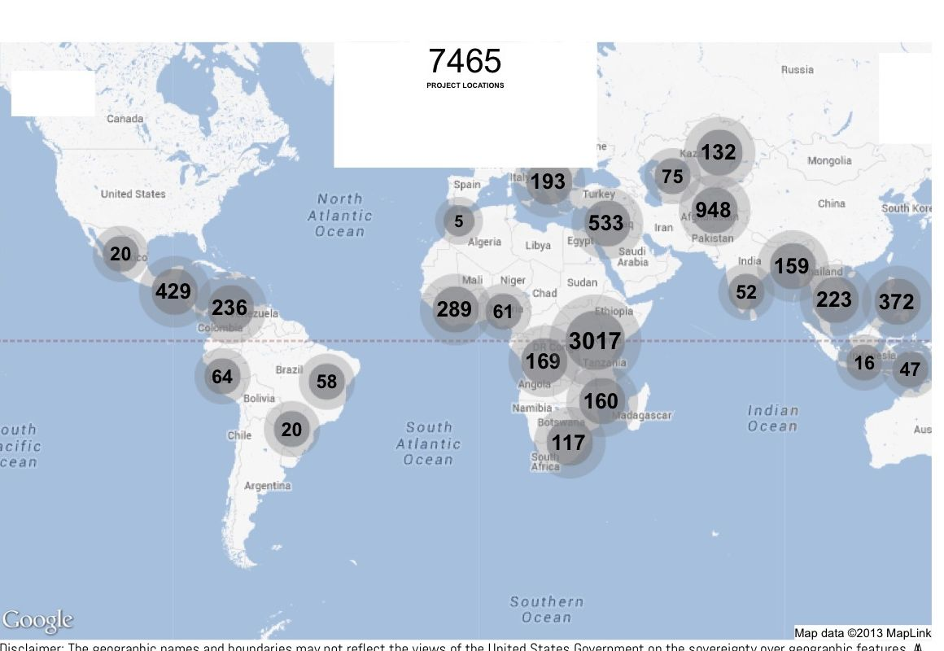

Notes:
A strong new partner – and one that we have learned to understand is USAID
It brings its own management and communications demands – as well as a whole new environment we have had to learn to work in
This map is from the USAID website – it doesn’t include everything they do – it’s self-reported information from different parts of the agency
I selected for project topics relevant to our work – there 7465 project locations on this map.

Slide 12
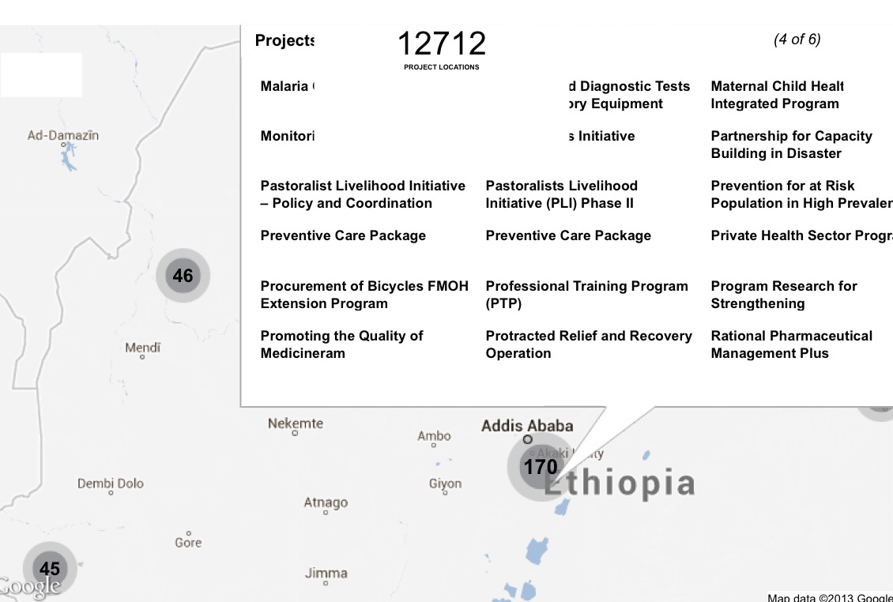
Notes:
Some of our work with USAID is at this level – it’s the level that USAID values most in some sense… where the lives of vulnerable people are impacted.
But we’ve also worked with the Climate Change team in DC and to help them develop the tools and knowledge the agency needs to do adaptation – to conceptualize it and prioritize it.
We have successfully negotiated some of these spaces so far – and are trying to prove that we are useful -

Slide 13
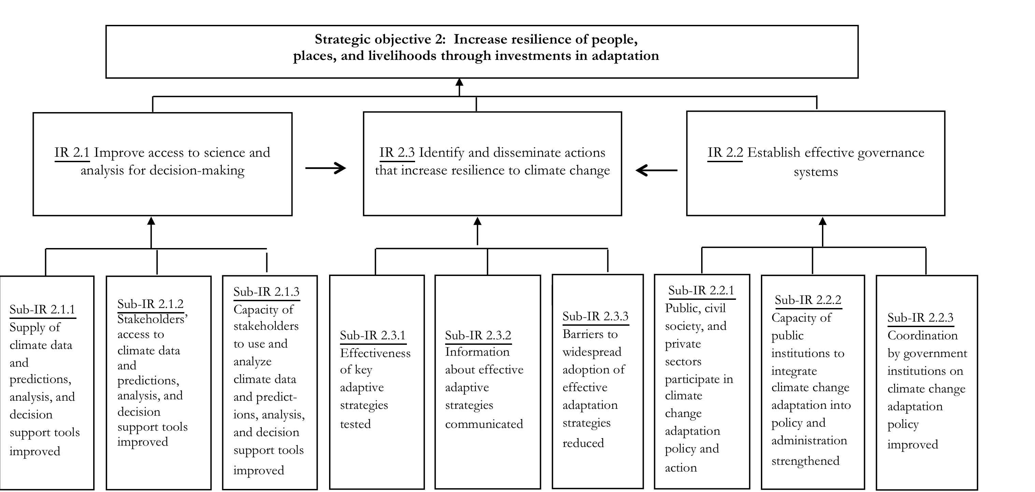
USAID Climate Change and Development Strategy
Adaptation Results Framework – March 2013

Slide 14
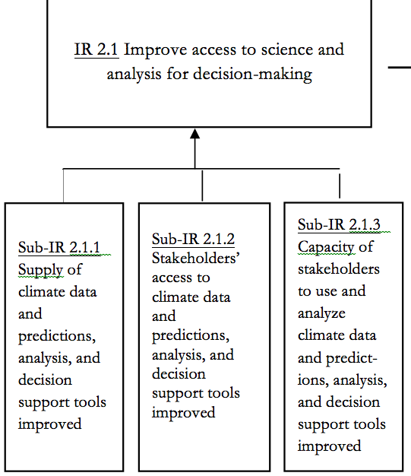

Slide 15
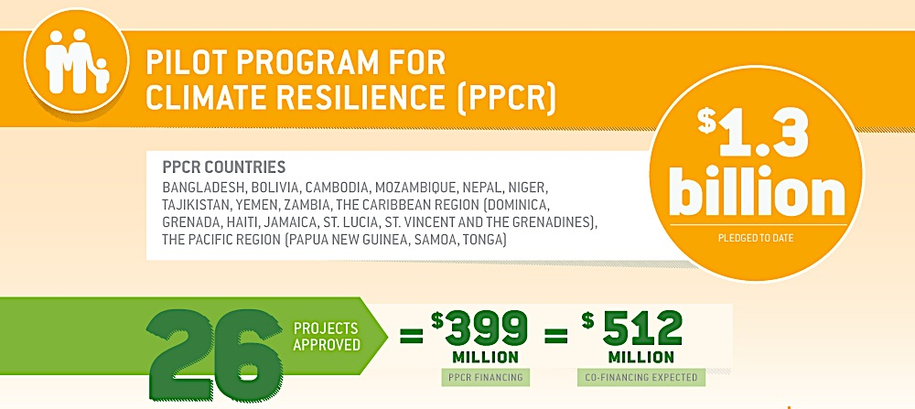
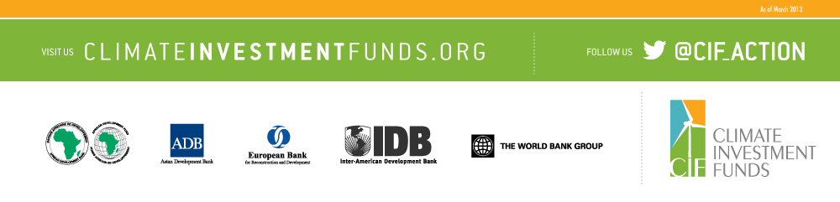
Notes:
The World Bank is the largest development organization in the world and the largest mobilizer of funding for adaptation.
The PPCR is probably to date the biggest source of funding for the work that IRI can help on – it’s also a bold attempt to bring a rational approach to development and adaptation.
The focus is on building resiliency and the money goes to a limited list of developing countries who will submit projects that are in line with their NAPAs (a device under the UNFCCC)
This is very significant funding that will require science inputs, research, guidance, to deliver – yet the fund is not really set up to fund research or to support organizations like the IRI
What’s our responsibility here? How can we engage this process robustly? Will someone else support the science that’s needed for this programs?

Slide 16
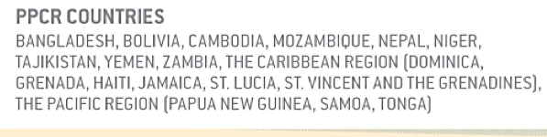
Notes:
The World Bank is the largest development organization in the world and the largest mobilizer of funding for adaptation.
The PPCR is probably to date the biggest source of funding for the work that IRI can help on – it’s also a bold attempt to bring a rational approach to development and adaptation.
The focus is on building resiliency and the money goes to a limited list of developing countries who will submit projects that are in line with their NAPAs (a device under the UNFCCC)
This is very significant funding that will require science inputs, research, guidance, to deliver – yet the fund is not really set up to fund research or to support organizations like the IRI
What’s our responsibility here? How can we engage this process robustly? Will someone else support the science that’s needed for this programs?

Slide 17
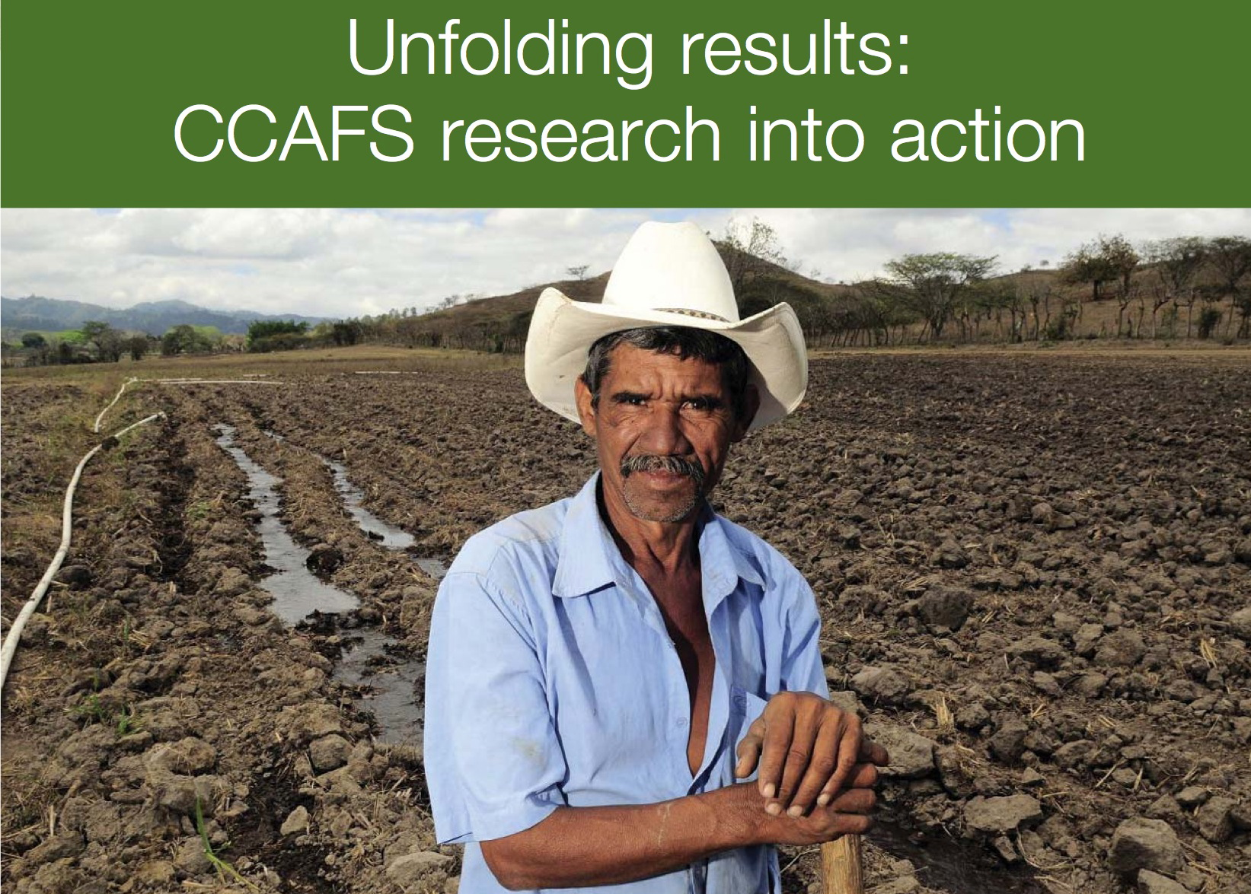
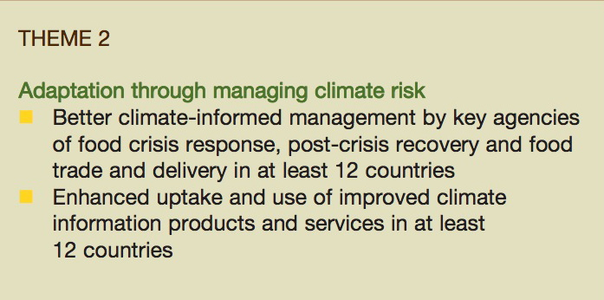
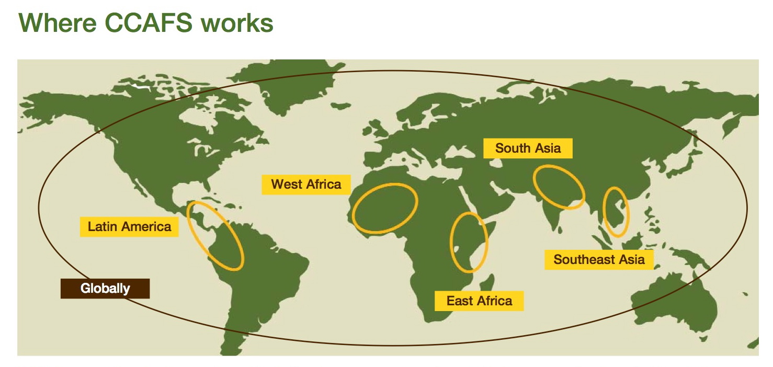
Notes:
You may remember CCAFS from the bar graph – you will be hearing more from them this afternoon.
Almost 700 K in funding to IRI -
67 M in 2012 – Theme 2 – of 4 themes – is perfectly aligned with IRI. It’s because Jim Hansen established this theme and now leads it from IRI.
This is the single largest international research effort to engage the problem of climate and agriculture – and it provides a great example of how the IRI can find opportunities and also face the responsibility of participating and engaging the critical problems or rural development, nutrition, food security, and agriculture.

Slide 18

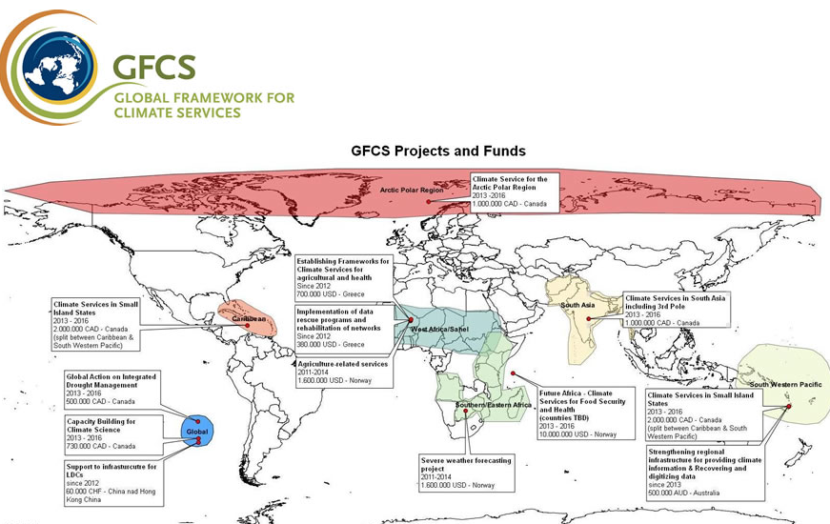
Notes:
About $40M
IRI involved in the organizing committee – Simon Mason involved in the drafting of the implementation plan and leading the WMO expert team for Climate Services Information Systems
Issues with coordination –
Negotiation for funding
Training component -

Slide 19
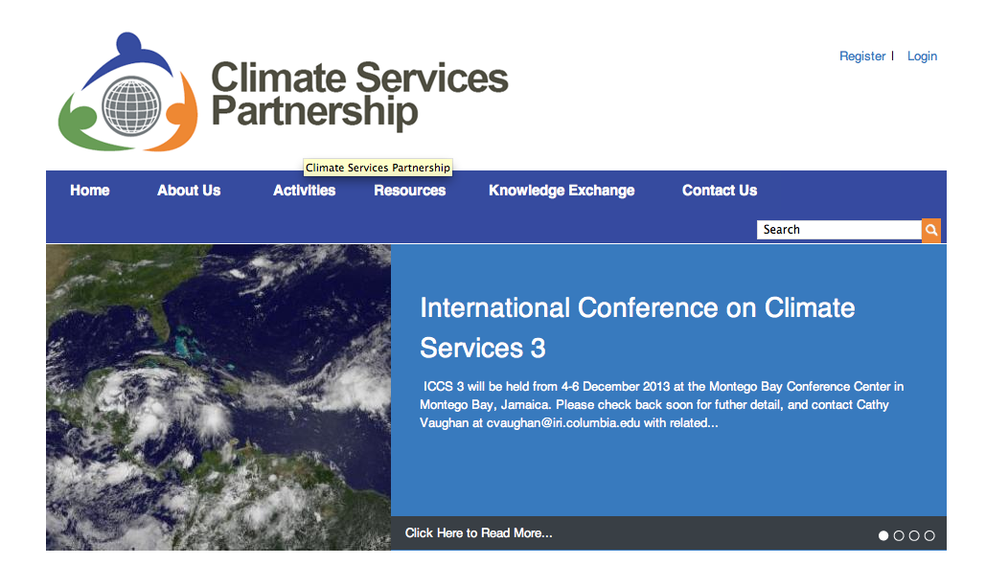
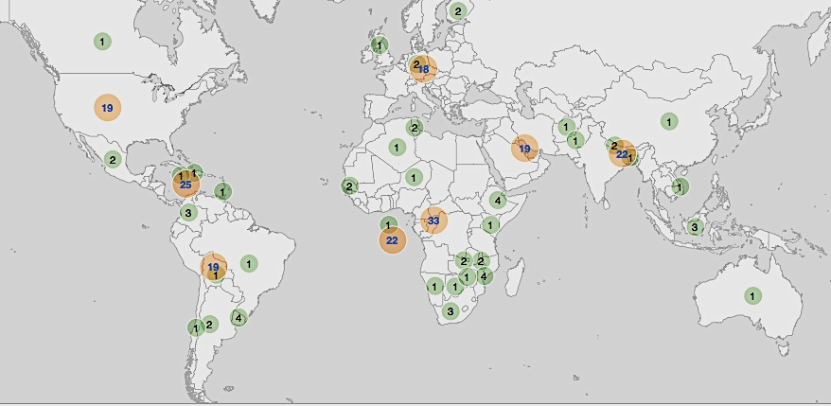
- Knowledge sharing
- Coordination
- Focus on Action
Notes:
All three of these organizations are members of the CSP –
Work with the GFCS
Case studies, evaluations, ethics, but also research
Early universe of climate services

Slide 20
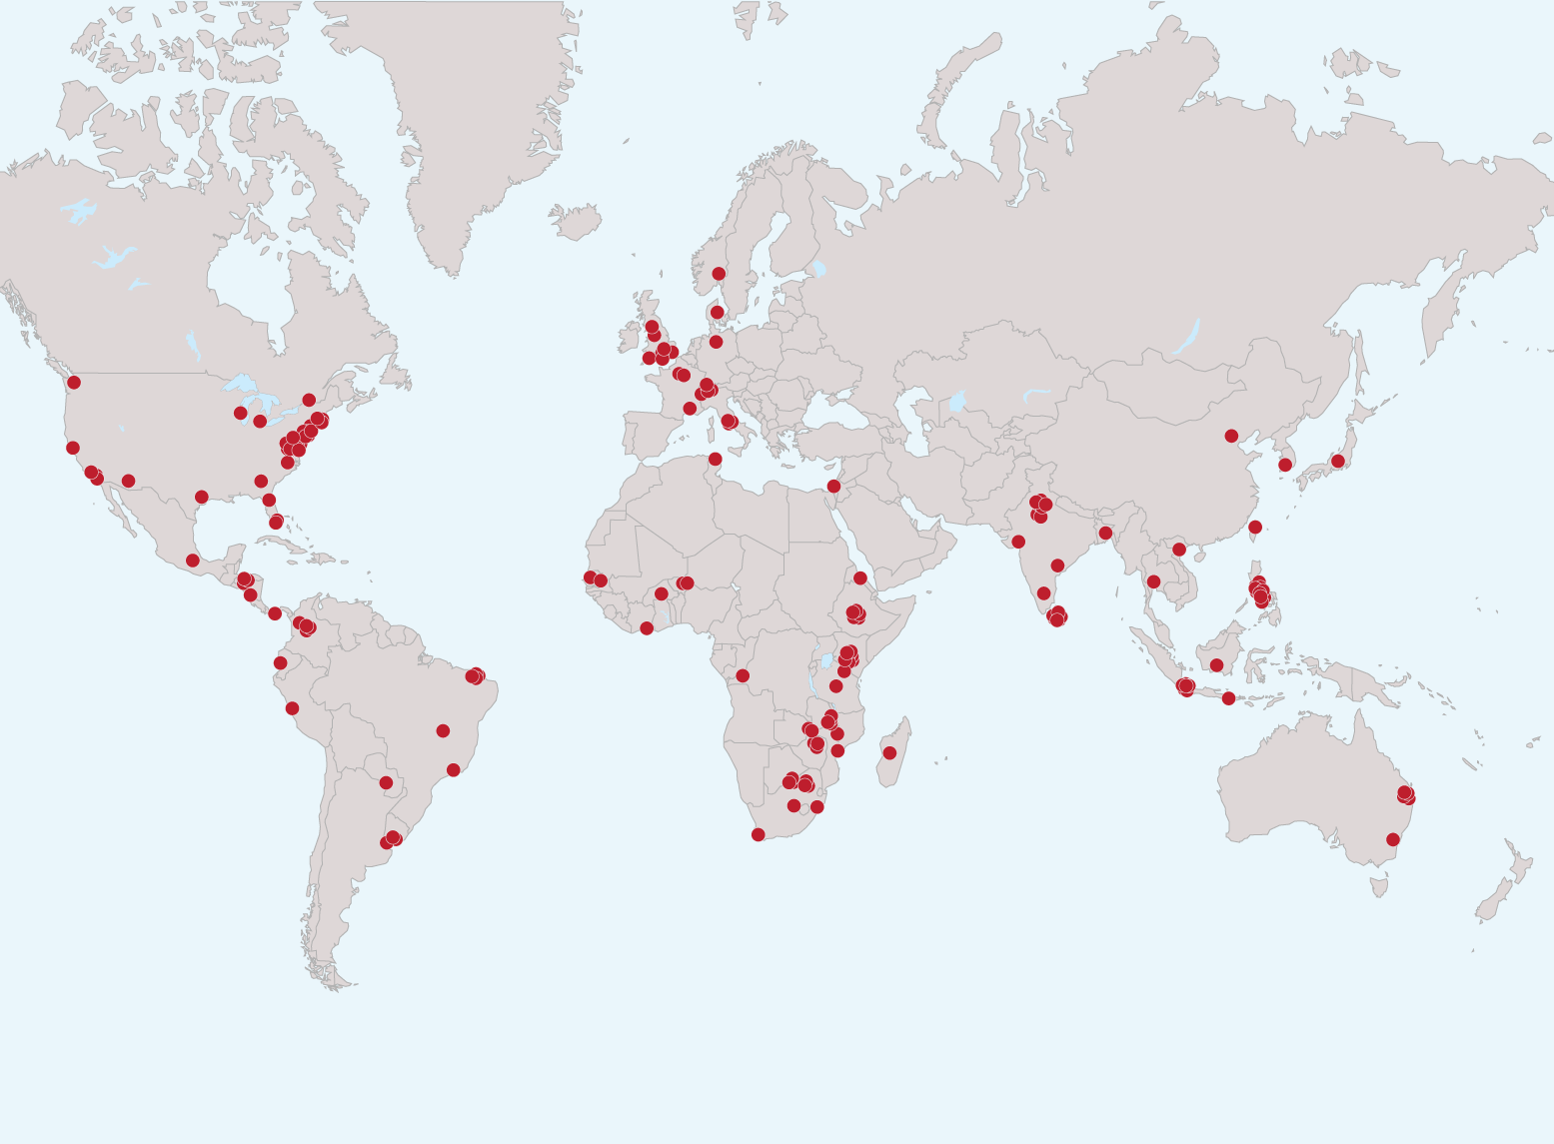
Collaboration
Institutions with which IRI has collaborated since 1996
Notes:
What NOAA support gave us was deep support for the global public goods on which many of the advances in climate science for development and for adaptation are built:\
- seasonal forecasts, COFs, CPT, IRI Data Library –
It also gave us the ability to engage over long periods of time, through changing political climates, the partners that are critical to this effort – and both of these are questions that remain in the air as we look forward –
This chicken pox map shows the institutions we have collaborated with over the years – IRI scientists have spent months in these places, they have sent us their staff for training and grad school, we have co-authored papers, we have collaborated to start to solve some of the most critical problems faced by their societies.
We have translated a lot of these relationships into the CSP – a network that has brought together practitioners, funders, scientists to collaborate on knowledge sharing and supporting each others efforts, creating a common understanding of what works and why. Cathy will tell you more this afternoon.
Our history and network helps us achieve great efficiency, vitality and opportunities that we at IRI sort of take for granted – next month in we were planning with USAID funding to start working on understanding the Climate Information needs of Central American farmers. We teamed up with Zamorano University a leader in agriculture research and education in the region – an old partner of ours – IRI has sent staff there – and they have sent staff to us. We worked with them in index insurance and other areas. We decided to bring in CRRH – also an old partner, they are based in Costa Rica and host the regional COF. We decided to time these events to go together – to bring Agriculture and Climate expertise together – but also to bring farmers and scientists together. Now CCAFS – which just expanded its network to Latin America. In addition to our in-house connection with CCAFS – the lead for Latin America is a Columbian economist who received a Fullbright fellowship to work at IRI a couple of years ago. This initial effort to understand and document farmer needs has already grown to include the most relevan regional organizations

Slide 21
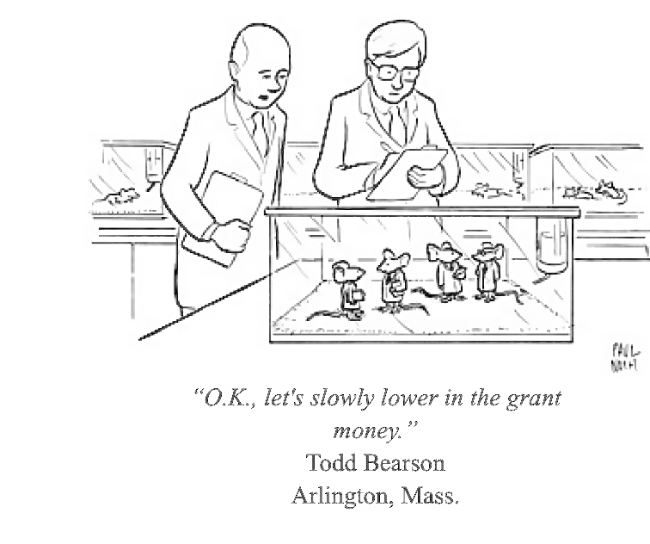
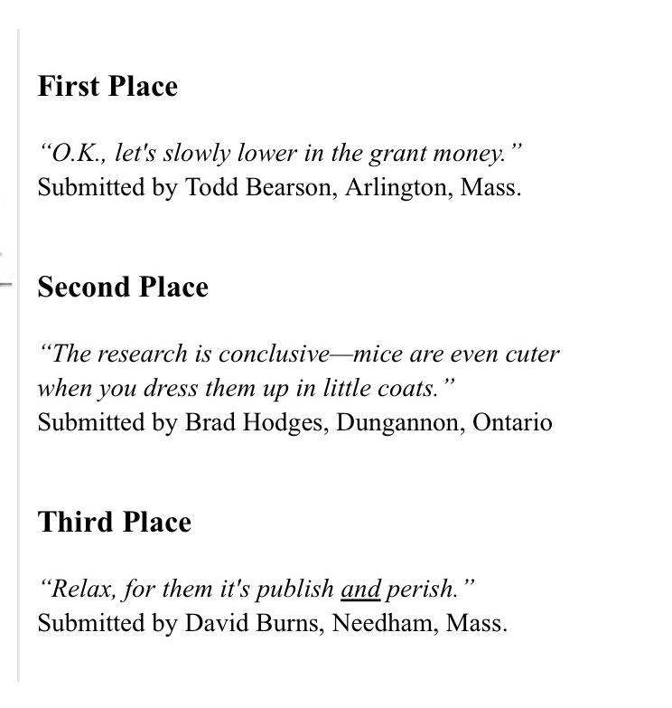
Notes:
The last couple of years have felt like a bit of a behavioral experiment –
Going forward we have choices to make – these have to be based in understanding who we want to be as an institute – but also in understanding what IRI does the world need – and what IRI is it willing to support…

Slide 22
How do we sustain the global public goods we produce?
What is the right balance of work at IRI?
Is outreach critical to our survival – non project events – COFs, COPs, Boards, travel – how do we sustain it?
Administrative, IT, communications, mgt. imbalance – how do we balance it?
How do we become more robust?

Slide 23
thank you
haresh@iri.columbia.edu

