Slide 1
Approach, Activities and
Achievements in
Sectors and Regions
Walter E. Baethgen
Leader, Sectorial and Regional Research Program
International Research Institute for Climate and Society
The Earth Institute, Columbia University, New York
baethgen@iri.columbia.edu

Slide 2
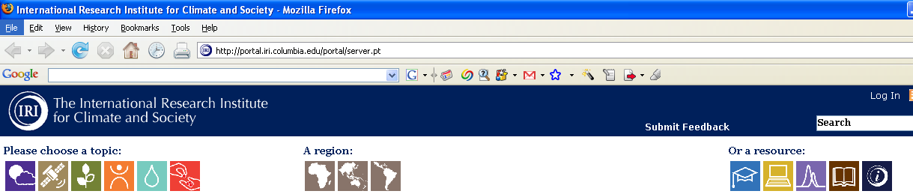


Topics:
Climate Science and Information
Sectorial and Regional Research
Environmental Monitoring
Agriculture / Food Security
Health
Water Resources
Natural Ecosystems
Disasters / Livelihoods
50%
Regions:
Africa
Asia / Pacific
Latin America / Caribbean
50%

Slide 3
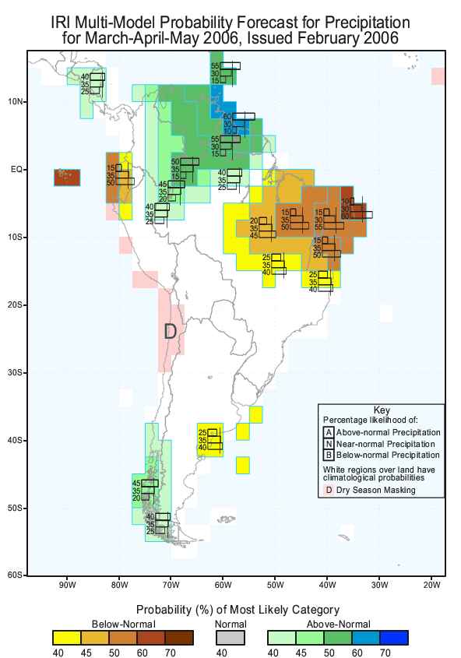
Work In Regions and Sectors
Initial focus:
Seasonal / Interannual
(Predictions and Applications)
Interactions with Partners / Users: Increased demand to expand to:
Longer Term (“Climate Change”)
Intra-seasonal (less than 3 months)
Interactions with Partners / Users, Expand from Prediction only to:
Historical analyses, Characterization
Monitoring

Slide 4
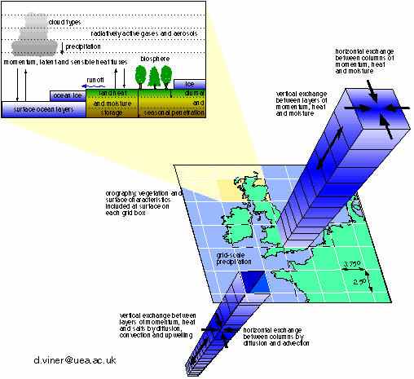
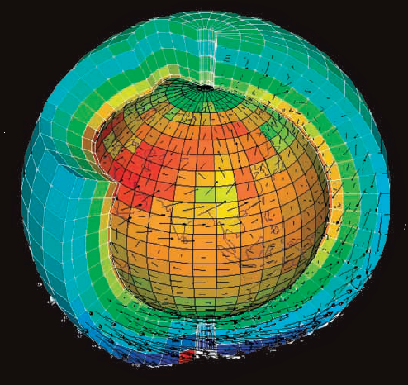
Interaction with Partners: Improve Adaptation
Adapt to What? Climate Change Scenarios: Using Climate Models (GCMs)
Complex models that simulate physical processes in the atmosphere, oceans and land
Great advances in science,
but still lots to understand:
Limitations of the Models
2. Key Input:
GHG Emissions
Assumptions:
(e.g., in 2080-2100)
Technologies?
Energy Sources?
Deforestation rates?
Population?
Uncertainties
(IPCC Scenarios)

Slide 5
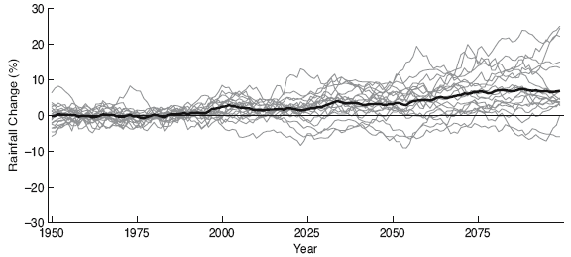
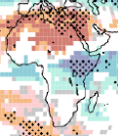
At Global level Uncertainties are Large, at Regional level they are larger
(Individual Model Runs and Averages)
East Africa
This is for large “Windows”
At Local level (most decisions) Uncertainties
are much larger
Giannini et al., 2007

Slide 6
Key Opportunities / Demands: Climate Change
Limitations of “traditional” climate change scenarios
Uncertainties
Double Conflict of Scales (too course, too far in the future)
Trends (“Climate Change”) Explain Relatively Small
Proportion of Total Variability (Lisa, Andy)
Need new approaches, methods and tools to
Work in Sectors and Regions

Slide 7
Climate Risk Management Approach in the IRI
(from months, through Decades, to Climate Change)
Four Pillars
Identify Vulnerabilities and Opportunities in Climate Variability
and Change in Collaboration with “Stakeholders”
(which systems, what components within systems)
Understand / Quantify / Reduce Uncertainties
(learn from the past, monitor the present, provide relevant info on the future)
Identify Interventions (Technologies) that Reduce Vulnerability
(e.g., vaccination, drought resistance crops, efficient irrigation)
Identify Policies and Institutional Arrangements that reduce
Vulnerability and/or Transfer Risks
(Early Warning / Early Response Systems, Insurance, Credit)
(Baethgen, 2010)

Slide 8
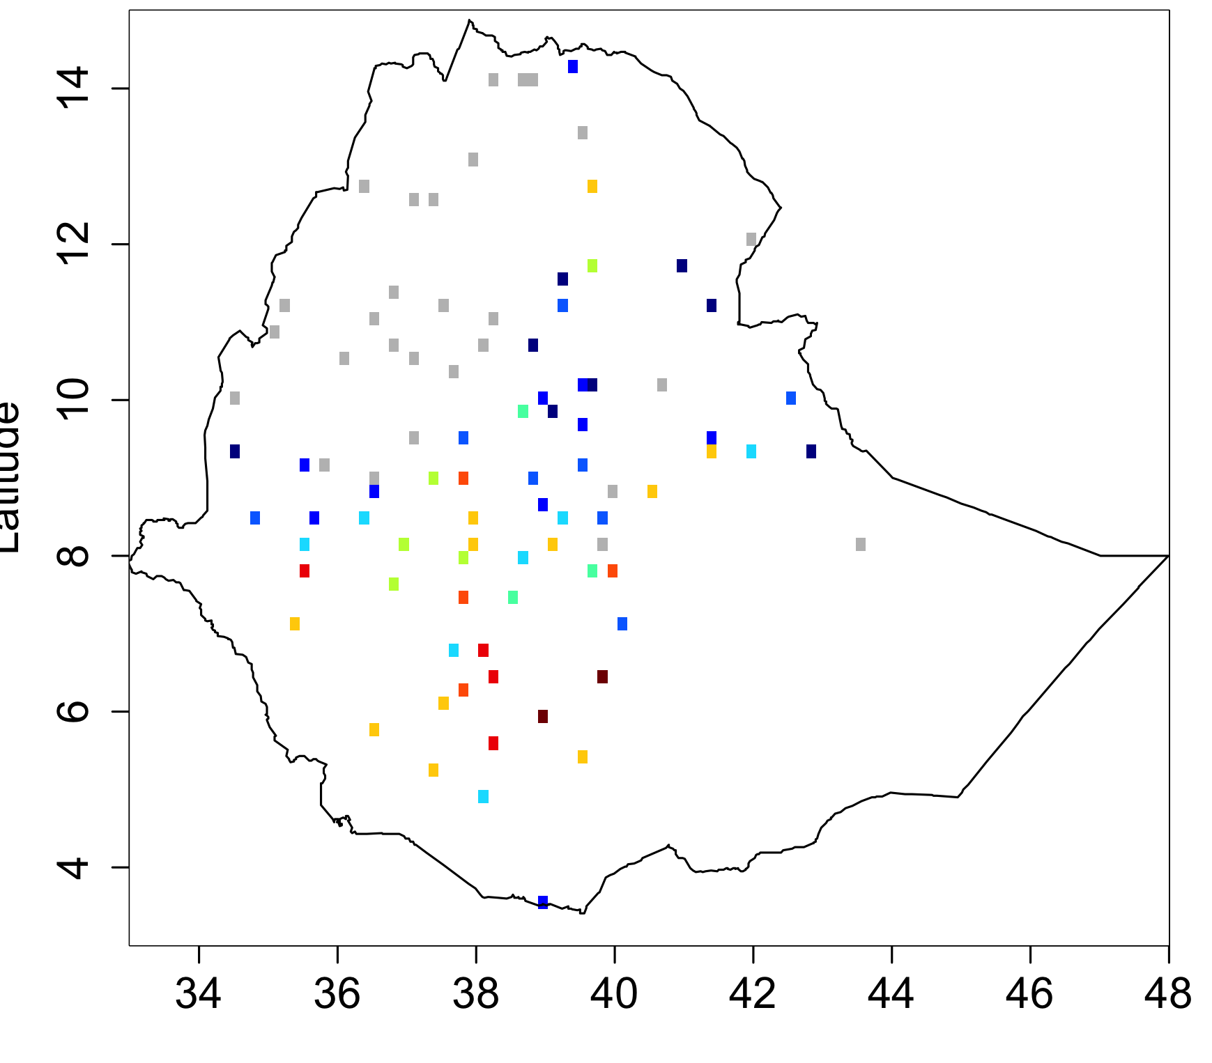
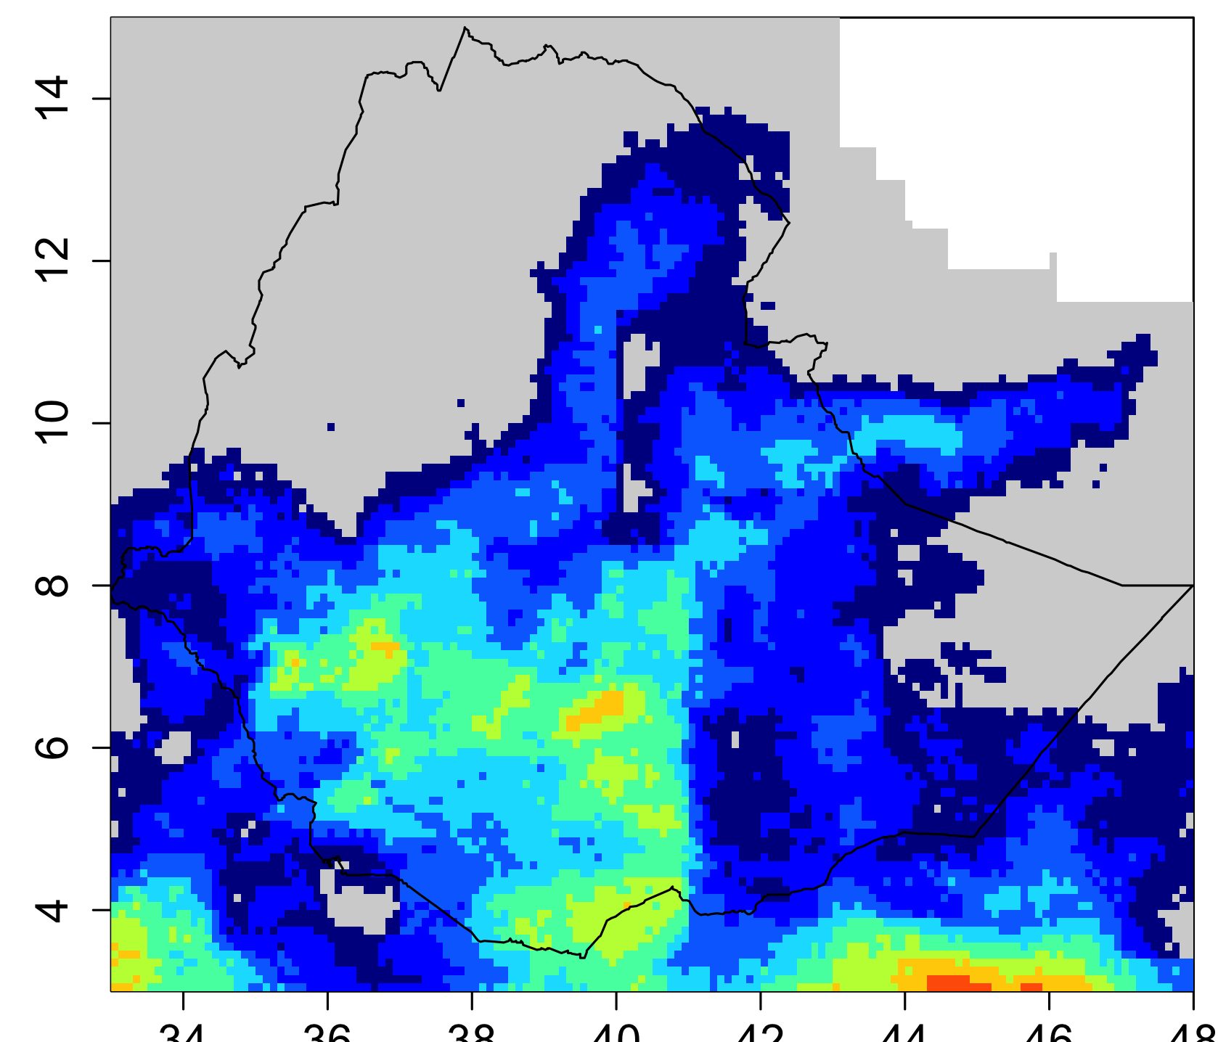
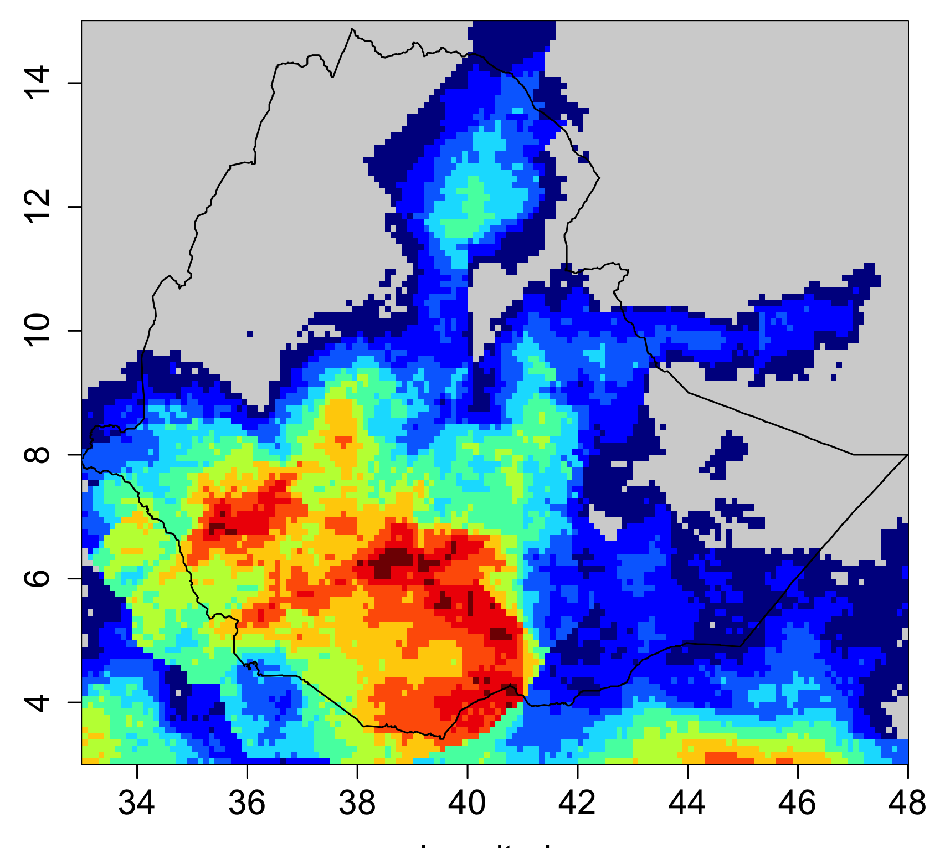
Understand / Quantify / Reduce Uncertainties: Learning from the Past
Much can be learned from understanding past Climate characteristics
Risks? Decadal Variability? Frequency / Intensity of Droughts? Successful Interventions?
But: Lack of long-term records with adequate coverage in developing countries
Ethiopia
IRI Work in Ethiopia (T. Dinku)
Weather Stations
Satellite Estimate
Combined product
Link to Sector Information:
Health
Water
Agriculture
Insurance
Ecosystems

Slide 9
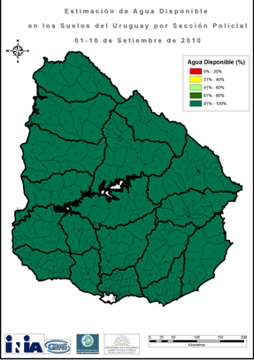
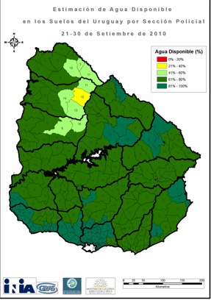
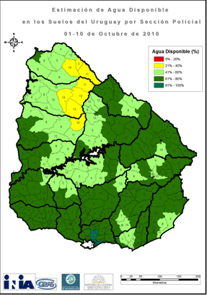
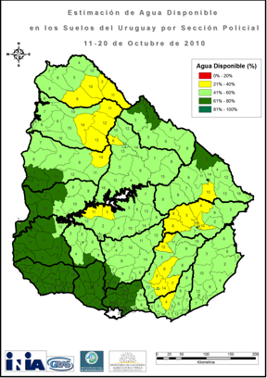
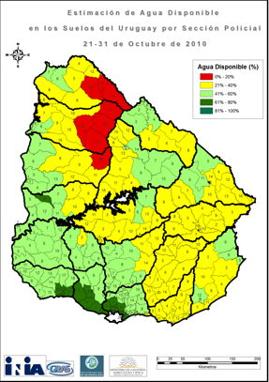
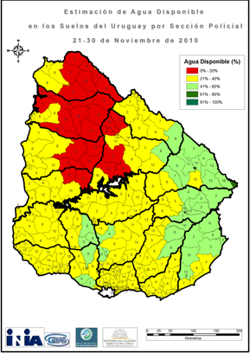
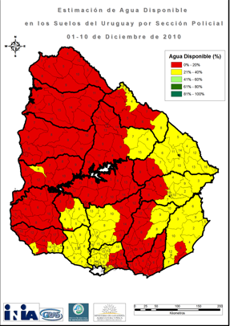
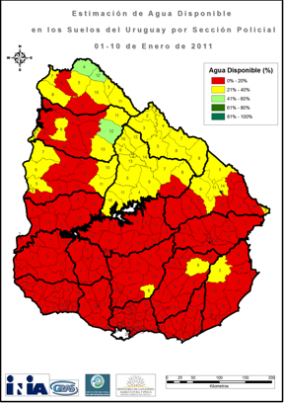


Understand / Quantify / Reduce Uncertainties: Monitoring the PRESENT
Drought in Uruguay
2010 / 2011:
Monitoring “Translated Climate”
(Soil Water Balance) by County
Sep 2010 Oct 2010
INIA GRAS - IRI
Provided this Information
to the Ministry of Agriculture and to
National Emergency System
(Evolution of the Drought)
Oct 2010 Nov 2010
December 2010:
Official Declaration of Emergency
based on this Information
Established Objective Priority for Aid
Requested more funds based on SCF
Dec 2010 Jan 2011
(Trust: 2013 World Bank Project Uruguay)

Slide 10
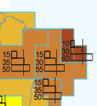
Understand / Quantify / Reduce Uncertainties: Providing Relevant Information of the FUTURE
One Example: Seasonal Climate Forecasts
White
Areas
in Map
10%
30%
60%
A
N
B
33%
33%
33%
Probability of Next Season being
“NORMAL”
"Wetter"
"Drier"

Slide 11
Understand / Quantify / Reduce Uncertainties: Providing Relevant Information of the FUTURE
Mean Monthly Rainfall in SW Uruguay (1910 – 2010)
Pick 15 years randomly

Slide 12
SW Uruguay: Monthly Precipitation
(15 Randomly Selected Years)

Slide 13
None of the years behaves like the long term mean
Probability of a year being “Average” = ZERO
Still, Planning/Decisions are often based on “AVERAGE” year
Can we do better?
Seasonal Climate Forecasts
Understand Historical Variability / associated risks
Study possible characteristics of Future Climate
Link it to Decision Systems

Slide 14
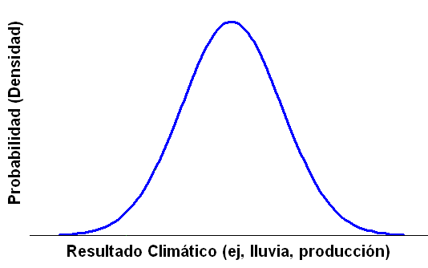
Our Approach to Climate Risk Management:
Manage the Entire Range of RISKS
Probability (Density)
Climate related Outcome (e.g., food production)

Slide 15
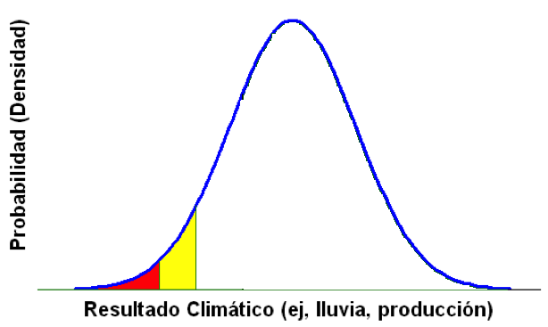
Our Approach to Climate Risk Management:
Manage the Entire Range of RISKS
Ag Production Systems,
Water Management,
are designed to
avoid this
Probability (Density)
HARDSHIP
e.g., Drought
CRISIS
e.g., Mitch
Climate related Outcome (e.g., food production)

Slide 16
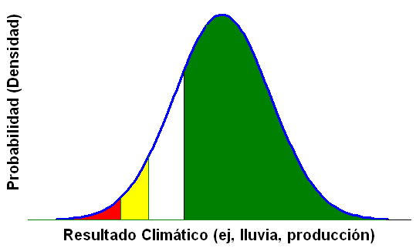
Our Approach to Climate Risk Management:
Manage the Entire Range of RISKS
Also Critical
For Development:
Risk aversion reduces Technology Adoption
Effect on Natural Resources
“Poverty Traps”
Ag Production Systems,
Water Management,
are designed to
avoid this
Probability (Density)
HARDSHIP
e.g., Drought
CRISIS
e.g., Mitch
MISSED
OPPORTUNITIES
Climate related Outcome (e.g., food production)

Slide 17
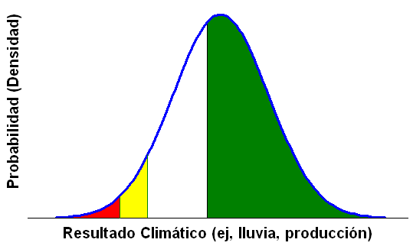
Our Approach to Climate Risk Management:
Manage the Entire Range of RISKS
Cover this to be able to take advantage of this
INDEX INSURANCE
Insurance that does not
aim to Compensate Damage
but to Take Advantage
of Opportunities (Geoff)
Probability (Density)
HARDSHIP
e.g., Drought
CRISIS
e.g., Mitch
Climate related Outcome (e.g., food production)

Slide 18
Challenge: Advances in Science not proportional to Applications in Decisions / Policy
  Science and Society: Information Chains, Networks
Knowledge
“Translation”,
“Tailoring”
Boundary
Organizations
Knowledge
Application
Operation
Policy
Knowledge
Generation
New Research
Questions
New Knowledge
Demands
Here are Key Challenges:
Need a “new type” of Scientist?
(Translator, Integrator)
Also: Multidisciplinary Research (EI, CU)
IRI Lesson learned: Inform Decisions and Policy Take Advantage, Understand constraints, etc
of Existing Information Networks ( “Simplified” Example in Agriculture)
International
Research
Institute
Local
University
Agricultural
Research
Institute
Extension
Service,
Adviser,
NGO
Farmer
Ministry,
Agribusiness,
Insurance
When the Links / Chains are not present we try to create them
(The solution is not to “skip links”, but to create/strengthen the links)
Notes:
Another key lesson in the first 15 years of the IRI
Need to establish or take advantage of chains of information in orther to provide effective Climate Services
Chains: It is much more effective to strengthen the links than skipping them. Best example is National Weather Services: working with them, imprving capacities one reaches a vast part of the society. Develop their capacities in linking with the sectors.
Also, strengthening the chain allows one to embed in their porcesses, as oppsed to telling them what they shoul dbe doing.
This is an area where IRI has been learning very useful lessons.

Slide 19
  Science and Society: Information Networks
  (Very) Simplified Example in Agriculture
Rural Social
Research
Institute
Extension
Service,
International
Research
Agriculture
Local
University
Advisers
Ministry
Farmer
Meteorological
Service
International
Research
Climate
Local
University
Ministry
Advisers
Farmers
Agricultural
Research
Institute
Agribusiness
Local
University
Regional
Research
Institute
Insurance
NGO
Financial
Services
Climate
Research
Institute
Understand the Network (links, processes)
Define priorities
“Target” users (problems/demands)
Strengthen links, communication
Notes:
Another key lesson in the first 15 years of the IRI
Need to establish or take advantage of chains of information in orther to provide effective Climate Services
Chains: It is much more effective to strengthen the links than skipping them. Best example is National Weather Services: working with them, imprving capacities one reaches a vast part of the society. Develop their capacities in linking with the sectors.
Also, strengthening the chain allows one to embed in their porcesses, as oppsed to telling them what they shoul dbe doing.
This is an area where IRI has been learning very useful lessons.

Slide 20
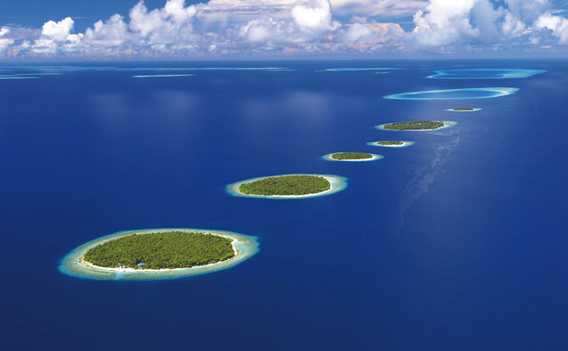
Challenge: Advances in Science not proportional to Applications in Decisions / Policy
Gap between Science and Policy, Decisions, Society
Decision-makers approach problems holistically and often intuitively
2. Science traditional reductionist approach:
Create “islands of knowledge in a sea of ignorance”
Common lack of Integration of Socially Relevant Outcomes
(Meinke et al., 2007; 2009)

Slide 21
Need to Integrate Science-Based Information of
Climate, Agronomy/Water/Health/Ecosystems
at different Scales (Temporal, Spatial)
and
Produce Information that is
UNDERSTANDABLE that TRIGGER ACTION
for Planning, Decision-making, Policies
Chains / Networks of Information
Integrated approach, Interdisciplinary teams
Also: Tools for Climate Risk Management

Slide 22






Climate Risk Management Approach and Tools:
(Applied Systems Analysis Approach)
Information and
DECISION
SUPPORT
SYSTEMS

Slide 23
CLIMATE
INFORMATION
Examples “IDSS Approach”
Early Warning Systems
Early Response to Emergencies
Reservoir Optimization
Crop Forecasts / Food Avail.
Crop Disease/Pest Outlooks
Climate Index Insurance
Feasibility of Technologies
Energy Generation (Biomass)
REMOTE
SENSING
EXISTING
DATABASES
SIMULATION
MODELS
GIS
“Traffic light”
colors
Different Spatial Resolutions: Region → Country → Provinces, counties → Users
Different Temporal Resolutions: Seasons → Decades → Climate Change
Easily Understandable / Actionable: Inform Decisions, Planning, Development
(IRI’s Map Rooms)

Slide 24
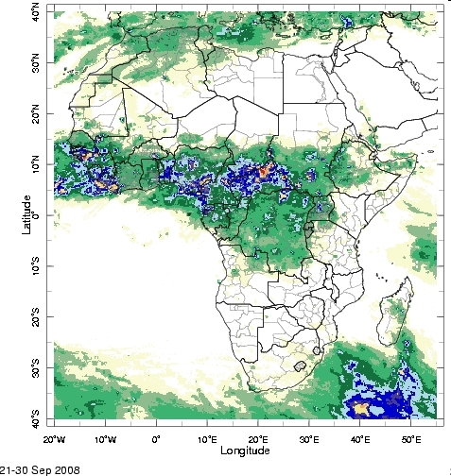
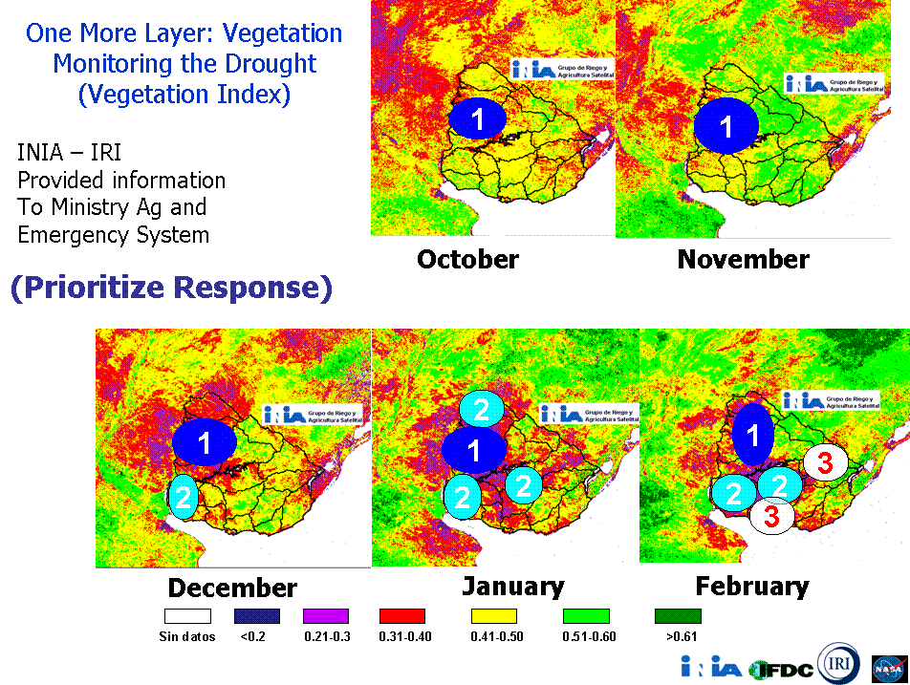


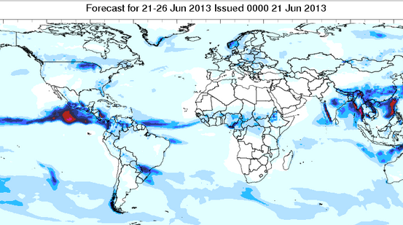





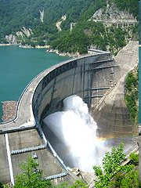
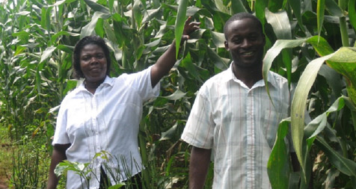
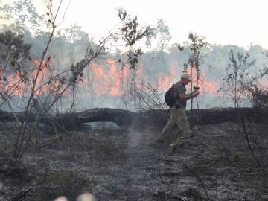



NWRB
Early Warning and
Response: Malaria
in Africa
Drought Early Warning
and Response in Agriculture
SE South America
Disaster Risk Reduction Early Warning and Response in Africa / Caribbean (IFRC)
Index Insurance
Programs
for Farmers in Africa and
Central America
Understanding
Escaped Fires
In Western Amazonia
(EICES, E3B, IRI)
Optimizing Water Management Philippines, Brazil, Chile

Slide 25
Final Comments:
IRI Experience in Sectors and Regions
Broadening the Scope
Moved beyond Seasonal/Interannual to Climate Change and Intraseasonal
Embedded Approach for Adaptation to Climate Change in Development Efforts
Climate Science – Society/Policy Interface
Knowledge/Information Chains / Networks
Understand the Context in which we try to inform Policy / Decisions
Asking the right Question:
“What climate information do you need? (NO)
“What problems are you facing that climate knowledge can inform / assist?
Science-based Resources to Inform Policy
Define a Framework (e.g., Four Pillars of Climate Risk Management Approach)
Use Integrative Approach and Tools: Decision Support Systems, Maprooms
Understandable and Actionable

Slide 26
Thank you
Walter E. Baethgen
Leader, Regional and Sectorial Research Program
IRI, The Earth Institute at Columbia University
Tel: (845) 680-4459
email: baethgen@iri.columbia.edu
Internet: http://iri.columbia.edu/

