Slide 1
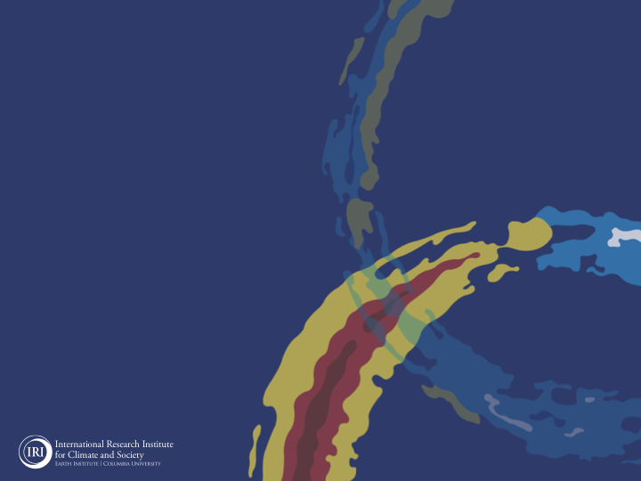
ENSO and Climate Outlook
September 2021:
Likelihood for a 2nd La Niña Increases.
Acknowledgements:
Jeffery Turmelle and Jing Yuan: forecast processing and web updates
Cuihua Li: Draft powerpoint development
IRI’s Climate Group, led by Dr. Andrew Robertson: Forecast system development, ongoing innovation, and verification

Slide 2
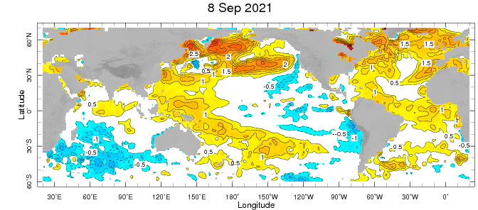
Weekly Sea Surface Temperature Anomalies (includes satellite data)
NINO3.4 = -0.4 C

Slide 3
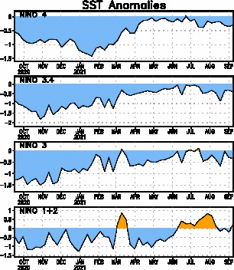
Near Dateline
This is the SST
Index
predicted
Eastern Eq. Pacific
Off Coast of S.America

Slide 4
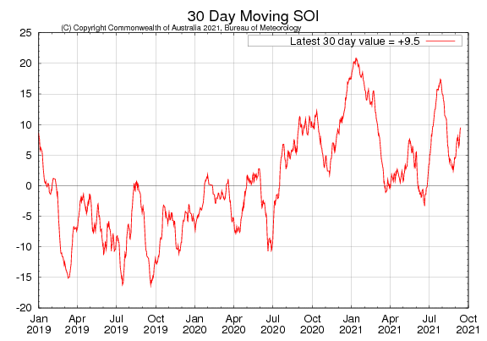
Tahiti_{SLP} – Darwin,AUS_{SLP}

Slide 5
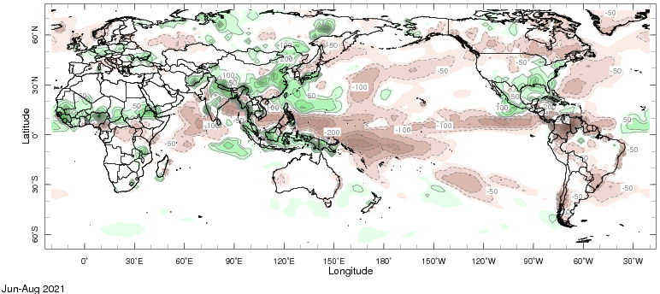
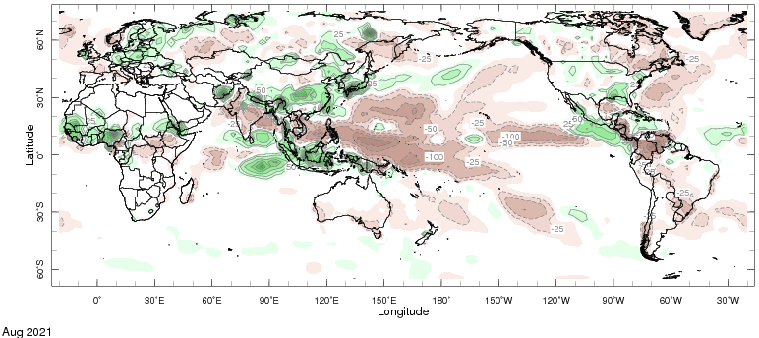
Precipitation Anomalies
JJA 2021
August 2021

Slide 6
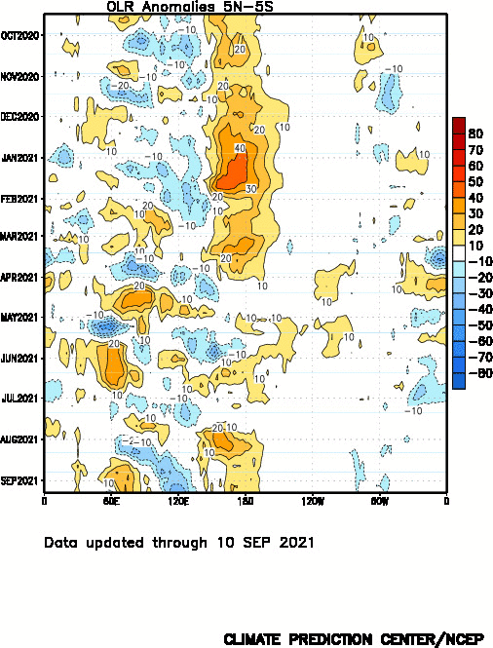
Drier
Wetter

Slide 7
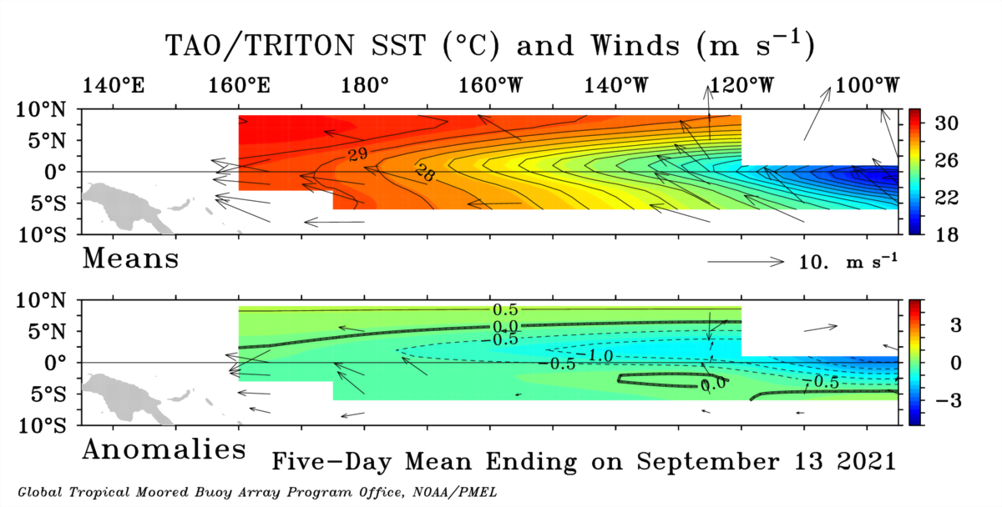

Slide 8
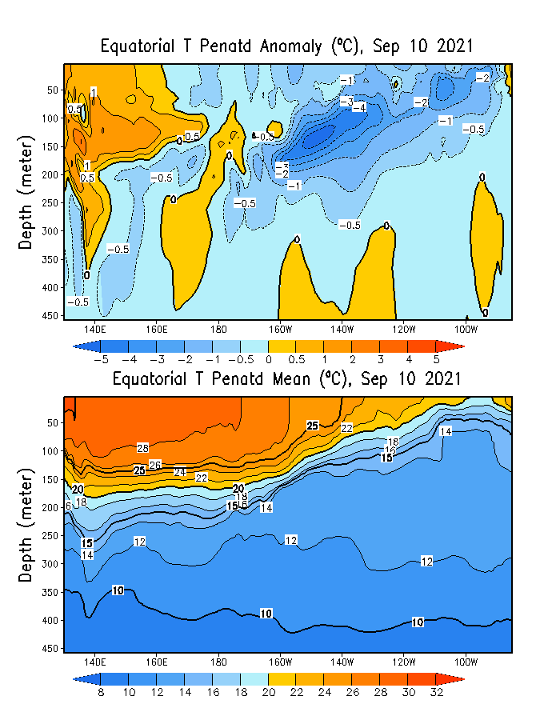
GODAS* Analysis
Used to initialize CFSv2 and CCSM4
ANOMALY
TOTAL
* Global Ocean Data Assimilation System

Slide 9
TOTAL
ANOMALY

Slide 10
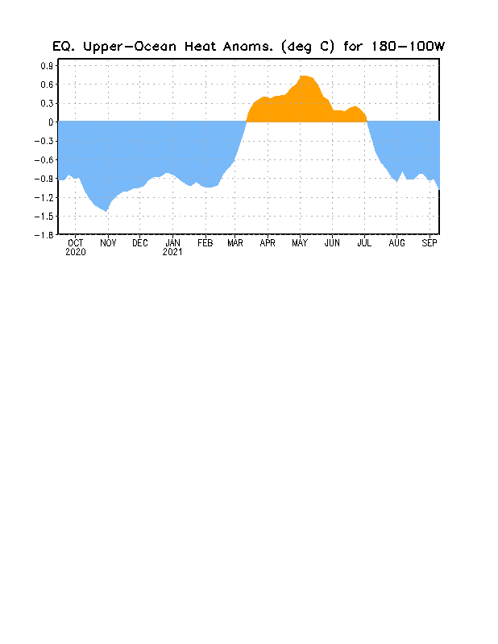

Slide 11
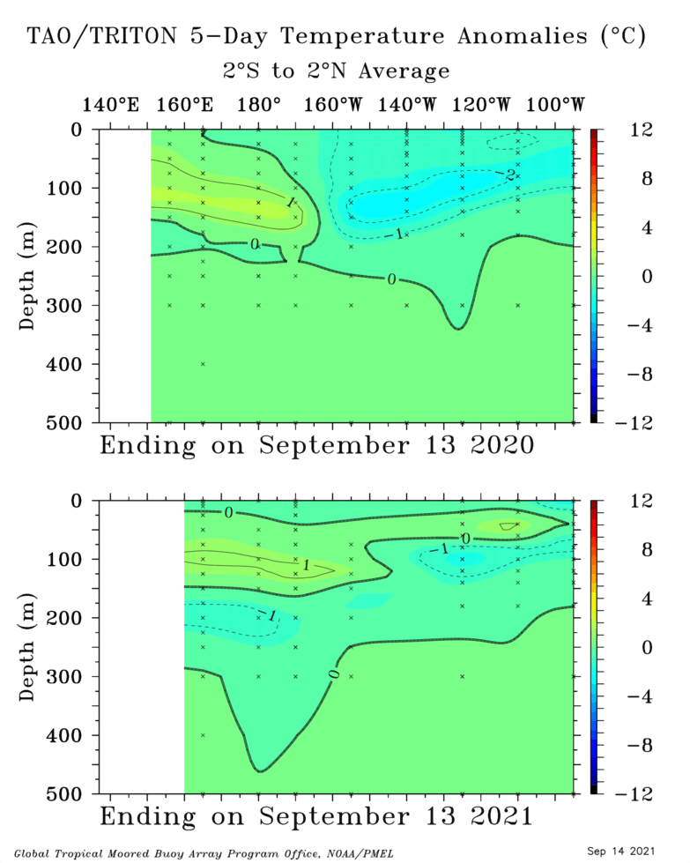
Last Year (Aug ‘20)
Last Month (Aug ‘21)

Slide 12
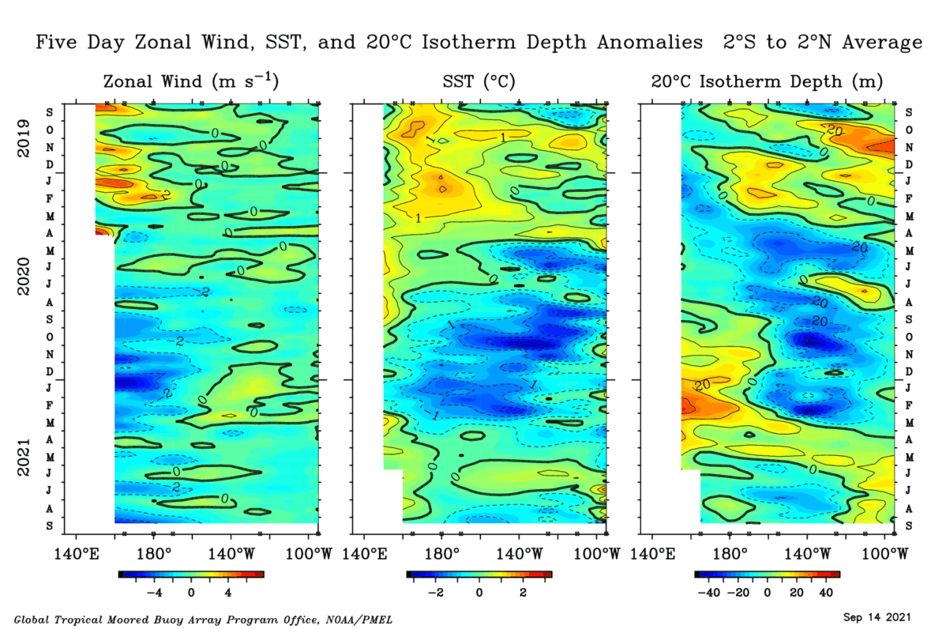

Slide 13
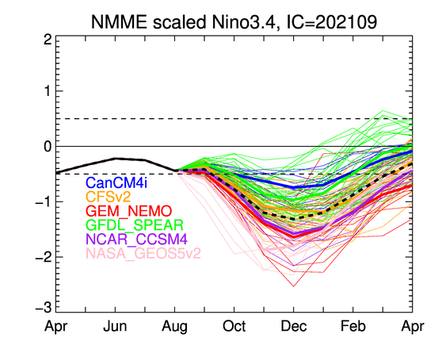

Slide 14
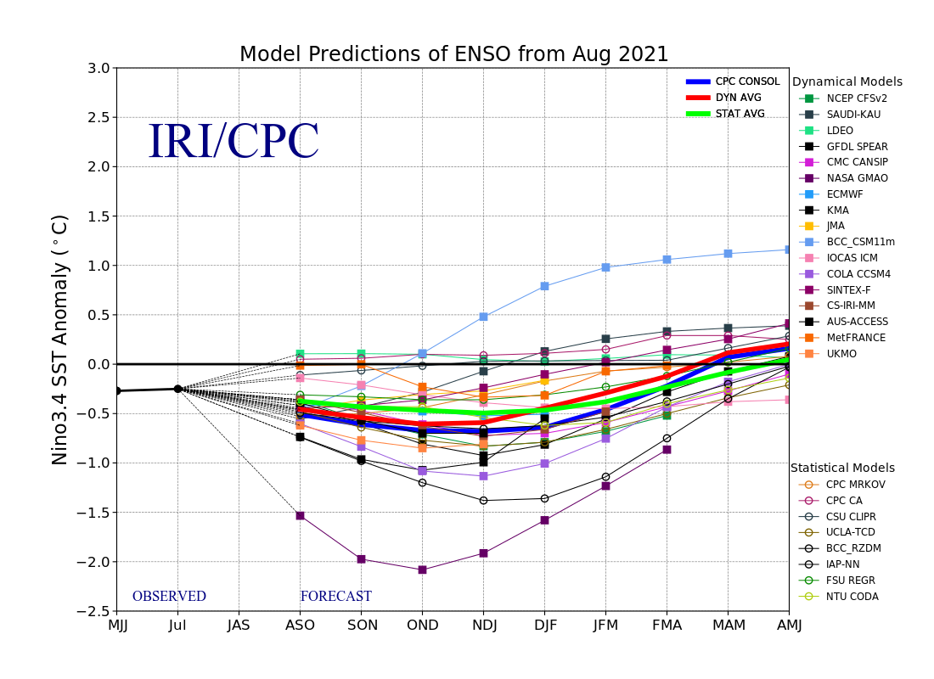
LAST MONTH

Slide 15
THIS MONTH

Slide 16
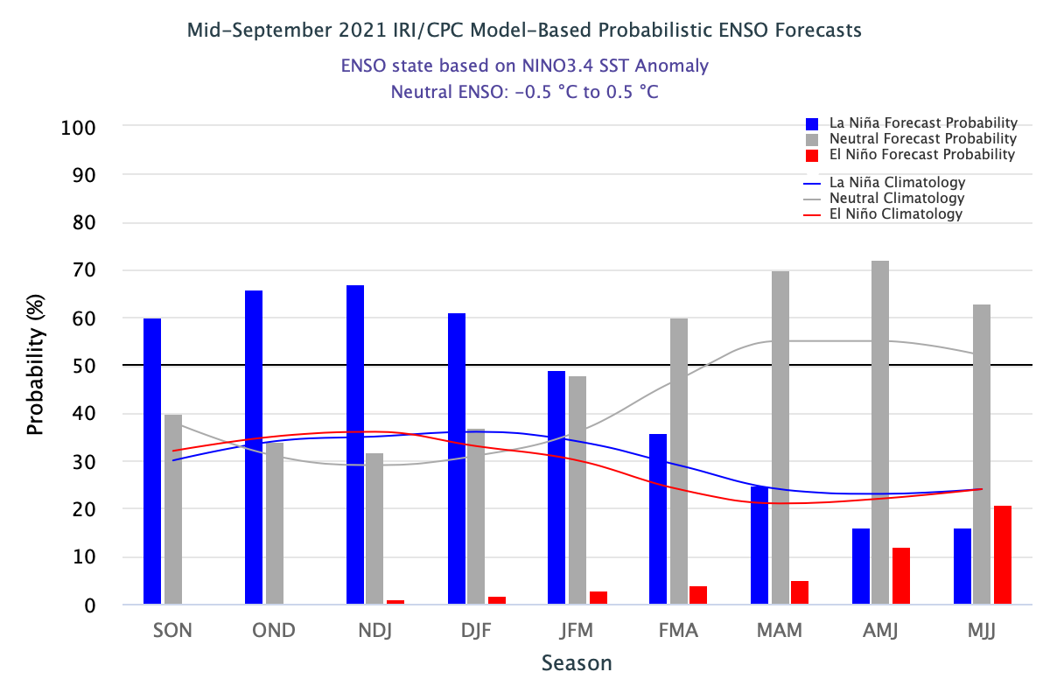
THIS MONTH

Slide 17
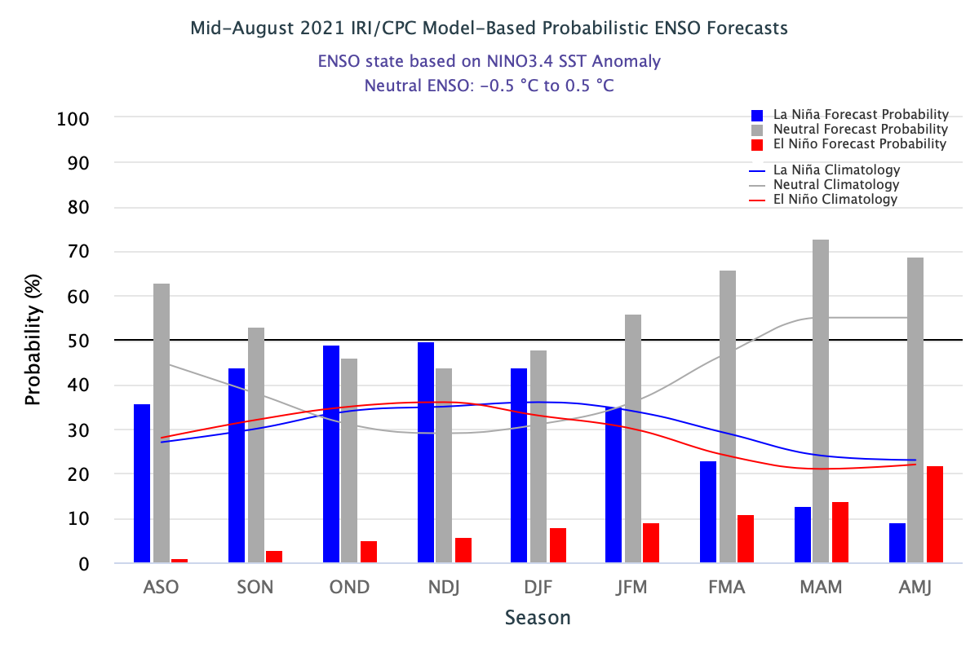
LAST MONTH

Slide 18
THIS MONTH

Slide 20
THIS MONTH

Slide 21
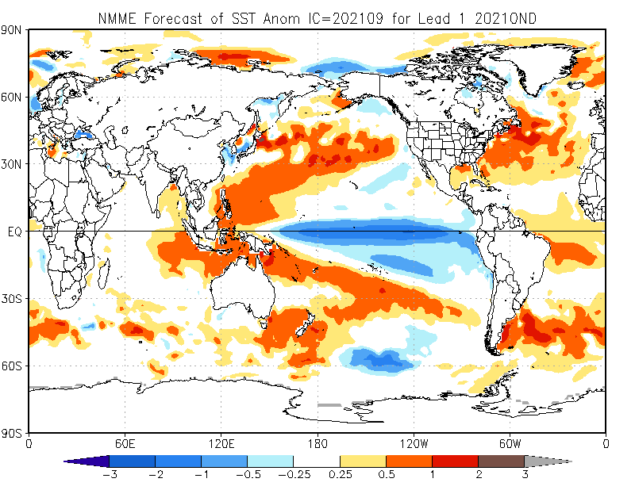

Slide 22
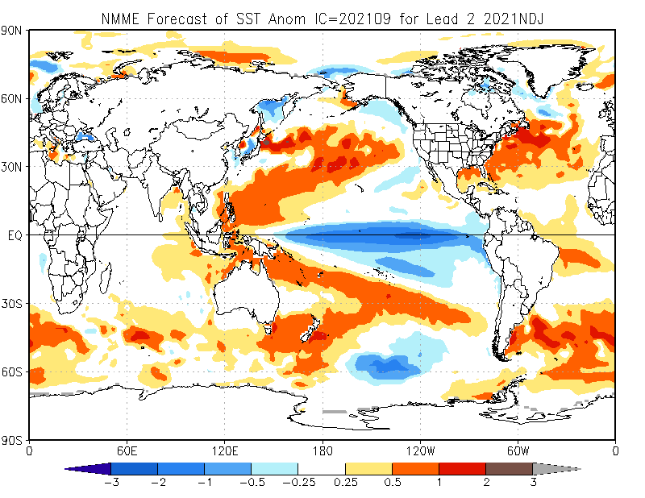

Slide 23
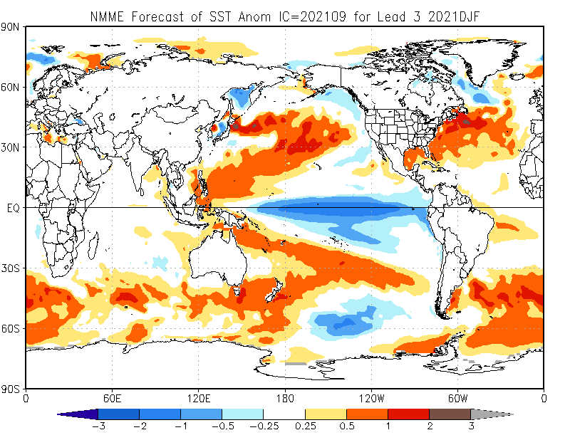

Slide 24
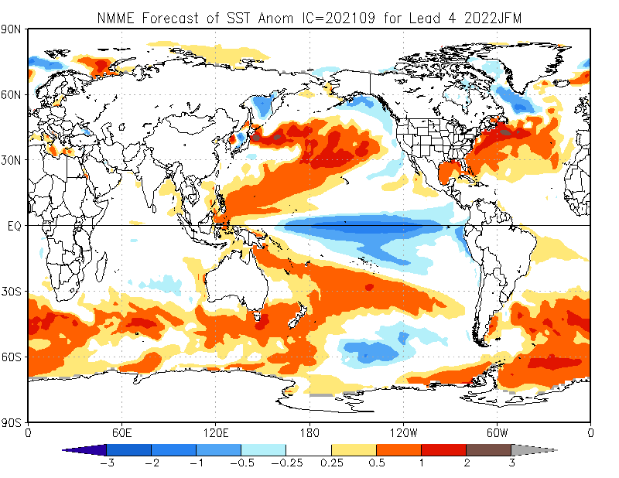

Slide 26
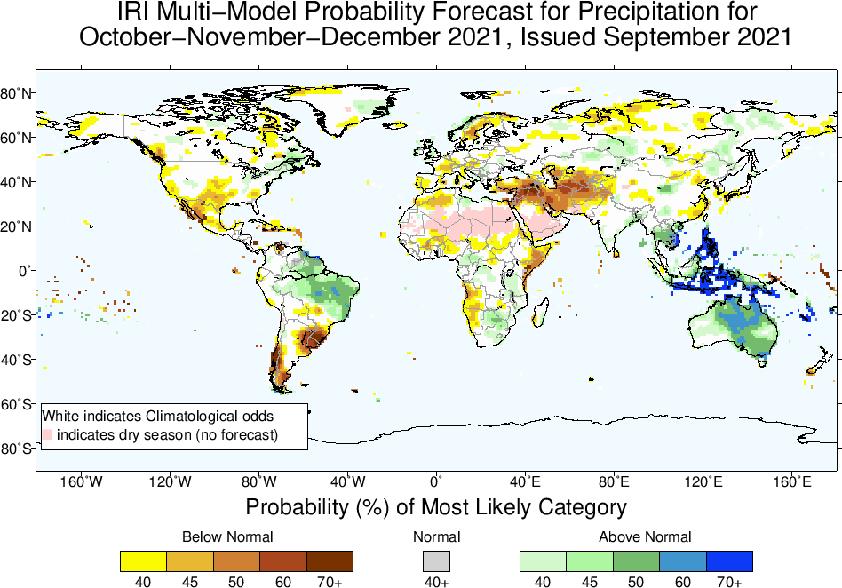

Slide 27
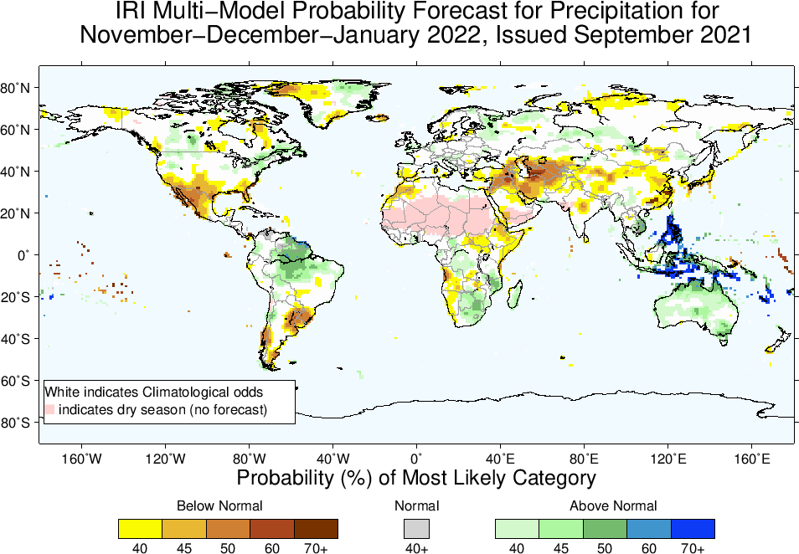

Slide 28
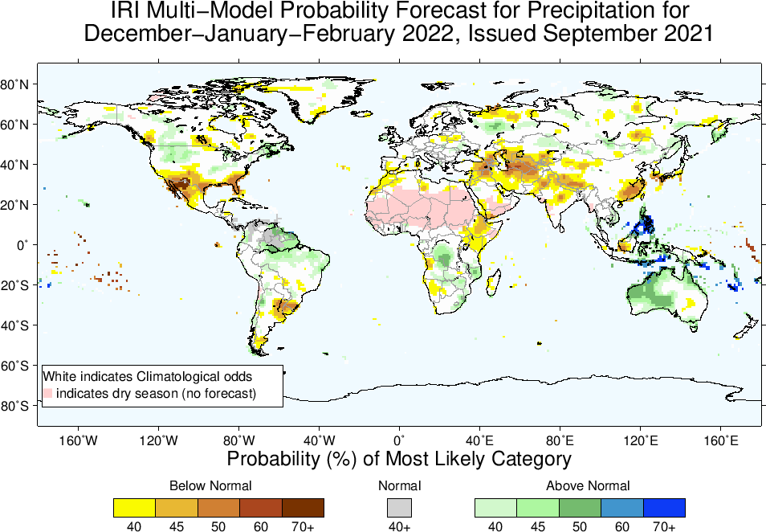

Slide 29
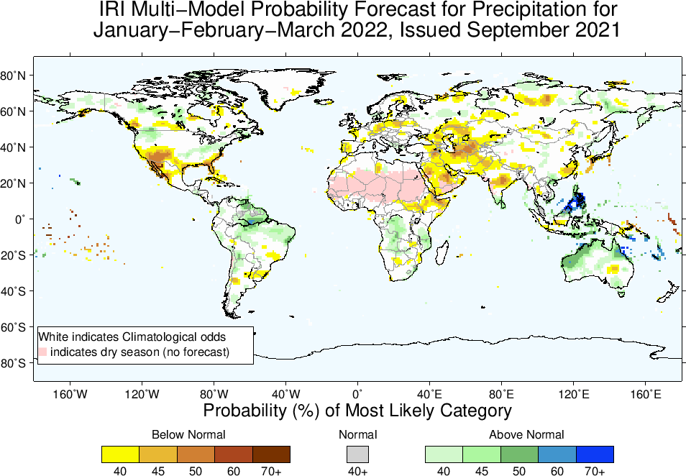

Slide 30
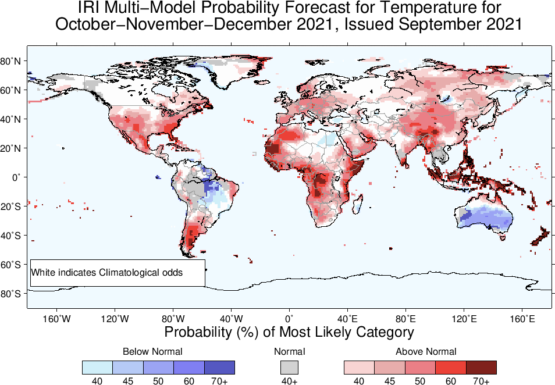

Slide 31
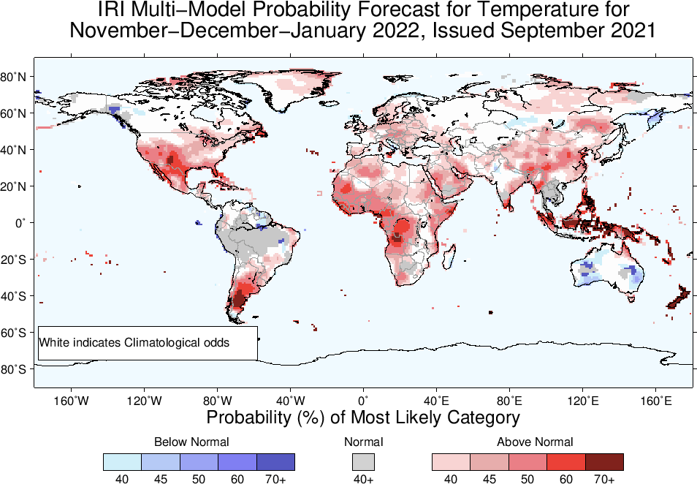

Slide 32
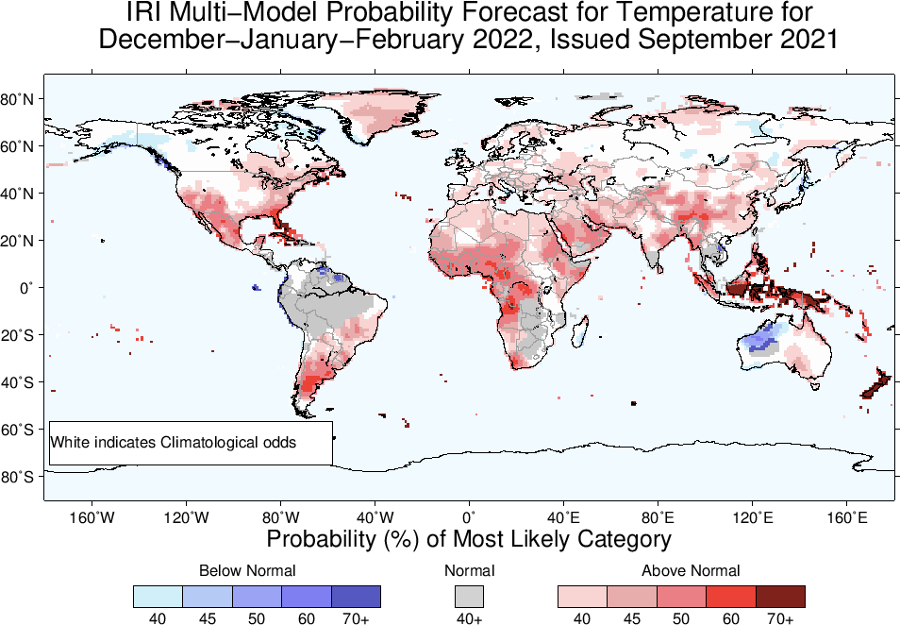

Slide 33
