Slide 1
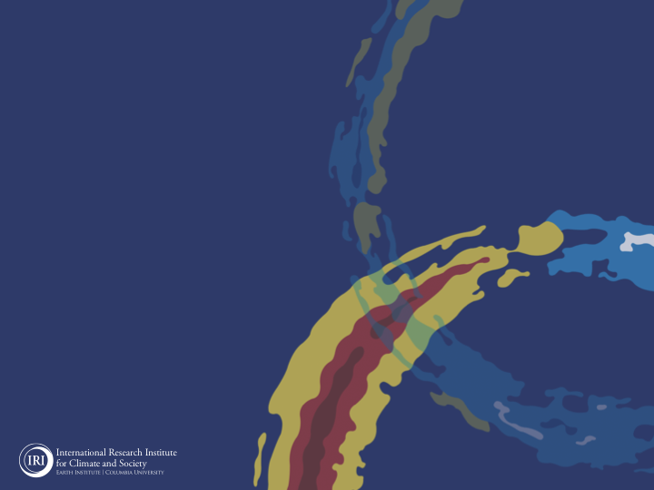

ENSO and Climate Outlook in October, 2023
M. Azhar Ehsan
(azhar@iri.columbia.edu)
Associate Research Scientist
IRI ENSO and Climate Forecast Lead
Jeffrey Turmelle and Jing Yuan: forecast processing and web updates
Cuihua Li: Draft PowerPoint development
IRI’s Climate Group, led by Dr. Andrew Robertson:
Forecast system development, ongoing innovation, and verification

Slide 2
Outline
Observed Oceanic and Atmospheric Conditions in
Tropical Pacific
Across the Globe
ENSO Forecast in
NMME
IRI ENSO Forecast Tool (Deterministic and Probabilistic)
Seasons Outlook of
SST
Precipitation and Temperature
Summary

Slide 3
Observations
Oceanic
Atmospheric

Slide 4
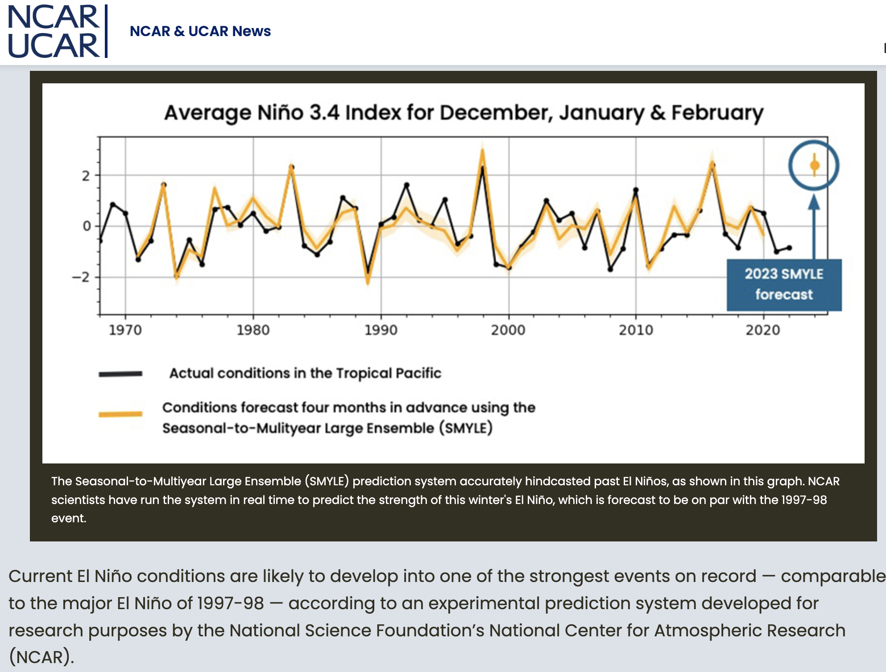
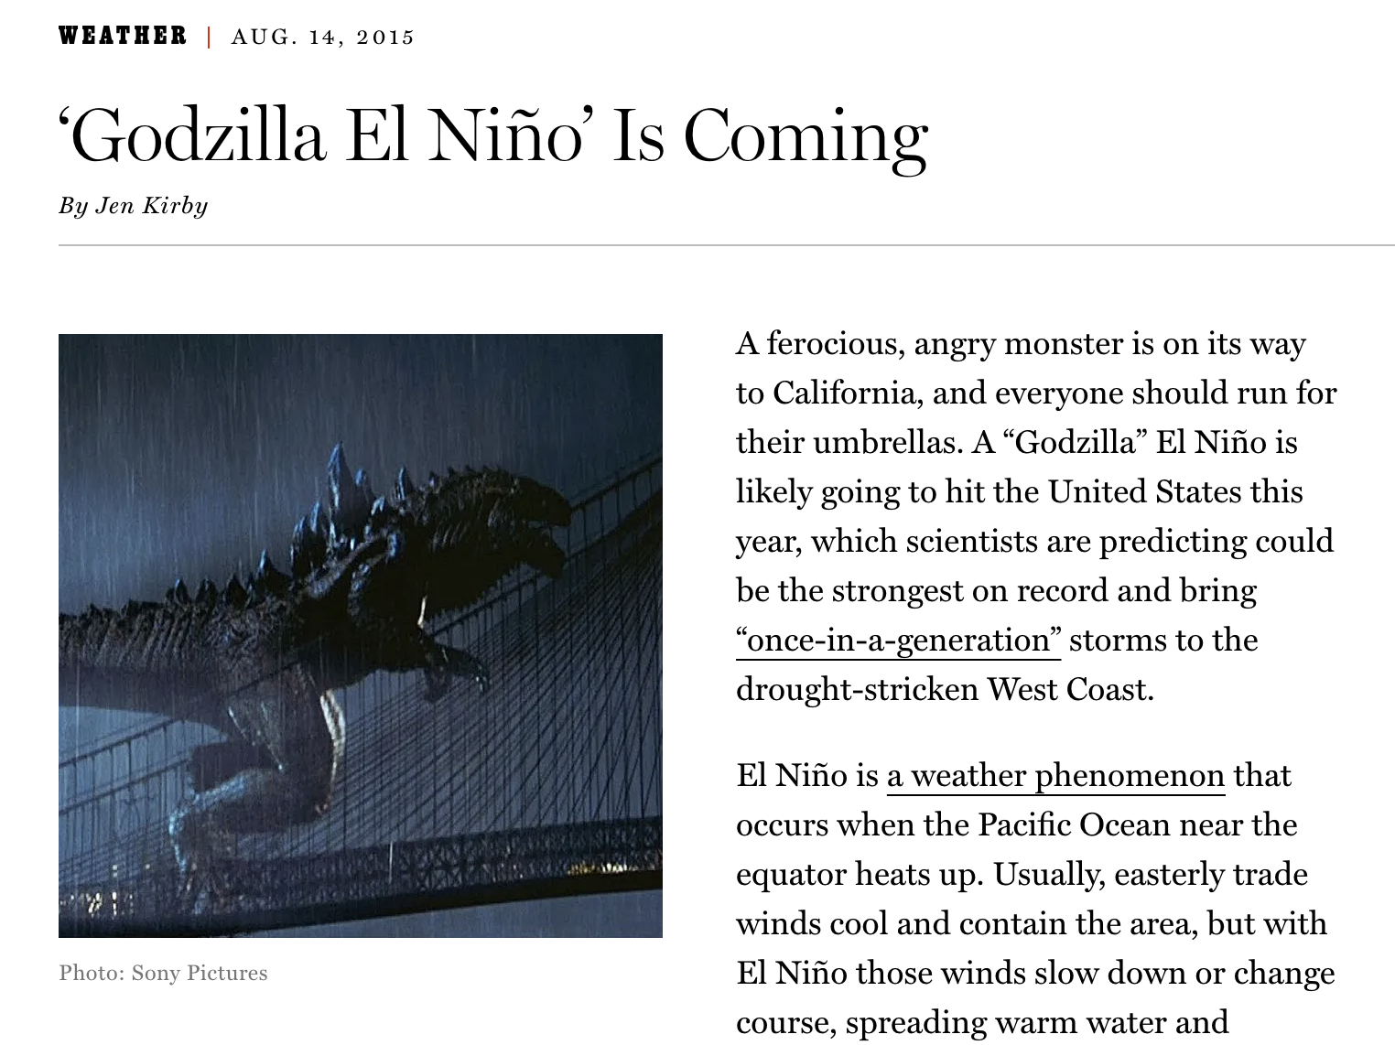
NCAR/UCAR ENSO Forecast (SMYLE, SEP 26, 2023)

Slide 5
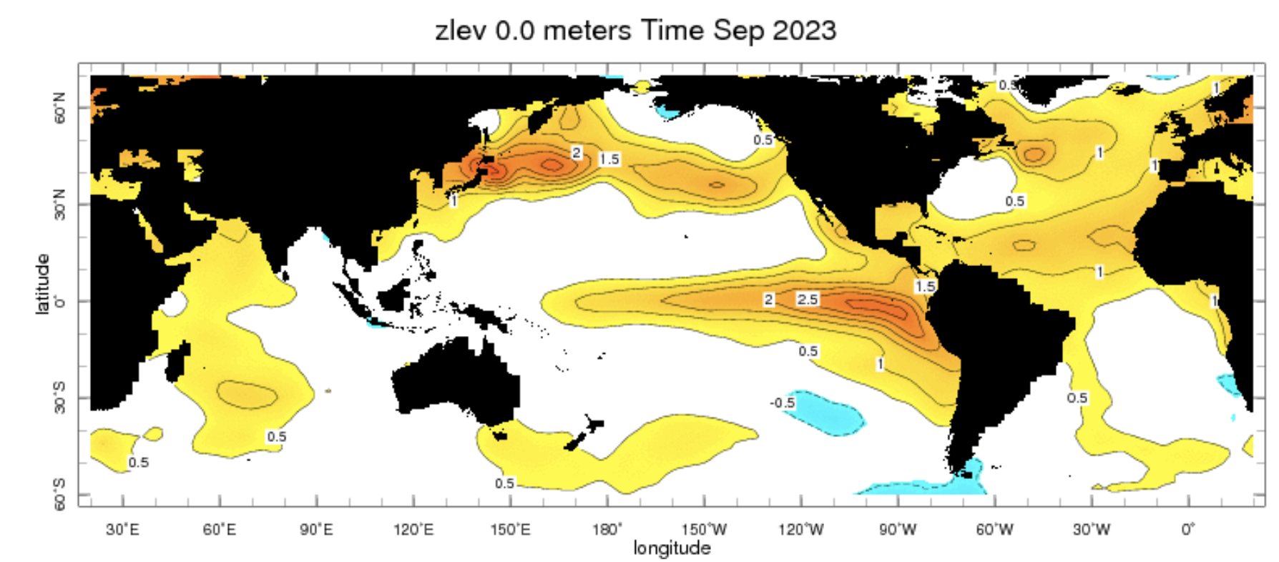
Evolution of SST Departures in Monthly Data
In the Pacific Ocean: Above-Average SSTs persisted across the central (across the Date Line), surrounded by strong +ve SSTA in the high latitudes (North Pacific Ocean), Negative PDO.
Indian Ocean: Above-Average SSTs in the West and Negative in the East, a +ve Indian Ocean Dipole
North-Pacific and North Atlantic Ocean: Above-Average SSTs
Source: https://iridl.ldeo.columbia.edu/maproom/Global/Ocean_Temp/ERSST_Anomaly.html

Slide 6
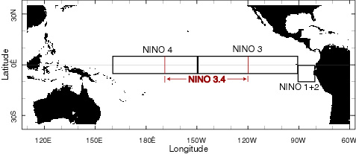
A comparison between NINO3.4 (Monthly) of 1997, 2015, and 2023 Warm Episodes

Slide 7
A comparison between NINO3.4 (Weekly) of 1997, 2015, and 2023 Warm Episodes

Slide 8
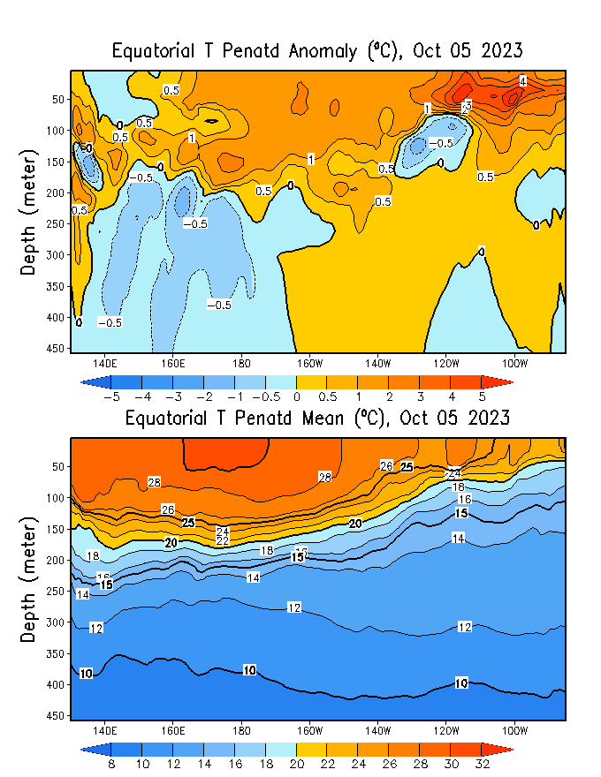
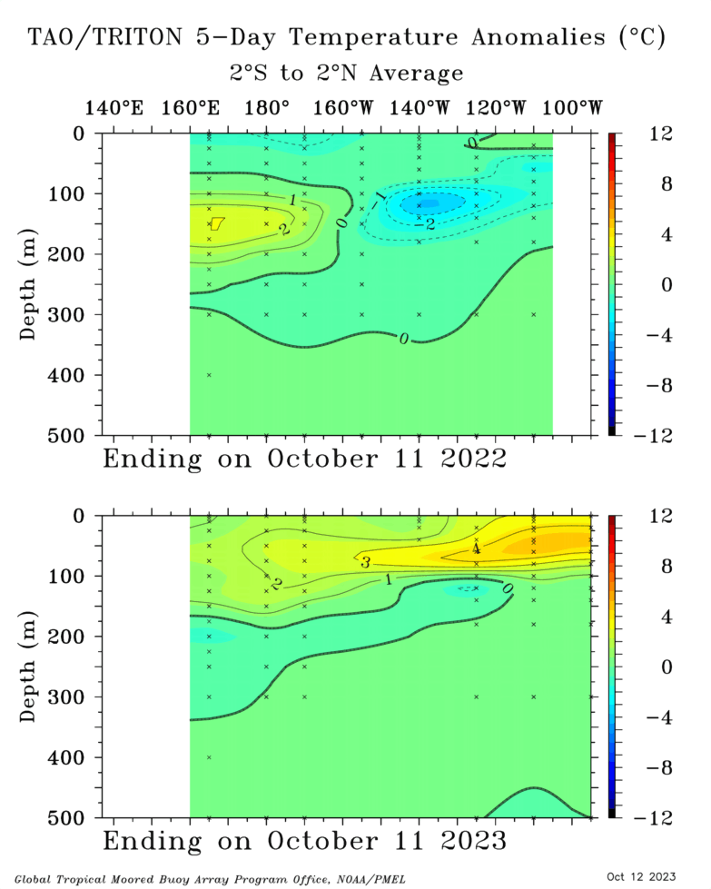
Subsurface Ocean Temperature Evolution
GODAS
TOGA/TAO, Oct 2022
TOGA/TAO, Oct 2023

Slide 9
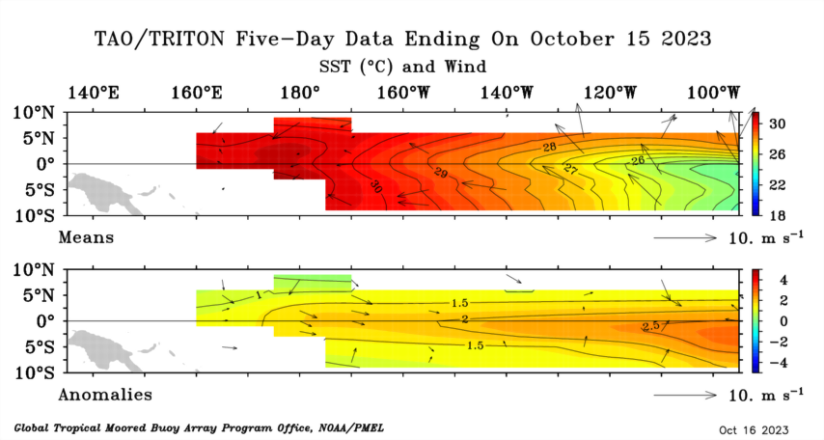
Most recent Sea Surface Temperature (SST) Lower-Level Winds

Slide 10
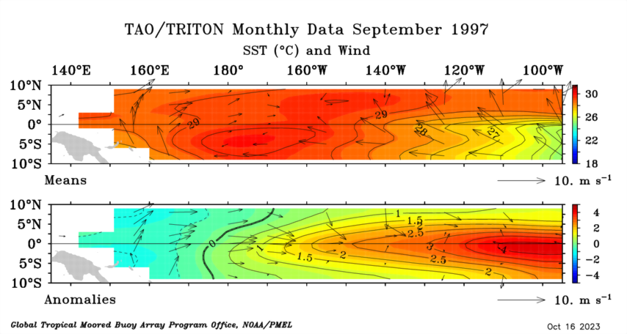
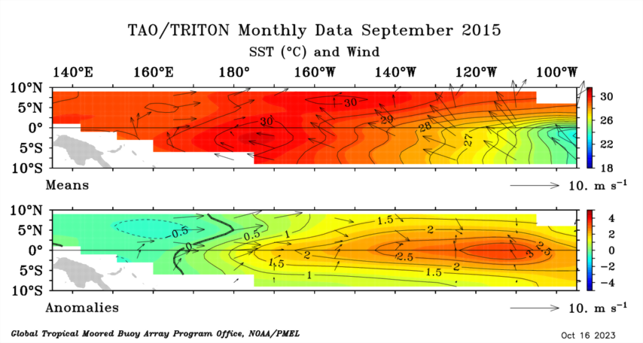
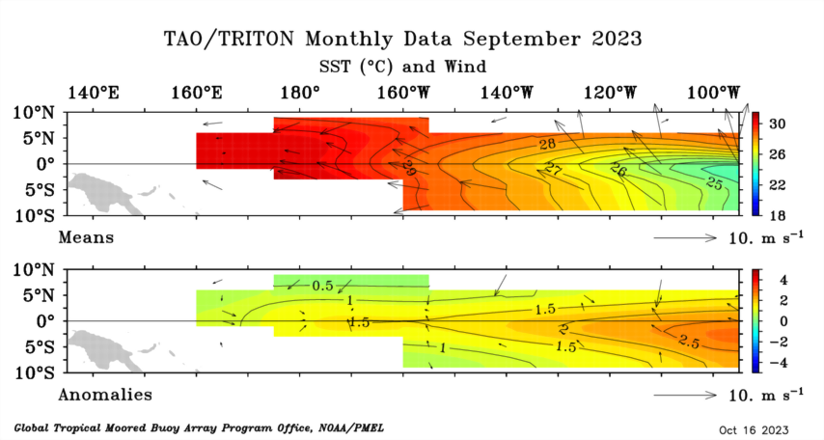
A comparison between Winds (Monthly) in 1997, 2015, and 2023 Septembers
https://www.pmel.noaa.gov/tao/drupal/disdel/

Slide 11
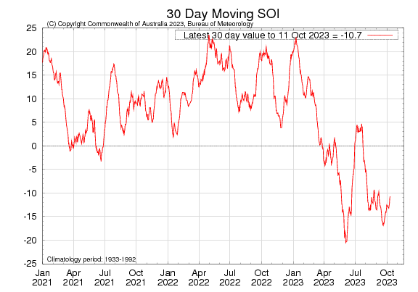
Most recent Southern Oscillation Index (SOI)
During El Niño, the pressure becomes below average in Tahiti and above average in Darwin, and the Southern Oscillation Index is negative.
A Sustained Negative values of the SOI above -7 typically indicate El Niño
Source:
http://www.bom.gov.au/climate/enso/#tabs=Pacific-Ocean&pacific=SOI

Slide 12
A comparison between SOI of 1997, 2015, and 2023 Warm Episodes

Slide 13
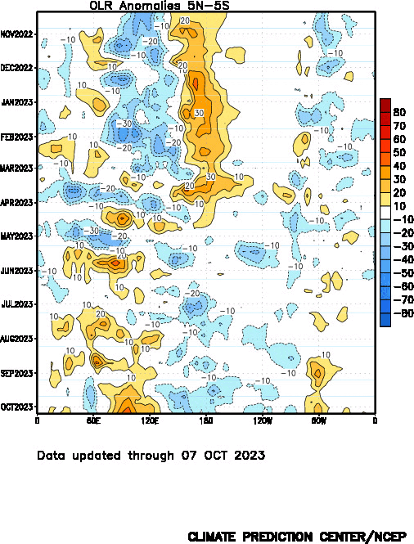
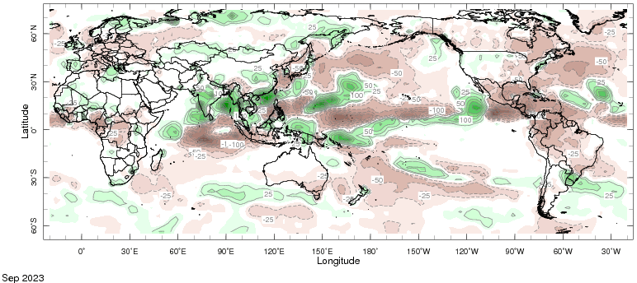
Most recent Outgoing Longwave Radiation (OLR) & Precipitation

Slide 14
A comparison between CP-OLR (170E-140W, 5S-5N) of 1997, 2015, and 2023 Warm Episodes

Slide 15
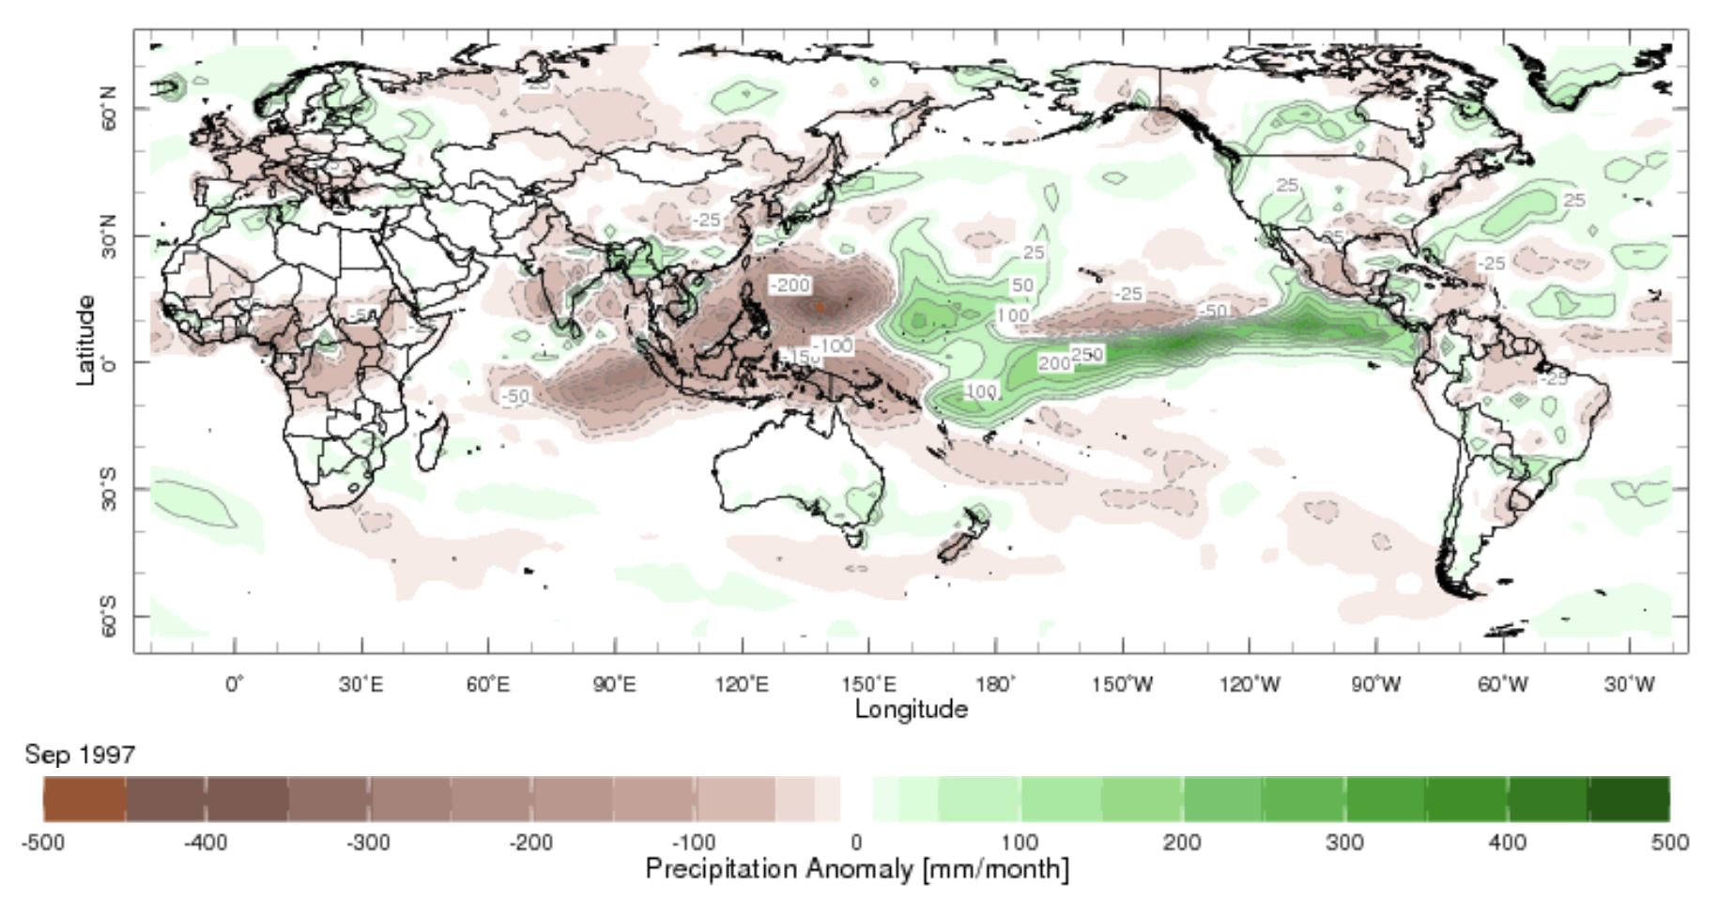
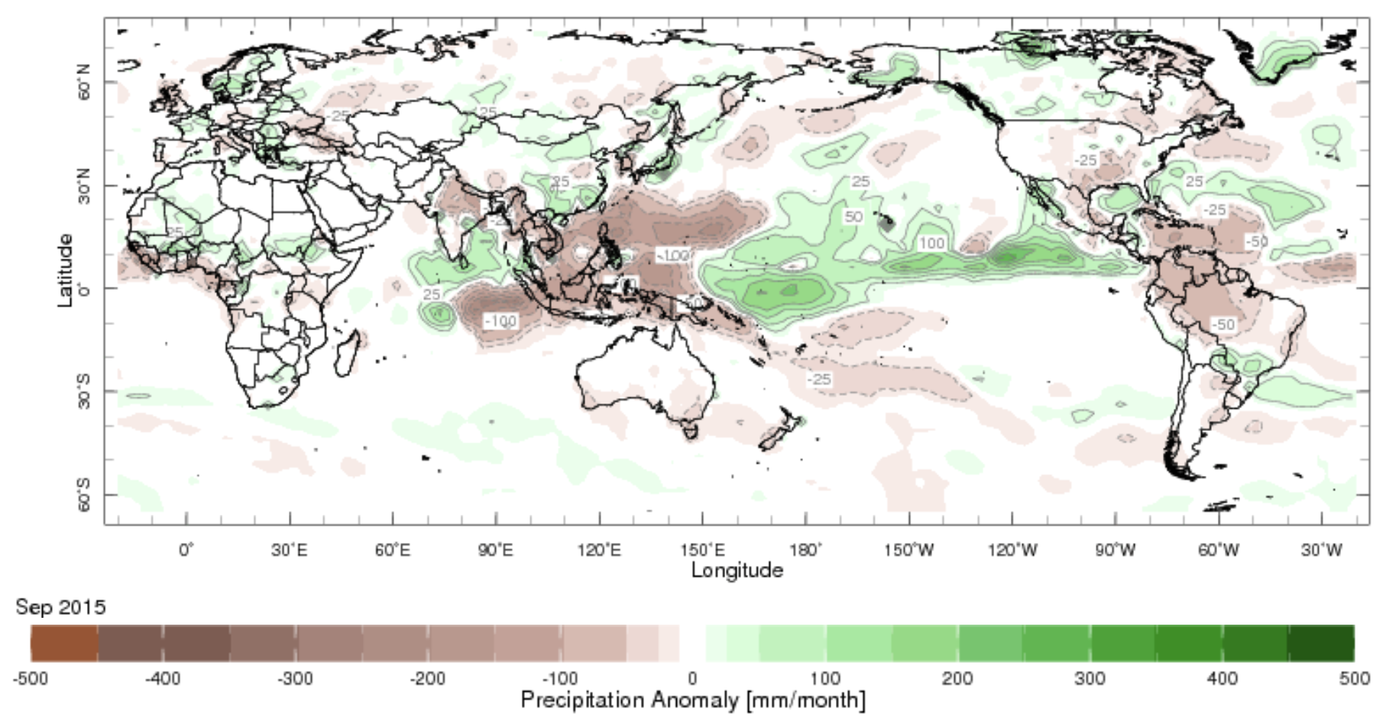
A comparison between Prcp. in 1997, 2015, and 2023 Septembers
Sep, 1997 Prcp, Anomalies
Sep, 2023 Prcp, Anomalies
Sep, 2015 Prcp, Anomalies

Slide 16
Forecasts
Nino-34 in NMME,
IRI ENSO Plume,
Probability of Nino-34,
Global SSTs from NMME,
Prcp. and Temp. outlook from IRI (Oct, Initial)

Slide 17
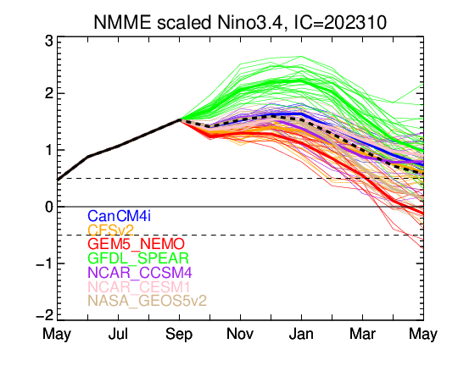
North American Multi Model Ensemble (NMME) ENSO Forecast (Oct, Initial)

Slide 18
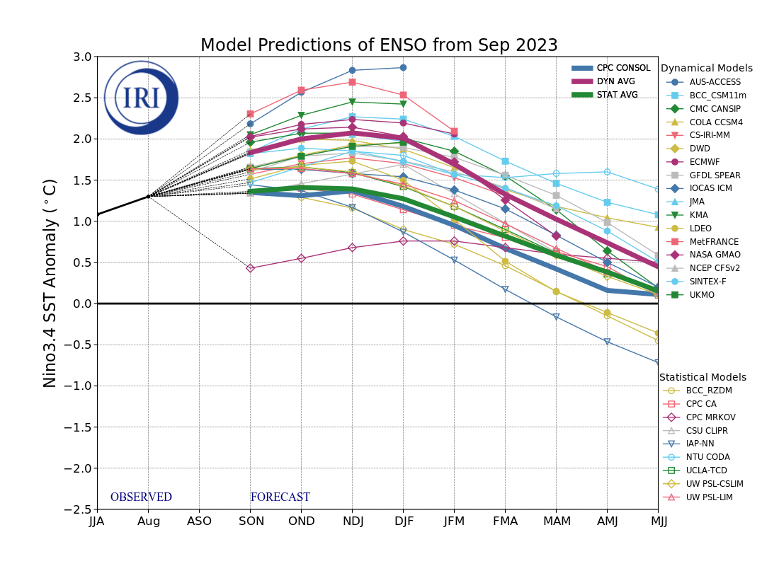
IRI’s ENSO Forecast Sep, 2023 (Last Month)

Slide 19
IRI’s ENSO Forecast Oct, 2023 (This Months)

Slide 20
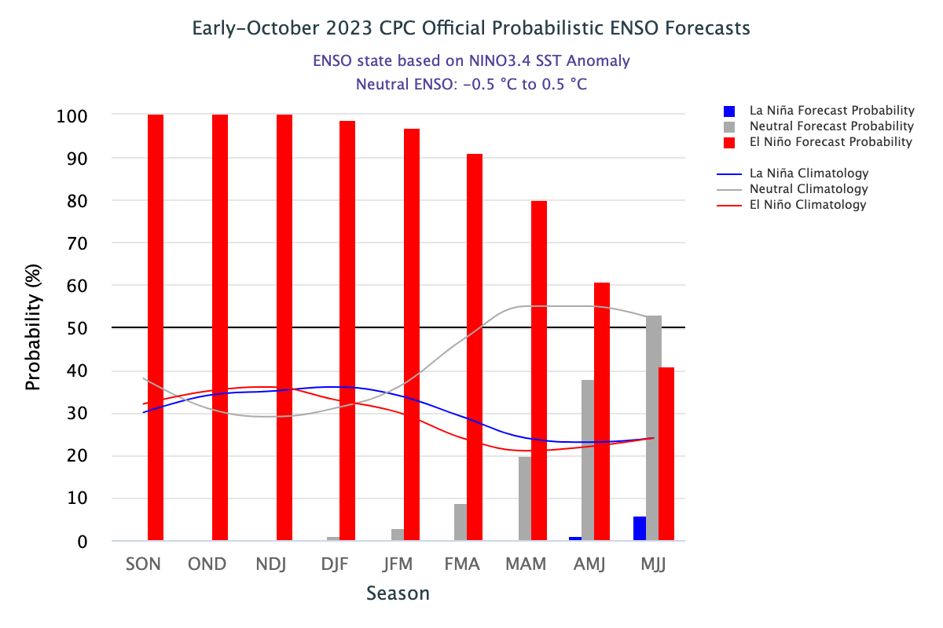
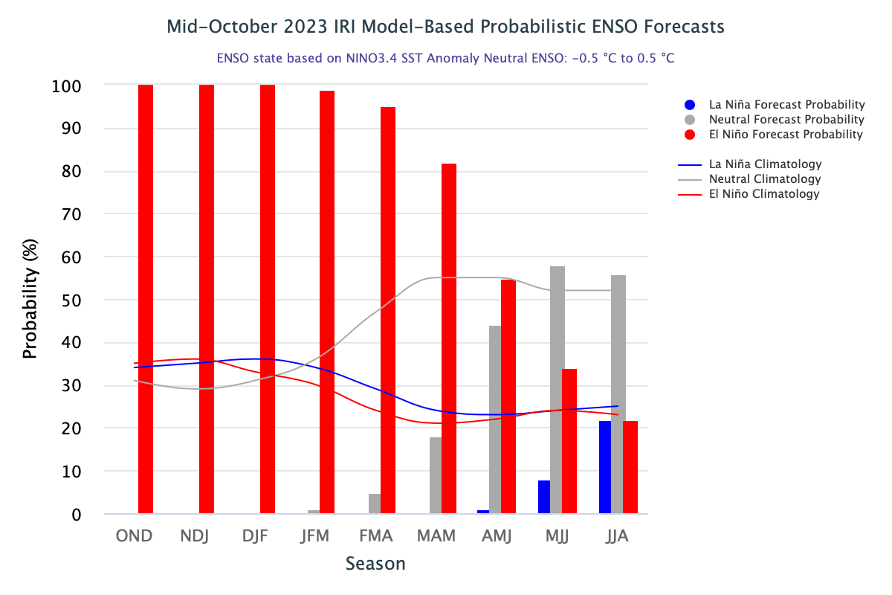
CPC (Released on Oct, 12) and IRI (will be on 19th Oct, today) Probabilistic ENSO Forecast Oct, 2023

Slide 21
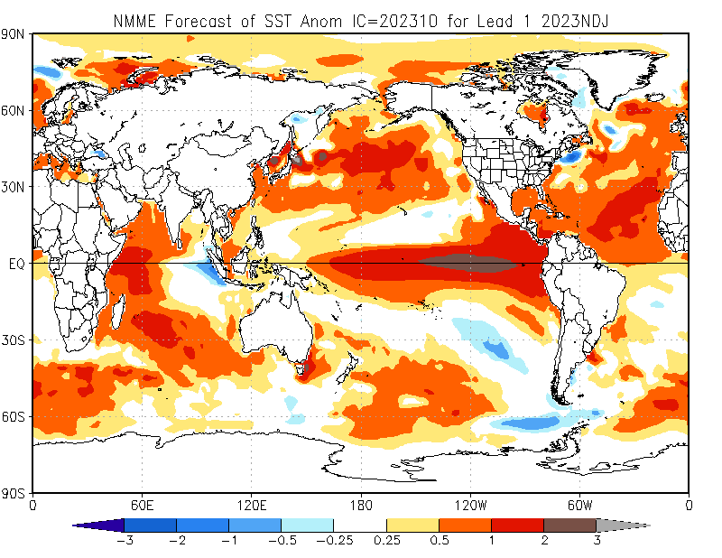
North American Multi Model Ensemble (NMME) SST Forecast

Slide 22
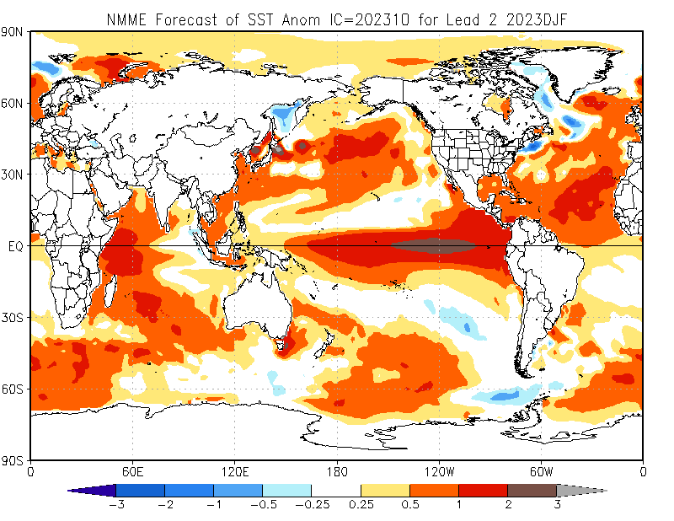

Slide 23
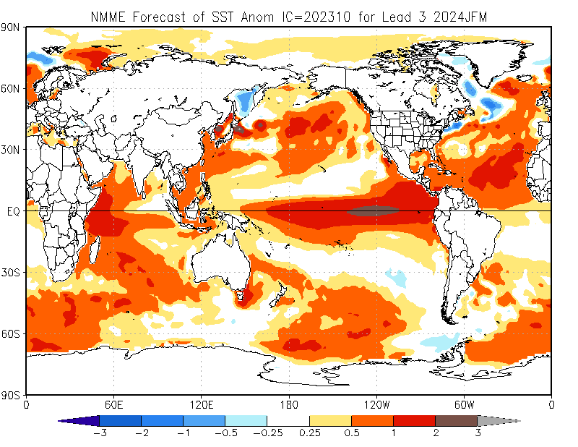

Slide 24
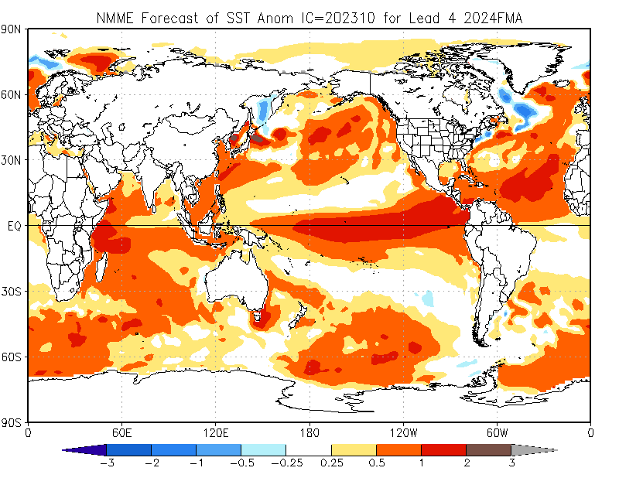

Slide 25
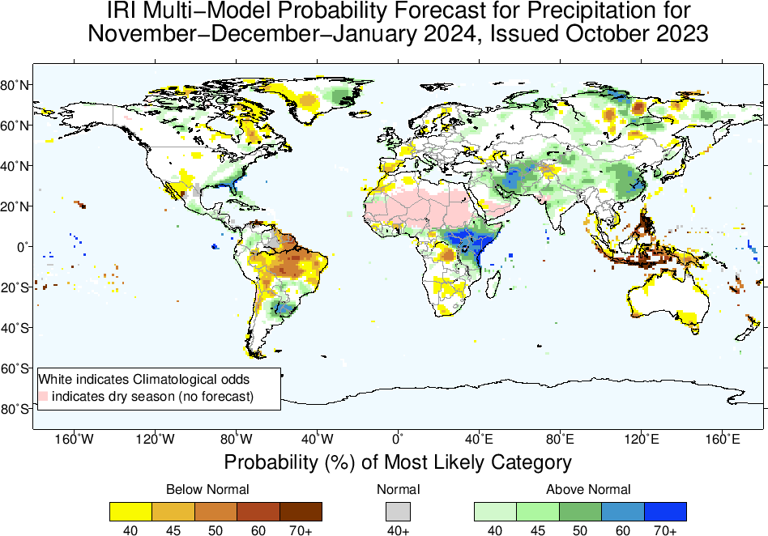
IRI-Precipitation Forecasts based on North American Multi Model Ensemble (NMME)

Slide 26
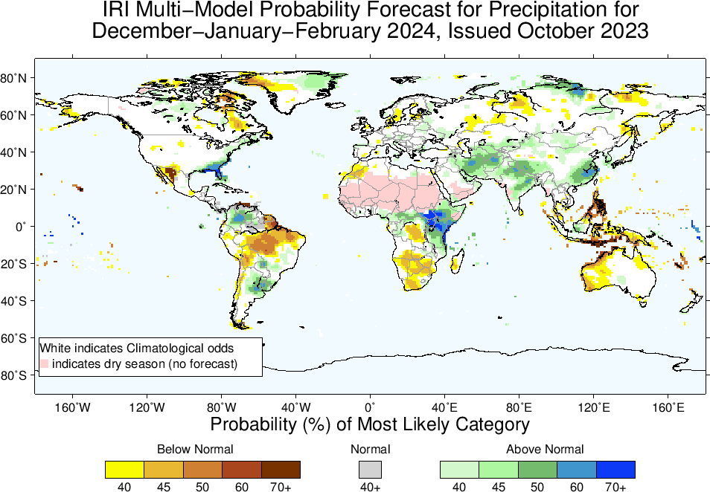

Slide 27
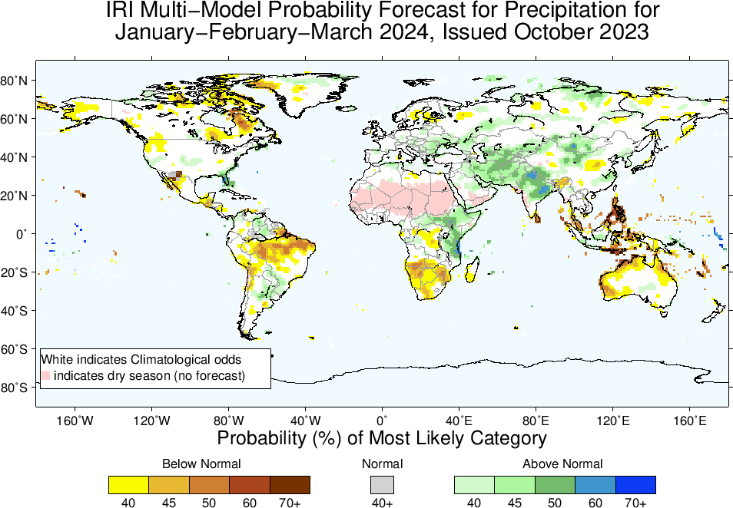

Slide 28
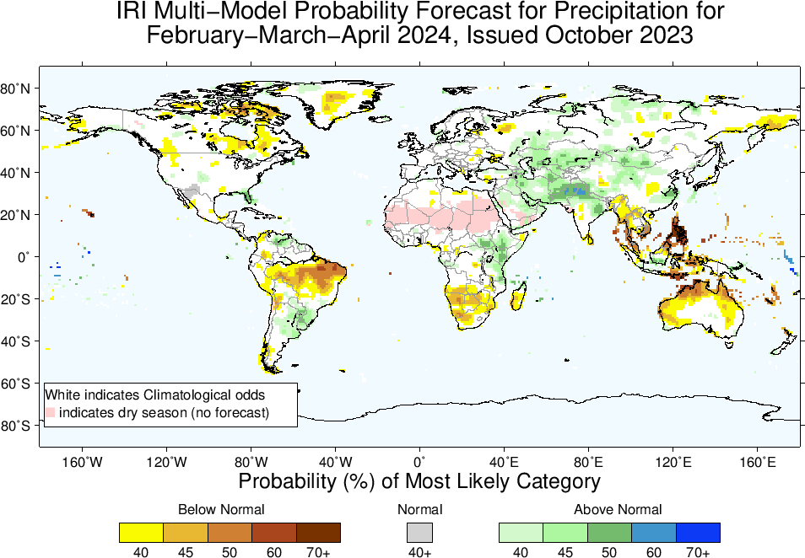

Slide 29
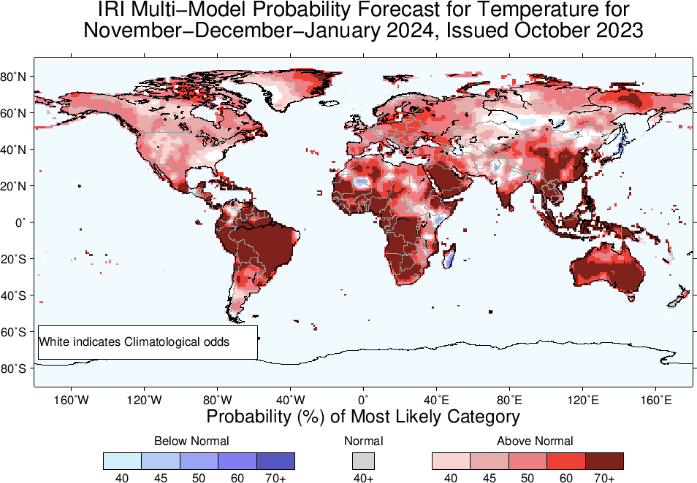
IRI-Temperature Forecasts based on North American Multi Model Ensemble (NMME)

Slide 30
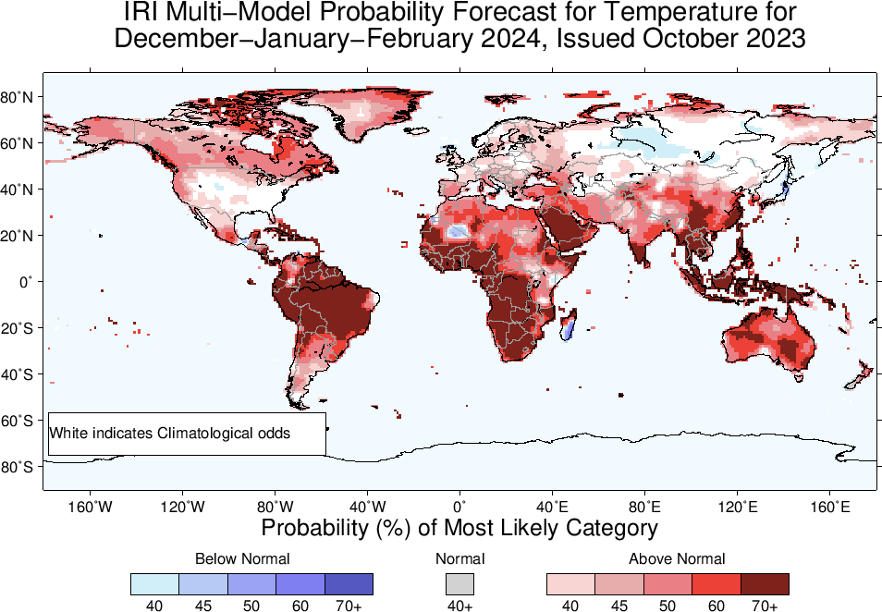

Slide 31
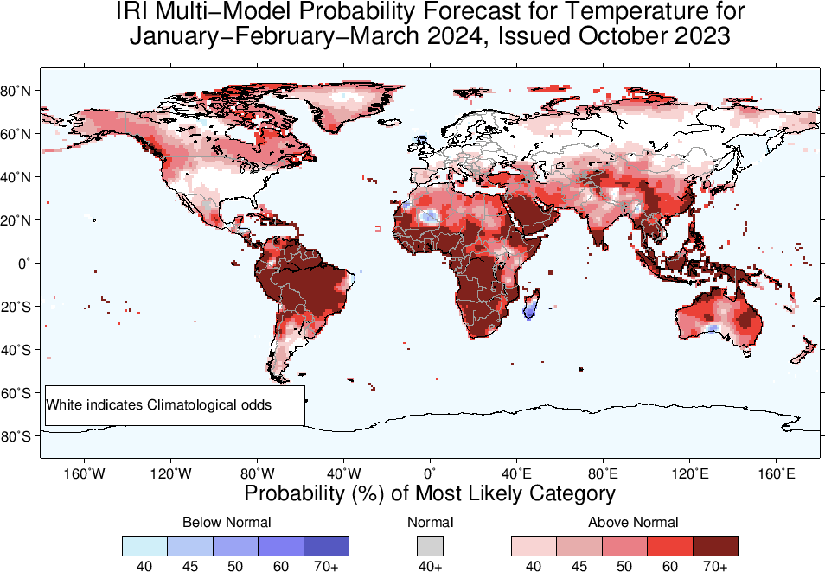

Slide 32
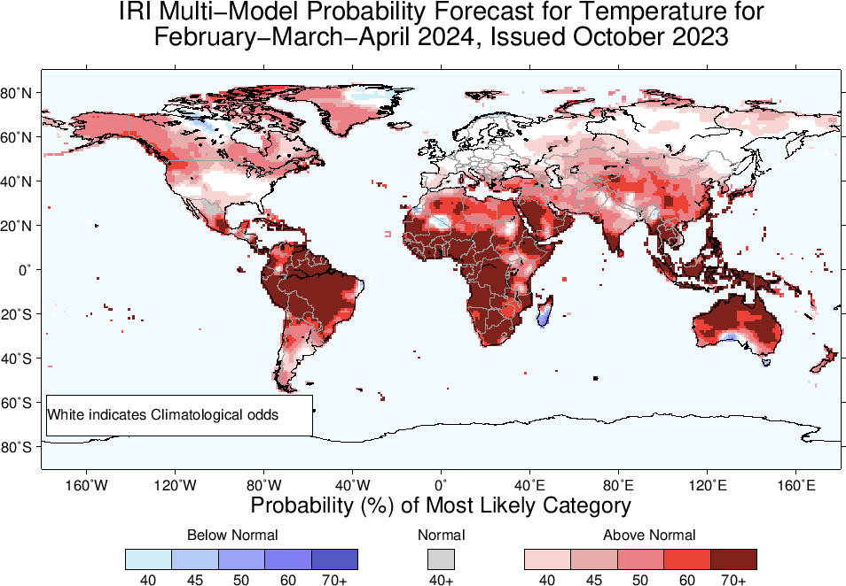

Slide 33
Summary
Significant warming of the ocean waters in the eastern and central Pacific Ocean has been underway since May 2023, reaching a current level of moderate intensity (Sep, NINO34. Value is +1.53).
Atmospheric coupling has been established over the past two months, although it has not reached the same level of intensity observed in previous warm episodes of comparable strength.
The latest forecasts suggest that the warming will persist through the boreal winter and early spring, gradually tapering off thereafter.
Regions where the Probabilities are high for Above-Normal Precipitation include, East Africa, Central South-west Asia, Northeast China, Southern particularly the southeastern parts of CONUS, over and around Uruguay.
Regions where the Probabilities are high for Below-Normal Precipitation include, northern parts of South America, South Africa, Maritime Continent regions, scattered regions in Australia.
Temperature across the globe warmer as we can see the forecast.

