Slide 1
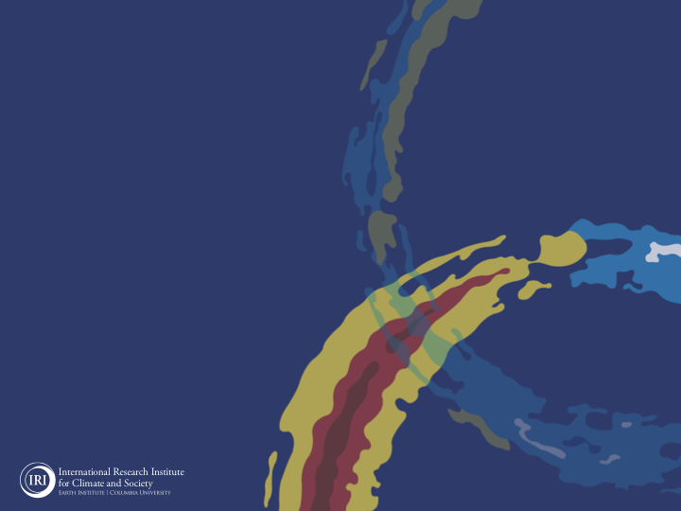
ENSO and Climate Outlook in November, 2023: El NINO and +IOD Continue!
M. Azhar Ehsan
(azhar@iri.columbia.edu)
Associate Research Scientist
IRI ENSO and Climate Forecast Lead
Jeffrey Turmelle and Jing Yuan: forecast processing and web updates
Cuihua Li: Draft PowerPoint development
IRI’s Climate Group, led by Dr. Andrew Robertson: Forecast system development, ongoing innovation, and verification

Slide 2
Outline
Observed Oceanic and Atmospheric Conditions in
Tropical Pacific
Across the Globe
ENSO Forecast in
NMME
IRI ENSO Forecast Tool (Deterministic and Probabilistic)
Seasons Outlook of
SST
Precipitation and Temperature
Summary

Slide 3
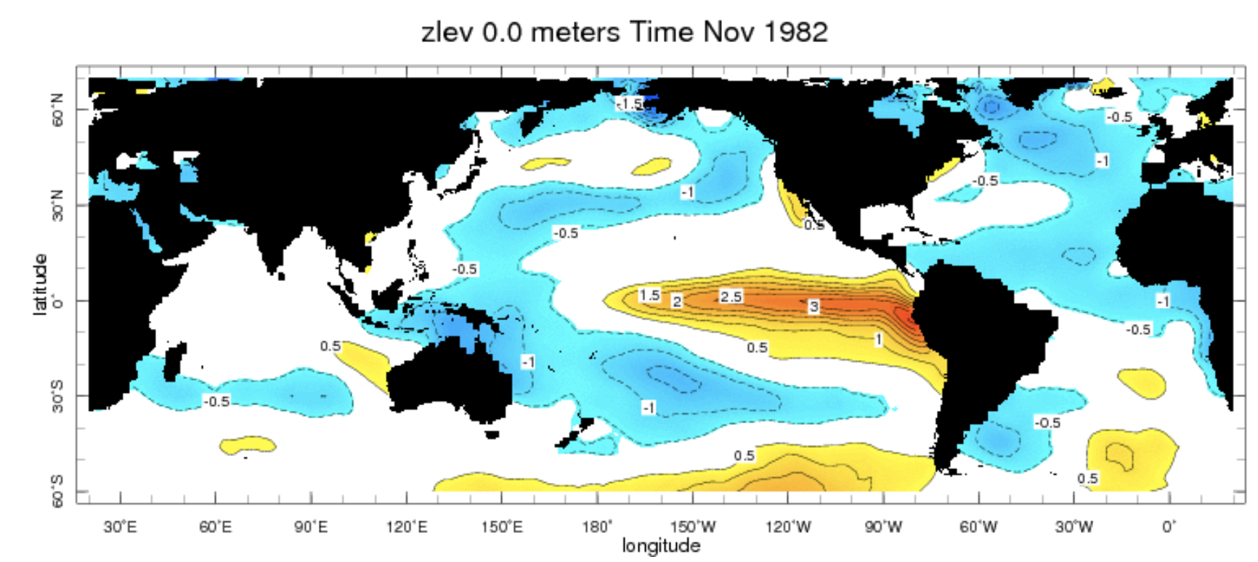
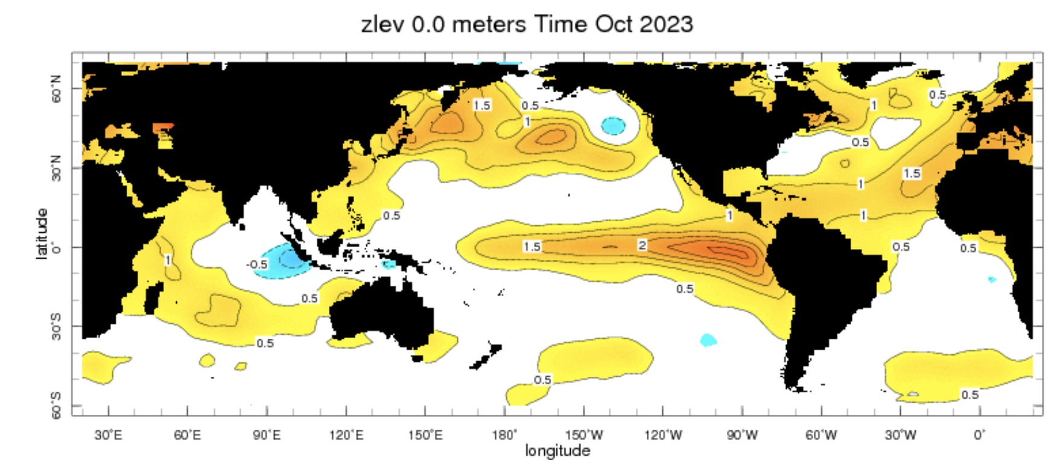

Slide 4
Observations
Oceanic
Atmospheric

Slide 5
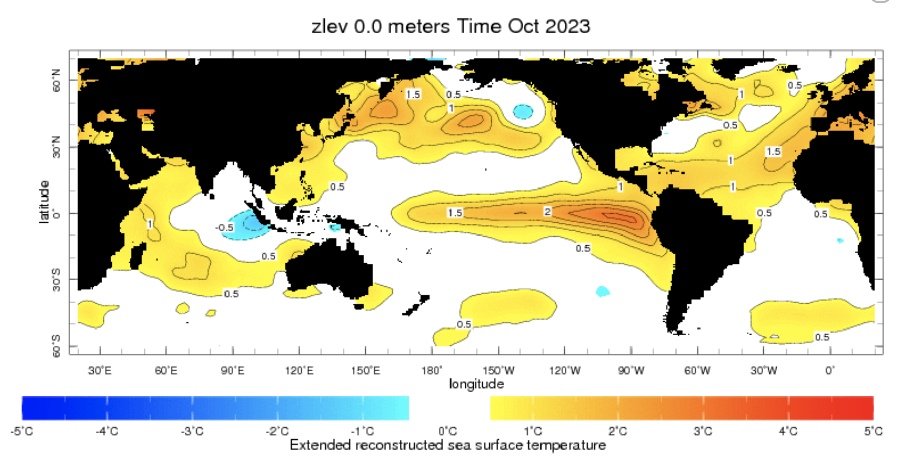
Evolution of SST Departures in Monthly Data
For Oct, 2023
NINO 1+2: +2.34
NINO3: +2.13
NINO3.4: +1.66
NINO4: +1.20
In the Pacific Ocean: Above-Average SSTs persisted across the central (across the Date Line), surrounded by strong +ve SSTA in the high latitudes
Indian Ocean: Above-Average SSTs in the West and Negative in the East, a +ve Indian Ocean Dipole (IOD, +1.55)
North-Pacific and North Atlantic Ocean: Negative PDO (-2.36), +ve Tropical North Atlantic (TNAI, +1.05)
Source: https://iridl.ldeo.columbia.edu/maproom/Global/Ocean_Temp/ERSST_Anomaly.html

Slide 6
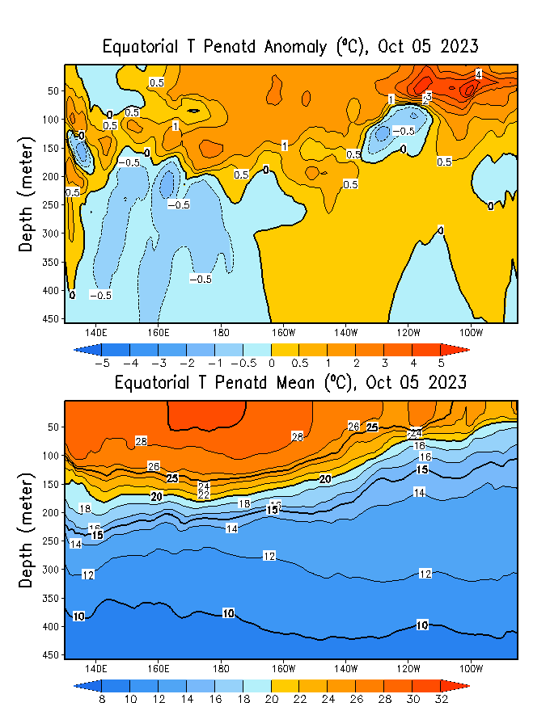
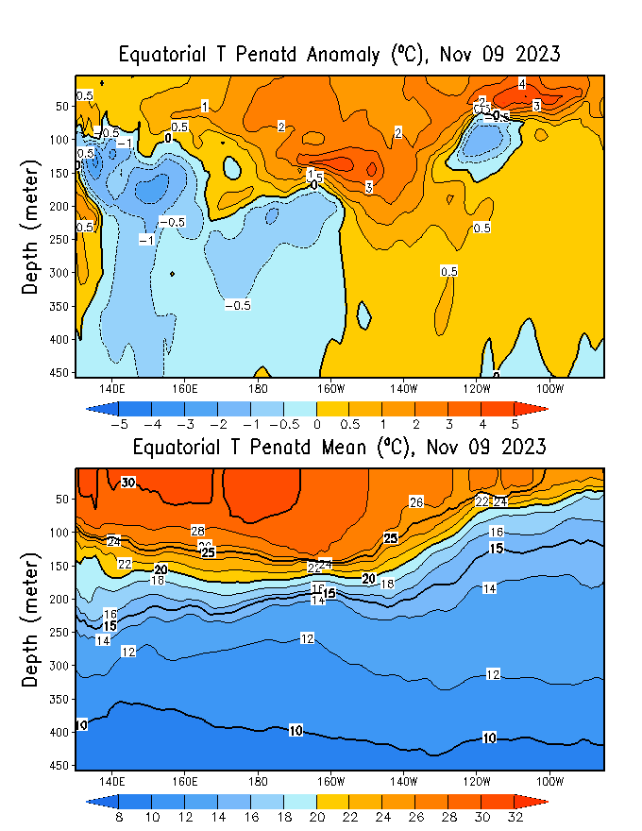
Subsurface Ocean Temperature Evolution
GODAS-Current
GODAS-Last Month (OCT)
A new initiation of a Downwelling oceanic Kelvin wave.
Strengthening of above-average subsurface temperatures in the central equatorial Pacific.
A region of cold water below the surface (50-100 m deep) located at 130W-110W, displaying negative anomalies.

Slide 7
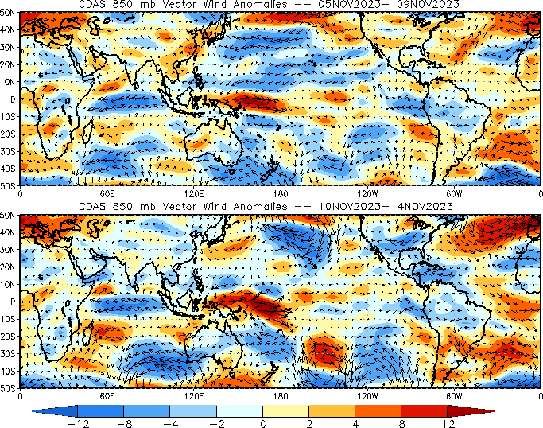
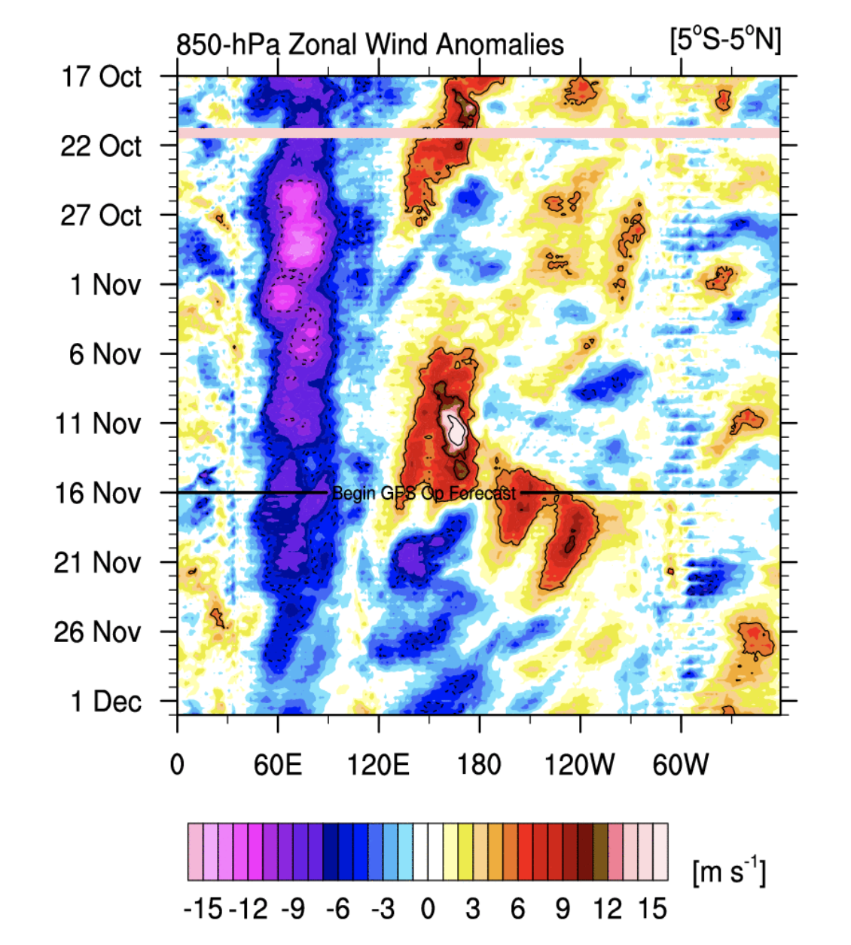
Sources:
http://mikeventrice.weebly.com/hovmollers.html
https://www.cpc.ncep.noaa.gov/products/precip/CWlink/MJO/pentad850winds.shtml

Slide 8
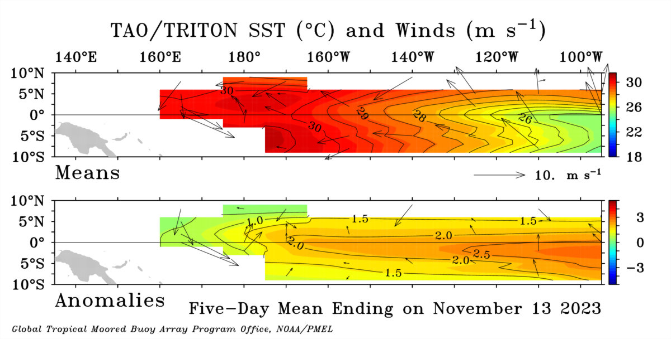
Most recent Sea Surface Temperature (SST) Lower-Level Winds

Slide 9
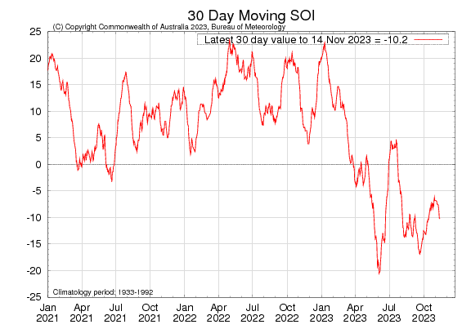
Most recent Southern Oscillation Index (SOI)
During El Niño, the pressure becomes below average in Tahiti and above average in Darwin, and the Southern Oscillation Index is negative.
A Sustained Negative values of the SOI above -7 typically indicate El Niño
Source:
http://www.bom.gov.au/climate/enso/#tabs=Pacific-Ocean&pacific=SOI

Slide 10
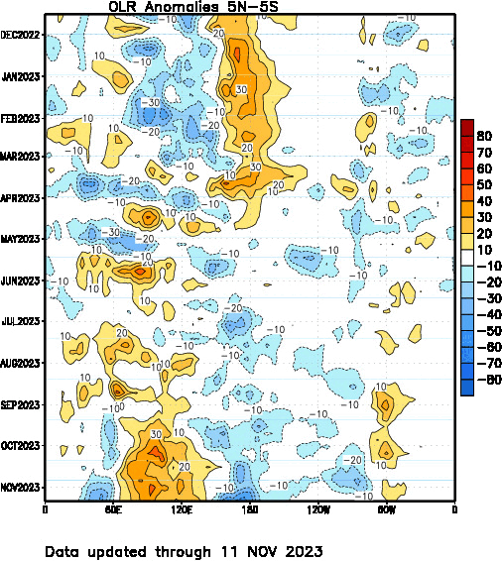
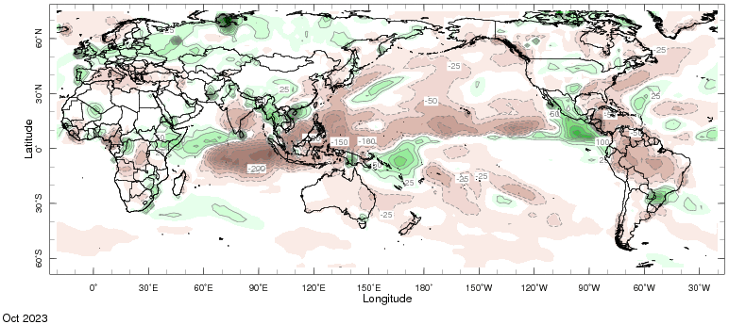
Most recent Outgoing Longwave Radiation (OLR) & Precipitation

Slide 11
Forecasts
Nino-34 in NMME,
IRI ENSO Plume,
Probability of Nino-34,
Global SSTs from NMME,
Prcp. and Temp. outlook from IRI (November, Initial)

Slide 12
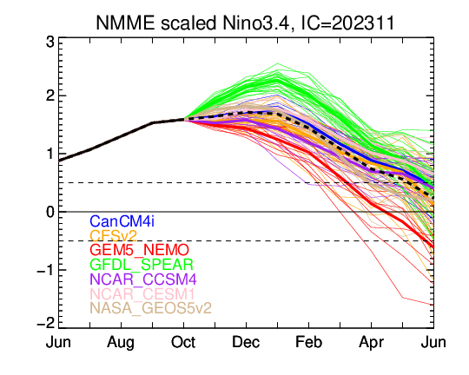
North American Multi Model Ensemble (NMME) ENSO Forecast (Nov, Initial)

Slide 13
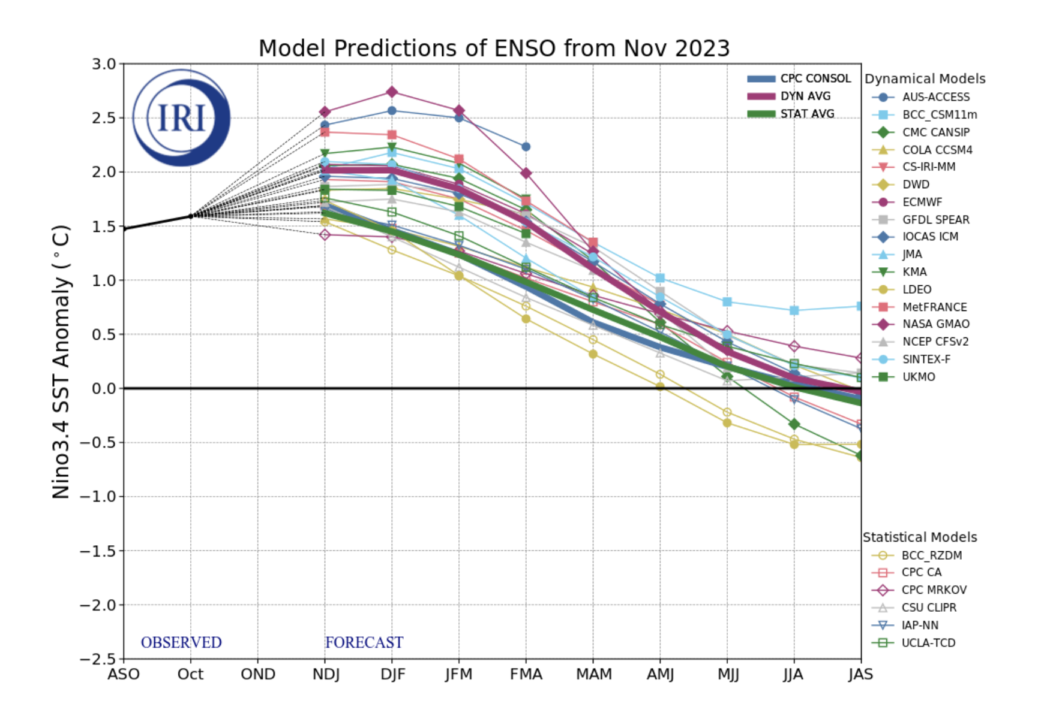
IRI’s ENSO Forecast Nov, 2023

Slide 14
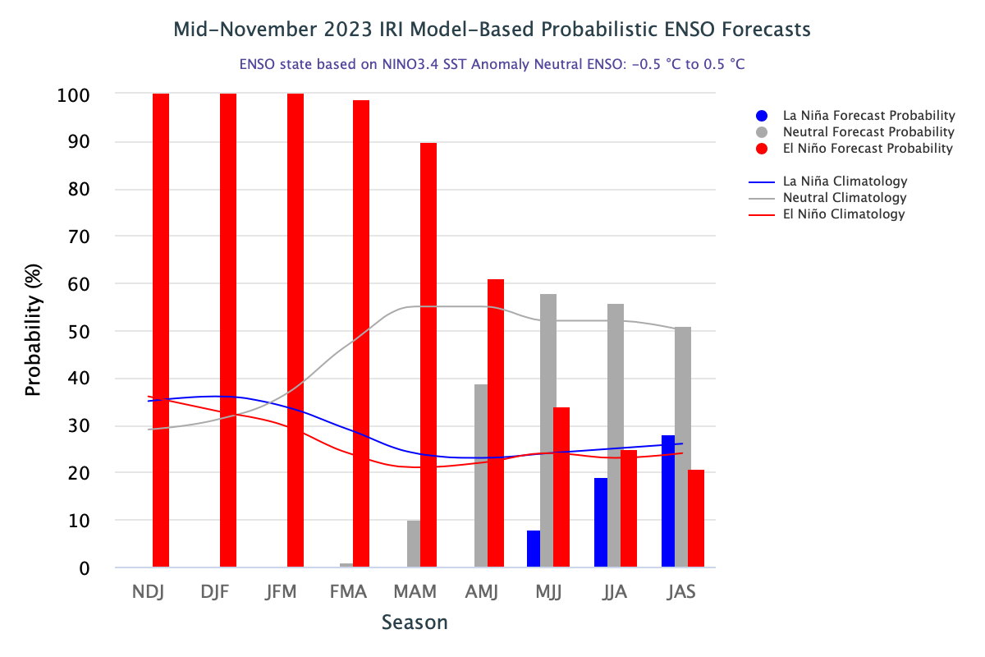
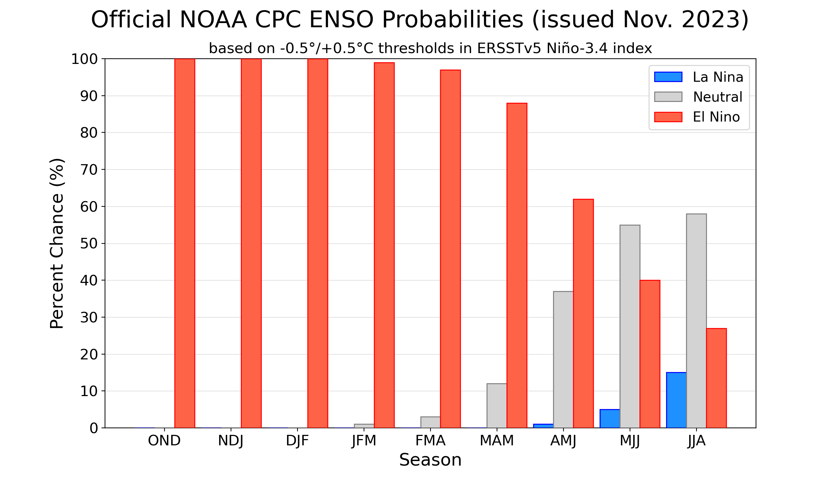
CPC (Released on Nov, 09) and IRI (will be on 19th Nov)

Slide 15
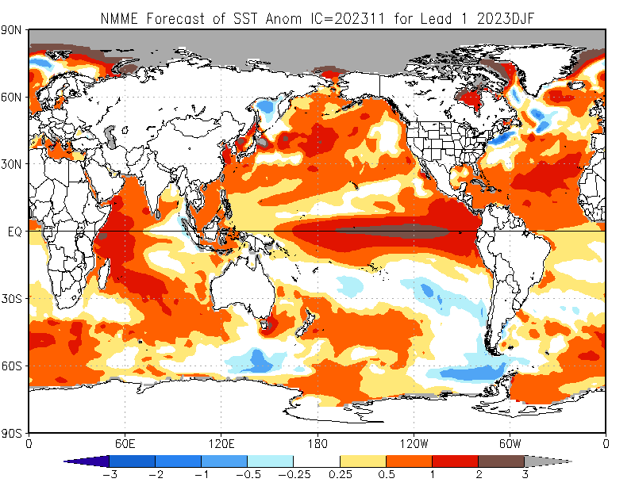
North American Multi Model Ensemble (NMME) SST Forecast

Slide 16
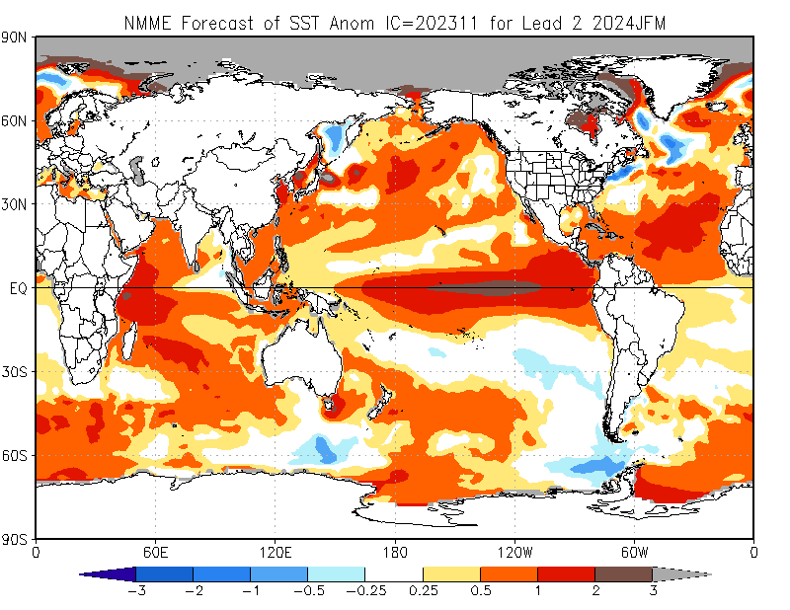

Slide 17
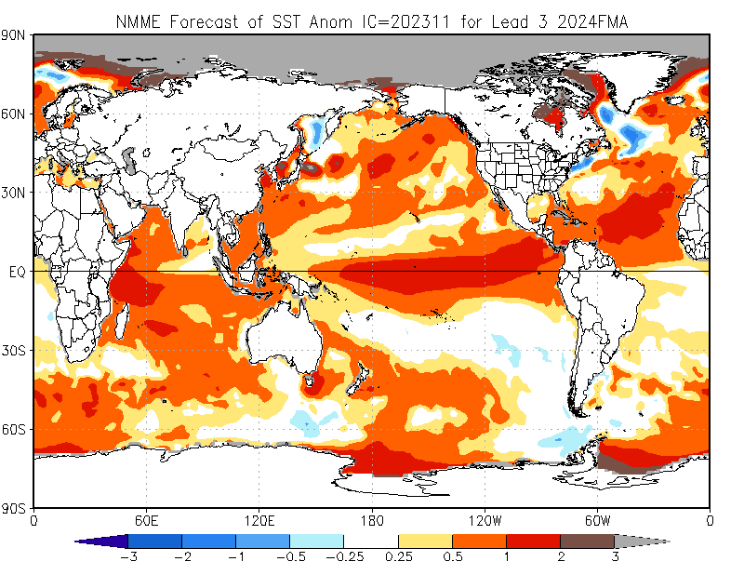

Slide 18
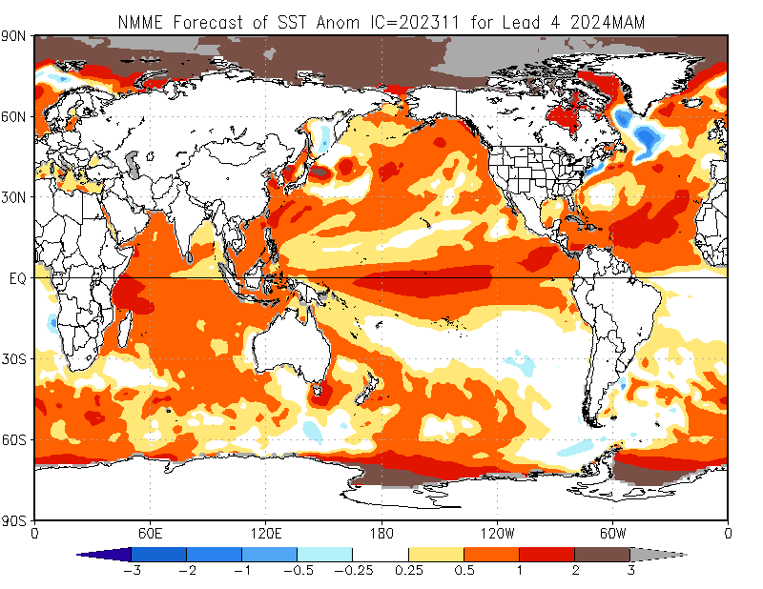

Slide 19
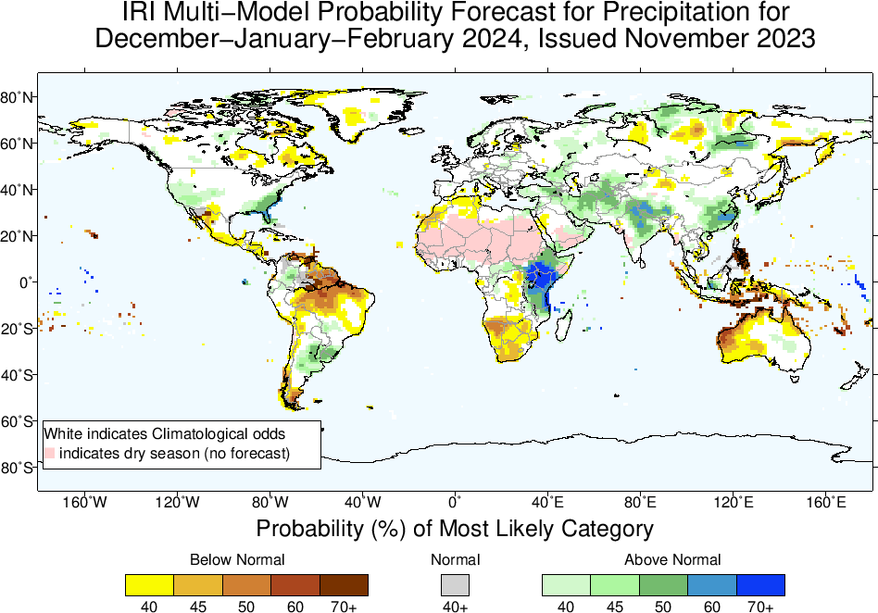
IRI-Precipitation Forecasts based on North American Multi Model Ensemble (NMME)

Slide 20
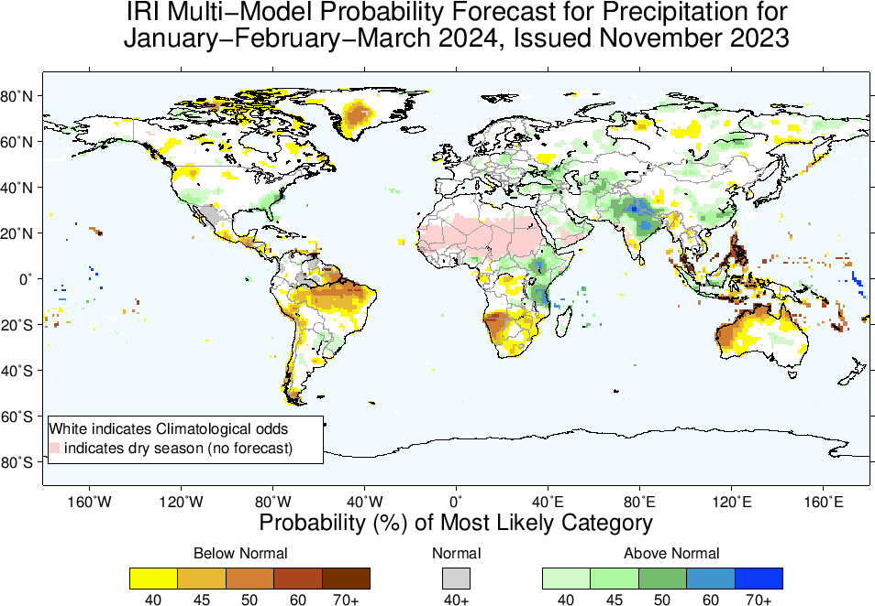

Slide 21
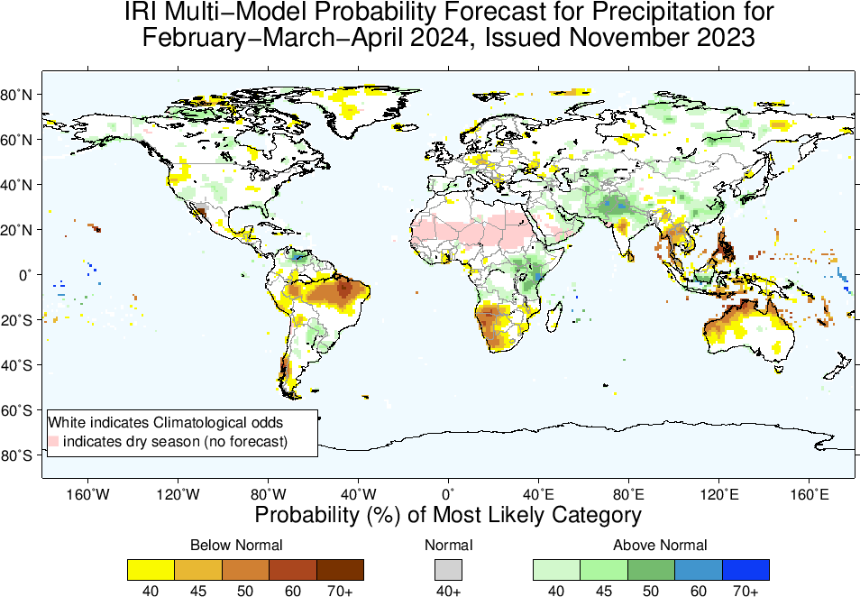

Slide 22
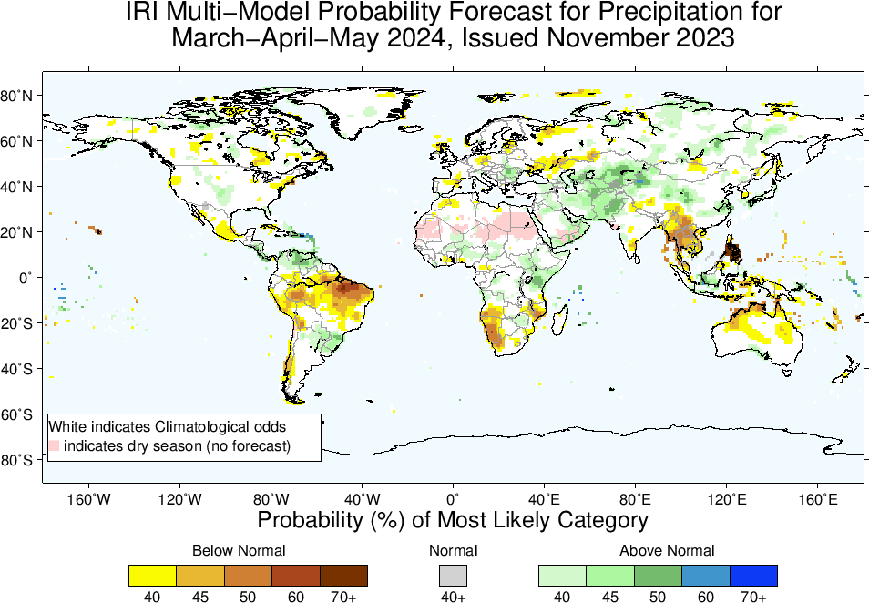

Slide 23
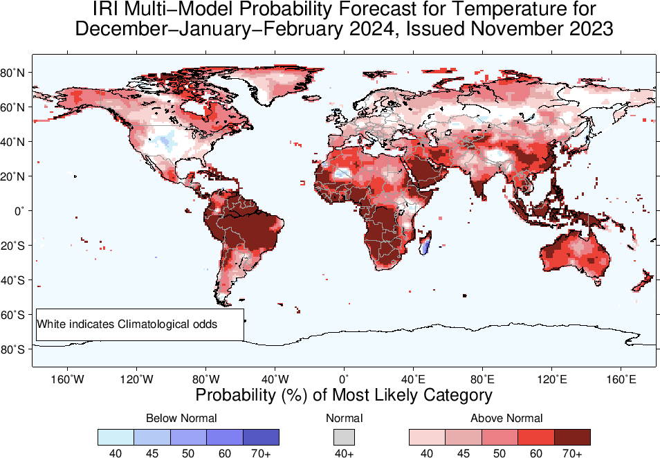
IRI-Temperature Forecasts based on North American Multi Model Ensemble (NMME)

Slide 24
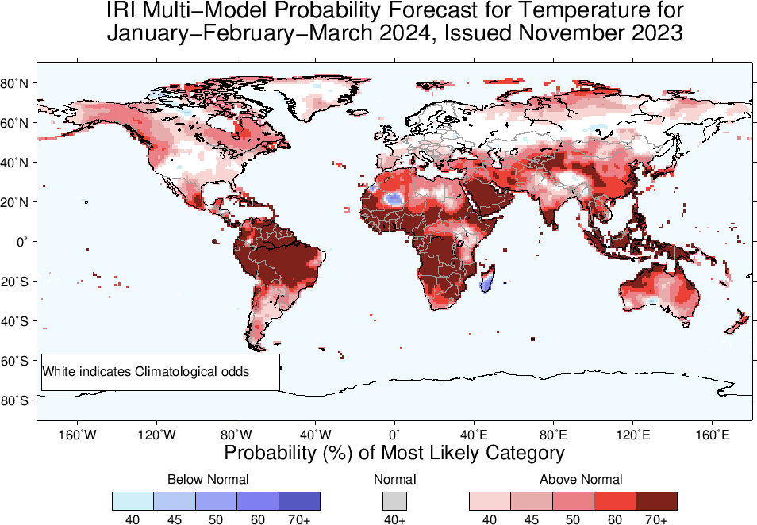

Slide 25
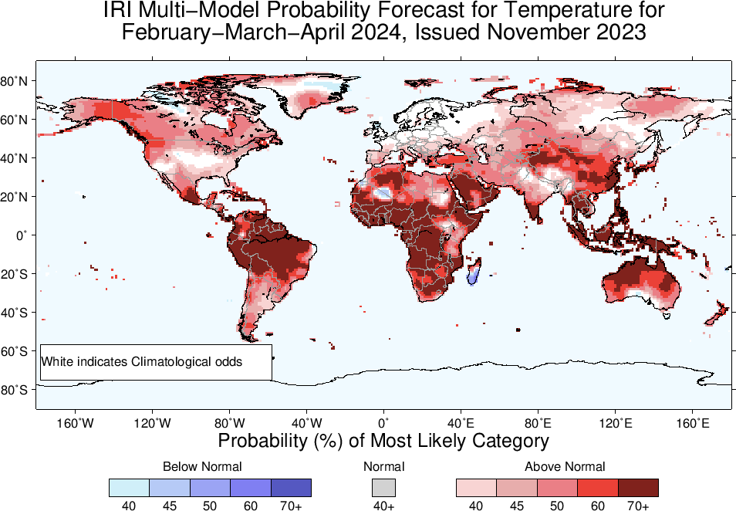

Slide 26
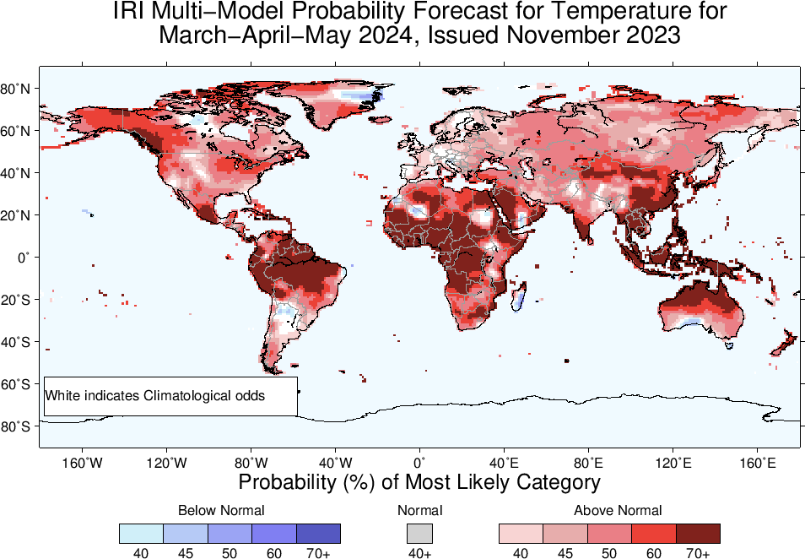

Slide 27
Summary
Current level of warming in the eastern and central Pacific Ocean, reaching a “strong” intensity (Oct, NINO3.4 Value is +1.59), while for last two weeks, it is at +1.80.
Positive Indian Ocean Dipole also continues.
The latest forecasts suggest that the warming will persist through the boreal winter and spring (90% in MAM-2024), gradually weakening thereafter.
Regions where the Probabilities are high for Above-Normal Precipitation include, East Africa, Central South-west Asia, Northeast China, Southern particularly the southeastern parts of CONUS, over and around Uruguay.
Regions where the Probabilities are high for Below-Normal Precipitation include, northern parts of South America, South Africa, Maritime Continent regions, scattered regions in Australia.
Temperature across the globe warmer as we can see the forecast, except over central CONUS where it shows below-normal in DJF.

