Slide 1
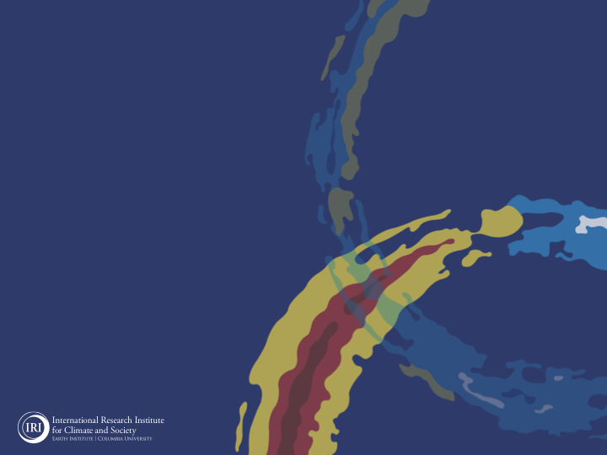
ENSO and Climate Outlook
November 2021:
A Weaker Double-Dip!
But not the Impacts,…
M. Azhar Ehsan
(azhar@iri.columbia.edu)
Associate Research Scientist
IRI ENSO and Climate Forecast Lead
Jeffery Turmelle and Jing Yuan: forecast processing and web updates
Cuihua Li: Draft PowerPoint development
IRI’s Climate Group, led by Dr. Andrew Robertson: Forecast system development, ongoing innovation, and verification

Slide 2
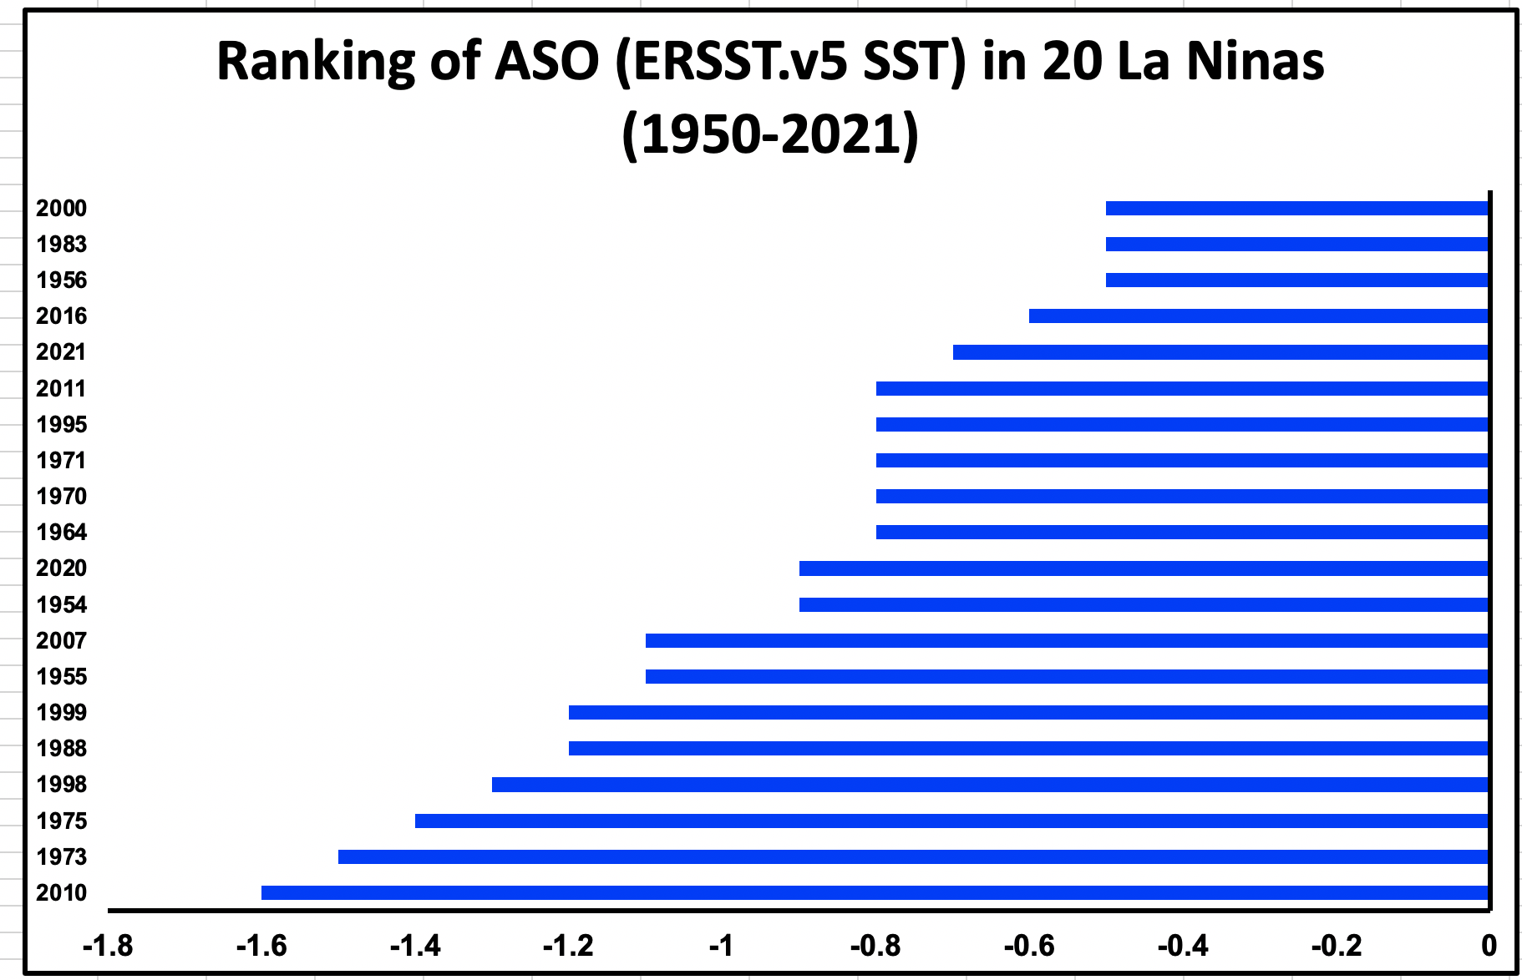
Ranking of Cold Episodes during Aug-Oct(ASO) from 1950 to 2021

Slide 3
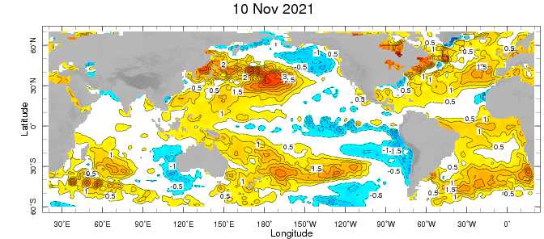
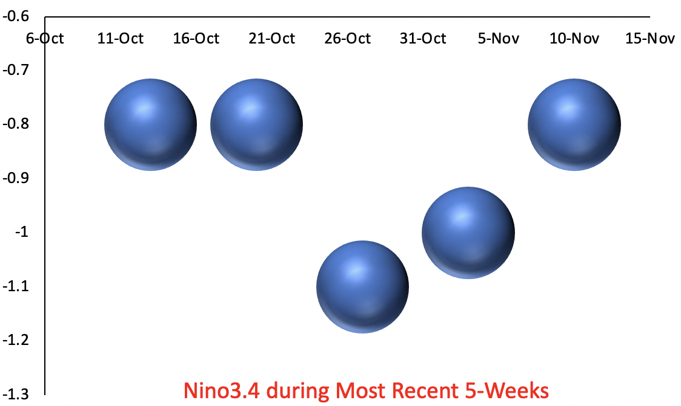
Weekly-average Sea Surface Temperature Anomalies for the Globe:
(OISST v2.1: 1991-2020 base period)

Slide 4
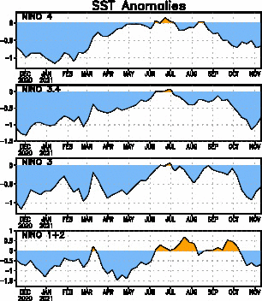
Near Dateline
This is the SST
Index predicted
Eastern Eq. Pacific
Off Coast of S.America

Slide 5
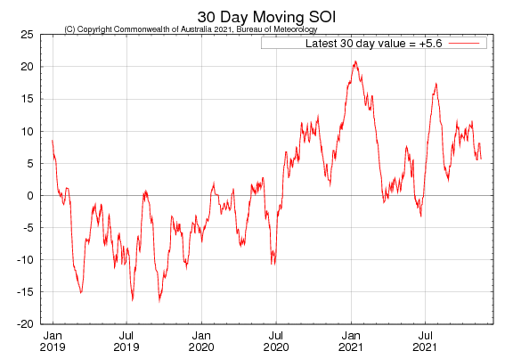

Slide 6
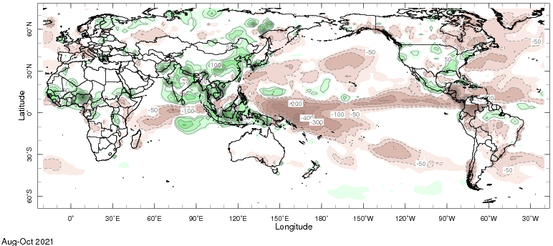
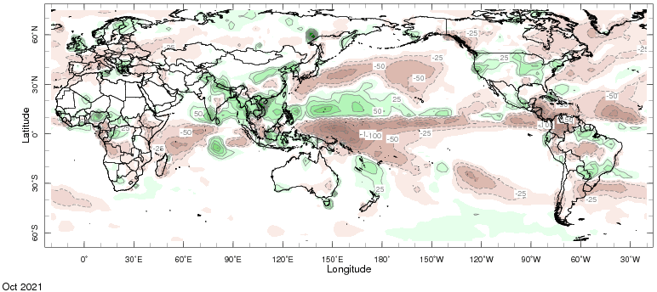

Slide 7
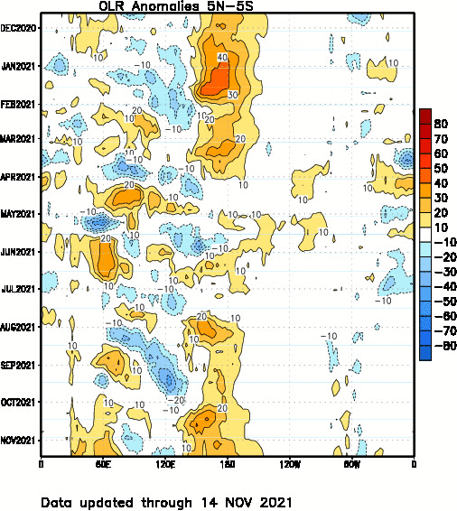
Less or No Clouds
Clouds

Slide 8
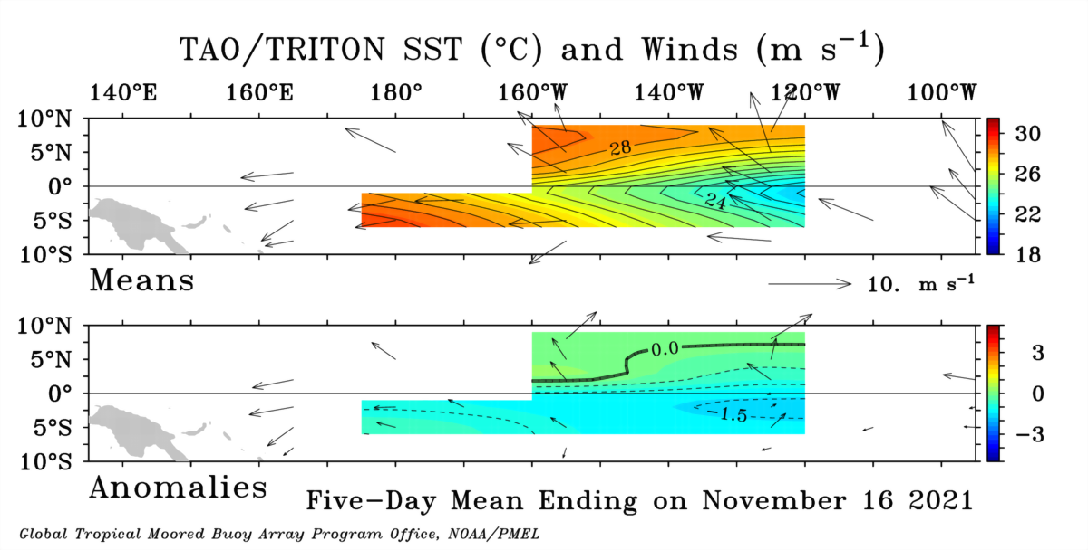
Mean SST (color) and Winds (Vectors)
Anomalous SST (color) and Winds (Vectors)

Slide 9
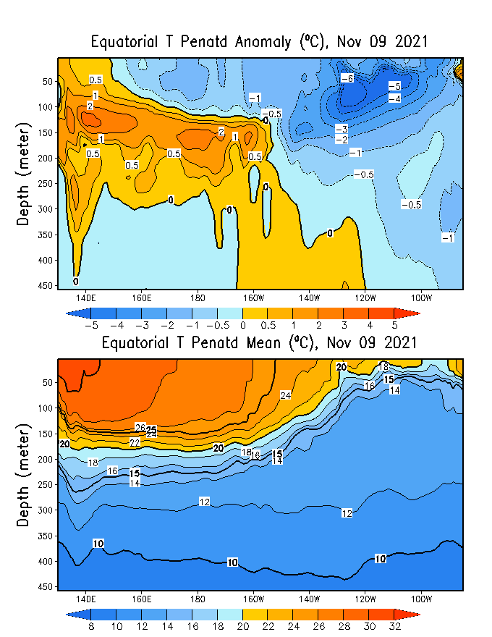
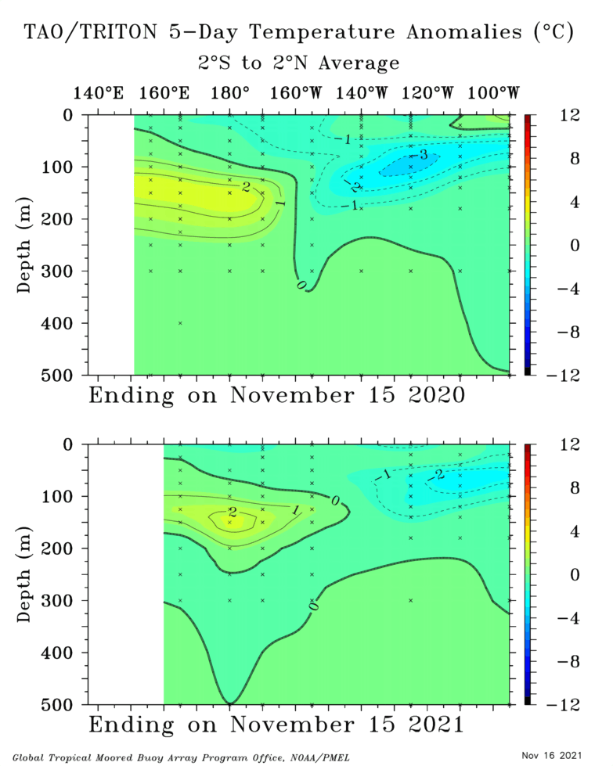
Analysis directly from TOGA-TAO buoy measurements:
Showing spatial distribution of temperature of water in the Subsurface upto 500 meter.
Global Ocean Data Assimilation System (GODAS)

Slide 11
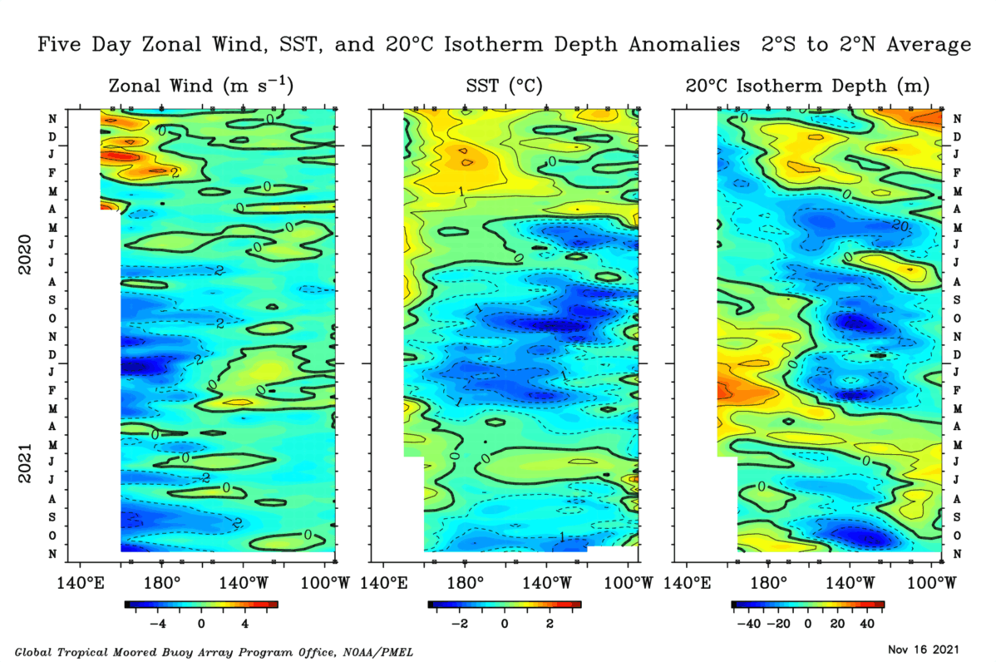

Slide 12
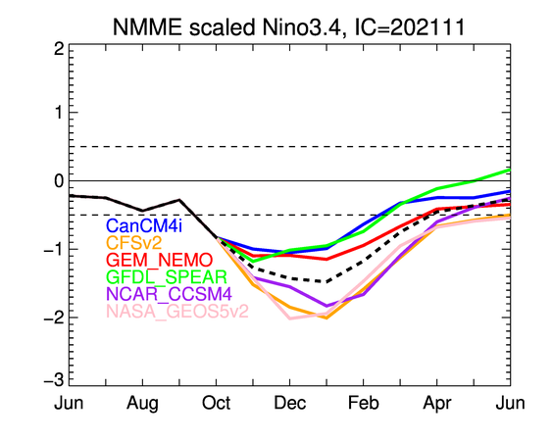
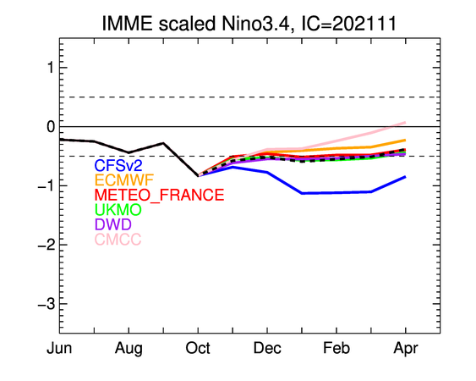
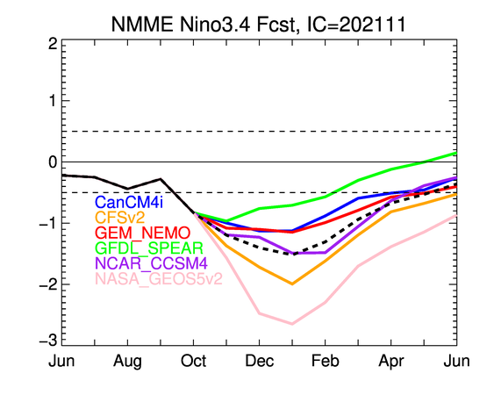

Slide 13
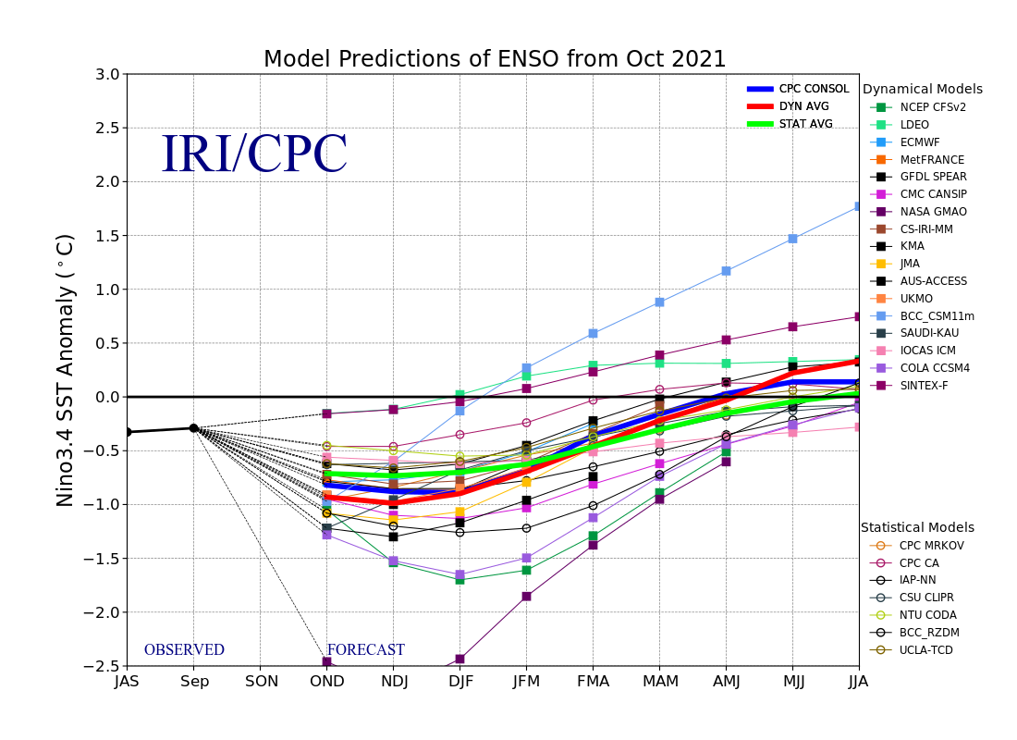
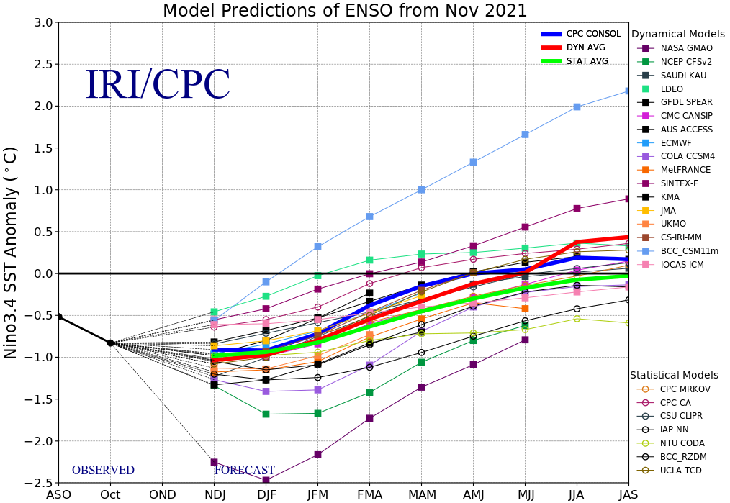
IRI- ENSO Plume Diagram

Slide 14
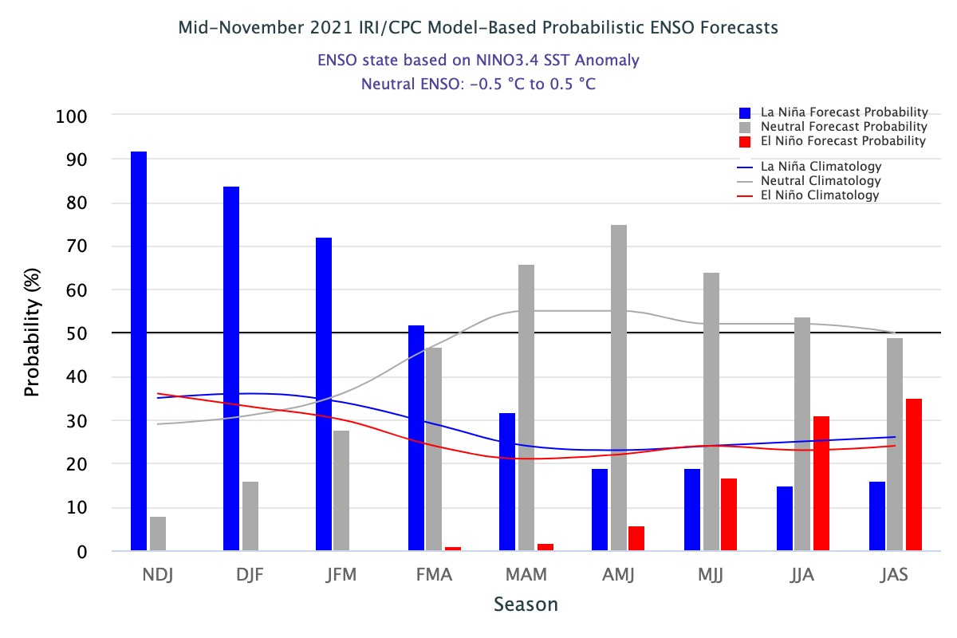
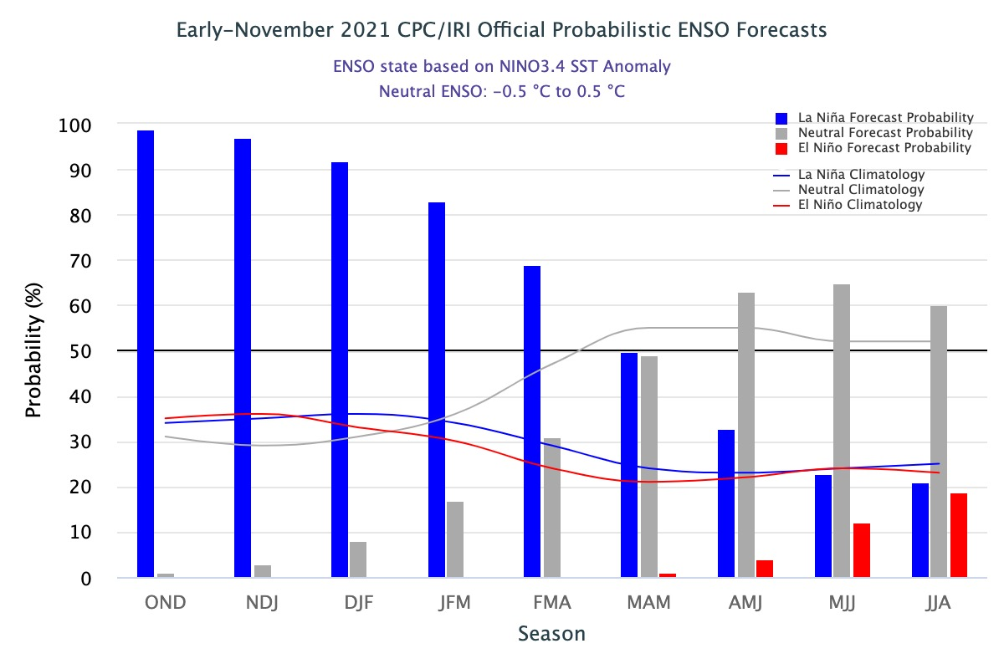

Slide 15
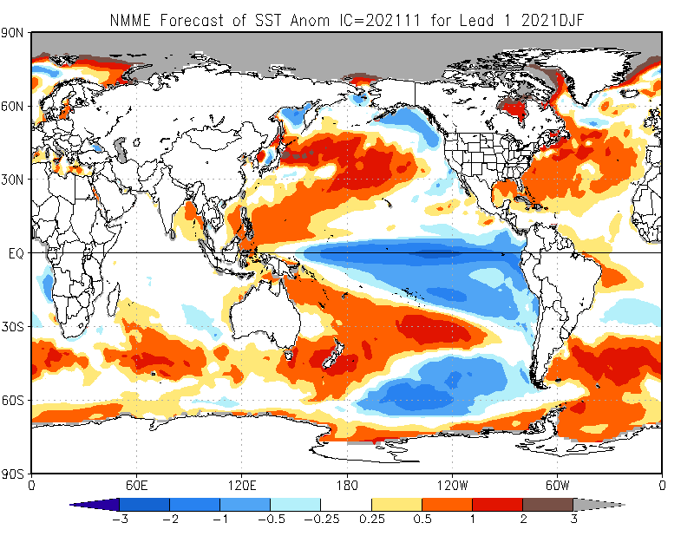

Slide 16
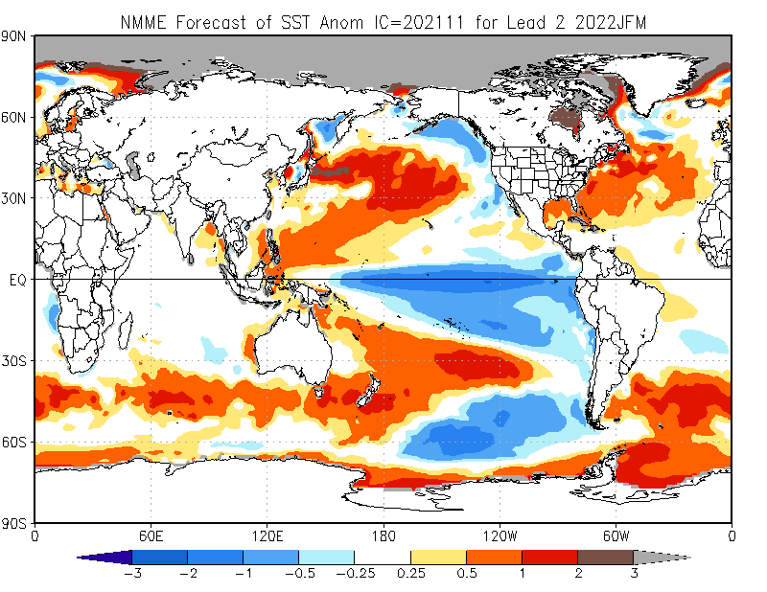

Slide 18
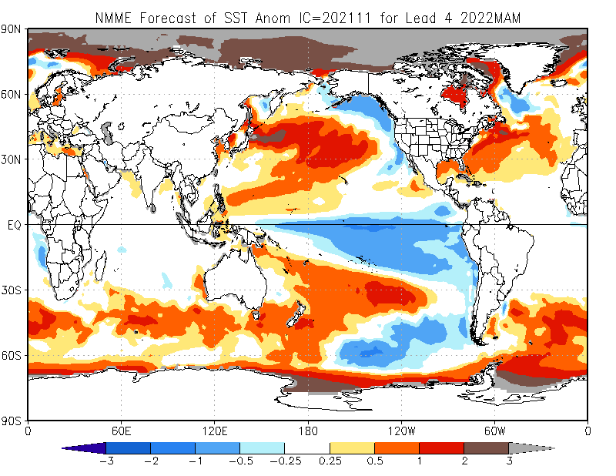

Slide 19
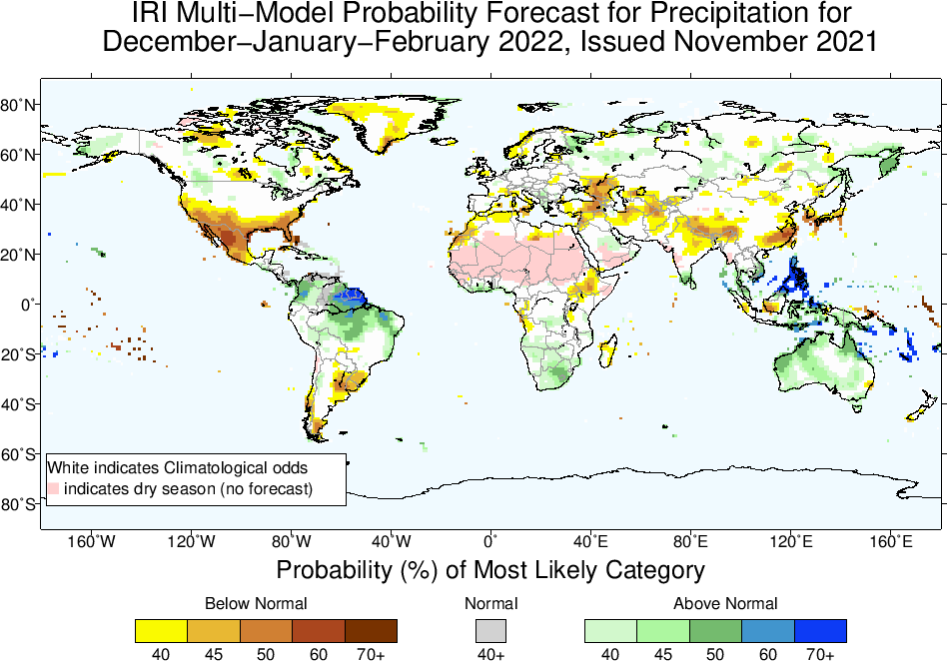
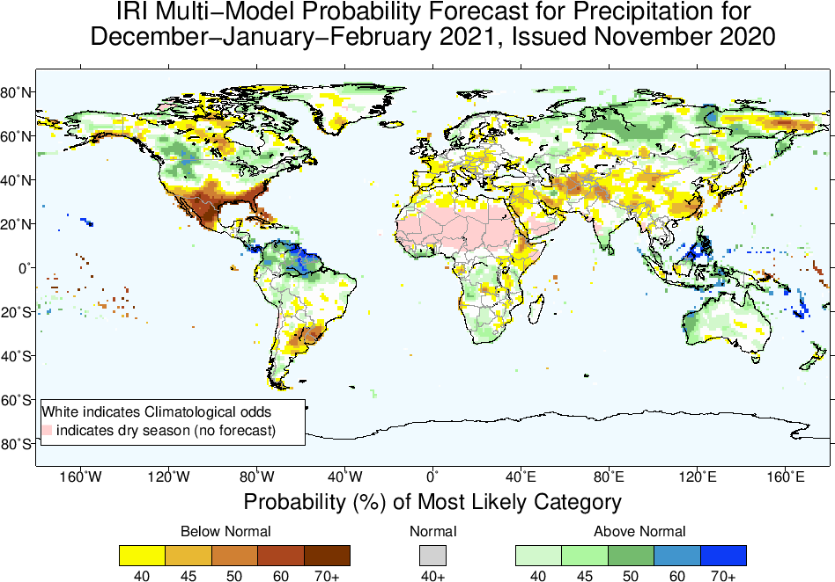
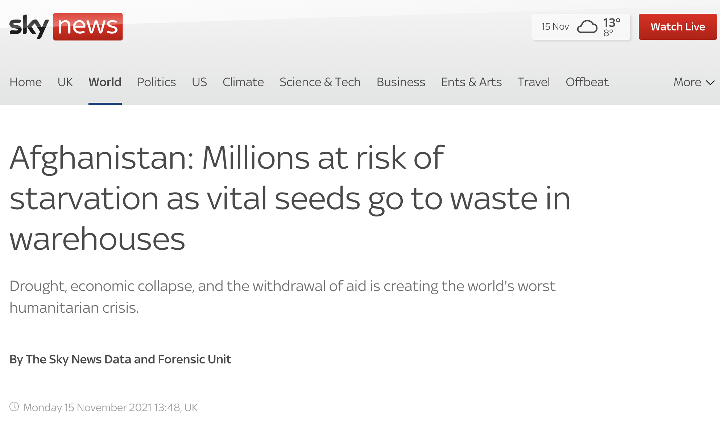
https://news.sky.com/story/afghanistan-millions-at-risk-of-starvation-as-vital-seeds-go-to-waste-in-warehouses-12465586

Slide 20
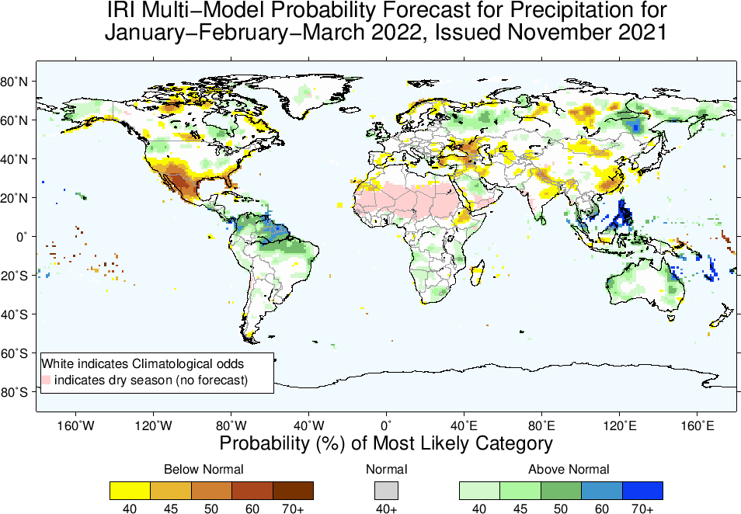

Slide 21
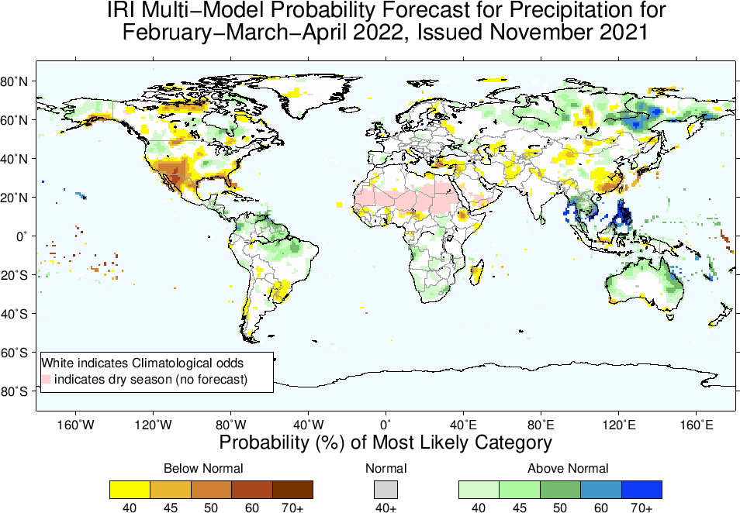

Slide 22
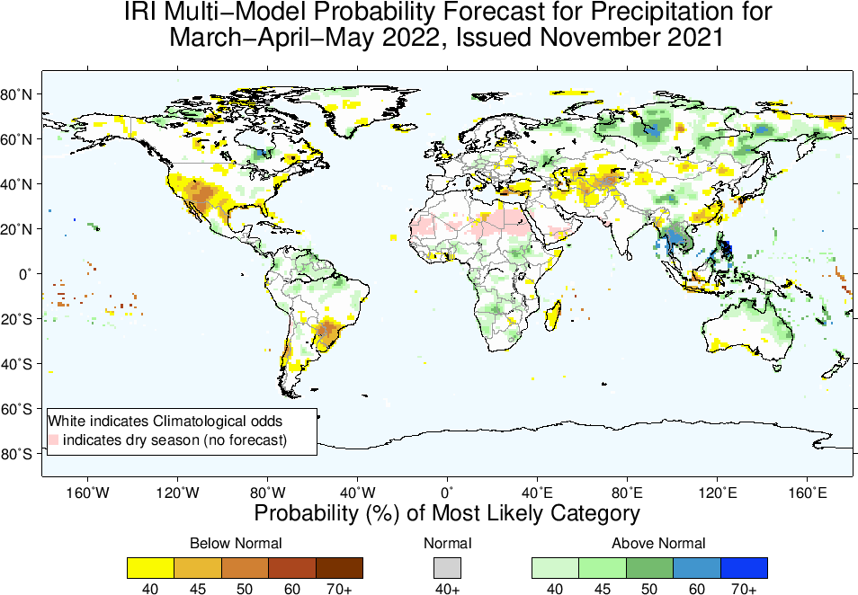

Slide 23
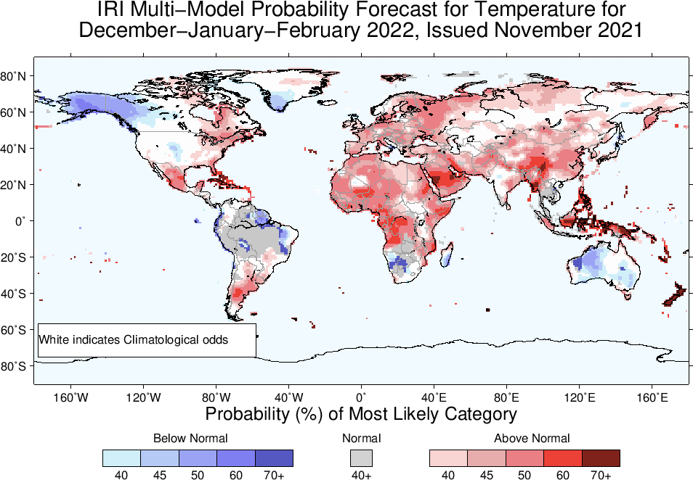

Slide 24
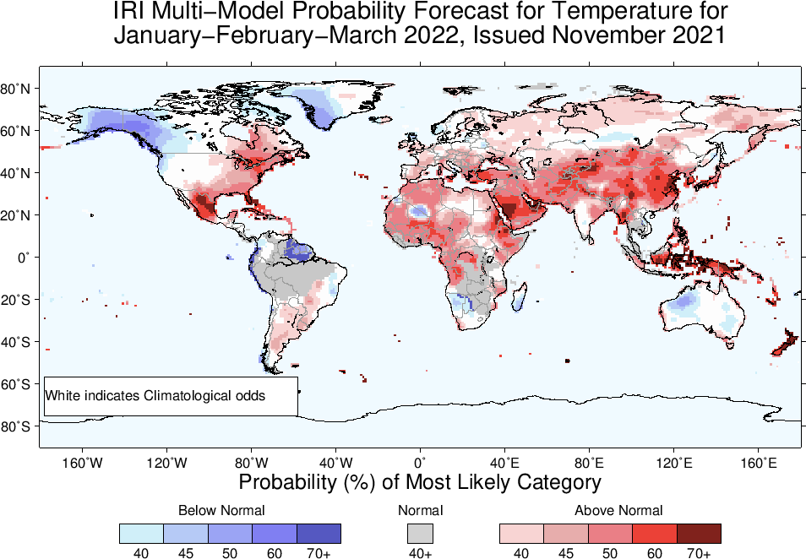

Slide 25
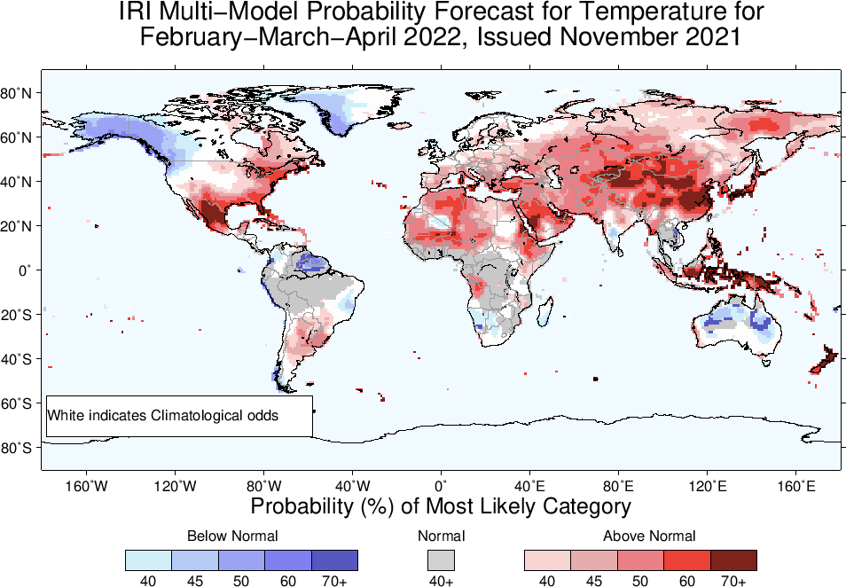

Slide 26
