Slide 1
ENSO and Climate Outlook in November, 2024
La Nina onsets are hard to Predict ☹
Ehsan, M. Azhar
(mae2171@columbia.edu)
Center for Climate Systems Research (CCSR),
Affiliate of NASA GISS and
International Research Institute for Climate and Society (IRI)
Dr. Andrew Robertson (CCSR): Forecast system development, ongoing innovation,
Jing Yuan (CCSR): Forecast Post-Processing,
Jeffrey Turmelle (IRI): Forecast Post-Processing and Web updates.

Slide 2
Outline
Observed Oceanic and Atmospheric Conditions in
Tropical Pacific
Across the Globe
ENSO Forecast in
NMME
IRI ENSO Forecast Tool (Deterministic and Probabilistic)
Seasons Outlook of
SST
Precipitation and Temperature
Summary

Slide 3
Observations
Oceanic
Atmospheric

Slide 4
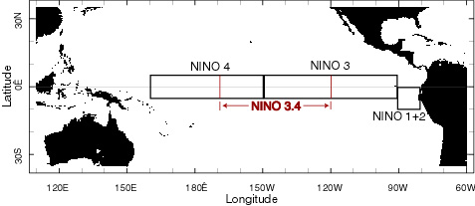
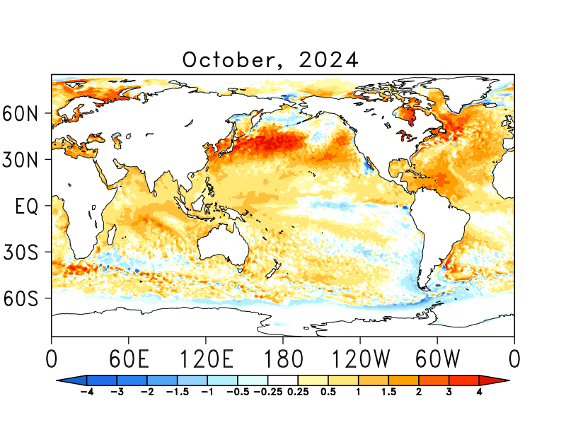
SST Departures in Monthly (Oct, 2024) Data: OISST v2
NINO3: 0.0
Latitude: 5°S - 5°N
Longitude: 210°E - 270°E
NINO4: +0.35
Latitude: 5°S - 5°N
Longitude: 160°E - 210°E
NINO12: -0.36
Latitude: 10°S - 0°N
Longitude: 270°E - 280°E
NINO34: -0.23
Latitude: 5°S - 5°N
Longitude: 190°E - 240°E
https://psl.noaa.gov/data/gridded/data.noaa.oisst.v2.highres.html

Slide 5
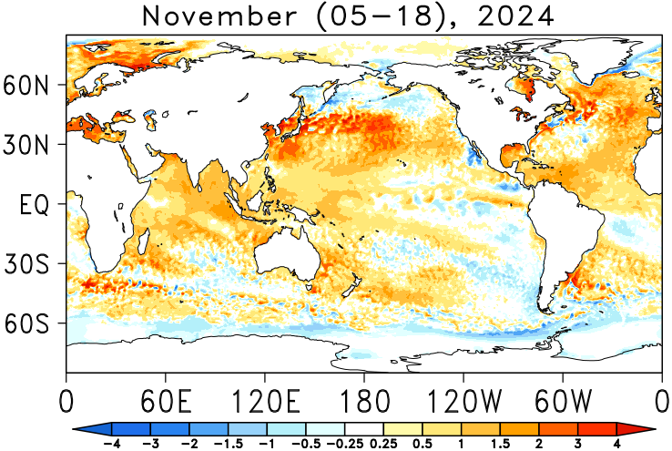
SST Departures in Last Two-Weeks (Nov 05-18) Data: OISST v2
NINO 1+2: +0.19
Latitude: 10°S - 0°N
Longitude: 270°E - 280°E
NINO 3: +0.12
Latitude: 5°S - 5°N
Longitude: 210°E - 270°E
NINO 3.4: +0.11
Latitude: 5°S - 5°N
Longitude: 190°E - 240°E
NINO 4: +0.51
Latitude: 5°S - 5°N
Longitude: 160°E - 210°E
https://psl.noaa.gov/data/gridded/data.noaa.oisst.v2.highres.html

Slide 6
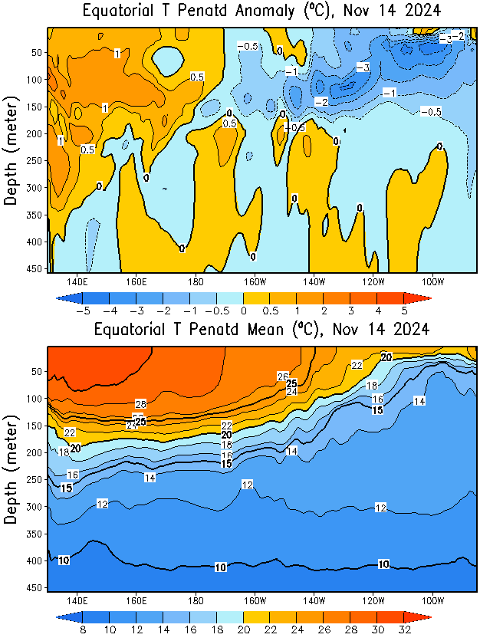
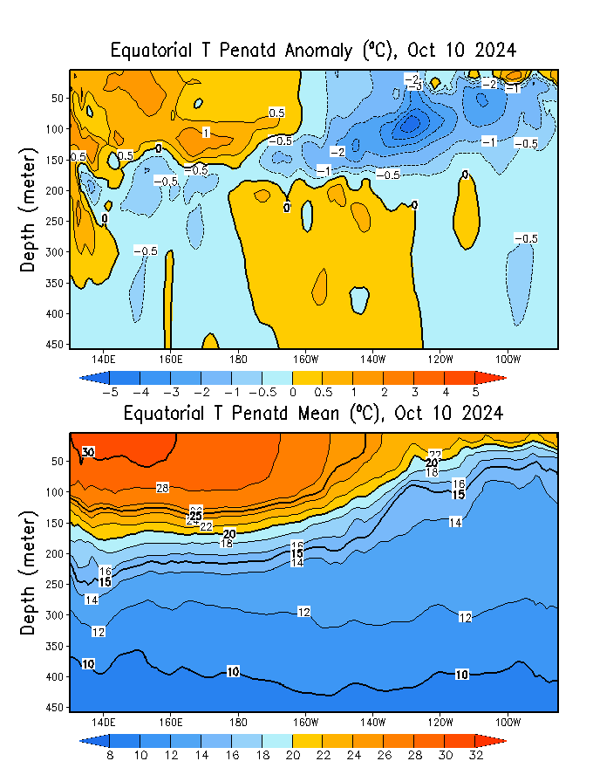
What is the underwater conversation?
Sep, 2024
November, 2024
Warm subsurface-to-surface temperature anomalies dominate from 140E to 180 in equatorial Pacific Ocean (Surface to 200 meter at depth).
October, 2024
Cold subsurface temperature anomalies Persisting but are not growing further!

Slide 7
What is the underwater conversation?
After reaching peak levels in April and May 2024, negative anomalies have shown a trend towards warmer temperatures, then increased again, then decreased for a shorter time, then increased again.
As of Mid-November, Index is near -0.6.

Slide 8
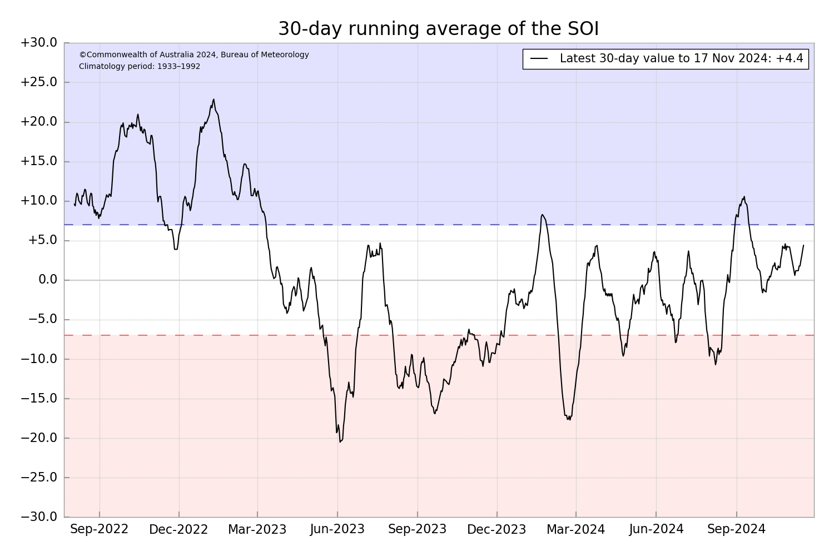
Most recent Southern Oscillation (Traditional & EQ) Index (SOI → in ENSO-Neutral Space)
Current SOI values is in ENSO-neutral range
(For October, 2024 it is 4.2)
Equatorial-SOI is also in ENSO-neutral range,
(For October, 2024 it is +0.8)
No change, from Sep (+0.7) to Oct.
During El Niño, the pressure becomes below average in Tahiti and above average in Darwin, and the Southern Oscillation Index is negative.
A Sustained Negative values of the SOI above -7 typically indicate El Niño
Source:
http://www.bom.gov.au/climate/enso/#tabs=Pacific-Ocean&pacific=SOI

Slide 9
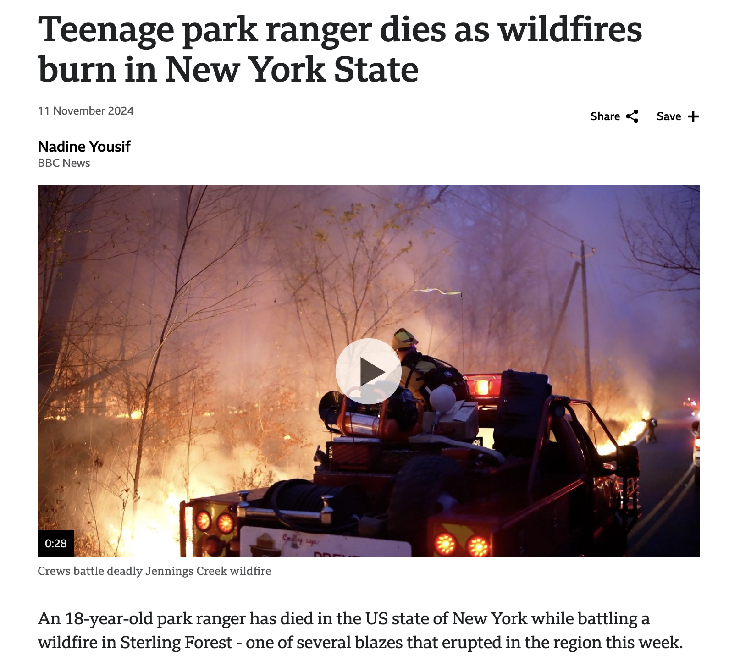
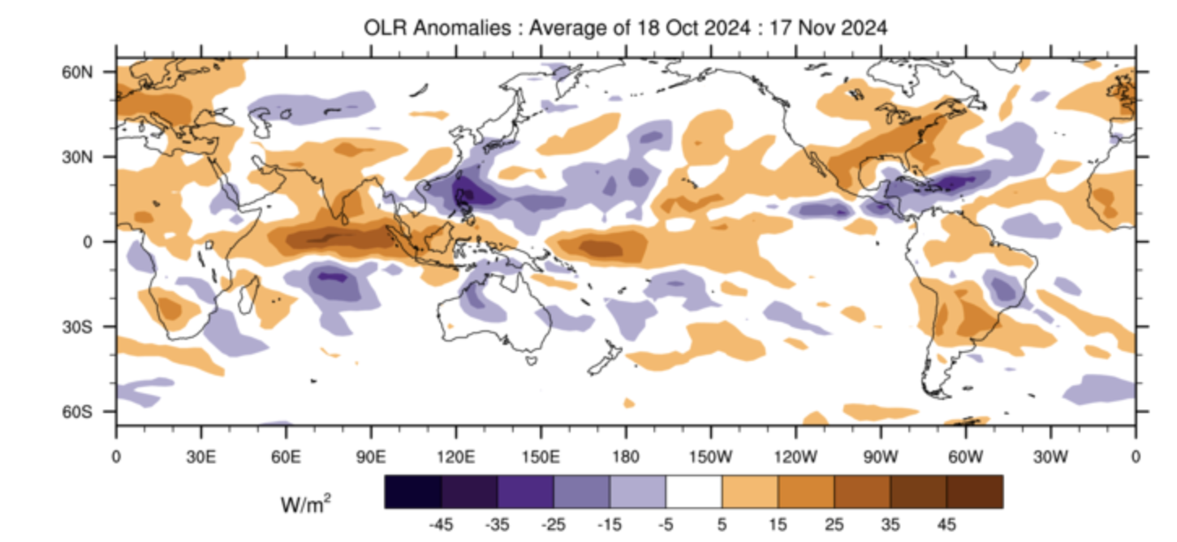
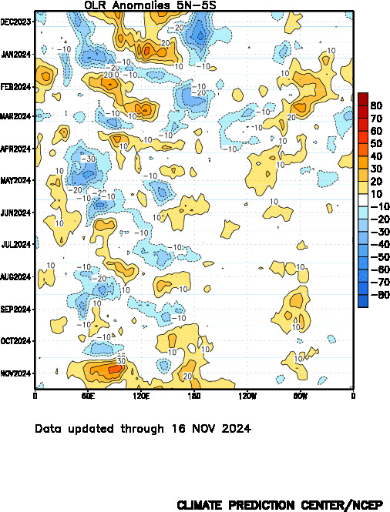
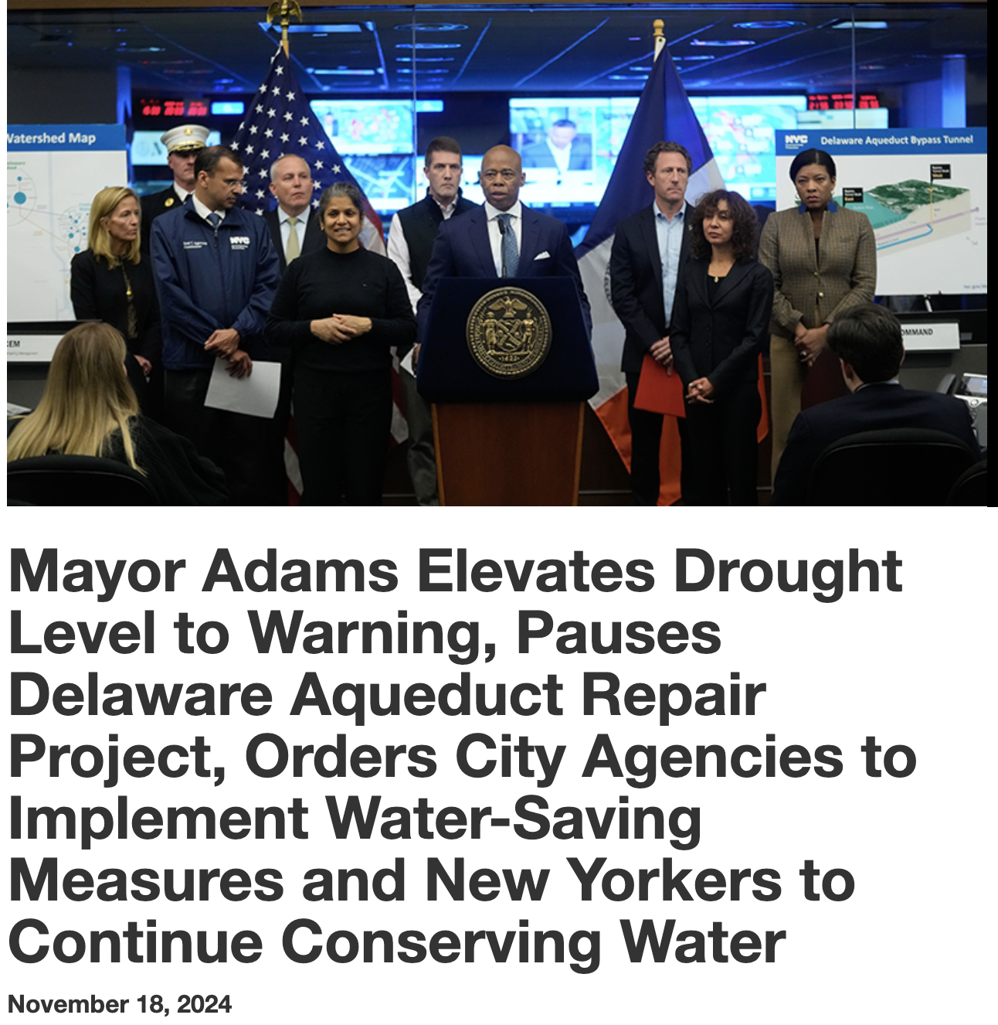
Most recent Outgoing Longwave Radiation (OLR)
Current OLR reduced convection over the Dateline as well as in the western Pacific, and Indian Ocean.
Last 30-Days (Mid-Oct to Mid-Nov), reduced convection over and around central and eastern Indian Ocean,
During El Niño, the convection is enhanced over-and-around the Date-Line, while suppressed during La Niña
Source:
http://www.bom.gov.au/climate/mjo/#tabs=Cloudiness
https://www.cpc.ncep.noaa.gov/data/indices/cpolr.mth.91-20.ascii

Slide 10
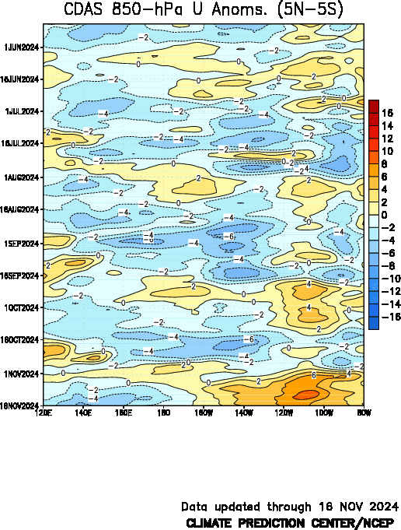
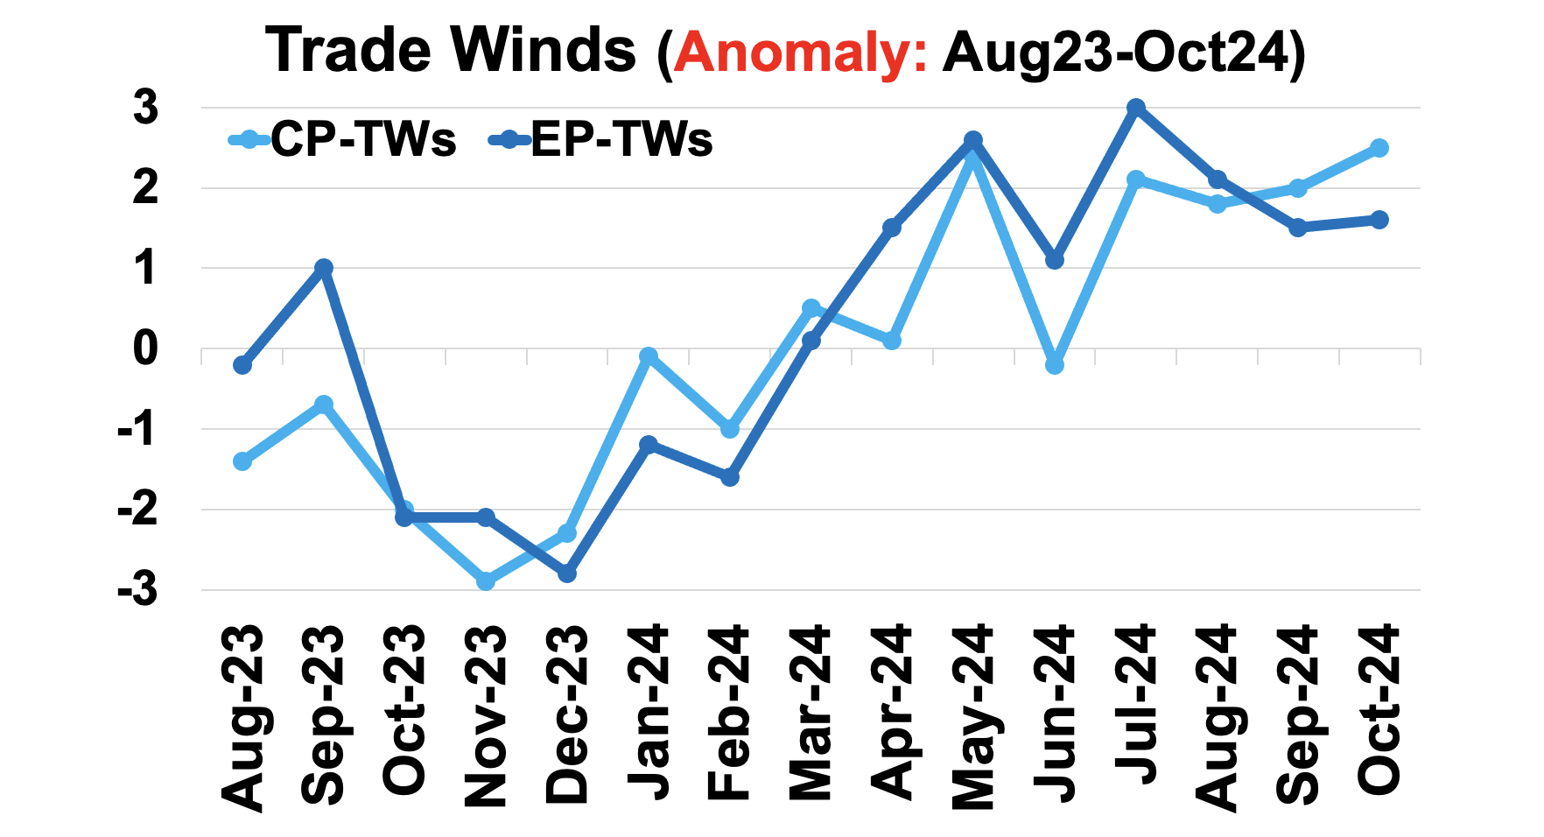
Most recent Lower-Level Winds (TW-Index)
Yellow Shading: Westerly Anomalies
Blue Shading: Easterly Anomalies
Another strong Episode of WWA!

Slide 11
Forecasts
IRI ENSO Plume,
Probability of Nino-34,
Global SSTs from NMME,
Prcp. and Temp. outlook from IRI (November, 2024)

Slide 12
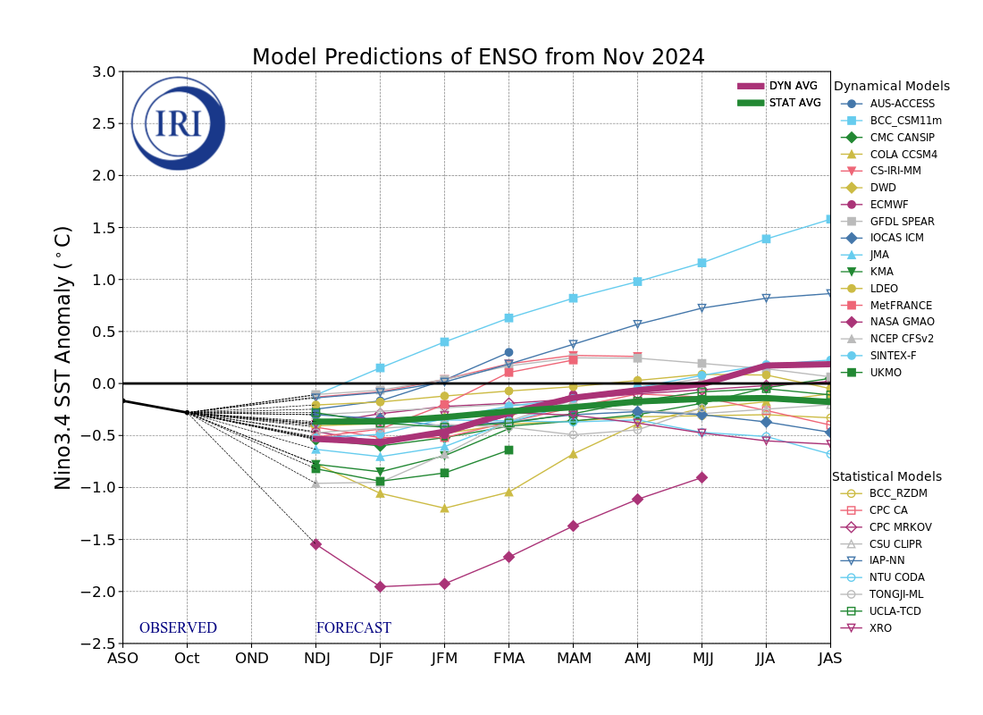
IRI’s ENSO Forecast (issued on 19th November, 2024)
Mean of STAT Models indicate ENSO-Neutral Conditions,
Mean of DYN Models reaching La Nina threshold (below the -0.5) just for two-seasons NDJ and DJF, 2025,
ENSO-Neutral Conditions, from JFM, 2025 onwards.

Slide 13
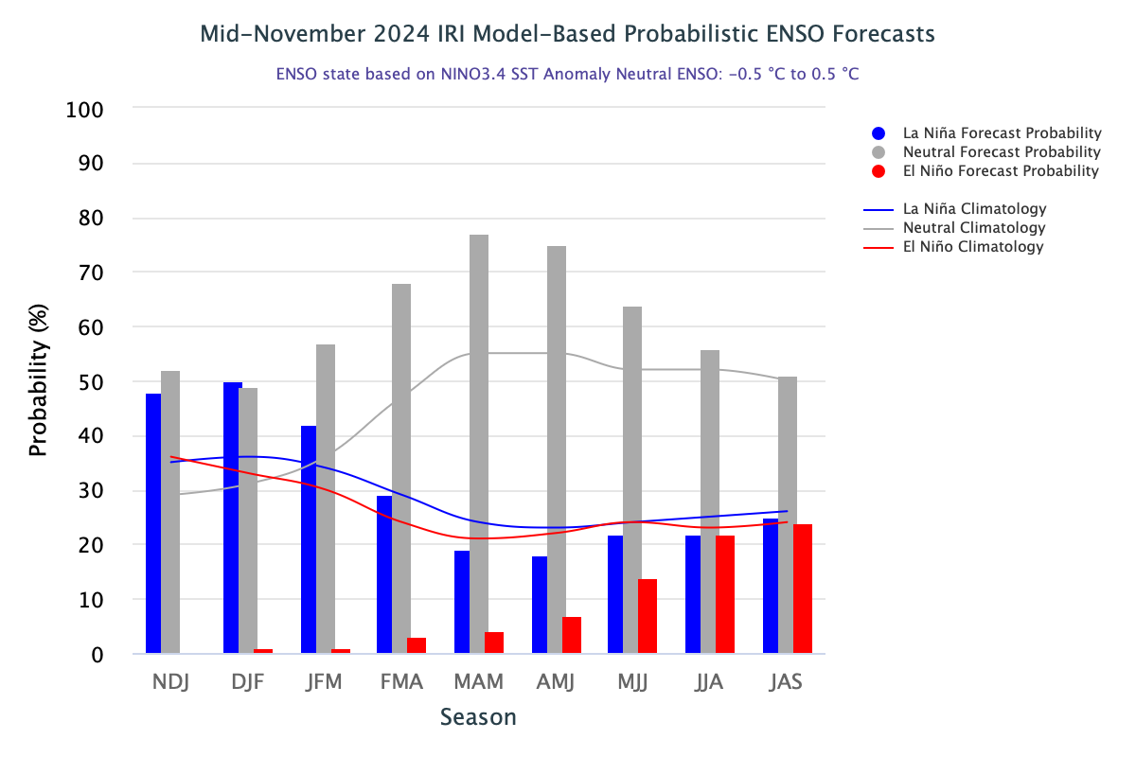
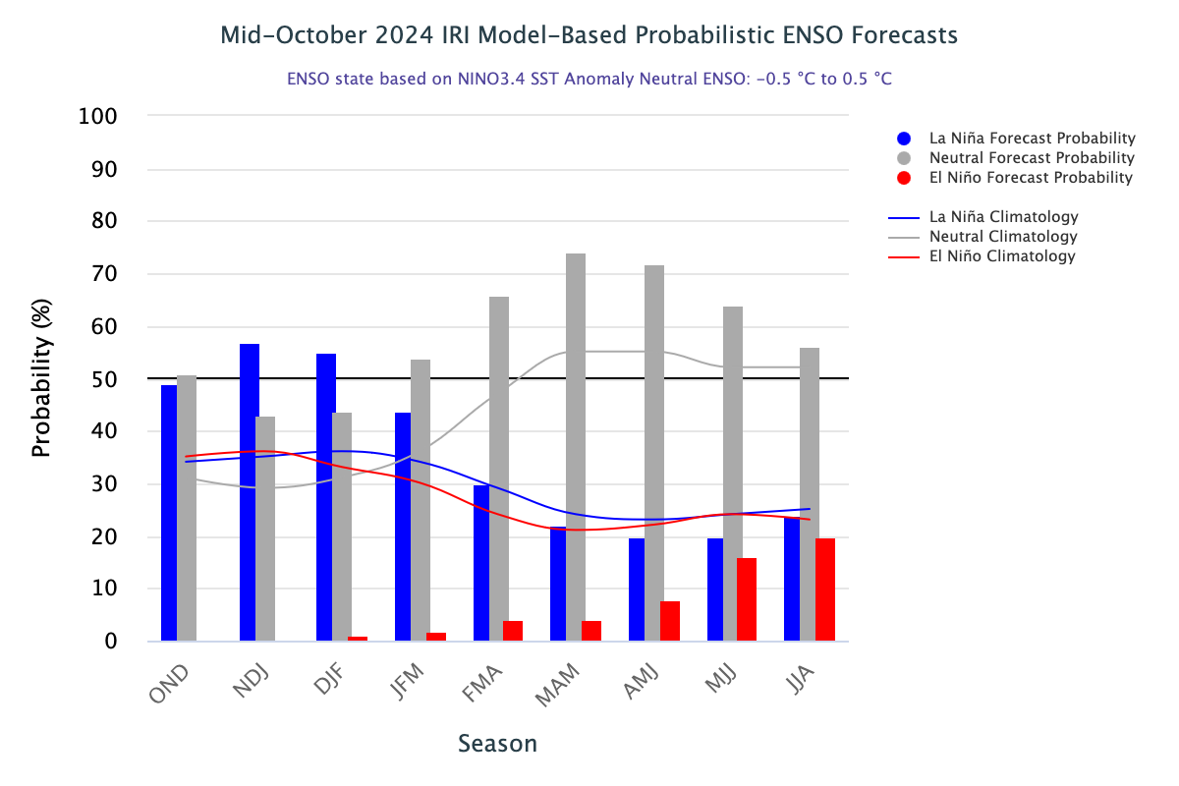
IRI’s Probabilistic (STAT+DYN) ENSO Forecasts (Issued on 19th November, 2024)
52% chances for ENSO-Neutral continuation NDJ-2025,
As per this objective ENSO tool, however, La Nina, has 1% more chance of happening during DJF, 2025 (50%), while ENSO-neutral continuation is estimated at 49%.
ENSO-neutral from JFM, 2025onwards.

Slide 14
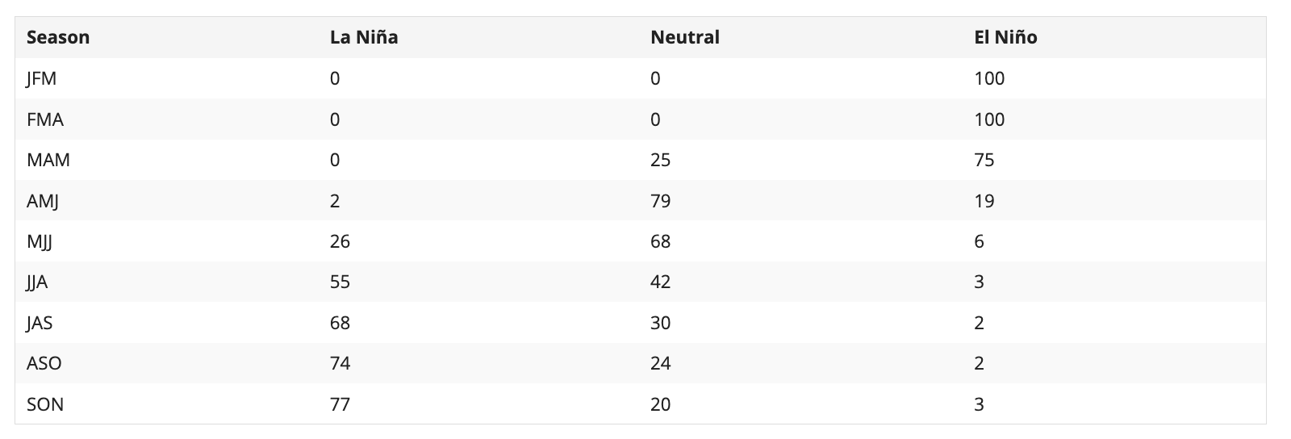
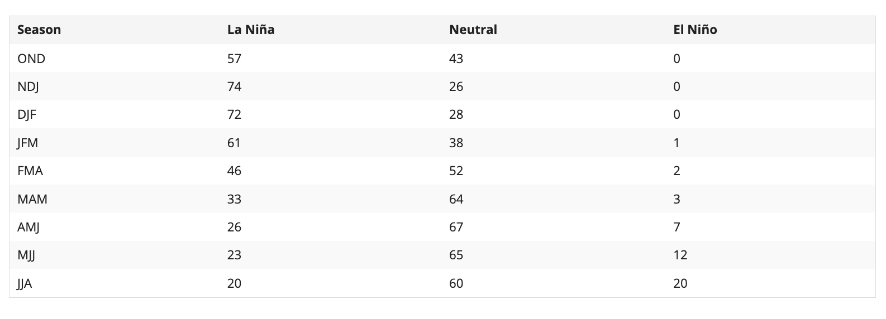

Slide 15
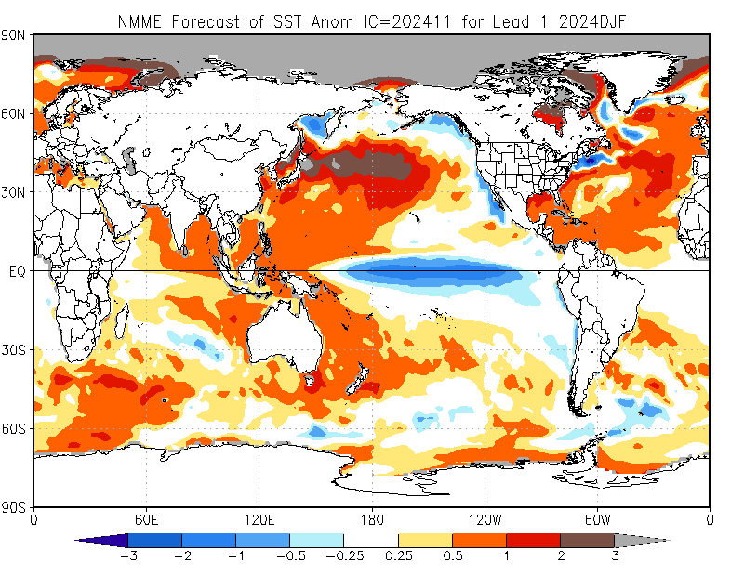
North American Multi Model Ensemble
(NMME) SST Forecast

Slide 16
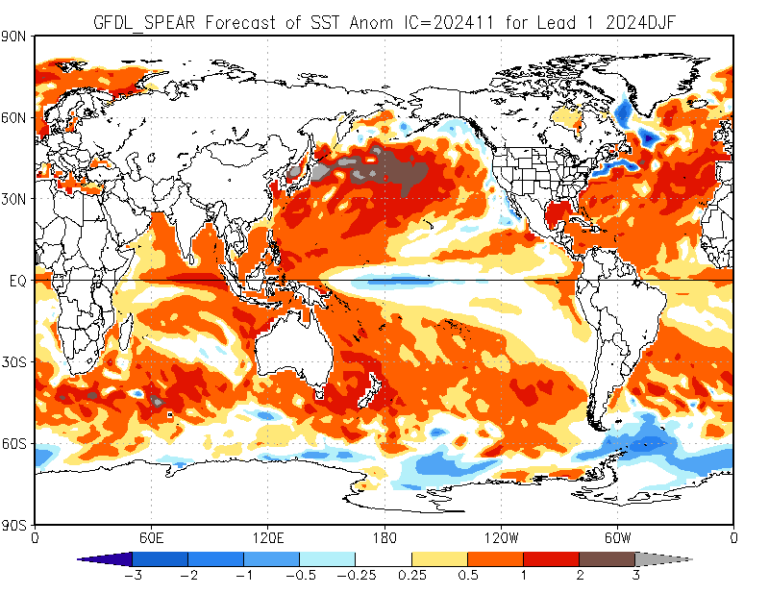
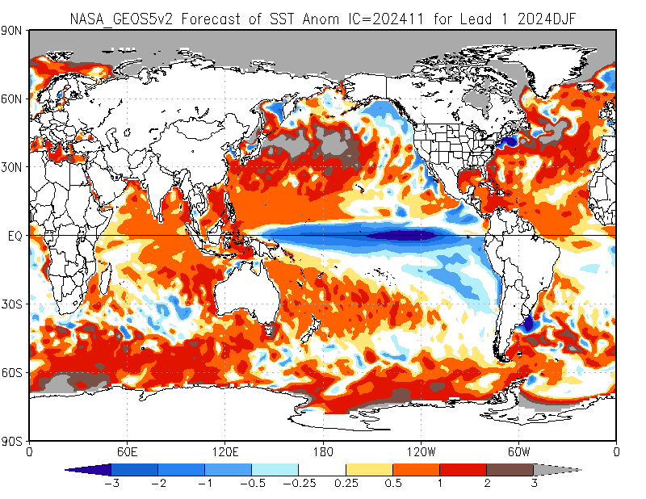
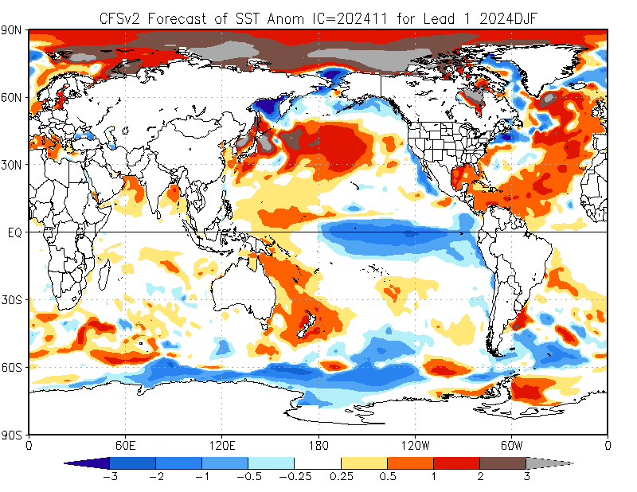
GFDL-SPEAR
NASA-GEOS5v2
CFSv2
https://www.cpc.ncep.noaa.gov/products/NMME/current/tmpsfc_Seas1.html

Slide 17
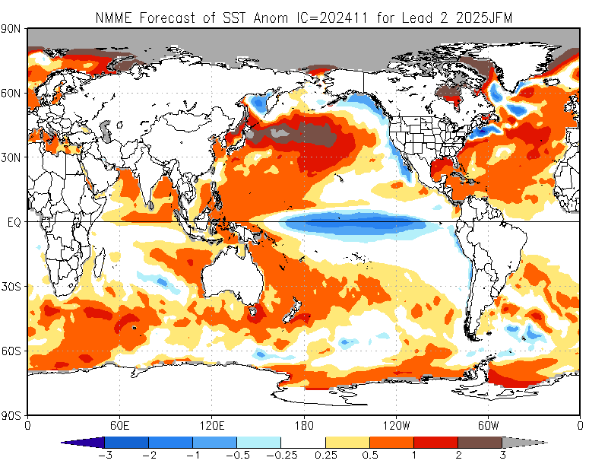

Slide 18
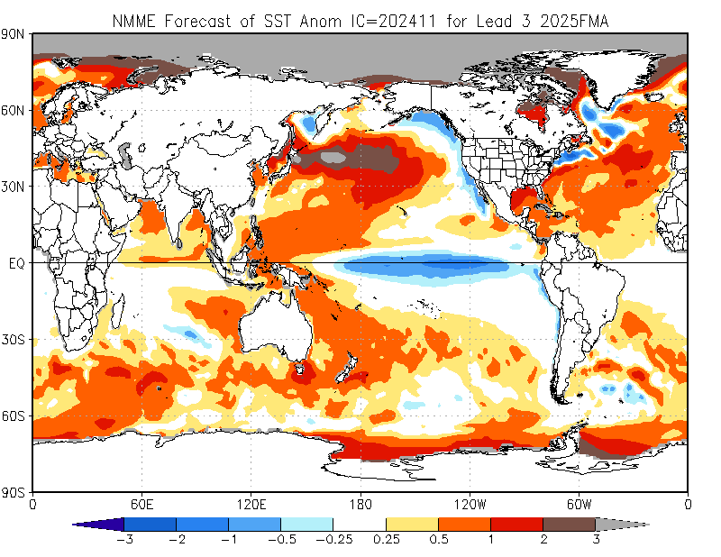

Slide 19
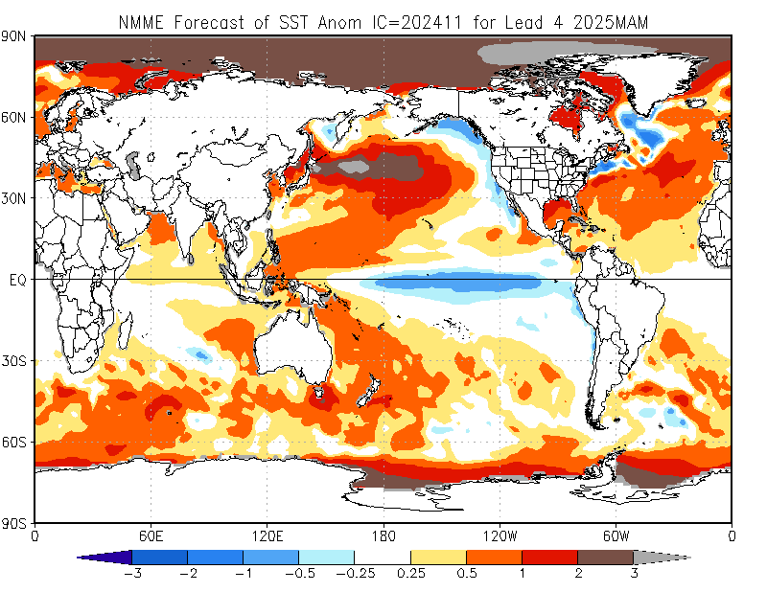

Slide 20
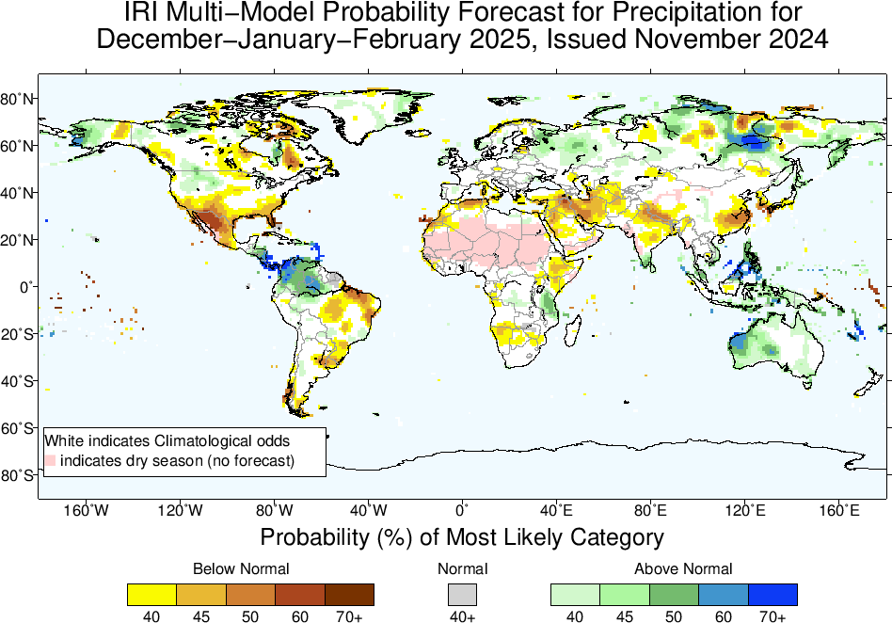
Precipitation Forecasts based on North American Multi Model Ensemble (NMME)

Slide 21
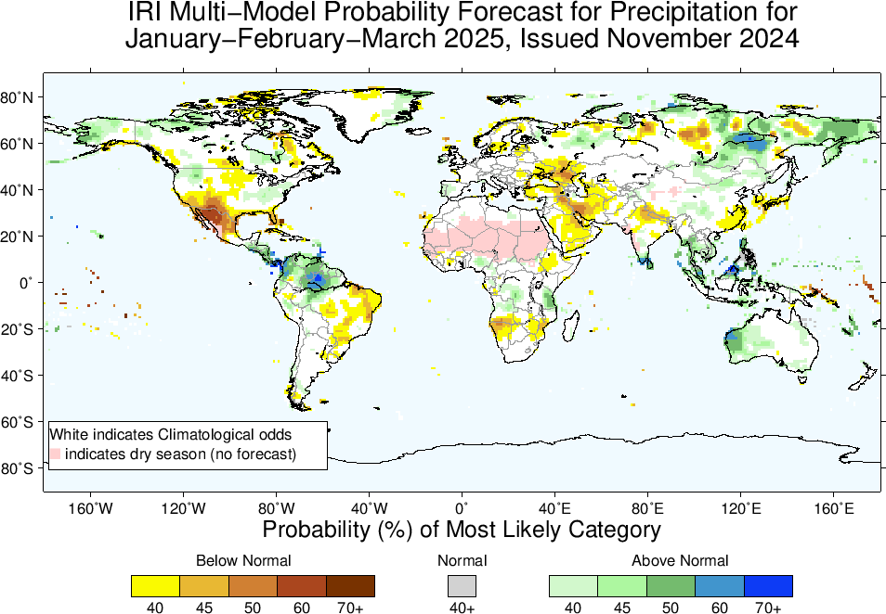

Slide 23
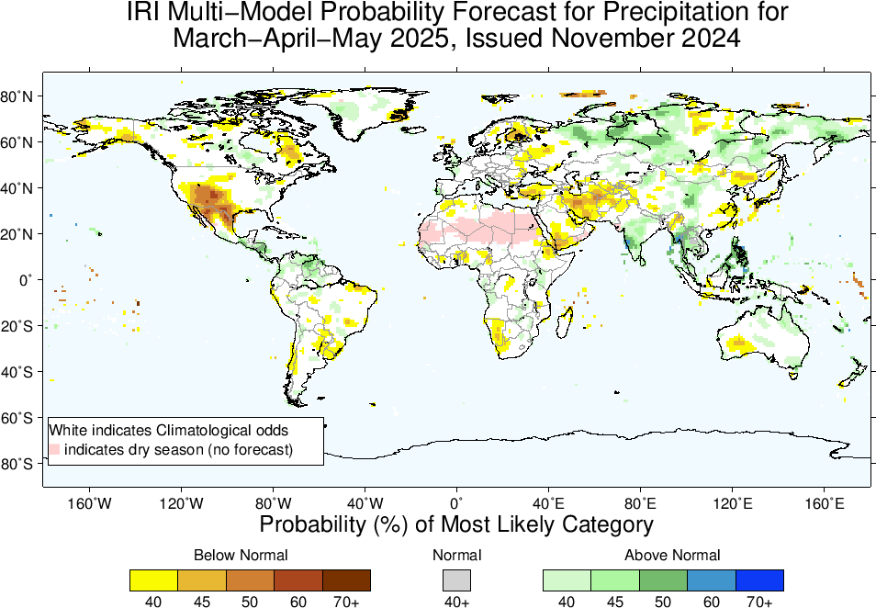

Slide 24
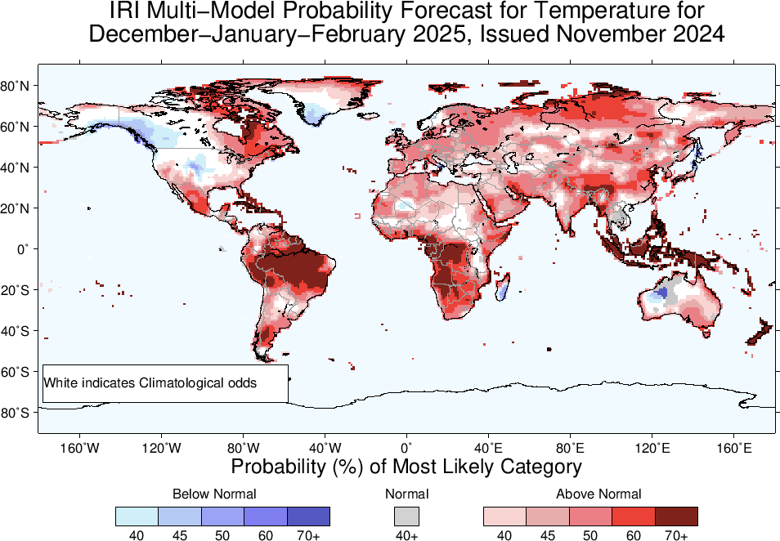
2m-Temperature Forecasts based on North American Multi Model Ensemble (NMME)

Slide 25
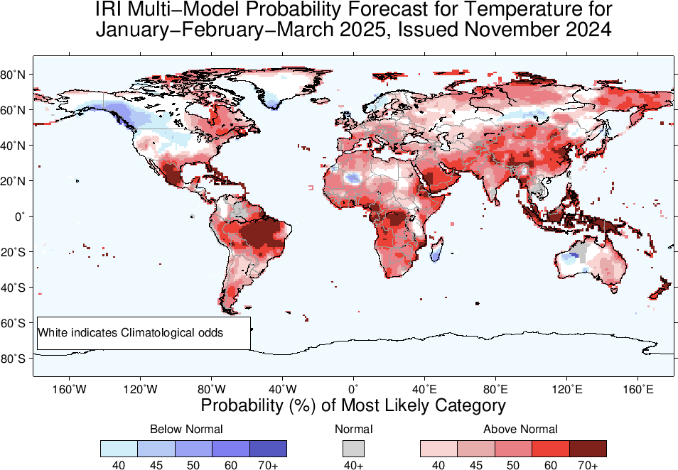

Slide 26
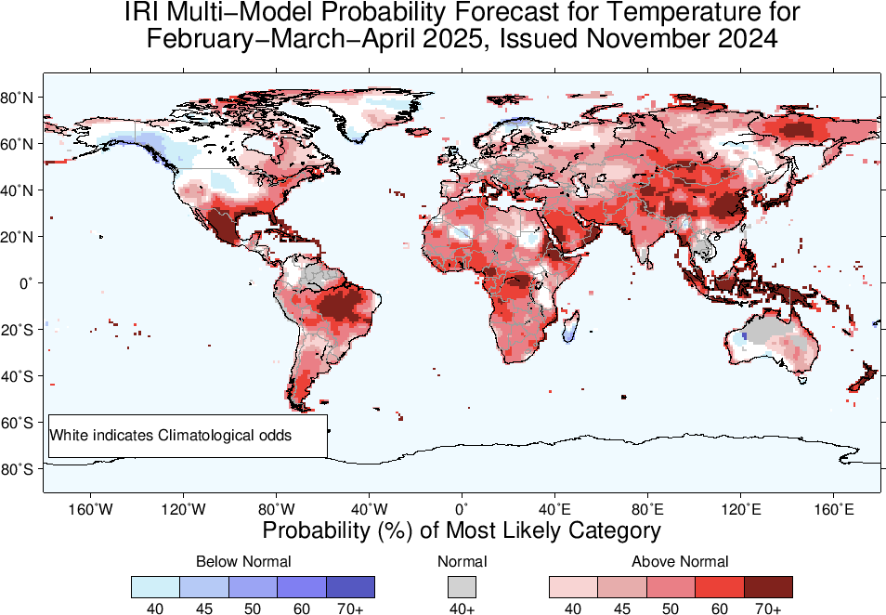

Slide 27
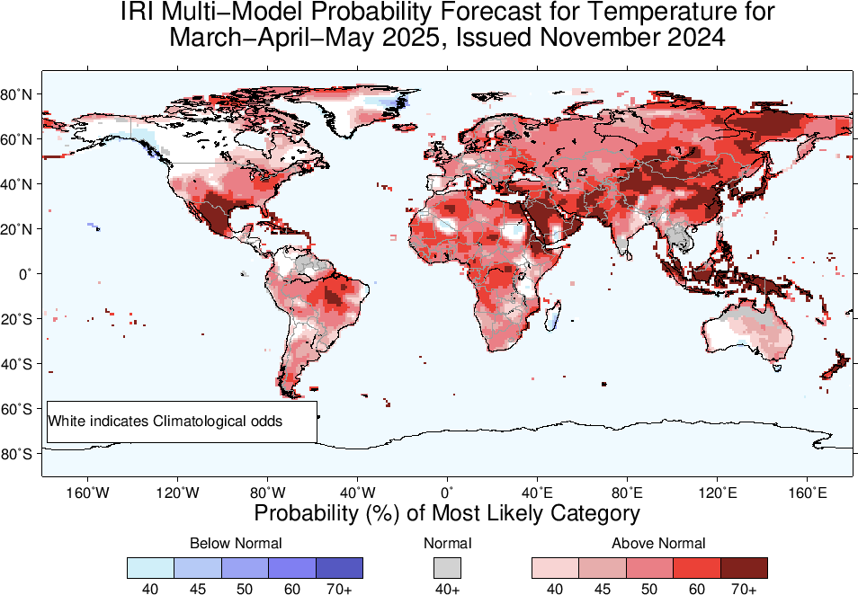

Slide 28
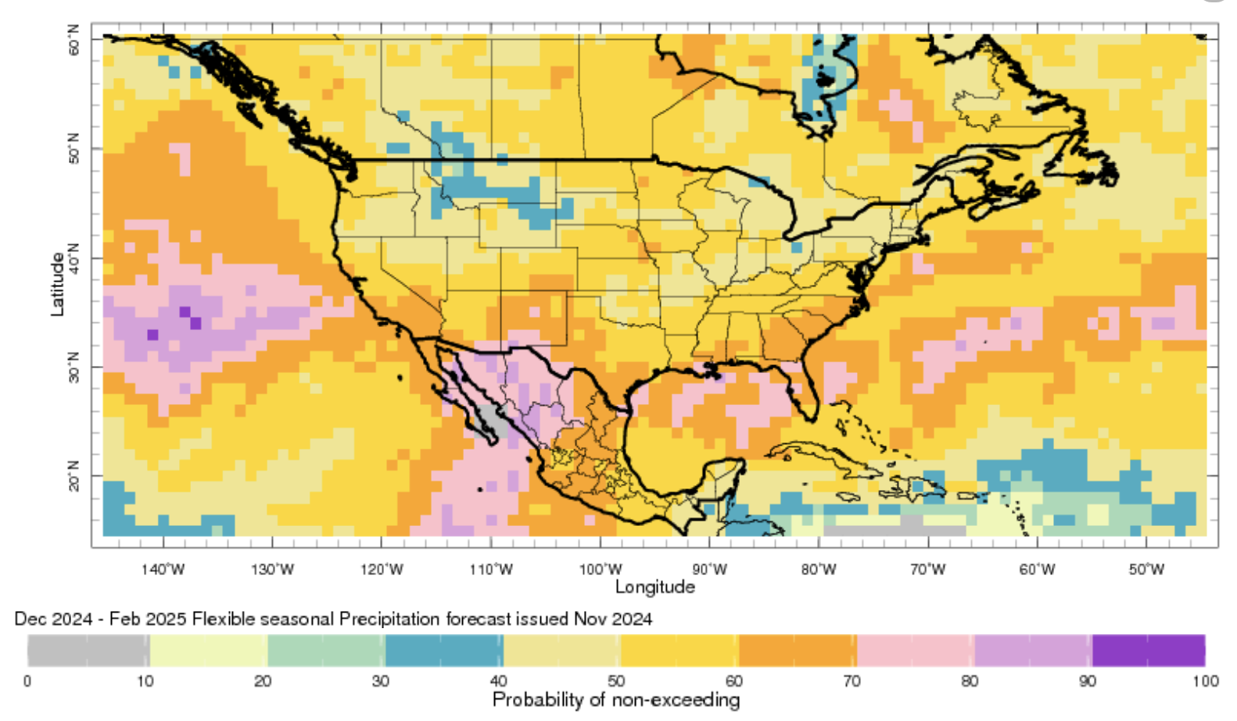
Summary
After end of 2023/24 El Nino, tropical Pacific is experiencing ENSO-neutral conditions since May, 2024 (NINO3.4 for May was +0.3, June was +0.24, July was +0.21, Aug was -0.07, and Sep was -0.15, and Oct was -0.23), while for most recent week ending on 13 Nov, 2024, it was 0.0.
Combined STAT+DYN guidance favors chances for ENSO-Neutral continuation (52%) as compared to La Nina Onset (48% in NDJ 2025).
Guidance from Combined DYN+STAT Forecasts show ENSO-Neutral continuation during the winter and Spring of 2025.

