Slide 1
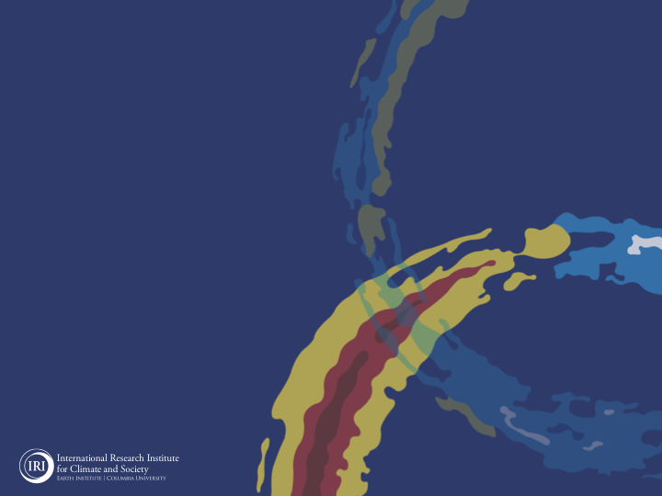
ENSO and Climate Outlook in
May, 2024
M. Azhar Ehsan
(azhar@iri.columbia.edu)
Associate Research Scientist
IRI ENSO and Climate Forecast Lead
Jeffrey Turmelle and Jing Yuan: forecast processing and web updates
Cuihua Li: Draft PowerPoint development
IRI’s Climate Group, led by Dr. Andrew Robertson: Forecast system development, ongoing innovation, and verification

Slide 2
Outline
Observed Oceanic and Atmospheric Conditions in
Tropical Pacific
Across the Globe
ENSO Forecast in
NMME
IRI ENSO Forecast Tool (Deterministic and Probabilistic)
Seasons Outlook of
SST
Precipitation and Temperature
Summary

Slide 3
Observations
Oceanic
Atmospheric

Slide 4
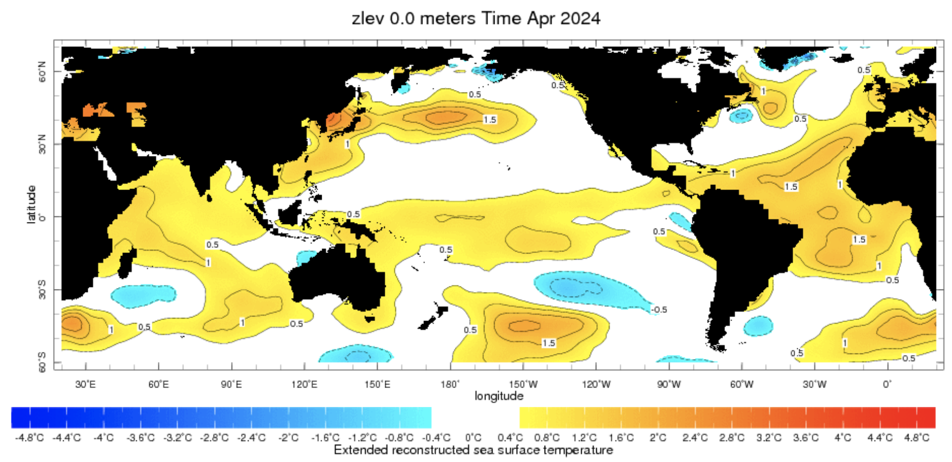
Evolution of SST Departures in Monthly (April, 2024) Data
For April, 2024
NINO 1+2: -0.03
NINO3: +0.54
NINO3.4: +0.80
NINO4: +0.93
In the Pacific Ocean: Above-Average SSTs persisted across the central (across the Date Line), weak negative close to SA-coasts
Indian Ocean: Warm across Indian Ocean, Neutral IOD (Index value is +0.22 as of 12 May, 2024),
North-Pacific and North Atlantic Ocean: Negative PDO (-2.09), Warm across Atlantic (TNAI, +1.54, TSAI, +1.31, TAtl, +0.86)
Source: https://iridl.ldeo.columbia.edu/maproom/Global/Ocean_Temp/ERSST_Anomaly.html

Slide 5
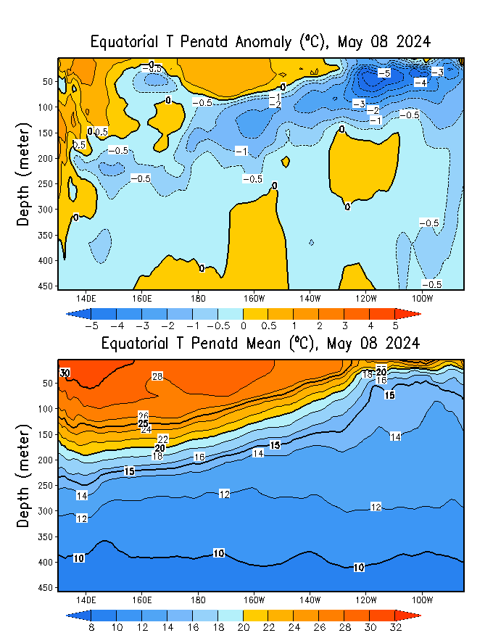
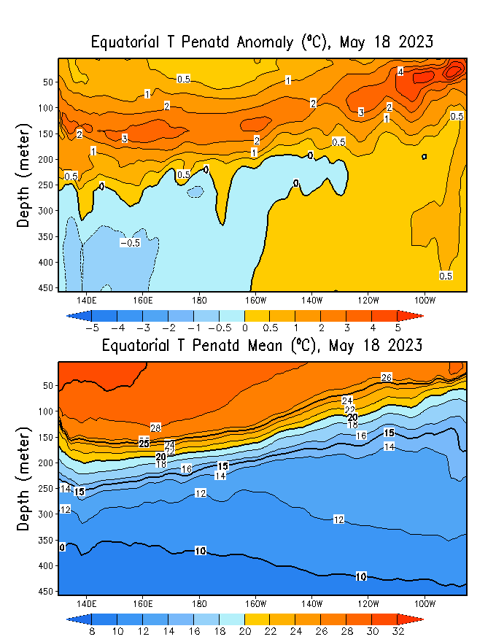
What is the underwater conversation?
March, 2024
May, 2024
May, 2023
Warm (~ +1C) subsurface-to-surface temperature anomalies dominate from 160E to 150W in equatorial Pacific Ocean (Surface to 50 meter at depth).
Cold subsurface temperature anomalies have strengthened in the Pacific Ocean and expanded to surface level at far eastern Pacific (130 W onwards).
April, 2024

Slide 6
What is the underwater conversation?
Following peak levels in November and December 2023, positive anomalies have diminished.
By February 2024, negative anomalies have begun to strengthen gradually, nearing an index value of approximately -1.0.

Slide 7
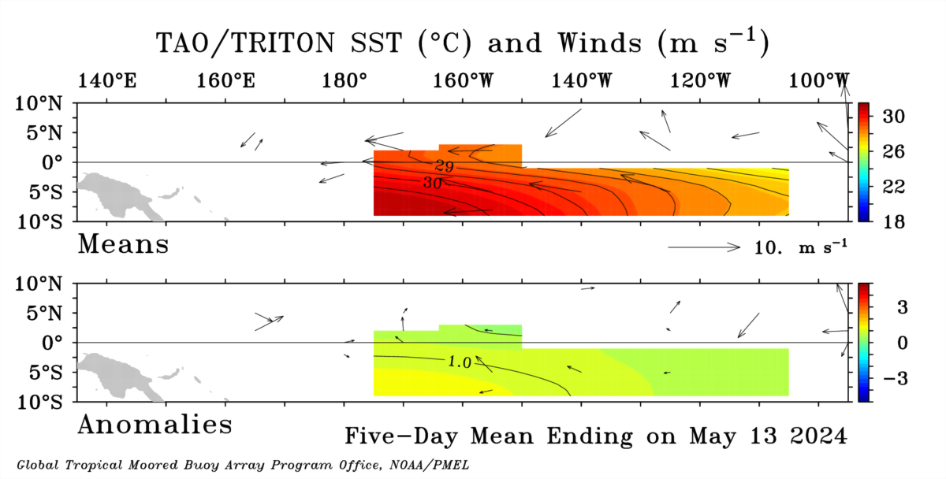
Most recent Lower-Level Winds (Blowing close to Normal)

Slide 8
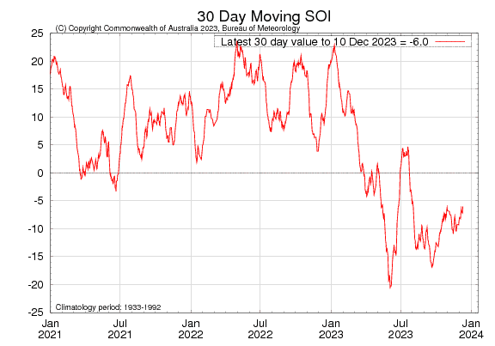
Most recent Southern Oscillation Index (SOI)
Current SOI values is in ENSO-neutral range
(For April, 2024 it is -6.3)
Equatorial-SOI is also in ENSO-neutral range,
(For April, 2024 it is 0.6)
During El Niño, the pressure becomes below average in Tahiti and above average in Darwin, and the Southern Oscillation Index is negative.
A Sustained Negative values of the SOI above -7 typically indicate El Niño
Source:
http://www.bom.gov.au/climate/enso/#tabs=Pacific-Ocean&pacific=SOI

Slide 9
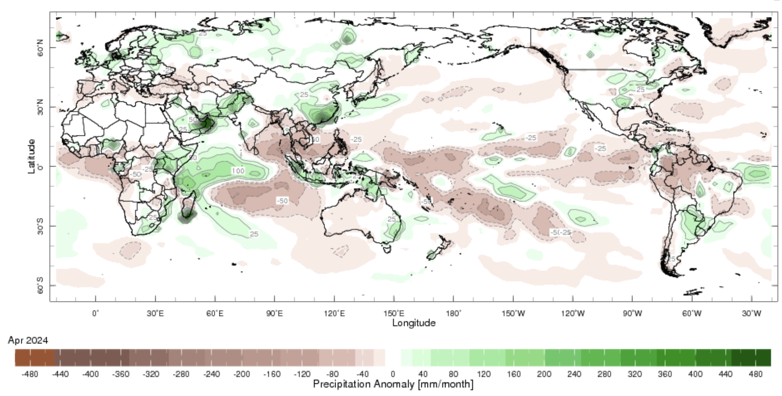
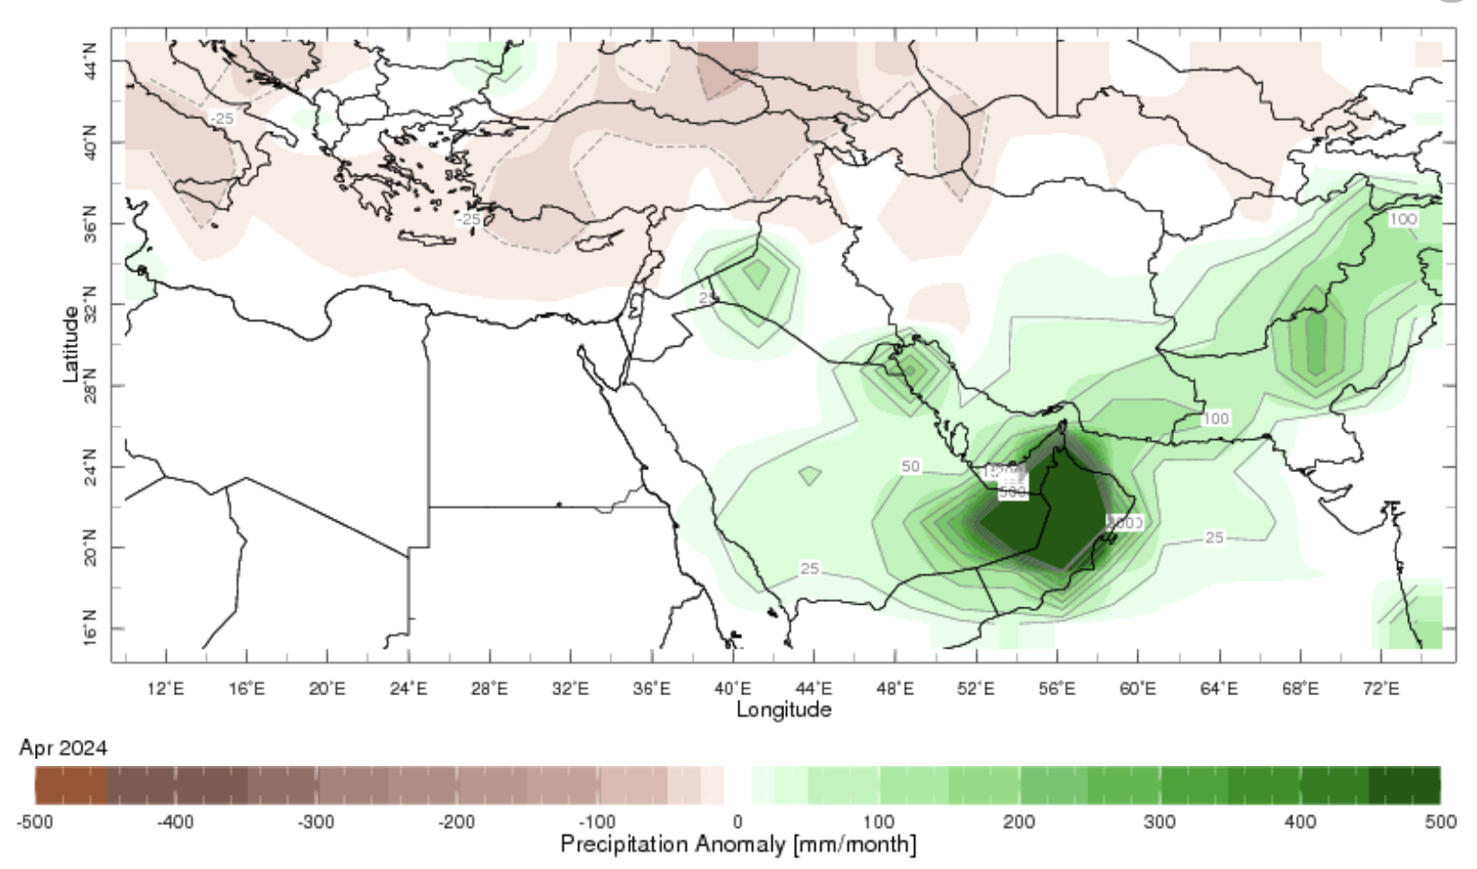
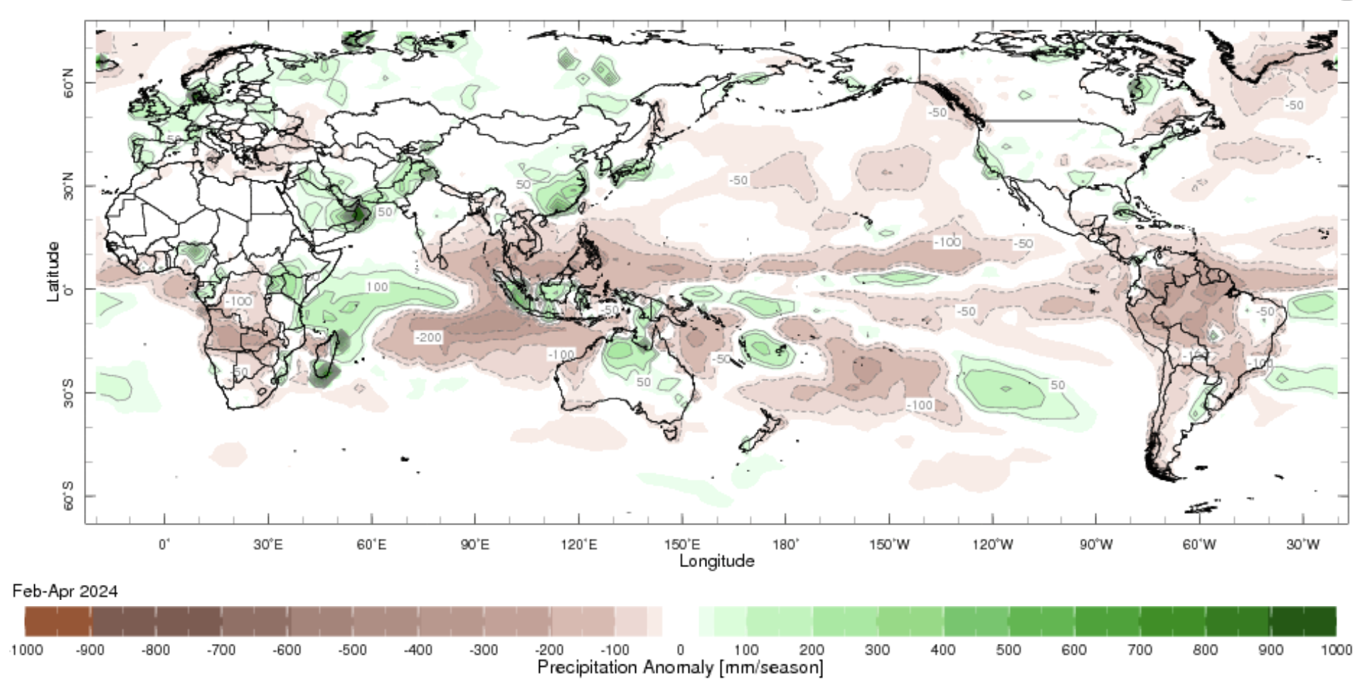
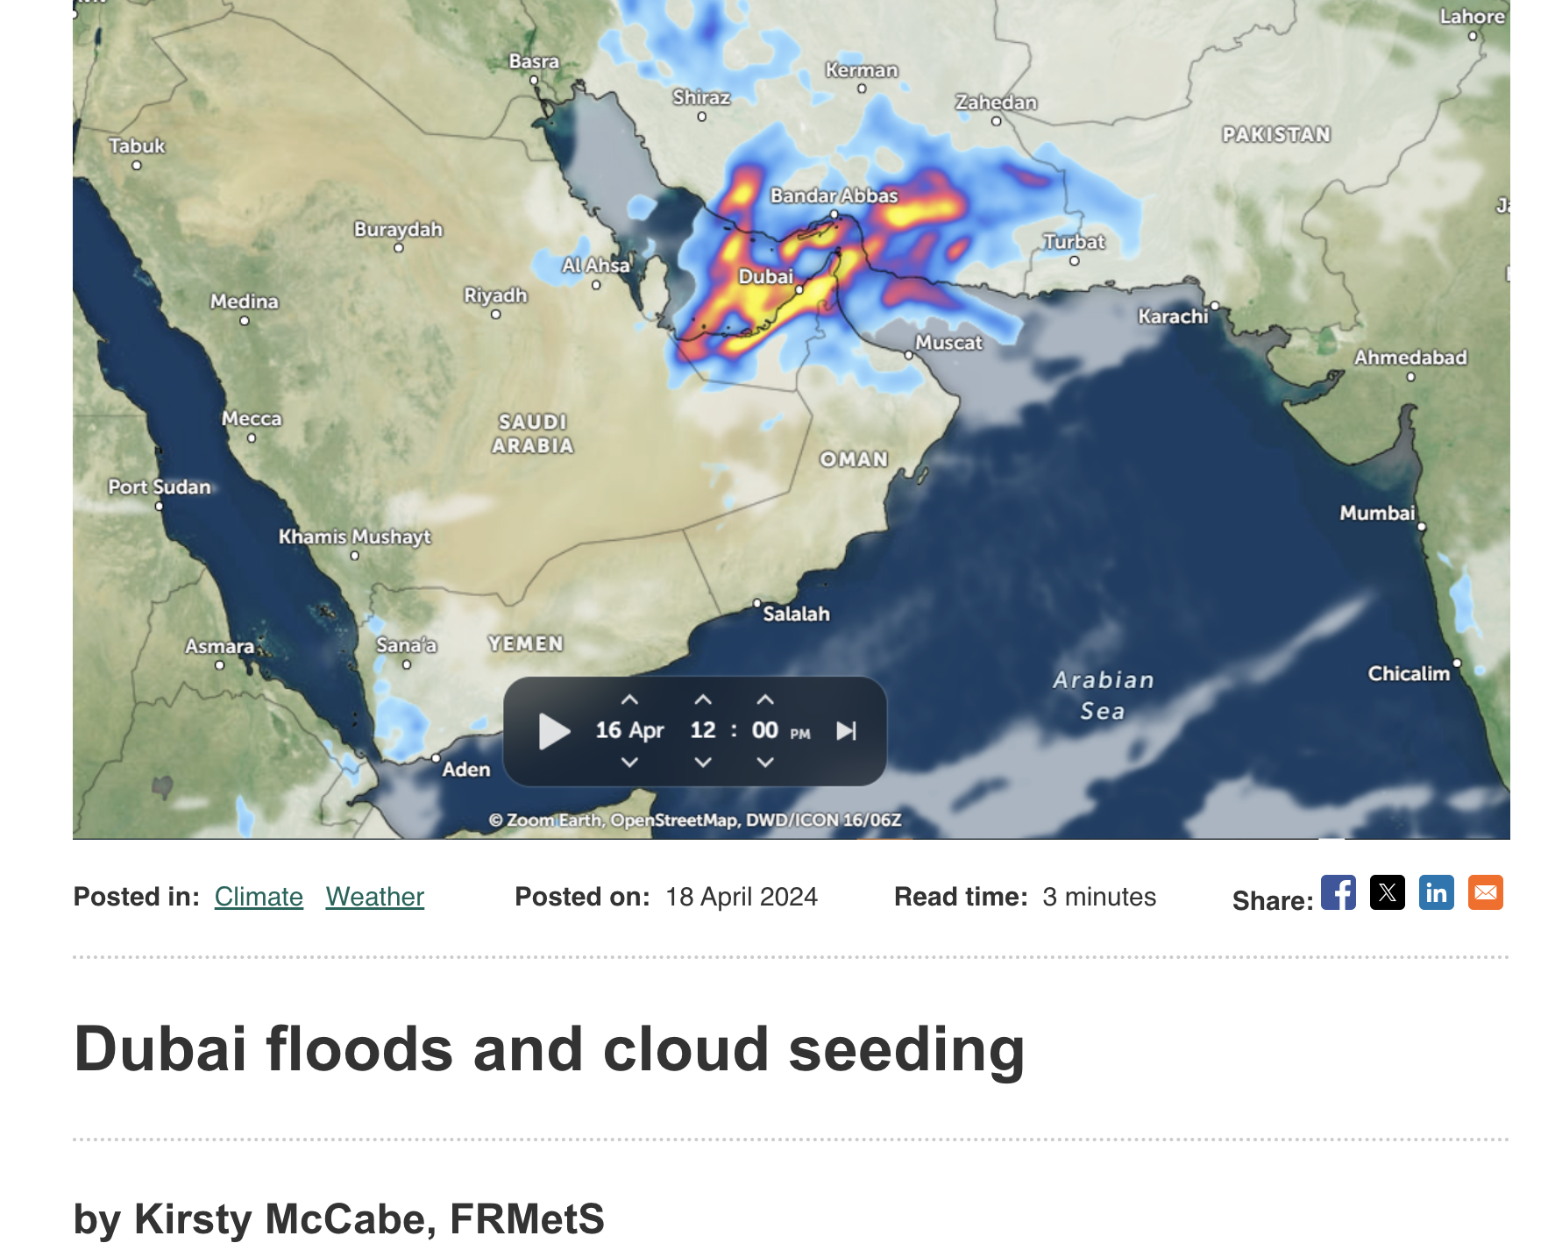
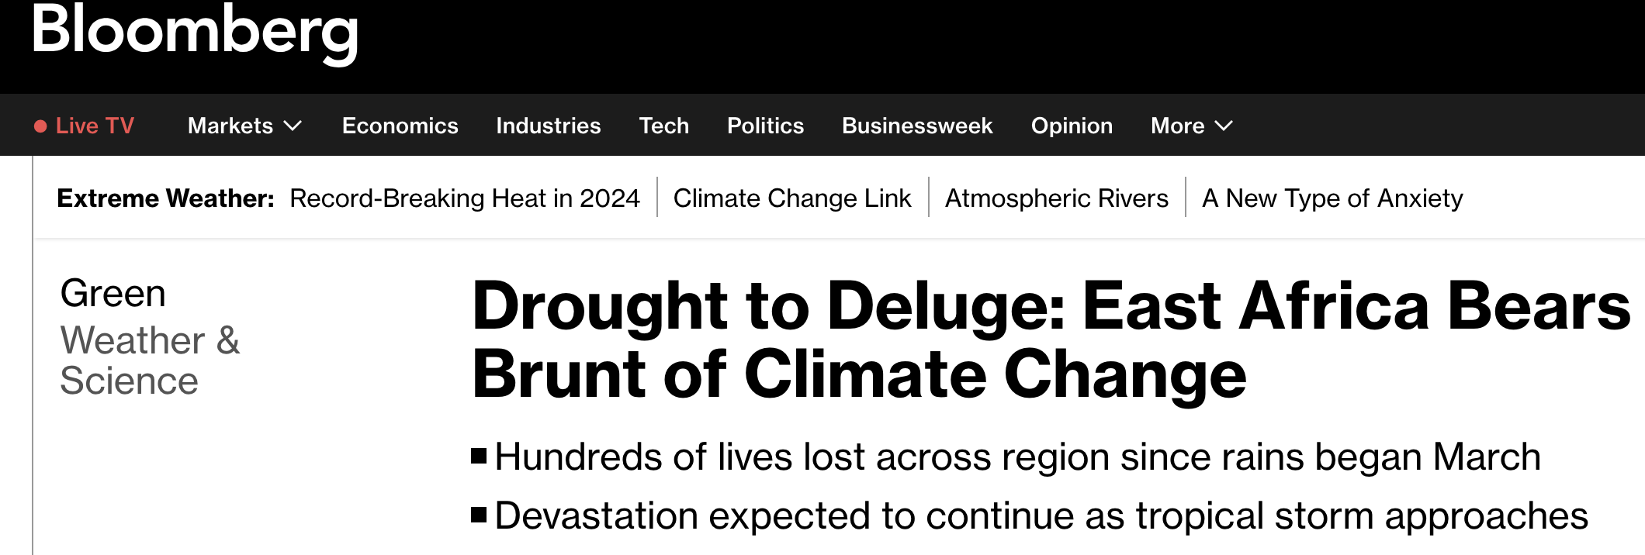
Most recent Precipitation (Prcp) April, and Feb to Apr (FMA), 2024

Slide 10
Forecasts
IRI ENSO Plume,
Probability of Nino-34,
Global SSTs from NMME,
Prcp. and Temp. outlook from IRI (May, 2024)

Slide 11
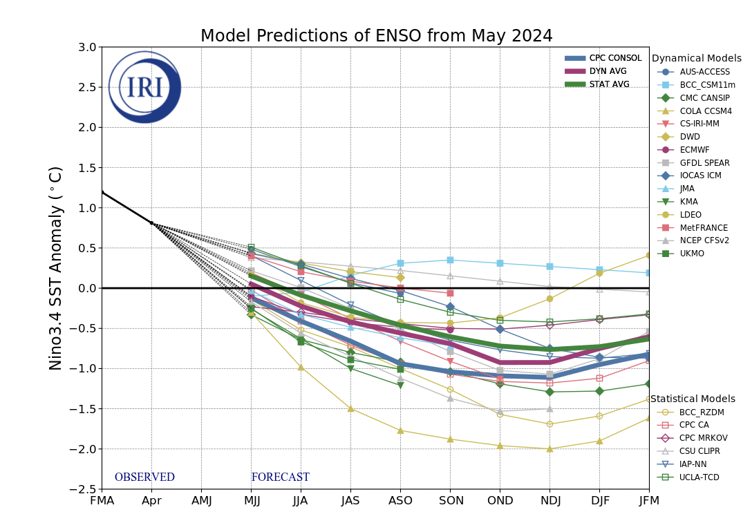
IRI’s ENSO Forecast May, 2024
Mean of DYN & STAT Models indicate ENSO-Neutral Conditions during Apr-Jun 2024, that continue till Jul-Sep 2024,
After four seasons of ENSO-neutral conditions, most models indicate a transition to La Niña in Aug-Oct 2024, that continues till the end of the forecasts,
There is significant uncertainty moving forward.

Slide 12
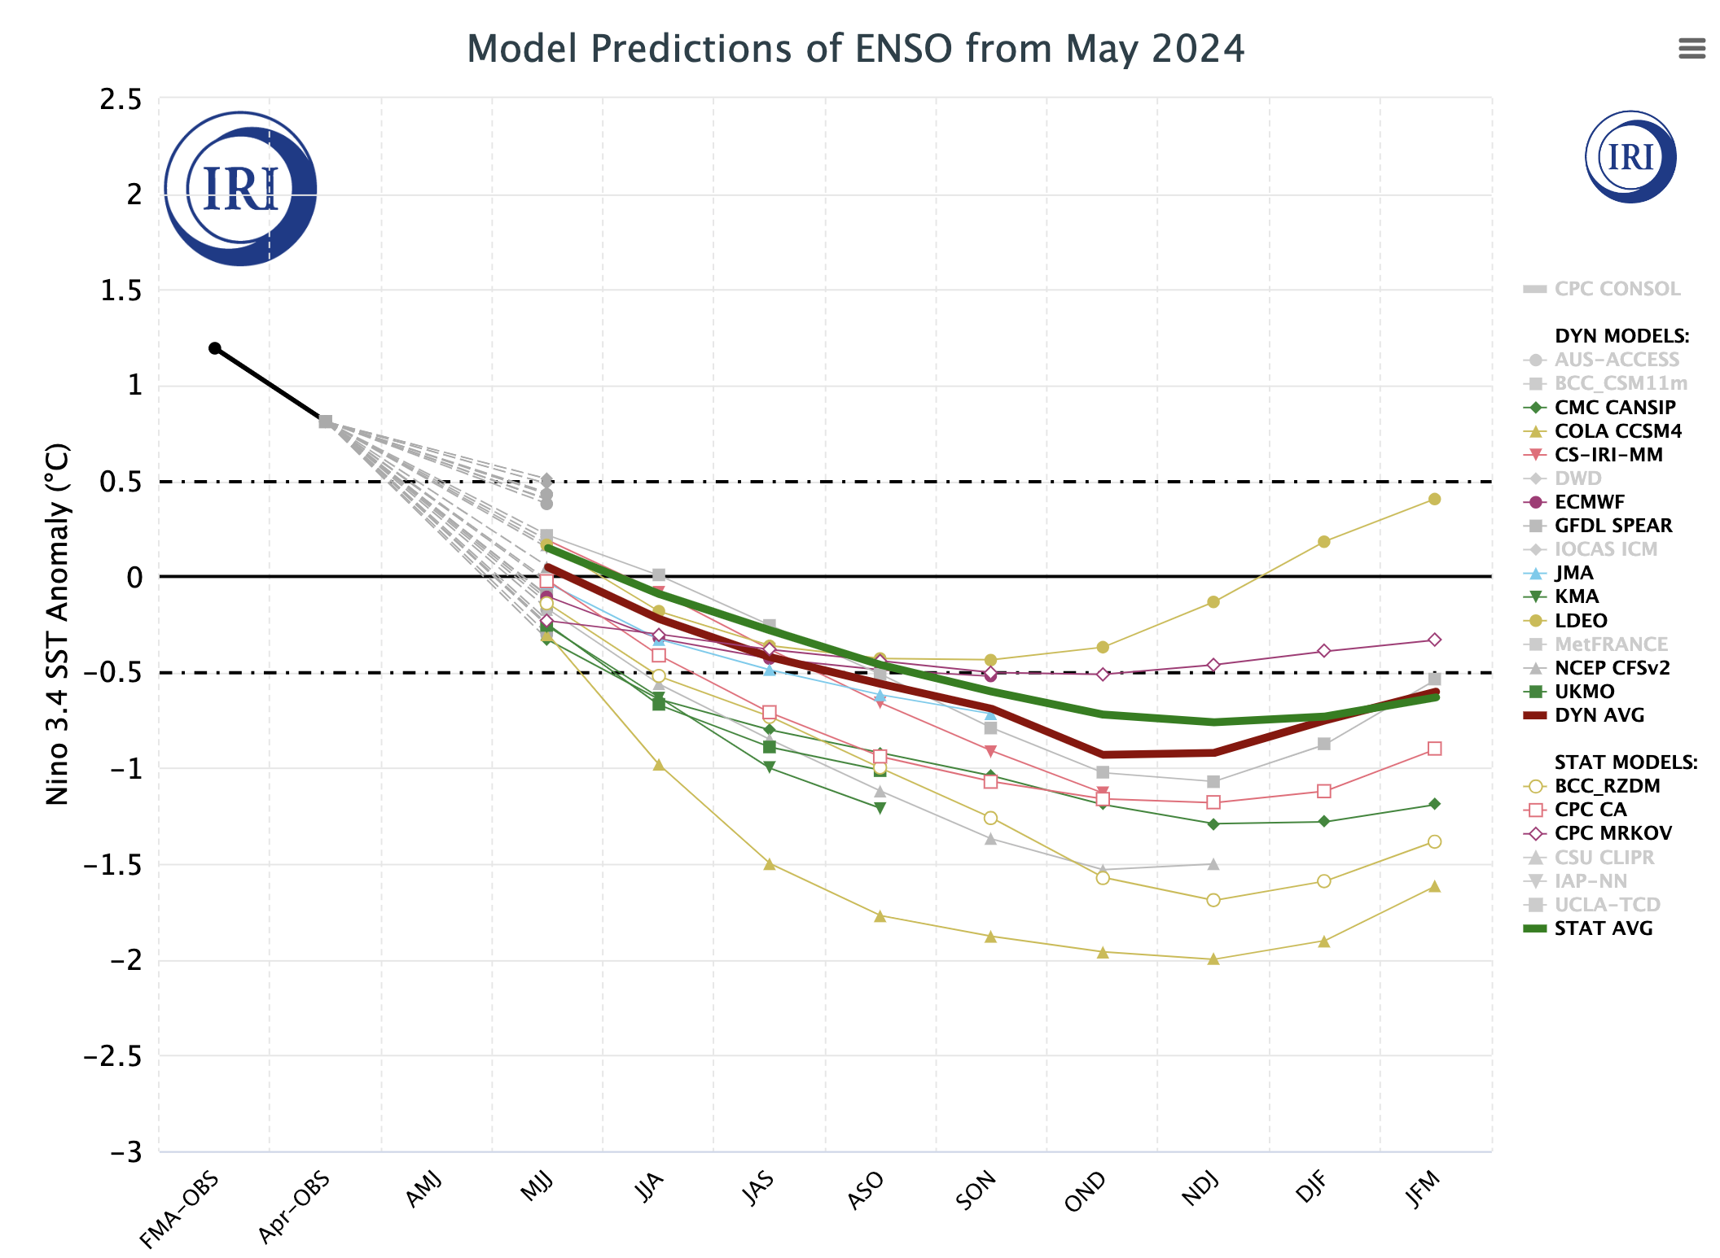
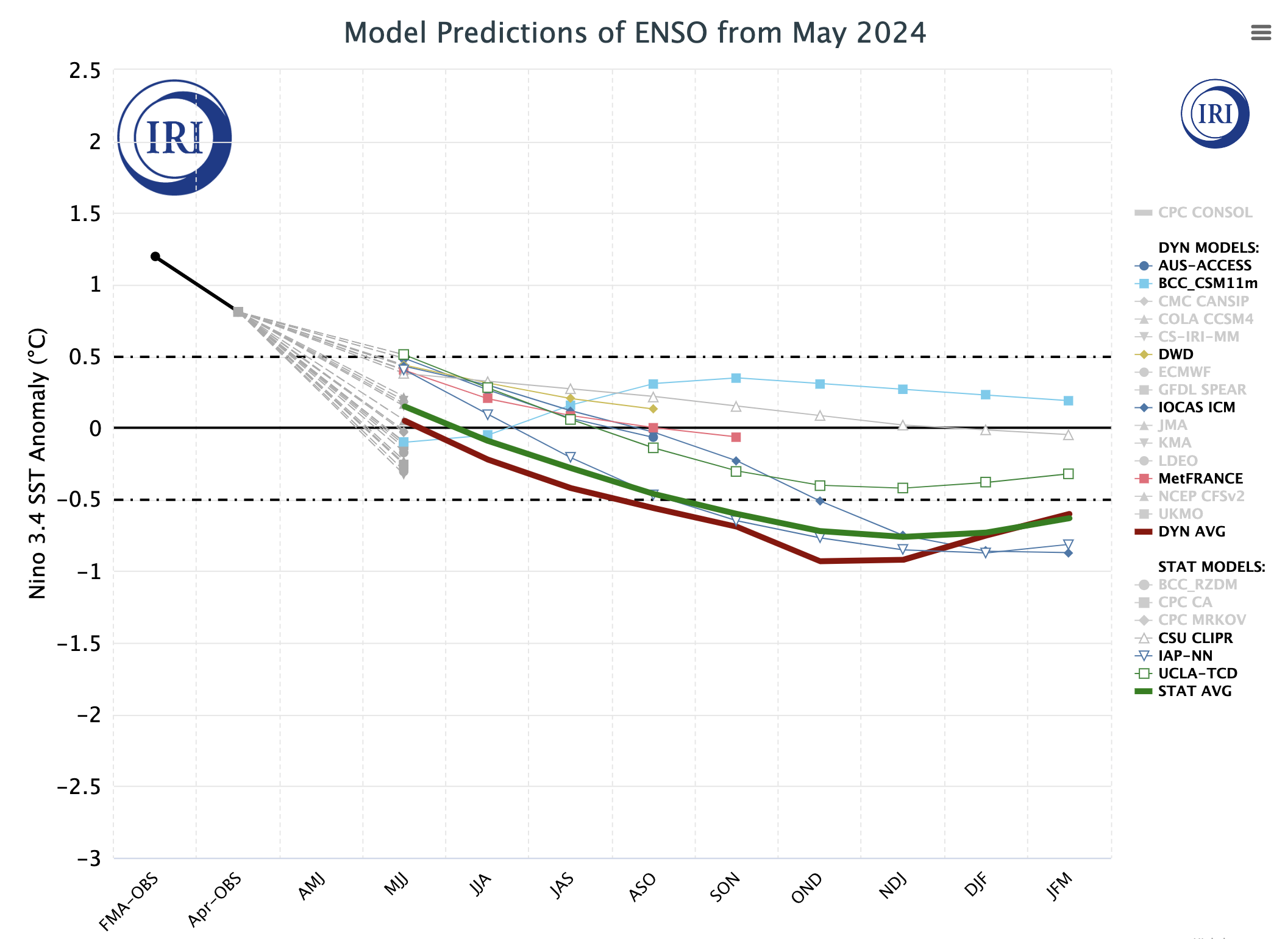
Colder Group of Models
Warmer Cluster of Models

Slide 13
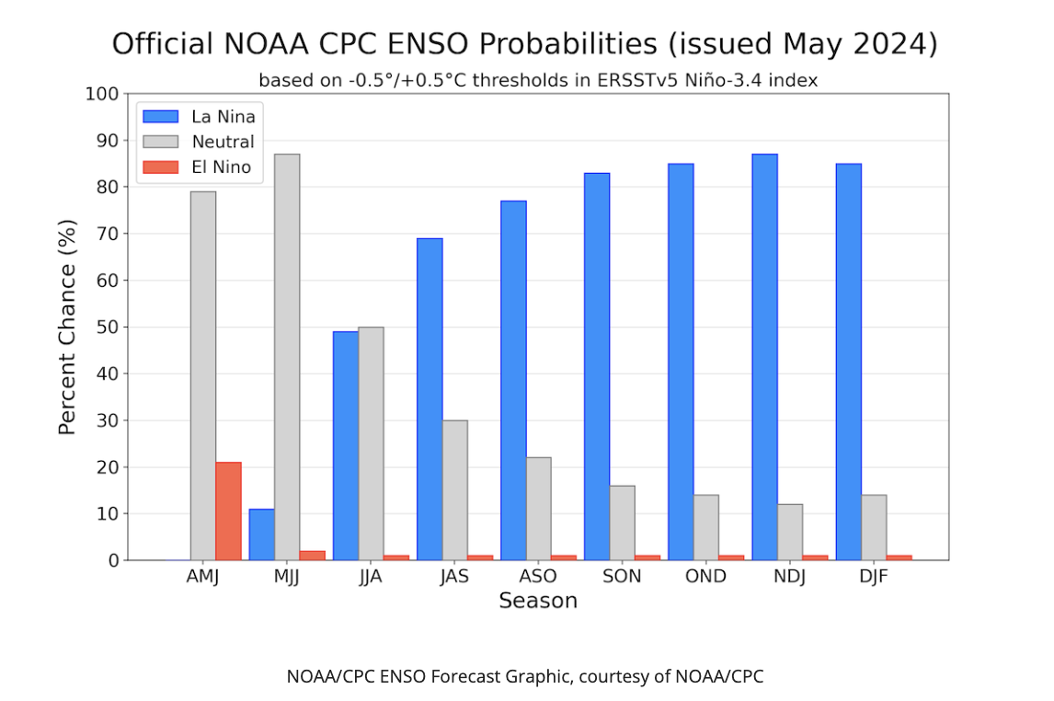
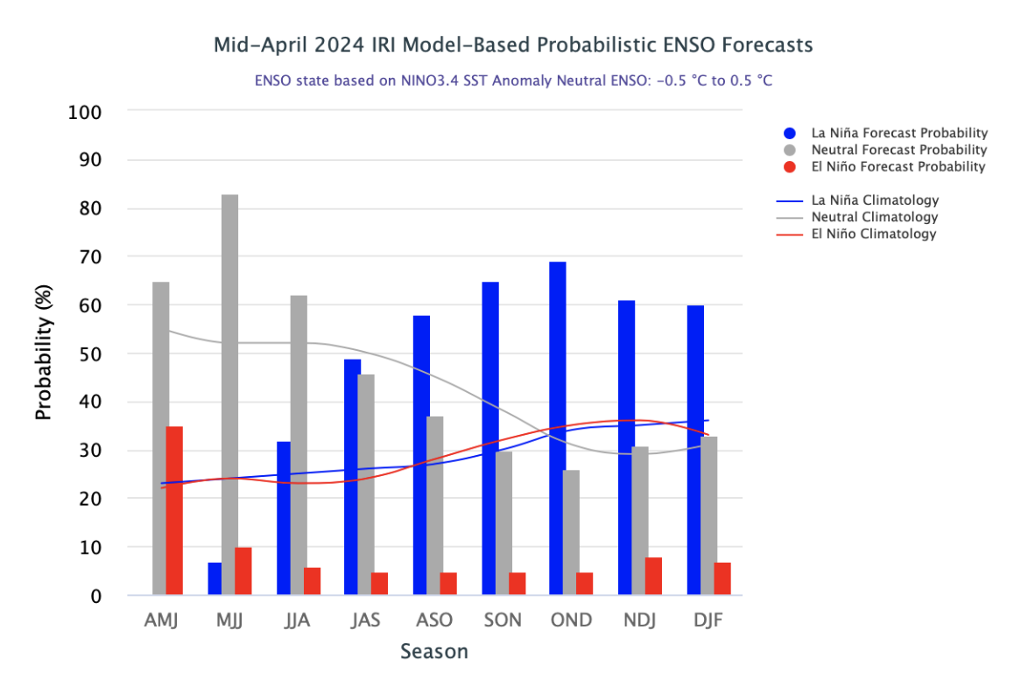
IRI’s Probabilistic ENSO Forecasts (will be on 19th May, 2024)
April, 2024

Slide 14
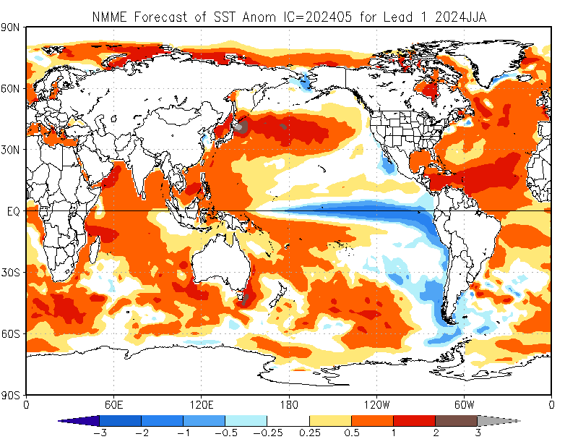
North American Multi Model Ensemble
(NMME) SST Forecast

Slide 15
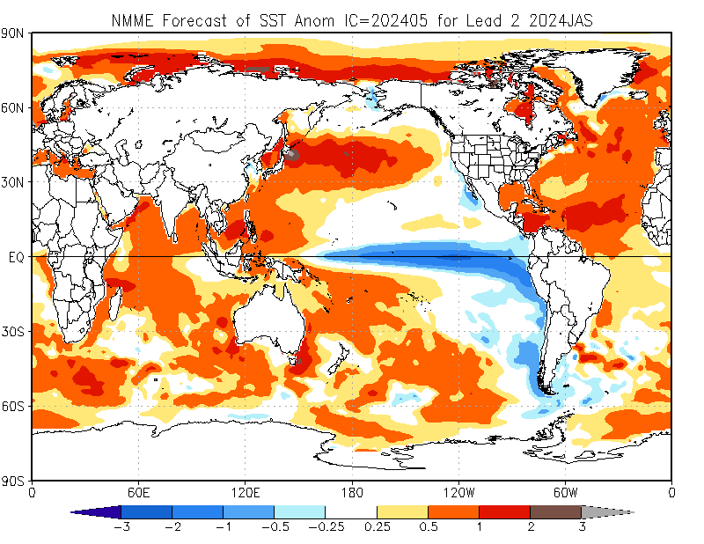

Slide 16
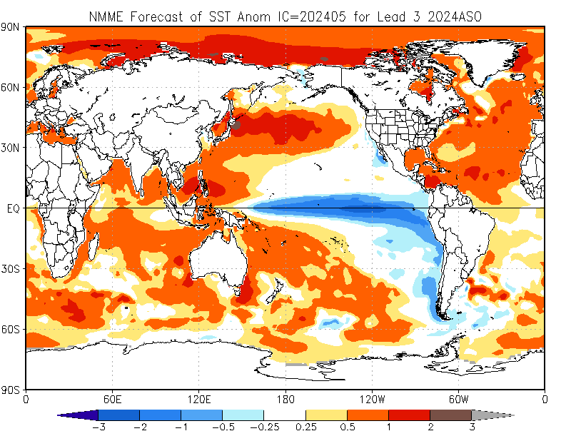

Slide 17
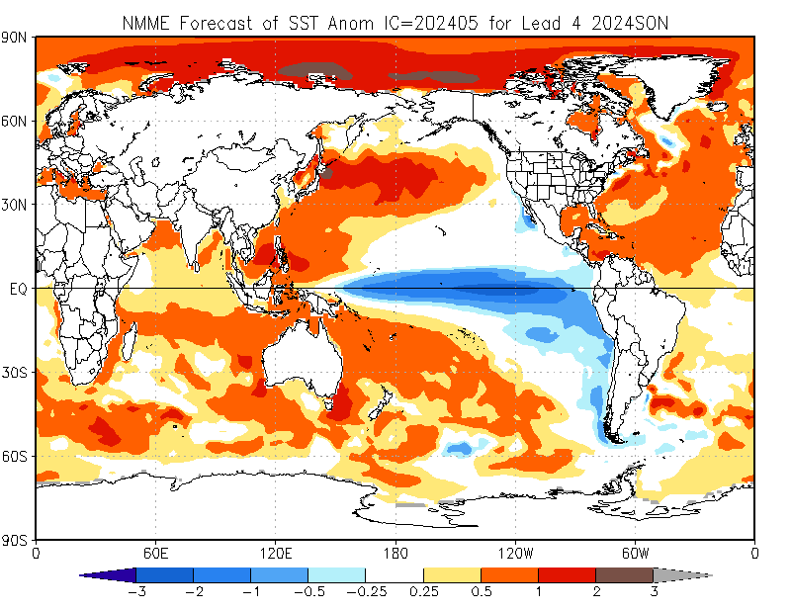

Slide 18
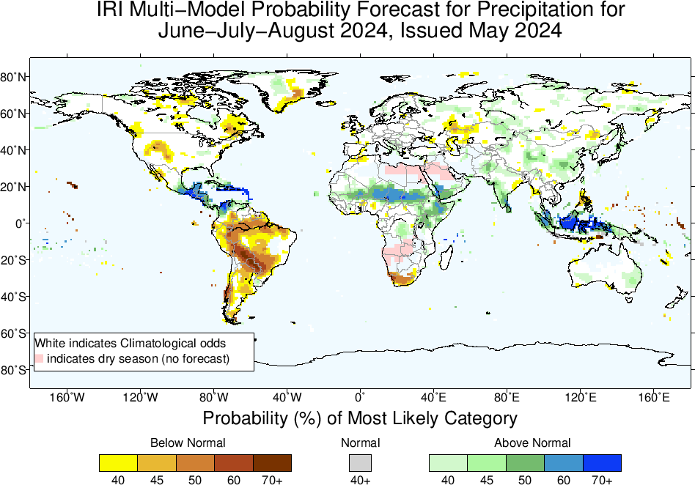
Precipitation Forecasts based on North American Multi Model Ensemble (NMME)

Slide 19
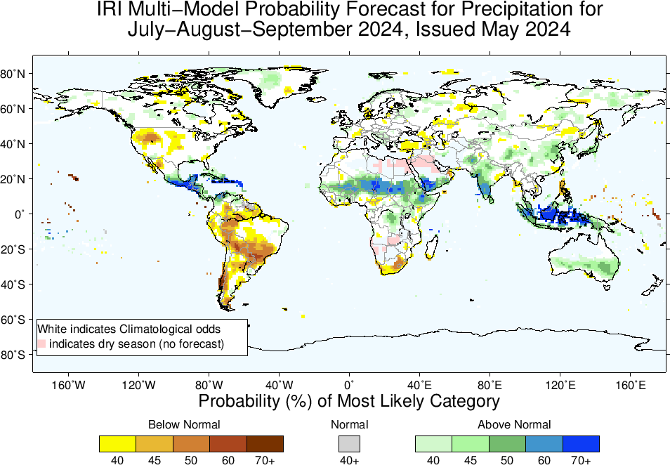

Slide 20
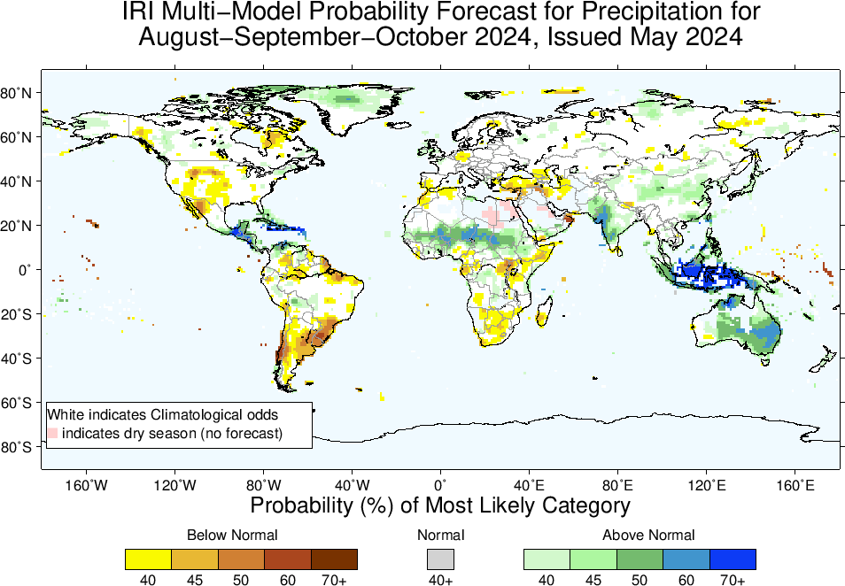

Slide 21
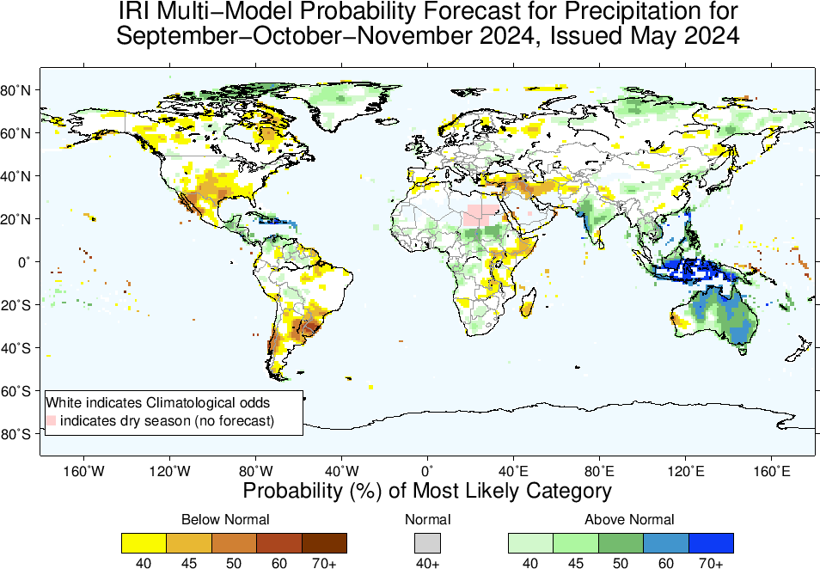

Slide 22
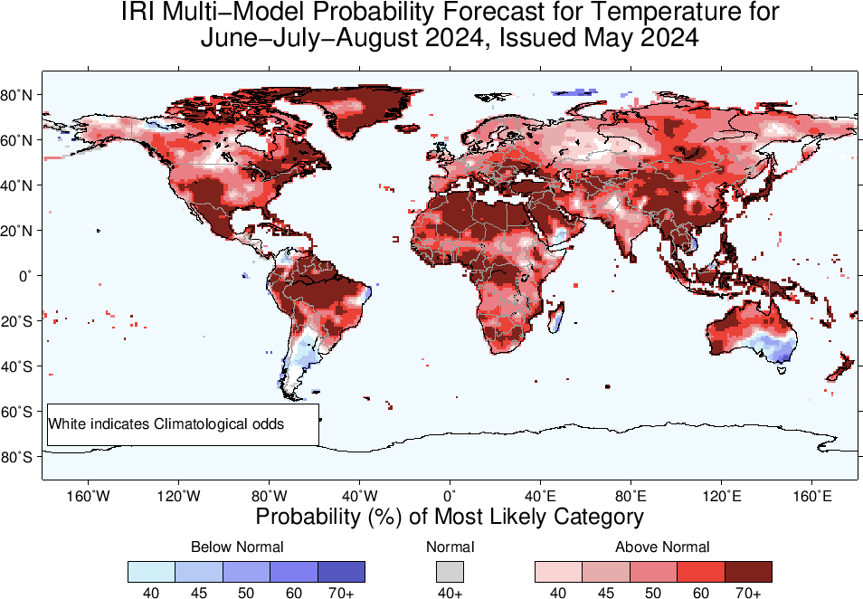
2m-Temperature Forecasts based on North American Multi Model Ensemble (NMME)

Slide 23
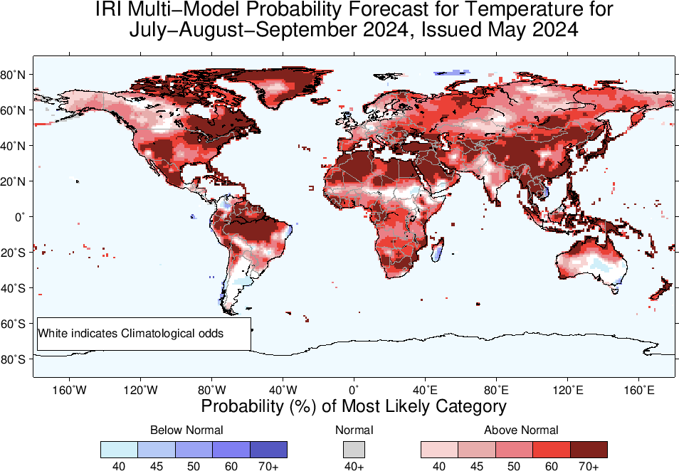

Slide 24
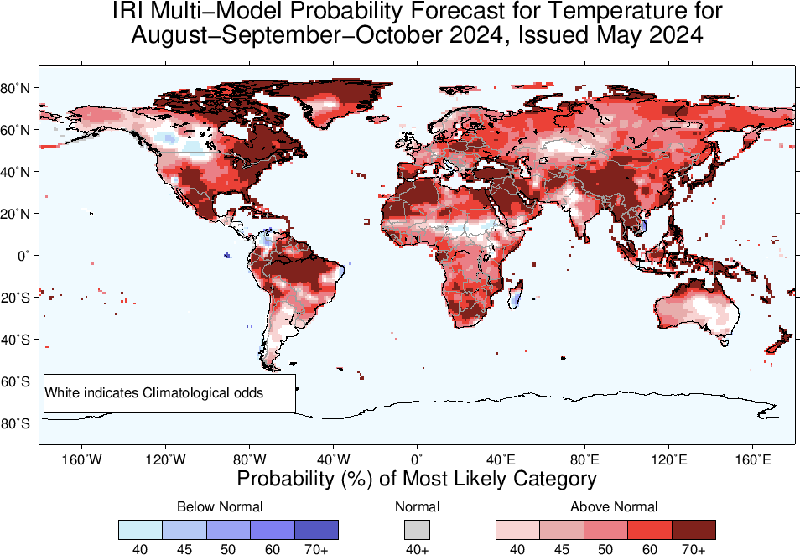

Slide 25
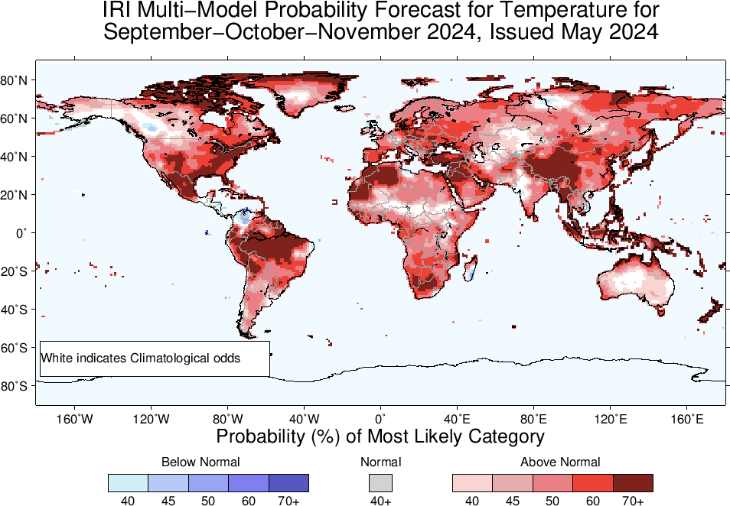

Slide 26
Summary
After its Peak in Nov-Jan, current El Nino has started declining (Dec, 2023 NINO3.4 Value was +1.99, while Jan, 2024 was +1.78, and Feb, was +1.53, March was +1.24, and April, was +0.8), while for most recent week ending on 08 May, 2024, it was +0.3.
This shows a declined El Nino state.
ENSO-Neutral is most probable in AMJ, MJJ, JJA, JAS, 2024
LA NINA is most likely from ASO, and remain so onward.
Given LA NINA, Monsoonal regions of Africa, Asia, MC, Australia, Central America, could experience wetter than normal conditions during their peak seasons (JJA, and JAS of 2024)
While, most of northern South America in JJA, and JAS, while most of southern South America in ASO and SON, and South Africa experience drier than normal conditions!

