Slide 1
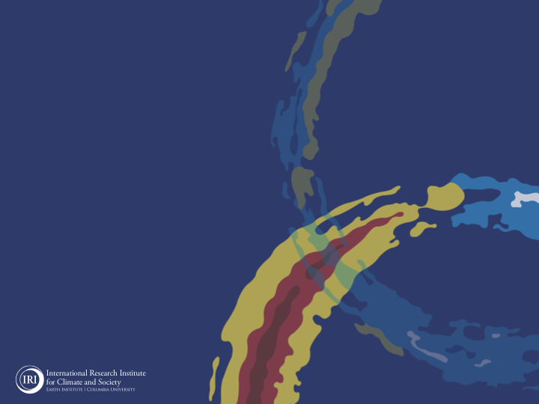
ENSO and Climate Outlook
May 2021:
ENSO-Neutral Conditions Ahead,
Probably.

Slide 2
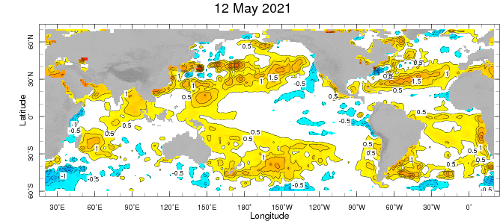
Weekly Sea Surface Temperature Anomalies (includes satellite data)
NINO3.4 = -0.3 C

Slide 3
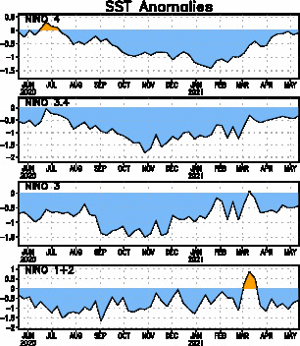
Near Dateline
This is the SST
Index
predicted
Eastern Eq. Pacific
Off Coast of S.America

Slide 4
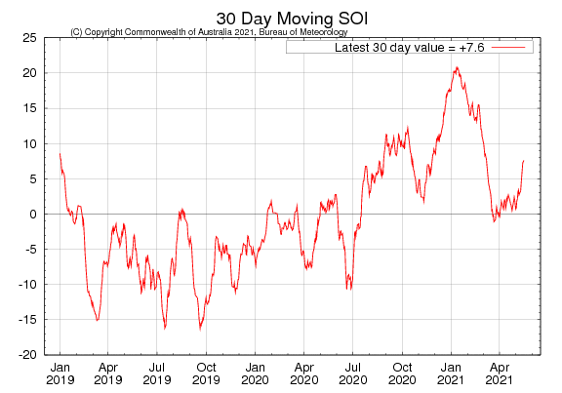
Tahiti_{SLP} – Darwin,AUS_{SLP}

Slide 5
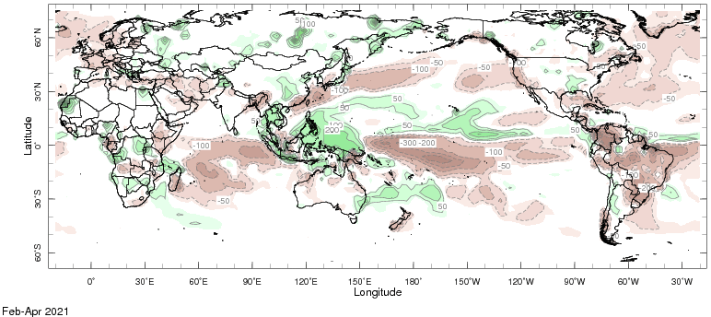
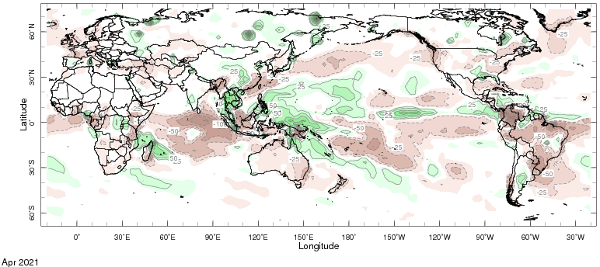
Precipitation Anomalies

Slide 6
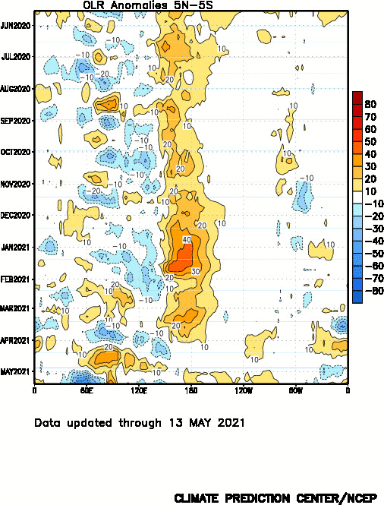
Wetter
Drier

Slide 7
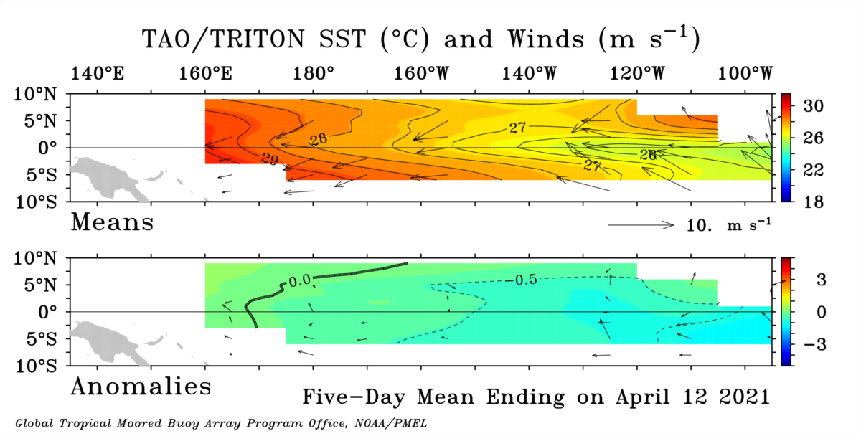

Slide 8
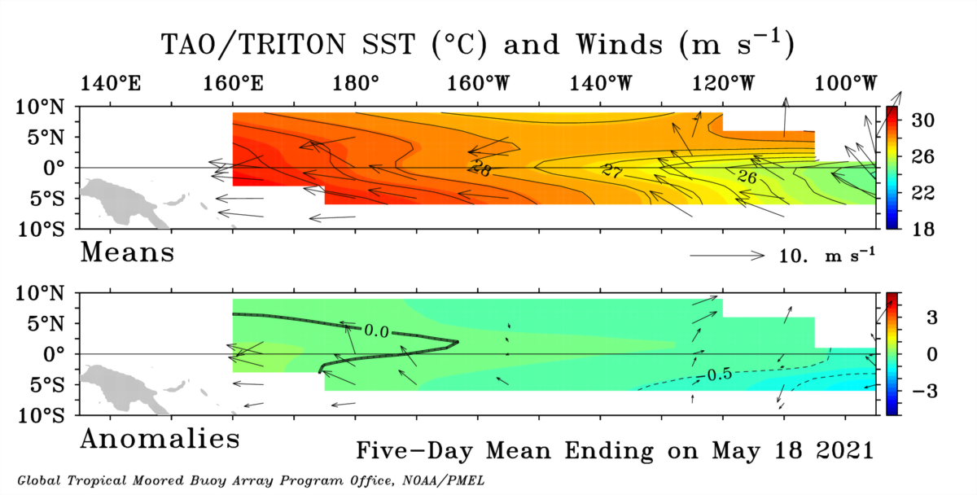

Slide 9
GODAS* Analysis
Used to initialize CFSv2 and CCSM4
TOTAL
ANOMALY
* Global Ocean Data Assimilation System

Slide 10
Analysis directly from TOGA-TAO buoy measurements.
TOTAL
ANOMALY

Slide 11
Analysis directly from TOGA-TAO buoy measurements.
Last Month (Apr ‘21)
Last 5 Days

Slide 12
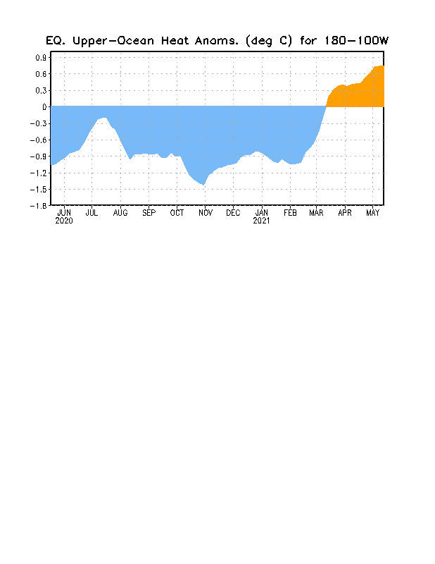

Slide 13
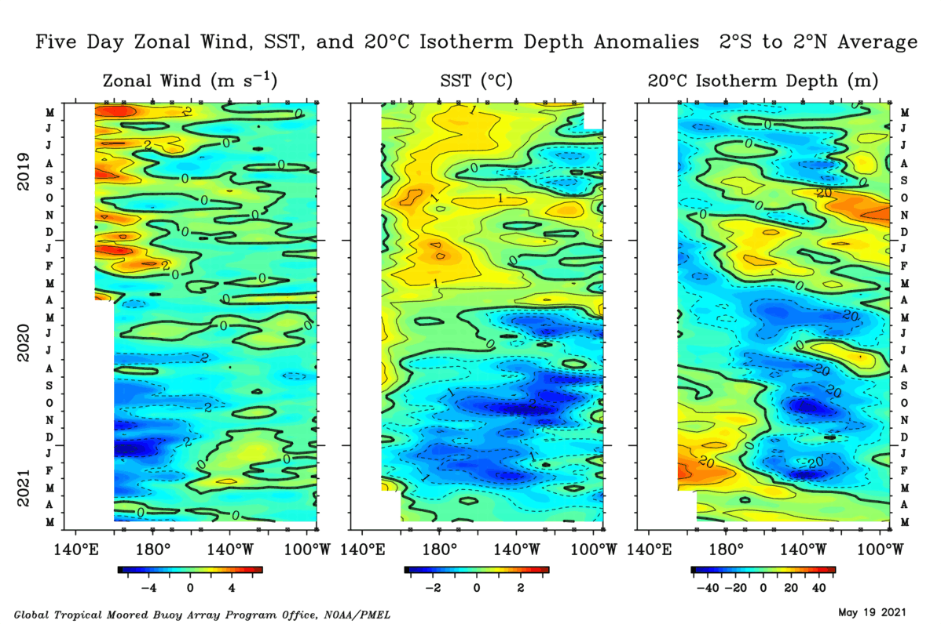

Slide 14
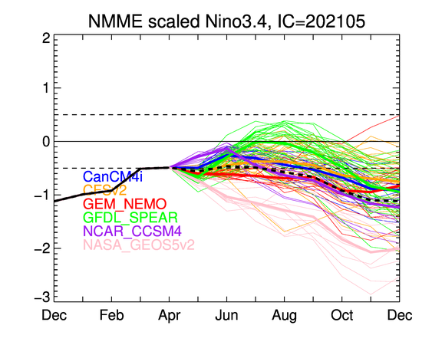

Slide 15
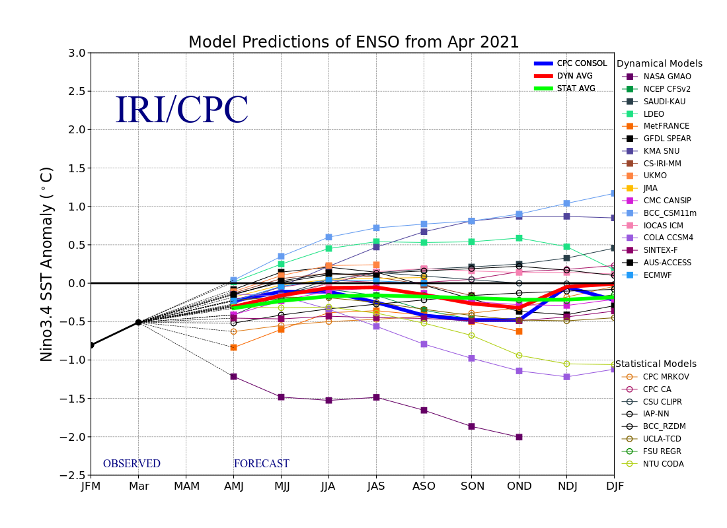

Slide 16
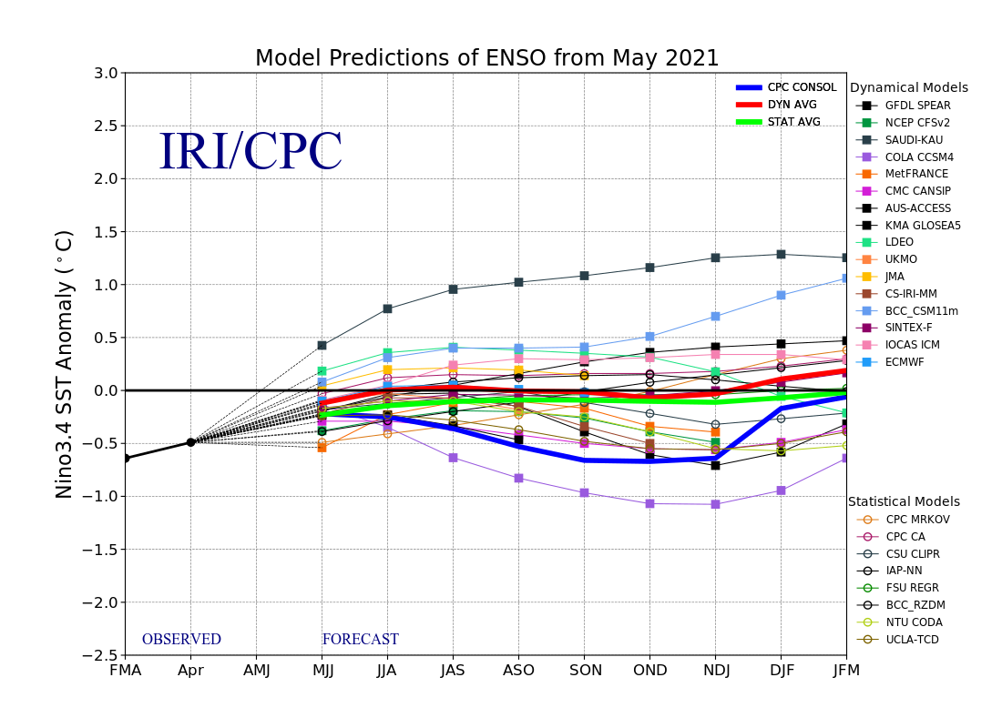

Slide 17
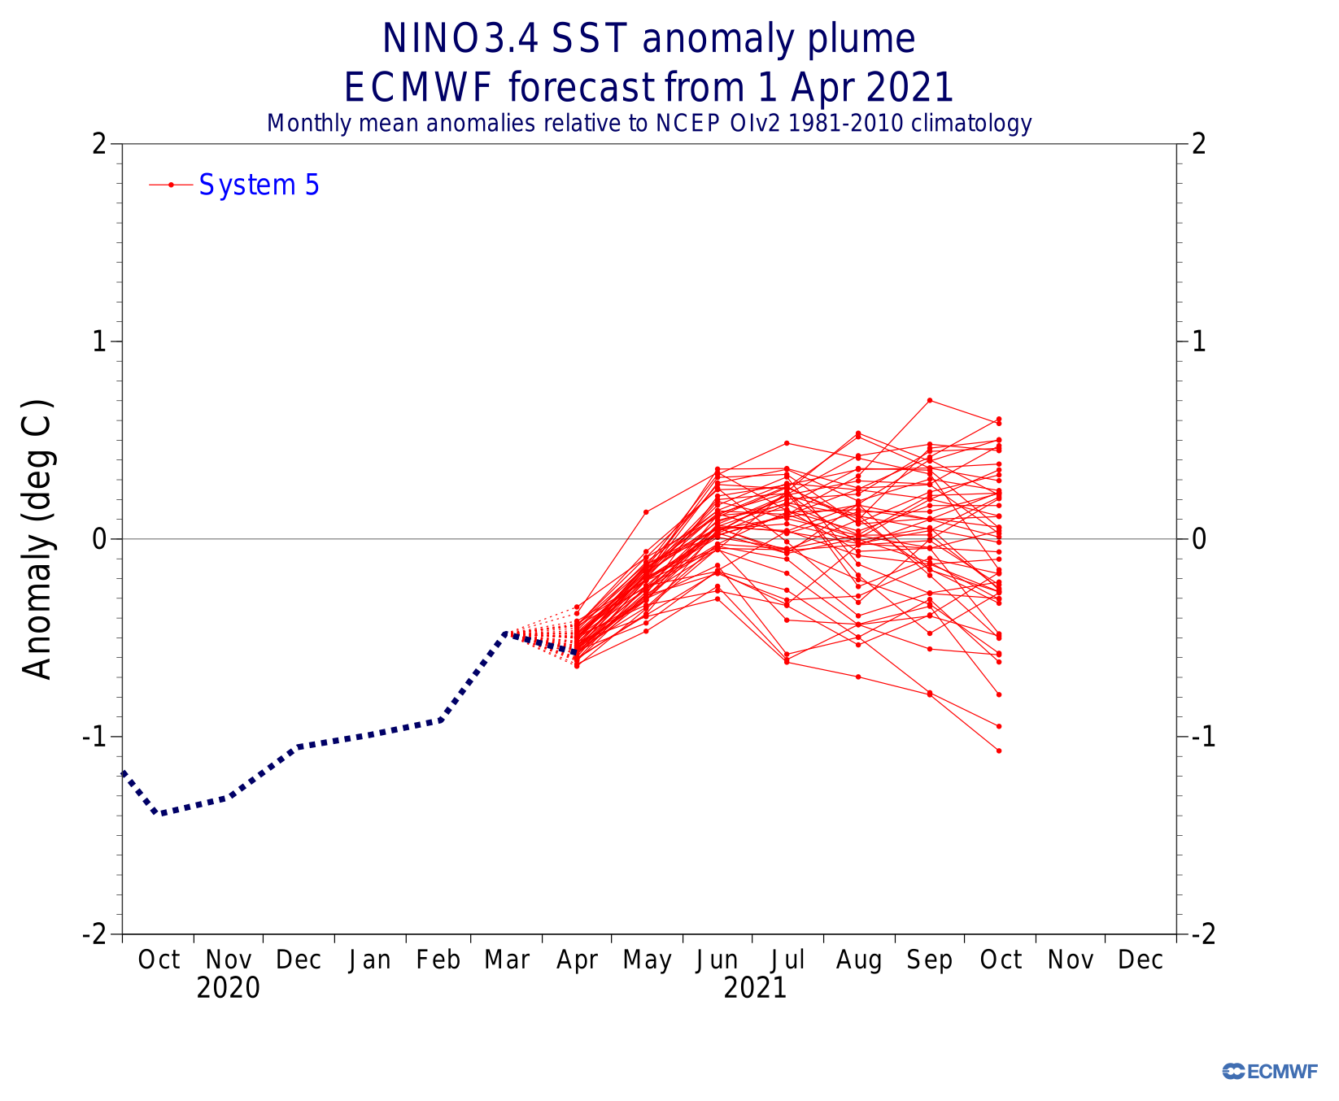
April Forecast
April Forecast

Slide 18
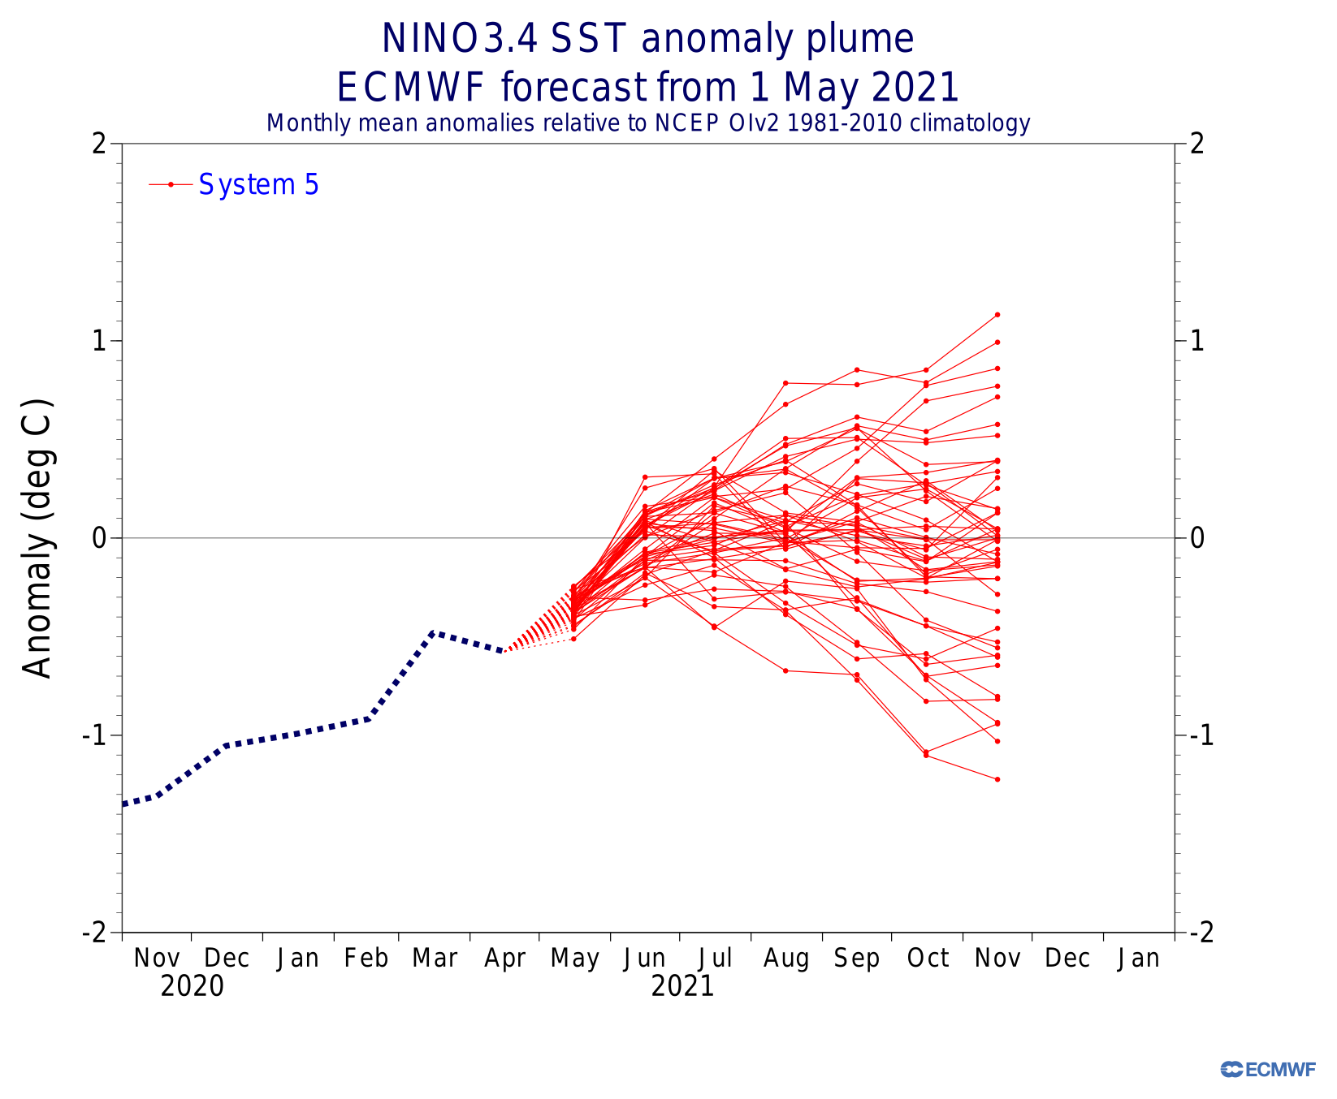
Current Forecast
April Forecast

Slide 19
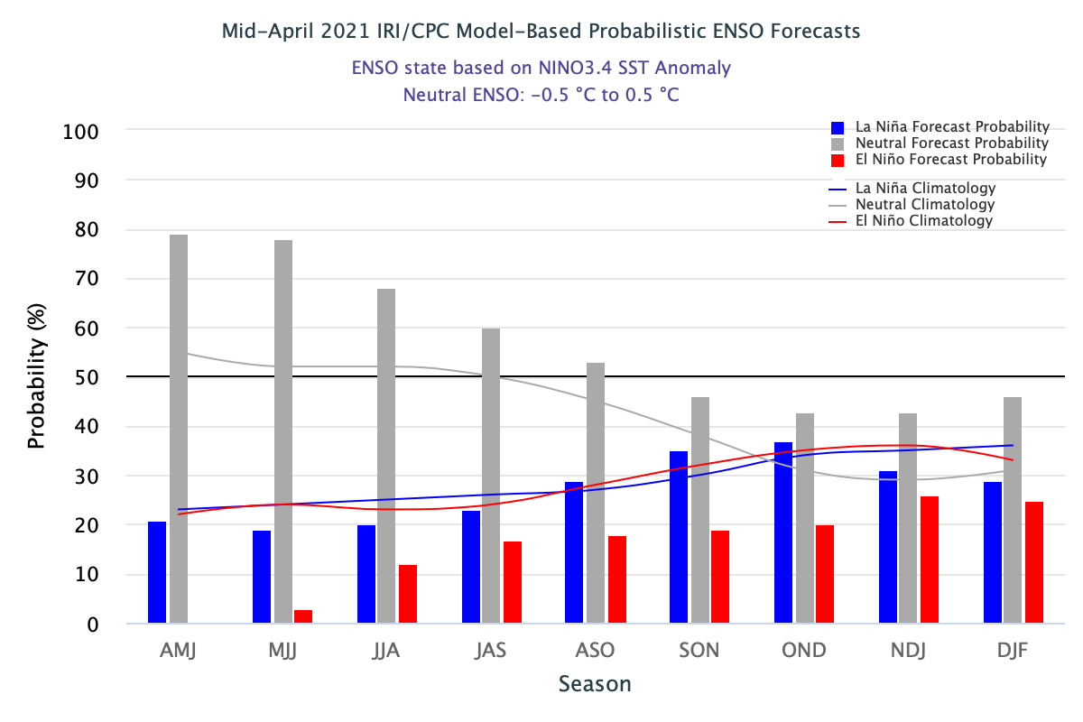

Slide 20
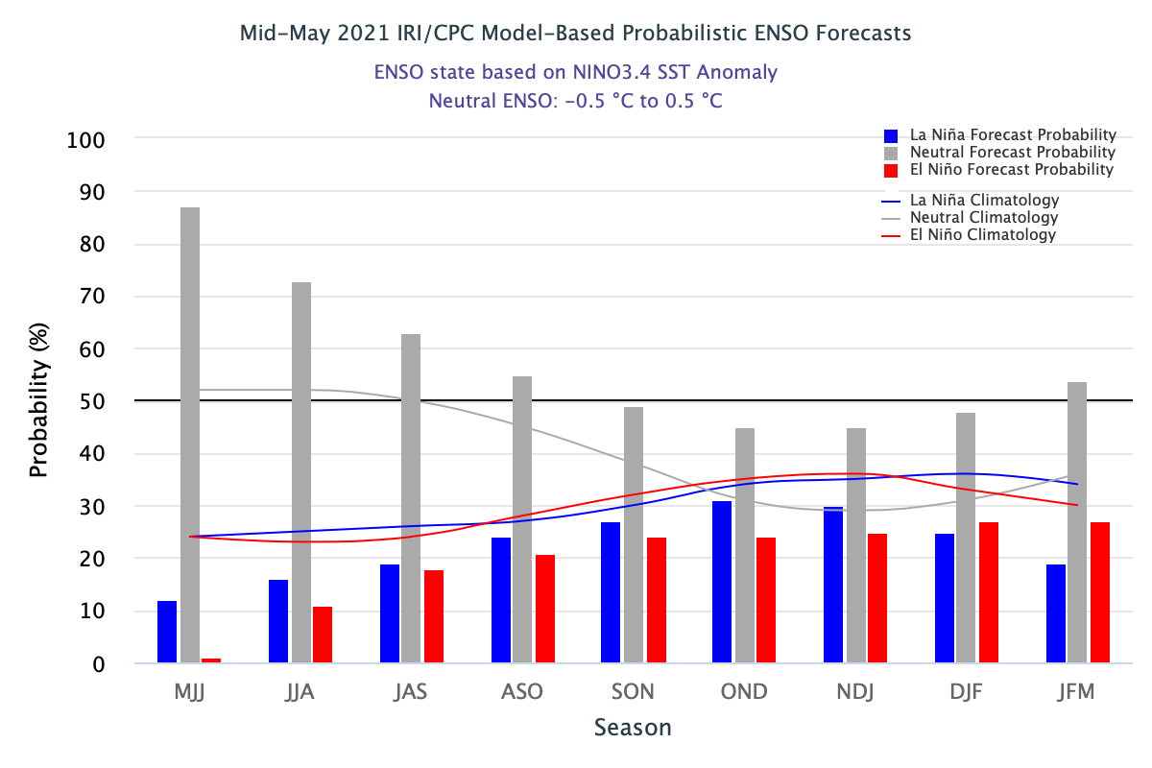

Slide 21
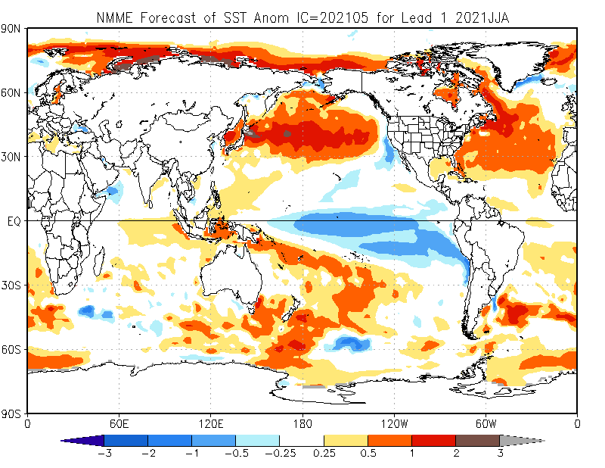
Includes NASA

Slide 22
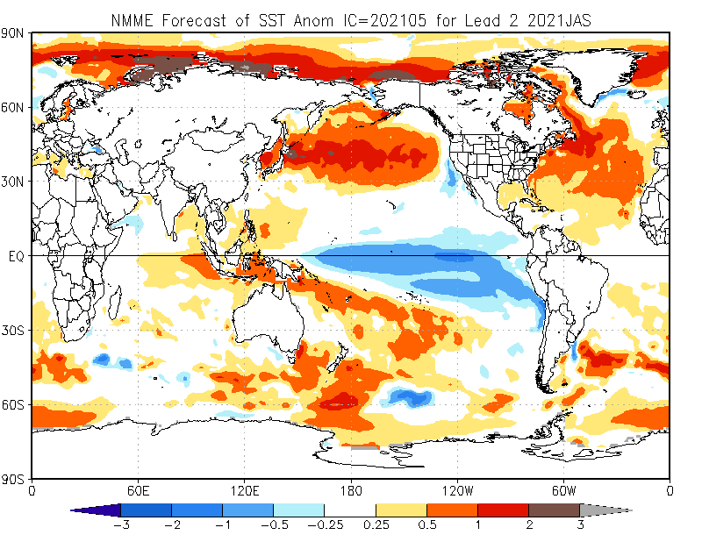
Includes NASA

Slide 23
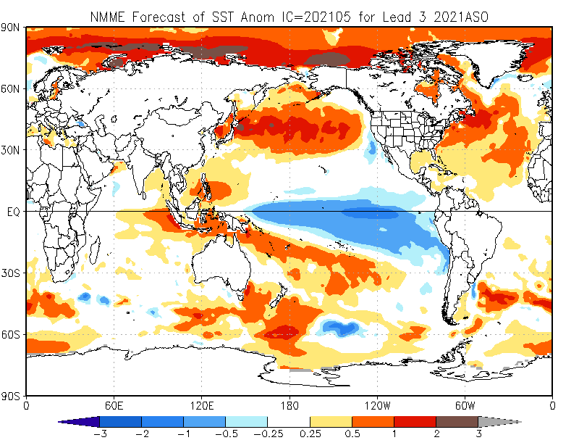
Includes NASA

Slide 24
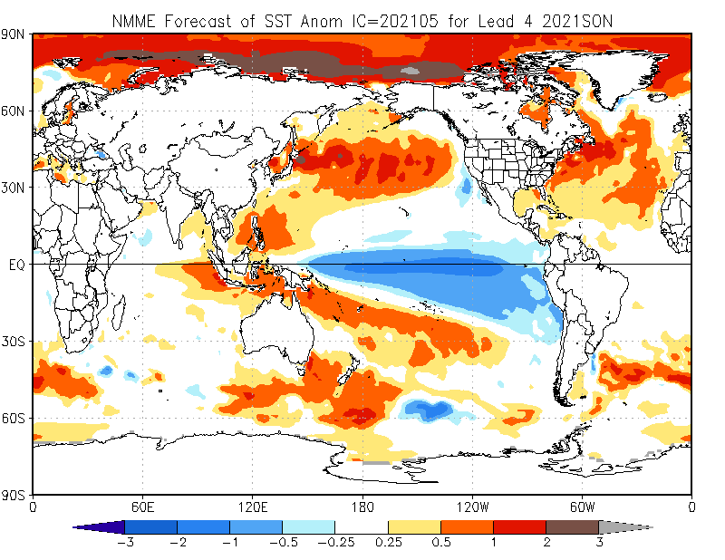
Includes NASA

Slide 25
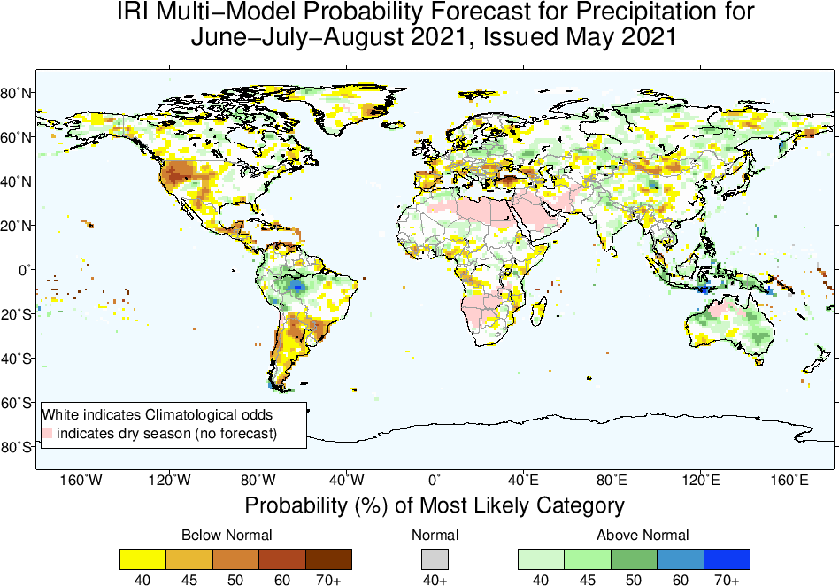

Slide 26
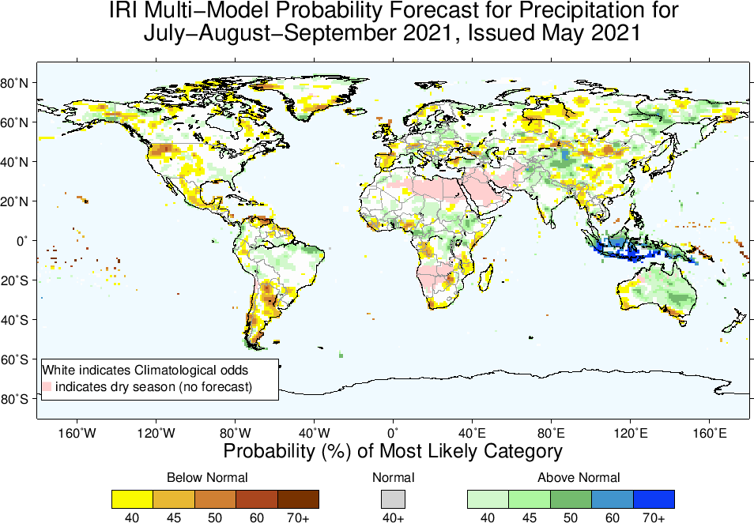

Slide 27
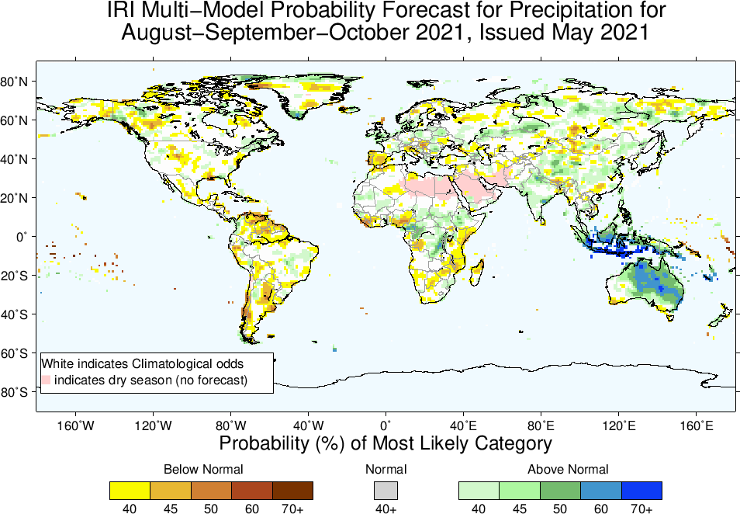

Slide 28
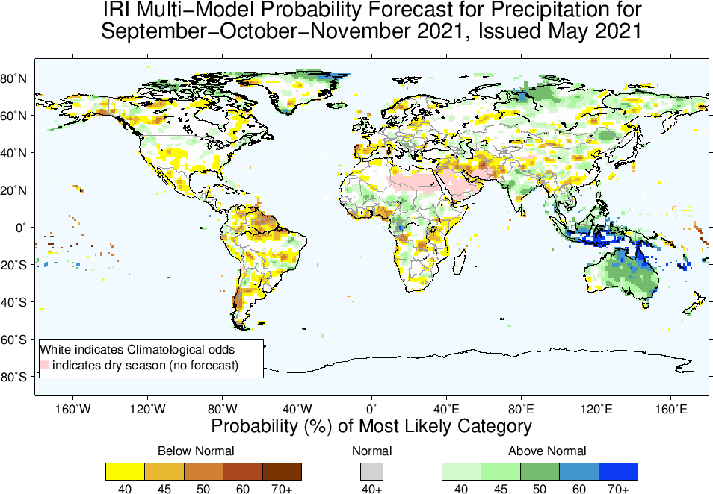

Slide 29
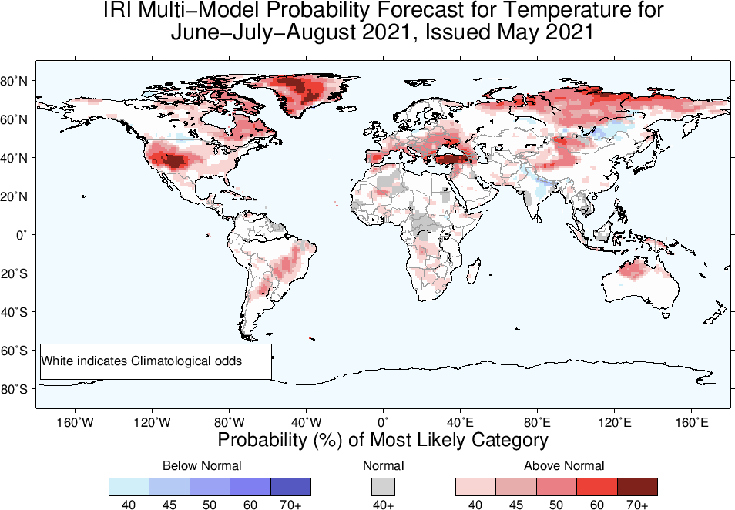

Slide 30
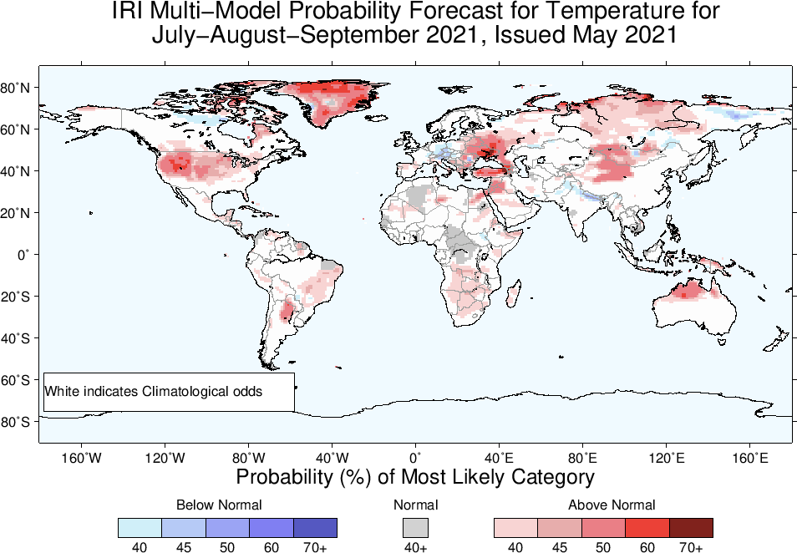

Slide 31
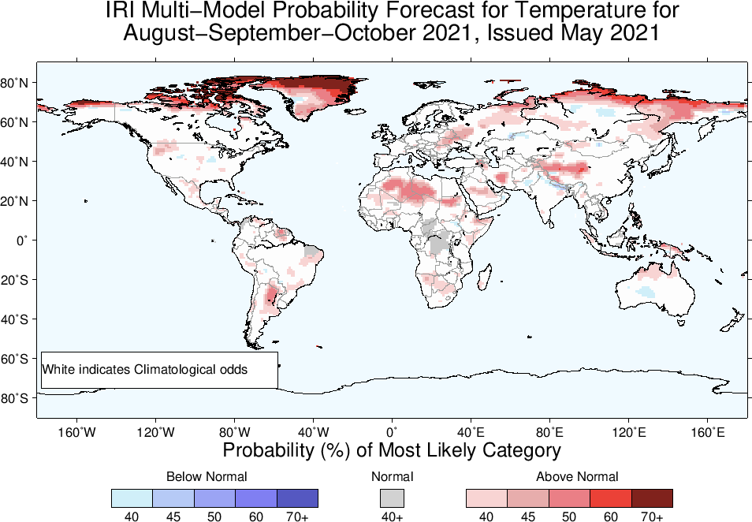

Slide 32
