Slide 1
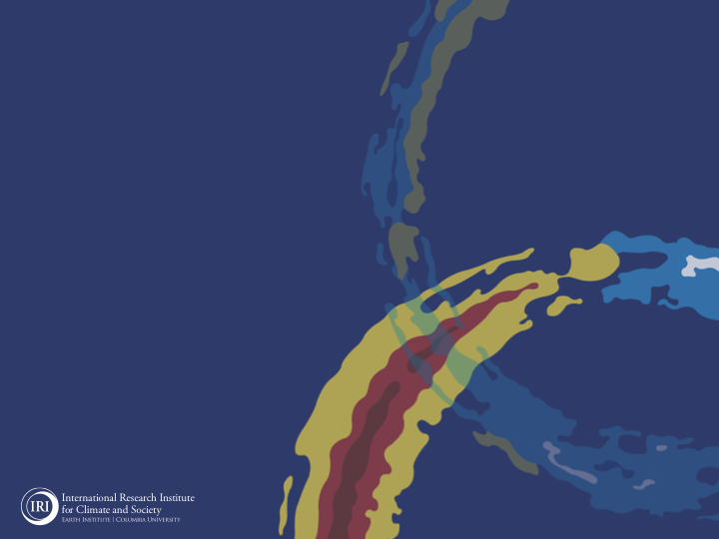
ENSO and Climate Outlook in
March, 2024
El Niño's Tenacity: Clinging on in the MJO’s Spring Dance Party!
M. Azhar Ehsan
(azhar@iri.columbia.edu)
Associate Research Scientist
IRI ENSO and Climate Forecast Lead
Jeffrey Turmelle and Jing Yuan: forecast processing and web updates
Cuihua Li: Draft PowerPoint development
IRI’s Climate Group, led by Dr. Andrew Robertson: Forecast system development, ongoing innovation, and verification

Slide 2
Outline
Observed Oceanic and Atmospheric Conditions in
Tropical Pacific
Across the Globe
ENSO Forecast in
NMME
IRI ENSO Forecast Tool (Deterministic and Probabilistic)
Seasons Outlook of
SST
Precipitation and Temperature
Summary

Slide 3
Observations
Oceanic
Atmospheric

Slide 4
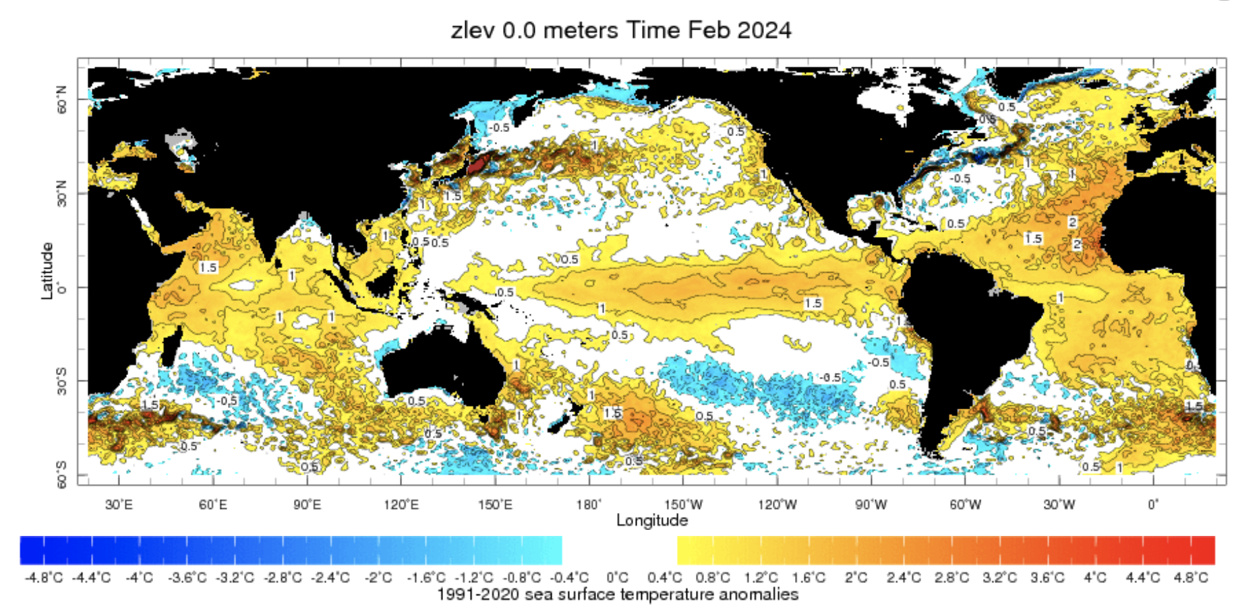
Evolution of SST Departures in Monthly (Feb, 2024) Data
For Feb, 2024
NINO 1+2: +0.92
NINO3: +1.47
NINO3.4: +1.53
NINO4: +1.22
In the Pacific Ocean: Above-Average SSTs persisted across the central (across the Date Line),
Indian Ocean: Warm across Indian Ocean, Neutral IOD (Though Index value is +0.86 as of 17 March, 2024),
North-Pacific and North Atlantic Ocean: Negative PDO (-1.33), Warm across Atlantic (TNAI, +1.34, TSAI, +1.24, TAtl, +1.02)
Source: https://iridl.ldeo.columbia.edu/maproom/Global/Ocean_Temp/ERSST_Anomaly.html

Slide 5
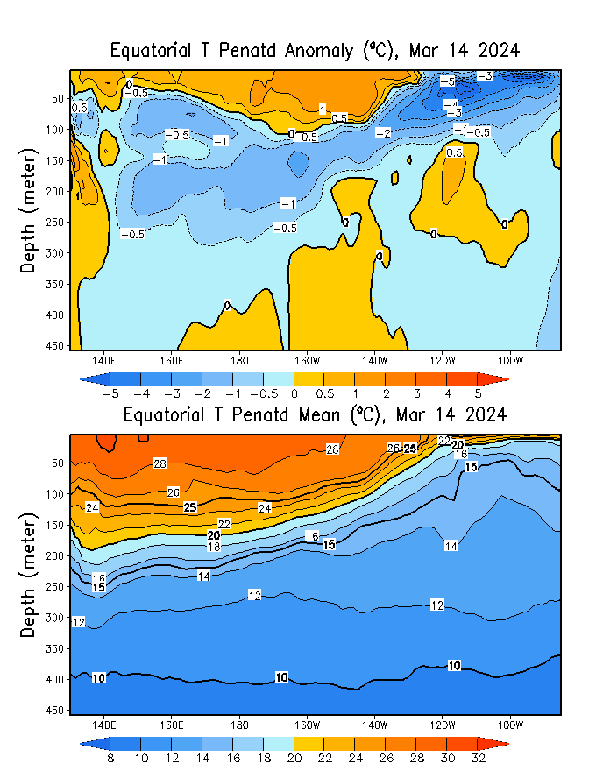
What is the underwater conversation?
January, 2024
March, 2024
Warm subsurface temperature anomalies dominate from 140E to 140W in equatorial Pacific Ocean (Surface to 50 meter at depth).
February, 2024
Cold subsurface temperature anomalies have strengthened in the Pacific Ocean and expanded to surface level at far easter Pacific (130 W onwards).

Slide 6
What is the underwater conversation?
Following peak levels in November and December 2023, positive anomalies have diminished.
By February 2024, negative anomalies have begun to strengthen gradually, nearing an index value of approximately -0.5.

Slide 7
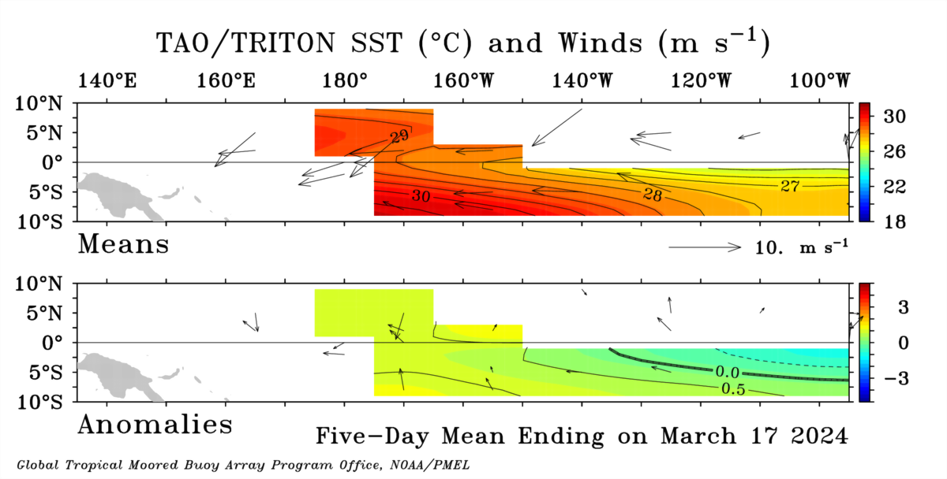
Most recent Sea Surface Temperature (SST) Lower-Level Winds

Slide 8
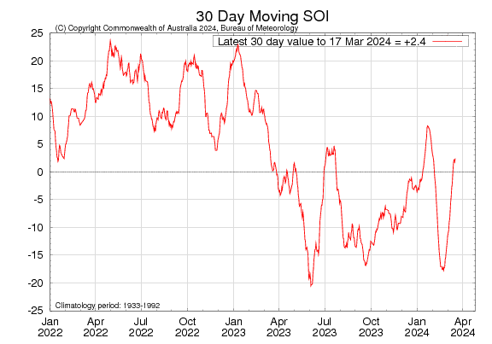
Most recent Southern Oscillation Index (SOI)
Current SOI values is in ENSO-neutral range.
During El Niño, the pressure becomes below average in Tahiti and above average in Darwin, and the Southern Oscillation Index is negative.
A Sustained Negative values of the SOI above -7 typically indicate El Niño
Source:
http://www.bom.gov.au/climate/enso/#tabs=Pacific-Ocean&pacific=SOI

Slide 9
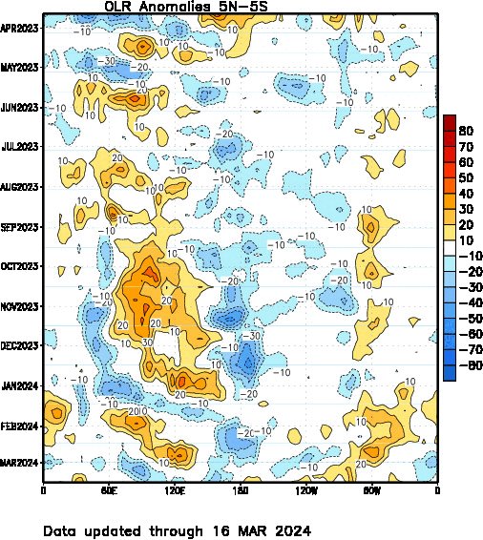
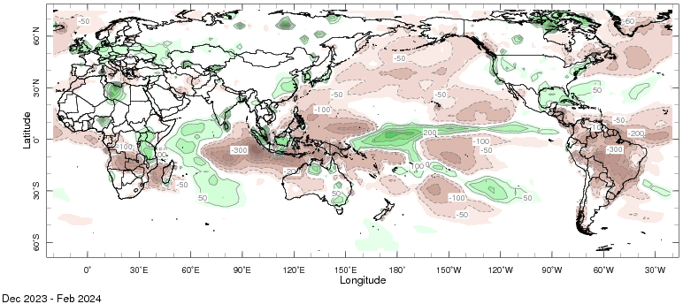
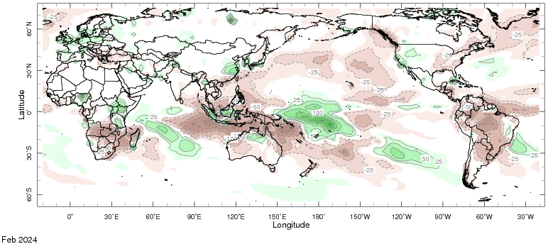
Most recent Outgoing Longwave Radiation (OLR) and Precipitation

Slide 10
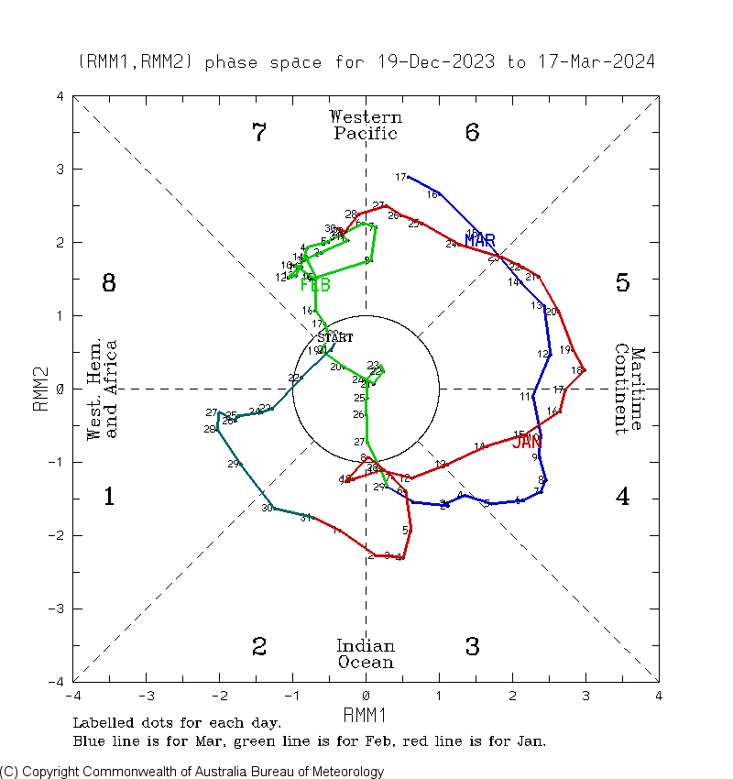
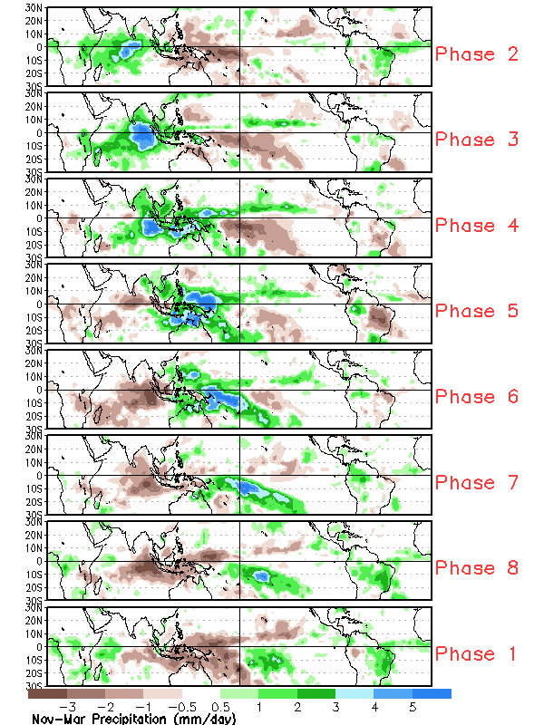
Most MJO-Index State (MJO)
During MJO Phases 6 and 7, there is often enhanced convection and rainfall activity over the central-western Pacific and,
Suppression of convection over the eastern Pacific.
This can lead to the weakening or suppression of trade winds in the central and eastern Pacific.
Again, a Constructive interference with ongoing El Nino.

Slide 11
Forecasts
Nino-34 in NMME,
IRI ENSO Plume,
Probability of Nino-34,
Global SSTs from NMME,
Prcp. and Temp. outlook from IRI (March, 2024)

Slide 12
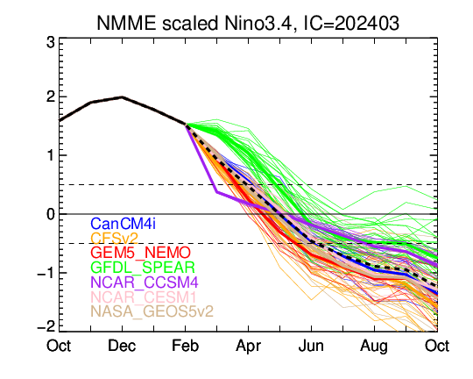
North American Multi Model Ensemble (NMME) ENSO Forecast (Mar, 2024 Initial)

Slide 13
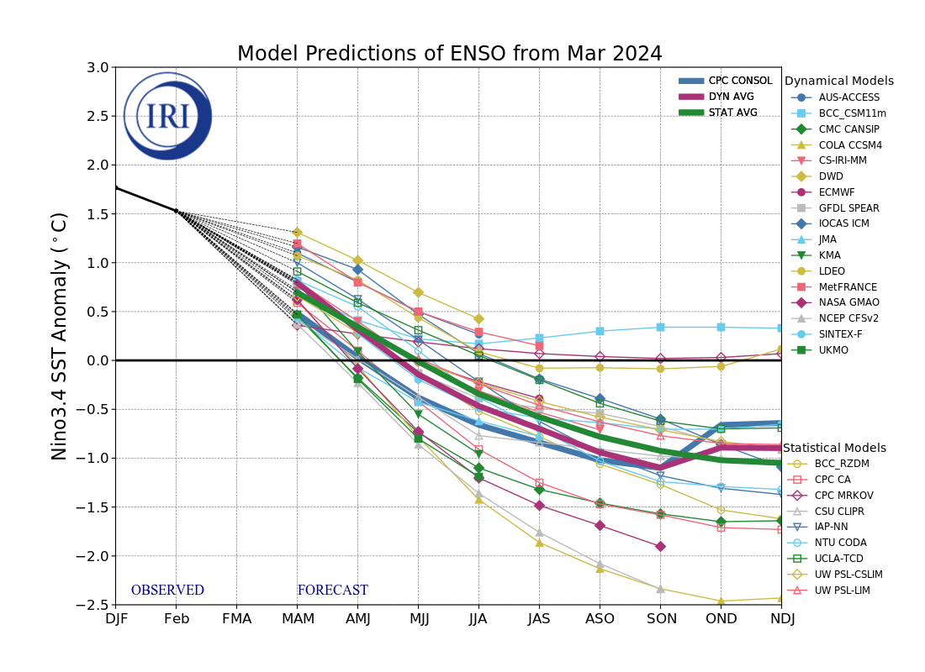
IRI’s ENSO Forecast March, 2024
Majority of models (DYN & STAT) indicate El Niño will persist through March-May 2024 and then transition to ENSO-neutral during April-June 2024.
After three seasons of ENSO-neutral conditions, most models indicate a transition to La Niña around Jul-Sep 2024.

Slide 14
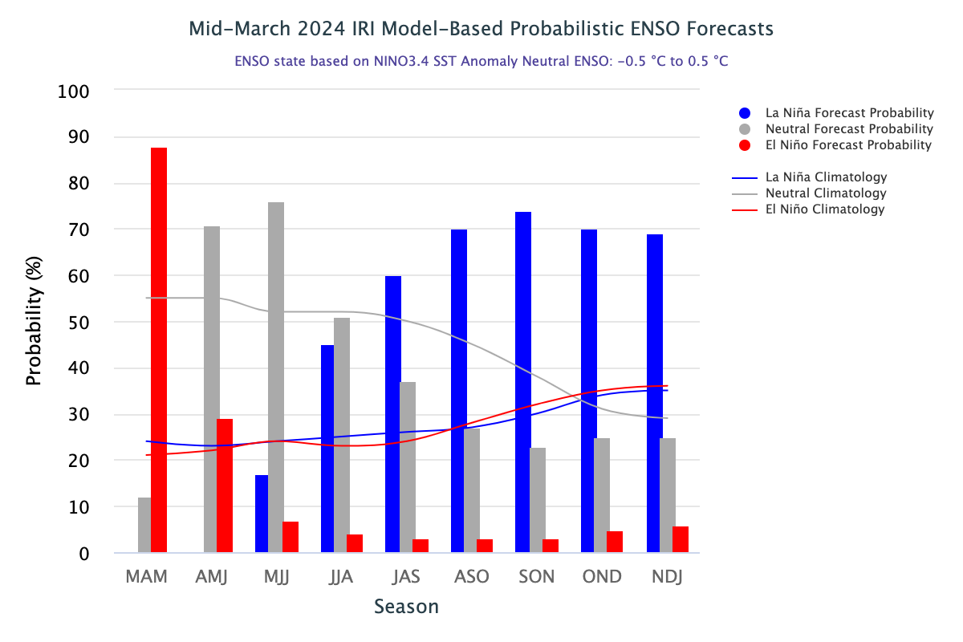
IRI’s Probabilistic ENSO Forecasts (on 19th March, 2024)

Slide 15
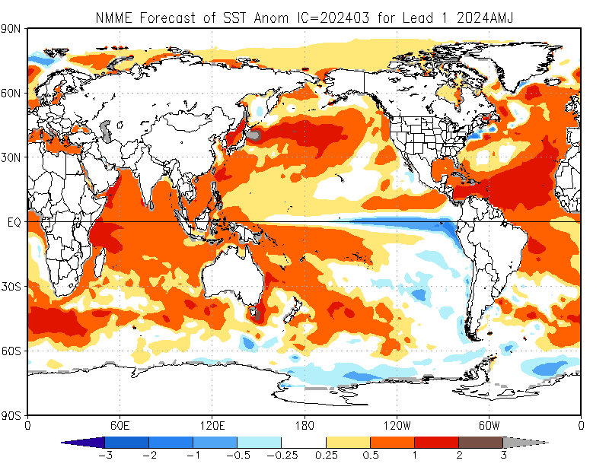
North American Multi Model Ensemble
(NMME) SST Forecast

Slide 16
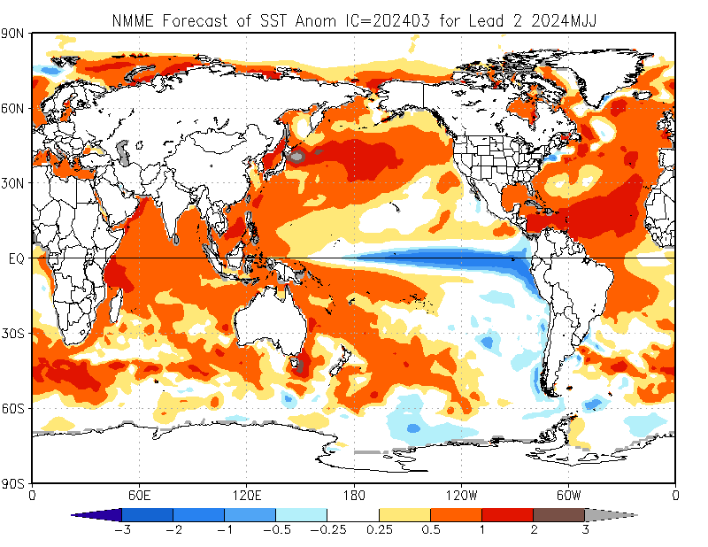

Slide 17
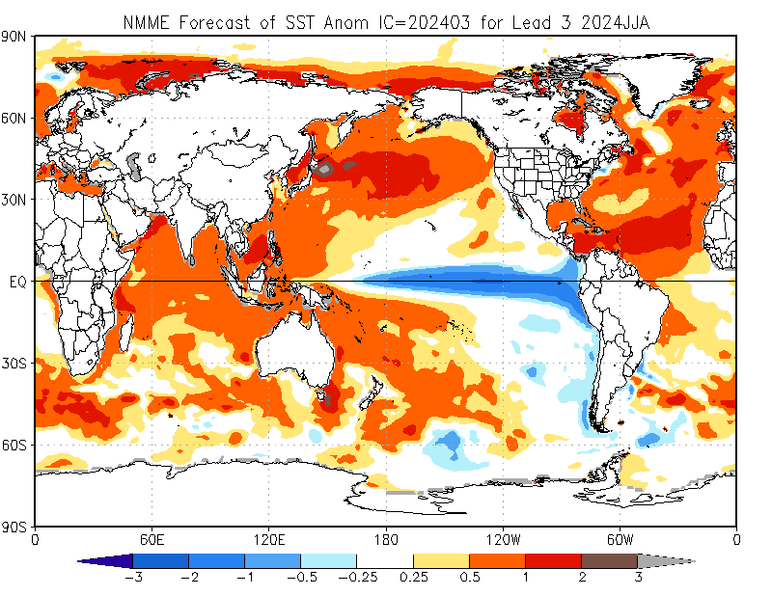

Slide 18
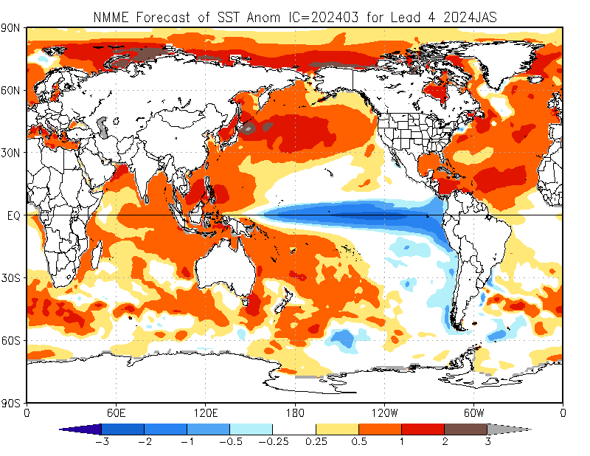

Slide 19
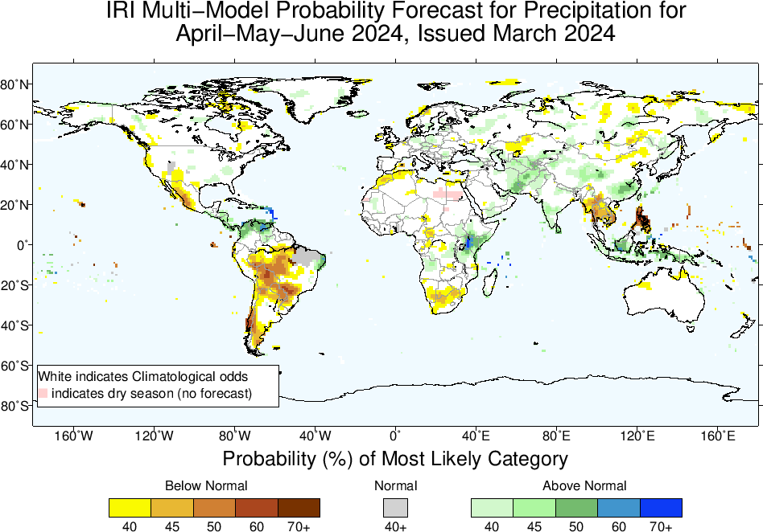
Precipitation Forecasts based on North American Multi Model Ensemble (NMME)

Slide 21
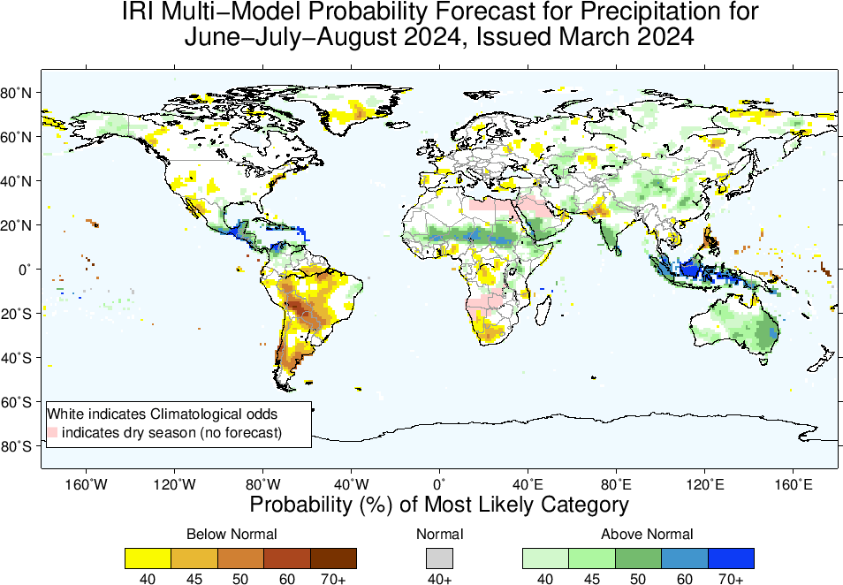

Slide 22
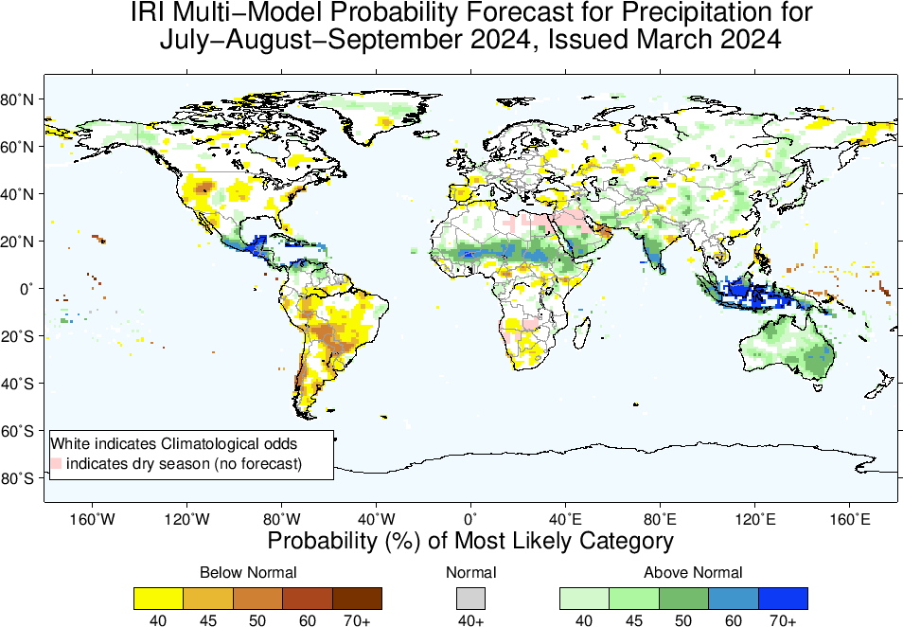

Slide 23
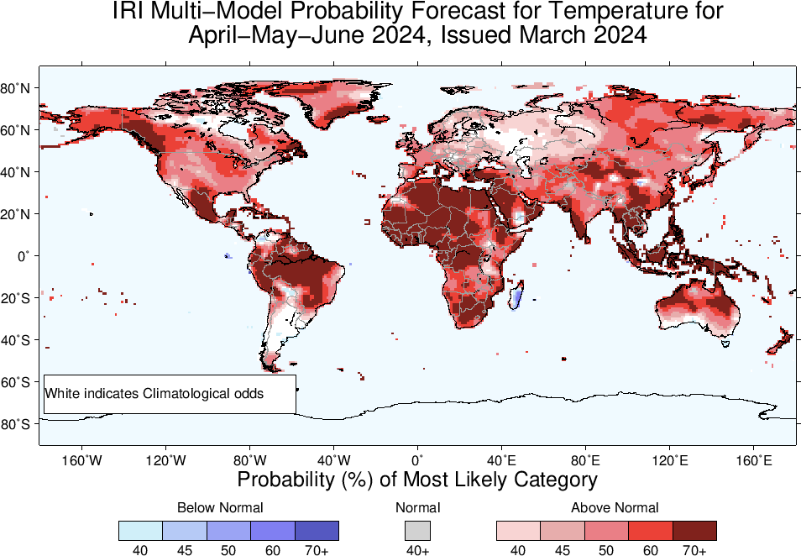
2m-Temperature Forecasts based on North American Multi Model Ensemble (NMME)

Slide 24
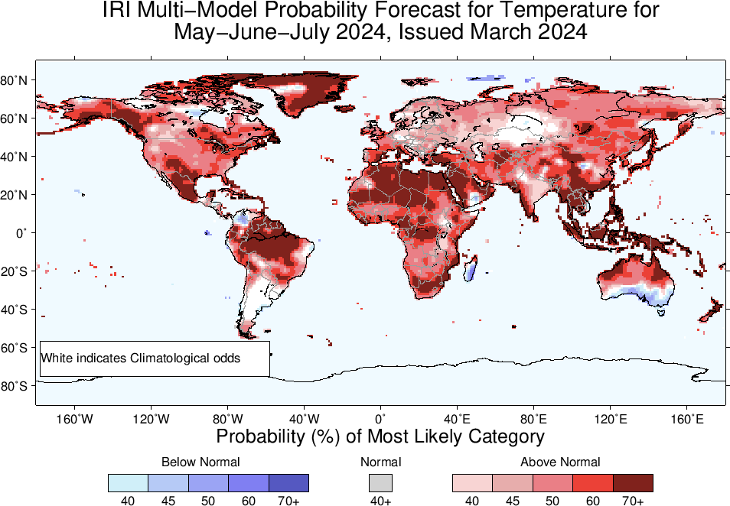

Slide 25
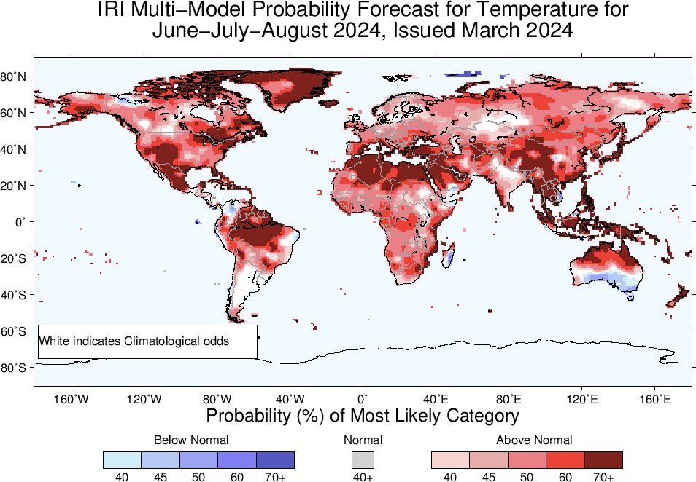

Slide 26
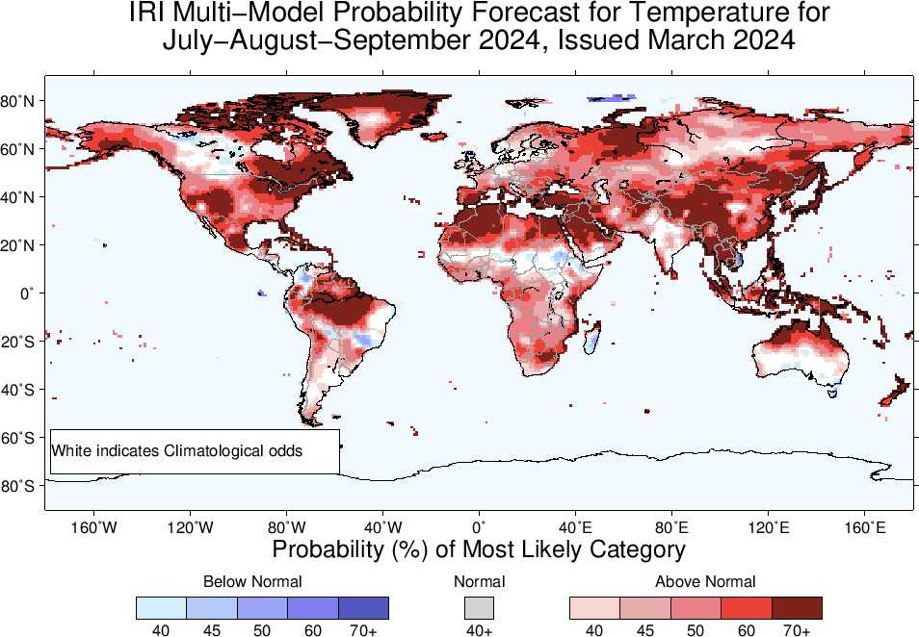

Slide 27
Summary
After its Peak in Nov-Jan, current El Nino has started declining (Dec, 2023 NINO3.4 Value was +1.99, while Jan, 2024 was +1.78, and Feb, was +1.53 ), while for most recent week ending on 13 March, 2024, it was +1.1.
This shows a gradually declining El Nino.
The latest forecasts suggest that the current El Nino will persist through the boreal Spring (88% in MAM-2024), sharply weakening thereafter.
ENSO-Neutral is most probable in AMJ, MJJ, and JJA, 2024.
LA NINA is most likely from JAS, and remain so onward.

