Slide 1
ENSO and Climate Outlook in May, 2025
ENSO Status “Non-Active”
Ehsan, M. Azhar
(mae2171@columbia.edu)
Center for Climate Systems Research (CCSR),
Affiliate of NASA GISS and
International Research Institute for Climate and Society (IRI)
Dr. Andrew Robertson (CCSR): Forecast system development, ongoing innovation,
Jing Yuan (CCSR): Forecast Post-Processing,
Jeffrey Turmelle (IRI): Forecast Post-Processing and Web updates.

Slide 2
Outline
Observed Oceanic and Atmospheric Conditions in
Tropical Pacific
Across the Globe
ENSO Forecast in
NMME
IRI/CCSR@NASA-GISS ENSO Forecast Tool (Deterministic and Probabilistic)
Seasons Outlook of
SST
Precipitation and Temperature
Summary

Slide 3
Observations
Oceanic
Atmospheric

Slide 4
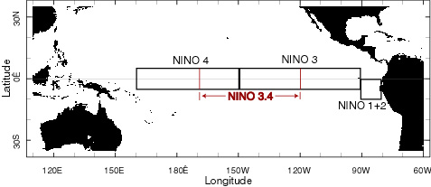
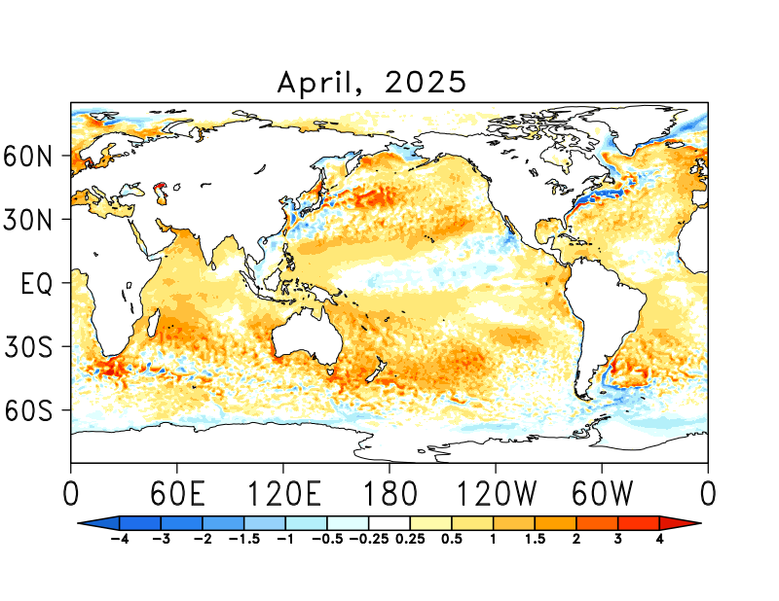
SST Departures in Monthly (April, 2025) Data: OISST v2
NINO3: 0.23
Latitude: 5°S - 5°N
Longitude: 210°E - 270°E
NINO4: -0.01
Latitude: 5°S - 5°N
Longitude: 160°E - 210°E
NINO12: 0.85
Latitude: 10°S - 0°N
Longitude: 270°E - 280°E
NINO34: 0.05
Latitude: 5°S - 5°N
Longitude: 190°E - 240°E
https://psl.noaa.gov/data/gridded/data.noaa.oisst.v2.highres.html

Slide 5
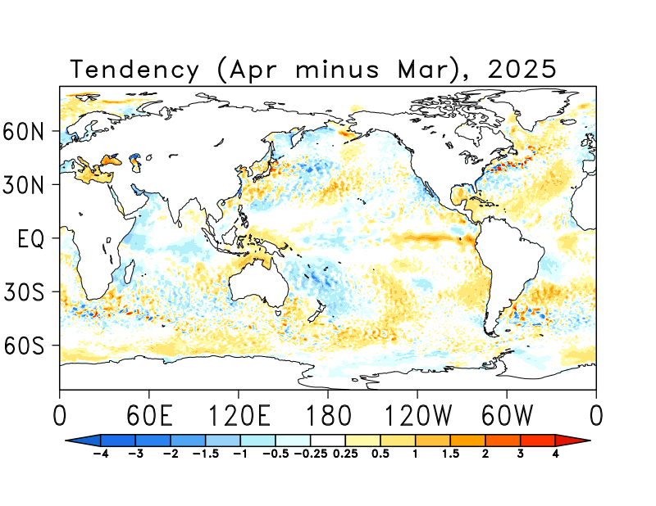
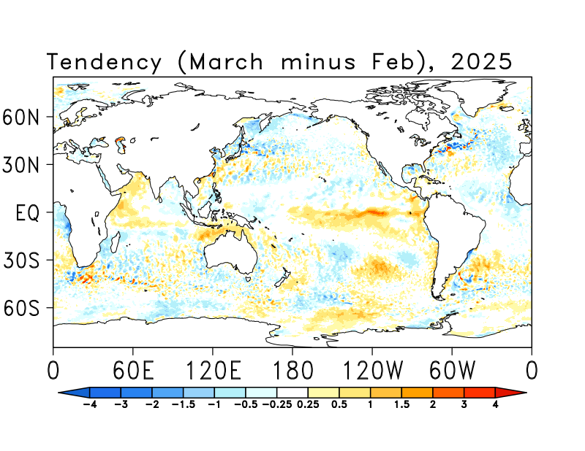
SST Anomalies Tendency (April minus March) Data: OISST v2

Slide 6
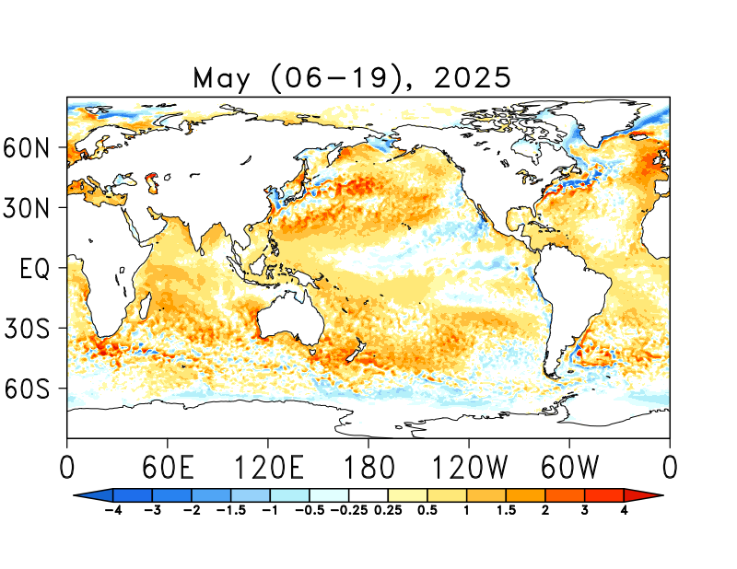
SST Departures in Last Two-Weeks (May 06-20) Data: OISST v2
NINO 1+2: +0.05
Latitude: 10°S - 0°N
Longitude: 270°E - 280°E
NINO 3: -0.03
Latitude: 5°S - 5°N
Longitude: 210°E - 270°E
NINO 3.4: 0.09
Latitude: 5°S - 5°N
Longitude: 190°E - 240°E
NINO 4: 0.06
Latitude: 5°S - 5°N
Longitude: 160°E - 210°E
https://psl.noaa.gov/data/gridded/data.noaa.oisst.v2.highres.html

Slide 7
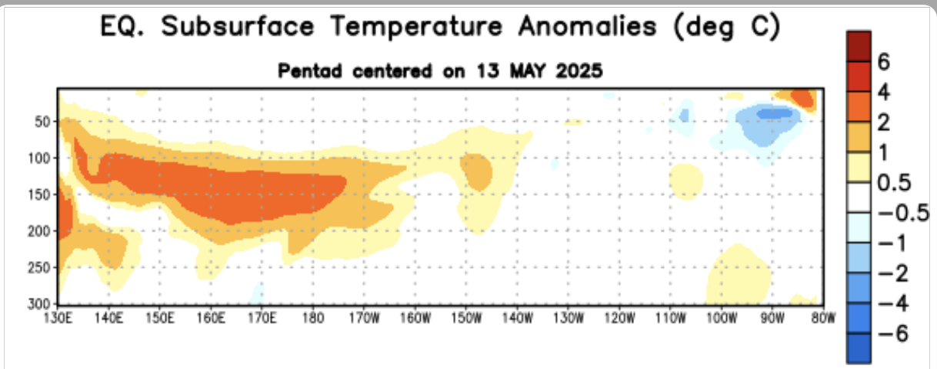
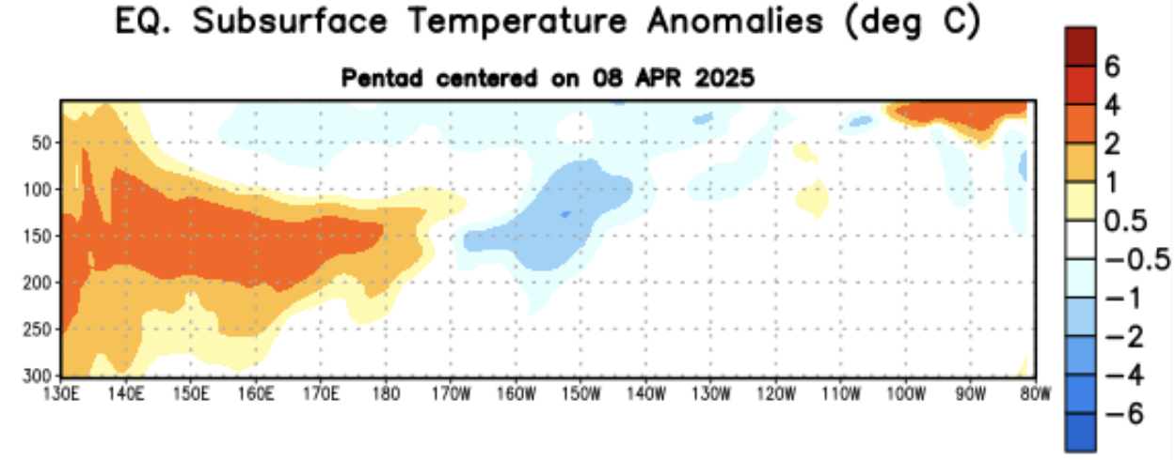
What is the underwater conversation?
March, 2025
Highlight:
Subsurface ocean temperatures from the Date Line to 80°W are near normal (between -0.5 and +0.5°C), with the central and eastern Pacific remaining mostly stable.
There are localized warm and cold anomalies in the far eastern Pacific—warm near the surface and cooler around 50 meters depth—but these are not expected to have significant impact.
Weak subsurface warming is present near and west of the Date Line, extending toward 150°W; while minor, it is worth monitoring.
April, 2025

Slide 8
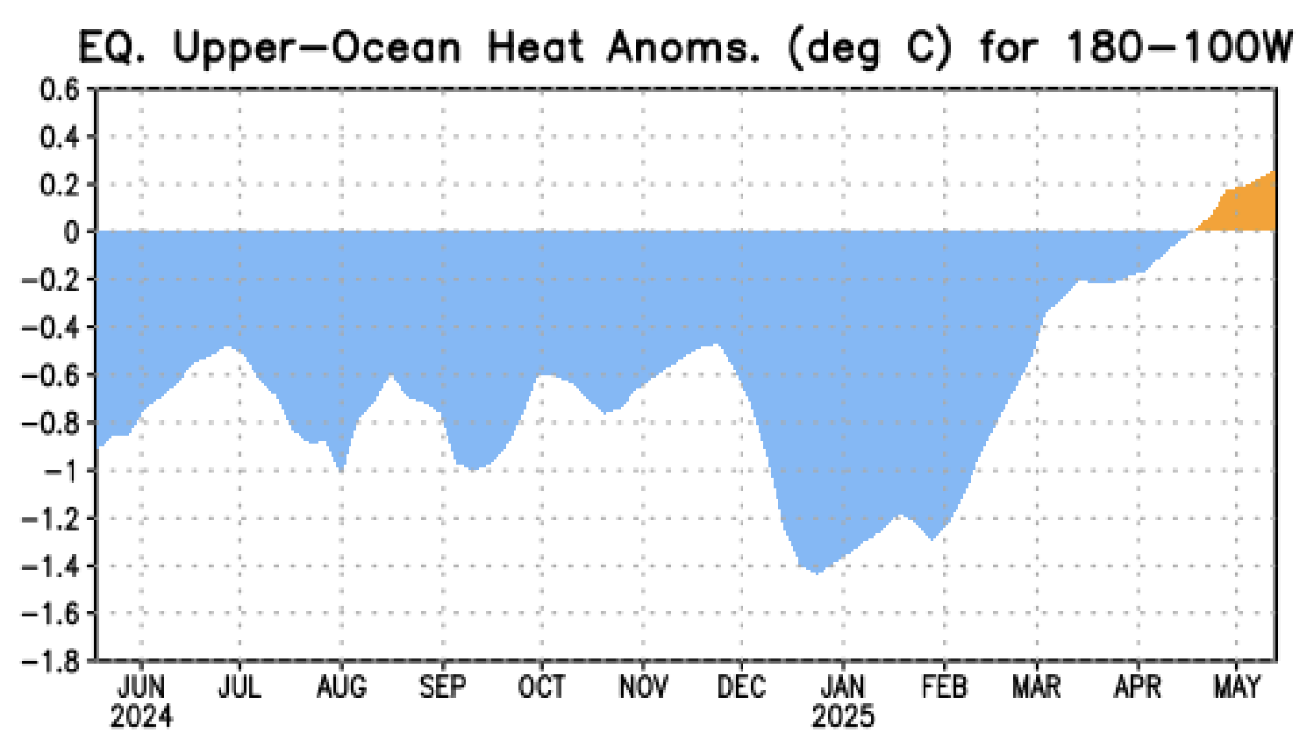
What is the underwater conversation?
Strongest upward trend during Feb, and as of Mar, 2025, Index crossed Zero-Line and now at positive value of +0.2!

Slide 9
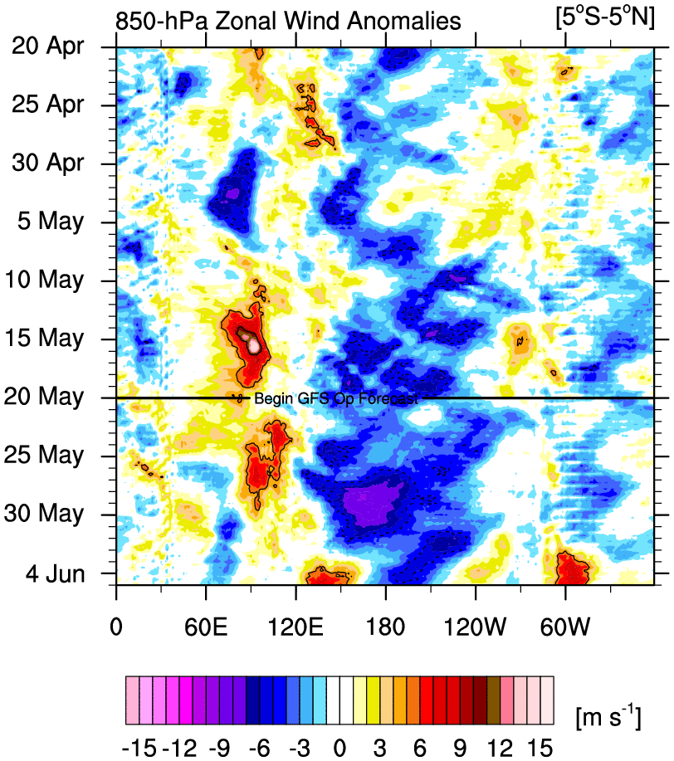
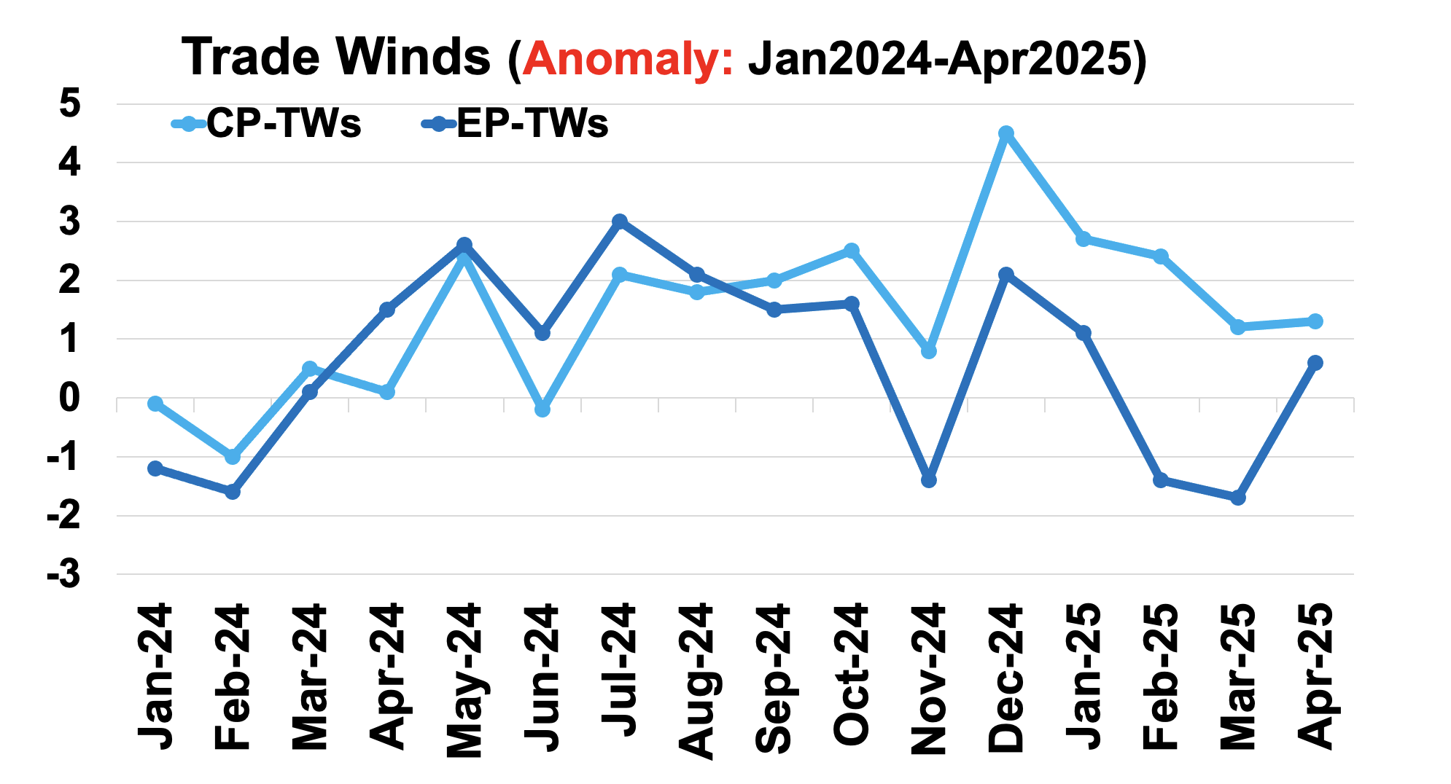
Most recent Lower-Level Winds (TW-Index)
Sources:
https://mikeventrice.weebly.com/hovmollers.html
https://www.cpc.ncep.noaa.gov/data/indices/epac850
Yellow Shading: Westerly Anomalies
Blue Shading: Easterly Anomalies

Slide 10
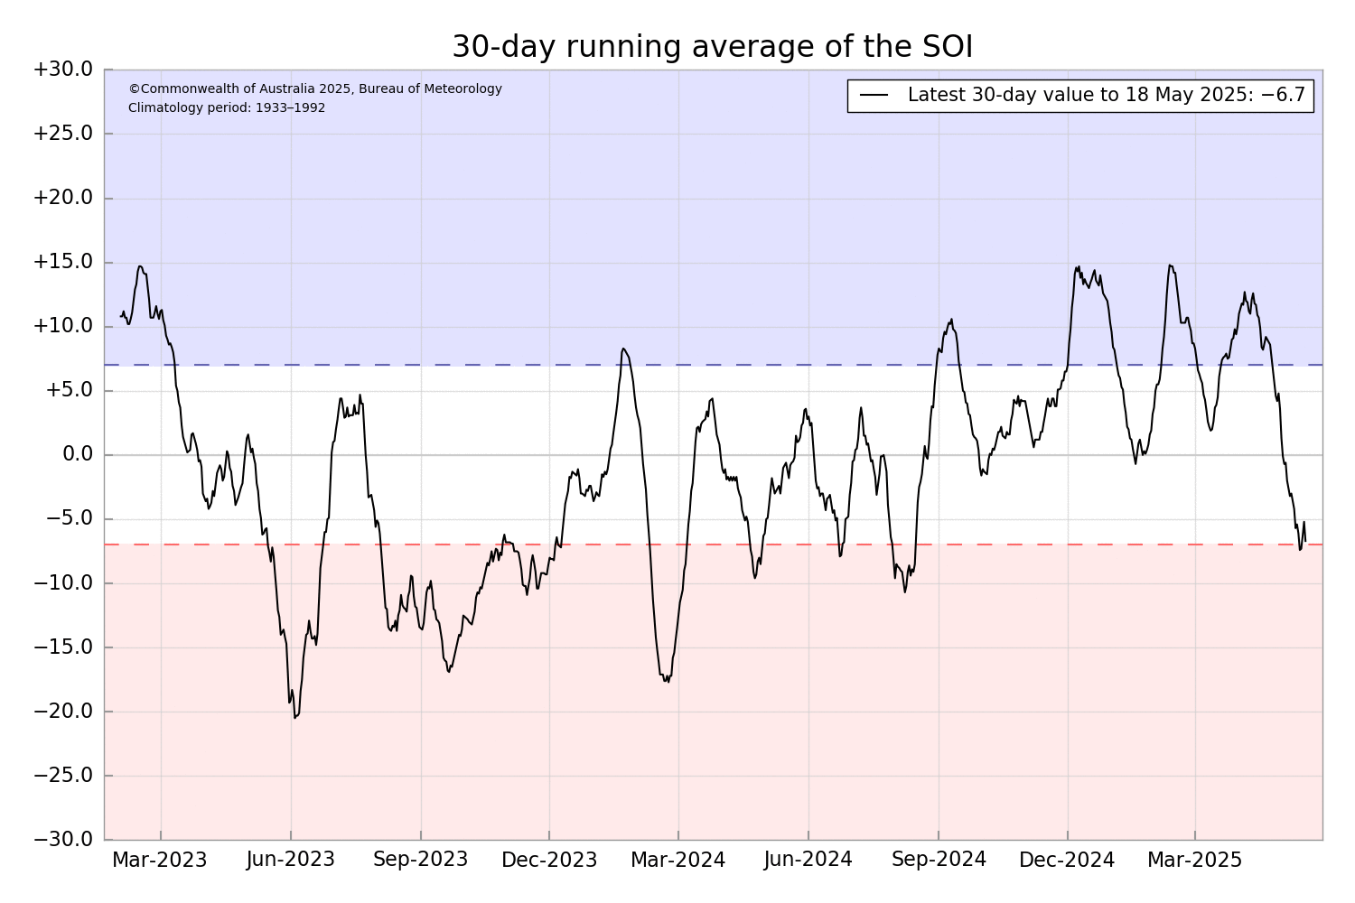
Most recent Southern Oscillation (Traditional & EQ) Index (SOI → in ENSO-N)
SOI values is in ENSO-Neutral range,
(Apr=+3.6),
Equatorial-SOI is in ENSO-Neutral range,
(Apr=0.6),
Eq-SOI and SOI both within ENSO-Neutral range during April, 2025.
During La Niña, the pressure becomes above-average in Tahiti and below-average in Darwin, and the Southern Oscillation Index is Positive.
A Sustained Positive values of the SOI above +7 typically indicate La Niña
Source:
http://www.bom.gov.au/climate/enso/#tabs=Pacific-Ocean&pacific=SOI

Slide 11
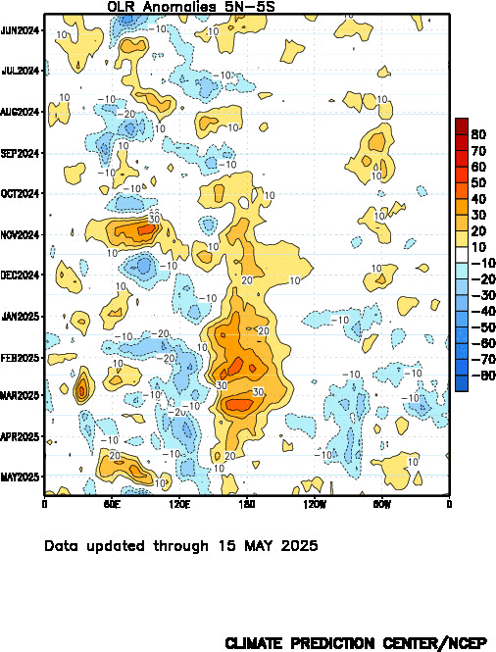
Most recent Outgoing Longwave Radiation (OLR)
(OLR → in ENSO-N)
OLR shows typical (Normal) convection over the Dateline since mid-April, 2025.
During La Niña, the convection is reduced over-and-around the Date-Line
Source:
https://www.cpc.ncep.noaa.gov/data/indices/cpolr.mth.91-20.ascii

Slide 12
Forecasts
IRI ENSO Plume,
Probability of Nino-34,
Global SSTs from NMME,
Prcp. and Temp. outlook from IRI (May, 2025)

Slide 13
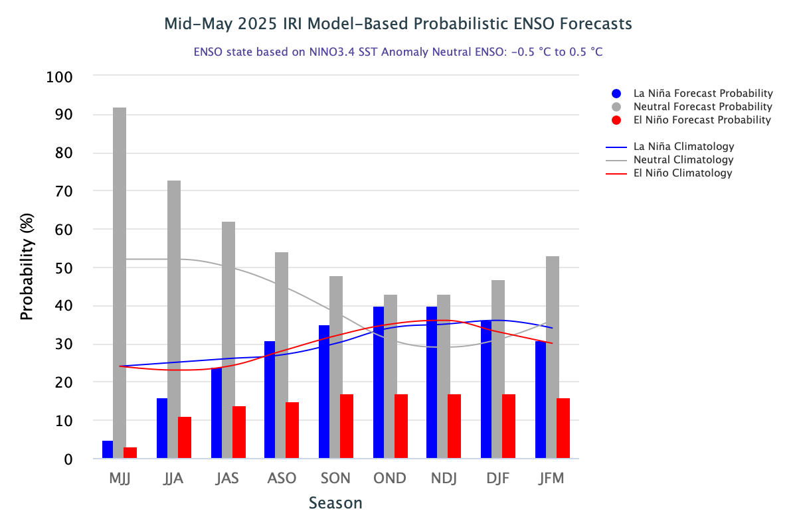
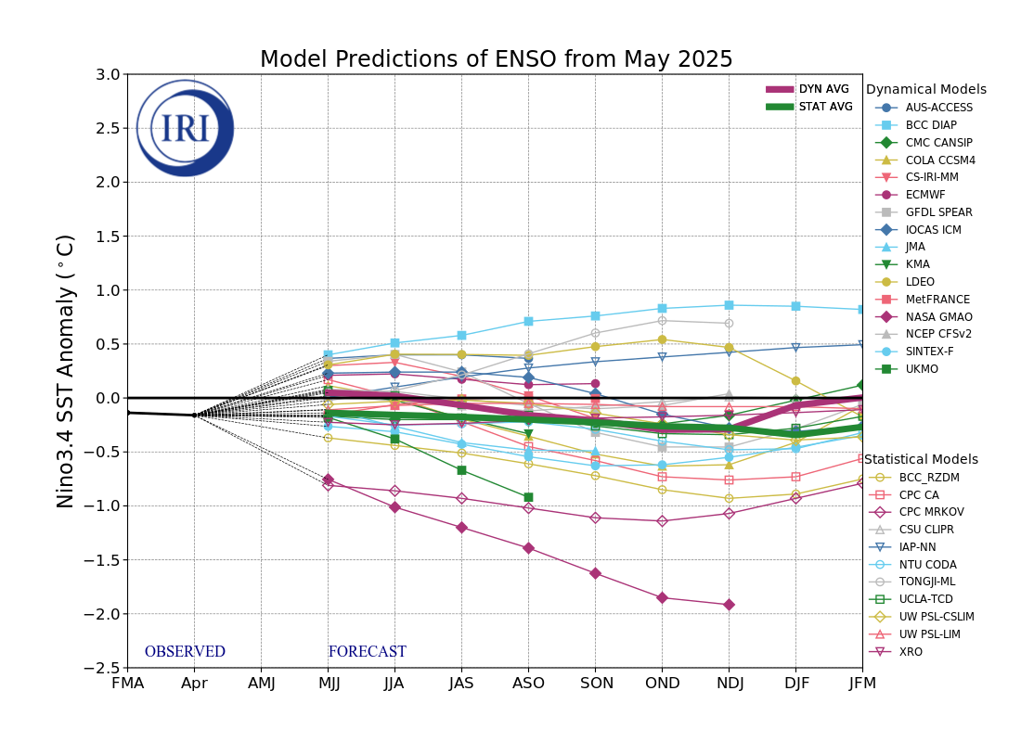
IRI’s ENSO Forecast (19th May, 2025)
DYN&STAT packed together to show; (STAT-AVG running slightly colder, as compared to DYN-AVG)
ENSO-neutral conditions from MJJ to the end of the forecasts.
This month 3-STAT, and 2-DYN models calling for La Nina.
Quite large spread.

Slide 14
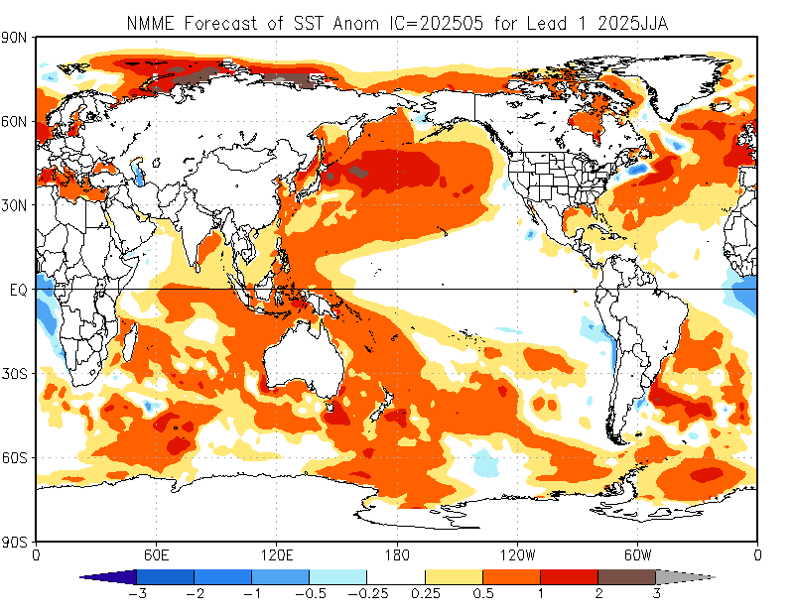
North American Multi Model Ensemble
(NMME) SST Forecast

Slide 15
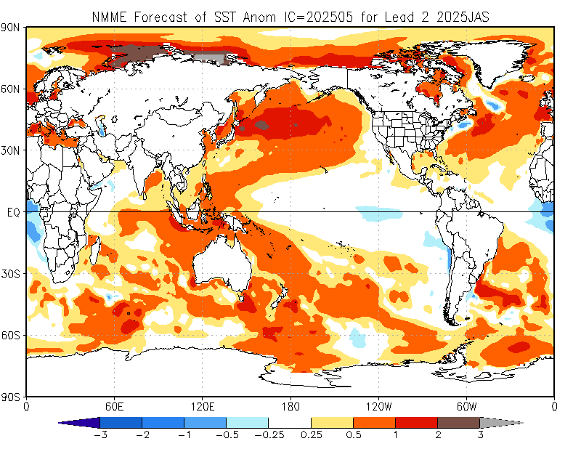
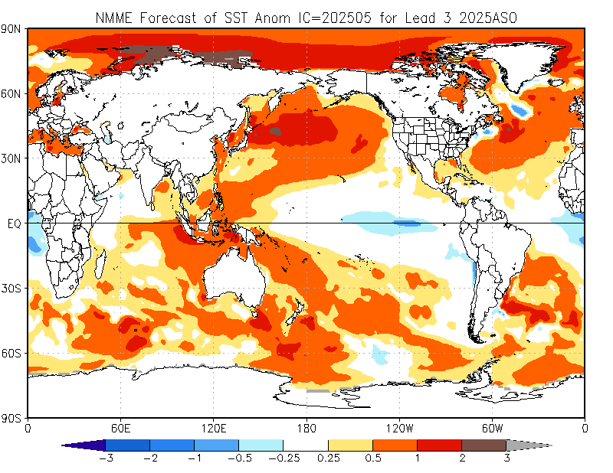
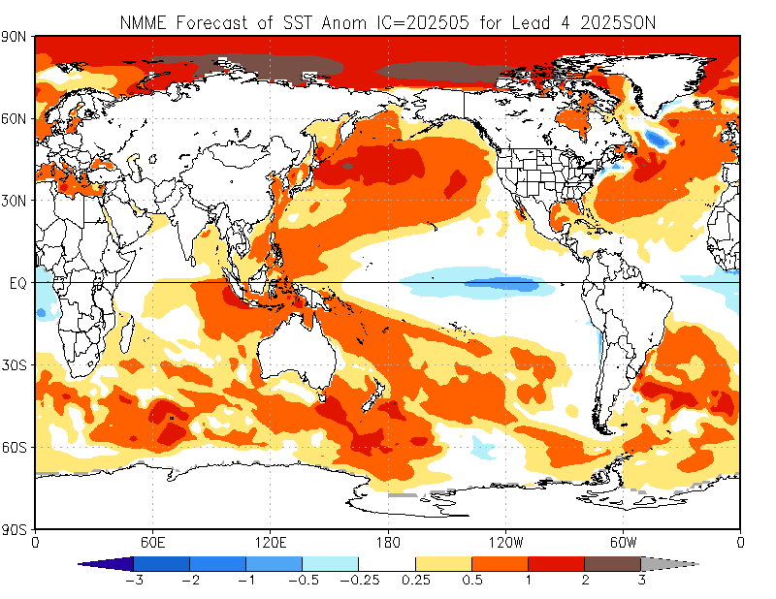

Slide 16
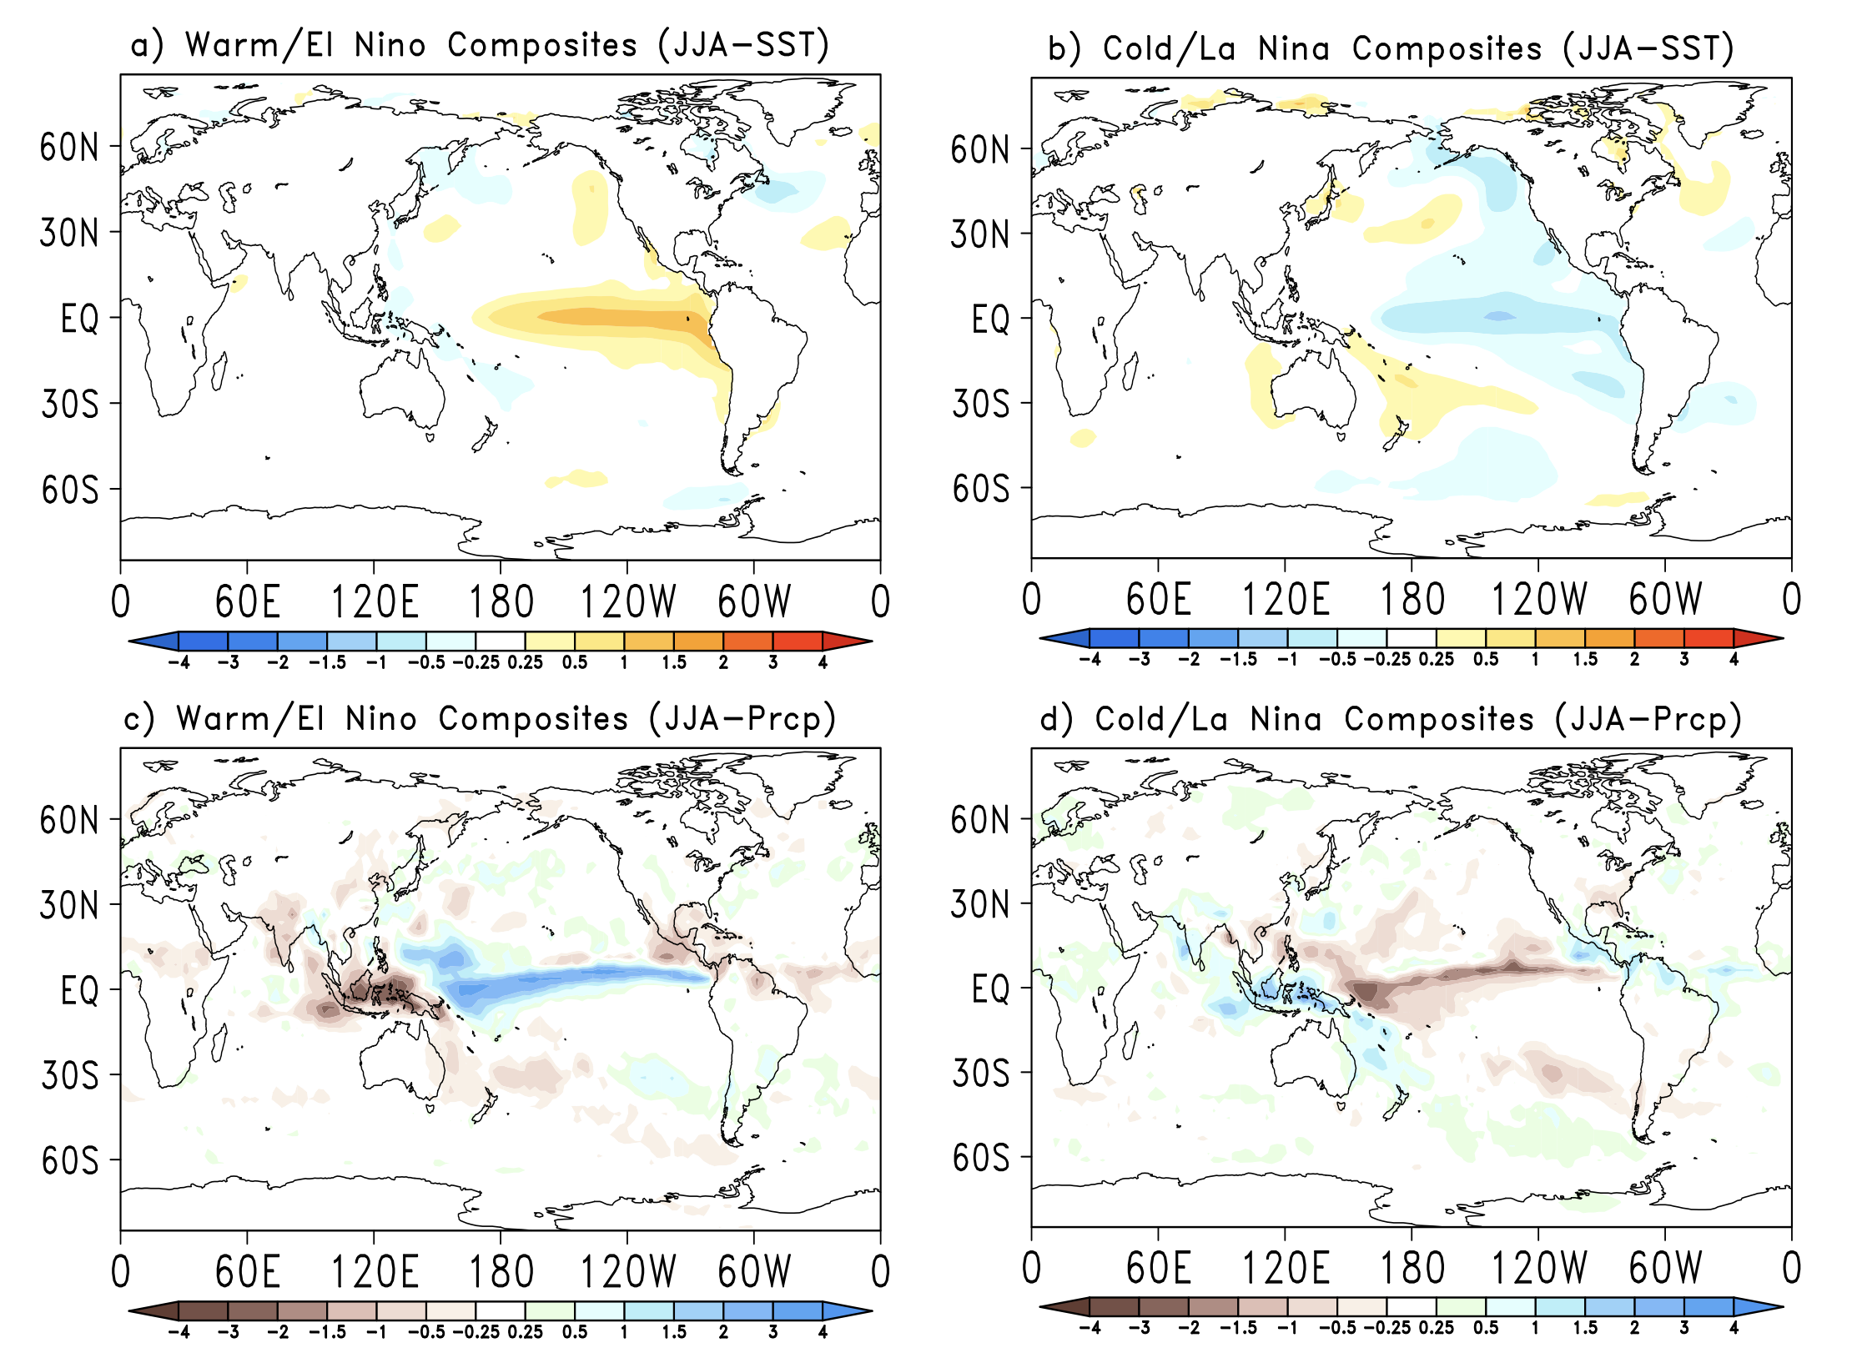
A Reminder about Precipitation Composites based on ENSO

Slide 17
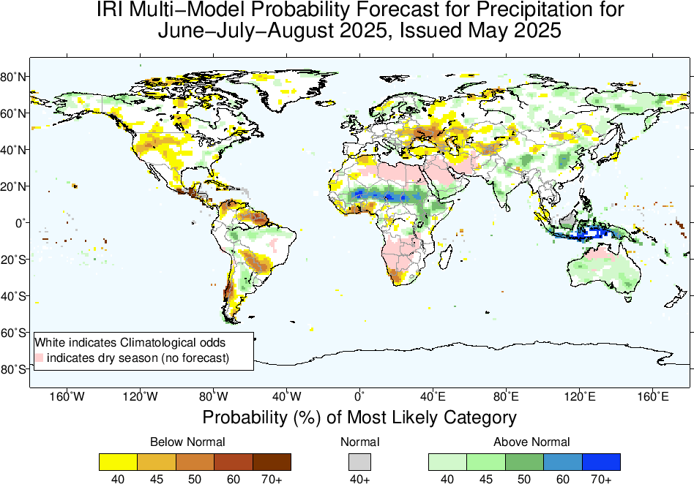
Precipitation Forecasts based on North American Multi Model Ensemble
North America:
A portion of the northwest United States, shows a probability (40-45% or more) of below-normal precipitation.
South America:
Northern regions, southern Chile, are expected to experience below-normal rainfall.
Africa:
West Africa, particularly around Gulf of Guneia, parts of South Africa,
Asia:
Areas around the Central-Southwest Asia also show BN rainfall tendencies.
Central America, South Asia, East Asia, MC and Australia:
Regions including parts of Alaska, eastern US, South of Amazon Basin, equatorial east Africa, Sahel, and South Asia, MC-regions, and Australia show above-normal precipitation probabilities.
Large swathes of Europe, parts of central Africa, and parts of the Middle East (pink: Dry Season) are marked in white, indicating climatological odds or no significant deviation from normal precipitation levels.

Slide 18
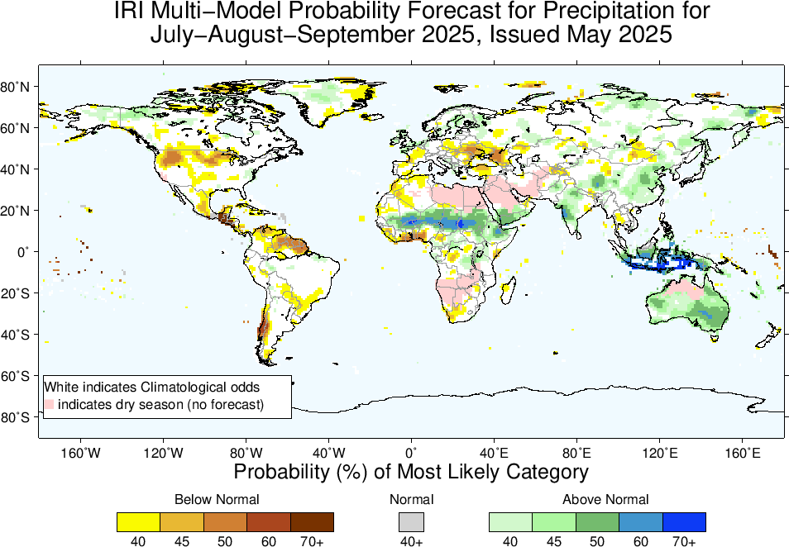
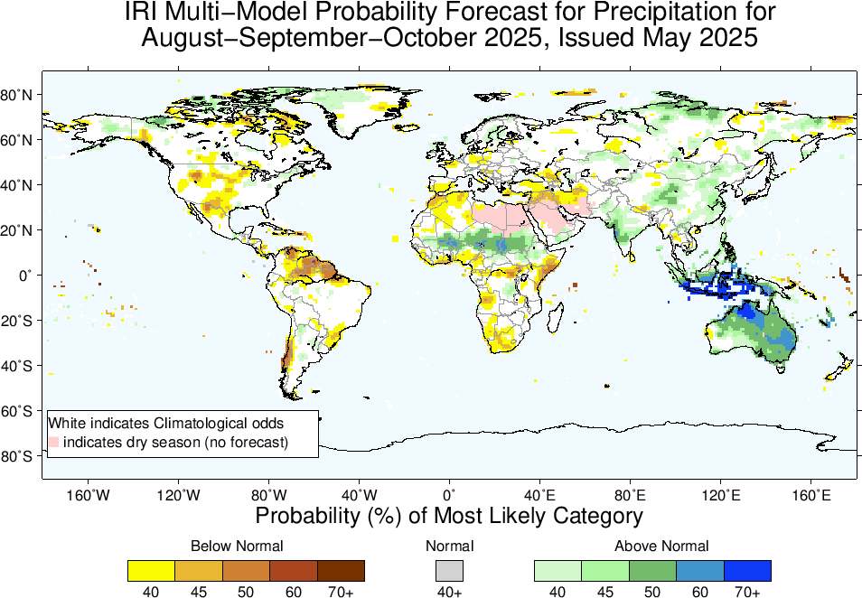
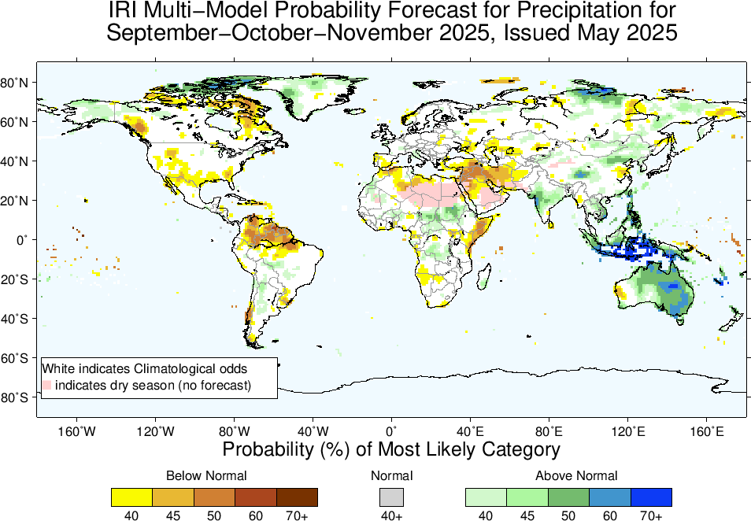

Slide 19
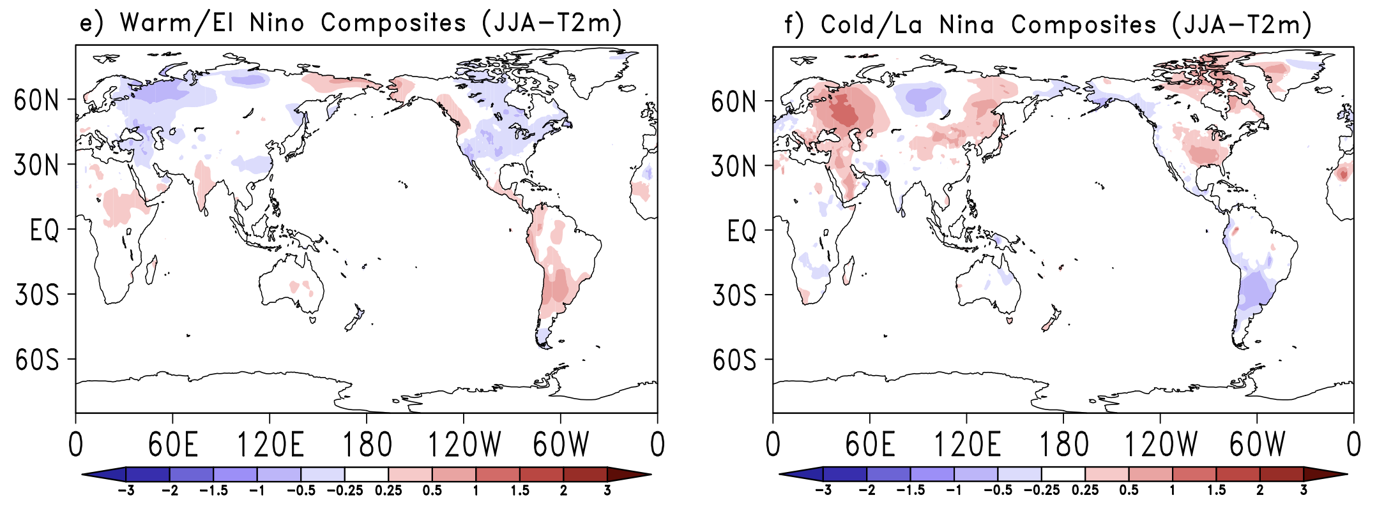

Slide 20
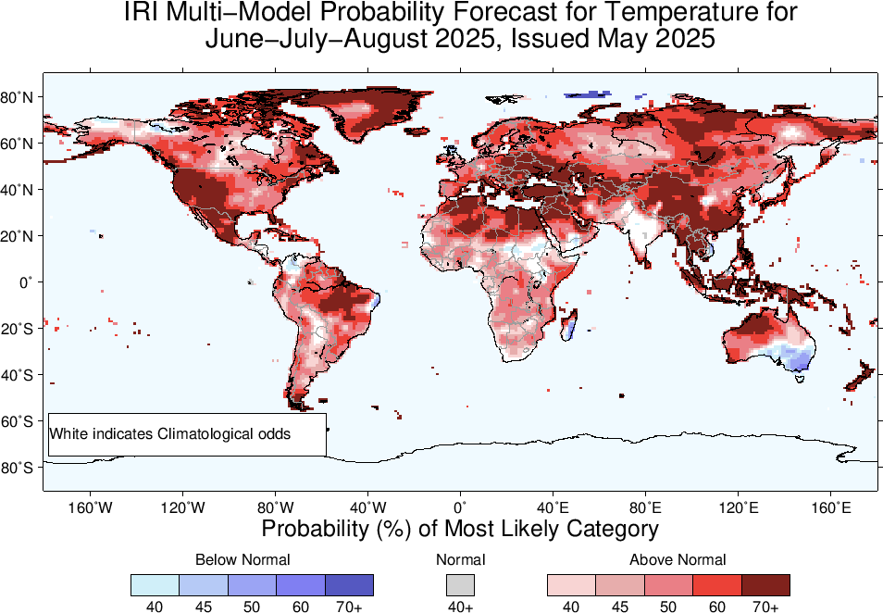
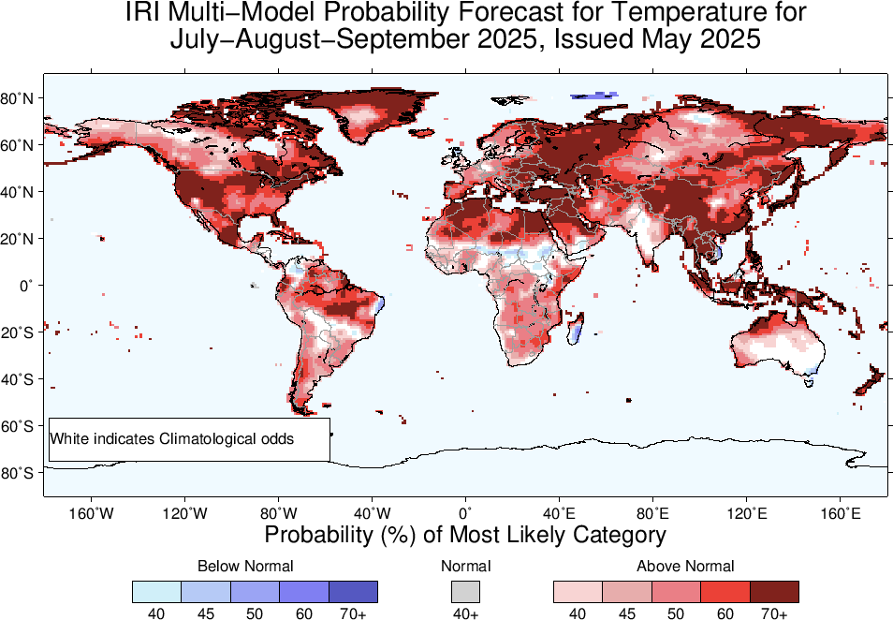
2m-Temperature Forecasts based on North American Multi Model Ensemble (NMME)

Slide 21
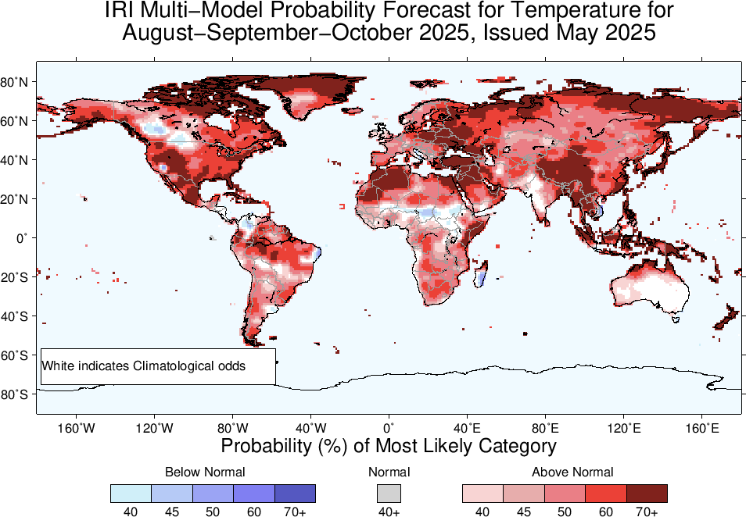
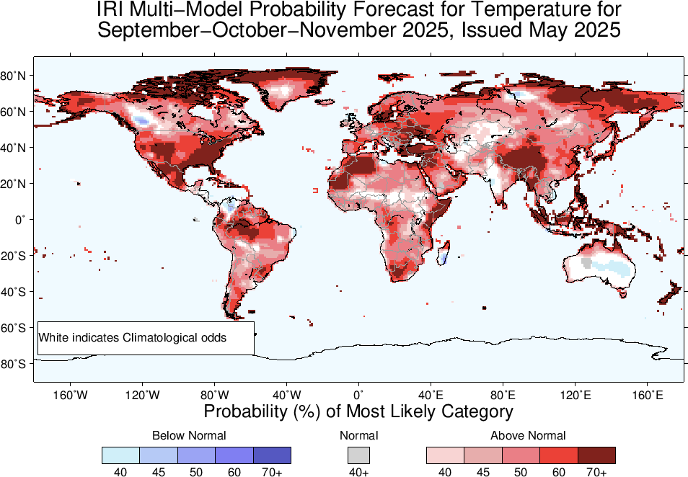

Slide 22
Summary
After end of 2023/24 El Nino, tropical Pacific has experienced ENSO-neutral conditions since May, to November, 2024 (NINO3.4 for May was +0.3, June was +0.24, July was +0.21, Aug was -0.07, and Sep was -0.15, Oct was -0.28, Nov was -0.14, Dec-24 was -0.62, Jan-25 was -0.71, Feb was -0.43, Mar was -0.1, and Apr was -0.16), and for most recent week ending on 14 May-2025, it was -0.1.
Mid May-2025 IRI/CCSR@NASA-GISS ENSO forecasts show that most models (with exception of 3 models) favors for ENSO-Neutral from the start to the end of the Forecasts.
CPC issued “Non-Active” ENSO status for May 2025.

