Slide 1
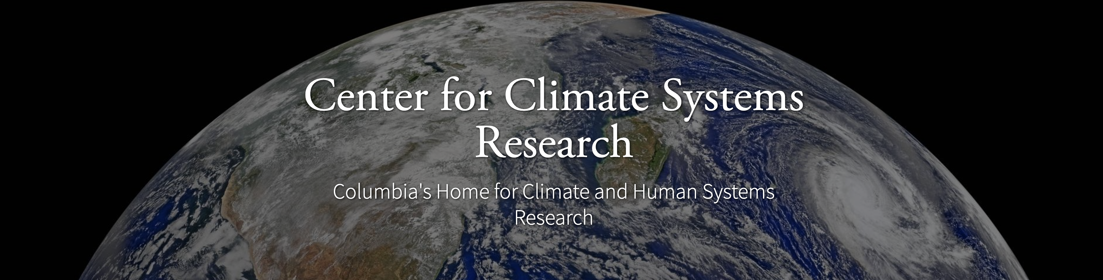


ENSO and Climate Outlook in March, 2025
Over Active Eastern Pacific: Weak La Niña Conditions turning to ENSO-Neutral!
Ehsan, M. Azhar
(mae2171@columbia.edu)
Center for Climate Systems Research (CCSR),
Affiliate of NASA GISS and
International Research Institute for Climate and Society (IRI)
Dr. Andrew Robertson (CCSR): Forecast system development, ongoing innovation,
Jing Yuan (CCSR): Forecast Post-Processing,
Jeffrey Turmelle (IRI): Forecast Post-Processing and Web updates.

Slide 2
Outline
Observed Oceanic and Atmospheric Conditions in
Tropical Pacific
Across the Globe
ENSO Forecast in
NMME
IRI ENSO Forecast Tool (Deterministic and Probabilistic)
Seasons Outlook of
SST
Precipitation and Temperature
Summary

Slide 3
Observations
Oceanic
Atmospheric

Slide 4
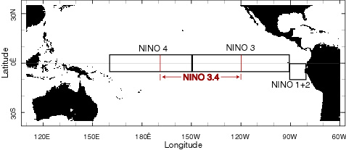
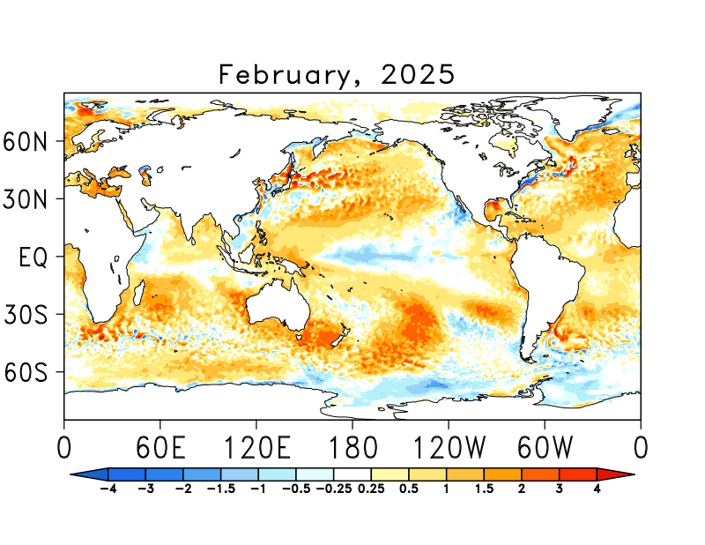
SST Departures in Monthly (February, 2025) Data: OISST v2
NINO3: 0.05
Latitude: 5°S - 5°N
Longitude: 210°E - 270°E
NINO4: -0.56
Latitude: 5°S - 5°N
Longitude: 160°E - 210°E
NINO12: 0.87
Latitude: 10°S - 0°N
Longitude: 270°E - 280°E
NINO34: -0.43
Latitude: 5°S - 5°N
Longitude: 190°E - 240°E
https://psl.noaa.gov/data/gridded/data.noaa.oisst.v2.highres.html

Slide 5
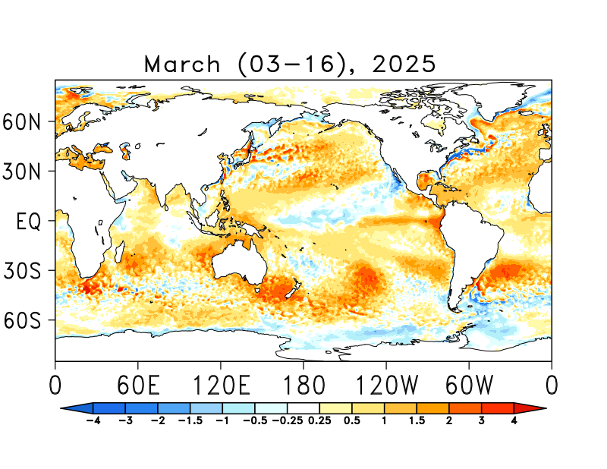
SST Departures in Last Two-Weeks (Mar 03-16) Data: OISST v2
NINO 1+2: +1.73
Latitude: 10°S - 0°N
Longitude: 270°E - 280°E
NINO 3: 0.73
Latitude: 5°S - 5°N
Longitude: 210°E - 270°E
NINO 3.4: 0.17
Latitude: 5°S - 5°N
Longitude: 190°E - 240°E
NINO 4: -0.31
Latitude: 5°S - 5°N
Longitude: 160°E - 210°E
https://psl.noaa.gov/data/gridded/data.noaa.oisst.v2.highres.html

Slide 6
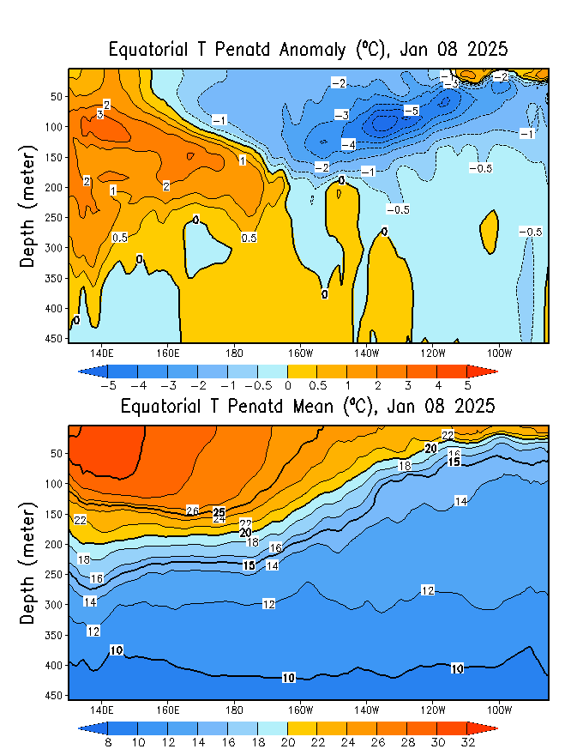
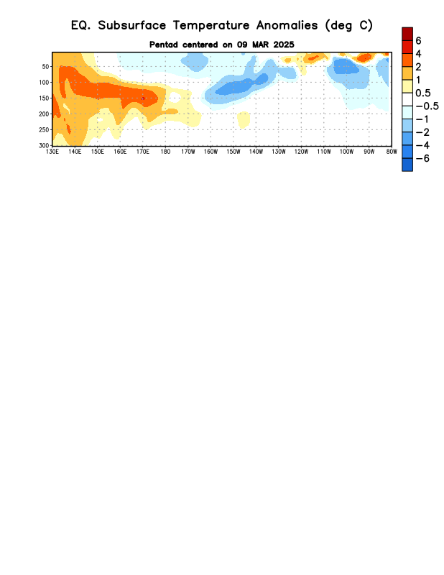
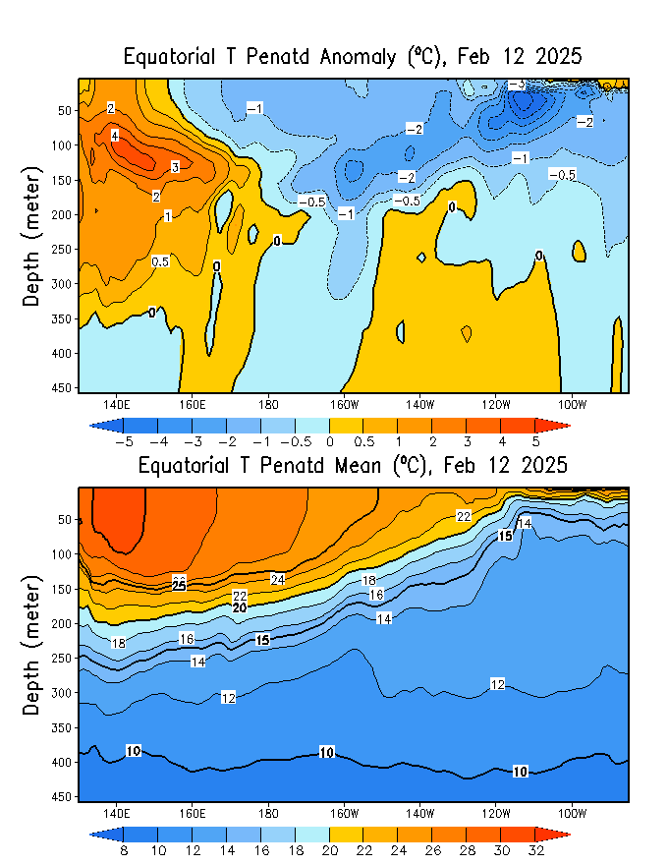
What is the underwater conversation?
January, 2025
March, 2025
Warm subsurface temperature anomalies dominate from 140E to 180 in equatorial Pacific Ocean at depth (100 to 250 meter at depth) and over the surface in the eastern Pacific (surface to 25 meters: very shallow).
Cold subsurface temperature anomalies Persisting, at depth in the eastern Pacific and central Pacific. Anomalies are much weaker compared to the last two months (Jan, and Feb, 2025).
February, 2025

Slide 7
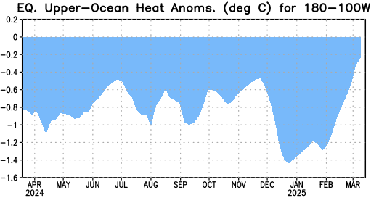
What is the underwater conversation?
Strongest upward trend during Feb, and as of Mar, 2025, Index reached to a value close to Zero!

Slide 8
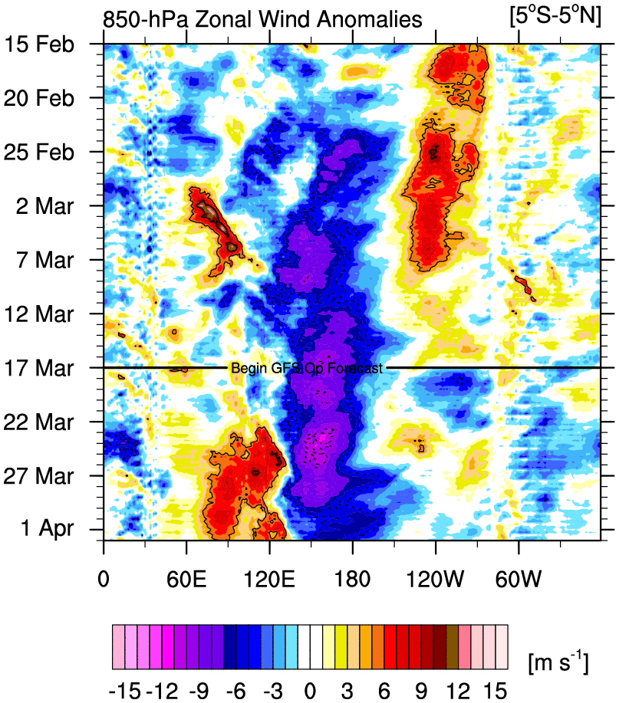
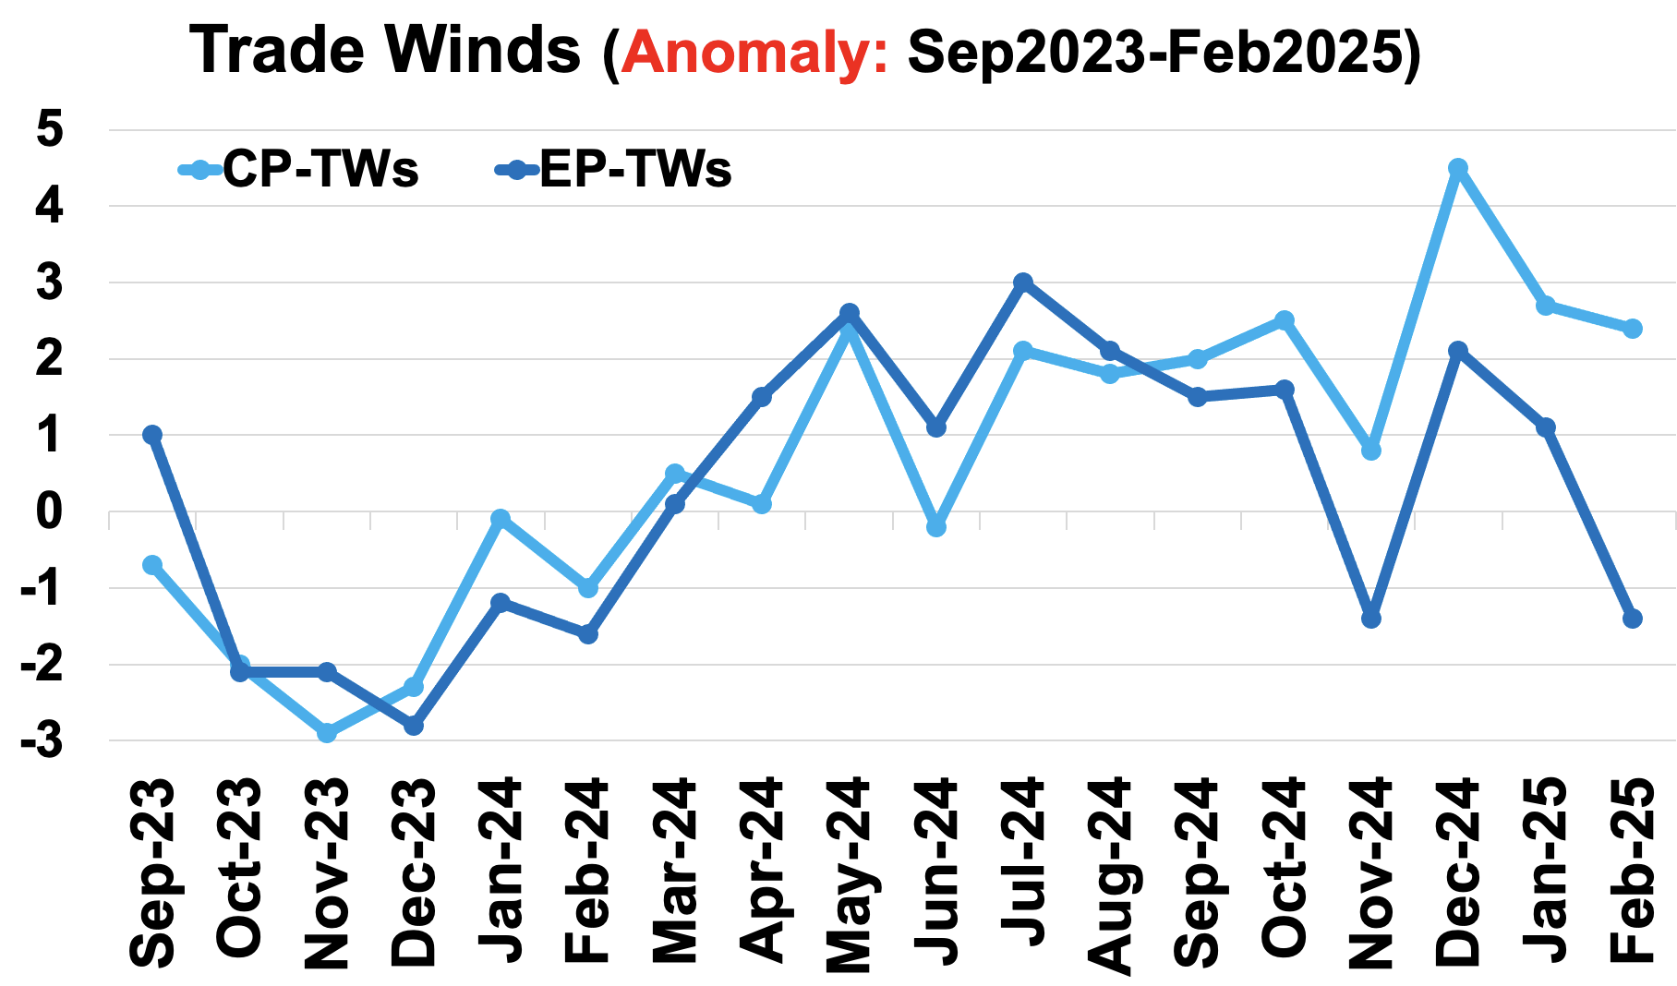
Most recent Lower-Level Winds (TW-Index)
Yellow Shading: Westerly Anomalies
Blue Shading: Easterly Anomalies
In shorter Forecasts; (Highlight for Feb-briefing)
Trades seems to remain relatively weak as compared to Dec-24 or even Jan-25.
Sources:
https://mikeventrice.weebly.com/hovmollers.html
https://www.cpc.ncep.noaa.gov/data/indices/epac850

Slide 9
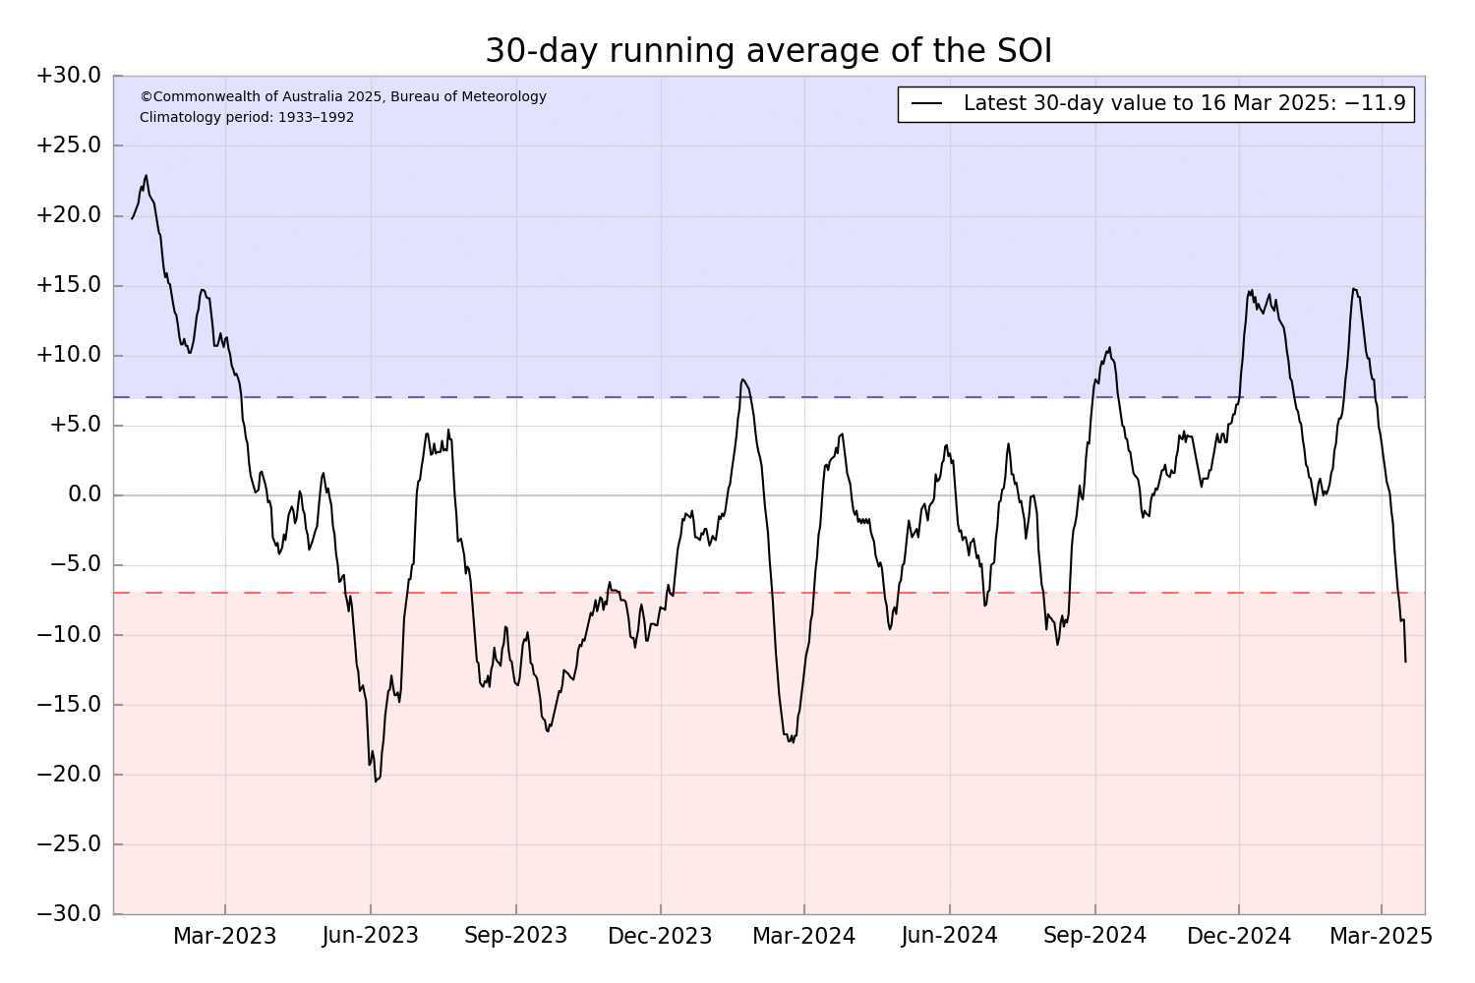
Most recent Southern Oscillation (Traditional & EQ) Index (SOI → in ENSO-Neutral Space)
SOI values is in ENSO-Neutral range
(Jan=3.7, Feb=+3.0), however;
Equatorial-SOI is in La Nina range,
(For Feb, 2025 it is +1.0)
Eq-SOI values sustained to remain in La Nina range since November, December, 2024 and January, 2025, reduced significantly in Feb, 2025.
During La Niña, the pressure becomes above-average in Tahiti and below-average in Darwin, and the Southern Oscillation Index is Positive.
A Sustained Positive values of the SOI above +7 typically indicate La Niña
Source:
http://www.bom.gov.au/climate/enso/#tabs=Pacific-Ocean&pacific=SOI

Slide 10
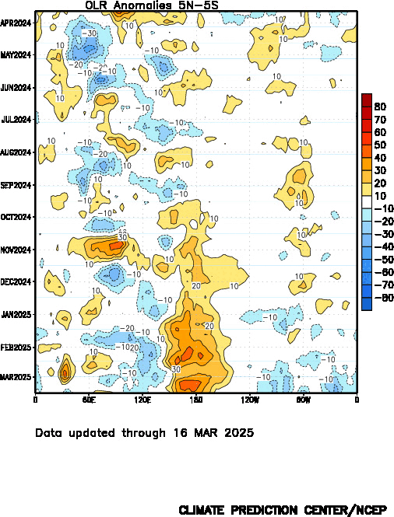
Most recent Outgoing Longwave Radiation (OLR)
(OLR → in La Nina Space)
OLR shows reduced convection over the Dateline since Sep, 2024,
Quite strong during January-February, and even in March (very strong Atmospheric signal of La Nina)
During La Niña, the convection is reduced over-and-around the Date-Line
Source:
https://www.cpc.ncep.noaa.gov/data/indices/cpolr.mth.91-20.ascii

Slide 11
Forecasts
IRI ENSO Plume,
Probability of Nino-34,
Global SSTs from NMME,
Prcp. and Temp. outlook from IRI (March, 2025)

Slide 12
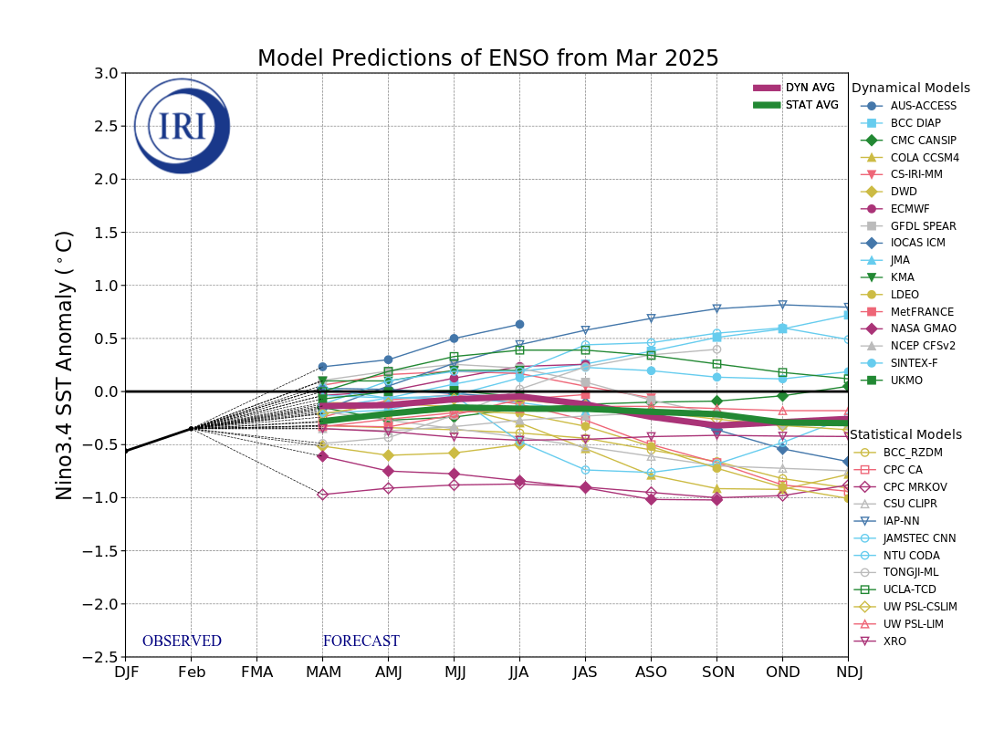
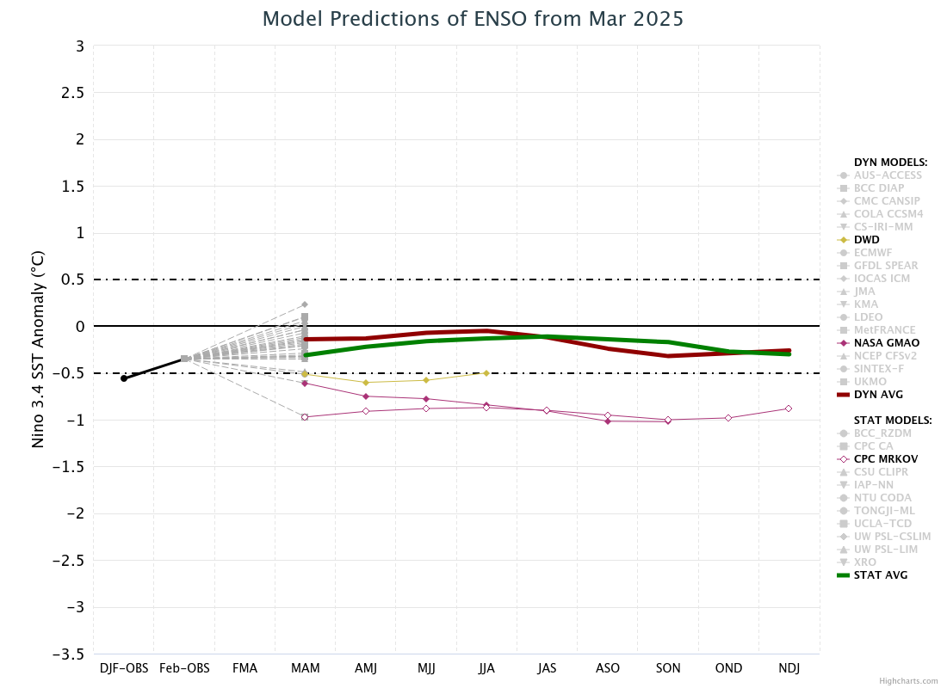
IRI’s ENSO Forecast (Today, 19th March, 2025)
This months Plume models packed together to show;
ENSO-neutral conditions from MAM to the end of the forecasts.
Three (2-DYN and 1-STAT) models out of 29 show continuation of La Nina conditions.

Slide 13
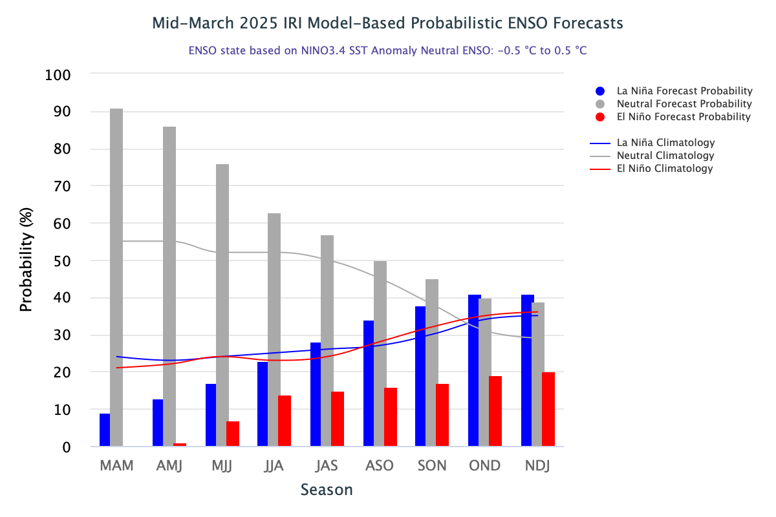
IRI’s Probabilistic (STAT+DYN) ENSO Forecasts (Today on 19th March, 2025)
ENSO-Neutral from MAM-2025 onwards,
La Nina is next dominant category (9% 😲), gradually increasing probability and become dominant again in NDJ-2025, same for El Nino starting in AMJ-2025.

Slide 14
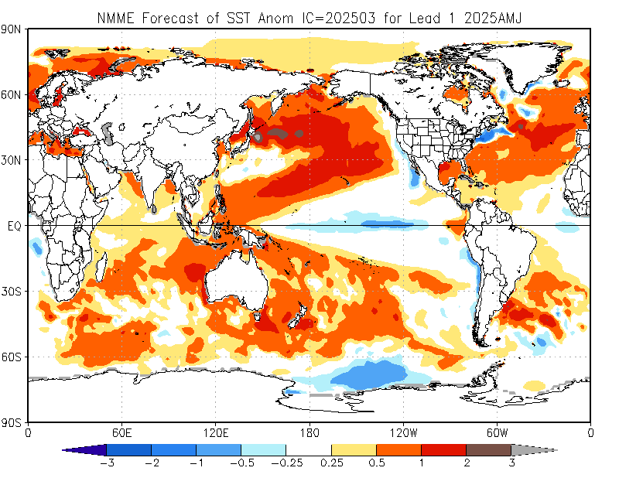
North American Multi Model Ensemble
(NMME) SST Forecast

Slide 15
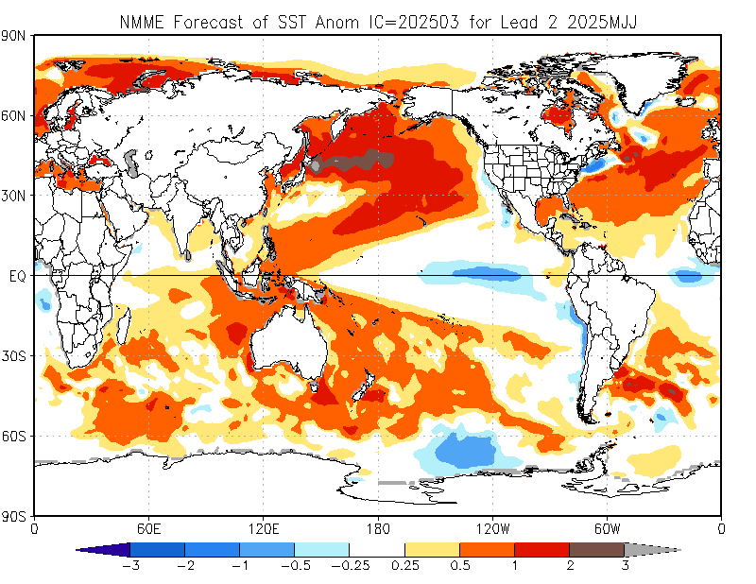
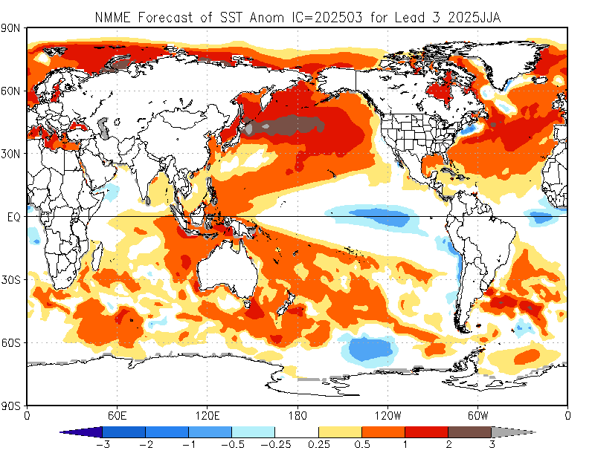
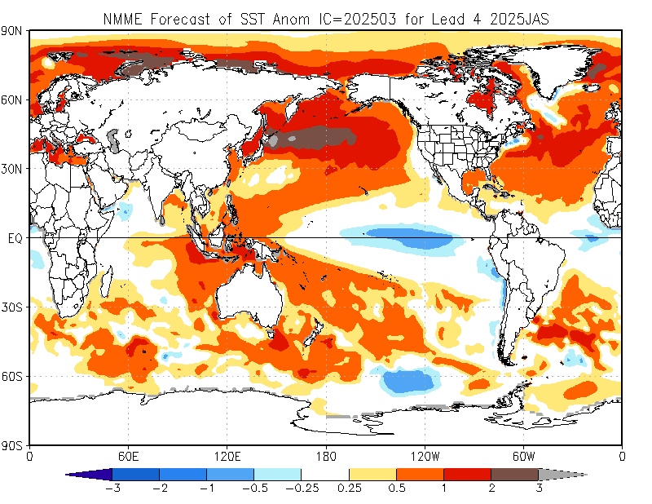

Slide 16
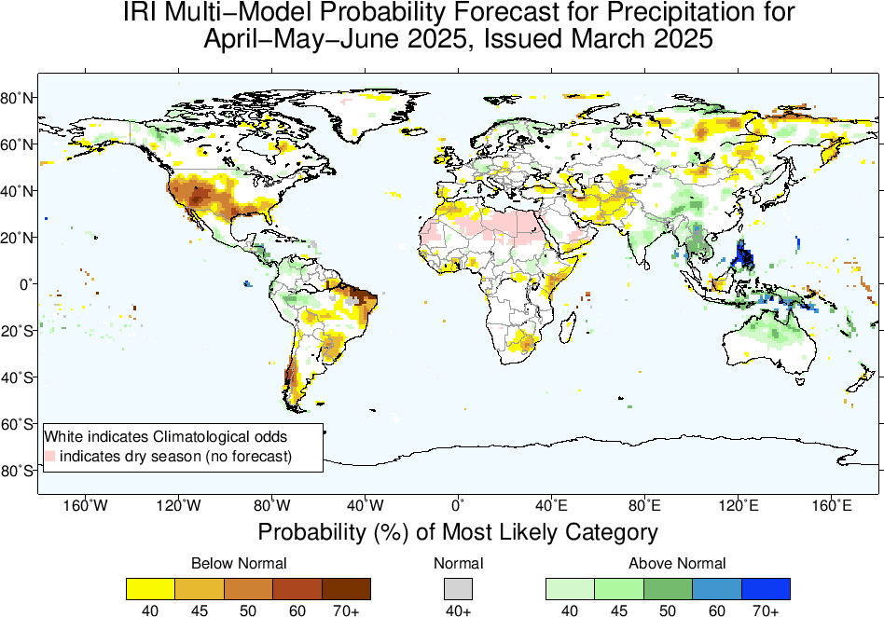
Precipitation Forecasts based on North American Multi Model Ensemble (NMME)
North America:
A large portion of the southern and western United States, including parts of Mexico, shows a high probability (50-70% or more) of below-normal precipitation.
South America:
Central regions, including parts of Brazil and surrounding areas, are expected to experience below-normal rainfall.
Africa:
Areas around the Horn of Africa and S-Africa (Eastern Side) exhibit BN rainfall tendencies.
Asia:
Areas around the Central-Southwest Asia also show BN rainfall tendencies.
Central America, South Asia, East Asia, MC and Australia:
Regions including parts of central America, northwest South America, India, Southeast Asia, southern and central China, MC-regions and northern Australia show above-normal precipitation probabilities.
Large swathes of Europe, central Africa, and parts of the Middle East are marked in white, indicating climatological odds or no significant deviation from normal precipitation levels.

Slide 17
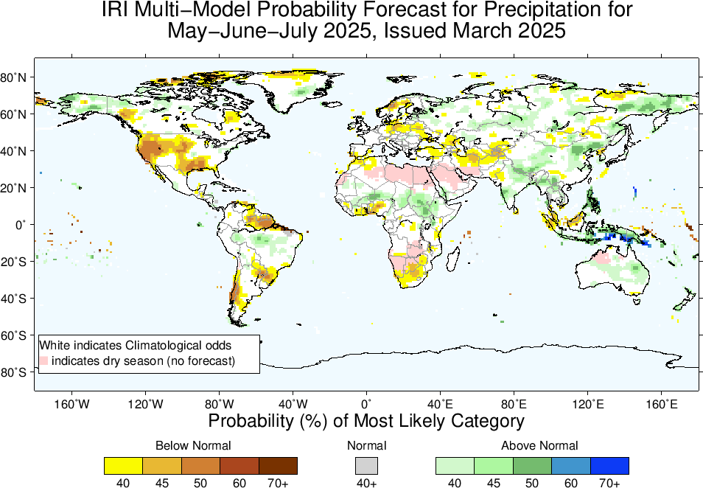
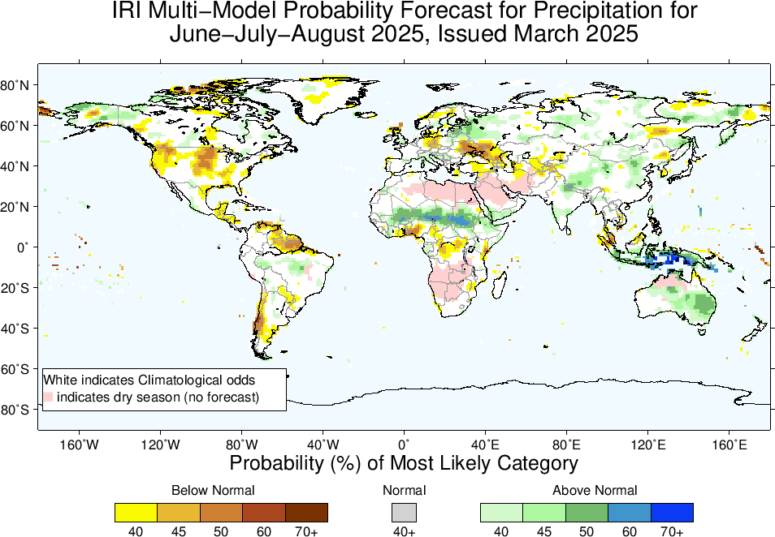
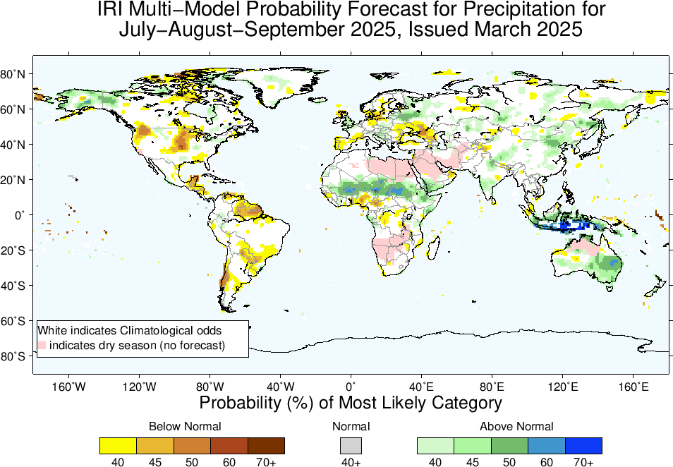

Slide 18
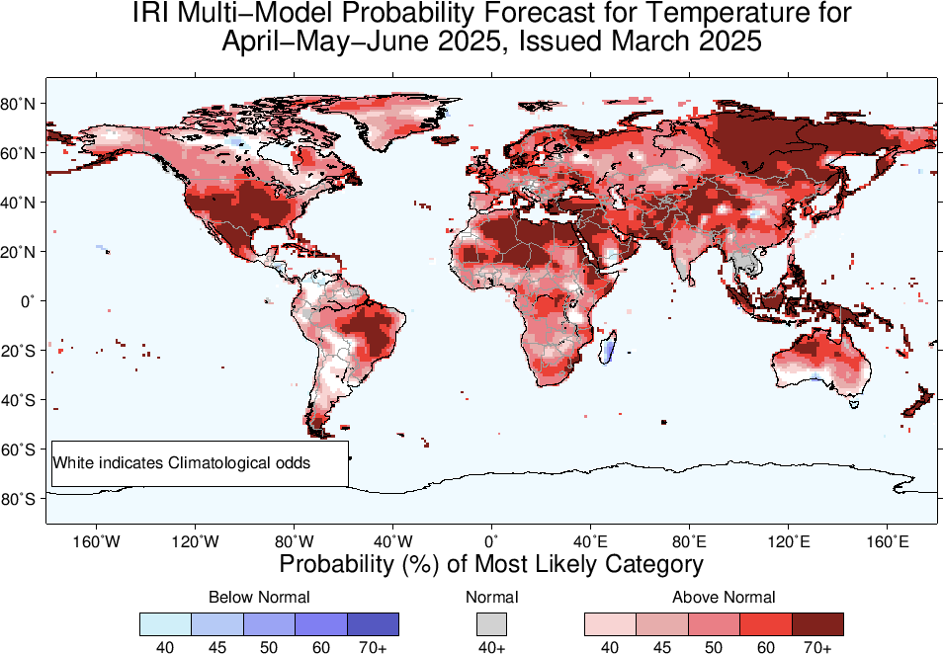
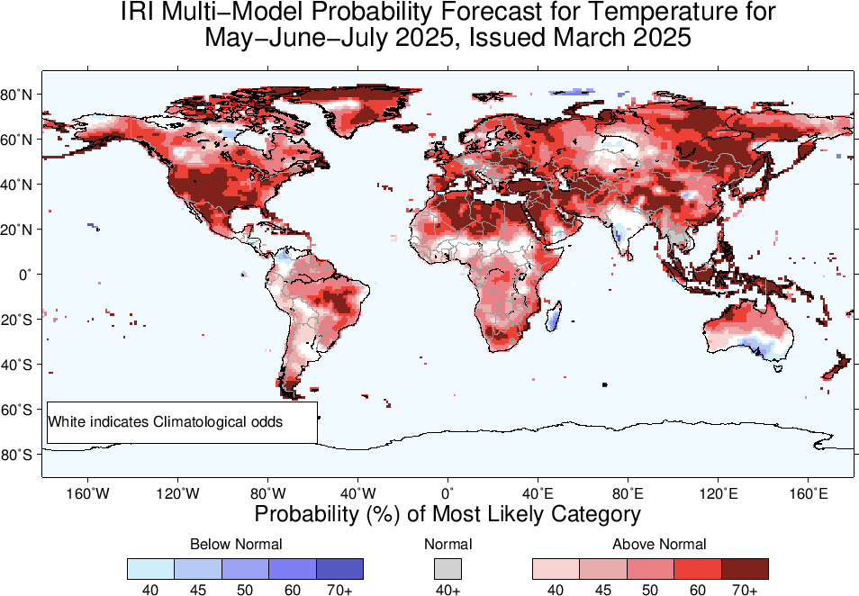
2m-Temperature Forecasts based on North American Multi Model Ensemble (NMME)

Slide 19
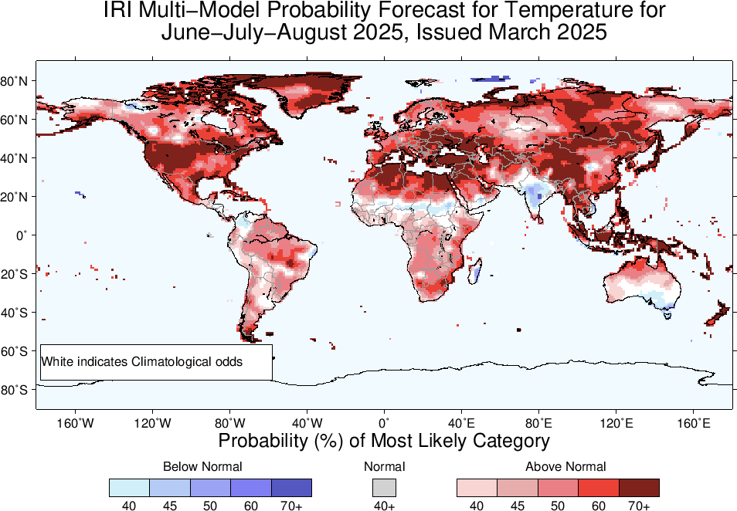
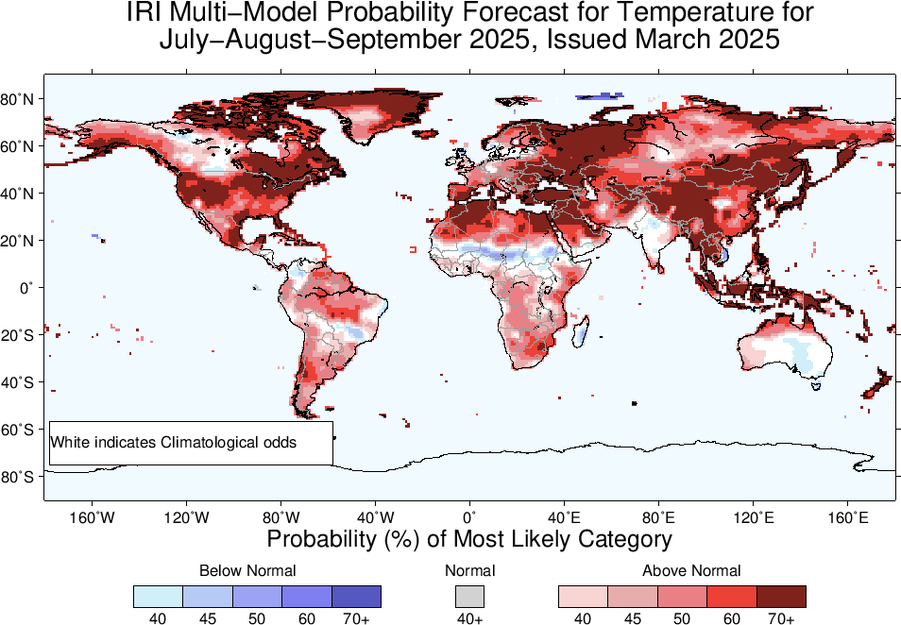

Slide 20
Summary
After end of 2023/24 El Nino, tropical Pacific has experienced ENSO-neutral conditions since May, to November, 2024 (NINO3.4 for May was +0.3, June was +0.24, July was +0.21, Aug was -0.07, and Sep was -0.15, Oct was -0.28, Nov was -0.14, Dec-24 was -0.62, Jan-25 was -0.71, and Feb was -0.43), and for most recent week ending on 12 Mar-25, it was 0.3.
Mid March-2025 IRI/CCSR@NASA-GISS ENSO forecasts show high probability for ENSO-Neutral from MAM (91% chances) to the end of the Forecasts,

