Slide 1
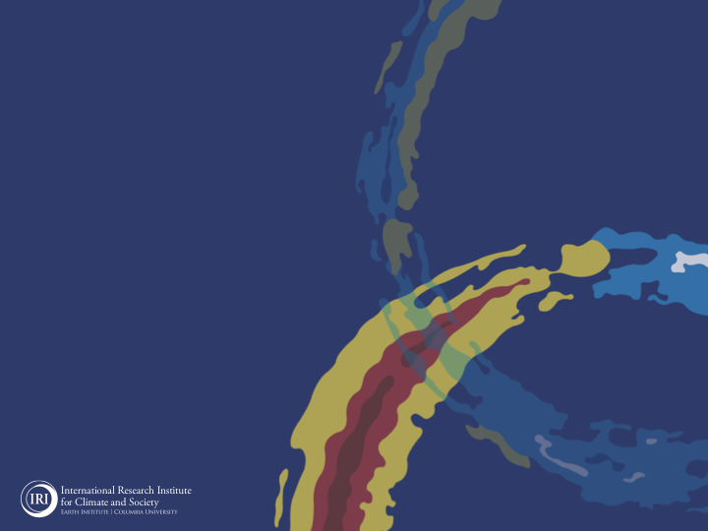
ENSO and Climate Outlook in
Jun, 2024
El Niño has left the building, bye bye
Neutral is just hanging out, Welcome
and La Niña is gearing up for her grand entrance! But, …
M. Azhar Ehsan
(azhar@iri.columbia.edu)
Associate Research Scientist
IRI ENSO and Climate Forecast Lead
Jeffrey Turmelle and Jing Yuan: forecast processing and web updates
Cuihua Li: Draft PowerPoint development
IRI’s Climate Group, led by Dr. Andrew Robertson: Forecast system development, ongoing innovation, and verification

Slide 2
Outline
Observed Oceanic and Atmospheric Conditions in
Tropical Pacific
Across the Globe
ENSO Forecast in
NMME
IRI ENSO Forecast Tool (Deterministic and Probabilistic)
Seasons Outlook of
SST
Precipitation and Temperature
Summary

Slide 3
Observations
Oceanic
Atmospheric

Slide 4
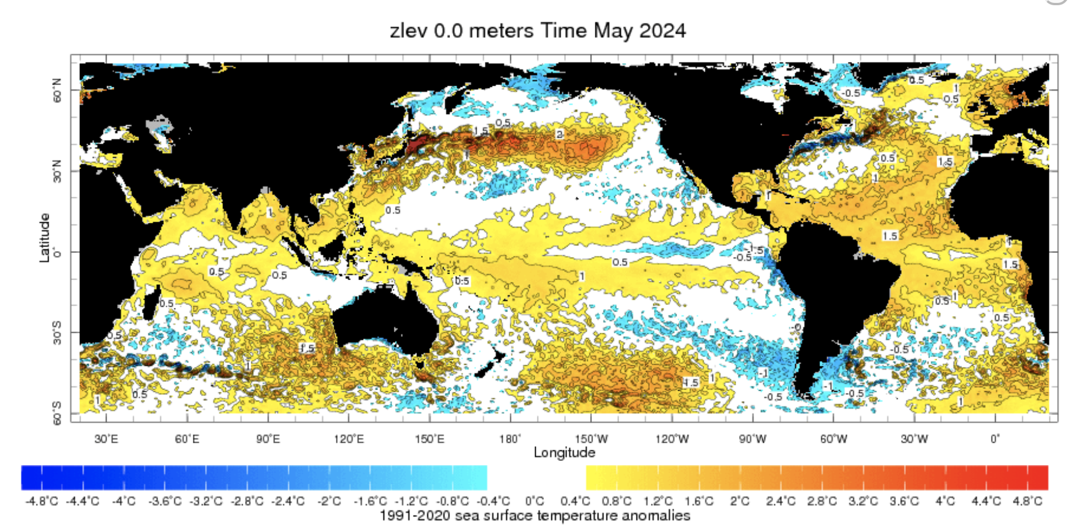
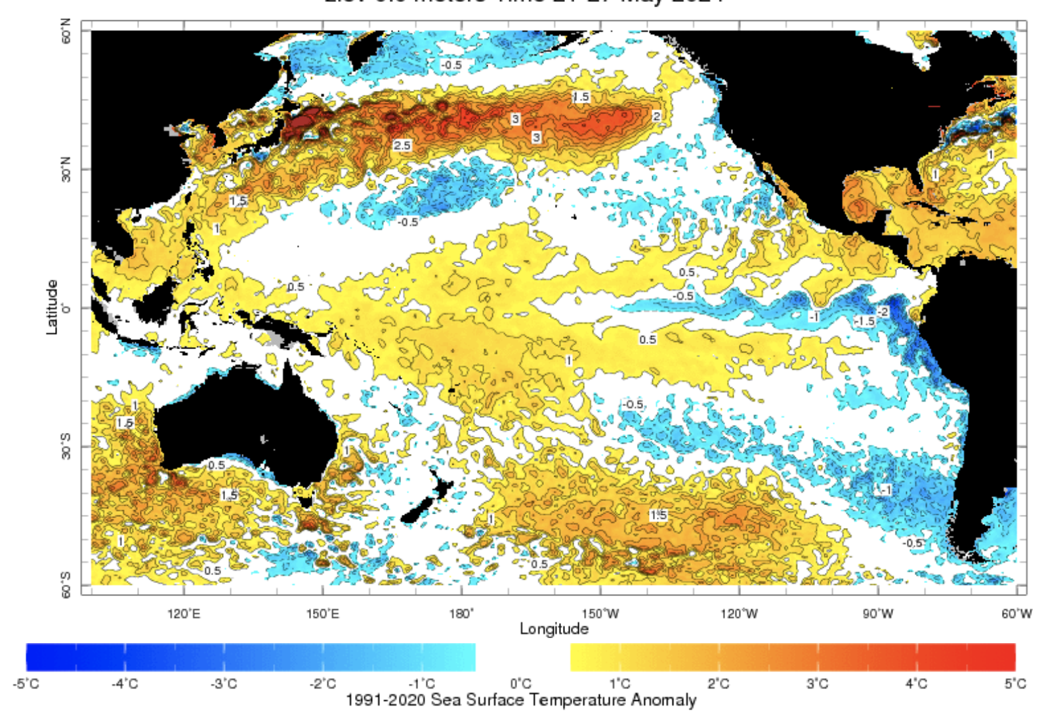
Evolution of SST Departures in Monthly (May, 2024) Data
For May, 2024
NINO 1+2: -0.68
NINO3: -0.03
NINO3.4: +0.30
NINO4: +0.70
In the Pacific Ocean: Above-Average SSTs persisted ONLY in WESTERN Pacific (over and across the Date Line), weak negative SSTs in the eastern Pacific
Indian Ocean: Basin wide warm across Indian Ocean, Neutral IOD (Index value is +0.0 as of 11 Jun, 2024),
North-Pacific and North Atlantic Ocean: Negative PDO (-2.97), Warm across Atlantic (TNAI, +1.49, TSAI, +0.98, TAtl, +0.66)
Source: https://iridl.ldeo.columbia.edu/maproom/Global/Ocean_Temp/ERSST_Anomaly.html

Slide 5
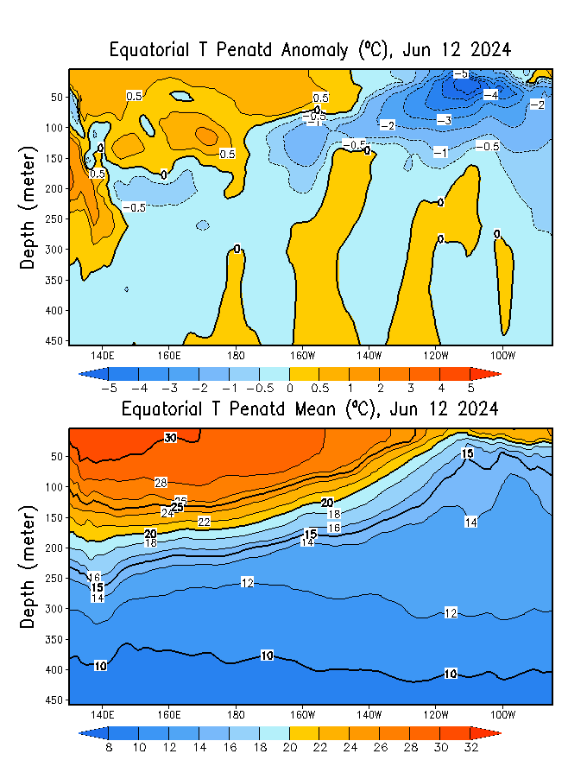
What is the underwater conversation?
April, 2024
Jun, 2024
Warm (~ +0.5C) subsurface-to-surface temperature anomalies dominate from 160E to 160W in equatorial Pacific Ocean (Surface to 100 meter at depth).
Cold subsurface temperature anomalies have extended and reached at the surface in eastern Pacific,
Warm/Cold in the West/East of 150W.
May, 2024

Slide 6
What is the underwater conversation?
After reaching peak levels in April and May 2024, negative anomalies have shown a trend towards warmer temperatures.
As of mid-June 2024, negative anomalies, nearing an index value of approximately -0.5.

Slide 7
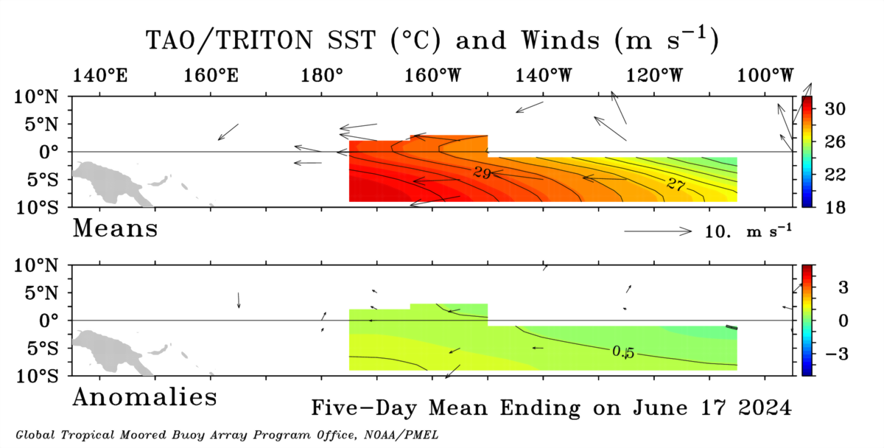
Most recent Lower-Level Winds (Blowing close to Normal)

Slide 8
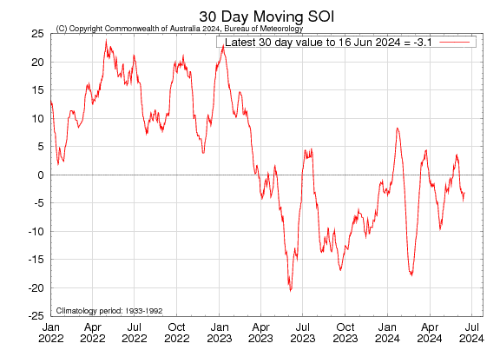
Most recent Southern Oscillation Index (SOI)
Current SOI values is in ENSO-neutral range
(For May, 2024 it is 3.6)
Equatorial-SOI is also in ENSO-neutral range,
(For May, 2024 it is 0.3)
During El Niño, the pressure becomes below average in Tahiti and above average in Darwin, and the Southern Oscillation Index is negative.
A Sustained Negative values of the SOI above -7 typically indicate El Niño
Source:
http://www.bom.gov.au/climate/enso/#tabs=Pacific-Ocean&pacific=SOI

Slide 9
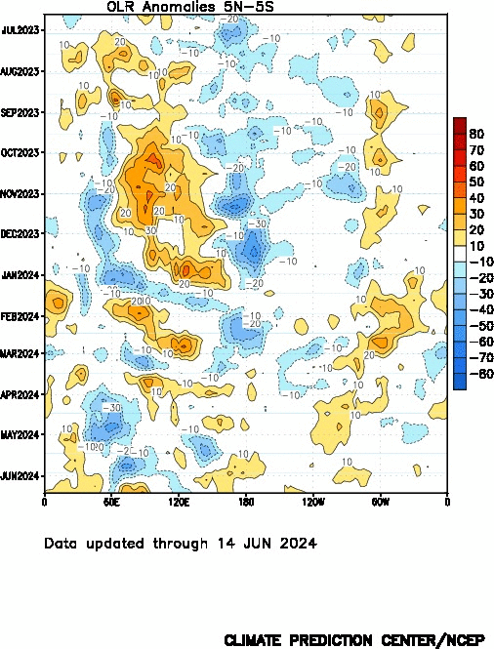
Most recent Outgoing Longwave Radiation (OLR)
Current OLR is near-Normal
Central Pacific (170°E-140°W,5°S-5°N) OLR Index is +8.58)
During El Niño, the convection is enhanced over-and-around the Date-Line, while suppressed during La Niña
Source:
https://www.cpc.ncep.noaa.gov/data/indices/cpolr.mth.91-20.ascii

Slide 10
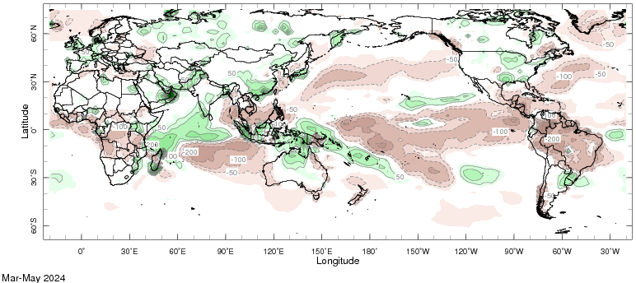
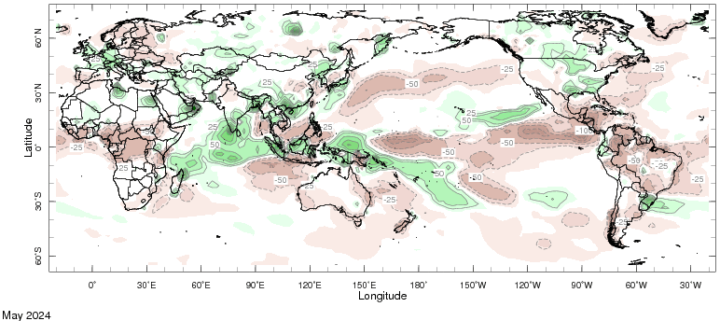
Most recent Precipitation (Prcp) May, and Mar to May (MAM), 2024

Slide 11
Forecasts
IRI ENSO Plume,
Probability of Nino-34,
Global SSTs from NMME,
Prcp. and Temp. outlook from IRI (June, 2024)

Slide 12
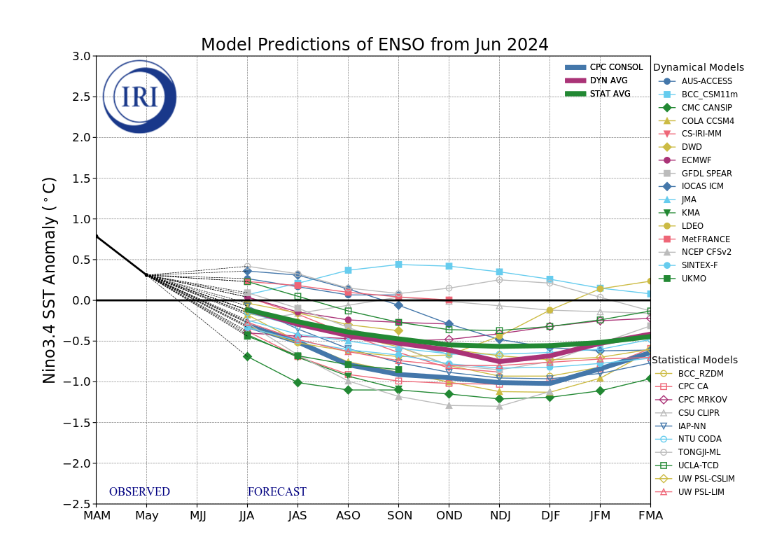
IRI’s ENSO Forecast Jun, 2024
Mean of DYN & STAT Models indicate ENSO-Neutral Conditions during May-Jun 2024, that continue till Jul-Sep 2024,
After three seasons of ENSO-neutral conditions, most models indicate a transition to La Niña in Aug-Oct 2024, that continues till the end of the forecasts.

Slide 13
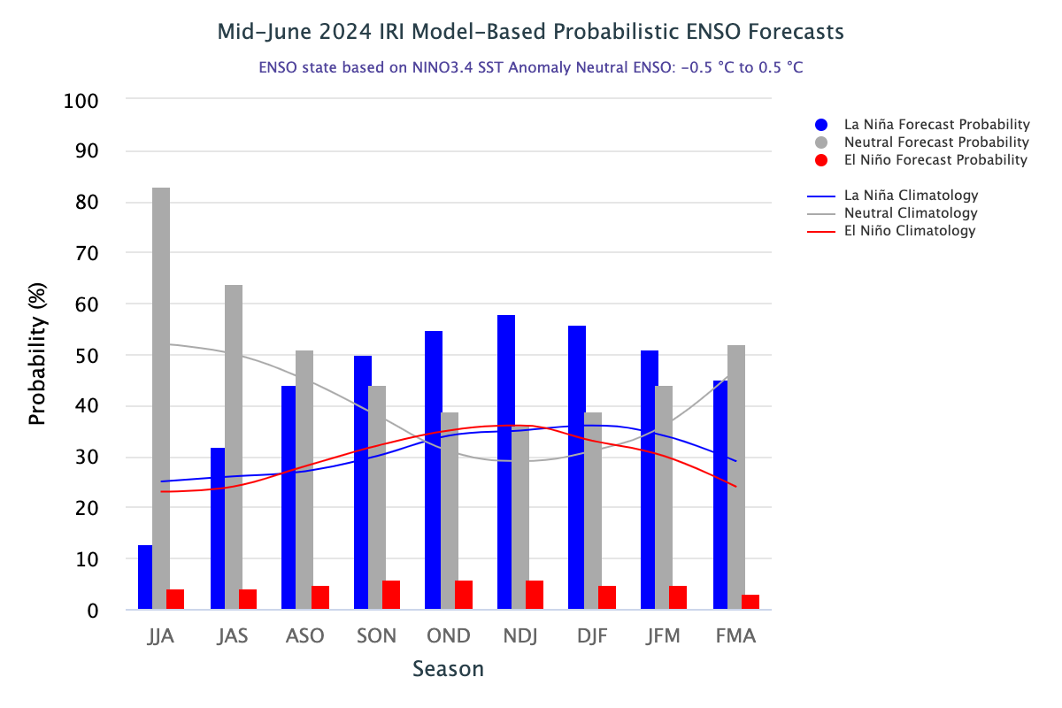
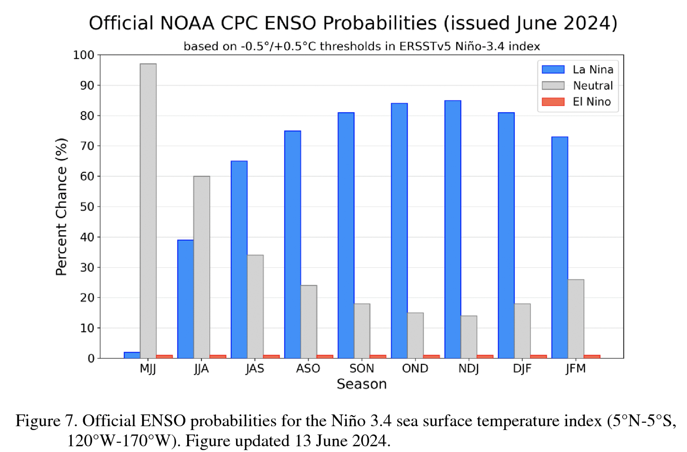
IRI’s Probabilistic ENSO Forecasts (on 20th Jun, 2024)

Slide 14
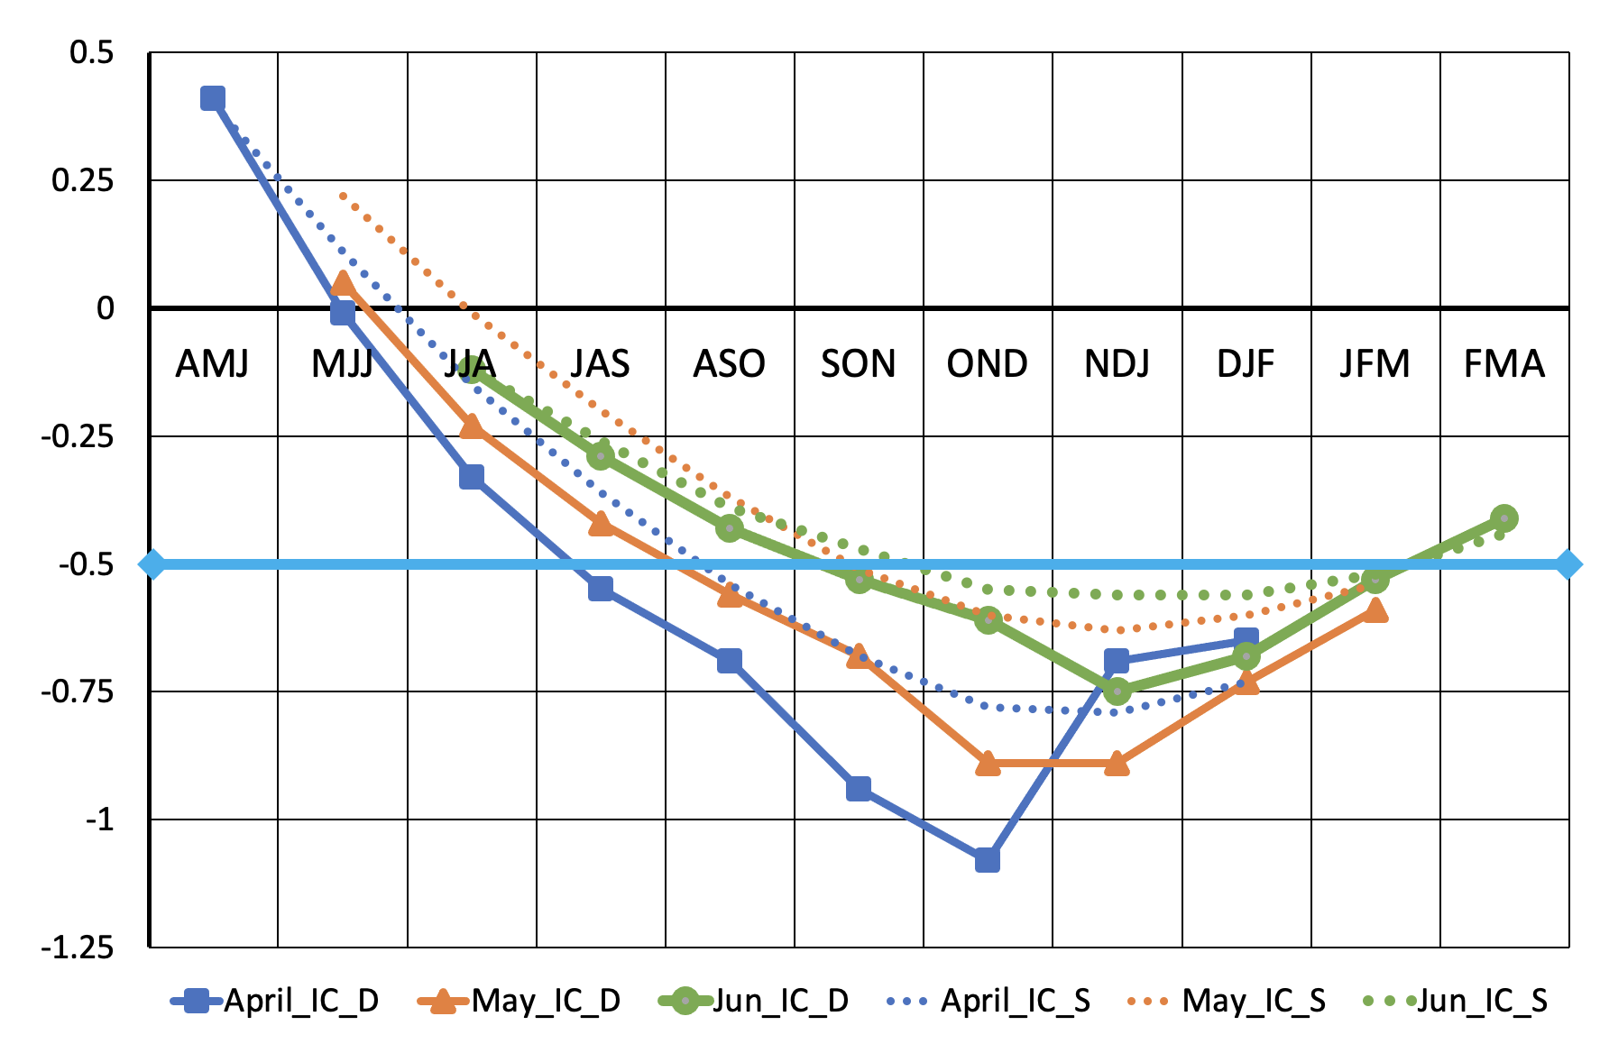
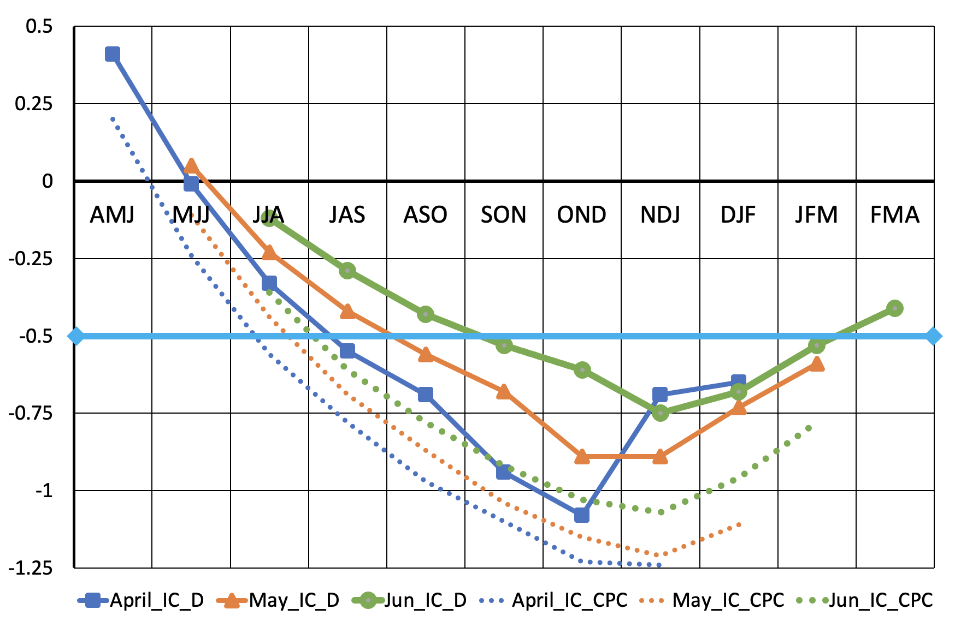
ENSO Forecast Apr, May, and Jun, 2024 Starts
DYN vs STAT Models
DYN-Models vs CPC

Slide 15
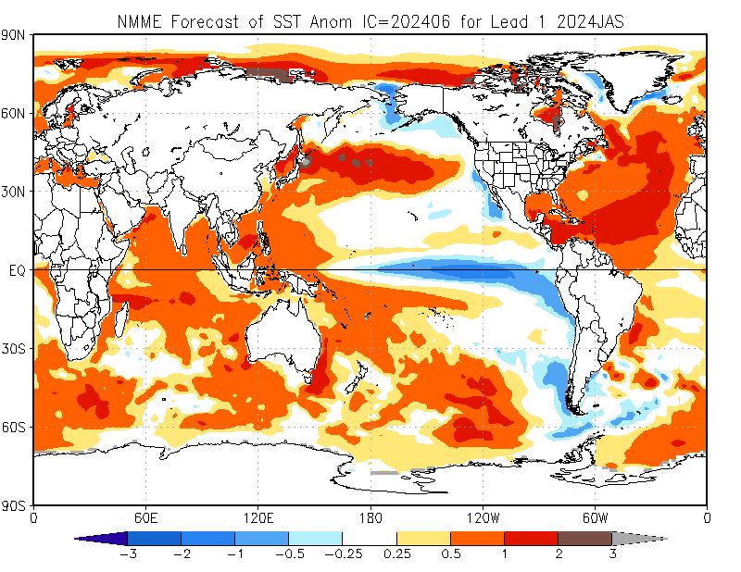
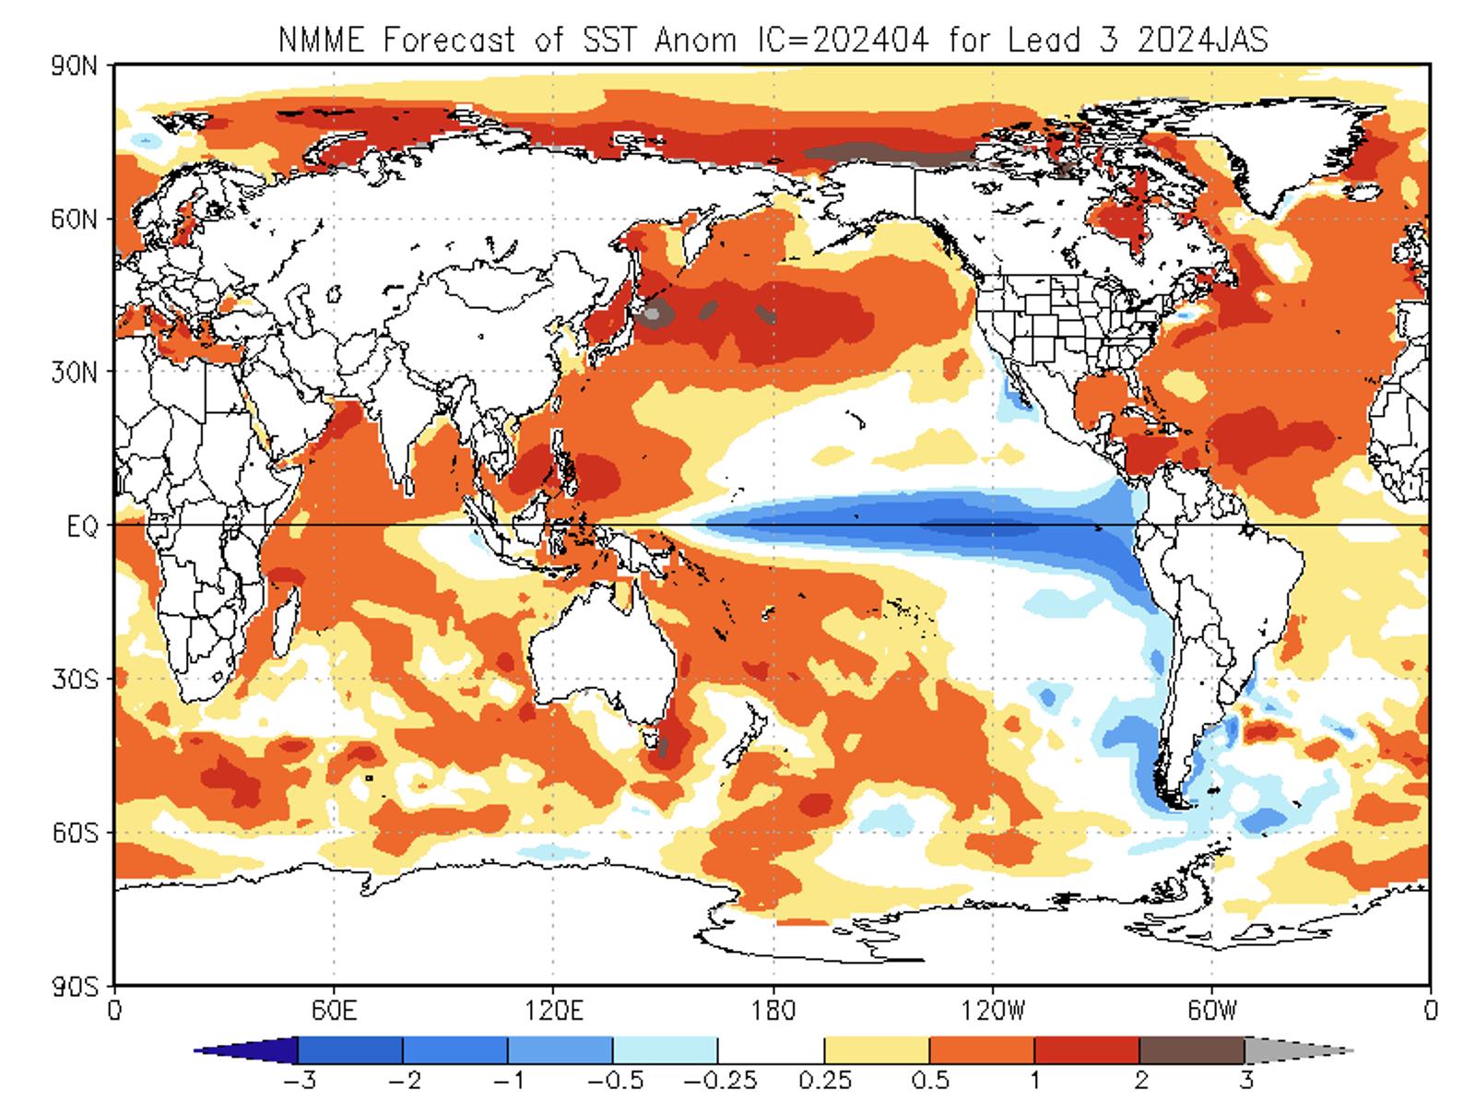
North American Multi Model Ensemble
(NMME) SST Forecast
JAS-2024 (April, Start)

Slide 17
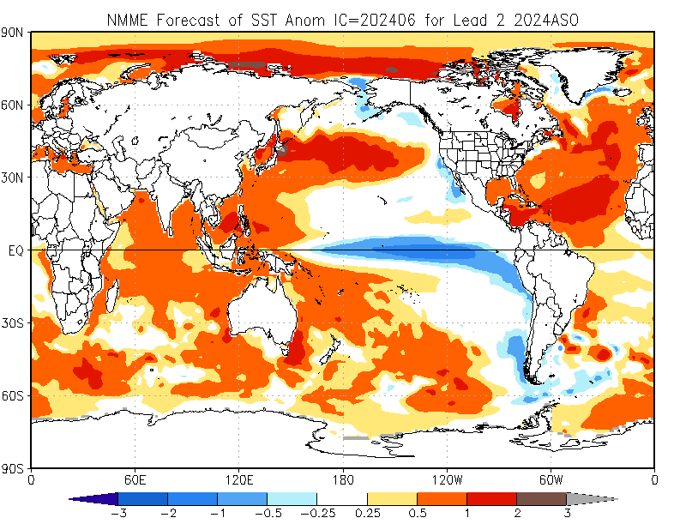

Slide 18
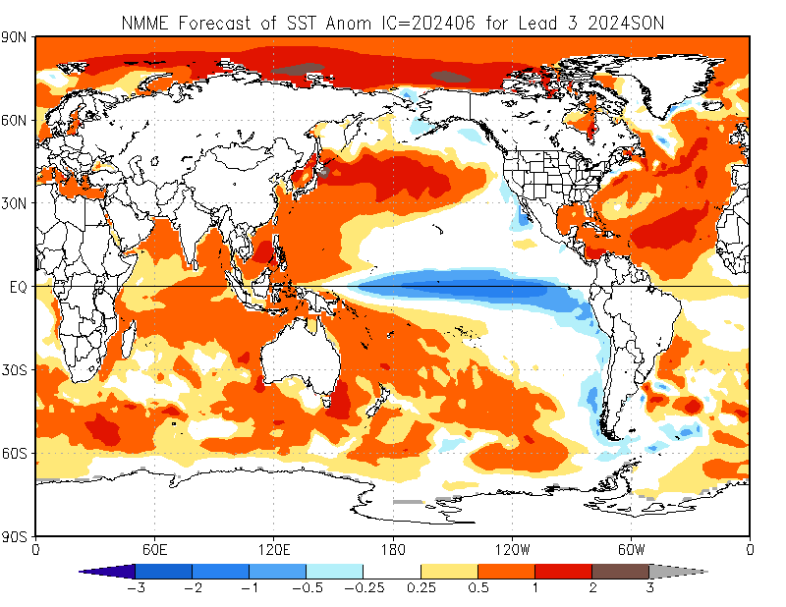

Slide 19
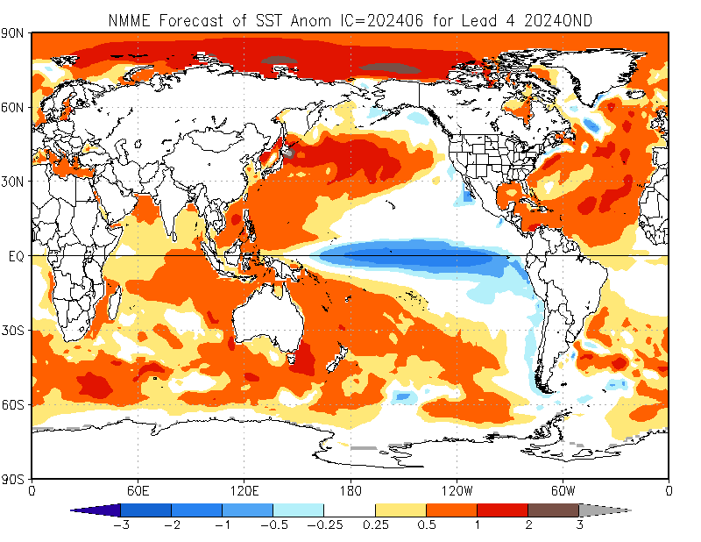

Slide 20
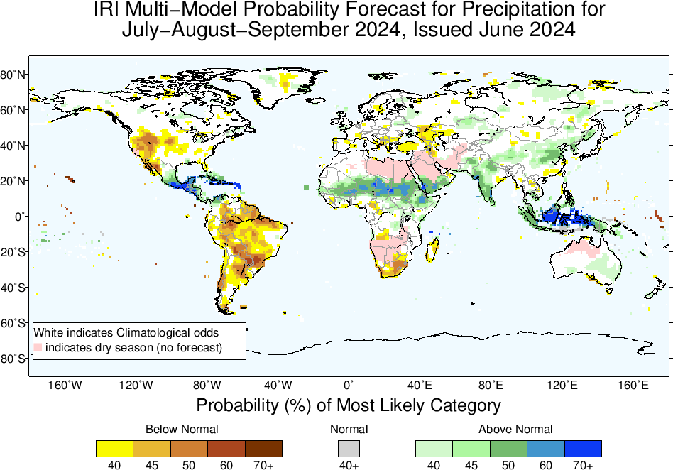
Precipitation Forecasts based on North American Multi Model Ensemble (NMME)

Slide 22
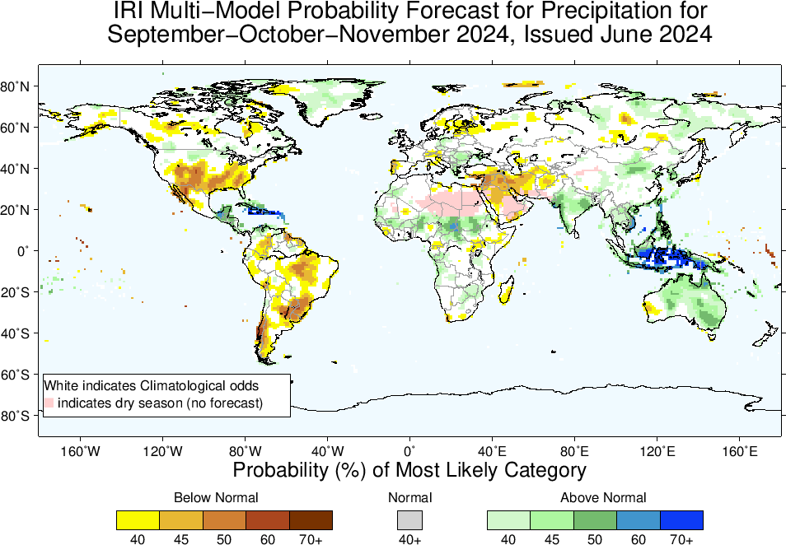

Slide 23
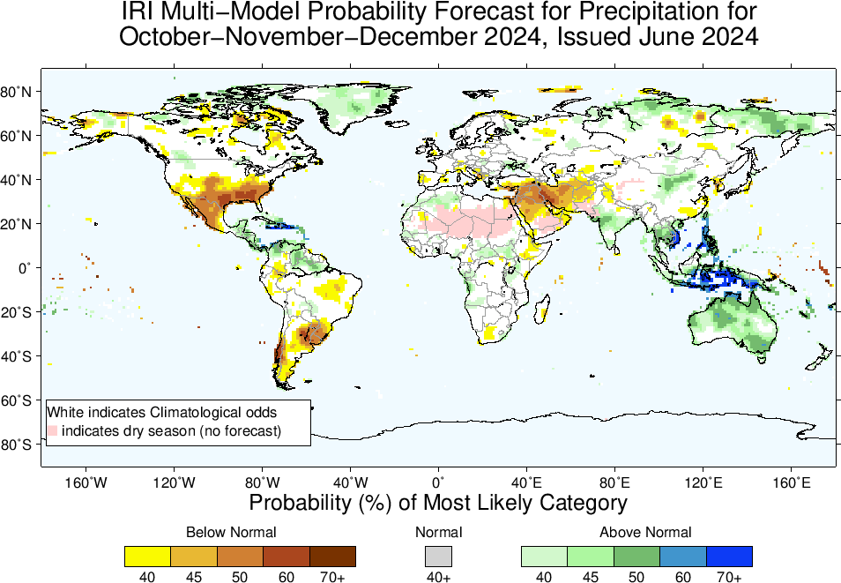

Slide 24
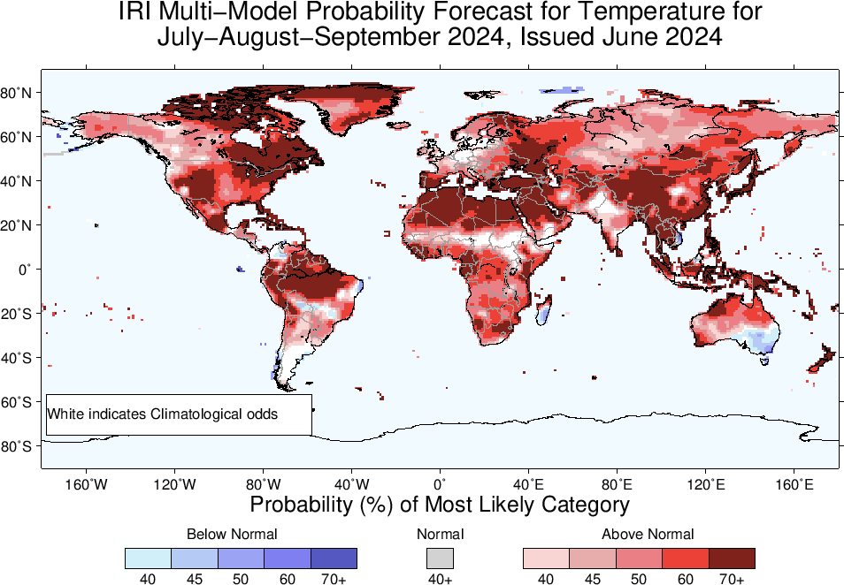
2m-Temperature Forecasts based on North American Multi Model Ensemble (NMME)

Slide 25
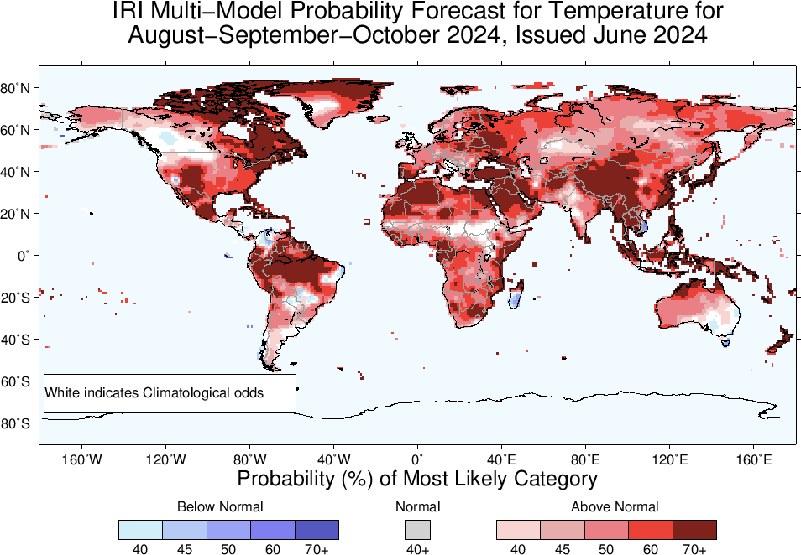

Slide 26
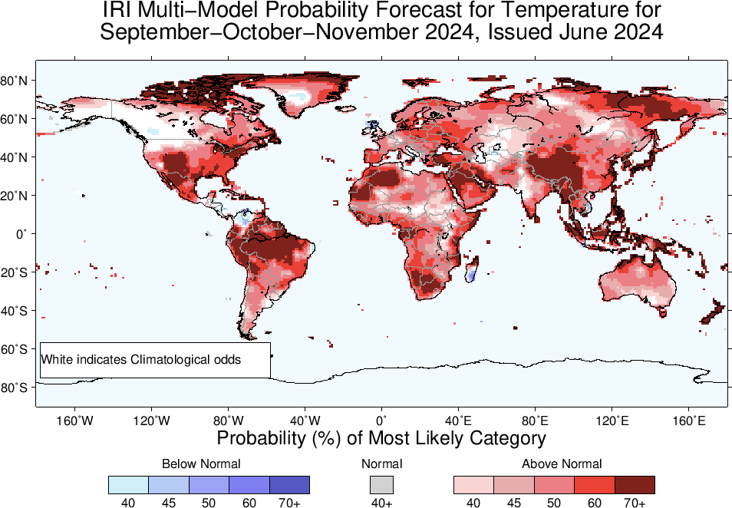

Slide 27
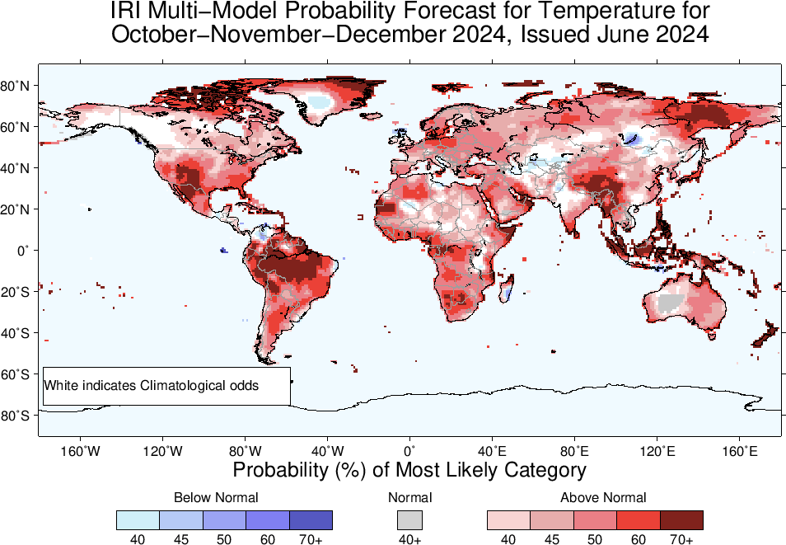

Slide 28
Summary
After its Peak in Nov-Jan, current El Nino has started declining (Dec, 2023 NINO3.4 Value was +1.99, while Jan, 2024 was +1.78, and Feb, was +1.53, March was +1.24, April, was +0.8, and May was +0.3), while for most recent week ending on 12 June, 2024, it was +0.0.
Bye-Bye El Nino of 2023/24 ☺
ENSO-Neutral is most probable in JJA, JAS, and ASO, 2024.
LA NINA is most likely from SON, and remain so onward, however, the odds are for her late and weak Onset. Mostly in low (50% in SON)-high (58% in NDJ) 50s.
Given LA NINA, Monsoonal regions of Africa, Asia, MC, Australia, Central America, could experience wetter than normal conditions during next two seasons (JAS, and ASO of 2024)
While, most of southern North America (southeast US), South America, central-Southwest Asia, and northeast Africa, experience drier than normal conditions!

