Slide 1
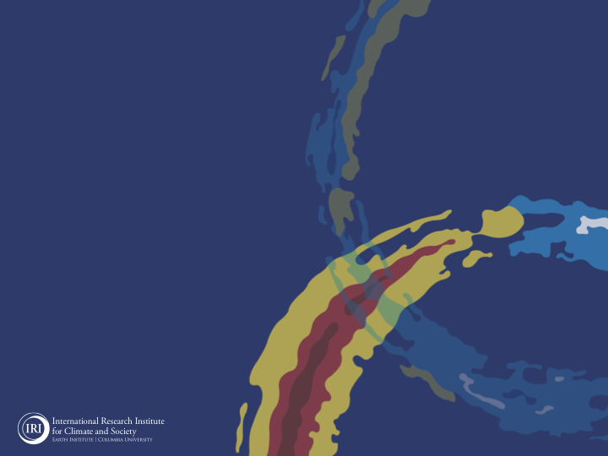
ENSO and Climate Outlook
in Jun, 2023
Chances of a strong El Niño (56%)
M. Azhar Ehsan
(azhar@iri.columbia.edu)
Associate Research Scientist
IRI ENSO and Climate Forecast Lead
Jeffrey Turmelle and Jing Yuan: forecast processing and web updates
Cuihua Li: Draft PowerPoint development
IRI’s Climate Group, led by Dr. Andrew Robertson: Forecast system development, ongoing innovation, and verification

Slide 2
Outline
Observed Oceanic and Atmospheric Conditions in
Tropical Pacific
Across the Globe
ENSO Forecast in
NMME
IRI ENSO Forecast Tool (Deterministic and Probabilistic)
Seasons Outlook of
SST
Precipitation and Temperature
Summary

Slide 3
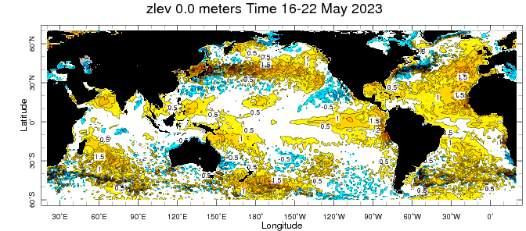
Evolution of SST Anomalies in Weekly Datasets
Highlights:
Top Story: El Nino is here.
Warm SSTAs have expanded further westward, reaching upto 150 W.
Warm tropical North Atlantic, and near Neutral in Indian Ocean.

Slide 4
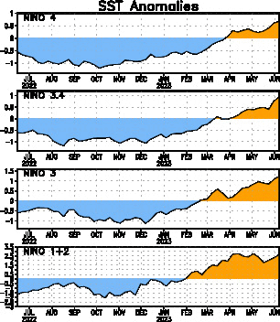
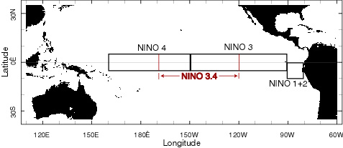
Most recent SST Anom.
Highlights:
Most Recent (07 Jun, 2023) SST Departures in different NINO regions
Niño 4
0.7ºC
Niño 3.4
0.9ºC
Niño 3
1.2ºC
Niño 1+2
2.6ºC

Slide 5
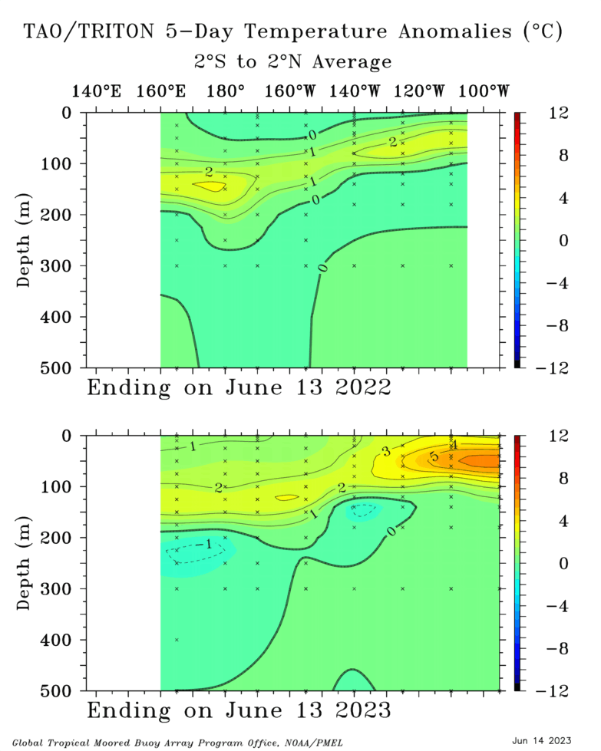
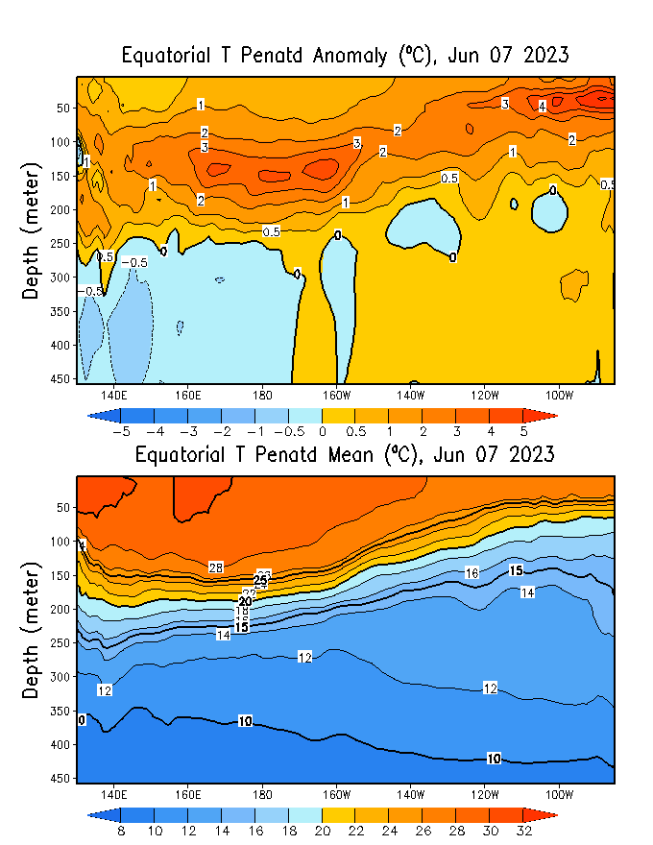
Subsurface Ocean Temperature Evolution
Highlights:
A nice Downwelling Kelvin Wave, responsible for;
subsurface movement of warm waters towards the eastern Pacific,
contributing to the futher development and intensification of ongoing El Niño conditions.

Slide 6
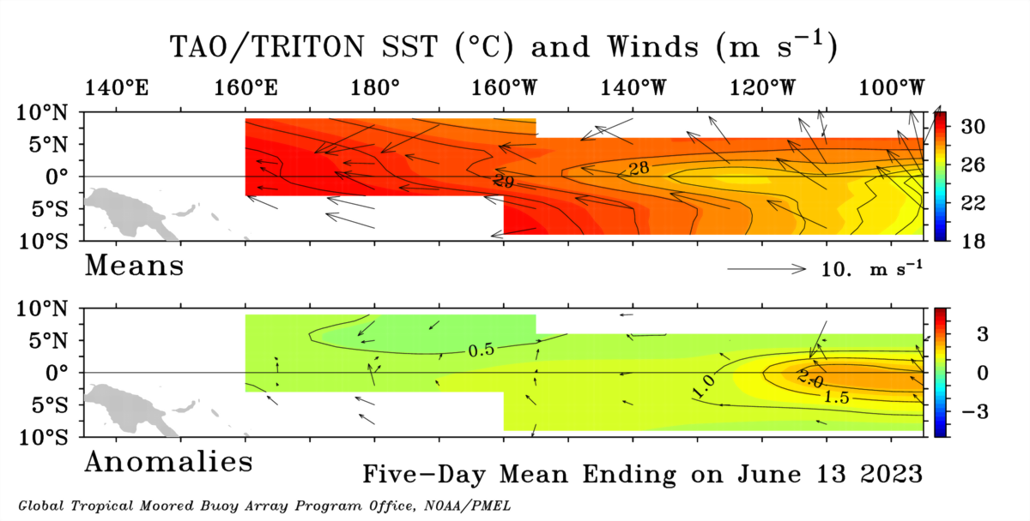
Most recent Lower-Level Winds
Highlights:
The trade winds observed in the 5-day period ending 13 June 2023 were below average in strength across the tropical.
In the tropical Pacific region, El Niño events typically lead to a sustained weakening or even a reversal of trade winds.

Slide 7
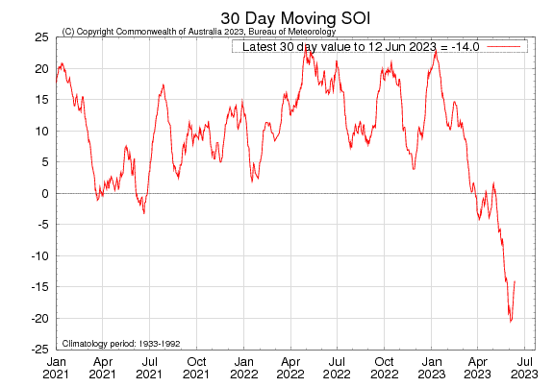
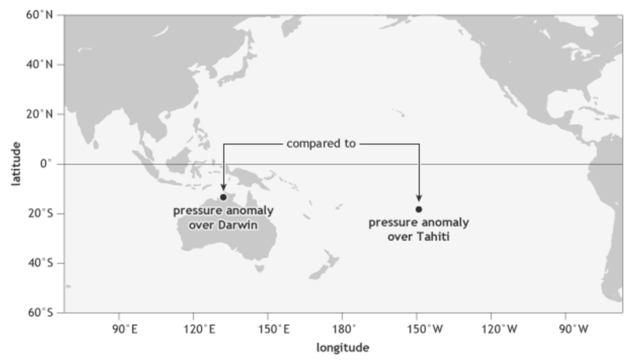
Most recent SOI
INDO
E-Pac
-1.0
During El Niño, the pressure becomes below average in Tahiti and above average in Darwin, and the Southern Oscillation Index is negative.
A Sustained Negative values of the SOI above -7 typically indicate El Niño

Slide 8
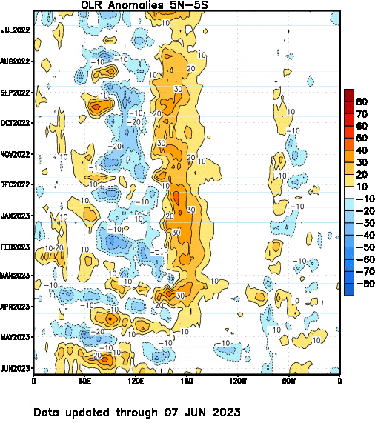
Most recent OLR
Highlights:
From beginning of year 2023, we are seeing convection that are crossing the Maritime Continent region.

Slide 9
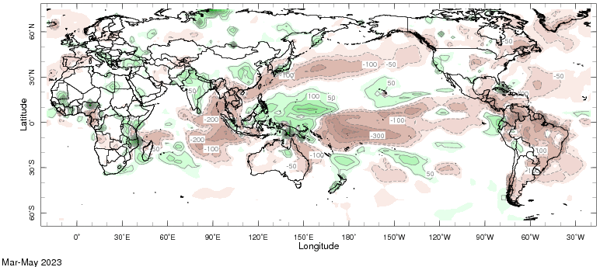
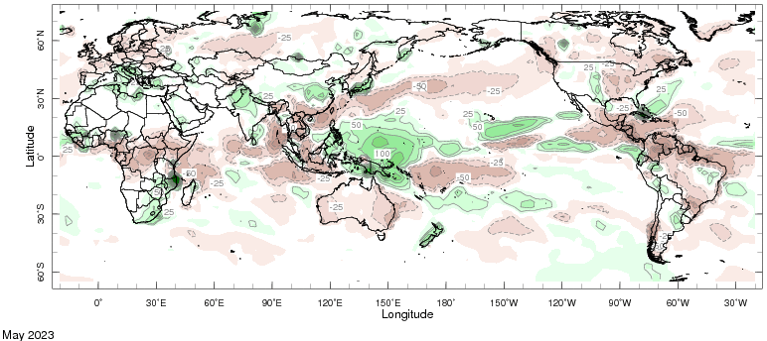
Most recent Precipitation

Slide 10
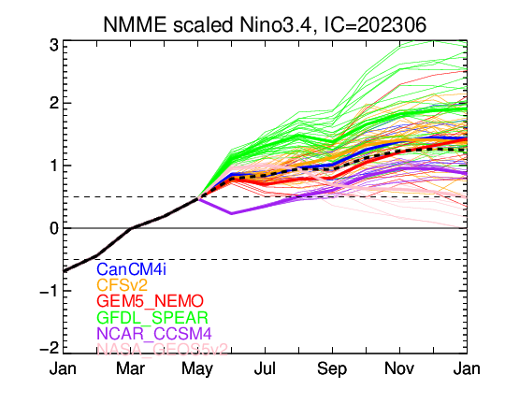
NMME’s ENSO Forecast

Slide 11
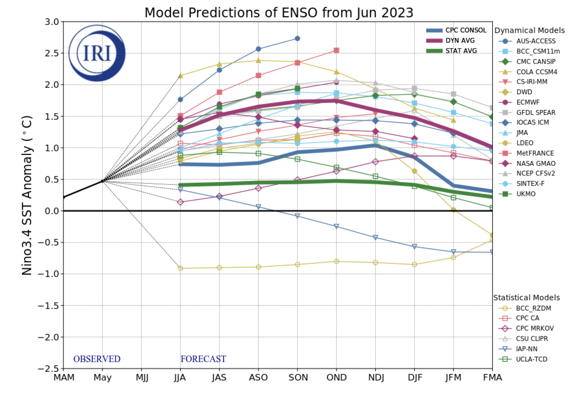
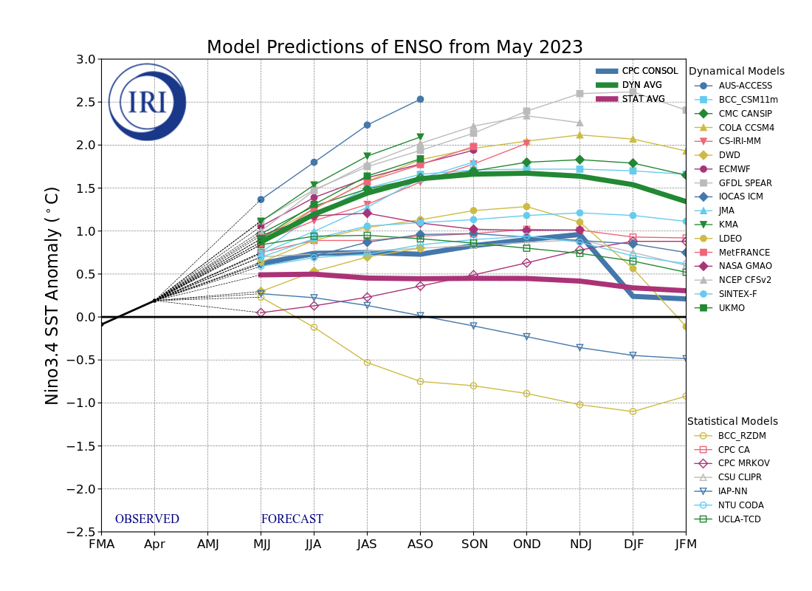
IRI’s ENSO Forecast (June, 2023: Caution about different colors)
Highlights:
A lot of spread (tail end of SPB)
Dynamical Models shows stronger warming as compared to Statistical models.
Some statistical models even telling us a different story like BBC_RZDM, IAP_NN, are quite prominent among others (like last month, April, 2023)

Slide 12
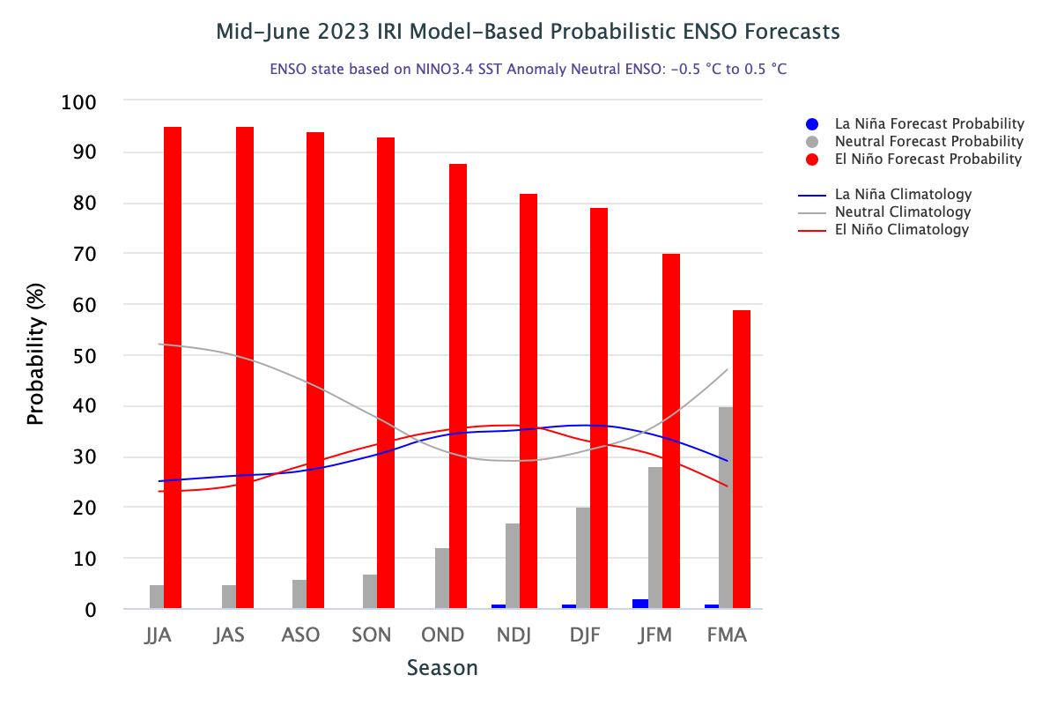
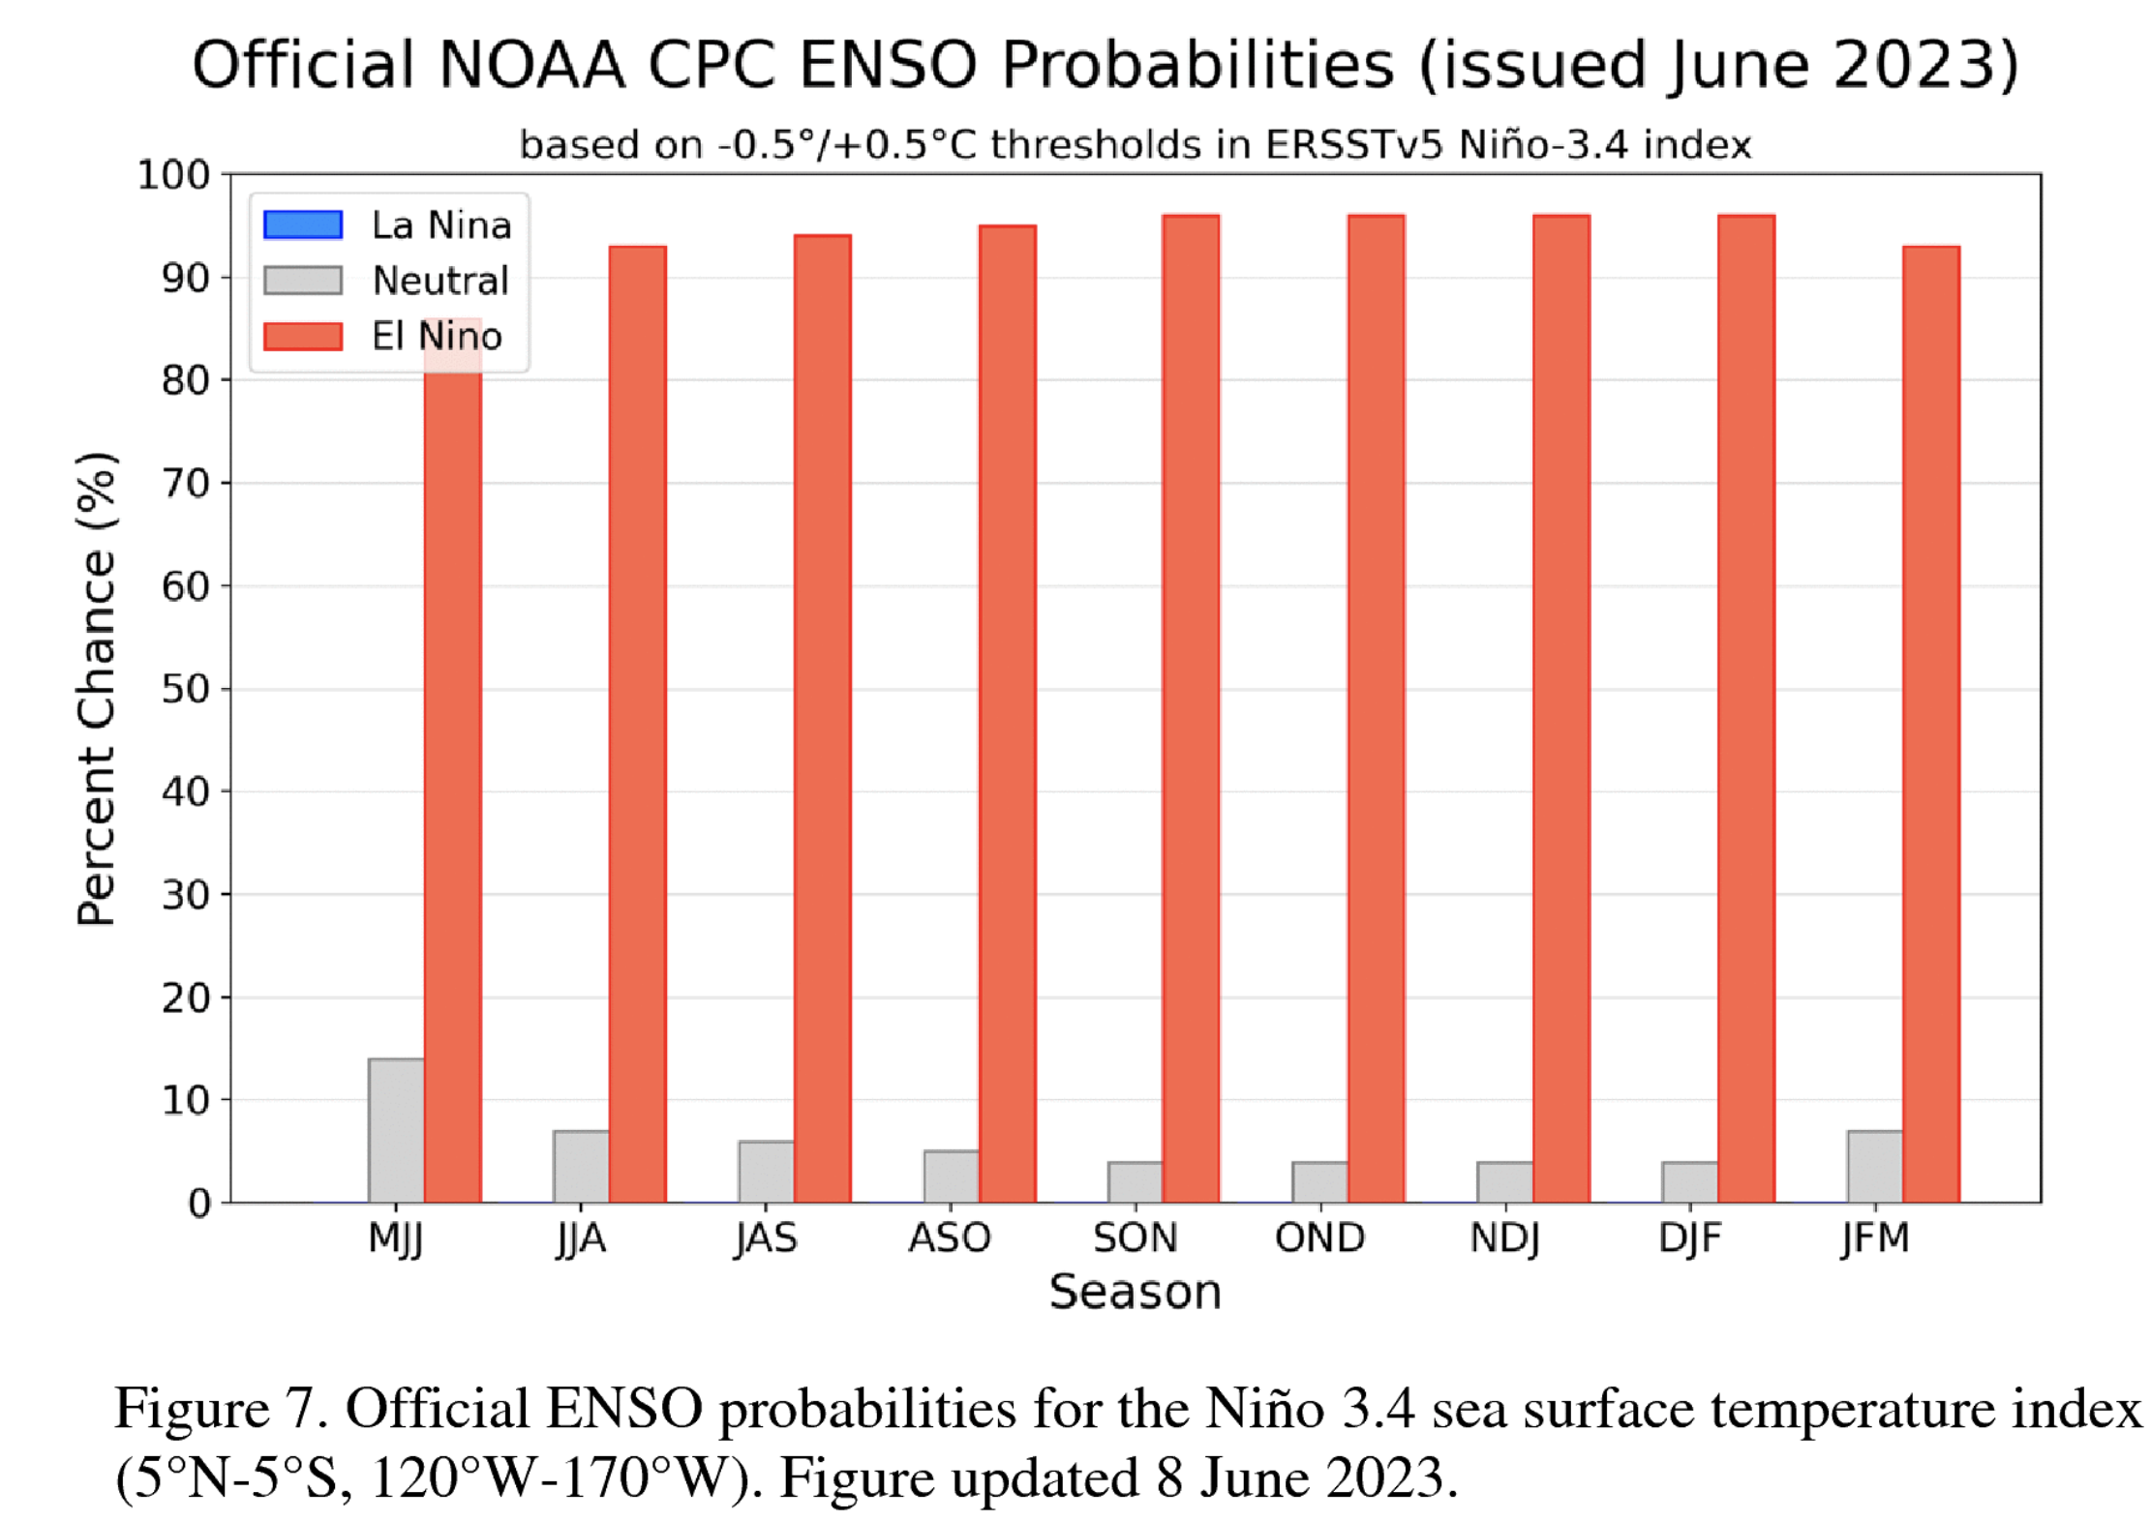
IRI’s ENSO Forecast (June, 2023) Probabilities

Slide 13
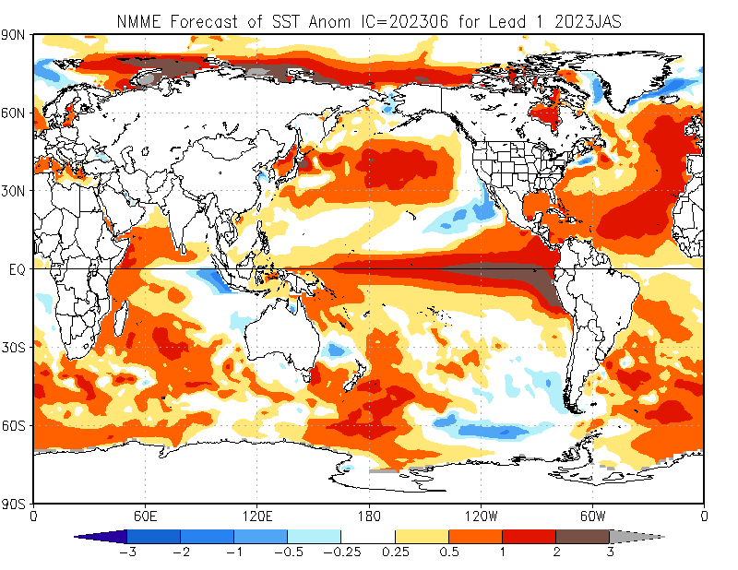

Slide 14
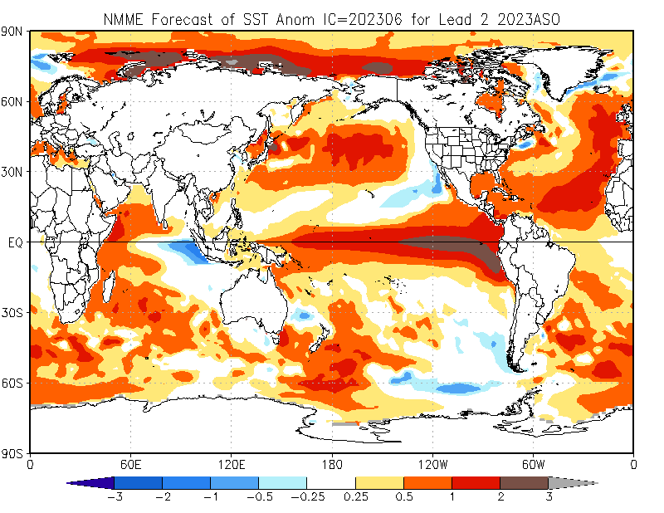

Slide 15
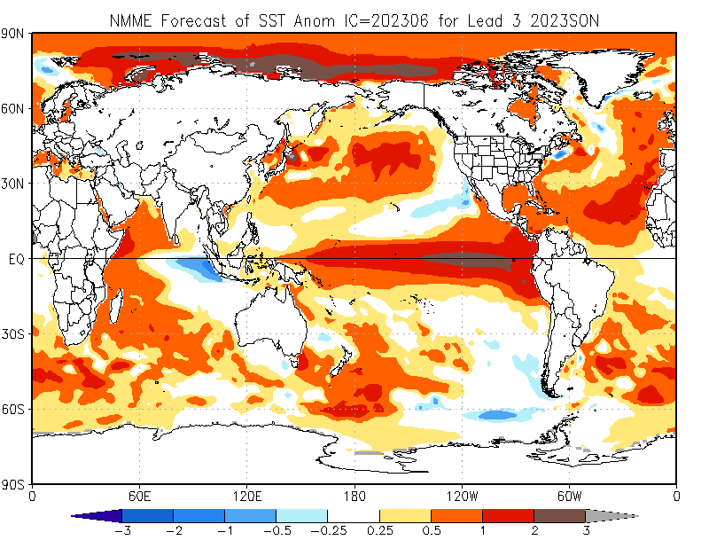

Slide 16
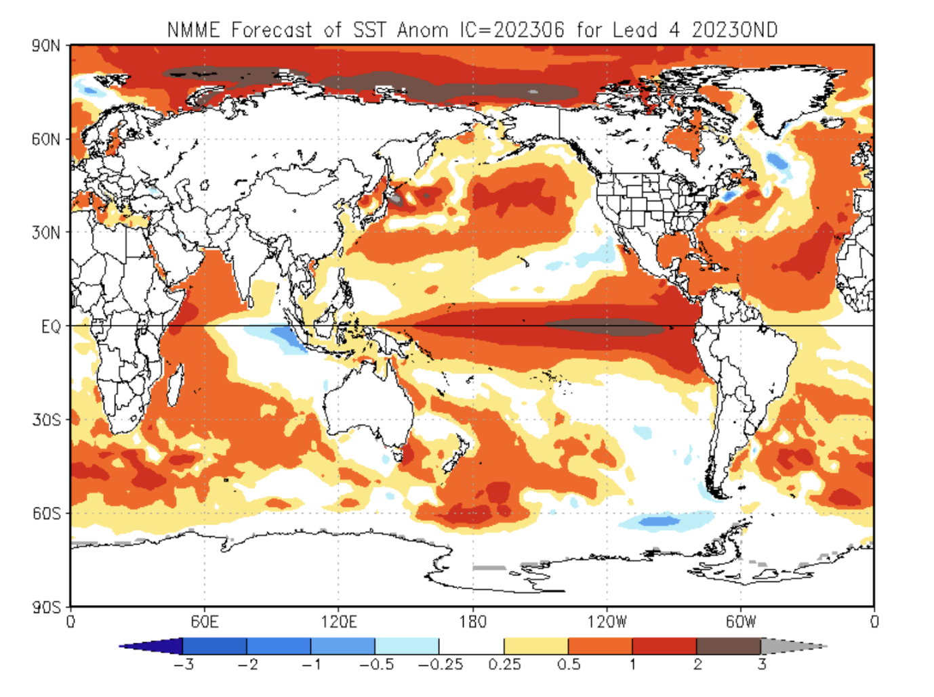

Slide 17
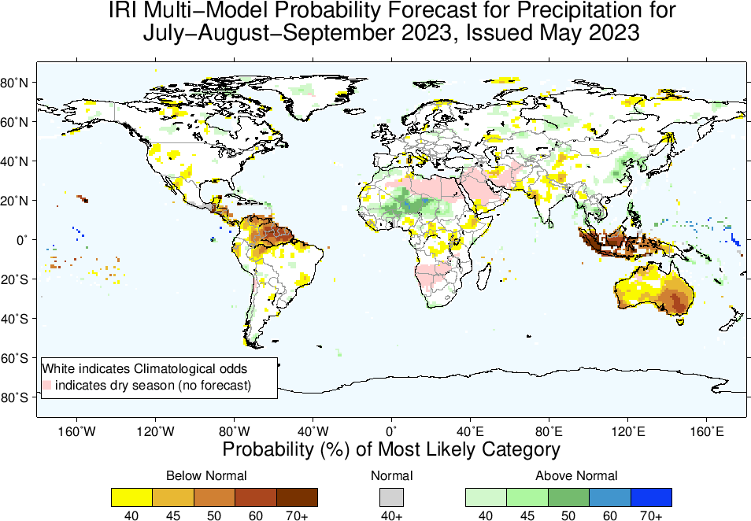
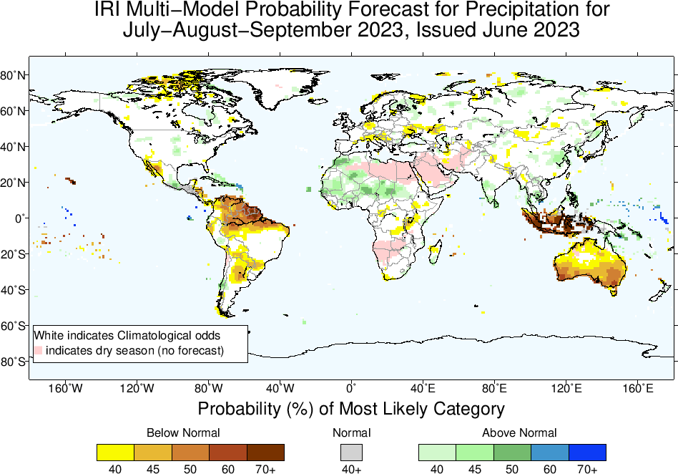
Precipitation Forecasts: Season # 1, Jul to Sep
Highlights:
Shift towards Normal to Above-Normal
Sahel region and Northwest Africa
Caribbean region
Sri Lanka, Southern India
Shift towards Normal to
Below-Normal
Northeast South America,
Maritime Continent,
Australia
Lackluster N-American & Indian monsoon
Credit: Thea TURKINGTON (NEA)

Slide 18
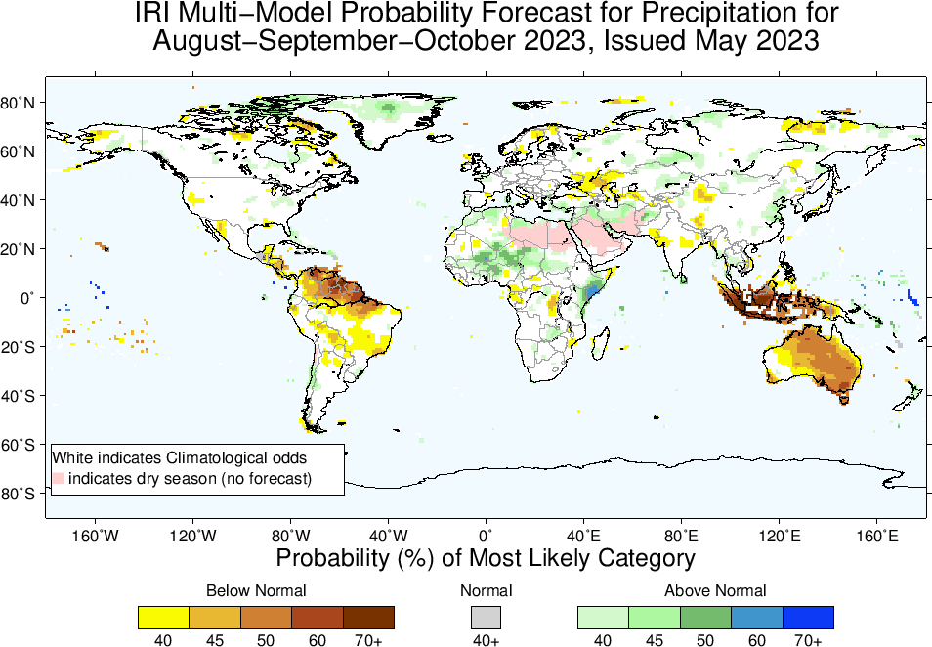
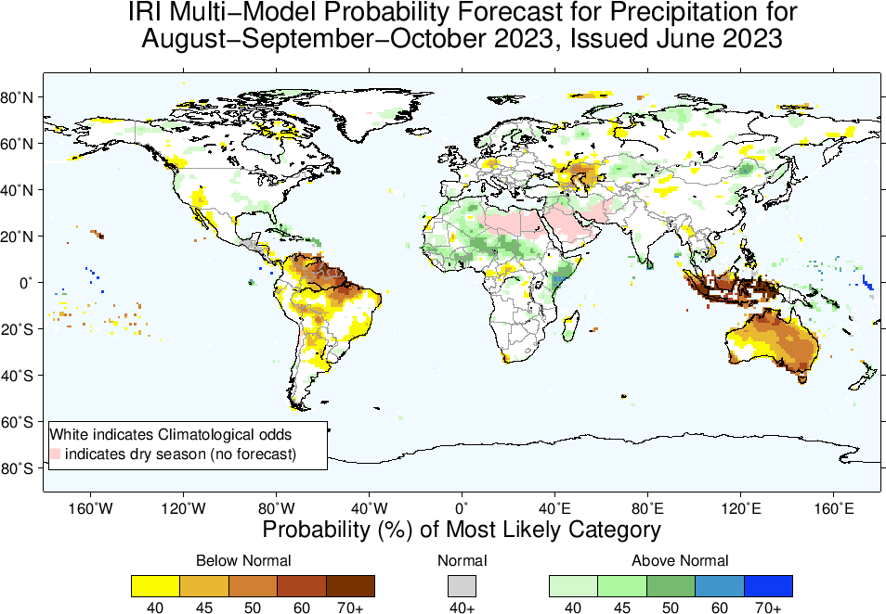
Precipitation Forecasts: Season # 2, Aug to Oct
Highlights:
Shift towards Normal to Above-Normal
Sahel region and Northwest Africa
Middle-East, Sri Lanka, Southern India, Caribbean regions
Northeast Africa, Parts of Madagascar (South-Southeast)
Shift towards Normal to Below-Normal
Northern parts of South America,
Central America,
Maritime Continent,
Australia
Lackluster N-American & Indian monsoon

Slide 19
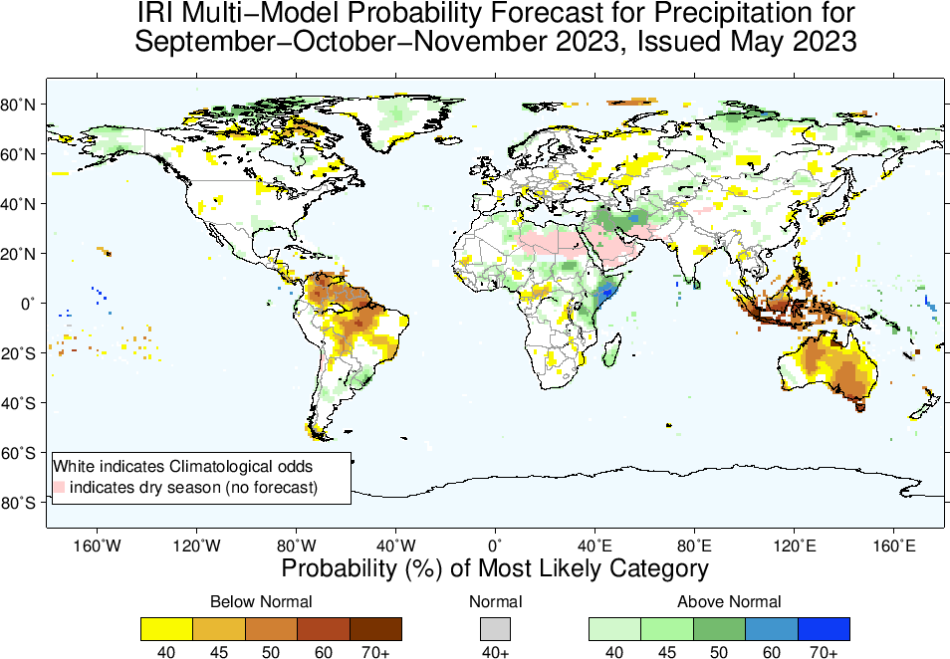
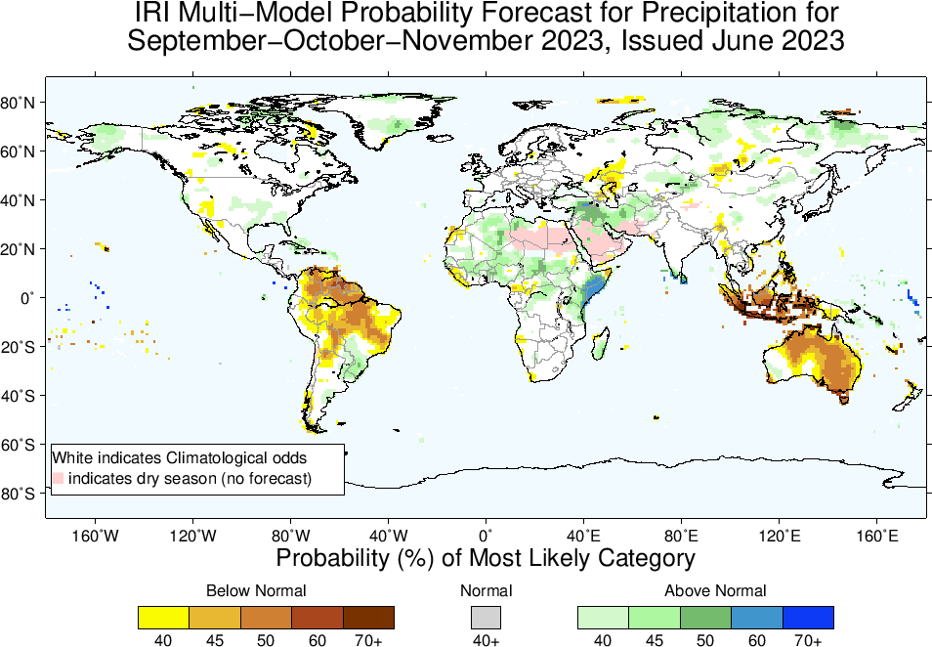
Precipitation Forecasts: Season # 3, Sep to Nov
Highlights:
Shift towards Normal to Above-Normal
Sahel region and Northwest Africa
Middle-East, region
Caribbean region, over and around Uruguay, southeast US, Alaska
Northeast Africa, Parts of Madagascar
Shift towards Normal to Below-Normal
Northern parts of South America,
Central America,
Maritime Continent,
Australia

Slide 20
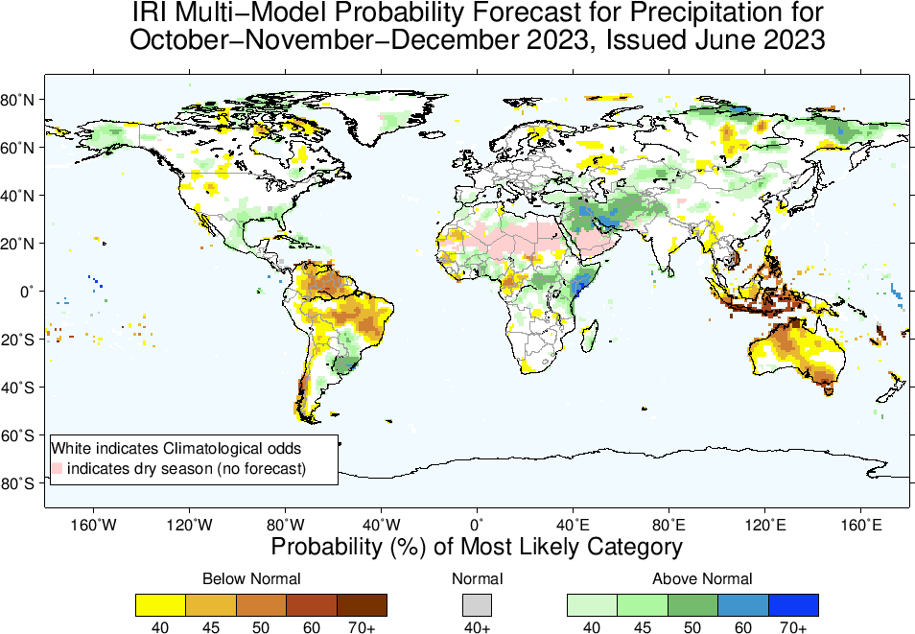
Highlights:
Shift towards Normal to
Above-Normal
Sahel region (Western)
North-east Africa (southeast Ethiopia, Somalia, eastern Kenya)
Caribbean region, over and around Uruguay, Southeast US, and Alaska
Middle-East/Western SA
Madagascar
Shift towards Normal to
Below-Normal
North-Northeast South America,
Central America,
South Asia,
Maritime Continent,
Australia
Precipitation Forecasts: Season # 4, Oct to Dec

Slide 21
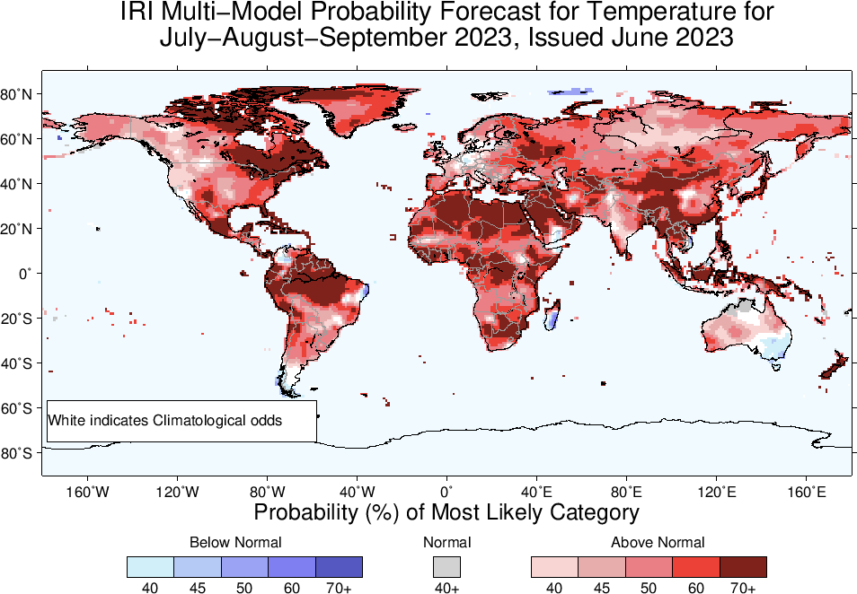
Highlights:
Shift towards Warmer/Above-Normal
Most land areas,
Southeast Asia, the Maritime Continent regions, Northeast South America.
Shift towards Colder/Below-Normal
Northern tip of South America,
Southern parts of Madagascar,
Southeast Australia
Temperature Forecasts: Season # 1, Jul to Sep

Slide 23
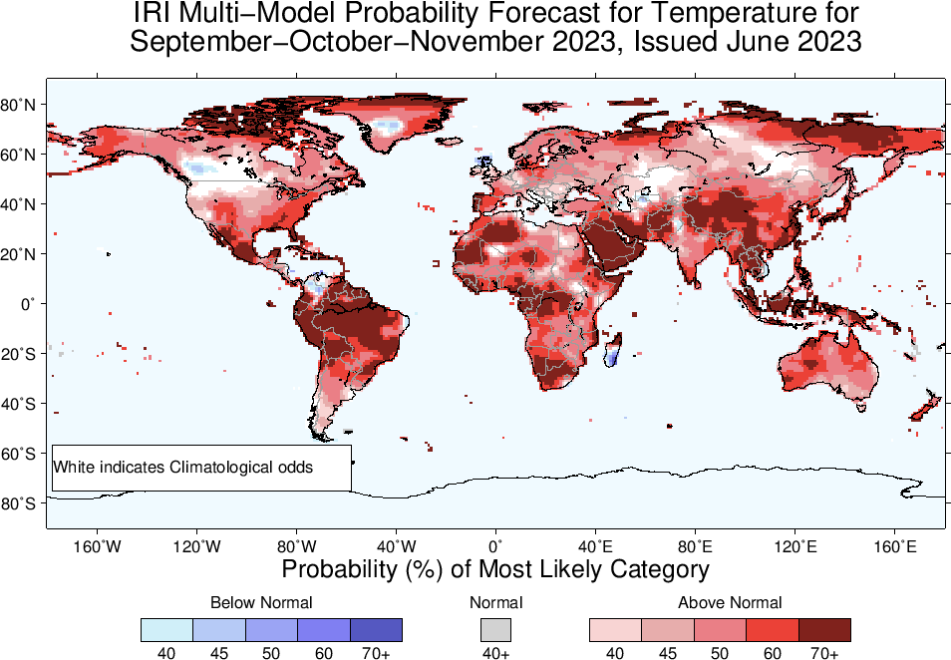

Slide 24
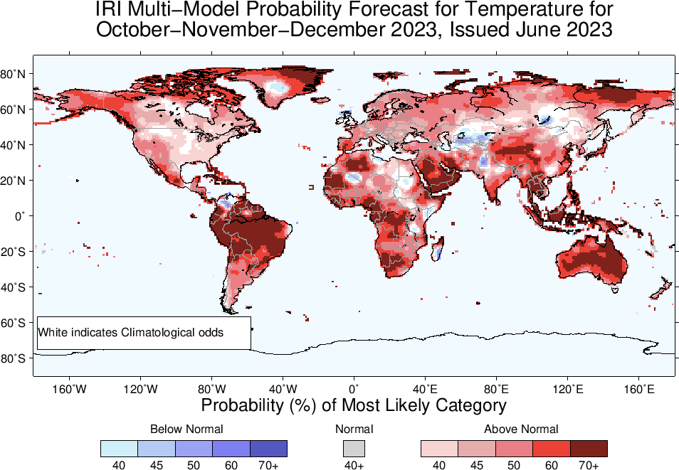

Slide 25
Summary
El Niño is here!
Sea surface temperatures (SSTs) are in El Nino range across the equatorial Pacific Ocean, and further warming up gradually. Substantially Warm SSTs across Pacific for example, NINO1+2, 3 and 3.4, and 4 are +2.6, +1.2, +0.9, and +0.7, on weekly basis.
Warm Sub-Surface across the Pacific.
A weak hint of coupling, still need to wait for a fully coupled evnt.
El Niño Advisory is in Place!

