Slide 1
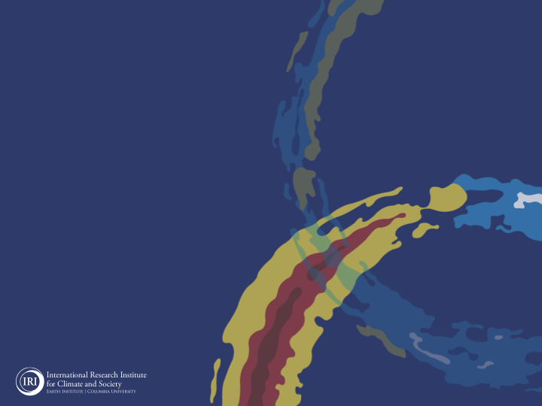
ENSO and Climate Outlook in
July, 2024
ENSO-neutral is expected to continue,…
M. Azhar Ehsan
(mae2171@columbia.edu)
Associate Research Scientist
Center for Climate Systems Research (CCSR)
Dr. Andrew Robertson (CCSR): Forecast system development, ongoing innovation,
Jing Yuan (CCSR): Forecast Post-Processing,
Jeffrey Turmelle (IRI): Forecast Post-Processing and Web updates.

Slide 2
Outline
Observed Oceanic and Atmospheric Conditions in
Tropical Pacific
Across the Globe
ENSO Forecast in
NMME
IRI ENSO Forecast Tool (Deterministic and Probabilistic)
Seasons Outlook of
SST
Precipitation and Temperature
Summary

Slide 3
Observations
Oceanic
Atmospheric

Slide 4
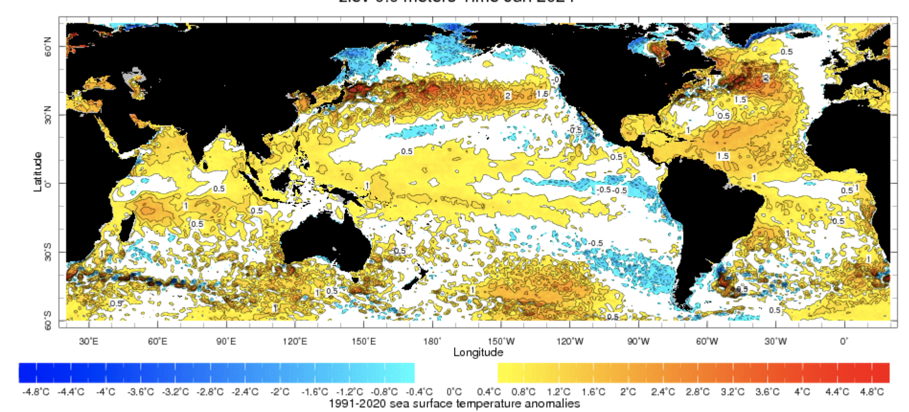
Evolution of SST Departures in Monthly (June, 2024) Data
For June, 2024
NINO 1+2: -0.65
NINO3: -0.14
NINO3.4: +0.24
NINO4: +0.65
In the Pacific Ocean: Above-Average SSTs persisted in WESTERN Pacific (over and across the Date Line), weak negative SSTs in the eastern Pacific
Indian Ocean: Basin wide warm across Indian Ocean, Neutral IOD (Index value is -0.17 as of 07 July, 2024),
North-Pacific and North Atlantic Ocean: Negative PDO, Warm across Atlantic (TNAI, +1.47, TSAI, +0.56, TAtl, +0.55)
Source: https://iridl.ldeo.columbia.edu/maproom/Global/Ocean_Temp/ERSST_Anomaly.html

Slide 5
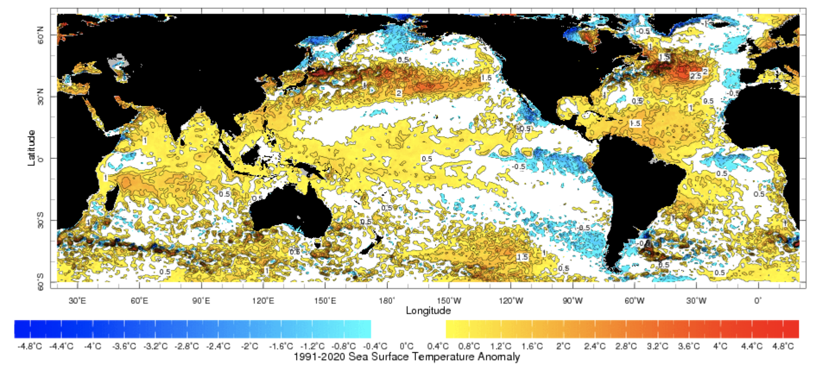
Evolution of SST Departures in Weekly Data (Last 4-Weeks)
https://www.cpc.ncep.noaa.gov/data/indices/wksst9120.for

Slide 6
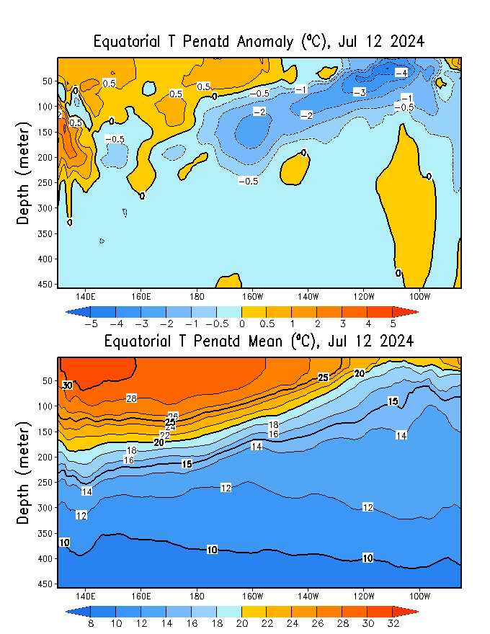
What is the underwater conversation?
May, 2024
Warm (~ +0.5C) subsurface-to-surface temperature anomalies dominate from 140E to 150W in equatorial Pacific Ocean (Surface to 100 meter at depth).
Cold subsurface temperature anomalies have extended and reached at the surface in eastern Pacific,
Around 160W, cold subsurface strengthens compared to the previous month.
June, 2024

Slide 7
What is the underwater conversation?
After reaching peak levels in April and May 2024, negative anomalies have shown a trend towards warmer temperatures.
As of early-July 2024, negative anomalies have started to recover.

Slide 8
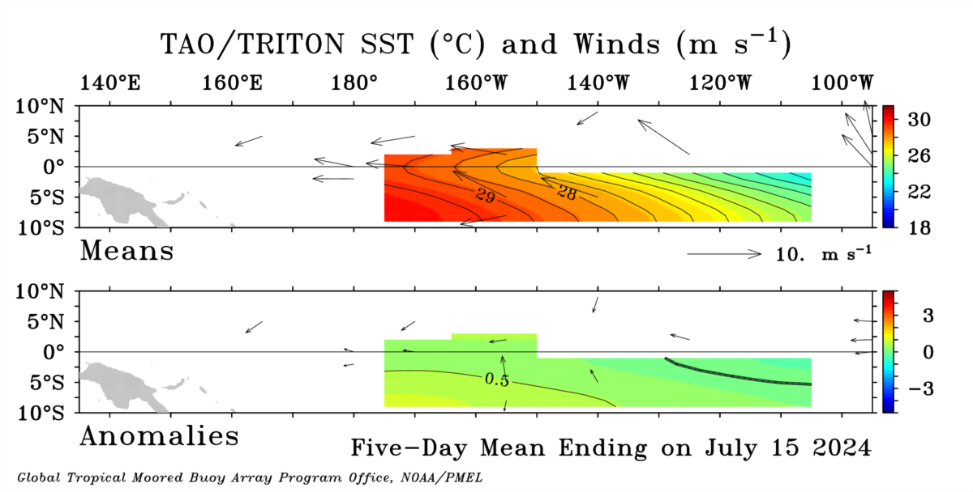
Most recent Lower-Level Winds (Blowing slightly stronger in Central Pacific)

Slide 9
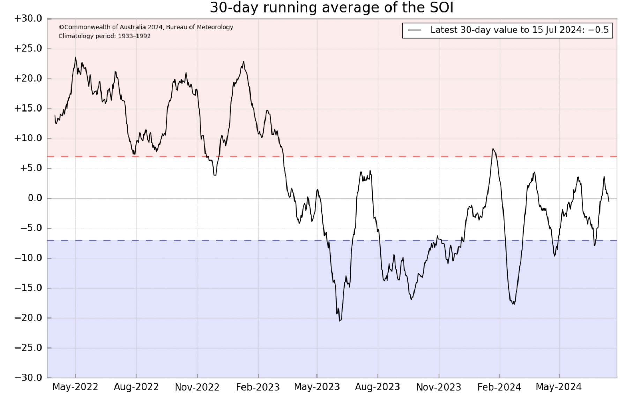
Most recent Southern Oscillation Index (SOI →ENSO Neutral)
Current SOI values is in ENSO-neutral range
(For June, 2024 it is -3.1)
Equatorial-SOI is also in ENSO-neutral range,
(For June, 2024 it is 0.6)
During El Niño, the pressure becomes below average in Tahiti and above average in Darwin, and the Southern Oscillation Index is negative.
A Sustained Negative values of the SOI above -7 typically indicate El Niño
Source:
http://www.bom.gov.au/climate/enso/#tabs=Pacific-Ocean&pacific=SOI

Slide 10
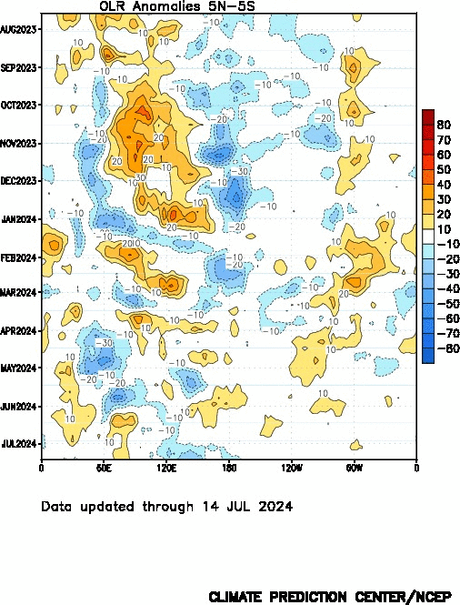
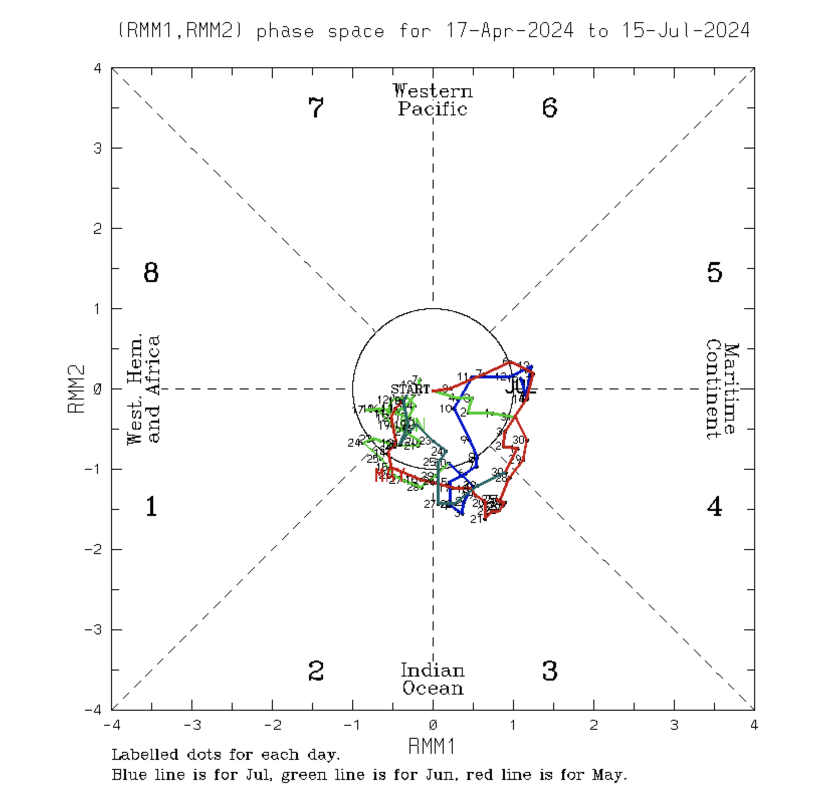
Most recent Outgoing Longwave Radiation (OLR)
MJO over MC, good for La NINA development, enhanced convection, stronger trades, active upwelling
Current OLR enhanced convection in the western Pacific (120E to 150E),
Also, over Date Line (weak enhanced convection, high-frequency variability).
During El Niño, the convection is enhanced over-and-around the Date-Line, while suppressed during La Niña
Source:
https://www.cpc.ncep.noaa.gov/data/indices/cpolr.mth.91-20.ascii

Slide 11
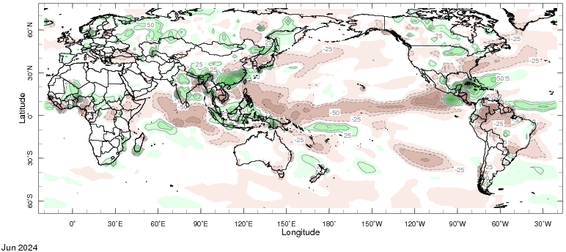
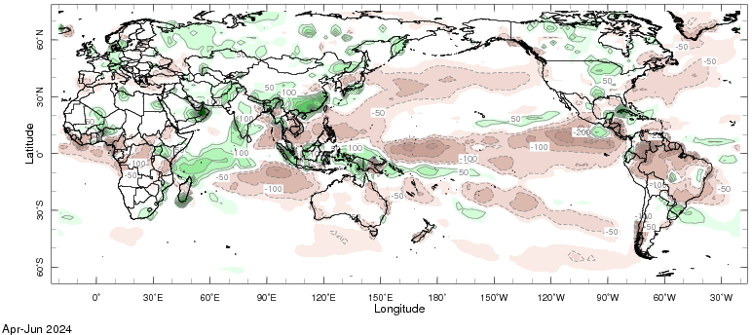
Most recent Precipitation (Prcp) June, and Apil to June (AMJ), 2024
June, 2024
April-May-June, 2024

Slide 12
Forecasts
IRI ENSO Plume,
Probability of Nino-34,
Global SSTs from NMME,
Prcp. and Temp. outlook from IRI (July, 2024)

Slide 13
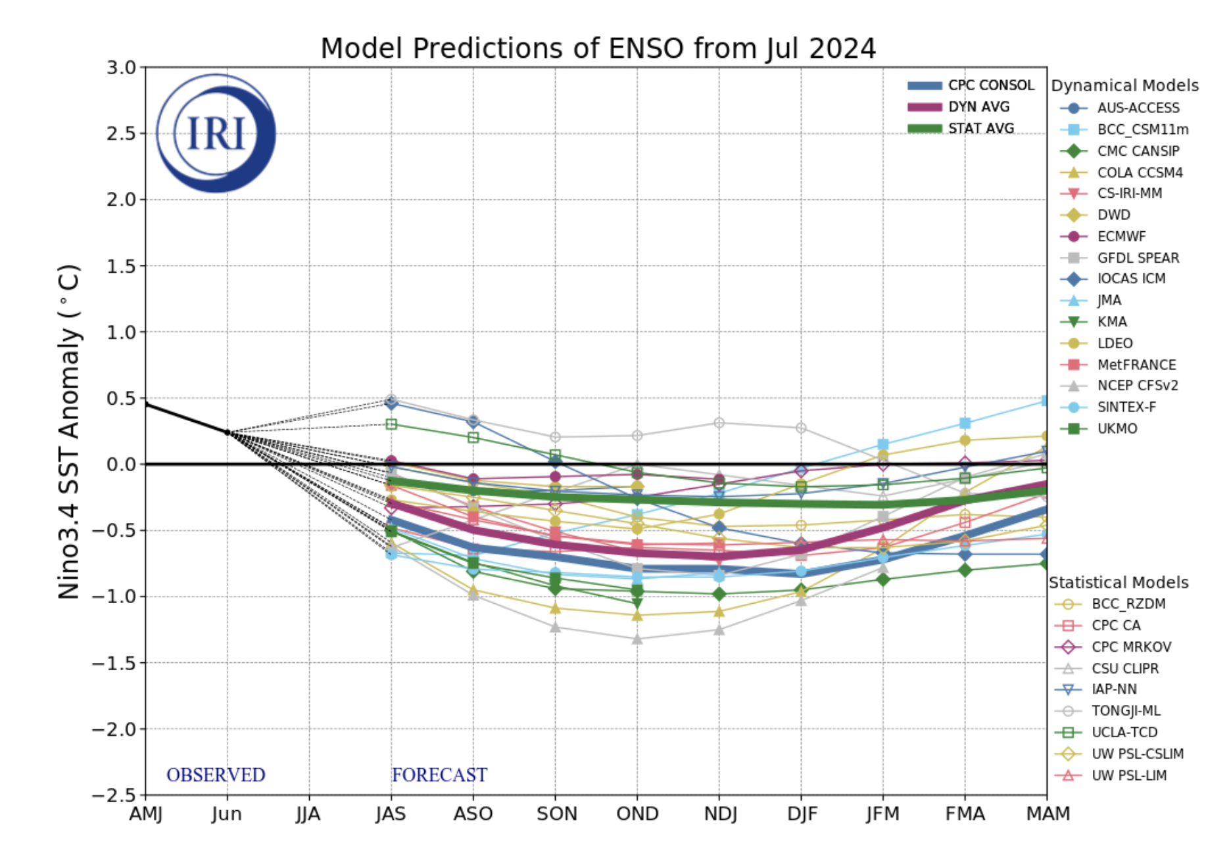
IRI’s ENSO Forecast July, 2024
Mean of STAT Models indicate ENSO-Neutral Conditions,
Mean of DYN Models just hit -0.5 threshold in ASO-2024,
50% (8 Models) call La NINA,
50% (8 Models) ENSO-Neutral), in ASO-2024,
Most EU-Models are calling ENSO-Neutral while NMME are calling La-NINA
JFM-2025 onwards ENSO-Neutral.

Slide 14
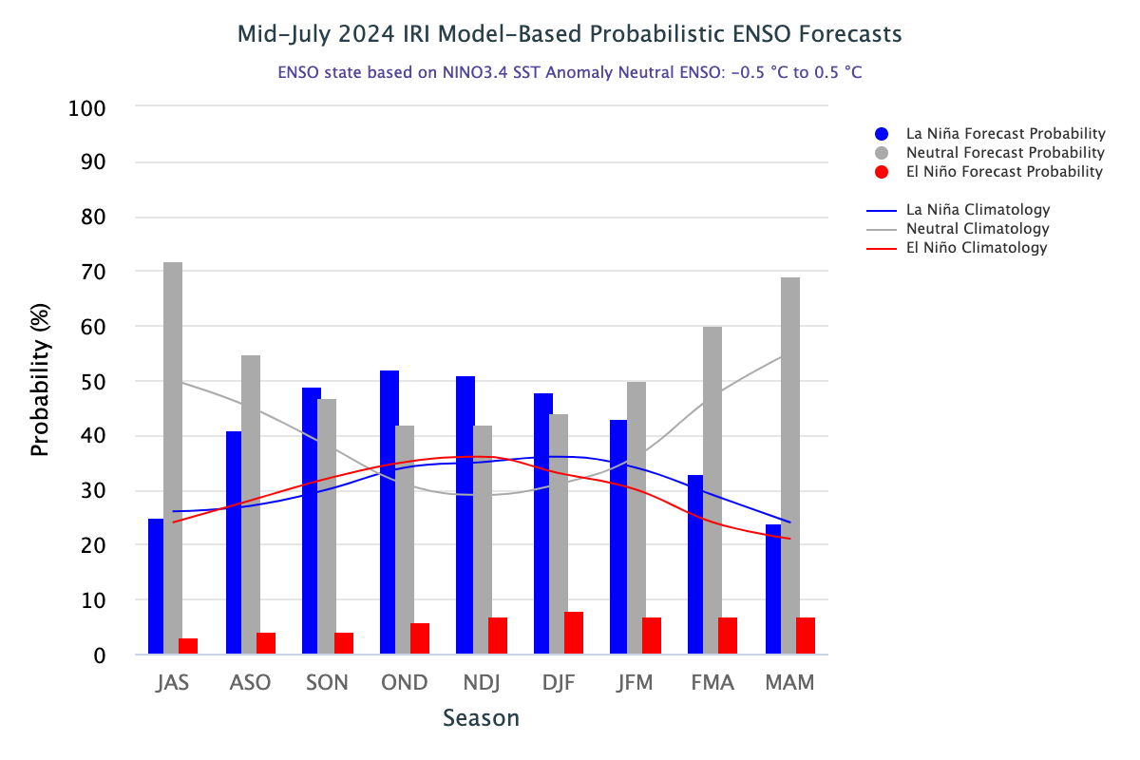
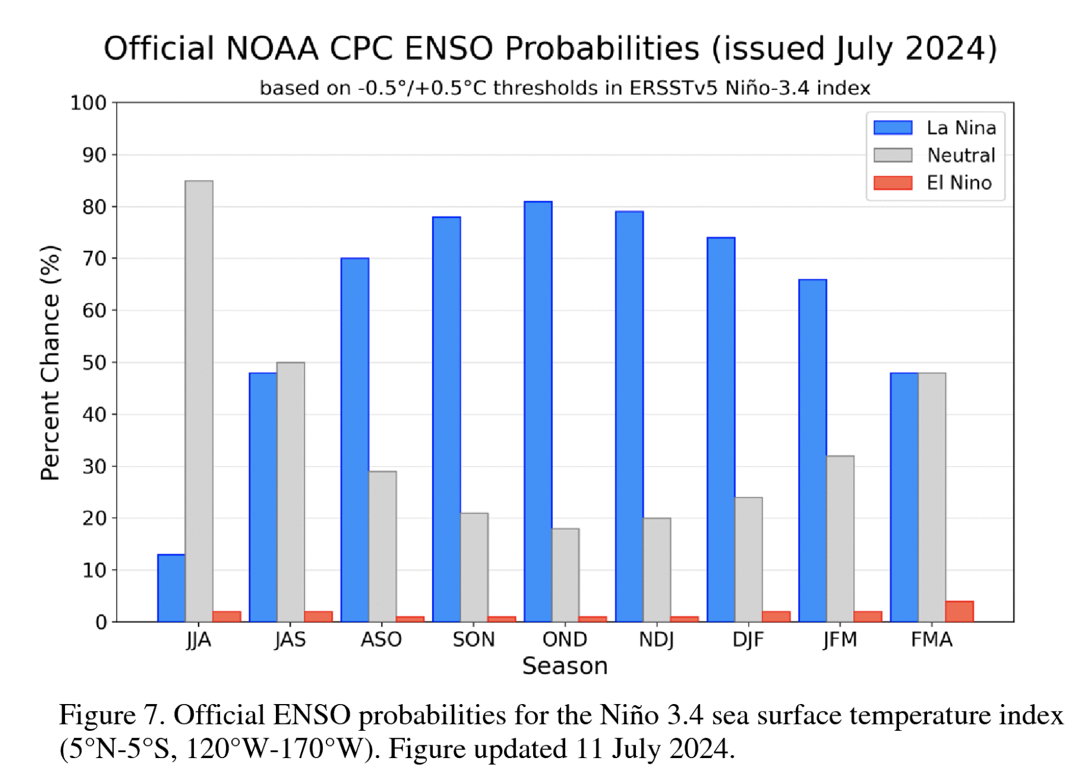
IRI’s Probabilistic ENSO Forecasts (will be on 19th July, 2024)
La NINA got 49% in SON, while ENSO-Neutral is at 47%,
She remain dominant for next three seasons,
ENSO-neutral from JFM, FMA, MAM, 2025

Slide 15
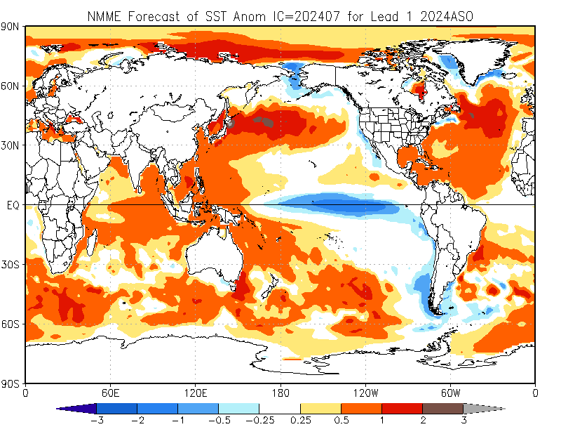
North American Multi Model Ensemble
(NMME) SST Forecast

Slide 16
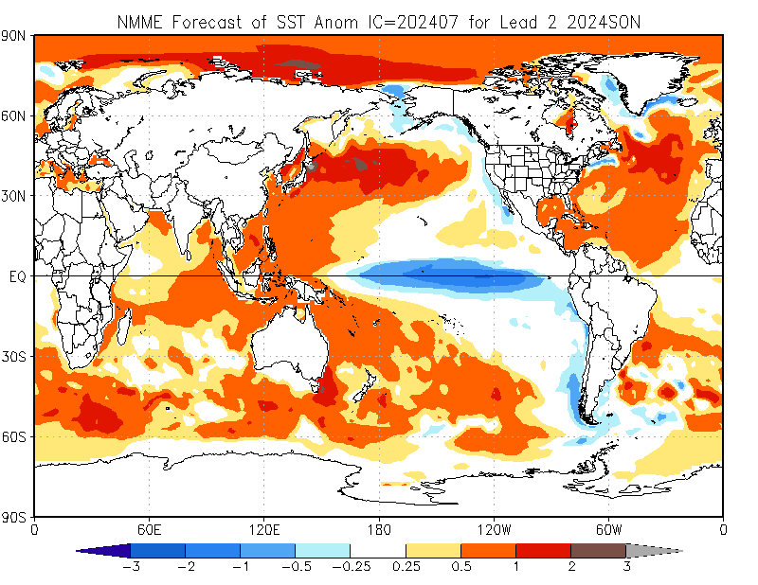

Slide 17
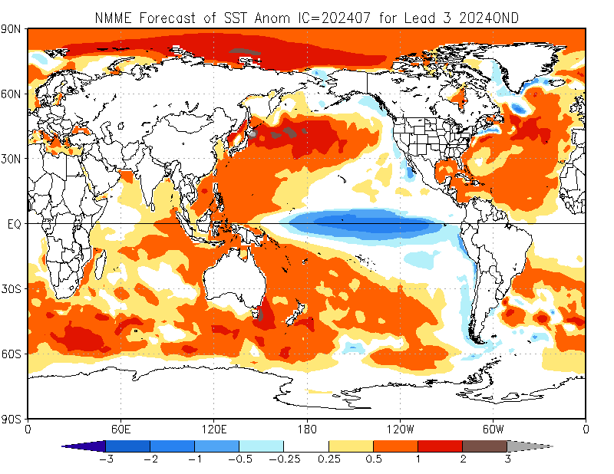

Slide 18
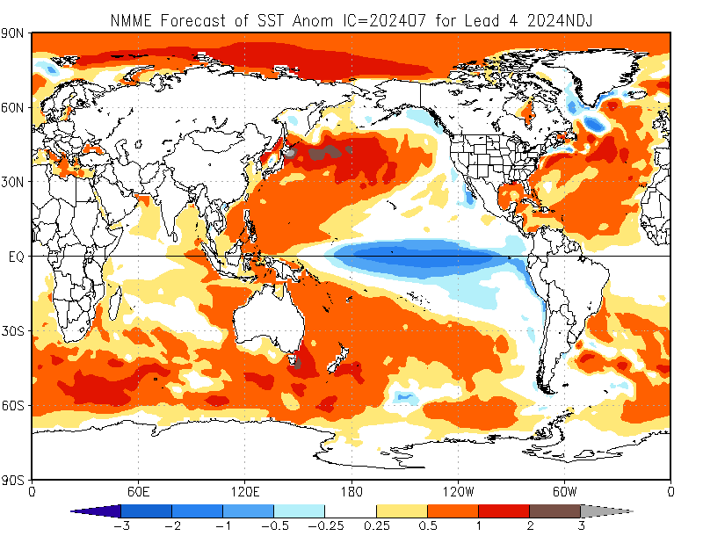

Slide 19
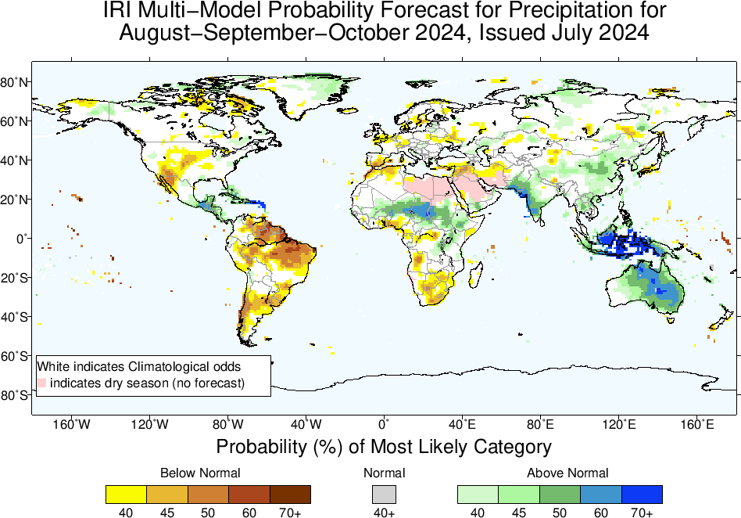
Precipitation Forecasts based on North American Multi Model Ensemble (NMME)

Slide 20
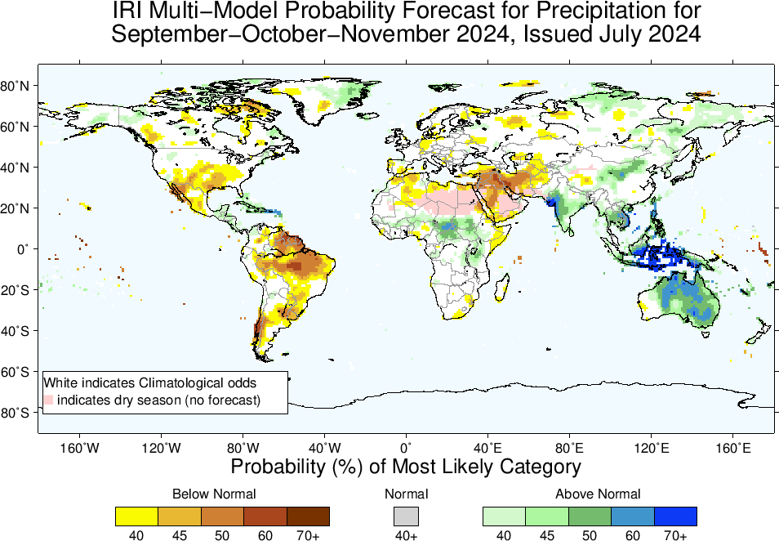

Slide 21
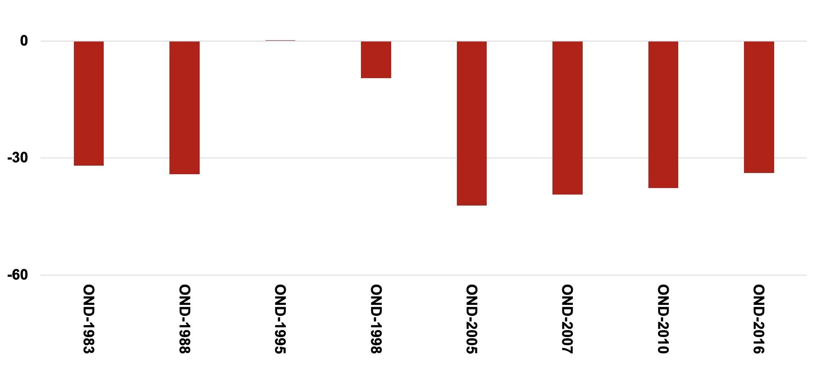
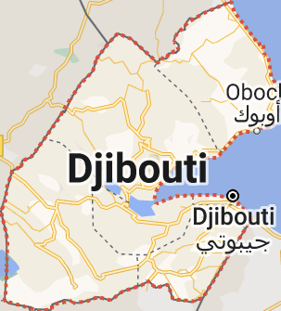
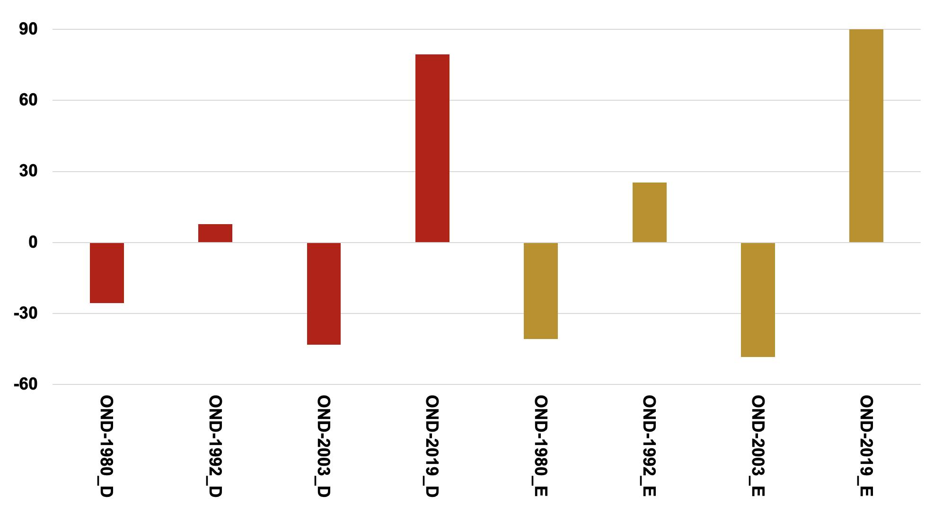
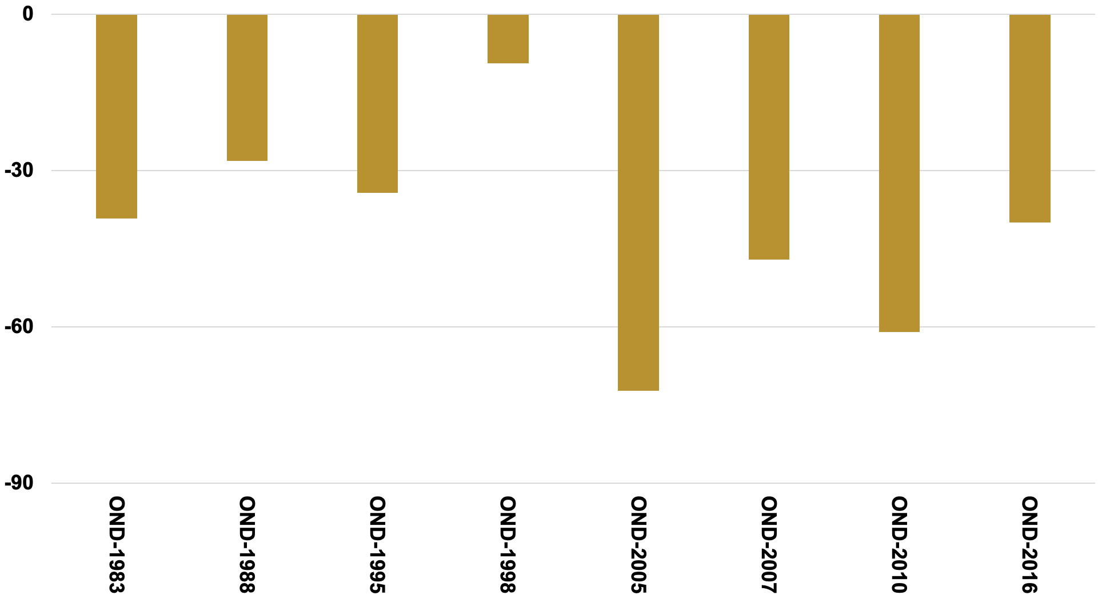
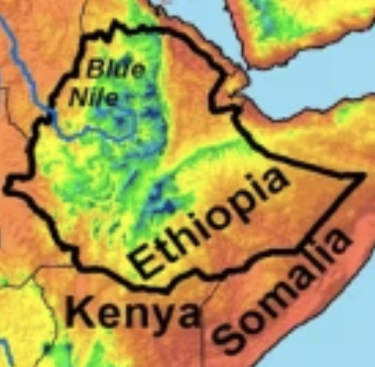
Djibouti and Ethiopian OND-Rainfall (1979 to 2024)
(Warm → Cold ENSO: 8 Cases)
(Warm → Neutral ENSO: 4 Cases)

Slide 22
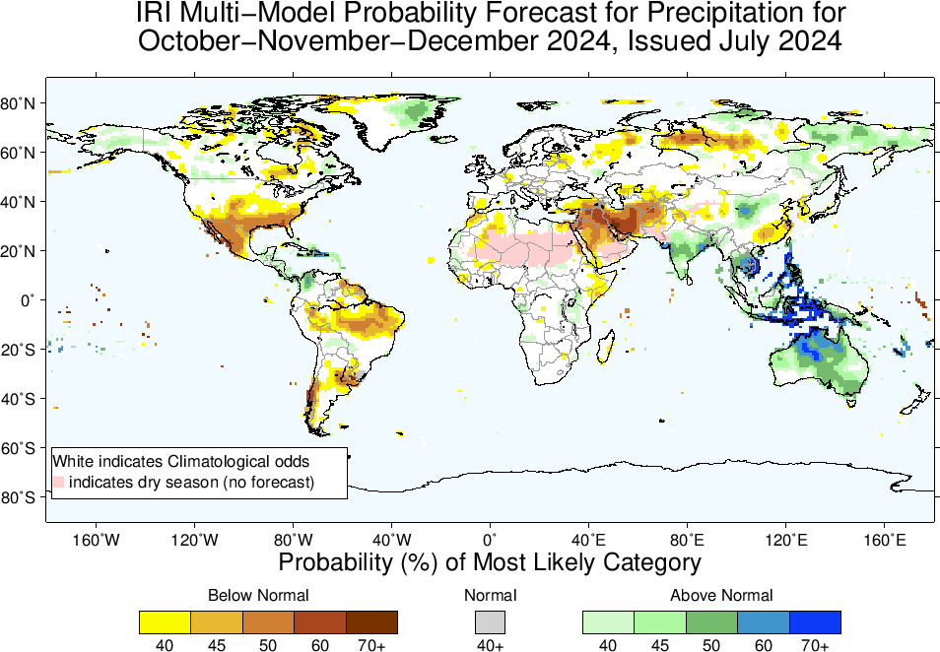

Slide 23
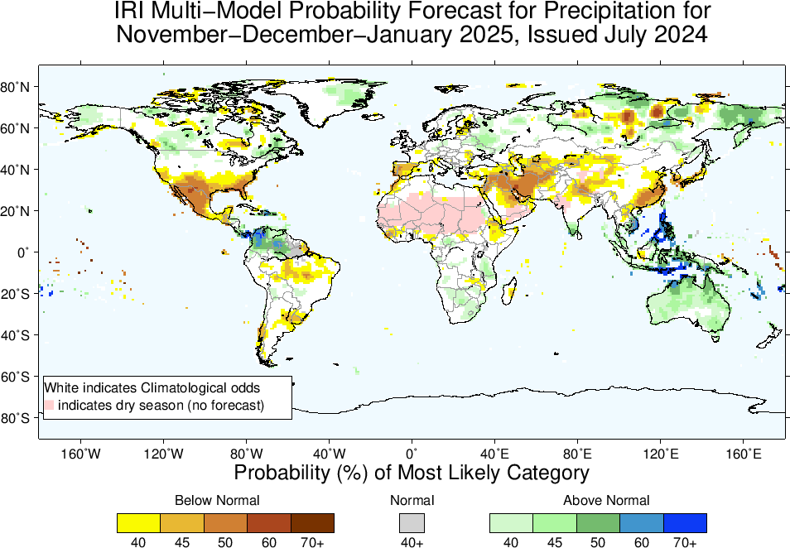

Slide 24
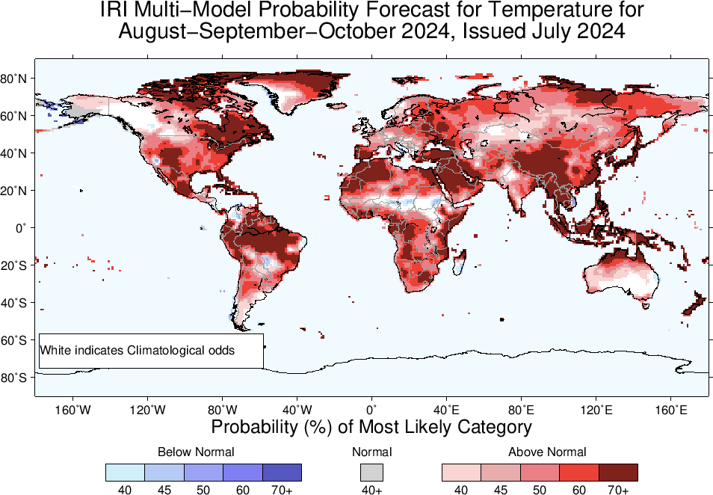
2m-Temperature Forecasts based on North American Multi Model Ensemble (NMME)

Slide 25
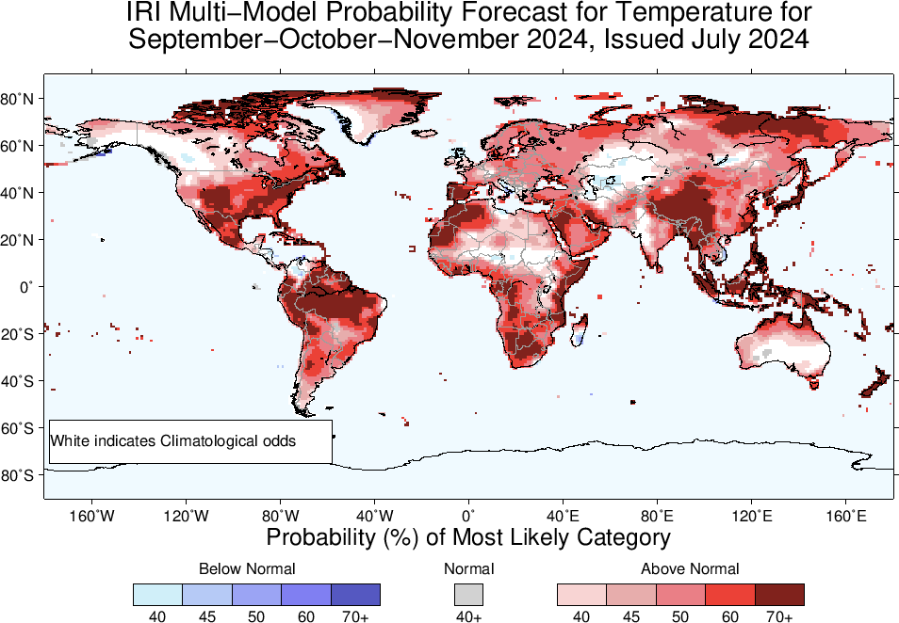

Slide 26
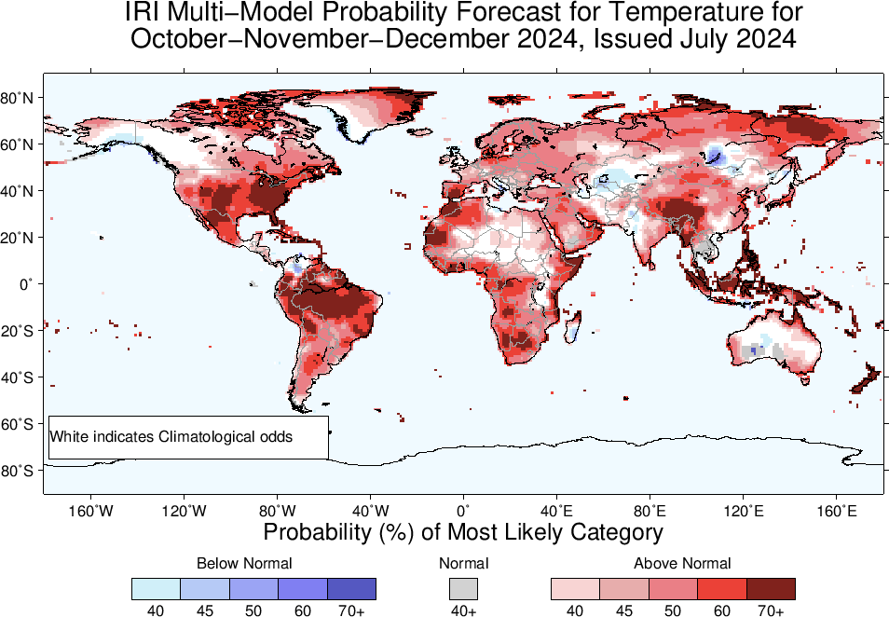

Slide 27
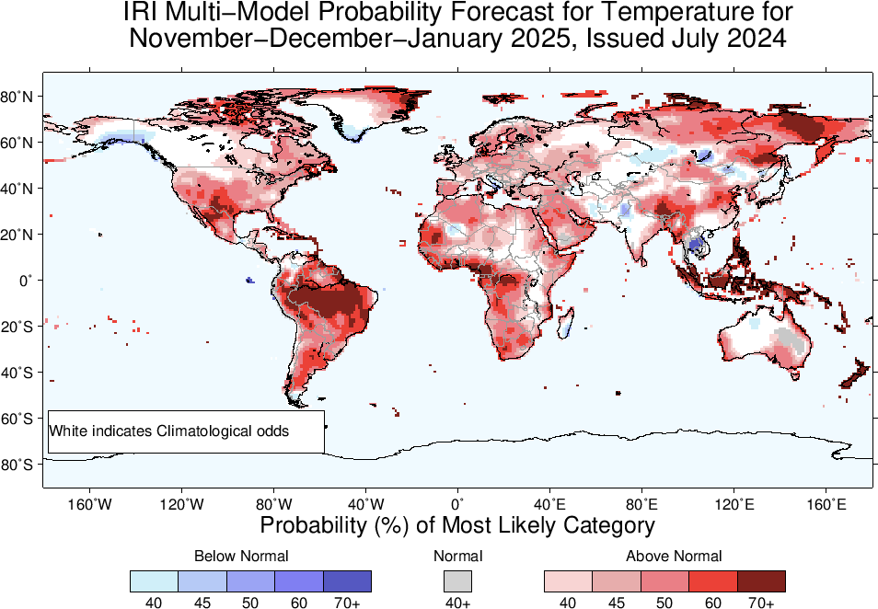

Slide 28
Summary
After its Peak in Nov-Jan, current El Nino has started declining (Dec, 2023 NINO3.4 Value was +1.99, while Jan, 2024 was +1.78, and Feb, was +1.53, March was +1.24, April, was +0.8, May was +0.3, and June was +0.24), while for most recent week ending on 10 July, 2024, it was +0.3 (~+0.3 during Last four weeks).
ENSO-Neutral continue during JAS, ASO, 2024.
LA NINA is slightly favored in SON (49%), and remain so (3-seasons) onward, however, the probability is quite low.
ENSO-Neutral at Longer leads, JFM, FMA, and MAM, 2025.
Most S-America, could experience dry conditions during ASO, and SON, 2024.
Given LA NINA in OND and NDJ (52% and 51%), regions that get rainfall during this time could experience a decrease e.g., NE-Africa, central Southwest Asia, Arabian Peninsula,
While, MC region, Australia, could experience wetter than normal conditions.
Northern South America, could experience wetter conditions starting from OND-2024 and NDJ-2025.

