Slide 1
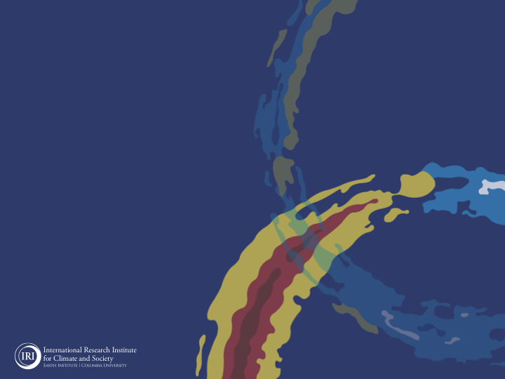
ENSO and Climate Outlook in
July, 2023
M. Azhar Ehsan
(azhar@iri.columbia.edu)
Associate Research Scientist
IRI ENSO and Climate Forecast Lead
Jeffrey Turmelle and Jing Yuan: forecast processing and web updates
Cuihua Li: Draft PowerPoint development
IRI’s Climate Group, led by Dr. Andrew Robertson: Forecast system development, ongoing innovation, and verification
https://en.wikipedia.org/wiki/Weakest_Link_(American_game_show)

Slide 2
Outline
Observed Oceanic and Atmospheric Conditions in
Tropical Pacific
Across the Globe
ENSO Forecast in
NMME
IRI ENSO Forecast Tool (Deterministic and Probabilistic)
Seasons Outlook of
SST
Precipitation and Temperature
Summary

Slide 3
Observations
Oceanic
Atmospheric

Slide 4
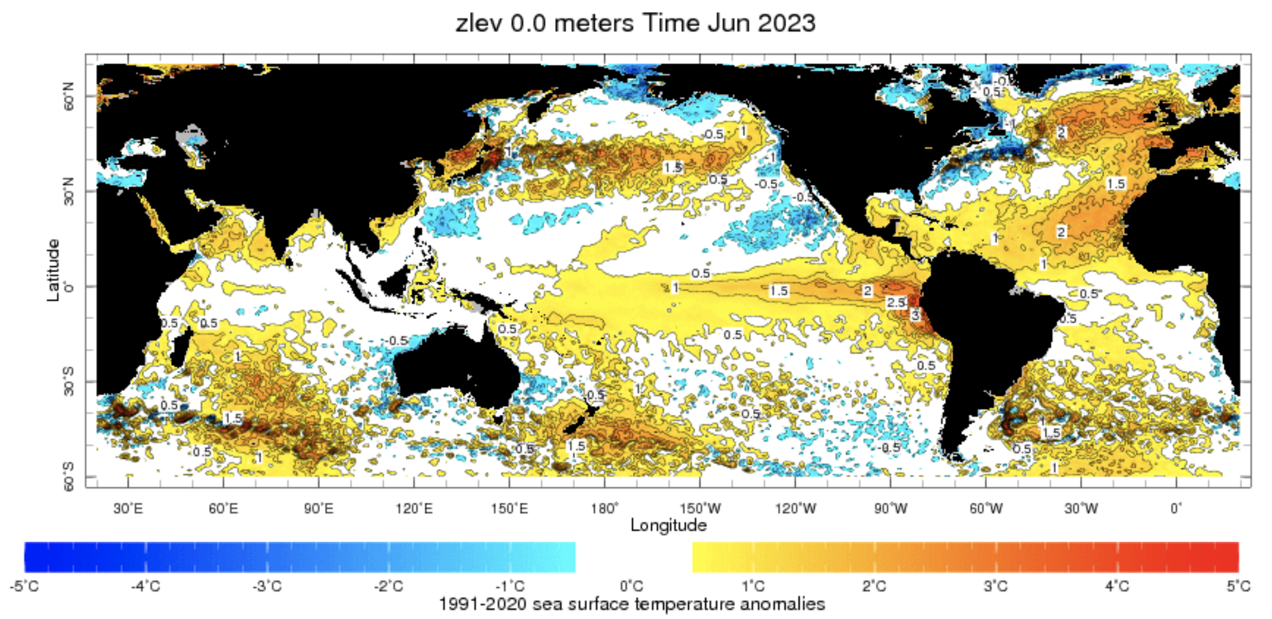
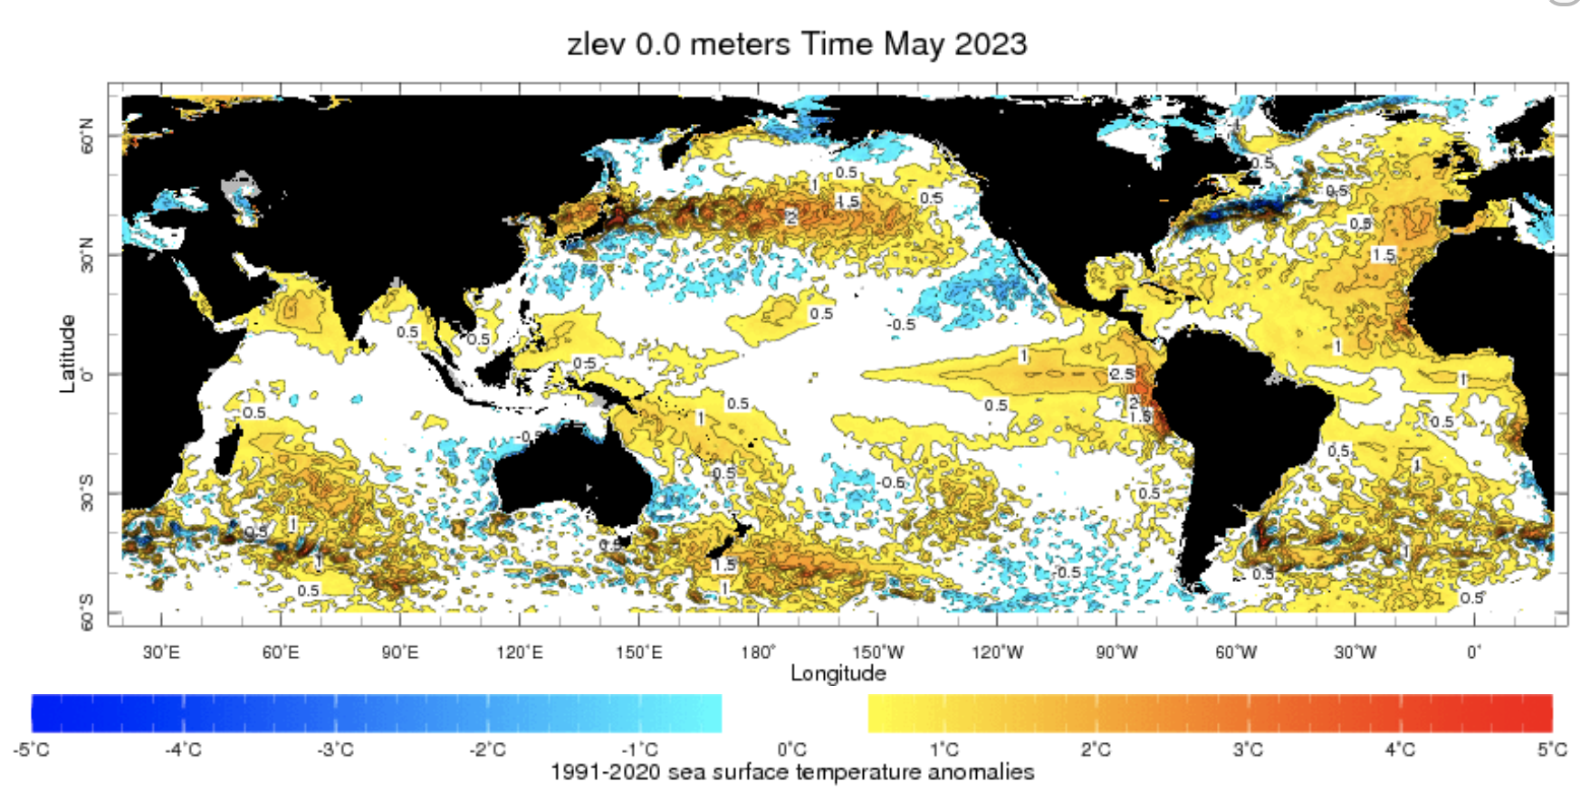
Evolution of SST Anomalies in Monthly Datasets
Highlights:
Top Story: El Nino is there.
Warm SSTAs have expanded further westward during last month.
Warm tropical North Atlantic, and northwest Indian Ocean.

Slide 5
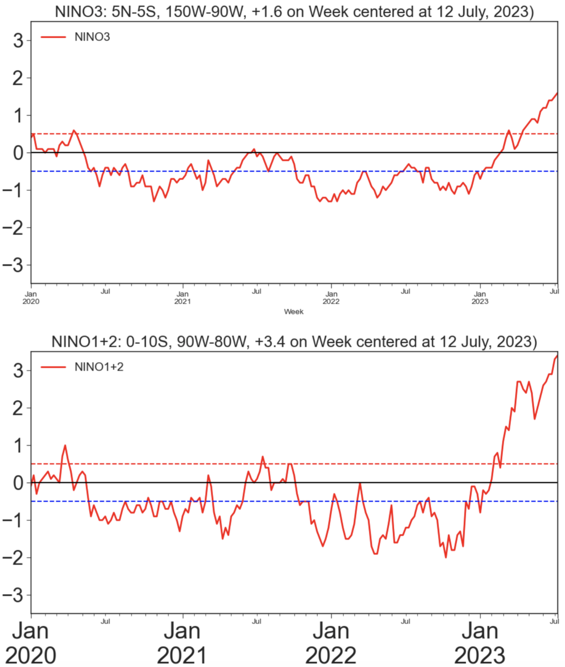
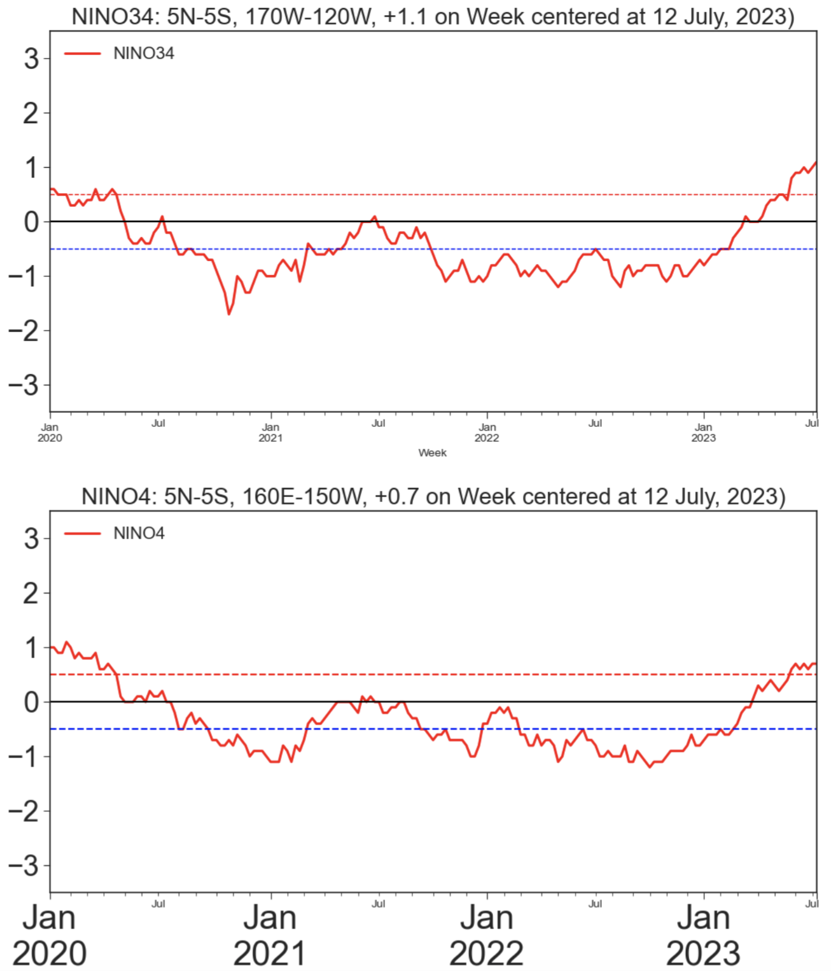
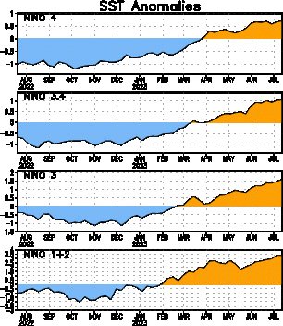
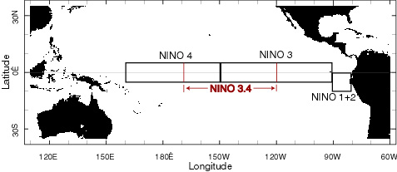
Weekly SST Anom. (12 July, 2023)
Eastern Pacific (+1.6)
Central-eastern Pacific Nino34 (+1.1)
Far-Eastern Pacific (+3.4)
Western Pacific (+0.7)

Slide 6
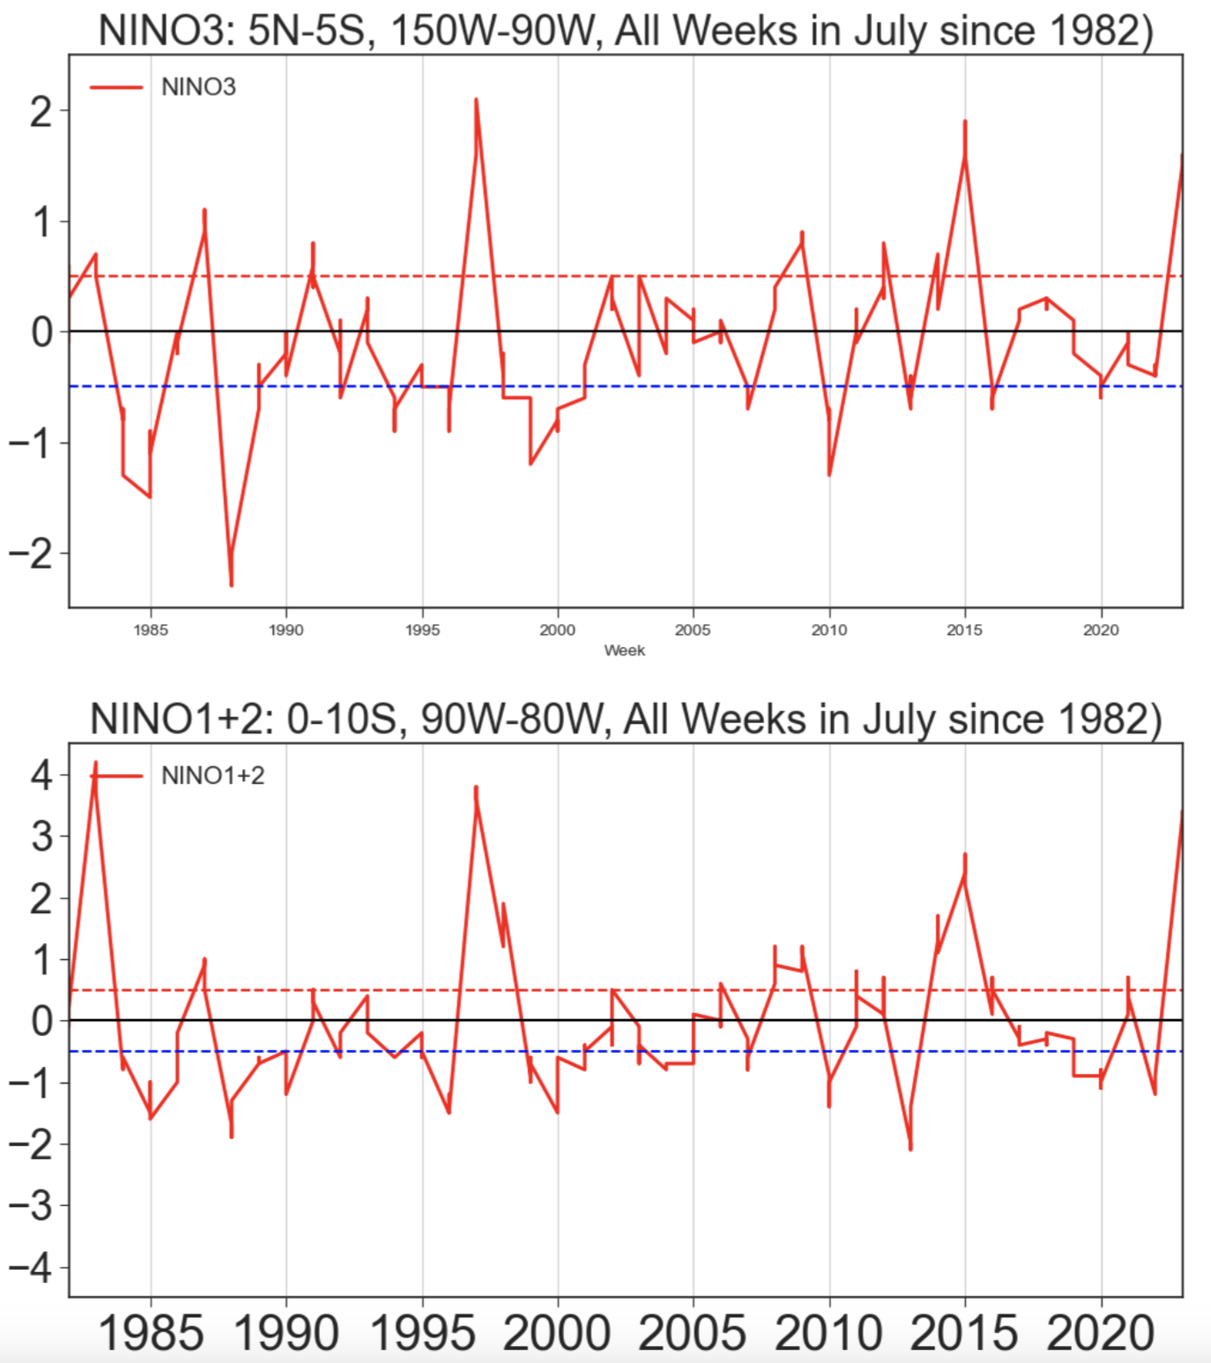
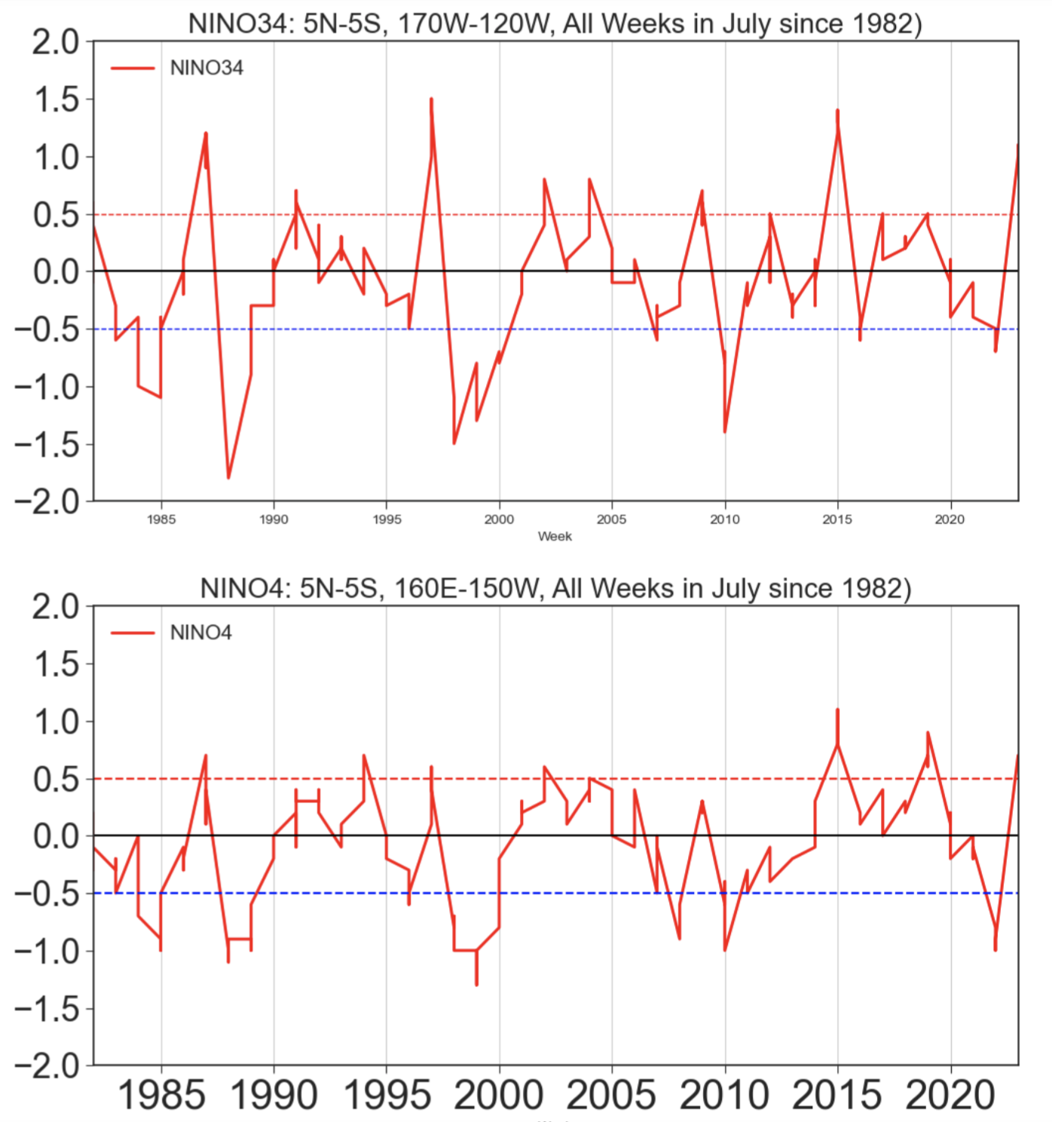
Weekly SST Anom. (All Weeks in July since 1982)
Eastern Pacific (+1.6)
Central-eastern Pacific (Nino34 +1.1)
Far-Eastern Pacific (+3.4)
Western Pacific (+0.7)

Slide 7
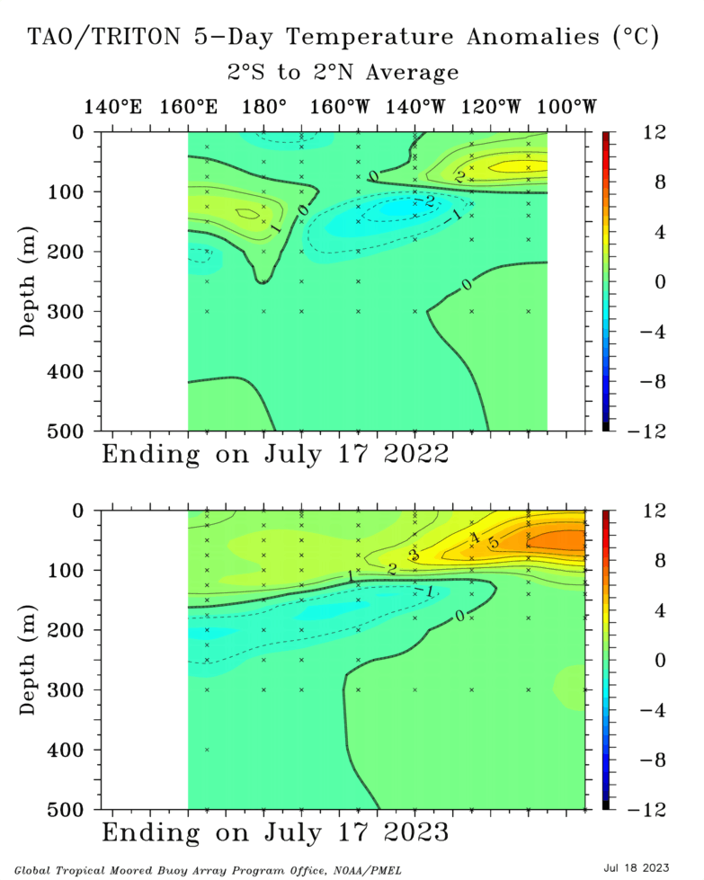
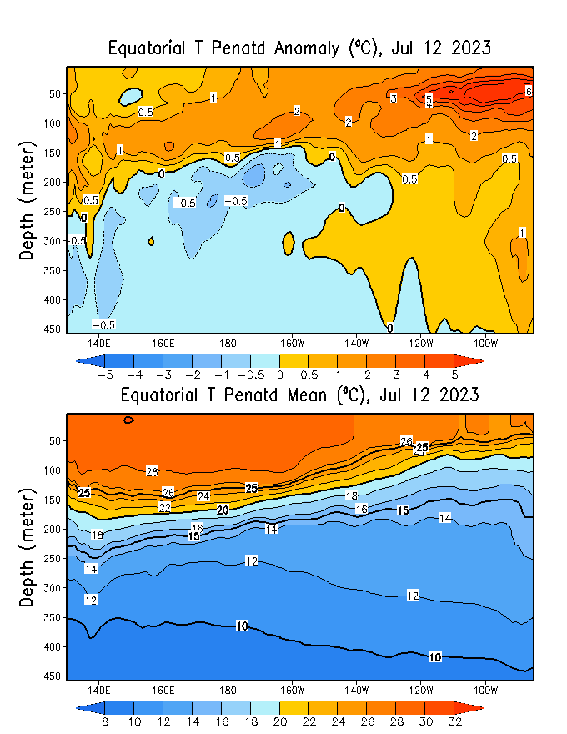
Subsurface Ocean Temperature Evolution
Highlights:
Downwelling Kelvin Wave keeps moving;
subsurface warm waters towards the eastern Pacific,
contributing futher development and intensification of ongoing El Niño conditions.
Cold water between 160E to 140W at depth.

Slide 8
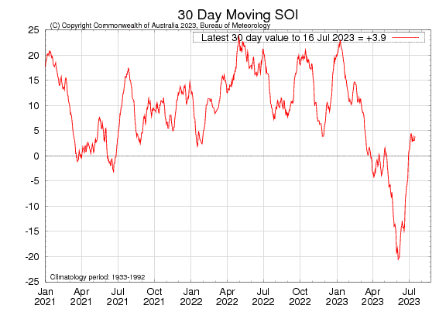
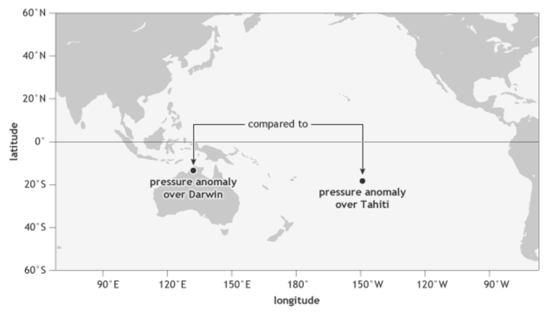
Most recent SOI
(This is SO part of EN-SO)
INDO
E-Pac
-0.5
During El Niño, the pressure becomes below average in Tahiti and above average in Darwin, and the Southern Oscillation Index is negative. Current values are quite steady during last couple of weeks.
A Sustained Negative values of the SOI above -7 typically indicate El Niño

Slide 9
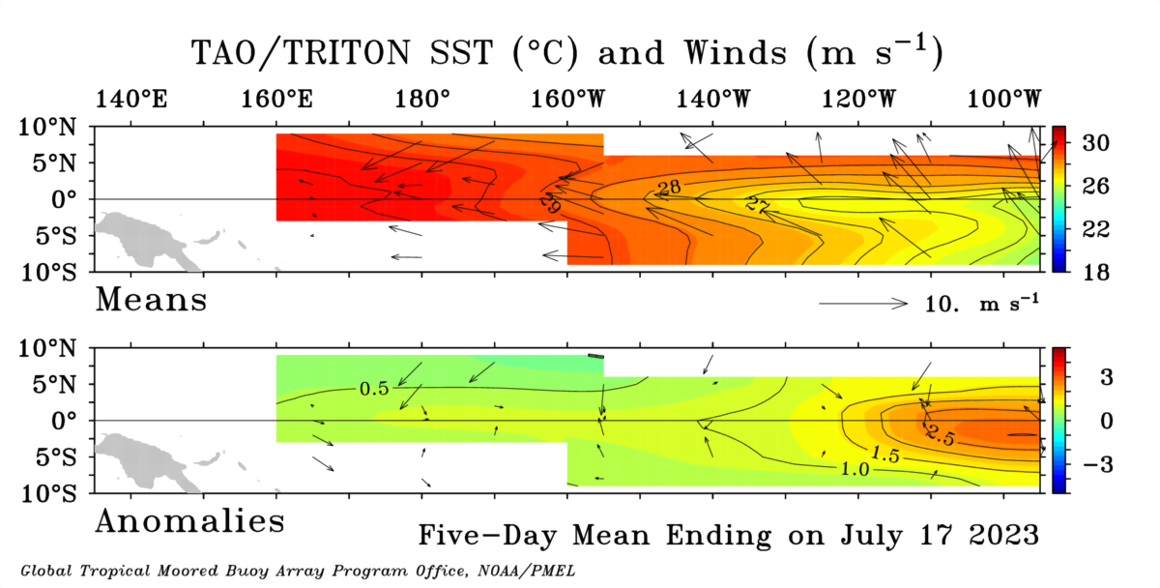
Most recent Lower-Level Winds
Highlights:
The trade winds observed in the 5-day period ending 17 July 2023 were near-normal across the tropical.
In the tropical Pacific region, El Niño events typically lead to a sustained weakening or even a reversal of trade winds.

Slide 10
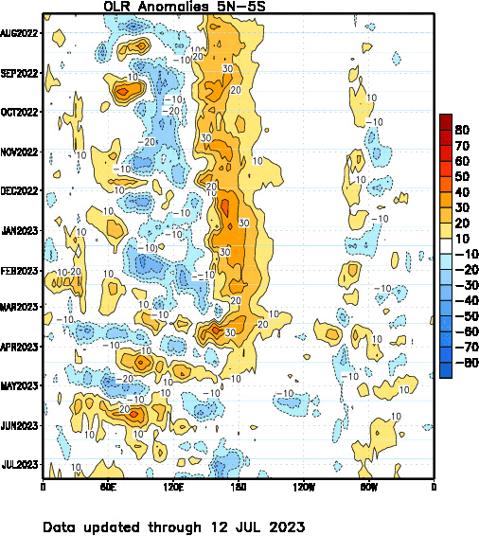
Most recent OLR
Highlights:
From beginning of year 2023, we are seeing convection that are crossing the Maritime Continent region.
High cloudiness over Dateline (west of it)

Slide 11
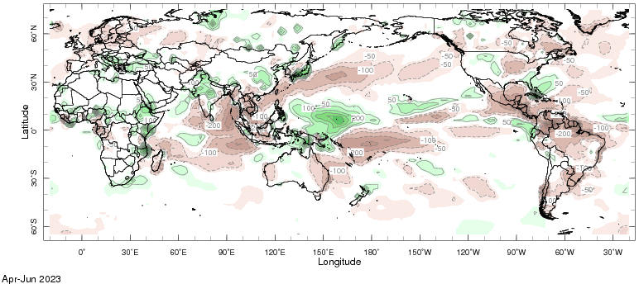
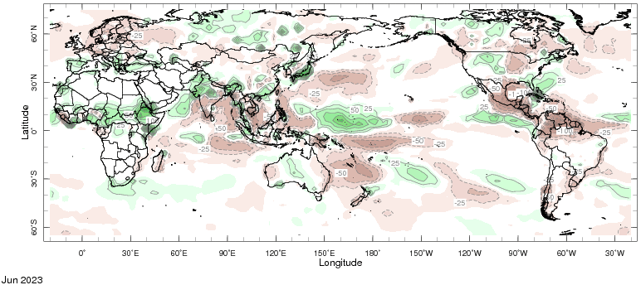
Most recent Precipitation
Path of Biparjoy
(6-19 June)

Slide 12
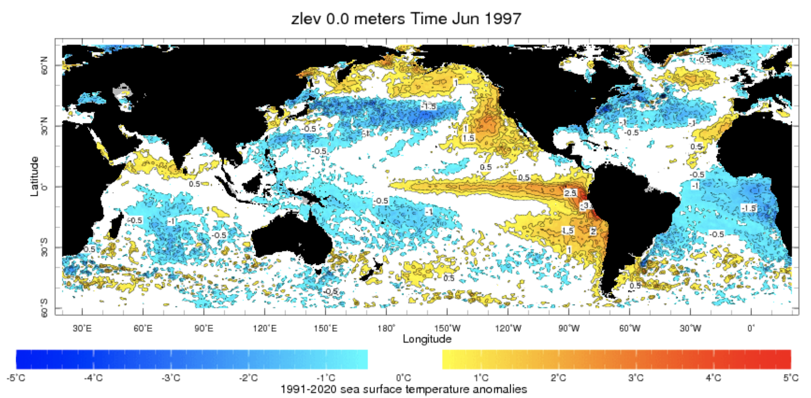
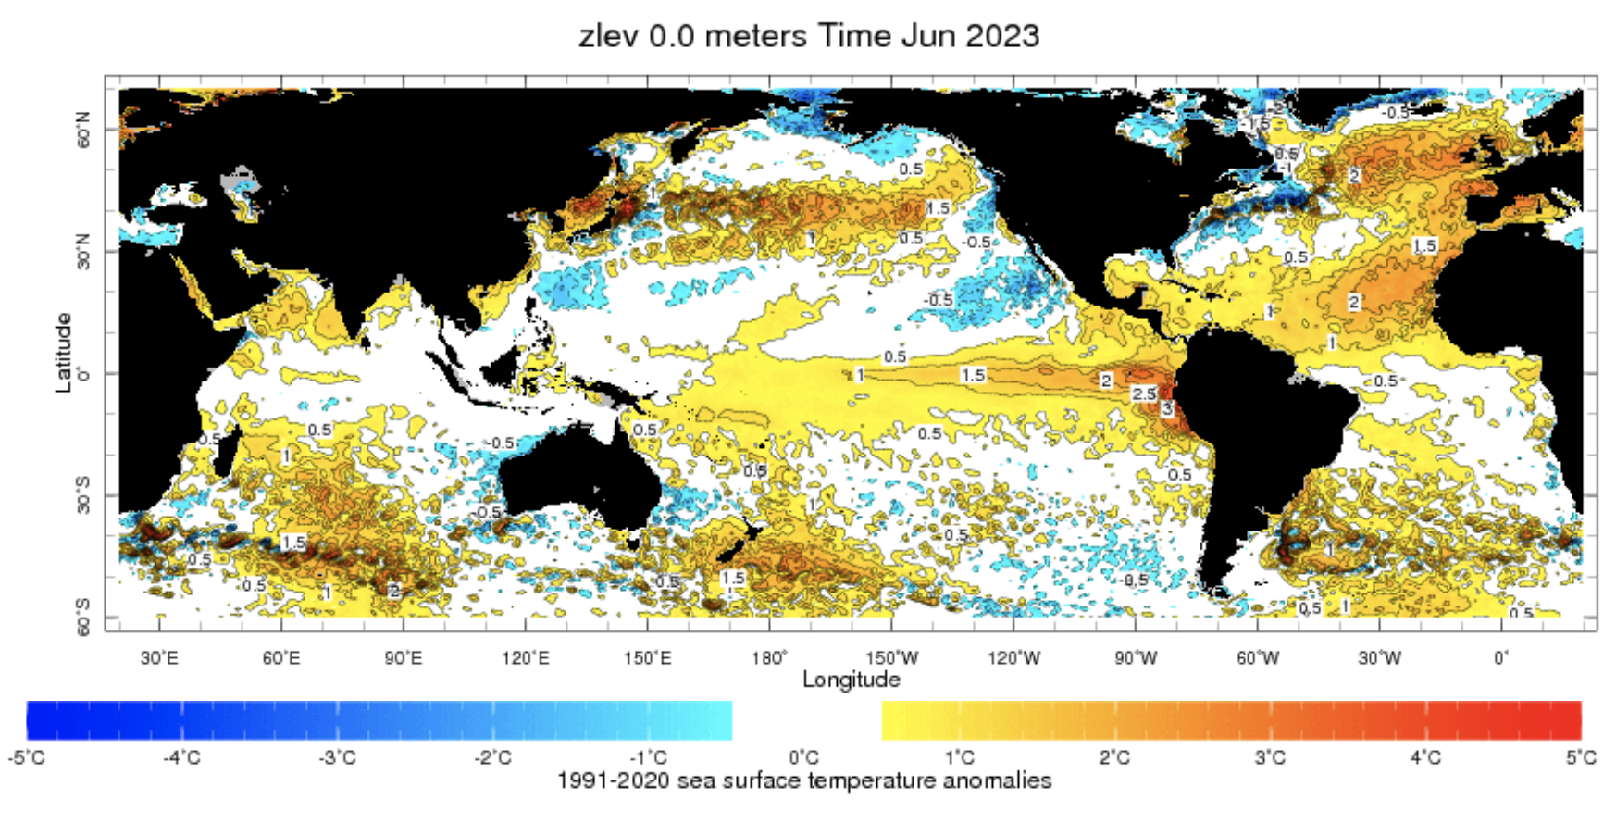
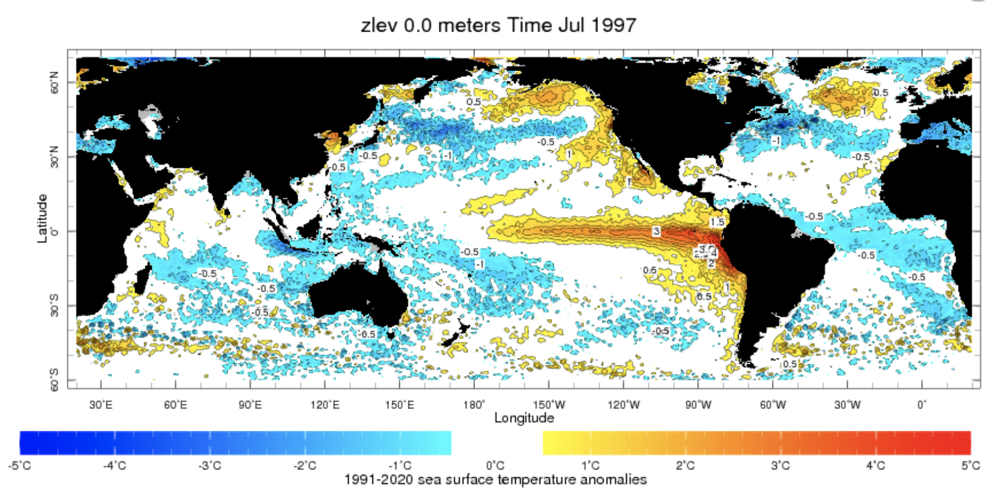

Slide 13
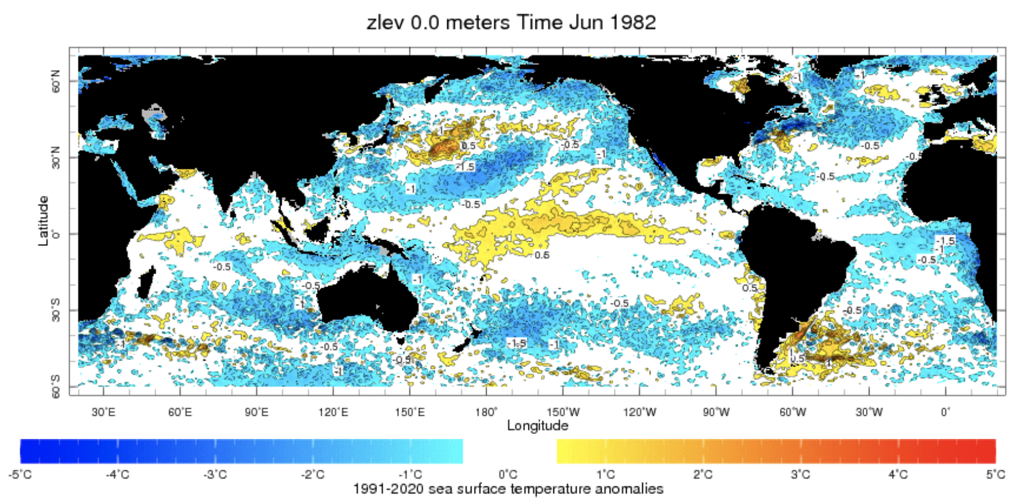
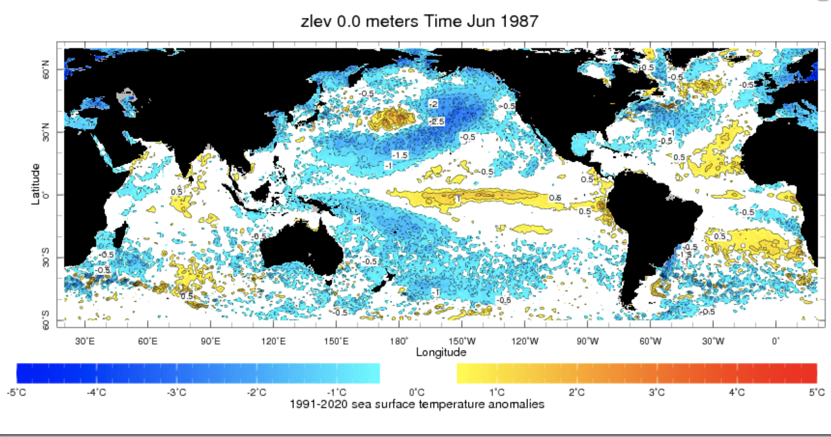
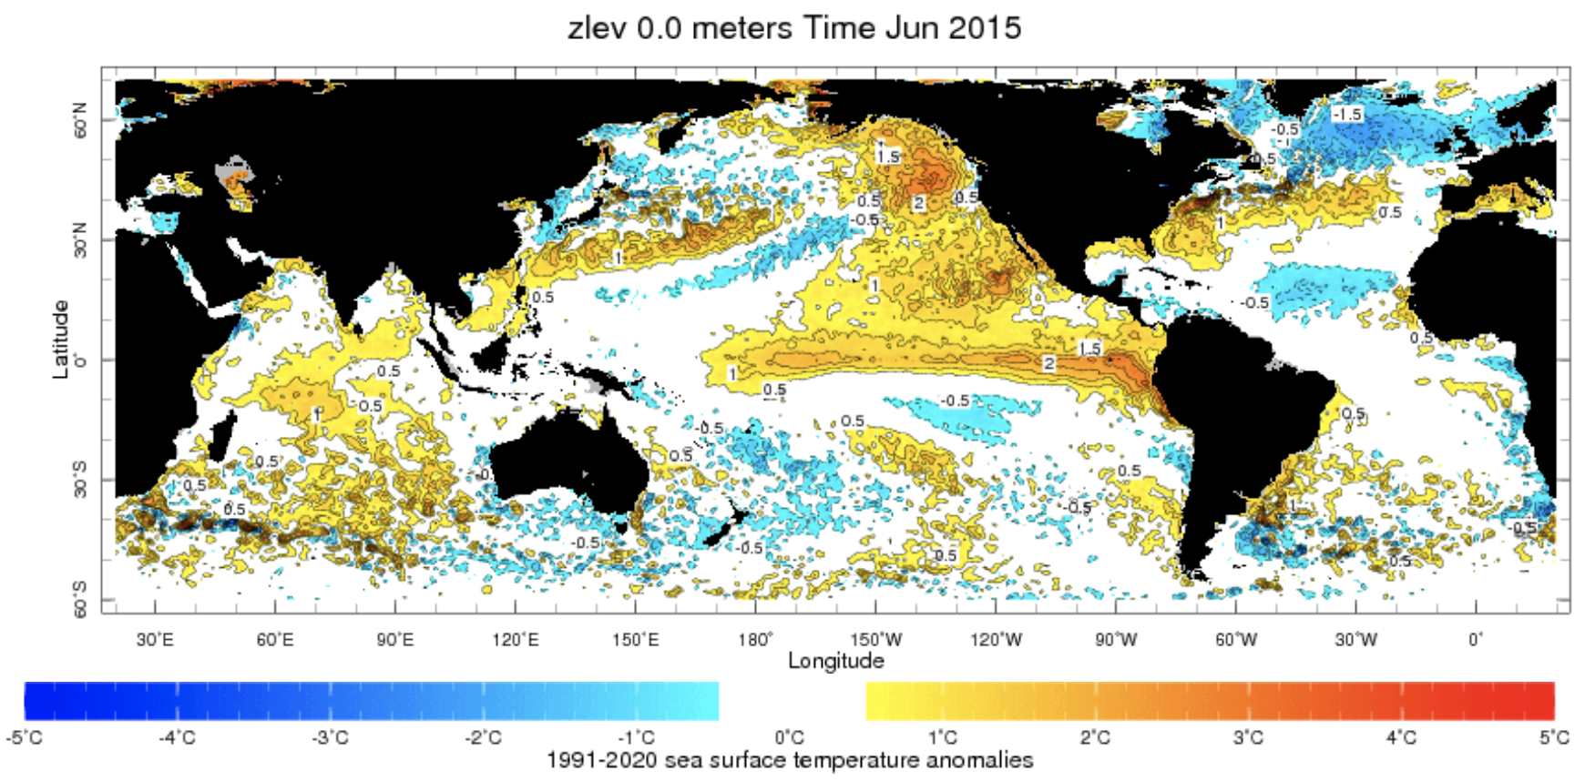
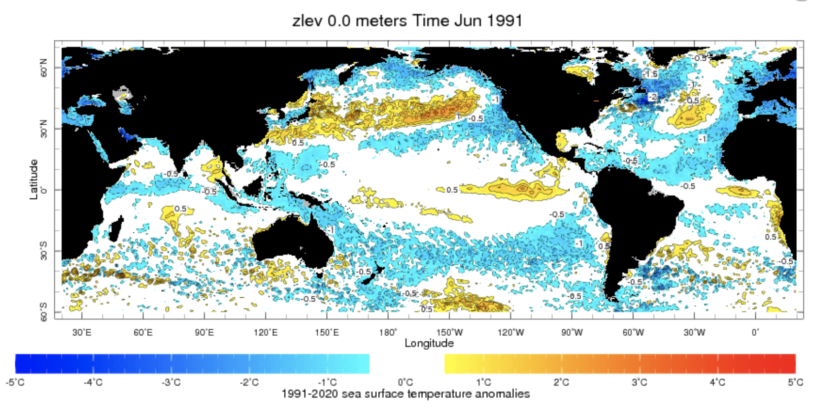
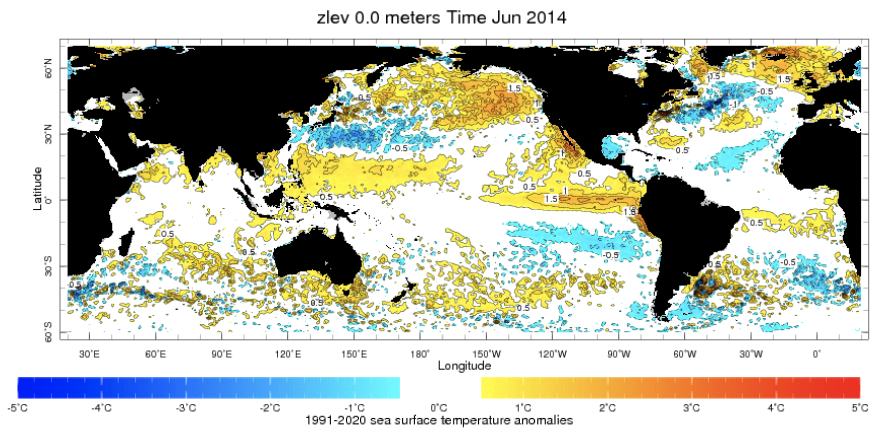

Slide 14
Zonal SST Gradient in Pacific Ocean
The contrast in sea surface temperatures between the eastern (coast of South America, is cooler) and western (Indonesia and the Philippines, is warmer) Pacific.
This temperature difference sets up the normal atmospheric circulation patterns and trade winds, which play a key role in maintaining the stability of the tropical Pacific climate.
During an El Niño event, the trade winds weaken or reverse.
The weakening of the trade winds is then associated with the establishment of a weak or reversed zonal SST gradient, with warmer waters in the east and cooler waters in the west.
If the zonal SST gradient is not established or is weak during the El Niño development phase, it can have the following impacts:
Weakened El Niño,
Shorter Duration,
Unpredictable Effects.

Slide 15
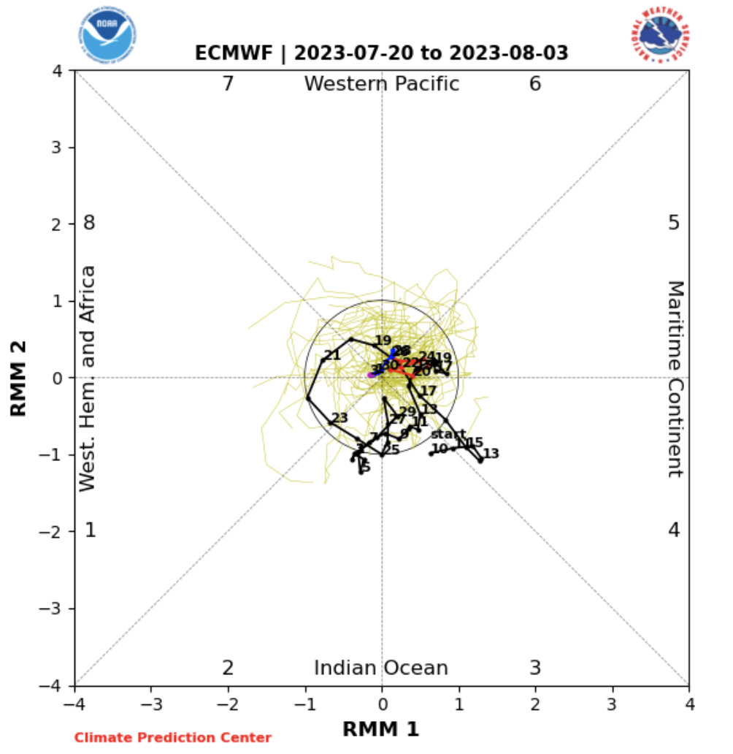
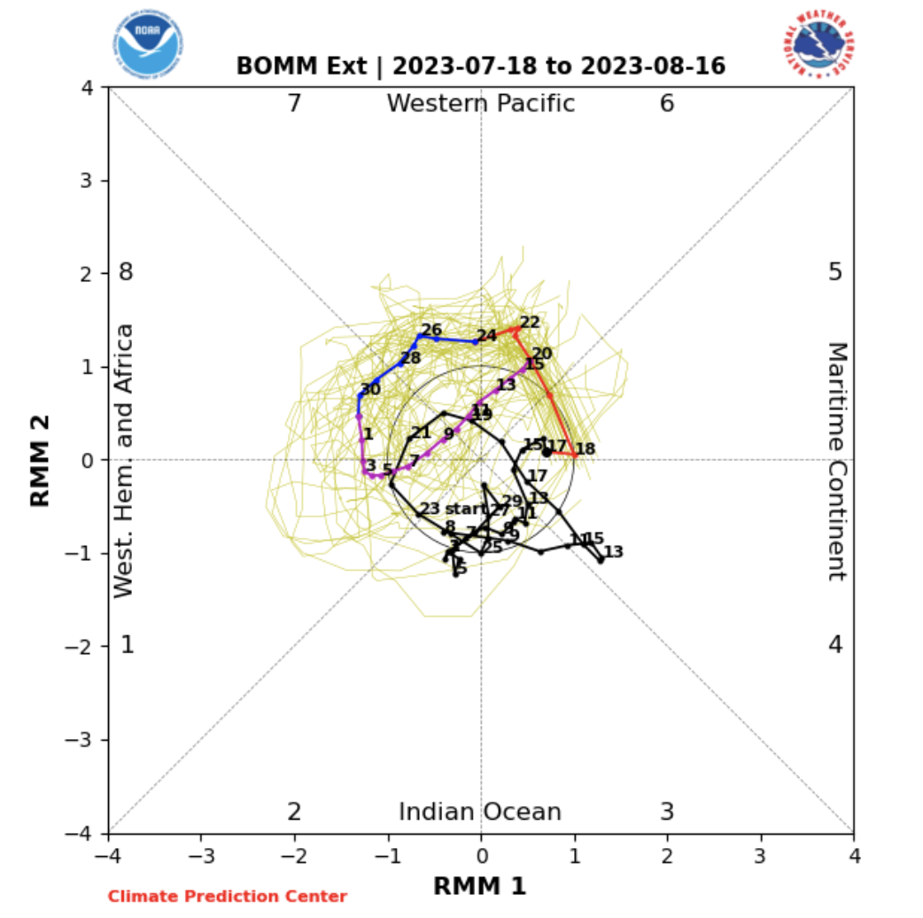
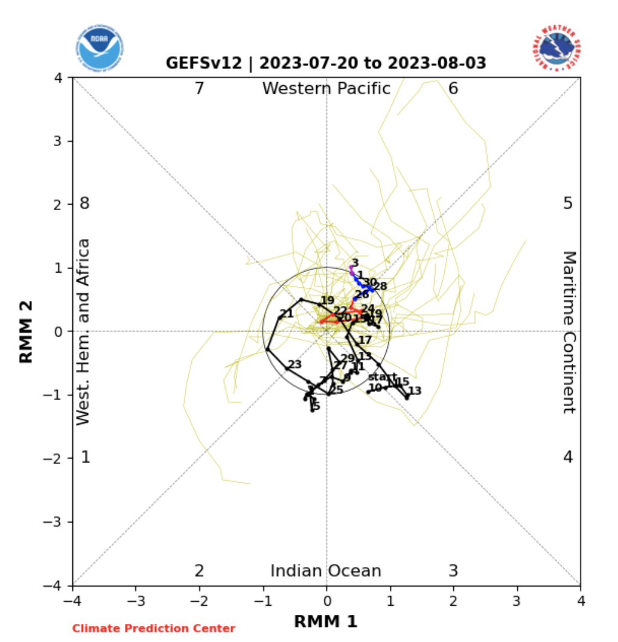
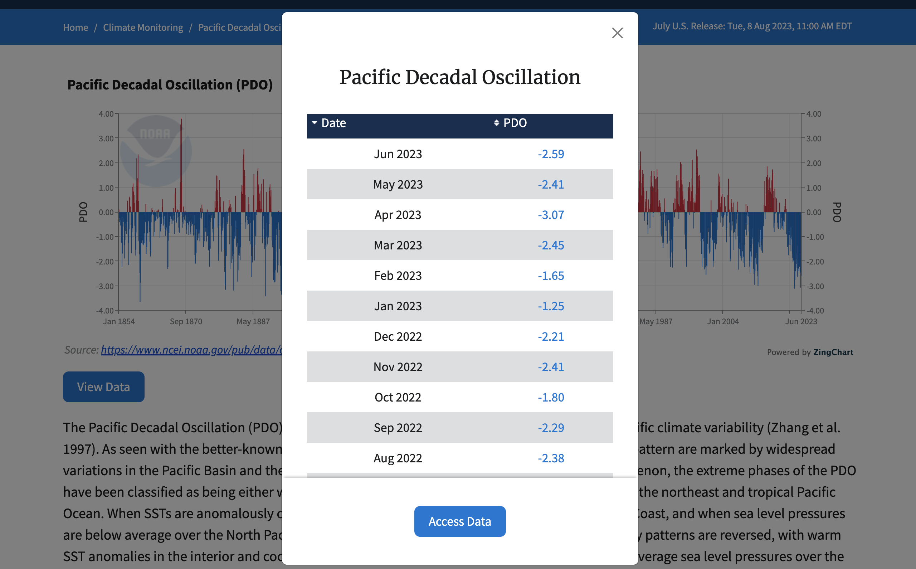
Help Needed
Shorter Time Scale (Some help)
Longer Time Scale (Almost Zero)
MJO is currently weak.
Models predicting to reach in the eastern Maritime Continent or Western Pacific region in next couple of weeks. If so this helps.

Slide 16
Forecasts
Nino-34 in NMME,
IRI ENSO Plume,
Probability of Nino-34,
Global SSTs from NMME,
IRI Global Prcp and Temp Probabilistic Forecasts,

Slide 17
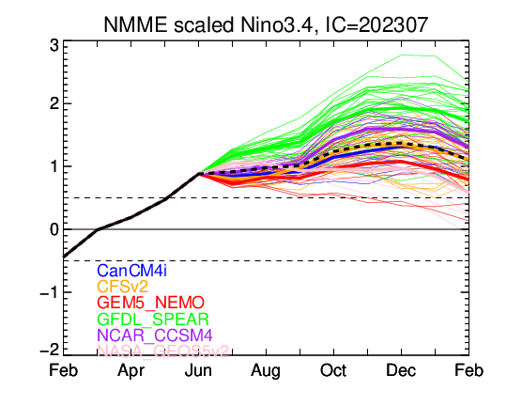
NMME’s ENSO Forecast

Slide 18
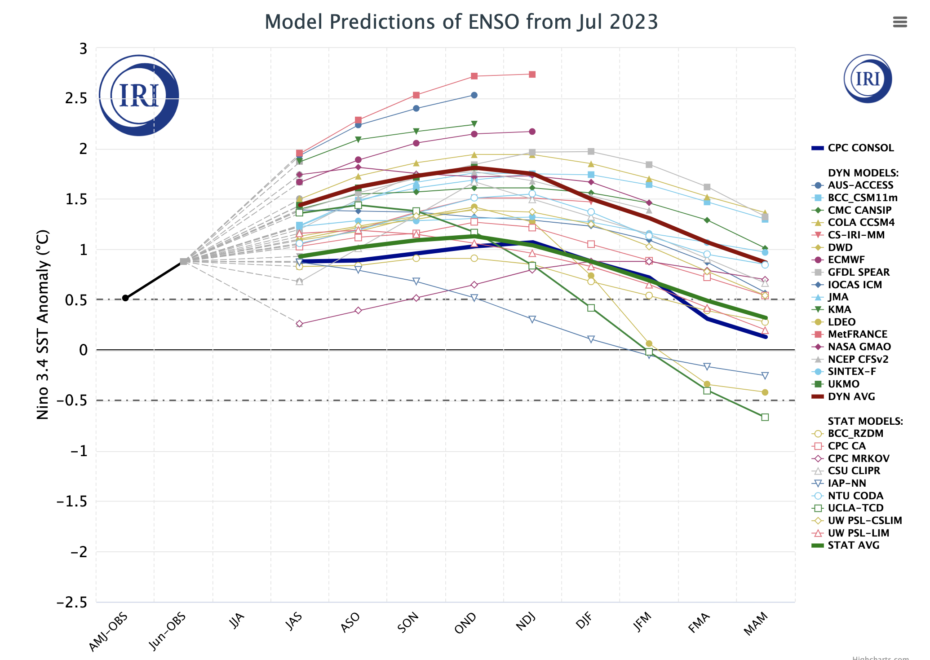
IRI’s ENSO Forecast July, 2023
Highlights:
A lot of spread in Amplitude (Weak to very Strong event)
Dynamical Models shows stronger warming as compared to Statistical models.
Some statistical models even telling us a different story just after Autumn of 2023 like IAP-NN, UCLA-TCD, LDEO.

Slide 19
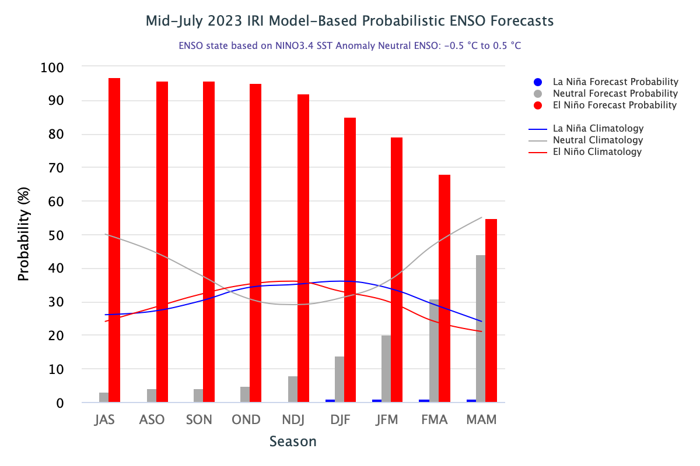
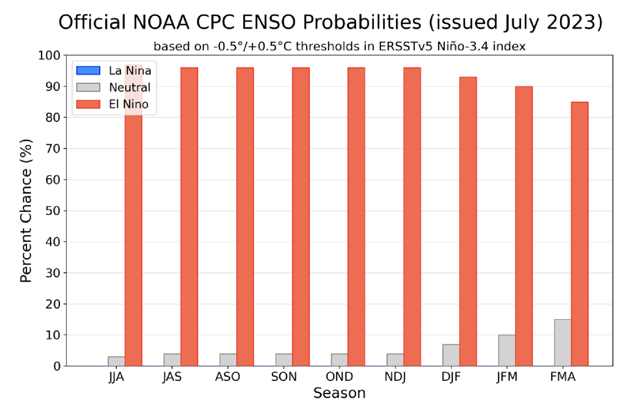
IRI’s ENSO Forecast (July, 2023) Probabilities
Highlights:
El Nino above 90% till Autumn of 2023.
Afterwards decrease in probability.
55% in 2024 Spring (MAM), still double from Climatology value.
Objective and Subjective Forecasts matches quite well till Autumn

Slide 20
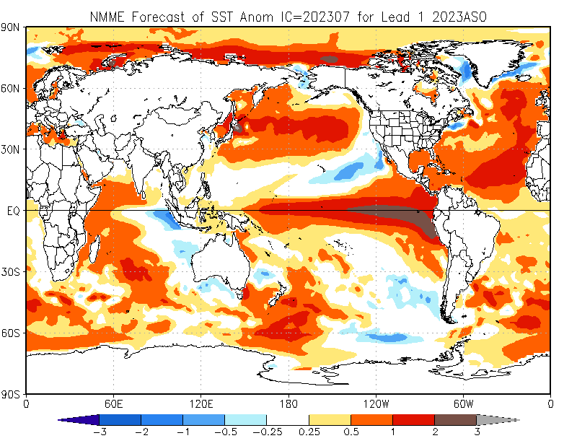

Slide 21
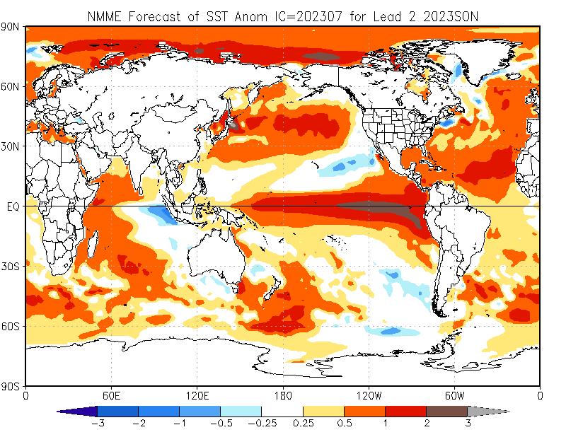

Slide 22
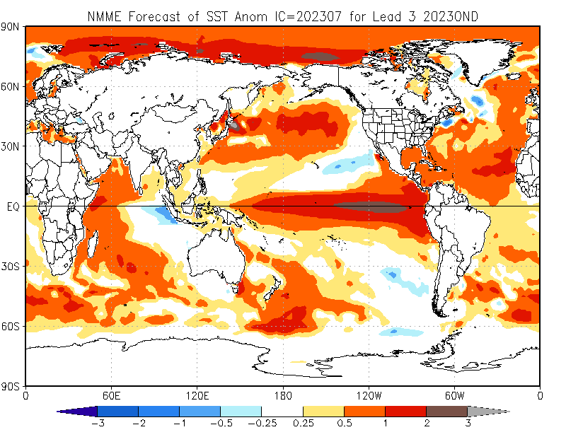

Slide 24
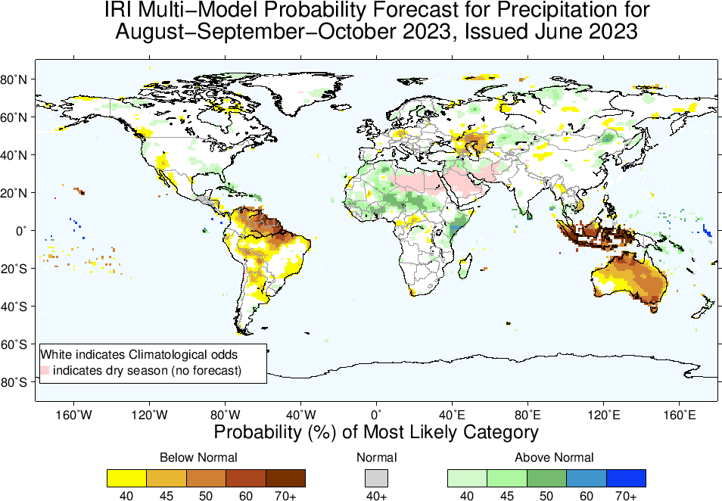
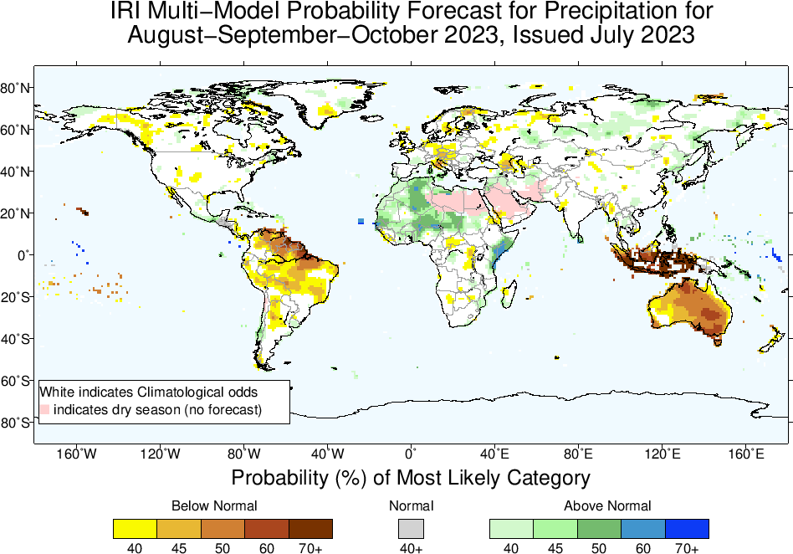
Precipitation Forecasts: Season # 1, Aug to Oct
Highlights:
Shift towards Normal to Above-Normal
Sahel region, Northwest and Northeast Africa
Middle East
Sri Lanka
Shift towards Normal to
Below-Normal
Northeast South America,
Maritime Continent,
Australia

Slide 25
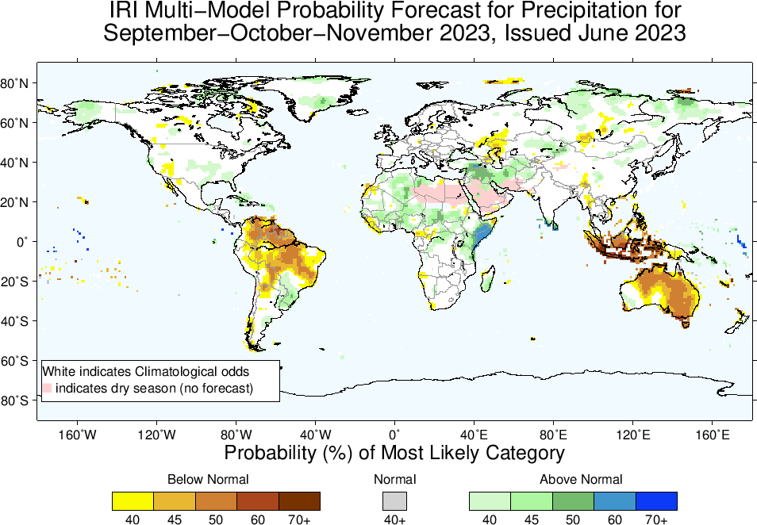
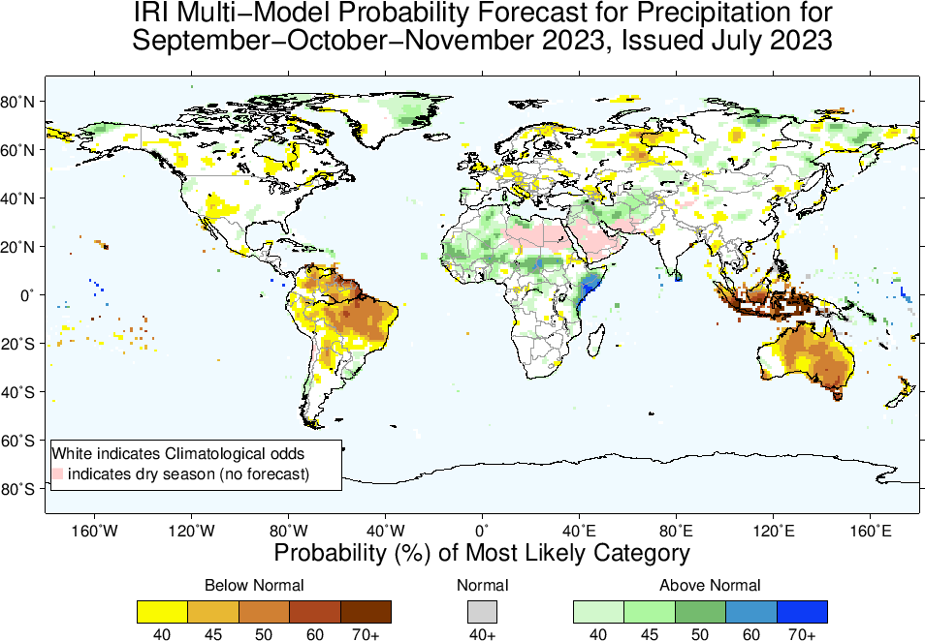
Precipitation Forecasts: Season # 2, Sep to Nov
Highlights:
Shift towards Normal to Above-Normal
Sahel region and Northwest Africa
Middle-East, Sri Lanka, Caribbean regions
Northeast Africa, Parts of Madagascar (South-Southeast)
Shift towards Normal to Below-Normal
Northern parts of South America,
Maritime Continent,
Australia

Slide 26
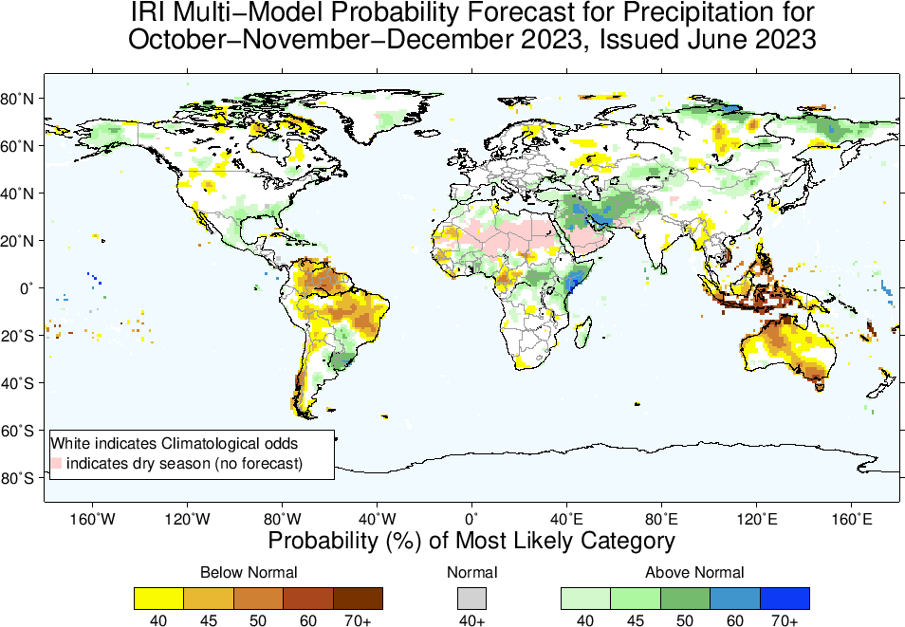
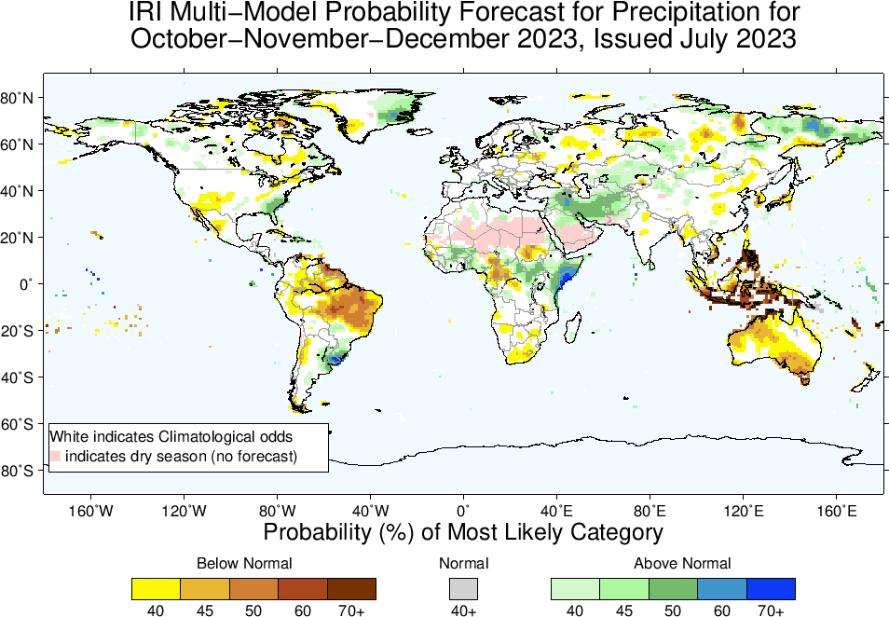
Precipitation Forecasts: Season # 3, Oct to Dec
Highlights:
Shift towards Normal to Above-Normal
Middle-East
Over and around Uruguay, southeast US
Northeast Africa, Parts of Madagascar
Shift towards Normal to Below-Normal
Northern parts of South America,
Central America,
Maritime Continent,
Australia

Slide 27
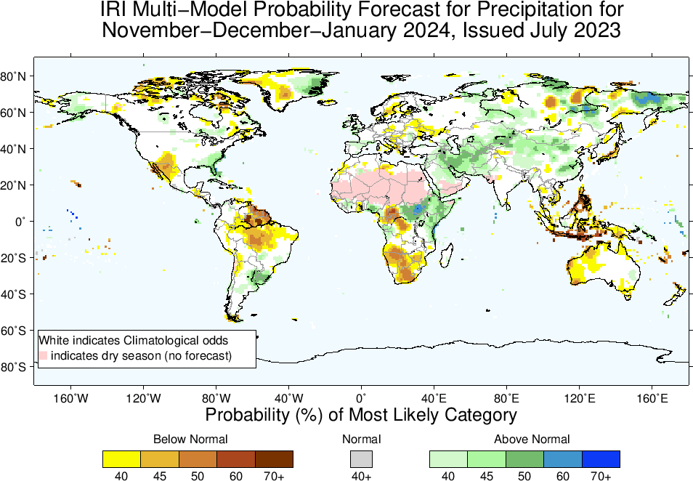
Highlights:
Shift towards Normal to
Above-Normal
Middle-East/Western SA
Northern China
North-east Africa (southeast Ethiopia, Somalia, eastern Kenya)
Over and around Uruguay, Southeast US, and Alaska
Shift towards Normal to
Below-Normal
North-Northeast South America,
Southwest US and northern Mexico,
Maritime Continent,
Western Australia
Precipitation Forecasts: Season # 4, Nov to Jan

Slide 28
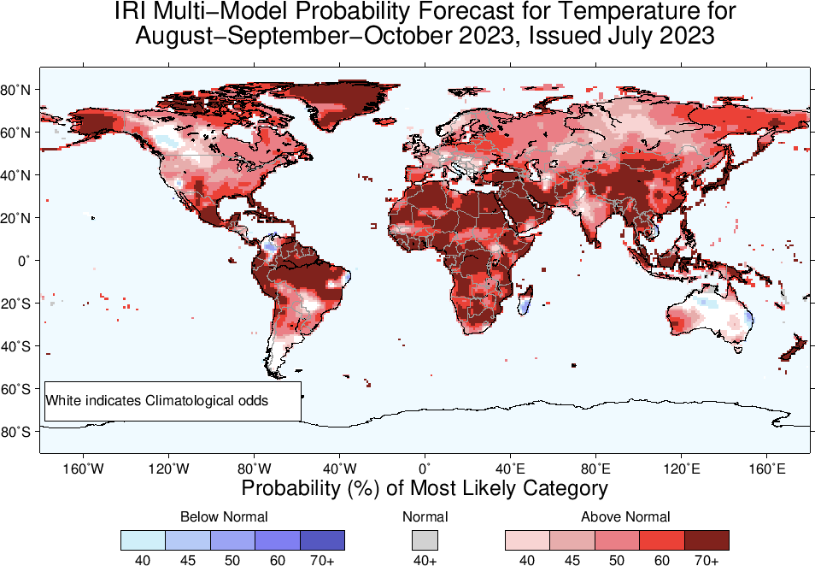
Highlights:
Shift towards Warmer/Above-Normal
Most land areas,
Southeast Asia, the Maritime Continent regions, Northeast South America.
Shift towards Colder/Below-Normal
Northern tip of South America,
Southern parts of Madagascar,
Southeast Australia
Temperature Forecasts: Season # 1, Aug to Oct

Slide 29
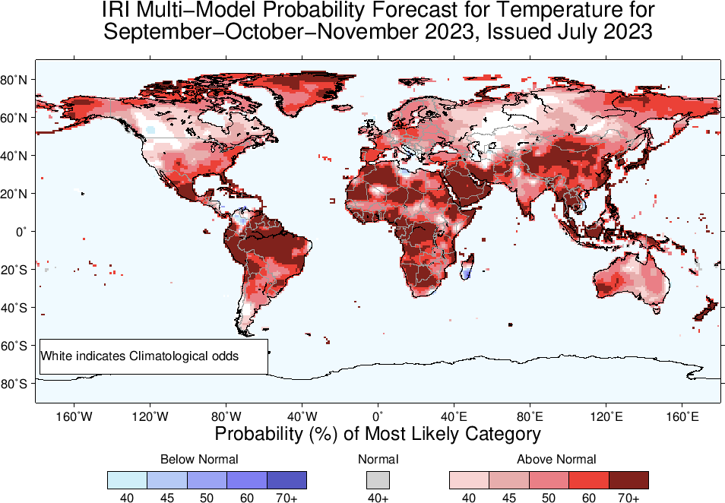

Slide 30
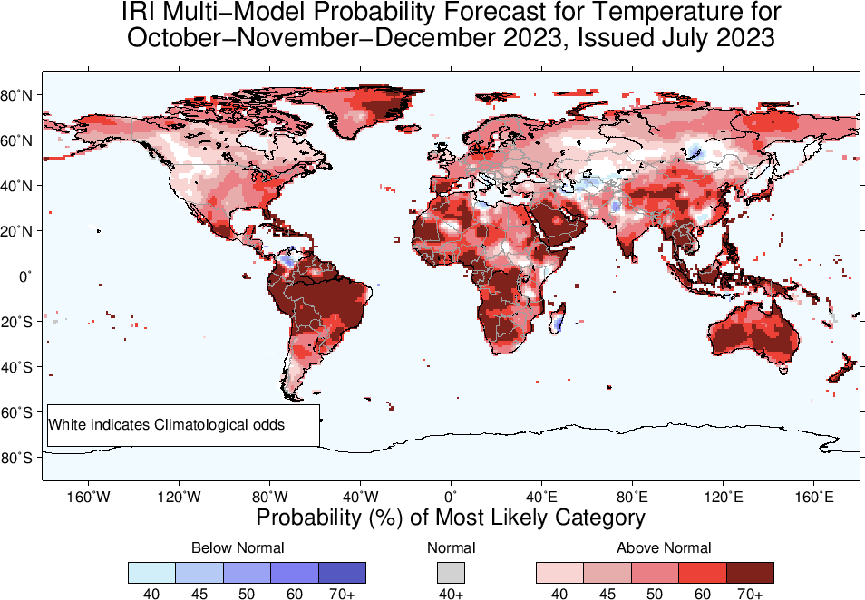

Slide 31
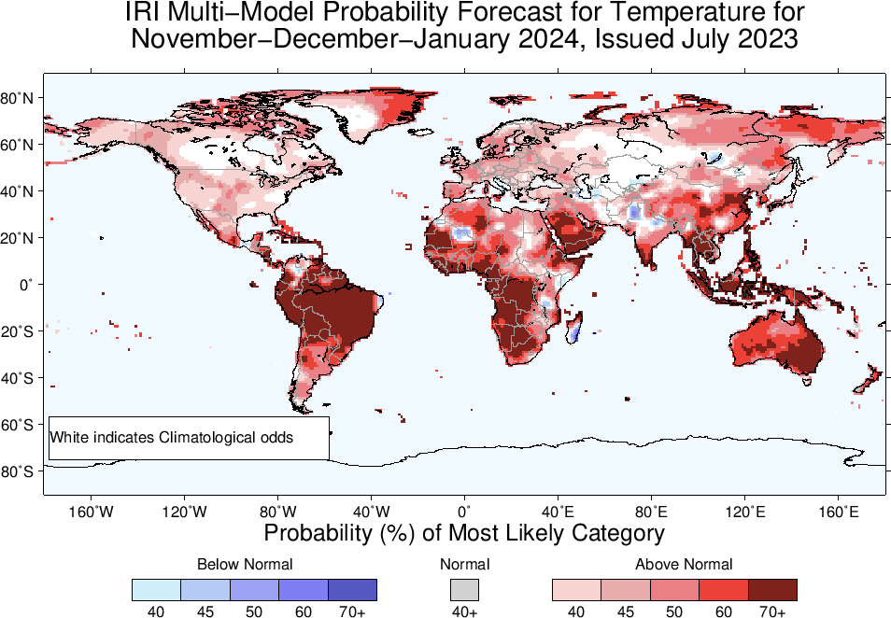

Slide 32
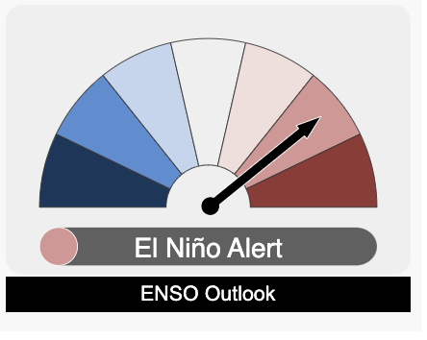
Summary
In response to the warming of the central-eastern equatorial Pacific Currently, no consistent changes have been observed in the atmosphere, such as shifts in “winds, clouds, and broad-scale pressure patterns”.
This suggests that the Pacific Ocean and atmosphere have not yet fully coupled, which is a characteristic feature of ENSO events.
Zonal SST gradient is also not established.
Possible impacts of above include;
Weakened El Niño,
Shorter Duration,
Unpredictable Effects.
http://www.bom.gov.au/climate/enso/#tabs=Overview

