Slide 1
ENSO and Climate Outlook in February, 2025
Soft La Niña Conditions, Hard-Hitting Impacts!
Ehsan, M. Azhar
(mae2171@columbia.edu)
Center for Climate Systems Research (CCSR),
Affiliate of NASA GISS and
International Research Institute for Climate and Society (IRI)
Dr. Andrew Robertson (CCSR): Forecast system development, ongoing innovation,
Jing Yuan (CCSR): Forecast Post-Processing,
Jeffrey Turmelle (IRI): Forecast Post-Processing and Web updates.

Slide 2
Outline
Observed Oceanic and Atmospheric Conditions in
Tropical Pacific
Across the Globe
ENSO Forecast in
NMME
IRI ENSO Forecast Tool (Deterministic and Probabilistic)
Seasons Outlook of
SST
Precipitation and Temperature
Summary

Slide 3
Observations
Oceanic
Atmospheric

Slide 4
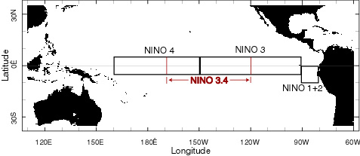
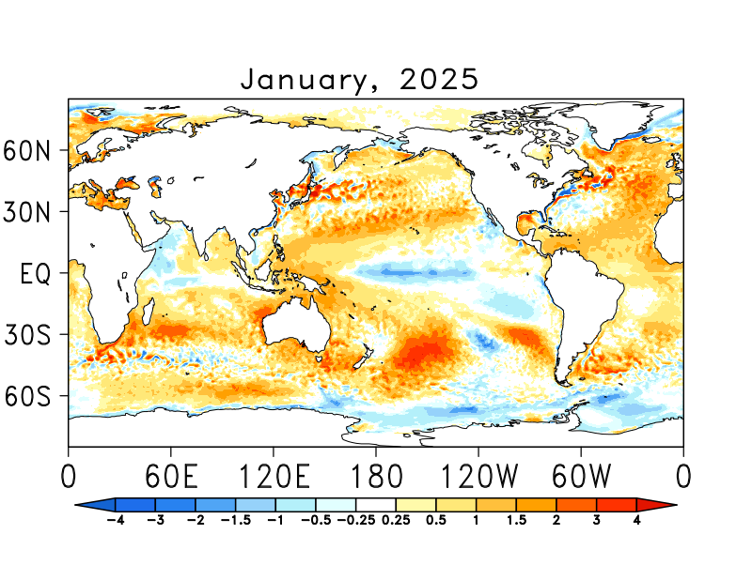
SST Departures in Monthly (January, 2025) Data: OISST v2
NINO3: -0.27
Latitude: 5°S - 5°N
Longitude: 210°E - 270°E
NINO4: -0.65
Latitude: 5°S - 5°N
Longitude: 160°E - 210°E
NINO12: -0.23
Latitude: 10°S - 0°N
Longitude: 270°E - 280°E
NINO34: -0.82
Latitude: 5°S - 5°N
Longitude: 190°E - 240°E
https://psl.noaa.gov/data/gridded/data.noaa.oisst.v2.highres.html

Slide 5
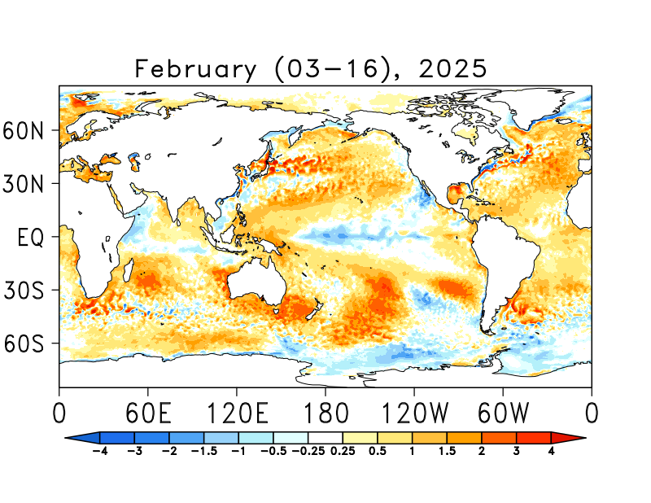
SST Departures in Last Two-Weeks (Feb 03-16) Data: OISST v2
NINO 1+2: +0.72
Latitude: 10°S - 0°N
Longitude: 270°E - 280°E
NINO 3: -0.01
Latitude: 5°S - 5°N
Longitude: 210°E - 270°E
NINO 3.4: -0.53
Latitude: 5°S - 5°N
Longitude: 190°E - 240°E
NINO 4: -0.70
Latitude: 5°S - 5°N
Longitude: 160°E - 210°E
https://psl.noaa.gov/data/gridded/data.noaa.oisst.v2.highres.html

Slide 6
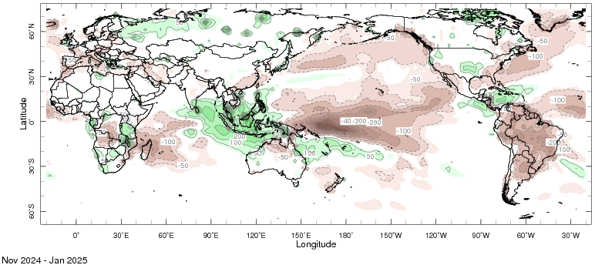
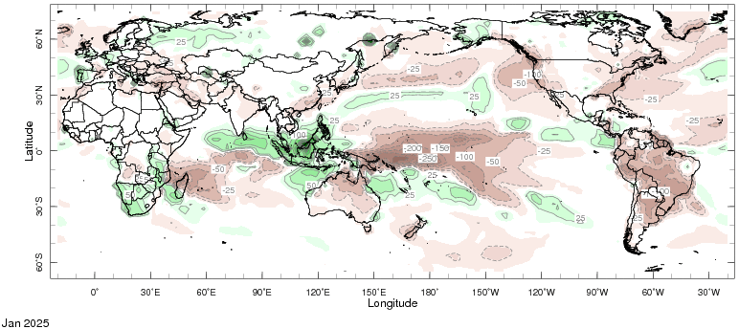
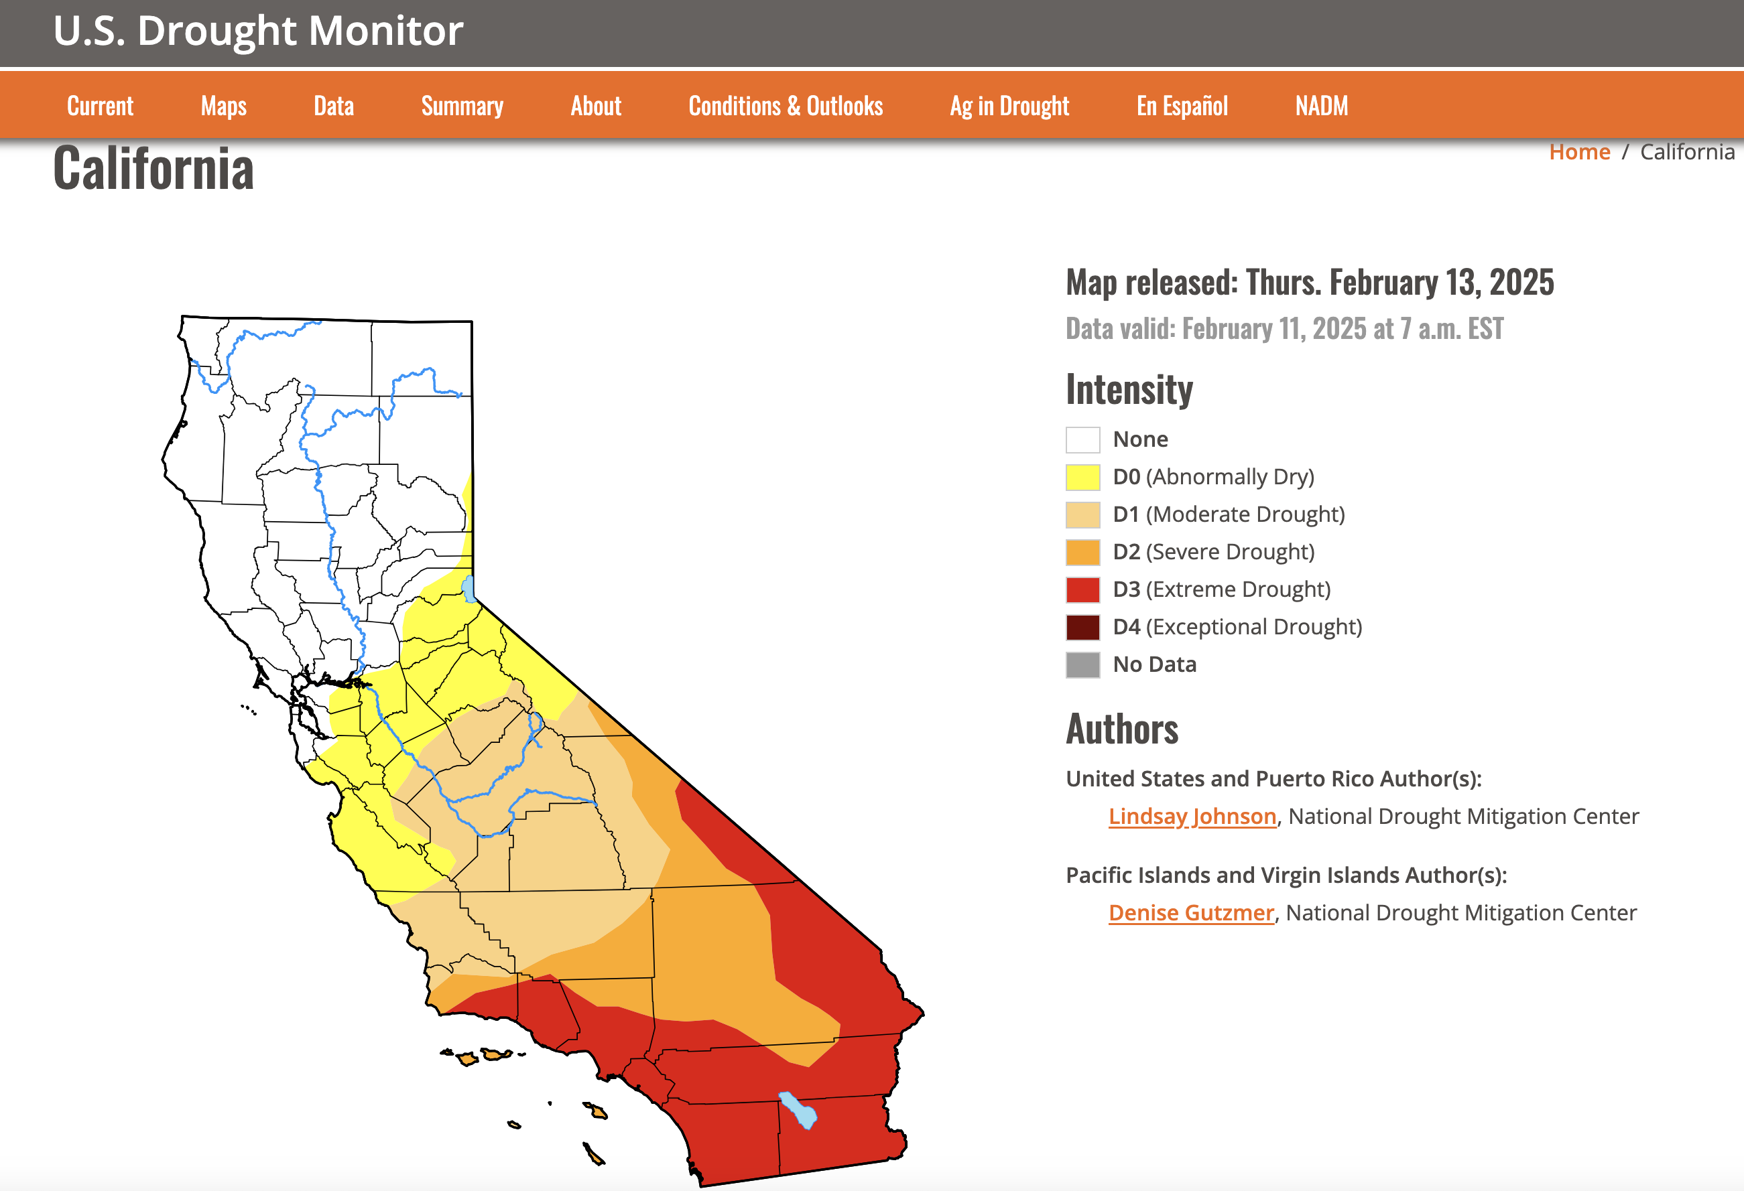
Prcp Anomalies (Jan, and Nov-Jan)
The observed Northern Hemisphere dominant winter/DJF precipitation regions defined as the % fraction of DJF to annual total precipitation

Slide 7
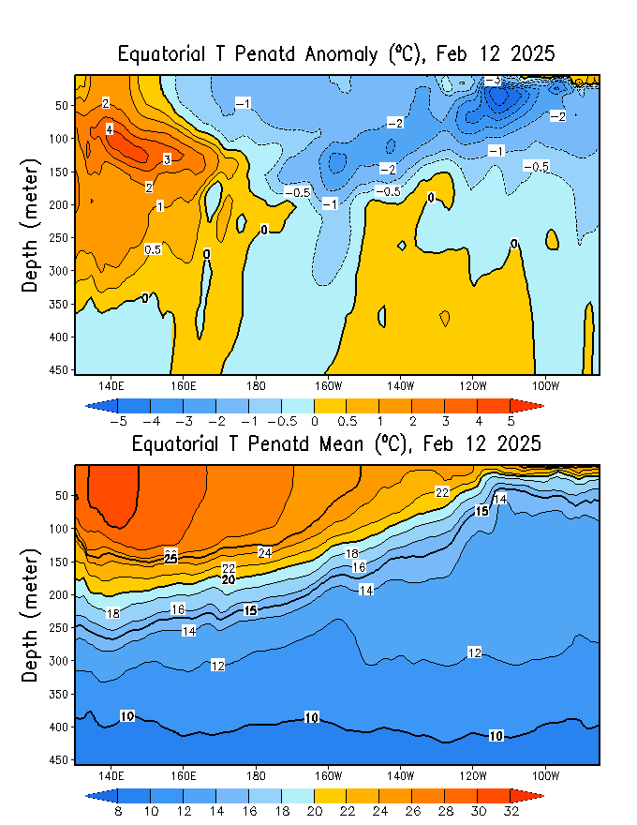
What is the underwater conversation?
December, 2024
February, 2025
Warm subsurface-to-surface temperature anomalies dominate from 140E to 160E in equatorial Pacific Ocean (Surface to 350 meter at depth) and over the surface in the far eastern Pacific.
January, 2025
Cold subsurface temperature anomalies Persisting, at depth (170E and Dateline to far east). close to surface between 170E-120W, and below 25 meters in far east (120W-80W)

Slide 8
What is the underwater conversation?
Strongest dive in negative anomalies since Dec-Jan-Feb, 2024, Index reached to a value of -1.4 in mid-December 2024,
Driving slightly upwards afterwards.

Slide 9
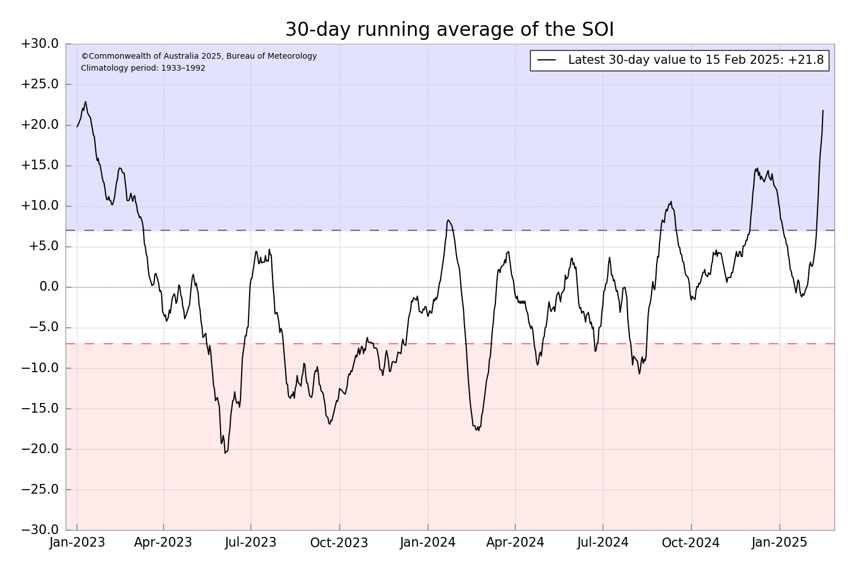
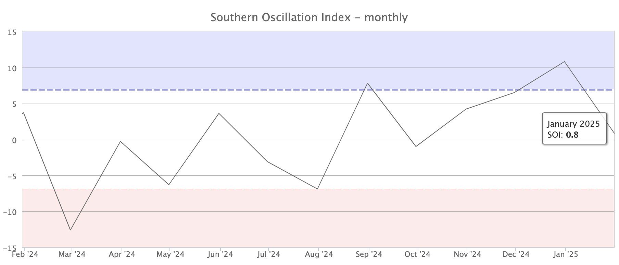
Most recent Southern Oscillation (Traditional & EQ) Index (SOI → in La Nina Space)
SOI values is in La Nina range
(For January, 2025 it is +0.8)
Equatorial-SOI is also in La Nina range,
(For January, 2025 it is +1.8)
Eq-SOI values sustained to remain in La Nina range since November, December, 2024 and January, 2025.
During La Niña, the pressure becomes above-average in Tahiti and below-average in Darwin, and the Southern Oscillation Index is Positive.
A Sustained Positive values of the SOI above +7 typically indicate La Niña
Source:
http://www.bom.gov.au/climate/enso/#tabs=Pacific-Ocean&pacific=SOI

Slide 10
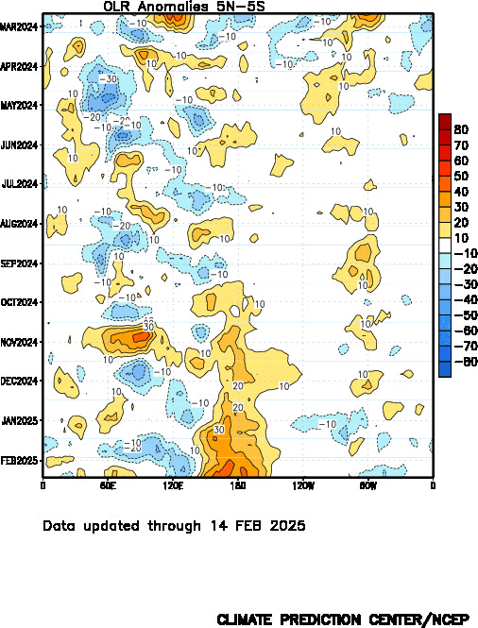
Most recent Outgoing Longwave Radiation (OLR)
(OLR → in La Nina Space)
OLR shows reduced convection over the Dateline since Sep, 2024,
Quite strong during January and February.
During La Niña, the convection is reduced over-and-around the Date-Line
Source:
https://www.cpc.ncep.noaa.gov/data/indices/cpolr.mth.91-20.ascii

Slide 11
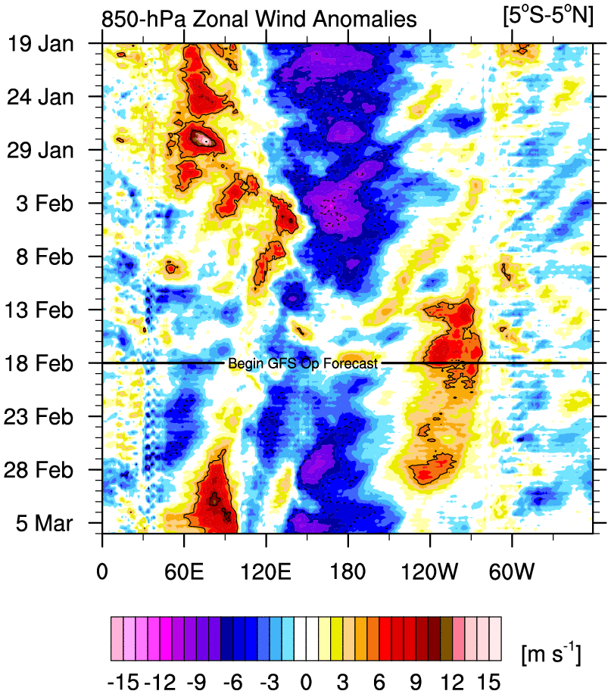
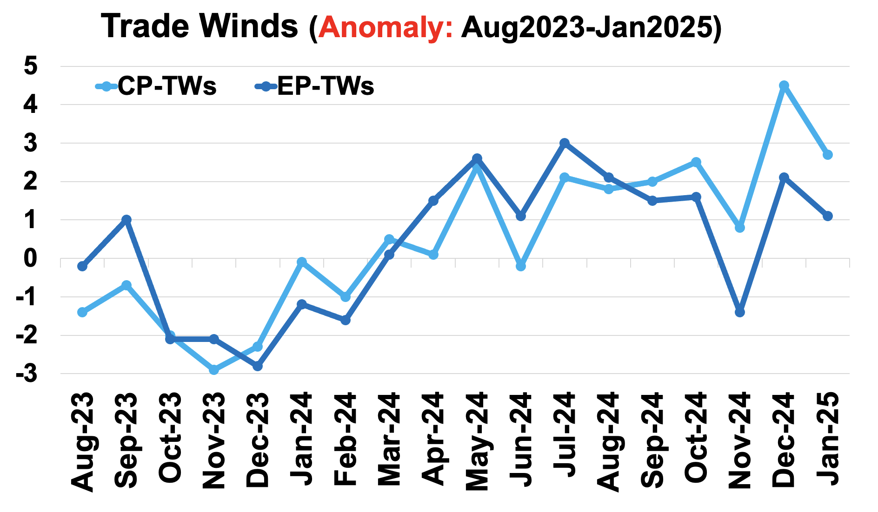
Most recent Lower-Level Winds (TW-Index)
Yellow Shading: Westerly Anomalies
Blue Shading: Easterly Anomalies
In shorter Forecasts;
Trades seems to remain relatively weak as compared to Dec-24 or even Jan-25.
Sources:
https://mikeventrice.weebly.com/hovmollers.html
https://www.cpc.ncep.noaa.gov/data/indices/epac850

Slide 12
Forecasts
IRI ENSO Plume,
Probability of Nino-34,
Global SSTs from NMME,
Prcp. and Temp. outlook from IRI (February, 2025)

Slide 13
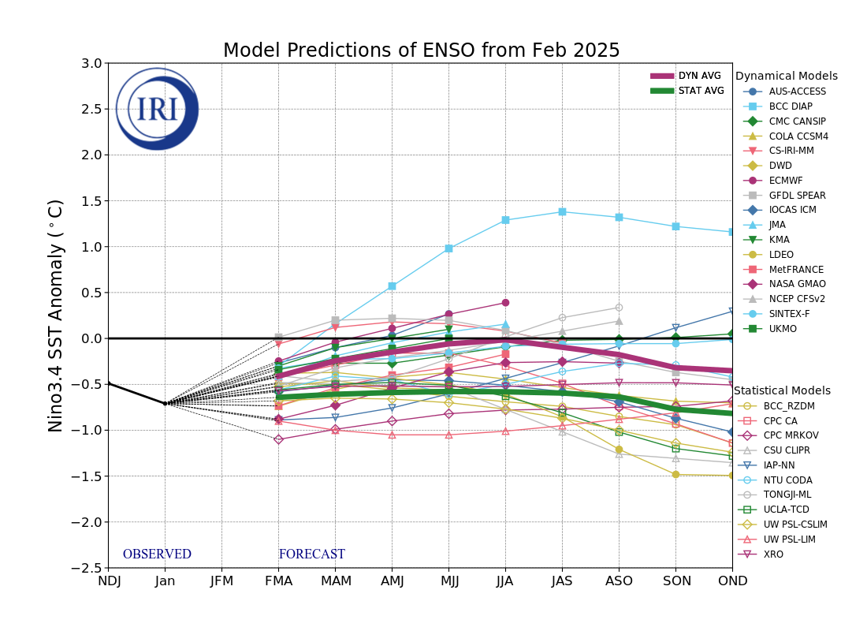
IRI’s ENSO Forecast (Today, 19th February, 2025)
Mean of STAT Models (9 out of 11) reach to La Nina threshold and continue to reflect it,
Mean of DYN Models is in ENSO-neutral range and continue to do so,
6 out of 17 DYN models reaching La Nina Threshold in FMA, and 4 in MAM, and 3 in AMJ.

Slide 14
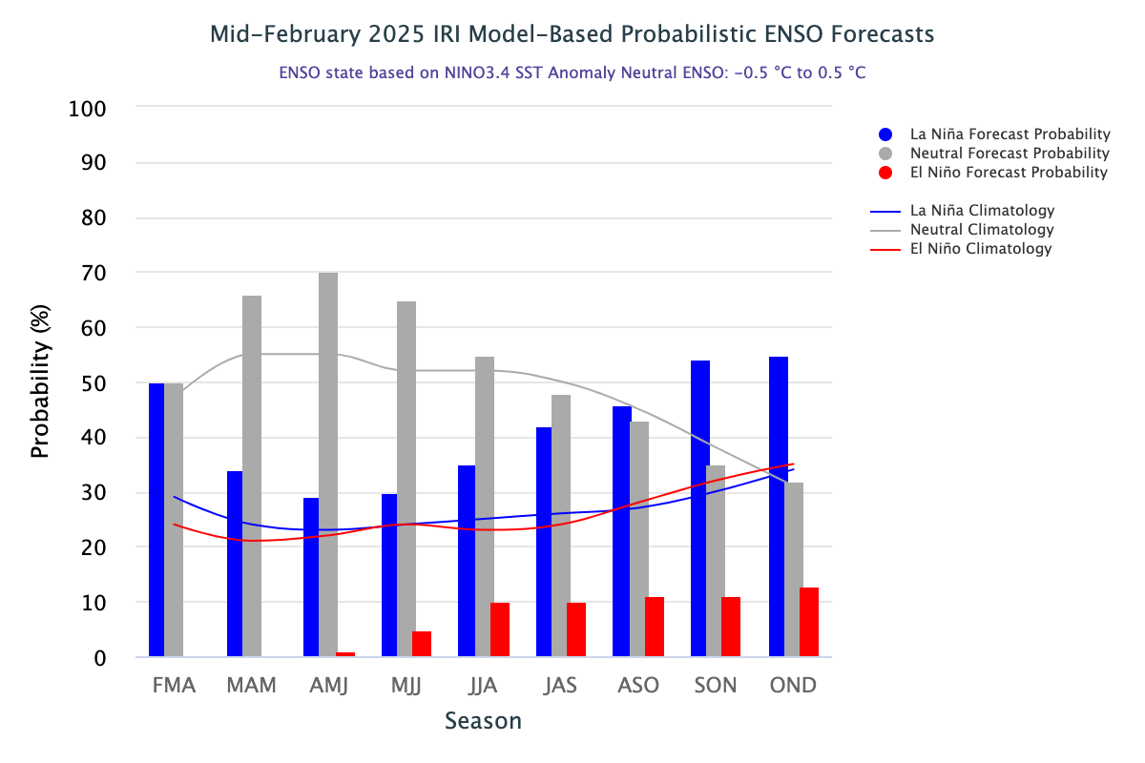
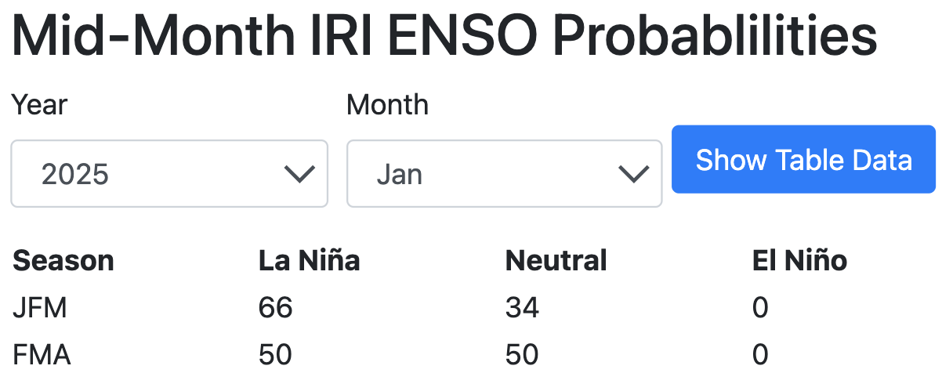
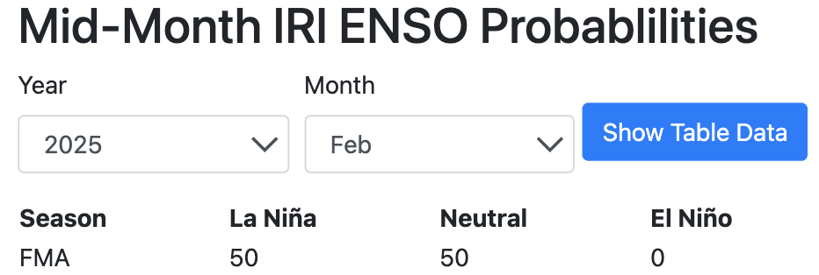
IRI’s Probabilistic (STAT+DYN) ENSO Forecasts (Today on 19th February, 2025)
Fifty for La Nina and Fifty for ENSO-Neutral,
ENSO-Neutral from MAM-2025 onwards,
La Nina is next dominant category, gradually increasing probability from JJA-2025 and become dominant again in SON-2025 and OND-2025.

Slide 15
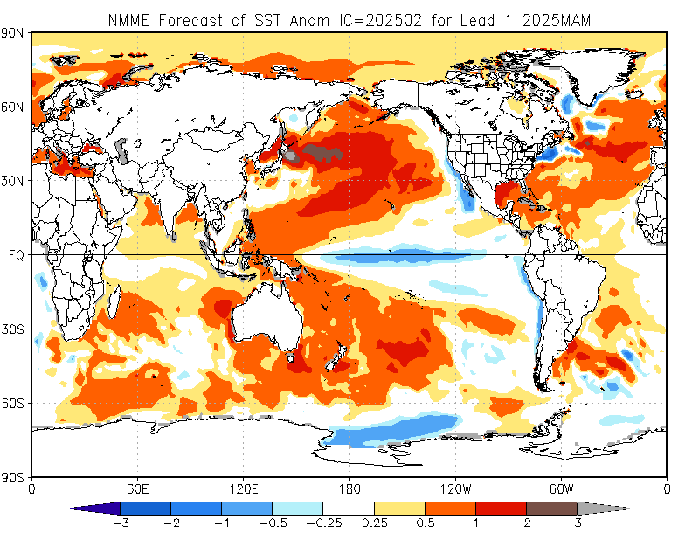
North American Multi Model Ensemble
(NMME) SST Forecast

Slide 16
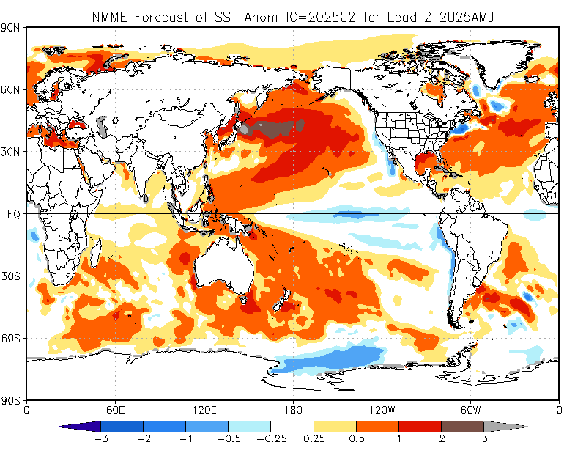

Slide 17
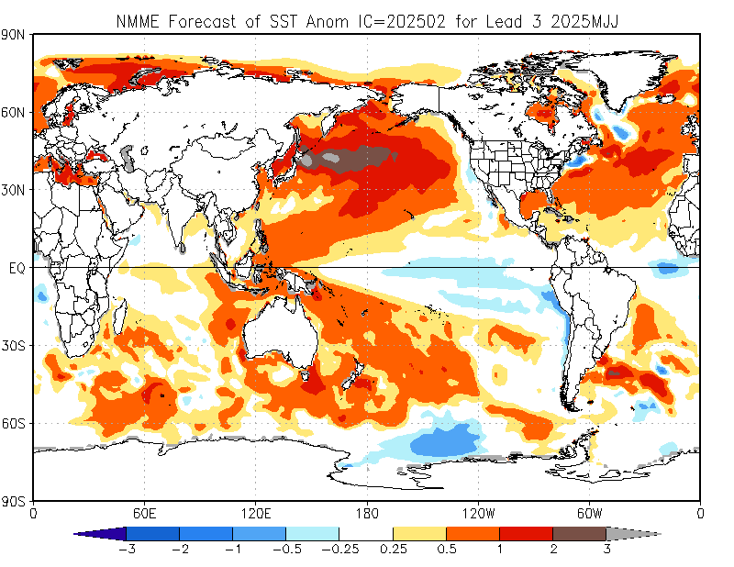

Slide 18
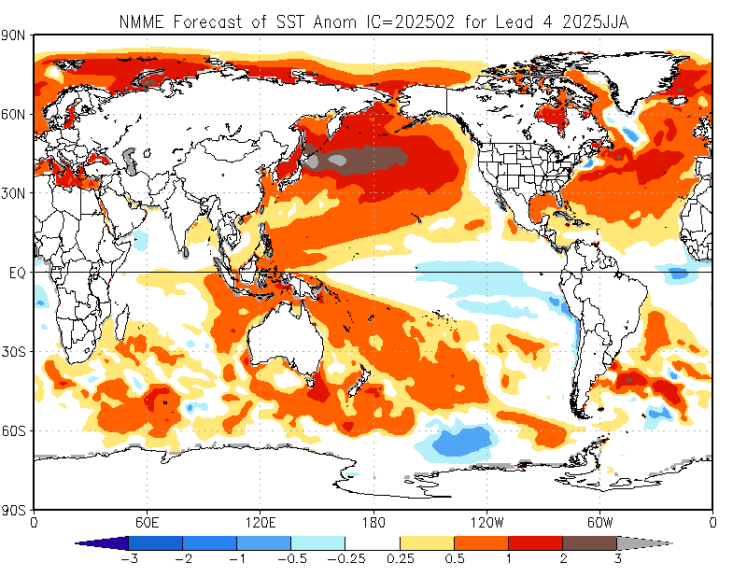

Slide 19
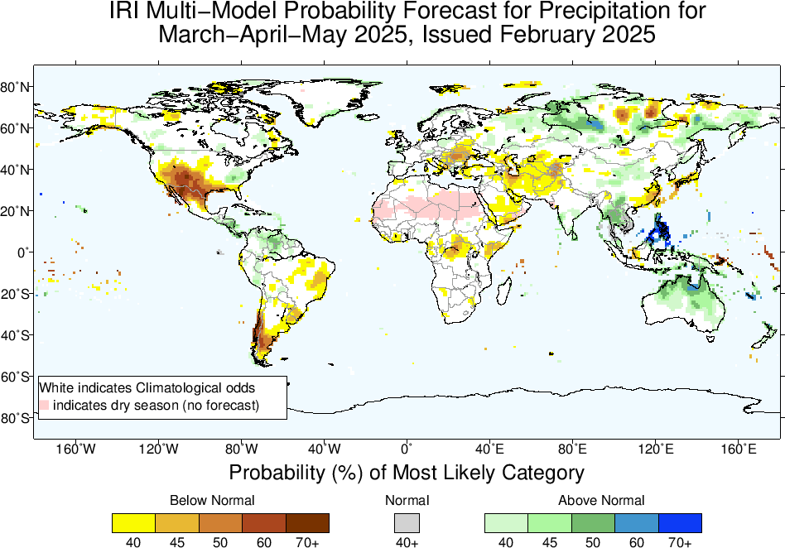
Precipitation Forecasts based on North American Multi Model Ensemble (NMME)
Key Points:
La Nina Conditions continue,
Wet/Dry northern/southern US, northern Mexico,
Central America, and northern South American in Above Normal, BN in southern South America,
Middle East/CSWA in Below-Normal, as well as northeast China,
Above-Normal favored in MC, Southeast Asia, and Australia,
A weak signal of BN in northeast Africa (start of long-rains, keep in eye)

Slide 20
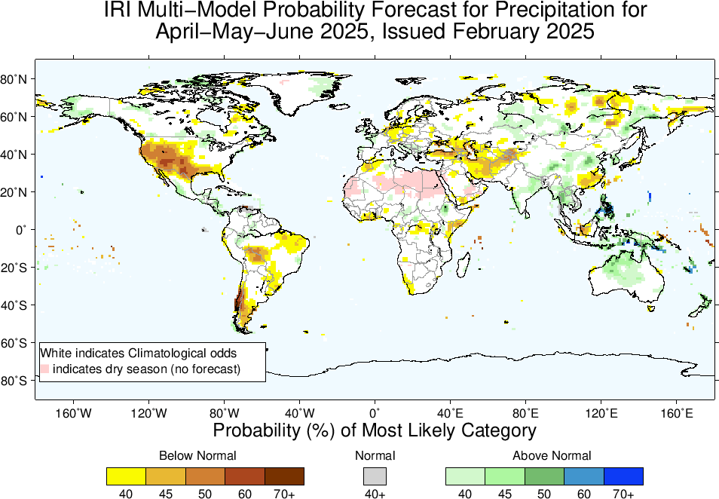

Slide 21
Key Points:
START of Monsoons in South West US (equal odds), Africa (AN, 40 to 45%), and Asia (~40%).

Slide 22
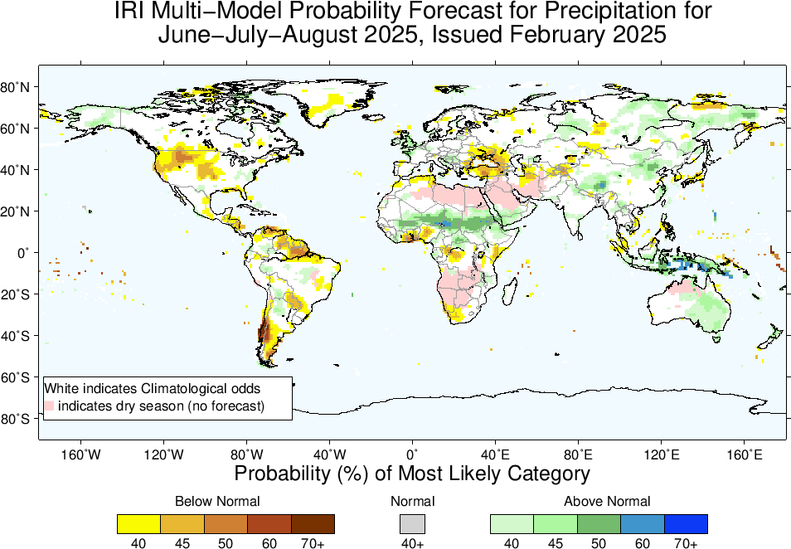

Slide 23
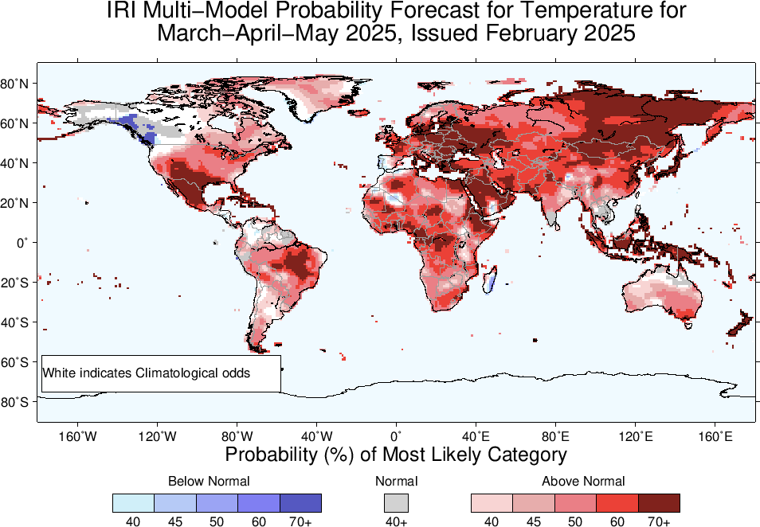
2m-Temperature Forecasts based on North American Multi Model Ensemble (NMME)

Slide 24
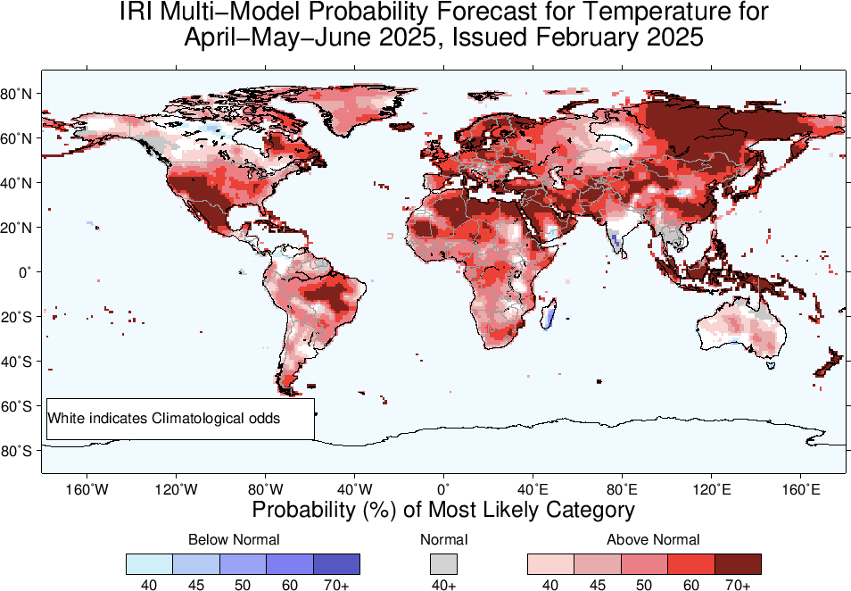

Slide 25
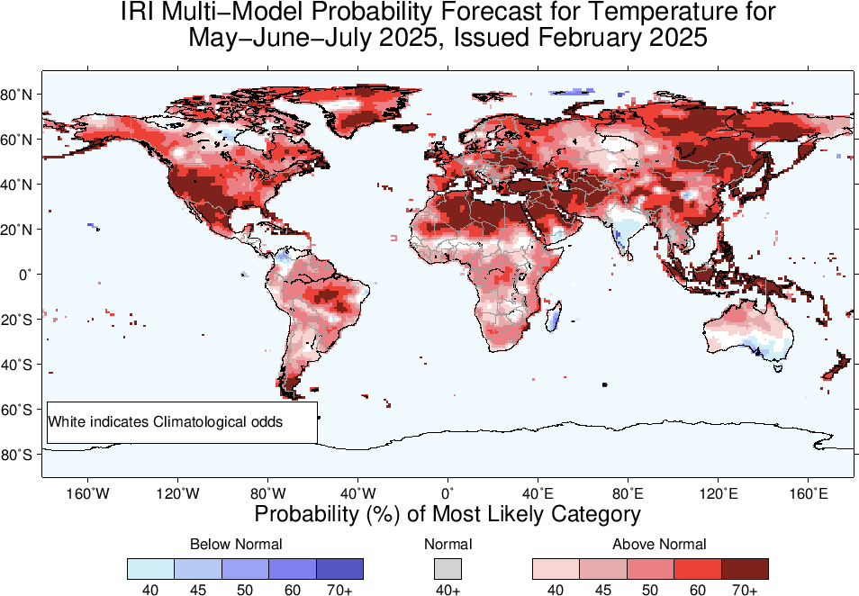

Slide 26
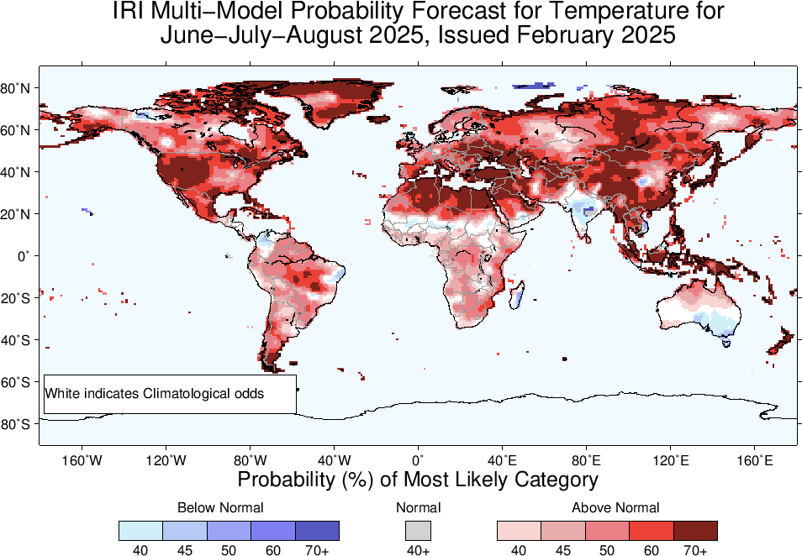

Slide 27
Summary
After end of 2023/24 El Nino, tropical Pacific has experienced ENSO-neutral conditions since May, to November, 2024 (NINO3.4 for May was +0.3, June was +0.24, July was +0.21, Aug was -0.07, and Sep was -0.15, Oct was -0.28, Nov was -0.14, Dec-24 was -0.62, and Jan-25 was -0.71), and for most recent week ending on 12 Feb-25, it was -0.3.
Mid Feb-2025 IRI/CCSR@NASA-GISS ENSO forecasts show Fifty/Fifty chances for La Nina and ENSO-Neutral for FMA-2025,
From MAM-2025 onwards ENSO-Neutral continuation till JJA-25.
In SON and OND-2025 La Nina is favoured again.
Long-range ENSO forecasts is uncertain at this point due to spring predictability barrier.

