Slide 1
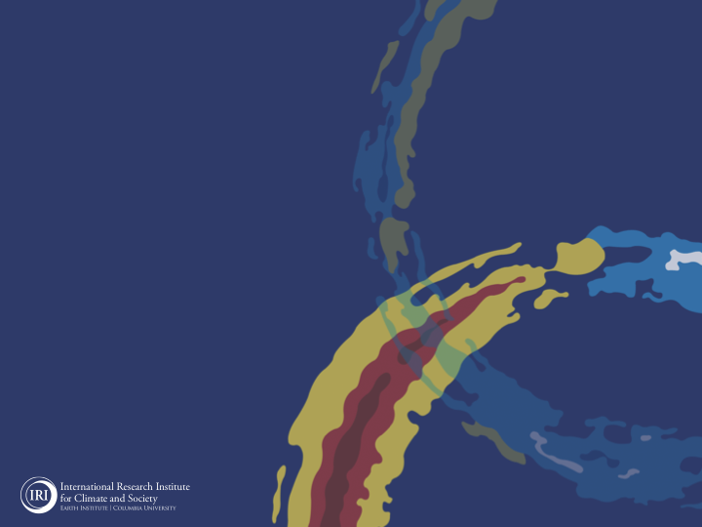

ENSO and Climate Outlook in December, 2023: El NINO Continue!
M. Azhar Ehsan
(azhar@iri.columbia.edu)
Associate Research Scientist
IRI ENSO and Climate Forecast Lead
Jeffrey Turmelle and Jing Yuan: forecast processing and web updates
Cuihua Li: Draft PowerPoint development
IRI’s Climate Group, led by Dr. Andrew Robertson:
Forecast system development, ongoing innovation, and verification

Slide 2
Outline
Observed Oceanic and Atmospheric Conditions in
Tropical Pacific
Across the Globe
ENSO Forecast in
NMME
IRI ENSO Forecast Tool (Deterministic and Probabilistic)
Seasons Outlook of
SST
Precipitation and Temperature
Summary

Slide 3
Observations
Oceanic
Atmospheric

Slide 4
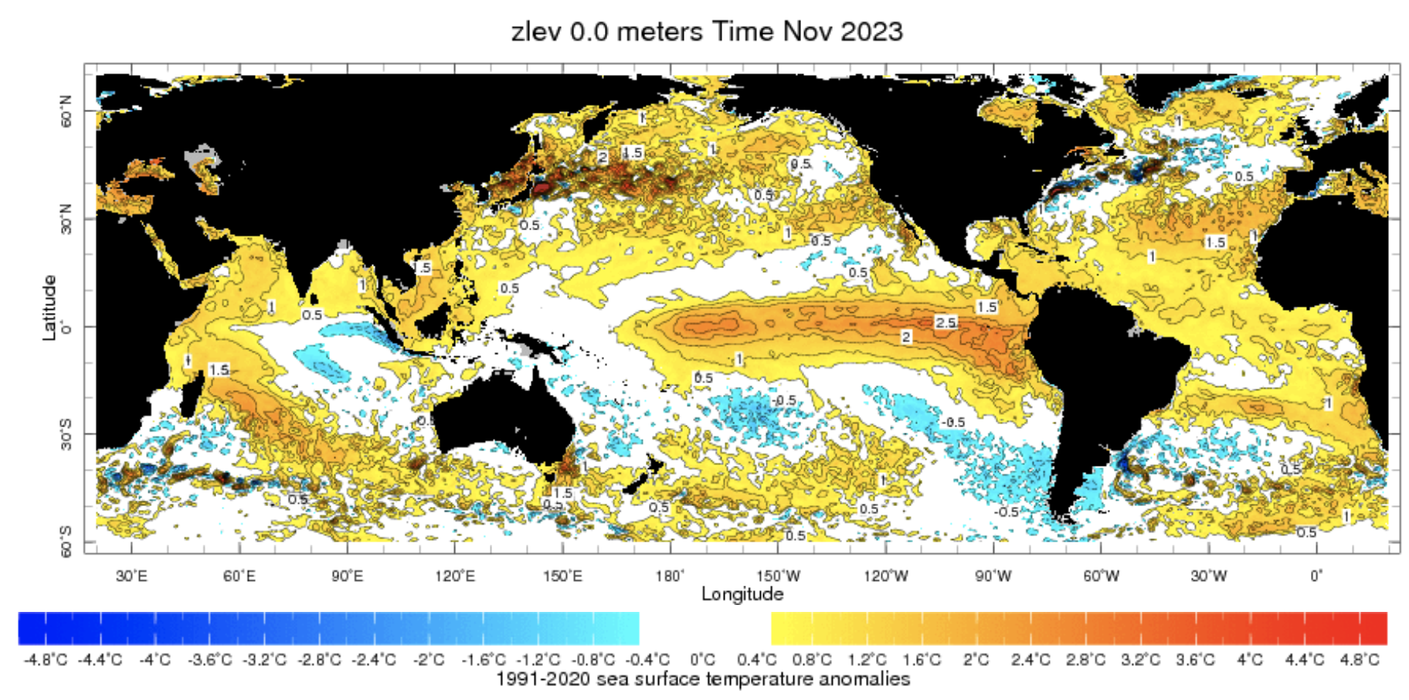
Evolution of SST Departures in Monthly Data
For Nov, 2023
NINO 1+2: +2.22
NINO3: +2.08
NINO3.4: +1.90
NINO4: +1.44
In the Pacific Ocean: Above-Average SSTs persisted across the central (across the Date Line), surrounded by strong +ve SSTA in the high latitudes
Indian Ocean: Above-Average SSTs in the West and Negative in the East, a +ve Indian Ocean Dipole (IOD, +1.38 for Nov 2023)
North-Pacific and North Atlantic Ocean: Negative PDO (-1.79), +ve Tropical North Atlantic (TNAI, +0.87)
Source: https://iridl.ldeo.columbia.edu/maproom/Global/Ocean_Temp/ERSST_Anomaly.html

Slide 5
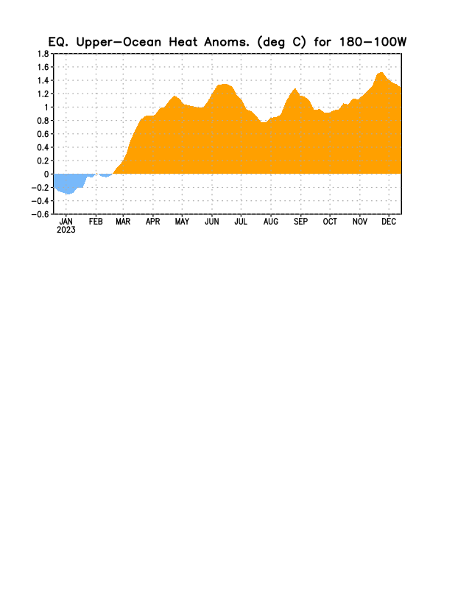
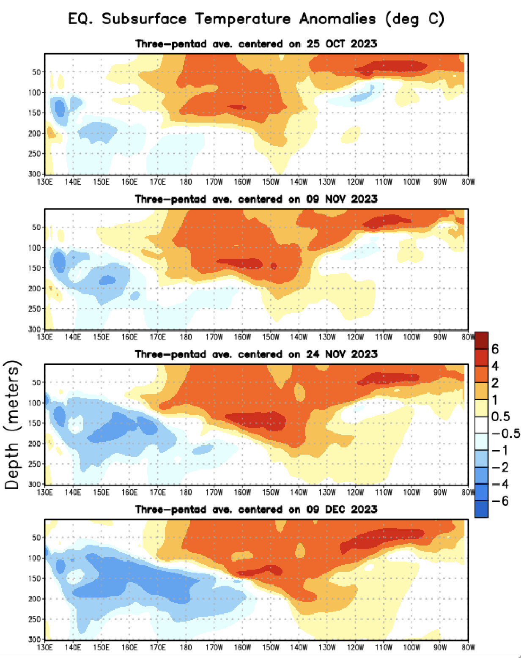
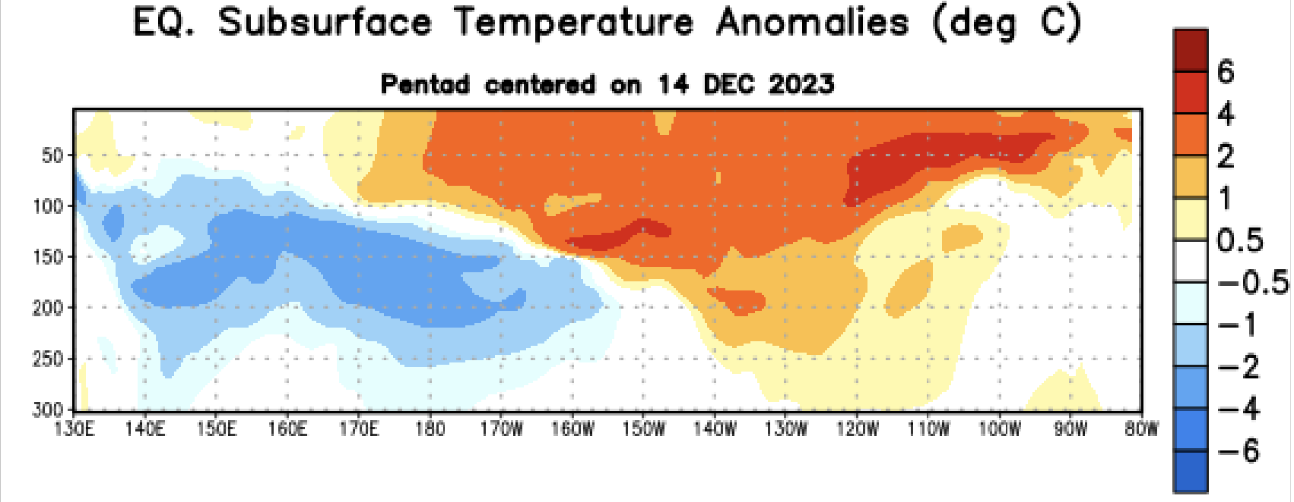
Subsurface Ocean Temperature Evolution
Positive subsurface temperature anomalies dominate most of the equatorial Pacific Ocean.
150m to surface from 150W to 110W,
100 m to surface 110 W to 80W,
100 m to surface, 170E to150W,
Negative subsurface temperature anomalies have strengthened in the western Pacific Ocean and expanded to 150ºW, while remaining at depth (Below 100 m)

Slide 6
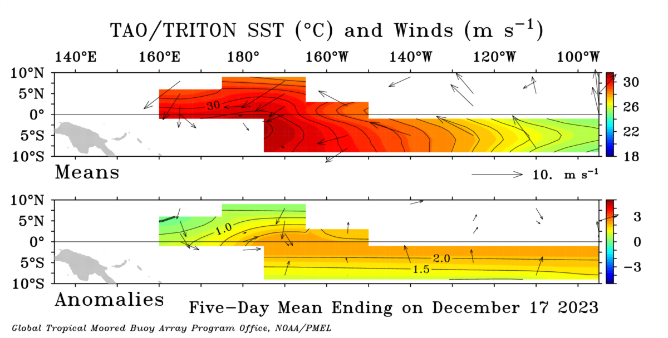
Most recent Sea Surface Temperature (SST) Lower-Level Winds

Slide 7
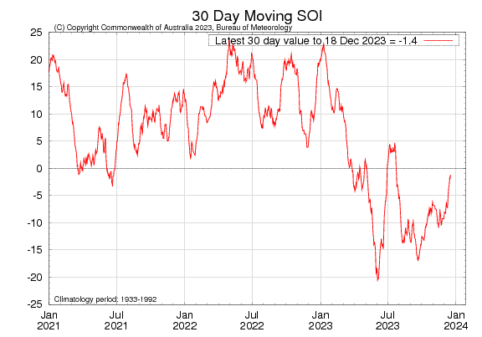
Most recent Southern Oscillation Index (SOI)
During El Niño, the pressure becomes below average in Tahiti and above average in Darwin, and the Southern Oscillation Index is negative.
A Sustained Negative values of the SOI above -7 typically indicate El Niño
Source:
http://www.bom.gov.au/climate/enso/#tabs=Pacific-Ocean&pacific=SOI

Slide 8
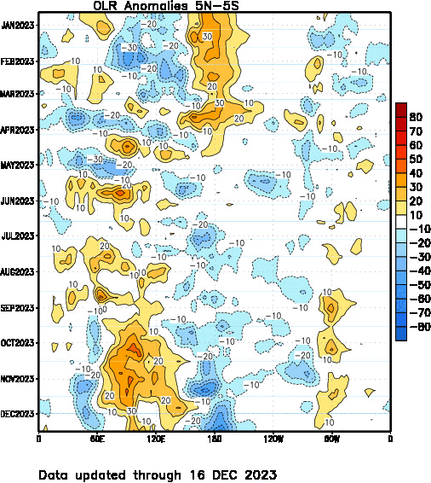
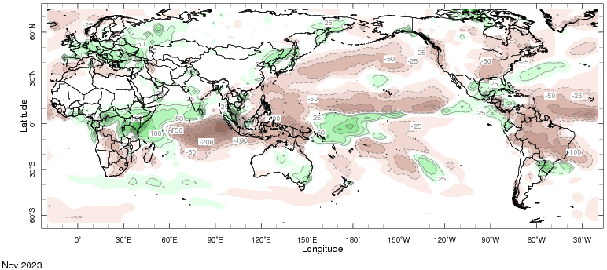
Most recent Outgoing Longwave Radiation (OLR) & Precipitation

Slide 9
A Quick Comparison (1997, 2015, and 2023)!

Slide 10
Forecasts
Nino-34 in NMME,
IRI ENSO Plume,
Probability of Nino-34,
Global SSTs from NMME,
Prcp. and Temp. outlook from IRI (December, 2023)

Slide 11
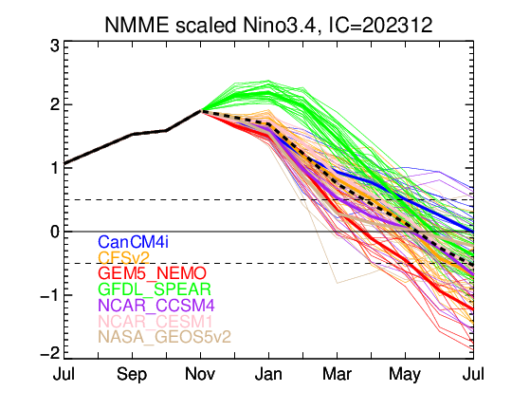
North American Multi Model Ensemble (NMME) ENSO Forecast (Dec, Initial)

Slide 12
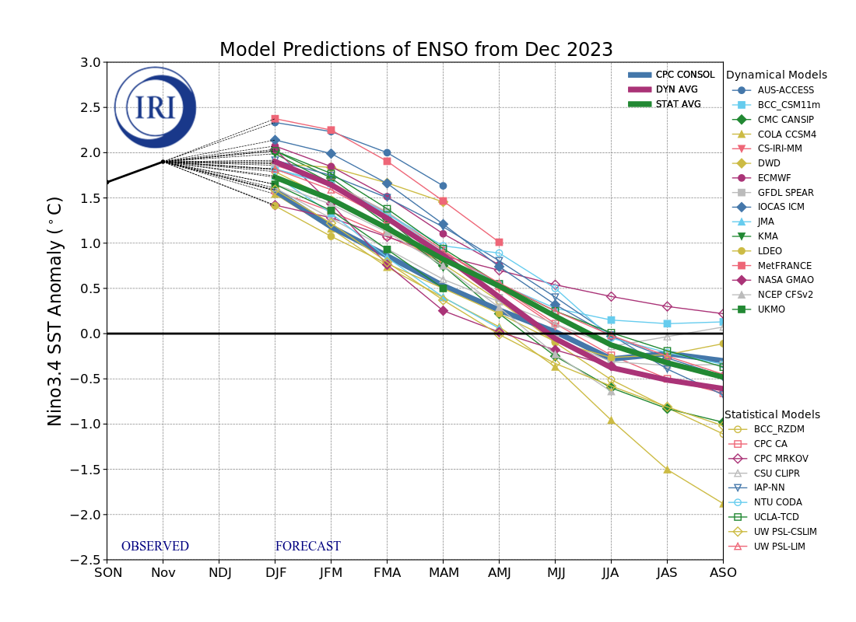
IRI’s ENSO Forecast Dec, 2023

Slide 13
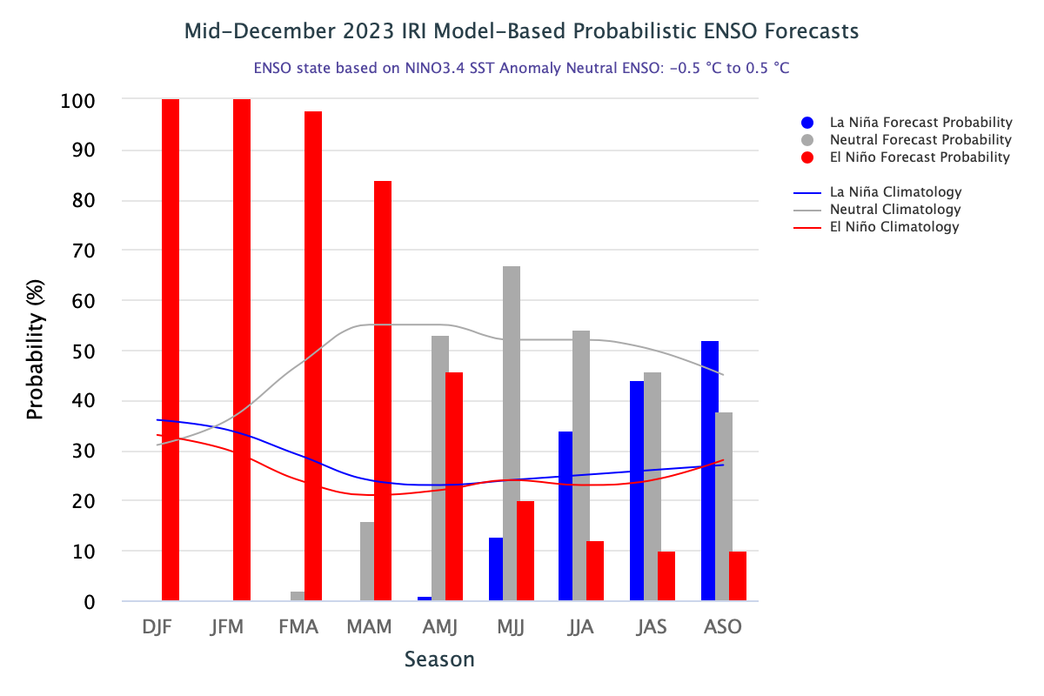
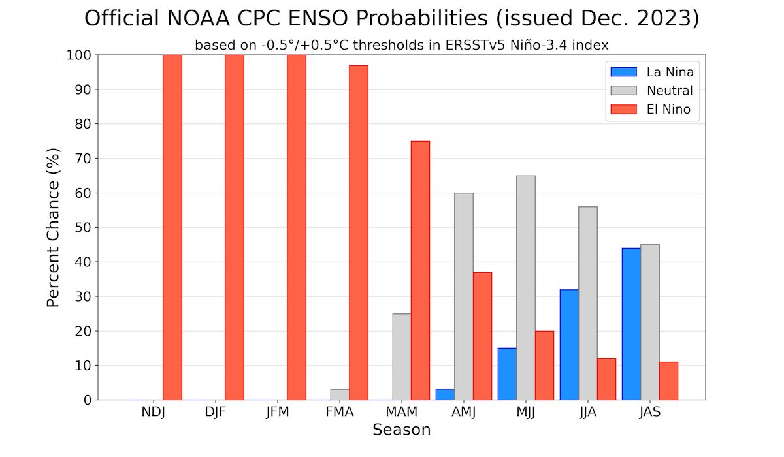
CPC (Released on Dec, 14) and IRI (on 19th Dec)

Slide 14
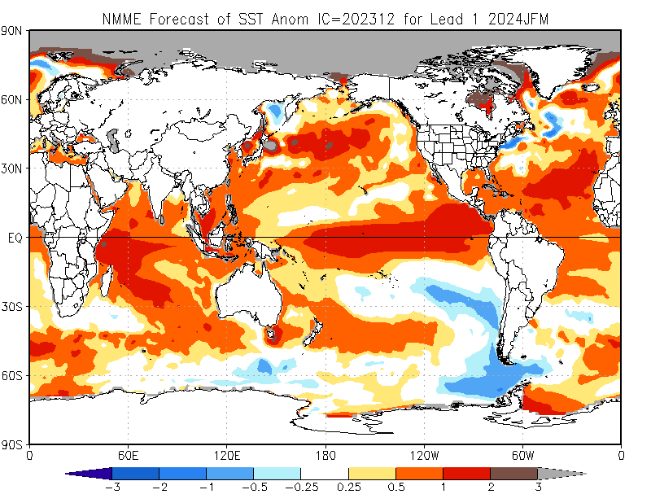
North American Multi Model Ensemble (NMME) SST Forecast

Slide 15
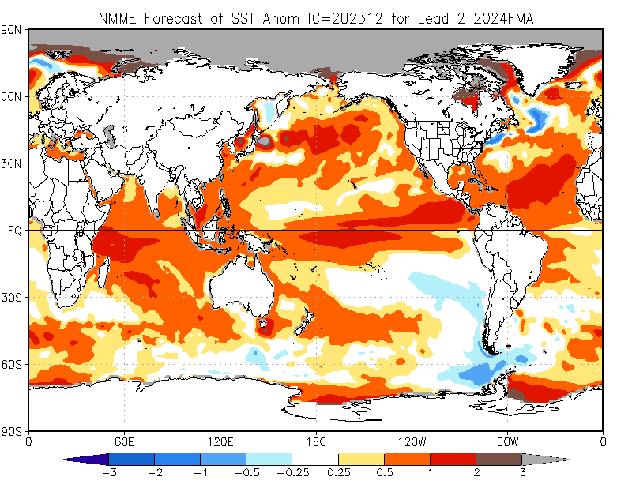

Slide 16
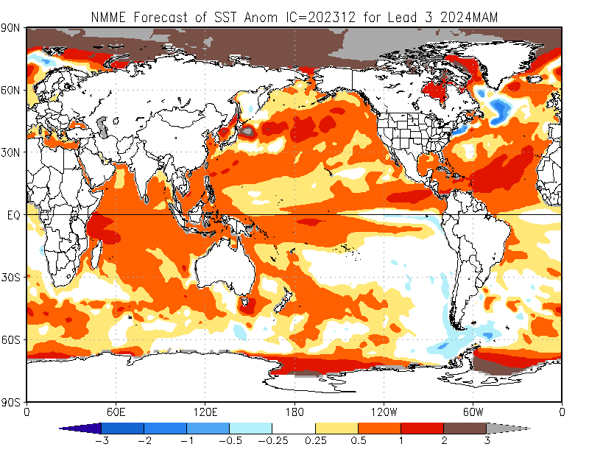

Slide 17
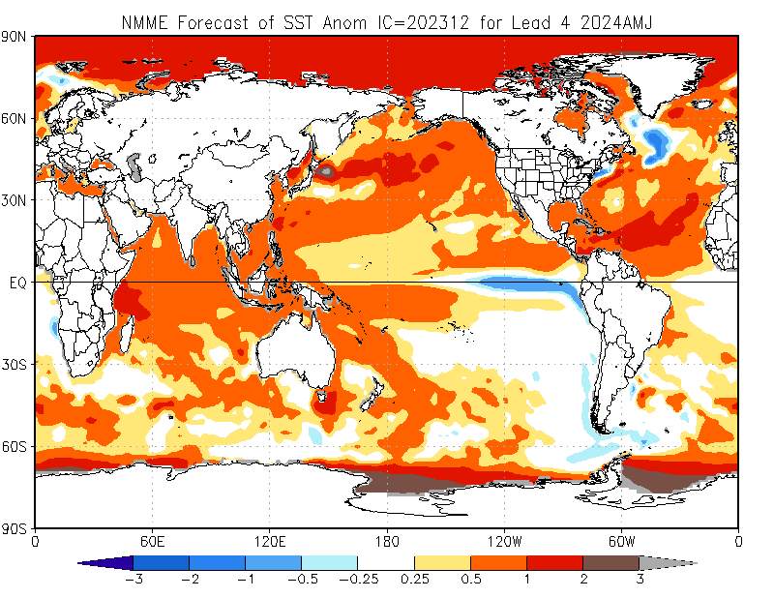

Slide 18
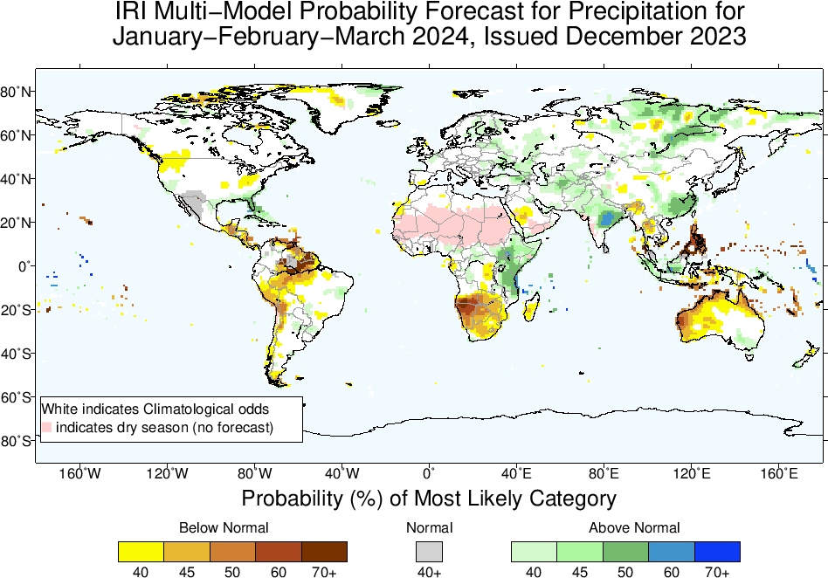
Precipitation Forecasts based on North American Multi Model Ensemble (NMME)

Slide 19
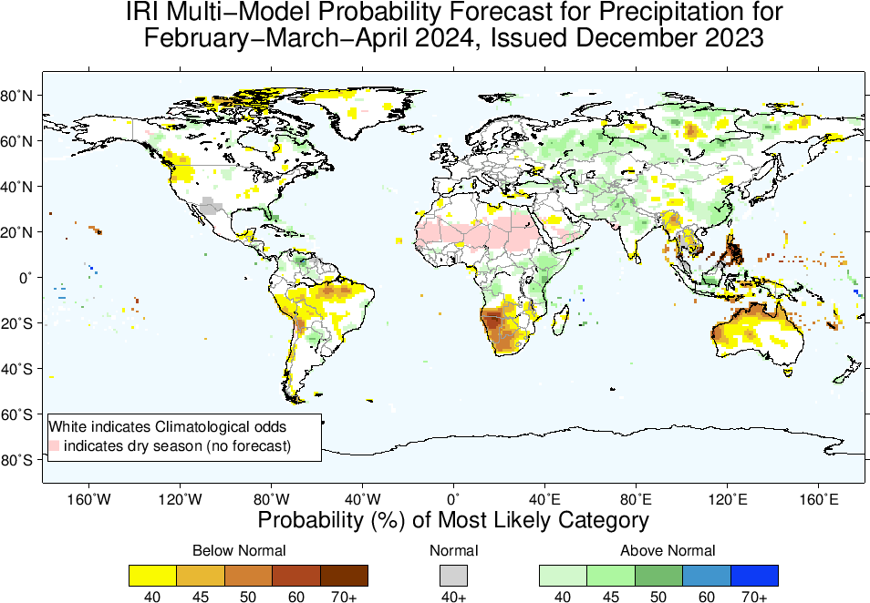

Slide 20
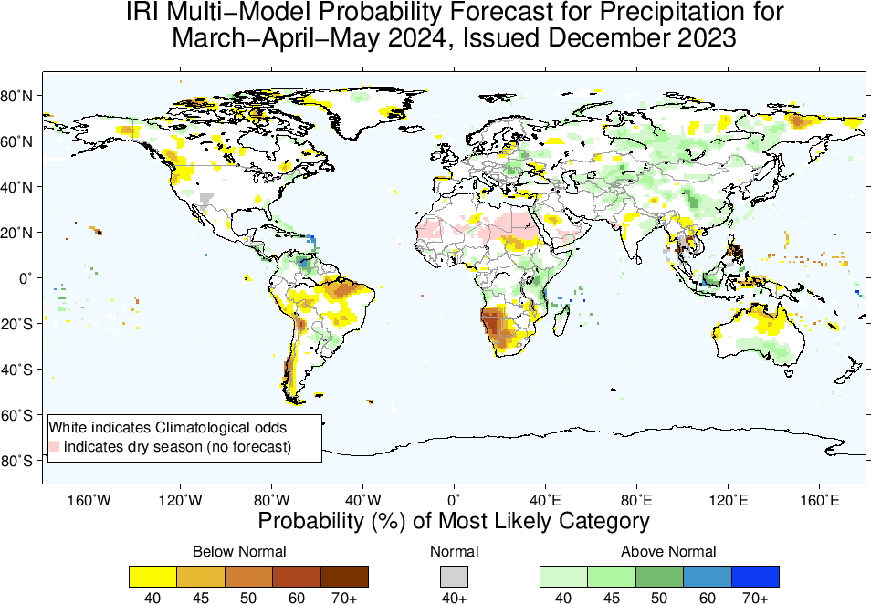

Slide 21
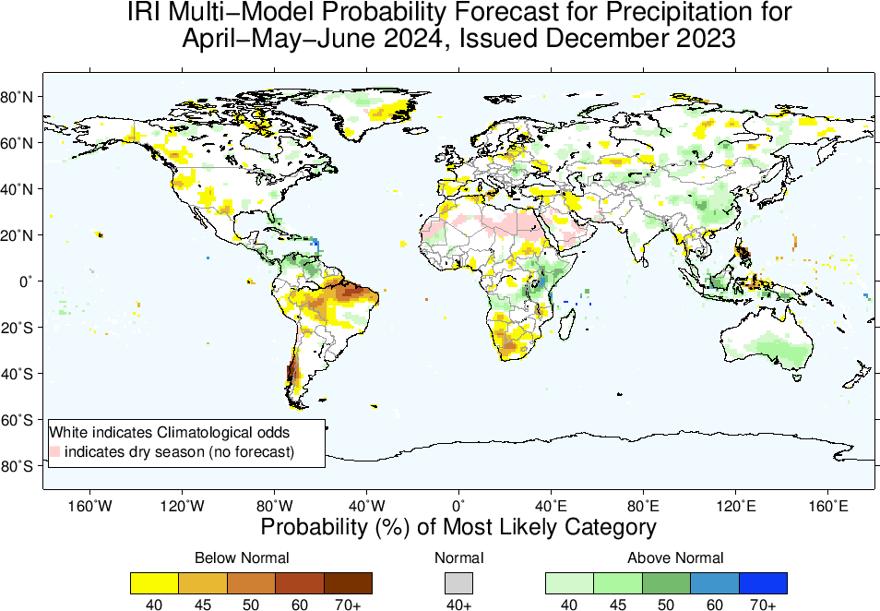

Slide 22
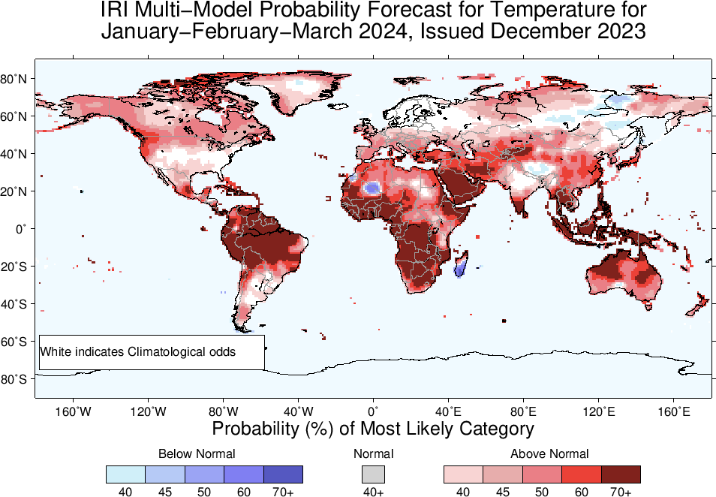
2m-Temperature Forecasts based on North American Multi Model Ensemble (NMME)

Slide 23
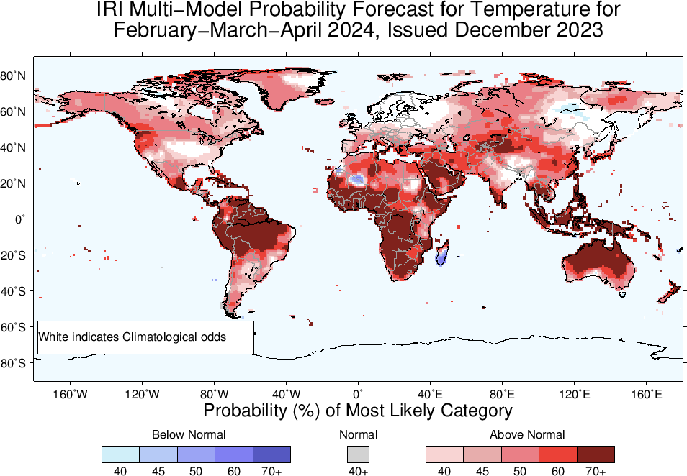

Slide 24
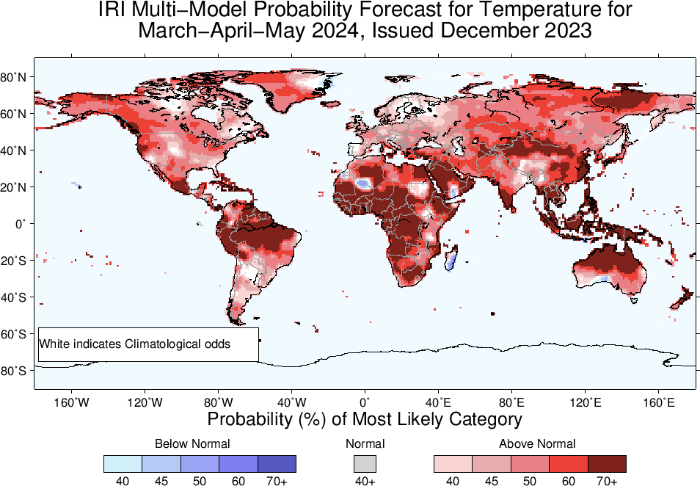

Slide 25
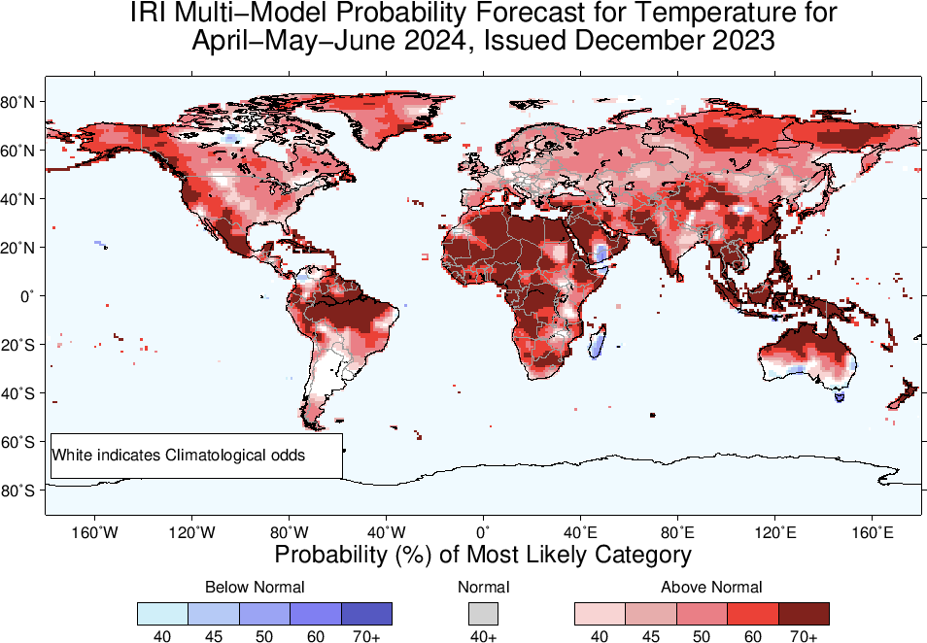

Slide 26
Summary
Current level of warming in the eastern and central Pacific Ocean, reaching a “strong” intensity (Nov, NINO3.4 Value is +1.90), while for last Four weeks, it is at +2.0.
Positive Indian Ocean Dipole also continues, though weakened.
The latest forecasts suggest that the warming will persist through the boreal winter and spring (84% in MAM-2024), gradually weakening thereafter.
Regions where the Probabilities are high for Above-Normal Precipitation include, East Africa, Central South-west Asia, Northeast China, Southern and southeastern parts of CONUS, over and around Uruguay. South and Southeast Australia show AN in MAM and AMJ-2024.
Regions where the Probabilities are high for Below-Normal Precipitation include, northeastern parts of South America, South Africa, Maritime Continent regions, scattered regions in Australia (in JFM and FMA, 2024).
Temperature across the globe is warmer.

