Slide 1
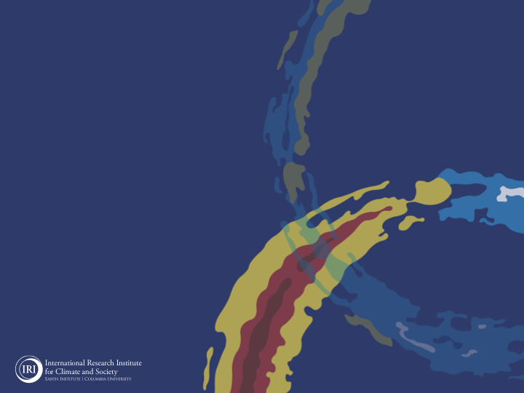
ENSO and Climate Outlook in
August, 2023
Weak Coupling: A comparison with 1997!
M. Azhar Ehsan
(azhar@iri.columbia.edu)
Associate Research Scientist
IRI ENSO and Climate Forecast Lead
Jeffrey Turmelle and Jing Yuan: forecast processing and web updates
Cuihua Li: Draft PowerPoint development
IRI’s Climate Group, led by Dr. Andrew Robertson: Forecast system development, ongoing innovation, and verification

Slide 2
Outline
Observed Oceanic and Atmospheric Conditions in
Tropical Pacific
Across the Globe
ENSO Forecast in
NMME (North American Multimodel Ensemble)
IRI ENSO Forecast Tool (Deterministic and Probabilistic)
Seasons Outlook of
SST (Sea surface Temperature)
Precipitation and Temperature
Summary

Slide 3
Observations
Oceanic
Atmospheric

Slide 4
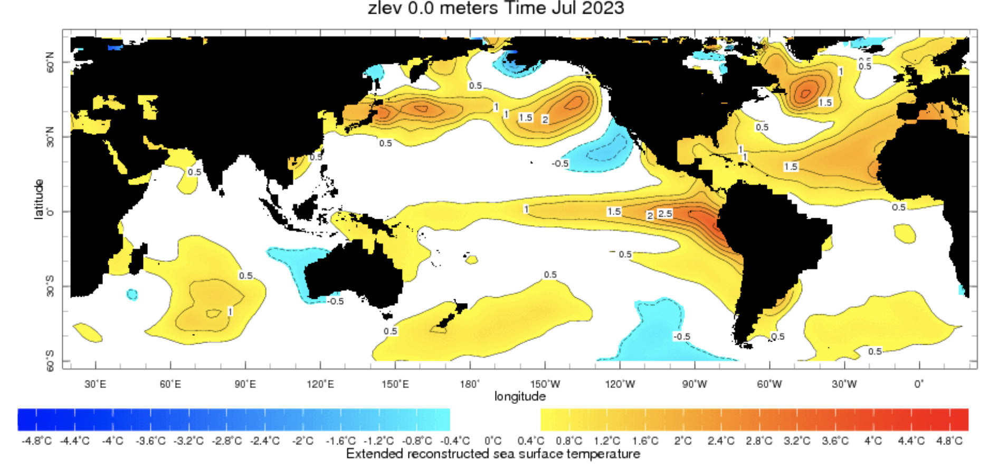
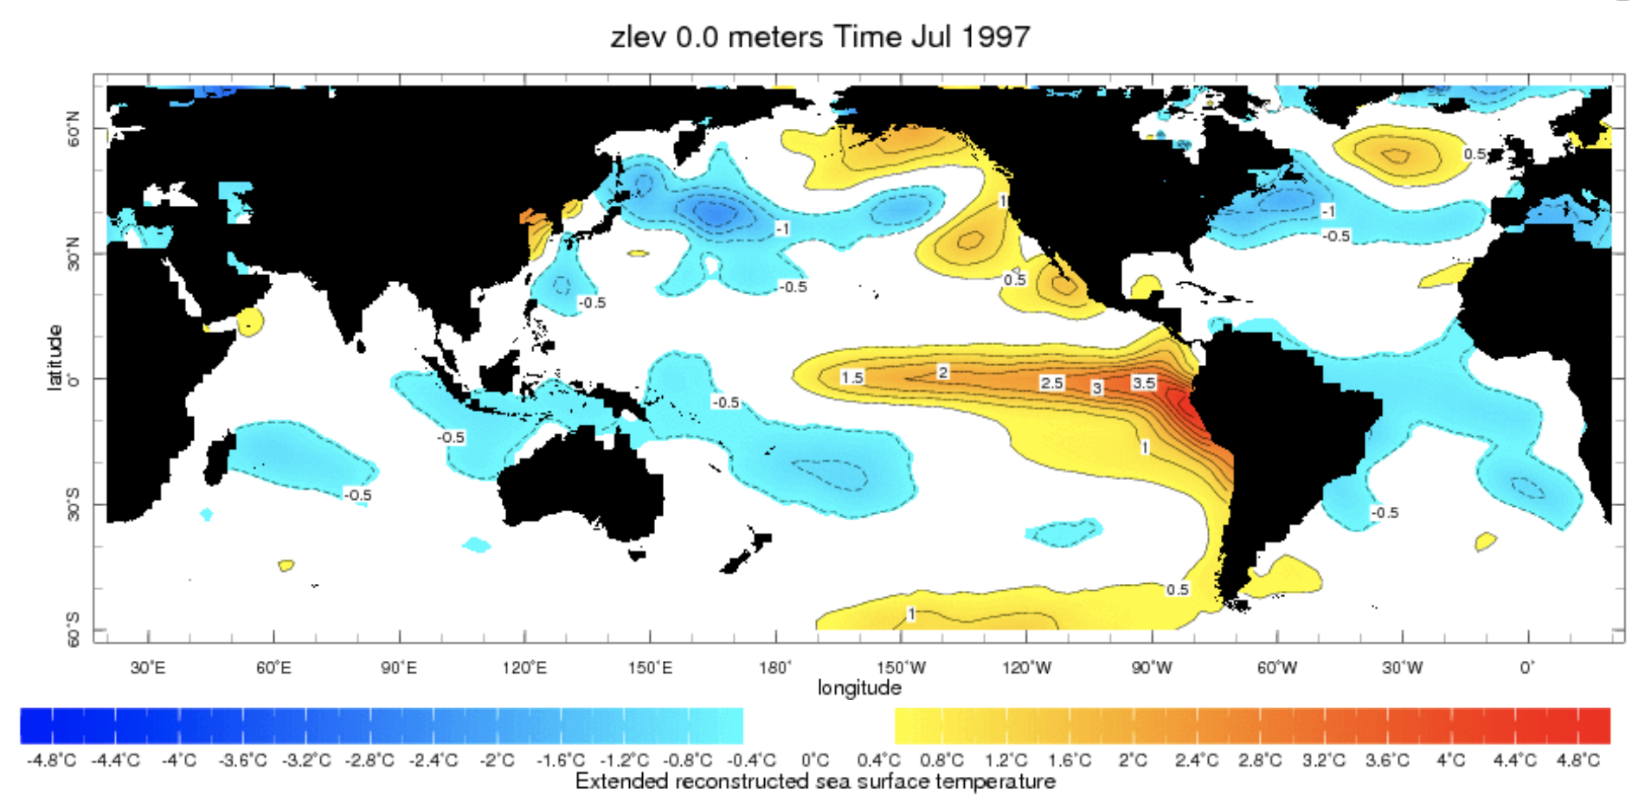
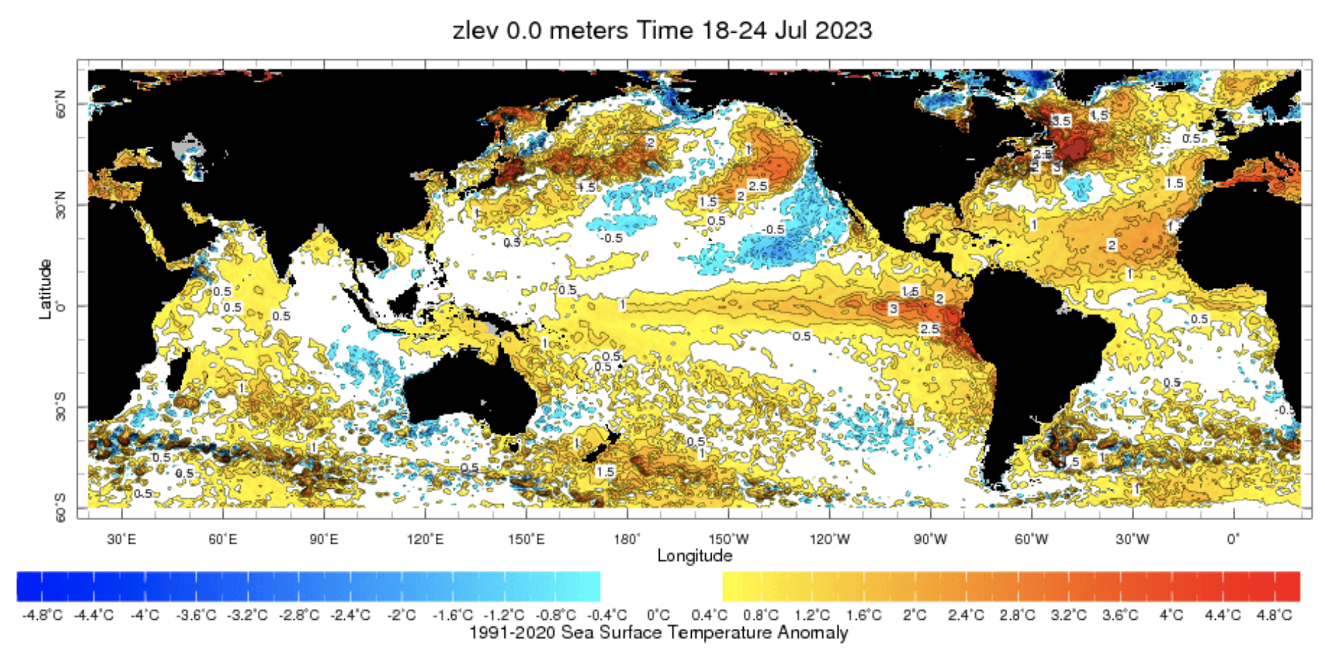
Evolution of Sea Surface Temperature (SST) Anomalies in Monthly Datasets
July-1997
Highlights:
Warm SSTAs have expanded further westward during last month,
Warm North Atlantic, and Pacific,
Indian Ocean Dipole (IOD) is Neutral (+0.32).

Slide 5
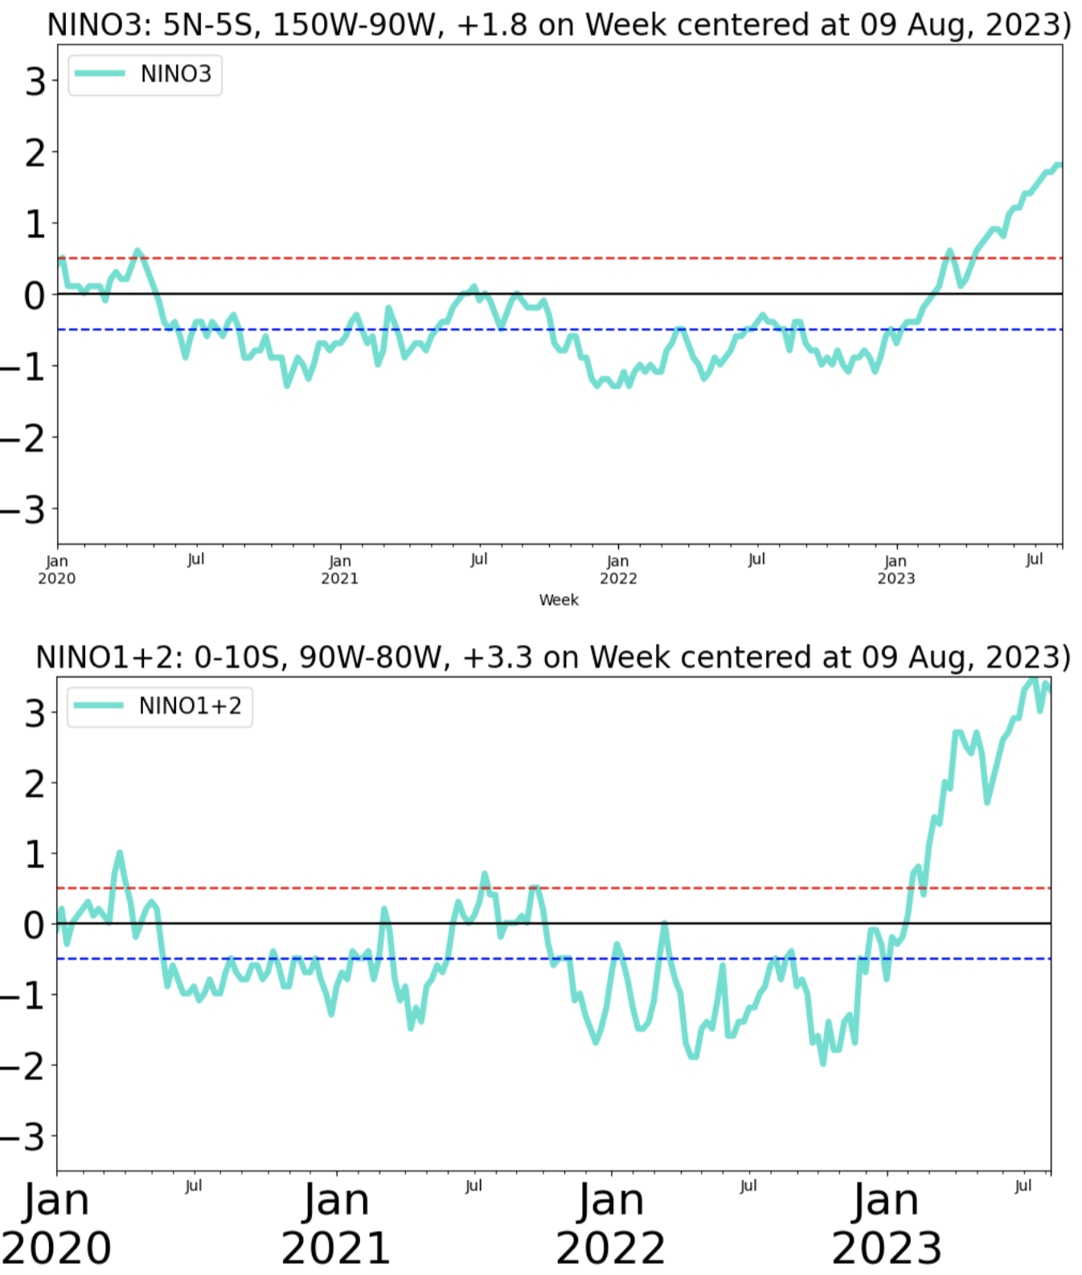
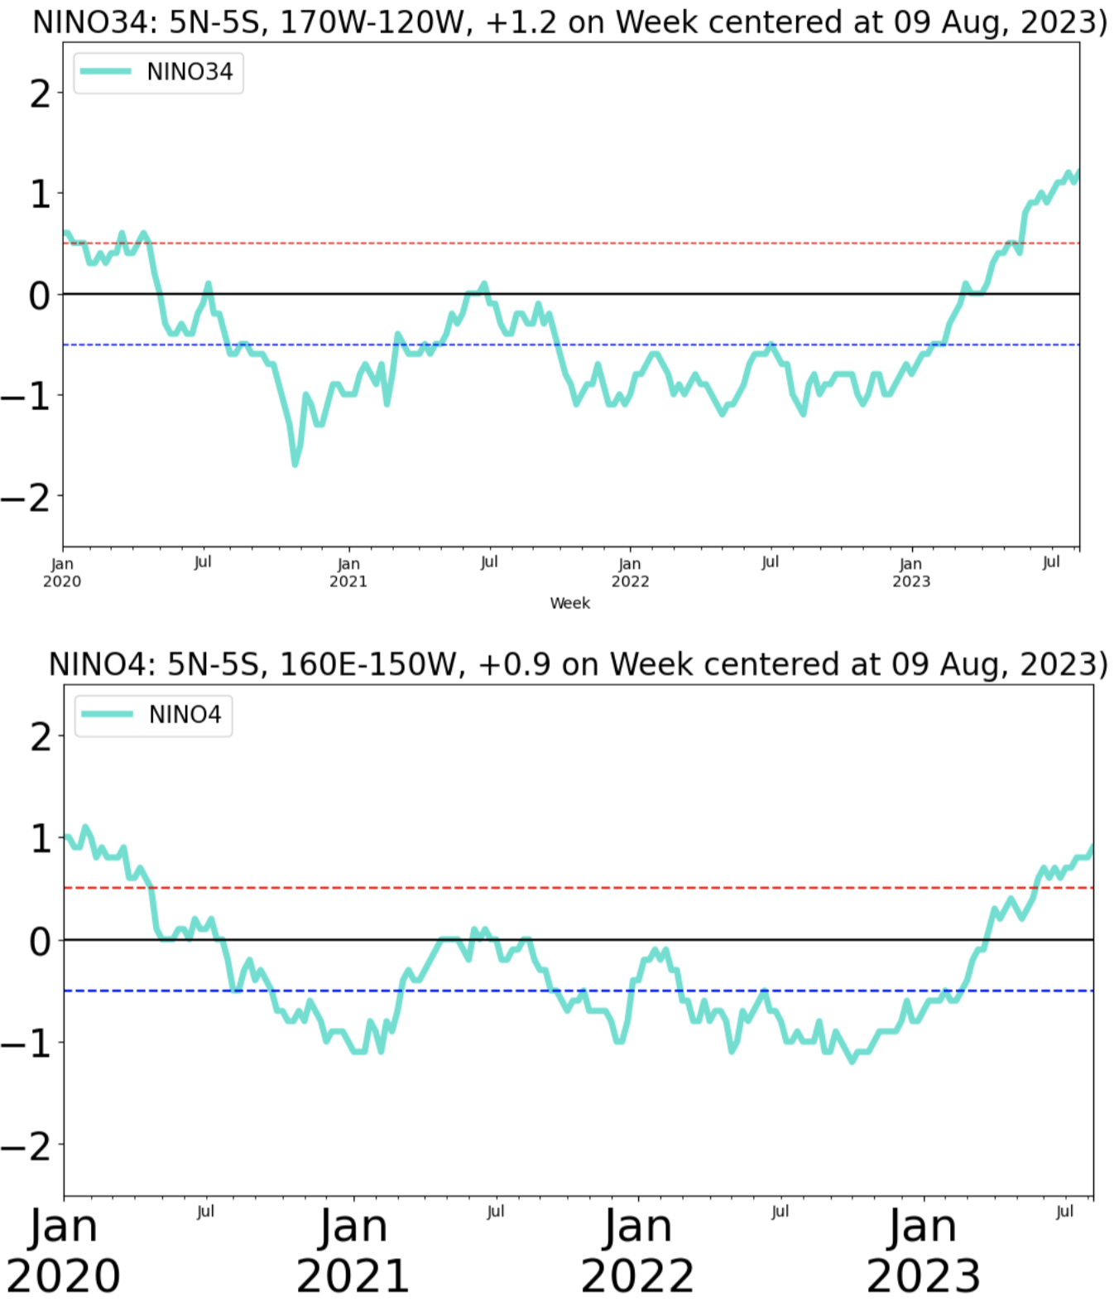
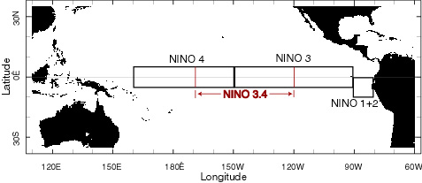
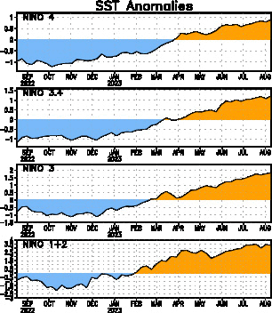
Weekly SST Anomalies (09 Aug, 2023)
Eastern Pacific (+1.8)
Central-eastern Pacific Nino34 (+1.2)
Far-Eastern Pacific (+3.3)
Western Pacific (+0.9)

Slide 6
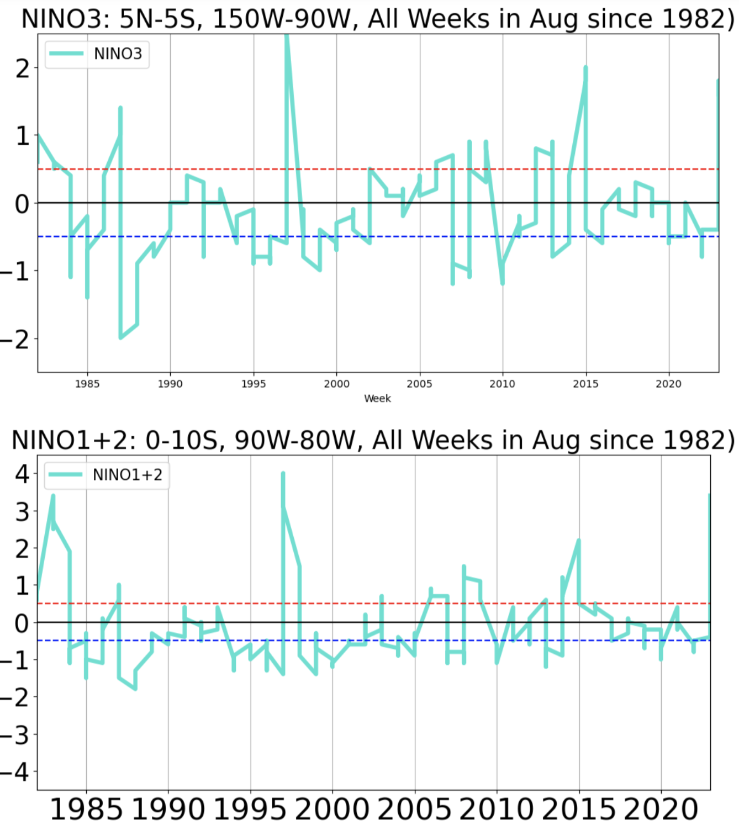
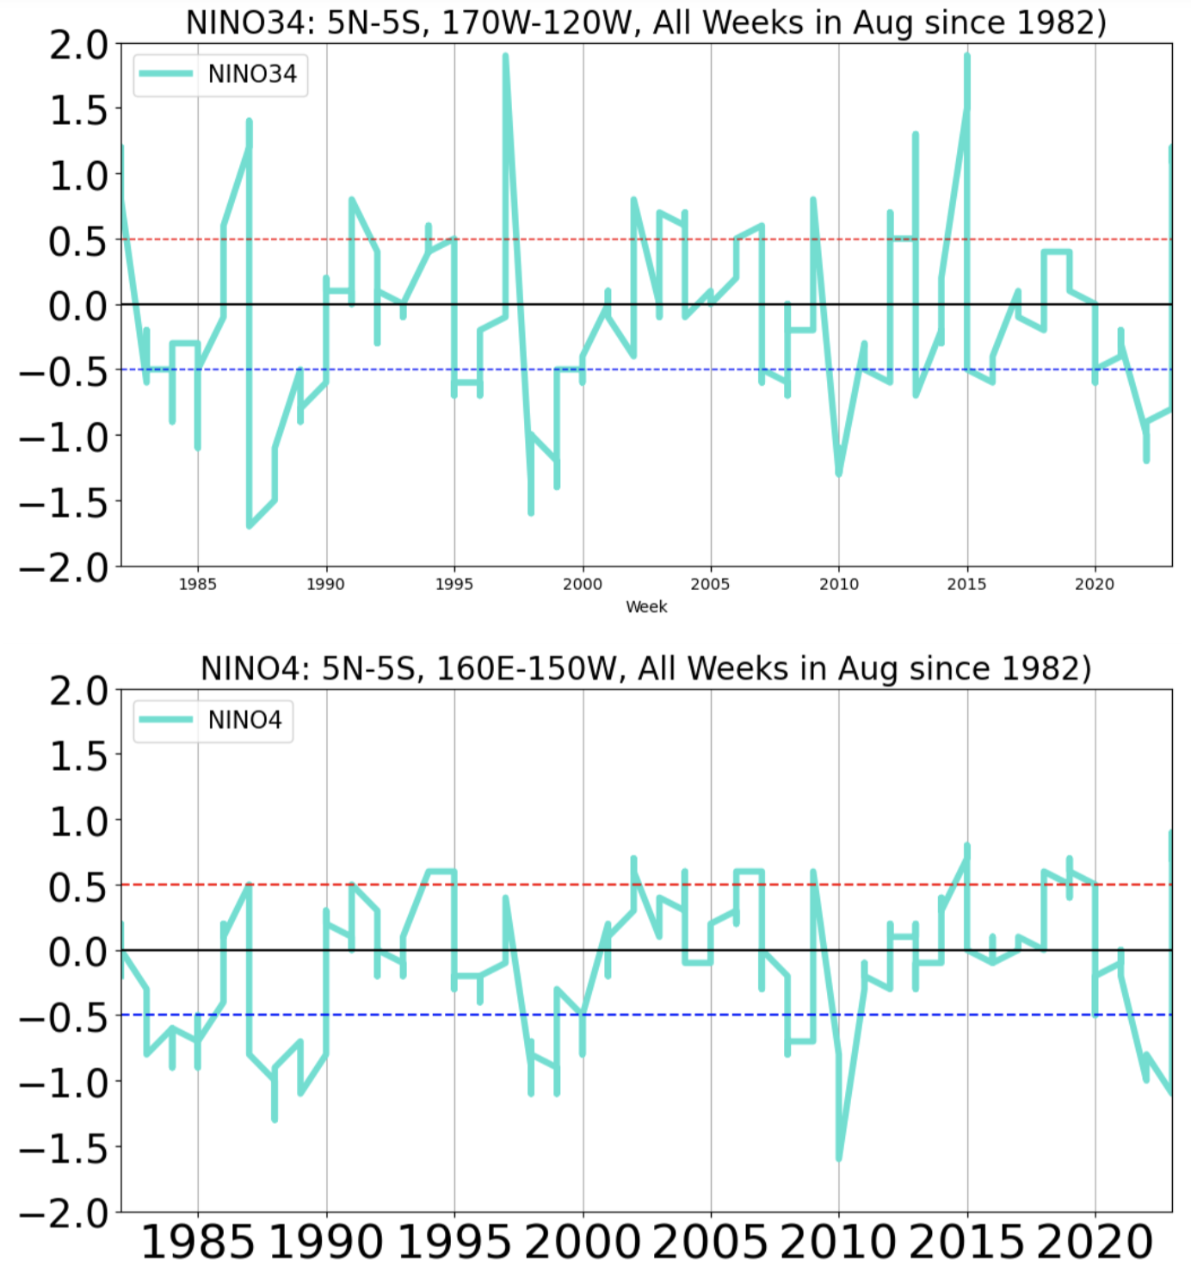
Weekly SST Anomalies (All Weeks in Aug since 1982)
Central-eastern Pacific (Nino34 +1.2,
“+1.8” record in 1997 & 2015)
Eastern Pacific (+1.8,
“+2.6” record in 1997)
Far-Eastern Pacific (+3.3,
“+4” record in 1997)
Western Pacific (+0.9,
“+0.9” record in 2023)

Slide 7
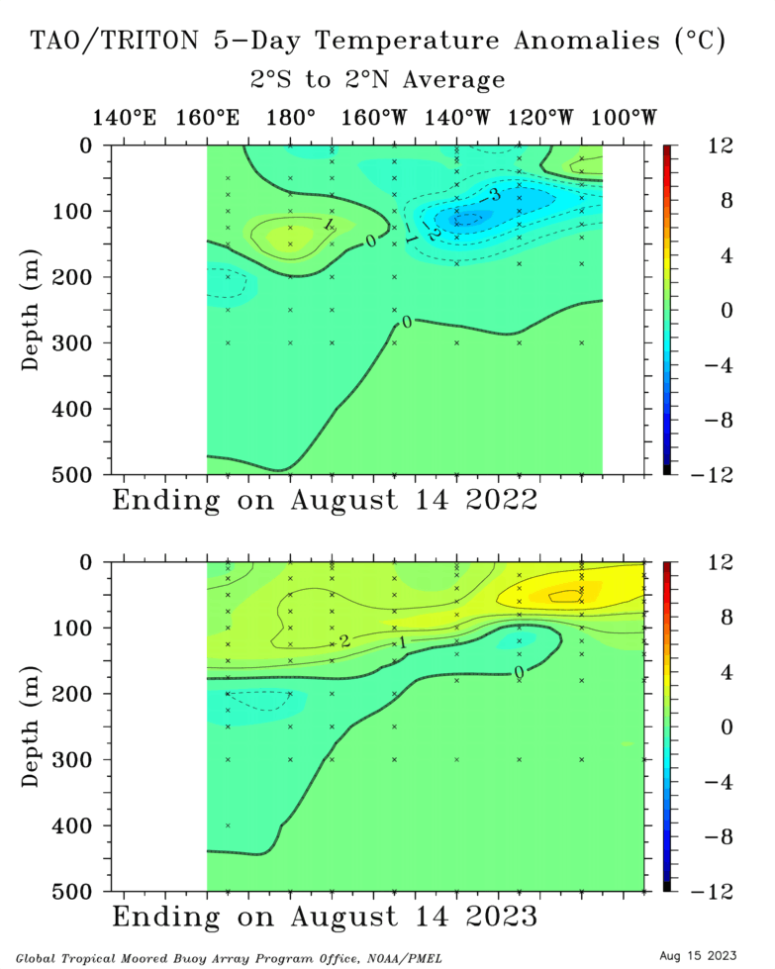
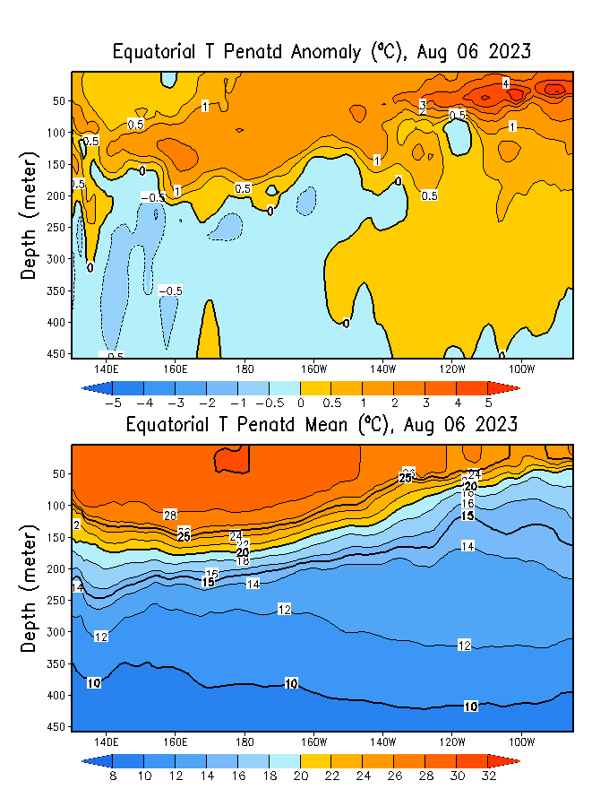
Subsurface Ocean Temperature Evolution
TOGA/TAO
Highlights:
Warm temperatures across the Pacific (150 m to surface),
Fuel to intensify ongoing El Niño.
Cold temperatures (140E to 140W) at depth.

Slide 8
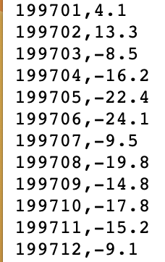
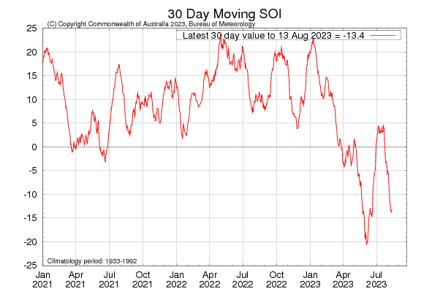
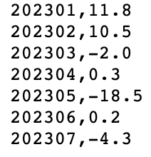
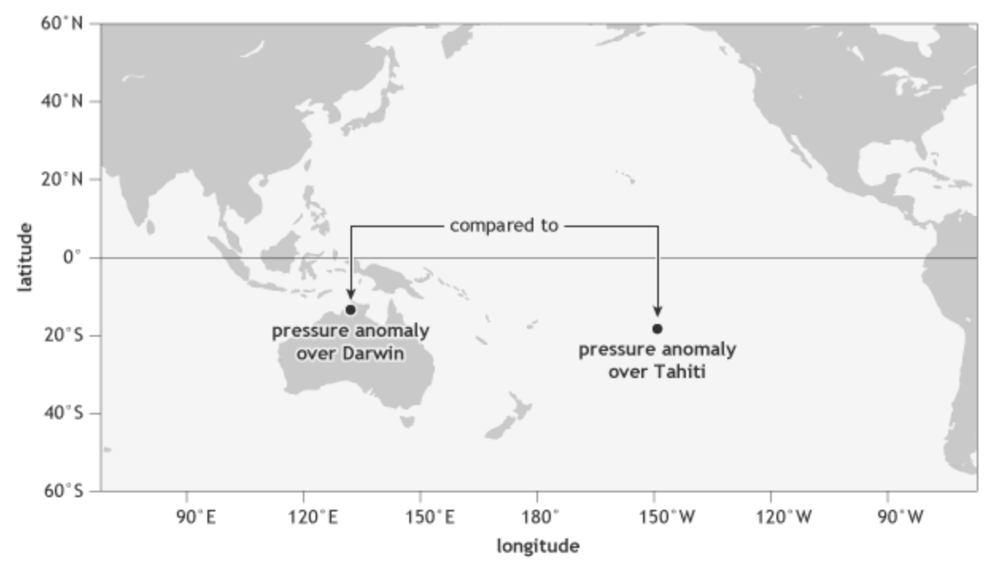
Most recent SOI (Southern Oscillation Index)
Monthly
(This is SO part of EN-SO)
INDO
E-Pac
-0.9
During El Niño, the pressure becomes below average in Tahiti and above average in Darwin, and the Southern Oscillation Index is negative.
A Sustained Negative values of the SOI above -7 typically indicate El Niño

Slide 9
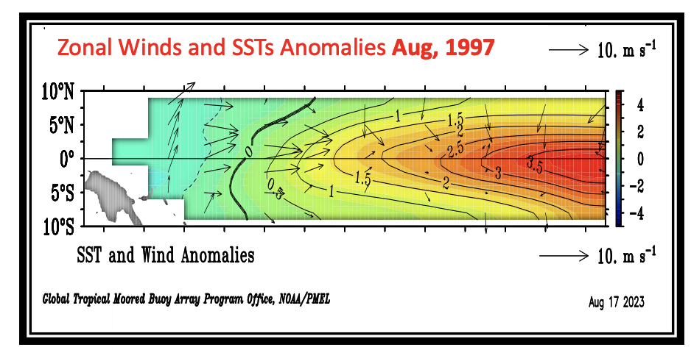
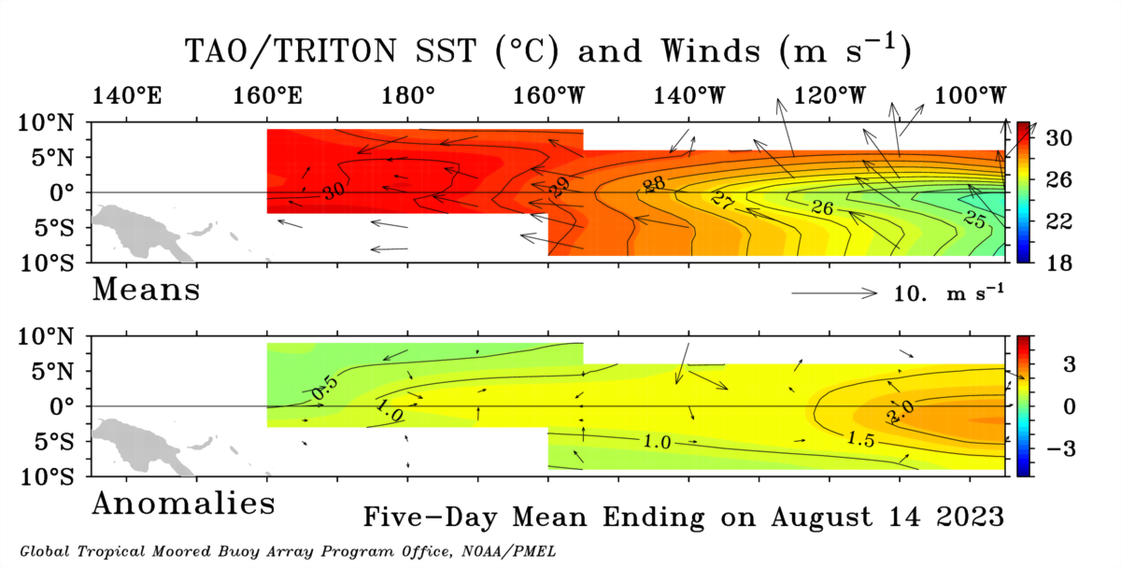
Most recent Lower-Level Winds
Highlights:
The trade winds observed in the 5-day period ending 14 August 2023 were near-normal to slightly below normal (near DateLine) across the tropical.
In the tropical Pacific region, El Niño events typically lead to a sustained weakening or even a reversal of trade winds.

Slide 10
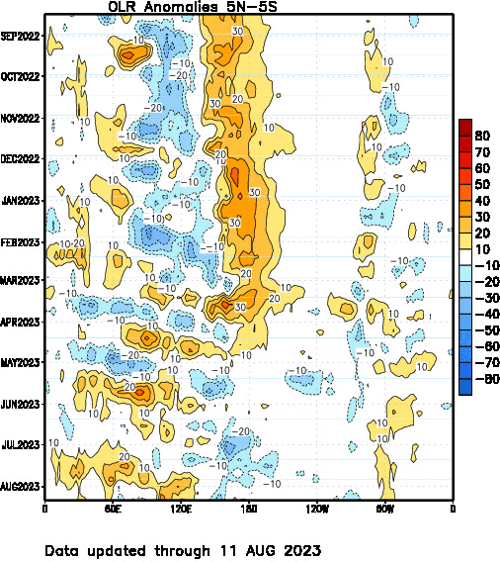
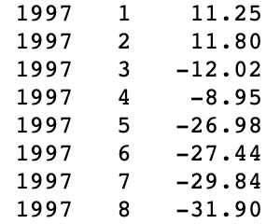
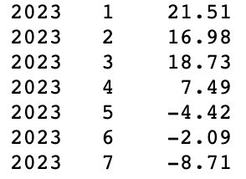
Most recent Outgoing Longwave Radiation (OLR)
Highlights:
Suppressed convection around 120E, and active west of Dateline, and between 120W and 80W.
+ve (Yellow) mean low cloudiness/below-normal Rainfall

Slide 11
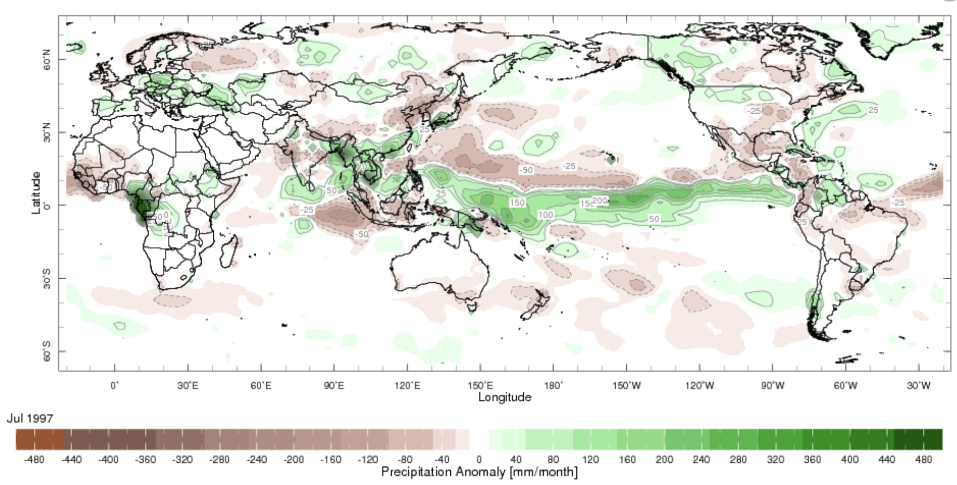
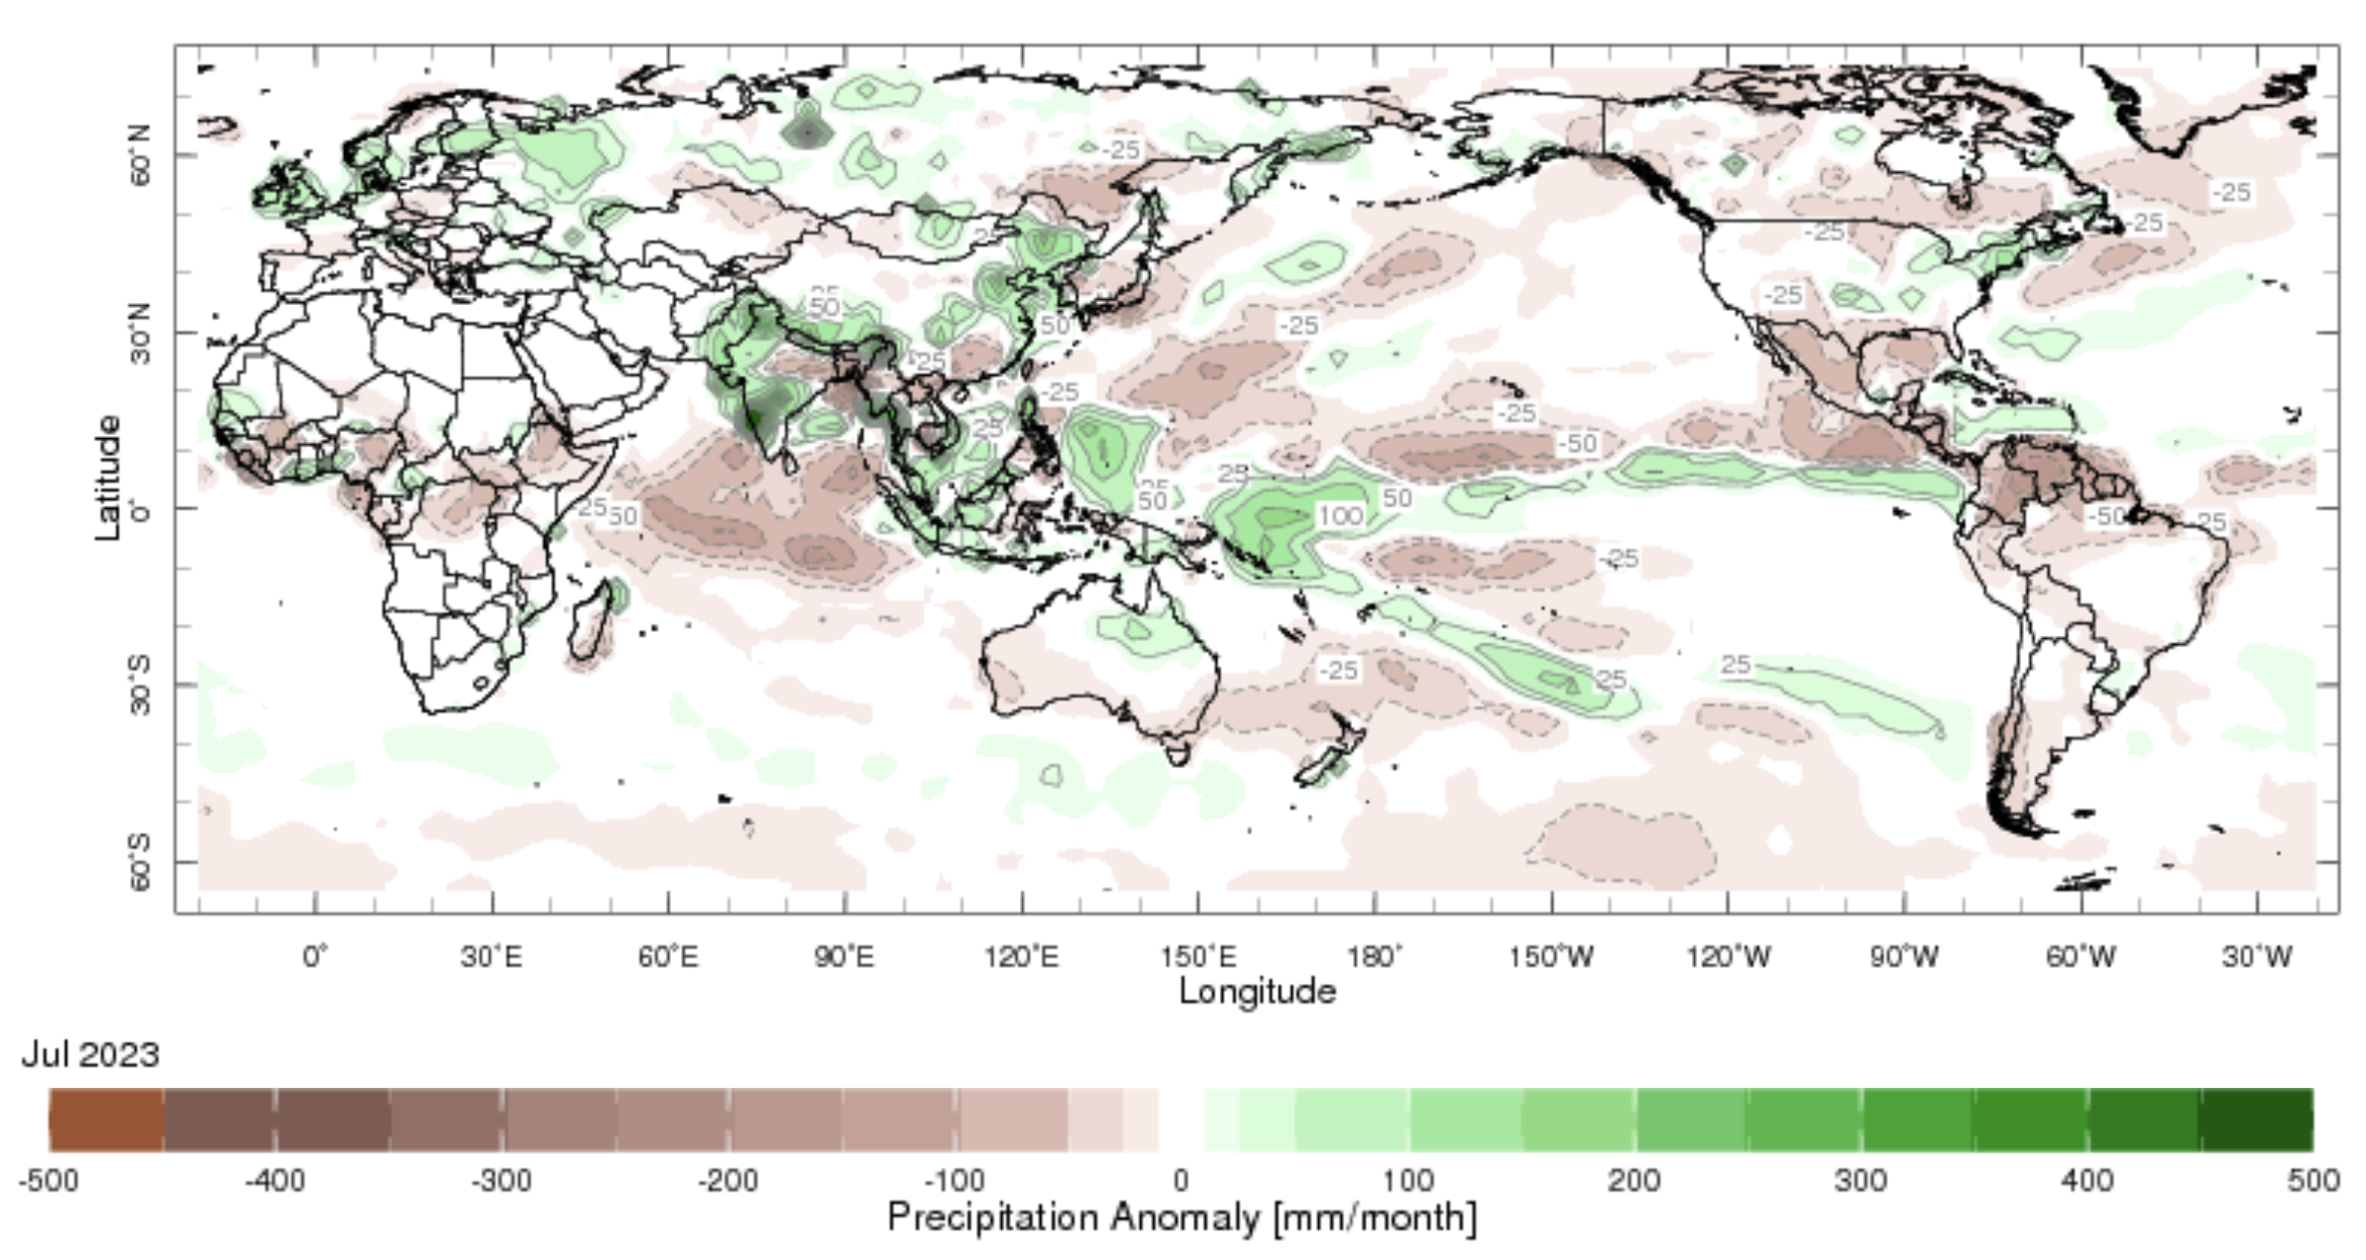
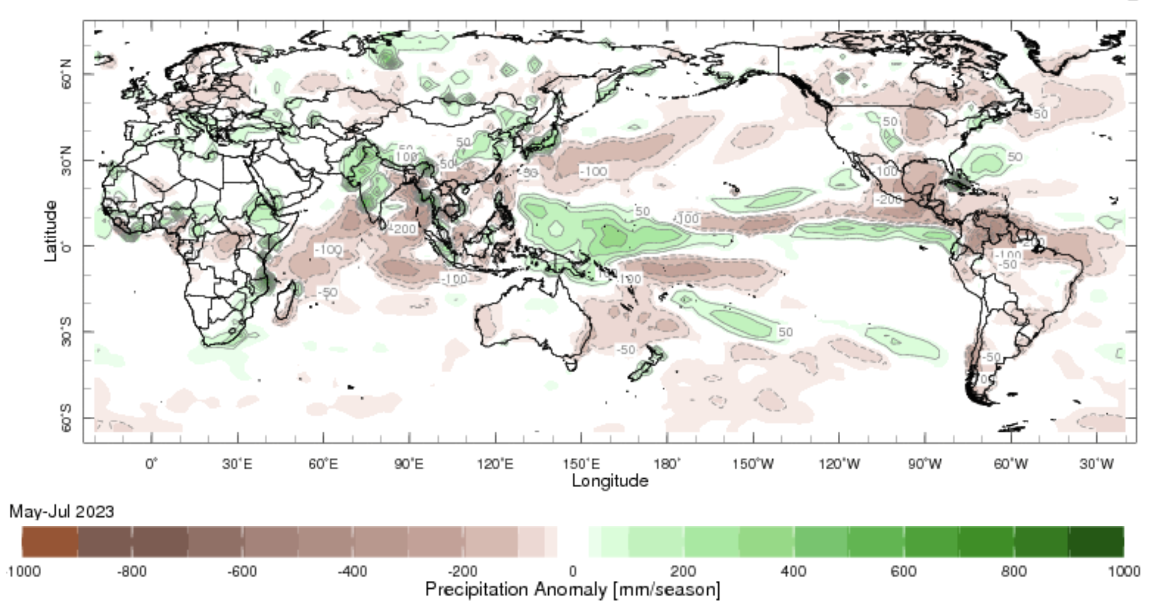
Most recent Precipitation
July-1997
July-2023
MJJ-2023

Slide 12
Forecasts
Nino-34 in NMME,
IRI ENSO Plume,
Probability of Nino-34,
Global SSTs from NMME,
IRI Global Prcp and Temp Probabilistic Forecasts,

Slide 13
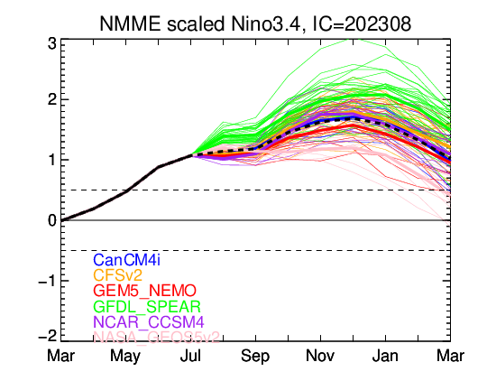
North American Multi Model Ensemble (NMME) ENSO Forecast

Slide 14
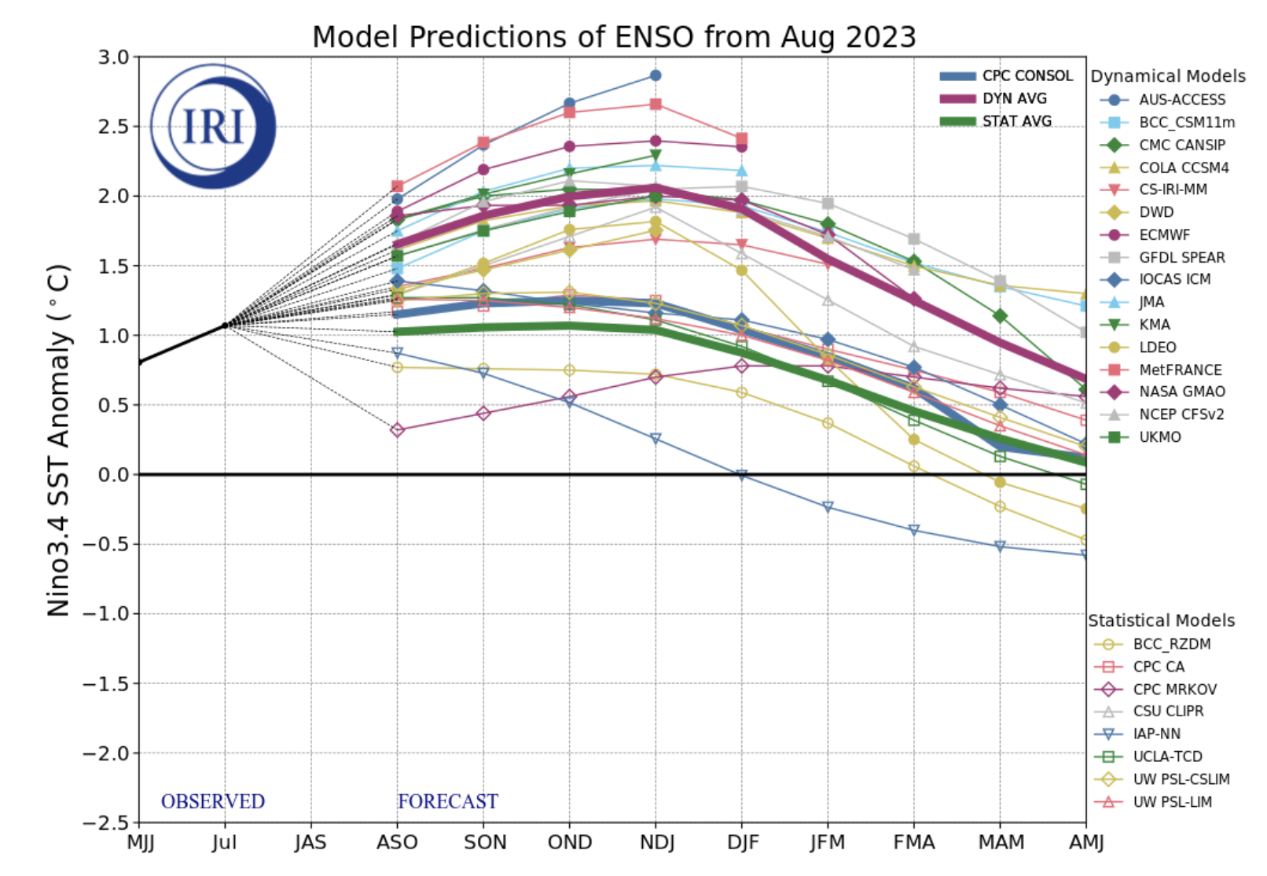
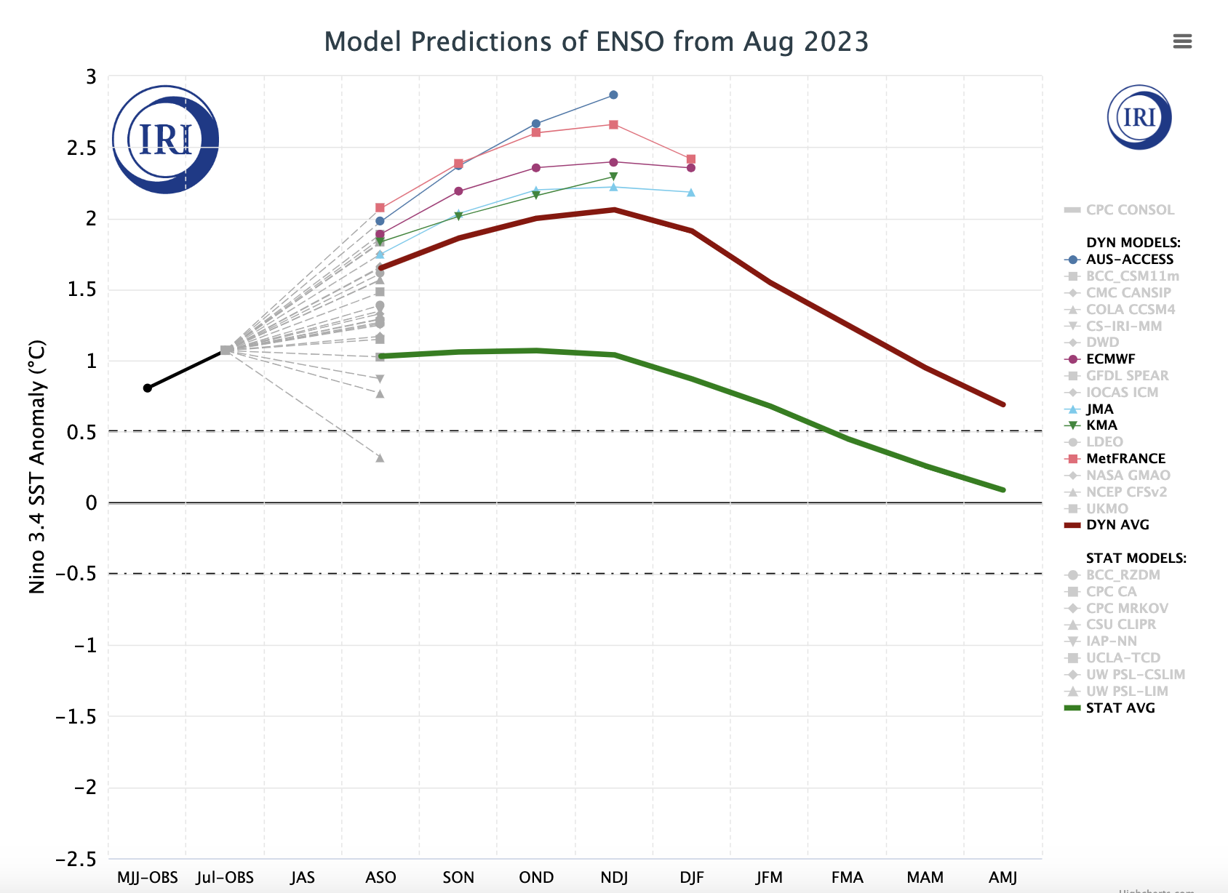
IRI’s ENSO Forecast Aug, 2023
Highlights:
A lot of spread in Amplitude (Weak to very Strong event)
Dynamical Models shows stronger warming as compared to Statistical models.

Slide 15
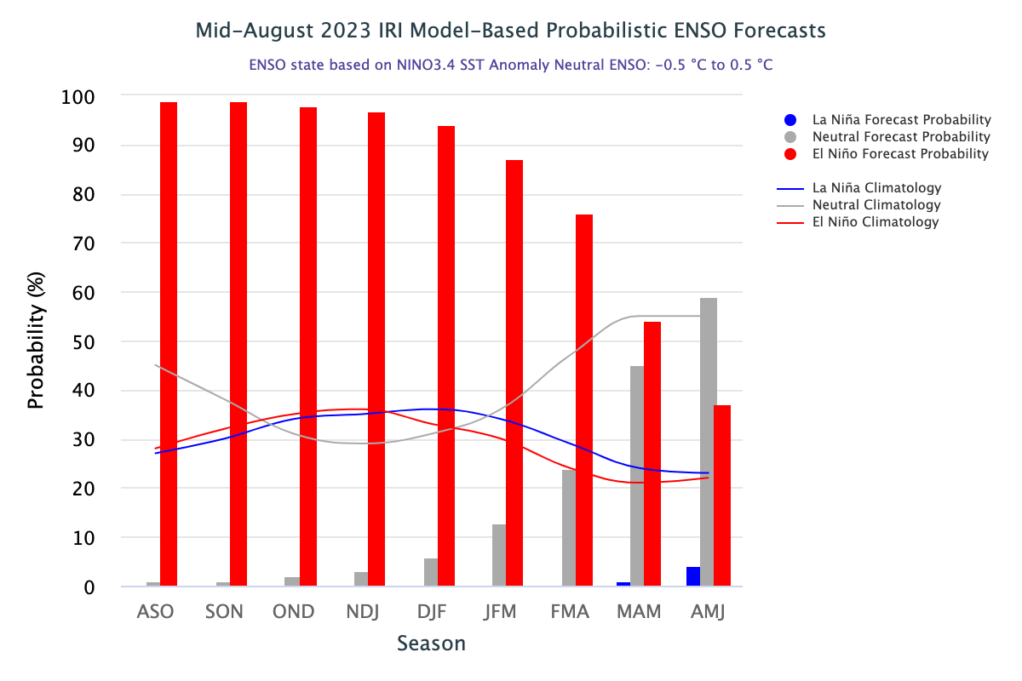
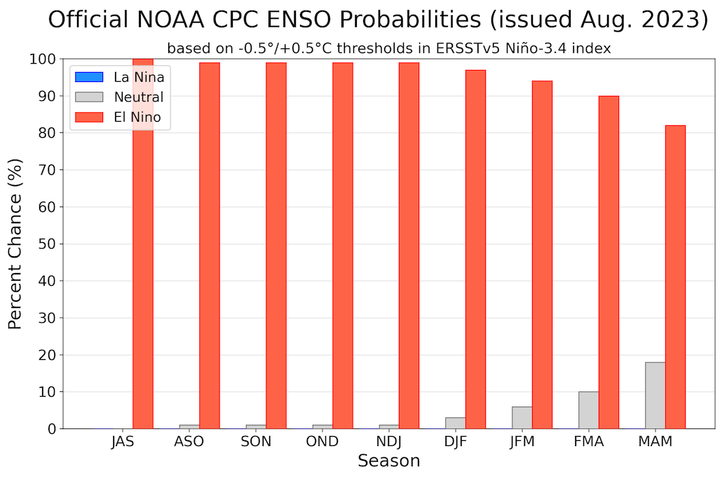
IRI’s ENSO Forecast (Aug, 2023) Probabilities
Highlights:
El Nino above 90% till winter of 2023/24.
Afterwards decrease in probability.
ENSO-Neutral is dominant (close to climatology) in late spring 2024.
Subjective Forecasts show much stronger probability numbers.

Slide 16
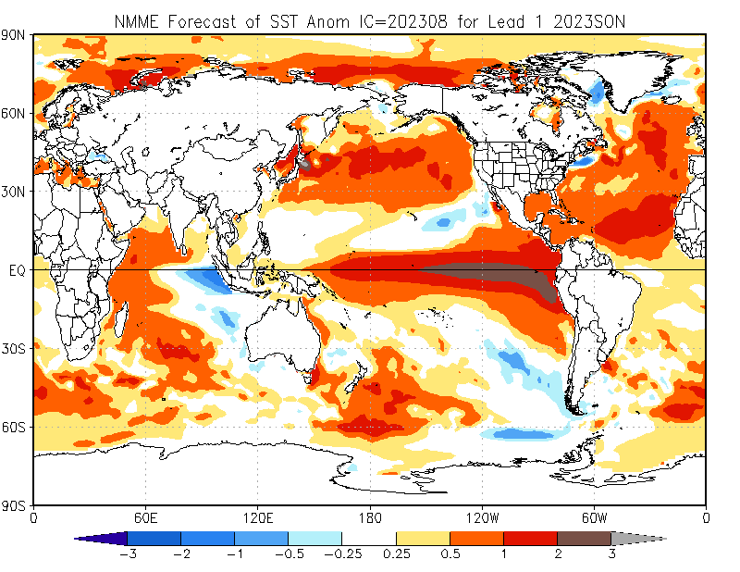
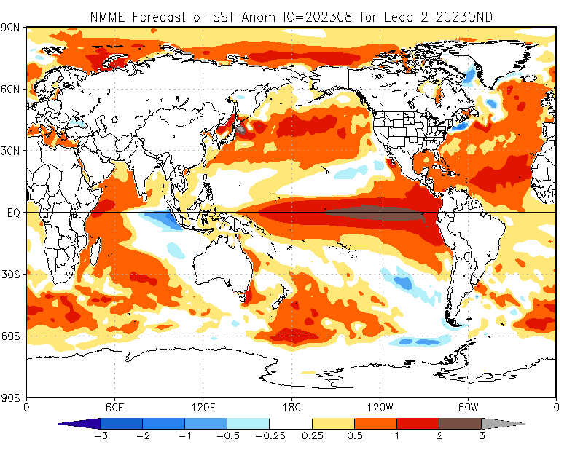
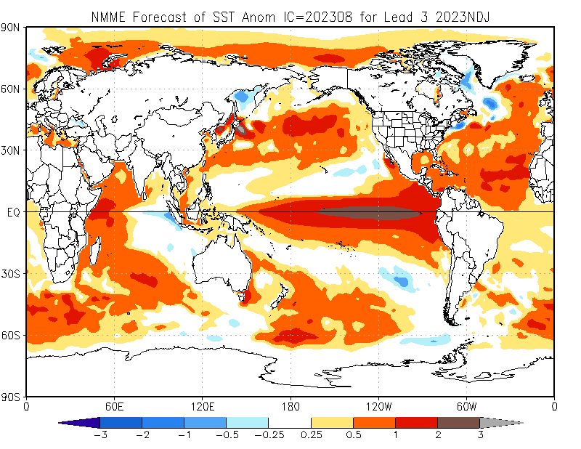
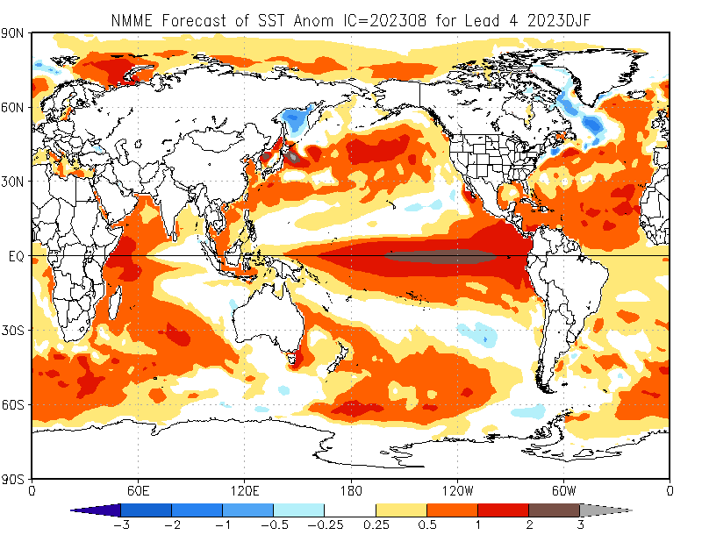
North American Multi Model Ensemble (NMME) SST Forecast
SON-2023
OND-2023
NDJ-2023/24
DJF-2023/24

Slide 17
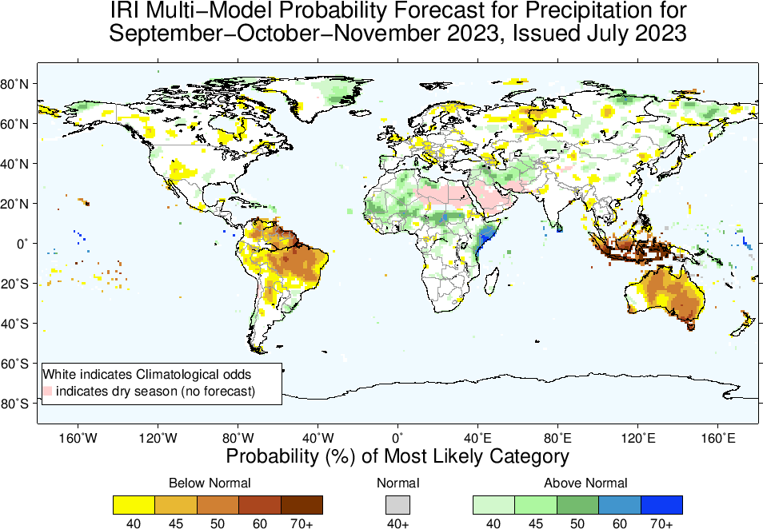
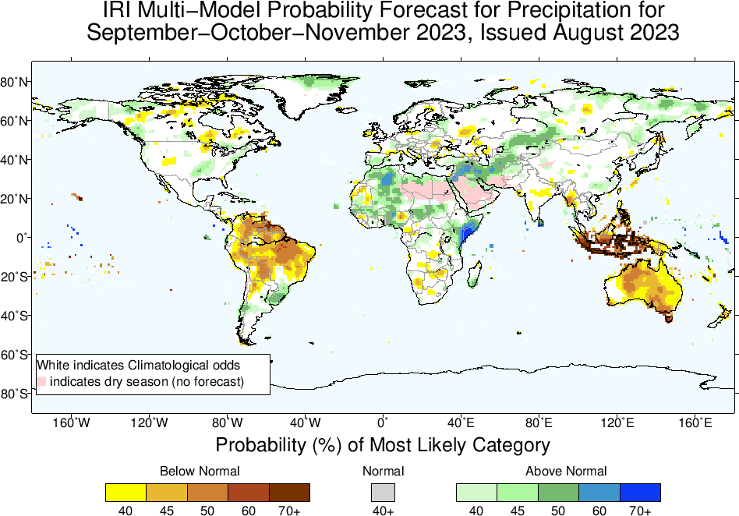
Precipitation Forecasts: Season # 1, Sep to Nov
Highlights:
Shift towards Normal to Above-Normal
Sahel region, Northwest and Northeast Africa
Middle East, central South west Asia, Kazakhstan
Sri Lanka
Uruguay, eastern parts of US
Shift towards Normal to
Below-Normal
Northern South America,
Maritime Continent,
Australia

Slide 18
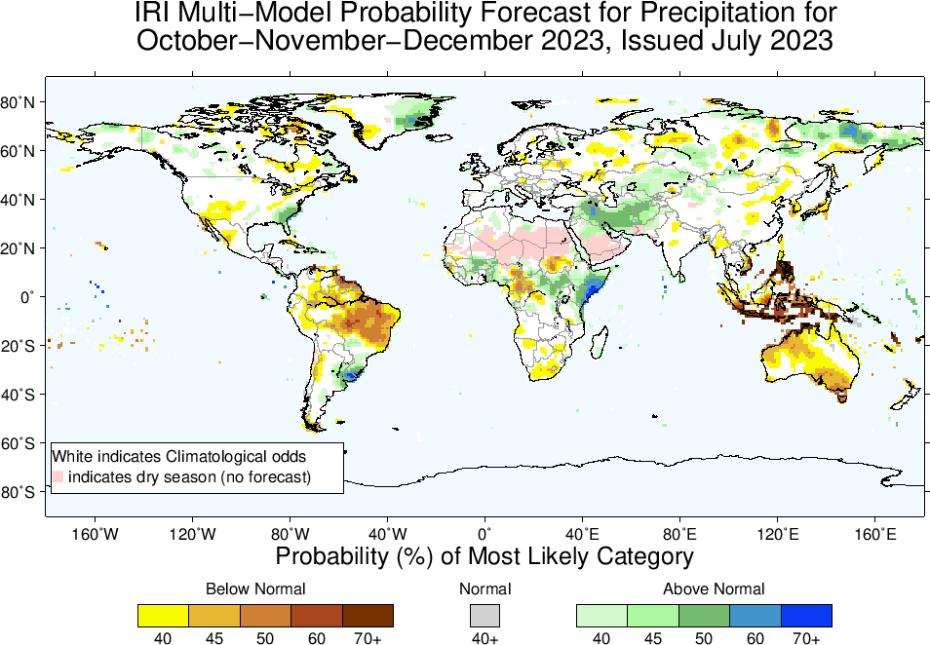
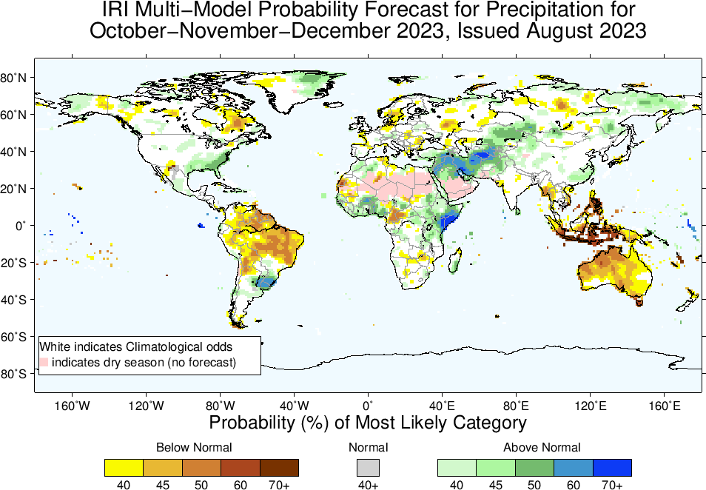
Precipitation Forecasts: Season # 2, Oct to Dec
Highlights:
Shift towards Normal to Above-Normal
Sahel region, Northeast Africa
Middle East, central South west Asia, Kazakhstan
Sri Lanka
Uruguay, eastern parts of US
Shift towards Normal to
Below-Normal
Northern South America,
Maritime Continent,
Australia

Slide 19
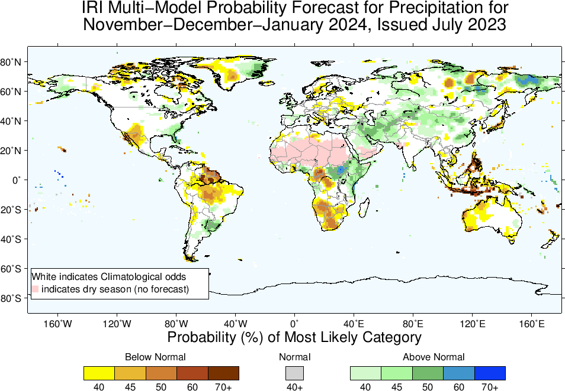
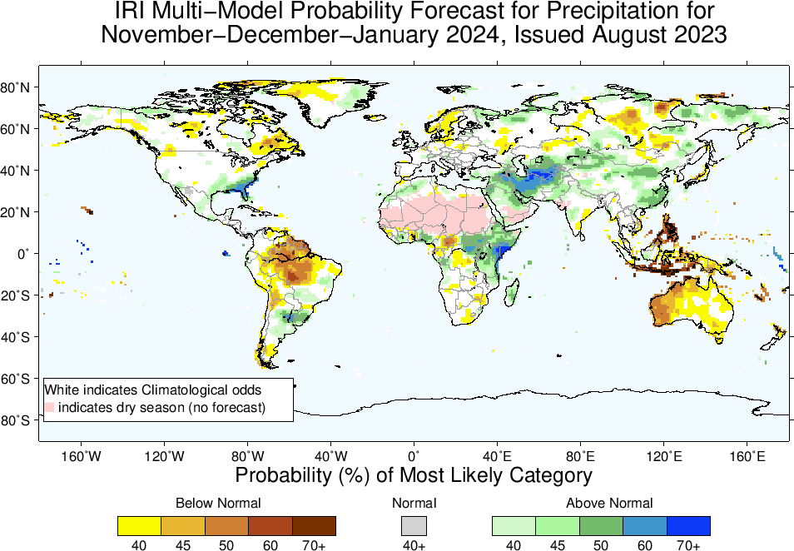
Precipitation Forecasts: Season # 3, Nov to Jan
Highlights:
Shift towards Normal to Above-Normal
Northeast Africa (eastward extended)
Middle East, central South west Asia, Kazakhstan, northern China
Uruguay, eastern parts of US
Shift towards Normal to
Below-Normal
Northern South America,
Maritime Continent,
Australia

Slide 20
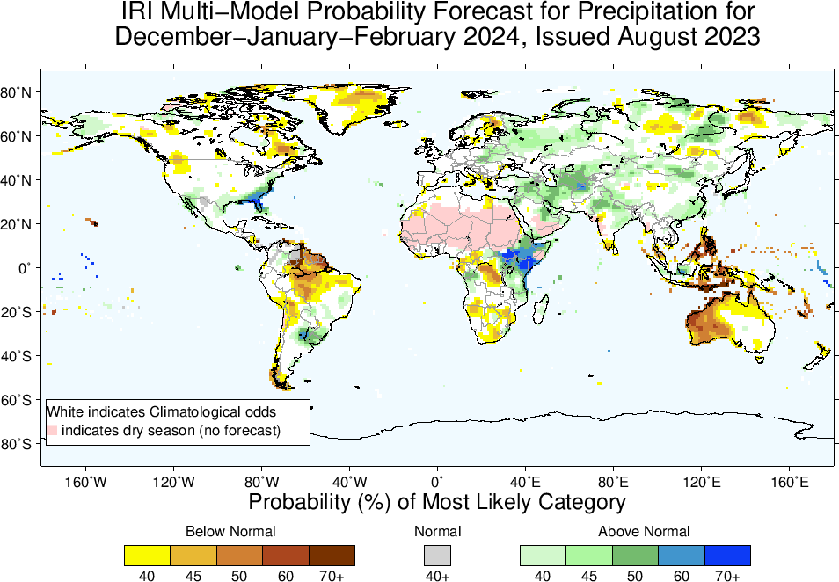
Highlights:
Shift towards Normal to Above-Normal
Northeast Africa (eastward extended)
Middle East, central South west Asia, Kazakhstan, northern China
Uruguay, eastern parts of US
Shift towards Normal to
Below-Normal
Northern South America,
Maritime Continent,
Australia
Precipitation Forecasts: Season # 4, Dec to Feb

Slide 21
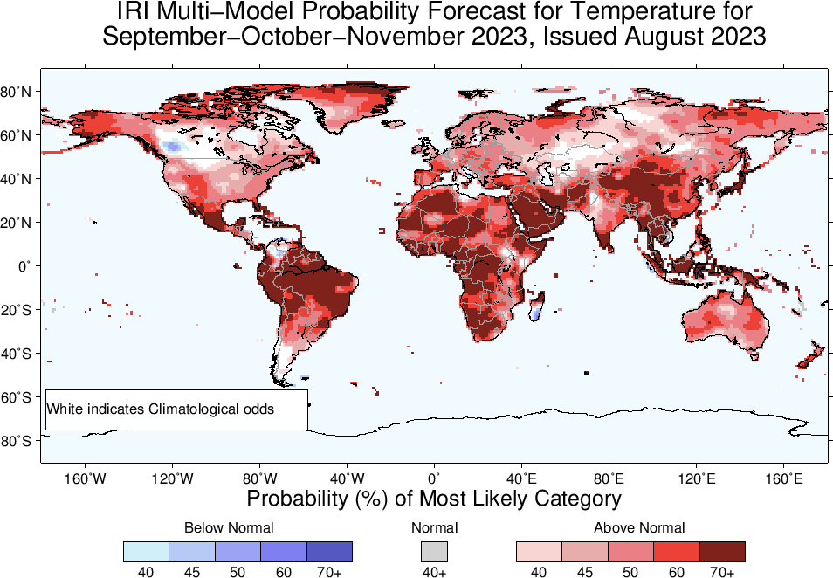
Highlights:
Shift towards Warmer/Above-Normal
Most land areas,
Southeast Asia, the Maritime Continent regions, Northeast South America.
Shift towards Colder/Below-Normal
Northern tip of South America,
Southern parts of Madagascar,
Parts of western Canada
Temperature Forecasts: Season # 1, Sep to Nov

Slide 22
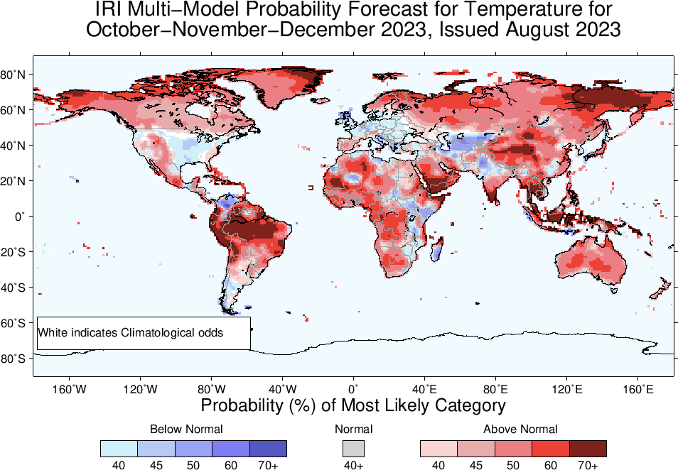

Slide 23
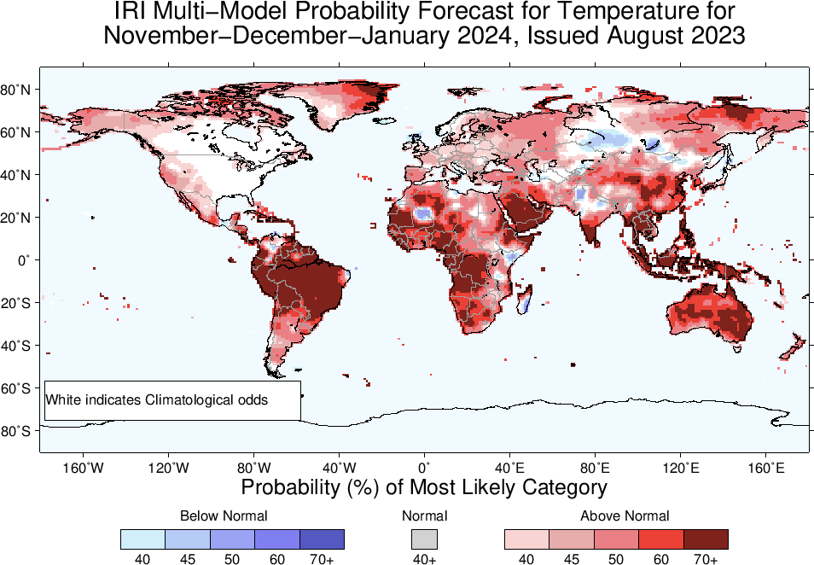

Slide 24
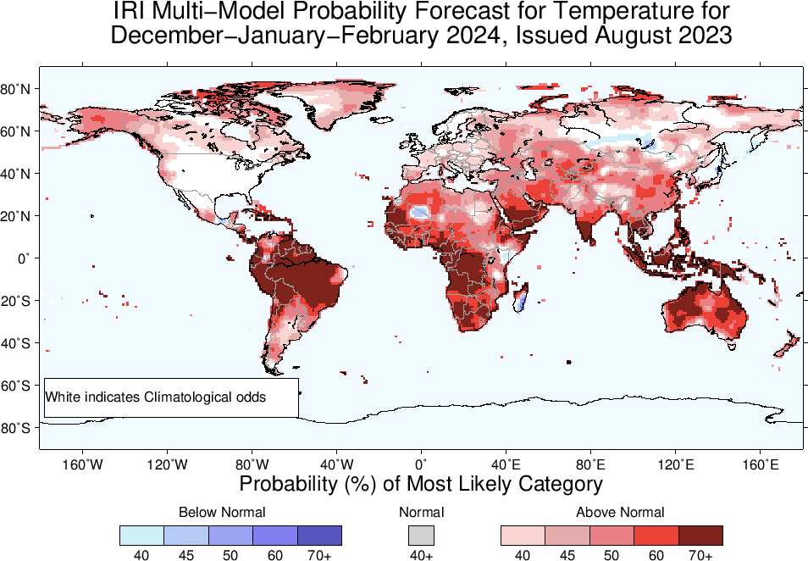

Slide 25
Summary
In response to the warming of the central-eastern equatorial Pacific Currently, weak changes have been observed in the atmosphere, such as shifts in “winds, clouds, and broad-scale pressure patterns”.
This suggests that the Pacific Ocean and atmosphere have not yet fully coupled, which is a characteristic feature of ENSO events.

