Slide 1
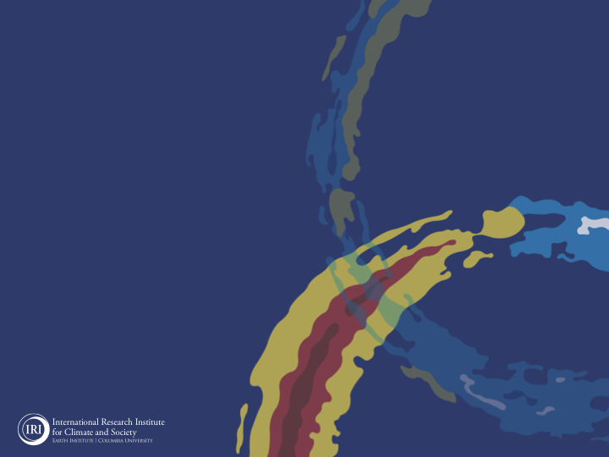
ENSO and Climate Outlook in
April, 2024
M. Azhar Ehsan
(azhar@iri.columbia.edu)
Associate Research Scientist
IRI ENSO and Climate Forecast Lead
Jeffrey Turmelle and Jing Yuan: forecast processing and web updates
Cuihua Li: Draft PowerPoint development
IRI’s Climate Group, led by Dr. Andrew Robertson: Forecast system development, ongoing innovation, and verification

Slide 2
Outline
Observed Oceanic and Atmospheric Conditions in
Tropical Pacific
Across the Globe
ENSO Forecast in
NMME
IRI ENSO Forecast Tool (Deterministic and Probabilistic)
Seasons Outlook of
SST
Precipitation and Temperature
Summary

Slide 3
Observations
Oceanic
Atmospheric

Slide 4
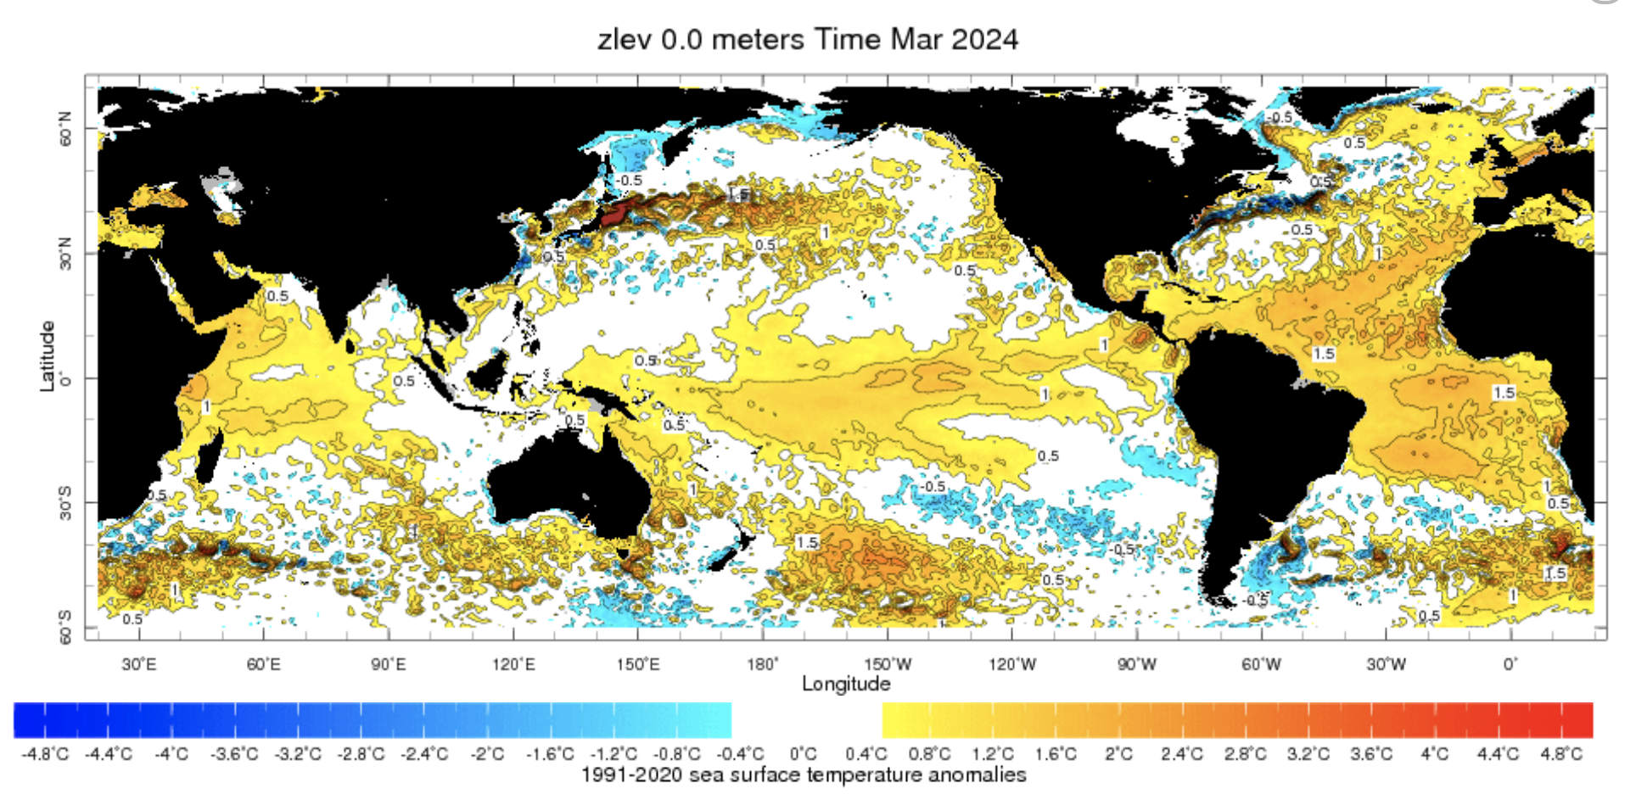
Evolution of SST Departures in Monthly (March, 2024) Data
For Mar, 2024
NINO 1+2: +0.28
NINO3: +1.03
NINO3.4: +1.24
NINO4: +0.93
In the Pacific Ocean: Above-Average SSTs persisted across the central (across the Date Line), weak negative close to SA-coasts
Indian Ocean: Warm across Indian Ocean, Weak +ve IOD (Index value is +0.56 as of 14 April, 2024),
North-Pacific and North Atlantic Ocean: Negative PDO (-1.57), Warm across Atlantic (TNAI, +1.45, TSAI, +1.41, TAtl, +0.87)
Source: https://iridl.ldeo.columbia.edu/maproom/Global/Ocean_Temp/ERSST_Anomaly.html

Slide 5
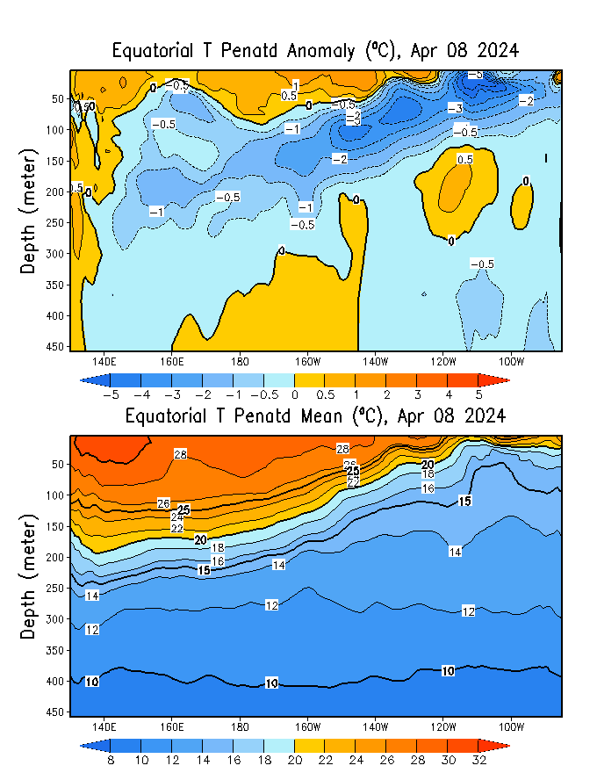
What is the underwater conversation?
January, 2024
February, 2024
April, 2024
Warm (~ +1C) subsurface temperature anomalies dominate from 140E to 140W in equatorial Pacific Ocean (Surface to 50 meter at depth).
Cold subsurface temperature anomalies have strengthened in the Pacific Ocean and expanded to surface level at far eastern Pacific (120 W onwards).
March, 2024

Slide 6
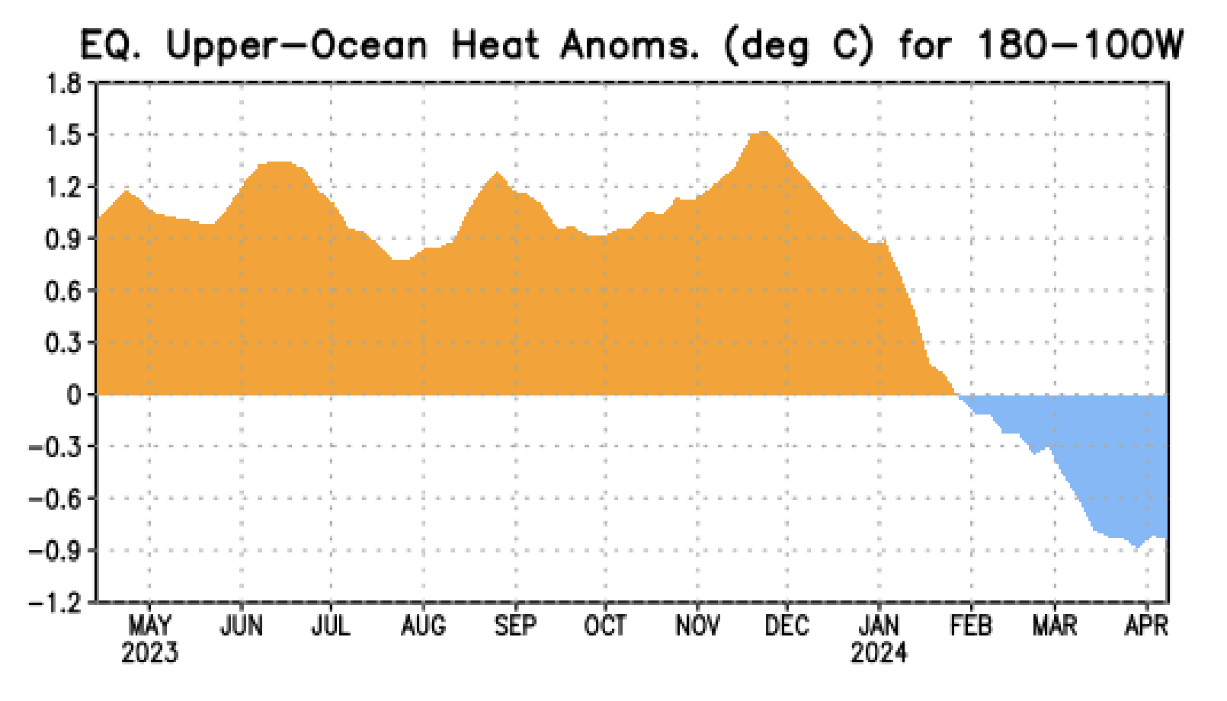
What is the underwater conversation?
Following peak levels in November and December 2023, positive anomalies have diminished.
By February 2024, negative anomalies have begun to strengthen gradually, nearing an index value of approximately -0.9.

Slide 7
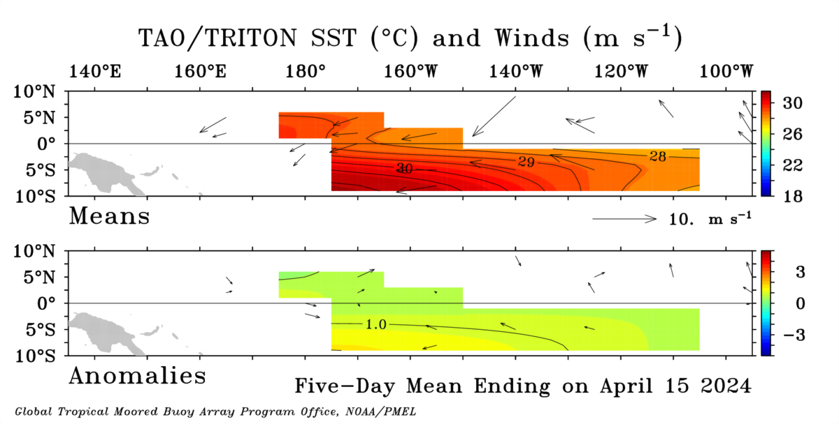
Most recent Sea Surface Temperature (SST) Lower-Level Winds

Slide 8
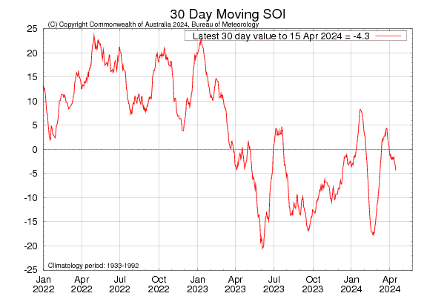
Most recent Southern Oscillation Index (SOI)
Current SOI values is in ENSO-neutral range.
During El Niño, the pressure becomes below average in Tahiti and above average in Darwin, and the Southern Oscillation Index is negative.
A Sustained Negative values of the SOI above -7 typically indicate El Niño
Source:
http://www.bom.gov.au/climate/enso/#tabs=Pacific-Ocean&pacific=SOI

Slide 9
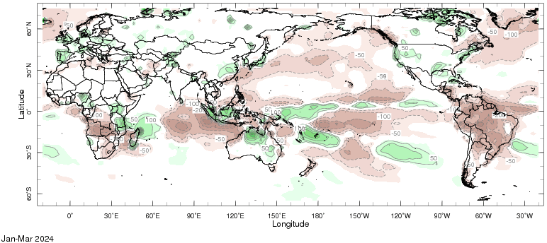
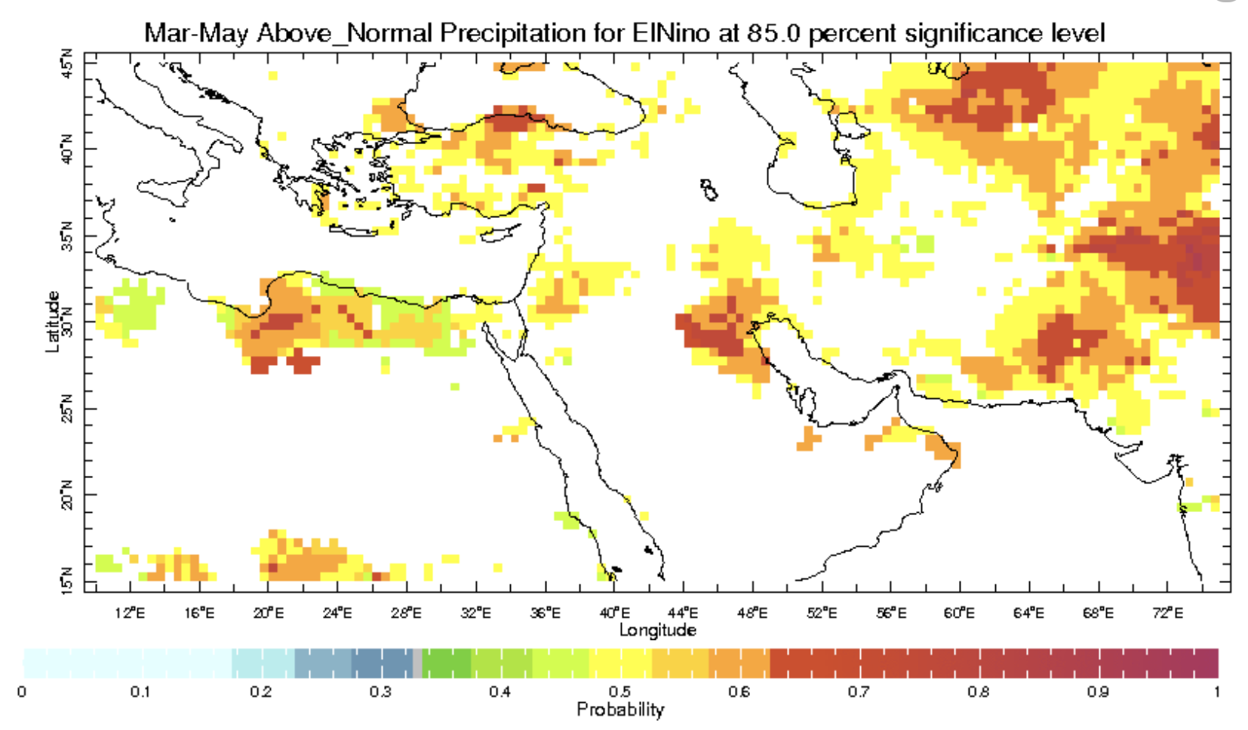
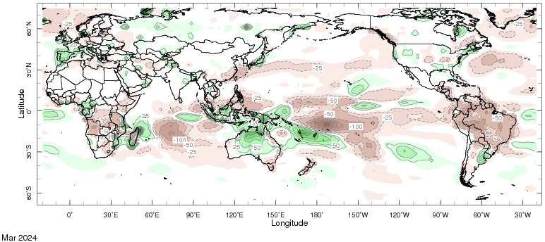
Most recent Outgoing Longwave Radiation (OLR??) and Precipitation
Jan-Feb-Mar, 2024
https://youtu.be/vNgTAXC0yeU
Mar, 2024

Slide 10
Forecasts
IRI ENSO Plume,
Probability of Nino-34,
Global SSTs from NMME,
Prcp. and Temp. outlook from IRI (April, 2024)

Slide 11
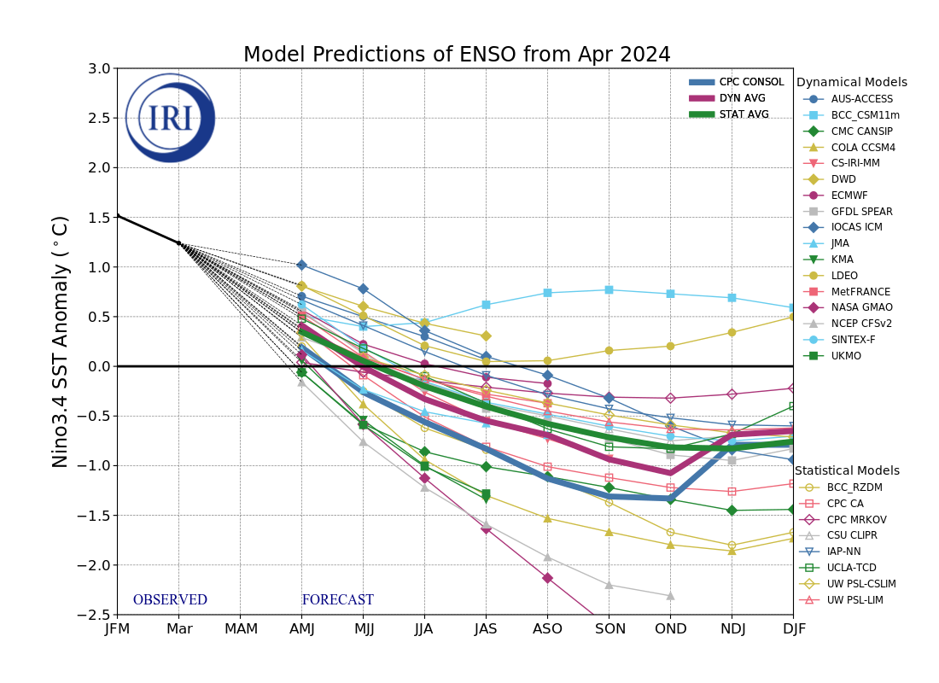
IRI’s ENSO Forecast April, 2024
Mean of DYN & STAT Models indicate ENSO-Neutral Conditions during Apr-Jun 2024, that continue till Jun-Aug 2024.
After three seasons of ENSO-neutral conditions, most models indicate a transition to La Niña in Jul-Sep 2024, that continues till the end of the forecasts.

Slide 12
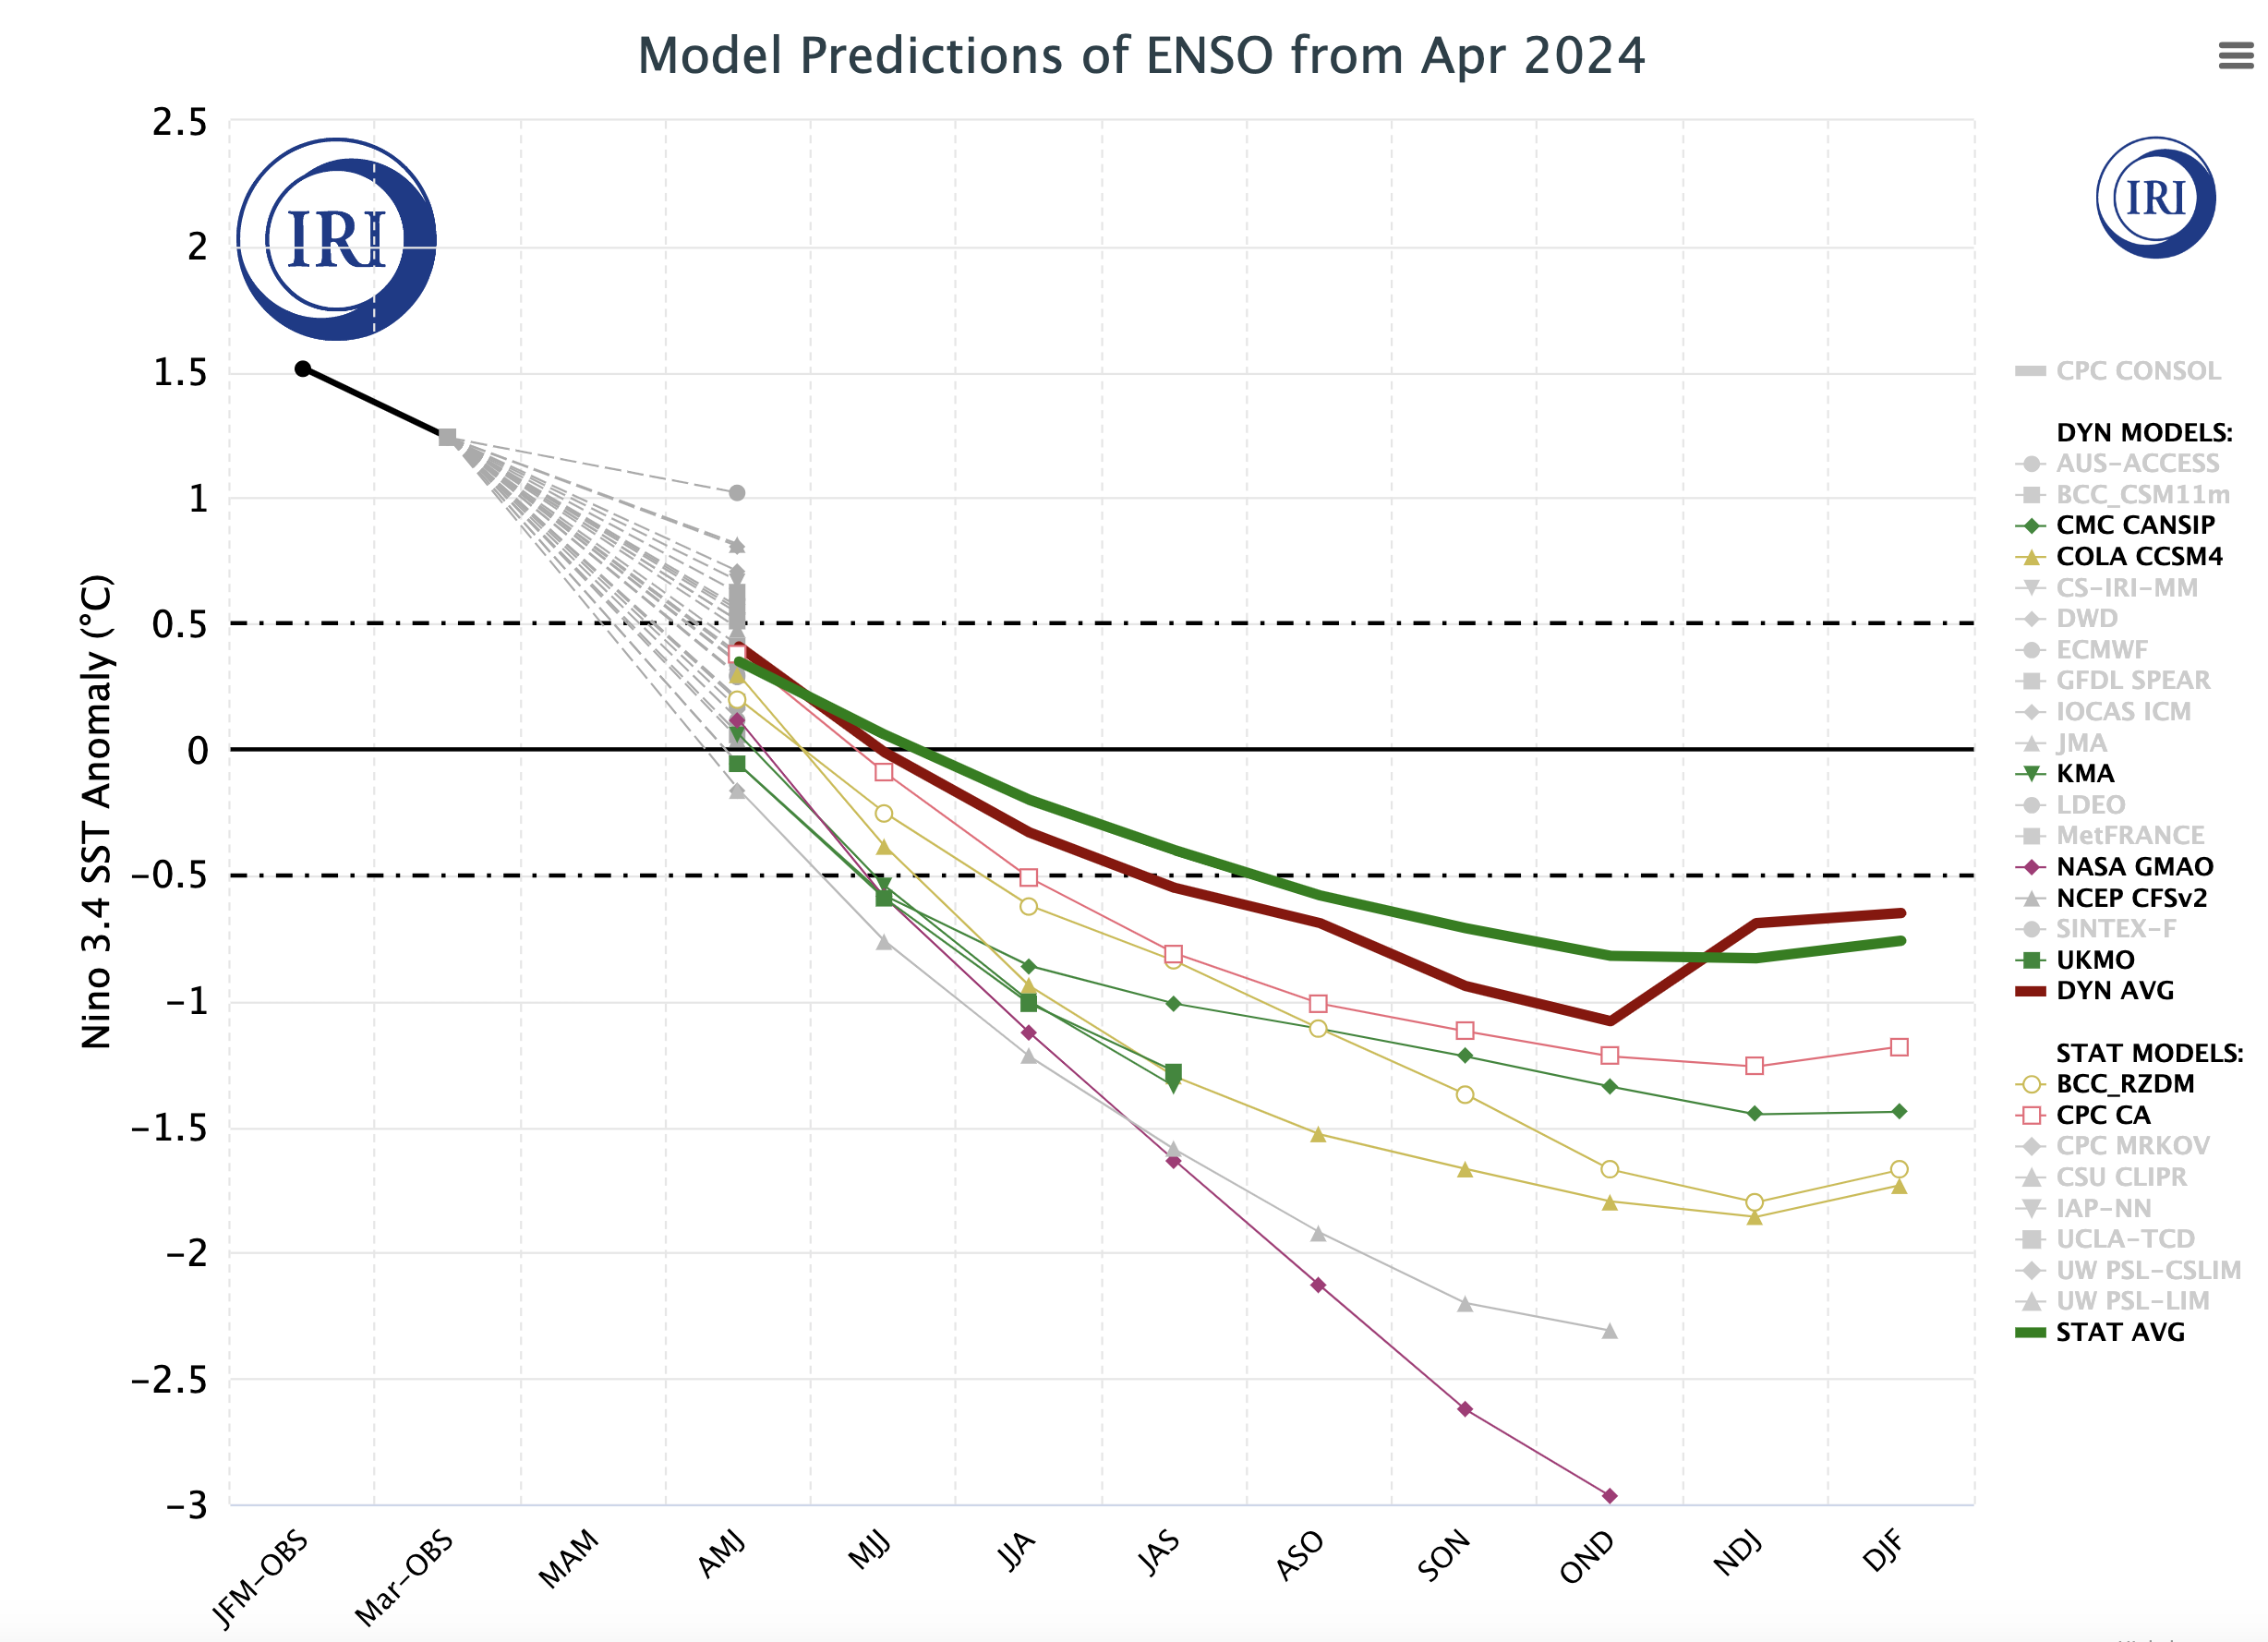
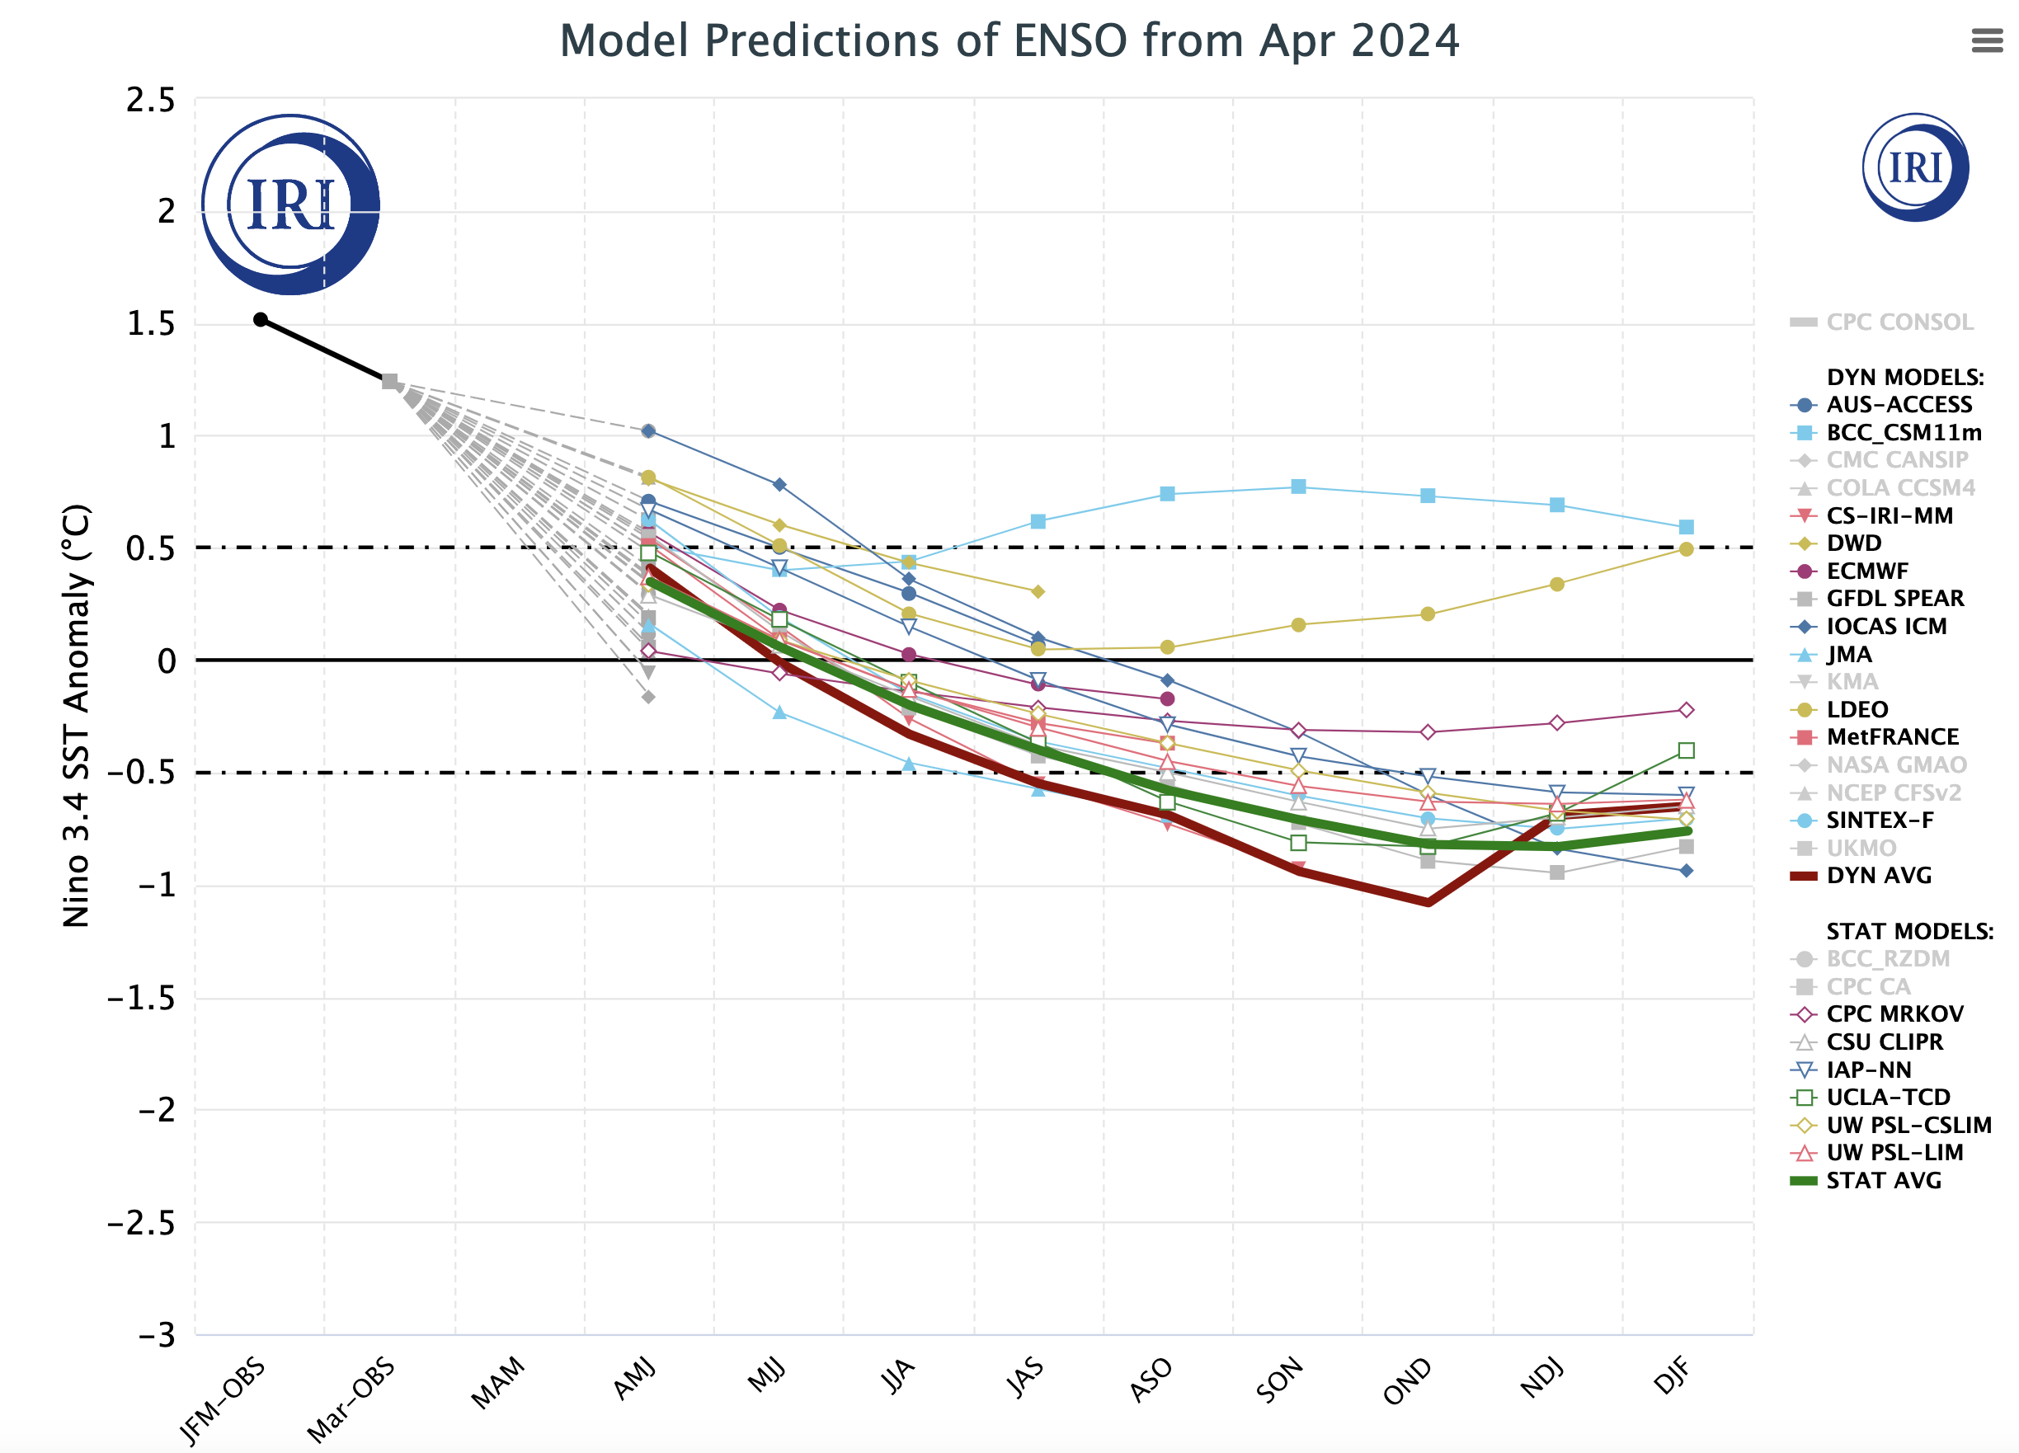
Colder Group of Models
Warmer Cluster of Models

Slide 13
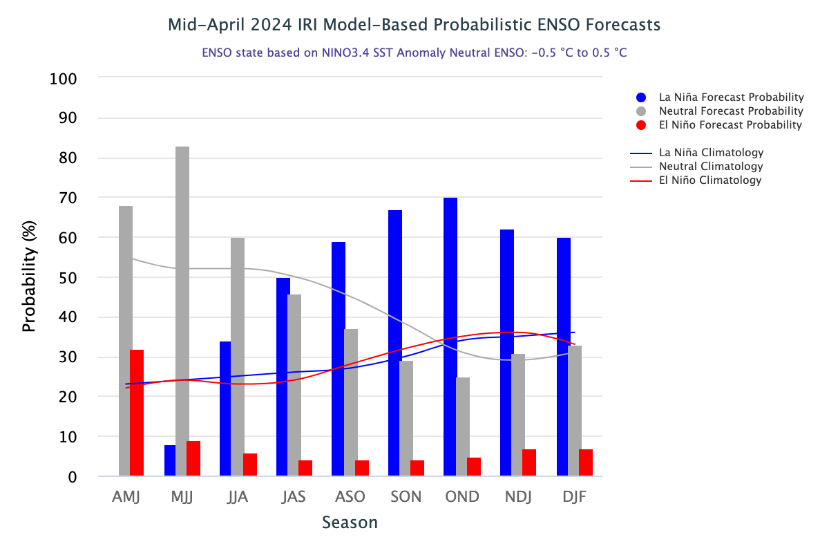
IRI’s Probabilistic ENSO Forecasts (will be on 19th April, 2024)

Slide 14
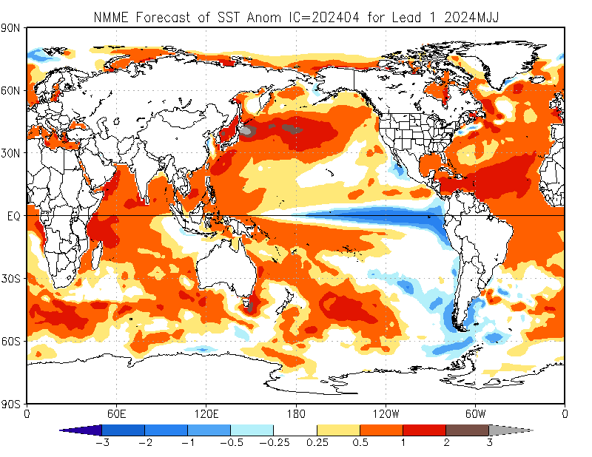
North American Multi Model Ensemble
(NMME) SST Forecast

Slide 15
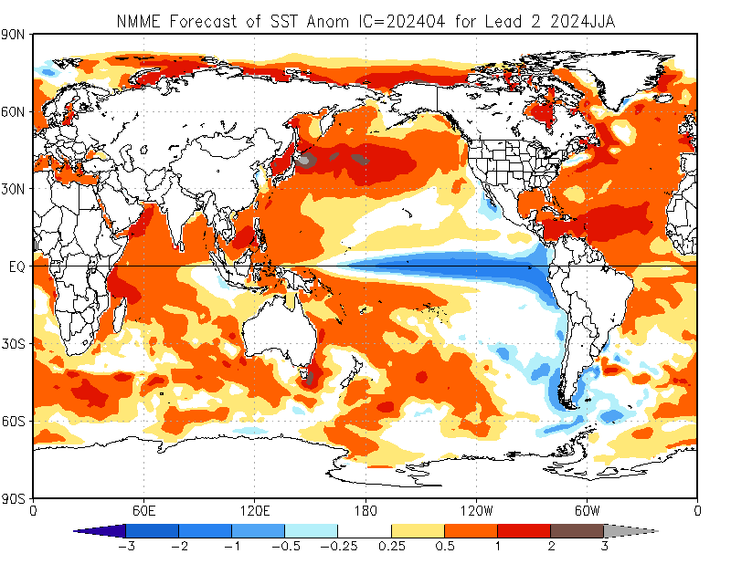

Slide 16
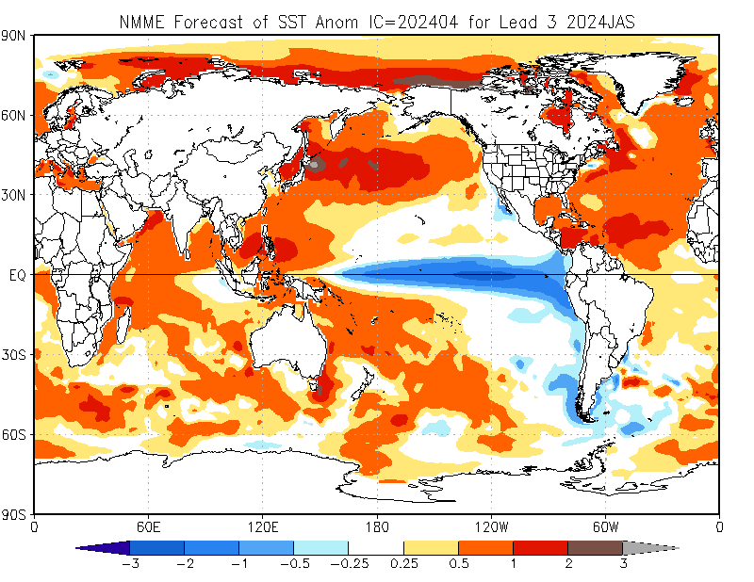

Slide 17
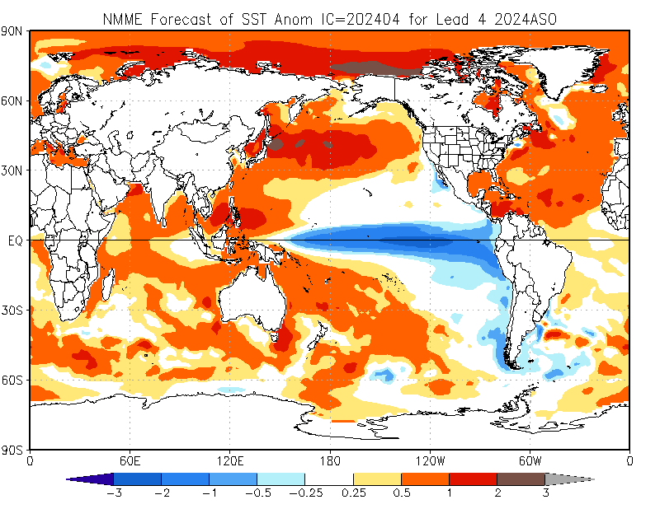

Slide 18
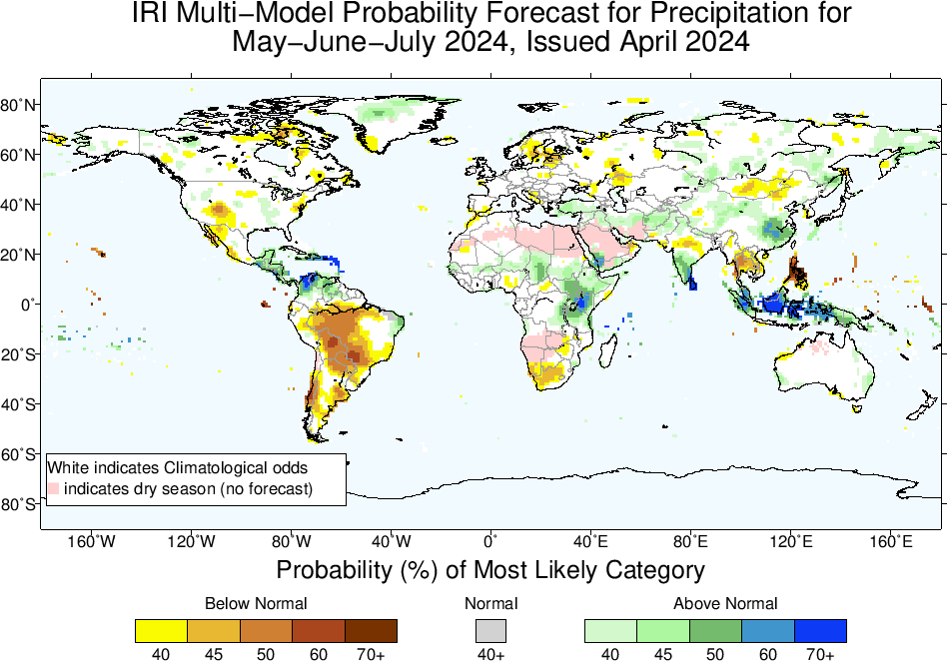
Precipitation Forecasts based on North American Multi Model Ensemble (NMME)

Slide 19
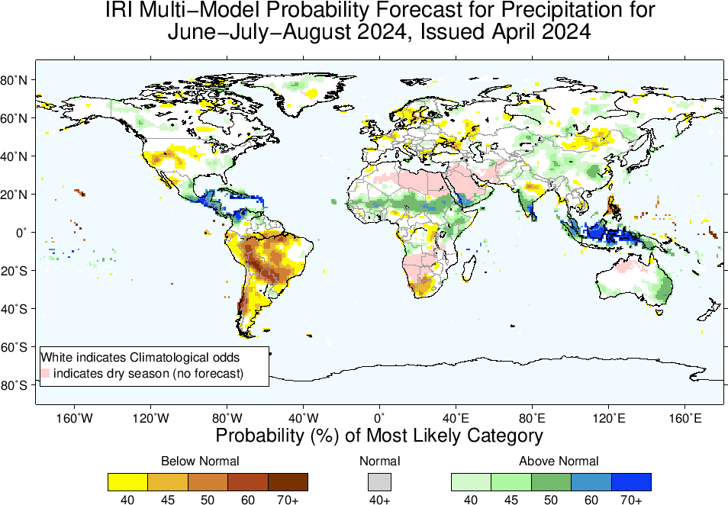

Slide 20
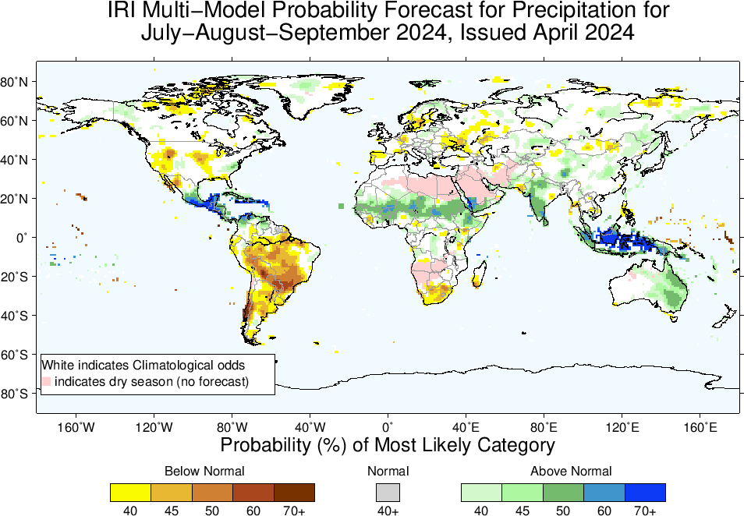

Slide 21
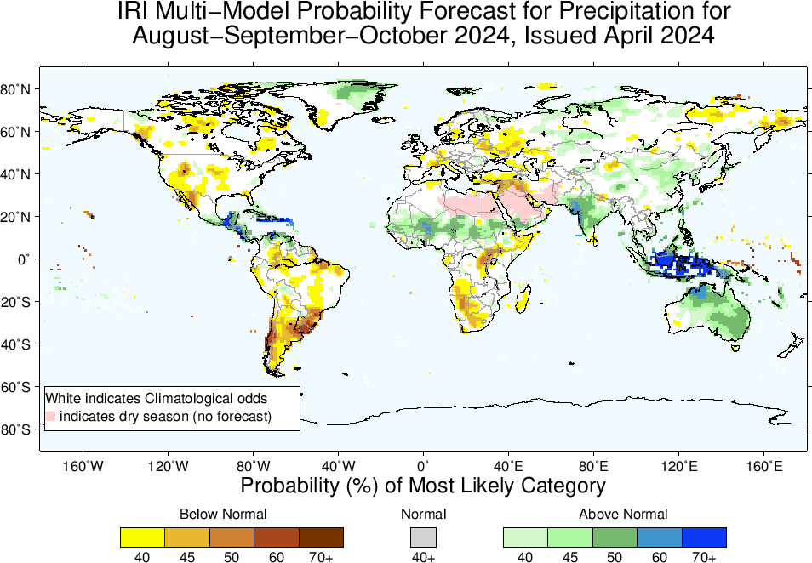

Slide 22
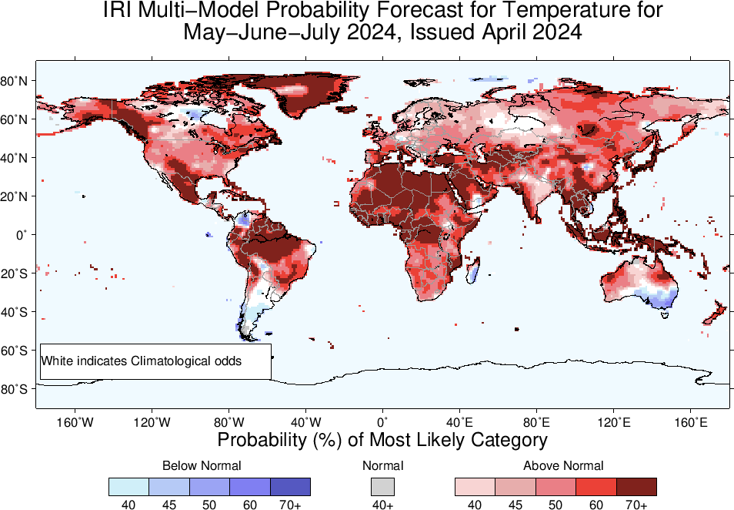
2m-Temperature Forecasts based on North American Multi Model Ensemble (NMME)

Slide 23
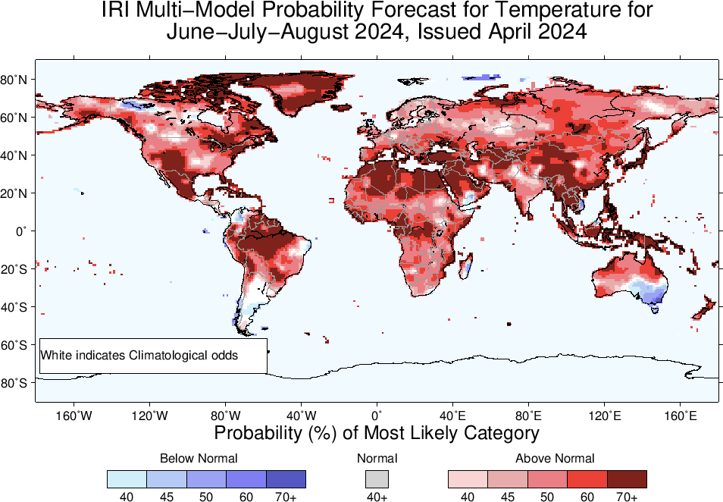

Slide 24
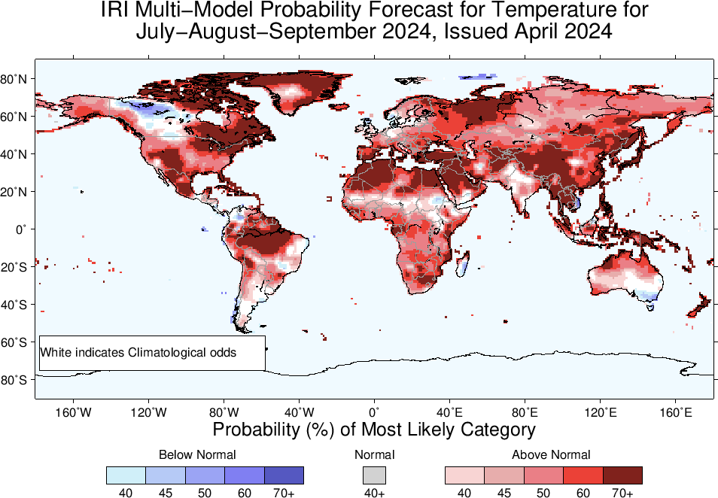

Slide 25
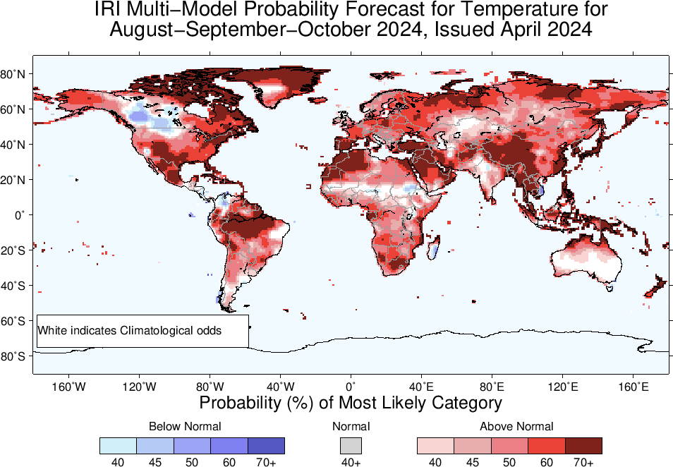

Slide 26
Summary
After its Peak in Nov-Jan, current El Nino has started declining (Dec, 2023 NINO3.4 Value was +1.99, while Jan, 2024 was +1.78, and Feb, was +1.53, and March was +1.24), while for most recent week ending on 10 April, 2024, it was +0.9.
This shows a gradually declining El Nino.
ENSO-Neutral is most probable in AMJ, MJJ, and JJA, 2024 (like previous month)
LA NINA is most likely from JAS, and remain so onward.
Given LA NINA, Monsoonal regions of Africa, Asia, MC, Australia, Central America, could experience wetter than normal conditions during their peak seasons (JJA, and JAS of 2024)
While, most of South America, and South Africa experience drier than normal conditions!

