Slide 1
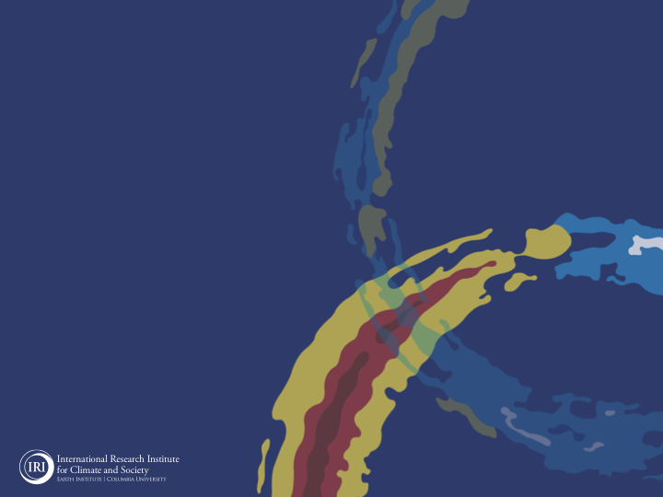
ENSO and Climate Outlook
in Aug 2022
Road clear for a Triple-Dip!
M. Azhar Ehsan
(azhar@iri.columbia.edu)
Associate Research Scientist
IRI ENSO and Climate Forecast Lead
Jeffery Turmelle and Jing Yuan: forecast processing and web updates
Cuihua Li: Draft PowerPoint development
IRI’s Climate Group, led by Dr. Andrew Robertson: Forecast system development, ongoing innovation, and verification

Slide 2
Outline
Observed Oceanic and Atmospheric Conditions in
Tropical Pacific
Across the Globe
ENSO Forecast in
NMME
IRI ENSO Forecast Tool (Deterministic and Probabilistic)
Seasons Outlook of
SST
Precipitation and Temperature
Summary

Slide 3
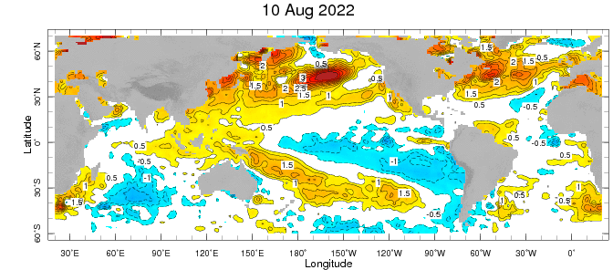
Evolution of EQ. Pacific SST Departures in Weekly OISST Data
In the Pacific Ocean: Below-average SSTs persisted across the central (across the Date Line), surrounded by strong +ve SSTA in the high latitudes.
Near-Neutral SSTAs exists in Eastern Pacific (130W to 90W.
Indian Ocean: Near-Normal SSTAs in the west and positive in the East, a –ve Indian Ocean Dipole (-1.15 for week ending on 14 August).
Atlantic Ocean: Patches of positive/Negative SSTAs in the equatorial AO

Slide 4
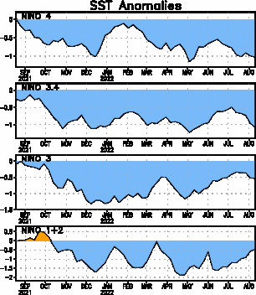
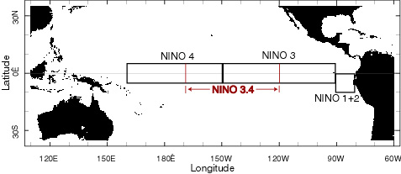
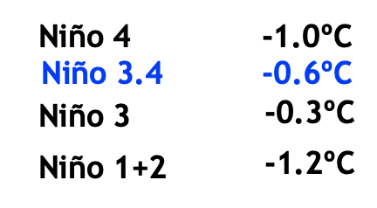
Most Recent SST Departures in different NINO regions (All cooler than the long-term avg, (1991-2020))
Niño 4
-1.0ºC
Niño 3.4
-1.1ºC
Niño 3
-0.5ºC
Niño 1+2
-0.5ºC
Changed by how much (July, 2022)?

Slide 5
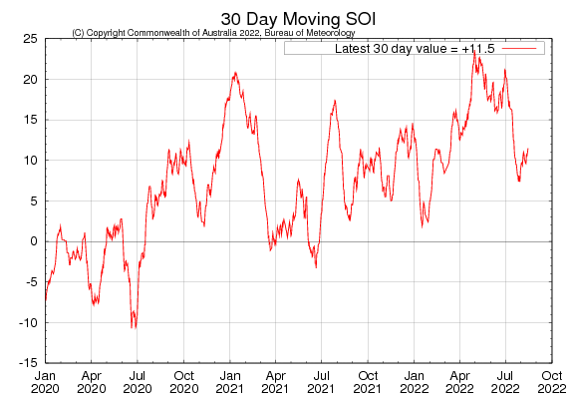
2021
2022
2020
Sustained positive values of the SOI above +7 typically indicate La Niña

Slide 6
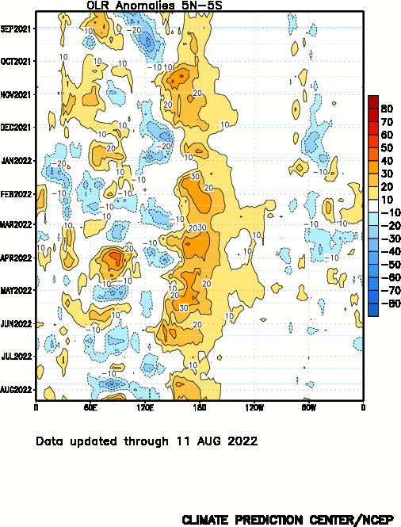
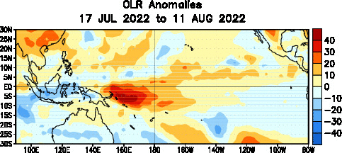

Slide 7
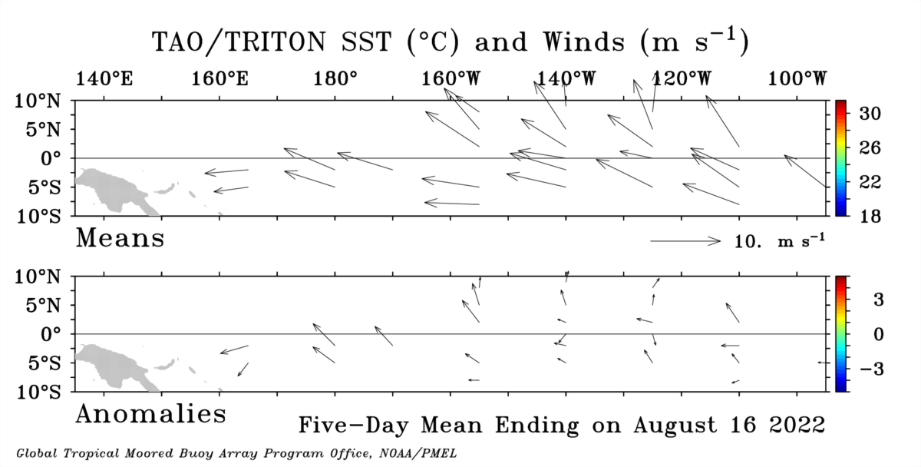

Slide 8
Most Recent

Slide 9
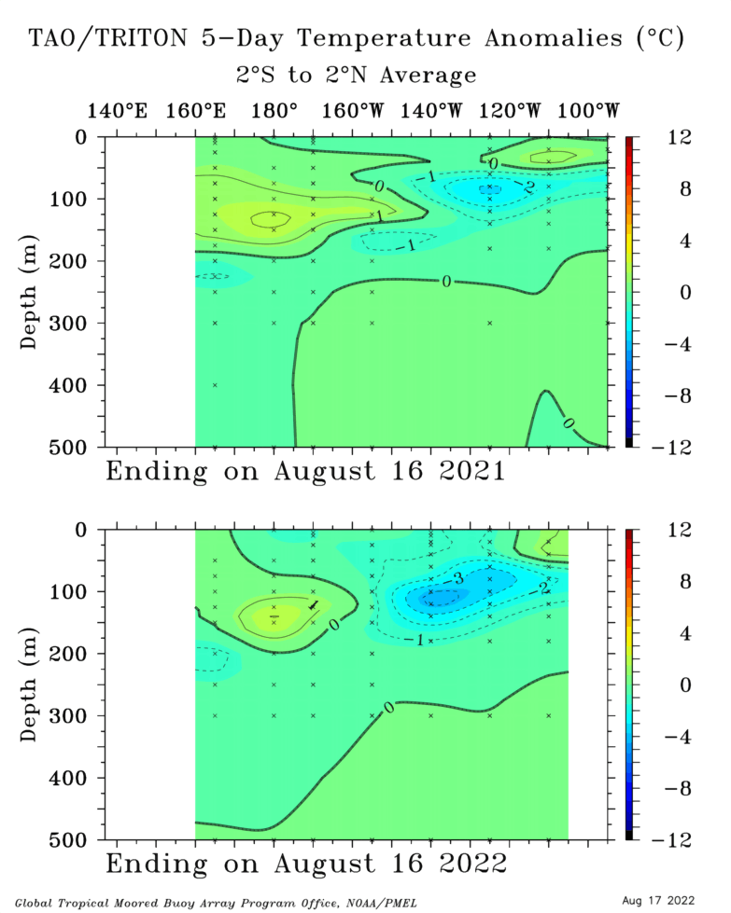

Slide 11
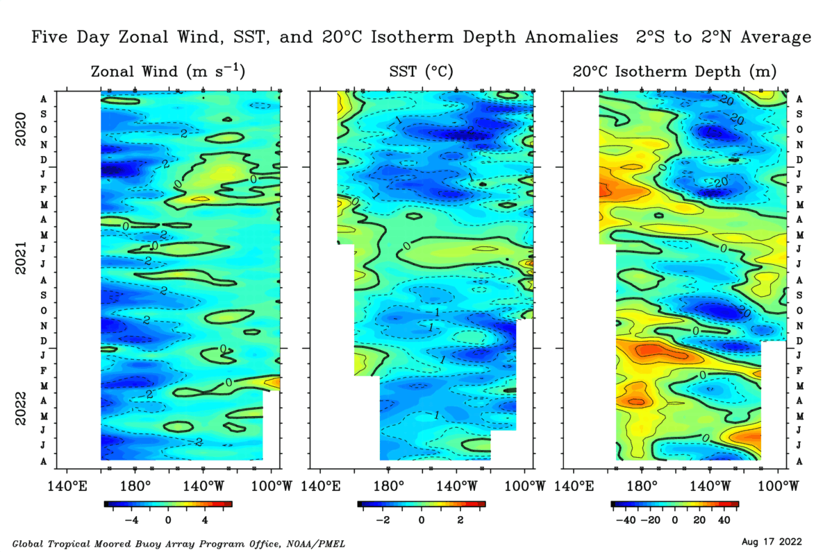

Slide 12
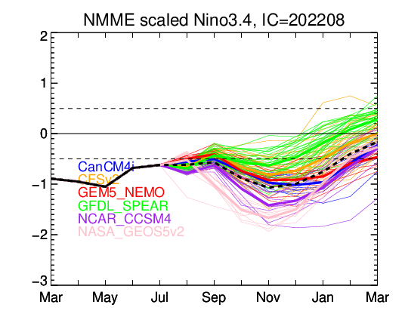
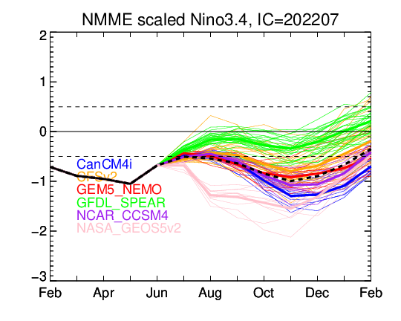
Last Month

Slide 13
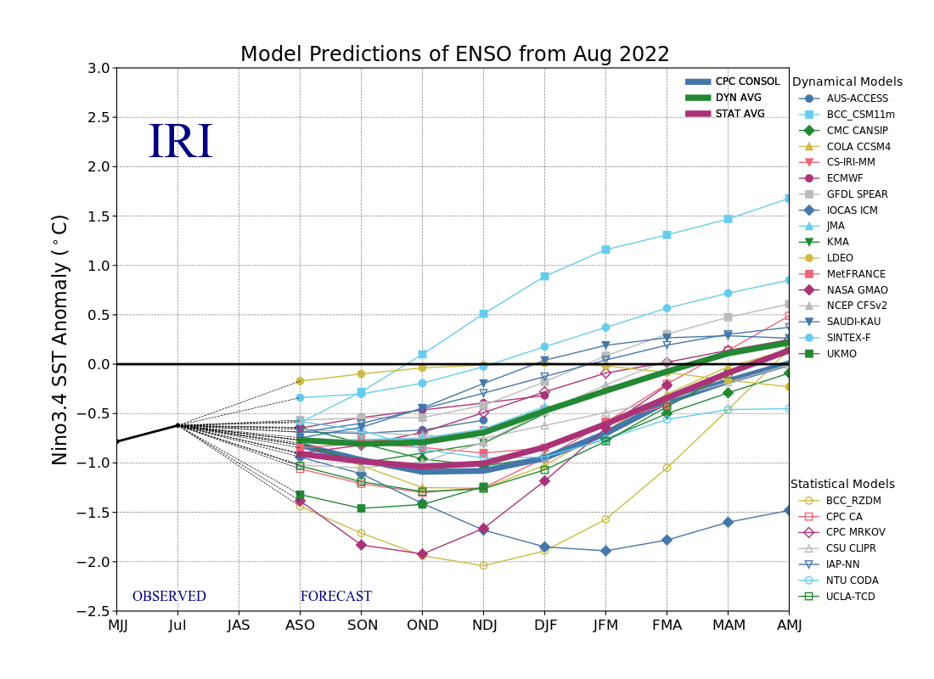
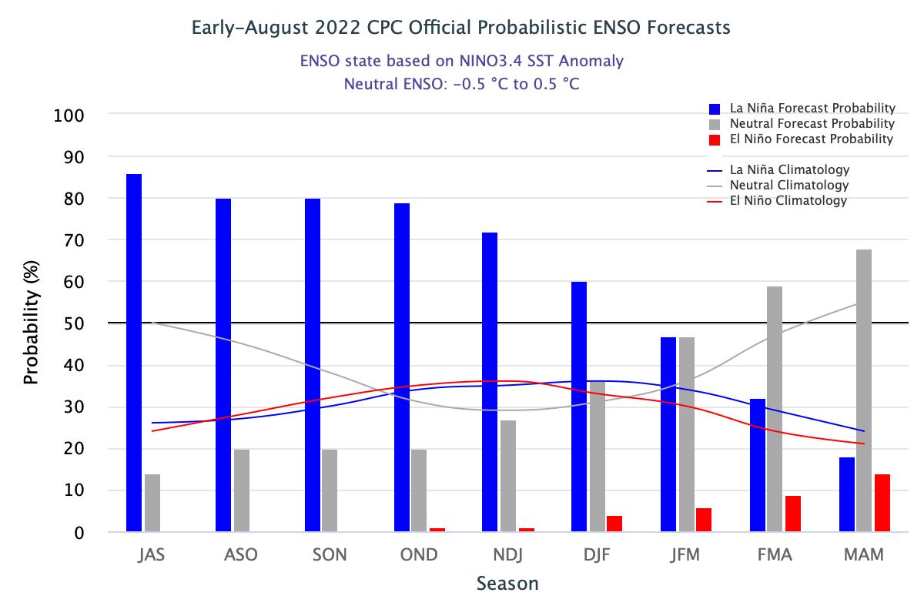
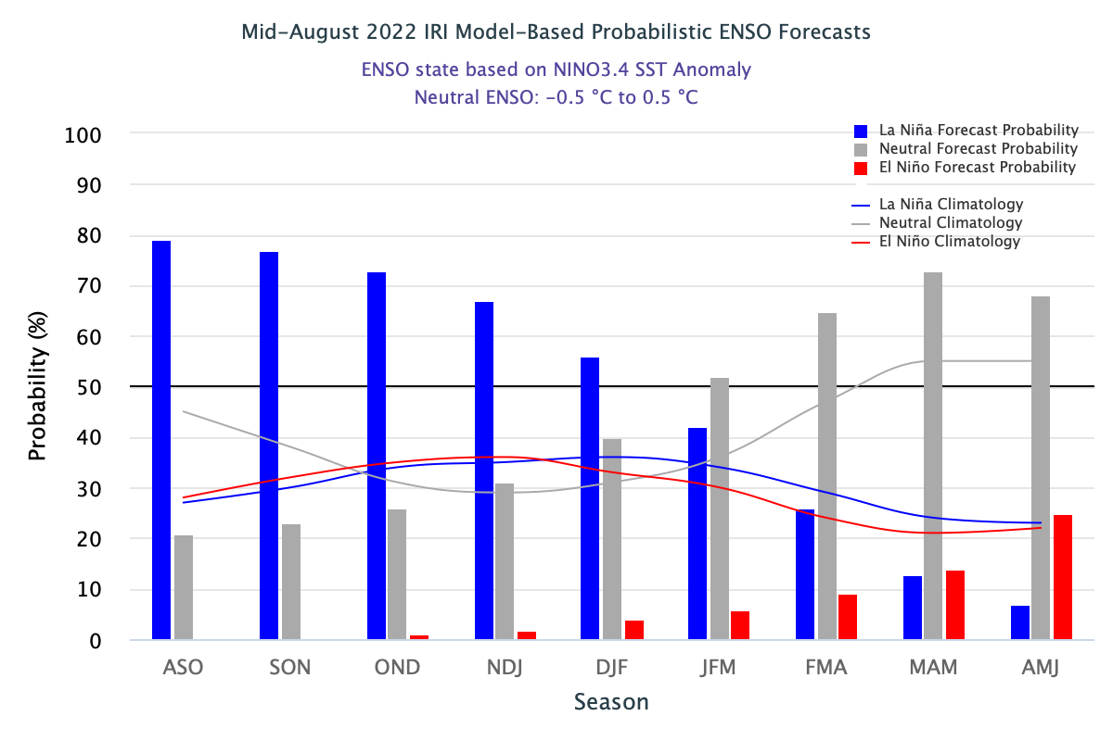

Slide 14
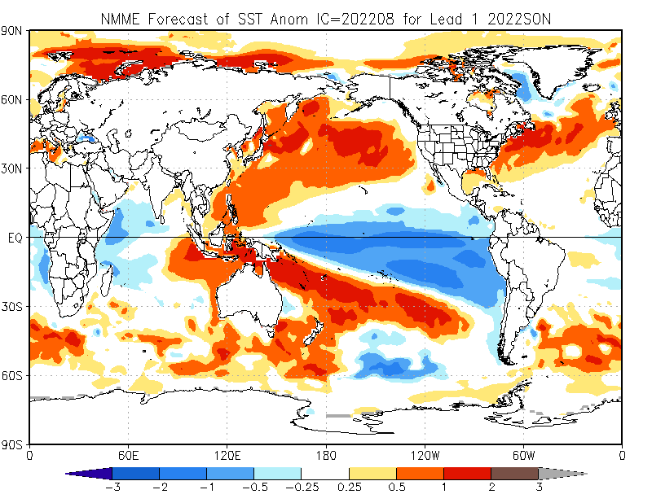

Slide 15
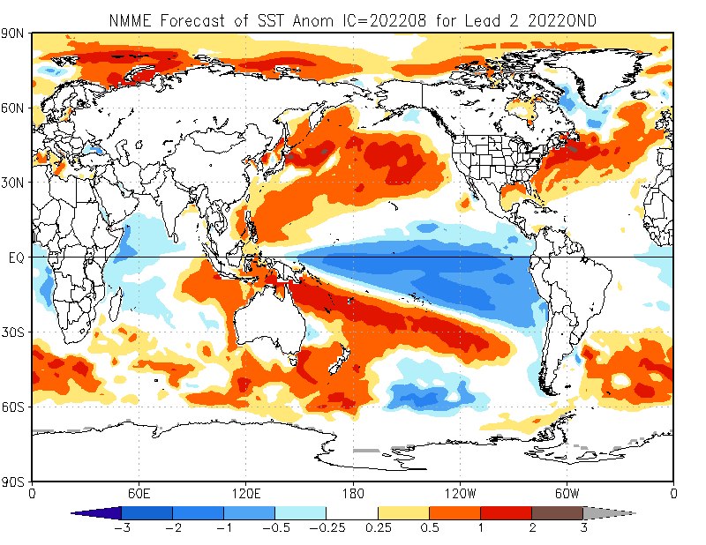

Slide 16
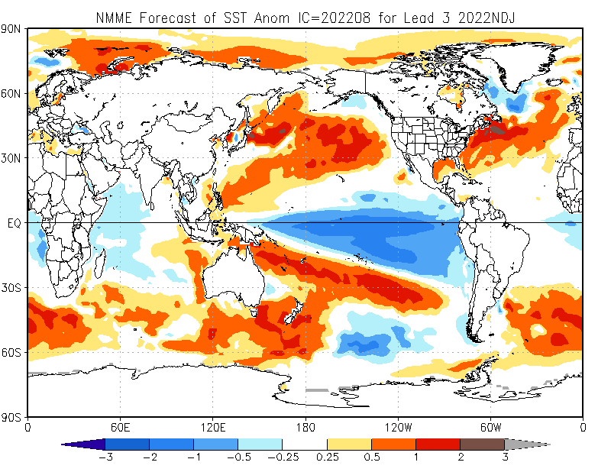

Slide 17
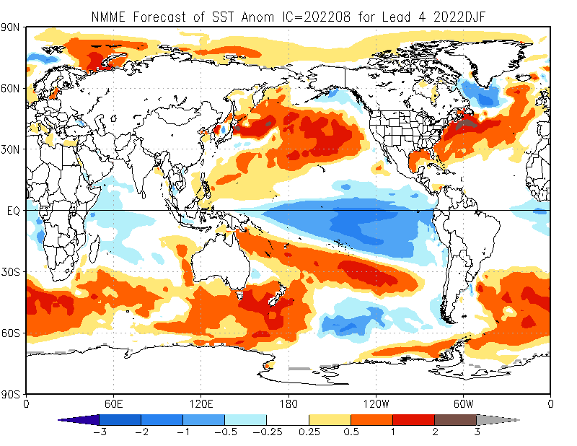

Slide 18
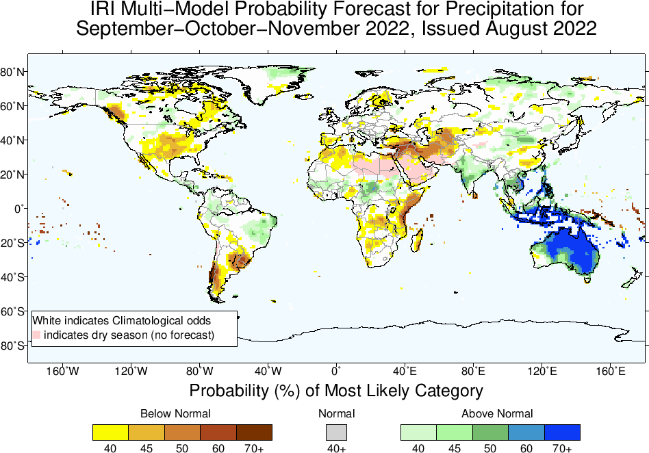

Slide 19
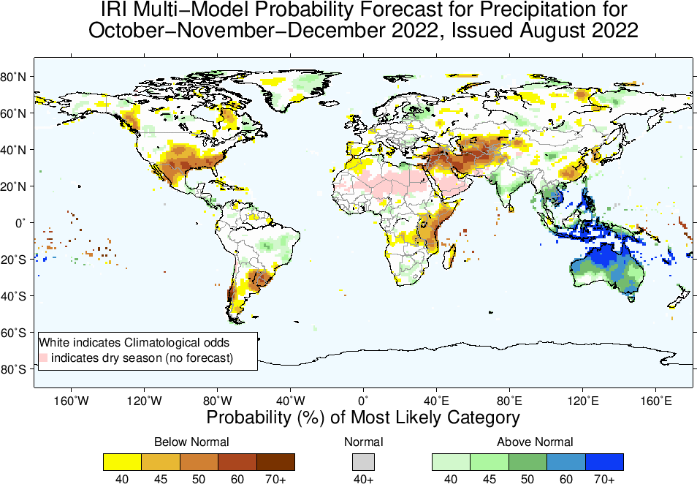

Slide 20
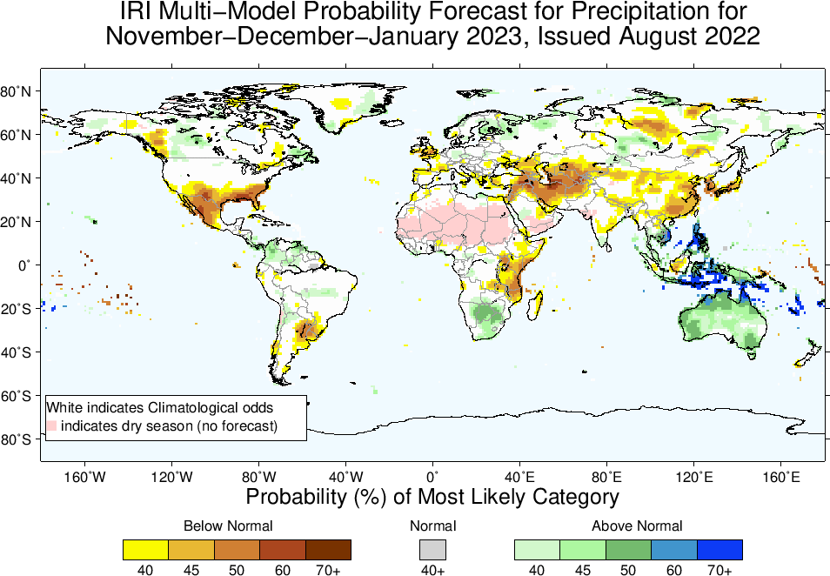

Slide 21
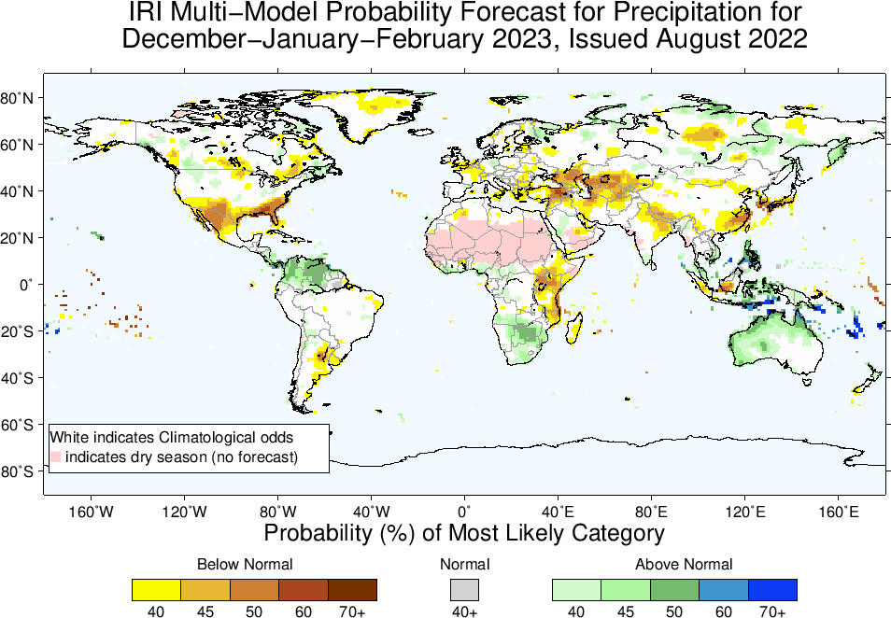

Slide 22
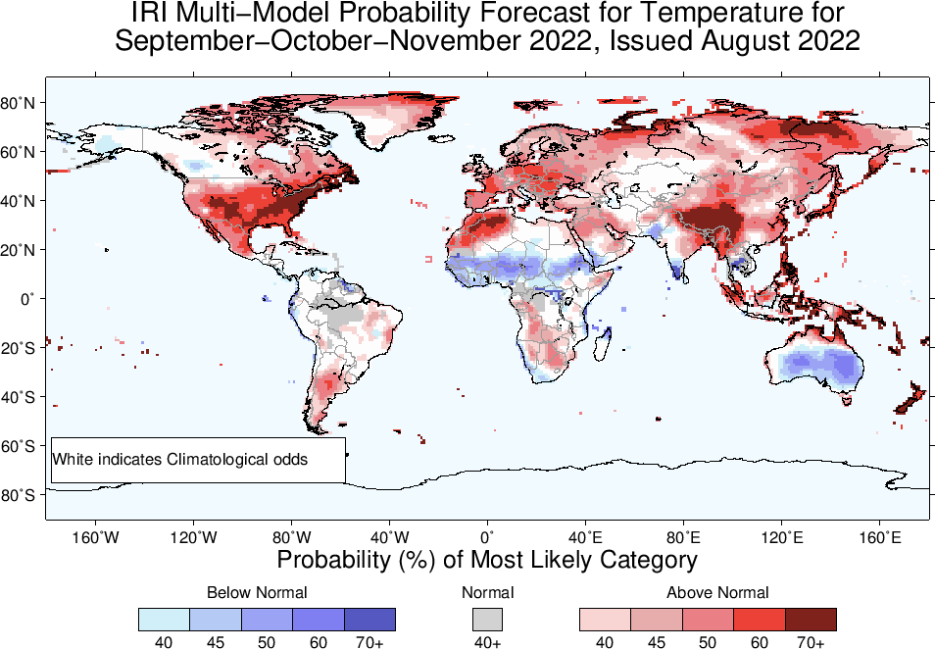

Slide 23
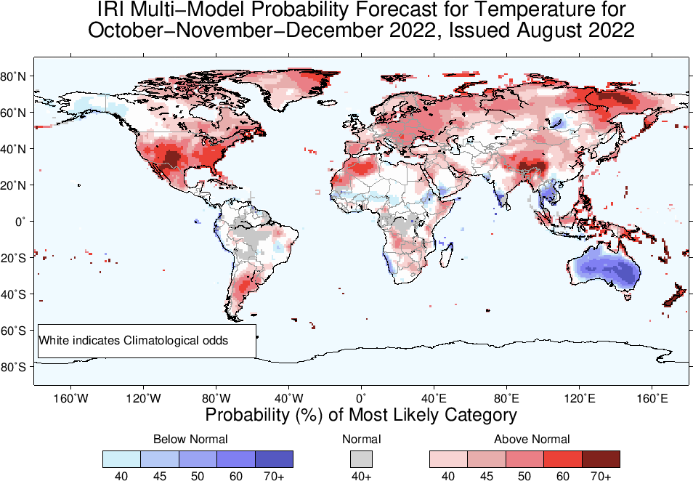

Slide 24
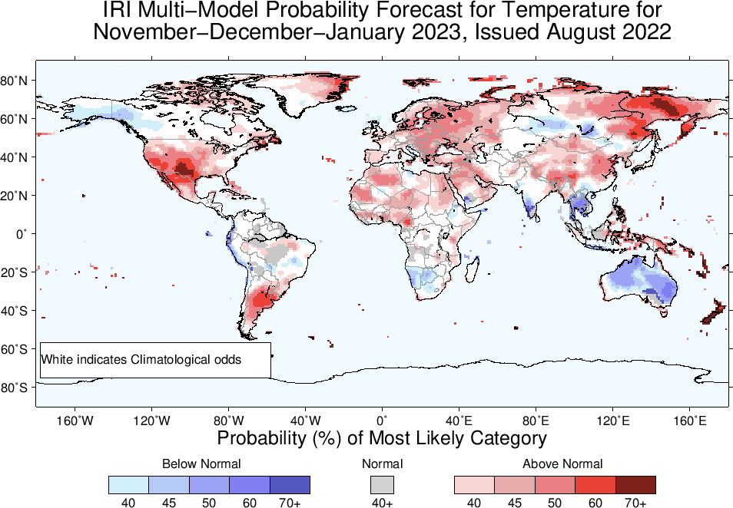

Slide 25
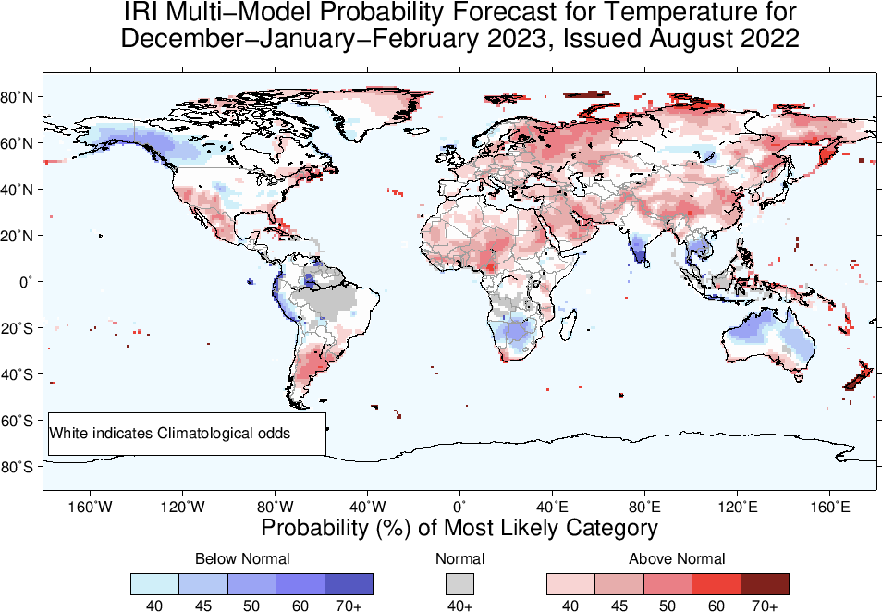

Slide 26
Summary
La Niña is strengthening, because;
Both Oceanic and Atmospheric conditions strengthening in the favour of La Nina; e.g.,
Sea surface temperatures (SSTs) are below average across the central equatorial Pacific Ocean.
SOI is positive (ticked up), stronger than average trade winds, reduced cloudiness over central Pacific (west of Date-line).
La Niña is favored to continue with high chances during next three seasons with probabilities greater than 60%, Moving forward probabilities for La Niña to continue till DJF-2023 is 56%.
ENSO-Neutral is most favorable starting from JFM-2023 onward.
Heading towards a “triple-Dip La Nina”!

