Slide 1
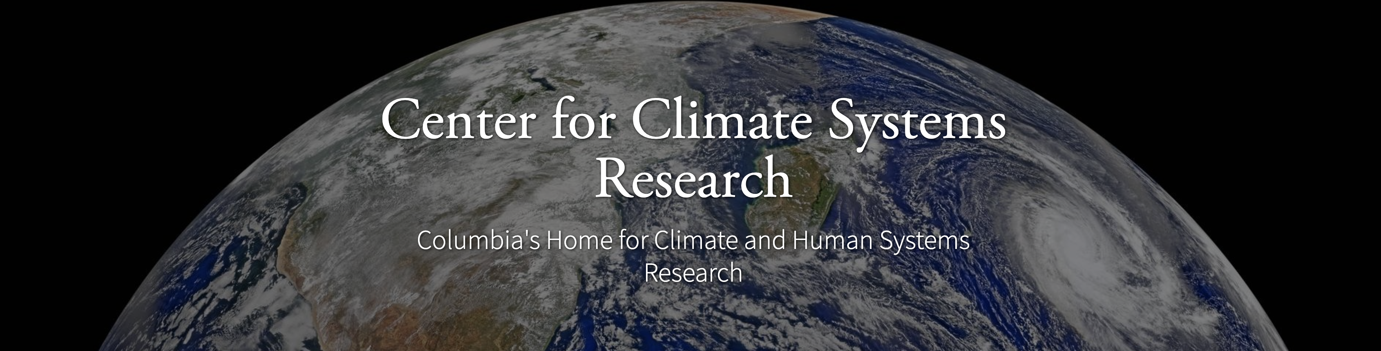


ENSO and Climate Outlook in April, 2025
Final La Nina Advisory and ENSO-Neutral!
Ehsan, M. Azhar
(mae2171@columbia.edu)
Center for Climate Systems Research (CCSR),
Affiliate of NASA GISS and
International Research Institute for Climate and Society (IRI)
Dr. Andrew Robertson (CCSR): Forecast system development, ongoing innovation,
Jing Yuan (CCSR): Forecast Post-Processing,
Jeffrey Turmelle (IRI): Forecast Post-Processing and Web updates.

Slide 2
Outline
Observed Oceanic and Atmospheric Conditions in
Tropical Pacific
Across the Globe
ENSO Forecast in
NMME
IRI/CCSR@NASA-GISS ENSO Forecast Tool (Deterministic and Probabilistic)
Another Forecast Tool (Work in Progress)
Seasons Outlook of
SST
Precipitation and Temperature
Summary

Slide 3
Observations
Oceanic
Atmospheric

Slide 4
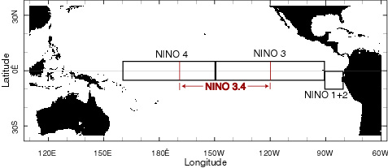
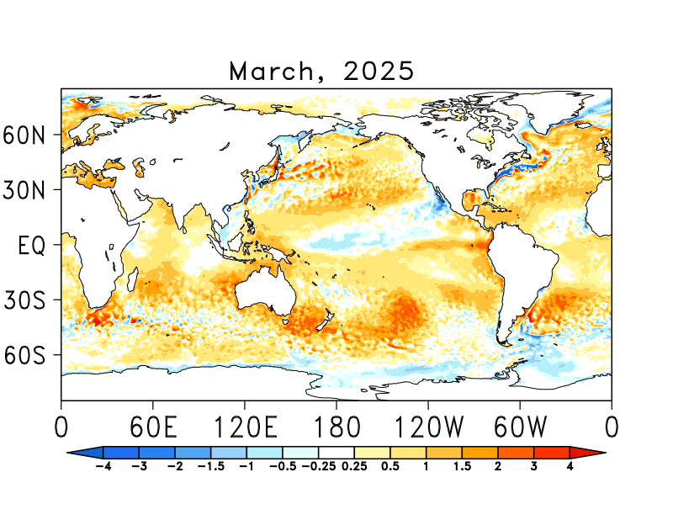
SST Departures in Monthly (March, 2025) Data: OISST v2
NINO3: 0.64
Latitude: 5°S - 5°N
Longitude: 210°E - 270°E
NINO4: -0.31
Latitude: 5°S - 5°N
Longitude: 160°E - 210°E
NINO12: 1.52
Latitude: 10°S - 0°N
Longitude: 270°E - 280°E
NINO34: 0.15
Latitude: 5°S - 5°N
Longitude: 190°E - 240°E
https://psl.noaa.gov/data/gridded/data.noaa.oisst.v2.highres.html

Slide 5
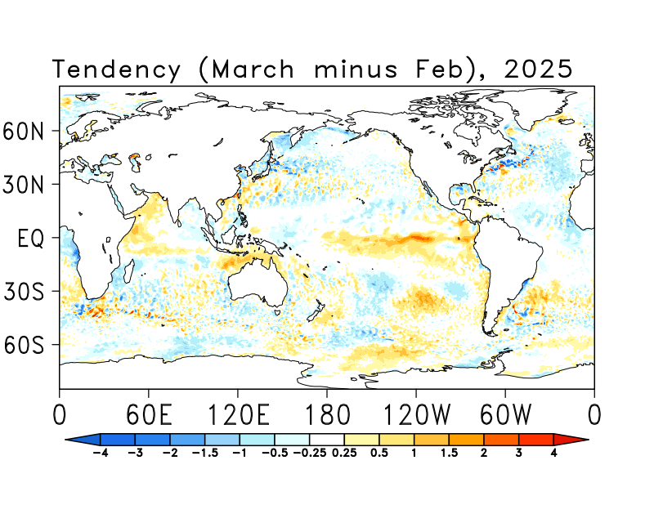
SST Anomalies Tendency (March minus Feb) Data: OISST v2

Slide 6
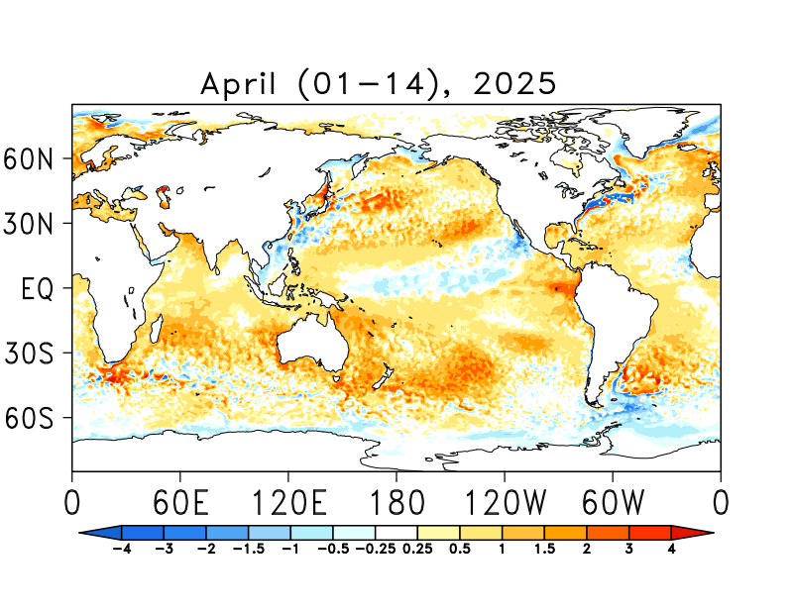
SST Departures in Last Two-Weeks (Apr 01-14) Data: OISST v2
NINO 1+2: +1.54
Latitude: 10°S - 0°N
Longitude: 270°E - 280°E
NINO 3: 0.49
Latitude: 5°S - 5°N
Longitude: 210°E - 270°E
NINO 3.4: -0.05
Latitude: 5°S - 5°N
Longitude: 190°E - 240°E
NINO 4: -0.19
Latitude: 5°S - 5°N
Longitude: 160°E - 210°E
https://psl.noaa.gov/data/gridded/data.noaa.oisst.v2.highres.html

Slide 7
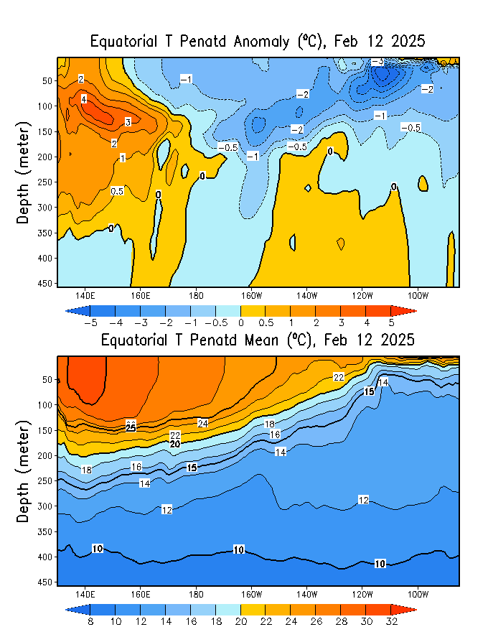
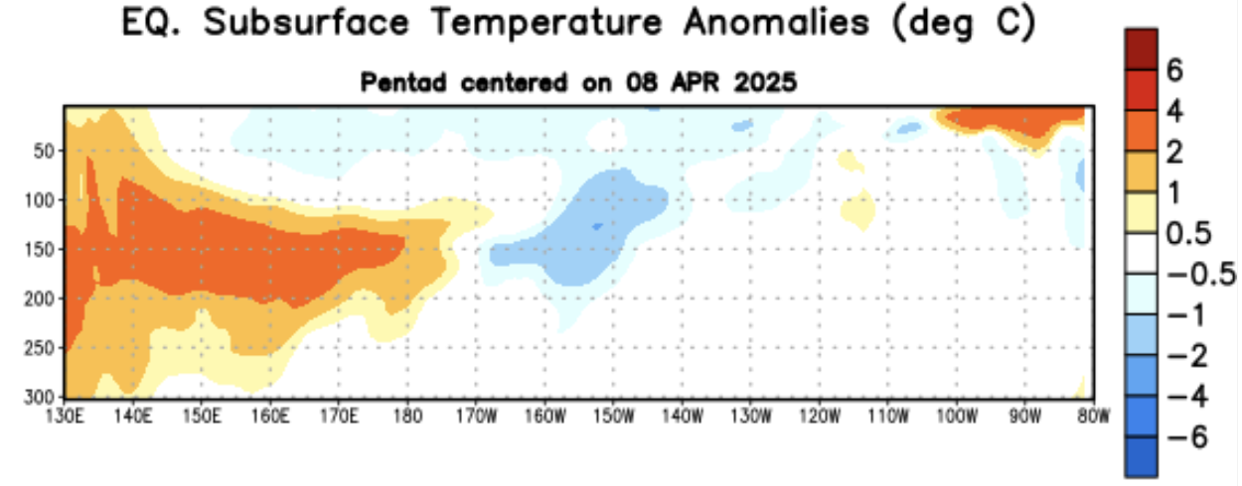
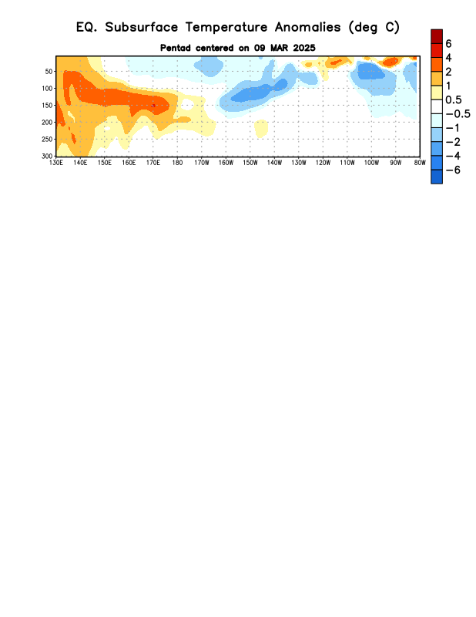
What is the underwater conversation?
W
C
W
February, 2025
April, 2025
Highlight:
Current subsurface ocean temperatures, including both warm and cold regions, aren’t giving us a clear signal about what to expect in the next few months. Recent data also show no obvious signs of downwelling or upwelling oceanic Kelvin waves. As a result, the outlook increasingly favors ENSO-neutral conditions in the near future.
March, 2025

Slide 8
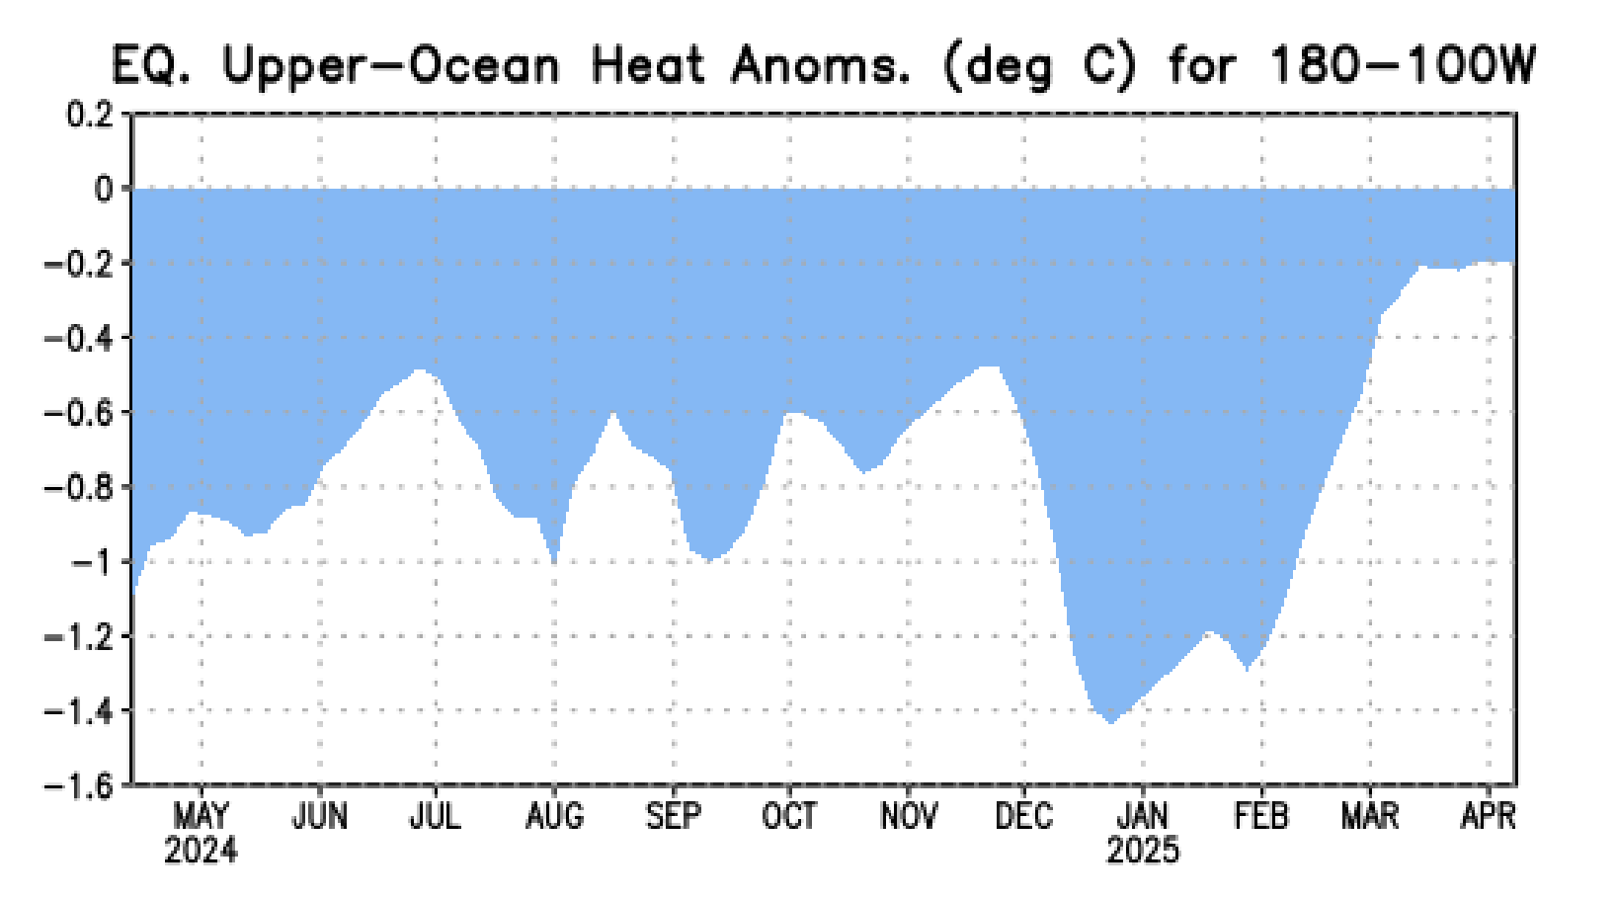
What is the underwater conversation?
Strongest upward trend during Feb, and as of Mar, 2025, Index reached to a stable value of -0.2!

Slide 9
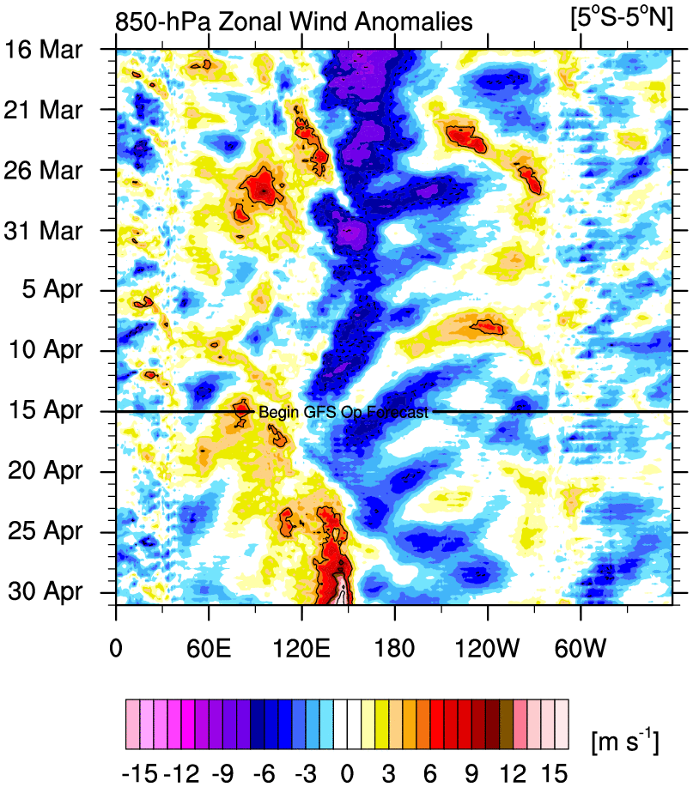
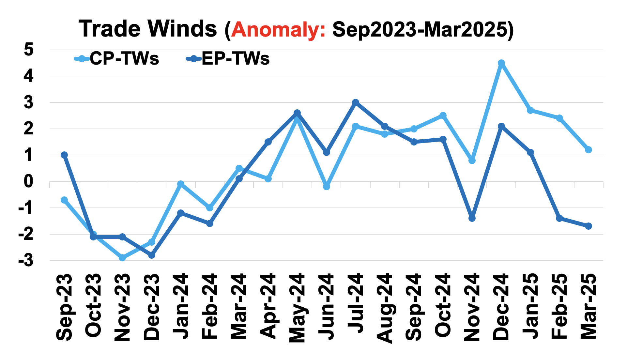
Most recent Lower-Level Winds (TW-Index)
Yellow Shading: Westerly Anomalies
Blue Shading: Easterly Anomalies
Sources:
https://mikeventrice.weebly.com/hovmollers.html
https://www.cpc.ncep.noaa.gov/data/indices/epac850

Slide 10
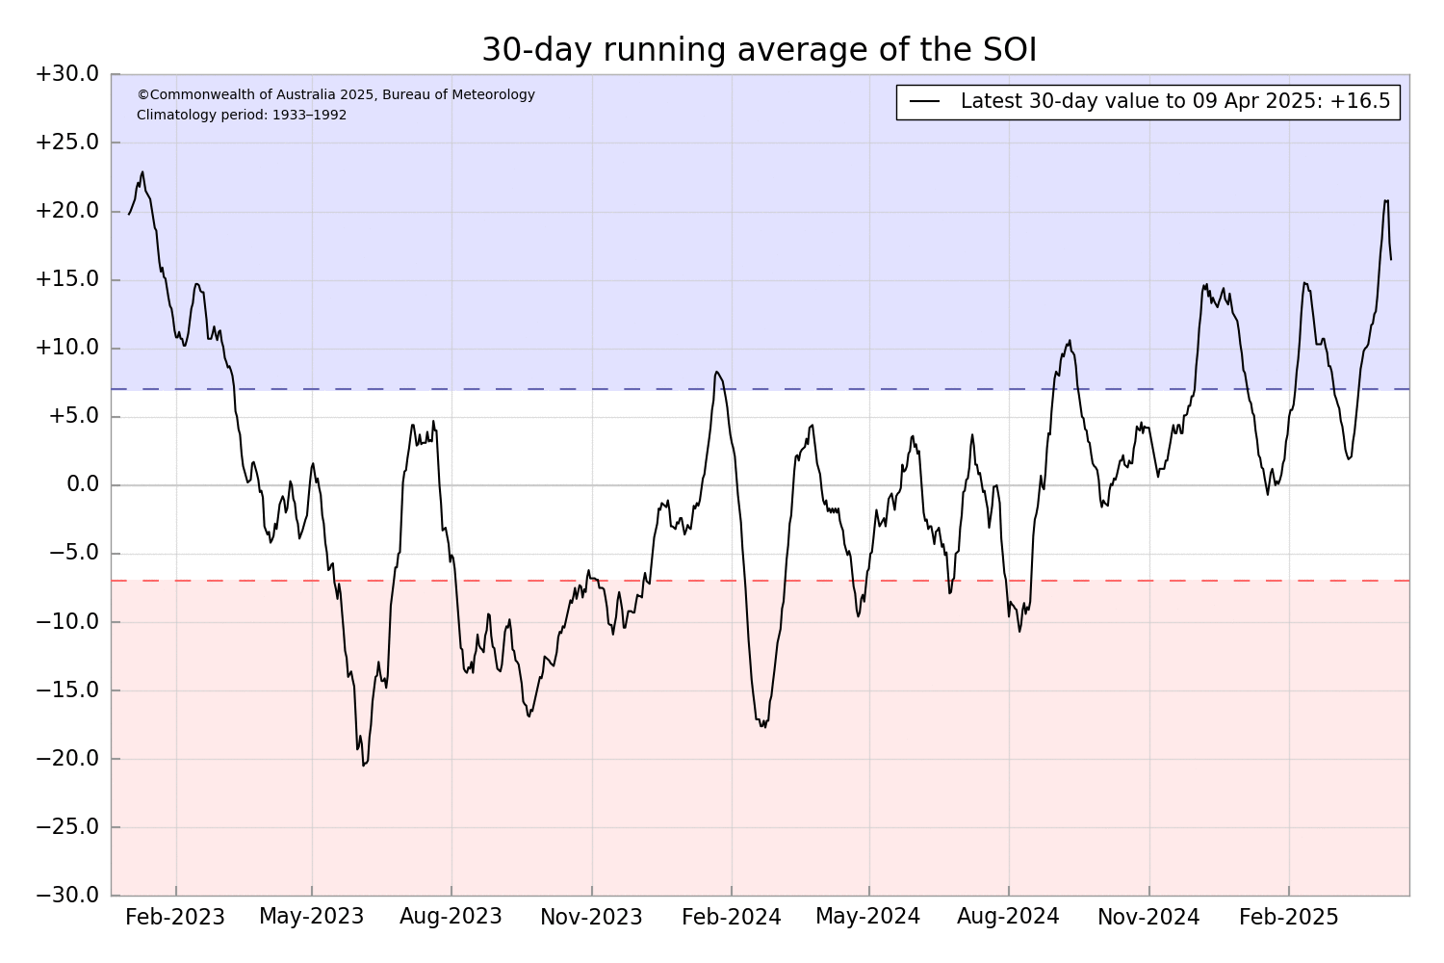
Most recent Southern Oscillation (Traditional & EQ) Index (SOI → in La Nina Space)
SOI values is in La Nina range
(March=+13.2),
Equatorial-SOI is in La Nina range,
(March=+1.5),
Eq-SOI values sustained to remain in La Nina range since November, December, 2024 and January, 2025, reduced significantly in Feb, 2025, increased again in March, 2025.
During La Niña, the pressure becomes above-average in Tahiti and below-average in Darwin, and the Southern Oscillation Index is Positive.
A Sustained Positive values of the SOI above +7 typically indicate La Niña
Source:
http://www.bom.gov.au/climate/enso/#tabs=Pacific-Ocean&pacific=SOI

Slide 11
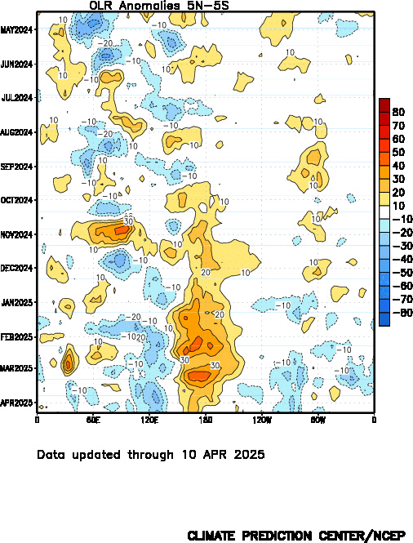
Most recent Outgoing Longwave Radiation (OLR)
(OLR → still in La Nina Space)
OLR shows reduced convection over the Dateline since Sep, 2024,
Quite strong during January-February, and even in March. Slightly reduced during April, 2025.
During La Niña, the convection is reduced over-and-around the Date-Line
Source:
https://www.cpc.ncep.noaa.gov/data/indices/cpolr.mth.91-20.ascii

Slide 12
Forecasts
IRI ENSO Plume,
Probability of Nino-34,
Global SSTs from NMME,
Prcp. and Temp. outlook from IRI (April, 2025)

Slide 13
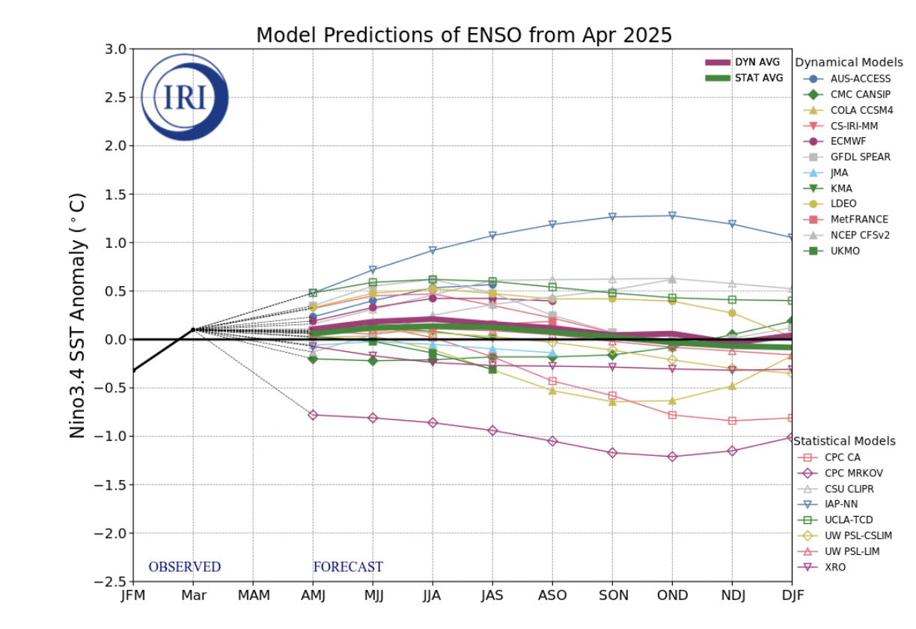
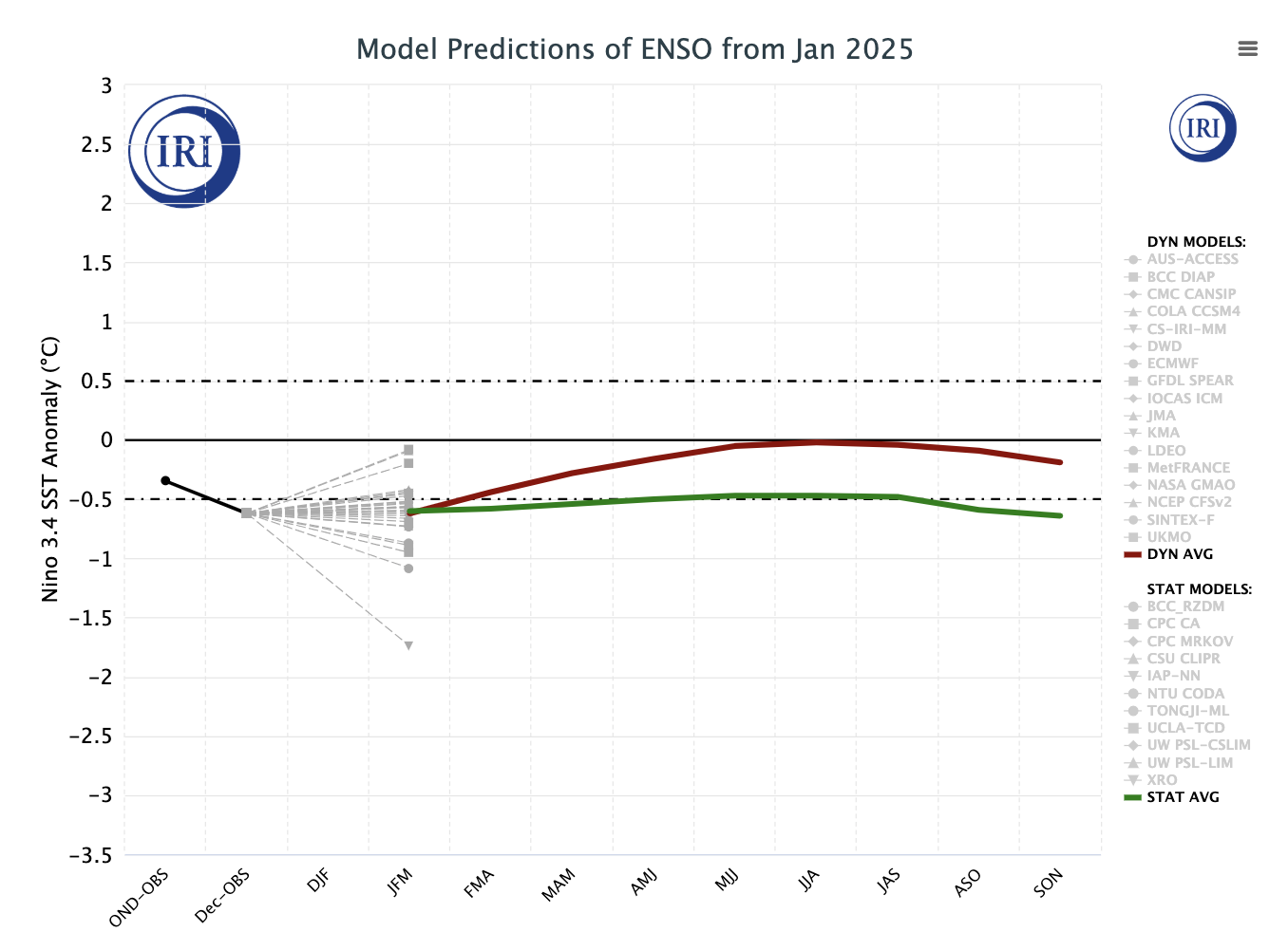
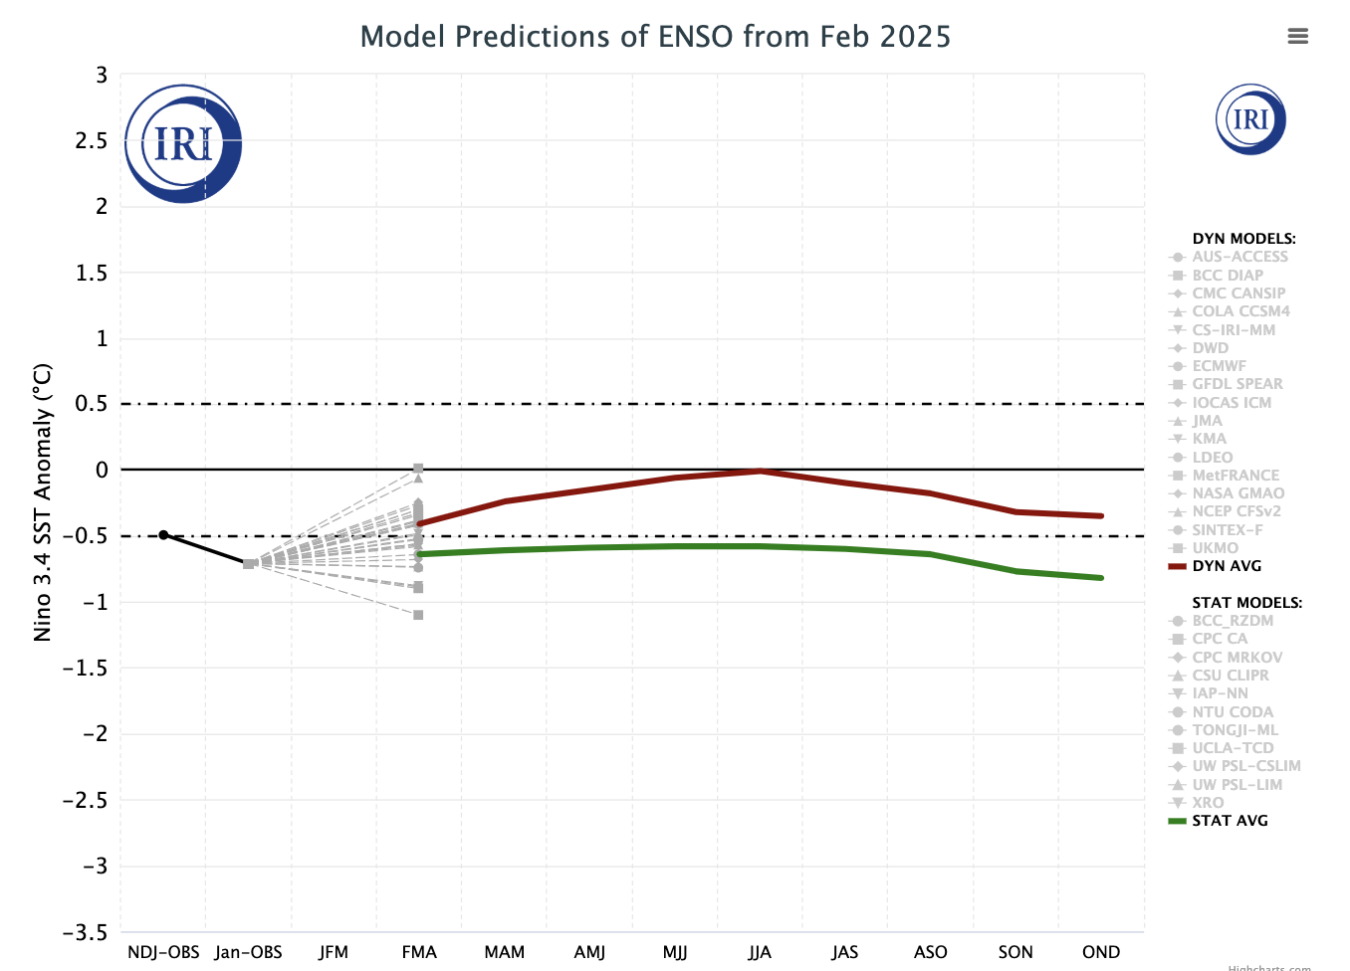
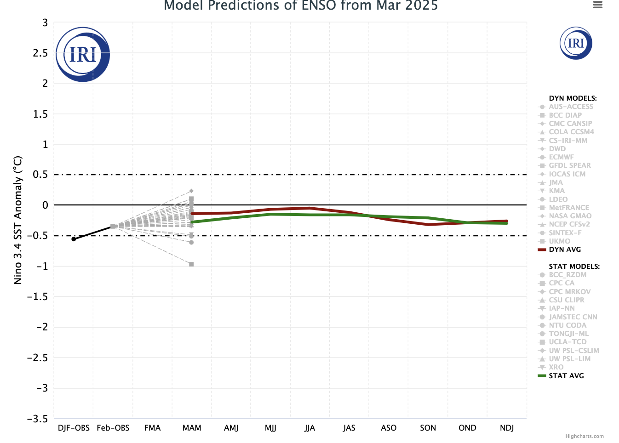
IRI’s ENSO Forecast (19th April, 2025)
This month again Plume models (DYN&STAT) packed together to show; (10 models are missing)
ENSO-neutral conditions from AMJ to the end of the forecasts.
CPC-MARKOV (STAT) calling for La Nina. Another CPC-CA (STAT) call for return to La Nina after Summer, including one DYN model DYN-COLA-CCSM4 (DYN)

Slide 14
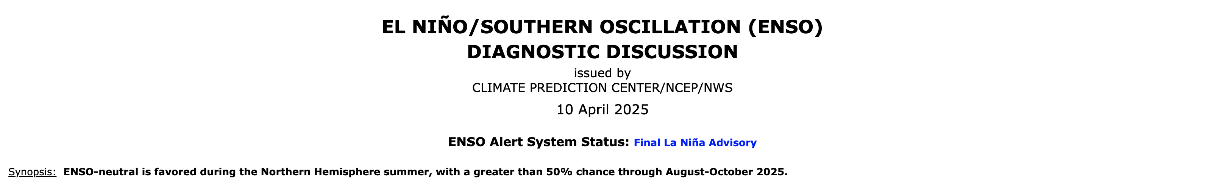
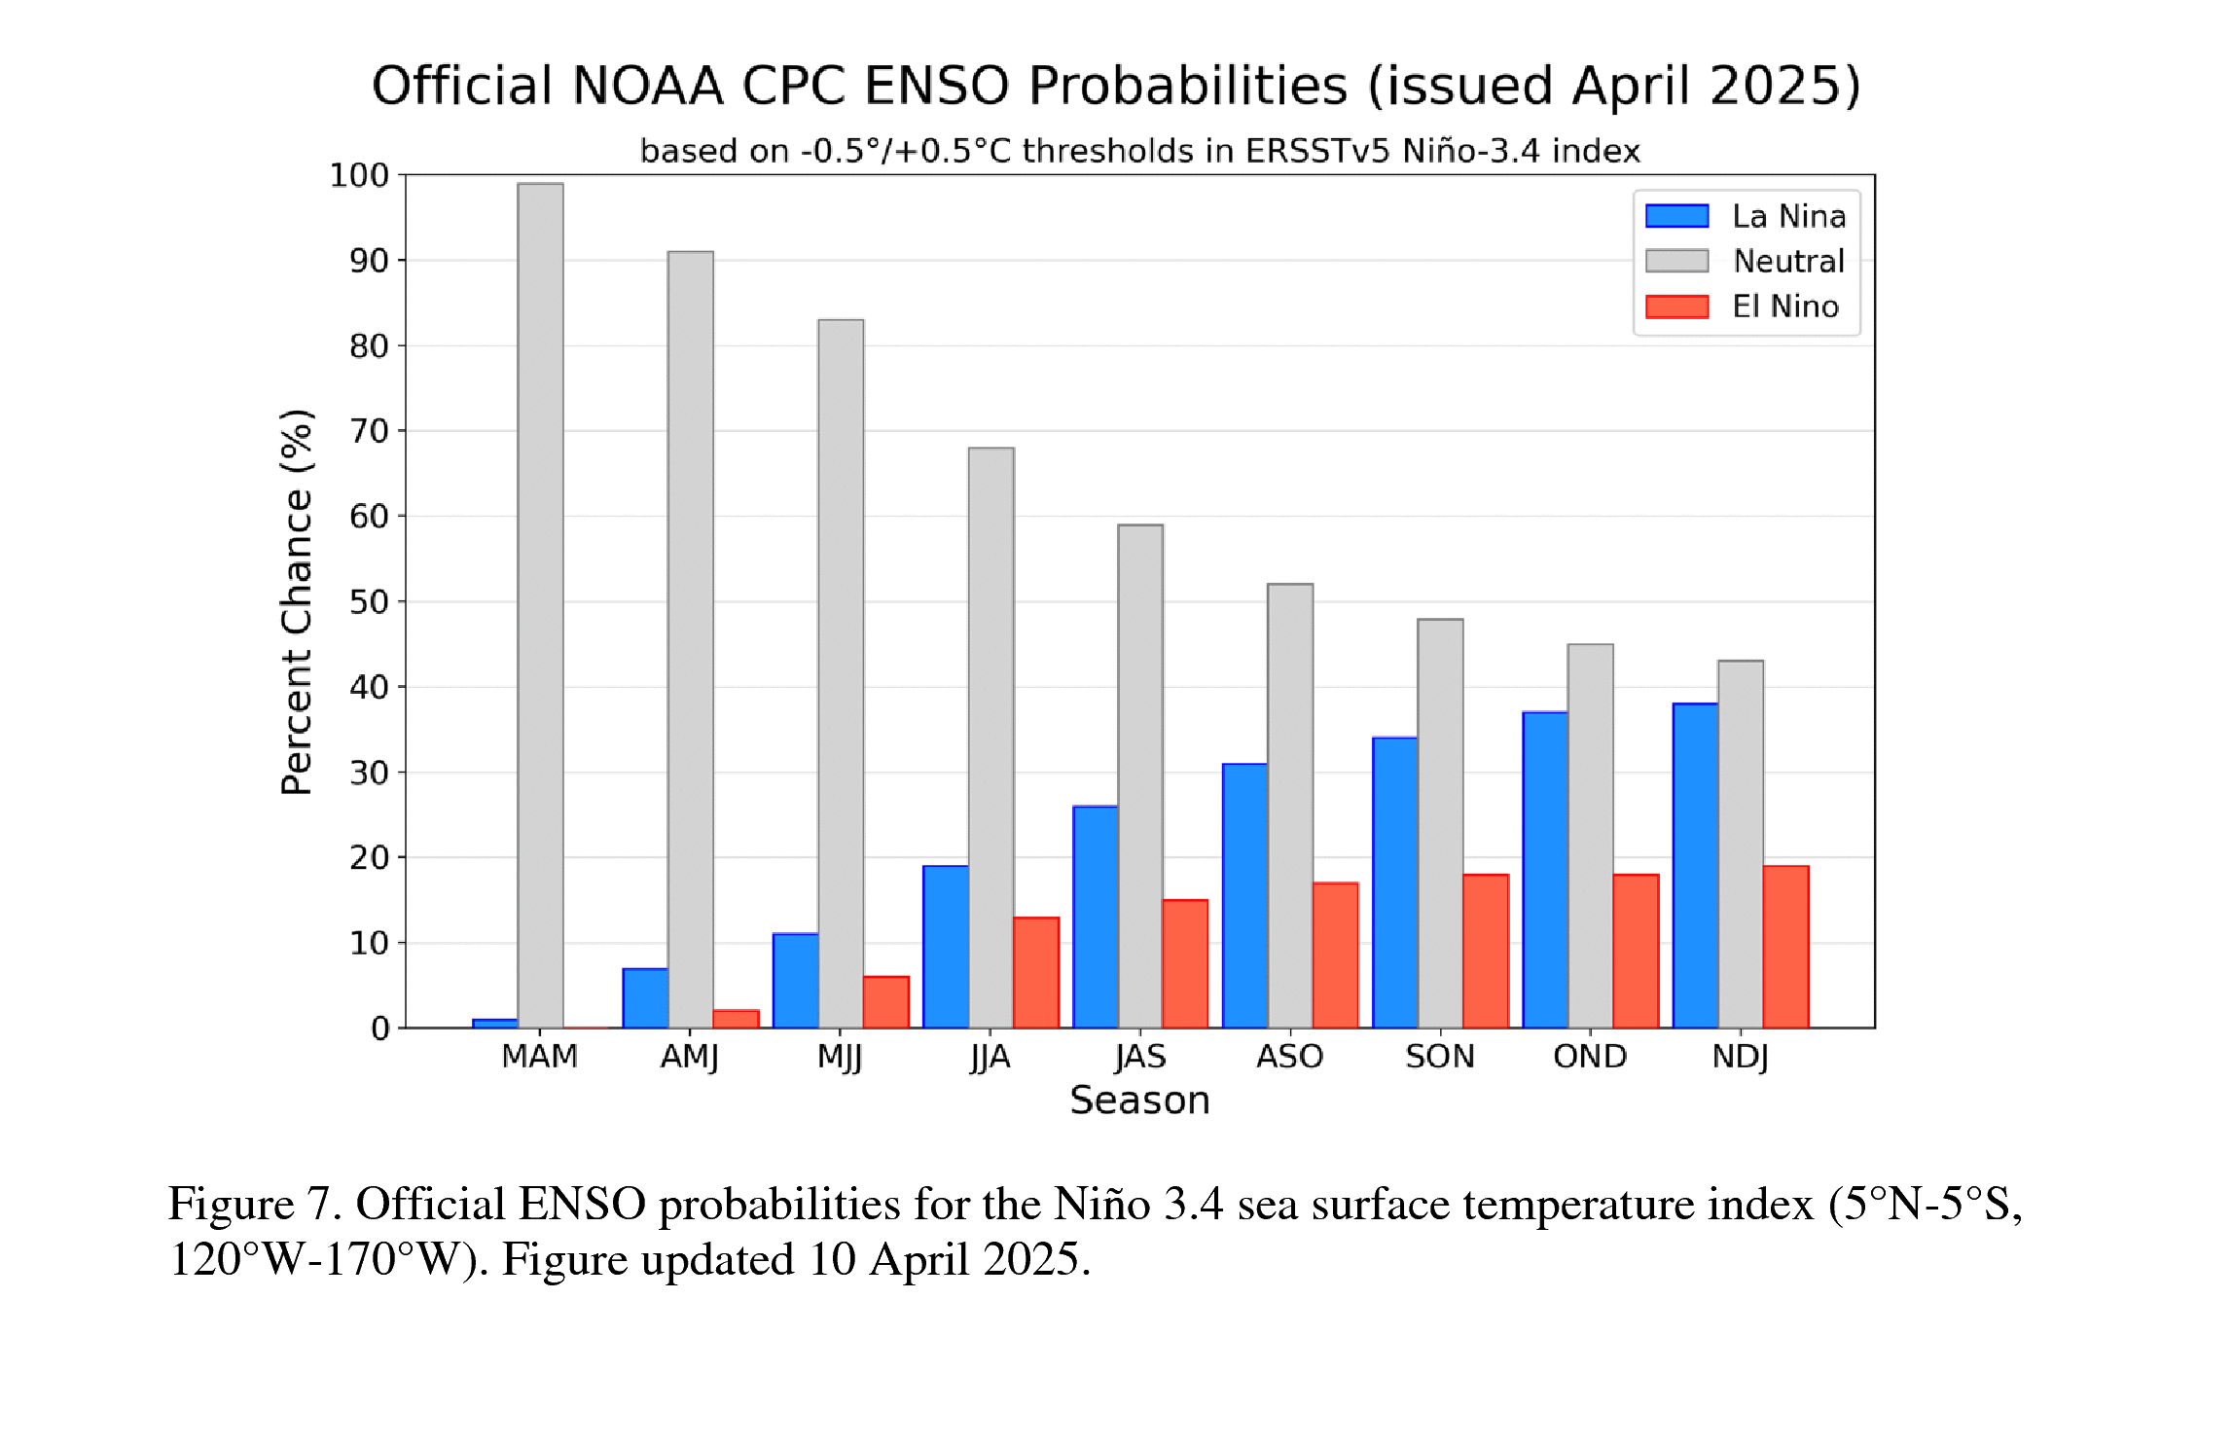

IRI’s Probabilistic (STAT+DYN) ENSO Forecasts (on 19th April, 2025)

Slide 15
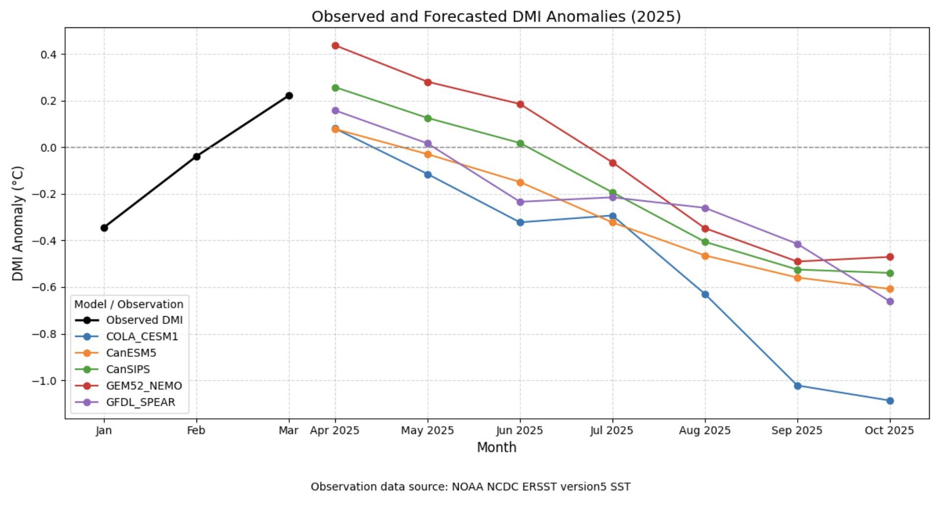

IRI’s IOD Index (Indian Ocean Dipole) Plume Forecast (based on NMME Models)
Courtesy: Laila Shaban

Slide 16
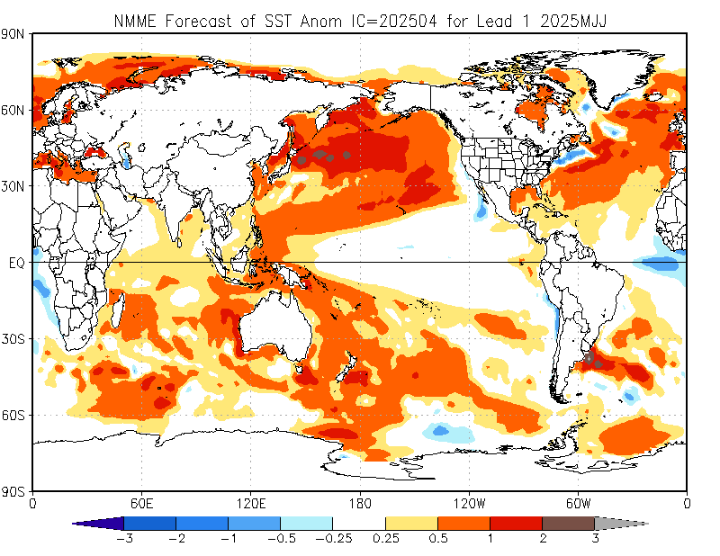
North American Multi Model Ensemble
(NMME) SST Forecast

Slide 17
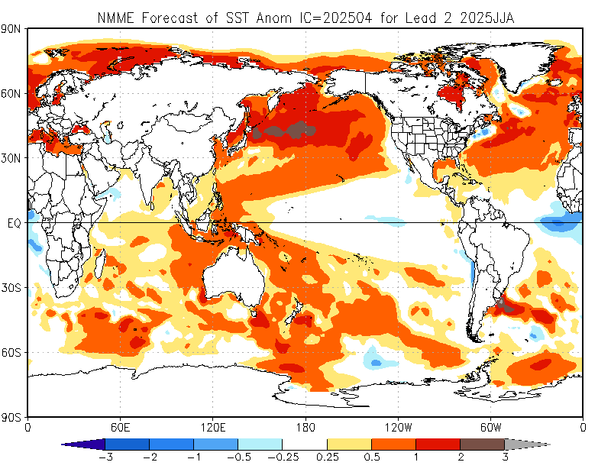

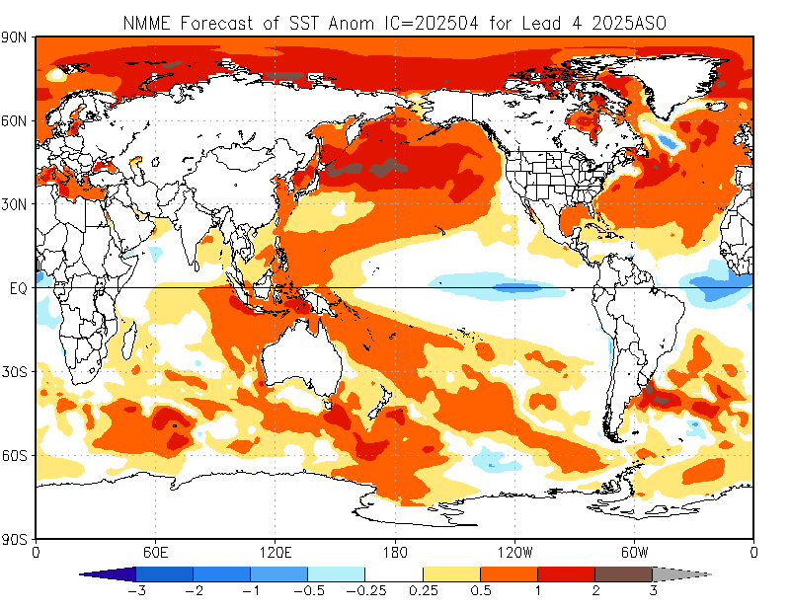

Slide 18
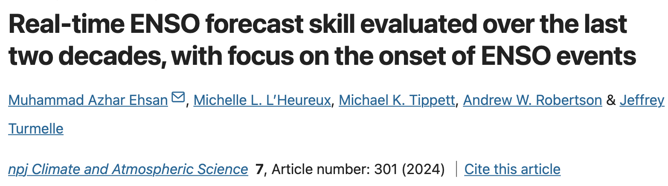
Accuracy is defined here as the ratio of correctly forecasted ENSO “onset times” to the total episodes.
A forecast at a given lead is considered a “hit” if the forecasted anomaly of the observed onset season meets or exceeds the threshold of +0.50 for warm episodes or −0.50 for cold episodes.
Strictly “Onset Season”

Slide 19
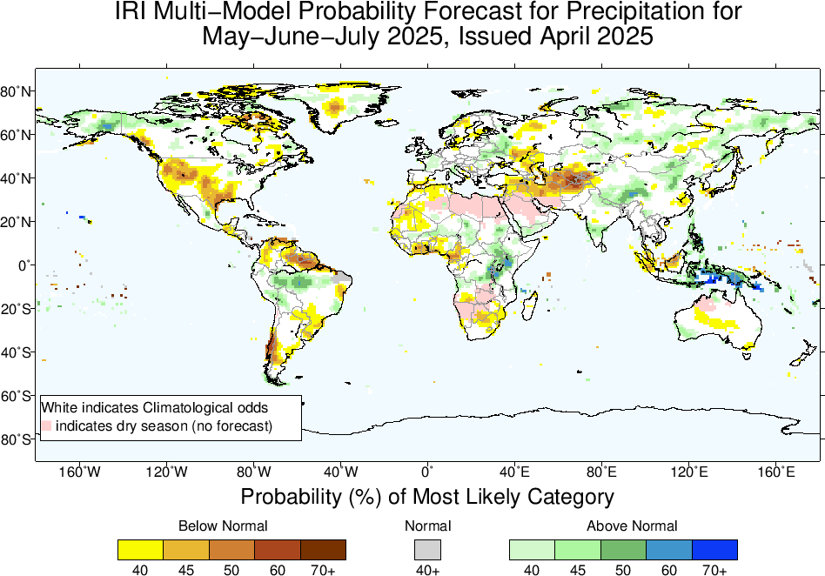
Precipitation Forecasts based on North American Multi Model Ensemble (NMME, without NASA-GEOSS2S)
North America:
A portion of the southern and western United States, including parts of Mexico, shows a high probability (45-55% or more) of below-normal precipitation.
South America:
Northern regions, southern Chile, and over and around Uraguay (weak signal) are expected to experience below-normal rainfall.
Africa:
West Africa, particularly around Gulf of Guneia, northeastern parts of South Africa,
Asia:
Areas around the Central-Southwest Asia also show BN rainfall tendencies.
Central America, South Asia, East Asia, MC and Australia:
Regions including parts of Alaska, central and western Brazil, equatorial east Africa, Sahle, and South Asia, MC-regions show above-normal precipitation probabilities.
Large swathes of Europe, central Africa, and parts of the Middle East are marked in white, indicating climatological odds or no significant deviation from normal precipitation levels.

Slide 20
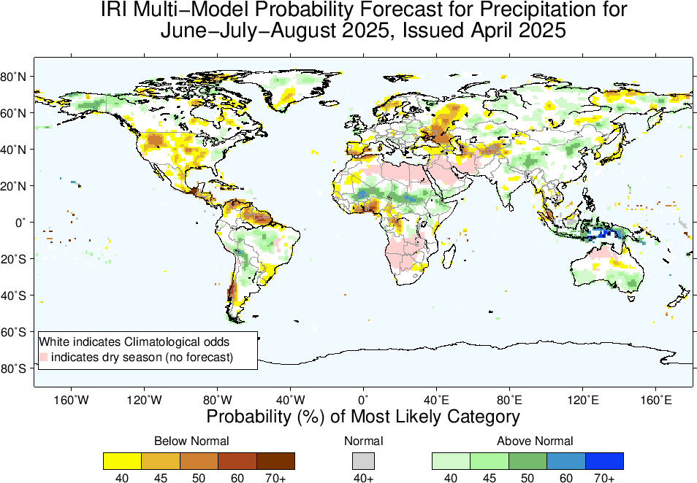
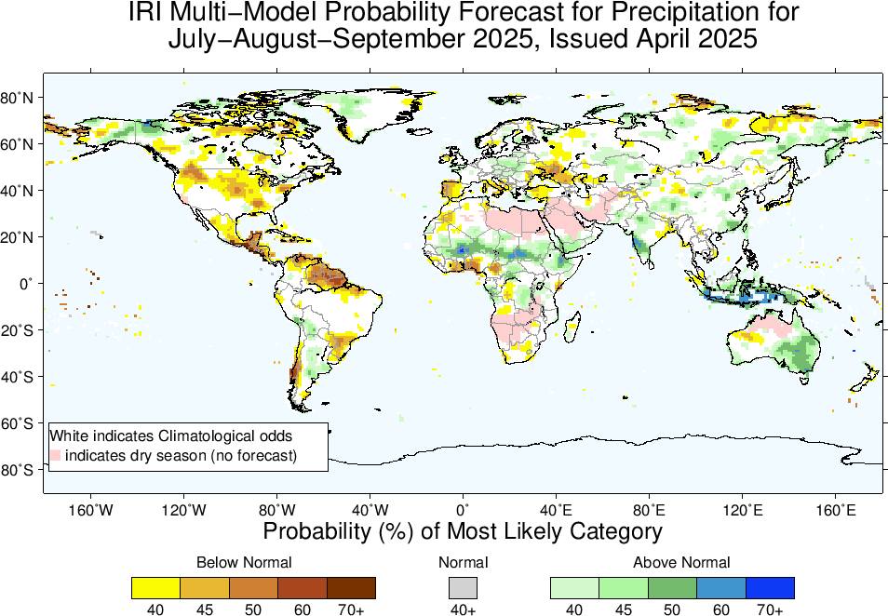
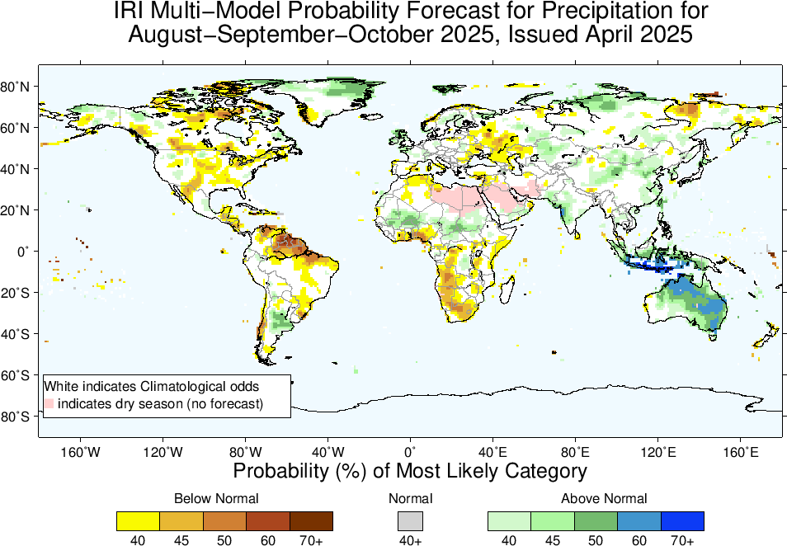

Slide 21
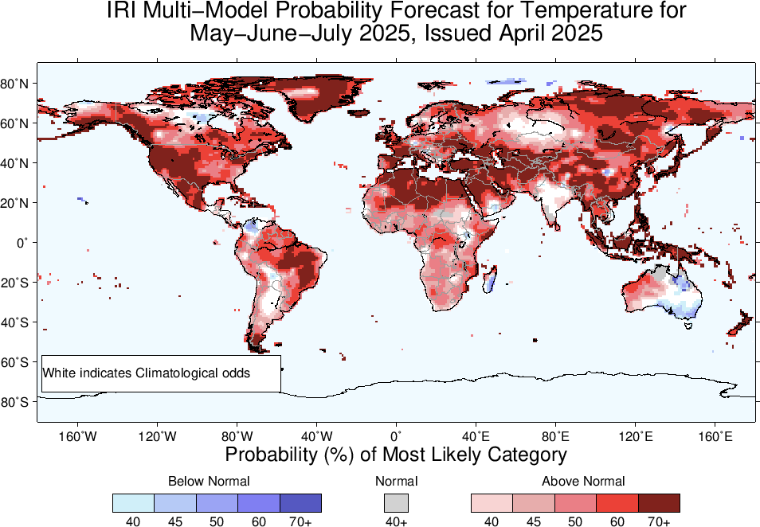
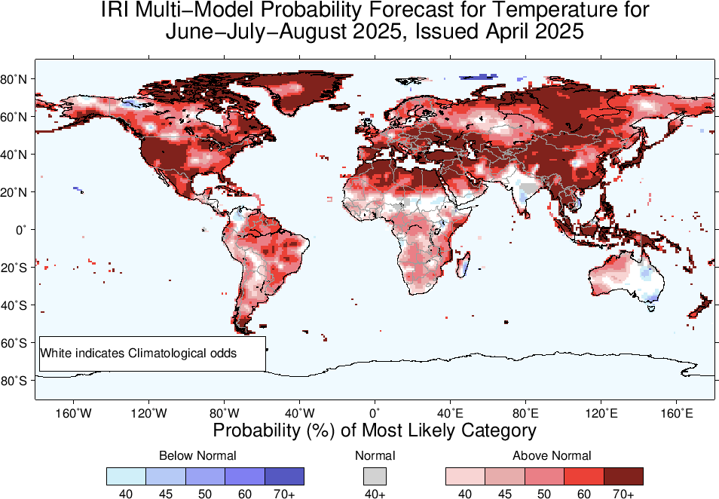
2m-Temperature Forecasts based on North American Multi Model Ensemble (NMME)

Slide 22
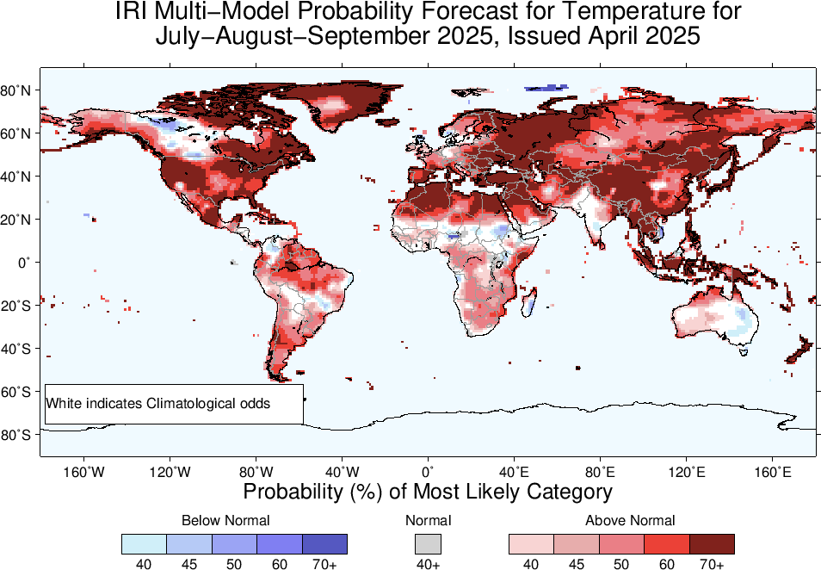
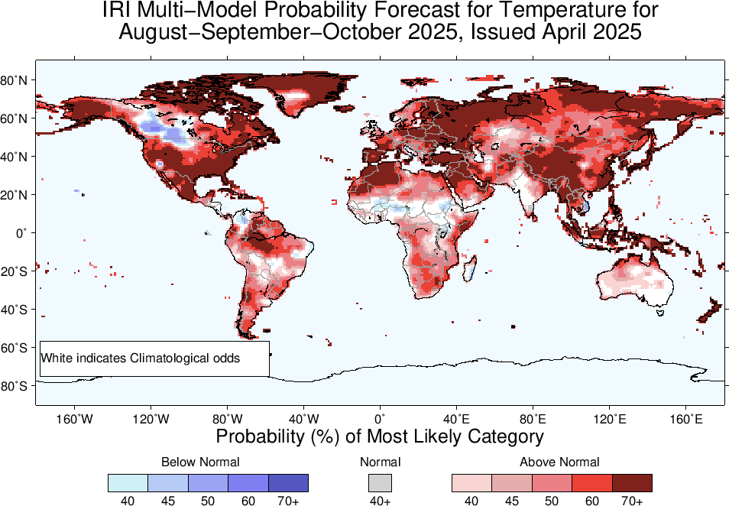

Slide 23
Summary
After end of 2023/24 El Nino, tropical Pacific has experienced ENSO-neutral conditions since May, to November, 2024 (NINO3.4 for May was +0.3, June was +0.24, July was +0.21, Aug was -0.07, and Sep was -0.15, Oct was -0.28, Nov was -0.14, Dec-24 was -0.62, Jan-25 was -0.71, Feb was -0.43, Mar was -0.1), and for most recent week ending on 09 April-2025, it was -0.1.
Mid April-2025 IRI/CCSR@NASA-GISS ENSO forecasts show that almost all models (with a one exception) favors for ENSO-Neutral from the start to the end of the Forecasts.
CPC issued Final La Nina Advisory for the month of April, 2025

