Slide 1
IRI Climate Briefing: Oct. 20, 2022 Sub-seasonal Update
Bohar Singh

Slide 2
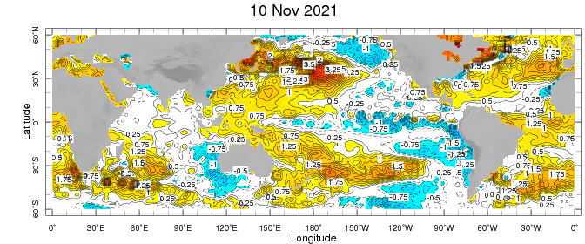
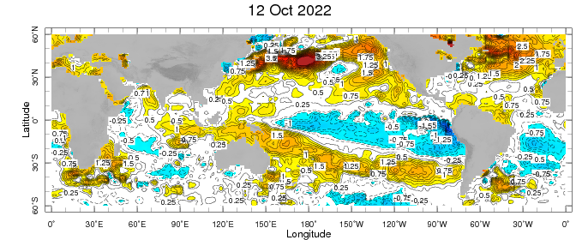
Sub-seasonal climate drivers: State of Climate
Cold anomalies in eastern and central Pacific become weaker as compared to previous month
Warm anomalies around Maritime continent expanded eastward in the west Pacific Ocean
Warm SST anomalies in the sub-tropical Pacific and North Atlantic Ocean weakened
Atlantic Ocean south of the equator become warmer as compared to previous month

Slide 3
State of the climate: Cloudiness and circulation
Source : CPC
Convective clouds are observed over Indian ocean and Maritime Continent
Clear sky is observed in over the eastern United States
Cloudiness is observed in over the western United states
Cloudiness over south Africa region

Slide 4
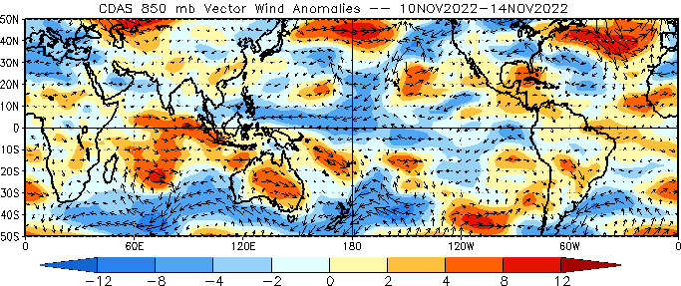
State of the climate: Cloudiness and circulation
Source : CPC

Slide 5
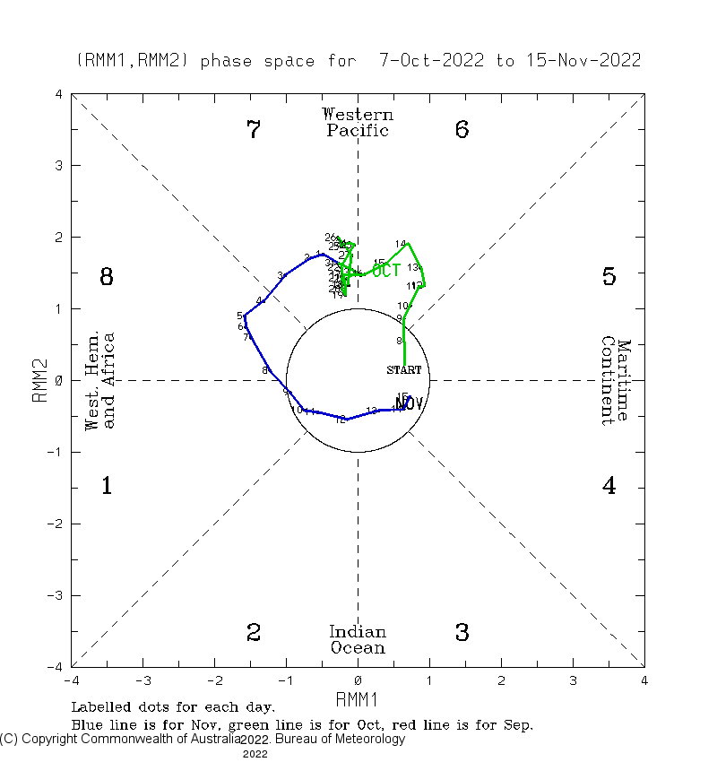
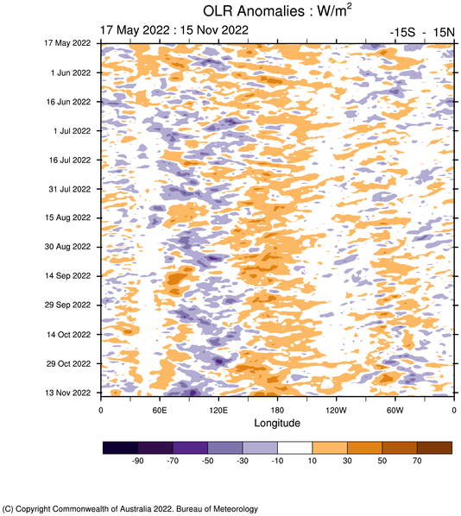
Current and Past evolution of the MJO Wheeler-Hendon Indices
Currently MJO is in development state in the west of Maritime continent

Slide 6
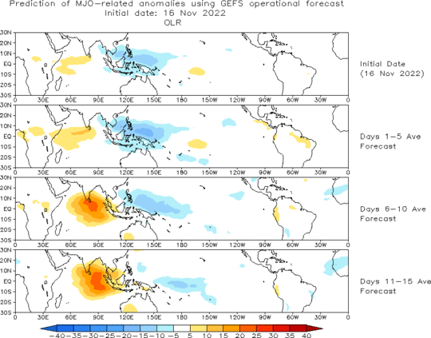
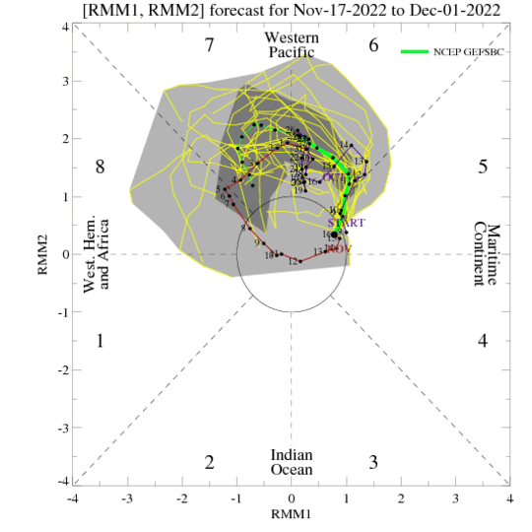
Forecast of MJO: Wheeler-Hendon Indices
MJO 15-day Forecast from NCEP GEFS model
Currently MJO is about to be active and expected to be remain active over next two weeks

Slide 7
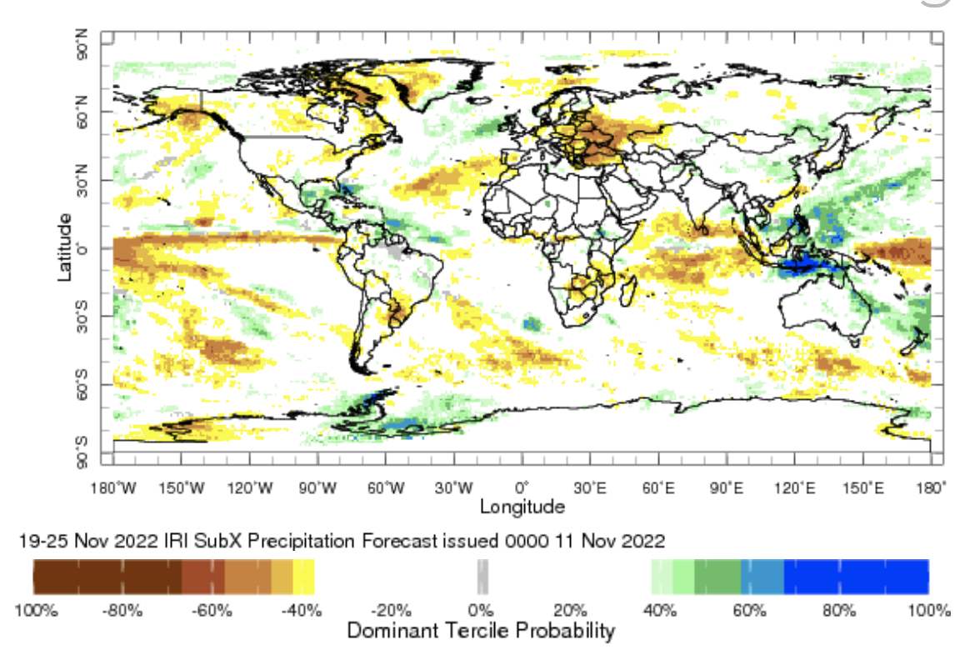
IRI Sub-seasonal Forecast: Precipitation (week 2)
Week:2: ( 19-25 Nov.)
Forecast issue date: Nov. 11th

Slide 8
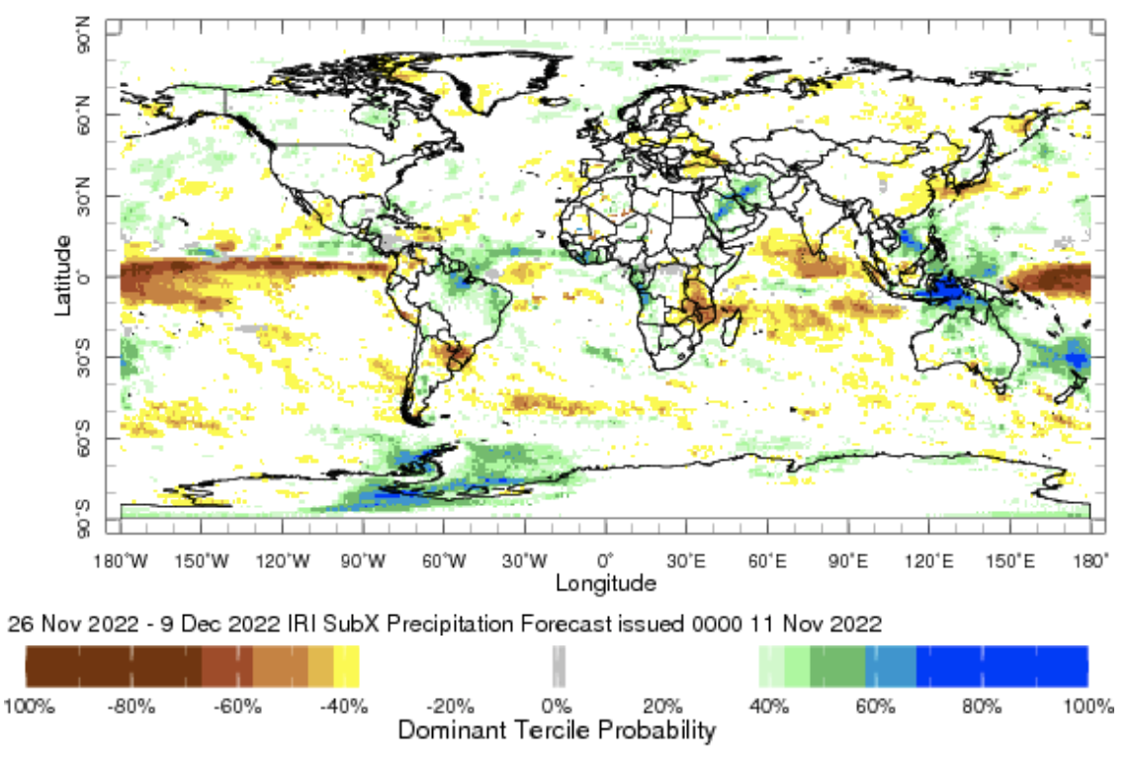
IRI Sub-seasonal Forecast: Precipitation (week 3 &4)
Week:3-4: ( 26 Nov.- 9 Dec.).
Forecast issue date: Nov. 11th

Slide 9
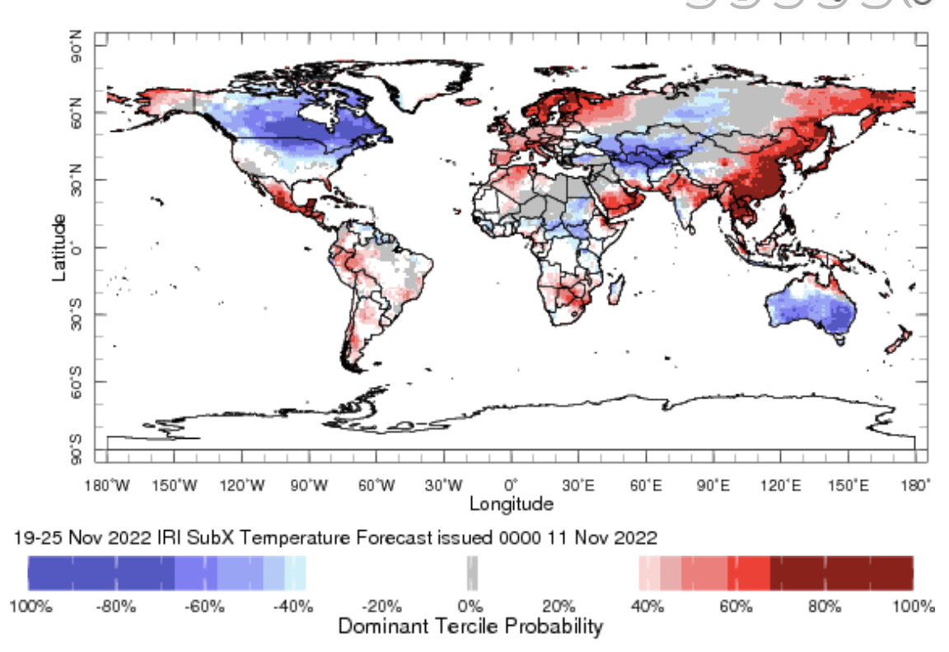
IRI Sub-seasonal Forecast : Near-Surface Temperature (week 2)
Week:2: ( 19-25 Nov.)
Forecast issue date: Nov. 11th

Slide 10
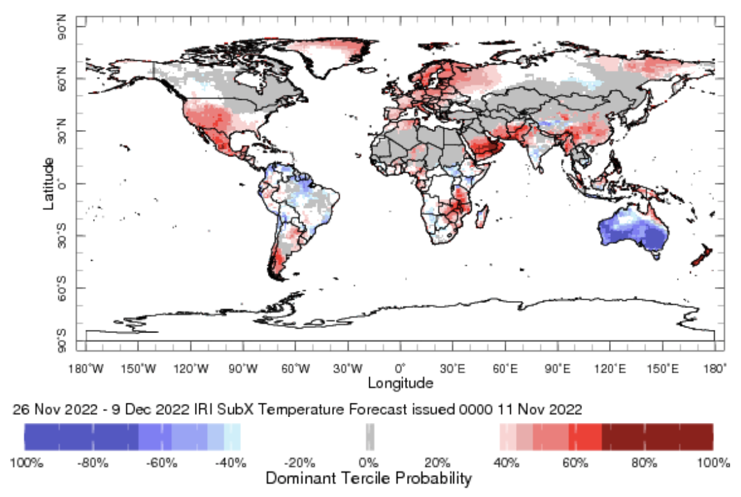
IRI Sub-seasonal Forecast : Near-Surface Temperature (week 3-4)
Week:3-4: ( 26 Nov.- 9 Dec.).
Forecast issue date: Nov. 11th

Slide 11
Summary
La Niña is weakening but active
MJO related convection and circulation are currently about to be active most likely remain active for next two week.
Maritime continent are likely to get above normal rainfall during week 2 and 3-4
Countries of east part of Southern Africa are likely to get below normal rainfall at week 2 and 3-4
Northern United States and Canada likely to see below normal temperature in week
Above normal temperature is expected over mid-southwest during weeks of 3-4 ( 26 Nov.- 9 Dec)
Below normal temperature is likely over entire Australian continent during next three weeks

Slide 12
Thank You!

