Slide 1
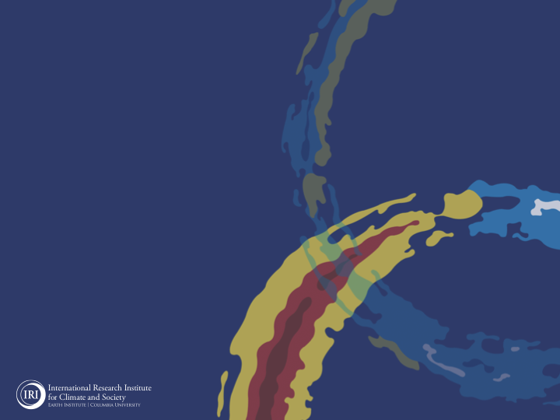

IRI Forecast Forum
Oct 2021
Ángel G. Muñoz

Slide 2
Summary
ENSO-neutral conditions are present, but equatorial sea-surface temperatures are below average across the central and east-central Pacific.
Transition from ENSO-neutral to La Niña conditions is favored in the next couple of months, with 60-65% chances of La Niña during NH winter 2021-22.
A large majority of the model forecasts predict Pacific SSTs to be below-normal through boreal fall and at least beginning of winter.
The RMM index shows a fairly stationary enhanced MJO envelope over the Maritime Continent (phases 4-5), and it is expected to weaken during the rest of Oct 2021.

Slide 3
Seasonal Timescale

Slide 4
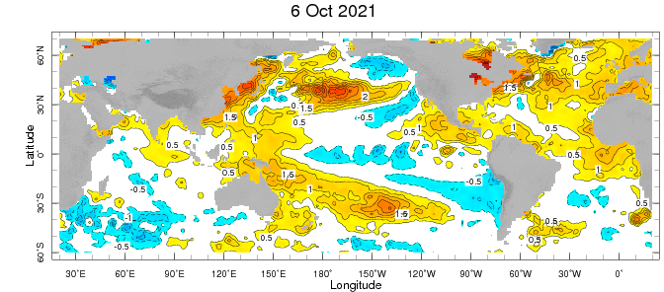

Slide 5
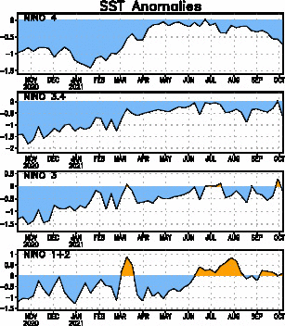

Slide 6
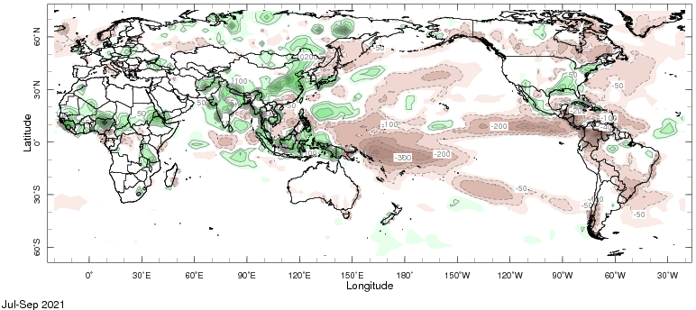
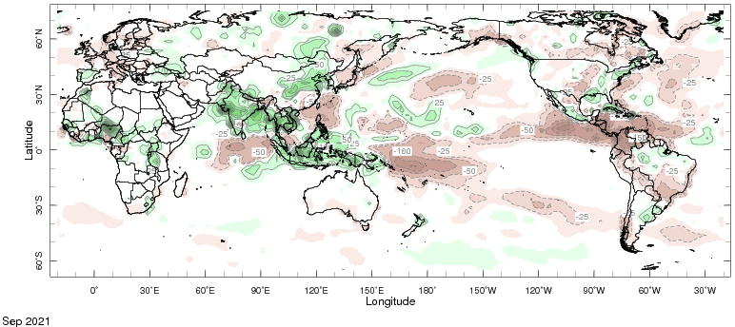

Slide 7
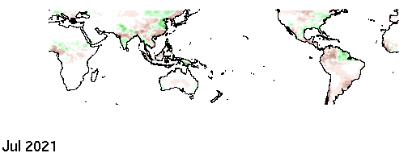


Slide 8
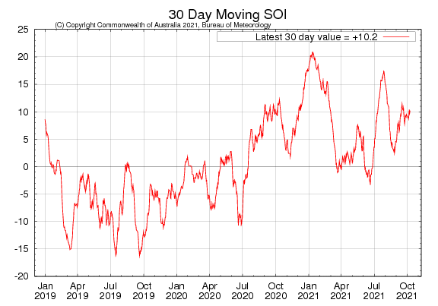

Slide 9
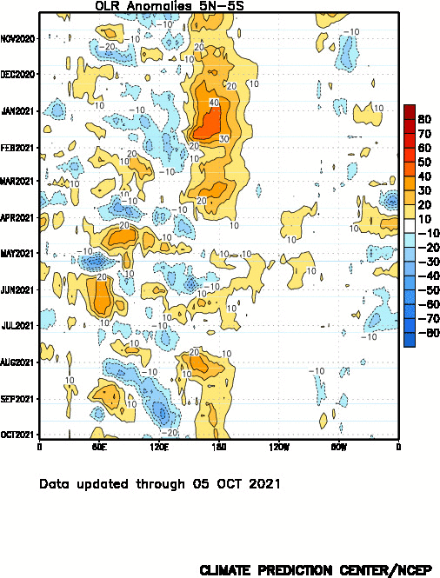

Slide 10
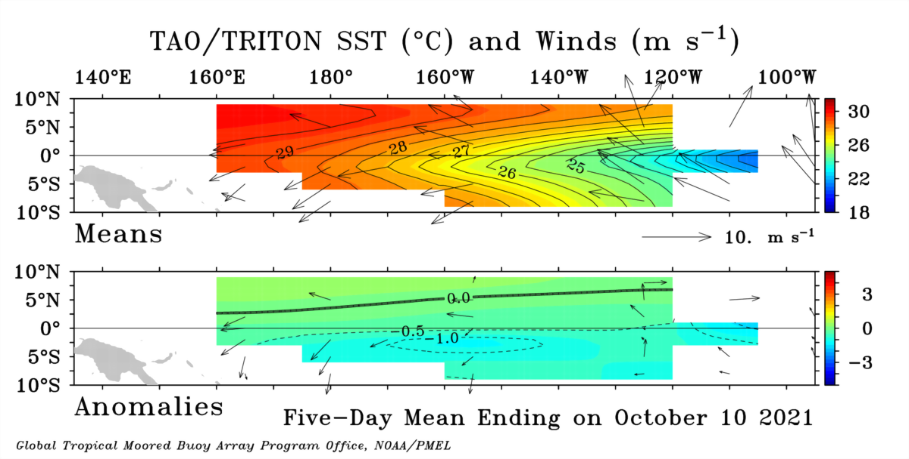

Slide 11
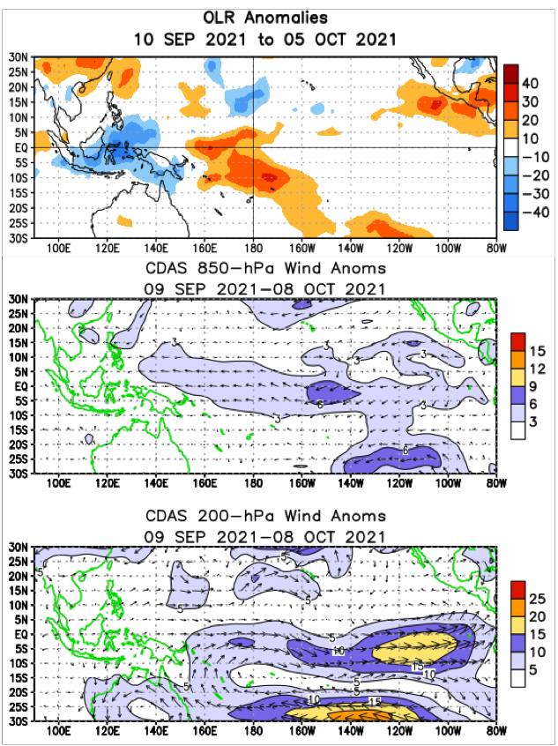

Slide 12
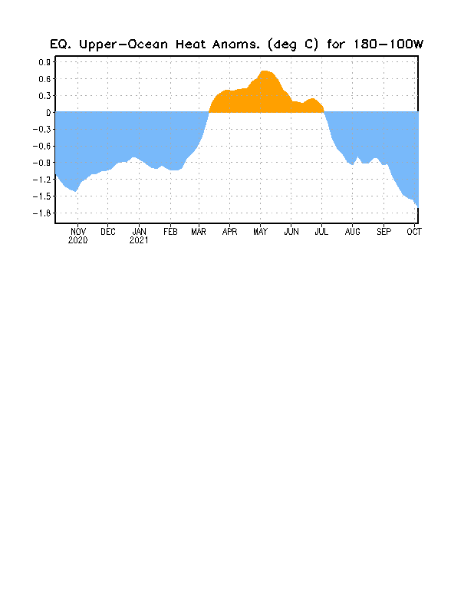

Slide 13
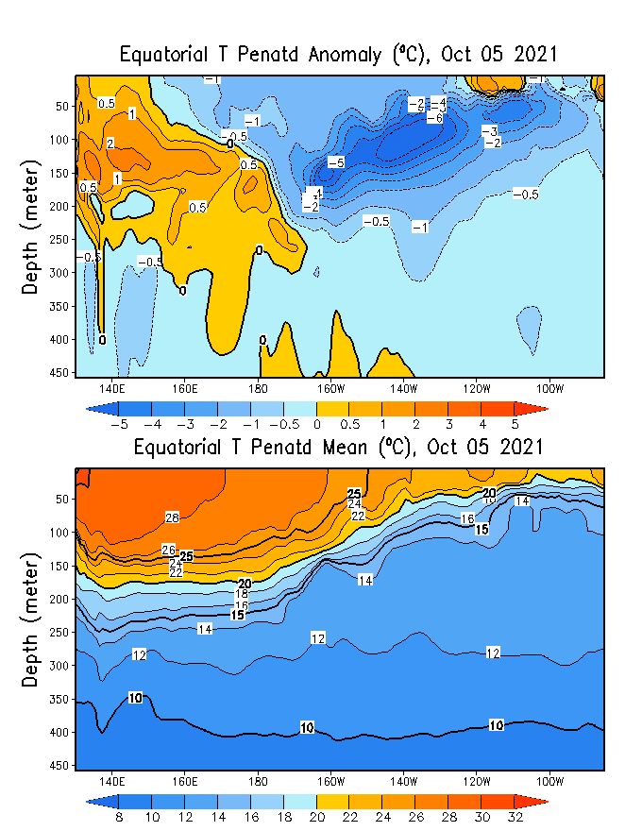
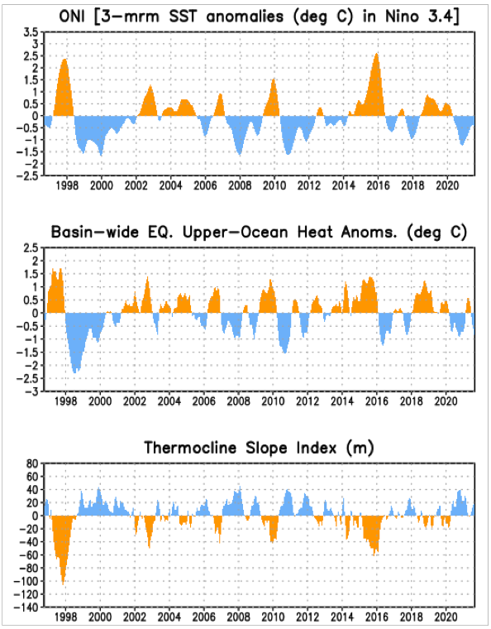

Slide 14
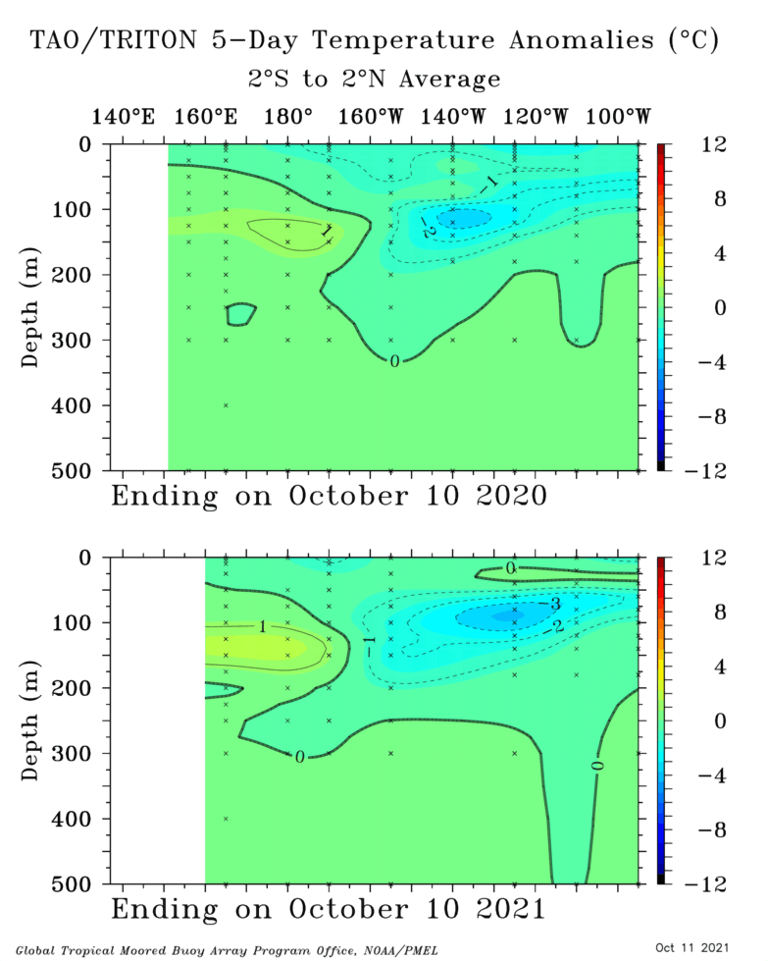

Slide 15
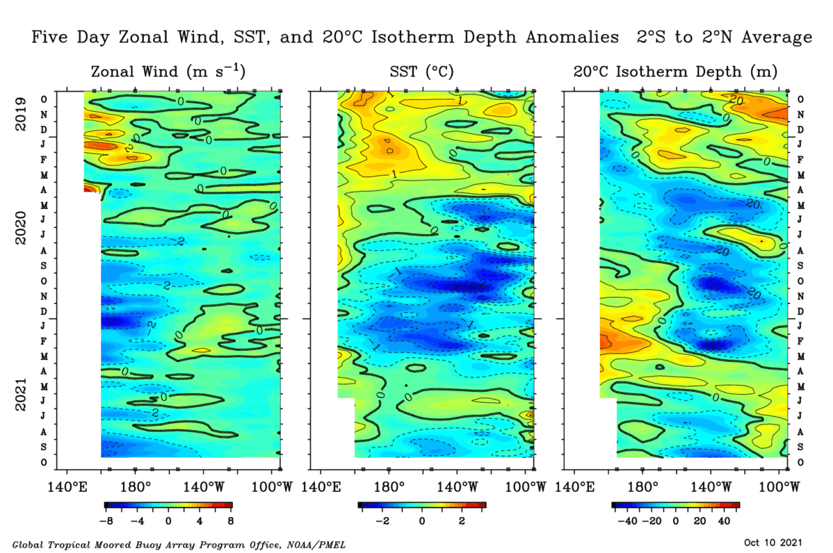

Slide 16
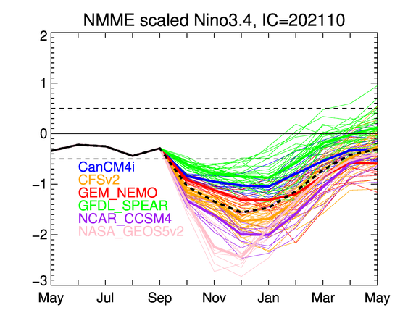

Slide 17
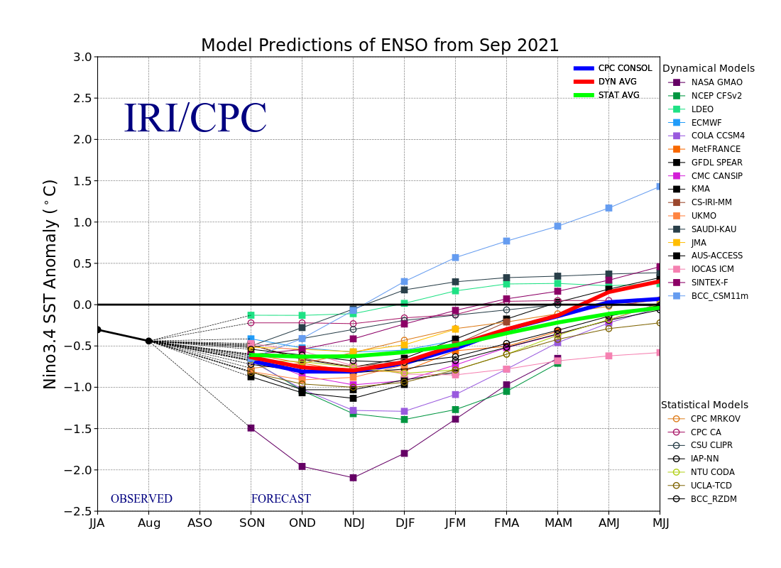

Slide 18
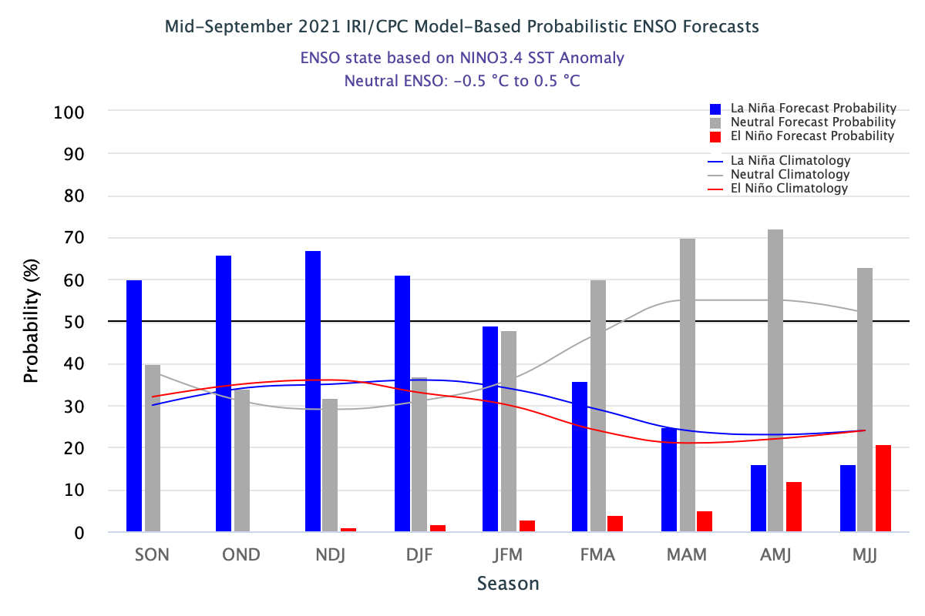

Slide 19
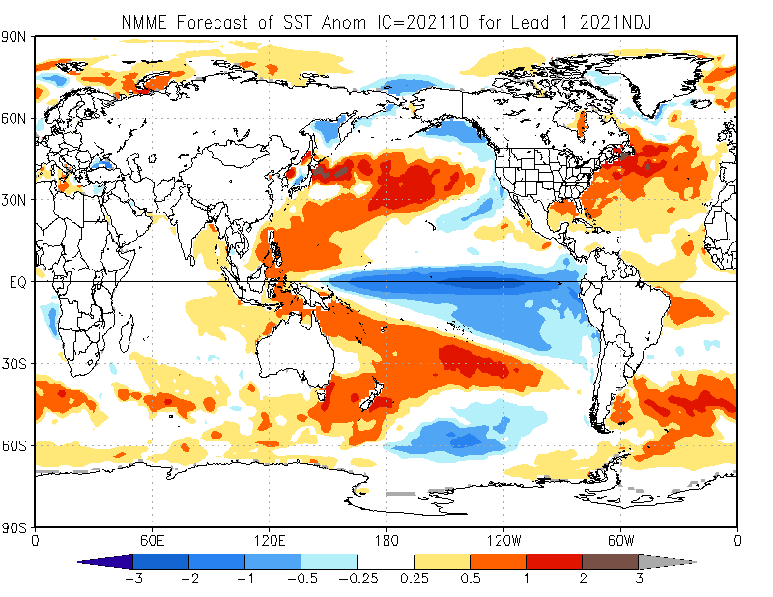

Slide 20
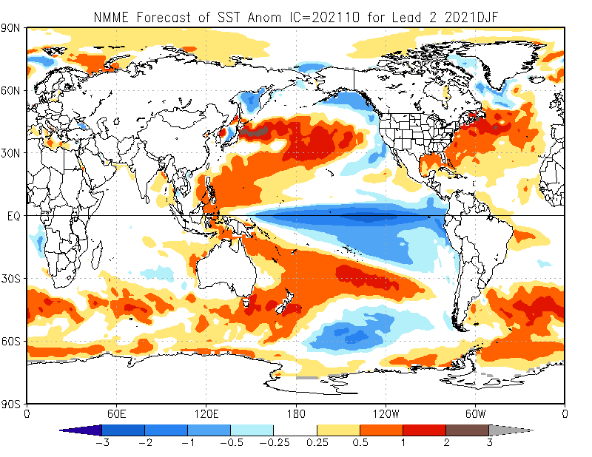

Slide 21
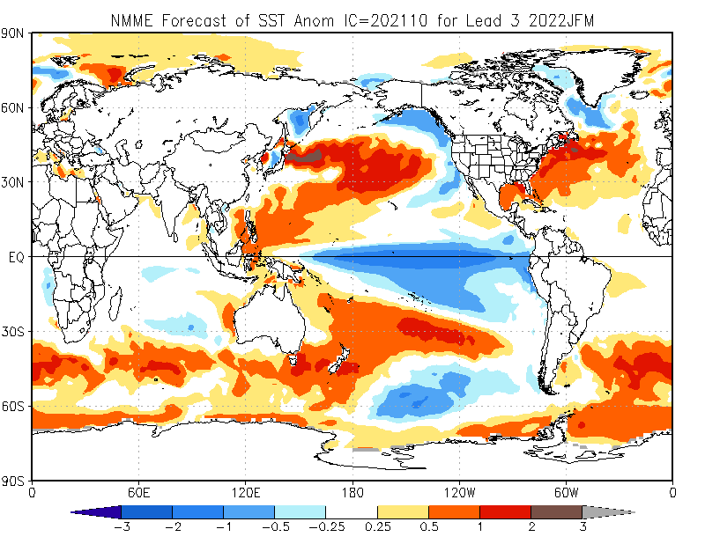

Slide 22
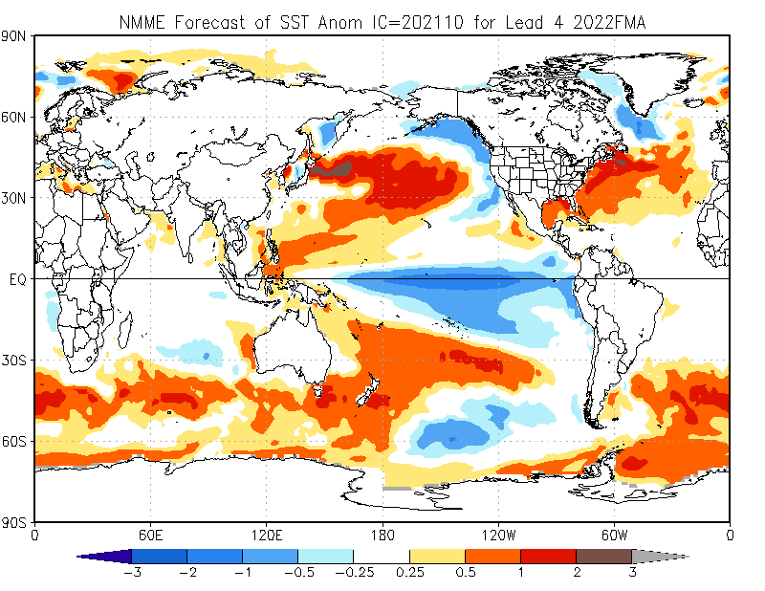

Slide 23
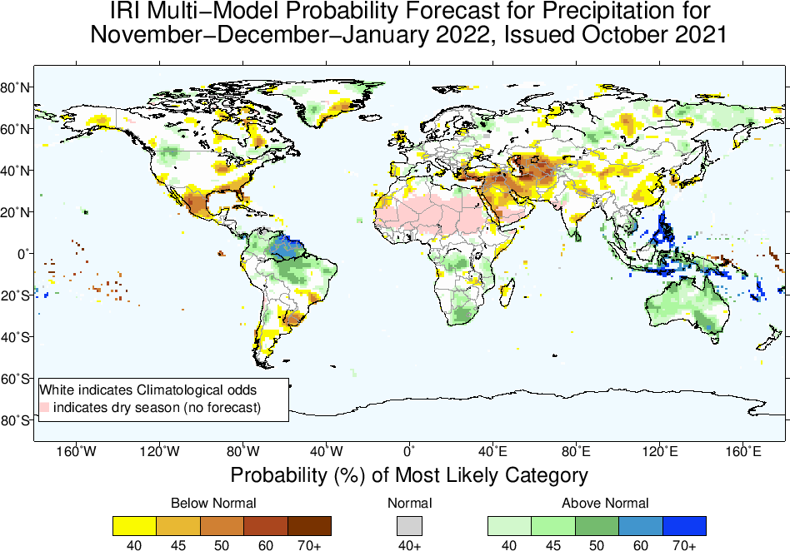

Slide 24
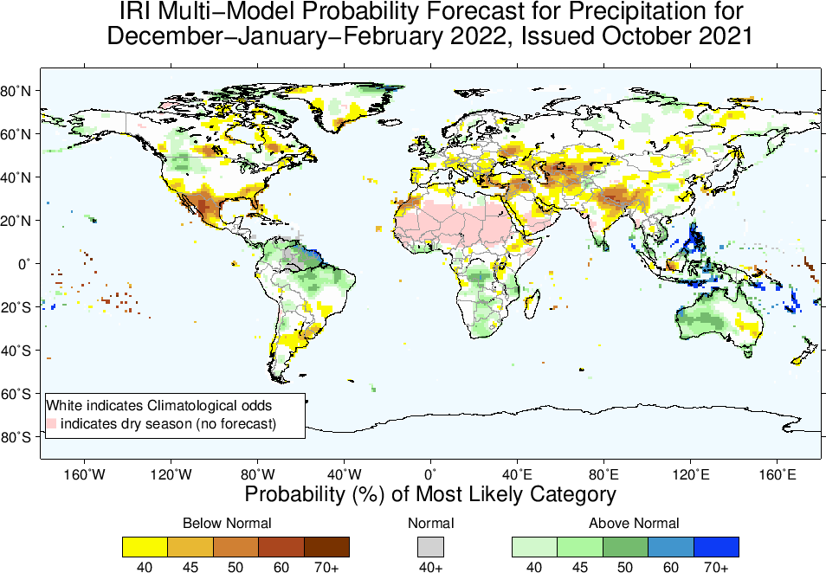

Slide 25
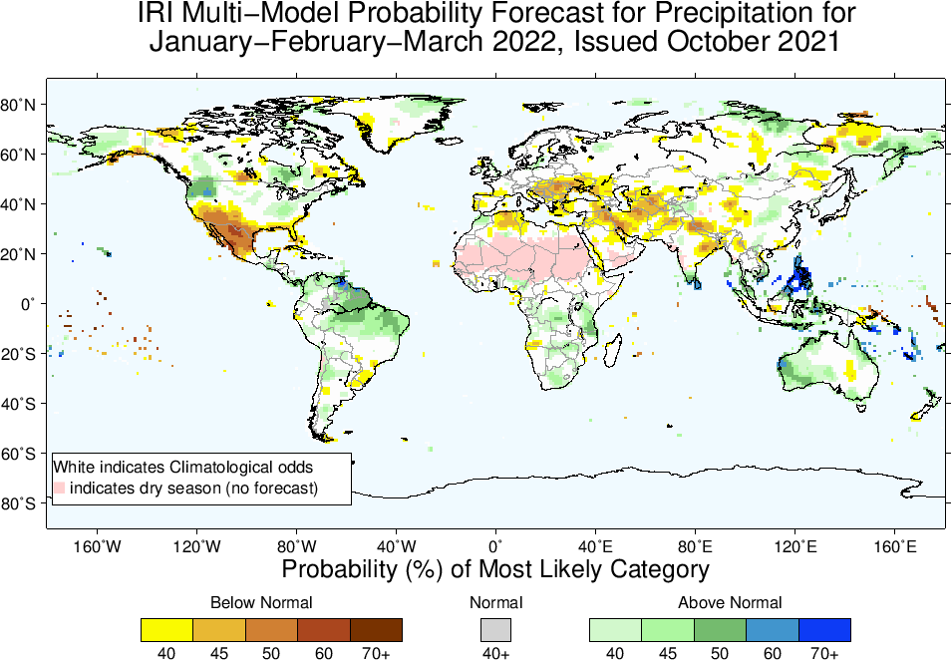

Slide 26
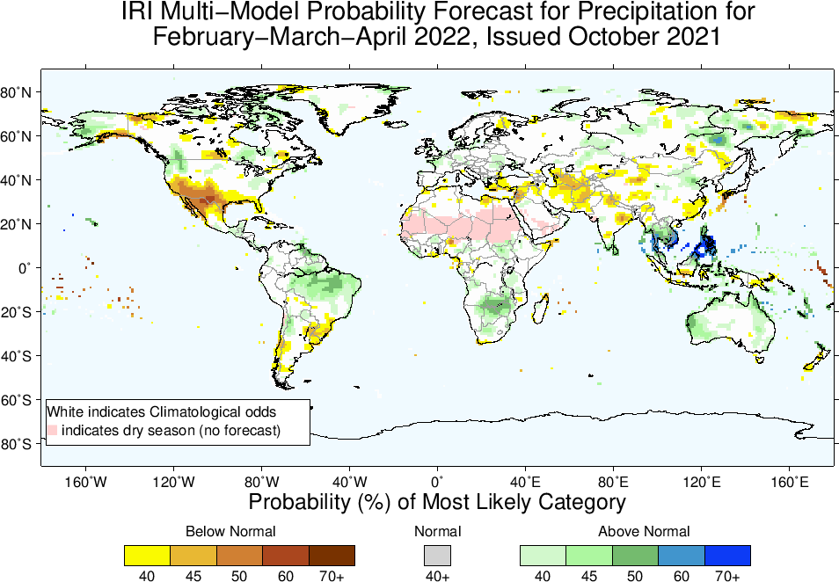

Slide 27
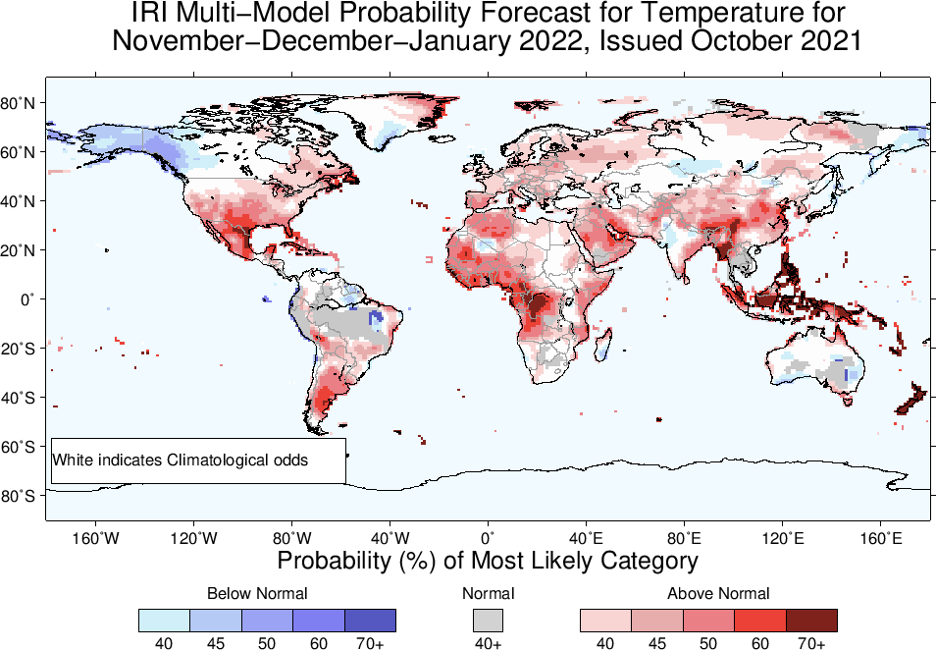

Slide 28
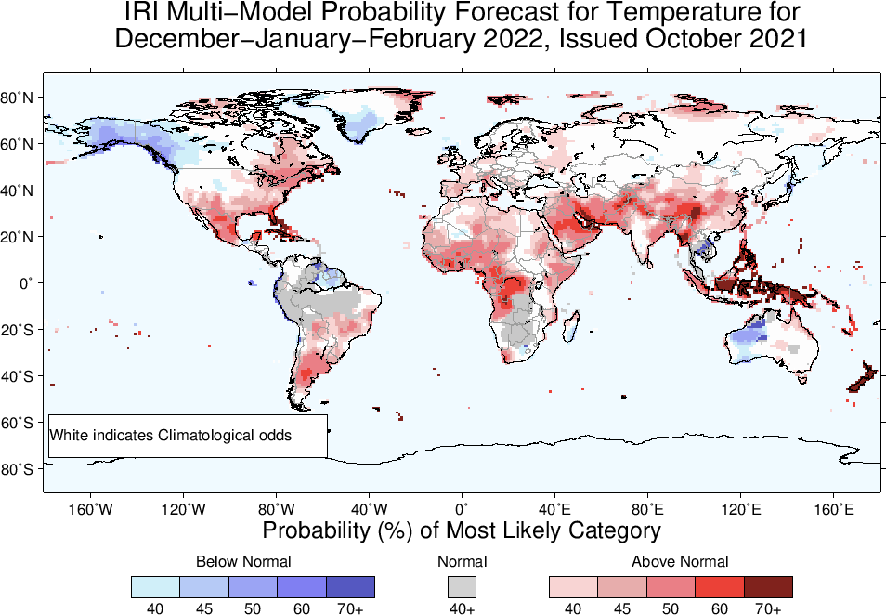

Slide 29
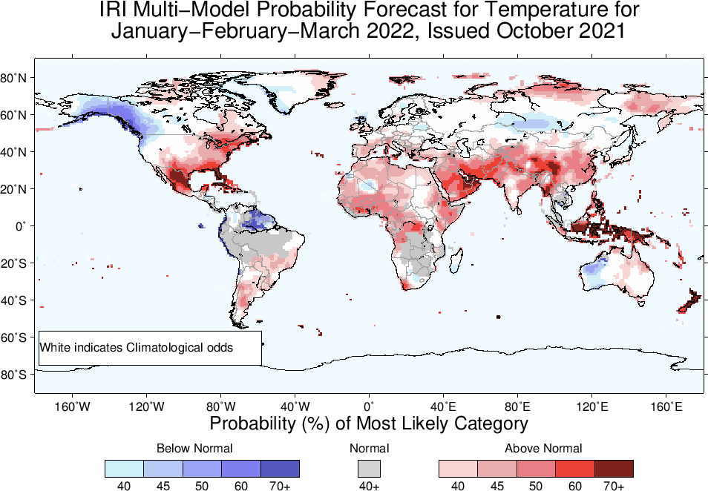

Slide 30
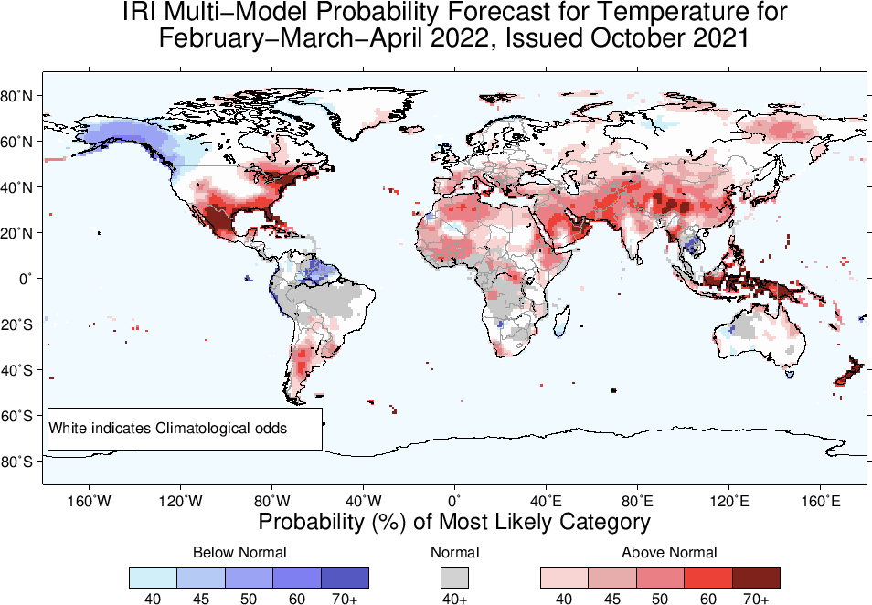

Slide 31
Subseasonal Timescale

Slide 32
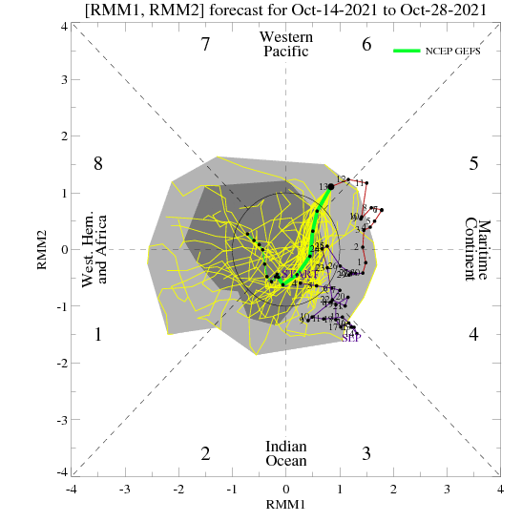
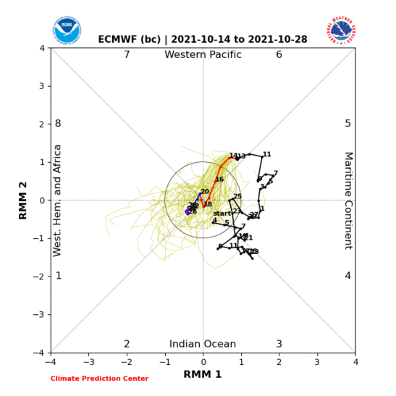
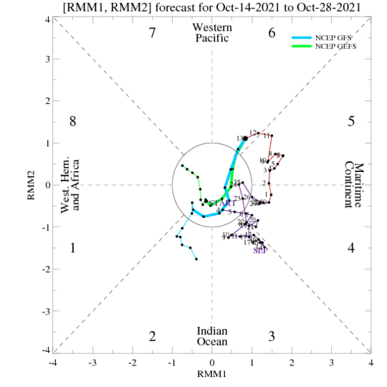
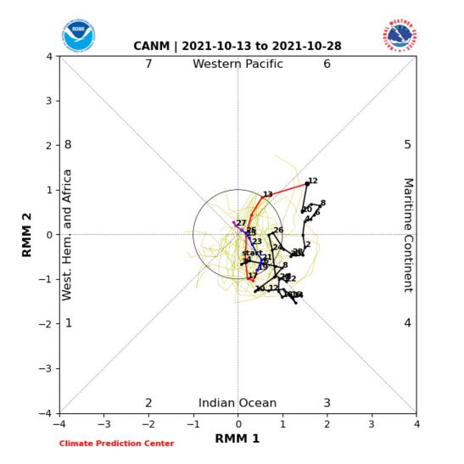

Slide 33
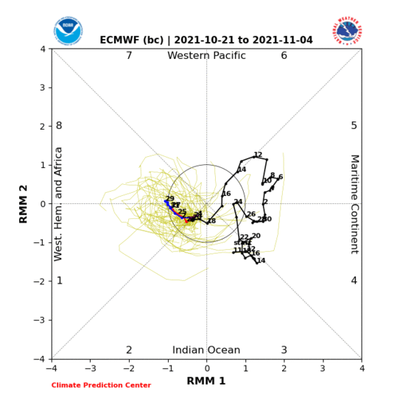
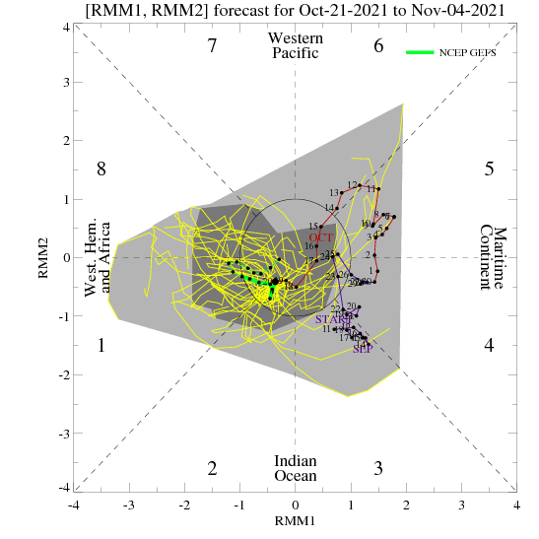
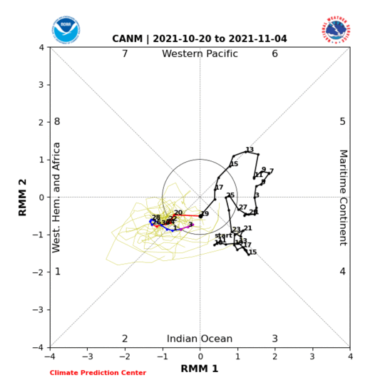
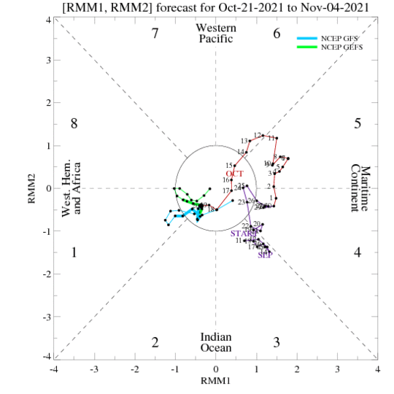

Slide 34
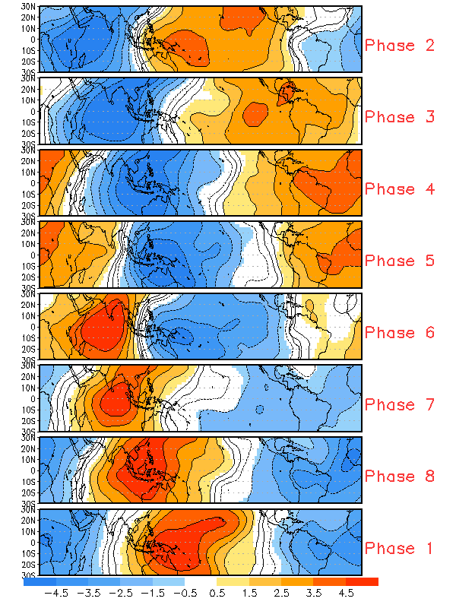
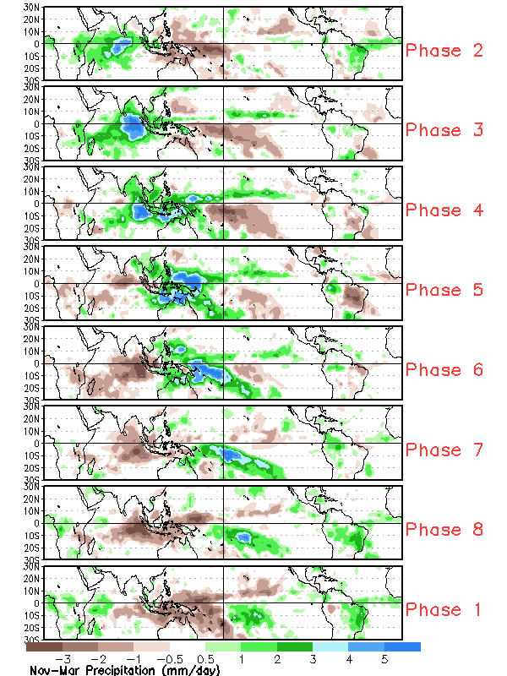

Slide 35
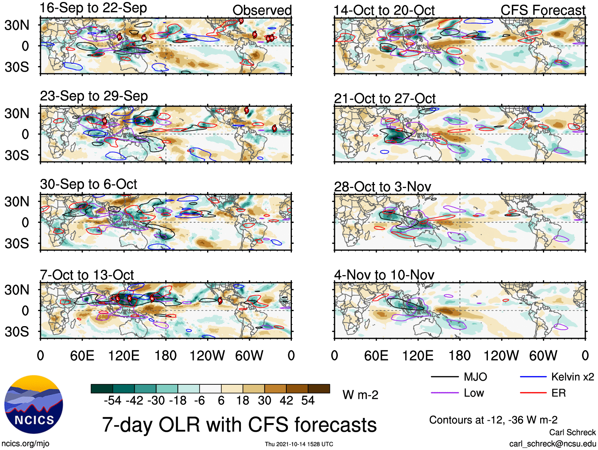

Slide 36
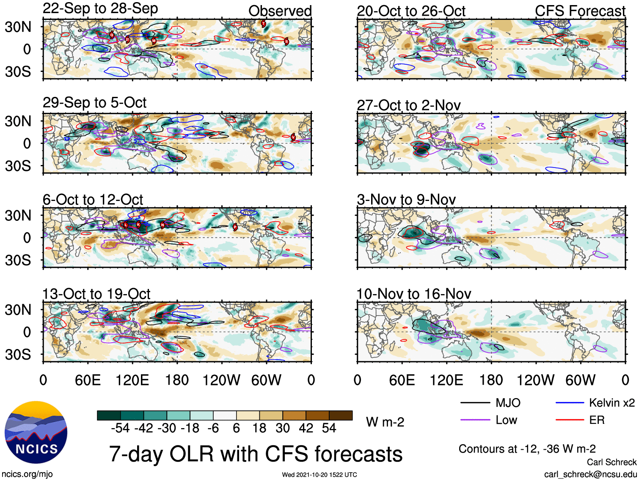

Slide 37
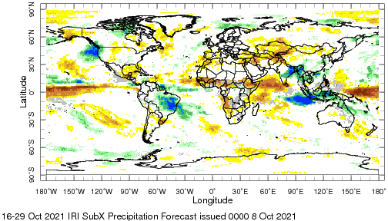
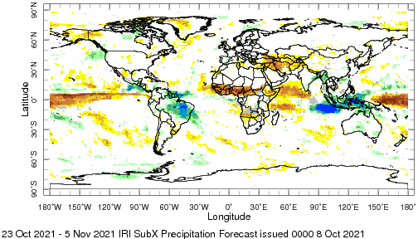

Slide 38
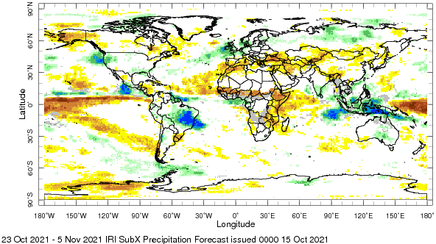
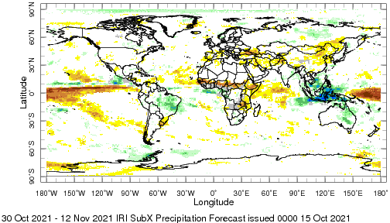

Slide 39
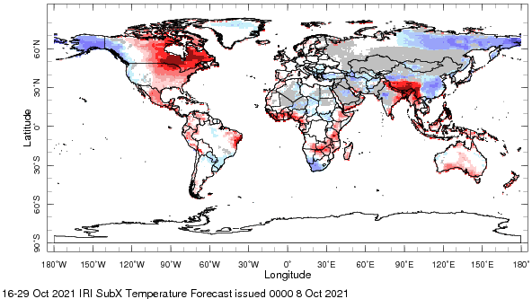
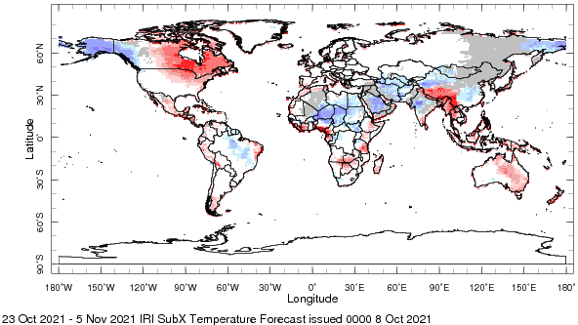

Slide 40
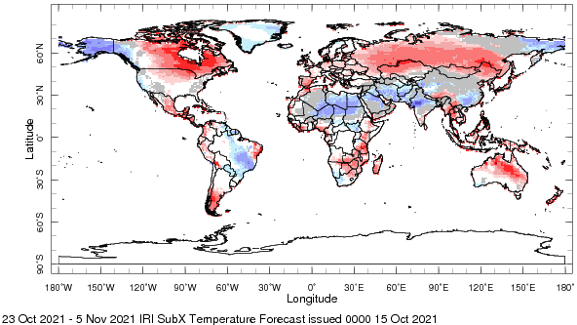
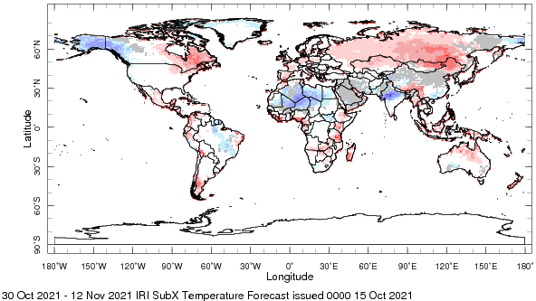

Slide 41
Summary
ENSO-neutral conditions are present, but equatorial sea-surface temperatures are below average across the central and east-central Pacific.
Transition from ENSO-neutral to La Niña conditions is favored in the next couple of months, with 60-65% chances of La Niña during NH winter 2021-22.
A large majority of the model forecasts predict Pacific SSTs to be below-normal through boreal fall and at least beginning of winter.
The RMM index shows a fairly stationary enhanced MJO envelope over the Maritime Continent (phases 4-5), and it is expected to weaken during the rest of Oct 2021.

Slide 42
IRI Forecast Forum
Oct 2021
Ángel G. Muñoz

