Slide 1
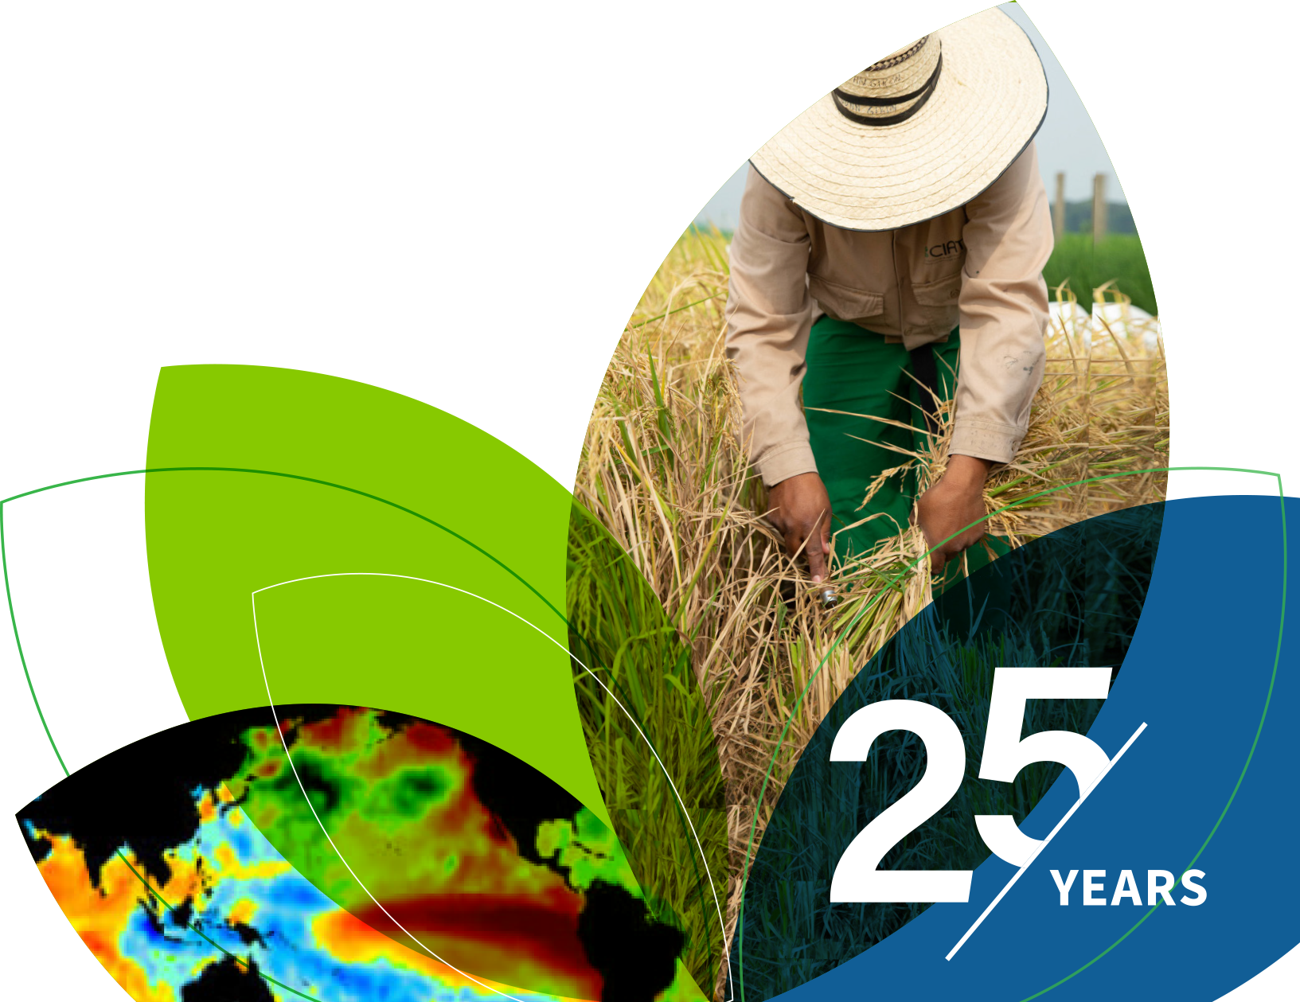
IRI Climate Briefing: May. 18, 2023 Sub-seasonal Update
Bohar Singh

Slide 2
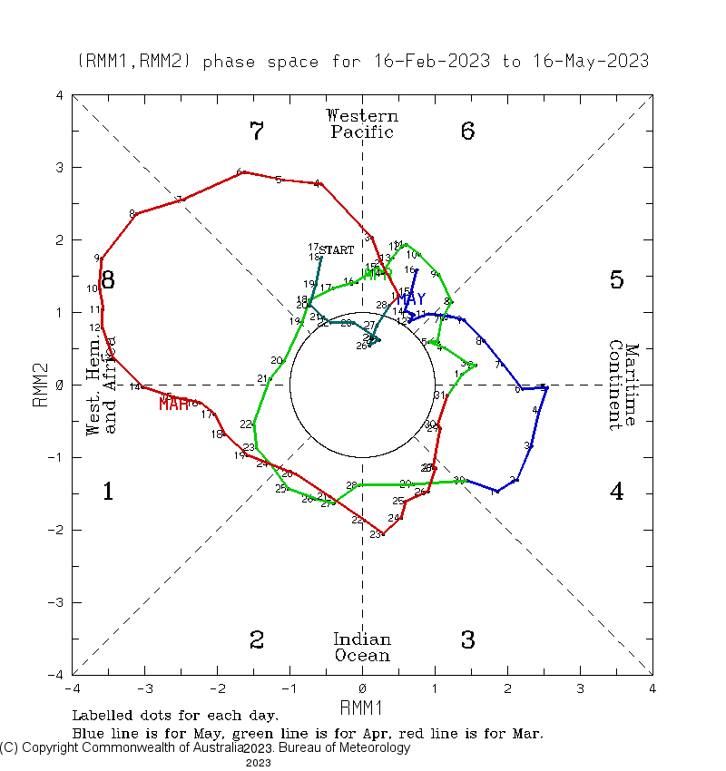
Current and Past evolution of the MJO Wheeler-Hendon Indices
MJO is in active state since late February and, currently it is in the west Pacific Ocean
1
3
These multiple MJO events and subsequent Oceanic Kelvin waves enforcing El Niño to become stronger
2
May be the reason behind confident El Niño forecast by dynamical models

Slide 3
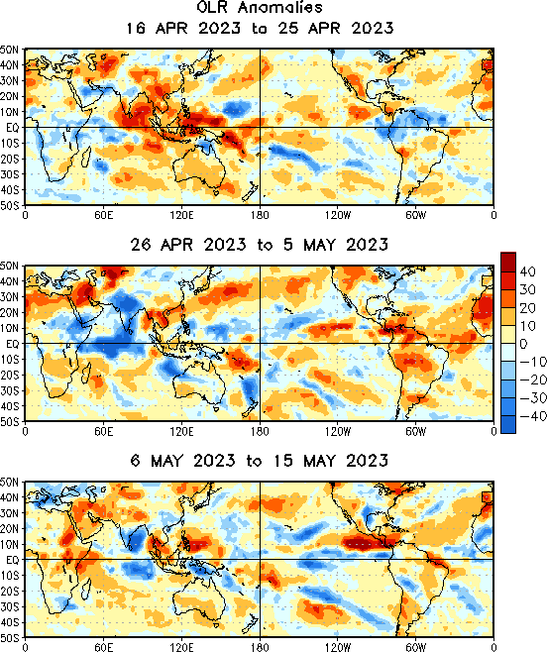
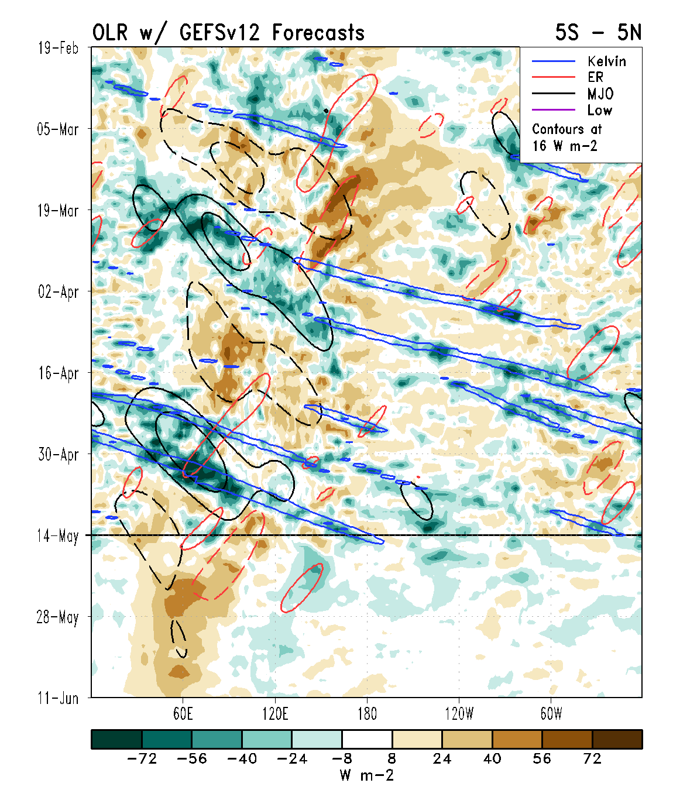
State of the climate: Cloudiness and wave propagation
MJO is moved through the Indian Ocean and Maritime Continent since mid April
However, convective phase is disrupted by Kelvin
And Rossby waves moving across the Pacific.

Slide 4
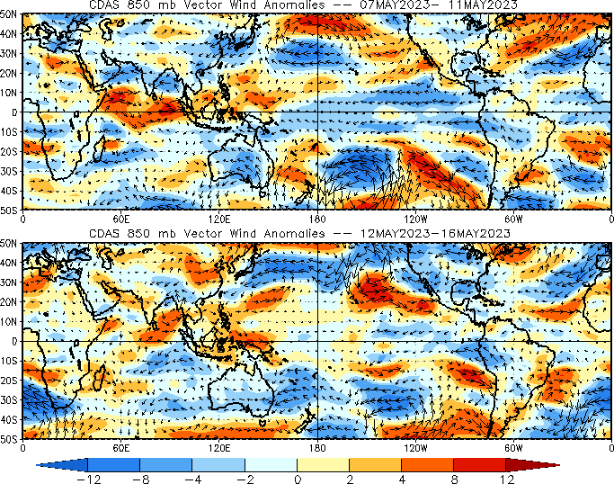
State of the climate : Circulation
Easterly winds over the central Pacific is become weak due to current MJO activity

Slide 5
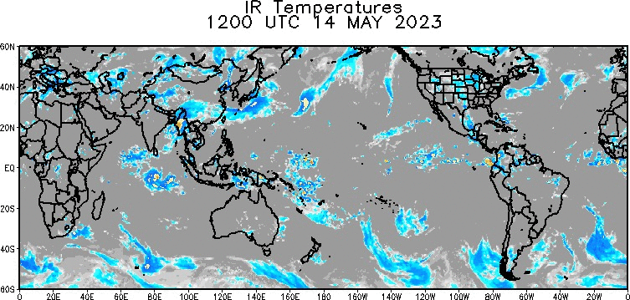
State of the climate :Global IR (14-17 May)
MJO scale cloudiness is rejuvenated recently in the western Pacific after destructive interference with high frequency waves

Slide 6
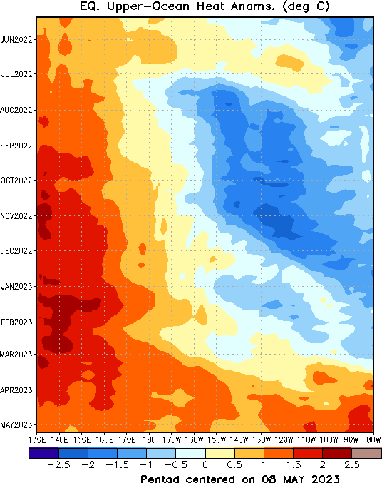
State of the climate : Upper Ocean heat Content
Due to episode of MJO related westerly wind burst (WWB) forced series of oceanic Kelvin wave
That leads to the expansion of warm pool eastward
WWB’s are making conditions favorable for stronger El-Niño .

Slide 7
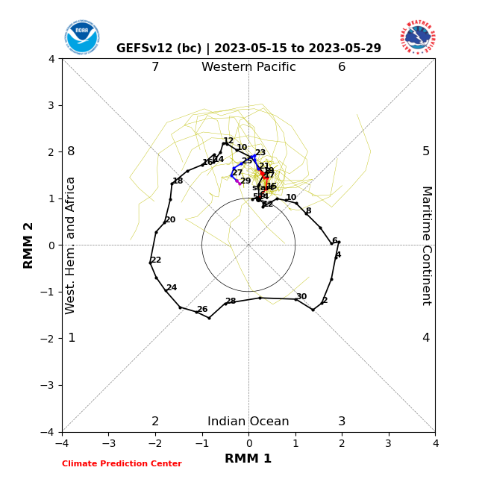
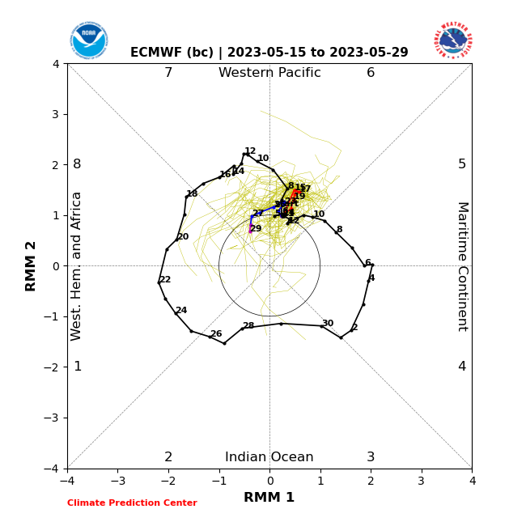
Forecast of MJO: Wheeler-Hendon Indices
MJO 15-day Forecast from NCEP GEFSv12 and ECMWF models
GEFSv12 Forecast
ECMWF Forecast

Slide 8
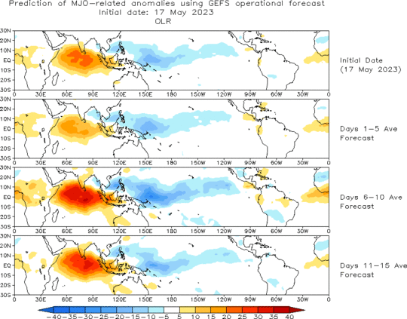
OLR anomalies 15-day Forecast from NCEP GEFS model
The forecast indicates that MJO becoming more stationary over the equatorial Pacific.

Slide 9
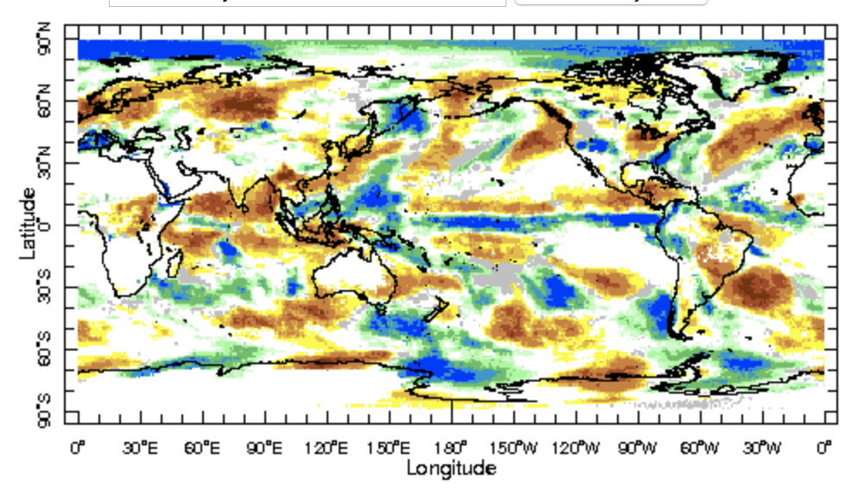
IRI Sub-seasonal Forecast: Precipitation (week 1)
Week:1 : ( 20th -26th May.)
Forecast issue date: May. 19th
Above normal rainfall is likely over Maritime continent and west pacific,
Dry conditions are likely over central Africa, southern India, Bangladesh and Myanmar

Slide 10
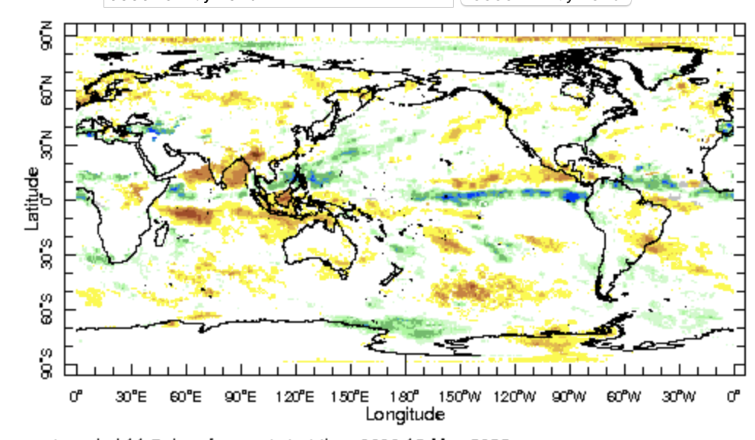
IRI Sub-seasonal Forecast: Precipitation (week 2 )
Week:2 : ( 27th May.-2nd June.)
Forecast issue date: May. 19th
Above normal rainfall is likely over eastern tropical Pacific Ocean and Sahel African region
Above normal conditions are also likely over north west Pacific Ocean

Slide 11
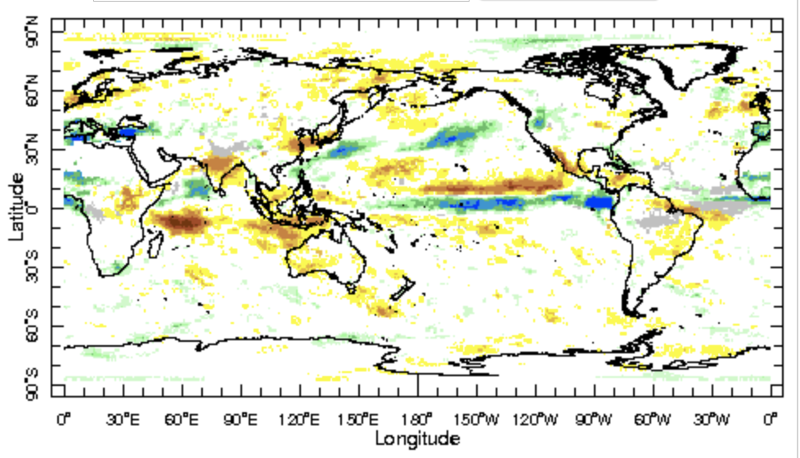
IRI Sub-seasonal Forecast: Precipitation (week 3+4 )
Week:3-4 : ( 3rd -16th June.)
Forecast issue date: May. 19th
Below normal rainfall is likely over western Australia and central India which suggest delay in monsoon onset.
West Africa region will be receiving likely above normal precipitation

Slide 12
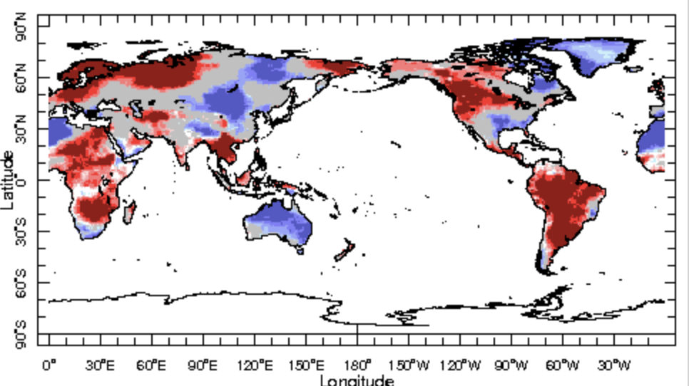
IRI Sub-seasonal Forecast : Near-Surface Temperature (week 1)
Week:1 : ( 20th -26th May.)
Forecast issue date: May. 19th
Above normal temperature is likely over larger region of Africa except north-west African regions
Northwest North America and larger parts of south America also experience warm temperatures

Slide 13
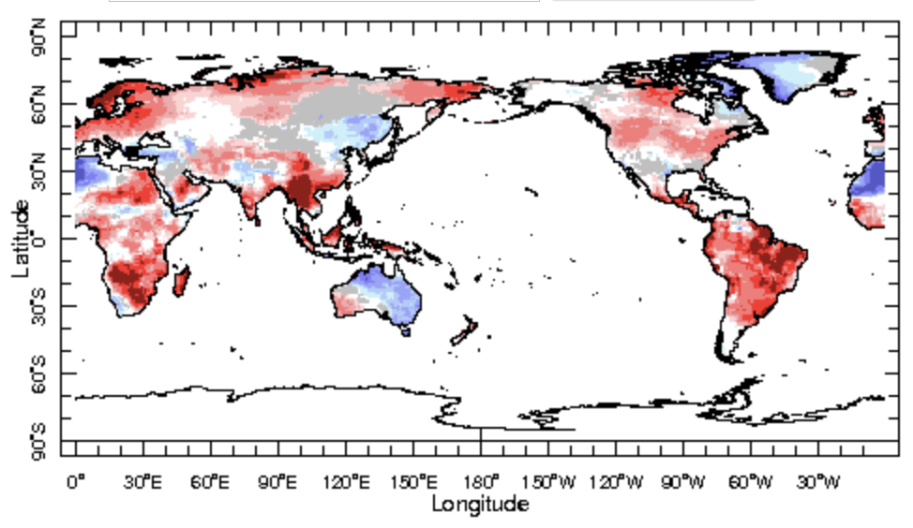
IRI Sub-seasonal Forecast : Near-Surface Temperature (week 2)
Week:2 : ( 27th May.-2nd June.)
Forecast issue date: May. 19th
Warm conditions likely to persist similar to week 1 forecast

Slide 14
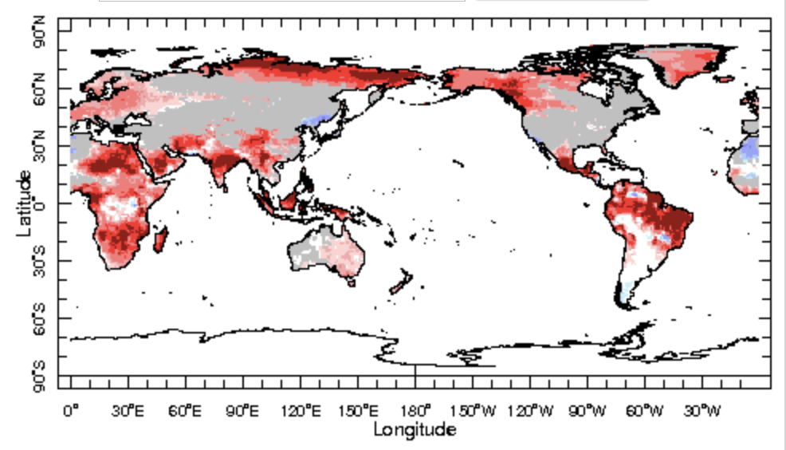
IRI Sub-seasonal Forecast : Near-Surface Temperature (week 3+4)
Week:3-4 : ( 3rd -16th June.)
Forecast issue date: May. 19th

Slide 15
Summary
El Niño : getting stronger by episodic forcing from MJO
Currently MJO is in active state, is likely in west Pacific
Another episode of MJO likely to be active in the west Pacific by the next week it will propagates slowly across the western Pacific through late May and early June.
MJO impacts, through its teleconnection are expect during coming weeks.
Indian monsoon is starting with a break and delyed monsoon onset is likely
West African monsoon region is likely to receive rainfall in the start of the season

Slide 16
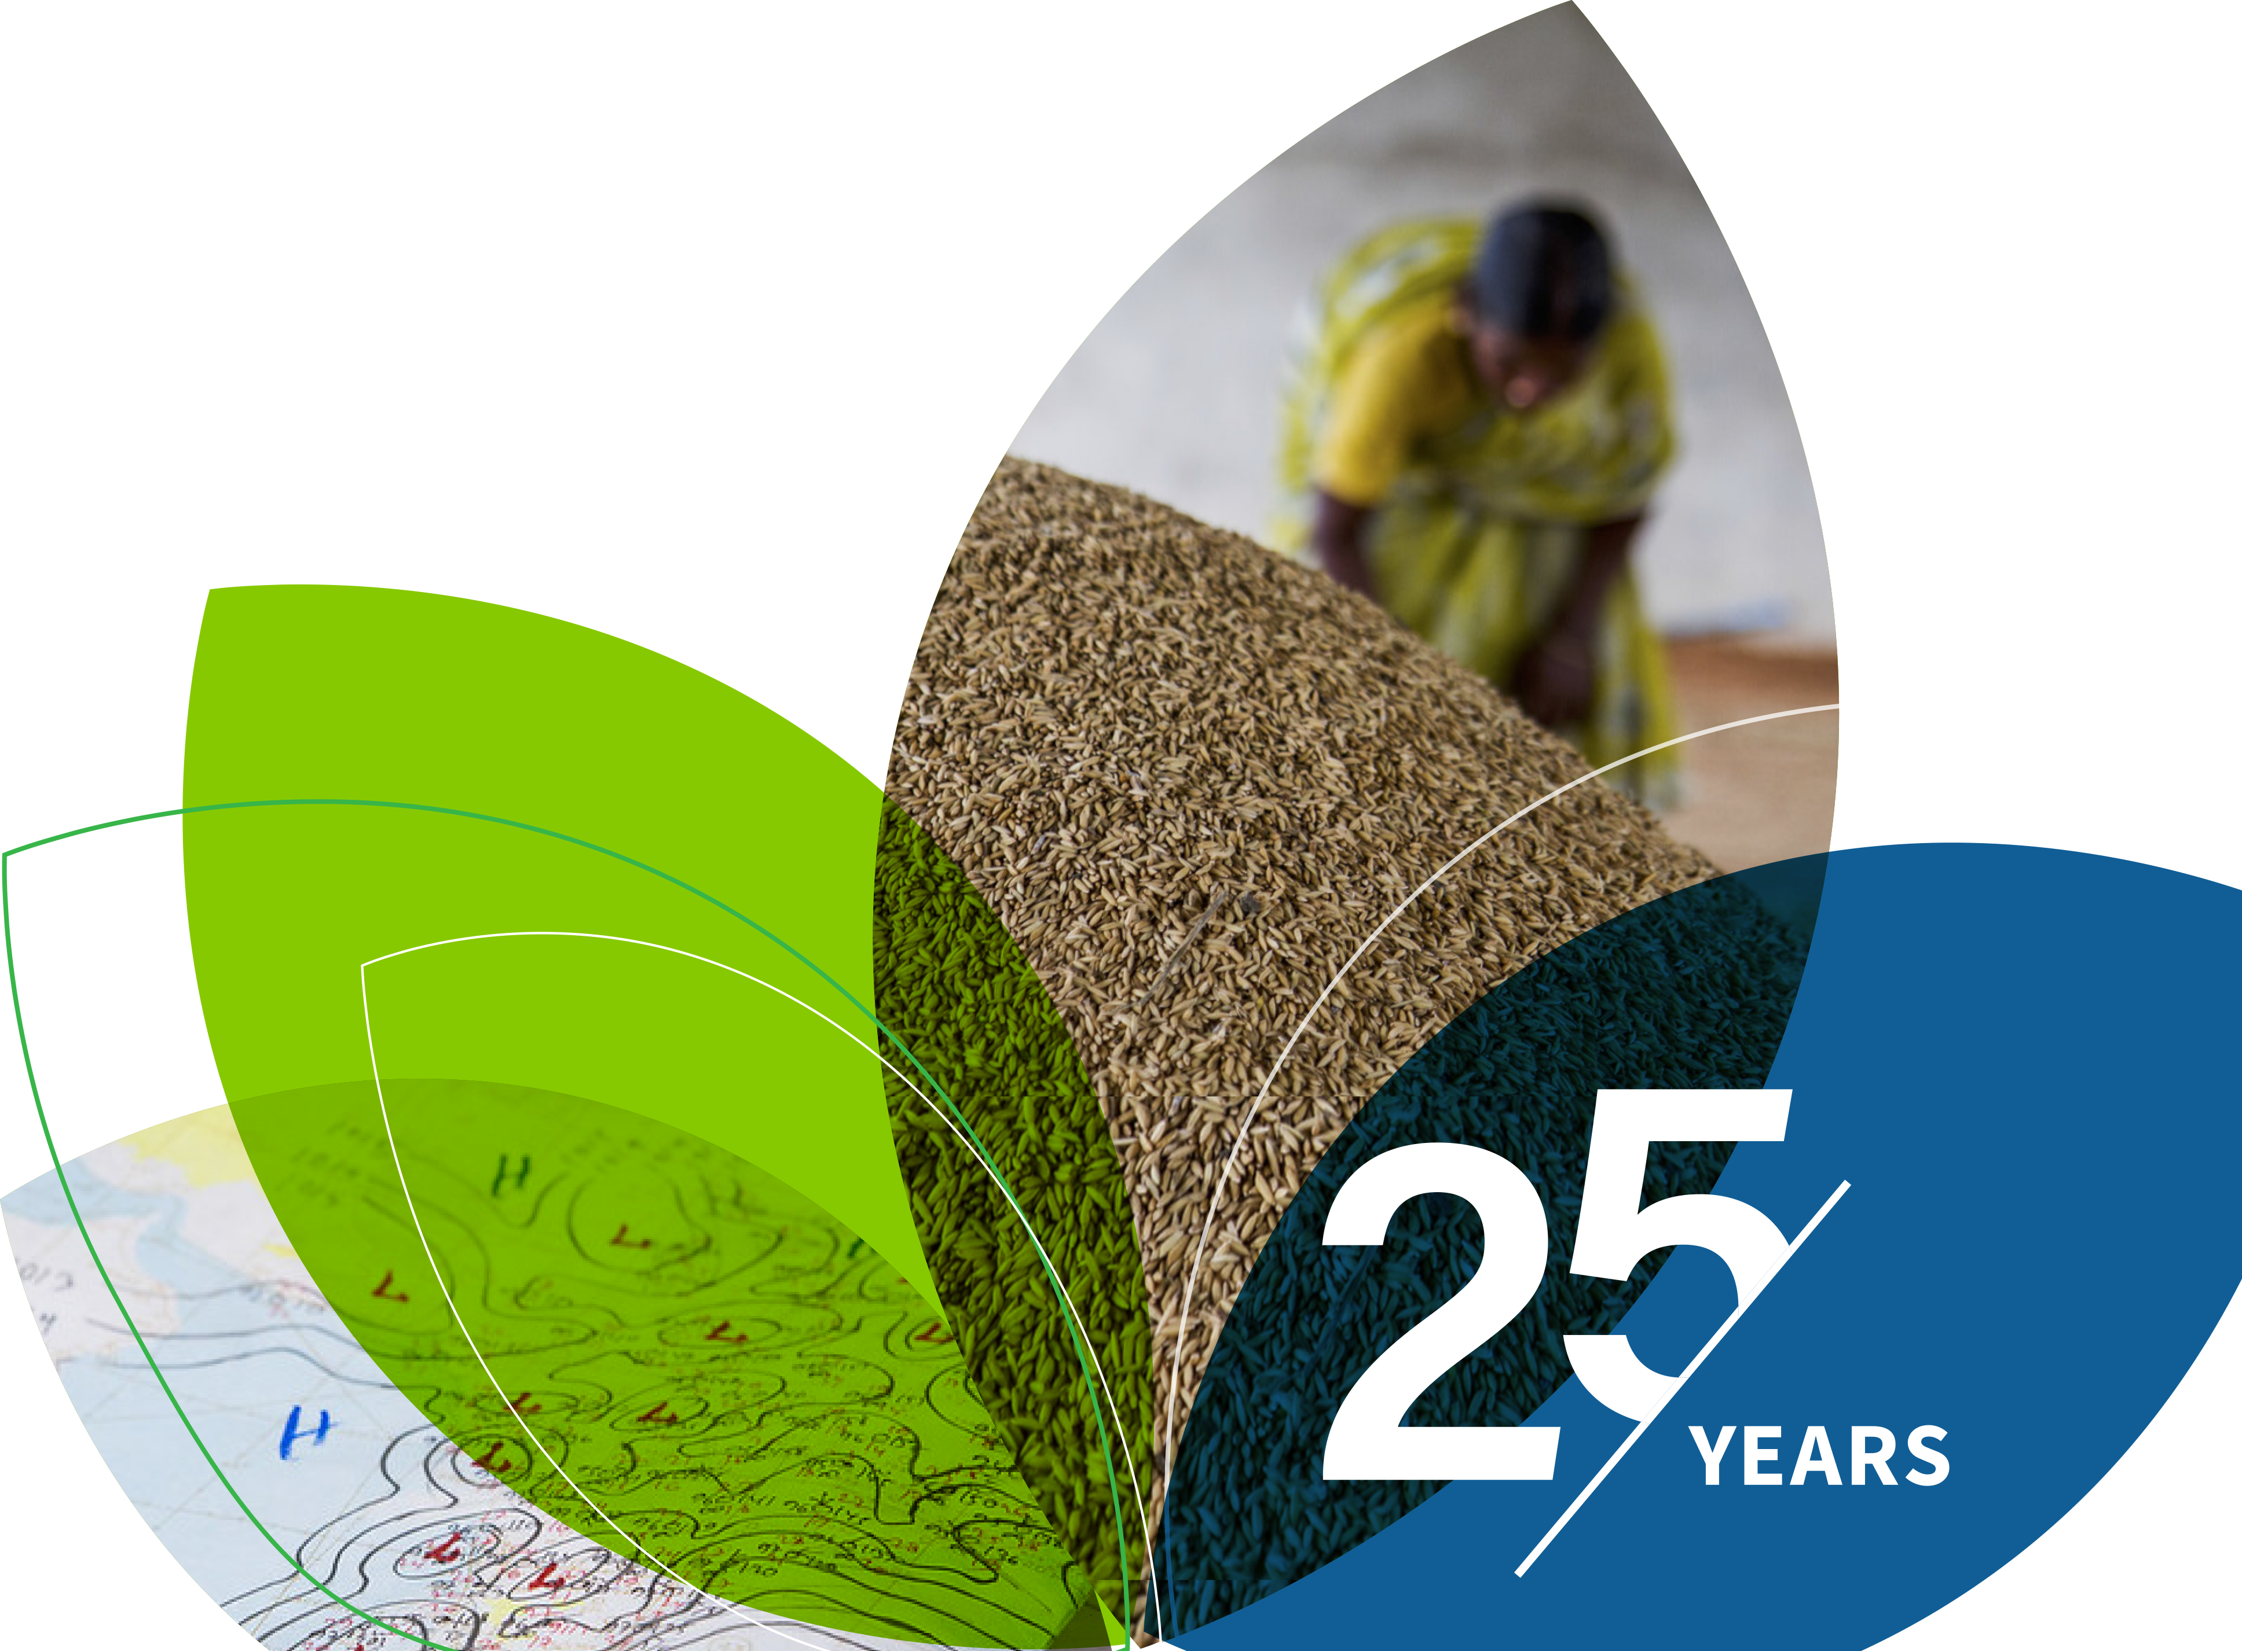
Thank You!

Slide 17
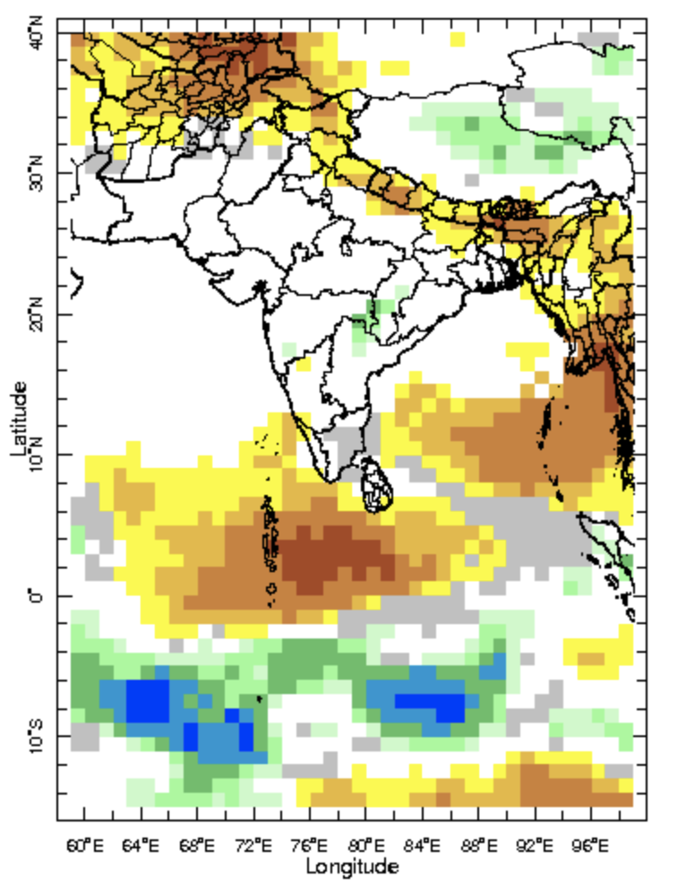
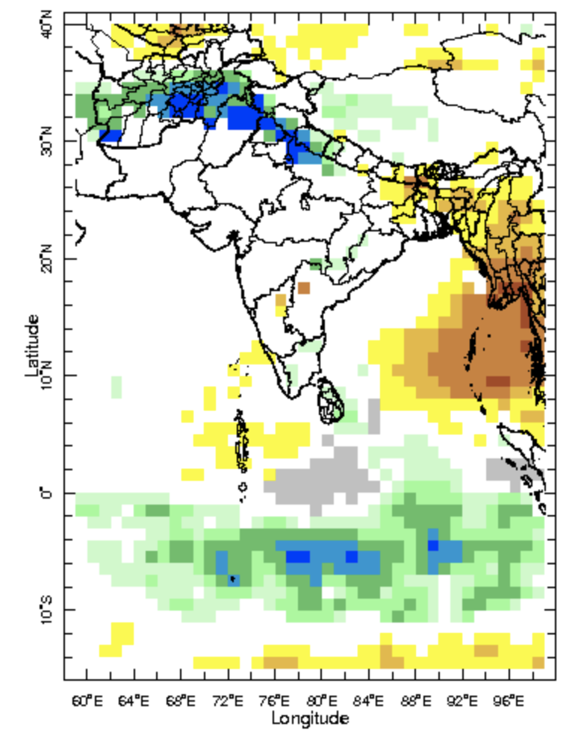
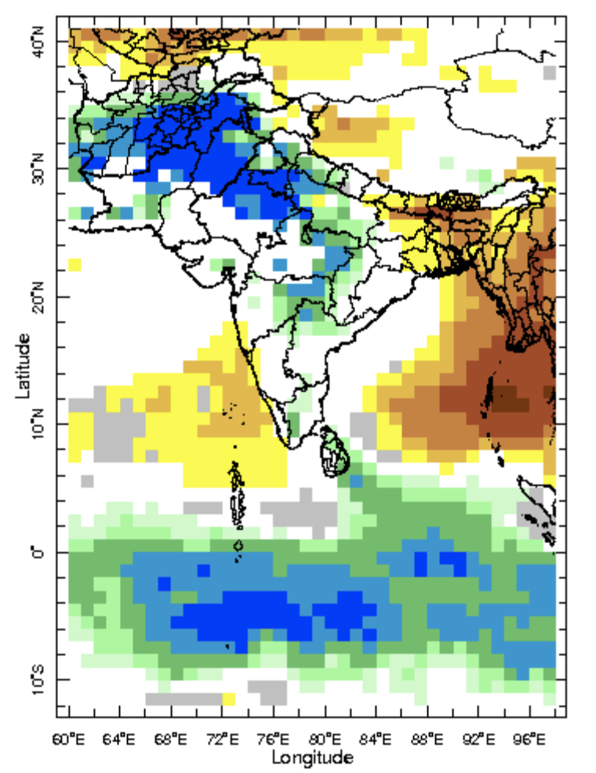
IRI-Sub-seasonal probabilistic rainfall forecast (issue date: Apr. 21st)
Week:1 : ( 22nd -28th Apr.)
Week:2 : ( 29th Apr.-5th May.)
Week:3-4 : ( 6th May.-19th Mar.)

